Slide 1
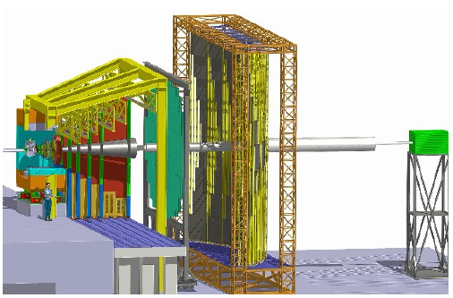
Charmonium production and detection with CBM experiment @ FAIR
Partha Pratim Bhaduri*
(on behalf of CBM Collaboration)
GSI, Darmstadt
Outline:
Introduction
Physics Motivation
J/ψ phenomenology @ FAIR
Reconstruction performance with MUCH
Summary
2nd Heavy Flavour Meet-2016,
February 3-5, 2016
SINP, Kolkata
*On leave from VECC, Kolkata

Slide 2
Introduction
J/ψ suppression is classical signature of de-confinement in relativistic nuclear collisions
Color screening prevents resonance binding of cc-bar pairs inside the plasma (Matsui & Satz, PLB, 1986)
Experiment reveal considerable suppression present in p+A collisions due to presence of cold nuclear matter: normal suppression/cold nuclear matter (CNM) suppression
Baseline for A+A collisions, to identify the ‘possible additional suppression patterns induced by plasma: anomalous suppression
Regeneration effects come into play at higher (RHIC, LHC) energies
The first measurement J/ψ production in heavy-ion collisions, in S+U collisions @ 200 A GeV by NA38 collaboration was compatible with suppression due to cold nuclear matter
“Anomalous” suppression was first observed in Pb+Pb @158 A GeV by NA50 Collaboration at SPS
No coherent theoretical interpretation: data can be explained by a variety of models with or without QGP effects
No anomalous suppression observed by the NA60 Collaboration In + In collisions @ 158 A
As of today, no data exists for J/ψ production in heavy-ion collisions below 158 A GeV

Slide 3
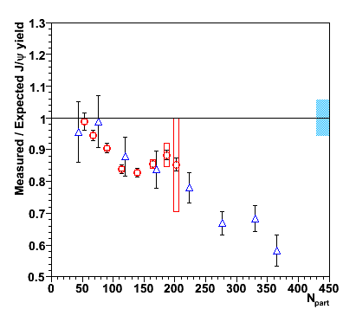
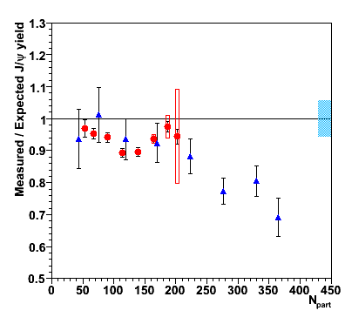
Lessons from SPS
Nuclear dissociations are conventionally described by Glauber model with the “normal” suppression quantified by an effective absorption cross section σ_{abs} : S ~ e^{-ρ σabs<L>}
“Anomalous” J/ψ suppression was first observed in Pb+Pb collisions by NA50 Collaboration and later in In+In collisions by NA60 Collaboration @158 A GeV at SPS
First reference measurements for estimating the nuclear effects were taken from p+A collisions by NA50 @ 400 GeV (σ_{abs} ^{J/ψ} (400 GeV) ~ 4.3 mb)
Subsequent p+A measurements @ 158 GeV by NA60 revealed σ_{abs} ^{J/ψ} (158 GeV) ~ 7.6 mb
Smaller anomalous suppression with respect to the previous estimates !!
In-In 158 GeV (NA60)
Pb-Pb 158 GeV (NA50)
σ_{abs} ^{J/ψ} _{400 GeV} ~4.3 mb
σ_{abs} ^{J/ψ} _{158 GeV} ~ 7.6 mb
Comparison of p+A measurements in the same kinematic & energy domain of that of A+A collisions is absolutely necessary

Slide 4
Facility for Antiproton and Ion Research (FAIR)
FAIR Modularized Start Version (MSV) :
SIS-100: protons up to 30 GeV, heavy-ions up to 12 (15) A GeV
FAIR Phase -II
SIS-300: protons up to 90 GeV heavy-ions up to 35 (45) A GeV
Intensities:
protons: up to 10¹³/s
  heavy-ions: up to 10⁹/s
  Nucleus-nucleus collisions: Compressed Baryonic Matter (CBM)
  Physics cases:
baryonic matter at highest densities
phase transitions and critical endpoint
in-medium properties of hadrons

Slide 5
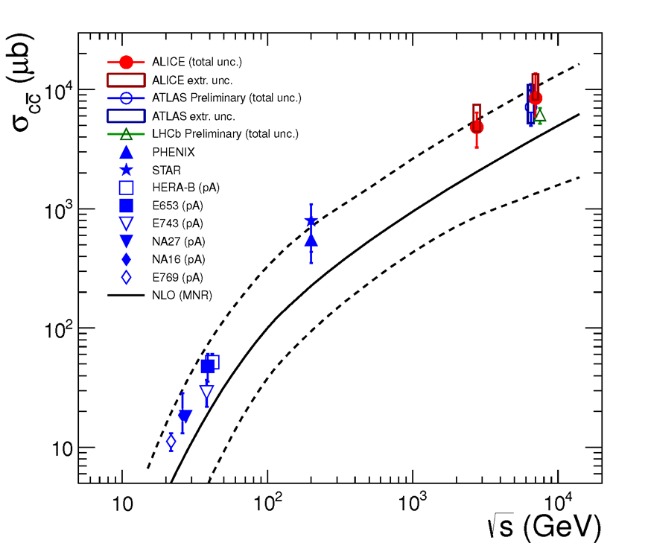
Charm production at FAIR and measuremnets with CBM
Cross sections and phase-space distributions of open and hidden charm in proton-nucleus collisions and nucleus-nucleus collisions.
Physics case
Charm production at threshold energies
Charm propagation in (dense) nuclear matter
JHEP07(2012)191
No charm data
at FAIR energies
FAIR
(SIS-100 + SIS-300)

Slide 6
Existing data for J/ψ production data close to threshold energies scenario
Expt. | p_{Lab} (GeV/c) | System | Channel | σ_{in} (nb)
CERN-PS | 24 | p-p | e⁺e⁻ | 0.56 +/-0.16
CERN-PS | 24 | p-C | e⁺e⁻ | 7.2+/-1.8
CERN-PS | 24 | p-W | e⁺e⁻ | 74+/-20
AGS | 30 | p-Be | e⁺e⁻ | 0.1
WA39 | 39 | p-p | μ⁺μ⁻ | 1+/-0.5
IHEP | 70 | p-Be | μ⁺μ⁻ | 32+/-8
Disperse data sets with proton beams
Only measurement of inclusive cross sections (limited phase space, no differential measurements)
No detailed study of target mass dependence, difficult to extract cold nuclear matter effects
Absolutely no data on charmonium production in A-A collisions below top SPS energy (E_{b} = 160 AGeV)

Slide 7
J/ψ measurement at CBM-FAIR: Uniqueness & Challenges
Uniqueness:
No data in heavy-ion sector below top SPS energies, exploratory measurements around threshold energies
Multi-differential and high precision measurements
Opportunities @ SIS-100:
Detailed measurement of charm production and propagation in cold matter with beams of proton and light nuclei (C, Ni, …)
Test of pQCD inspired models at low energies
Possibility to investigate sub-threshold production of charm with heavy-ion (Au) beams
Opportunities @ SIS-300:
Production will be dominated by initial hard collisions, subsequent recombination effects is negligible
Exact traces of the suppression pattern unlike higher energies
Characterization of the dense baryonic medium
Challenges:
Production cross sections are dramatically small
Requires accelerators with unprecedentedly high beam intensities; with beam intensity for Au ions of 10⁹/sec and 1 % λ_{I} peak event rate 10 MHz
Detectors with high rate capabilities
On-line event selection to reduce the raw data rate down to recordable

Slide 8
Phenomenological of J/ψ production at FAIR energies

Slide 9
J/ψ production in proton induced collisions @FAIR
(can be realized at SIS-100)
Calculations within two-component QVZ model
(J. Qui, J.P. Vary and X. Zhang, Phys. Rev. Lett. 88, 232301 (2002))
Charmonium production in hadronic collisions: factorizable two step process:
First stage: production of a cc-bar pair with relative momentum q² (calculable from pQCD)
Second stage: transition to color neutral physical bound state (non-perturbative transition probability F(q²) parametrized using different functions:
F^{(P)}(q²) : power law from mimics COM
F^{(G)}(q²) : Gaussian form mimics CSM
In p+A collisions CNM effects come into play:
Modification of nuclear parton densities in the initial stage
Dissociation of the nascent cc-bar pairs in the final stage via:
multiple soft scattering of the cc-bar pairs inside nuclear medium
modifies the formation probability: F(q²) => F(q² + ε²L)
reduction in charmonium production cross section
Different from conventional Glauber approach

Slide 10
Initial state parton shadowing
EPS09 set of nuclear parton distribution function (nPDF)
R_{i}(x,Q²,A) converts free proton distributions into nuclear distribution assuming factorization: f_{i}(A, x, Q²)=R_{i}(A, x, Q²) x f_{i}^{p}(x, Q²)
SPS
FAIR
x_{SPS} ~ 0.18 Anti-shadowing @ SPS
x_{FAIR} ~ 0.45 Shadowing @ FAIR

Slide 11
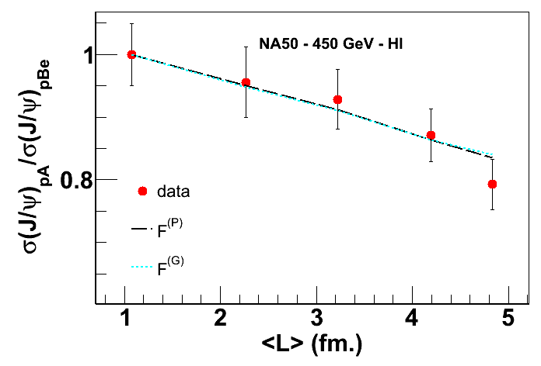
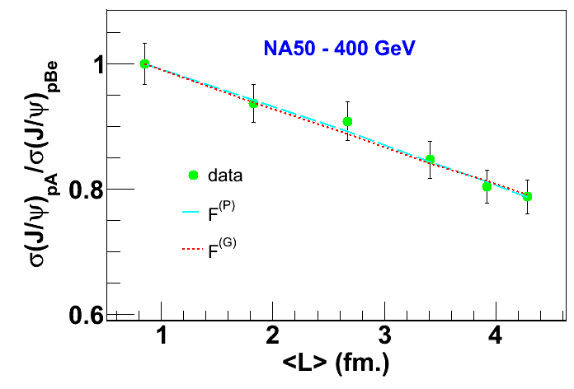
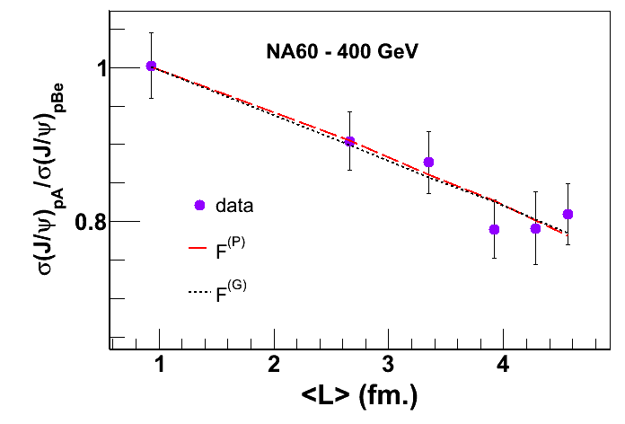
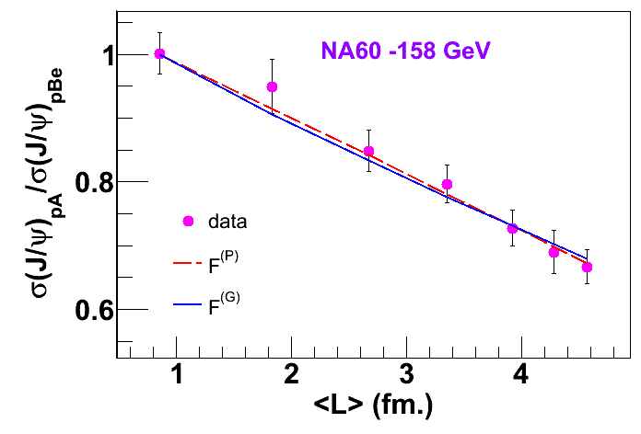
Calibration of the model at SPS
Phys. Rev. C 84, 054914 (2011)
Both F^{P}(q²) & F^{G}(q²) describe the available data reasonably well
Data are unable to distinguish different color neutralization schemes
Extracted ε² values characterizing final state dissociation in the model show a non-negligible dependence on the energy of the incident proton beam

Slide 12
Prediction @ FAIR-pA collisions
Power law form: F^{(P)} (q²)
Gaussian form: F^{(G)} (q²)
Parameterizing the E_{Lab} dependence of ε² and extrapolate to FAIR energy domain
More dissociation at lower energy collisions

Slide 13
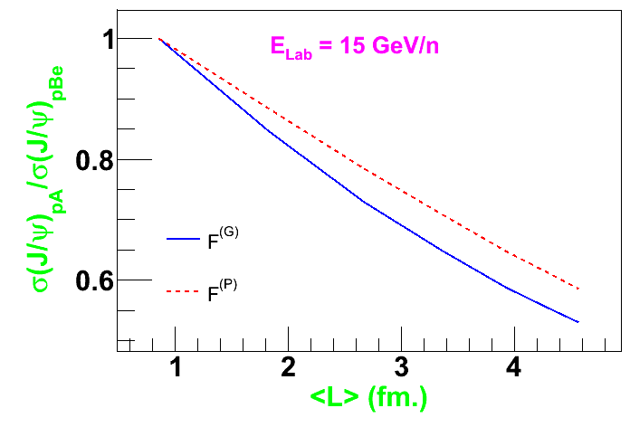
Nuclear suppression in p+A collisions@ FAIR SIS-100
PPB, A. K. Chaudhuri and S. Chattopadhyay, Phys. Rev. C 84, 054914 (2011)
E_{p} = 30 GeV
E_{p} = 15 GeV
Larger suppression @ FAIR energy domain compared to SPS
Shadowing of the target parton densities in the initial state; larger dissociation in the final state (σ_{abs} ~ 10 - 12 mb @ 15 GeV)
Lower be the beam energy higher is the difference between the amount of suppressions following two hadronization schemes
Can be tested with high statistics data from SIS-100 p+A measurements

Slide 14
Time scales in nuclear collisions
Define collision time: t_{coll} ~ 2R_{A}/γ_{CM}
Degree of nuclear suppression depends on t_{coll}
At SPS ~ 1 fm (significant effect)
At FAIR ~3 fm (probably most dominant effect)
J/ψ formation time:
Rest frame: τ_{J/ψ}~ 0.8 – 0.9 fm
Collision frame: t_{J/ψ} ∼ γτ_{J/ψ}
At FAIR produced medium would see fully formed J/ψ resonances

Slide 15
J/ψ production in nuclear collisions: initial state effect
Variation of the shadowing function S^{AA} with b
SPS: Pb+Pb @ 158 A GeV
CBM: Au+Au @ 30 A GeV
Implementation of local shadowing, with shadowing parameter dependent on local density
Enhancement of the gluon densities inside target and projectile nucleons:
Anti-shadowing effects in J/ψ production @ SPS
Depletion of the gluon and quark densities inside target and projectile nucleons
Shadowing effects @ FAIR
Strongest effects in central collisions

Slide 16
Prediction @ FAIR
CNM suppression in 30 A GeV Au+Au collisions
PPB, A.K. Chaudhuri and S. Chattopadhyay, Phys. Rev. C 85, 064911 (2012)
PPB, A.K. Chauduri and S. Chattopadhyay, Phys. Rev. C 89, 044912 (2014)
Cold matter effects are more vigorous @ FAIR compared to SPS:
Effective shadowing of the nuclear pdfs
Larger final state dissociation (ε² increases with decreasing E_{b})
Larger collision time (passing time) compared to SPS/RHIC

Slide 17
Anomalous suppression @ FAIR:I
First calculations from HSD group
(Olena Linnyk et al., arXiv:nucl-th/0612049, Nucl. Phys. A786:183 – 200,2007.
Two distinct scenarios have been considered:
QGP threshold melting (Satz et al’ 03):
Based on Debye screening
Different states have different melting temperatures and hence different dissociation densities: ε _{d}∼ (T_{d})⁴
if local energy density ε(x,y,τ) > ε _{d,} corresponding state fully suppressed
valid for ε(x,y,τ) > ε_{c} ~ 1 GeV/fm³
(b) Hadronic co-mover dissociation [Gavin & Vogt, Capella et al.`97]:
Suppression by low energy inelastic scattering with co-moving mesons
Both the scenarios can explain the heavy-ion data at SPS

Slide 18
HSD predictions for charmonium suppression at FAIR
Olena Linnyk et al., arXiv:nucl-th/0612049, Nucl. Phys. A786:183 – 200,2007.
CNM suppression employed via Glauber model, with σ_{abs} ~ 4.5 mb (the then available value)
Different scenarios can be distinguished already at FAIR energies:
Ψ´ over J/Ψ ratio and survival probability are lower in the comover absorption model since the average comover density decreases only moderately with lower bombarding energy whereas the energy density decreases rapidly
No collisional dissociation in the plasma phase

Slide 19
Anomalous suppression @ FAIR : II
PPB, A. K. Chaudhuri and S. Chattopadhyay, Phys. Rev. C 88, 061902 (R) (2013)
Effect of Debye screening in a hot baryonic plasma using a different variant of threshold model
In-medium Debye radius r_{D} (T,μ_{q}) is employed to decide the fate of a J/ψ implanted in the medium
Medium evolution is mimicked by UrQMD dynamics supplemented with a suitable plasma EOS to obtain local T and μ_{q}
QGP Survival probability:
r_{i} denotes the size of the particular charmonium state
Screening remains operative as long the plasma is alive
Inclusive survival probability is obtained by integrating over space time
Implement threshold energy density (ε_{c} ~ 1 GeV/fm³) for plasma formation finite space-time extent of the plasma

Slide 20
Model prediction for J/ψ suppression due to screening inside the plasma
30 A GeV Au+Au collisions
Total suppression is obtained assuming factorization, R_{AA}=R_{AA}^{CNM} x S^{QGP}
Dominant contribution from CNM effects (~ 90 % : initial state shadowing ~ 15 % final state dissociation of the pre-resonant cc-bar pairs ~ 75 %)
Debye screening causes much weaker suppression (10 -15 %)
Collision dissociation (thermal and pre-thermal) with hard partons neglected
Require high precision data to isolate the QGP effects

Slide 21
p_{T} independent suppression
τ_{E} vs τ_{QGP} for central Au+Au collision @ 30 A GeV (SIS-300)
τ_{E} : escape time of J/ψ from the plasma
τ_{QGP}: life time of the plasma
Even for p_{T} ~ 2 GeV/c τ_{E} > τ_{QGP}
p_{T} independent survival probability @ FAIR unlike higher energies

Slide 22
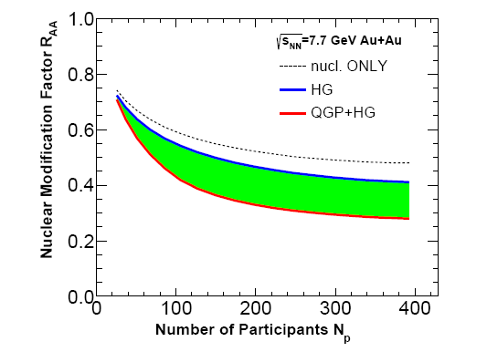
Anomalous suppression @ FAIR:III
Bayoi Chen, arXiv:1510.07902v2
Dynamics of charmonium from Boltzmann equation
Medium evolution via (2+1) ideal hydrodynamic equation with EOS with 1st order p.t.
Suppression due to screening + gluo-dissociation in the plasma phase
Suppression in the thermalized hadronic medium (hot hadron gas)
No contribution from recombination effects in either phase
More suppression in the plasma phase compared to hadronic phase

Slide 23
Summary: Charmonium at FAIR
J/ψ suppression has long been considered as a potential signature for QGP formation in nuclear collisions.
At FAIR energies the exact traces of the suppression pattern can be seen as the primordial suppression will not be masked by subsequent regeneration effects either in hadronic or partonic phase
However a very careful study is necessary to understand the cold nuclear effects
In A+A collisions, CNM effects is the most dominant source of J/ψ suppression
Anomalous suppression pattern seems to have sensitivity to the suppression mechanism
Interesting information can also be obtained from ψ’-to-J/ψ ratio and hidden-to-open charm ratio
Demands for high precision data set to be collected at FAIR to isolate the QGP effects

Slide 24
J/ψ detection via di-muon channel at CBM
Simulation of MUon CHamber (MUCH) detector system

Slide 25
CBM setup with MUon CHamber (MUCH) subsystem
STS track, vertex and momentum reconstruction
MUCH muon identification
TRD global tracking
RPC-ToF time-of-flight measurement
PSD centrality determination
RPC (TOF)
TRD
MuCh
STS
PSD

Slide 26
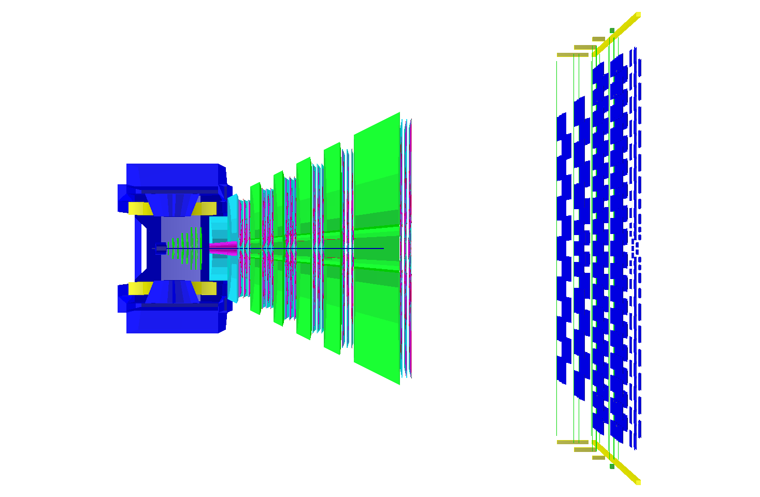
MUCH sub-system: J/ψ → μ+μ- reconstruction
μ⁺
See talk by A. K. Dubey
μ⁻
Comprises of several detectors & segmented hadron absorbers made of C & Fe
Total absorber is segmented & detectors are placed inside absorbers to facilitate tracking
Detectors are high resolution gas chambers with Argon as active medium
Angular acceptance:
θ_{min}=5.7º: η_{max}= 3
θ_{max}=25º degree: η_{min}=1.44

Slide 27
Simulation setup
Input
  background – UrQMD generator
  J/ψ:
    yield from HSD generator
    phase space distribution from PLUTO generator
Transport – cbmroot framework with GEANT3
Selection of reconstructed tracks based on associated hits and track c²

Slide 28
Momentum distribution of reconstructed single muon tracks
Absorbers introduce a lower threshold to the single muon momentum (p_{min} ~ 3 GeV/c)
Shift in mean p value by ~ 1 GeV/c
Very high momentum muons outside detector geometrical acceptance

Slide 29
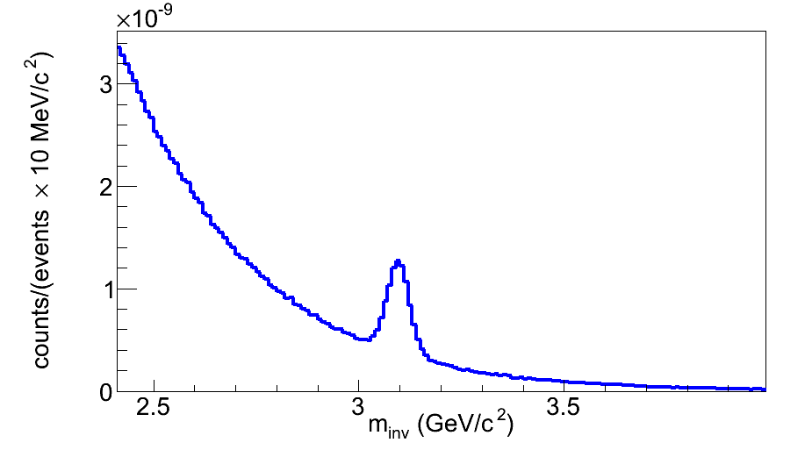
Invariant mass spectra: SIS-300 Au+Au collisions @ 25 A GeV
Operation at maximum rate (10 MHz)
Trigger logic for online event selection
Central collisions
Eff.xAcceptance ~ 8 %
σ_{M} ~ 27 MeV
Clearly identified peak over the background: highly feasible detection
Background from Drell-Yan and semi-muonic open charm decays are negligibly small
About factor of 4 better mass resolution (~ 100 MeV for 158 A GeV Pb+Pb collisions @ NA50)
Mass shape fitted with symmetric Gaussian
Improved S/B for central collisions

Slide 30
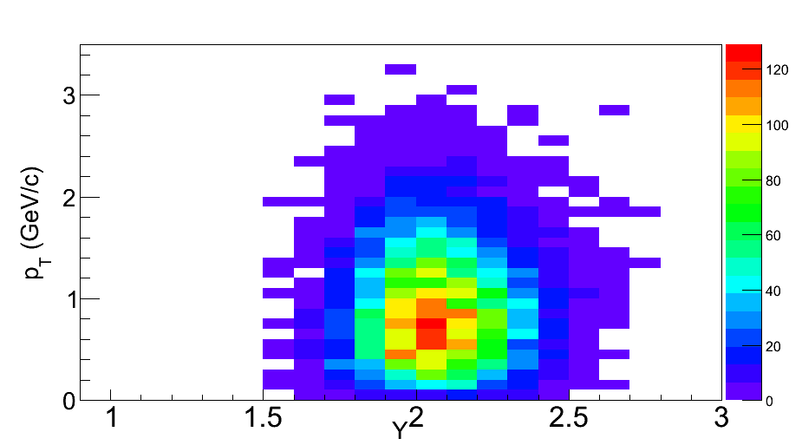
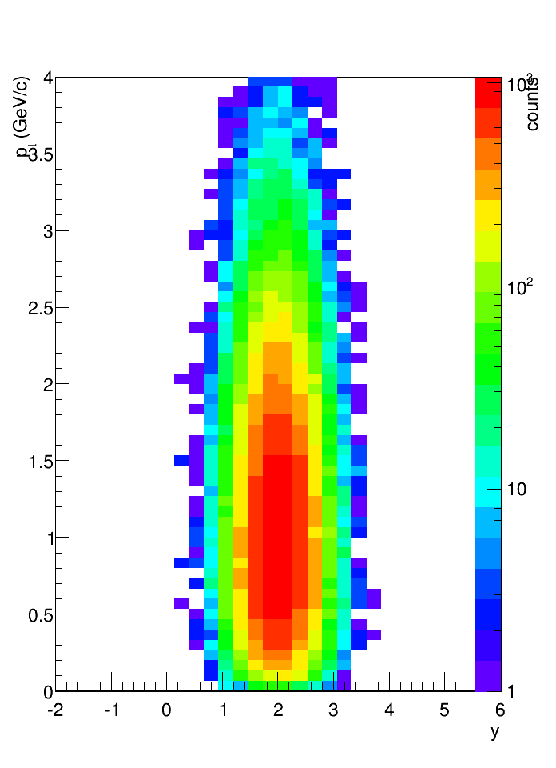
Acceptance (y-p_{T}) plots: SIS-300 25 A GeV Au + Au collisions
Reconstructed Central
Pluto input
y_{beam} ~ 3.99
MUCH has coverage for mid-rapidity

Slide 31
Beam time requirements: SIS-300
Used J/ψ statistics (central collisions) = 8×10⁵ J/ψ
    Multiplicity (HSD) =1.92×10⁻⁵,
    branching ratio = 0.06
    Efficiency = 0.08
Required central events
8×10⁵ /(1.92×10⁻⁵×0.06x0.08) ≈ 8.6×10¹²
Required minimum bias events ≈ 34.4×10¹²
Reaction rate 10⁷ events/sec:
34.4×10⁵ sec ~ 35 days

Slide 32
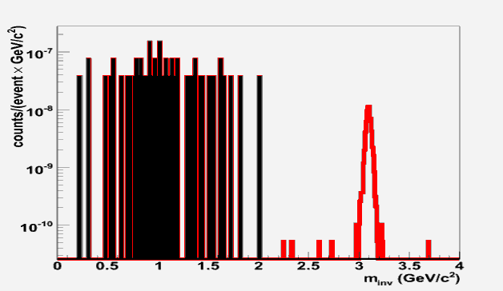

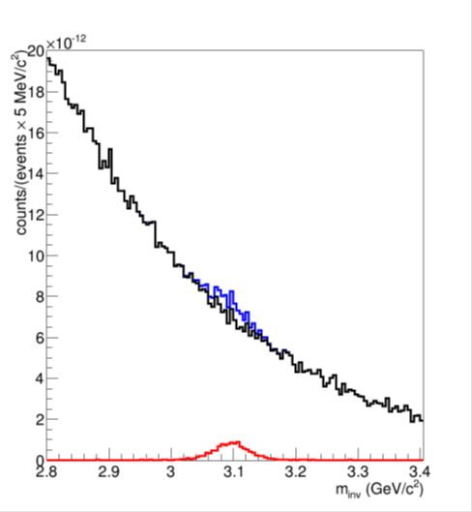
Charmonium in CBM at SIS100
Commissioning of high rate data taking (10 MHz)
Exploratory measurement: Charmonium production
30 GeV p + Au
central Au+Au at 10 A GeV
1000 J/ψ in 10¹² events (1 day)
(multiplicity from HSD)
1000 J/ψ in 10¹³ events (10 days)
(multiplicity from HSD)
J/ψ → µ+µ-
J/ψ → µ+µ-

Slide 33
Summary: Charmonium with CBM
Performance study of the muon detection system with simulated signal and background yields for central Au+Au collisions
With assumed charmonium yields, the measurements should be feasible with MUCH subsystem of CBM
The measurements require high interaction rate and fast detectors
Online triggers are being designed to reduction of data volume to a recordable rate.
The signal invariant mass has a Gaussian shape, thanks to low material budget of STS, and provides a better mass resolution compared to previous experiments
For collisions at SIS-100 (eg: 30 GeV p+A), a reduced version of MUCH subsystem with 3 stations should be sufficient for J/ψ reconstruction.

Slide 34
Acknowledgement
Subhasis Chattopadhyay, VECC, Kolkata
Asis Kumar Chaudhuri, VECC, Kolkata
Anna Senger, GSI, Darmstadt
Peter Senger, GSI, Darmstadt
Aleberica Toia, Gsi, Dramstadt
Iouri Vassiliev, GSI, Darmstadt
Ilya Selyuzhenkov, GSI, Darmstadt
for collaboration in work and stimulating discussions

Slide 35
Thank You

Slide 36
Back ups

Slide 37
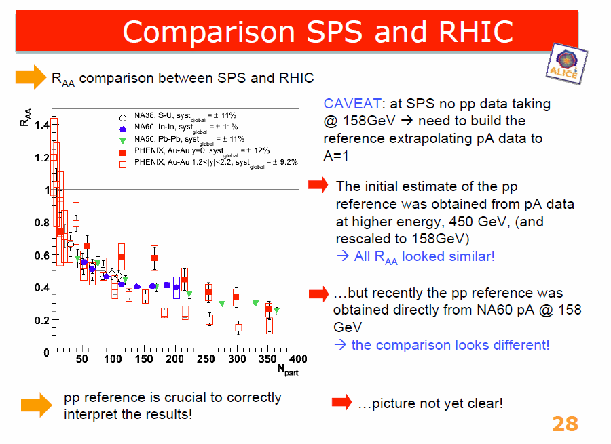
Lessons from SPS : II
From R. Arnaldi’s talk @ “Quarkonia in deconfined medium”

Slide 38
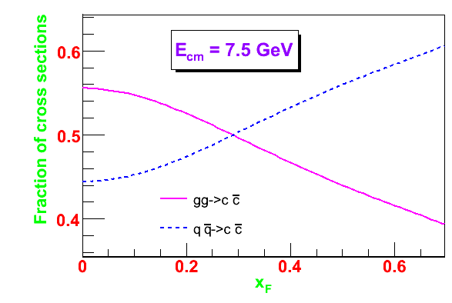
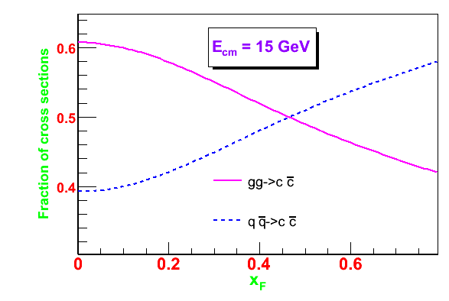
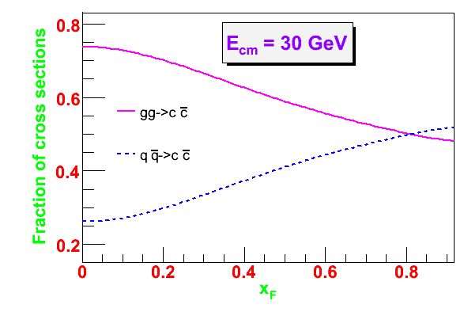
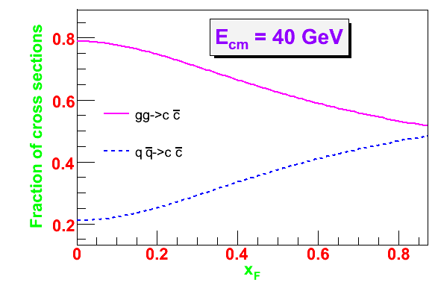
Comparison between the relative size of the two sub-processes
Lower x_{F} gluon fusion dominates
Higher x_{F} quark annihilation dominates
The critical value (x_{F}^{Crit}) depends on collision energy
Consistent with the behavior of pdf
High energy collisions (RHIC, LHC) : reliable description from gg fusion alone
Low energy collisions (FAIR, NICA): significant contribution from quarks

Slide 39
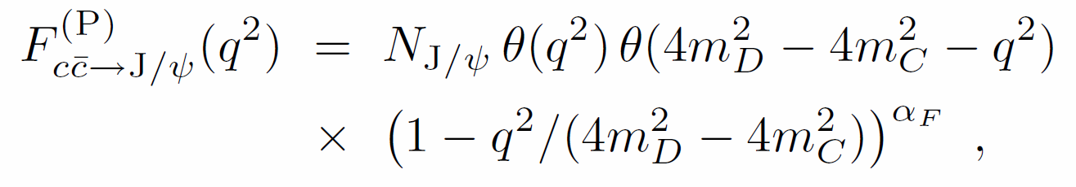
Parametric forms of transition probability
CSM
COM

Slide 40
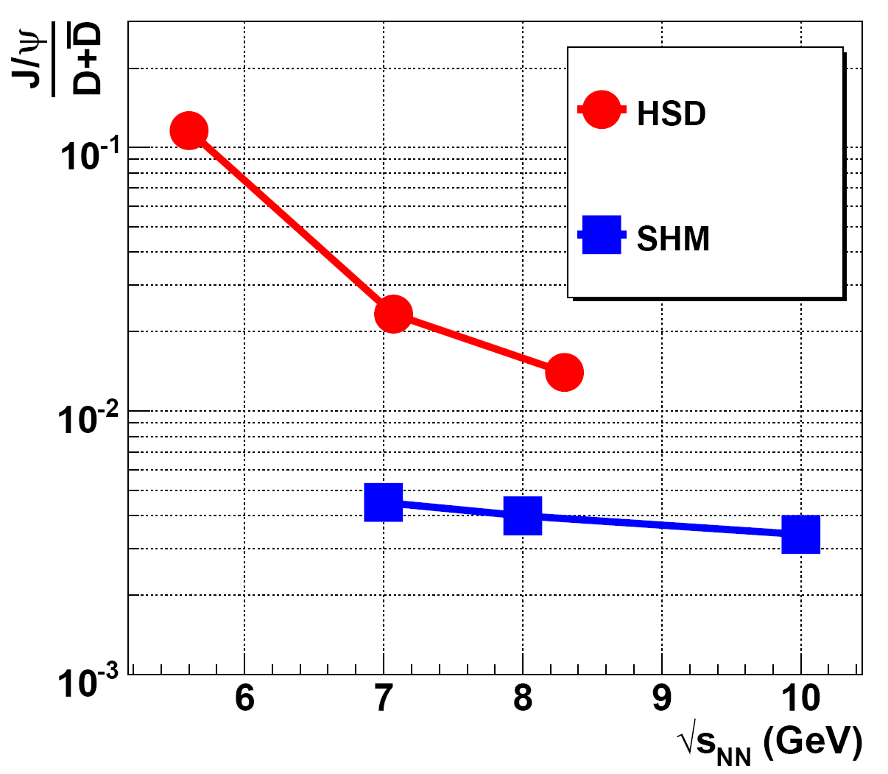
Hidden-to-open charm ratio
SHM: assumes complete de-confinement (partonic scenario)
HSD: purely hadronic medium
Different production threshold owing to different production mechanisms
Might help to probe the de-confinement transition

Slide 41
J/ψ Spectrum with other physical sources
Very small contribution from DY and open charm decays @ CBM energies

Slide 42
Composition of background tracks

Slide 43
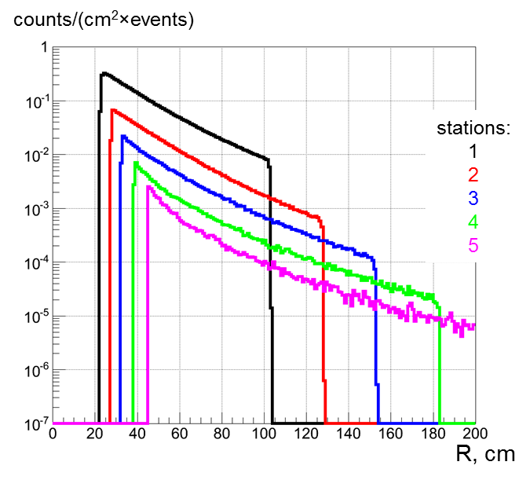
Radial distribution of particle density
Radial distribution of particle density in central Au + Au collisions @ 25 A GeV
Distributions correspond to the average over the three layers
Maximum near the beam pipe & falls as we go away from the centre
Maxium particle rate @ MUCH at 1st station ~ 3 MHz
For minimum bias collisions numbers will roughly be 25 % of the central values

Slide 44
SIS-300 configuration:Pad multiplicty
Station # | R_{in} (cm) | R_{out} (cm) | N_{sector} | Minm. pad area (cm²) | Maxm pad area (cm²) | # of channels
1 | 16.5 | 82.5 | 14 | 0.29x0.29 | 1.44x1.44 | 130956
2 | 21.5 | 107.5 | 18 | 0.38x0.38 | 1.9x1.9 | 132084
3 | 26.5 | 132.5 | 22 | 0.46x0.46 | 2.3x2.3 | 133188
4 | 32.5 | 162.5 | 26 | 0.57x0.57 | 2.84x2.84 | 132444
5 | 39 | 195 | 32 | 0.68x0.68 | 3.4x3.4 | 135552
6 | 52 | 260 | 42 | 0.91x0.92 | 4.54x4.54 | 138096
Radial segmentation with square pads of dphi = 1 degree
Total number of readout channels for all 6 stations (3x6=18 layers)=802320
For each station radii of the outermost (3rd) layer is used
For a given station number of sectors is decided by N=2*pi*R_{out}/40

Slide 45
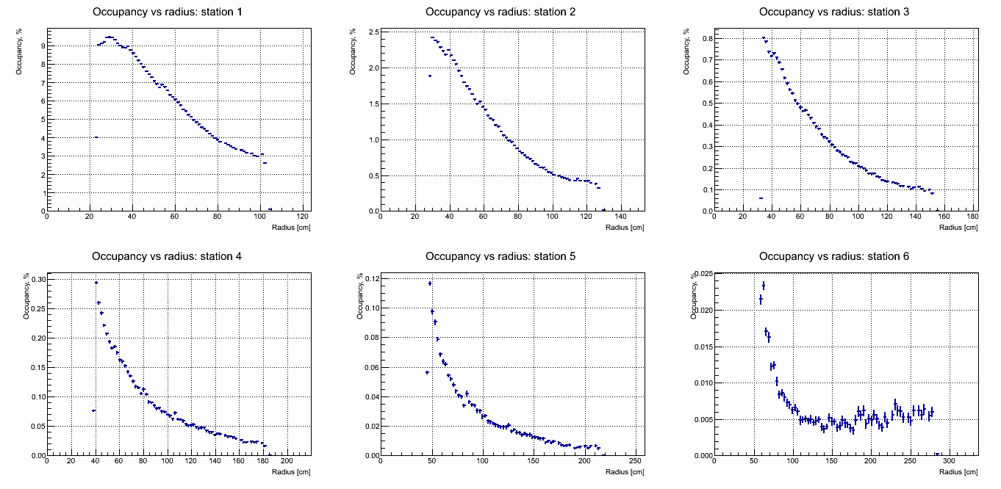
Radial distribution of occupancy: 25 A GeV central Au+Au collisions
Occupancy is defined as the fraction of fired pads
Maxm. Occupancy is ~ 9 % @ first station
For mbias collisions numbers are factor of 4 down
45

Slide 46
Reconstruction of muon tracks: p_{T} distribution
Input
Reconstructed
Single muon tracks reconstructed from STS and MUCH
Shift of mean for reconstructed tracks to the higher p_{T}
Low pT muons pass through the beam pipe or stopped in shield

Slide 47
Generation of signal muons in PLUTO
J/ψ mesons are produced from PLUTO event generator
PLUTO based on thermal fireball model; produced particles from a thermal source (generally energy sampling following relativistic Boltzmann distribution)
No explicit 4-momntum conservation in the reaction (NN collision)
Tuning for CBM investigations:
Thermal transverse distribution following dN/dp_{T} ~ p_{T}exp(-m_{T}/T_{eff}) (T_{eff} ~ T_{fo} + mv_{r}²)
Gaussian rapidity distribution following dN/dy_{cm} ~ exp(-y_{cm}²/2σ²)
Generate azimuthal angles following uniform random distribution
Input parameters: T_{fo} (= 170 MeV), sigma and v_{r}=0.0
Generate 4-momentum of J/psi
Decay isotropically into di-muons in the mother rest farme
Boost the muons into the laboratory frame

Slide 48
Selection of absorber thickness

Slide 49
Reconstruction of J/psi: p_{T} distribution
Input
Reco.
Pair p_{T} distribution is nicely reproduced

Slide 50
II. Hadronization of the cc-bar pair:
Till date no unique theoretical description: Different models :
Color Singlet Model (CSM)
Requires the cc-bar pair to be produced in a color singlet state, with the same quantum numbers of the charmonium state under study. Hadronization probabilility is proportional to the square of the hadronic wave function at the origin
Color Evaporation Model (CEM)
The cross section for the production of a certain charmonium state is a fixed fraction F of the production cross section for cc pairs with m<2m_{D}
NRQCD or Color Octet Model (COM)
cc-bar pairs are produced in a given spin angular momentum & color state (both singlet & octet) subsequent color neutralization occurs by radiation of soft gluons; contains contribution of both singlet & octet states

Slide 51
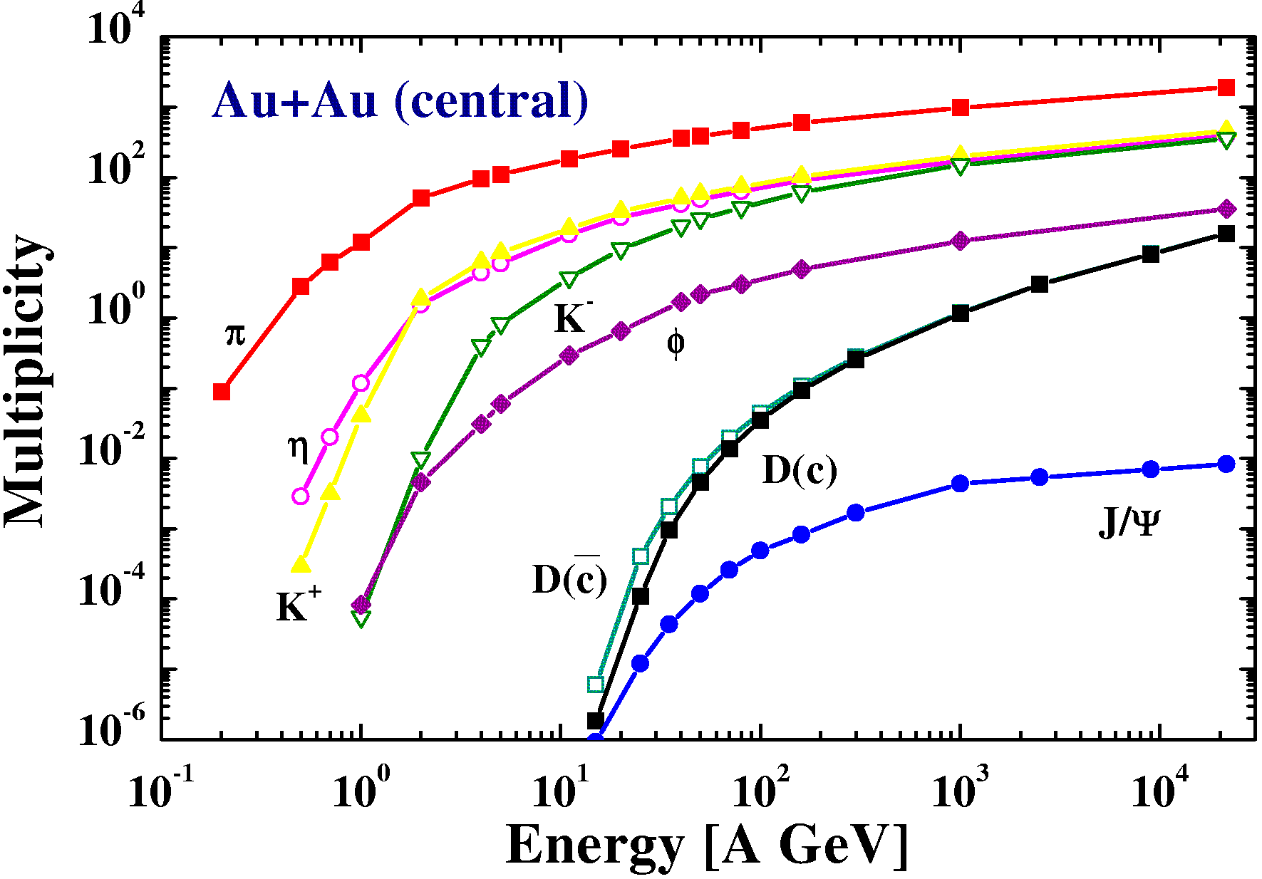
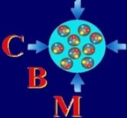
SIS
100/300
Multiplicity in central Au+Au collisions
W. Cassing, E. Bratkovskaya, A. Sibirtsev, Nucl. Phys. A 691 (2001) 745
Low charm multiplicity
Rare particles with high statistics
High beam intensity
Interaction rate: 10 MHz
Fast detectors/DAQ
Notes:
51

Slide 52
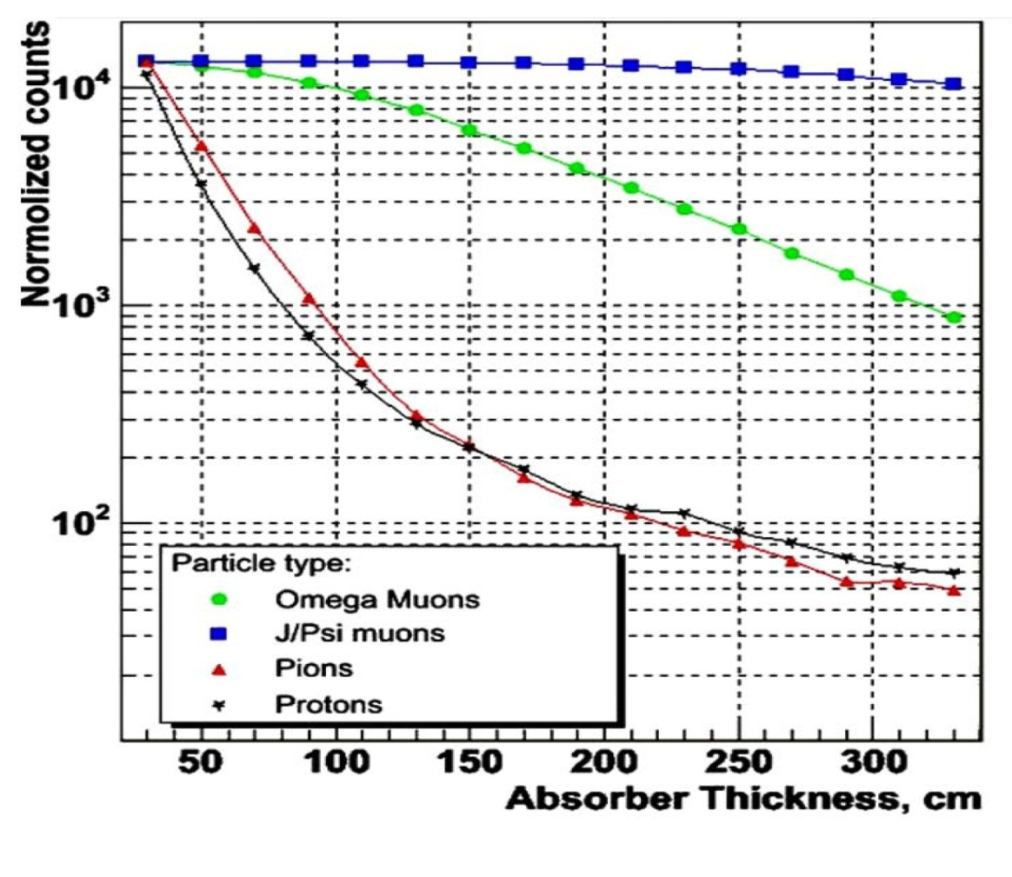
Muon measurements at FAIR energies:
detector design considerations
Determination of effective absorber thickness
particle momenta:
Au+Au 25 A GeV
central collisions
counts ( a.u.)

Slide 53
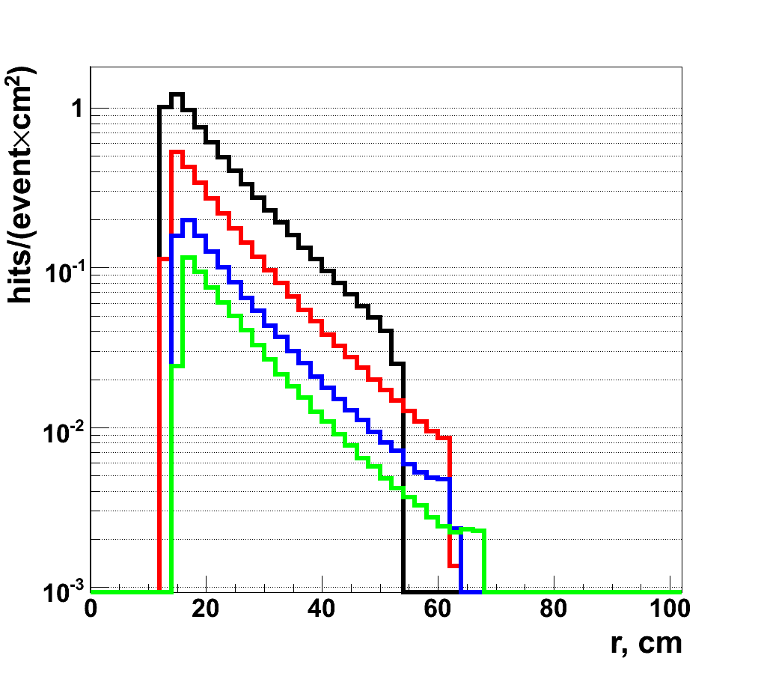
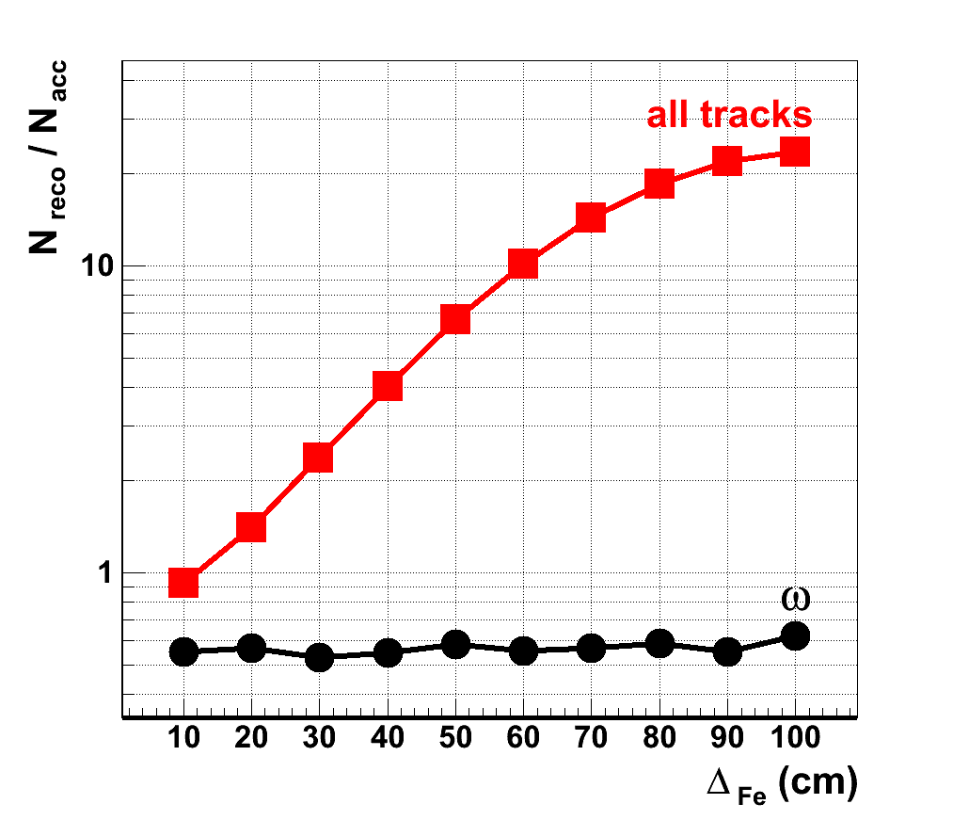
Absorber thickness versus track mismatches
Au+Au 25 A GeV central collisions
particle density after first absorber layer
mismatches
10 cm Fe
20 cm Fe
30 cm Fe
40 cm Fe
Smaller absorber thickness: too high particle density to handle
Larger absorber thickness: Large number of fake bkg tracks due to track mismatch

Slide 54
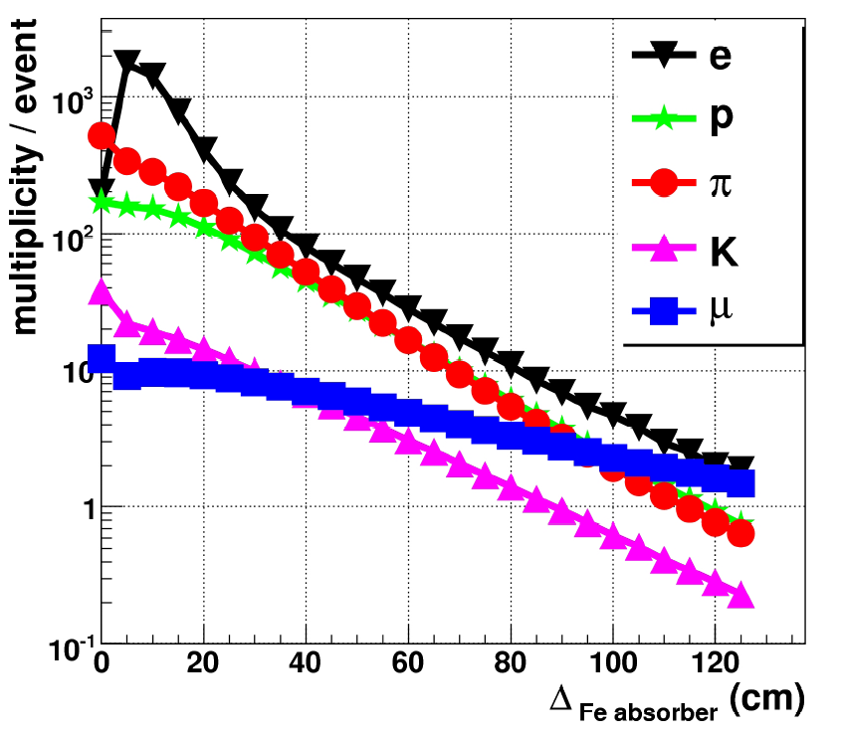
Particle multiplicity versus absorber thickness
Au+Au 25 A GeV central collisions
in detector layer behind first absorber

Slide 55
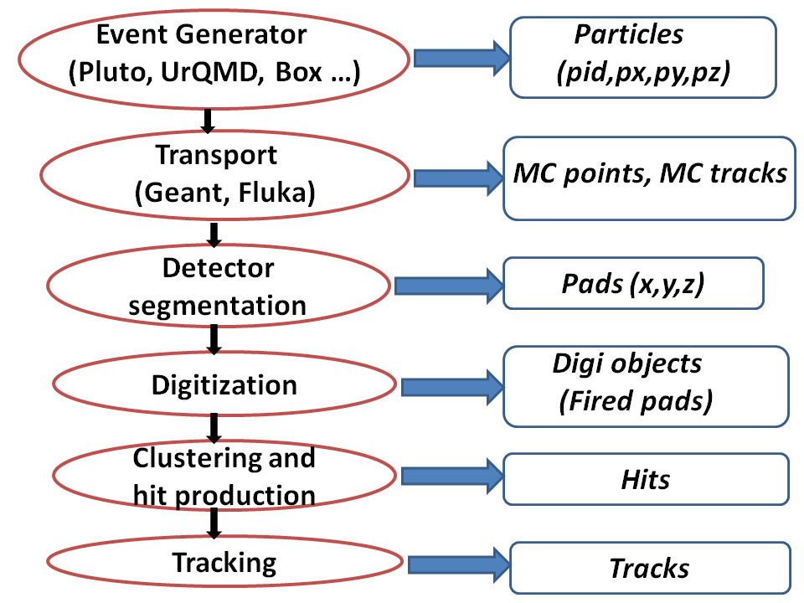
Basic ingredients of simulation: CBMROOT

