Slide 1
Topic IV: Target area related aspects
Debris mitigation
Avoid sources
Protection of sensitive components against debris
On-target beam requirements and characterization
On-shot measurements
Stability issues
Parallel system use issues

Slide 2
Debris mitigation
General contributions:
Update since last meetings (GSI)
Tests of optical components as debris shield (LULI)
What is the debris mitigation strategy in your facility?
Did you test / can you recommend certain types of debris shield?
What are the debris sensitive items at your facility (parabola, gratings, mirrors…)?
Please describe the typical / worst ever impact debris in your target area(s).
Do you enforce certain debris mitigation design rules on the experiment setup?
Do you regularly monitor debris-related problems generated by the experiments, and if so, how?
Do you have a “beam dump” strategy to avoid uncontrolled beam propagation and ablation?
Do you see problems with certain gases/gas targets or other specific target materials?

Slide 3
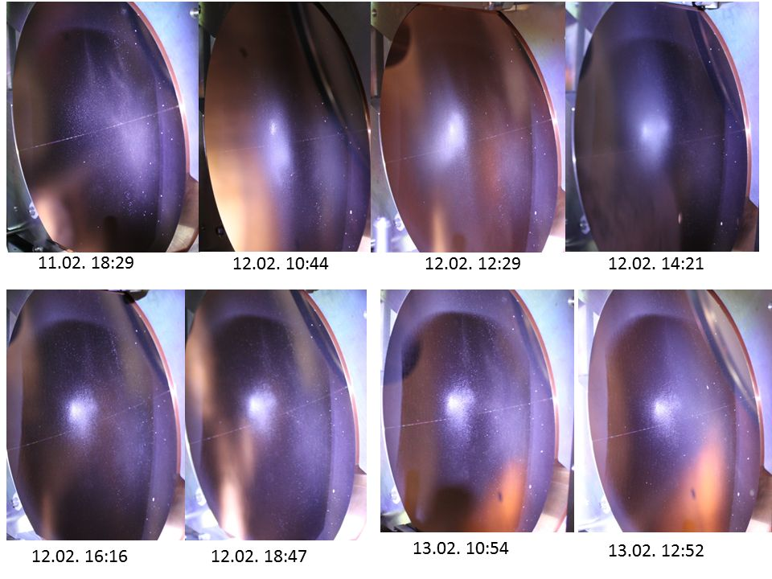
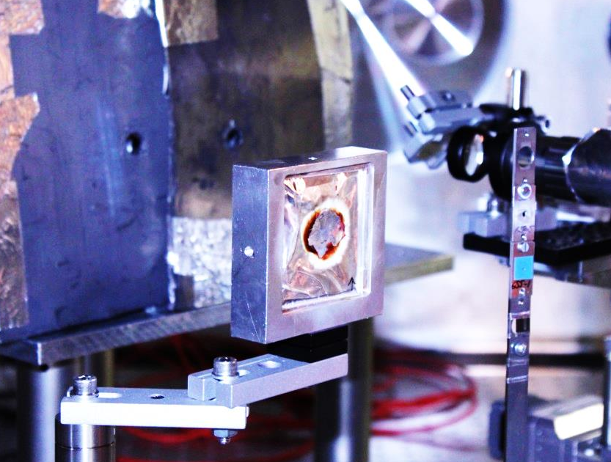
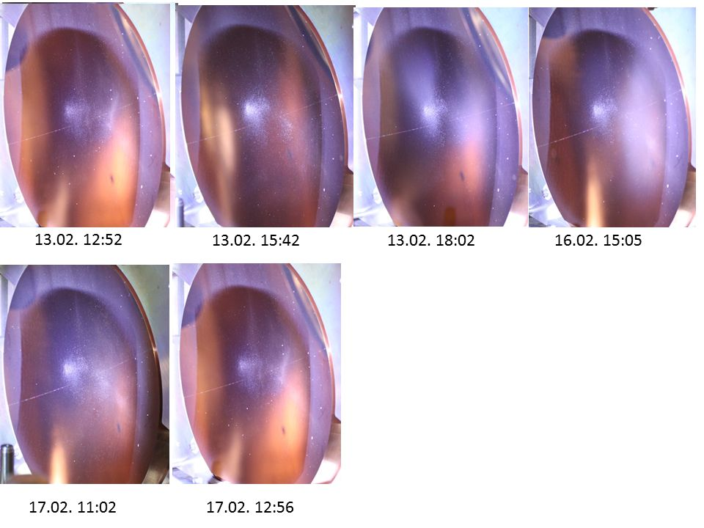
GSI: Debris tracking
Time series of OAP taken in-between shots
Debris source: Target support frames and first layer of RCF stack

Slide 4
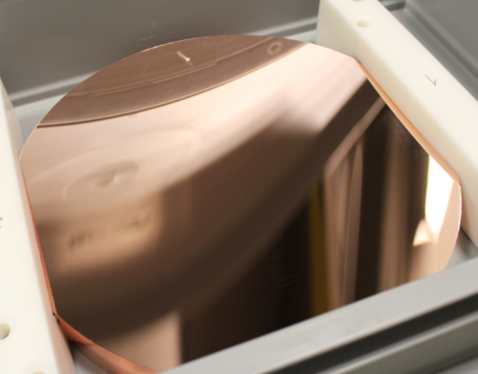
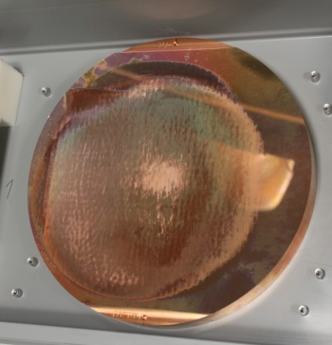
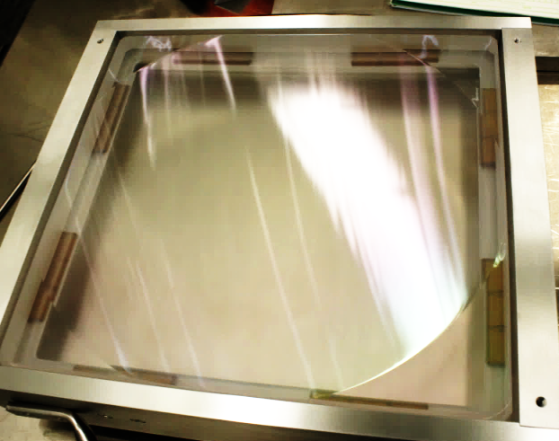
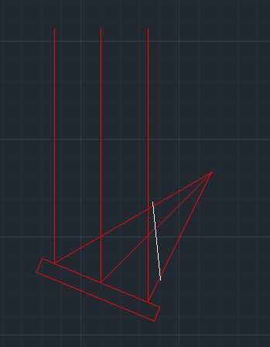
GSI: Parabola status
Refurbishment of copper OAPs possible, but optical quality limited
Acquisition of MLD parabola with same geometry (f=400 mm, 45°)
Debris shield required, single-pass if possible

Slide 5
Debris mitigation
What is the debris mitigation strategy in your facility?
Did you test / can you recommend certain types of debris shield?
GSI: Up to now, no exclusion of any target type, but we now try to minimize metallic target support debris (use plastic carriers for thin foils so that debris can be removed with solvent). Rotate target surface and try to shield optics in direct line of sight from debris source. Optical test of 200 + 400 µm glass (Schott) planned
LULI:
MRS: We put a protective wafer (AR coated) in between focusing parabola and the target. We also have a mylar sheet to protect for windows / optics.
RAL: Glass pellicle (0.775mm thick) in front of main focusing optic for Vulcan target areas (sourced from Ohara, main parameter is Total Thickness Variation (TTV) of 1um which will give less than 1 wave of error).
Gemini parabola protected by nitrocellulose pellicle sourced from National Photocolor – glass pellicles are too thick.
Targets thicker than 1um must be tilted away from main optic, typically greater than 10 degree incident angle. This is relaxed if shooting via plasma mirror. Delrin plastic is banned from being used as a target or components near interaction as it shatters into shrapnel that causes severe damage to optics it hits. Shatter test has been performed on other plastics / resins
Permanent optical probe setup in TAP chamber has covers to reduce debris coating of optics
PETAL: Gate between PETAL laser and the interaction chamber for all the shots using LMJ beamlines only. Disposable debris shield for all the shots not requiring a perfect focal spot.
AWE: During shot time, long pulse beam lines have debris shielding (10mm fused silica glass 360mm dia.) and we are currently working on a short pulse debris shield (700mm OD, 1mm thick – looking at polishing and coating options). If a beam line isn’t being used we will replace the debris shield with a metal blank and cover the parabola with a Lexan shield (v low outgassing polycarbonate allows backlighting to see what would have coated the parabola). Targets are discussed at the design review and if a particular target raises concerns we will do a preliminary shot to assess what damage we would see in a campaign. There are currently no mitigation strategies for the diagnostics (some fitted with disposable lenses)

Slide 6
Debris mitigation
What are the debris sensitive items at your facility (parabola, gratings, mirrors…)?
GSI: Parabola, focus diagnostics (objective, beamline optics), all mirrors and windows of the target chamber in direct line of sight from target and secondary sources (ablation by stray light)
LULI:
MRS: Focusing parabola/windows for target imaging/optics (filters)
RAL: Main focusing optic and beam line mirrors in interaction chamber; smaller lens and mirror optics for diagnostics are replaced as needed.
PETAL: Too early to answer this question (no shot on target with PETAL up to now)
AWE: The parabola is the highest concern due to large surface area at f3. We do see damage and regularly monitor it. The focus lenses are seeing damage too due to a) shrapnel ricocheting around chamber and getting between the 10mm gap between debris shield and lens, b) debris moving around chamber (possibly due to venting) and coating both sides of the lenses – see angle hairs generation and recently coating damage

Slide 7
Debris mitigation
Please describe the typical / worst ever impact debris in your target area(s).
GSI: Generally coating of parabola, sometimes small impact craters. Thin layers on walls and windows.
LULI:
MRS: Target debris on the protective wafer (-20% transparency); Slide showing used protective wafer
RAL: Worst: Delrin target holder shattered and punched through a pellicle and damaged a parabolic mirror.
Typical: Degradation of main parabola substrate so that new replacement surface coatings do not last as long before needing replacement. Diagnostic lenses close to target (within 40cm) unless protected will need replacing at end of an experiment.
PETAL: Too early to answer this question (no shot on target up to now)
AWE: Worst ever impact debris – see walls of chamber slide after LIR experiment. Looked like someone hitting golf ball at target chamber wall. Also after an experiment (classified) that was trying to ascertain impulse of relatively low fluence on sapphire dampers – deep impact damage to debris shields and mounts

Slide 8
Debris mitigation
Do you enforce certain debris mitigation design rules on the experiment setup?
GSI: Non-metallic target supports to avoid unnecessary coating on metal parabola, plastic where possible.
LULI:
MRS: -
RAL: See first question
PETAL: We have such design rules for LMJ experiments
AWE: No

Slide 9
Debris mitigation
Do you regularly monitor debris-related problems generated by the experiments, and if so, how?
GSI: No regular monitoring, but photos when possible to see changes.
LULI:
MRS: with a calibrated photodiode (after focal spot)
RAL: Pairs of sample plates in chamber, one is replaced after each experiment and one is kept in for whole year
PETAL: -
AWE: After every campaign we will look for new damage in the chamber, photographing anything of interest. Debris shields are scanned on a large A3 flat bed scanner to see how much damage has been done since last time used and as a witness. SP lexan shield is taken out and checked for anything interesting. The chamber also acts as a poor multi directional coating machine and we see some interesting coating affects after some campaigns. This coating is then over coated or ablated with later shots.

Slide 10
Debris mitigation
Do you have a “beam dump” strategy to avoid uncontrolled beam propagation and ablation?
GSI: First layer of RCF stack as plastic foil if possible, scatter screens for laser light passing the target no longer out of Al foil but PTFE or ground glass where possible.
LULI:
MRS: We installed a manual beam dump in between the adaptive optic chamber and the interaction chamber.
RAL: No
PETAL: Yes we do. URO H9 in the compression chamber for the gratings and for the tilted windows
AWE: No, evidence in chamber of beam misses on table and walls and what looks like the pre-critical plasma acting as a meta optic in some of the the beam burns on the chamber walls

Slide 11
Debris mitigation
Do you see problems with certain gases/gas targets or other specific target materials?
GSI: Not yet.
LULI:
MRS: -
RAL: Delrin and other materials that shatter in a similar way when undergoing an impact / shock
PETAL: Too early to answer this question (no shot on target up to now)
AWE: Gas filled targets bigger and the extra metal has added problems

Slide 12
On-target beam requirements and characterization
General Contributions:
On-target, on-shot intensity determination and pulse duration measurements (1 to 20 ps) (GSI)
Full characterization of focused UV/Vis/IR laser beams using ablation imprint techniques originally developed for extreme ultraviolet and soft x-ray lasers (?)
Pointing stability issues (RAL?) Fast beam stabilization in Gemini under test, pointing pre-compensation in Vulcan
A few slides on our pointing stability measurements. This is a current area of concern for us. (AWE)
Short presentation of LP3 ASUR system and their alignment and intensity determination (MRS)
How do you (if at all) or your users typically determine the on-target, on-shot intensity?
How and at which point do you typically measure / document the on-shot pointing stability of your system?
What are the typical / most stringent pointing stability requirements in your facility?
Did you determine / eliminate sources of pointing variation in your system, and do you implement specific measures (e.g. infrastructure shut-down) to stabilize the system for the shots?

Slide 13
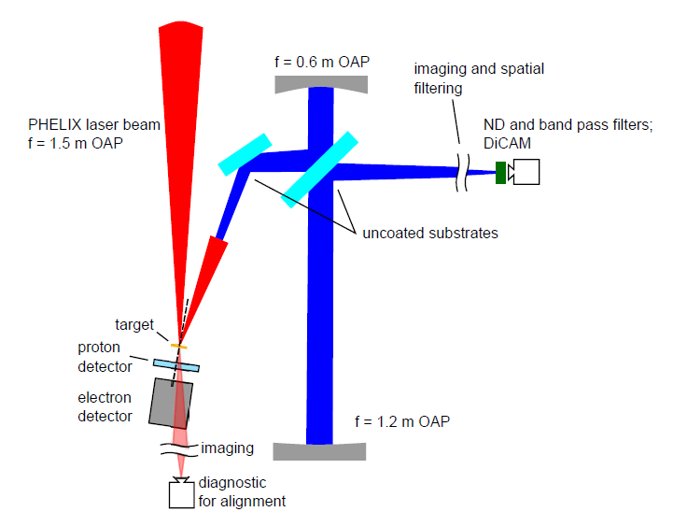
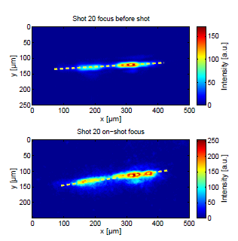
GSI: On-shot 3ω imaging
Setup
Measurement

Slide 14
On-target beam requirements and characterization
How do you (if at all) or your users typically determine the on-target, on-shot intensity?
GSI: Measurement of alignment focus before shot, on-shot pulse duration to compare with duration set offline (full beam, not very reliable), measurement of energy before compression with leakage on calorimeter calibrated against full-beam calorimeter.
LULI:
MRS: beam size measured with a beam profiler and an imaging strategy (to be detailed during the meeting)to image the beam on the target plan.
RAL: Calculated only. Measure spot size and distribution in low power mode and assume similar for on shot. Pulse duration and energy measured on shot.
PETAL: On shot focal spot measurement at 2w. Low energy measurements. Complete diagnostic set-up after the compression chamber
AWE: Short Pulse beamlines - Spatial profile of unamplified OPA pulses are imaged at the target plane using an insertable camera during campaign setup. On-shot wavefront measurements are captured to ensure this does not differ significantly from the unamplified beam. Some on-shot spatial x-ray diagnostics confirm expected spot size. Pulse duration is captured on a shot using a FROG (Swamp Optics Grenouille). For the frequency doubled beamline the energy on target is determined by a CW power measurement ratio in the target chamber and the final diagnostic station together with a calibrated energy meter in this station on the shot. For the non-frequency doubled beamline the pre-compressor energy is measured using a wholebeam caliorimeter and cross calibrated against an energy meter in a diagnostic station. The on shot energy on target is then scaled from this energy meter based on reflectivity and throughput calculations.
Long Pulse beamlines – Typically these beamlines use phase plates to provide a larger focal spot on target. Significant optical modeling backed up by spatial x-ray diagnostics used to confirm optical model. Pulse duration measured using streak cameras. Energy is measure using whole beam calorimeters prior to the final focusing lenses and cross calibrated against energy meter in diagnostic stations.

Slide 15
On-target beam requirements and characterization
How and at which point do you typically measure / document the on-shot pointing stability of your system?
GSI: Farfields at preampilfier, mainamplifier and compressor output sensors automatically recorded to shot database.
LULI:
MRS: Using a beam profiler: monitor the beam center (barycenter) for 100 shots: if it moves less than 1 µm (rms), it’s ok.
RAL: (Vulcan) Pre-compressor diagnostics. Post compressor diagnostics not reliable for pointing at the moment
PETAL: -
AWE: We measure far field positions on a camera for the amplified beam both pre and post compressor. We are reliant on feedback from our users from data recorded by their diagnostics for the on-target pointing stability. These differ significantly between campaigns and are reliant on a number of variables; this is therefore an inconsistent process.

Slide 16
On-target beam requirements and characterization
What are the typical / most stringent pointing stability requirements in your facility?
GSI: Typical: 10-50 microns (foils, wires), special: 5-10 microns (few-micron spheres)
LULI:
MRS: Better than 5 µrad
RAL: (Vulcan) Target on some experiments (20um or less), otherwise pinhole around 10 diffraction limited or larger
PETAL: -
AWE: Typically we are required to hit a target that is 50 microns. Our frequency doubled short pulse beamline requires the two beamlets to overlap when focused, this is therefore 10 microns.

Slide 17
On-target beam requirements and characterization
Did you determine / eliminate sources of pointing variation in your system, and do you implement specific measures (e.g. infrastructure shut-down) to stabilize the system for the shots?
GSI: General decoupling of optics from housings where possible, beam transport in stable atmospheres. If there is foreseen construction or crane works during beam times, we have asked for a short machine stop for the shots (until shot is through, 5-10 min). Still unresolved pointing issues varying on hourly and daily basis (few to sometimes more than five spot diameters)
LULI:
MRS: We tried to attenuate vibrations (due to a cryostat) that significantly increase the pointing instabilities.
RAL: ISIS neutron source power supply induces 50Hz oscillation in Gemini beam – minimized by synchronizing to this frequency
PETAL: -
AWE: Movement of motorized components under vacuum resulted in significant heating and associated alignment drift. Movement of motorized components minimized where possible to improve pointing stability. Vibration from plant equipment observed on target.

Slide 18
Parallel system use
Contributions:
Optimization of parallel operations to multiple target areas (RAL)
Can you or do you plan to supply beams from the same source to different target areas in parallel?
Please describe the mode of parallel operation and if this happens regularly or as an exception.
How do you handle conflicts between different beam destinations?

Slide 19
Parallel system use
Can you or do you plan to supply beams from the same source to different target areas in parallel?
GSI: Switching between target areas is manual and takes at least an hour, so far, no parallel service planned.
LULI:
MRS: We can supply 2 multiTW beams simultaneously (10 TW/100 Hz & 20 TW/10 Hz)
RAL: Vulcan: beams are sent to one area at a time but run parallel target area operations. Takes about 10-20 minutes to switch and align beam to other area for pulsed beam / shots
PETAL: No.
AWE: n/a

Slide 20
Parallel system use
Please describe the mode of parallel operation and if this happens regularly or as an exception.
GSI: -
LULI:
MRS: It happens exceptionally (picture to be shown during the meeting)
RAL: Vulcan: going to full parallel operations where all experiments are expected to be running alongside another experiment
PETAL: -
AWE: n/a

Slide 21
Parallel system use
How do you handle conflicts between different beam destinations?
GSI: -
LULI:
MRS:
RAL: No specific plan, experimental teams are expected to discuss between themselves and the laser operators beam delivery on a day-to-day time basis. Video phones and intercoms are in target areas, control rooms and laser areas to facilitate this.
PETAL: -
AWE: n/a

