Slide 1
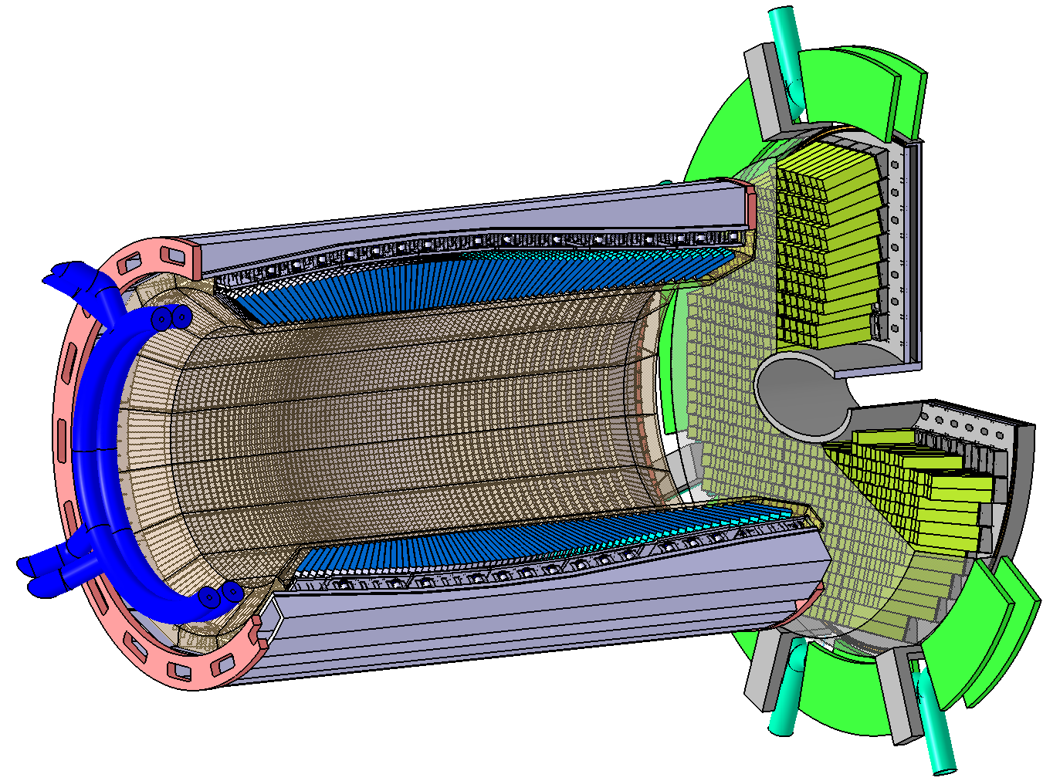
ADC for EMC
- PANDA EMC Readout System
3,600
13,888
Preamplifier
Basel
Photosensor
VPTT
949
60
Data Concentrator, 16-ch
949
ADC 64-ch, 14-bit, 80-MSPS
Compute Node
Compute Node
60
Compute Node
11,952
Photosensor
APD
46,788
Preamplifier
APFEL (GSI)
Pawel Marciniewski, EMC FEE/DAQ Meeting, KVI, 30.03.2016

Slide 2
ADC for EMC
- PANDA EMC Readout System
3,600
217
217
ADC 64-ch
13,888
Preamplifier
Basel
Photosensor
VPTT
22
Data Concentrator, 16-ch
Compute Node
Compute Node
22
Compute Node
366
ADC 64-ch
11,952
Photosensor
APD
46,788
122
Preamplifier
APFEL (GSI)
Pawel Marciniewski, EMC FEE/DAQ Meeting, KVI, 30.03.2016

Slide 3
ADC for EMC
- Final ADC Count
 | CHANNELS | SENSORS per ch. | RANGES | ADC CH | ADC NO | ADC SUM | SPARES | PROD
OPTION1
FWE-VPTT | 768 | 1 | 2 | 1536 | 24
FWE-APD | 3088 | 2 | 2 | 12352 | 193 | 217 | 33 | 250
BAR-APD | 11360 | 2 | 2 | 45440 | 710
BKE-APD | 692 | 2 | 1 | 1384 | 22 | 732 | 68 | 800
SUM |  |  |  | 60712 | 949 | 949 | 101 | 1050
OPTION2
FWE-VPTT | 768 | 1 | 2 | 1536 | 24
FWE-APD | 3088 | 2 | 2 | 12352 | 193 | 217 | 33 | 250
BAR-APD | 11360 | 1 | 2 | 22720 | 355
BKE-APD | 692 | 1 | 1 | 692 | 11 | 366 | 34 | 400
SUM |  |  |  | 37300 | 583 | 583 |  | 650
OPTION3
FWE-VPTT | 768 | 1 | 2 | 1536 | 24
FWE-APD | 3088 | 2 | 2 | 12352 | 193 | 217 | 33 | 250
BAR-APD (65 MSPS) | 11360 | 2 | 2 | 22720 | 355
BKE-APD (65 MSPS) | 692 | 2 | 1 | 692 | 11 | 366 | 34 | 400
SUM |  |  |  | 37300 | 583 | 583 |  | 650
Pawel Marciniewski, EMC FEE/DAQ Meeting, KVI, 30.03.2016

Slide 4
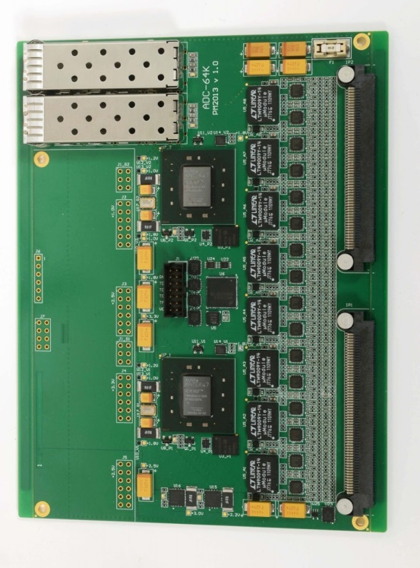
ADC for EMC
- Final ADC Modifications
 | Modification | Comment | Status
1 | Versatile Link/SFP+ options | SFP+ is still kept as a fall-back option | √
2 | GTX-link added to the backplane | Allows for external cascading of the readout chain | √
3 | Power via backplane | Bigger backplane connector with more pins providing power | √
4 | Power and control over front panel | Option for front power distribution. | √
5 | Passive power monitor | All voltages and currents assembled on two connectors for monitoring | √
6 | Active power monitor | 32-channel slow ADC for health monitoring under run conditions | √
7 | Test pulse generator | Risk of performance drop | X
Pawel Marciniewski, EMC FEE/DAQ Meeting, KVI, 30.03.2016

Slide 5
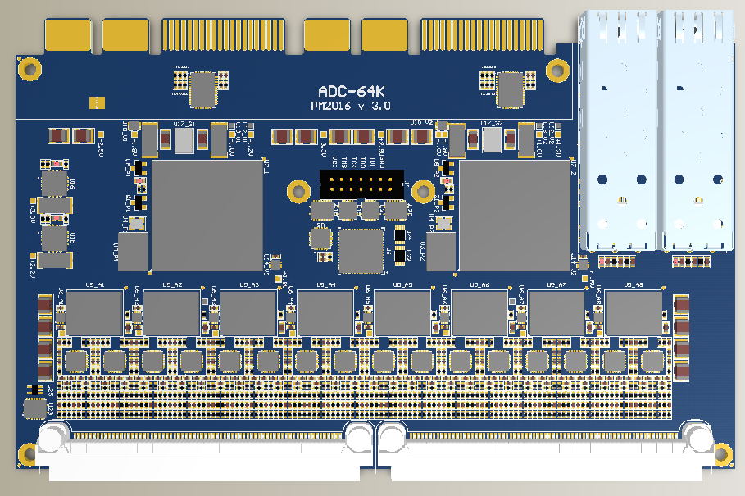
ADC for EMC
- Final ADC Modifications
Pawel Marciniewski, EMC FEE/DAQ Meeting, KVI, 30.03.2016

Slide 6
ADC for EMC
- Final ADC Modifications
Ceramic Capacitors
Pawel Marciniewski, EMC FEE/DAQ Meeting, KVI, 30.03.2016

Slide 7
ADC for EMC
- Final ADC Modifications
Mounting Holes
Pawel Marciniewski, EMC FEE/DAQ Meeting, KVI, 30.03.2016

Slide 8
ADC for EMC
- Final ADC Modifications
Bigger Connectors
For power distribution
and GTX
Pawel Marciniewski, EMC FEE/DAQ Meeting, KVI, 30.03.2016

Slide 9
ADC for EMC
- Final ADC Modifications
Versatile Link option
Pawel Marciniewski, EMC FEE/DAQ Meeting, KVI, 30.03.2016

Slide 10
ADC for EMC
- Final ADC Modifications
Flat Zero-cost power monitoring and supply connector
Pawel Marciniewski, EMC FEE/DAQ Meeting, KVI, 30.03.2016

Slide 11
ADC for EMC
- Final ADC Modifications
16-channel full power monitors
(option)
Pawel Marciniewski, EMC FEE/DAQ Meeting, KVI, 30.03.2016

Slide 12
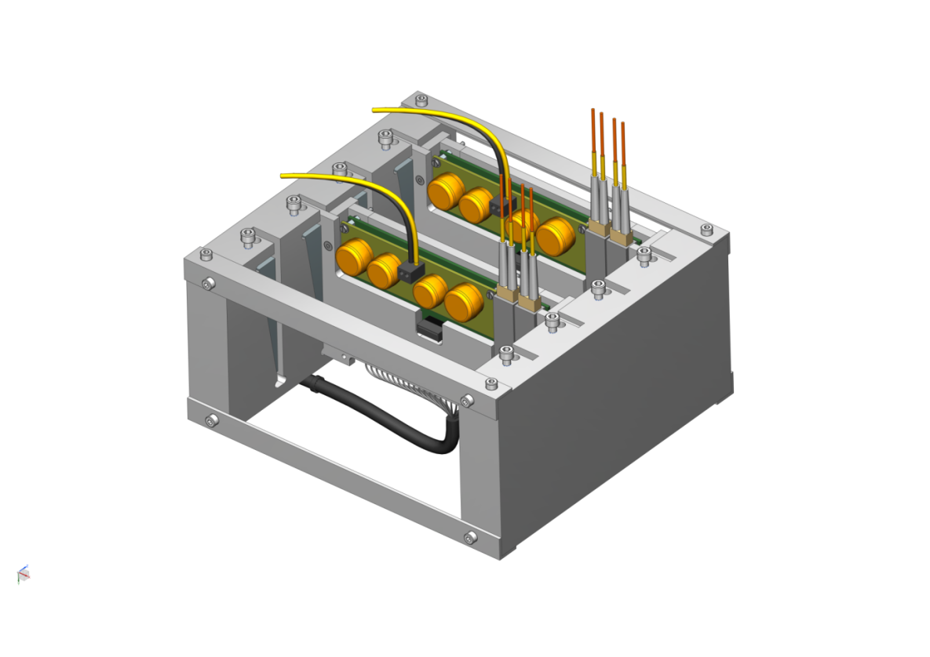
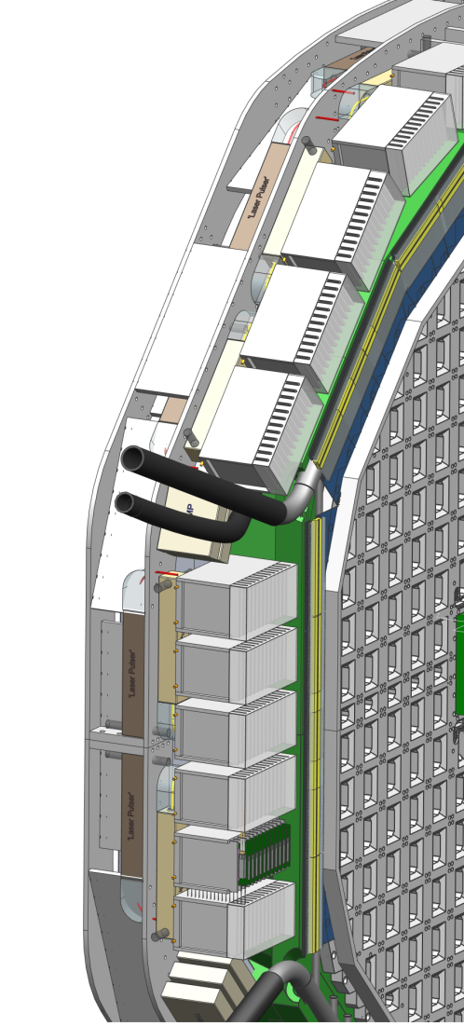
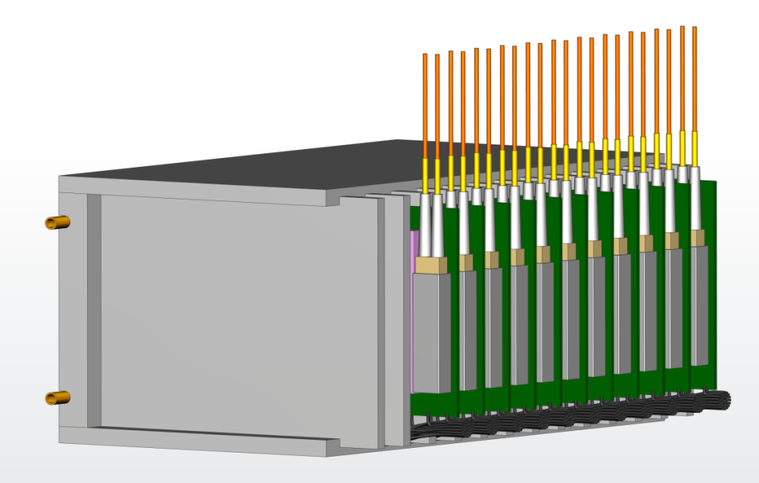
ADC for EMC-Endcap
- Encapsulation and Cooling
Courtesy KVI
Pawel Marciniewski, EMC FEE/DAQ Meeting, KVI, 30.03.2016

Slide 13
ADC for EMC
- Pre-production tests
 | Tests | Comment | Status
1 | GTX Bandwidth | Done for 2 GB/s, faster SFP+ is ordered to test higher frequencies | Done
2 | Input configuration | ADC prepared with different input filters to be tested in Stockholm. Preparations with TRB started | Work on
3 | Radiation immunity | Tests with a neutron beam at TSL, Uppsala were planned in cooperation with KVI, but were postponed. | Urgent
4 | Burn-up tests | We have 6 modules which should be left powered and cooled for a longer time to detect possible failures/shortcomings. | Urgent
Pawel Marciniewski, EMC FEE/DAQ Meeting, KVI, 30.03.2016

Slide 14
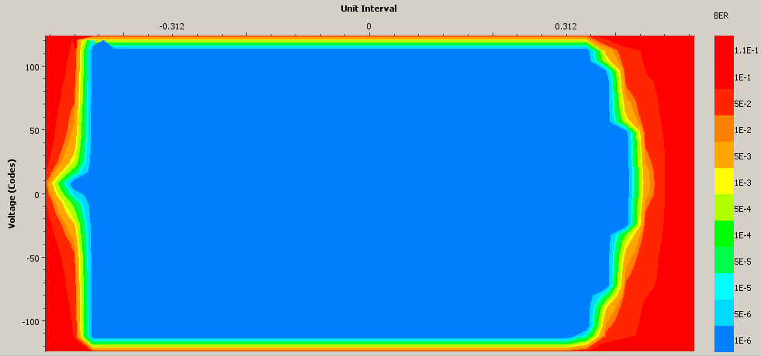
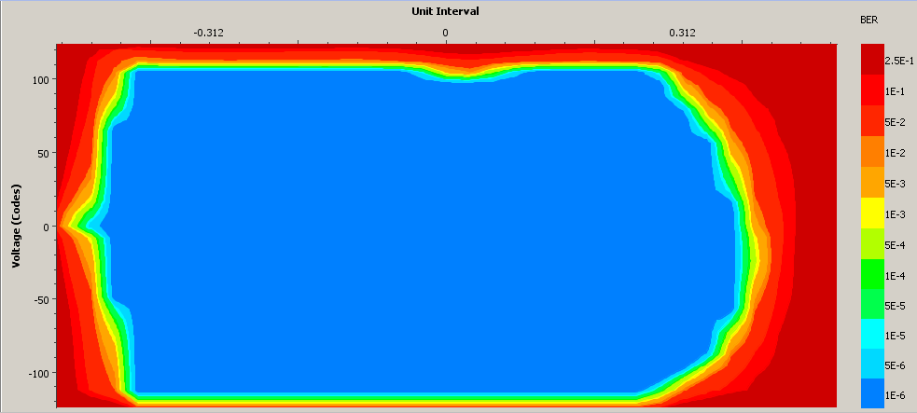
ADC for EMC
- Pre-production tests – IBERT 2.0 Gbps
Pawel Marciniewski, EMC FEE/DAQ Meeting, KVI, 30.03.2016

Slide 15
ADC for EMC
- Completing the system
 | Tests | Comment | Status
1 | Test station | Start-up station with controlled power supply and power monitoring, configuration, test and readout. | Engineer needed
2 | ADC enclosure | 230 enclosures needed | Preliminary design
3 | Crate mechanics and cooling | ADC prepared with different input filters to be tested in Stockholm. Preparations with TRB started | Preliminary design
4 | Power Supply | 1V – 6A, 2.5V – 6A, 3.3V – 1A per module. Air core DC/DC design needed. | Engineer needed
Pawel Marciniewski, EMC FEE/DAQ Meeting, KVI, 30.03.2016

Slide 16
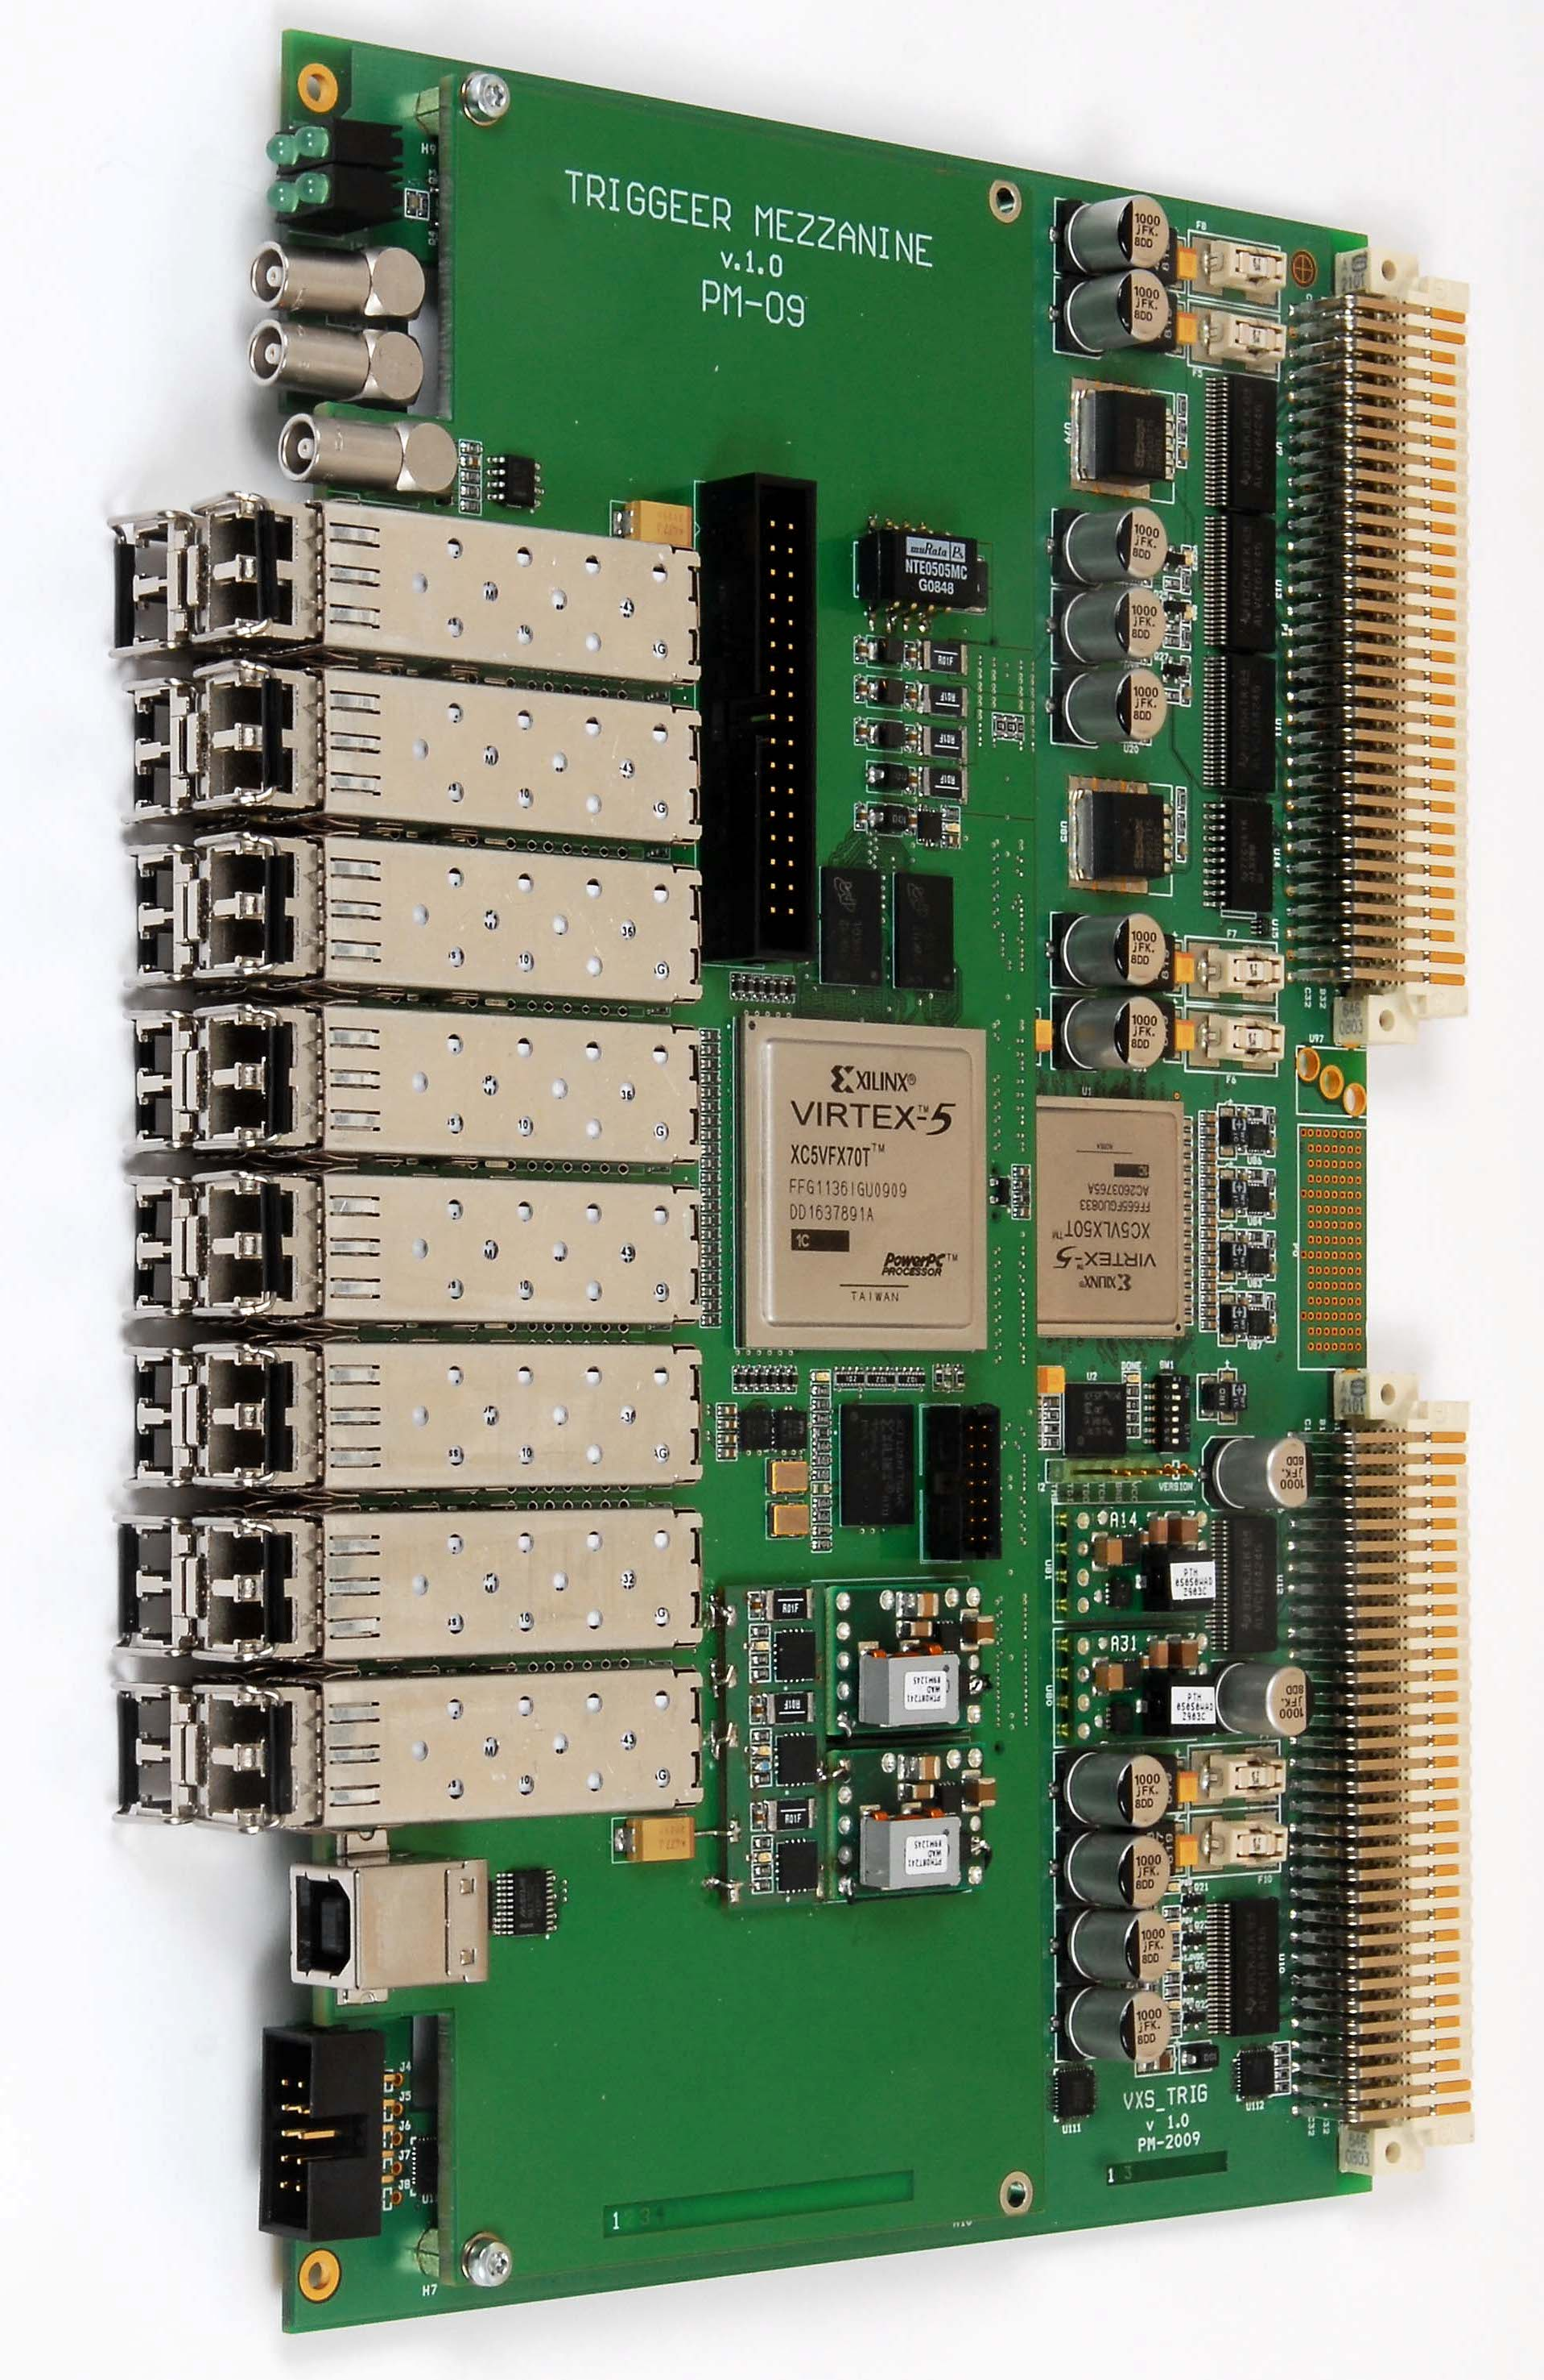
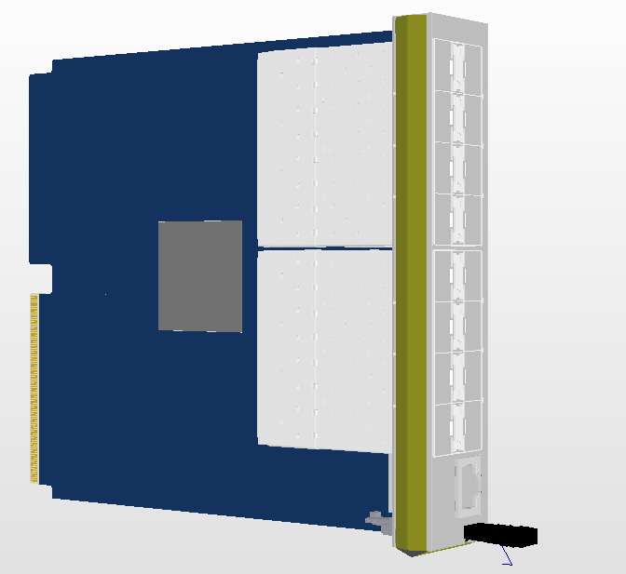
ADC for EMC
- Data Concentrators
VME64x
AMC (uTCA)
180 mm
Kintex Ultrascale 20nm
16 Optical Links
10 Gbit/s
151 mm
8 10Gbit/s
lanes
to uTCA
1Gbit Ethernet
Pawel Marciniewski, EMC FEE/DAQ Meeting, KVI, 30.03.2016

Slide 17
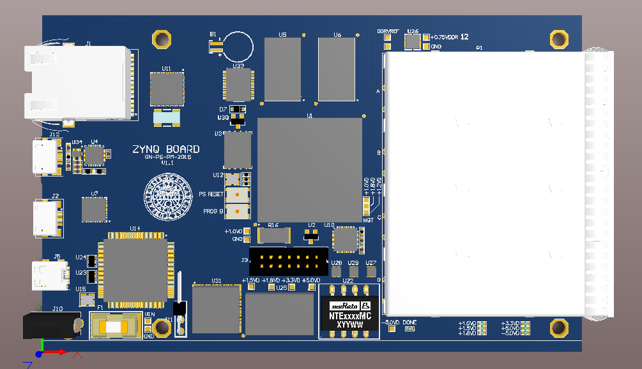
ADC for EMC
- ZYNQ Data Concentrator
Pawel Marciniewski, EMC FEE/DAQ Meeting, KVI, 30.03.2016

Slide 18
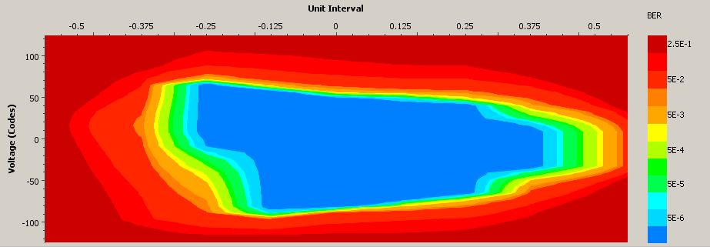
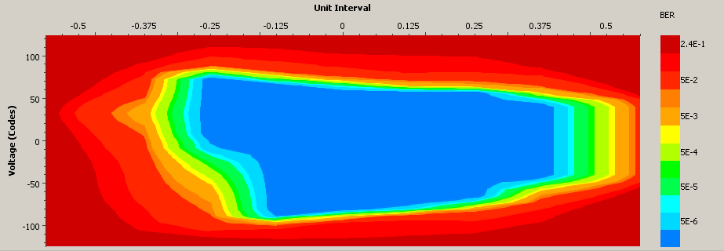
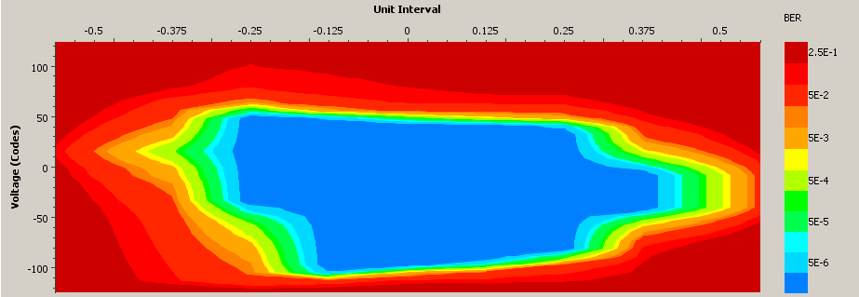
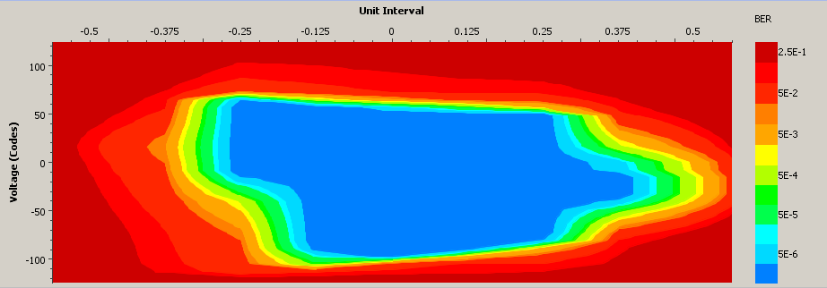
ZYNQ Data Concentrator
- Tests and debugging
Hardware check:
SFP+ optical loopback test @ 6.25 Gbps
DDR 533 | √
UART | √
Flash | √
SDHC | √
PLL | √
SFP+ | √
USB 2.0 | ?
HDMI | X
Firmware & software
Basic Configuration | √
Hello world test | √
DDR test | √
Hardware test | √
LINUX | X
Pawel Marciniewski, EMC FEE/DAQ Meeting, KVI, 30.03.2016

Slide 19
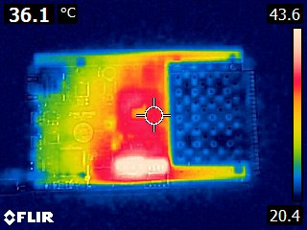
ZYNQ Data Concentrator
- 6.25 Gbps
Pawel Marciniewski, EMC FEE/DAQ Meeting, KVI, 30.03.2016

Slide 20
ADC for EMC
- Schedule
 | 2014 |  |  |  | 2015 |  |  |  | 2016 |  |  |  | 2017 |  |  |  | 2018
EMC SADC
ADC tests
Final design
Final version production
Firmware development
Radiation immunity test
First production batch
Batch testing
Batch burn-in
Partial assembly
Second production batch
Final implementation
EMC Data Concetrators
DC design
DC testing
Prototype production
Batch production
System testing
Pawel Marciniewski, EMC FEE/DAQ Meeting, KVI, 30.03.2016

Slide 21
ADC for EMC-Endcap
Thank You !
Pawel Marciniewski, EMC FEE/DAQ Meeting, KVI, 30.03.2016

