Slide 1
Slow Extraction in Electron Machines…
Wolfgang Hillert
Physics Institute of Bonn University
…based on the experience at our in-house accelerator
Darmstadt 02-Jun-2016

Slide 2
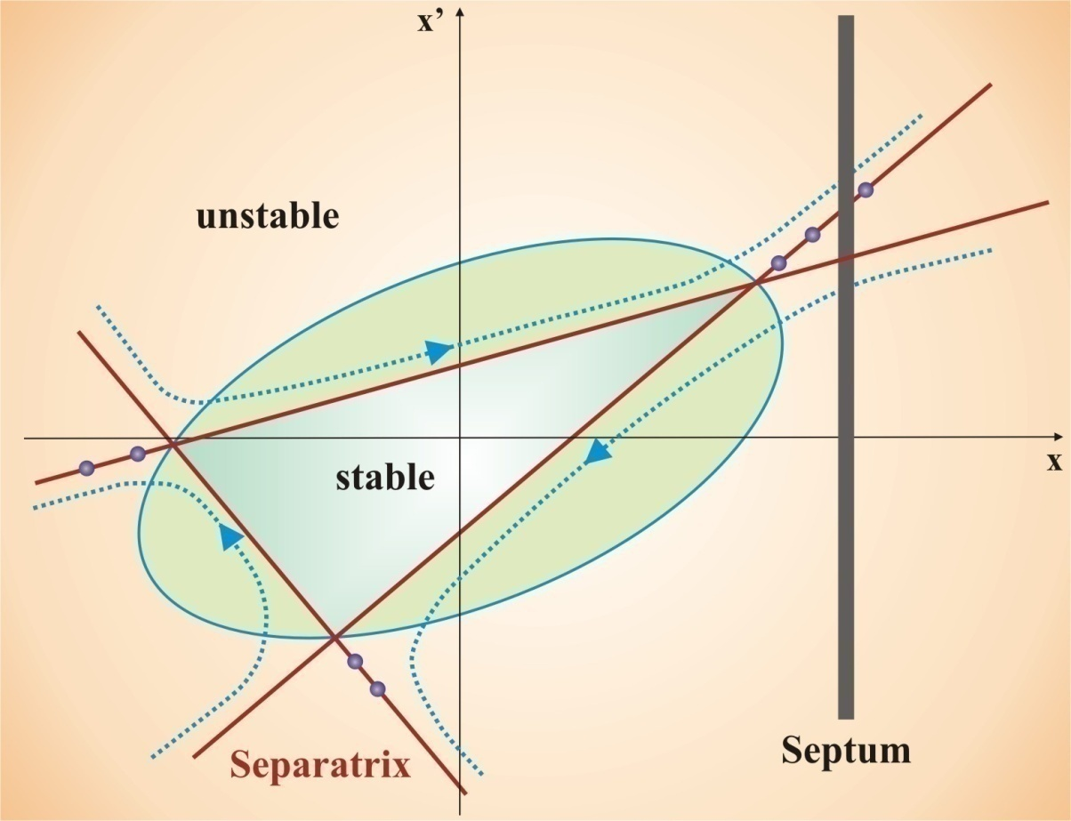
Extraction at a 3rd Integer Resonance

Slide 3
3

Slide 4
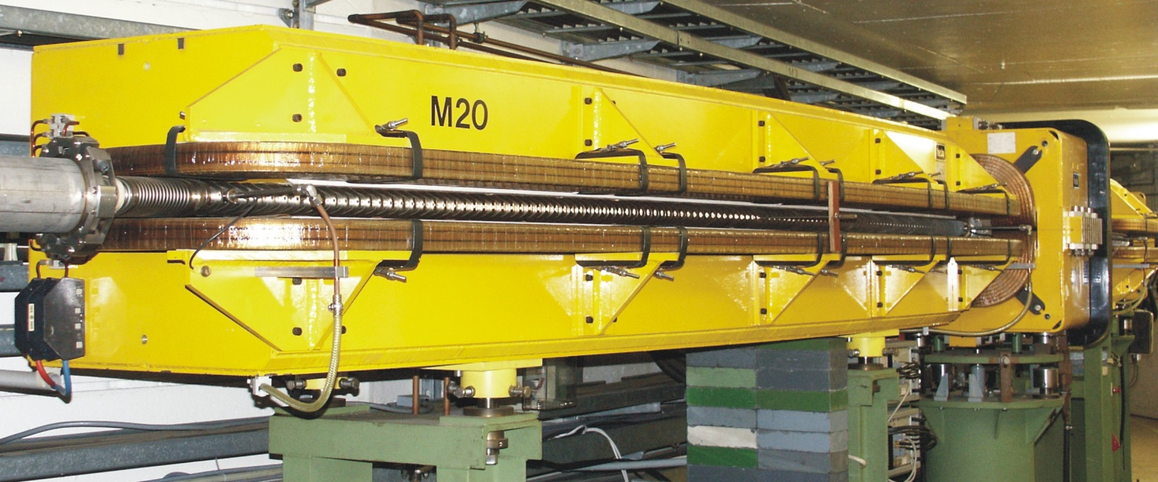
FODO Lattice
B_{max}= 1.07 T @ I = 3100A
g_{max} = 10 T/m @ I = 915A
4

Slide 5
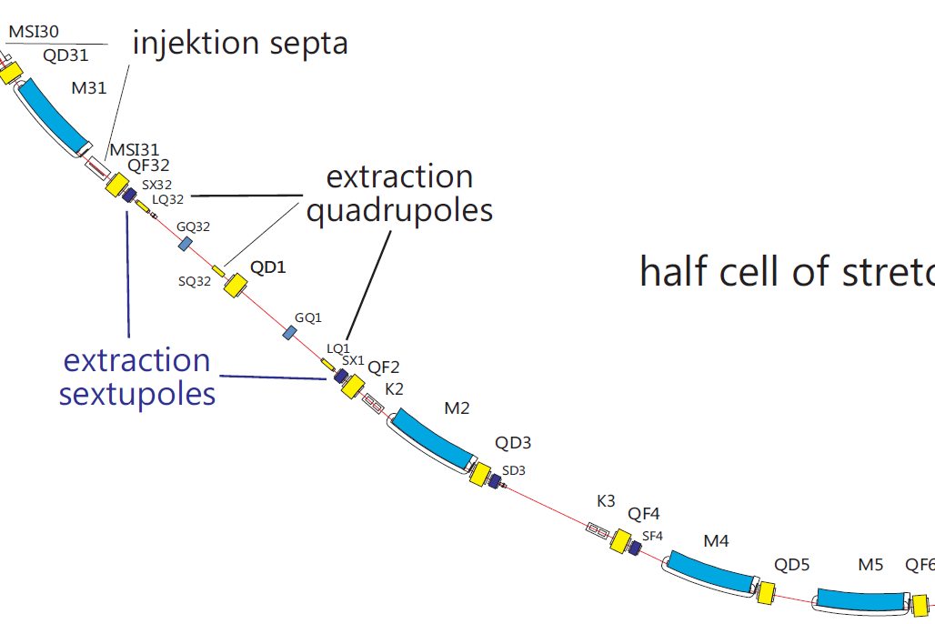
Resonance Excitation
Dispersion suppression using missing dipole concept
Resonance extraction with extraction sextupoles in dispersion free straights
Tune variation with ironless extraction quadrupoles
5

Slide 6
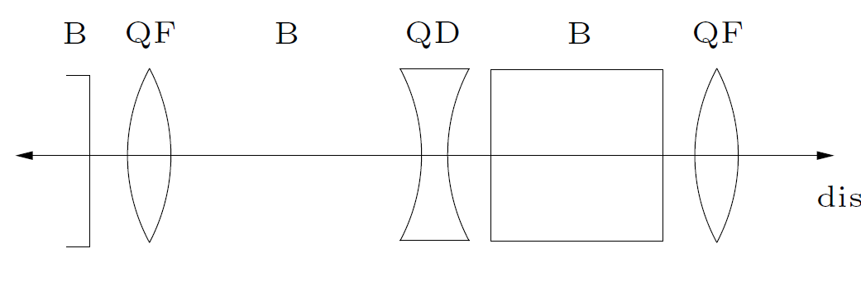
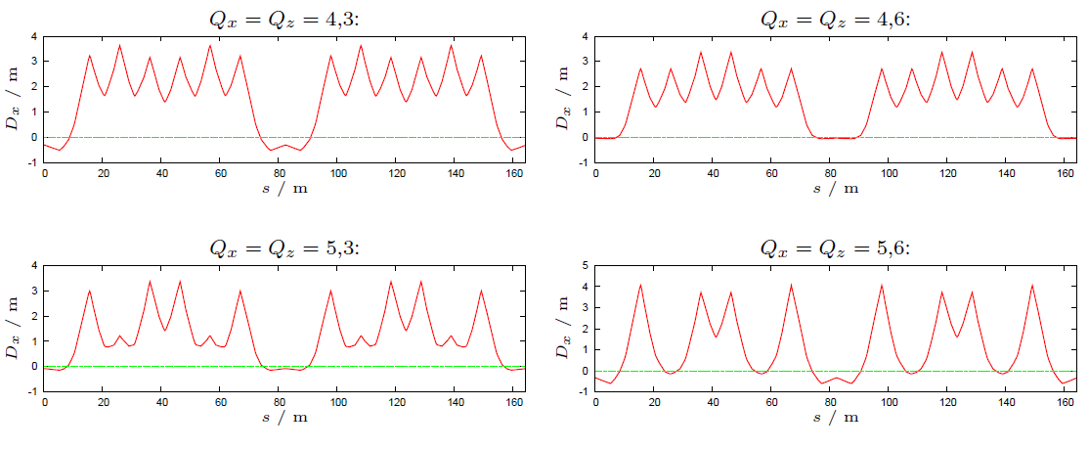
Dispersion Suppression
6

Slide 7
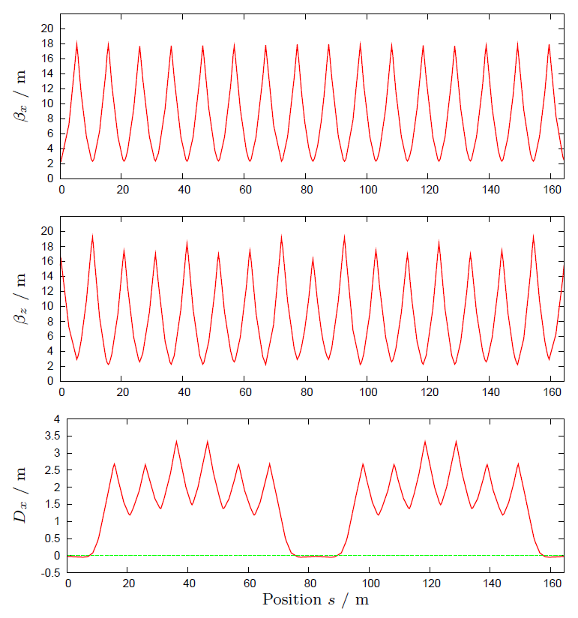
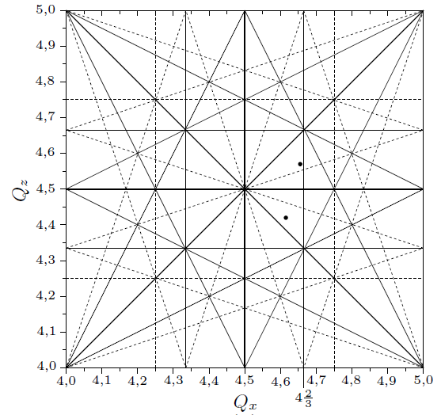
Choice of Betatron Tunes
Beta functions and dispersion
Tune diagram
7

Slide 9
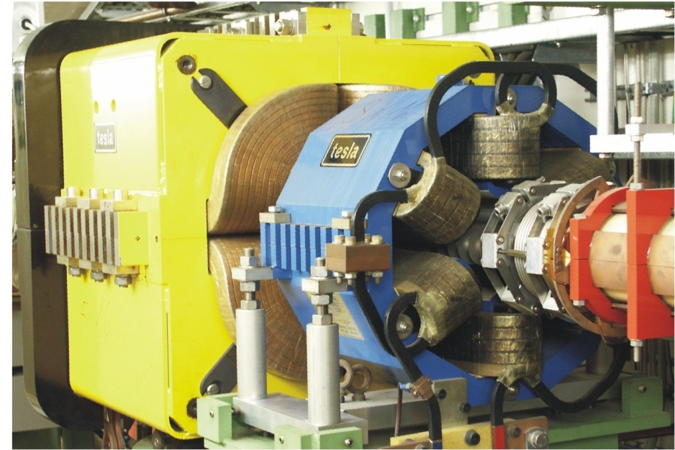
Slow Beam Extraction
Sextupole Magnets (Extraction):
Excitation of a third integer resonance
Ironless Quadrupole Magnets (Extraction):
Shift of the horizontal betatron tune close to a third integer value, “current feedback-loop“
9

Slide 10
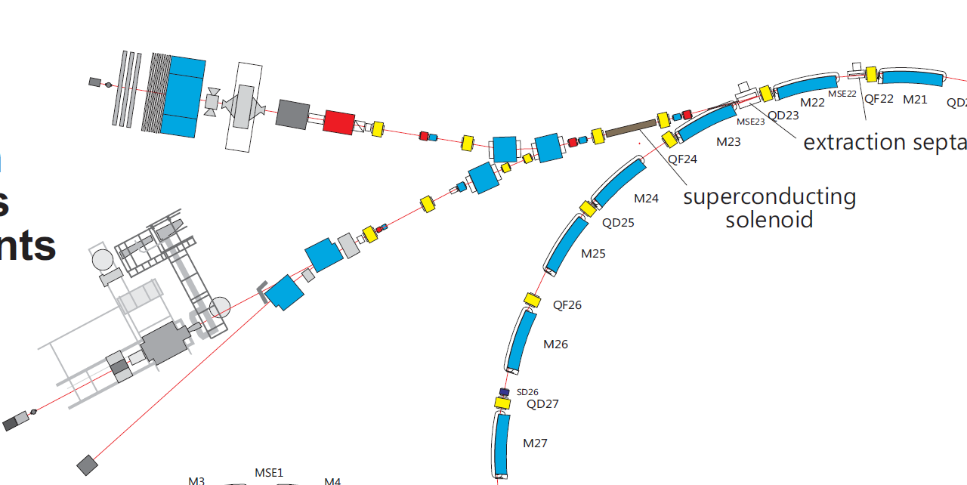
Intensity & Position Stabilisation
Experiments
extr. quads
Lin. Pol g
~ 0.5 nA
linpol γ
ELSA
10

Slide 11
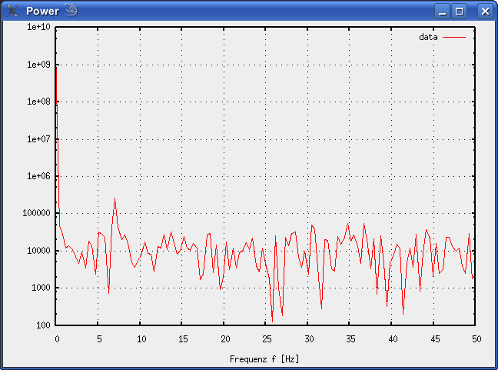
Intensity Stability
Stabilization of
“overall”
tagging rate
(tagger-or)
11

Slide 12
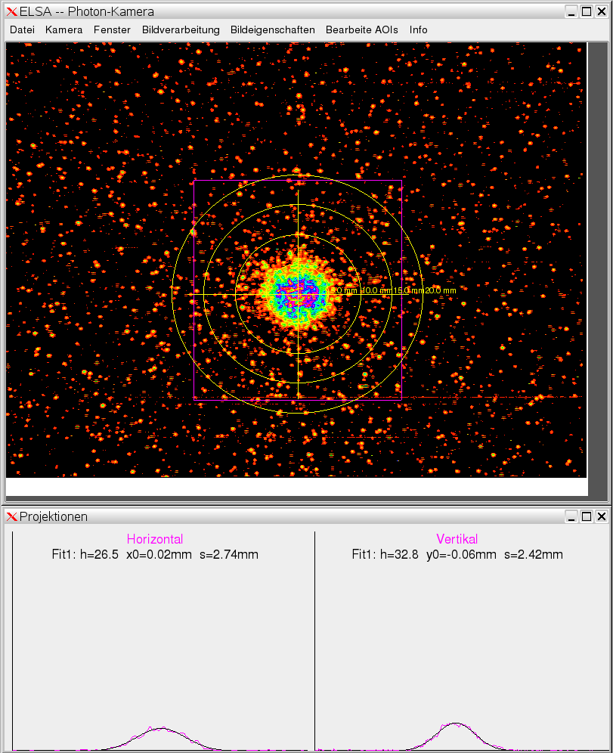
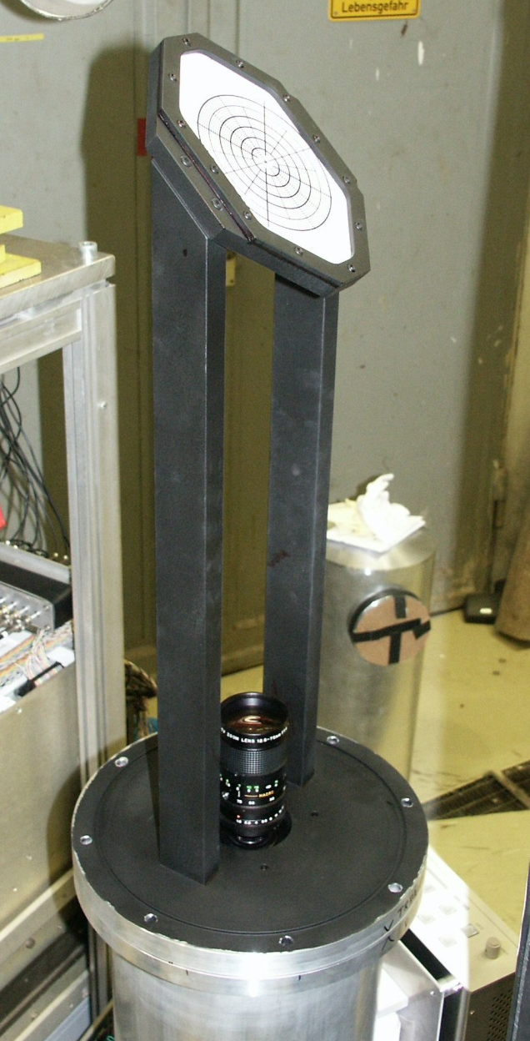
Photon Camera
12

Slide 13
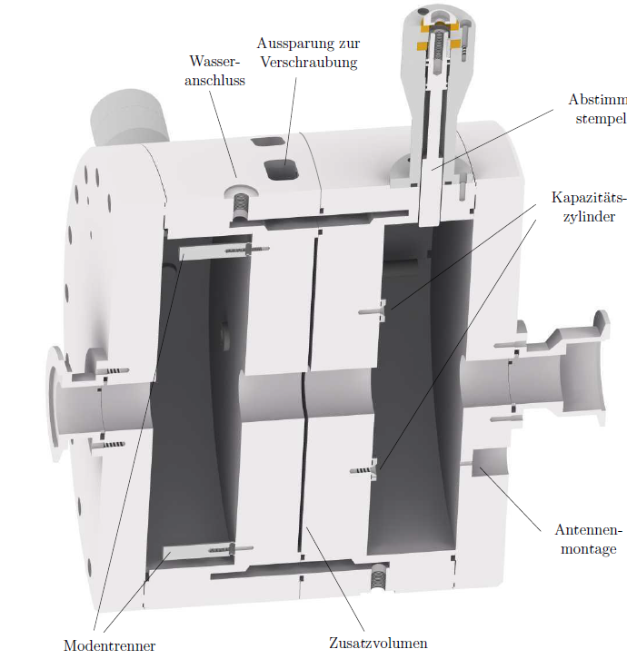
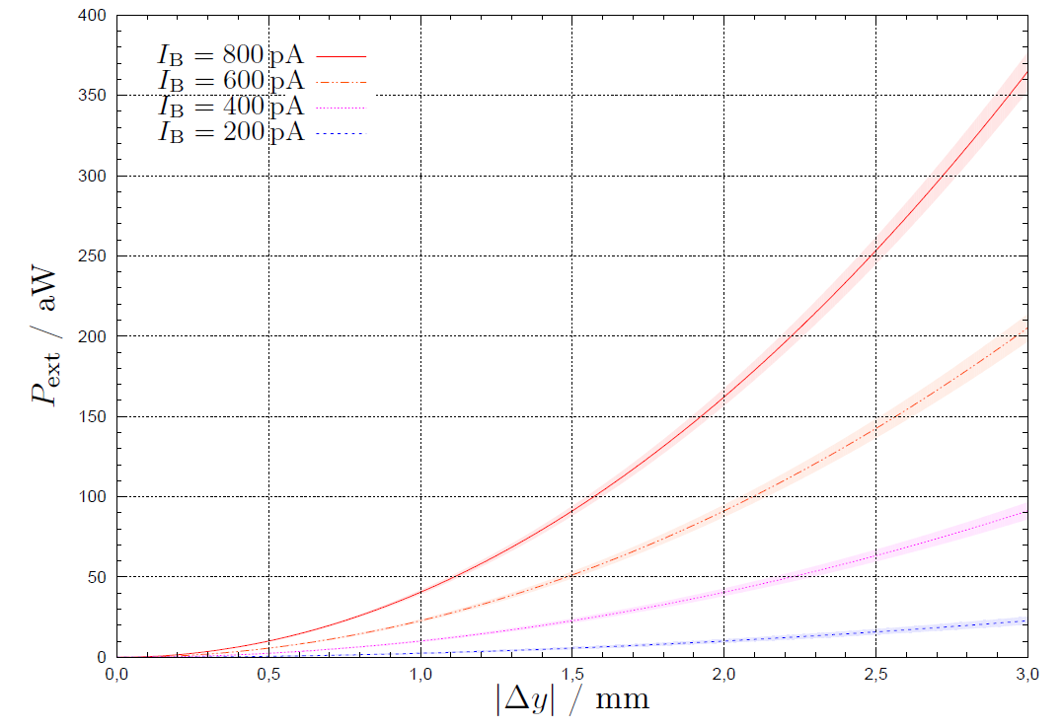
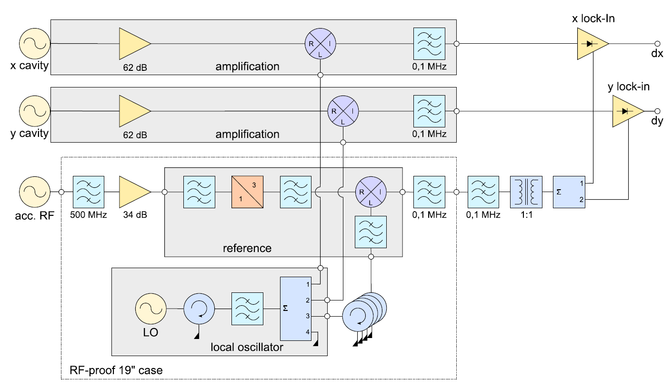
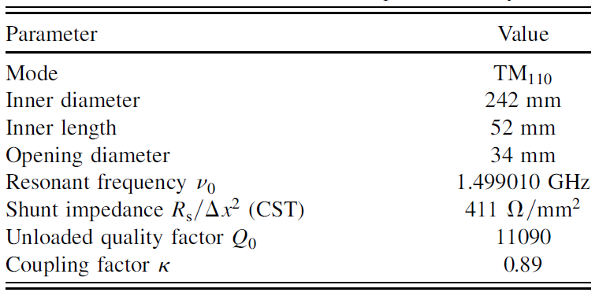
Position Measurement in the pA-Regime
Δx < 50μm @ I = 100 pA, dx = 1mm
lock-in
technique!
13

Slide 14
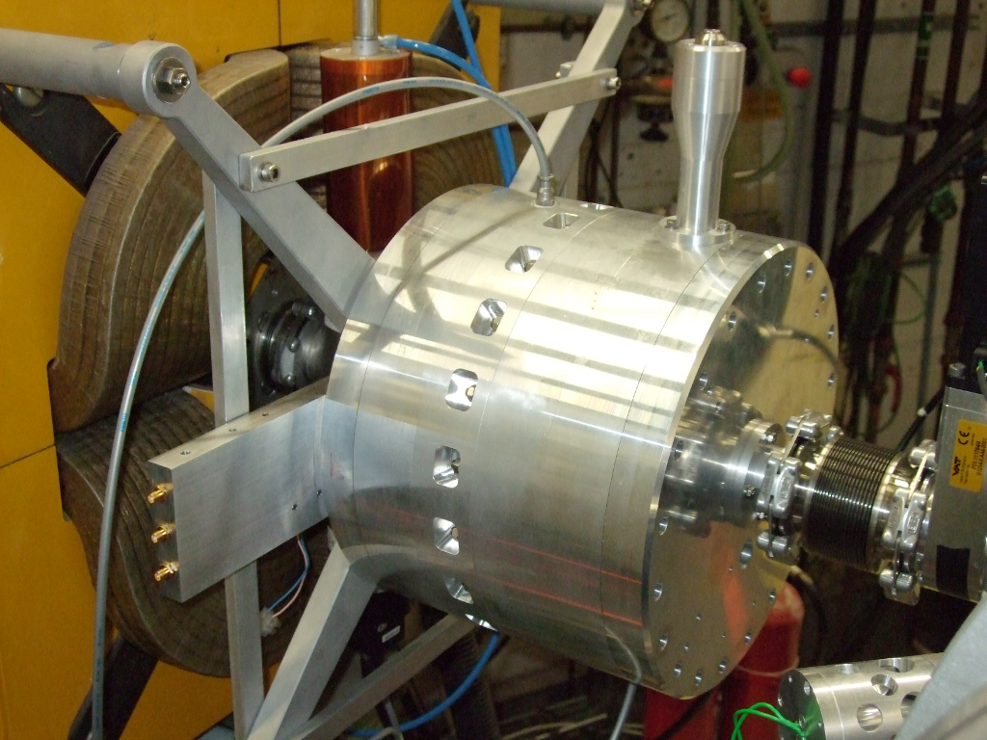
14

Slide 15
Spill Characteristics:
Beam Parameters:
Intensity: adjustable, 0.1 fA < I < 1…10 nA
Beam Parameters:
horz.: affected by extraction, have to be measured
vert, long: about the same as the internal values
Long-Term Stability:
beam pointing stability ≤ 20 μrad ↔ photon-camera
beam position stability ≤ 0.2 mm ↔ RF-cavity
15

Slide 16
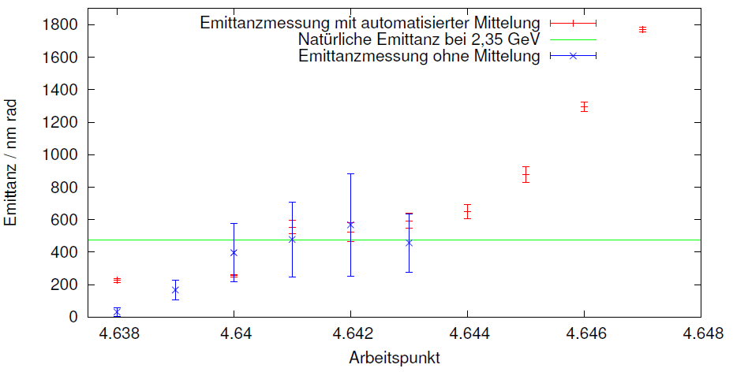
Horizontal Emittance

Slide 17
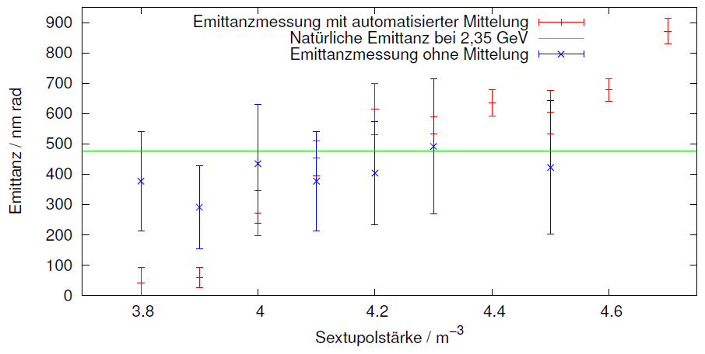
Horizontal Emittance

Slide 18
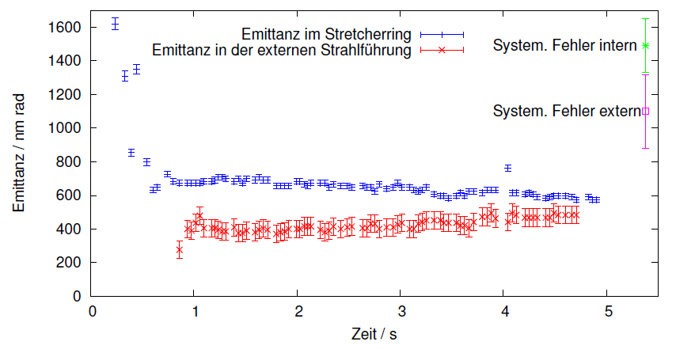
Horizontal Emittance

Slide 19
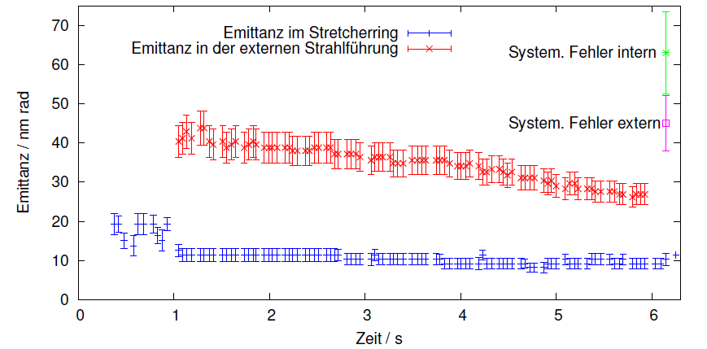
Vertical Emittance

Slide 20
Experimental R&D

Slide 21
Resonance Scan
Requirements:
Precise setting of the tunes (ΔQ_{x} < 10⁻⁴)
ironless air core quadrupole magnets
Precise measurement of the tunes (dQ_{x} < 10⁻⁴)
dedicated 3D bunch by bunch feed-back system
Precise measurement of the beam loss
dedicated beam loss monitoring system
Fully automatized parameter setting and data taking

Slide 22
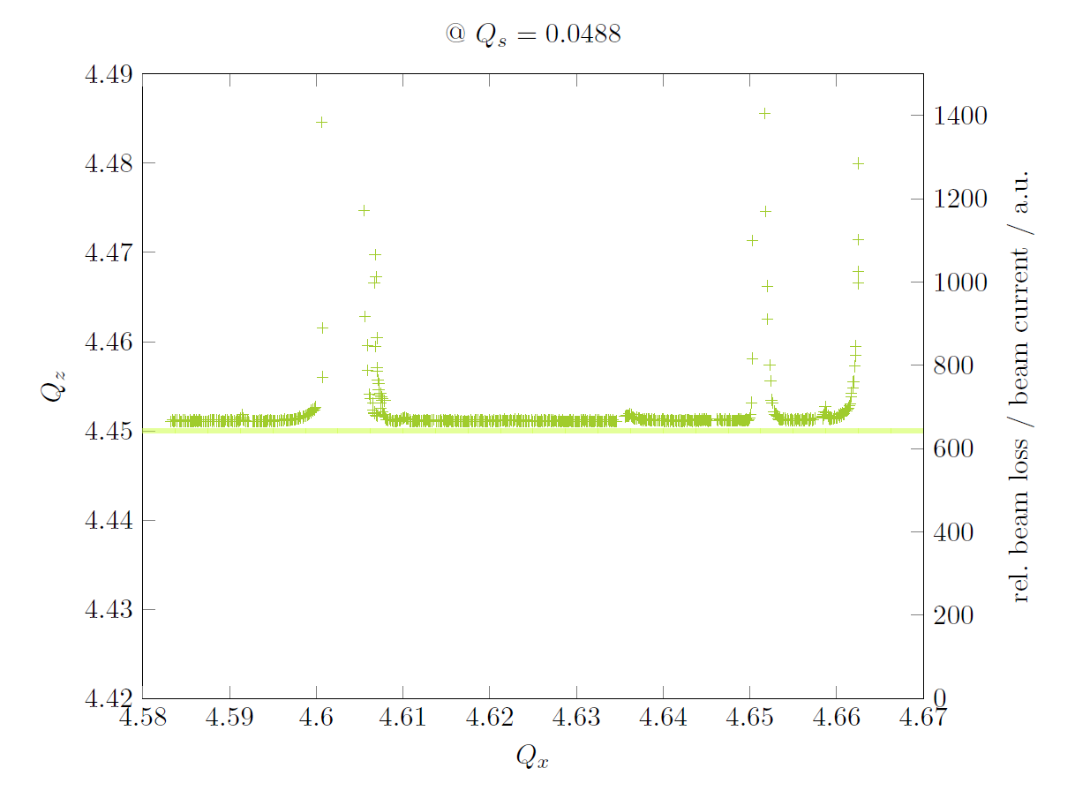

Slide 23
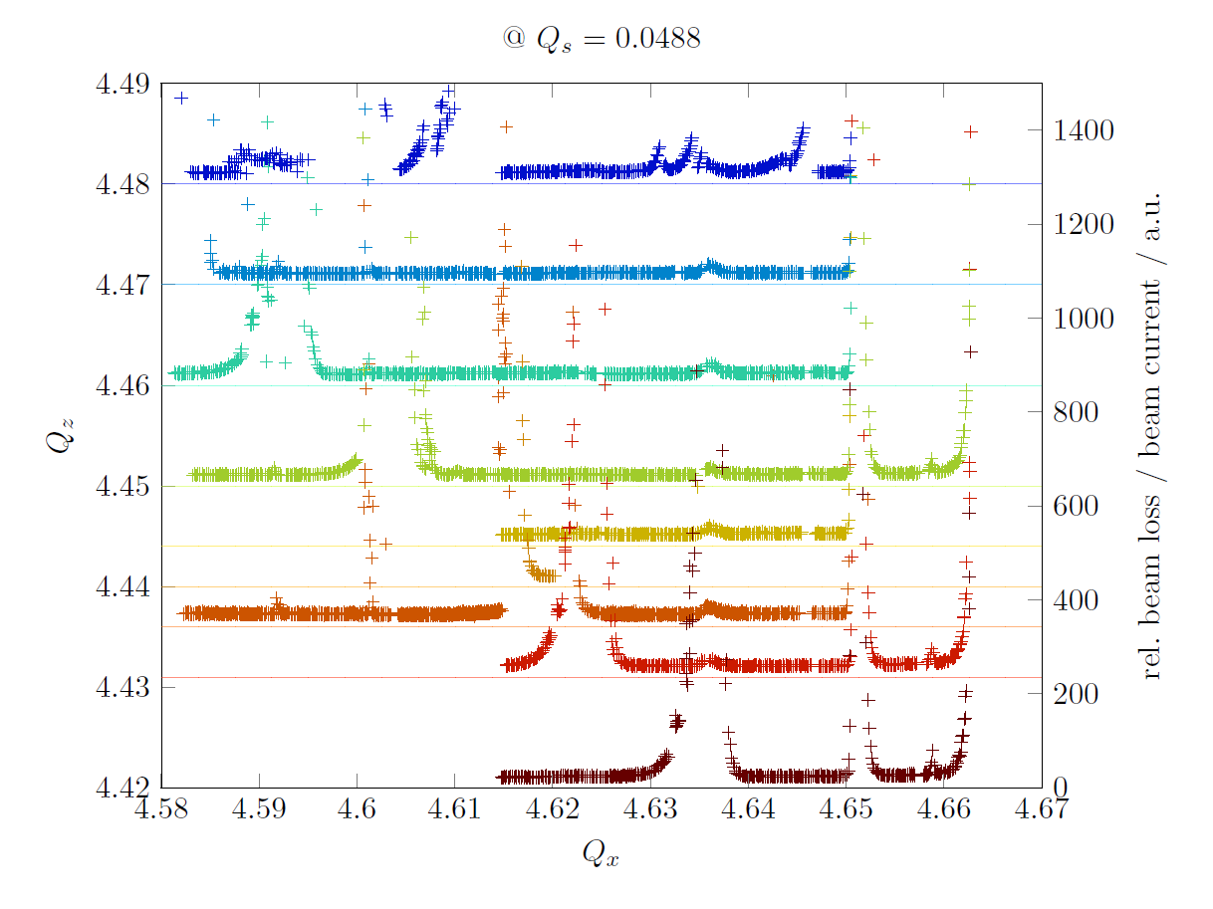

Slide 24
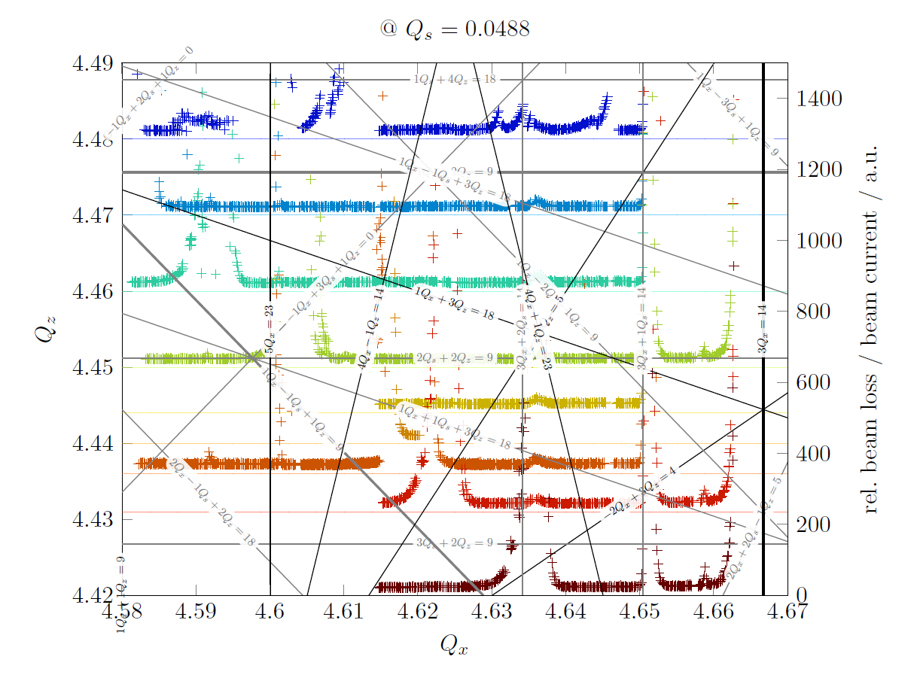

Slide 25
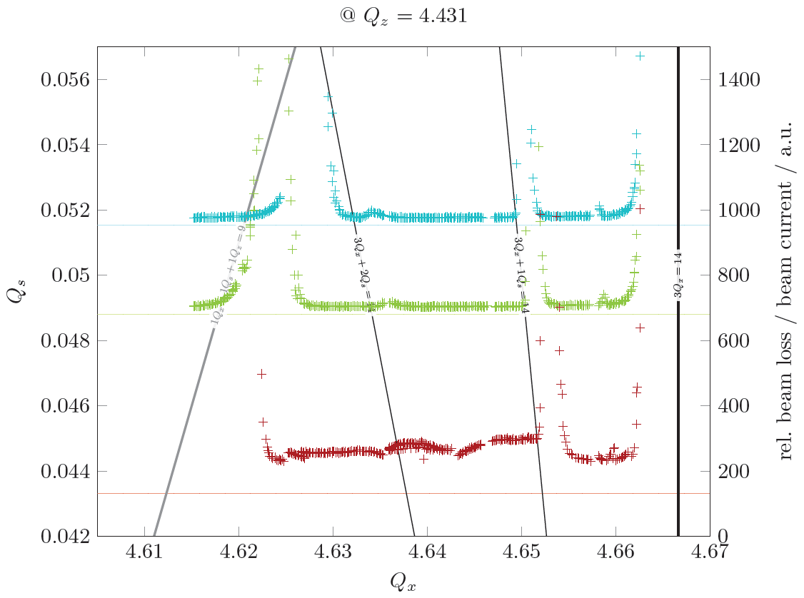

Slide 26
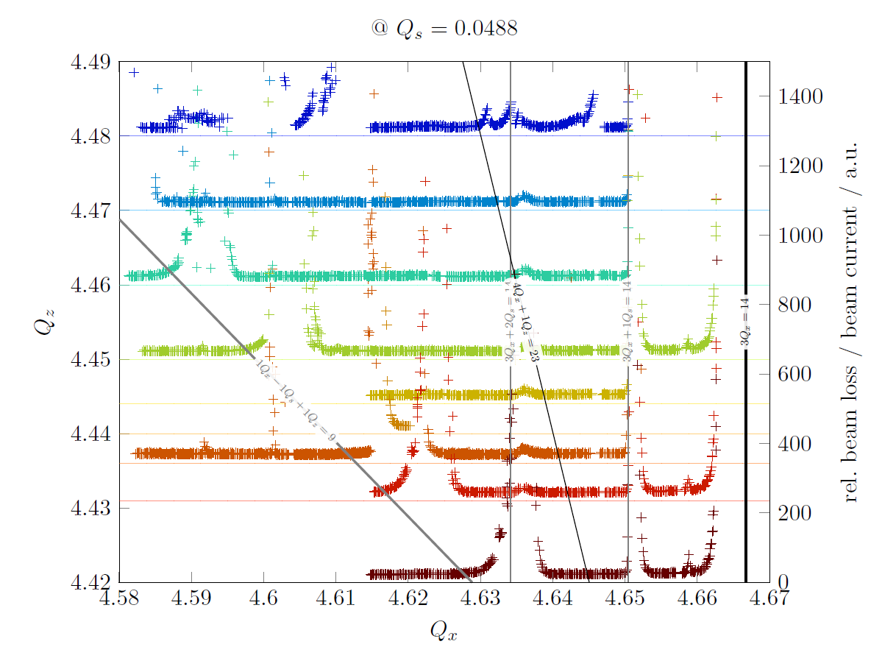

Slide 27
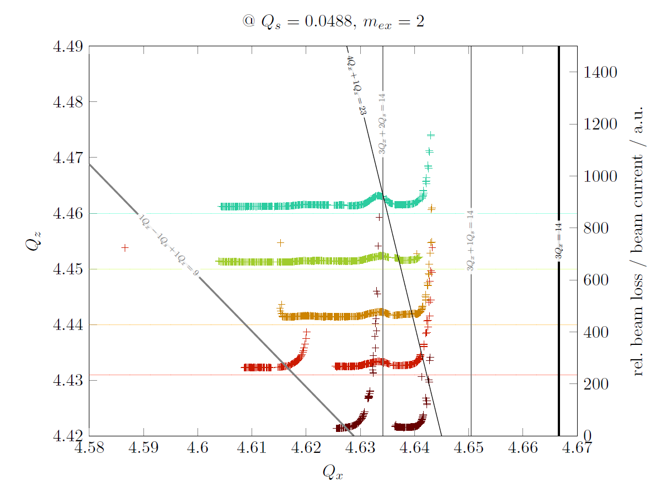

Slide 28
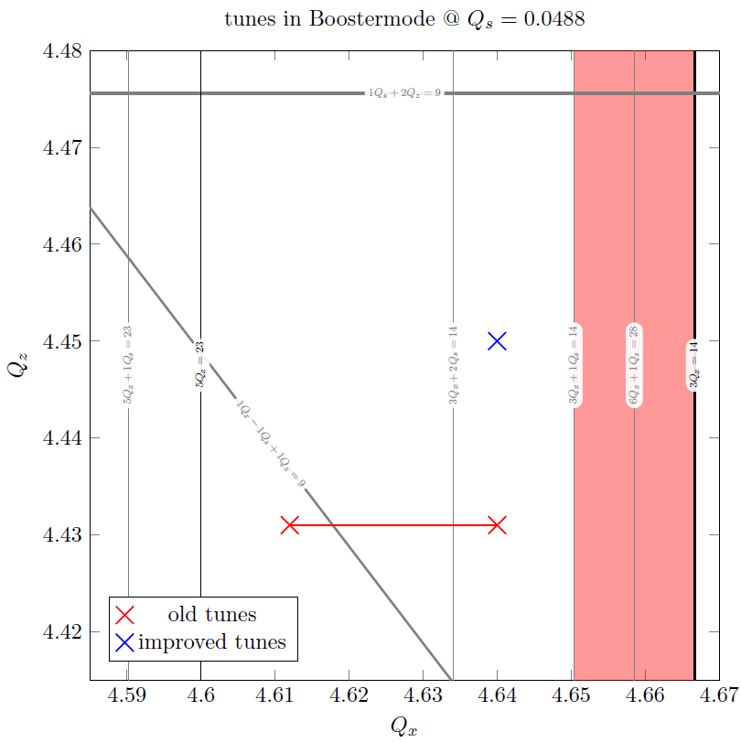
Choice of Optimum Tunes
Tune diagram

Slide 29
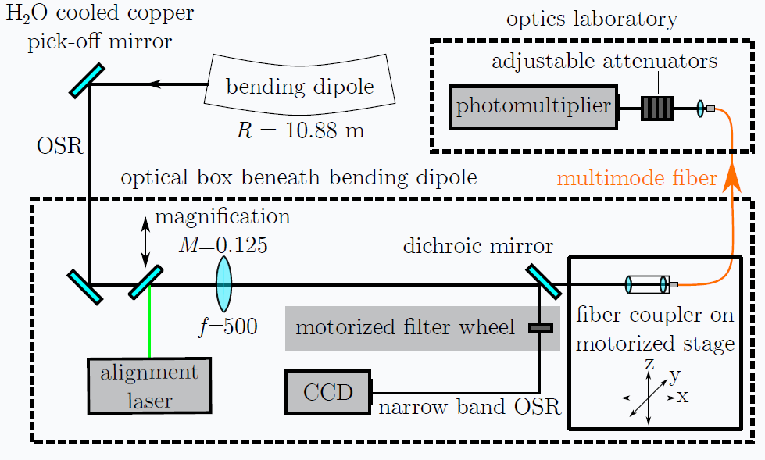
SR based Intensity Monitoring

Slide 30
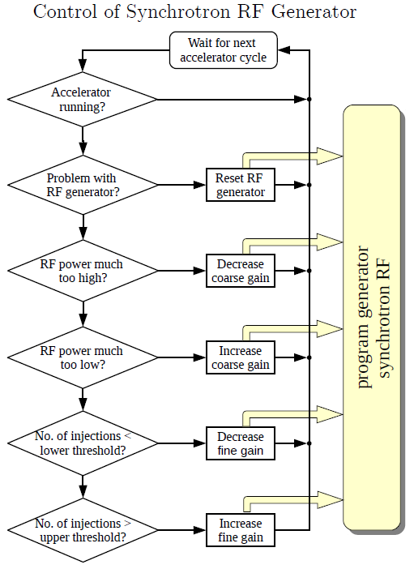
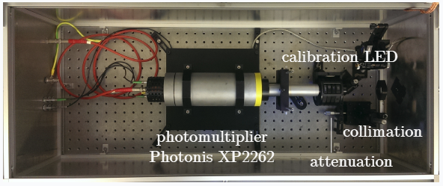
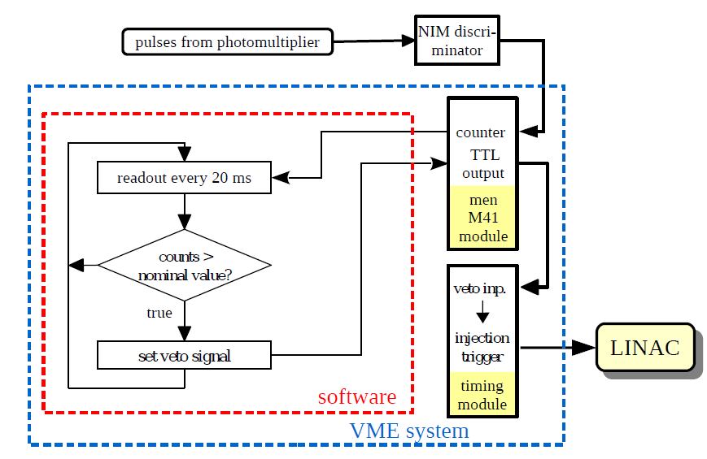
Ultra-low Current Injection

Slide 31
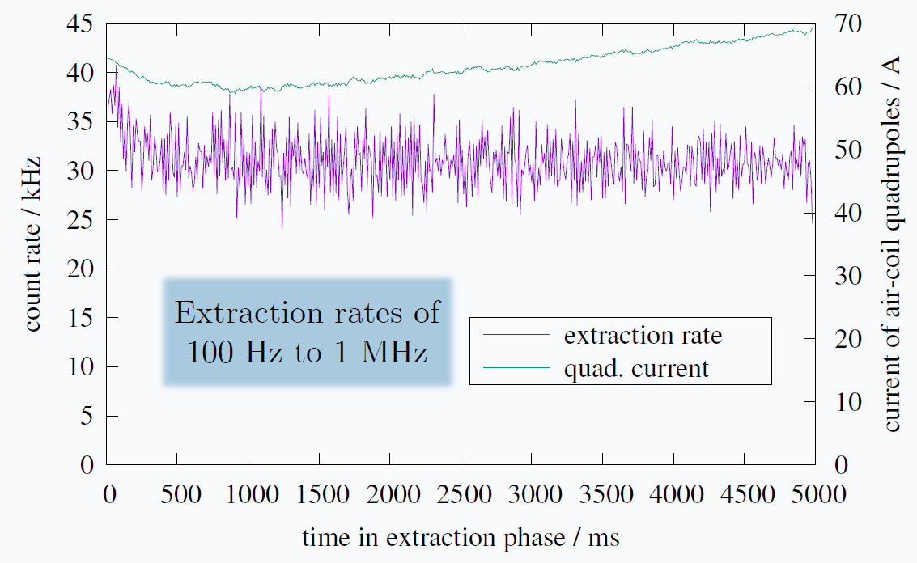
Typical Performance

Slide 32
Summary
Slow electron extraction at a 3rd integer resonance
resonance excitation with sextupoles in dispersion free straights
shrinking of phase stable triangle with ironless quadrupoles
in case of synchro-betatron coupling extraction at 3Q_{x}+Q_{s} = n possible
Stabilization of beam parameters
intensity: feed-back on extraction quadrupoles (← intensity signal)
pointing: feed-back on extraction septum (← quadrupole current)
Dynamic range
ext. currents 0.1 fA < I < 10 nA depending on fill of the storage ring

Slide 33
Appendix
… spares …

Slide 34
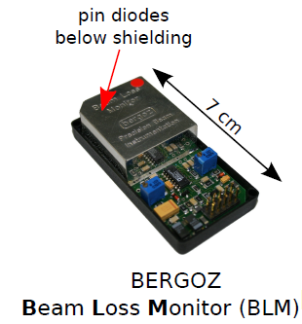
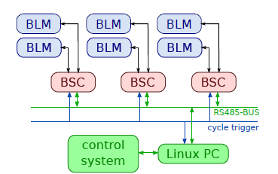
Beam Loss Monitoring System
QF
32x
QD

Slide 35
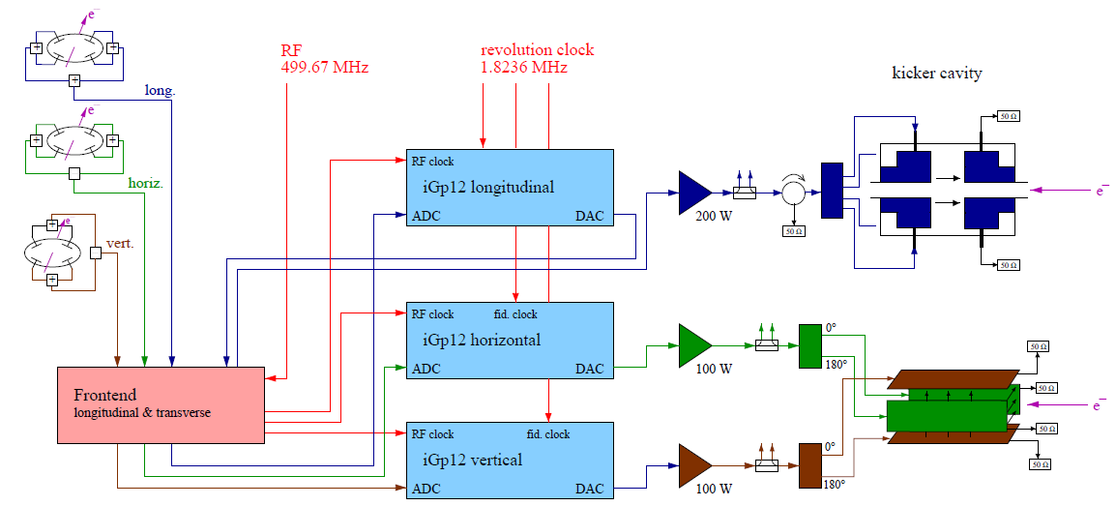
Bunch by Bunch Feedback
System Layout:
©DIMTEL, Inc.

Slide 36
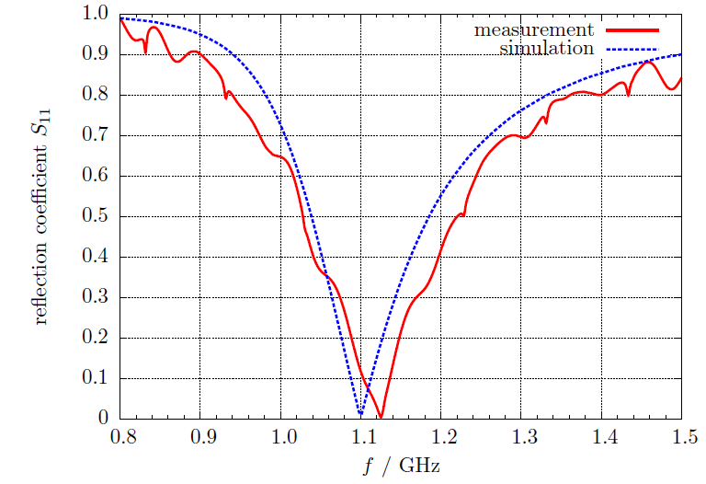
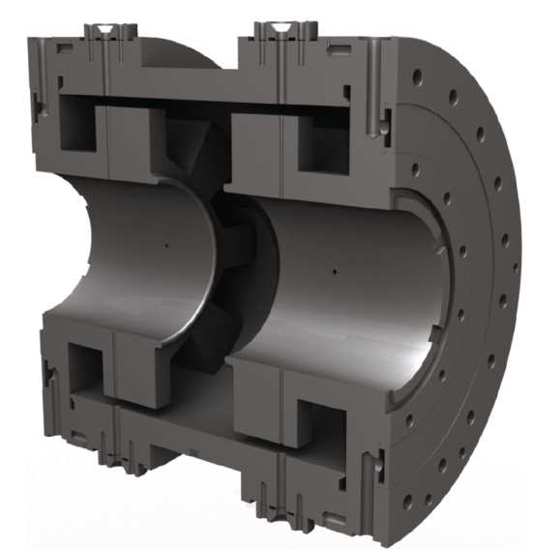
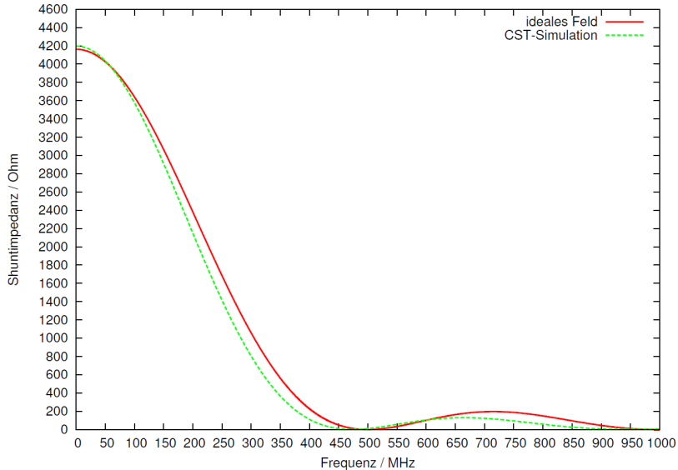
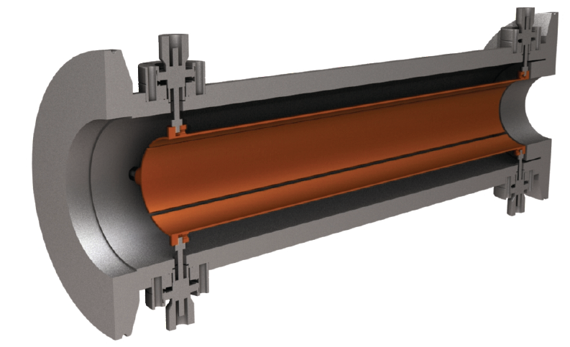
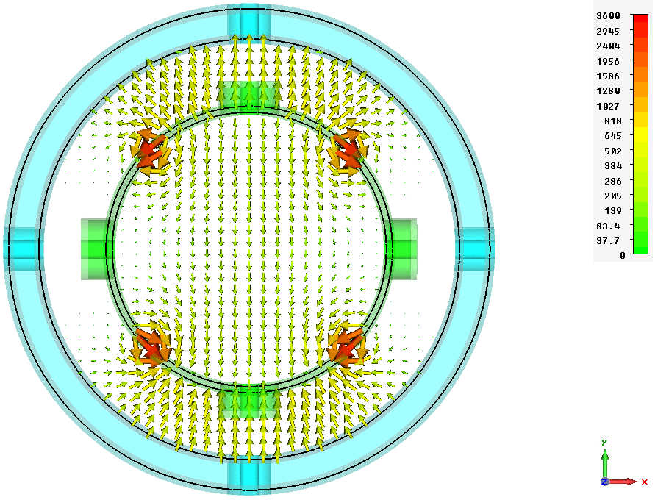
Broad-Band Kickers (developed and constructed in-house)
Longitudinal: Kicker Cavity
ν = 1.13 GHz
Q_{L} = 3.78
R_{S} = 387 Ω
BW = 255 MHz
Transverse: Stripline Kicker
f = 0 - 250 MHz

Slide 37
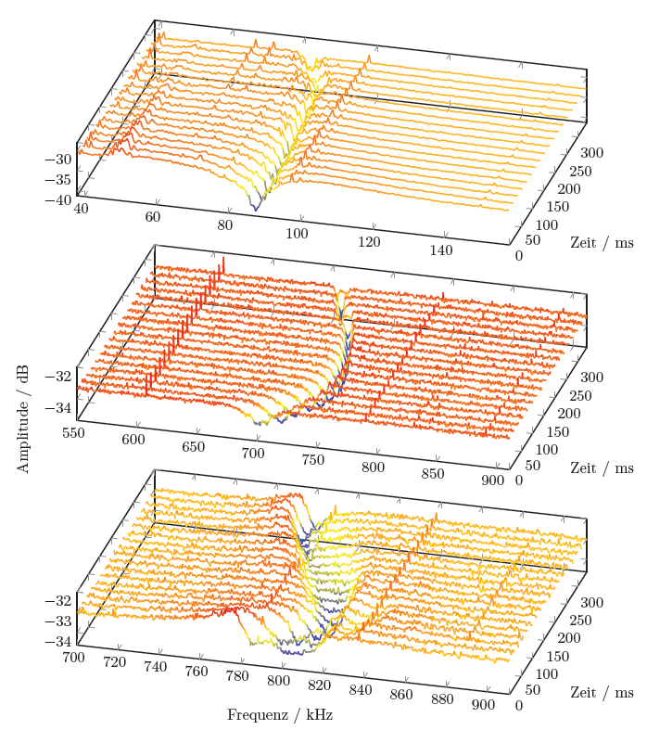
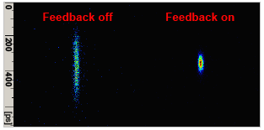
Feedback based Tune Measurement
Damping of Instabilities:
Coherent Signal:
Bunch Length:
Beam Spectrum:
FB on
s
x
z
E = 1.2 GeV
Allows stable operation of ELSA with currents up to 200mA!

Slide 38
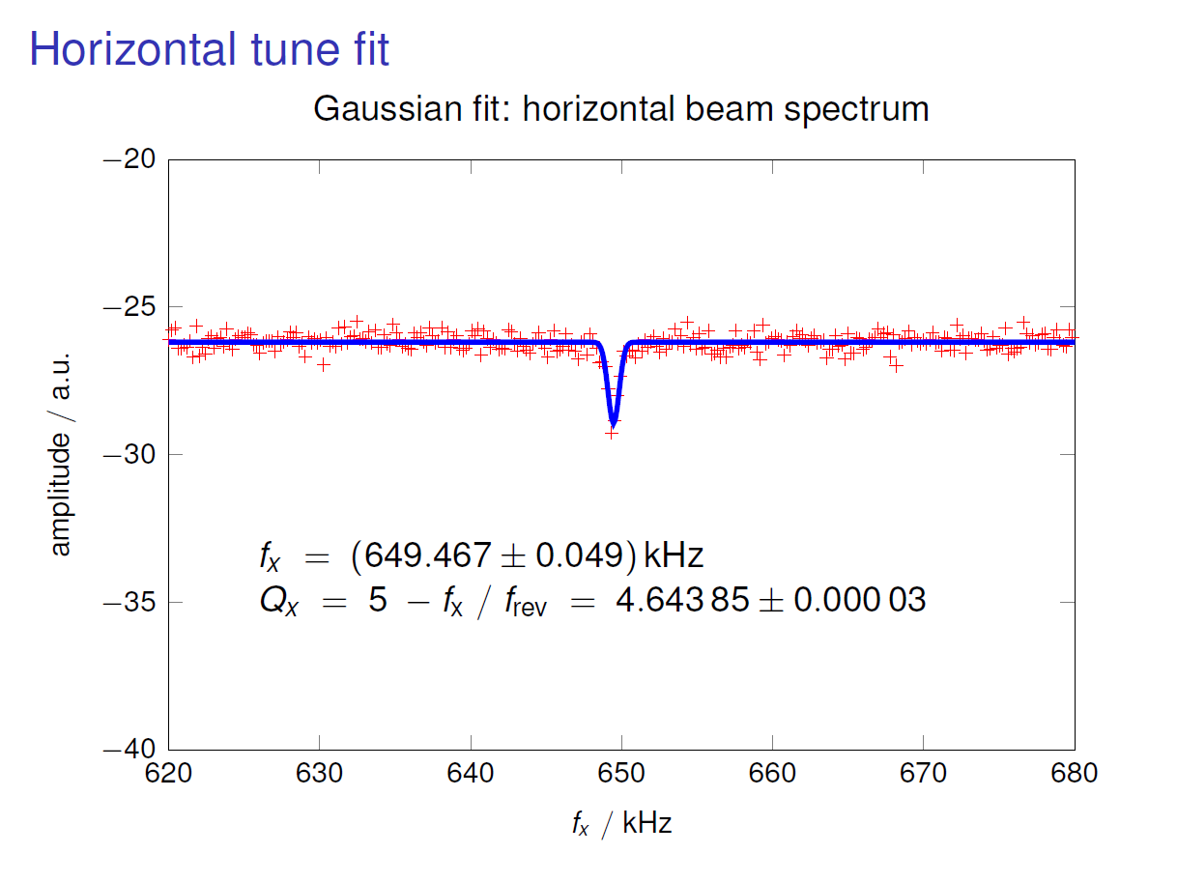

Slide 39
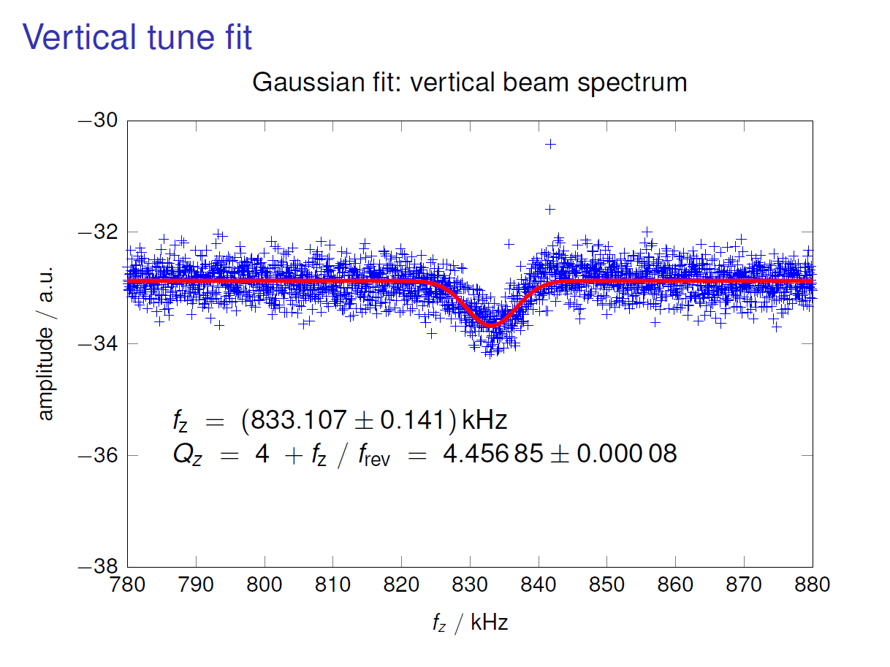

Slide 40
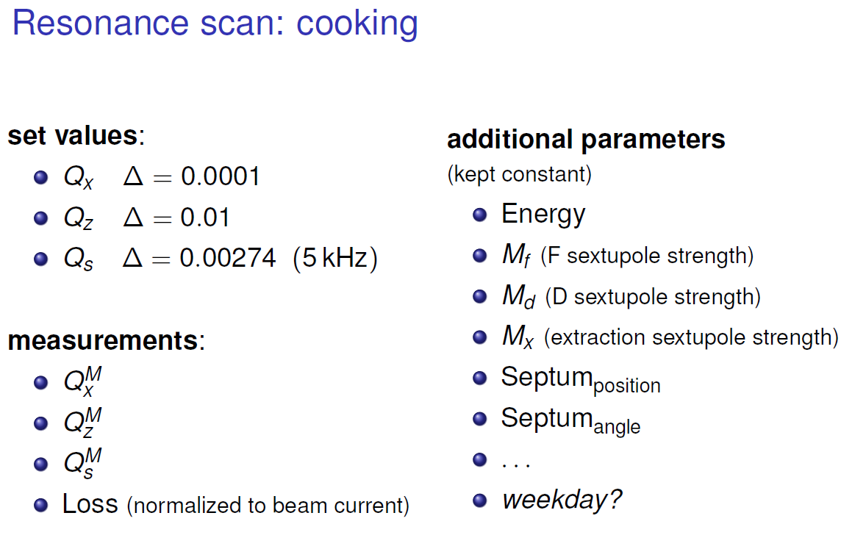

Slide 41
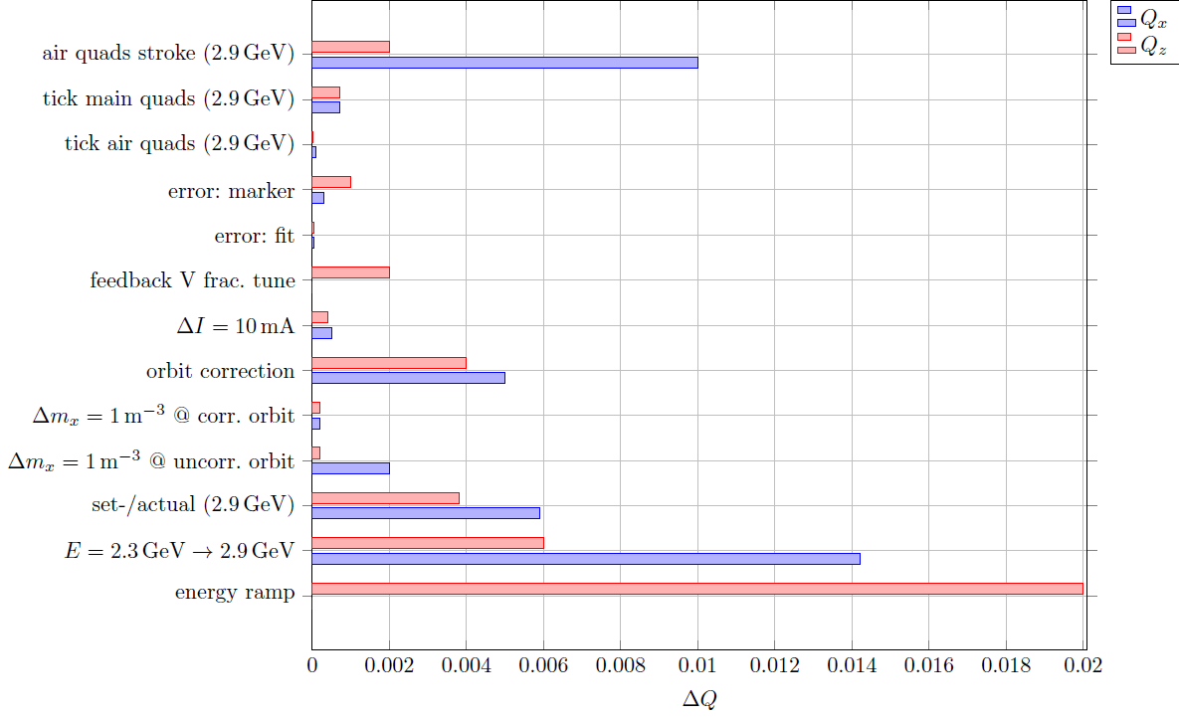
Tune Dependencies

Slide 43
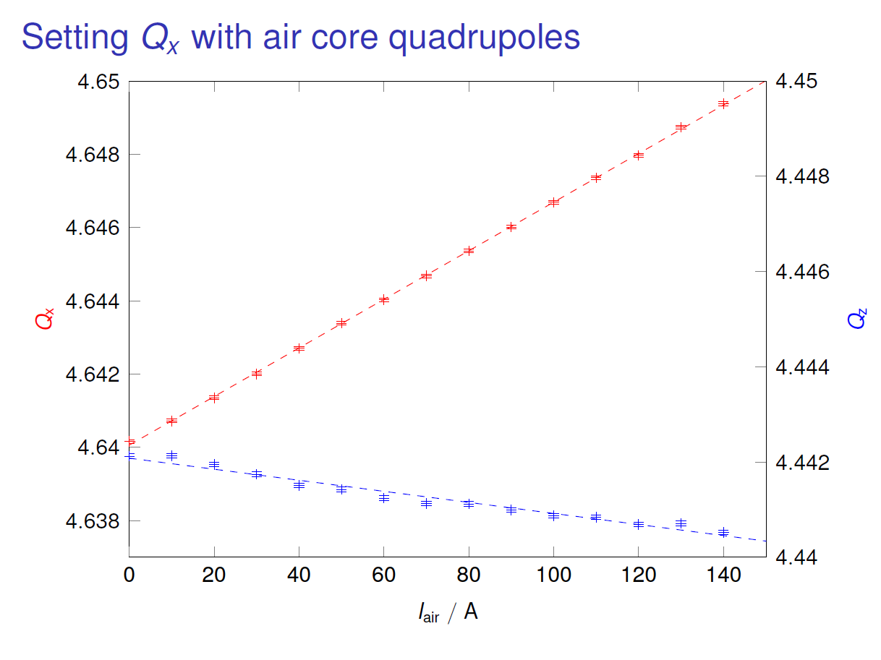

Slide 44
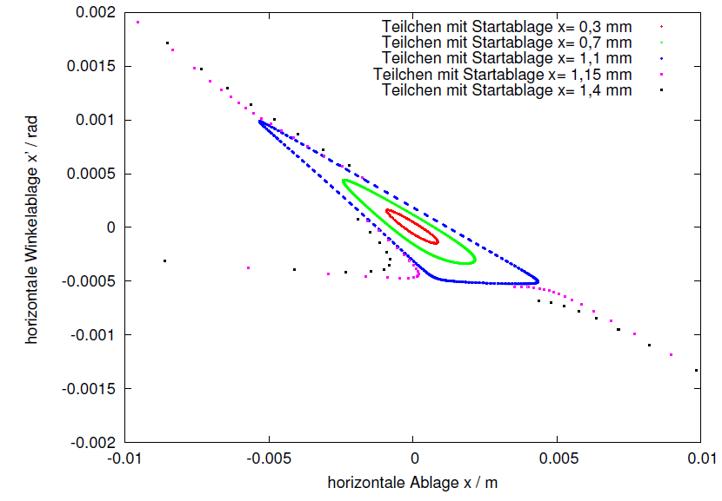
Horz. Phase Space with MAD-X
m_{x} = 4m⁻³, L=28.7cm
Q_{x} = 4.6585

Slide 45
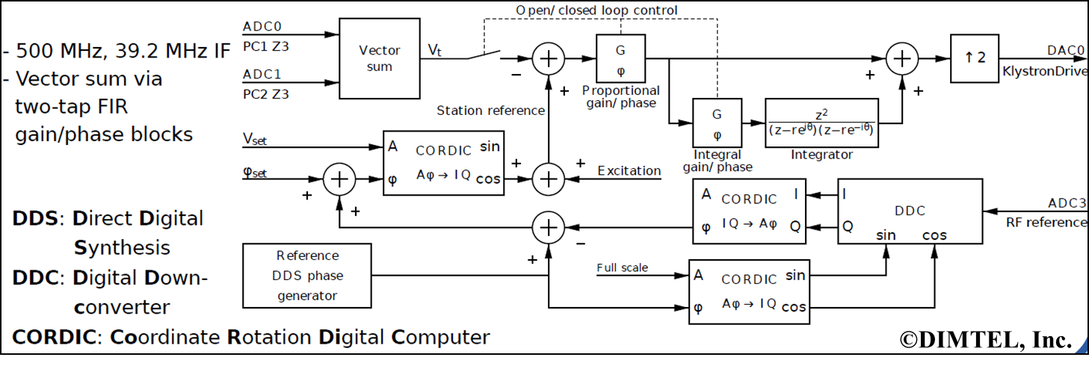
RF Control & Stabilization

Slide 48
Accelerator Cycle

