Slide 1
J-PARC Slow Extraction
Slow Extraction Workshop (Darmstadt)
2016.06.01
KEK/J-PARC
Masahito Tomizawa

Slide 2
Contents
J-PARC Slow Extraction History
J-PARC Slow Extraction Schemes
Extraction Devices
Present Performances of the Slow extraction
Issues
Future Plan

Slide 3
J-PARC Slow Extraction Brief History
•First Slow Beam Jan., 2009
•East Japan Earth Quake March, 2011
•Slow Beam Operation resumed in Jan. 2012
•Radiation leakage incident at the experimental hall
in May, 2013
•Slow Beam Operation resumed in April, 2015
SX-RUN
2015 4/24-5/7、 6/4-6/26、10/15-12/18、
2016 5/27-(6/29)

Slide 4
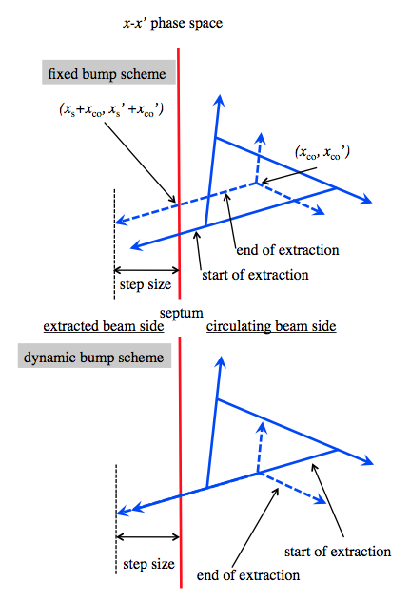
Schemes for Very High Extraction Efficiency (low beam loss)
◎Electrostatic Septum (ESS) QF-QF high β (small α) 40m
-> large step size (20mm)
◎dispersion free at ESS + low horizontal chromaticity
-> Separatrix is independent of Δp/p
depends on tune (constant resonant sextupole)
1/3 resonant extraction

Slide 5
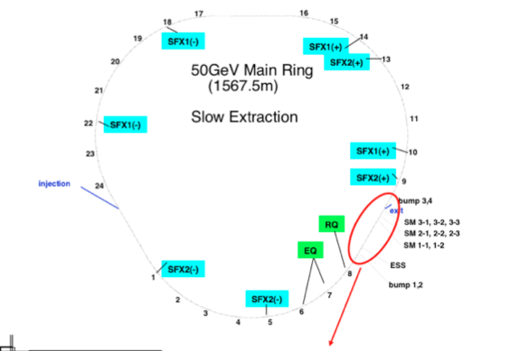
Tune is approached linealy to 22.333 resonance by 48-QFNs in the arcs

Slide 6
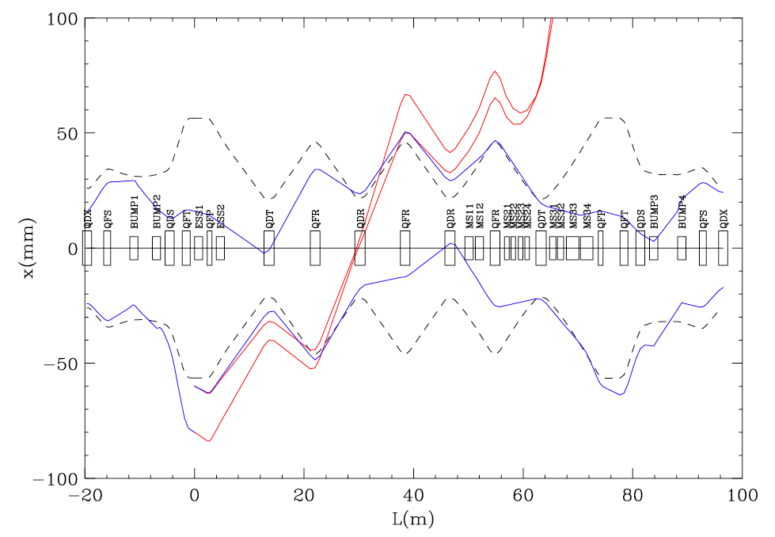

Slide 7
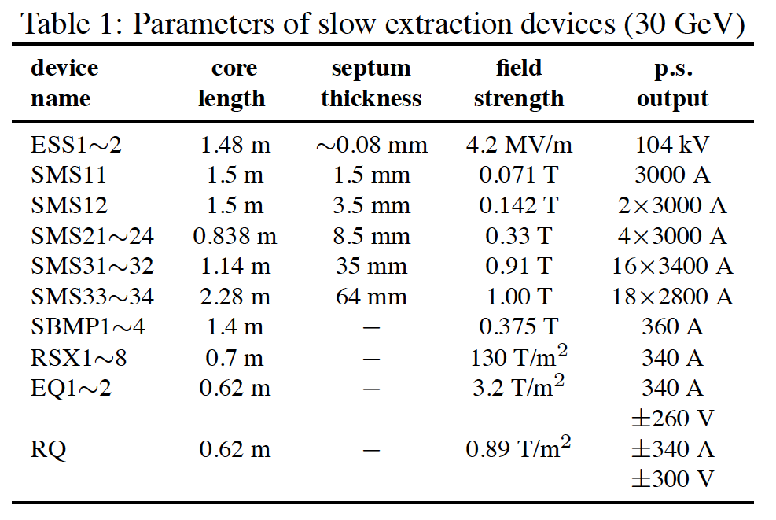

Slide 8
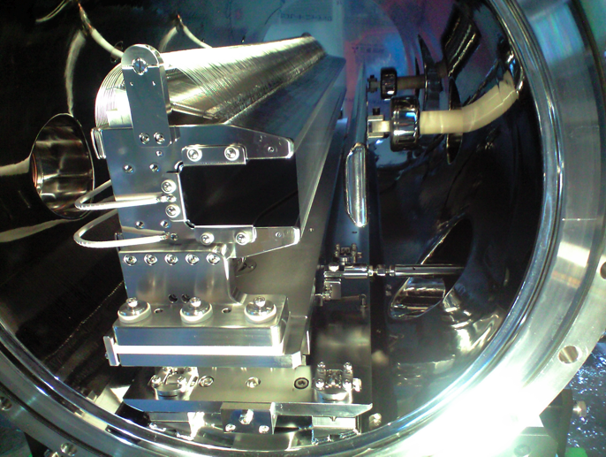
Electro Static Septa (ESS1,2)

Slide 9
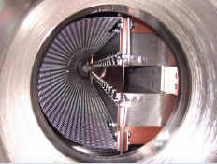
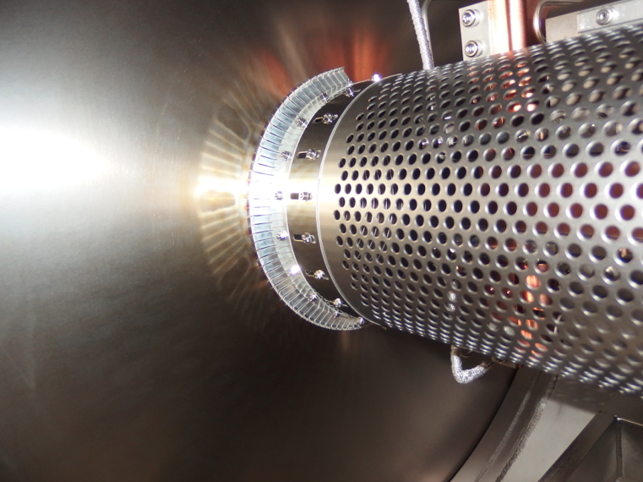
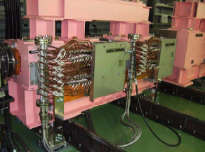
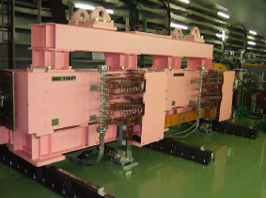
Low field magnetic septa (SMS11,12)
Mid field magnetic septa (SMS21-24)
High field magnetic septa (SMS31,32)
High field magnetic septa (SMS33,34)

Slide 10
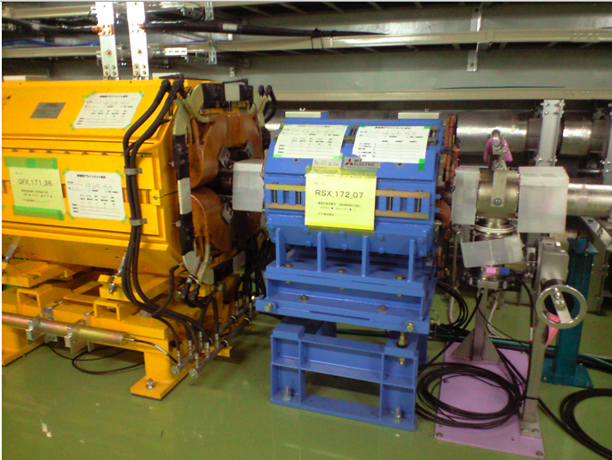
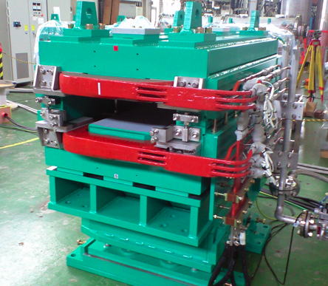
Resonant Sextupoles (RSX1-8)
Bump Magnets (sbmp1-4)

Slide 11
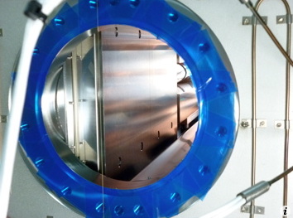
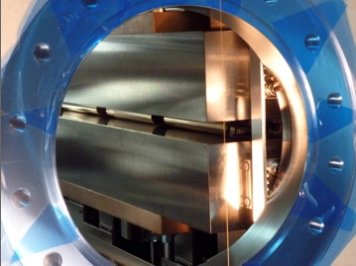
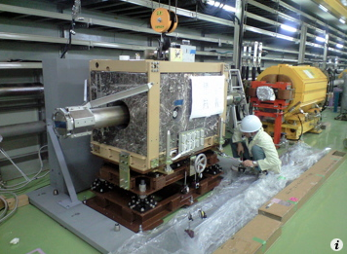
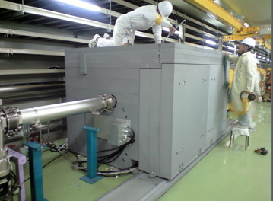
Slow Collimators
scrape beam hallo produced by hitting on the ESS ribbons
residual radioactivity improvement by SX collimator
900μSv/h -> 150μSv/h @downstream quadrupole duct (on contact, 4hr. cooling)

Slide 12
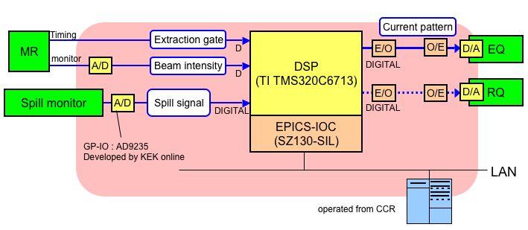
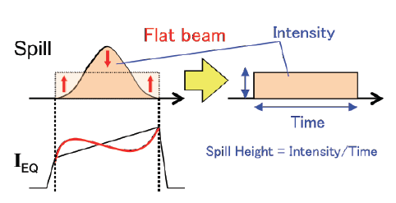
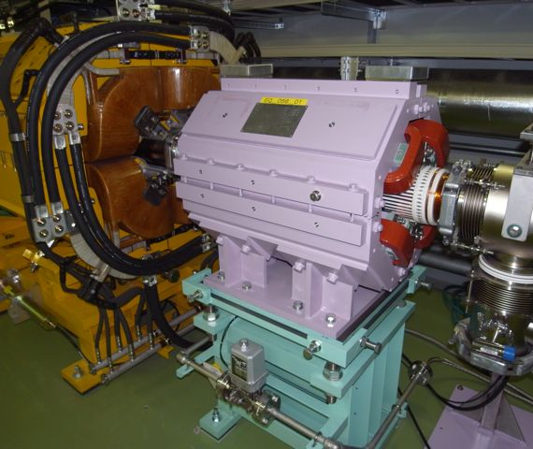
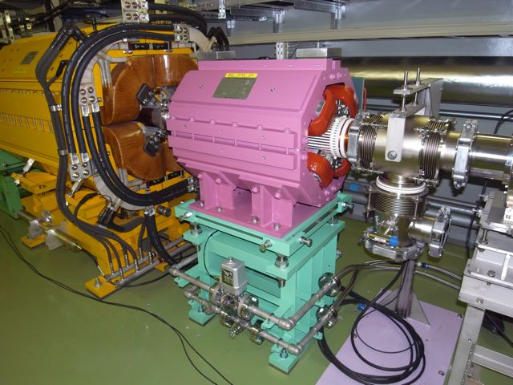
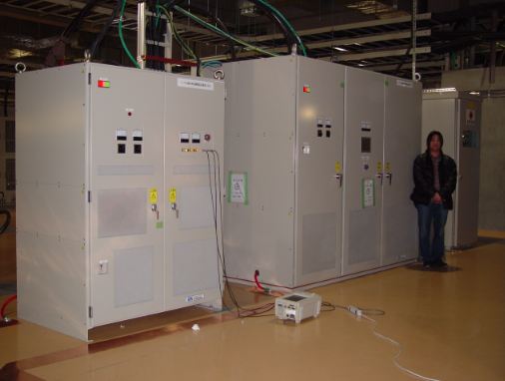
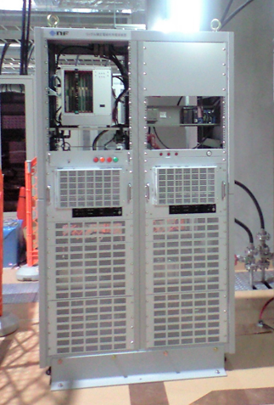
Beam Spill Feedback System
A beam intensity monitor is placed in external beam line.
Uniform beam spill shape is obtained from tune modulation by quadrupoles EQ
Tune ripples are compensated by quadrupole RQ (and EQ)
A DSP processes EQ and RQ current values from the monitor signal
EQ-1
RQ
RQ P.S.
EQ P.S.

Slide 13
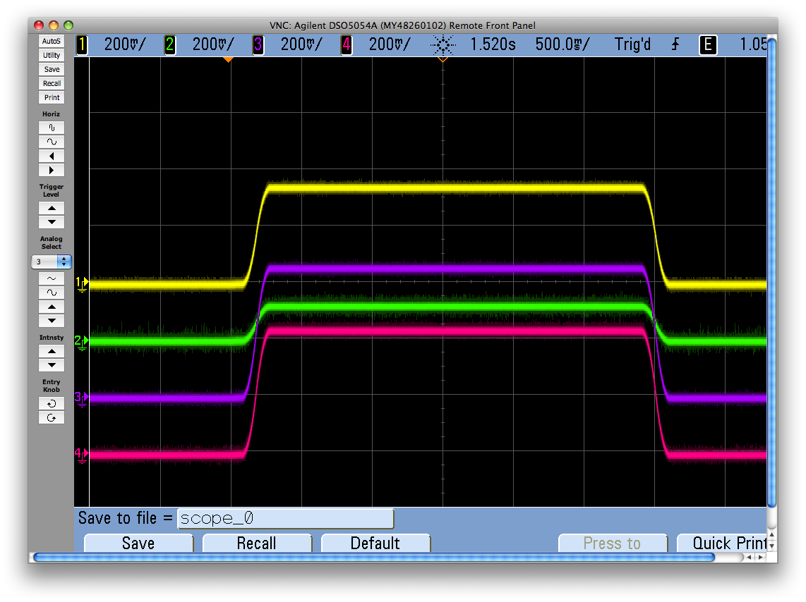
Dynamic Bump System
Dynamic bump parameters are processed by
a DSP from QFN pattern and real time EQ currents
digital
spill monitor
Spill
DSP unit
Bump
DSP unit
DCCT
D/O
O/A
AMP
SBMP P.S.
optical
gate
to EQ P.S.
efficiency 98.3%
to RQ P.S.
Loss -> 1/3.4
efficiency 99.5%
fixed bump
real time dynamic bump

Slide 14
Transverse System (D1 strip line kicker)
0.01-200MHz
suppress
multipactering
solenoid(+)
500W AMP
1kW
combiner
matched load
500W AMP
500W AMP
1kW
combiner
matched load
500W AMP
length 1.5m
Transverse RF System (D3 strip line kickers in series)
0.1-100MHz
Length 0.7m
3kW AMP
matched load
3kW AMP
matched load
DLC coating
to suppress multipactering
solenoid(-)
solenoid(+)

Slide 15
Transverse RF setting example
D3 strip line kicker
47.47139057MHz
19steps
D1 strip line kicker
Noise width 1KHz
1KHz
Mixing
noise width = 62.5 kHz
(/frev = 0.327)
252.5KHz
frev=0.191167307692307MHz

Slide 16
Present SX Abort System
Stop signal
QFN correction coil ramping Power Supply
Resonant Sextupole P.S.
Stop signal
OR
Stop signal
Acc.
Fast MPS
System
Stop signal
From PLC
I set
Target
Spill DSP
EQ P.S.
SX BLM
Others
I mon
I set
Dynamic bump DSP
4 magnets currents are proportionally decreased to zero.

Slide 17
SX Abort Example
SX Beam Study BLM76 (ESS1) beam loss count increase
2015/11/25 12:07 run65 #109878
Present MR can not abort beam at any timing
SX Abort
ESS beam loss
Slow Extraction
Fast Extraction
To dump
Very useful to protect the slow devices and targets from a high intensity beam

Slide 18
Beam Intensity dependent phenomena
◎Beam Deceleration during debunch process
by RF cavity impedances
present cure -> beam loading compensation by RF feed forward
◎beam loss at Injection period and beginning of acceleration
space charge tune shift or transverse instability
present cures -> tune, chromaticity adjust and BxB F.B.
◎Instability during debunch process
•vacuum pressure rise in the whole ring
•electron cloud
•beam loss in debunch and slow process
present cures -> chromaticity, longitudinal dipole oscillation

Slide 19
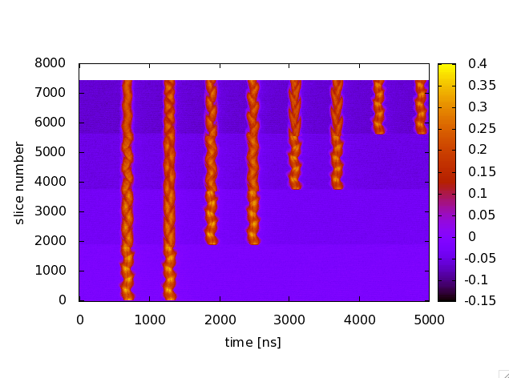
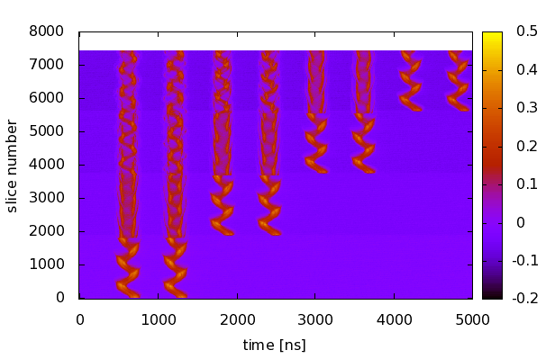
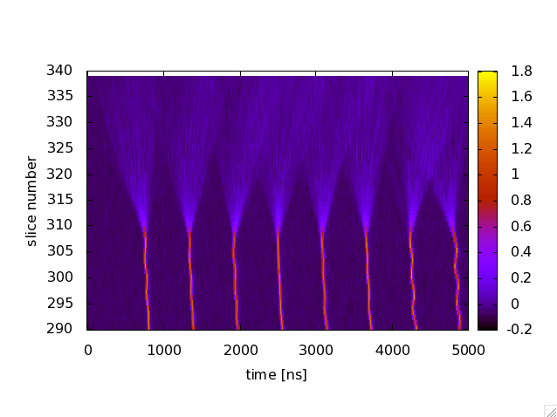
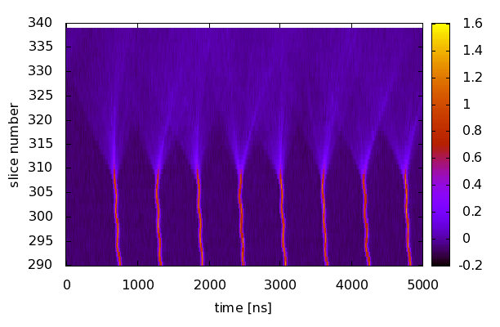
(after 11/5 RF No5 Gap Open -> Short)
w/o dipole oscillation
w/ dipole oscillation
Global offset -19 deg
Global offset -19 -> +21 deg
Wall Current Monitor
37.7kW
38kW
151106_14,15
38.7kW
151106_34,35
150ms

Slide 20
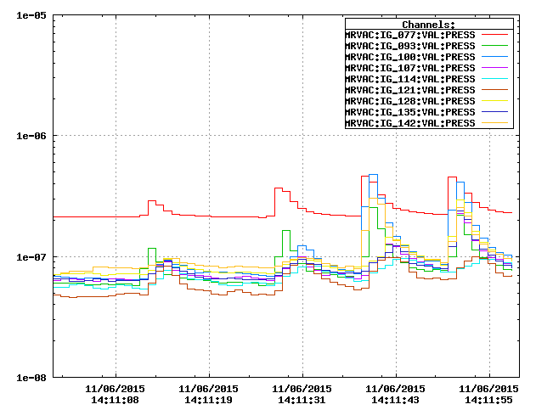
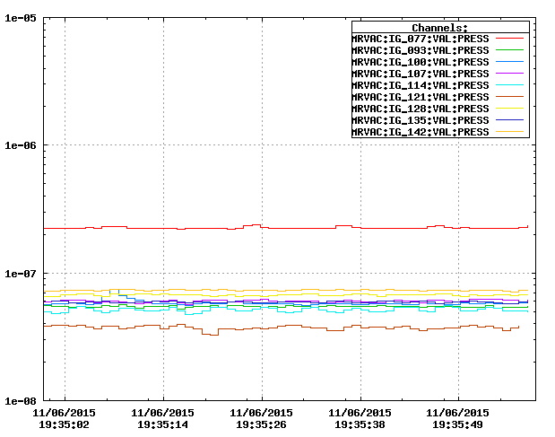
w/o dipole oscillation
w/ dipole oscillation
Global offset -19 deg
#136953
Global offset +21 deg
#137110
37.7kW
38.6kW
Electron cloud monitor ↓
Electron cloud monitor ↓
Electron cloud has been suppressed by the dipole oscillation
Vacuum pressure rise has been suppressed by the dipole oscillation

Slide 21
w/o dipole oscillation
w/ dipole oscillation
Global offset -19 deg
#136968 37.7kW
Global offset +21 deg
#137009 38.7kW
Eff. 99.4%
Eff. 99.1%
(after No5 cavity gap short)
(after No5 cavity gap short)
Instability occurred during debunch process
Instability suppressed by dipole oscillation
debunch -> Slow
(Qx’,Qy’) = (-6.0,-7.1) -> (-0.67,-2.4)
debunch -> Slow
(Qx’,Qy’) = (-5.0,-7.1) -> (-0.67,-2.4)

Slide 22
41.6kW User Operation Performances
Upper limit determined from target heat capacity
•dipole oscillation
•Dynamic bump
•ESS1（rotation）,ESS2(parallel、rotation) position tuning
•SMS1(parallel） position tuning
#110023 (RUN65)
Efficiency 99.52%
Duty 42%
Spill length 2.1s
Beam loss distribution at slow region
Beam loss distribution In the whole Ring
Beam loss Intensity during extraction
ESS-SMS region
DCCT
Red signal x8
Collimator
(Before Linear Acc)
5.52 cycle 2.93s flat top

Slide 23
41.6kW User Operation Performances
Av. Duty 42%
Beam Spill
Spill length 2.1s
Duty Factor in a Spill
Large tune ripple produced
by BM and Q current ripple
New Result 5/29 Study Duty 58%

Slide 24
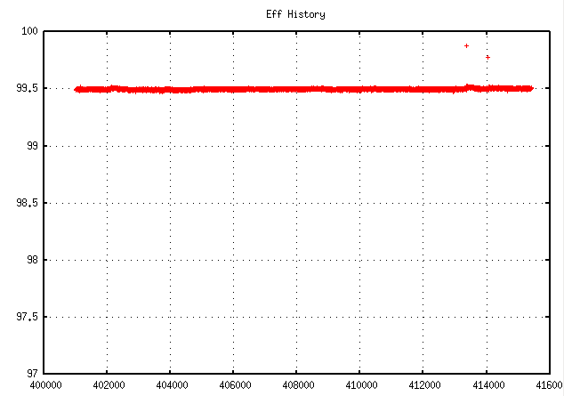
Extraction Efficiency Trend
41.6kW (4.8x10¹³ppp)
RUN65
24.5hours

Slide 25
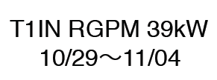
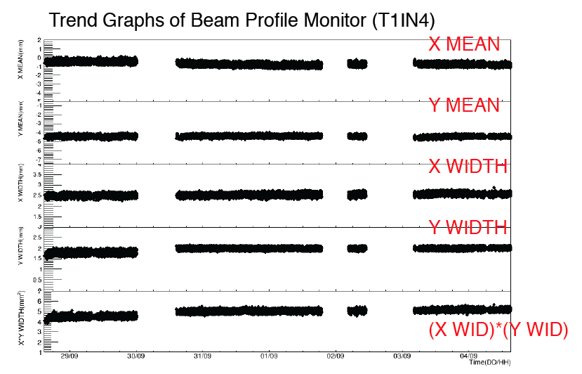
Position and width trends of beam delivered at target
Thanks for Hadron Group

Slide 26
Trends of Beam Power and its Integration After Recovery
41.6 kW
24 kW
@resumption
1kWday=1.81x10^16 p
Alanine dosemeter
Total absorption dose so far (2900kWdays)
ESS1 feedthrough port 28kGy
ESS2 feedthrough port 3.6kGy

Slide 27
Residual Radioactivity
The 42kW SX beam stopped 12/18 9:00
12/18 4hours on contact, 30cm
12/25 on contact, 30cm
01/20 on contact, 30cm
03/09 on contact, 30cm
Unit: mSv/h
ESS1 U
- , -
2.0, 0.3
- , -
- , -
ESS1 D
- , -
7.0, 0.6
- , -
1.8 , 0.2
ESS2 U
- , -
1.4, 0.46
- , -
1.8 , 0.2
SXCol D
5.0 , 0.5
1.7, 0.25
- , -
- , -
SMS1 U
3.0 , 0.5
1.1 , 0.2
- , -
- , -
SMS1 D
- , -
1.0 ,0.25
- , -
- , -
SMS2 U
- , -
0.3 ,0.05
- , -
- , -
Q076 U
>10 , 1.8
4.0 , 0.8
- , -
- , -
aisle
0.27
0.08
0.05
0.018
Q077 U
- , -
1.0, 0.3
- , -
- , -
Q078 U
- , -
1.0, 0.25
- , -
- , -
aisle
0.12
0.01
0.015
0.009
Q082 U
- , -
2.0, 0.25
- , -
- , -
SMS31 U
- , -
3.6 , 0.4
- , -
- , -
SMS33 U
- , -
0.85 , 0.1
- , -
- , -

Slide 28
Plans for a higher beam power
•intra-bunch F.B. --- the instability at the beginning of the acceleration
•(dipole oscillation and) 2nd harmonic cavities
RF bucket is miss matched -> reduces peak current
•longitudinal VHF cavity (2018)
large dp/p and lower peak current
•Repetition rate will go up for a higher beam power
Power supply for BM and QM will be replaced for Nu operation (2018)
5.52 s -> 3.93s (2.63 s flat top)
Beam power gain x 1.4 under discussion

Slide 29
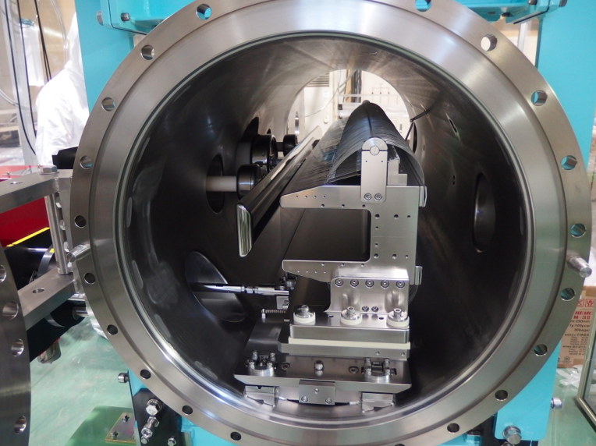
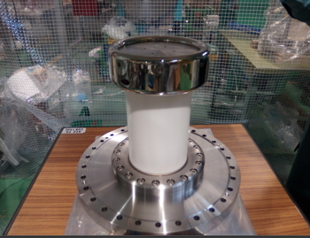
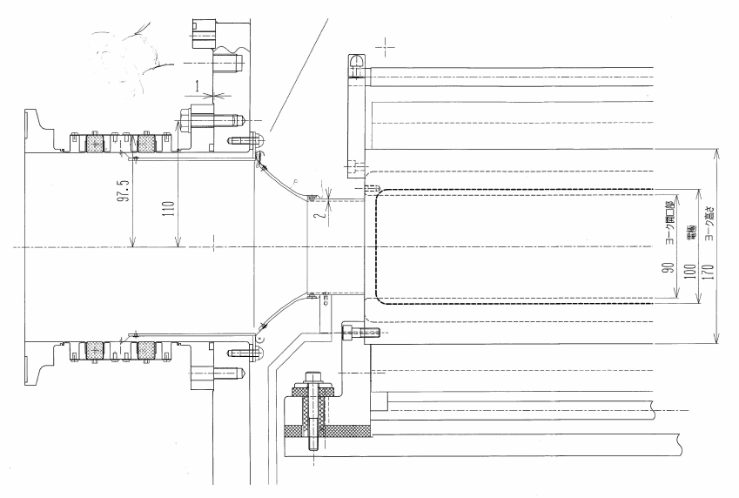
Development of titanium ESS
◎ titamium chamber、yoke、endplates
to reduce residual radioactivity
◎Feedthrough
•titanium ring and flange
•electric field gradient
•fluorinert circulation
◎Planned RF contact
140 kV achieved (operating voltage 104.4kV)

Slide 30
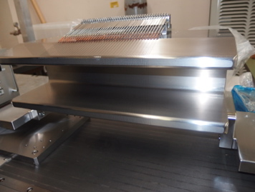
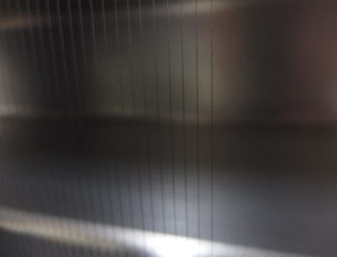
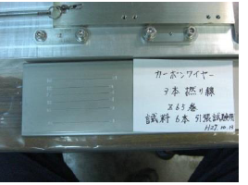
Future ESS
○ scatterer
○ low-Z septum material
CNT
φ125μm (three φ50μm)
φ80-90μm
Carbon wire ESS R&D
High voltage test will be planed after finishing titanium ESS job
φ120-150μm (φ7μm fibers are twisted)

Slide 31
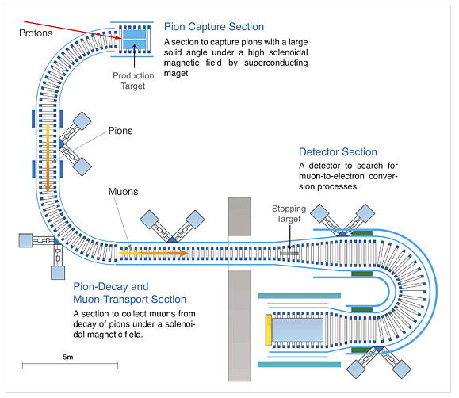
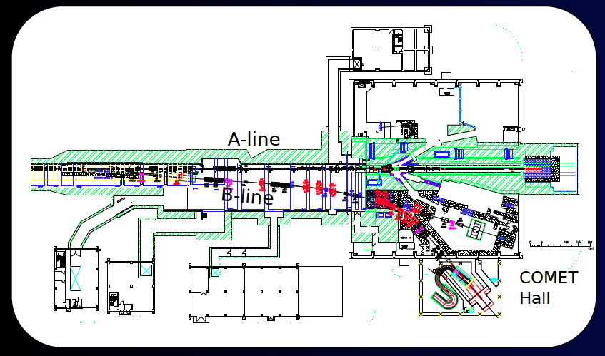
COMET
(COherent Muon to Electron Transition)
Phase-I
Beam power 3.2kW
Sensitivity <10⁻¹⁴
Beam cond. 2018〜
DAQ 100days
Phase-II
Beam power 56kW
Sensitivity <10⁻¹⁶
Beam cond. 2022〜
DAQ 1 year
COMET beam line and building
has been constructed.

Slide 32
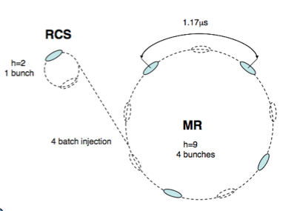
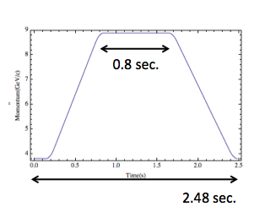
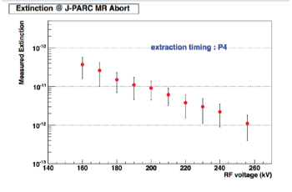
8GeV Acceleration Study for COMET (w/o Slow)
8 GeV Acc. and Fast extraction
Measure profiles at the end of flat top
Measured extinction v.s. RF voltage
H-rms-ε 0.62π
V-rms-ε 0.68π
8GeV Slow Extraction Test and Extinction Measurement will be planned

Slide 33
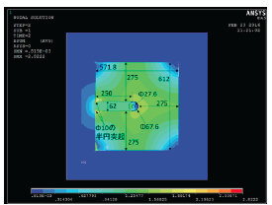
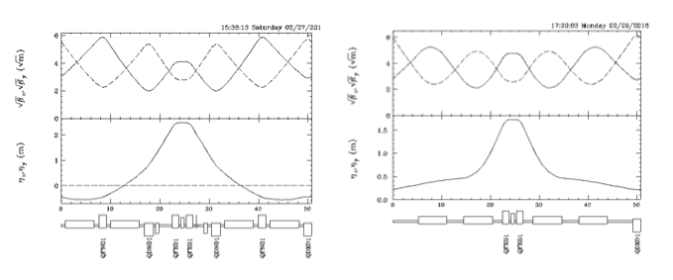
SX-Stretcher Design Study
Collaboration with TRIUMF A.Konaka
KEK Low Temp. Center T. Ogitsu G
Neutrino RUN and SX RUN compete for beam time
A SX stretcher has a great advantage.
During slow extraction (2-3s), beam can be delivered to Neutrino.
Base line design
Hybrid: SC-quadrupole magnets
and combined function transmission line superferric magnets
MR (One arc module)
Hybrid lattice ring (One arc module)
C= 1567.5m
(Qx,Qy)=(22.295,20.75)
Transition γ 31.6i
C= 1567.5m
(Qx,Qy)=(22.295,20.75)
Transition γ 21.7

