Slide 1
Slow Extraction for the Mu2e Experiment at Fermilab
Vladimir Nagaslaev, FNAL
Slow Extraction Workshop, Darmstadt
1 June, 2016

Slide 2
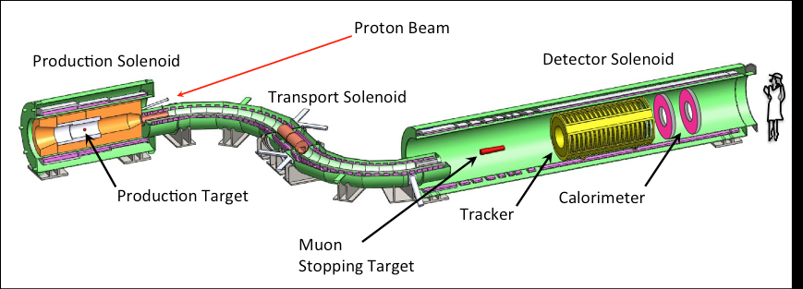
The Mu2e Experiment
, SES ~ 3e-17
New physics if >0
Mu2e proposes to measure the ratio of the rate of the neutrinoless, coherent conversion of muons into electrons in the field of a nucleus, relative to the rate of ordinary muon capture on the nucleus:
Mu2e TDR, arXiv:1501.05241

Slide 3
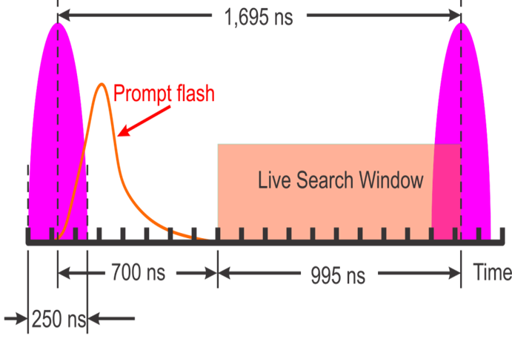
Beam Structure Requirements
Pulsed beam
Detector dead time - 700ns
Detector Live time - 995ns
Extinction level - < 10⁻¹⁰ relative to the pulse intensity

Slide 4
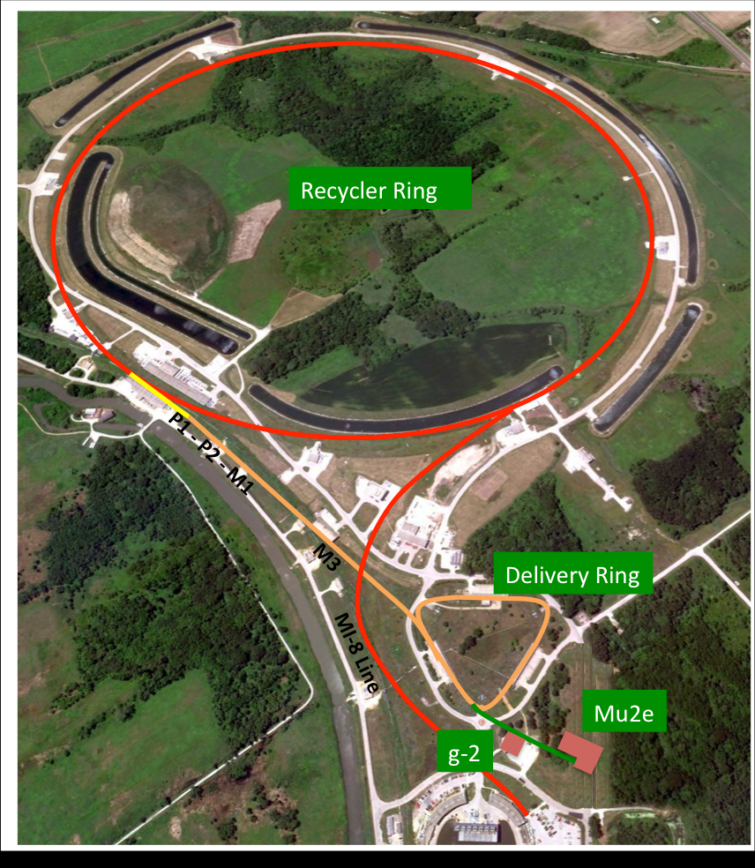
Beam Delivery
Enhancement of the FNAL Accelerator complex, 500kW
Repurposing the FNAL
Anti-Proton source as the Muon Campus
Mu2e upgrades
  Recycler RF
  Transport to DR
  Delivery Ring RF
  Resonant Extraction
  External Beam line
  Extinction System
  Extinction Monitoring
  Target Station
Main Injector
Recycler Ring
Going live in FY2021
Production starts this year

Slide 5
Beam Parameters
Parameter | Value
Main Injector (MI) Cycle time | 1.333 sec
Number of spills per MI cycle | 8
Number of protons per micro-pulse | 3.9×10⁷ protons
Maximum DR Beam Intensity | 1.0×10¹² protons
Beam-On Duty Factor | 28 %
Duration of each spill | 43 msec
Reset time gap between spills | 5 msec
Spill rate variations | ±50 %
Extraction efficiency | >98 %

Slide 6
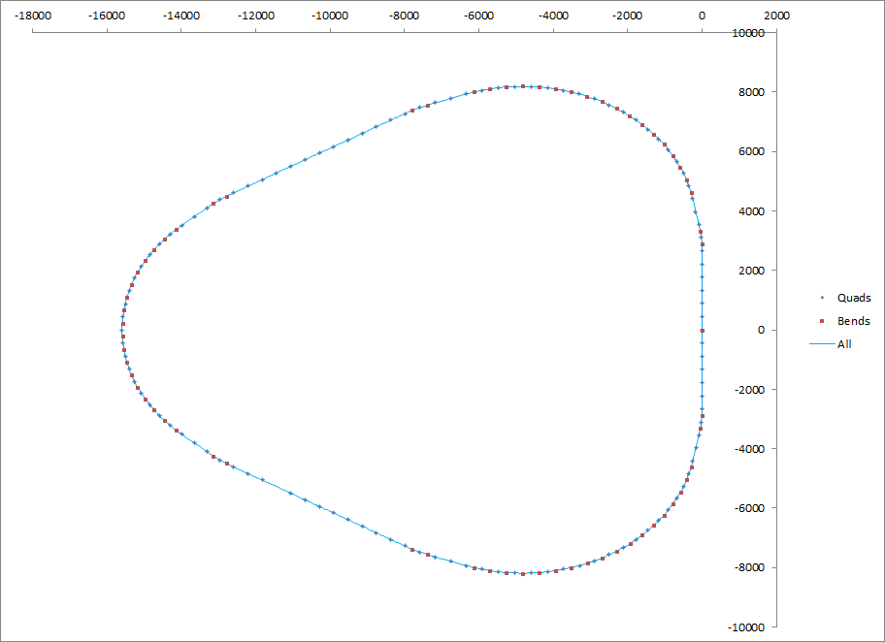
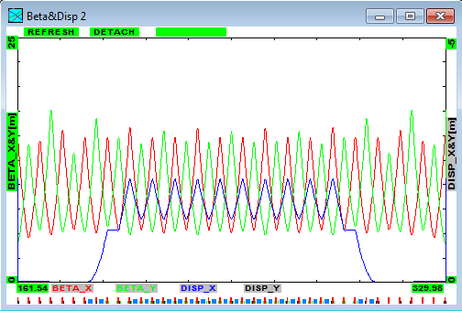
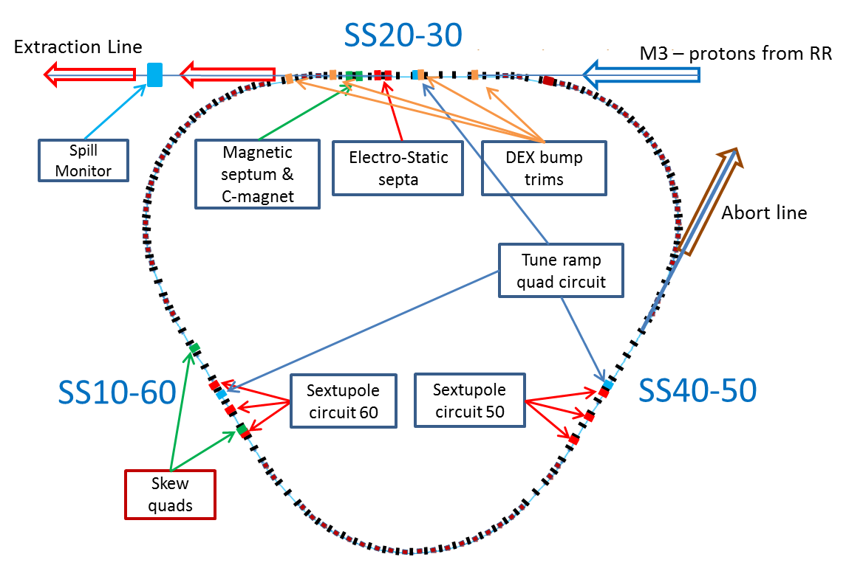
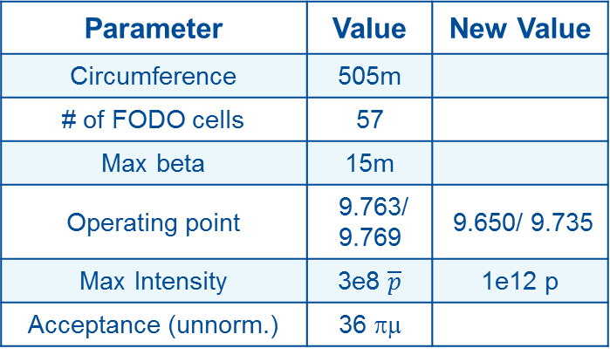
Legacy Debuncher Ring
Parameter | Value | New Value
Circumference | 505m
# of FODO cells | 57
Max beta | 15m
Operating point | 9.763/ 9.769 | 9.650/ 9.735
Max Intensity | 3e8 $\overline{p}$ | 1e12 p
Acceptance (unnorm.) | 36 πμ
Injection
Extraction to Accumulator
Debuncher Ring
Delivery Ring
Lattice functions in 1/3 of the Debuncher
(original design)

Slide 7
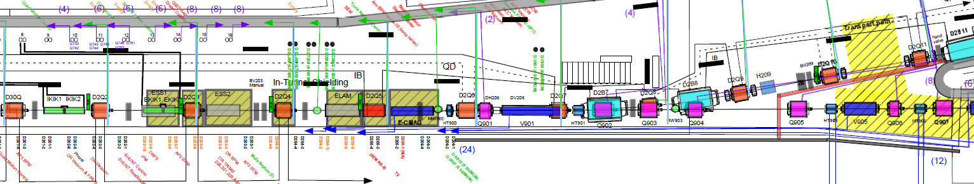
Specifics of the Delivery Ring
Delivery Ring legacy design features:
  Strong focusing, space constraints
  Max beta = 15m
  Machine acceptance = 36 π-mm-mr
  Light enclosure shielding
  Vacuum > 1e-8 Torr
Ring
ESS1
ESS2
MS1
MS2
Beam line

Slide 8
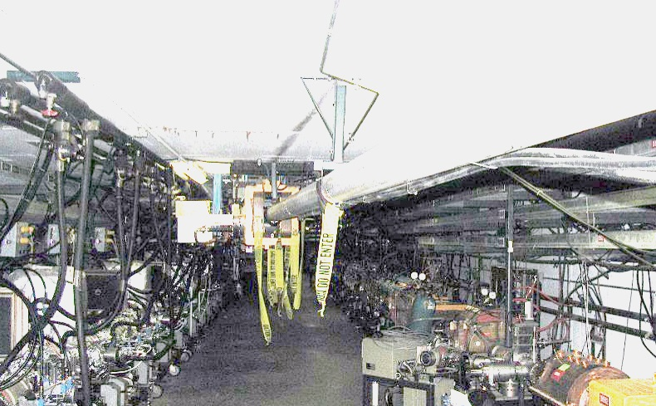
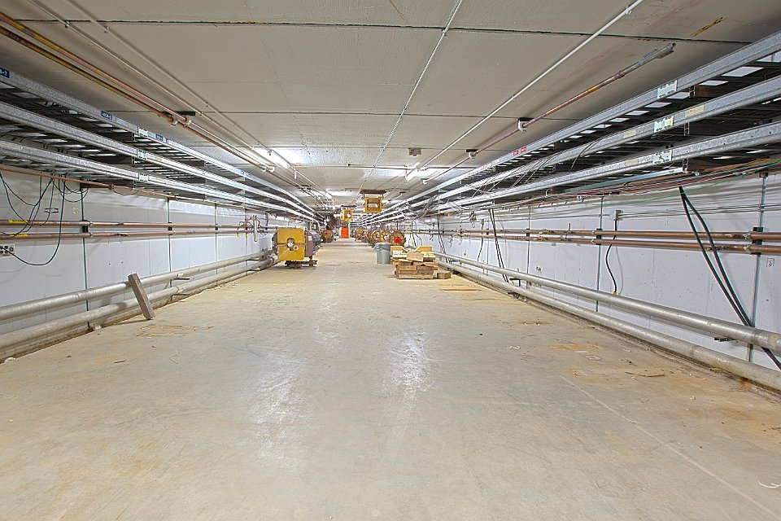
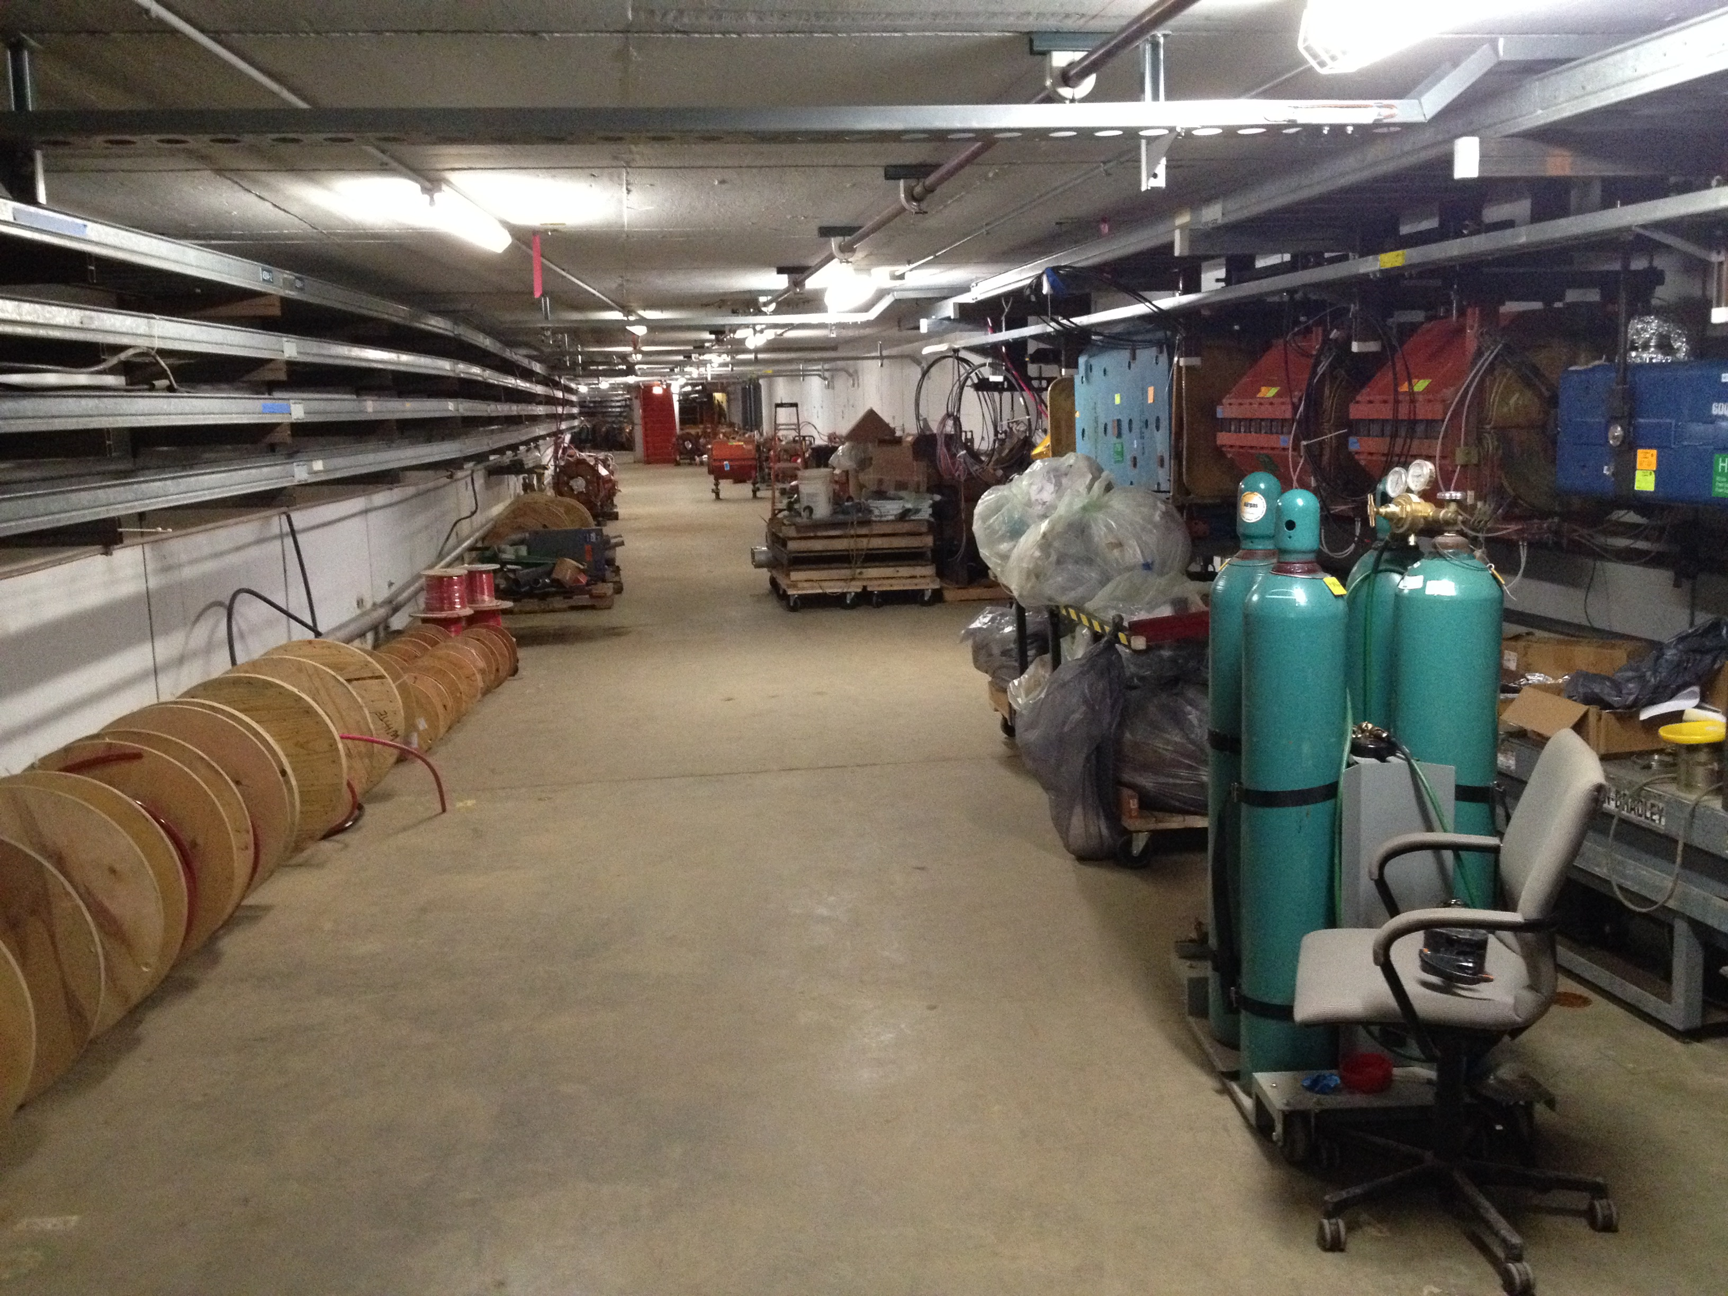
Tunnel works in progress
AP30 SS in Collider Run
AP30 SS in June 2015
Scheduled to resume operations in 2017 for g-2 experiment
AP30 SS in June 2016

Slide 9
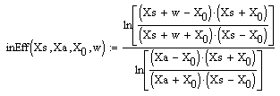
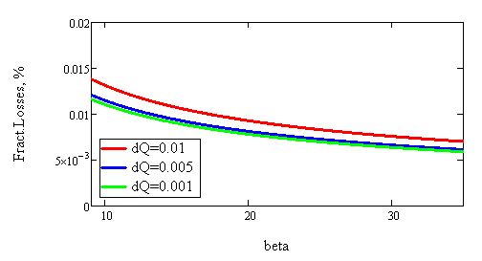
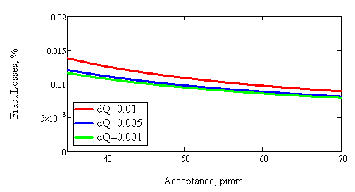
Performance Calculation
Semi-analytical extension of the perturbation model:
V.Nagaslaev, L.Michelotti: FERMILAB-FN-0974-AD-APC-CD
Septum plane position is constrained
Geometrical losses vs beta-function at ESS
Geometrical losses vs machine acceptance

Slide 10
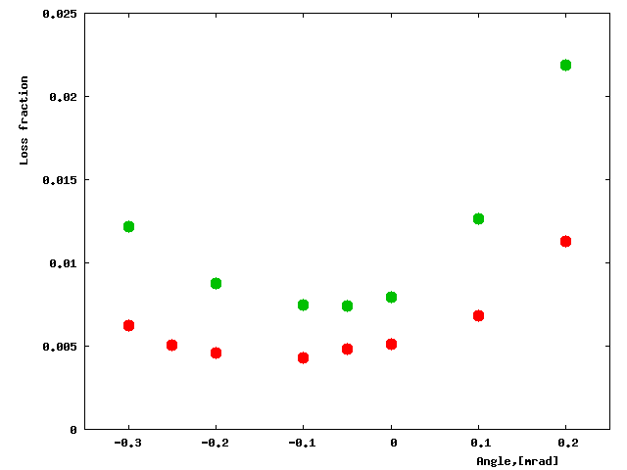
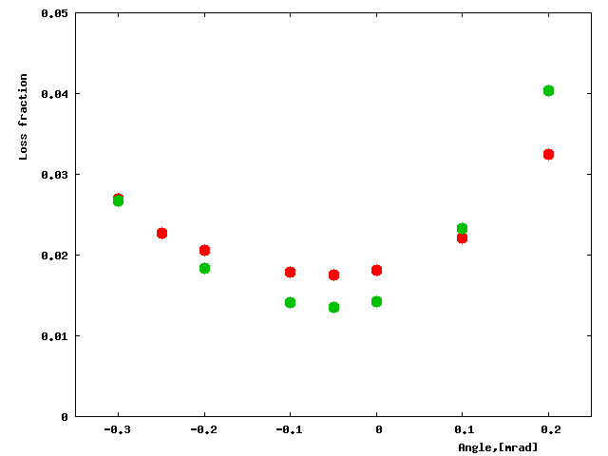
MARS Simulations and Geometry Choices
Local losses vs beam angle.
Total losses vs beam angle.
Red- 100μ wires; Green- 50μ foils
Note different scale!
The choice between wires or foils is not trivial. Our choice for foils is made based on previous experience with SE in Main Injector at FNAL.

Slide 11
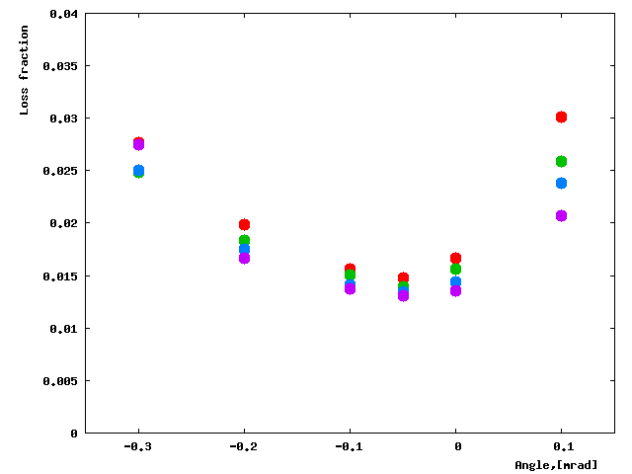
MARS Simulations and Geometry Choices
MARS:
Total losses vs beam angle.
Septa lengths:
  Losses are most significant in ESS1
  Losses grow with ESS1 length due to the beam angle spread
  Performance can be improved by making L1 < L2
ESS1/ESS2 length ratio:
Purple-0.5m/2.5m; Blue-0.7m/2.3m; Green-1m/2m; Red-1.5m/1.5m
Practical choice: L1=1.25m (+0.5m diffuser)
and L2=1.75m leads to equal total vessel lengths. This makes design of two septa fully interchangeable.

Slide 12
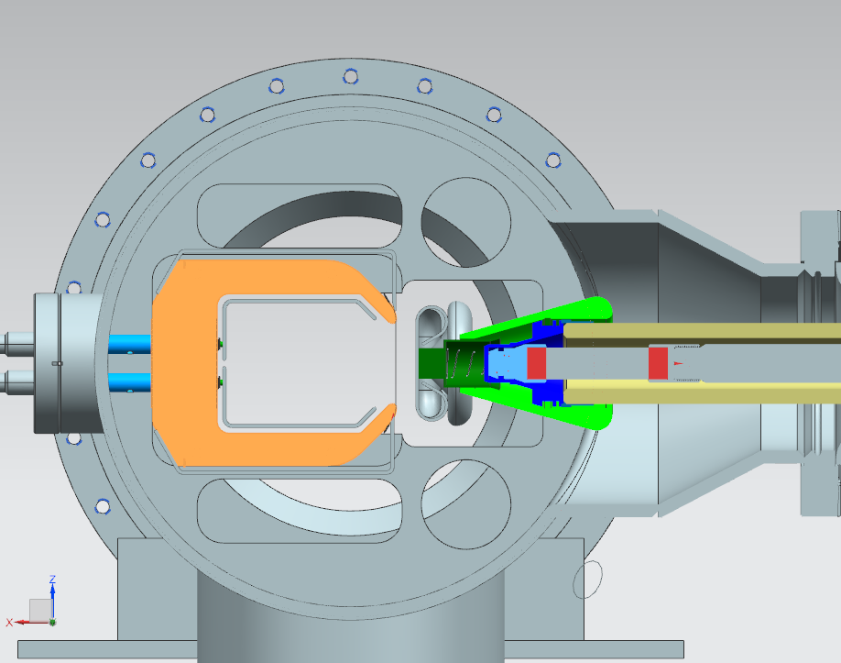
Electrostatic Septum
Asymmetric/Symmetric
Frame (yoke) not movable
Foils
  W25Re, 25u X 1mm
  Spacing 2.5mm
  Tension + Retraction > 1 kg
  Foils coupling
Retraction concept
  Single spring
  Retraction time ~2ms
Diffuser
  Ti (grade 2) foils

Slide 13
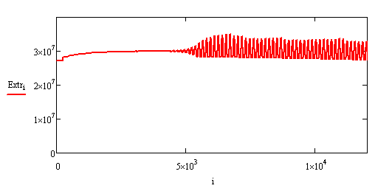
RF Knock Out
RFKO Emittance Growth Rate simulations (FERMILAB-CONF-11-475-AD ):
Growth rate: ,
Works only for chromatic beam tune spread (not SC)
High tune spread also leads to the extracted beam angle spread, which affects extraction efficiency
In our case the trade-off is at C_{X}=1
Difficult to model regulation with tracking codes
Tried to use semi-analytical tracking

Slide 14
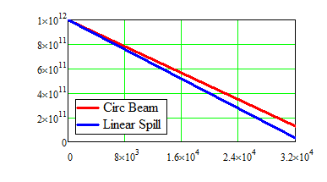
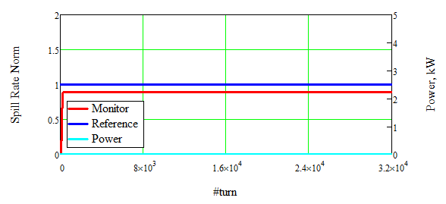
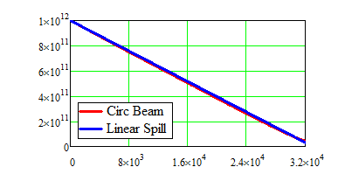
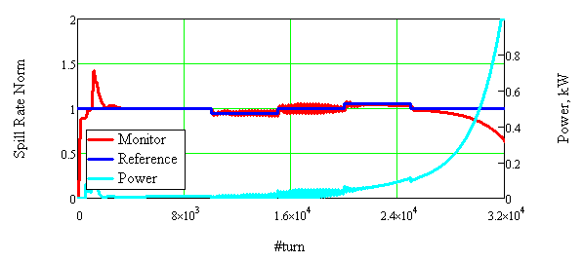

Slide 15
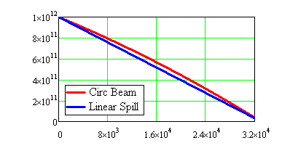
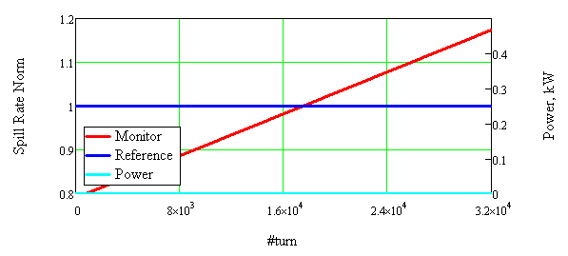
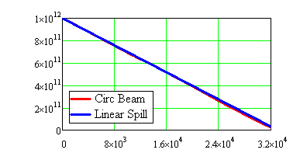
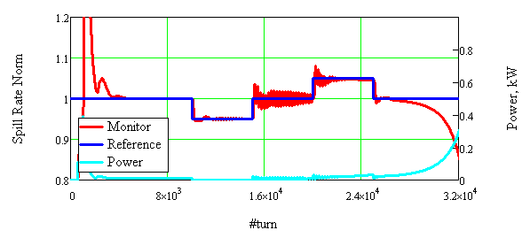

Slide 16
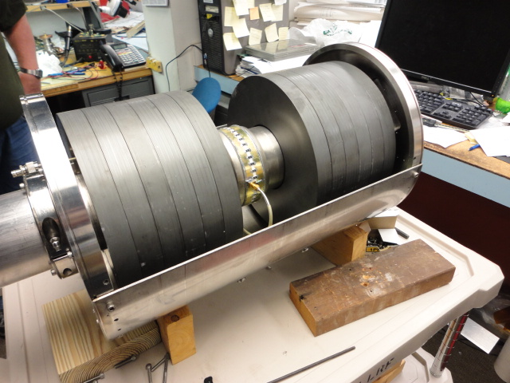
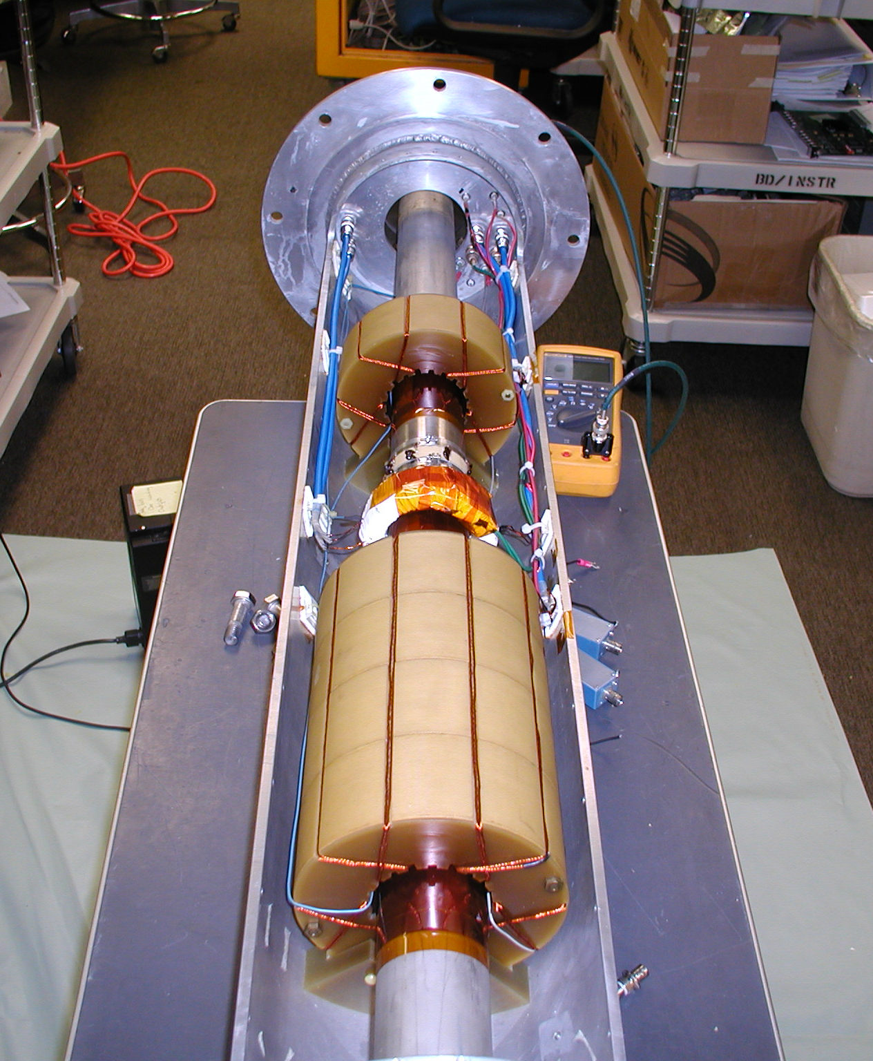
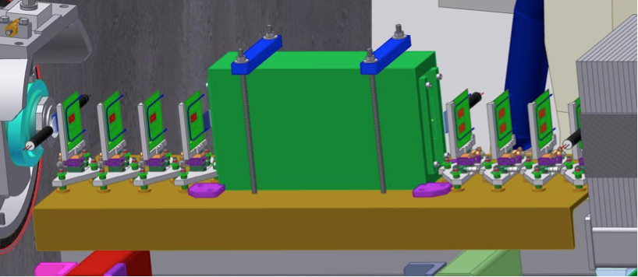
Spill Regulation
Ref
Learning function filter (feedforward)
RFKO Power
RFKO Kicker
Δ
Σ
RFKO
FM
Δ
Adaptive PID filter (feedback)
Squeeze correction
RQ, QXR
Ref
Realized in MVME5500 and FPGA
Slow learning and fast adaptive PID filters
Regulation to both RFKO and quads
Possible addition of “bucker” quads
Important low noise monitoring
Additional line of monitoring from ExtMon
Spill Monitoring

Slide 17
Summary
Slow Extraction for the Mu2e goes live in FY2021
Production starts late this year
Number of challenging requirements:
  High extraction efficiency
  Low spill variations
  Short spill duration
Discussions are greatly appreciated!

