Slide 2

Electrostatic septa design and development at CERN
J. Borburgh
With valuable input from B. Balhan, H. Day, B. Goddard, G. Grawer, A. Prost

Slide 3
Outline
CERN electrostatic septa inventory
Recent and ongoing developments
HV cable damage and replacement
Conclusions

Slide 4
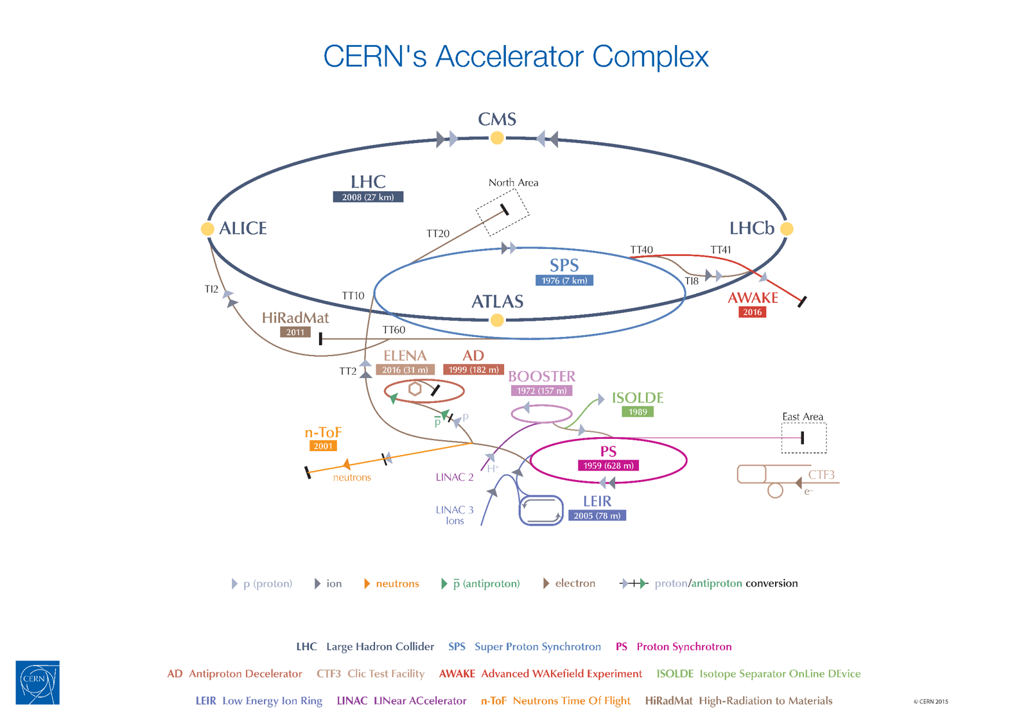
(5 x) ZS
ZSTF
SEH23
SEH31
SEH10

Slide 5
1. CERN electrostatic septa inventory
 | U_{nom} [kV] | U_{peak} [kV] | E_{nom} [MV/m] | Gap _{nom.} [mm] | Cathode length [mm] | Vacuum [mbar] | Bake out [°C] | Cathode | Septum
LEIR, SEH10 | 70 | 120 | 1.8 | 40 | 720 | 10⁻¹² | 300 | Ti | Mo foil 100 µm
PS, SEH23 | 170 | 250 | 10 | 17 | 778 | 10⁻⁹ | 90 | Al (s.a)* | Mo foil 100 µm
PS, SEH31 | 180 | 250 | 9 | 20 | 1850 | 10⁻⁹ | - | Al (c.a)** | Mo foil 100 µm
SPS, ZS | 220 | 280 | 11 | 20 | 3000 | 10⁻⁹ | 90 | Al (c.a)** | WRe wire 60 µm 100 µm
SPS, ZSTF | 220 | 280 | 11 | 20 | 3000 | 10⁻⁹ | 90 | Al (c.a)** | WRe wire 60 µm
*c.a: chromic acid anodisation, **s.a: sulphuric acid anodisation
U_{peak} used for conditioning prior to operation

Slide 6
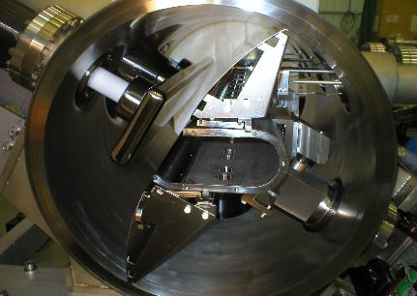
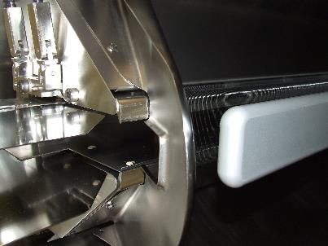
Layout
Ti cathode
AL (chromic anodised) cathode
HV deflectors
HV deflectors
Septum foil
Ion trap electrodes
Septum wires
Remote displacement systems

Slide 7
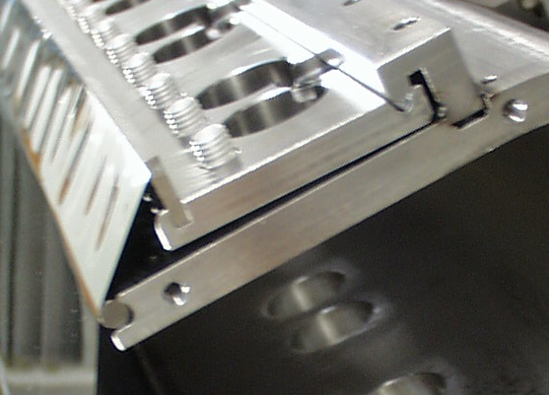
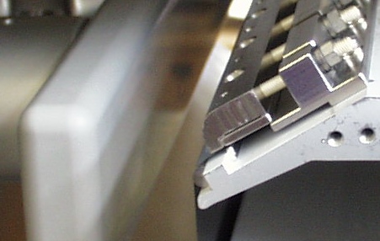
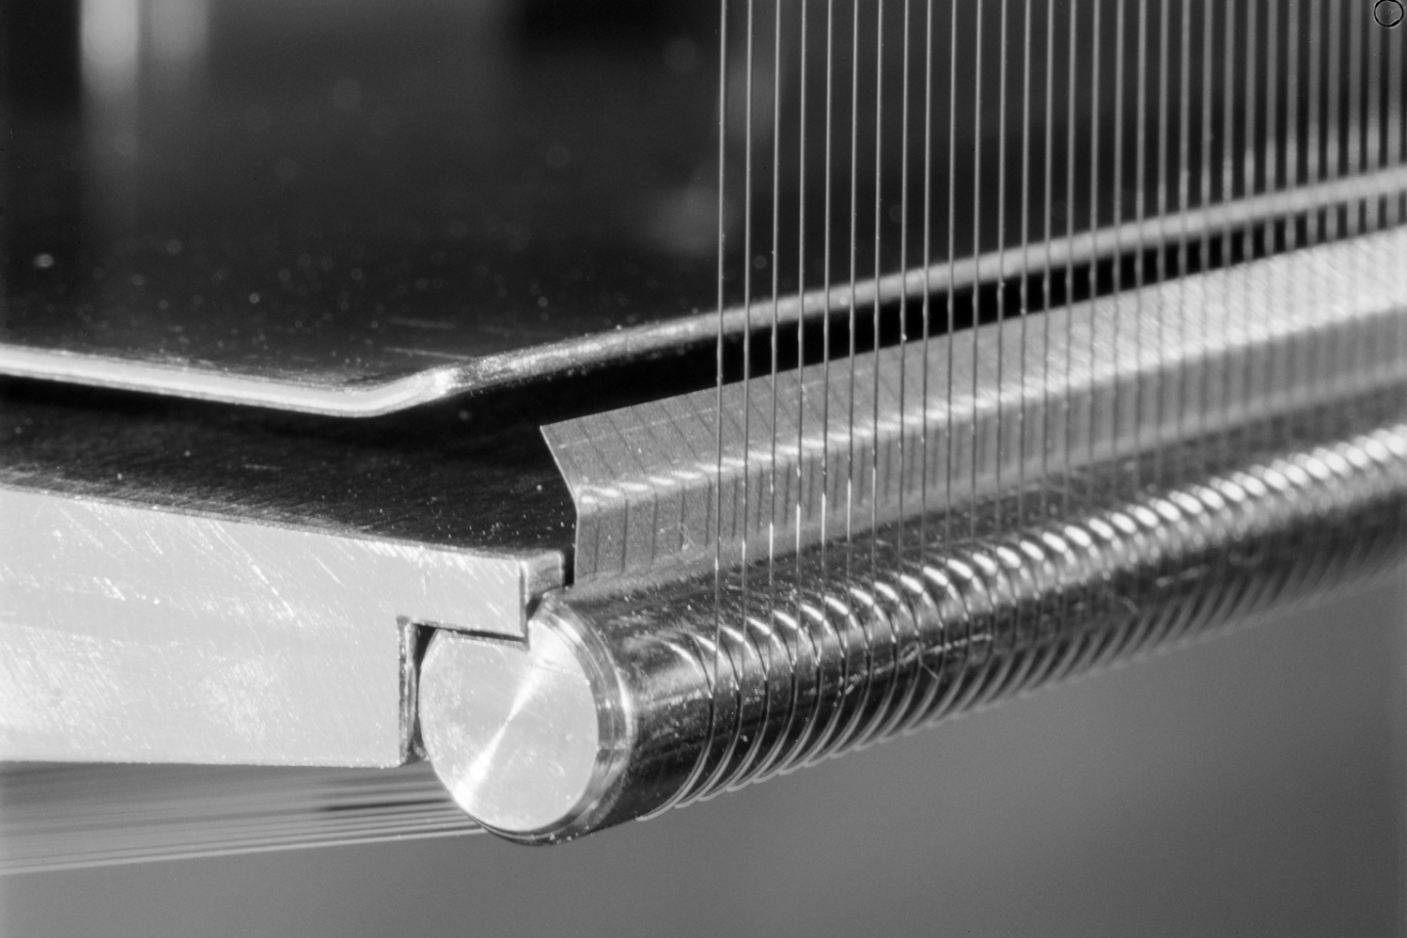
Septum material
Mo Foil
Welded to fixation (bake-able 300°C)
Clamped (bake-able 120 °C)
Wre wire
Purchased @ ø120 µm.
Chemically polished to desired diameter (60 µm or 100 µm) to remove incrusted graphite particles from wire drawing process.

Slide 8
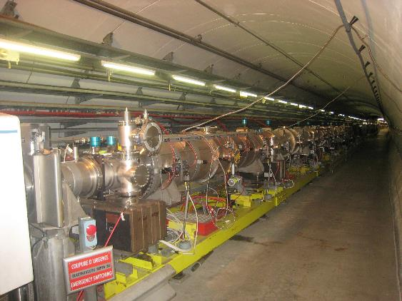
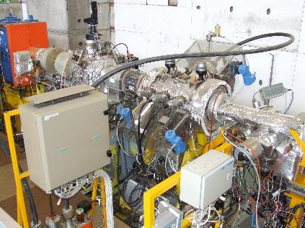
Scale
5 ZS on common girder installed in the SPS
>15 meters
SEH10 installed in LEIR
< 1 m

Slide 9
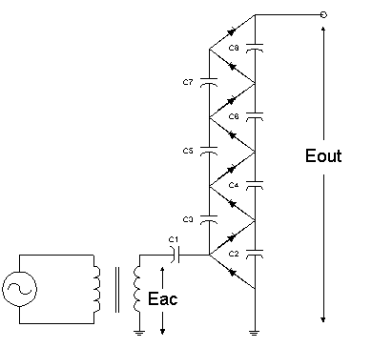
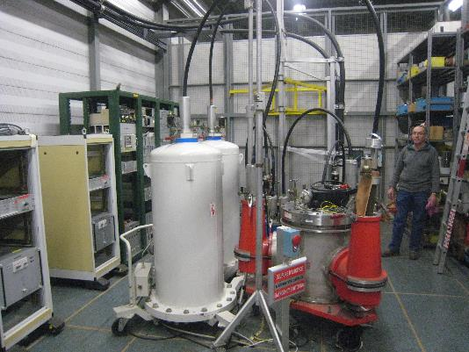
HV generation
Cockroft Walton stages
Max. output: 300 kV, 10 mA,
Ripple: <5 × ±10⁻⁴,
total voltage error: <10⁻³.
Notes:
The HV generators precise to ±10⁻⁴.
Ripple is <5 × ±10⁻⁴.
Temperature coefficient is < 10⁻⁴/°C.
Total voltage error <10⁻³ for normal operation.

Slide 10
Outline
CERN electrostatic septa inventory
Recent and ongoing developments
HV cable damage and replacement
Conclusions

Slide 11
2. Recent and ongoing developments
Verification max. field as function of cathode materials.
HV feedthrough insulation
E-cloud mitigation
  Multi-cycling (cathode and ion traps voltage adjustment as function of beam)
  Solenoid
  Increase vacuum pumping speed
Beam impedance reduction
Beam loss optimisation:
  dedicated talk Matthew Fraser
  improved precision septum position

Slide 12
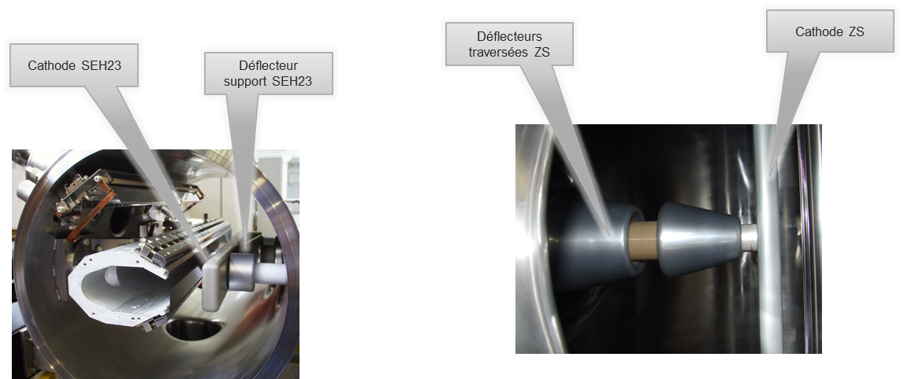
I. Tests on anodisation of HV elements
Anodisation of Al HV deflectors and parts [1]:
  Chromic anodisation for parts with gaps < 20 mm (cathodes)
  Sulphuric anodisation for parts with gaps ≥ 20 mm (HV deflectors)
Since chromic acid use will be restricted from 2017 in EU [2], tests on using Al s.a. cathode were done [3].

Slide 13
HV Conditioning of SEH23 with Al (s.a.) cathode
HV Consolidation 250kV with 17mm gap during 1 week: no sparks.

Slide 14
Maximum field tests
Septum | Cathode | Max. Voltage [kV] | Gap [mm] | Max. Field [MV/m]
ZS | Al c.a. | 260 | 20 | 13
SEH23/31 | Al c.a. | 250 | 17 | 14.7
SEH10 | Ti | 160 | 30 | 5.5 / 6
SEH23 test | Al s.a. | 250 | 17 | 14.7
Ti results indicated without/with residual DC current,
all other test results indicated where residual DC current <1µA.
Tests were done without beam.

Slide 15
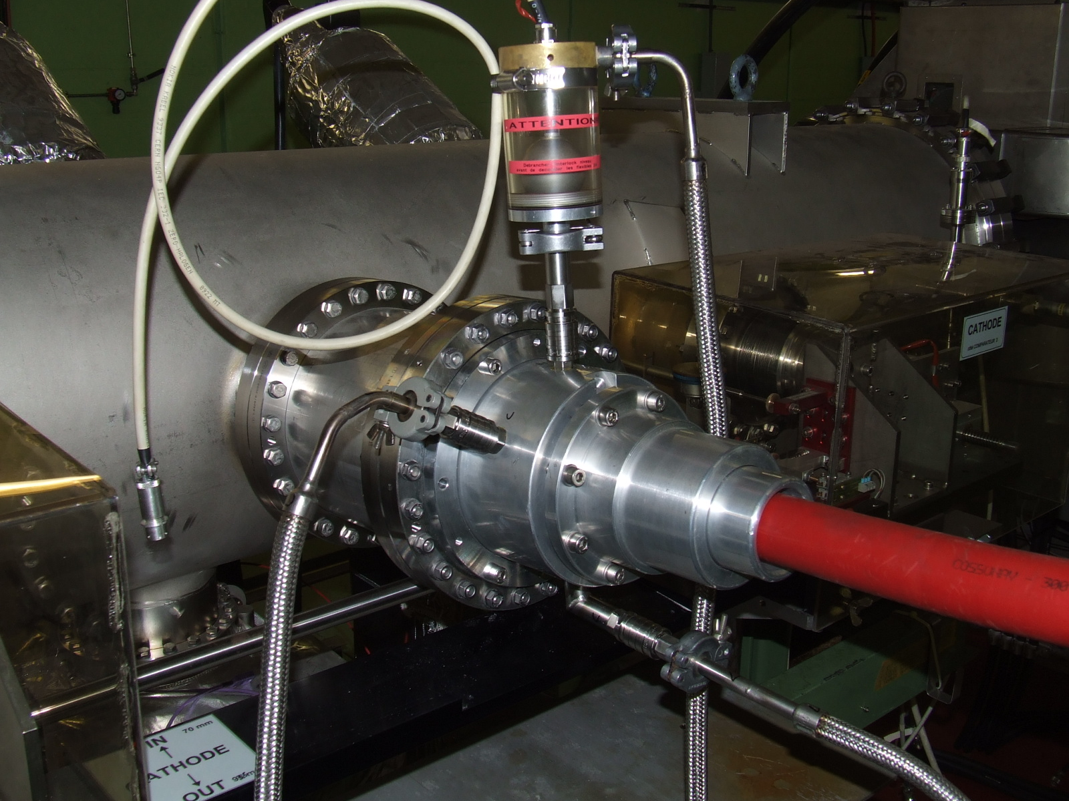
II. HV feedthrough insulation
Feedthrough and HV connector insulated with liquid: in PS used SHELL Diala oil in highly radioactive areas.
Redesigned to allow used of recirculating 3M Fluorinert FC-77.
Online recirculation allows for filtering and de-humidification in external insulating liquid conditioning station.

Slide 16
II. ZS behaviour observed with LHC beams
Several types of LHC beams: 25, 50 and 100 ns bunch spacing.
Increased Spark Rate with 50 and 25 ns beams
  → may damage ZS, reduce lifetime
‘High spark rate’ phenomenon (> 10 sparks in < 5 s.) observed with 25 ns beams
  → Switch Off: ZS main voltage + I_{trap} power supplies
Important Outgassing (> 10⁻⁷ mbar) with 25 ns beams
  → Switch Off ZS, close sector valves

Slide 17
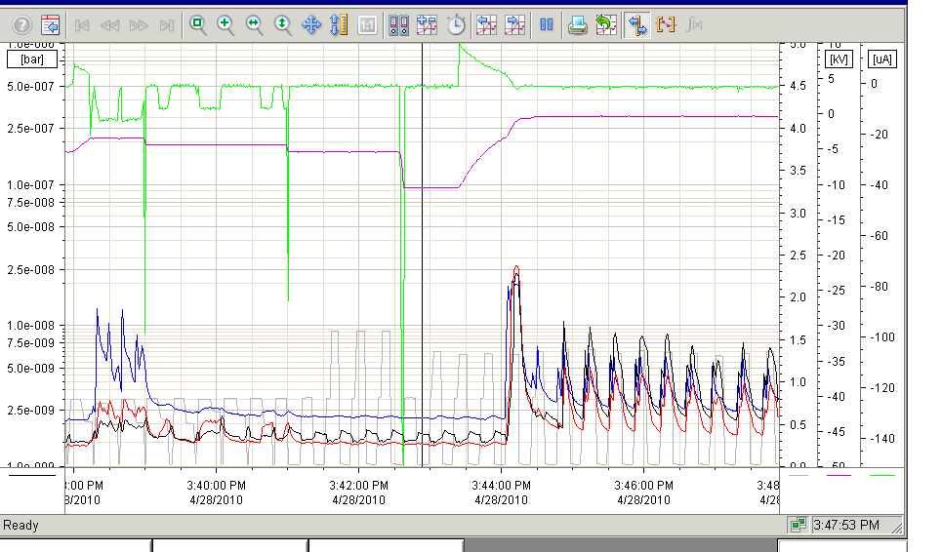
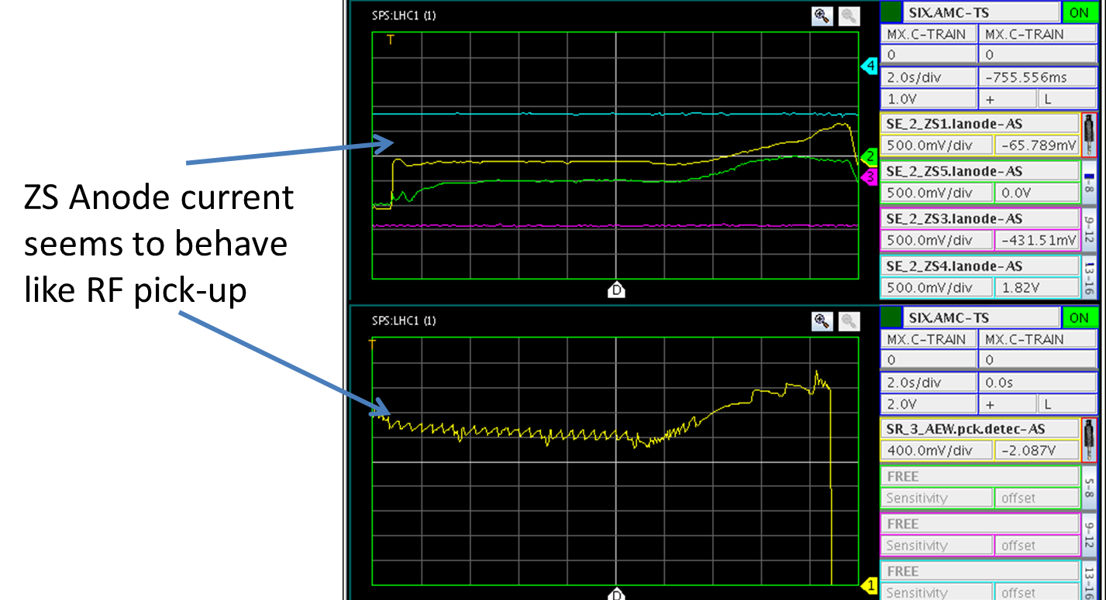
Electron-cloud
Since 2002 incident, where ZS was damaged by scrubbing, ZS were used in ‘retracted’ position and with Ion trap Voltage on and main cathode HV generator on at 0 kV.
Anode seems to behave as RF pick-up, as observed in measured anode current.
Depending on beam, a lot of vacuum activity is observed in ZS tanks.
By applying ≥ ~10 kV main field (!) the vacuum activity can be reduced.
Notes:
When beam is injected into SPS, the I_{anode} appears to drops.
If this would be due to protons hitting the anode we would lose 10¹⁴ particles per second!!!
However, no current is observed in generators→ electrons emitted from anode ????
By applying main gap field the vacuum activity can be reduced.
U Main ≤ -3kV for Itrap settings -3, -6kV
U Main ≤ -1.5kV for Itrap settings -1.5, -4.5kV
Setting the Itrap settings to 0, -3 kV, tripped the vacuum interlock.

Slide 18
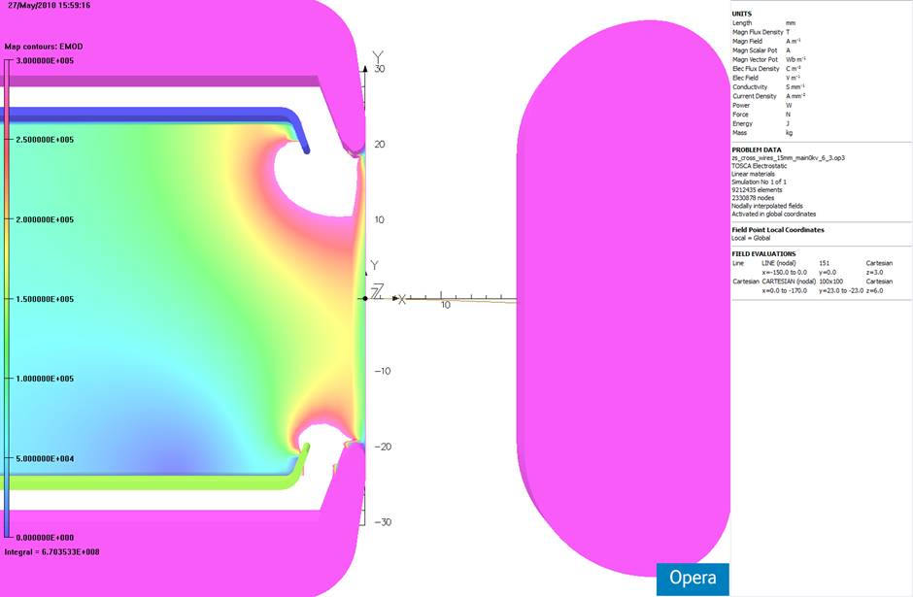
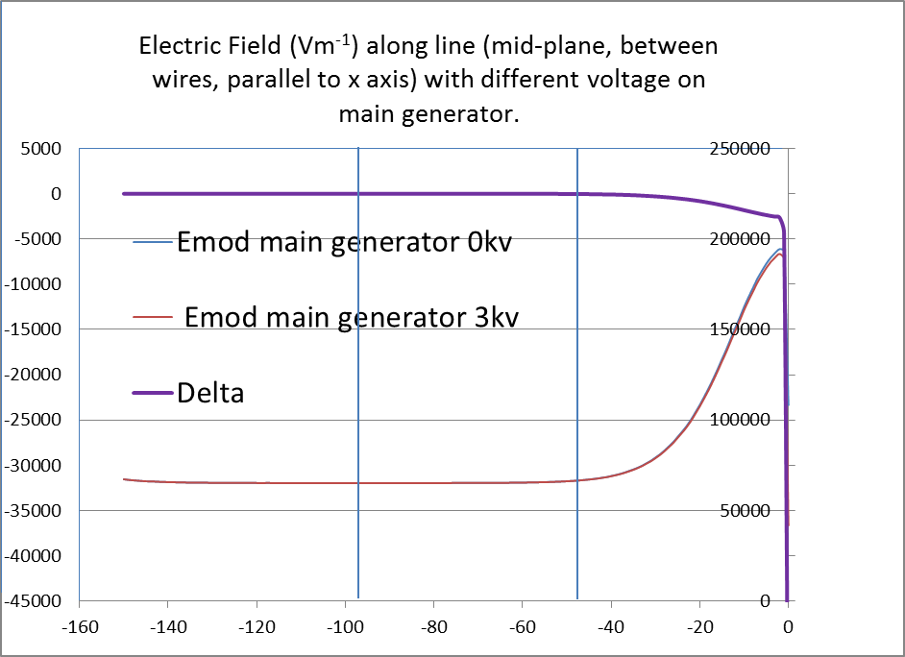
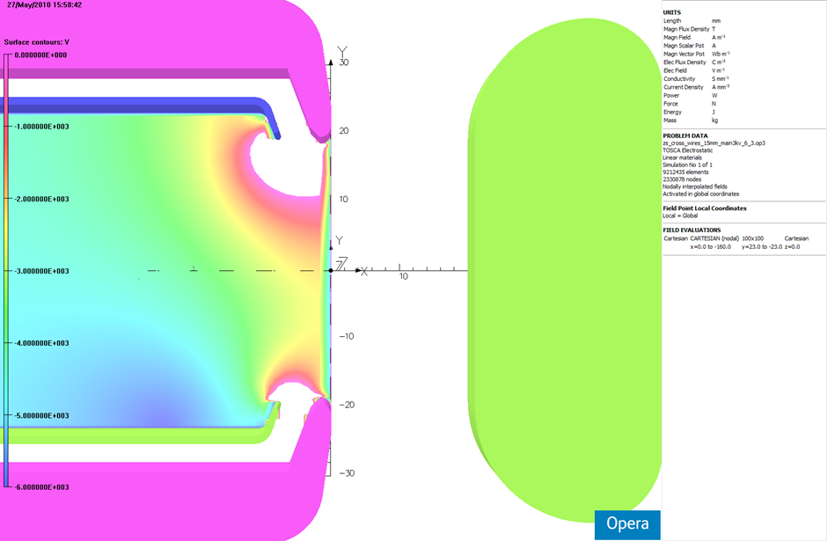
Anode support 3D field
Ion traps on(-3, -6 kV)
Main Voltage 0 kV
Electric Field (Vm⁻¹) along line (mid-plane, between wires, parallel to x axis) with different voltage on main generator.
Ion traps on(-3, -6 kV)
Main Voltage -3 kV
Edms n°1077335

Slide 19
Origin of e-cloud
The origin of the e-cloud is still unclear.
Simulations show that an Ion Trap ΔV≥500V should be sufficient to avoid e-cloud [4].
Influence of main gap on vacuum activity not fully understood for the time being.
Suspicion that Ion Traps voltage (DC high impedance) perturbed by RF from beam.
Hypothesis is that e-cloud may build up in adjacent pumping modules and deteriorate ZS vacuum (no independent vacuum measurement).
See electric circuit

Slide 20
Multi-cycling
To reduce vacuum activity as well as spark rate:
a dynamic cycling for ion trap and main field voltages was developed and deployed,
dynamically adapt trip levels and interlock settings,
as a function of the beam (type) in the machine.

Slide 21
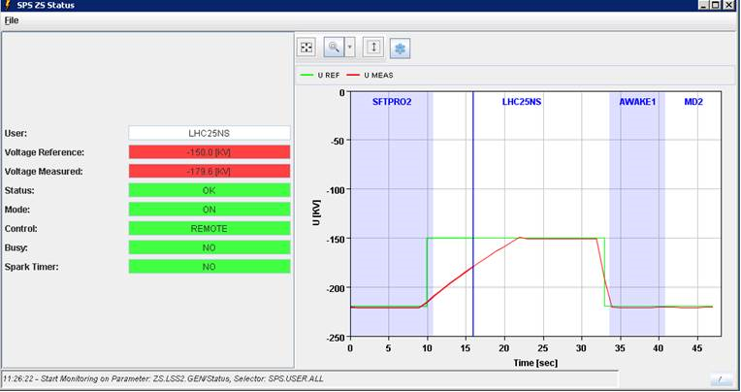
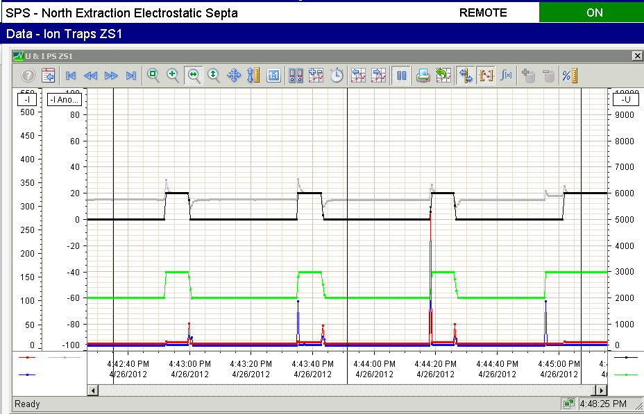
ZS main and ion trap voltage cycling
For the main generator a set of two current references has been built, the first one “Beam” with the typical reference of ~200µA and a second one “no beam” to recharge quickly the HV circuit with a current of max. ~2mA.
To protect the ZS in case of sparking during the recharging, an interlock was implemented to swap from “no Beam” reference to “Beam” reference.

Slide 22
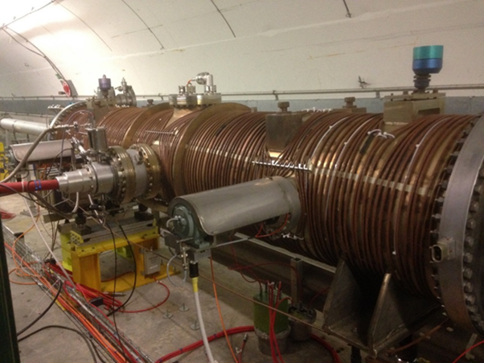
Test with solenoid at ZSTF
All modifications before installation are tested at ZSTF before deployment:
to limit risks for operation
to limit interventions in highly radioactive area
Solenoid could be powered to 20 A, yielding an approx. 5 Gauss solenoidal field. Up to 25A vacuum activity reduced, no further improvement was observed for higher currents [5].

Slide 23
Increase of vacuum pumping
For LIU-SPS project, ZS are being upgraded [6].
Present
2 x 400 l/s ion pumps,
installed on neighbouring Pumping Modules.
Upgrade (2019/2020)
2 x 500 l/s ion pump,
2 NEG cartridges (1000l/s),
installed directly on the ZS tanks.

Slide 24
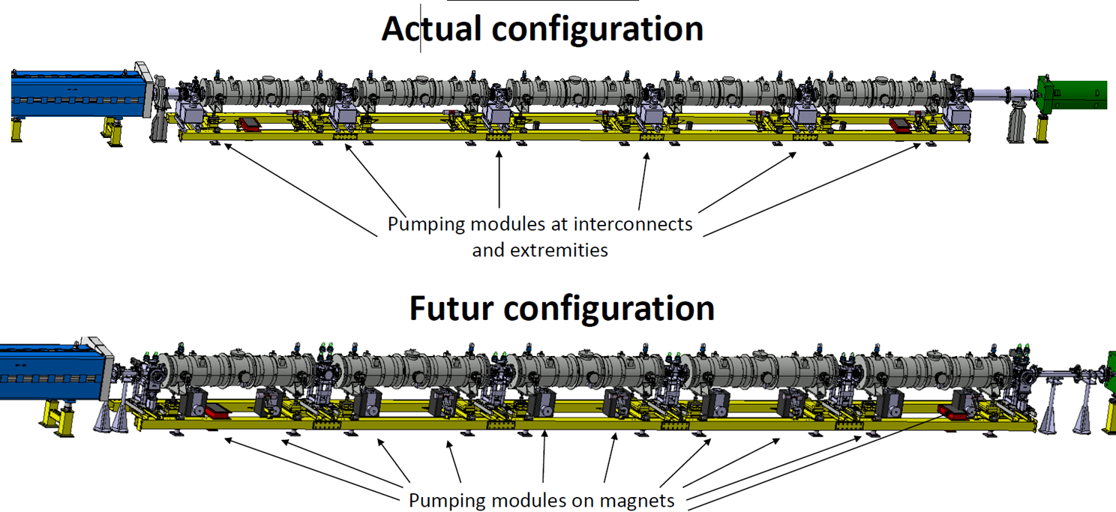
Upgraded ZS layout
Present layout
Future layout
Septa

Slide 25
III. Beam impedance reduction
Contribution of electrostatic septa to SPS beam impedance on % level.
Other systems being optimised (kickers for example), so need to improve as well.
Besides, e-cloud origin suspected from pumping modules between ZS.
→ replace pumping modules with ZS interconnects, preserving impedance better.
→ install RF transitions between ZS beam flanges and anode support.

Slide 26
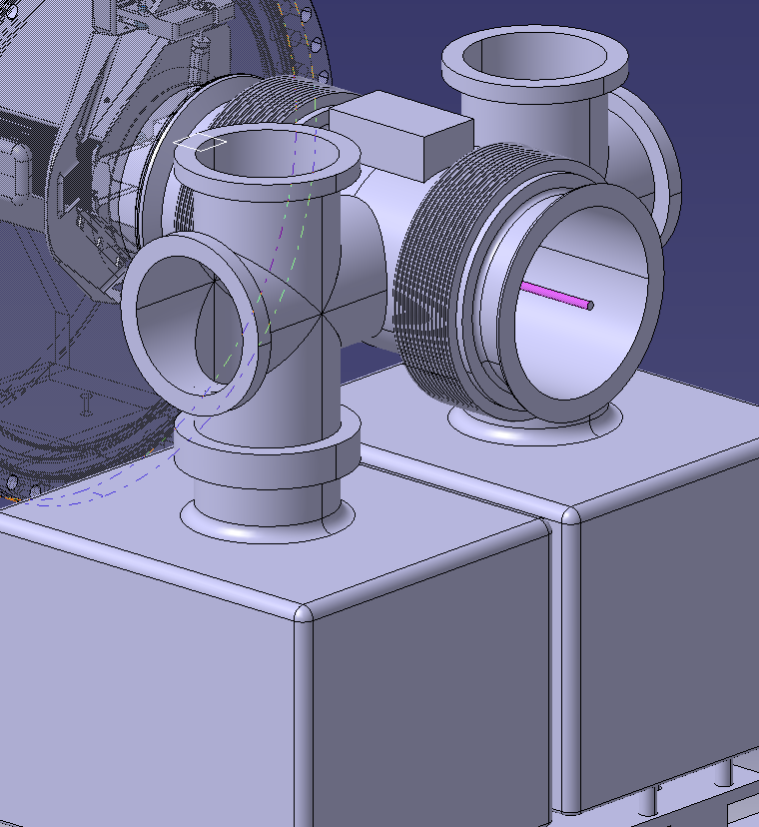
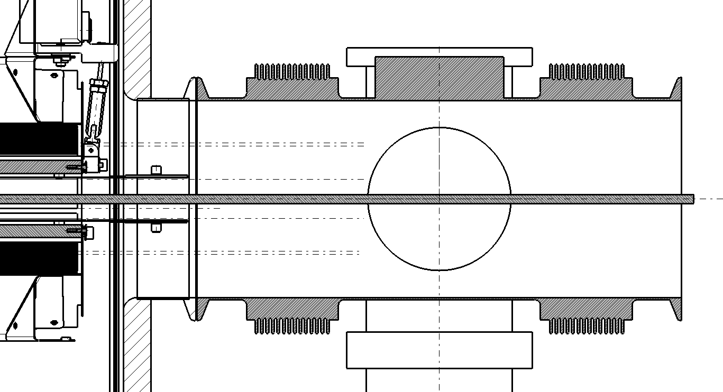
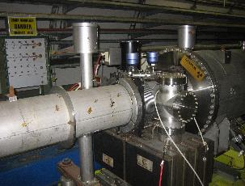
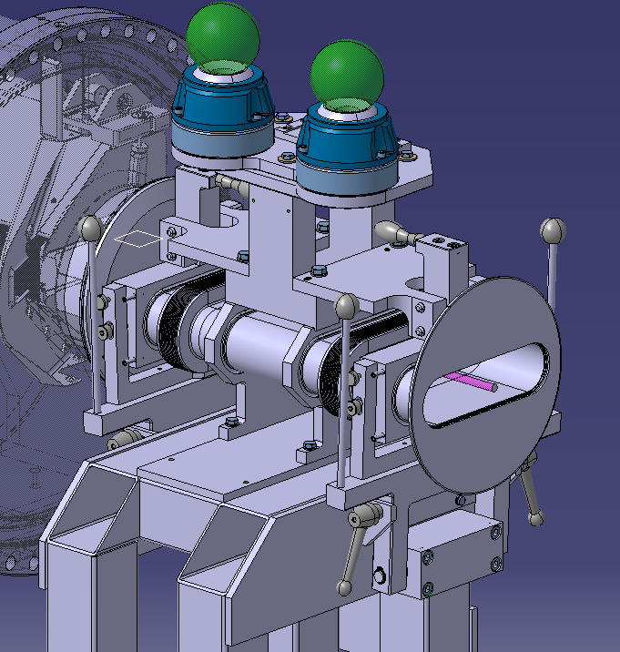
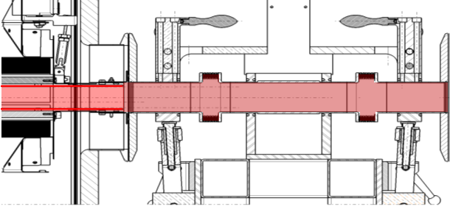
ZS beam impedance reduction
Actual ZS interconnect cross section, side view
BEAM
New ZS interconnect cross section, side view
BEAM

Slide 27
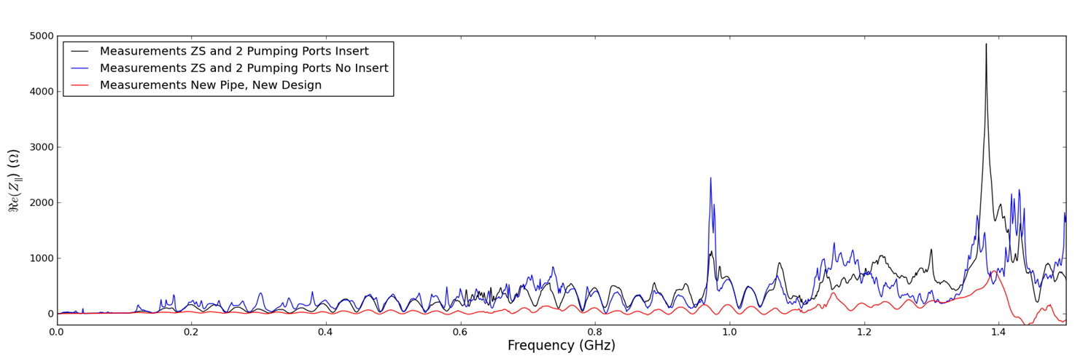
Impedance measurements
Longitudinal impedance measurements were done for comparison on:
  existing ZS + pumping module (pumping port),
  upgraded ZS + RF transition (insert) + ZS interconnect
Notes:
Addition of insert suppresses many low frequency cavity modes. Does create a large new one at 1.38GHz
Insert and new elliptical beam pipe effectively suppress any longitudinal modes below 1.2GHz. Much better impedance performance longitudinally`

Slide 28
IV. Beam loss reduction: improved septum positioning
To allow more regular scans (to optimise septum position w.r.t. the beam to minimise losses).
2 types of improvement are explored:
  Servo positioning instead of deadbeat during scanning
  Improvement of precision in septum positioning from ±100 µm to ±50 µm
  → improvements being studied both on the mechanics as controls side
Accompanying improvements in instrumentation might also help (better resolution grids, diamond BLMs, ...?)

Slide 29
Outline
CERN electrostatic septa inventory
Recent and ongoing developments
HV cable damage and replacement
Conclusions

Slide 30
3. HV cable damage and replacement
Standard industry HV cable was installed during construction of the PS and SPS and reliably in use > 30 yrs.
Paper/oil insulated cables not produced anymore: very reliable and very compact design.
To maintain compatibility with all connectors cables compatible with existing systems was manufactured on purpose. Not always easy to find supplier for < 1 km of non-standard cable.

Slide 31
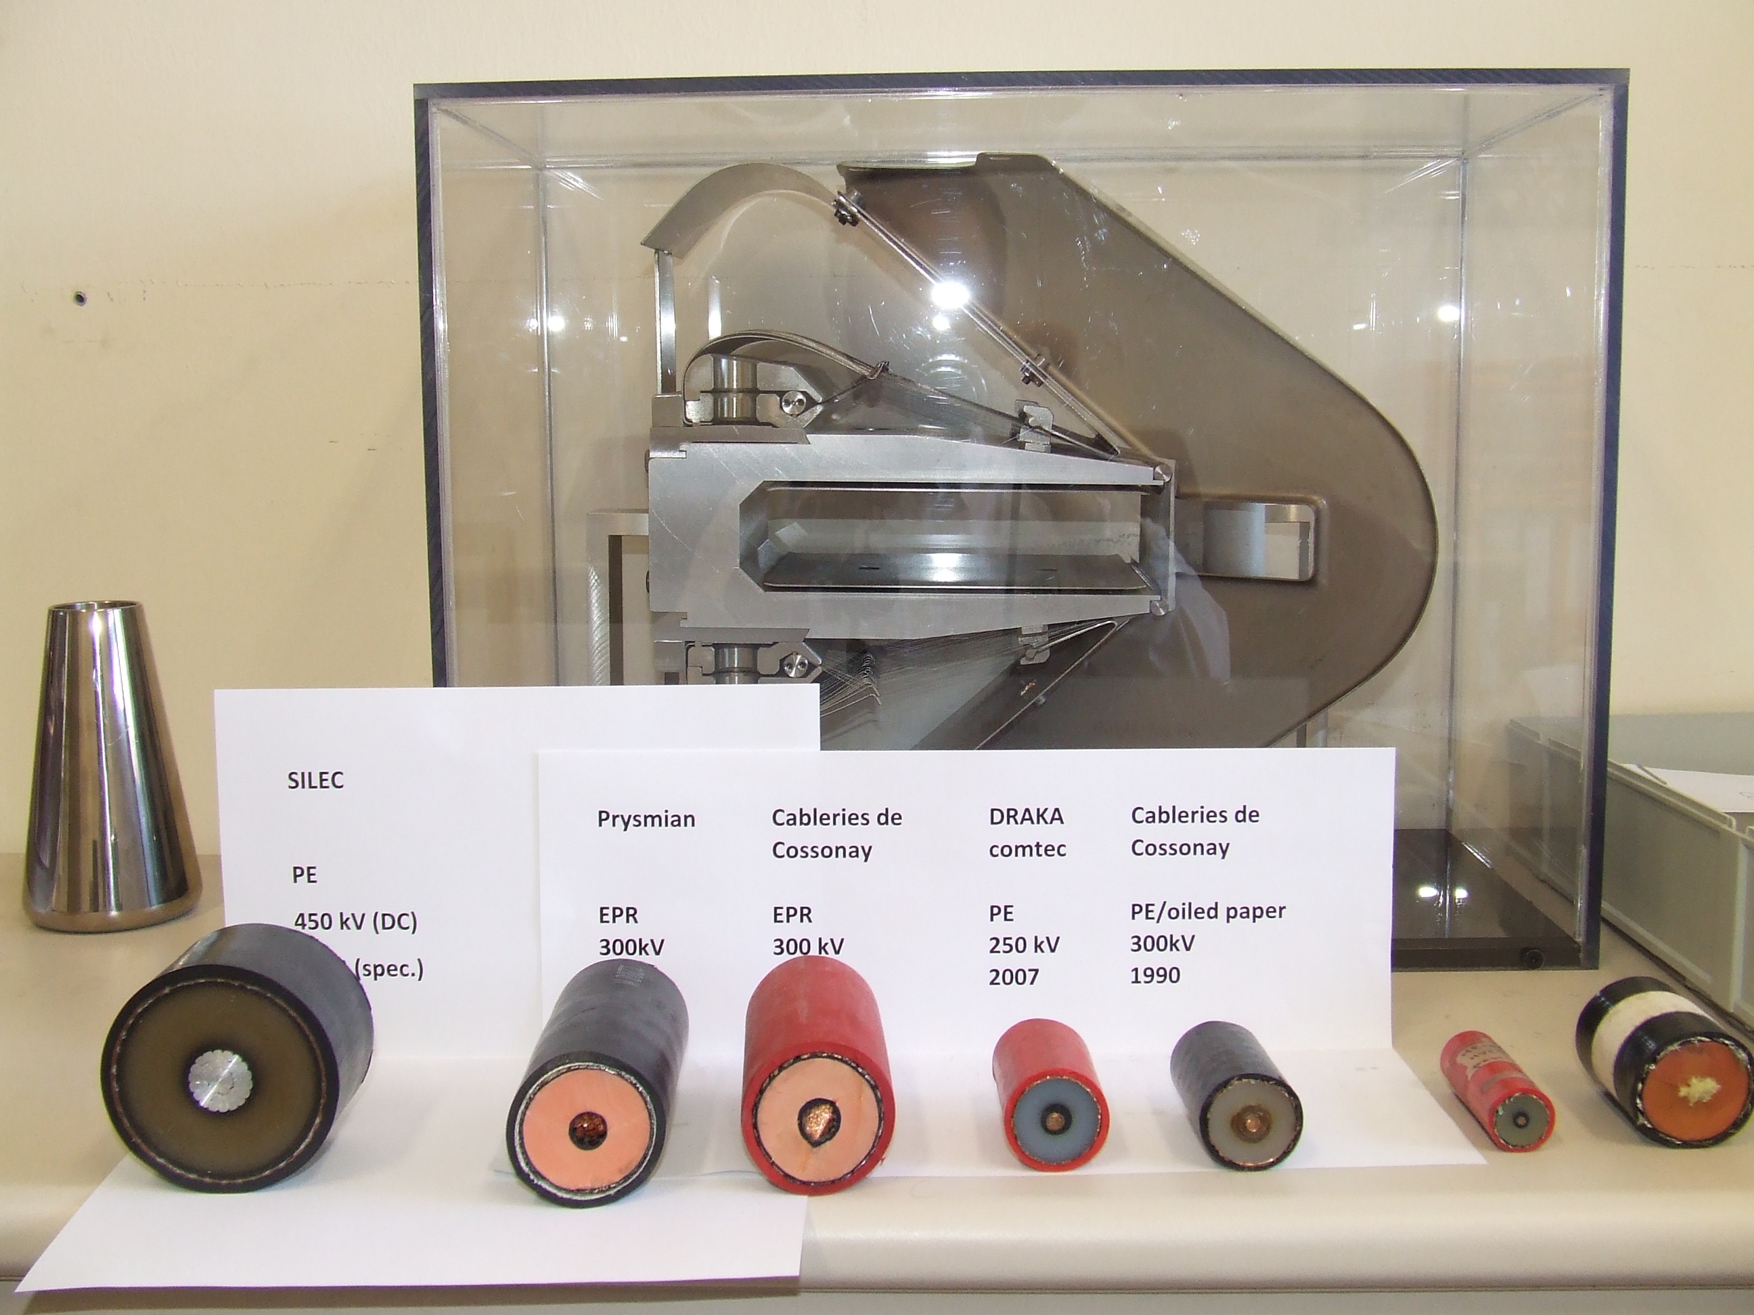
Challenges with newly produced cables
Mandatory fire resistance tests (flame propagation,
XLPE, reasonably radiation resistant, but very high electrical resistance prevents ionised charges to be transported sufficiently: cable life time ~ 2 weeks (!) in high radiation applications.
EPR cable relative low electrical resistance of insulation: high DC current offset, would make operation of septum with longer cable lengths (> 10 m) more difficult.

Slide 32
Cable specifications
In past dedicated CERN specifications used.
More recently, specifications based on IEC norm ( for ex. 60840) for AC cables.
Since 2012, CIGRE recommendation 496 published for DC cables up to 500 kV, and more and more suppliers are getting familiar and equipped for tests
  → added pre-qualification: 1 yr
  → partial discharge and impulse test not included

Slide 33
CERN HV cable consolidation
PS now using recent and modern technology cable. MTBF getting longer again (from <1 yr to several years).
SPS tunnel cables are to be renewed. Link between surface and tunnel (> 40 yrs old) planned to be replaced at end of this decade.

Slide 34
Outline
CERN electrostatic septa inventory
Recent and ongoing developments
HV cable damage and replacement
Conclusions

Slide 35
4. Conclusions
Efforts on electrostatic septa diluted over time, also due to available time/resources.
In last 10 years efforts mainly focussed on HV cables to increase MTBF.
Efforts now directed to improve spark rate and reduce vacuum activity on SPS wire septa with LHC beams.
Beam impedance being reduced for SPS septa.
Results of consolidation and upgrade efforts should be available to operation after LS2.

Slide 36
References
C. Germain et al., “Technical developments of the CERN electrostatic program”, 2nd Int. Symp. On Insulation of High Voltages in Vacuum, p.279 -291, Boston (1966).
ECHA Annex XIV of REACH (authorisation list) of 11/1/2016: Sunset date Chromic acid, EC number 231-801-5: 21/9/2017
A. Prost, TE-ABT-SE Section meeting 4/5/2016, Indico.cern.ch/event/505577
G. Rumolo, “E-cloud build up simulations for ZS”, SPSU study group meeting, 22 April 2010
B. Balhan, J. Borburgh, “Observations and measurements on the ZS during the SPS MD”, SUSG meeting 20 May 2010, CERN edms 1079513
B. Balhan, TE-ABT-SE Section meeting 4/5/2016, Indico.cern.ch/event/505577

Slide 37
Back up slides

Slide 38
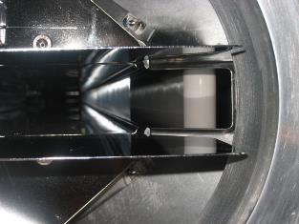
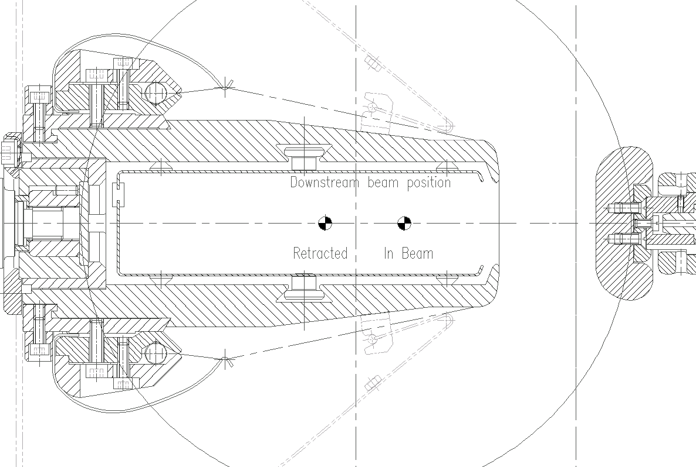
ZS HV circuit
-3 kV
Itrap box under ZS
R 1MΩ
R 500MΩ
R 500MΩ
-220 kV
R 1MΩ
R 100KΩ
I ANODE
-6 kV
→16
ZS Improvement ABTEF 19/07/13

Slide 39
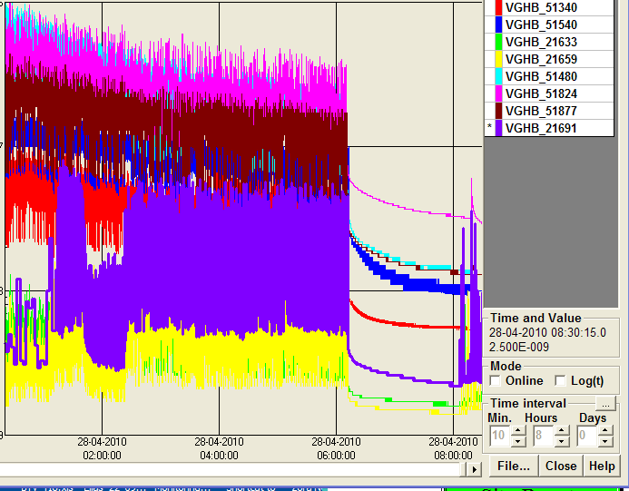
ZS Vacuum activity as a function of beam position
‘In beam’
‘Retracted’
Little conditioning effect observed
NB: LHC25 beam wasn’t at the nominal settings as yet (1 batch, 60 bunches, RF not nominal).
Edms n°1077335

Slide 40
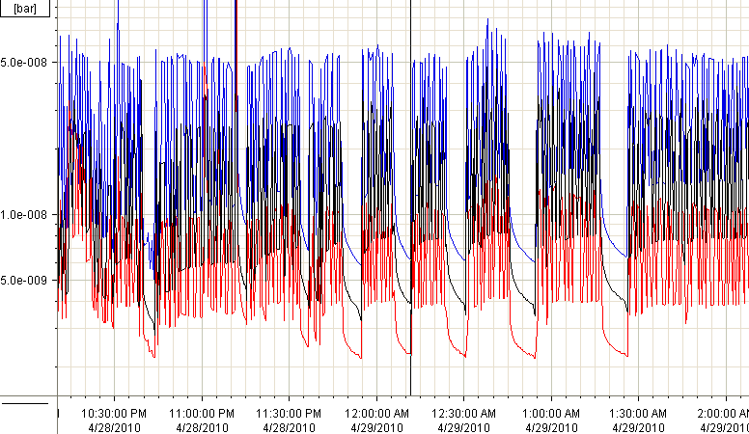
Repeated high intensity cycles
RF voltage increased to 7MV as from here
The night of 29/4/2010 4 batches of 72 bunches were taken with nominal beam parameters (from 12:40 am onwards) .
The main voltage was kept at -7 kV, Itrap voltage at -3, -6 kV.
Nominal beam parameters were more difficult to sustain the beam setting used before. The vacuum levels degraded a factor 10.
Running several hours does not show any further degradation of vacuum in ZS.
Applying a higher voltage to the main gap did not yield a further reduction of the vacuum levels.
Edms n°1077335

Slide 41
New RF Screen under study

