Slide 1
SIS 18 Änderungen
Petra Schütt
Operateurs-Schulung 3.2.2016

Slide 2
Overview
SIS18 Upgrade and Maintenance
  Ramp rate (dipole power converters)
  renewal of water cooled power cables
  h=2 acceleration cavities, renewal of cooling disks in the ferrite cavities.
  new alignment of extraction septum
Control system and Diagnostics
  Beam diagnostics, IPM
  New electronics for beam position monitors
  for 2016 legacy software will still be available (SISModi etc.)
  for 2018 “retrofitting” of FAIR control system
Link to existing facilities (GaF) – civil construction
Many thanks C. Omet and J. Stadlmann for the permit to copy their slides from the report “SIS18 Status” at 13th MAC, 27.04.2015.

Slide 3
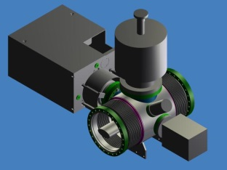
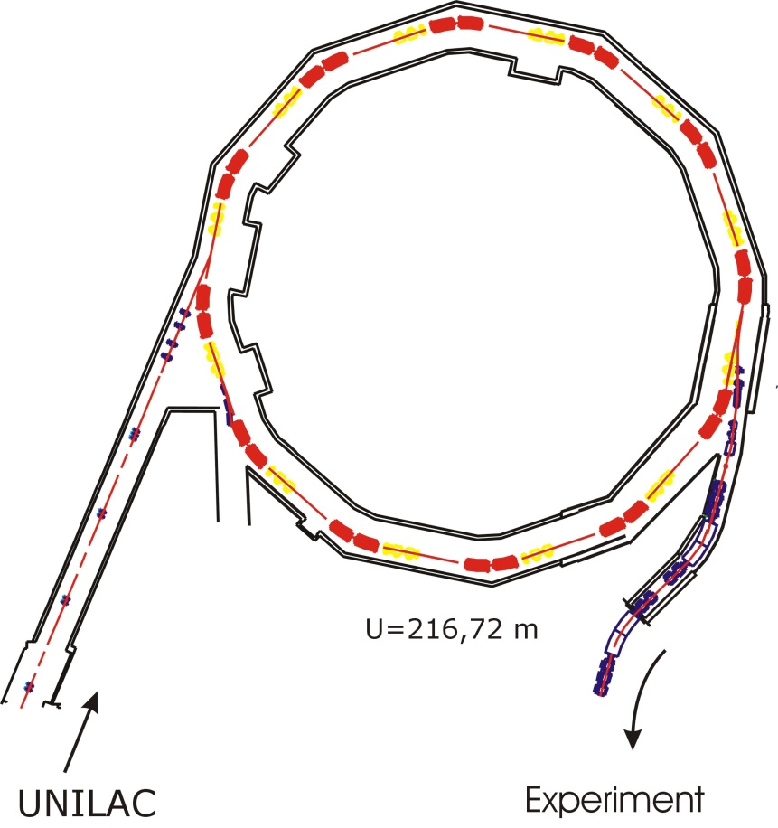
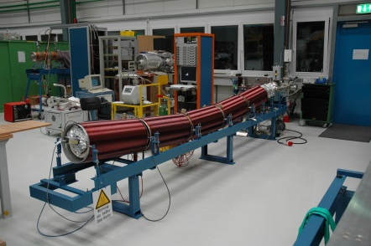
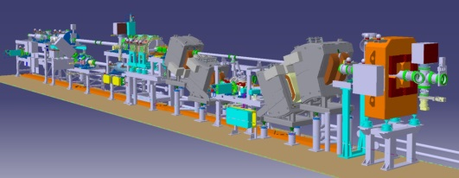
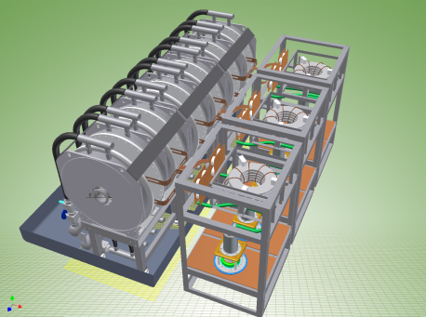
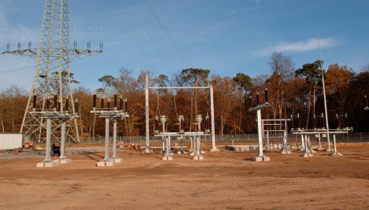
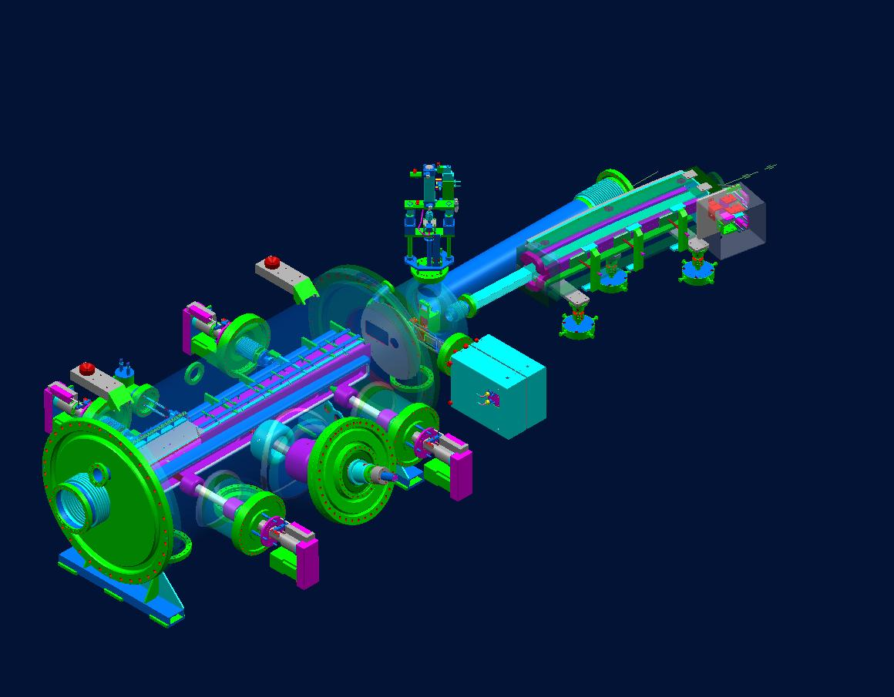
SIS18 upgrade program
Scrapers and NEG coating for pressure stabilization
Injection system for low charged state heavy ions
Charge separator for higher intensity and high quality beams
Power grid connection
h=2 acceleration cavities for faster ramping
The SIS18 upgrade program: Booster operation with low charge state heavy ions

Slide 4
SIS18 upgrade program
Pulse power connection - completed
Dedicated 110 kV power connection and transformer for fast ramping (2006 and 2010)
Replacement of Main Dipole Power Supplies
Operation with 10 T/s up to 18 Tm (2015)
RF System
New h=2 acceleration cavities (1st cavitiy 2014)
Bunch compression system (2012)
UHV System - completed
New, NEG coated dipole- and quadrupole chambers (2009)
Insertions - completed
Set-up of a „low-desorption“ scraper system (2009)
Injection / extraction systems - completed
New, large acceptance injection system plus HV power supply (2007)
Set-up of a TK charge separator (2007)
Beam diagnostics systems
Fast residual gas profile monitor and high current transformer (2008)
Development of high current operation
Compensation of resonances, impedance issues etc. (ongoing)

Slide 5
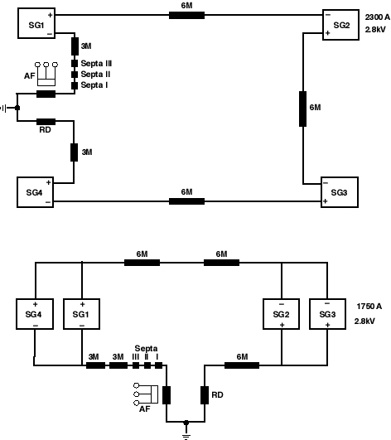
SIS18 fast ramping
High average beam intensity require short cycle times with fast ramping.
Shortening of cycle time (low charge state operation).
Higher repetition rate (booster operation 2.7 – 4 Hz).
Increase average intensity (x 2...9).
SIS12 Mode (max. 0.5 MeV/u U⁷³⁺)
4 power converters in series supply 4 groups of 6 dipoles
B_{max} = 1.2 T; dB/dt = 10 T/s
P_{max} = +26/-23 MW
SIS18 Mode (max. 1 GeV/u U⁷³⁺)
2 groups of 2 parallel power converters supply 2 groups of 12 dipoles
B_{max}= 1.8 T; dB/dt = 4 T/s
P_{max} = +19/-17 MW
Power converter upgrade for 10 T/s up to 18 Tm is near to be finished. Current operation possible up to dB/dt = 4 T/s ~ 1 Hz.

Slide 6
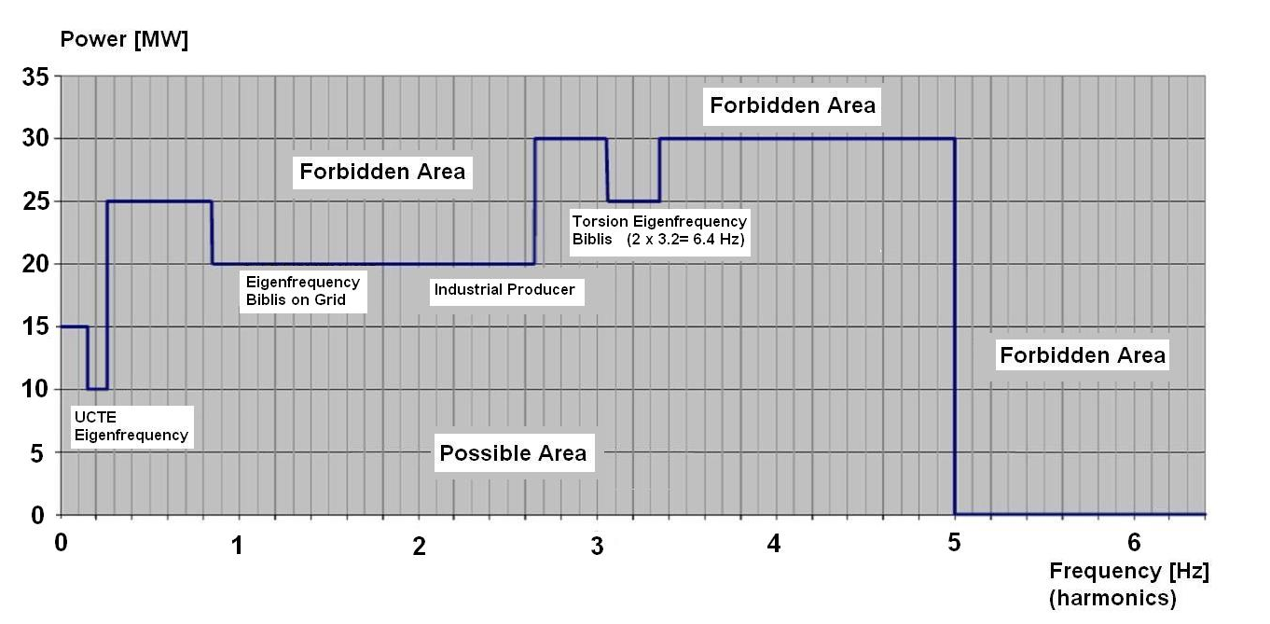
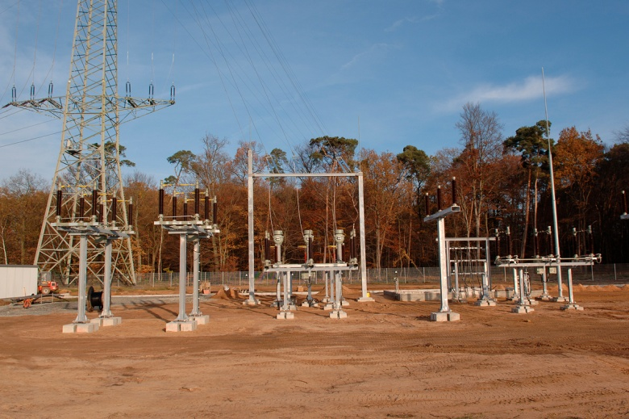
110 kV power connection
Study of electromechanical resonance (damping) of Biblis B generator shaft done.
Measurements of torsion and power oscillation in the grid done.
Transformer station “Leonhardstanne” at GSI has to be modified in conjunction with new FAIR transformer stations. Then, full power can be drawn.
Machine / mode | Pulse power [MW] | Max. ramp rate [T/s]
SIS18 (now) | -18 +20 | 4.0
SIS12 (now) | -24 +27 | 10.0
SIS18 (FAIR) | ±42 | 10.0
SIS100 | ±26 | 4.0
SIS300 | ±23 | 1.0
Project completed

Slide 7
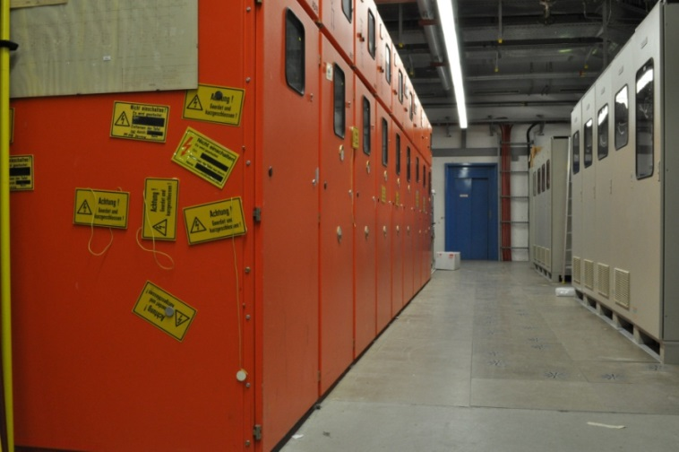
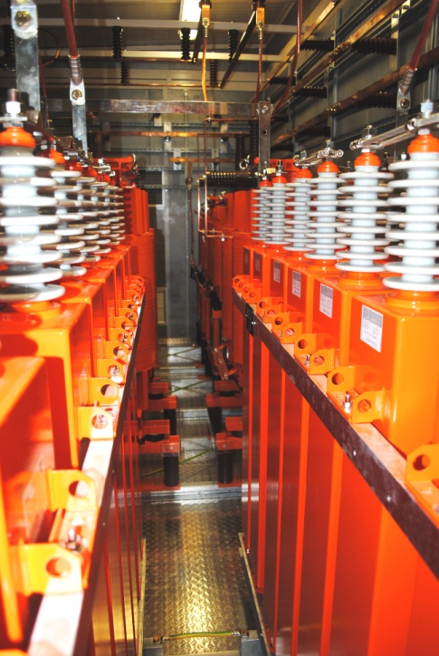
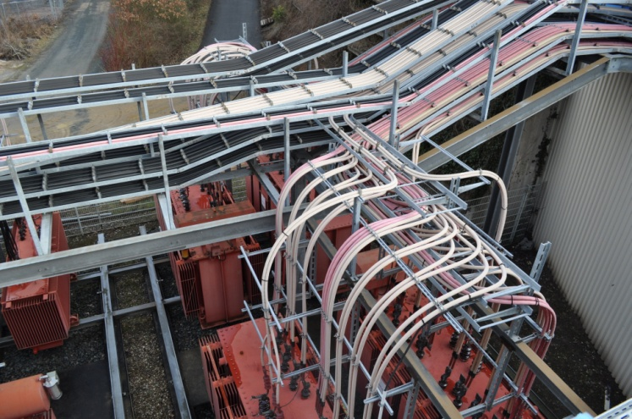
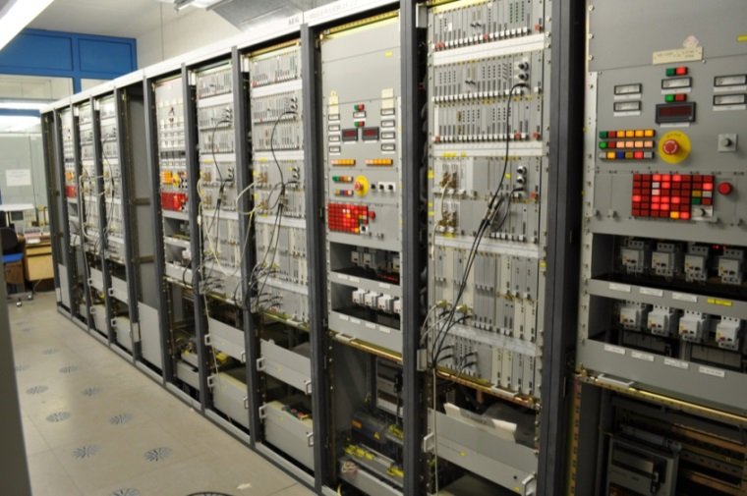
New dipole power converter for ramping with 10 T/s
Upgrade of SIS18 Main Dipole Power Converter System for 19kA/s up to 3500A
Contract signed in December 2012 with GE (USA)
Delivery of power grid filter unit mid of 2013 completed
Scheduled final commissioning in 2016

Slide 8
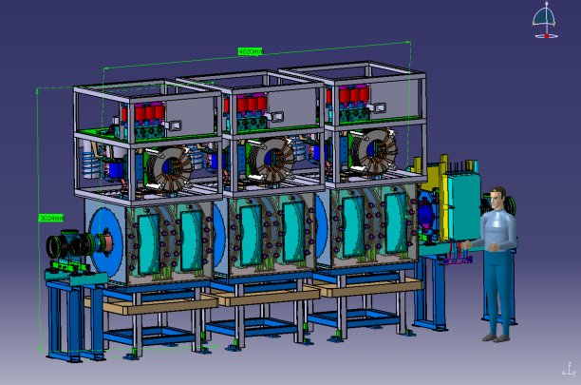
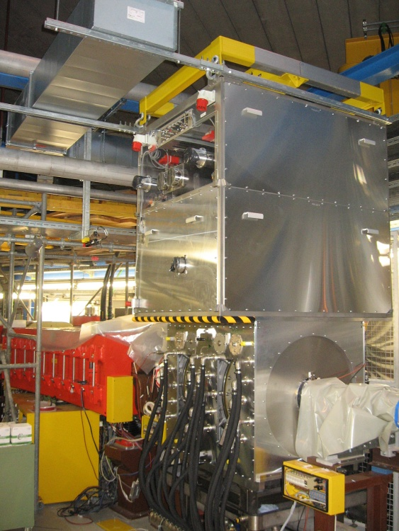
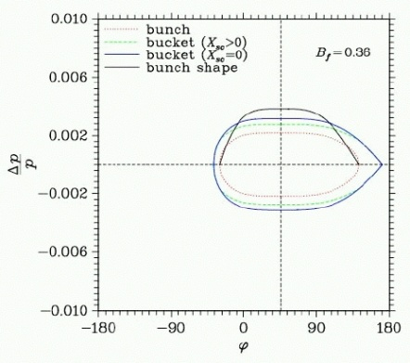
New SIS18 h=2 acceleration system
Sufficient RF voltage for fast ramping with low charge state heavy ions
  2x10¹⁰ U⁷³⁺ acceleration with 4 T/s
  1.5x10¹¹ U²⁸⁺ acceleration with 10 T/s
Sufficient bucket area for minimum loss (30% safety)
50 kV (0.5 – 50 kV) – high power requirements
Flat bunch profile (high Bf) for lower incoherent tune shift
Two harmonic acceleration
  h=4 (existing cavities)
  h=2 (new cavities)
Compatibility with SIS100 RF cycle
Installation of first module completed, tested with beam.

Slide 9
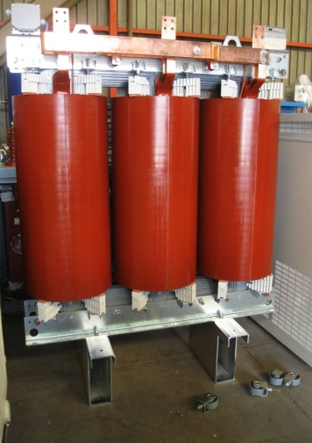
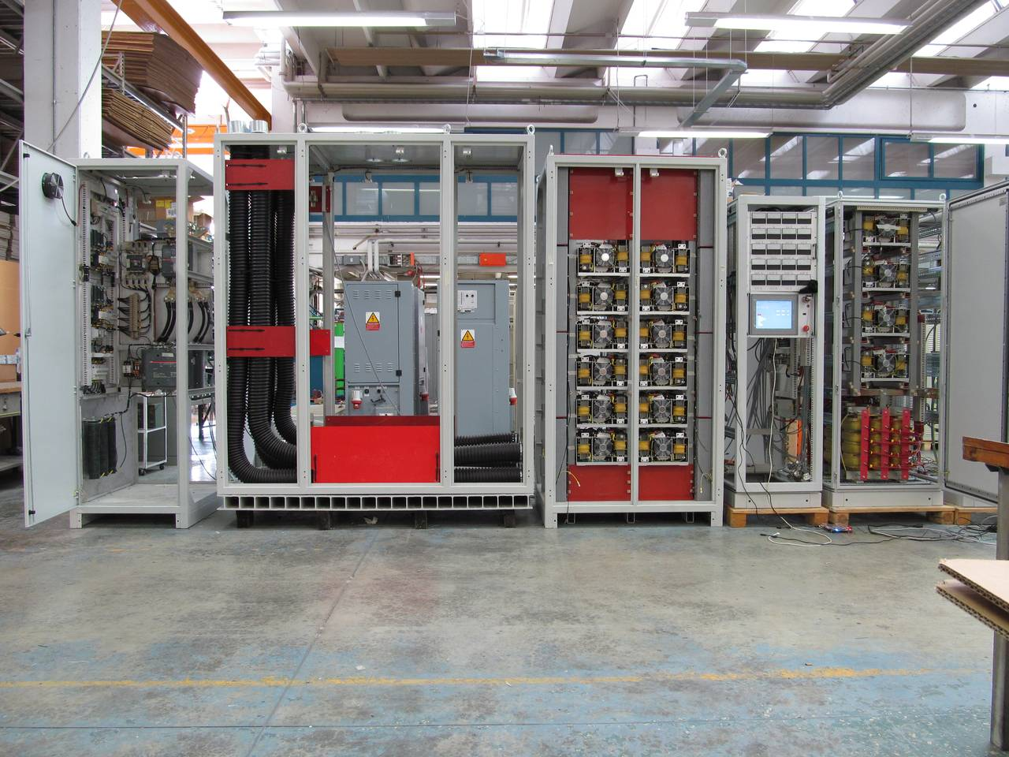
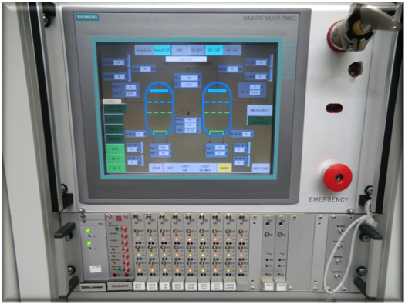
Supply units for new SIS18 acceleration cavities
Status:
1st supply unit delivered by OCEM in August 2012.
Delivery of all remaining (2nd and 3rd) supply units and cavities completed
2nd and 3rd cavity awaiting assembly in tunnel (radiation in this area has to decay).

Slide 10
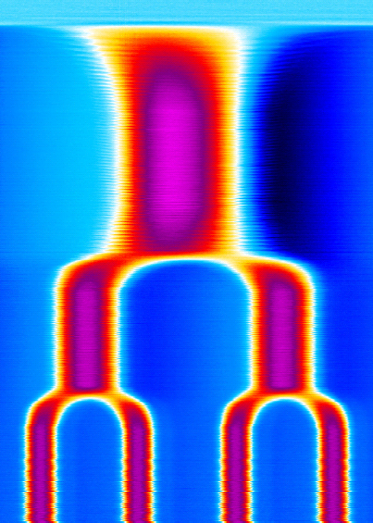
Test of digital RF controls
Status:
Multi-harmonic cavity synchronization system available in SIS18
Several beam experiments successfully performed
Optimization and control system integration ongoing
Ion Bunch Shape
before manipulation
after manipulation
during dual harmonic RF
Test with dual harmonic operation
Test with bunch merging
10

Slide 11
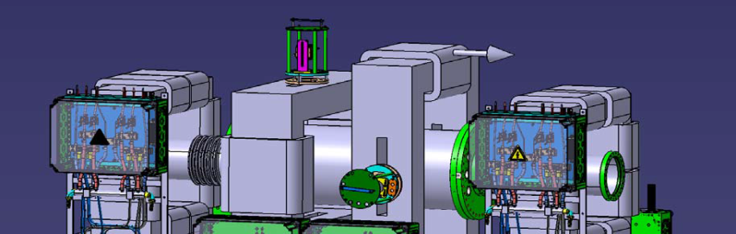
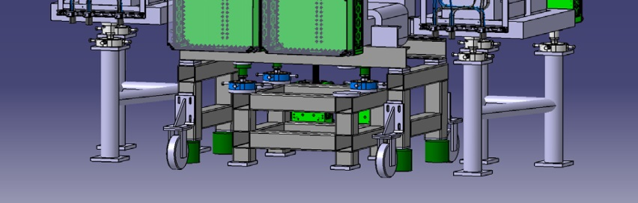
SIS18: Upgrade beam diagnostics system
Profile and beam position verification in front of injection septum
BPM’s: Digital, programmable front-end electronics for BPMs, new, stable preamplifiers
Feed back systems (TFS and LFS) need own, independent diagnostics
High current transformer (5 A) installed
Fast transformer in extraction channel installed
Q - value measurement working (in exp. mode)
Radial feedback / steering during ramping
New, residual gas profile monitor for high time and spatial resolution
IPM with magnet system
Fast, turn-by-turn measurement of the transverse beam size, e.g. during injection process.
Magnetic and electric field for imaging of the ionized residual gas ions onto a phosphor screen (even under the influence of strong beam space charge).
High voltage boxes and UHV tank delivered.
Magnet system and power supplies in tendering process.

Slide 12
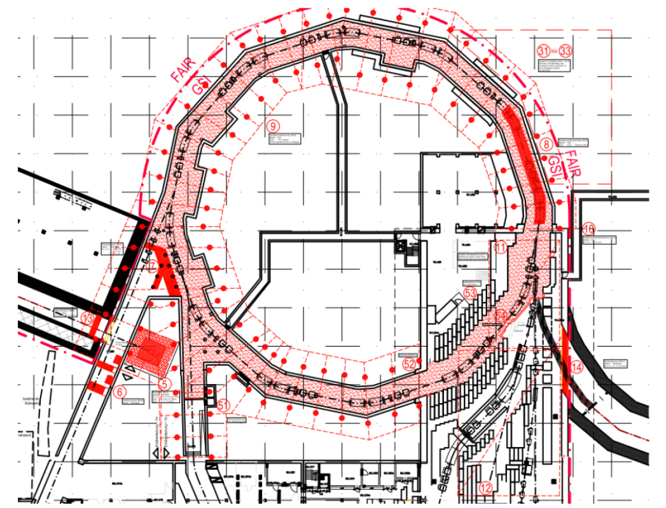
Link Existing Facility – Civil Construction
Project leader: A. Schuhmann (GSI)
  External planning companies: STEAG (buildings, infrastructure), Müller&Bleher (electrical systems)
Radiation protection measures
  Various shielding thickness enhancements
  Underpressure generation in the tunnel (treatment of radioactive air). ➔ Sealing of every little air leak...
  Cooling water circuit for magnetic extraction septa will be separated.
Link to FAIR via p-LINAC and tunnel T101
  Wall openings, static enhancements.
  Re-routing of cable trays and other infrastructure.
  p-LINAC beam dump between injection and reinjection channels.
Status:
  Currently in LPh4 (HOAI Leistungsphase 4 = licence planning)
  Permit to build will be submitted to authorities in May 2015

Slide 13
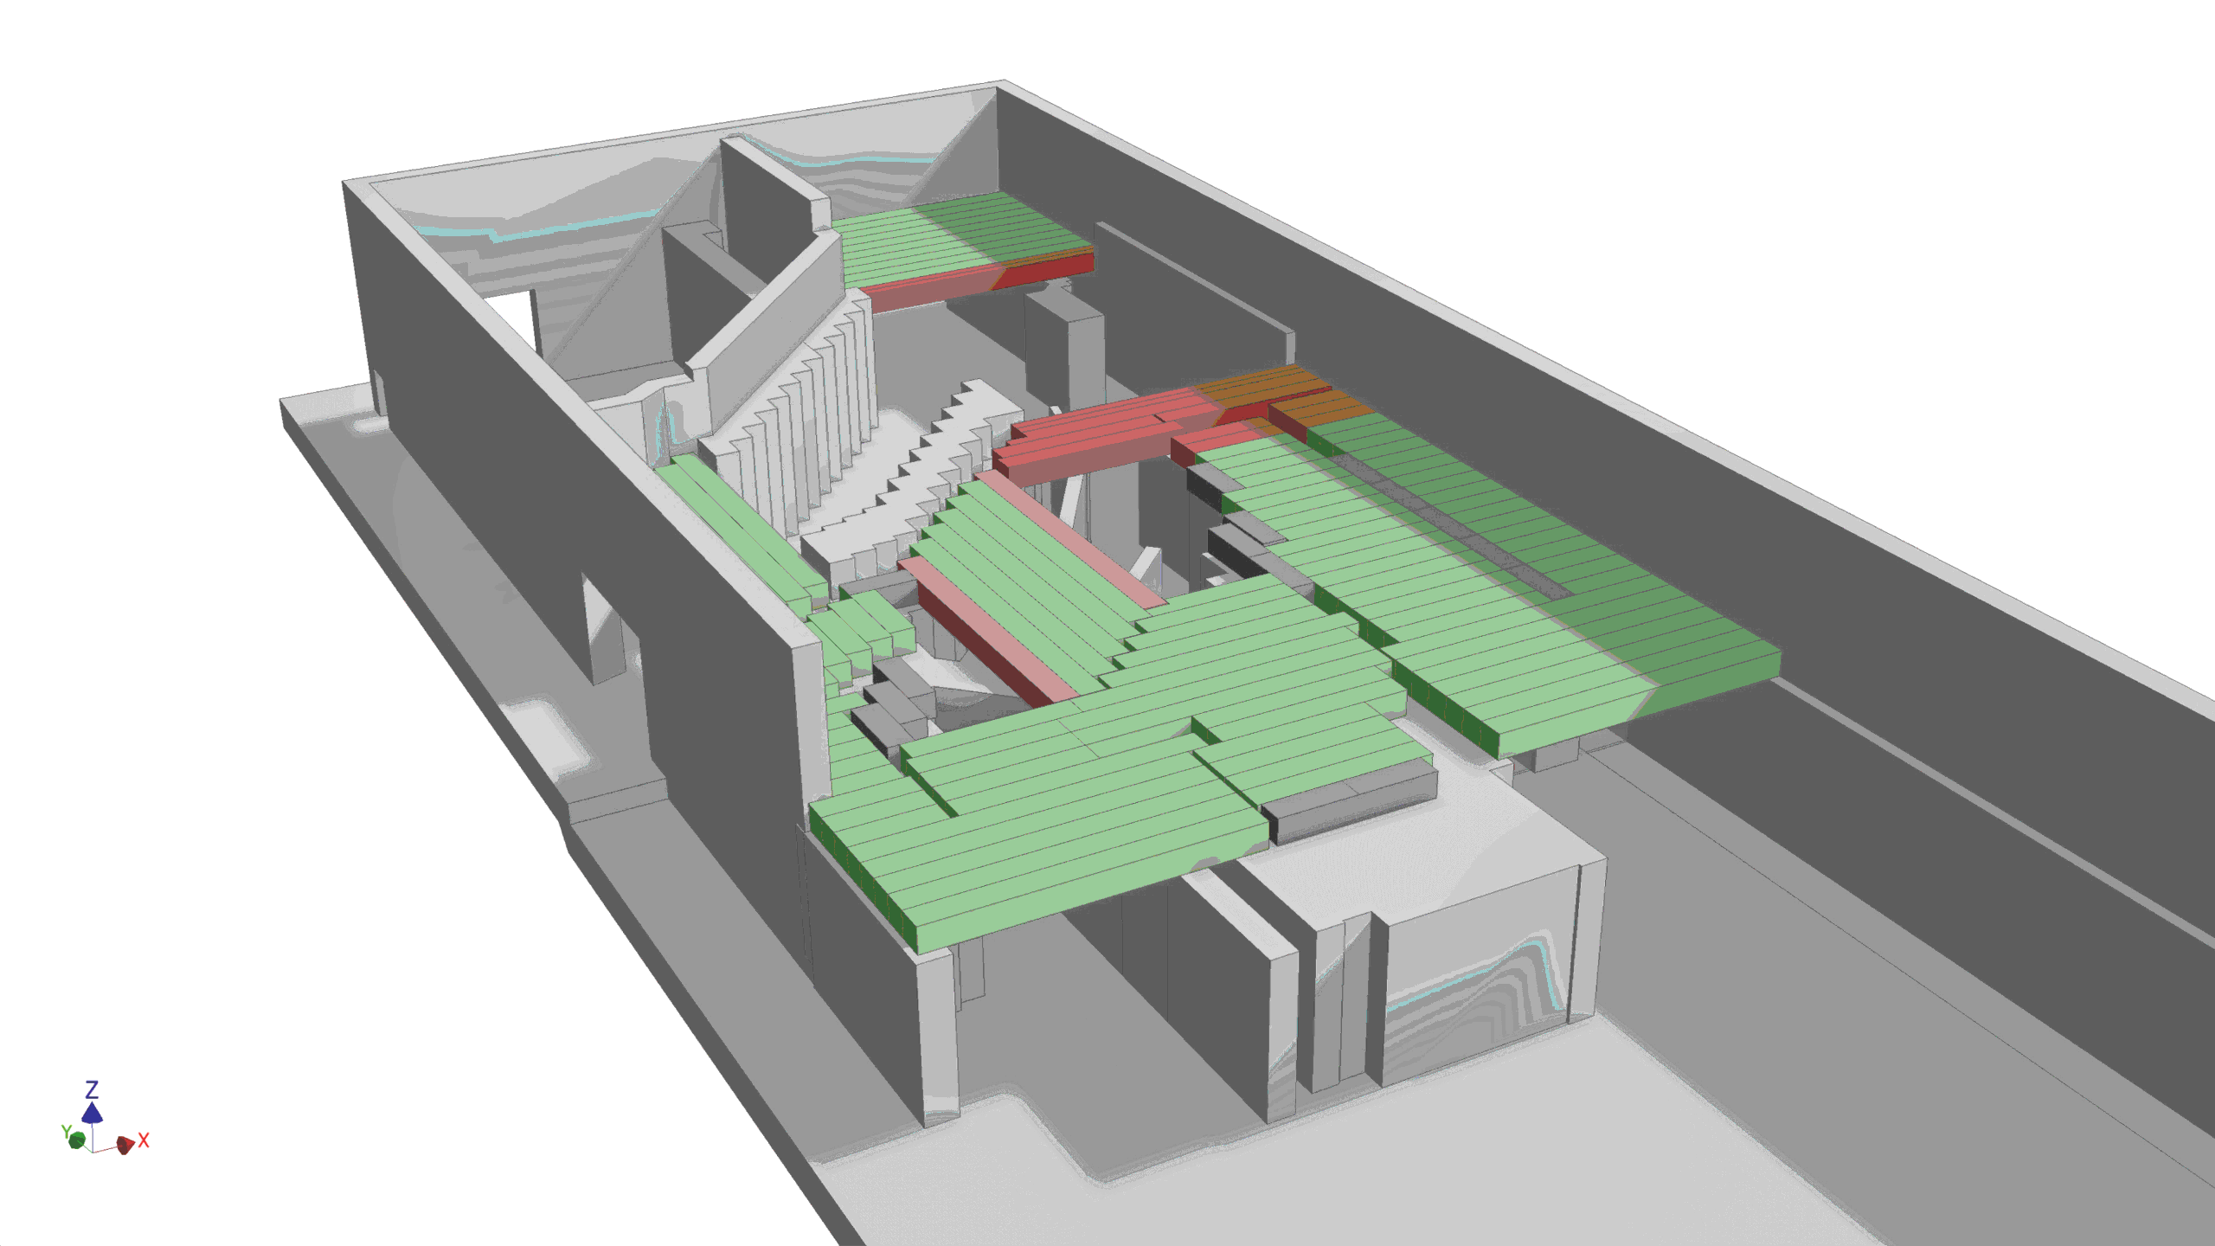
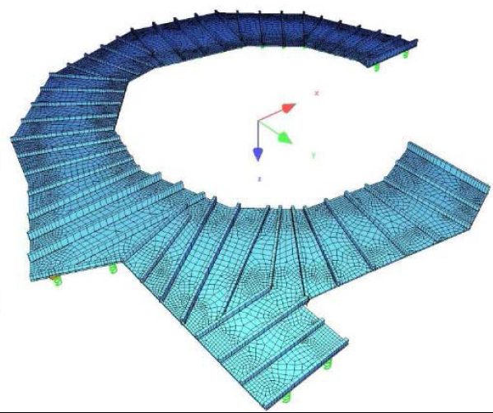
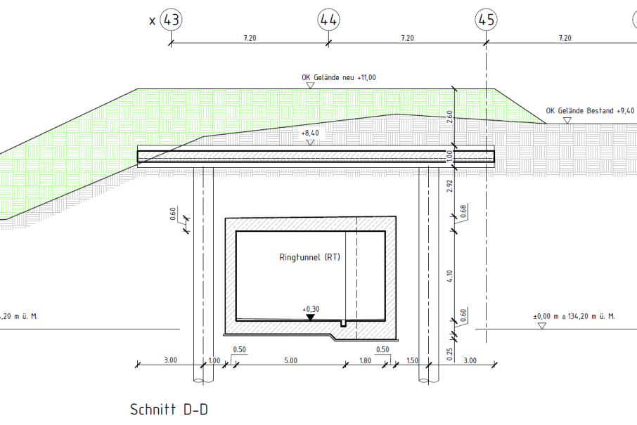
Link existing facility – Civil construction
Concrete bars in TR hall (red: hematite concrete because of space restrictions).
Table construction on top of the SIS18 tunnel to support the additional earth shielding. The additional 1.5 m earth corresponds to 1% continuous beam loss at maximum SIS18 energy and 8 600 h operation per year.

