Slide 1
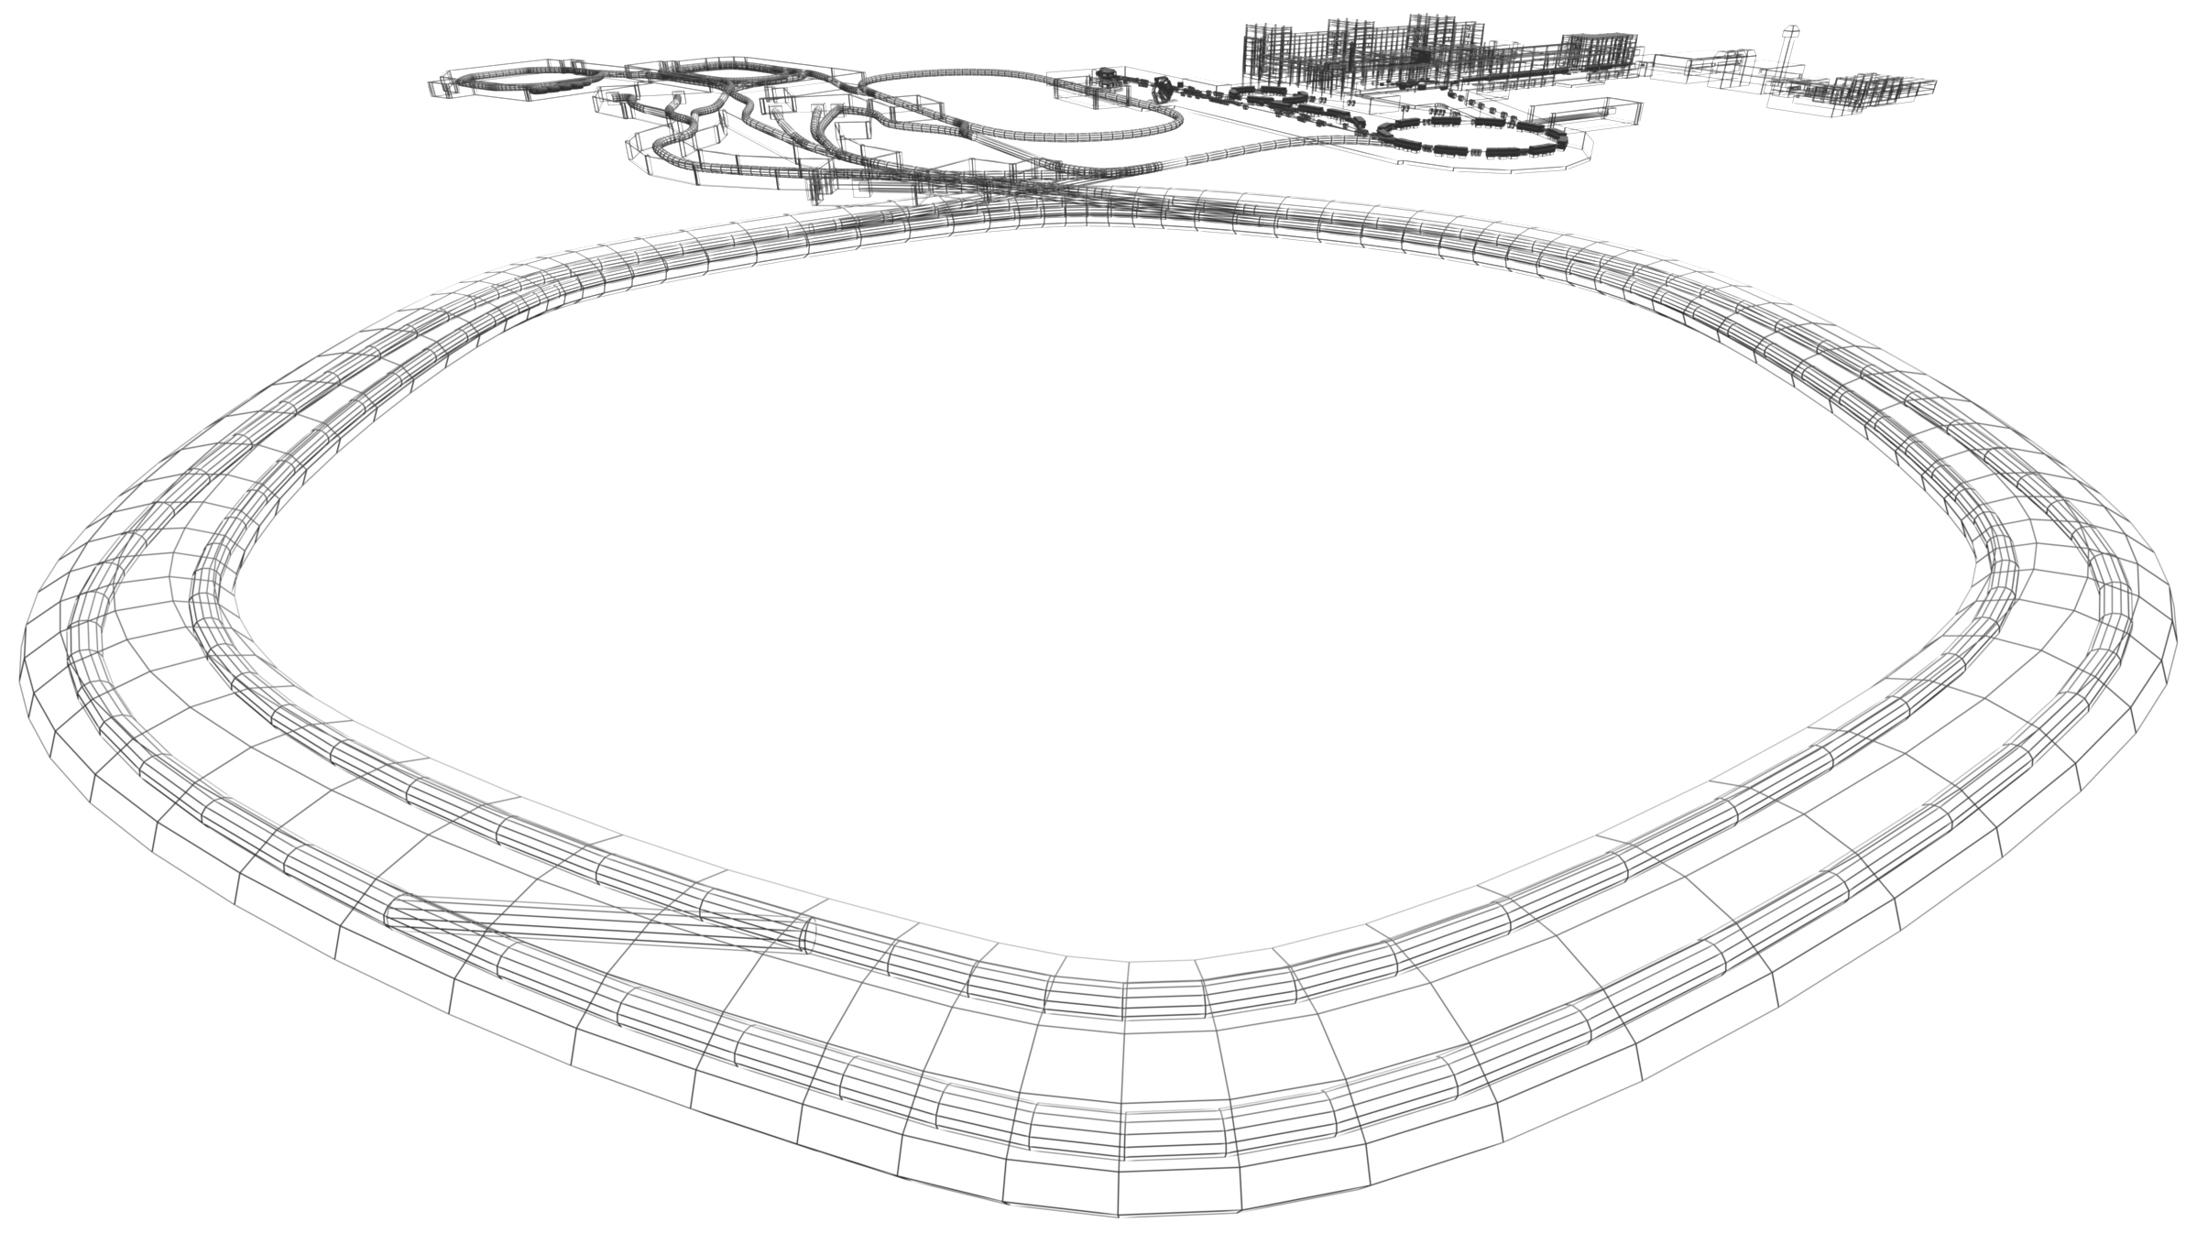
Status APPA – Cave and BIOMAT
Daniel Severin, GSI

Slide 2
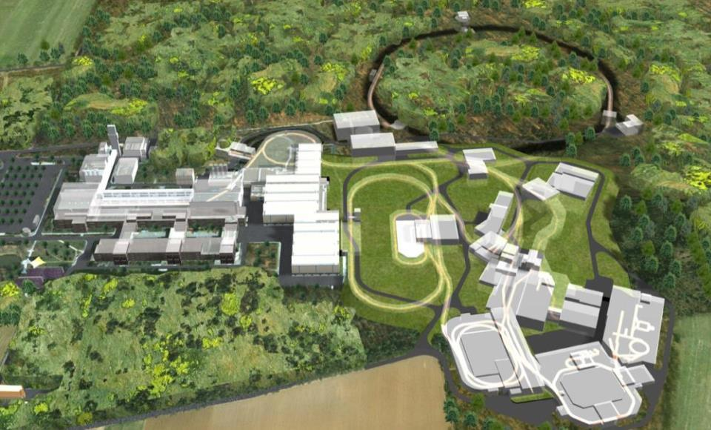
APPA Cave

Slide 3
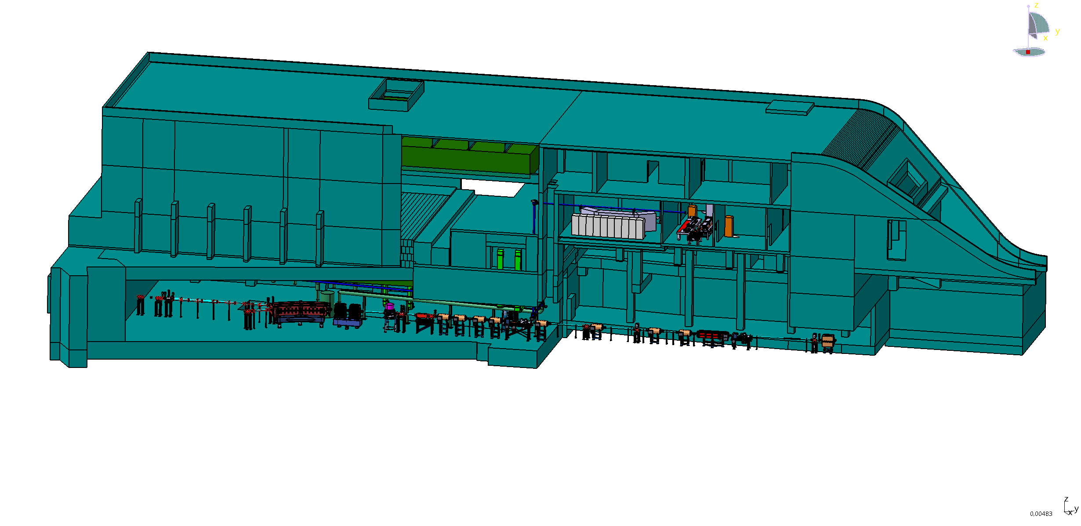
APPA facility
- 12 m
Experimental Hall ~ 50 x 23 m²
two beam lines with 5 target points
Auxiliary building and transfer beam line:
laboratories , testing rooms, control rooms, meeting rooms
General infrastructure: PS, media, IT, electronics for controls

Slide 4
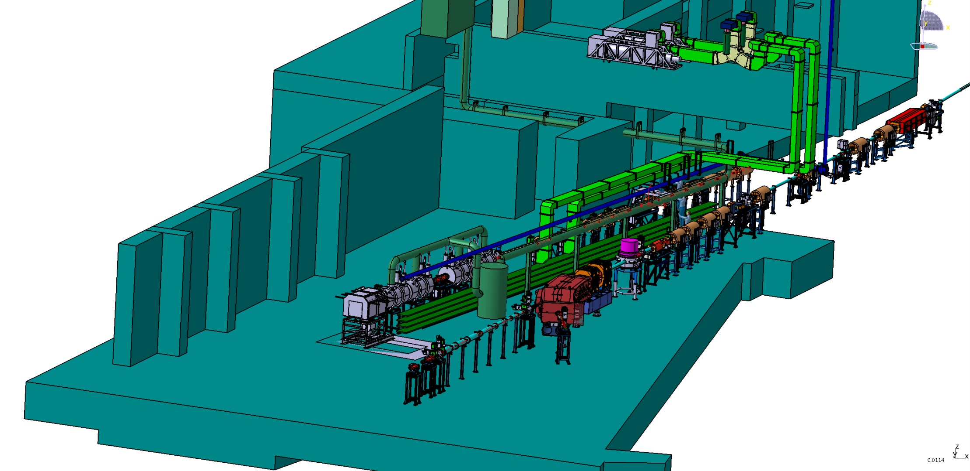
APPA Experimental Hall
HEDgeHOB
WDM
PRIOR
SPARC
BIOMAT

Slide 5
Summary of A. Braening-Deminan 1 year ago
✔
SPARC in APPA cave is well on the way
Support and contributions are welcome
Design completion
Preparation of the TDR
Costs evaluation
Particle detector R&D (synergy with CRYRING and FISIC,
M. Lestinsky and D. Vernhet)
Beam Dump design
Stripper Design
Funding
Civil construction (input)
ongoing
Beamtime 2016
Diamond detector tests
started
addressed to the acc. depart.

Slide 6
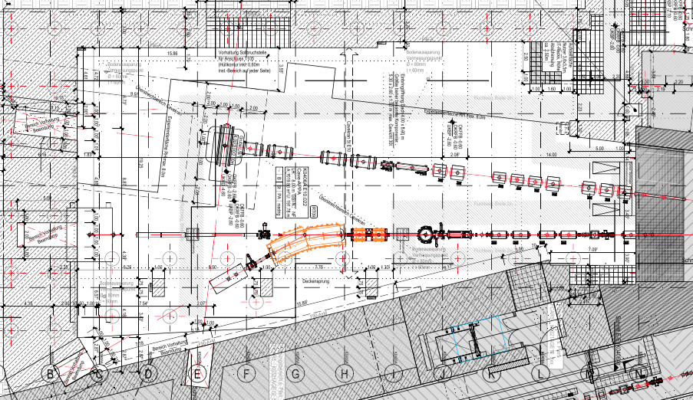
Cave and beam dumps

Slide 7

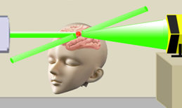
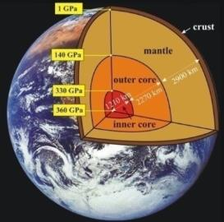
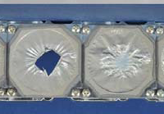
Biophysics
Materials Research
Space radiation biophysics
Gap in knowledge of biological effects of very high energetic ions Main hindrance toward manned space exploration
Particle therapy: “theranostics”
Use of high energetic proton beams for
simultaneous diagnostics and therapy
Materials behavior under extreme conditions
Irradiations under high pressure solids with new phases, unknown phase transitions in mineralogy and geophysics
Radiation hardness of accelerator and spacecraft components
Ion-matter interaction at relativistic beam energies
Notes:
replaced 'burned' epoxy with Kapton foils darkened by ion-beam induced graphitization

Slide 8
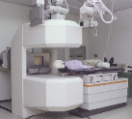
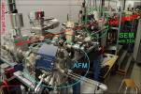

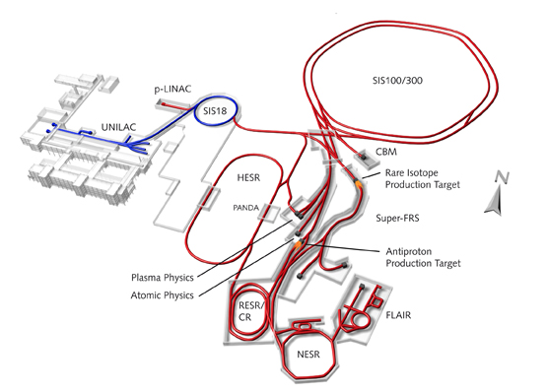

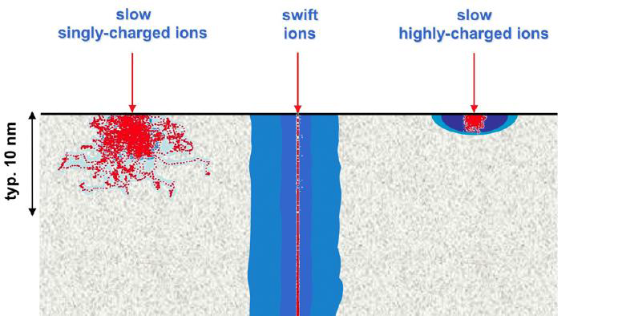
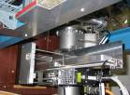
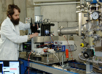


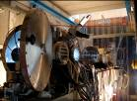
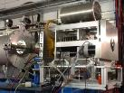




BIOMAT: a unique user facility
Cave M
Medical Cave
M-Branch
In-situ and On-line Analysis of Irradiated Material
Cryring
MAT target station
M1
Microscopy
M2
X-Ray Diffraction
M3
Multi-Analysing Chamber
Long-distance
Microscopy
IR Spectrometer
Sample
Curvature
Measurement
Ion Beam
Mass
Spectrometer
Gas Flow
Controller
University of Stuttgart
University of Duisburg Essen
Helmholzzentrum Berlin / GSI
Universities of Darmstadt, Dresden
Göttingen, Jena, Heidelberg
X0
Autosampler
X6
Cell irradiation
APPA Cave
High energy Cave
Microprobe
Single Ion Control
Cave A
Irradiation Cave
single ion
random
ordered
cells

Slide 9
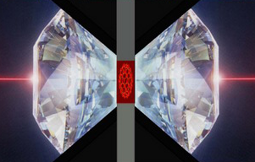


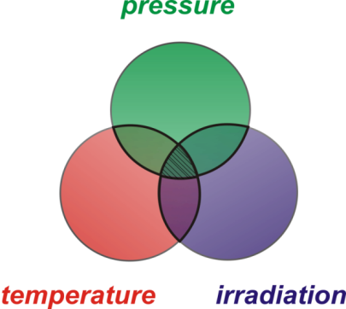
High-pressure experiments
2 mm
Raman signal
high energy
Au, Pb, U ions
diamond anvil cell
10-1000 kbar
x-ray diffraction
Extreme Environments
synthesis and stabilization of new materials
nanoscale manipulation of materials properties
recover exotic high-pressure phases
simulate radioactivity effects within Earth’s interior

Slide 10
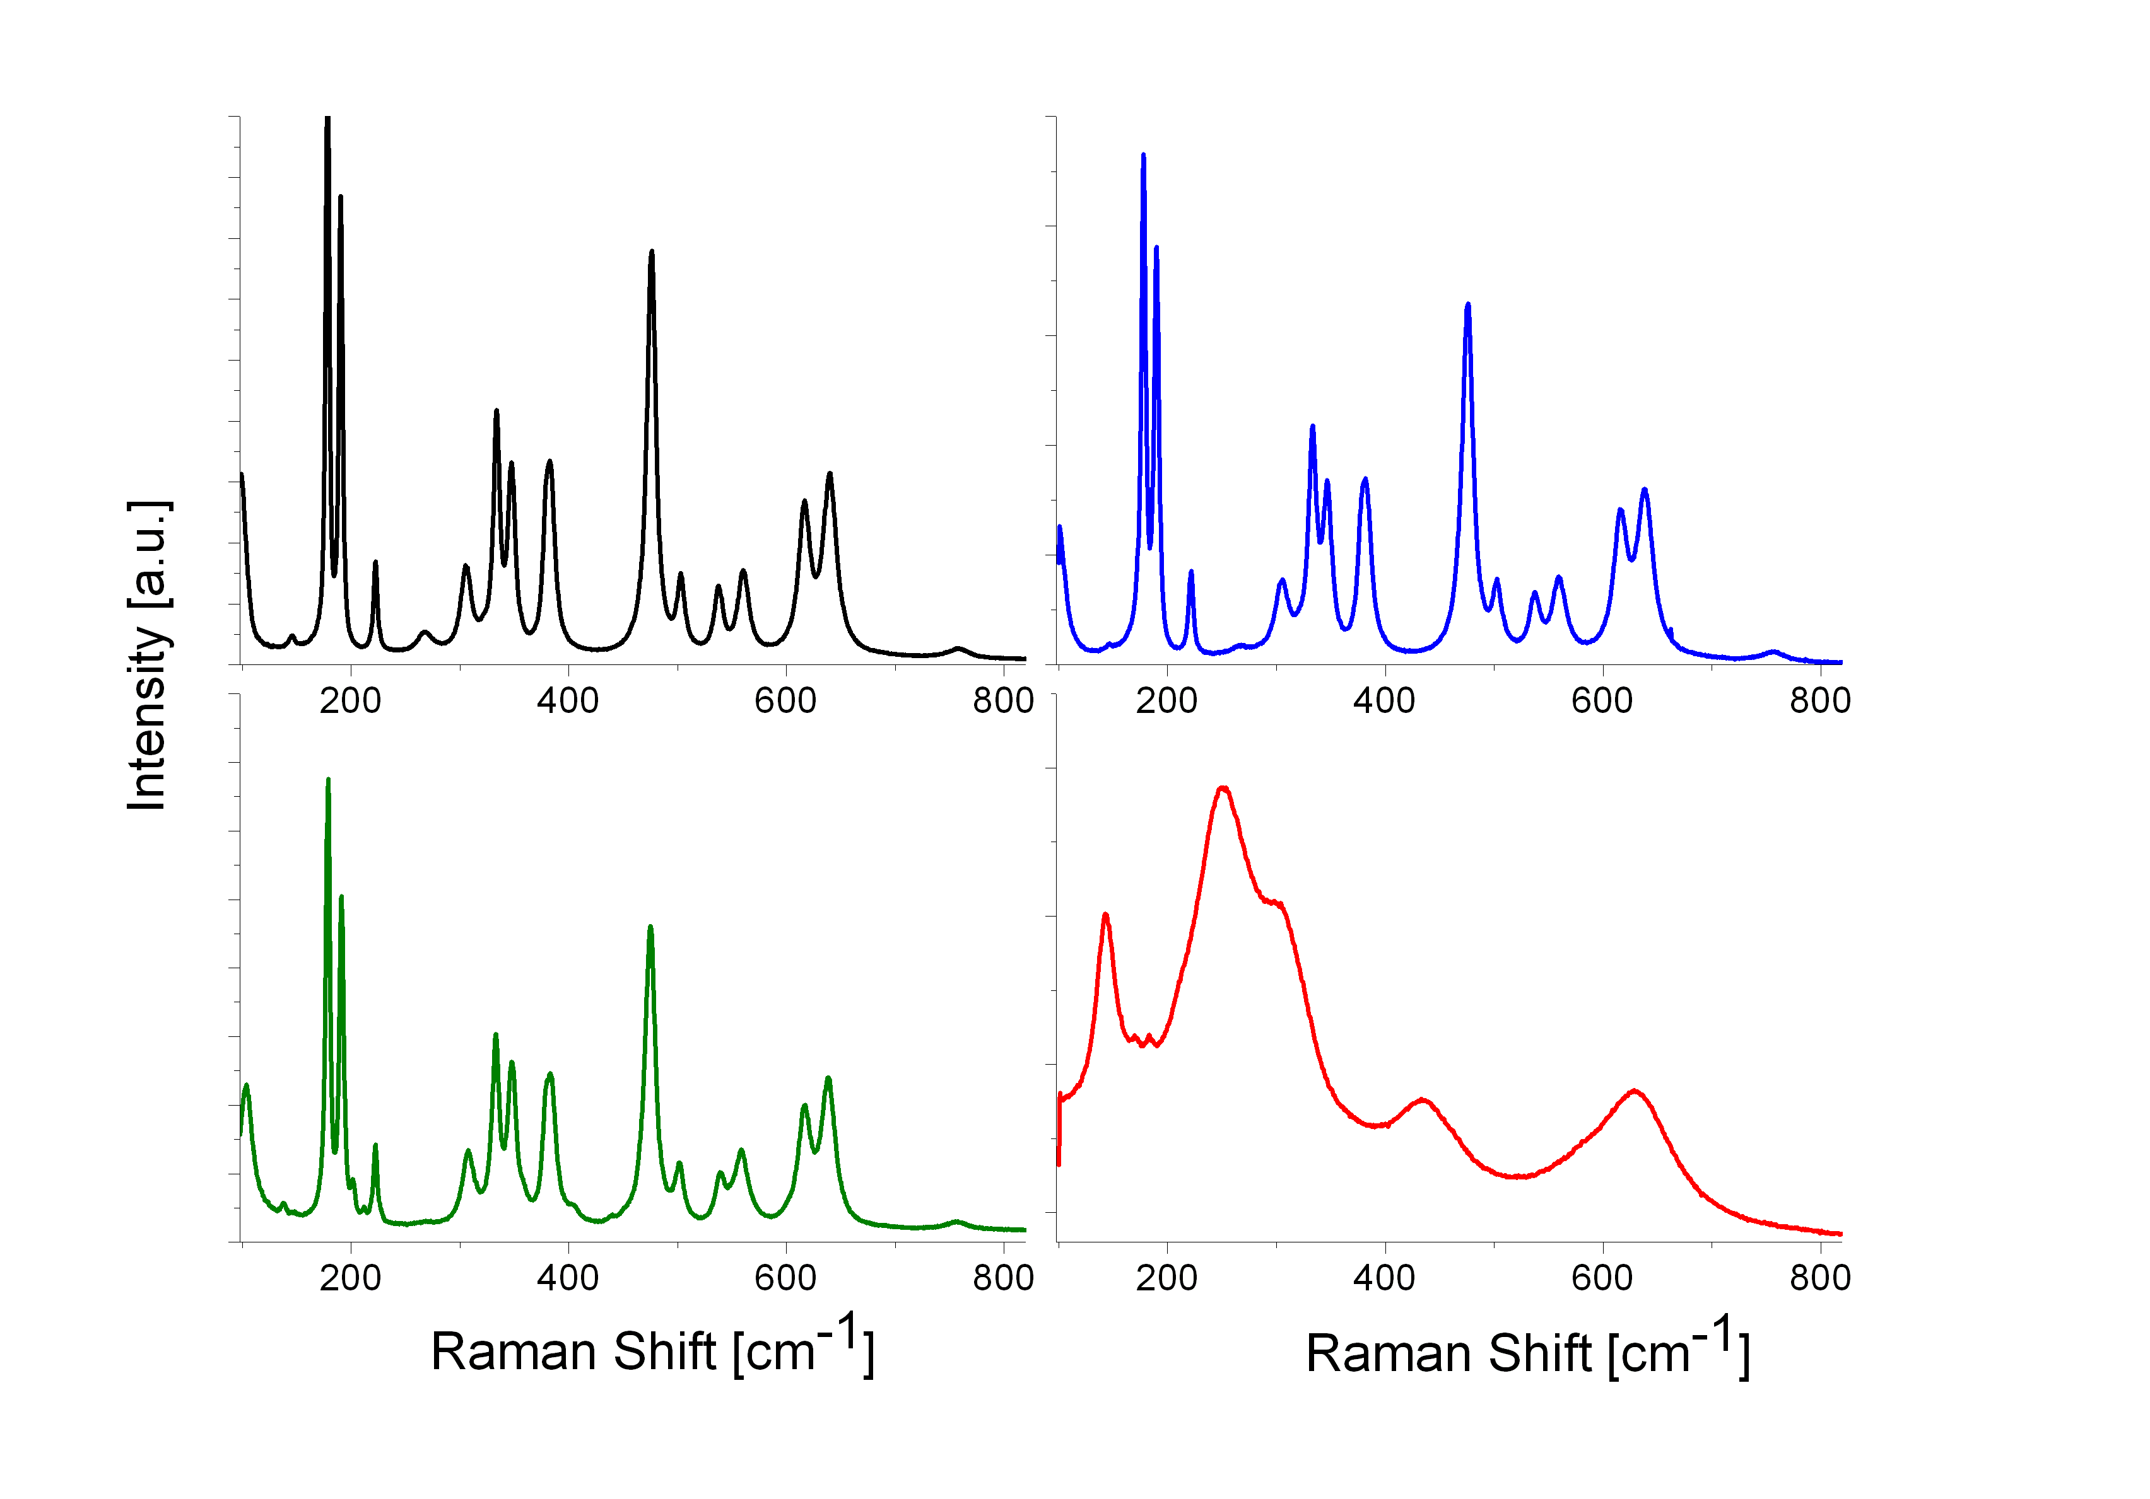
High-pressure experiments
irradiation
Zirconiumdioxid ZrO₂
1.5×10¹¹ U/cm²
monoklin
monoklin
P=11 Gpa
(relaxed after 2 weeks)
monoklin
1.5×10¹¹ U/cm²
P = 11 GPa
(relaxed after 2 weeks)
pressure
tetragonal

Slide 11
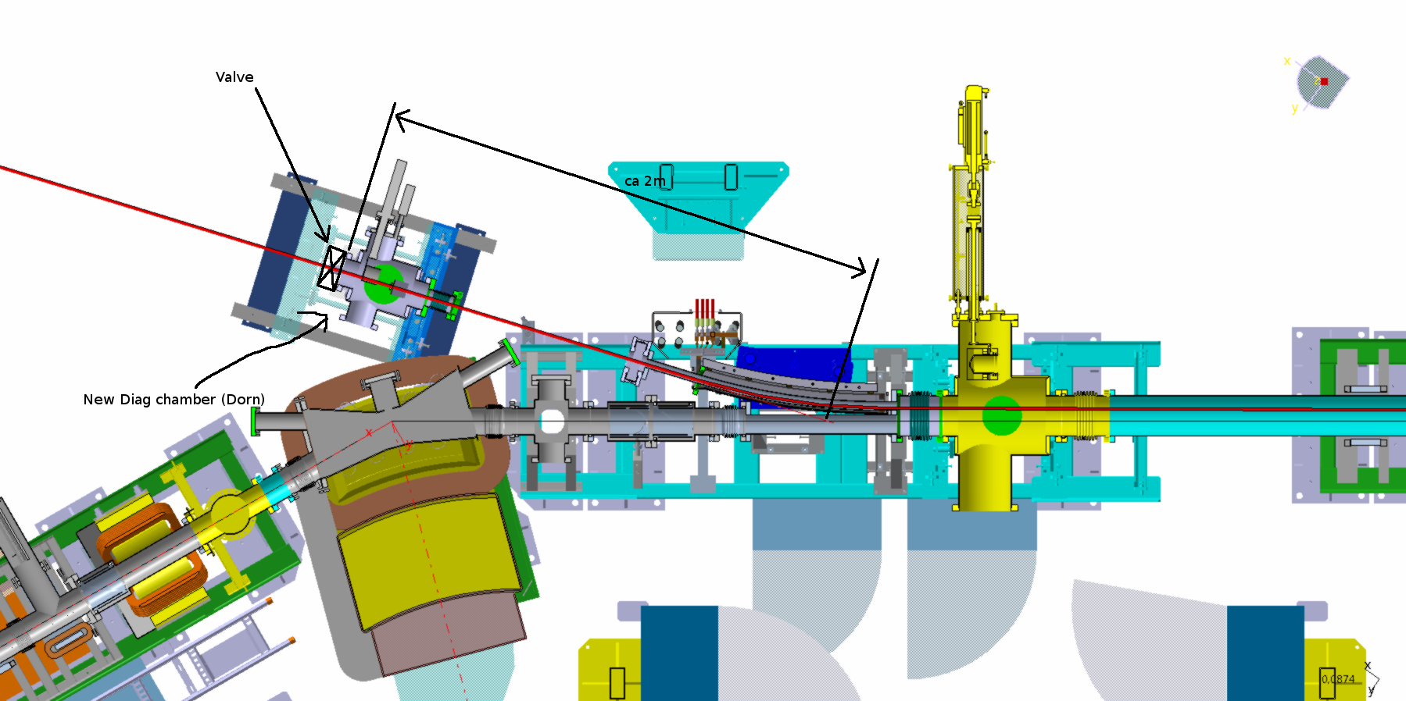
MAT at CRYRING
Topics:
surface desorption
sputtering processes
luminescence
MAT Setup:
setup for extracted beams
flexible configuration
demanding UHV conditions
Instrumentation:
beam line equipment
irradiation chamber
in-situ analysis
Funding:
Verbundforschung (2016-2019)

Slide 12
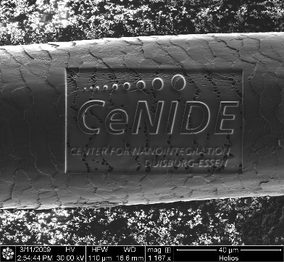
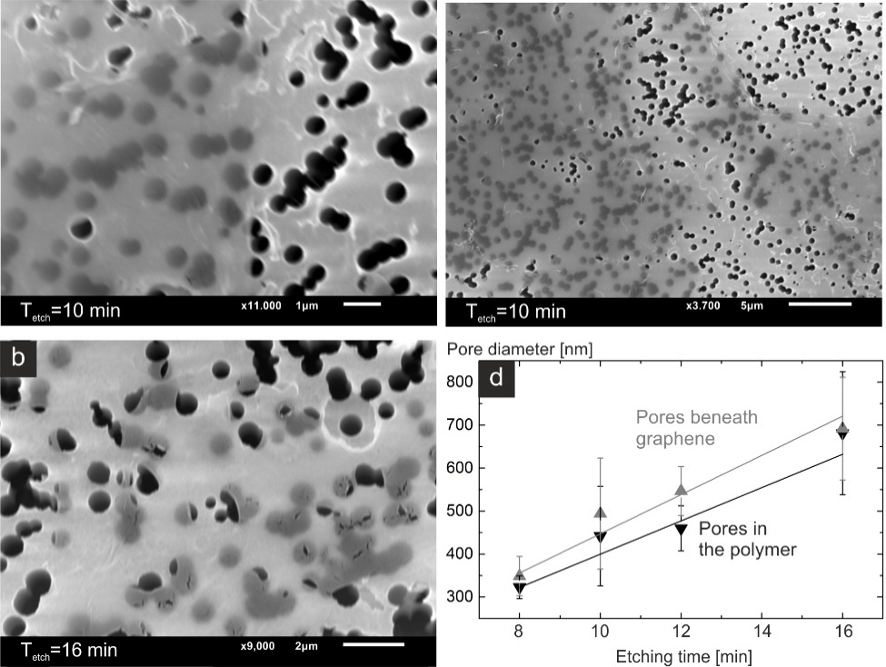
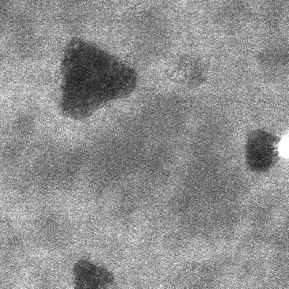
Irradiation Effects in Solids
keV MeV keV & q
Collisions Ionization Collisions & Ionization
Graphene
PET
MoS₂
5 nm
Tona et al., Phys. Rev. B 77 (2008) 155427
Notes:
Damit kann man die gezeigten Modifikationen wie folgt zuordnen …

Slide 13
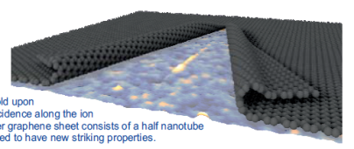
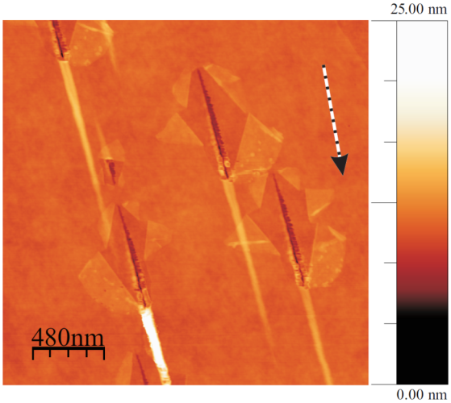
Modifying graphene with heavy ions
749 MeV Pb, θ = 2°
Formation of closed bilayer edge graphene structure
Ion irradiation under
glancing incidence (θ = 2°)
single graphene layer
on PMMA
University of Duisburg-Essen, Prof. M. Schleberger
Notes:
The group of Marika Schleberger uses this in-situ AFM facility to investigate the morphological modification of thin films, and in particular of graphene layers under swift heavy ion irradiation. They found out that that wehn irradiated under gracing incidence with heavy ions, the graphene folds along the ion trajectory creating a closed bilayer edge structure. On this picture they show a graphene layer placed on PMMA, that has been irradiated with Pb ions, 750 MeV under a small 2 degrees angle. The image visualies the graphene zipped structures.
The folding efficiency of SLG is typically around 100%. This can be used to test for successful irradiation.
It is thought that the ion creates a line of defects in the graphene sheet by direct damage due to electronic excitation.
Material from the substrate and/or the interfacial layer between the graphene layer and the substrate is ejected.

Slide 14
Modifying graphene with heavy ions
749 MeV Pb, θ = 2°
SHI induced morphology changes on supported and free-standing graphene layers
SiO₂
Nano-riffle
Closed bilayer edge structure
University of Duisburg-Essen, Prof. M. Schleberger
Notes:
To check this, they performed another experiment irradiating a SGL previously tranferred onto a pre-structured Si substrate. In the circle parts (in blue) the SGL is suspended, while on the rest (orange) the SGL is lying on the Si substrate. The tracks on the supported SGL display the same morphology as the tracks on the previous example, altrhough much smaller (question: with smaller you mean shorter?). In the freestanding area, nano-rifts are observed.
The formation of CBE is thus attributed to the ejection of material of the underlying support, while in suspended graphene only the linear riffles are observed.
By irradiating samples with various ion energies, they determined experimentally that the threshold for defect creation directly by the SHI projectile is around
S =5 keV/nm

Slide 15
Summary
Status APPA Cave
  We are on track
  Next tasks:
    TDR SPARC+BIOMAT beamline
    Beam dumps design
BIOMAT
  Unique user facility
  Example of MAT experiments:
    High pressure cells
    Cryring

Slide 16
Thanks for your attention and special thanks to Angela, Radek, Stephan and Abel

Slide 17
End

Slide 18
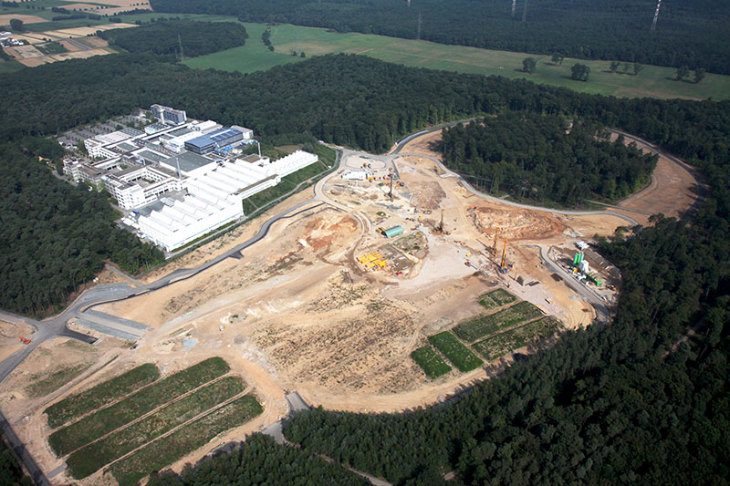
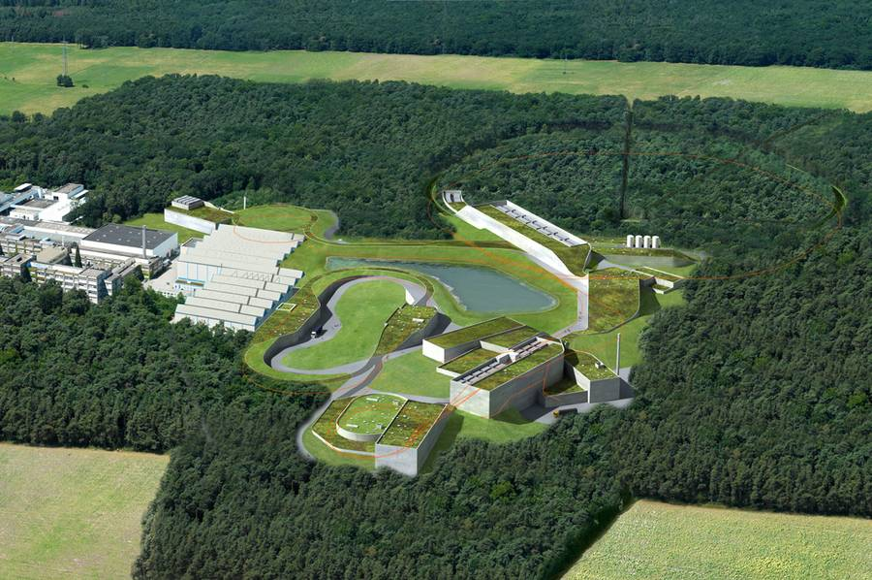
Next Steps

Slide 19
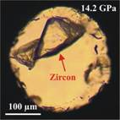
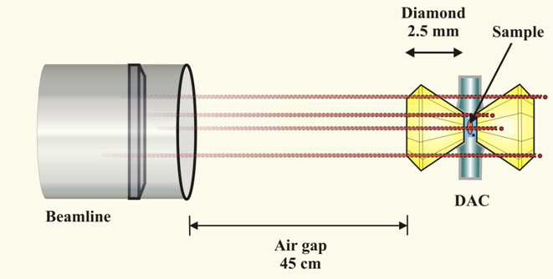
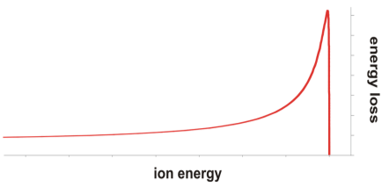
Irradiation of material under extreme pressure

