Slide 1


Multiple Electron Removal from H₂O by light ion impact
Wania Wolff
Instituto de Física
Universidade Federal do Rio de Janeiro

Slide 2
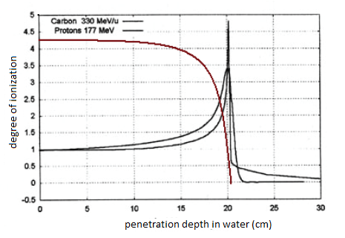
MOTIVATION radiation physics
The irradiation of tumors by high-energy protons and carbon ions - “standard” treatment in cancer therapy
In hadron-therapy treatments, heavier atomic ions, like carbon ions, have show advantages over protons. They provided a more defined and higher local dose deposition. They allow a better control in irradiation of tumors and a lower or late toxicity.
Ion-beam therapy strongly relies on a detailed characterization of the damage caused by energetic ion impact on H₂O

Slide 3
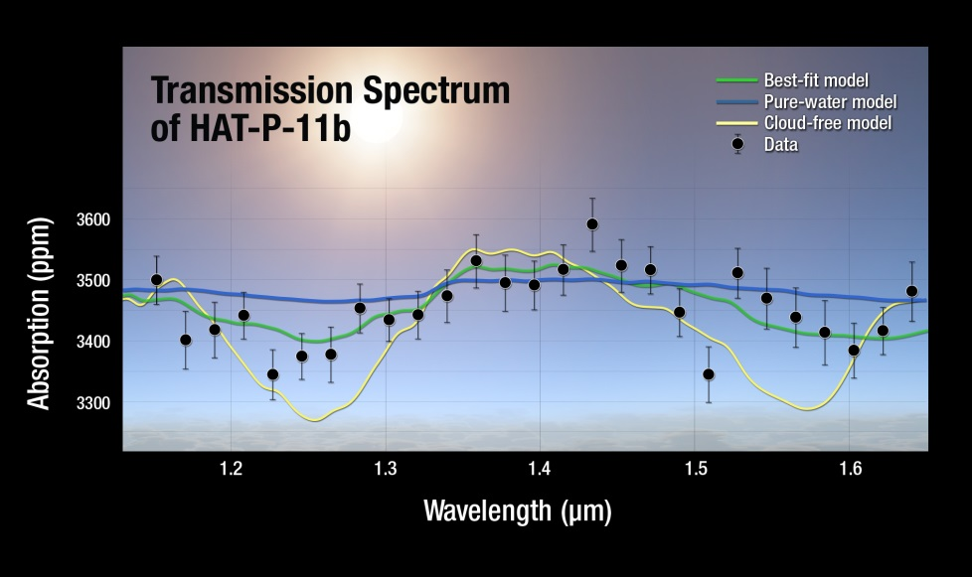
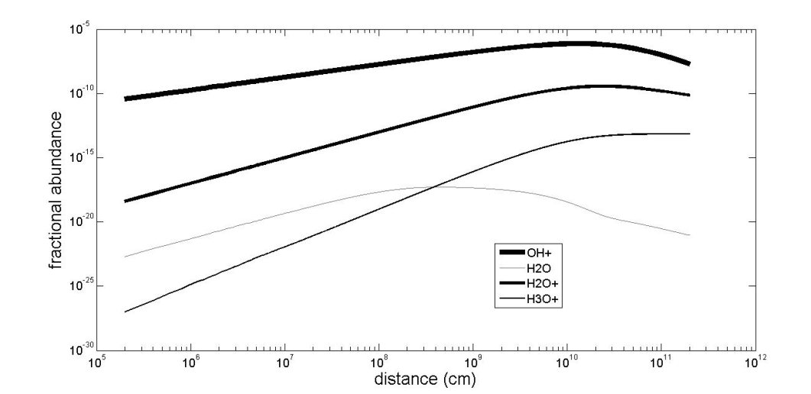
MOTIVATION astrochemistry
In search of earth like planets EXOplanets/EXOmoons and mass expelled from planets, NASA telescopes found water vapour in 2015. Water molecules are subjected to cosmic rays, winds and stars ionizing radiation.
Molecular formation along the atmospheric mass loss of HD 20945
Transmission spectrum for exoplanet HAT-P-11b collected by NASA's Kepler, Hubble and Spitzer observatories. The results show a strong detection of water absorption . NASA/ESA/STSc
Fractional abundance profiles (relative to H ) of water species. Peak fractional abundance for H₂O⁺ reaches 10 ⁻¹⁰ and the ion OH+ reaches a remarkable peak value of 10⁻⁷

Slide 4
Previous work
There are studies concerning the influence of the velocity and charge state of the projectile on the dissociation of water with light and heavy ion at keV and tens MeV energies,

Slide 5
Previous work
Missing link
There are studies concerning the influence of the velocity and charge state of the projectile on the dissociation of water with light and heavy ion at keV and tens MeV energies,
Detailed knowledge of features of the dissociation pattern leading to the formation of multiply charged water fragments in the intermediate energy range remains scarce.

Slide 6
Previous work
Missing link
Present work
There are studies concerning the influence of the velocity and charge state of the projectile on the dissociation of water with light and heavy ion at keV and only a few at Me V/u energies.
Detailed knowledge of features of the dissociation pattern leading to the formation of multiply charged water fragments in the intermediate energy range remains scarce.
Study performed at 2 laboratories almost at the same time
Bare ions, H⁺ and Li^{3+,} were used as a benchmark in the comparison with other dressed ions, as Li⁰⁻²⁺ , C¹⁻²⁺ to study the role of projectile screening in molecular dissociation.
projectile energy varied in the range 200-900 keV/u
FOCUS:
Energy and time-of-flight distributions of water ionic fragments.
Absolute cross section for n- electron removal measured for pure ionization and electron capture. Combined results allowed a qualitative as well as quantitative interpretation of the data

Slide 7
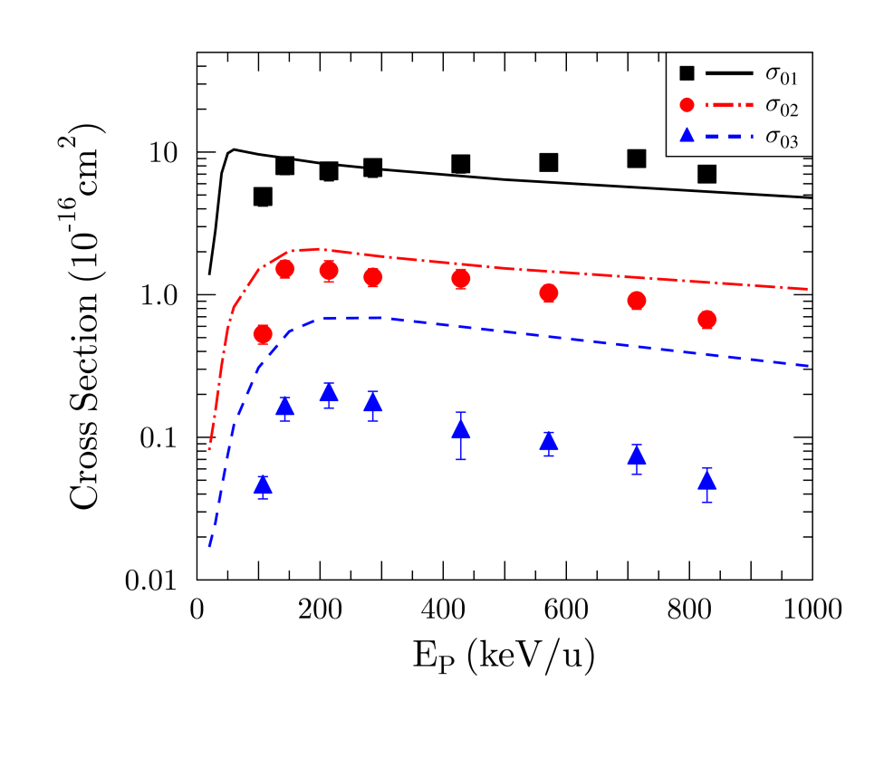
exp. absolute partial cross sections + TC-BGM calculation
pure ionization
with removal of 1, 2 and 3 electrons
Cross sections for higher degrees of ionization are overestimated by the calculations, which points to limitations of the calculation

Slide 8
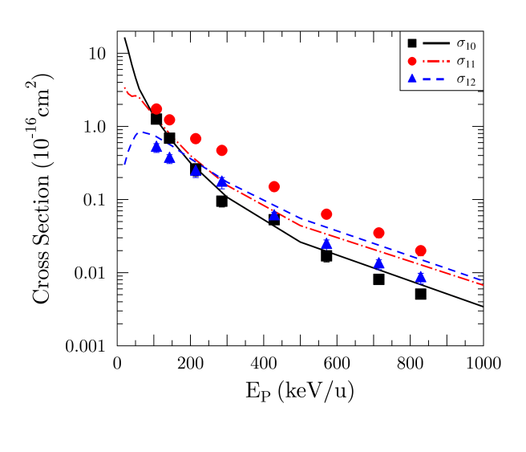
exp. absolute partial cross sections + TC-BGM calculation
pure ionization
single electron capture
with removal of 1, 2 and 3 electrons
Inclusion of the Auger effect improves the agreement for the capture channels σ₁₀, , unexplained factor of 2–3 discrepancies observed for the transfer-ionization channel σ₁

Slide 9
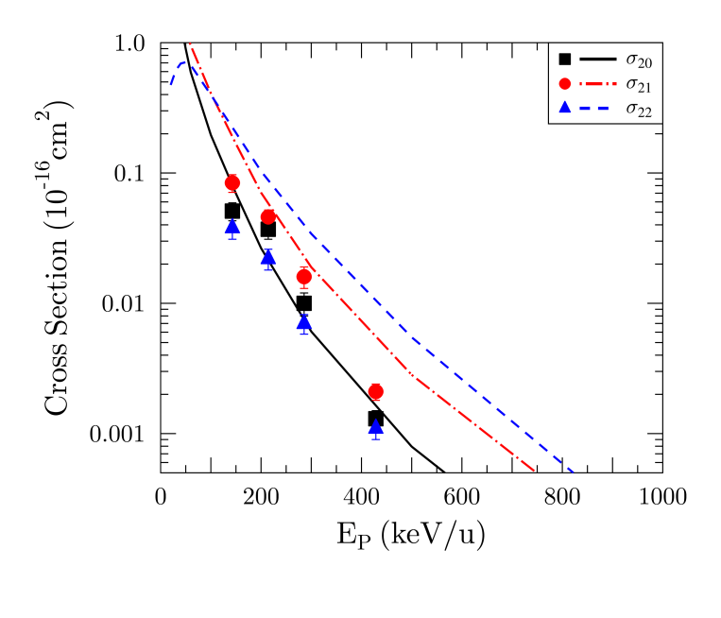
exp. absolute partial cross sections + TC-BGM calculation
pure ionization
single and double electron capture
with removal of 1, 2 and 3 electrons
* TC-TGM without/with Auger inclusion

Slide 10
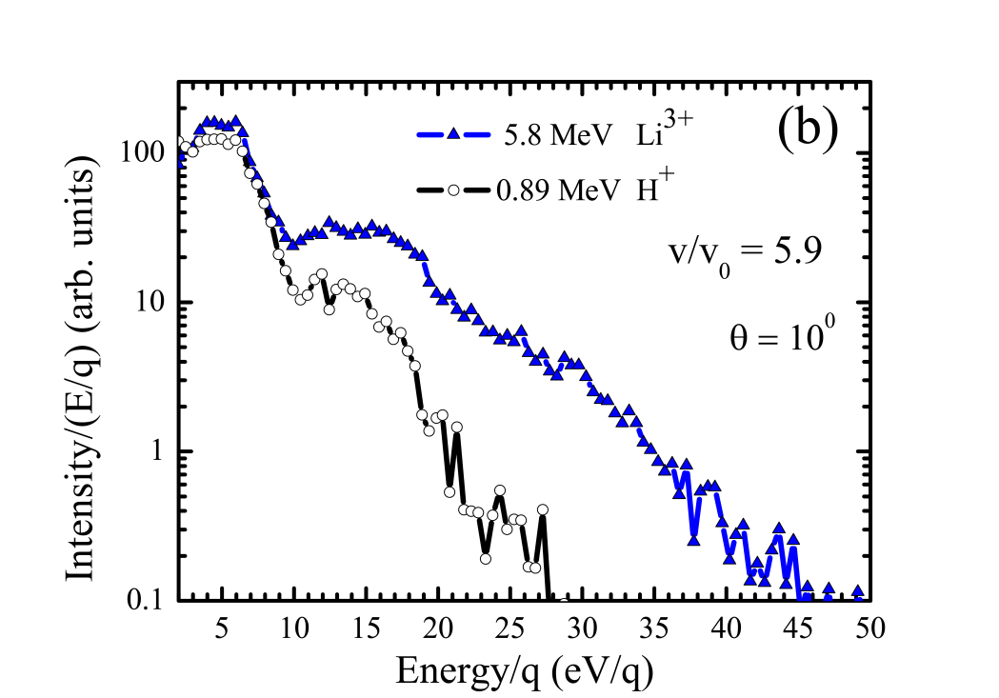
systematic investigation fragment-ion energy distributions
Atomic species
Proton and bare lithium ion
H⁺ energy distributions
the hydrogen ions acquire a broad range of energies from eV to tens of eV with abundances varying by orders of magnitude.

Slide 11
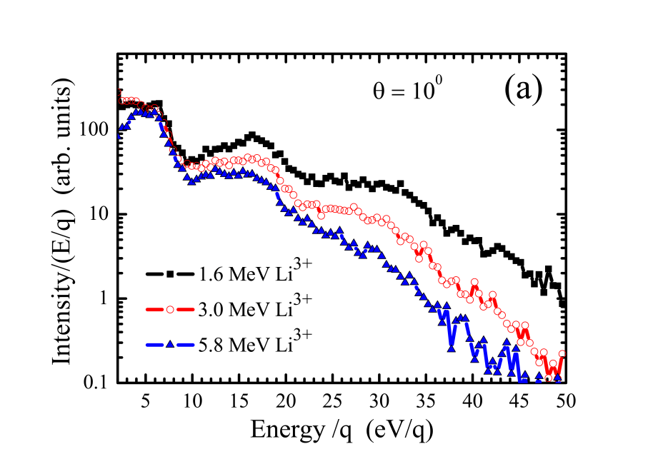
systematic investigation fragment-ion energy distributions
Atomic species
Proton and bare lithium ion
Incident energy of
bare lithium projectiles
H⁺ energy distributions
the hydrogen ions acquire a broad range of energies from eV to tens of eV with abundances varying by orders of magnitude.

Slide 12
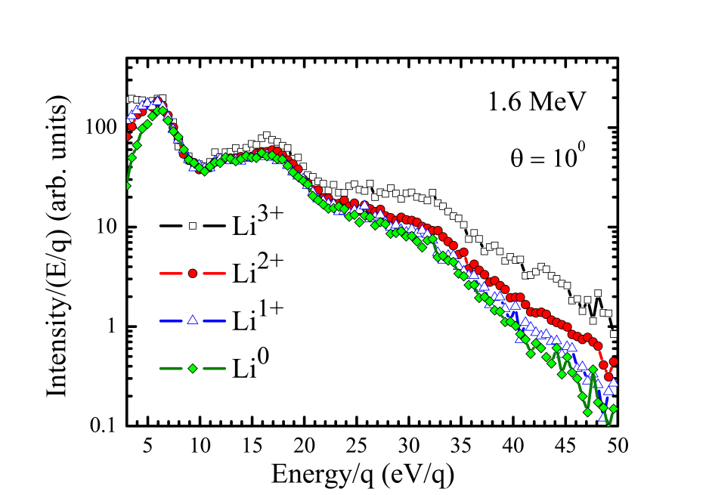
systematic investigation fragment-ion energy distributions
Atomic species
Proton and bare lithium ion
Incident energy of
bare lithium projectiles
Charge state of
lithium projectiles
from neutral to bare
H⁺ energy distributions
the hydrogen ions acquire a broad range of energies from eV to tens of eV with abundances varying by orders of magnitude.

Slide 13
Qualitative interpretation
fragment-ion energy distributions
Incident energy of bare lithium projectiles
2
3
4
energetic H⁺ ions

Slide 14
Qualitative interpretation
fragment-ion energy distributions
+
absolute partial cross section
Incident energy of bare lithium projectiles
2
3
4
energetic H⁺ ions

Slide 15
Qualitative interpretation
fragment-ion energy distributions
+
absolute partial cross section
Incident energy of bare lithium projectiles
2
3
4
energetic H⁺ ions
double electron removal channels of electron capture competes with pure ionization.
Same behaviour applies to triple electron removal channels

Slide 16
fragment-ion energy distributions
+
absolute partial cross sections
electron capture and transfer processes - disregarded
contribution pure single, double and triple ionization
.

Slide 17
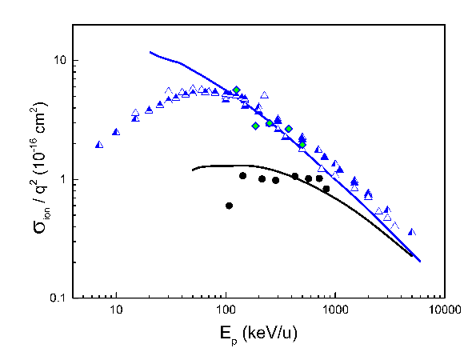
fragment-ion energy distributions
+
absolute partial cross sections
electron capture and transfer processes - disregarded
contribution pure single, double and triple ionization
q² - scaling rule applies at this velocity.
Black and blue symbols and lines applies to Li ³⁺ and H ⁻

Slide 18
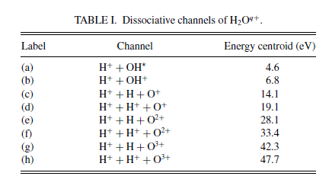
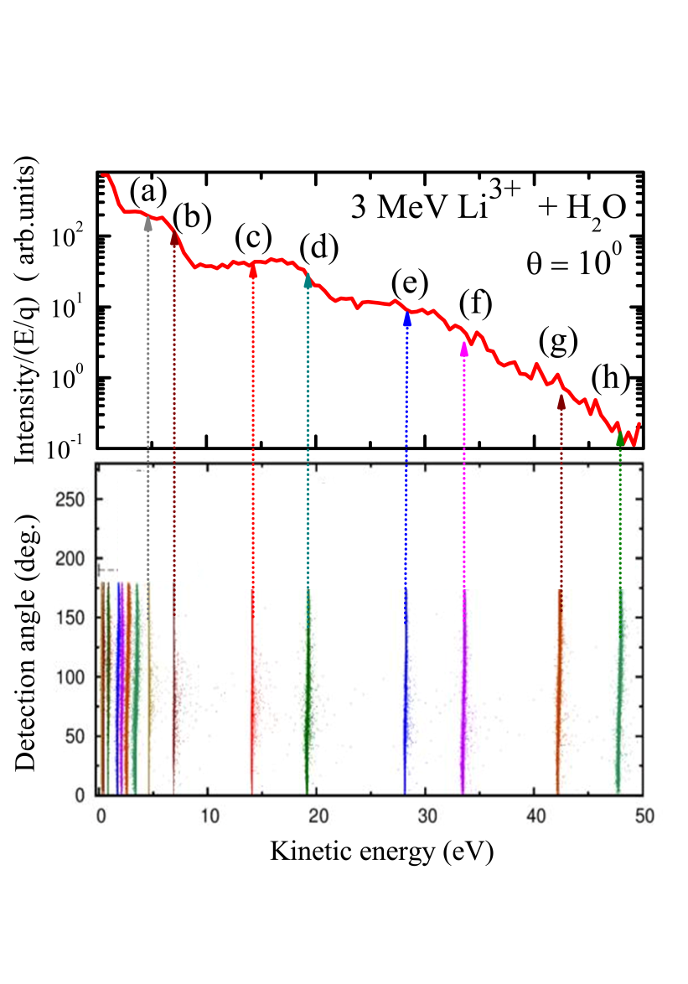
Quantitative interpretation
CE-CTMC model + fragment-ion channels
Calculations were used to link the measured fragment-ion energy distributions to final dissociative states of water
O^{q+} ions
H⁺ ions

Slide 19
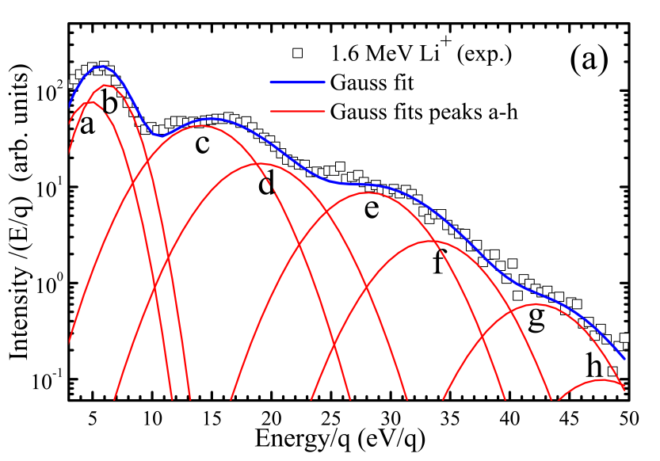
Quantitative interpretation
CE-CTMC model + fragment-ion channels
Calculations were used to link the measured fragment-ion energy distributions to final dissociative states of water
guide
O^{q+} ions
H⁺ ions

Slide 20
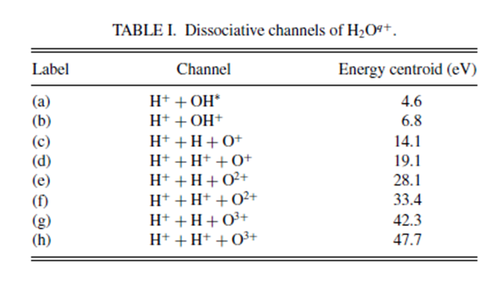
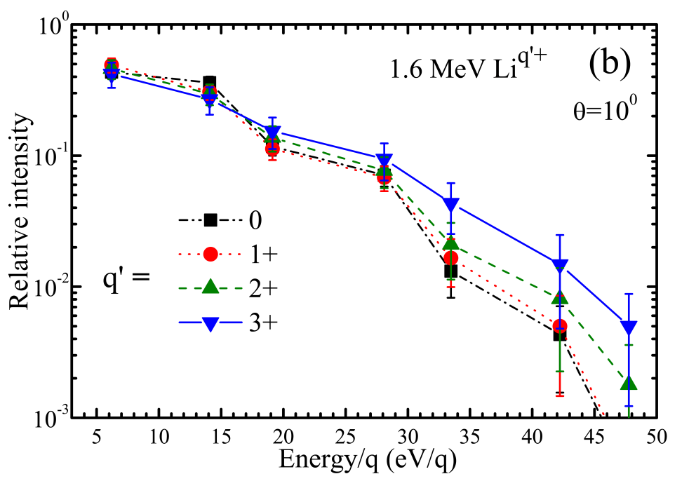
charge state of transient molecule yield (q-electron removal)
or
fragmentation channel yield
It is important to correlate the charge state of the transient water molecule H₂O^{q+} prior to dissociation – q-multiple electron removal with the fragmentation channels – with the ejected ion atomic species H⁰ , H⁺ and O^{q+}
(b+c)
(d+e)
(f+g)
(h)
q- electron removal
1
2
2
3
3
4
4
5
2
3
4

Slide 21
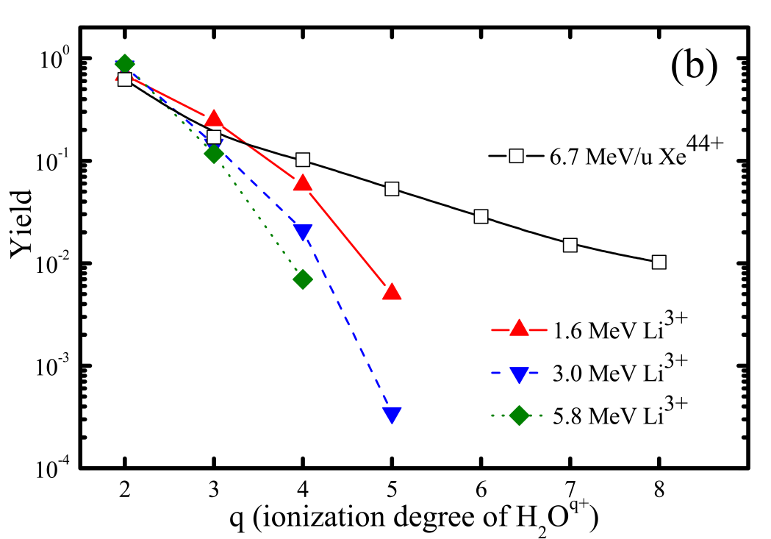
q-electron removal yield of bare lithium ions - Li³⁺
steep decrease of yields
order of magnitude
as function of the q-removal of electrons

Slide 22

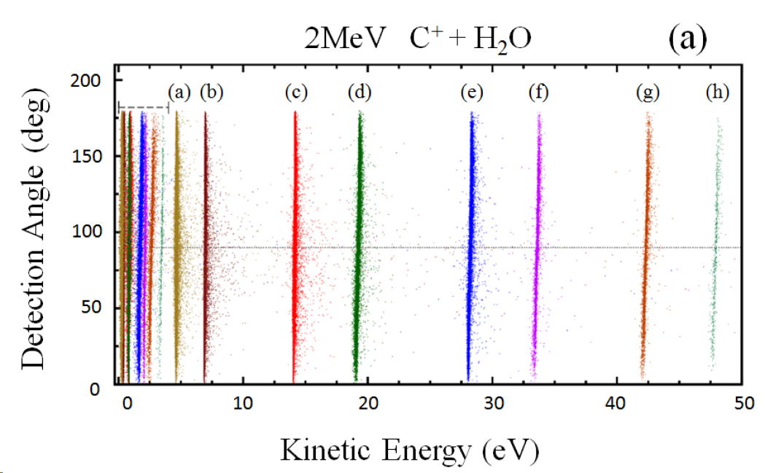
Model

Slide 23
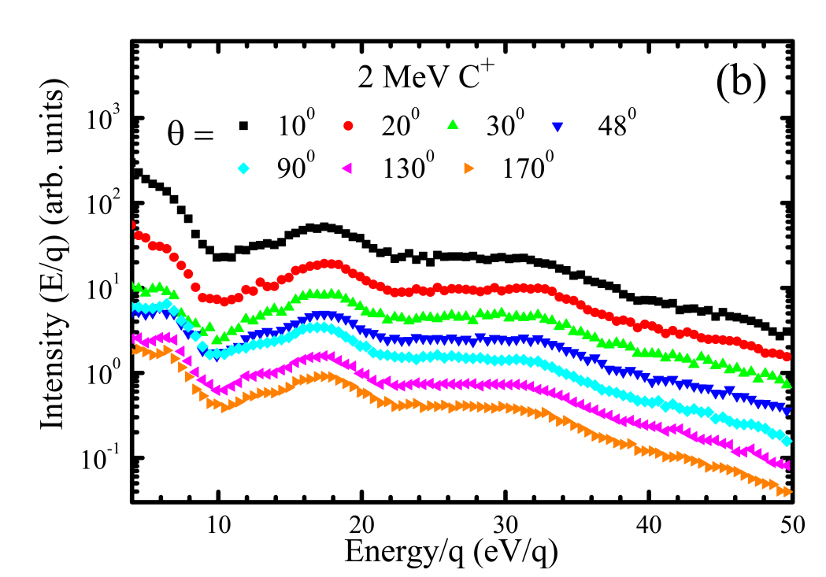
Model
Experiment
isotropic angular dependence
good agreement

Slide 24
O^{q+} ions
overcome limited information on low energy part of energy distributions, = O ^{q+} ions
relative contribution of q charge states
of target oxygen atoms of H₂O

Slide 25
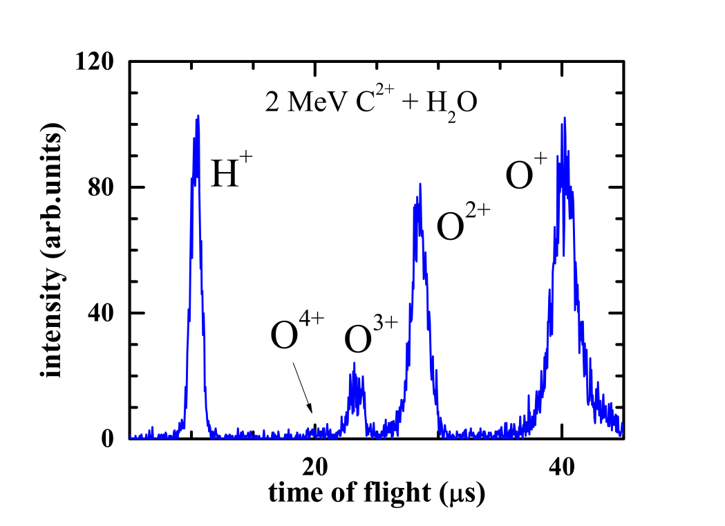
O ^{q+} ions
Time of Flight Mass Spectrometry
overcome limited information on low energy part of energy distributions, O ^{q+} ions
relative contribution of q charge states
of the oxygen atoms of the H₂O
fragment- ions with energy per charge E=3eV/q – 10eV/q at 10 degree

Slide 26
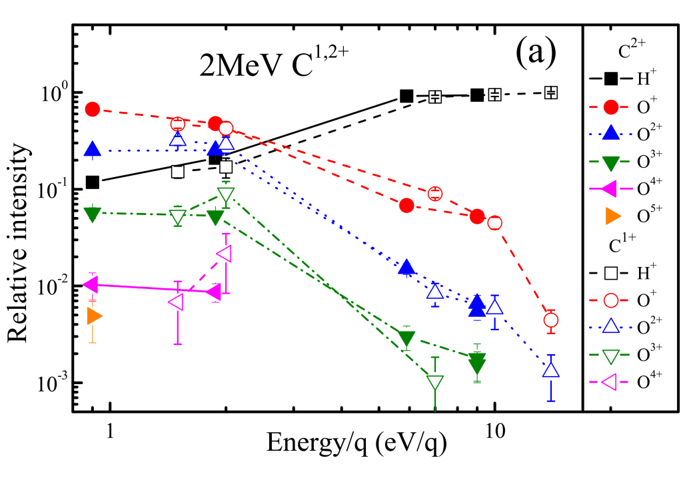
multiple charged oxygen fragments – O ^{q+}
induced by C^{1,2+} impact
fragment-oxygen ions with fixed E/q
relative intensities quite similar
screened projectiles with charges 1+ and 2+ do not have major influence on the energy transferred to the O^{q+} ions
relative intensities of fragment ion formation normalized to the sum of all charged ions differential to selected kinetic energy of the ions in eV per charge

Slide 27
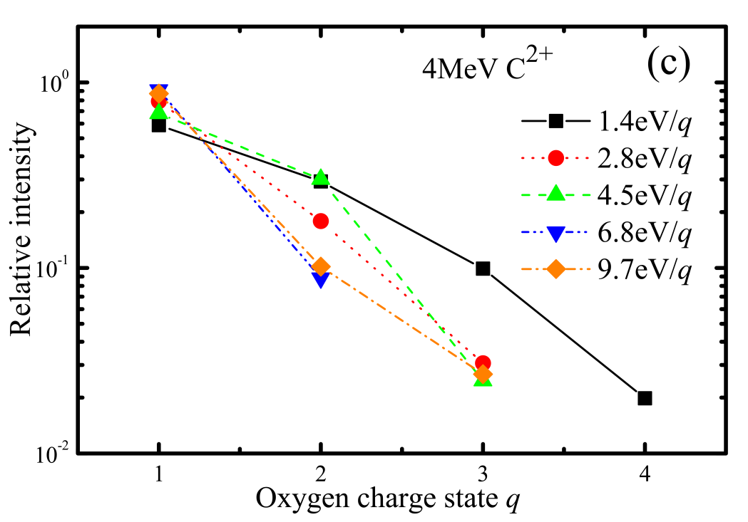
multiple charged oxygen fragment-ions
Production of O^{q+} ions
main production
at all energies (1.4 to 9.7 eV/q)
singly charged oxygen ions
E/q
q-state
intensity

Slide 28
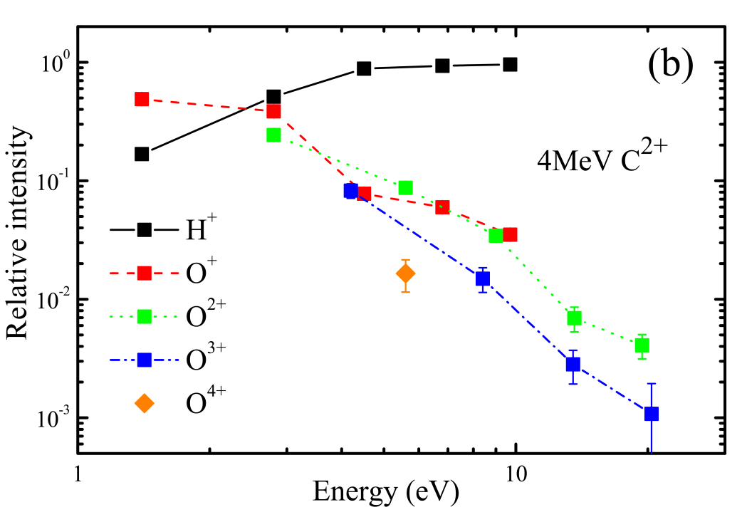
multiple charged oxygen fragment-ions
Production of O^{q+} ions
Energy of O^{q+} ions
Detection of small amounts of highly energetic oxygen ions
main production
at all energies (1.4 to 9.7 eV/q)
singly charged oxygen ions
E/q
q-state
intensity

Slide 29
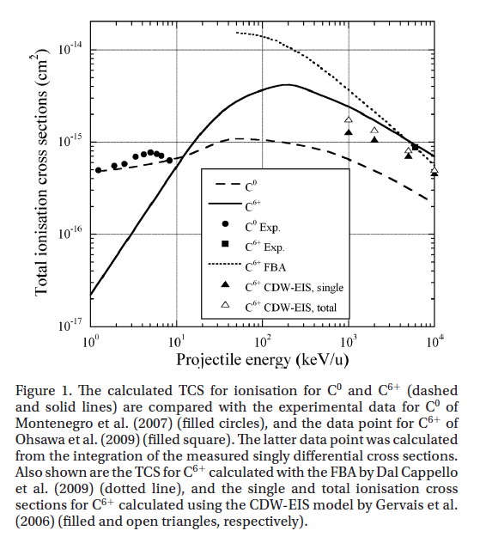
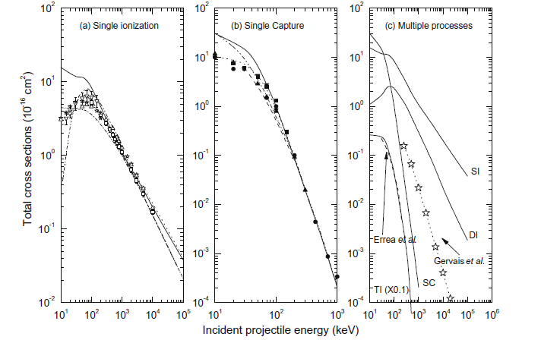
Cross sections for bare and dressed carbon ions in water and neon at 6 MeV/u
T. Liamsuwan et al , Phys. Med. Biol. 58 (2013) 641–672, Int. J. of Rad. Biol. 2012; 88(1–2): 45–49
Total cross sections for ionizing processes induced by proton impact on molecules of biological interest: A classical trajectory Monte Carlo approach, H. Lekadir, et al, NIM B 267 (2009) 1011–1014
Investigation at high energies

Slide 30
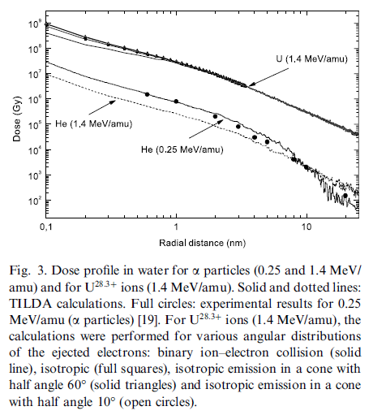
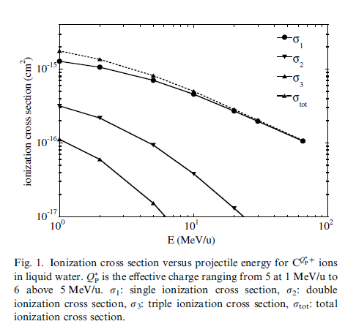
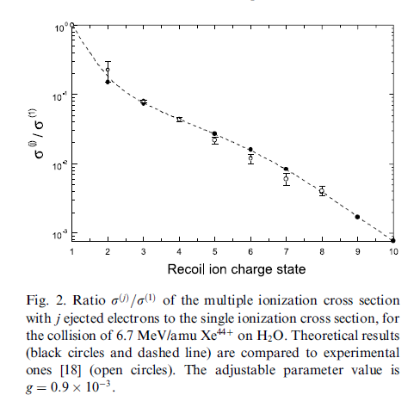
Investigation at high energies with highly charged states
Monte Carlo simulation of the role of multiple ionization in the production of
H₂O and O₂ for swift carbon ions from 1 to 65 MeV/u (ionization based on IEM model + Q average of capture and loss channels)
B. Gervais et al, Chem. Phys. Lett.410 (2005) 330–334, B. Gervais et al. / Rad. Phys. and Chem. 75 (2006) 493–513
Multiple ionization in the earlier stages of water radiolysis
G H Olivera et al, Phys. Med. Biol. 43 (1998) 2347–2360 at 6:7 MeV/u Xe44+ ions.
Multiple ionization of water by heavy ions: a Monte Carlo approach
C. Champion, NIM B 205 (2003) 671–676

Slide 31
Recent data on analogues DNA molecules
Differences in fragmentation pattern proton and C³⁺ collision on pyrimidine proton impact production of molecular species m=26 and 53 dressed carbon ion impact atomization process double ionization
m=26
C₂ H_{n}/ CNH
m=53
CH_{n}
CH_{n}
M=12
C₂ H_{n}/ CNH

Slide 32
Future investigation
Detailed knowledge absolute cross section values and of features of the dissociation pattern leading to the formation of multiply charged water fragments at
very high and
highly charged ions remains scarce
Only few systems measured at high MeV/u energies with H, C, and Xe ions on water and biological molecules
Absolute ionization and electron loss sections with removal of q-electrons removal of the water molecule need to be measured!

Slide 33






Collaborators
Instituto de Física, Universidade Federal de Río de Janeiro (IF-UFRJ), Brazil
H Luna and Eduardo C. Montenegro
Department of Physics, Stockholm University, Alba Nova University Center, Stockholm, Sweden
R Schuch
IFISUR, CONICET, Dpto de Física, Universidad Nacional del Sur, Bahía Blanca, Argentina
N D Cariatore and S Otranto
Centro Atómico Bariloche, CONICET, S. C. de Bariloche, Río Negro, Argentina
D Fregenal, G Bernardi and S Suárez
Institut für Theoretische Physik, Goethe-Universität, Frankfurt, Germany
T. Pausz , M. Murakami, H. J. Lüdde, M. Horbatsch
Department of Physics and Astronomy, York University, Toronto, Ontario, Canada
T. Kirchner

Slide 34
CONCLUSION experiments vs. theories
Pure-ionization and single- and double-capture cross sections were measured for Li³⁺ impact on H₂O molecules in the energy range from 0.75 to 5.8 MeV. The results were compared to TC-BGM IEM calculations coupled with Auger-electron emission
The results show good overall agreement between theory and experiment for the total single capture and for pure single and double ionization.
Cross sections for higher degrees of ionization are typically overestimated by the calculations, which points to limitations of the calculation
Inclusion of the Auger effect improves the agreement with experimental data, notably for the capture channels σ₁₀, σ₂₀, σ₂₁. But unexplained factor of 2–3 discrepancies were observed for the transfer-ionization channel σ_{11.}

Slide 35
CONCLUSION experiments vs. theories
Pure-ionization and single- and double-capture cross sections were measured for Li³⁺ impact on H₂O molecules in the energy range from 0.75 to 5.8 MeV. The results were compared to TC-BGM IEM calculations coupled with Auger-electron emission
The results show good overall agreement between theory and experiment for the total single capture and for pure single and double ionization.
Cross sections for higher degrees of ionization are typically overestimated by the calculations, which points to limitations of the calculation
Inclusion of the Auger effect improves the agreement with experimental data, notably for the capture channels σ₁₀, σ₂₀, σ₂₁. But unexplained factor of 2–3 discrepancies were observed for the transfer-ionization channel σ_{11.}
With the aid of CE-CTMC calculation the high-energy H⁺ fragments were correlated with the fragmentation channels involving multiple target ionization.
The calculations predict that, ionization processes arise from collisions involving small impact parameters (b < 2 a.u.). Such close collisions lead to multiple ionization, which can be directly related to the O^{q+} production.

Slide 36
CONCLUSION - Experiments
FRAGMENT-ION and TIME-OF-FLIGHT DISTRIBUTIONS
+ CROSS SECTIONS
A systematic experimental and theoretical study is presented for the energy, angular distribution, and time-of-flight of fragment ions from H₂O dissociation produced in collisions with proton, lithium atom, lithium and carbon ions at the intermediate-energy range.

Slide 37
CONCLUSION - Experiments
FRAGMENT-ION and TIME-OF-FLIGHT DISTRIBUTIONS
+ CROSS SECTIONS
A systematic experimental and theoretical study is presented for the energy, angular distribution, and time-of-flight of fragment ions from H₂O dissociation produced in collisions with proton, lithium atom, lithium and carbon ions at the intermediate-energy range.
The fragment-ion energy distribution of water molecule shows a clear dependence in the production of higher-energy H⁺ fragments (above 20 eV structure) with the projectile’s incident energy and charge state.

Slide 38
CONCLUSION - Experiments
FRAGMENT-ION and TIME-OF-FLIGHT DISTRIBUTIONS
+ CROSS SECTIONS
A systematic experimental and theoretical study is presented for the energy, angular distribution, and time-of-flight of fragment ions from H₂O dissociation produced in collisions with proton, lithium atom, lithium and carbon ions at the intermediate-energy range.
The fragment-ion energy distribution of water molecule shows a clear dependence in the production of higher-energy H⁺ fragments (above 20 eV structure) with the projectile’s incident energy and charge state.
The relative intensities of the fragmentation channels or q-electron removal yields are consistent with the experimental data of absolute q-electron removal cross sections.

Slide 39
CONCLUSION - Experiments
FRAGMENT-ION and TIME-OF-FLIGHT DISTRIBUTIONS
+ CROSS SECTIONS
A systematic experimental and theoretical study is presented for the energy, angular distribution, and time-of-flight of fragment ions from H₂O dissociation produced in collisions with proton, lithium atom, lithium and carbon ions at the intermediate-energy range.
The fragment-ion energy distribution of water molecule shows a clear dependence in the production of higher-energy H⁺ fragments (above 20 eV structure) with the projectile’s incident energy and charge state.
The relative intensities of the fragmentation channels or q-electron removal yields are consistent with the experimental data of absolute q-electron removal cross sections.
The occurrence of higher ionization degrees in the fragmented H₂O molecule occurs as the projectile energy decreases in the MeV/u to keV/u range.
In this energy range, transfer ionization leads to H₂O^{q+} with degrees of ionization of 2+ to 4+. This becomes as important as single direct ionization and single electron capture. For higher impact energies, direct ionization prevails and higher charge states of the fragmented molecule become less abundant.

Slide 40
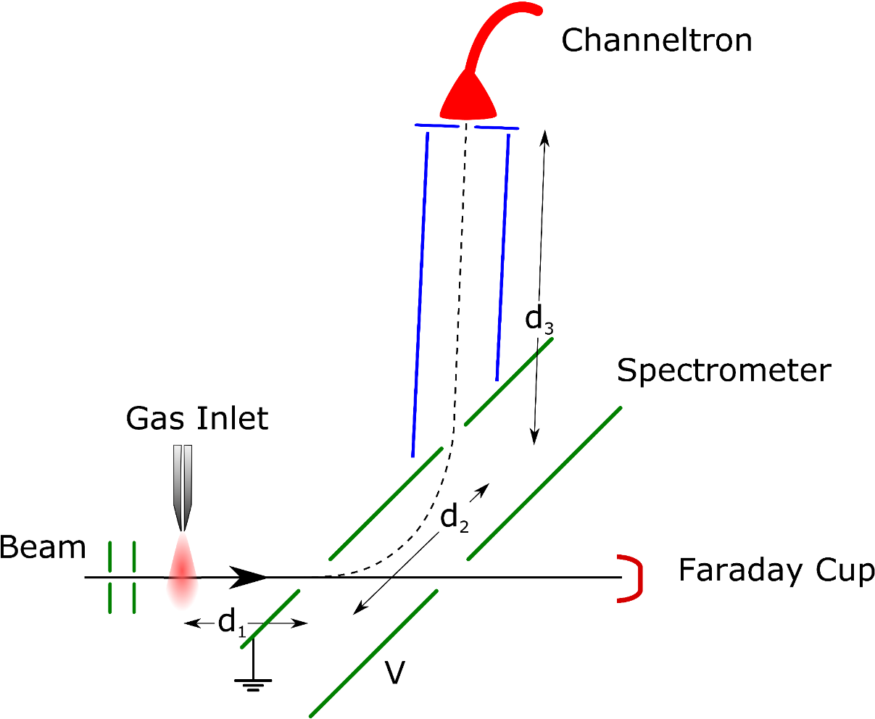
Scheme of interaction region and main experimental components used for collecting the fragment-ions from the target operation electrostatic spectrometer or time-of-flight spectrometer with continuous beam or pulsed beam respectively
Experimental setup for distributions

Slide 41
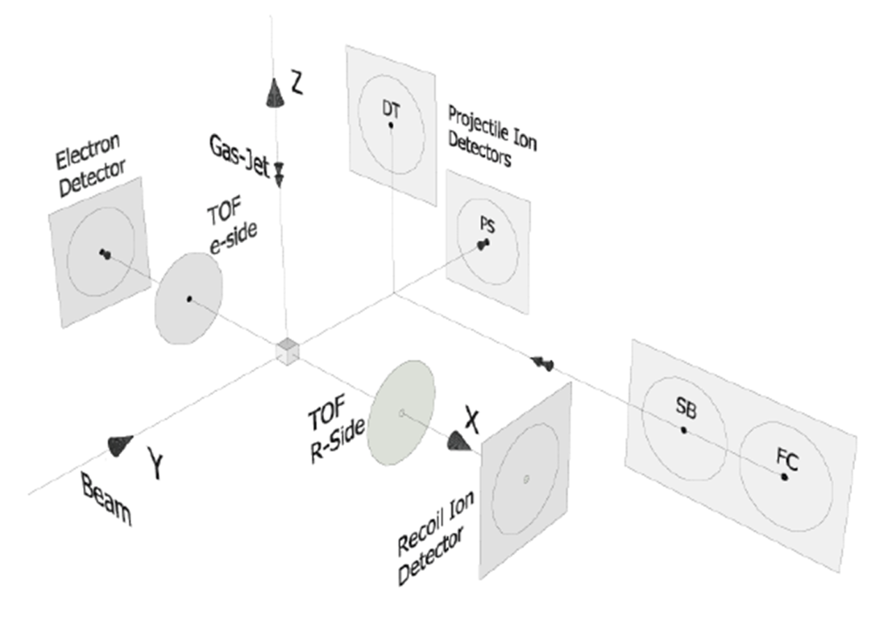
Scheme of interaction region and detectors used for collecting emitted electrons, fragment ions and projectiles after interaction in coincidence
+ and growth rate method absolute cross sections of n- electron removal for pure ionization single capture double capture
Experimental setup for cross section

Slide 42
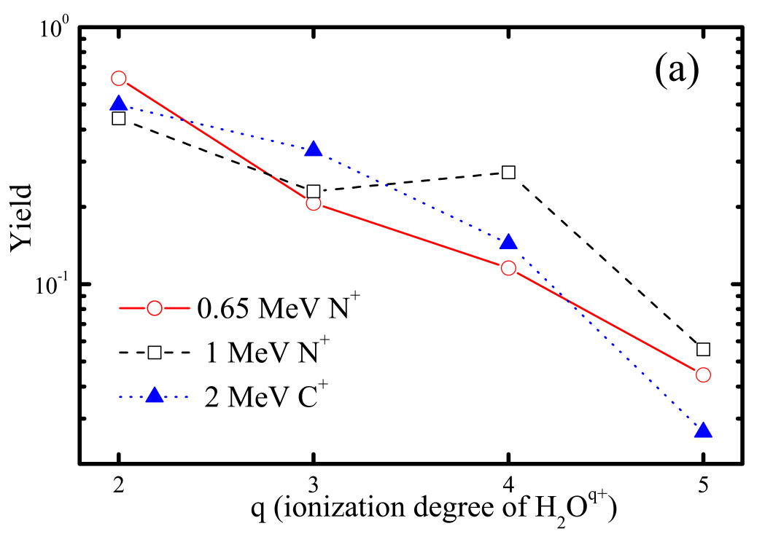
comparison previous and present work
Single charged projectiles – C⁺ and N⁺
q-electron removal
(b+c)
(d+e)
(f+g)
(h)
q- electron removal
1
2
2
3
3
4
4
5

Slide 43
Theoretical approach
CE n-CTMC
model
Two-body and/or three-body dissociation probabilities were based on
N-Body Classical Trajectory Monte-Carlo simulations (n-CTMC)
conjugated with
Coulomb Explosion Model (CE)
Coulomb explosion dynamics consider projectile’s position and momenta at the time the n-electron removal takes place via ionization, charge-transfer ou transfer ionization (post-collision interaction is included).
Two semi-empirical models were applied for the interfragment potential: screened or dipole type + coulombic potential

Slide 44
fragmentation channel yields
Fragment-ion distributions
Charge dependence
Energy dependence

Slide 45

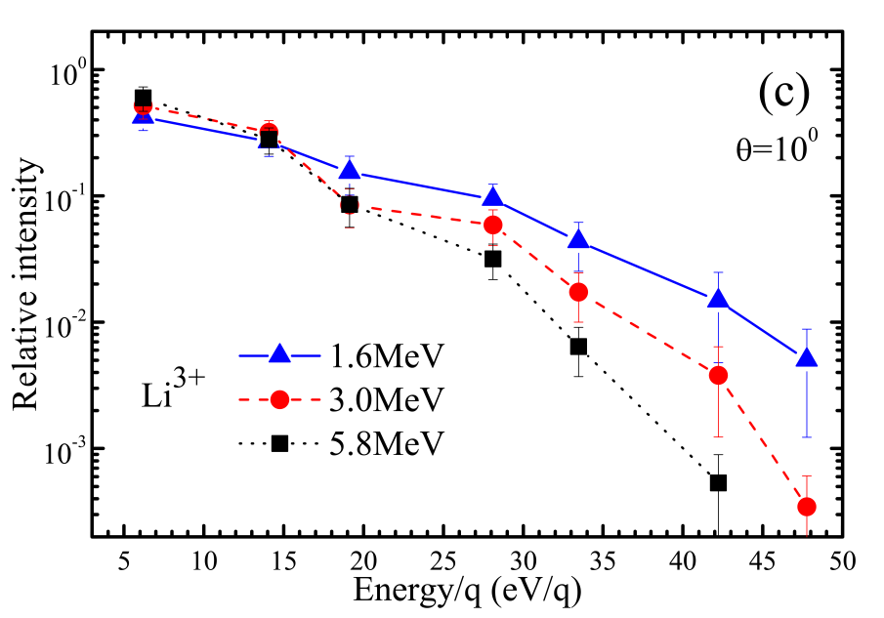
fragmentation channel yields
relative intensity of fragmentation channels
Fragment-ion distributions
Charge dependence
Energy dependence

