Slide 1
Cryogenic Current Comparators – basics and the next generation
Volker Tympel¹, R. Neubert¹, P. Seidel¹, R. Geithner^{2,3},
J. Golm^{1,3},T. Stöhlker^{2,3,4}, F. Kurian^{2,3,4},
T. Sieber⁴, M. Schwickert⁴, M. Fernandes^{5,6}
¹Institute of Solid State Physics, University of Jena, Germany;
²Institute for Optics and Quantum Electronics, University of Jena, Germany;
³Helmholtz Institute Jena, Germany;
⁴GSI Helmholtz Center for Heavy Ion Research, Darmstadt, Germany;
⁵The Cockcroft Institute, University of Liverpool, Daresbury, U.K.;
⁶CERN European Organization for Nuclear Research, Geneva, Switzerland
13th SPARC Topical Workshop 16.–20. Sep. Jagiellonian University in Kraków, Poland

Slide 2
OUTLINE
● Why superconducting?
● Cryogenic Current Comparator (CCC)
● Does it work?
● Next generation CCC-XD: Flux concentrator
● Challenges
● Short summary
V. Tympel (Institute of Solid State Physics) Friedrich-Schiller University Jena, Germany
Notes:
Planned Future installations of the SQUID-based Beam Current Monitor

Slide 3
Why superconducting?
Shielding
better
Aluminum 1.5 mm
Tin plate 0.8 mm
Cu 0.8 mm
V2A steel 1.7 mm
Aluminum foil, single layer
Decreasing of the magnetic field
Frequency f / Hz
V. Tympel (Institute of Solid State Physics) Friedrich-Schiller University Jena, Germany

Slide 4
Why superconducting?
Shielding
mu-metal
Nickel–iron soft magnetic alloy
Aluminum 1.5 mm
Tin plate 0.8 mm
Cu 0.8 mm
V2A steel 1.7 mm
Aluminum foil, single layer
Decreasing of the magnetic field
Frequency f / Hz
V. Tympel (Institute of Solid State Physics) Friedrich-Schiller University Jena, Germany

Slide 5
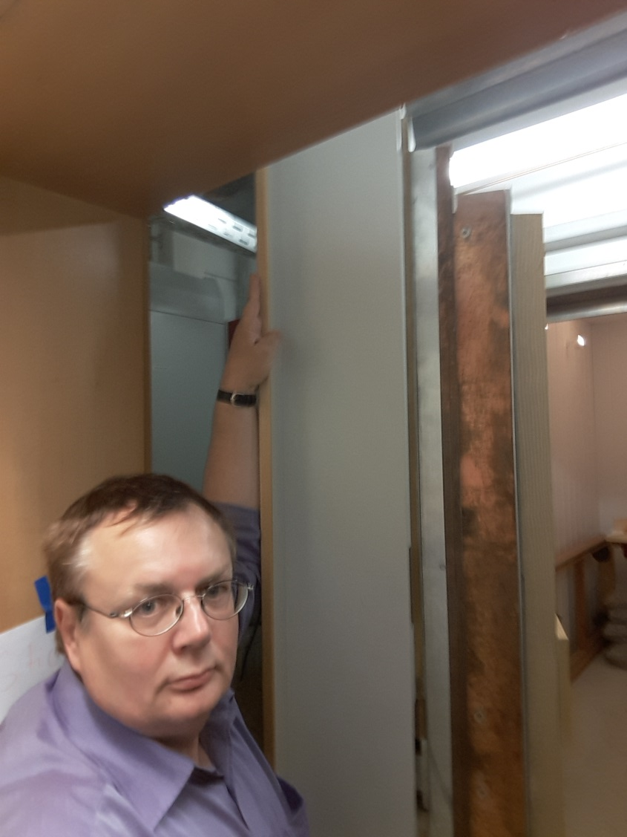
Why superconducting?
Shielding
Door of the magnetically shielded room
at the university of Jena:
2 layers mu-metal
1 layer Cu
43 cm
Thickness
V. Tympel (Institute of Solid State Physics) Friedrich-Schiller University Jena, Germany

Slide 6
Why superconducting?
Shielding
B_{outside}= B_{inside}
B_{outside}>> 0
B_{inside}=0
Normal conductor
Superconductor
Meissner effect: the expulsion of a magnetic field
=> ideal magnetic shielding
V. Tympel (Institute of Solid State Physics) Friedrich-Schiller University Jena, Germany

Slide 7
Why superconducting?
DC-Transformer
B_{outside}= B_{inside}
B_{outside}>> 0
AC
AC/DC
B_{inside}=0
AC
AC/DC
Normal conductor
Superconductor
Normal conductor
Superconductor
Meissner effect: the expulsion of a magnetic field
=> ideal magnetic shielding
A constant magnetic field leads to
screening current => DC- Sensor
V. Tympel (Institute of Solid State Physics) Friedrich-Schiller University Jena, Germany

Slide 8
Why superconducting?
SQUID – Sensor
DC-SQUID
I_{bias}
V_{SQUID}
V_{SQUID}
operating
point
B
(n+½)∙Φ₀
JJ
A
JJ
V_{SQUID}
∆V
n∙Φ₀
∆V
I_{bias}
I
Φ_{n}
Φ_{n+1}
Φ
Φ = ∫ B dA
Φ₀
Two Josephson junctions act as a
DC-SQUID, Interference leads to
=> high sensitivity.
The magnetic-field dependency => resolution: << Φ₀
A closed loop control => range: >> Φ₀
V. Tympel (Institute of Solid State Physics) Friedrich-Schiller University Jena, Germany

Slide 9
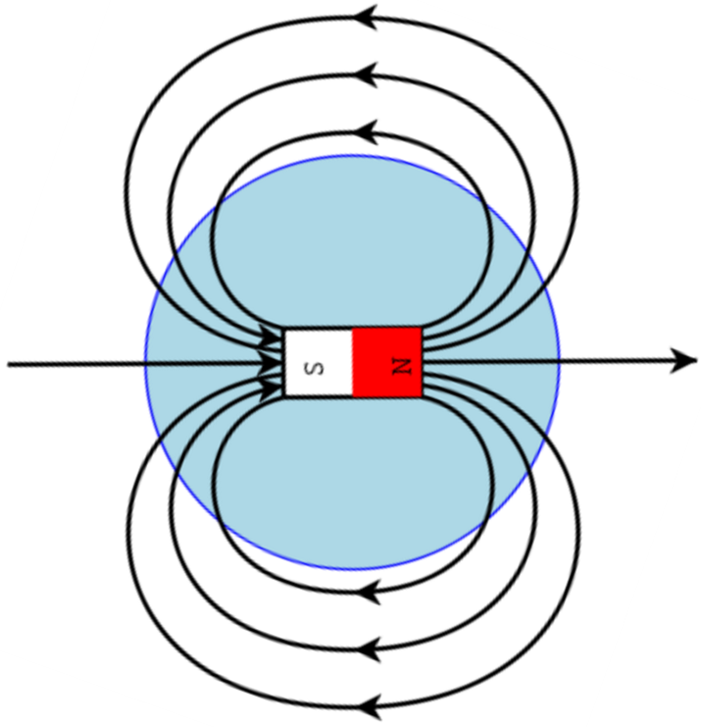
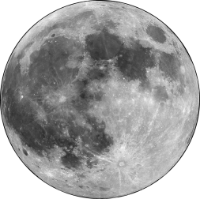
Φ₀ flux quantum?
≈ 2∙10⁻⁹ µT m² = 2∙10⁻⁵ µT cm²
B ≈ 20∙10⁻⁵ µT
B ≈ 60 µT
Moon
R ≈ 400 000 km
S
N
3 mm
Φ₀
3 mm
@ moon
Earth

Slide 10
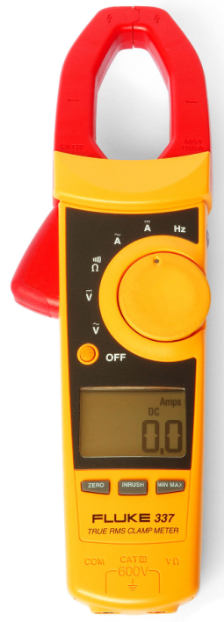
CCC
strong beam
B
5 A
charged
particle
beam
Principle of the
Cryogenic
Current
Comparator
V. Tympel (Institute of Solid State Physics) Friedrich-Schiller University Jena, Germany

Slide 11
CCC
weak beam
Principle of the
Cryogenic
Current
Comparator
i
B=0
-i
B
charged
particle
beam
5 nA
contactless & non-destructive
V. Tympel (Institute of Solid State Physics) Friedrich-Schiller University Jena, Germany

Slide 12
Superconducting shielding
Pick-up coil
Transformer
SQUID
Four-wire
Measurement
Flux
Compensator
Flux gap
Compensation
Current
Magnetic field B
Charged particle beam
Cryogenic liquid
LHe
Magnetic flux
Concentrator ring
Metrology
Calibration
Current

Slide 13
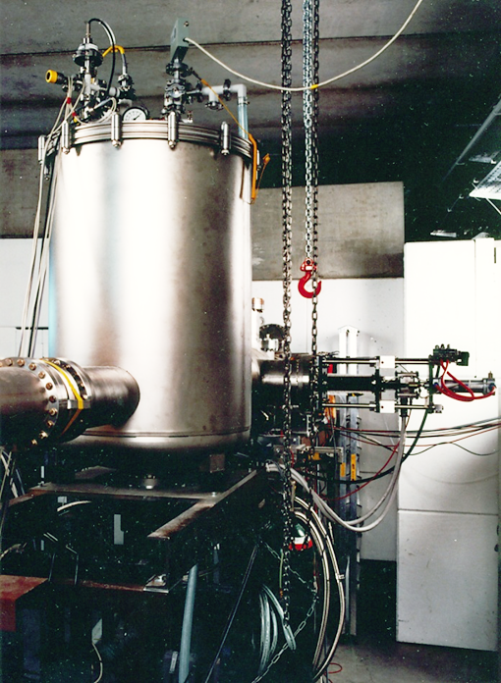
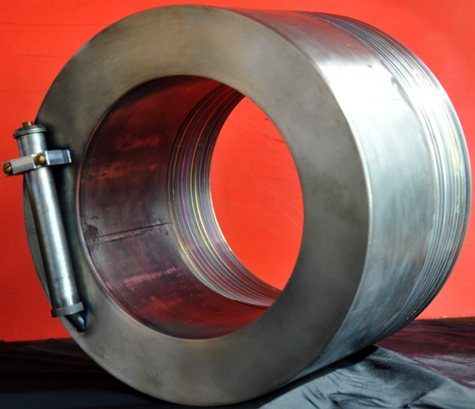
Realisations
@ GSI
@ CERN
Pb-shielded CCC assembled
in a beam line
Nb-shielded CCC before assembling
in a beam line.
[A. Peters et al., A Cryogenic Current Comparator for the Absolute Measurement of nA Beams, AIP Conf. Proc. 451 pp. 163-180 (1998)]
V. Tympel (Institute of Solid State Physics) Friedrich-Schiller University Jena, Germany

Slide 14
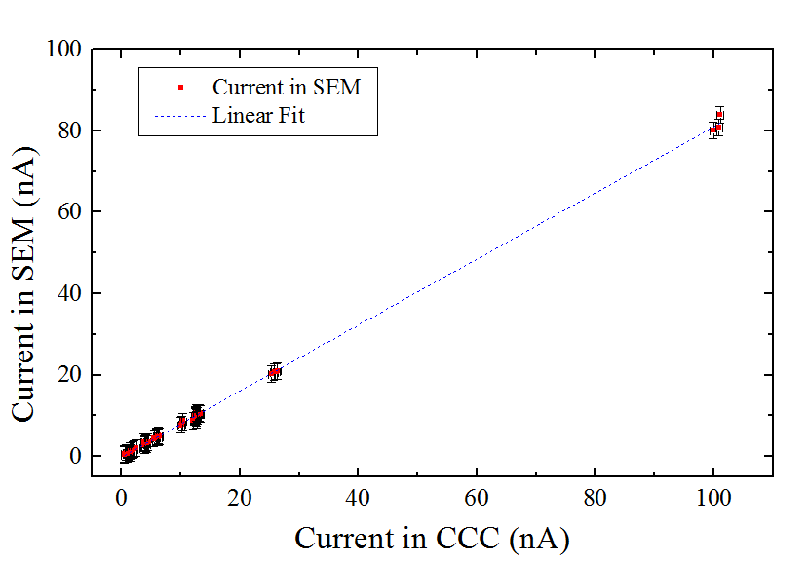
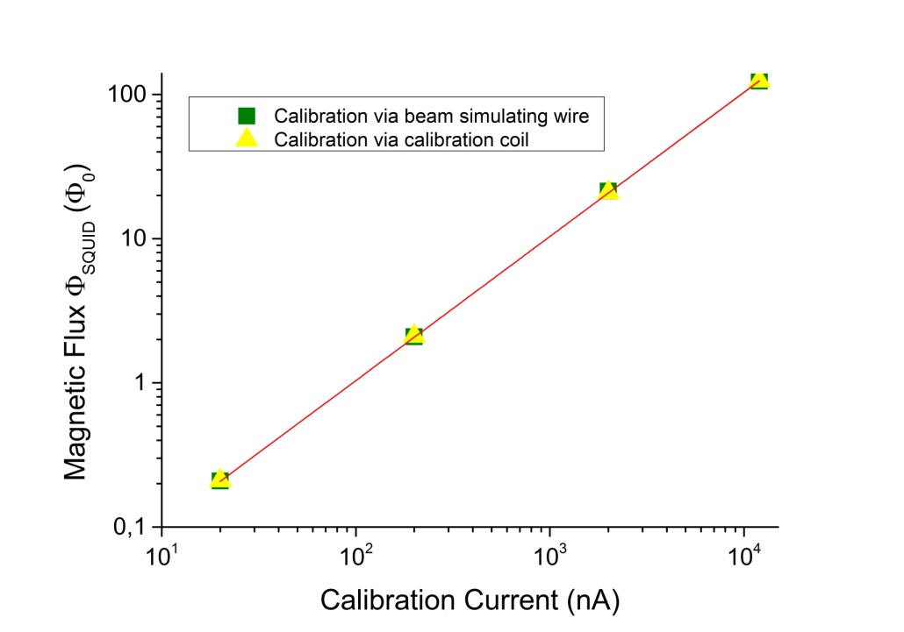
It works!
@ GSI
@ CERN
Linear correlation between SEM and
CCC signal with a slope of ~ 0.8.
Current sensitivity of the CCC tested via
beam simulating wire or to calibration coil.
V. Tympel (Institute of Solid State Physics) Friedrich-Schiller University Jena, Germany

Slide 15
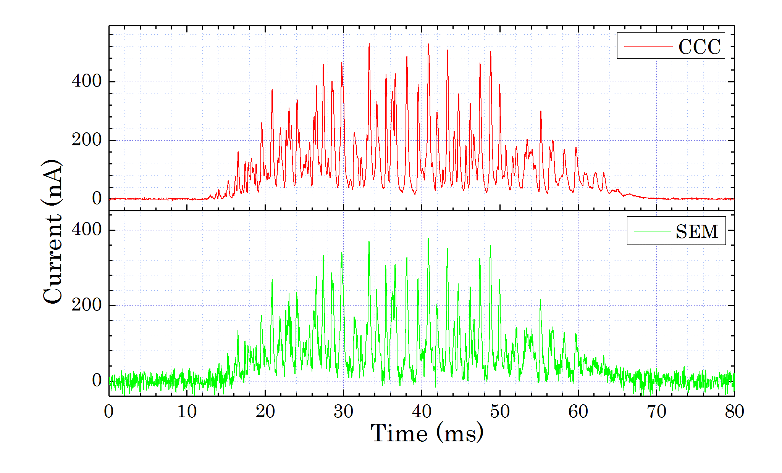
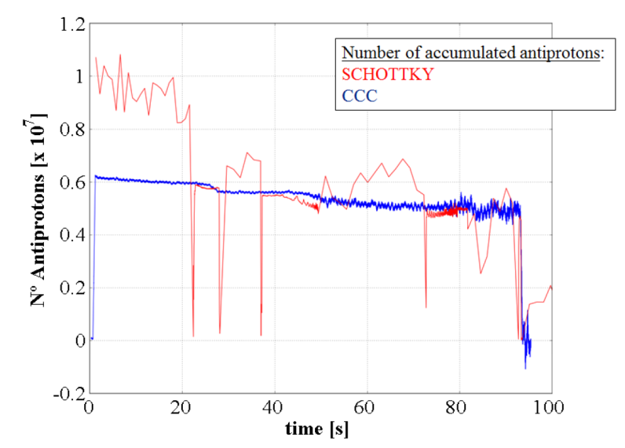
It works!
@ GSI
spill monitoring
@ CERN
SEM/CCC measurement of a 600 MeV/u beam of slowly extracted Ni²⁶⁺ ions.
Longitudinal-Schottky and CCC measurement during one AD cycle (10% nominal intensity). IBIC2016: 3-nA beam without problems
[R. Geithner et al., Cryogenic current comparator for storage rings and accelerators, MOPB013, Proc. of IBIC2015, Proc. of IBIC2015]
[M. Fernandes et al., A Cryogenic Current Comparator for the Low
Energy Antiproton Facilities at CERN, MOPB043, Proc. of IBIC2015]

Slide 16
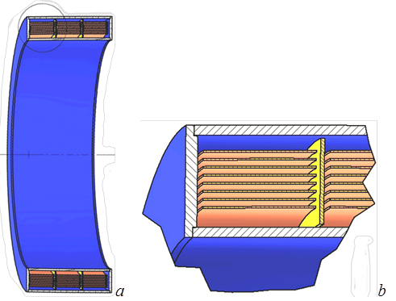
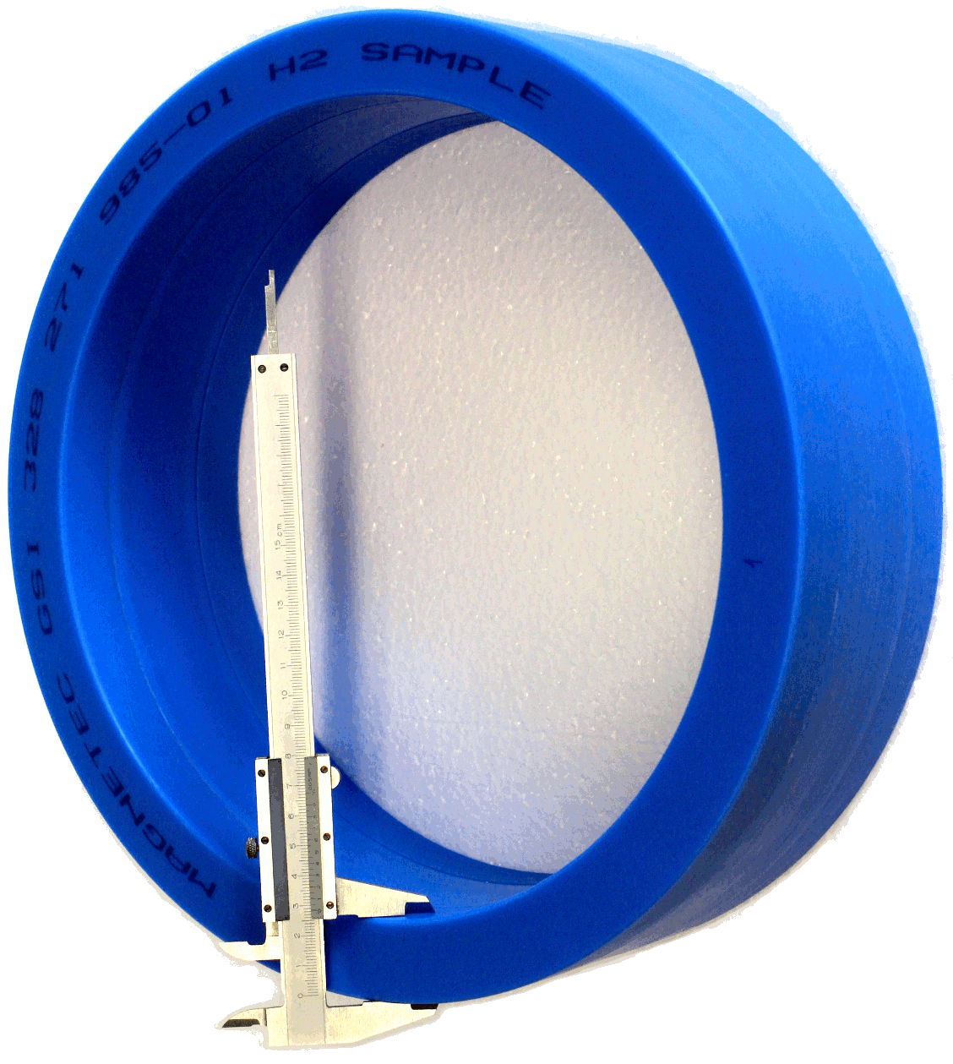
Next generation: CCC-XD
● @ FAIR larger beamline diameter => CCC with eXtended Dimensions CCC-XD
● larger bandwidth => new core materials
GSI328plus
specific thermo-magnetic, gas and heat treatment process of amorphous Fe-alloy NANOPERM® ribbons
330 mm
≈ 1500 turns of
15 µm layers
V. Tympel (Institute of Solid State Physics) Friedrich-Schiller University Jena, Germany

Slide 17
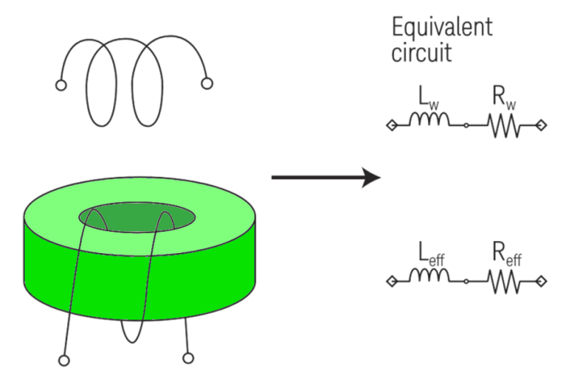
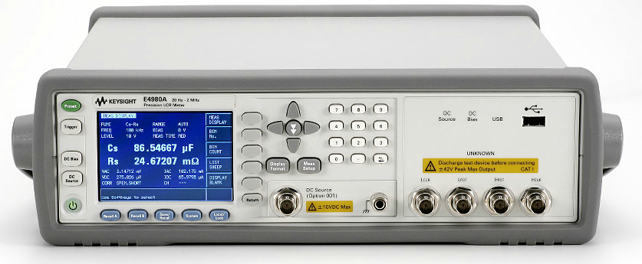
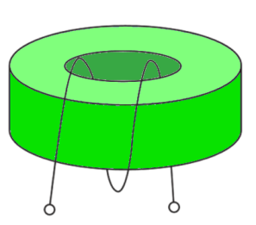
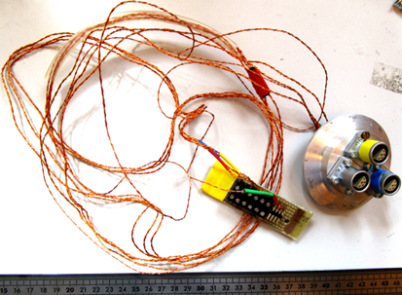
CCC-XD: Flux concentrator
E4980A Precision LCR Meter, 20 Hz to 2 MHz
Without core
With core
Mode: L_{s}-R_{s}
$${\hat{μ}}_{r}=\frac{\hat{μ}}{μ_{0}}={μ^{′}}_{r}−j∙{μ^{′′}}_{r}$$
$$=\left(\frac{μ^{′}}{μ_{0}}\right)−j∙\left(\frac{μ^{′′}}{μ_{0}}\right)$$
Complex relative
permeability
$$tan\left(δ_{m}\right)=\frac{R_{s}}{X_{Ls}}=\frac{{μ^{′′}}_{r}}{{μ^{′}}_{r}}$$
Loss angle $δm$
V. Tympel (Institute of Solid State Physics) Friedrich-Schiller University Jena, Germany

Slide 18
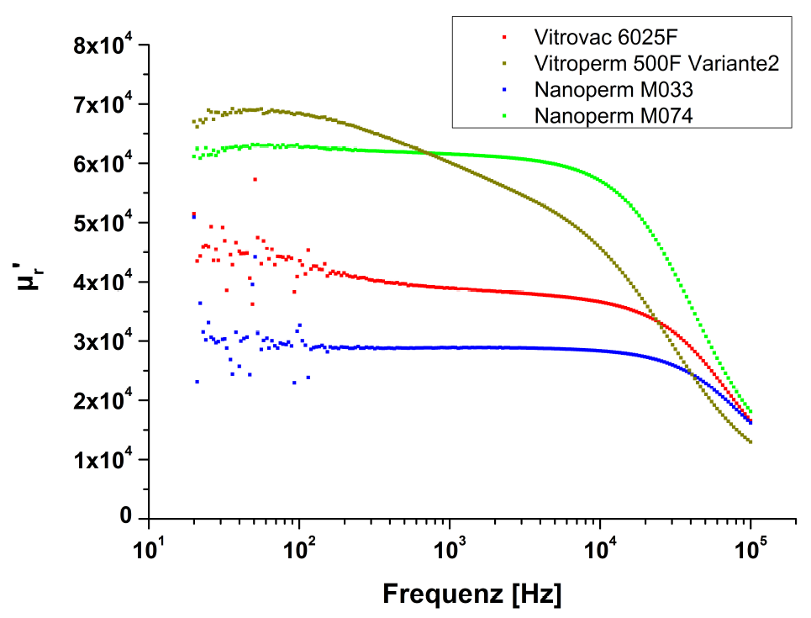
CCC-XD: Flux concentrator
First measurements @ 4.2 K:
● noisy
● core materials with
small bandwidth
100 kHz
Thesis, René Geithner, 2013
„Untersuchung der Tieftemperatureigenschaften magnetischer Materialien für den Einsatz im Kryostromkomparator“
Ls-Messungen bei 4,2 K
V. Tympel (Institute of Solid State Physics) Friedrich-Schiller University Jena, Germany

Slide 19
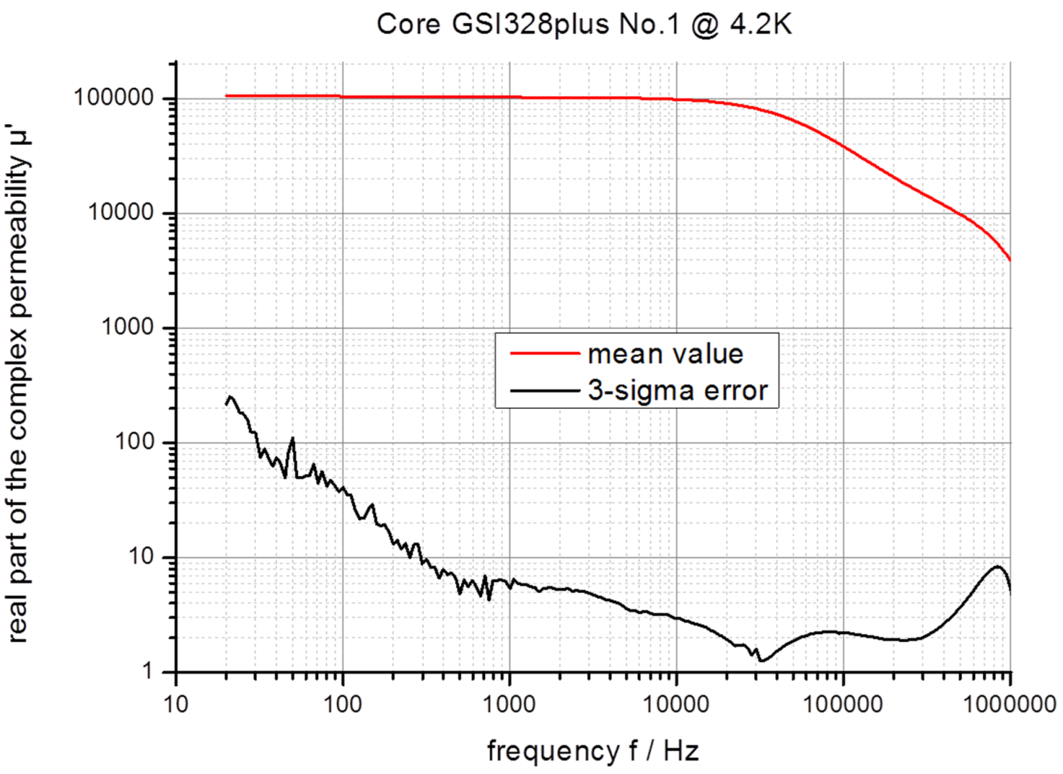
CCC-XD: Flux concentrator
Now @ 4.2 K:
● SNR better 200 : 1
● core materials with
larger bandwidth
100 kHz
Tympel, et al., IBIC 2016
„The next generation of Cryonic Current Comparators for beam monitoring“
V. Tympel (Institute of Solid State Physics) Friedrich-Schiller University Jena, Germany

Slide 20
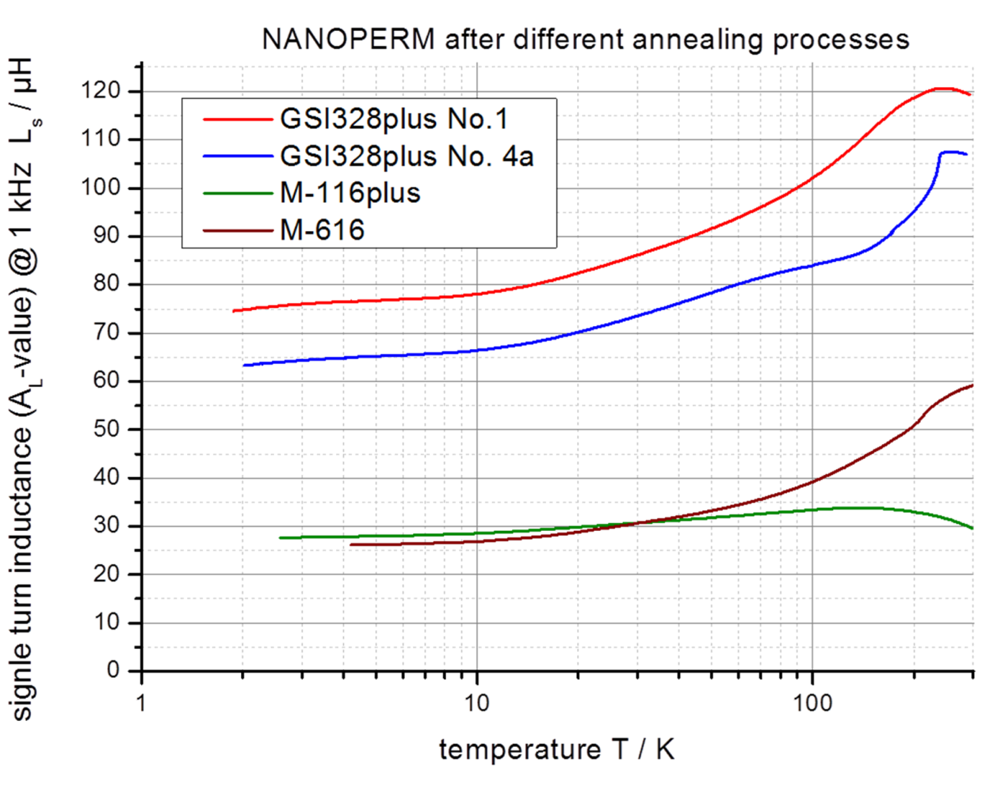
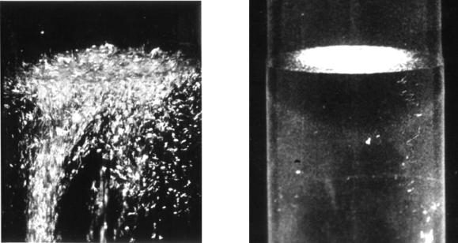
CCC-XD: Flux concentrator
Now: Temperature below 2 K
● below Lambda-point
(50 hPa & 2,17 K)
=> superfluid He II
He I
He II
Thermal
Conductivity => ∞
Tympel, et al., IBIC 2016
„The next generation of Cryonic Current Comparators for beam monitoring“
4.2 K
V. Tympel (Institute of Solid State Physics) Friedrich-Schiller University Jena, Germany

Slide 21
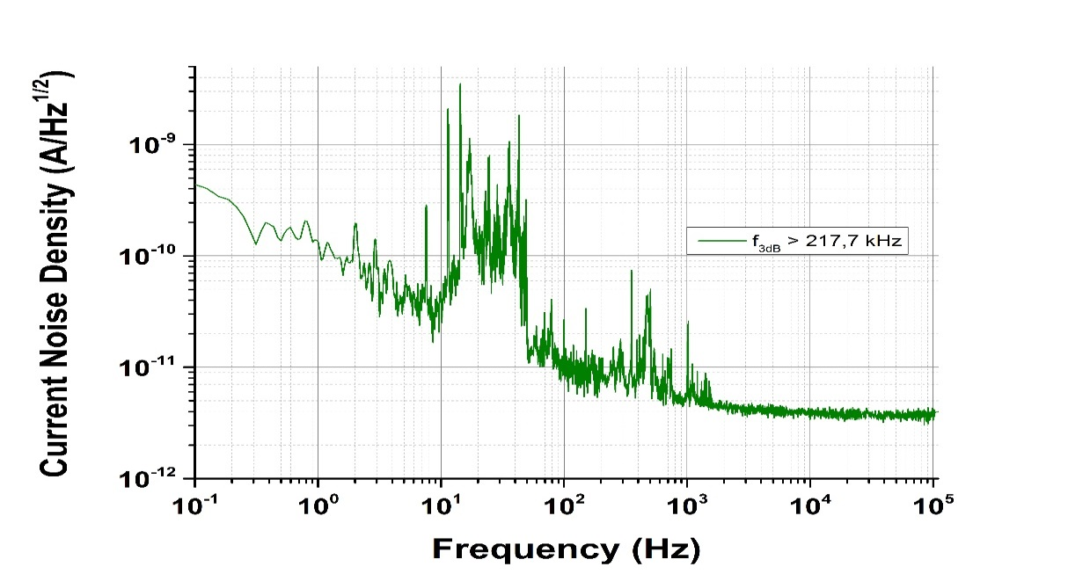
Next challenges
● Drifts
● Microphonic effects
green: Faraday Cup
black: DESY-CCC
Geithner et al., Rev. Sci. Instrum., 82(1):013302, 2011
V. Tympel (Institute of Solid State Physics) Friedrich-Schiller University Jena, Germany

Slide 22
Thank you for your attention.
Short summary
Charged beam:
Squid it !
V. Tympel (Institute of Solid State Physics) Friedrich-Schiller University Jena, Germany

Slide 23
Number?

Slide 24
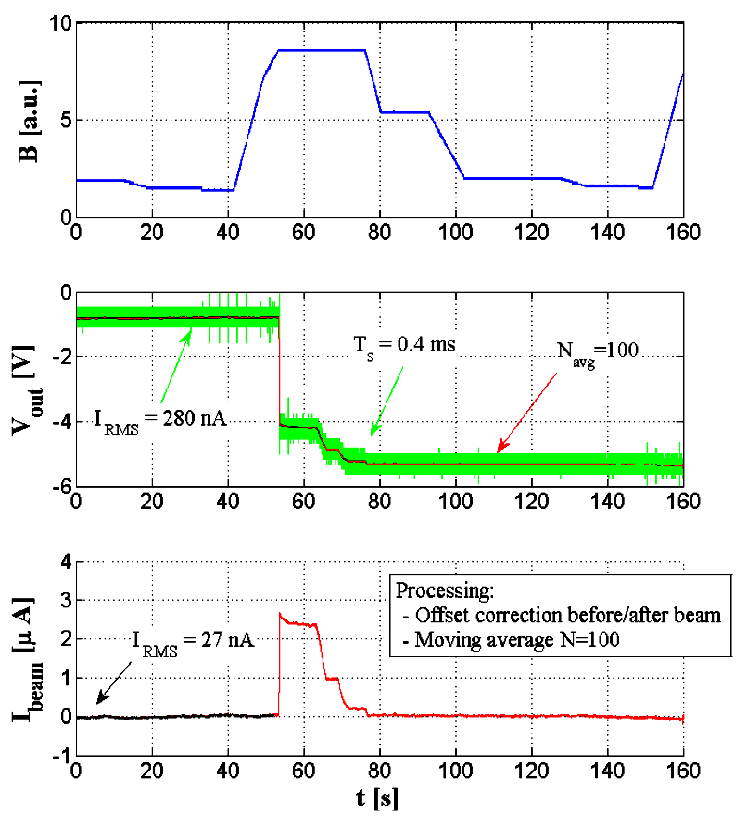
Magnetic disturbance
Magnetic Cycle of AD Dipoles in arbitrary units
SQUID/FLL raw signal of beam current ( green), and same signal filtered with a moving average (red)
Calibrated beam current measurement after filtering and baseline recovery (before beam injection and after beam extraction)
[M. Fernandes et al., A Cryogenic Current Comparator for the Low
Energy Antiproton Facilities at CERN, MOPB043, Proc. of IBIC2015]

Slide 25
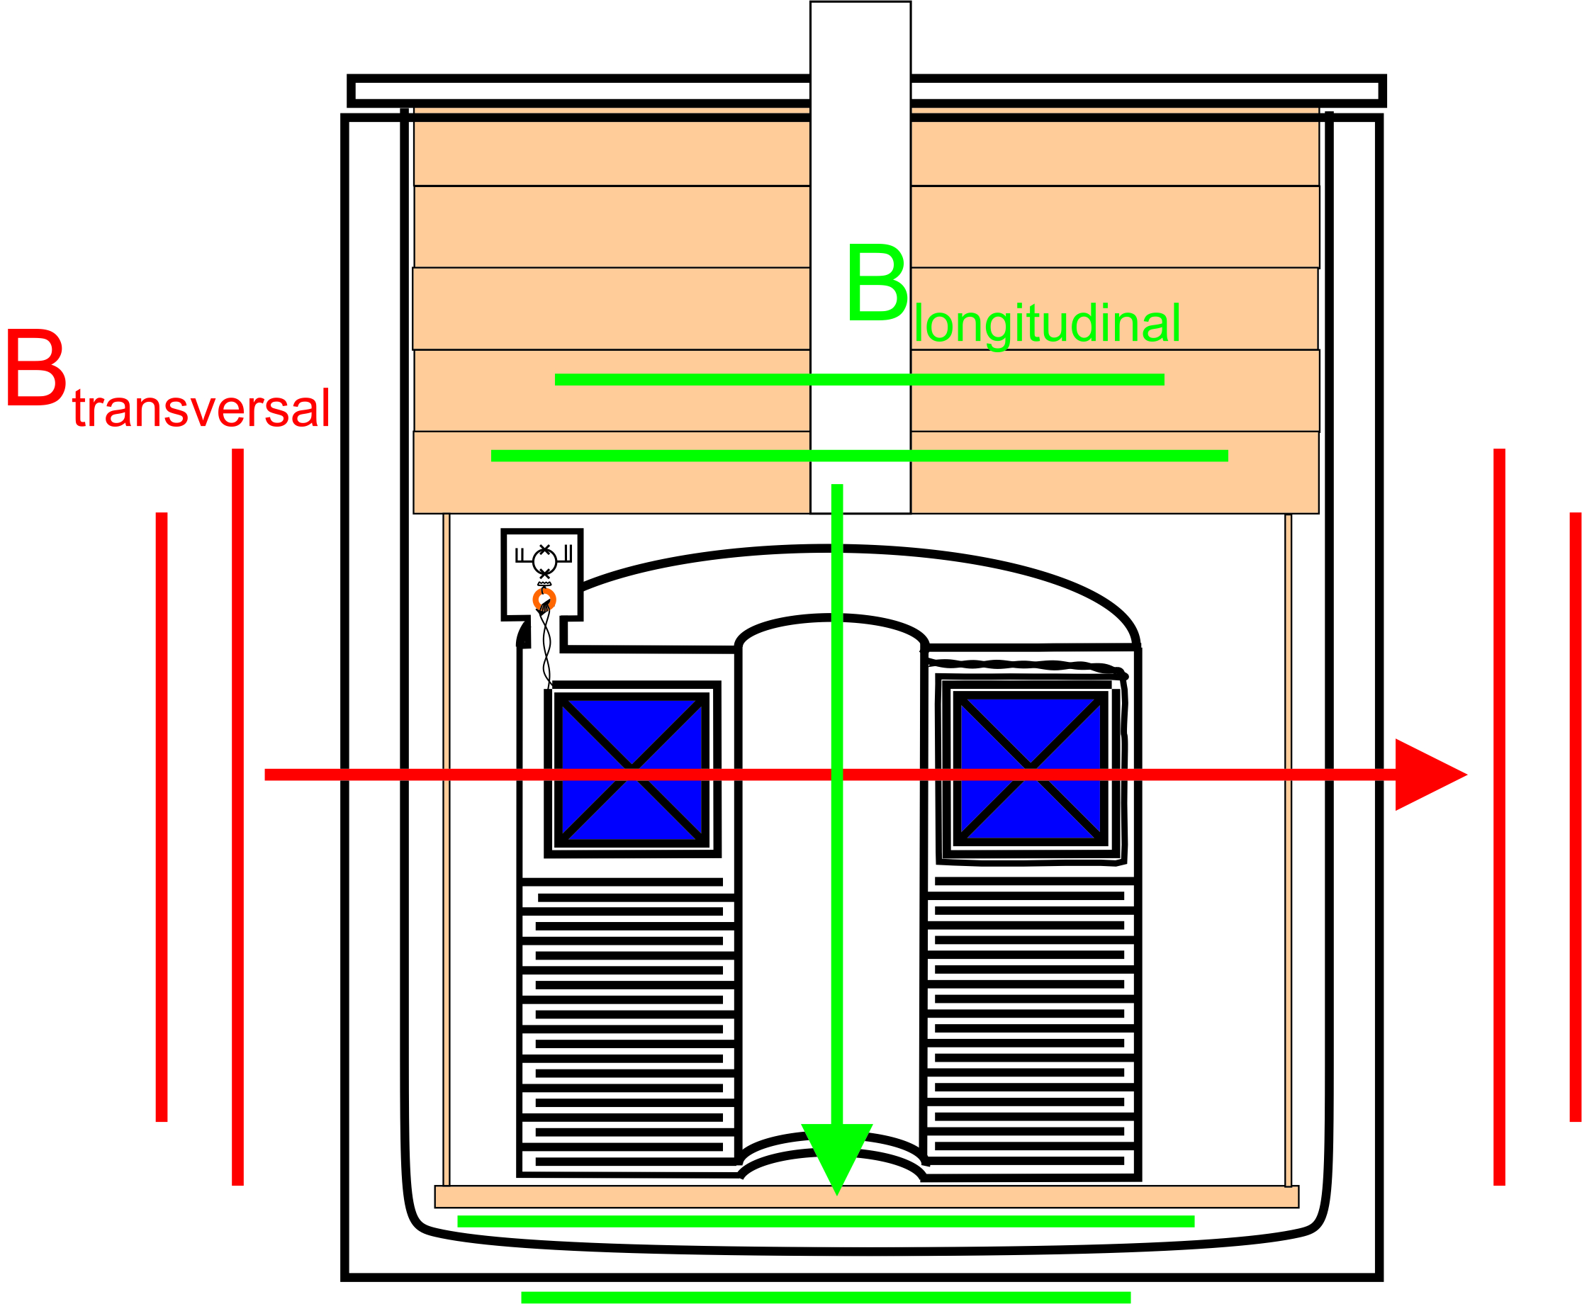
Attenuation Factor FAIR-CCC
Increased number of meander from 7 auf 12
Transvers fields (perpendicular to beam)
187 dB, (DESY-CCC:167 dB)
Longitudinal fields (parallel to beam)
199 dB, (DESY-CCC: 187 dB)

Slide 26
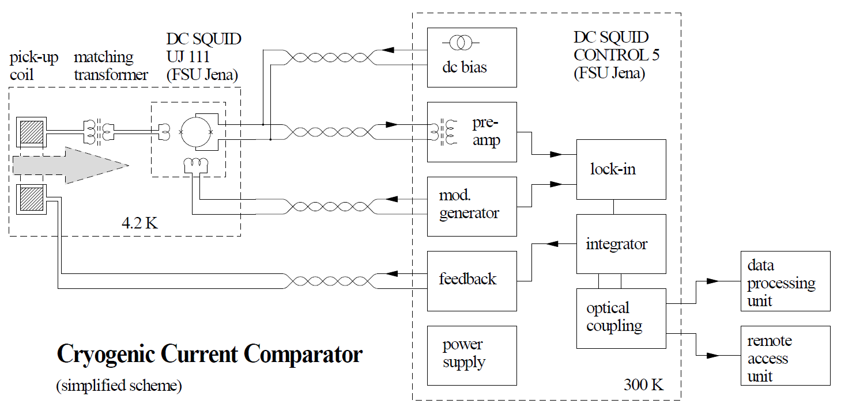
OPERATION
Working principle of SQUID electronics in flux-locked loop (FLL) mode
Environment & Calibration Handling
Notes:
Due to the periodically dependence of the voltage the SQUID is not useful for flux changes above 0.5 phi0 in this way because it is not clear on which point of the U-phi characteristics you are.
Therefore an electronics in flux-locked loop (FLL) mode is used which runs the SQUID in the working point with maximum sensitivity.
I f the flux through the SQUID is changed the voltage drop is amplified and integrated and current is applied to the feedback coil which is in our case an additional winding on the pickup coil to compensate the flux and stabilize the working point.
The signal you measure is the feedback signal. With the knowledge of the overall flux sensitivity in flux/voltage you can calculate the flux trough the pickup coil and if you know the overall current sensitivity in current/flux you can calculate the beam current.

Slide 27
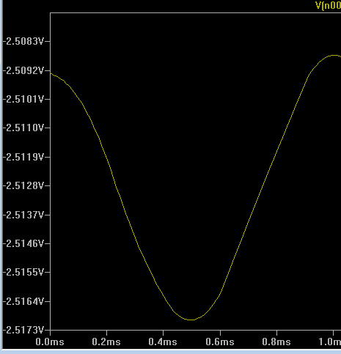
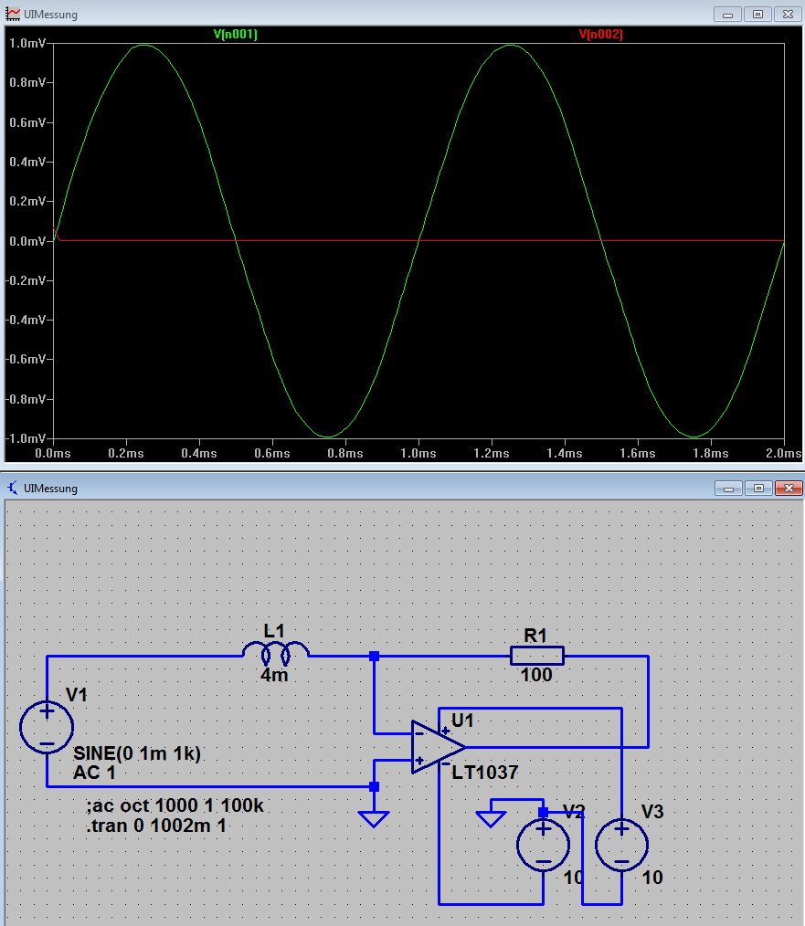
4 Kernmessungen - Induktivitätsmessungen
27
Automatisch
Abgleichende
Messbrücken-
Methode:
1. Erzeugung virtueller Masse „Low“
2. L-Berechnung durch u_{H}(t), u_{R}(t)
und R1
Low
u_{H}(t)
u_{L}(t)
u_{R}(t)
$$Z_{L1}=R_{1}∙\frac{u_{H}}{u_{R}}$$

Slide 28
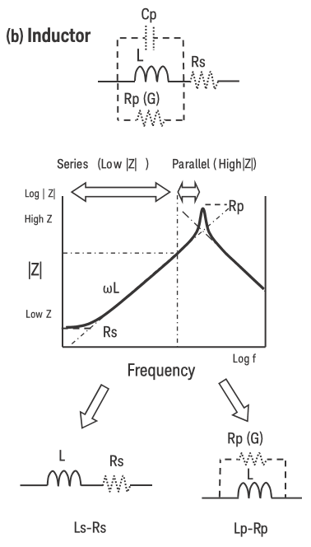
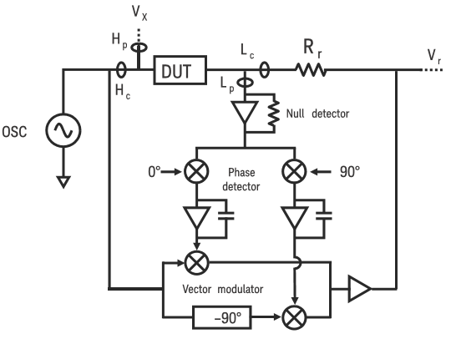
4 Kernmessungen - Induktivitätsmessungen
28
E4980A Precision LCR Meter, 20 Hz to 2 MHz

Slide 29
4 Kernmessungen - Komplexe Permeabilität$\hat{μ}$
29
E4980A Precision LCR Meter, 20 Hz to 2 MHz
ohne Kern
mit Kern
Mode: Ls-Rs
$${\hat{μ}}_{r}=\frac{\hat{μ}}{μ_{0}}={μ^{′}}_{r}−j∙{μ^{′′}}_{r}$$
$$=\left(\frac{μ^{′}}{μ_{0}}\right)−j∙\left(\frac{μ^{′′}}{μ_{0}}\right)$$
Komplexe relative
Permeabilität
$$tan\left(δ_{m}\right)=\frac{R_{s}}{X_{Ls}}=\frac{{μ^{′′}}_{r}}{{μ^{′}}_{r}}$$
Verlustwinkel $δm$

Slide 30
4 Kernmessungen - Komplexe Permeabilität$\hat{μ}$
30
$$L_{s}={L_{s,eff}−L}_{s,w}$$
Korrekturen:
$$R_{s}={R_{s,eff}−R}_{s,w}$$
Verlustwinkel:
Re:
$${μ^{′}}_{r}=\frac{L_{s}}{{f_{c}∙L}_{0}}$$
$${μ^{′}}_{r}\sim { L}_{s}$$
$$tan\left(δ_{m}(f)\right)\sim \frac{R_{s}\left(f\right)}{{f∙L}_{s}\left(f\right)}$$
Im:
$${μ^{′′}}_{r}=\frac{R_{s}}{{2πf∙f_{c}∙L}_{0}}$$
$${μ^{′′}}_{r}\sim \frac{R_{s}}{f}$$
Toroidspule mit N Windungen:
Außendurchmesser $r_{a}$
Innendurchmesser $r_{i}$
Höhe $h$
Korrekturfaktor geom. Induktivität
Fluktuations-Dissipations-Theorem
Dissertation René Geithner, 2013
$$f_{c}=\frac{A_{ef}}{\left(r_{a}−r_{i}\right)∙h}$$
$$L_{0}=N^{2}∙\frac{μ_{0}∙h}{2π}∙ln\left(\frac{r_{a}}{r_{i}}\right)$$

Slide 31
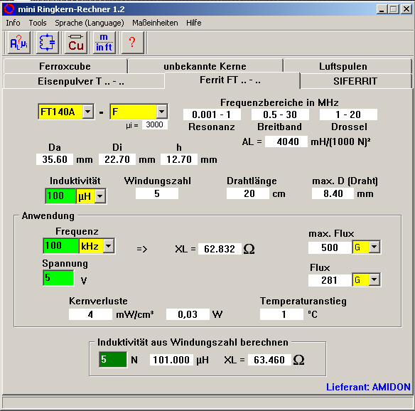
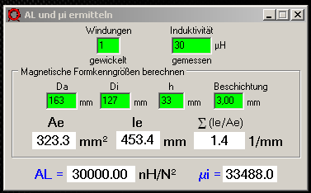
4 Kernmessungen – A_{L}-Wert
31
$$L=A_{L}∙N^{2}$$
$$Problem: L\left(f\right)=A_{L}\left(f\right)∙N^{2}$$

Slide 32
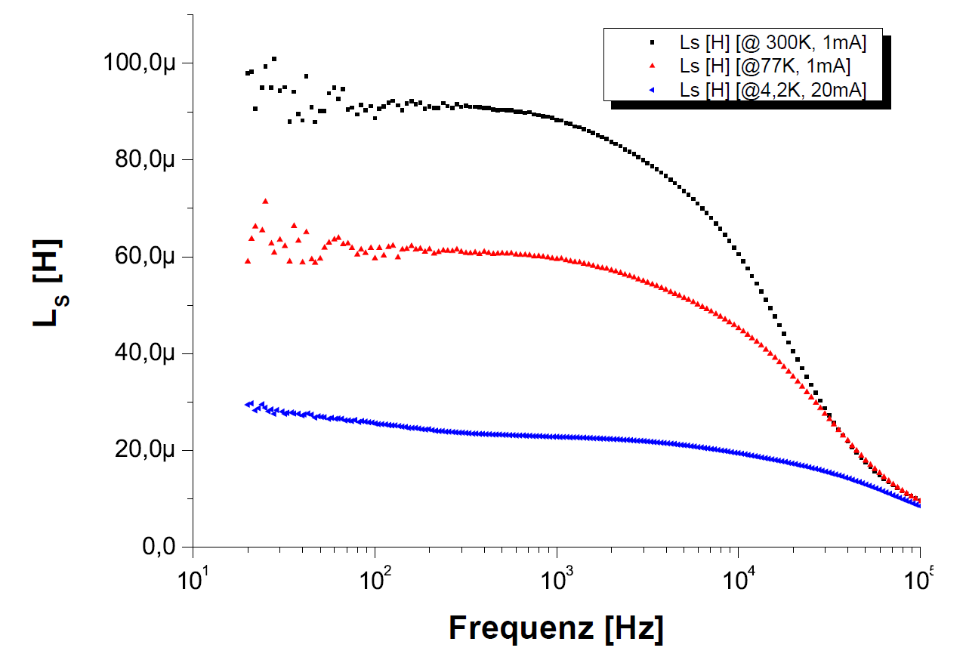
4 Kernmessungen – Erfahrungen
32
„Optimierung eines kryogenen Stromkomparators
für den Einsatz als Strahlmonitor“
Dissertation
René Geithner, 2013
100 kHz
Strom möglichst hoch!
E4980A LCR-Meter: 20 mA
Induktivität der DESY-CCC-Pickup-Spule mit Vitrovac 6025F

Slide 33
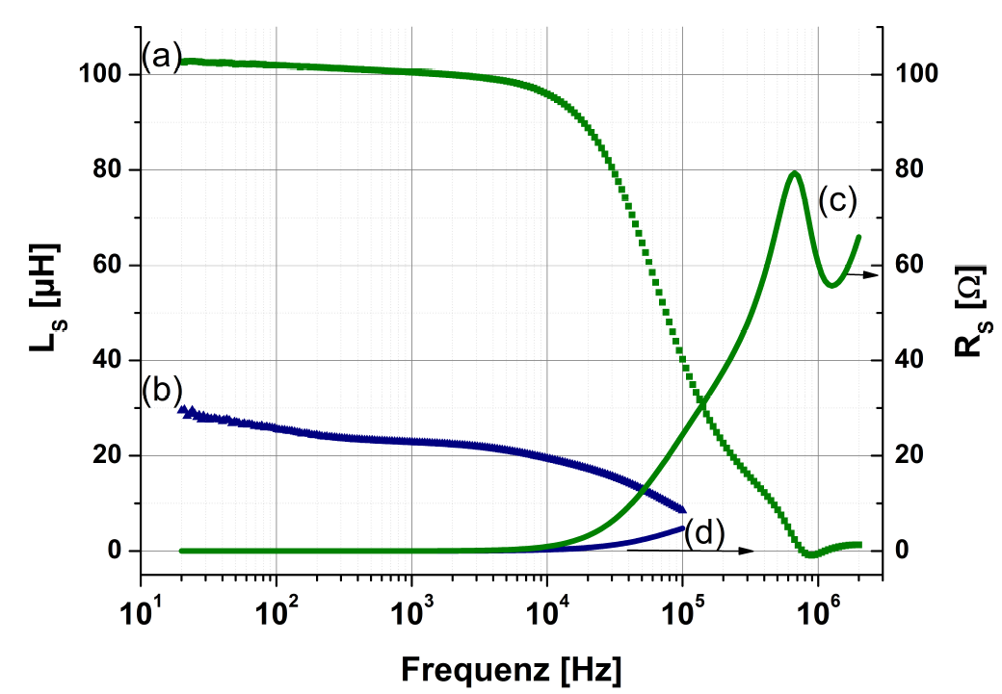
4 Kernmessungen – letzte Pickup-Spule
33
„Optimierung eines kryogenen Stromkomparators
für den Einsatz als Strahlmonitor“
Dissertation
René Geithner, 2013
Ls/Rs-Messungen bei 4,2 K; blau: DESY-CCC
grün: FAIR-CCC: Nanoperm M764

Slide 34
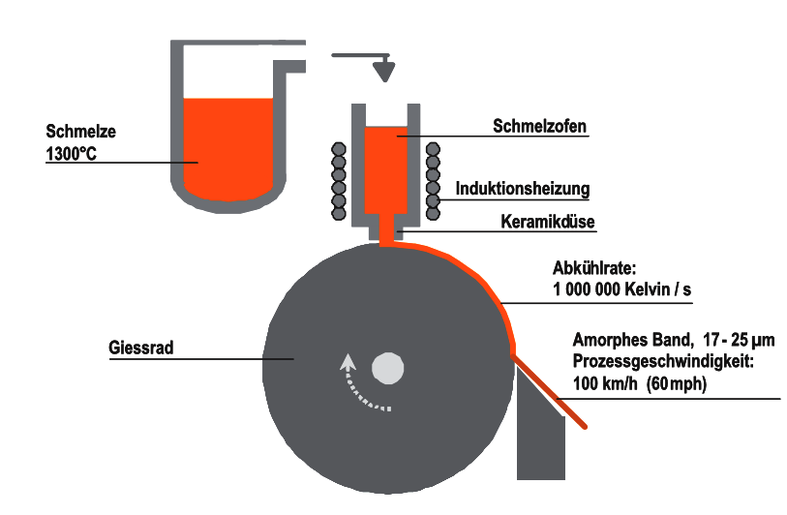
4 Kernmessungen – neue Testkerne
34
Vacuumschmelze Hanau:
amorphe Kerne: Vitrovac
nano-kristalline K.: Vitroperm
Magnetec GmbH:
nano-kristalline K.: Nanoperm
Rascherstarrungstechnologie für amorphe Bänder
Bänder => gewickelte Kerne

Slide 35
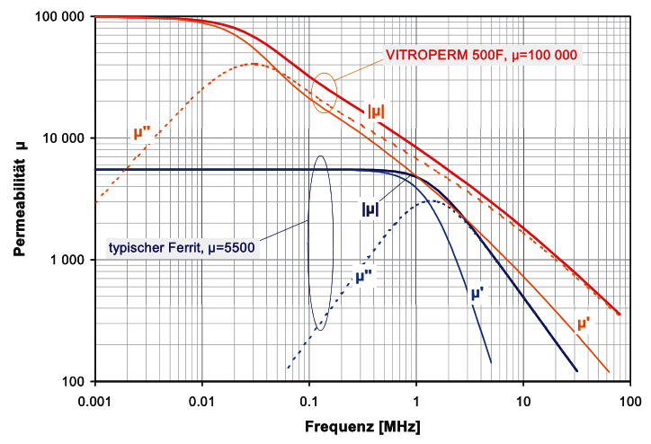
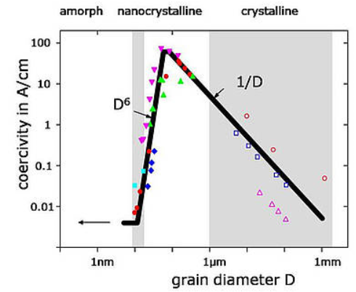
4 Kernmessungen – neue Testkerne
35
Wärme-
behandlung:
[Vacuumschmelze Hanau]

Slide 36
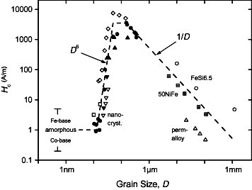
Coercivity Hc vs. grain size D for various soft magnetic metallic alloys:
Fe–Nb–Si–B (solid triangles) [12],
Fe–Cu–Nb–Si–B (solid circles) [2] and [12], Fe–Cu–V–Si–B (solid nablas [2] and open down triangles [13]),
Fe–Zr–B (open squares) [14],
Fe–Co–Zr (open diamonds) [16],
NiFe alloys (+ center squares and open triangles) [17] and
Fe–6.5 wt.% Si (open circles) [18]. (Reprinted from Herzer [2].)

Slide 37
4 Kernmessungen – neue Messungen
37
M-116 @ RT
Korrektur:
$$L_{s}={L_{s,eff}−L}_{s,w}$$

Slide 38
4 Kernmessungen – Kurzschluss-Korrektur
38
Korrektur:
$$L_{s}={L_{s,eff}−L}_{s,w}$$

Slide 39
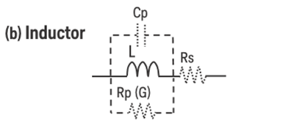
4 Kernmessungen – Anzahl der Windungen
39
M-116 @ RT
Viele Windungen:
stabile Daten
aber
schnell Resonanzen
34
1

Slide 40
4 Kernmessungen – Messkabel
40
M-116+ @ RT
Je kurzer,
desto besser!
„3er-Kabel“ für den Kryostaten

Slide 41
4 Kernmessungen – Messstrom
41
M-116 17 Wdg @ RT
Ls / Rs hängen
vom Messstrom ab!
E4980A max.: 20 mA
Magnetec: 100 mA

Slide 42
4 Kernmessungen – Messungen im Weithalskryostaten
42
M-116 / 116+ @ 4,2 K
4,2 K
Lange Kabel
1 Windung
Störungen
50 Hz / 150 Hz
Auf stabile Verkabelung achten!

Slide 43
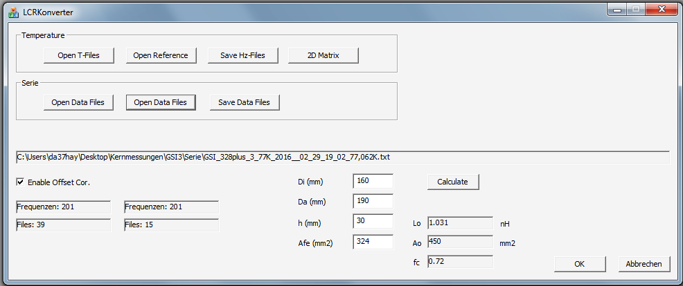
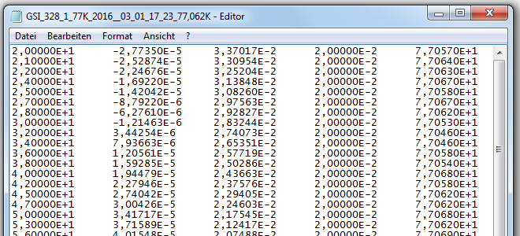
4 Kernmessungen – Messungen Auswerteprogramm
43
Alle 11 Min.
ein File mit
201 Frequenzen
je Frequenz:
Temperatur
Ls
Rs
C++ Programm: Mess-Files einlesen und verrechnen
Erstellen von Ls(T) / Rs(T) und 3D-Vorlagen
Erstellen Mittelwerte / Vertrauensbereich

Slide 44
4 Kernmessungen – Messungen Auswerteprogramm
44
Ls
Vertrauensbereich
$${\overline{L}}_{s}±{\frac{s}{\sqrt{n}}∙t}_{\left(1−\frac{α}{2},n−1\right)}$$
3-Sigma Bereich:
20 Hz: 1 / 200
100 kHz: 1/ 100 000
Störungen
35 Hz - ?
50 Hz - Netz
150 Hz - Netz
M-116+ @ 4,2 K

Slide 45
4 Kernmessungen – Messungen Auswerteprogramm
45
Rs
3-Sigma Bereich:
20 Hz: 1 / 10
100 kHz: 1/ 50 000
Störungen
35 Hz - ?
50 Hz - Netz
150 Hz - Netz
M-116+ @ 4,2 K

Slide 46
4 Kernmessungen – Messungen Auswerteprogramm
46
µ‘
M-116+ @ 4,2 K

Slide 47
4 Kernmessungen – Messungen Auswerteprogramm
47
µ‘‘
M-116+ @ 4,2 K
>100 kHz

Slide 48
4 Kernmessungen – Messungen Auswerteprogramm
48
tan(δ_{m})
M-116+ @ 4,2 K

Slide 49
4 Kernmessungen – Messungen Auswerteprogramm
49
Ls linear
z.B. 20 Hz:
(28,3 ±0,2) µH P=99,8 %
+ systematische
Fehler !
M-116+ @ 4,2 K

Slide 50
4 Kernmessungen – Messungen Auswerteprogramm
50
tan(δ_{m}) linear
M-116+ @ 4,2 K

Slide 51
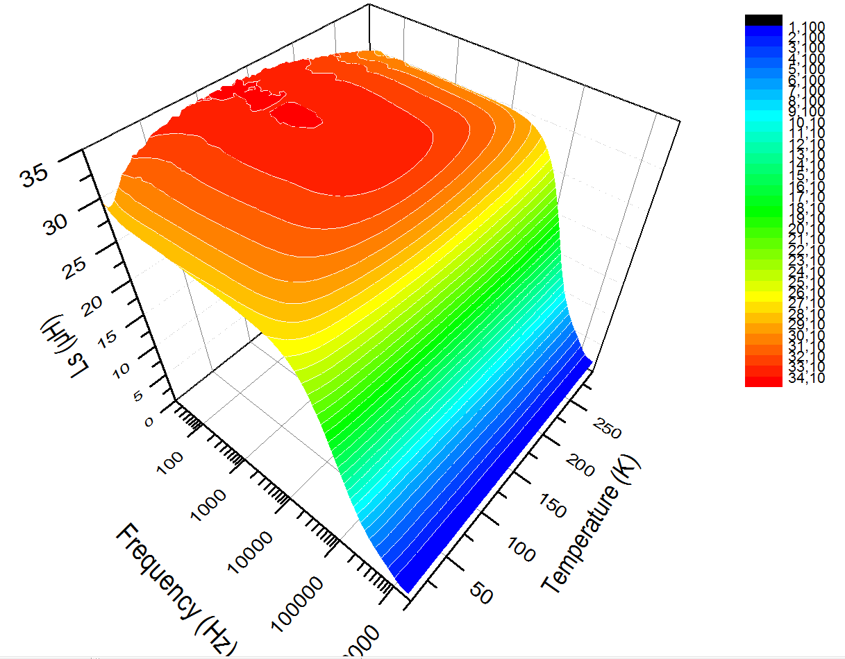
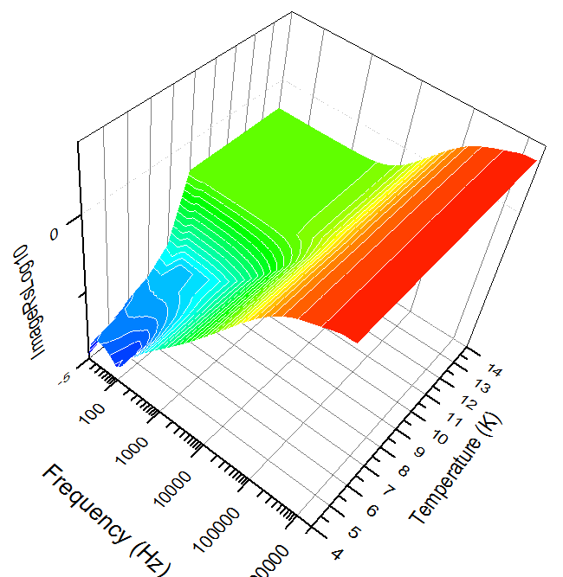
4 Kernmessungen – 3D Diagramme
51
M-116plus Ls
M-116plus Rs log₁₀

Slide 52
4 Kernmessungen – Ls(T)
52
„100 000er“-µ‘-Kern
„30 000er“-µ‘-Plus-Kern

Slide 53
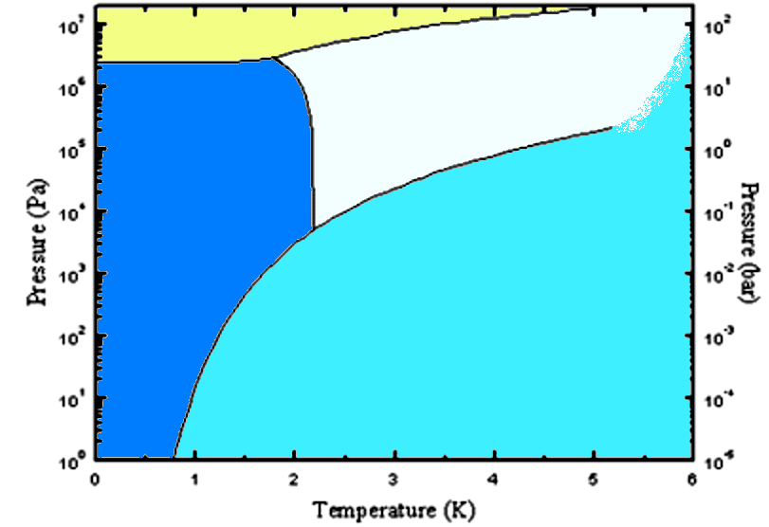
5 < 4,2 K suprafluides LHe II
53
fest
⁴He I
flüssig
Druckverminderung
Abpumpen von He
4,2 K
⁴He II
supra-fluid
λ-Punkt
50,36 hPa
2,1768 K
Druck p / bar
Druck p / Pa
gasförmig
Temperatur T / K

Slide 54
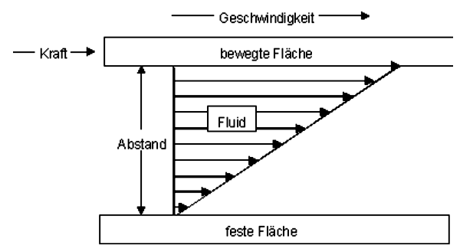
5 < 4,2 K suprafluides LHe II
54
Quantenflüssigkeit mit
makroskop. Quanteneffekt
Innere Reibung / Viskosität η
$$u$$
$$A$$
$$F_{R}$$
$$F_{R}=−η∙A∙\frac{du}{dy}$$
$$y$$
Dynamische Viskosität in mPa∙s :
Glas @RT 10²²…10²⁴
Steinsalz 10¹⁸…10²¹
Glas @Verarbeitungstemp. 10⁶…10¹²
Wasser @20°C 1
Diethylether 0,24
LN₂ 0,14
LHe II => 0
https://www.youtube.com/watch?v=2Z6UJbwxBZI

Slide 55
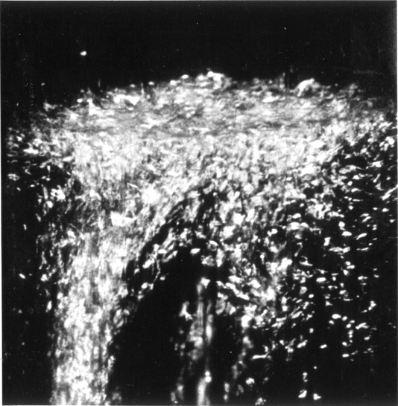
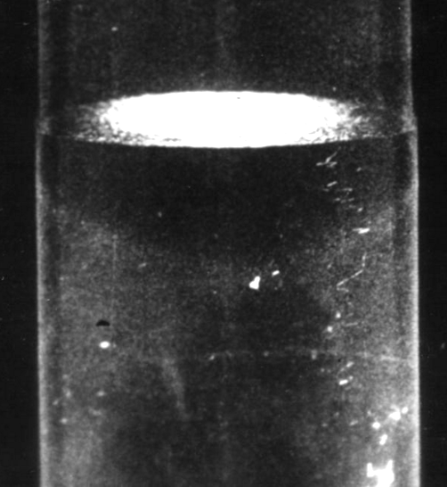
5 < 4,2 K suprafluides LHe II
55
Quantenflüssigkeit mit
makroskop. Quanteneffekt
Wärmeleitfähigkeit λ
$$\dot{Q}=λ∙A∙\frac{ΔT}{l}$$
Wärmeleitfähigkeit in W/(K∙m) :
Polystyrol ≈ 0,04
LN₂ 0,15
Glas ≈ 0,8
Messing 120
Kupfer rein 400
Diamant 2400
LHe II => ∞
LHe I
LHe II
keine Siedeblasen
weniger Rauschen
https://www.youtube.com/watch?v=2Z6UJbwxBZI

Slide 56
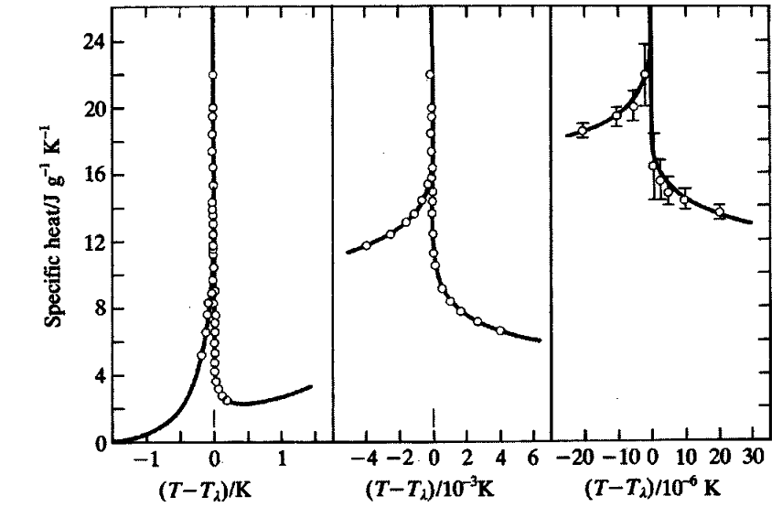
5 < 4,2 K suprafluides LHe II
56
Quantenflüssigkeit mit
makroskop. Quanteneffekt
spez. Wärmekapazität c
$$c=\frac{ΔQ}{m∙ΔT}$$
T_{λ} = 2,1768 K @ 50,36 hPa
* Kalibrierung
* Temperaturstabilisierung
M. J. Buckingham , W. M. Fairbank, ‘‘The nature of the λ-transition in liquid helium’’, Progress in Low Temperature Physics, 1961, Vol. 3, pp. 80–112.

Slide 57
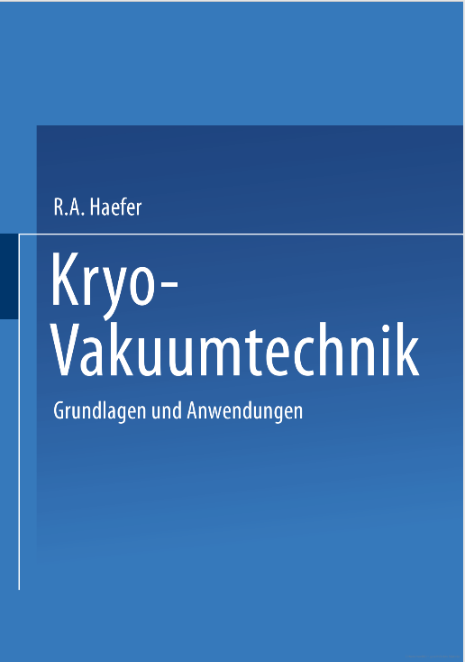
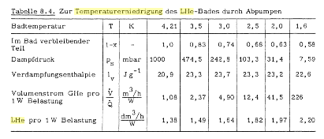
5 < 4,2 K Abpumpen
57
Theorie: Ende
Start
Praxis: Ende

Slide 58
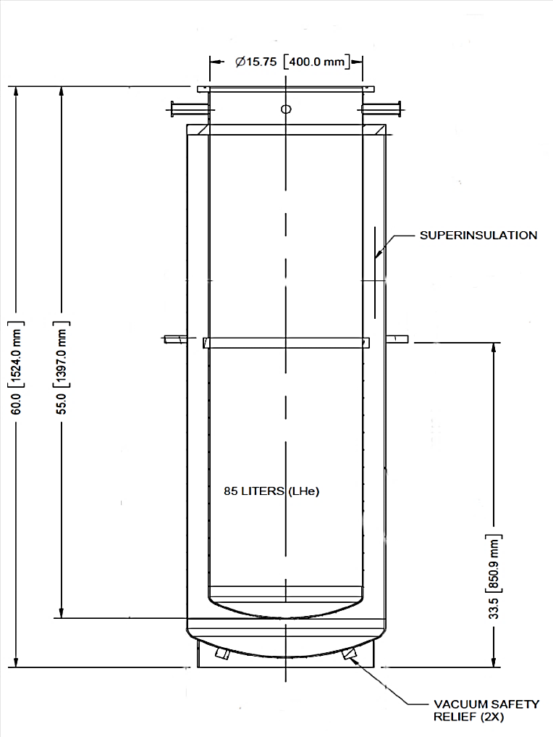
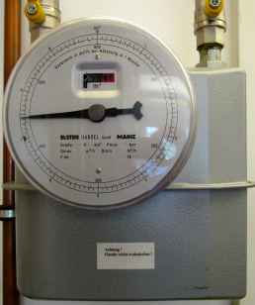
5 < 4,2 K Abpumpen
58
Weithals-Kryostat
Bypass
Druckmesser
He-
Rückleitung
≈1000 mbar
Scroll-
pumpe
15 m³/h
He-
„Uhr“
10 dm³/U
Nadelventil
He-Druckausgleich
Gefüllt: LHe-Bedarf: ca. 0,63 l/h => 450 mW

Slide 59
5 < 4,2 K Abpumpen
08:07
15 s/U
59
09:10
13 s/U
He-“Verbrauch“
s/U
Vor: 75
Anfang: 25
Begrenzung: 13
Ende: 80
+ 12h 80
07:50
25 s/U
08:30
14 s/U
10:10
13 s/U
Gasstrom-Regelung
über Nadelventil
11:45
13 s/U
Temperatur T / K
Bypass auf
12:40
24 s/U
λ-Punkt 2,1768 K
14:15
48 s/U
19:15
80 s/U
Druck p / mbar
[Thermodynamic Properties of Helium ... Robert D. McCarty,1973]

Slide 60
5 < 4,2 K Abpumpen
60
Temperatur-Sensor
OK ?
Maximum der
spez. Wärmekapazität
beim Lamda-Punkt T_{λ}
sollte nachweisbar sein!
λ-Punkt 2,1768 K

Slide 61
5 < 4,2 K He-Druckausgleich
61
Temperatur
OK ?
Lamda-Punkt
T_{λ}
Temperatur T / K
λ-Punkt 2,1768 K
19:30
19:20
in 10 Minuten auf Normaldruck
Druck p / mbar
[Thermodynamic Properties of Helium ... Robert D. McCarty,1973]

Slide 62
5 < 4,2 K Abpumpen
62
Spezialanfertigung
GSI-328plus No.4
1. Messung
2 K - RT
328 mm

Slide 63
5 < 4,2 K Abpumpen
63
Spezialanfertigung
GSI-328plus No.4
1. Messung
2 K - RT
328 mm

