Slide 1
V Stancalie¹, M. Zamfirescu¹, J. Rothardt^{3,4}, M. Letsinski², Z. Adelcovic²,R. Klas^{3,4}, M. Tschernajew^{3,4}, T. Kühl^{2,3}, T.Stöhlker^{2,3} ¹National Institute for Laser, Plasma and Radiation Phys.,077125 Magurele-Ilfov, Romania ² GSI Helmholtzzentrum für Schwerionenforschung, 6429 Darmstadt, Germany ³ Helmholtz Institute Jena, 07743 Jena, Germany ⁴Institute of Applied Physics, Friedrich-Schiller-Universität Jena, 07743 Jena, Germany
Coupling of lasers to the UHV of storage rings

Slide 2
OUTLINE
Motivation & Introduction INFLPR in-kind contribution to SPARC@FAIR
The UNIT Summary of the most important technical parameters of the XUV-storage-ring coupling unit
Physics related Summary of theoretical and experimental works performed at the INFLPR in support of SPARC@FAIR
Outlook

Slide 3
MOTIVATION
The Technical Design Report: SPARC@HERS: Instrumentation, approved by the Expert Committee Experiments (ECE) on 22 Jan 2016, establishes a large group of Institutes, including the National Institute for Laser, Plasma and Radiation Physics (INFLPR), distributed over the subjects Laser Spectroscopy, Intense Laser/Ion Interaction and Laser Cooling.
More than 70 researchers, including the INFLPR researchers are listed as participants for these subjects. The INFLPR in-kind contribution is dedicated to design work on the laser beam transport and interaction chamber for the HESR.
The INFLPR scientific collaboration within different SPARC working groups started in 2006 ( DR and MPI studies)
WP 1.2. High Intensity Laser; WP 3.11. Implementation of a Laser Setup; Theory working group
Time | PSP code 1.3.1.3.11 |  |  | Costs
Construction 2007 - 2012 | Investment | Experiment Infrastructure | Laser set-up | 200 kE
 | Development of an X-ray laser | Test Experiments at the Reinjection Beam Line | Laser System with High Repetition rate, Installation of Components | 200 kE /2005

Slide 4
INTRODUCTION
The development of new lasers with novel sources like soft-X-ray lasers or high average power XUV-lasers require specific technical design for the coupling module to the storage ring and for the corresponding differential pumping stages (including the turbo pumps).
In collaboration between the Institute of Applied Physics (FSU&HI Jena) and the INFLPR, existing data in conjunction with new experimental tools will be used to establish technical issues and requirements, and workout the design of an appropriate optical experiment coupling the new XUV source and the storage ring.
As a next step we will carry out the commissioning of the experimental setup and configuration which will be the XUV-storage ring coupling unit.
Preliminary technical specifications and requirements of an appropriate solution for coupling of lasers to UHV storage ring are presented here.

Slide 5
THE UNIT
Vacuum chambers
Vacuum pumps and controllers incl. security shut down system
Mechanical support frame for mounting at beam height
Pressure measurement system for all chambers
Adjustment system for below mounted in-flange tubes
Heater blankets

Slide 6
THE UNIT: Concept of the XUV source
HHG chamber
Mirror chamber
30 cm
70 cm
Ar
Tube d=5mm,
L=100mm
60 cm
Gas nozzle
GIPs
20 cm
Opposite
nozzle
XUV mirrors
Turbo-pump
Turbo-pump
Pre-pump
Pre pump
Pre pump

Slide 7
THE UNIT: Concept of the XUV source
1. option:
Apertures
30 cm
(round chamber)
70 cm
mirror chamber
(angular, chamber)
Aperture 10mm
Fast shutter valve CF 100
4xDN63 CF
y
60 cm
Pump
x
Pinhole
Pump
Pump
Gas jet
z
20 cm
Cleanest Space
15 cm
10⁻³ mbar
10⁻⁶ mbar
Turbo-pump
Turbo-pump
10⁻¹¹ mbar
Pump
Pump
Pump
Pre pump
Pre pump

Slide 8
THE UNIT: Concept of the XUV source
30 cm
(round chamber)
70 cm
mirror chamber
(angular, narrow chamber)
Fast shutter valve CF 100
4xDN63 CF
2. option:
Filter foils
y
60 cm
Filter
x
Pinhole
Gas jet
z
Coupling unit / differential pumping unit
Cleanest Space
20 cm
15 cm
10⁻³ mbar
10⁻⁶ mbar
Turbo-pump
Turbo-pump
T=5% (each filter)
10⁻¹¹ mbar
Needs to be improved!
Pre pump
Pre pump

Slide 9
THE UNIT: Concept of the XUV source
1. option:
Apertures
30 cm
(round chamber)
70 cm
mirror chamber
(angular chamber)
Aperture 10mm
Fast shutter valve CF 100
4xDN63 CF
Tube d=5mm,
L=100mm
60 cm
Pump
Pump
Pump
Gas nozzle
20 cm
Opposite
nozzle
CRYRING
15 cm
10⁻³ mbar
10⁻⁶ mbar
Turbo-pump
Turbo-pump
10⁻¹¹ mbar
Pump
Pump
Pump
Pre-pump
Pre pump
Pre pump

Slide 10
THE UNIT: Concept of the XUV source
Diff. pumping stages 1 -3
30 cm
Fast shutter
valve CF 100
Tubes d=10mm,
L=100mm
CRYRING
NEG-pump
NEG-pump
Turbo-pump
Pre pump

Slide 11
THE UNIT: Concept of the XUV source
Diff. pumping stages: concept of the movable apertures
in the connection flanges
CF40 flange
+- 2°
Tube
Flexible
bellow
+- 10 mm
Tube holder
+- 10 mm

Slide 12
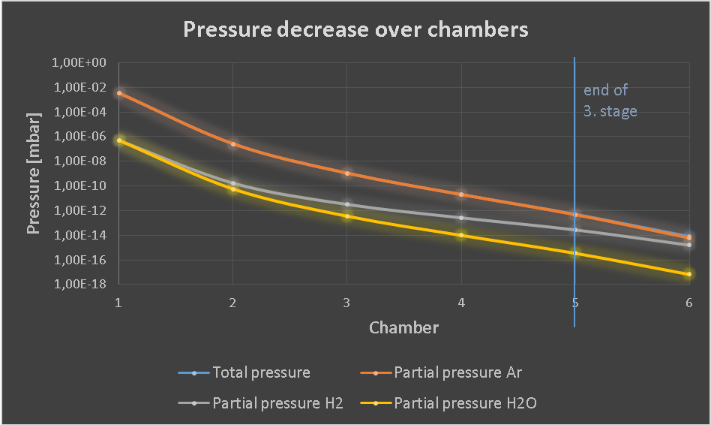
THE UNIT: Concept of the XUV source

Slide 13
THE UNIT: TECHNICAL SPECIFICATIONS
Input pressure : < 10⁻⁶ mbar, mainly Argon or Krypton
Outlet pressure: < 10⁻¹¹ mbar
Max. heating temperature of whole system: 300 ºC
Chamber material : corresponding to the requirements of 10⁻¹¹ mbar
Surface quality: idem
Clear aperture diameter for XUV beam : 10mm adjustable to the beam axis
Max size: length < 1.2 m (as short as possible)., height < 0.5 m, depth < 0.5 m
Max weight 500kg
Max electrical power consumption: 5kW
Max cooling water heat load: 2KW
Coupling unit and XUV source setup for tests: mid of 2017
Whole system ready for experiments at CRYING: end of 2017

Slide 14
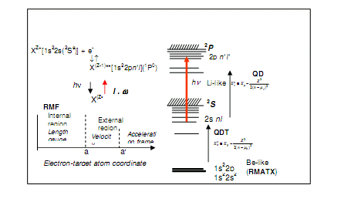
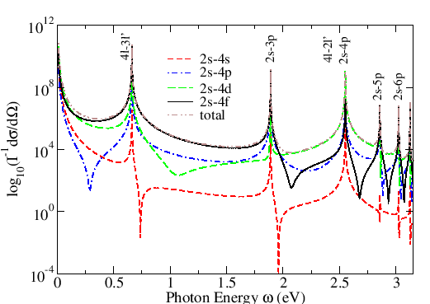
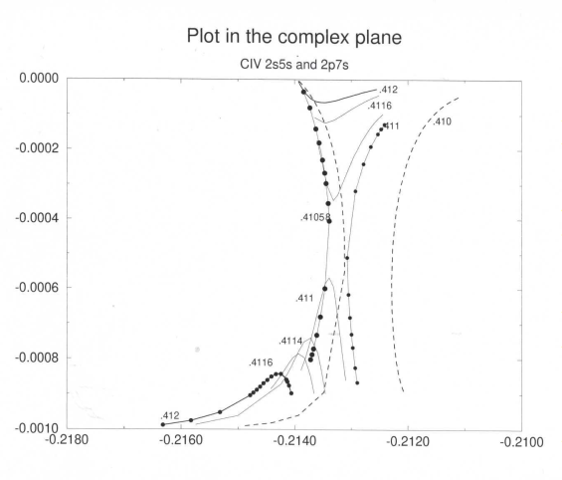
Physics related/ Expertise/INFLPR
Theory &simulation
(Collaboration with QUB, ISM (former LIXAM), ITM Kyoto Univ, Inst Adv. En.)
Structure calculation for ITM-TF:
(RMATX II, GRASP,DARC,ICFT, BPRM)
Photon and Electron interactions with atoms and ions (RMF, TDSE)
Selected bibliography: contributors V Stancalie, G Buica, V Pais, C Iorga
ADNDT 2016(a,b), PRA 2015, AIP Adv 2015, EPJD 2012 - 2014, POP 2005(a,b), PRA 2006, PRA 2005(a,b), LPB 2006, 2007, 2009, Can J Phys 2015, RRP 2015

Slide 15
Physics related/Expertise/INFLPR
XRL Experiments. Collaboration with GSI, ENSTA, IPFN, LaserLab
Refine the XRL experiments @ GSI
Experiments at shorter XRL wavelengths @ CETAL
Experiments with multiple pulses pumping @ LASERLAB facilities
Selected bibliography: contributors D.Ursescu, G Cojocaru, R Banici, R Ungureanu, L Ionel
Optics Express 24, 2016, LPB 32, 2014, Optics Express, 22, 2014, Optics Letters 40, 2015,Optics letters, 37, 2012, Optics Letters, 39, 2014(in collaboration),EPL 94, 2011

Slide 16
Planned activities 2017
Atomic data for HCI ( Li-like and Mg –like)
state-selective photo recombination process in highly charged ions
derivation of an analytical formula for DCS in inelastic electron-hydrogen scattering by a circularly polarized laser field: polarization effects in laser assisted inelastic electron-atom scattering (Buica, PRA2015)
Provide the optimized design of the HHG XUV laser beam –HESR coupling unit
Coupling unit and XUV source setup for tests: mid of 2017
Evaluation of the performances of a coupling unit prototype and perform tests at CRYRING –end 2017. Whole system ready for experiments at CRYING: end of 2017

Slide 17
Thank you for your attention!
Thank you for you attention!

