Slide 1
Faculty of Physics, Astronomy and Applied Computer Science
Andrzej Warczak
13th SPARC Topical Workshop
Krakow, 16-20 September, 2016

Slide 2
3 in 1
Welcome
The Faculty in numbers
SPARC in Poland
13th SPARC Topical Workshop
Krakow, 16-20 September, 2016

Slide 3
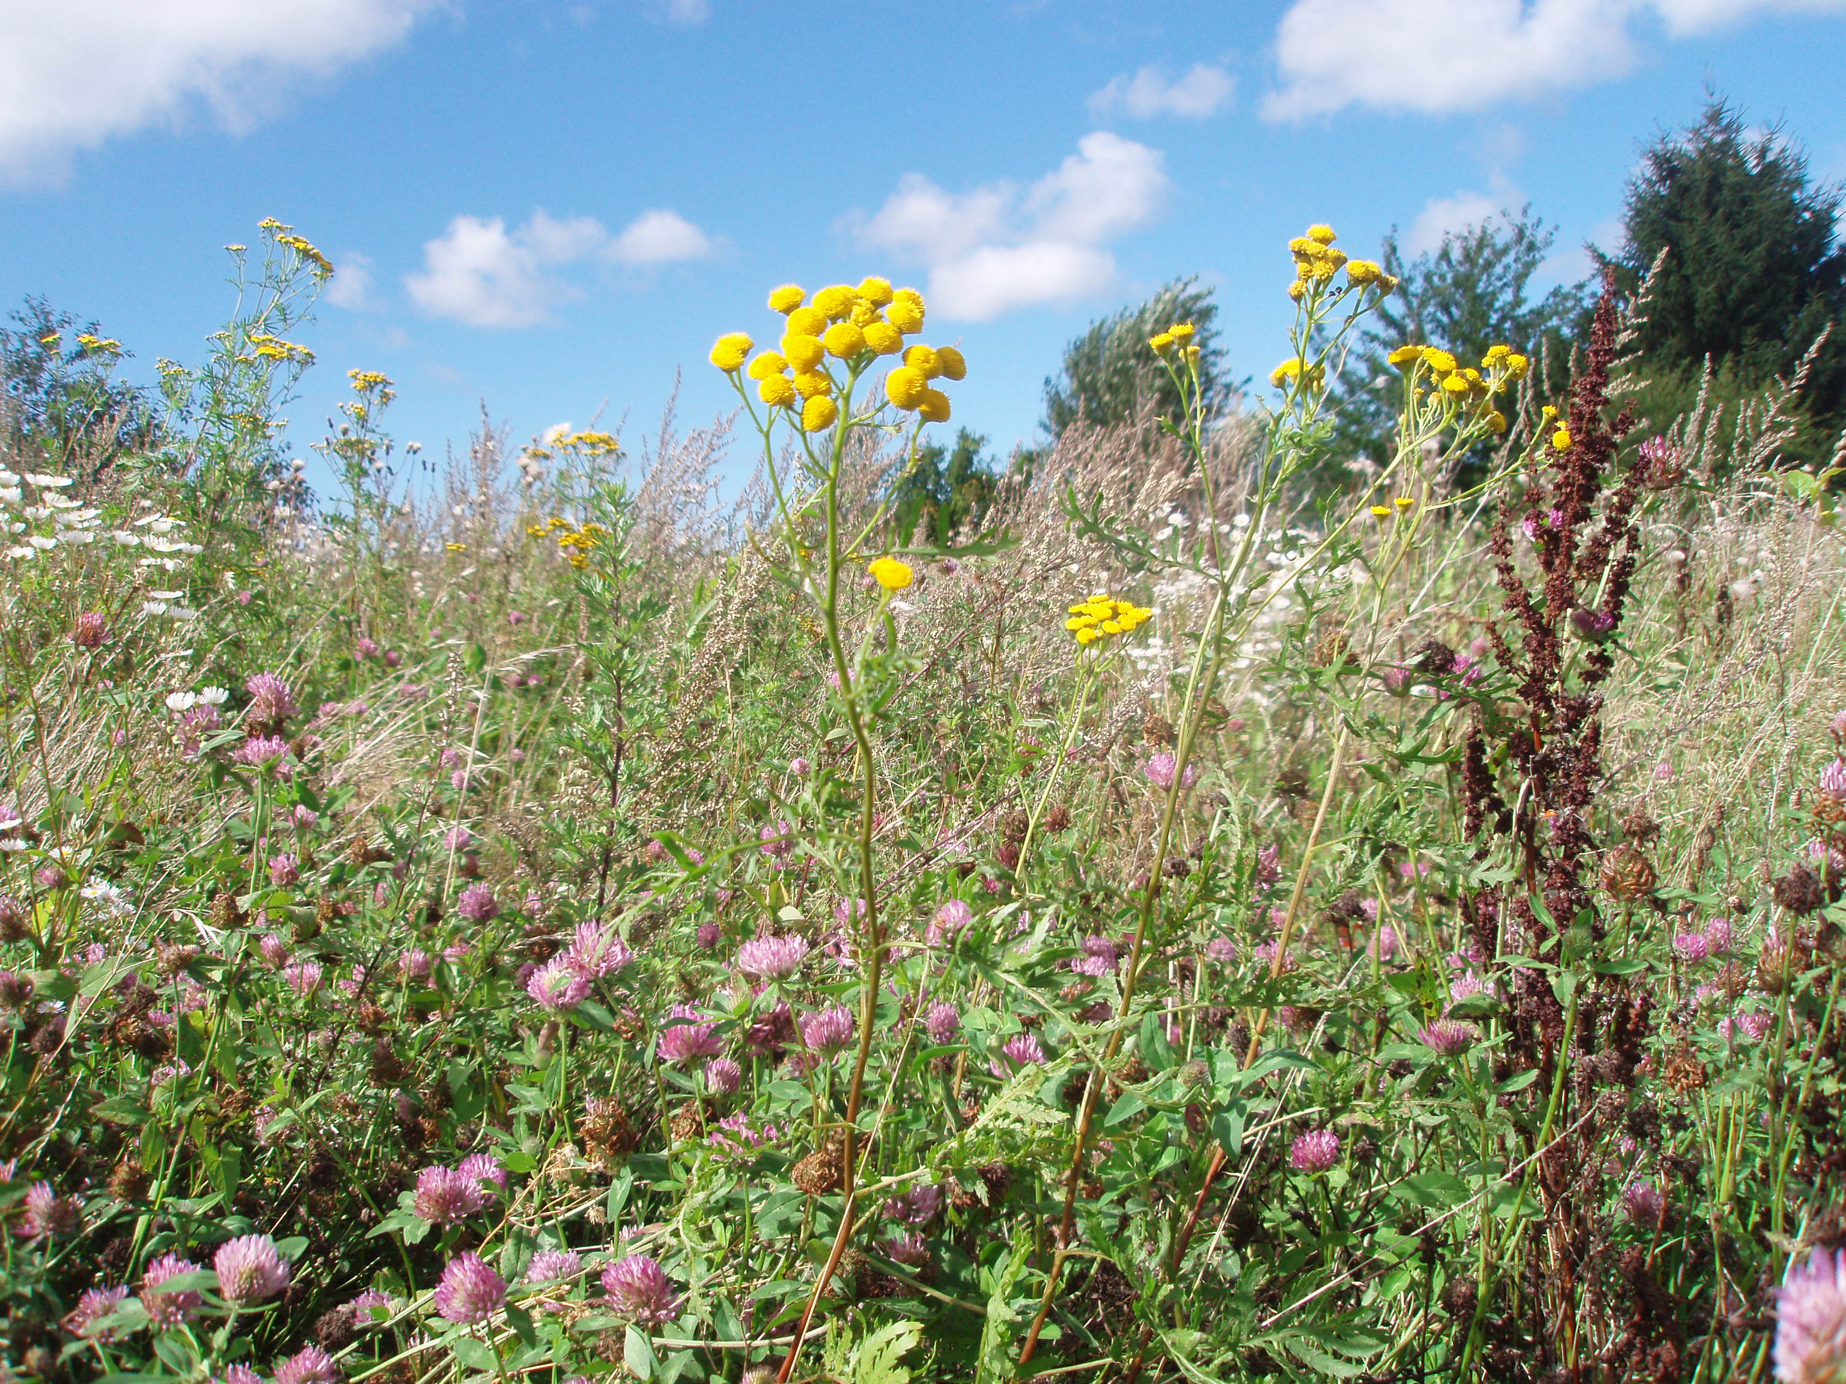
Welcome all SPARC members and fans in Krakόw!
13th SPARC Topical Workshop
Krakow, 16-20 September, 2016

Slide 4
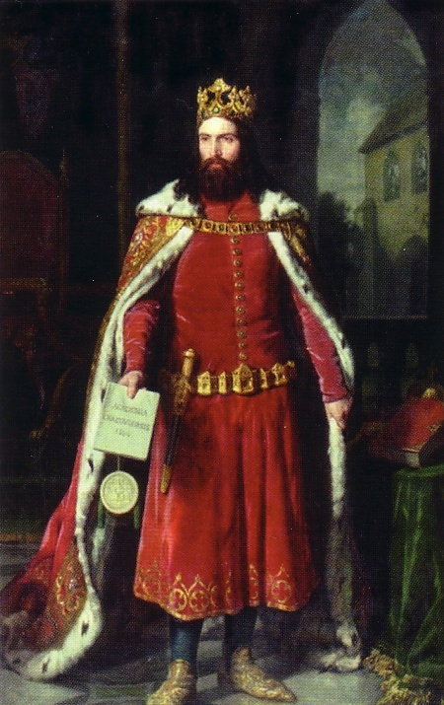
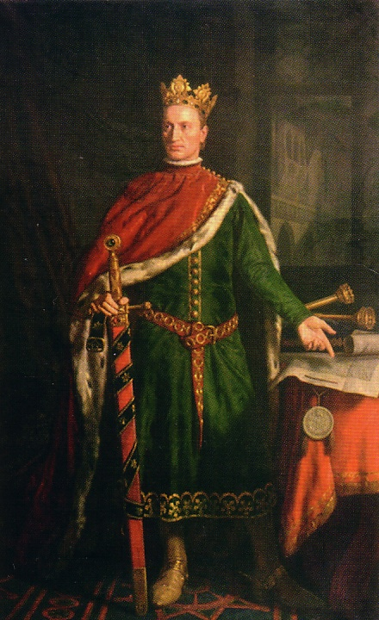
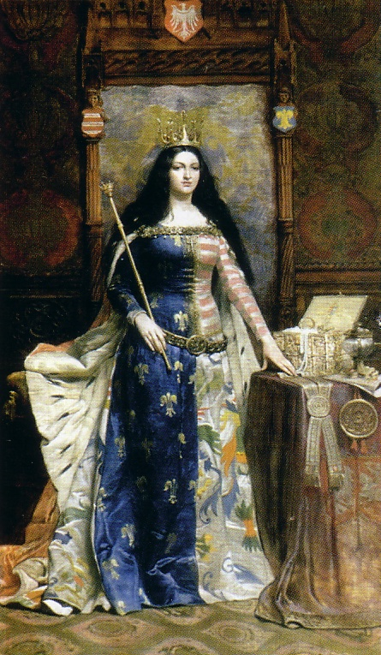
Jagiellonian University in Cracow
652 YEARS OF TRADITION
King Vladislaus Jagiełło
Queen Jadwiga
King Casimir the Great
13th SPARC Topical Workshop
Krakow, 16-20 September, 2016

Slide 5
Faculty of Law and Administration
Faculty of Medicine
Faculty of Pharmacy
Faculty of Health Care
Faculty of Philosophy
Faculty of History
Faculty of Philology
Faculty of Polish Studies
Faculty of Physics, Astronomy and Applied Computer Science
Faculty of Mathematics and Computer Science
Faculty of Chemistry
Faculty of Biology and Earth Sciences
Faculty of Management and Social Communication
Faculty of International and Political Studies
Faculty of Biophysics, Biochemistry and Biotechnology
13th SPARC Topical Workshop
Krakow, 16-20 September, 2016

Slide 6
INSTITUTE OF PHYSICS - PHYSICS DEPARTMENTS
Atomic Optics
Advanced Materials Engineering
Hot Matter Physics
Medical Physics
Methods of Teaching
and Methodology of Physics
Nuclear Physics
Biosystems Physics
Photonics
Radiospectroscopy
Solid State Physics
Experimental Computer Physics
Physics of Nanostructures
and Nanotechnology
Synchrotron Radiation
Statistical Physics
Particles Theory
Field Theory
Relativity and Astrophysics
Applied Computing Methods
Condensed Matter and Nanophysics
Many Body Quantum Theory
Discrete Field Theory
Theory of Complex Systems
13th SPARC Topical Workshop
Krakow, 16-20 September, 2016

Slide 7
THE FACULTY IN NUMBERS
13th SPARC Topical Workshop
Krakow, 16-20 September, 2016

Slide 8
ACADEMIC and TECHNICAL STAFF
SCIENTISTS AND TEACHERS - 194
Professors: 65
Associate professors: 83
Lecturers: 6
Assistants : 40
TECHNICAL STAFF
AND ADMINISTRATION - 117
TOTAL: - 311
13th SPARC Topical Workshop
Krakow, 16-20 September, 2016

Slide 9
STUDENTS (2015)
Physics 206
Astronomy 125
Materials Science 167
Biophysics 146
Computer Science 663
TOTAL: 1307
(undergraduate + graduate)
PHD students 183
13th SPARC Topical Workshop
Krakow, 16-20 September, 2016

Slide 10
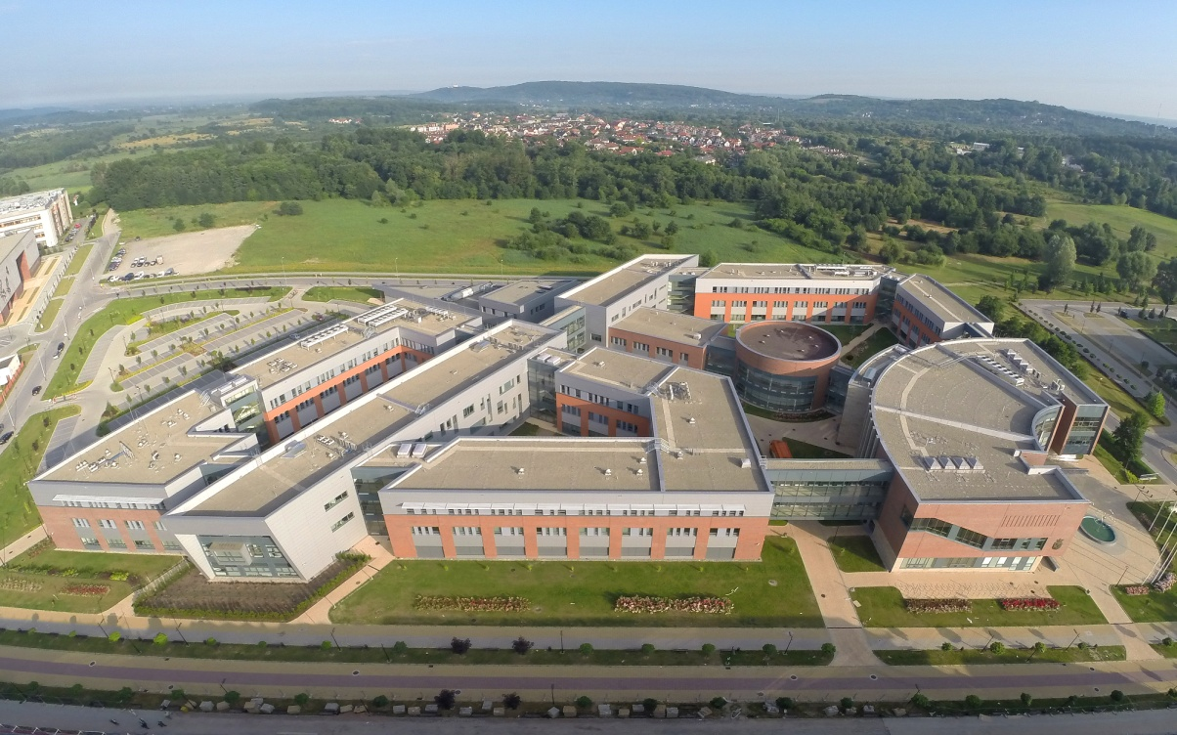
2014/2015 – the Faculty moves to a new location
SIZE OF THE NEW BUILDING
Total volume: 145 250 m³
Total area: 23 448 m²
Teaching area: ~ 4 000 m²
Library: ~ 1 000 m²
Research laboratories: ~ 5 000 m²
Officies for researchers
and administration: ~ 4 000 m²
Total investment cost: ~ 60 M€
13th SPARC Topical Workshop
Krakow, 16-20 September, 2016

Slide 11
TECHNICAL DETAILS
Up-to-date IT infrastructure with over 5000 end-users
(data flow speed from 1 Gb/s up to 20 Tb/s)
14 laboratories screened against electromagnetic noise
(Faraday caves)
Laboratories for nanotechnology experiments with special protection against vibrations
35 clean-room laboratories
13th SPARC Topical Workshop
Krakow, 16-20 September, 2016

Slide 12
RESEARCH STATUS
Recent running projects:
National grants - 125
EU grants - 27
Total projects budget: ~ 20 M€
13th SPARC Topical Workshop
Krakow, 16-20 September, 2016

Slide 13
RESEARCH STATUS
Above 500 scientific papers published yearly
in internationally recognised journals
(Thomson Reuters Master Journal List)
13th SPARC Topical Workshop
Krakow, 16-20 September, 2016

Slide 14
RESEARCH STATUS
Since 2012 the Faculty is a member
of the Excellence Center - KNOW
13th SPARC Topical Workshop
Krakow, 16-20 September, 2016
Notes:
The Faculty is a leading scientific institution in Poland.

Slide 15
RESEARCH STATUS
Scientific category A+ awarded to the Faculty in 2013
13th SPARC Topical Workshop
Krakow, 16-20 September, 2016

Slide 16
RESEARCH STATUS
The Faculty is running scientific cooperation with more
than 100 institutes and universities from all over the world
13th SPARC Topical Workshop
Krakow, 16-20 September, 2016

Slide 17
THE FACULTY OPERATES:
Acta Physica Polonica B
ESTABLISHED IN 1920 BY THE POLISH PHYSICAL SOCIETY RECOGNIZED BY THE EUROPEAN PHYSICAL SOCIETY
(Thomson Reuters Master Journal List)
Covers the following areas of physics:
General and Mathematical Physics
Particle Physics and Field Theory
Nuclear Physics
Theory of Relativity and Astrophysics
Statistical Physics
13th SPARC Topical Workshop
Krakow, 16-20 September, 2016

Slide 18
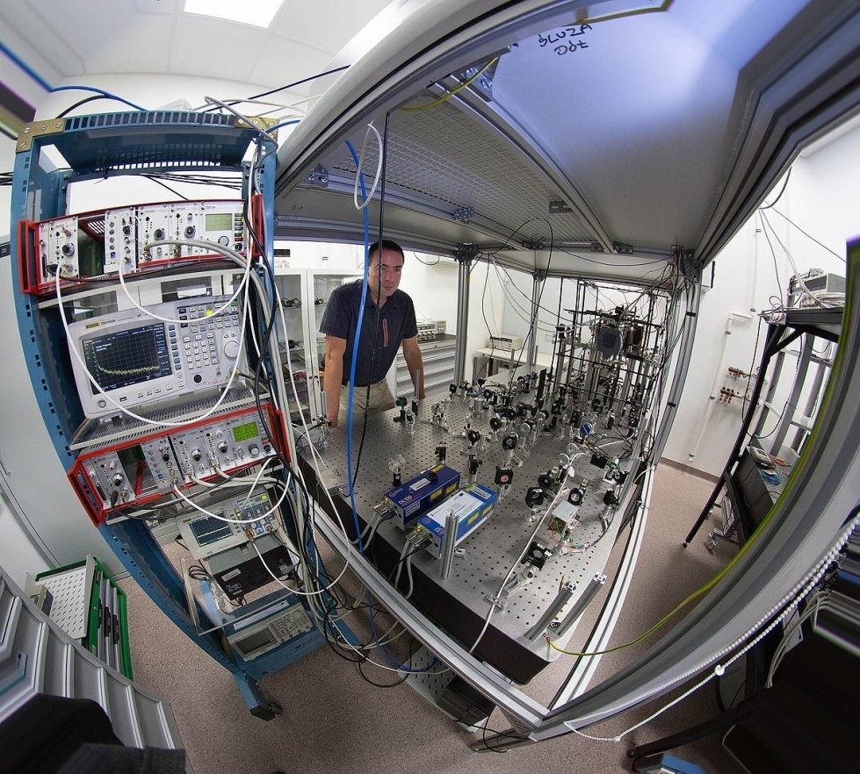
RECENT UPGRADE of SCIENTIFIC
EQUIPMENT
Government budget
EU funds
Total ~ 15 M€
13th SPARC Topical Workshop
Krakow, 16-20 September, 2016

Slide 19
AVERAGE RESEARCH AND TEACHING FUNDING
Government budget
National grant agencies
EU and other international grants
Total ~ 10 M€/year
13th SPARC Topical Workshop
Krakow, 16-20 September, 2016

Slide 20
SPARC in Poland
13th SPARC Topical Workshop
Krakow, 16-20 September, 2016

Slide 21
research programme includes
experimental collaborations
which form four scientific pillars
APPA (Atomic, Plasma Physics and Applications)
CBM/HADES (Compressed Baryonic Matter)
NUSTAR (NUclear STructure, Astrophysics and Reactions)
PANDA (AntiProtons ANnihilation at DArmstadt)
13th SPARC Topical Workshop
Krakow, 16-20 September, 2016

Slide 22
All the Polish teams included into the FAIR program
are organized in the form of a consortium „FEMTOFIZYKA”
These teams represent 11 Polish scientific institutions and contribute to the four FAIR pillars
Board of the „FEMTOFIZYKA” consortium meets
at the Jagiellonian University
(the Polish holder of the FAIR shares)
13th SPARC Topical Workshop
Krakow, 16-20 September, 2016

Slide 23
Scientific groups from
are responsible for the Polish SPARC input for FAIR
(environment for atomic collision physics at FAIR)
13th SPARC Topical Workshop
Krakow, 16-20 September, 2016

Slide 24
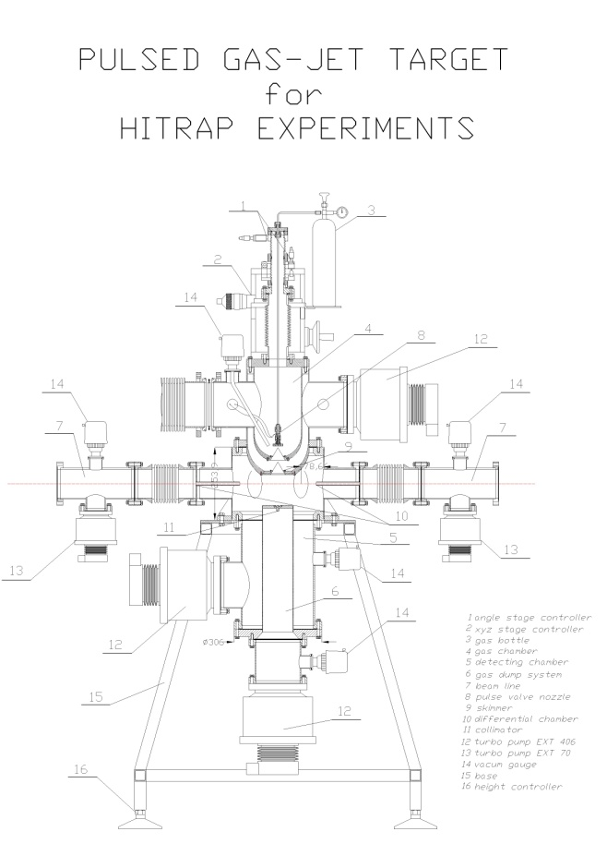
Development of a gas-target setup for matter
and antimatter collision studies with antiprotons
and heavy HCI’s at the HITRAP facility for FAIR
2007-2009 design of the pulsed jet target
INTAS research project
(with GSI and Khlopin Radium Institute)
13th SPARC Topical Workshop
Krakow, 16-20 September, 2016

Slide 25
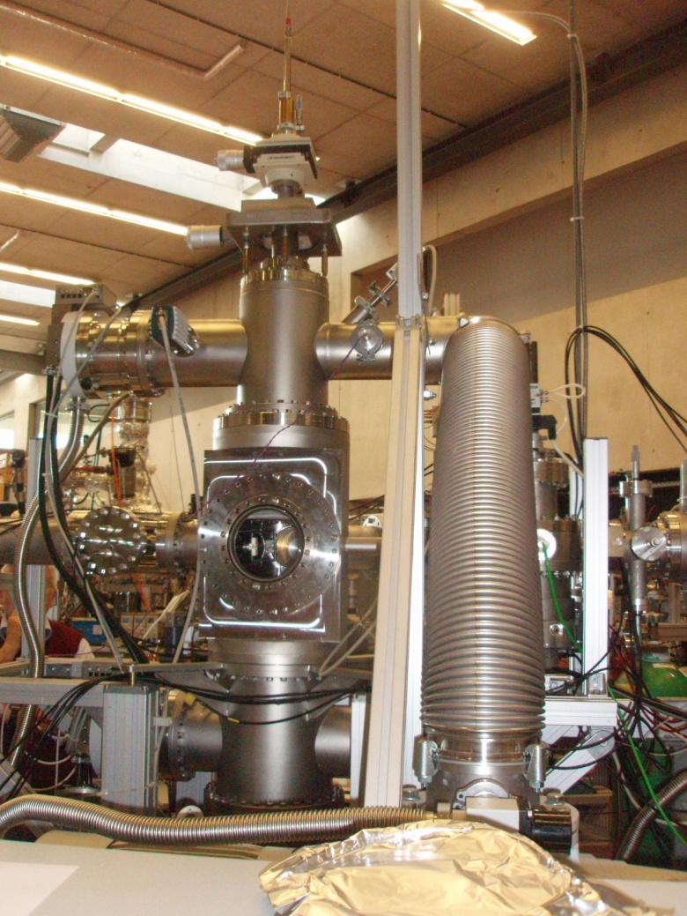
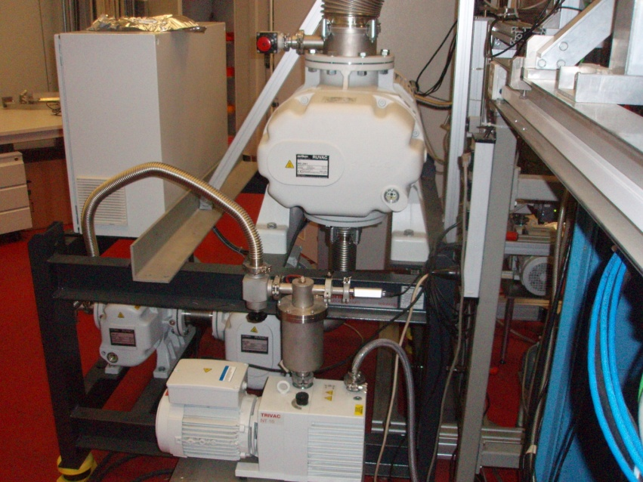
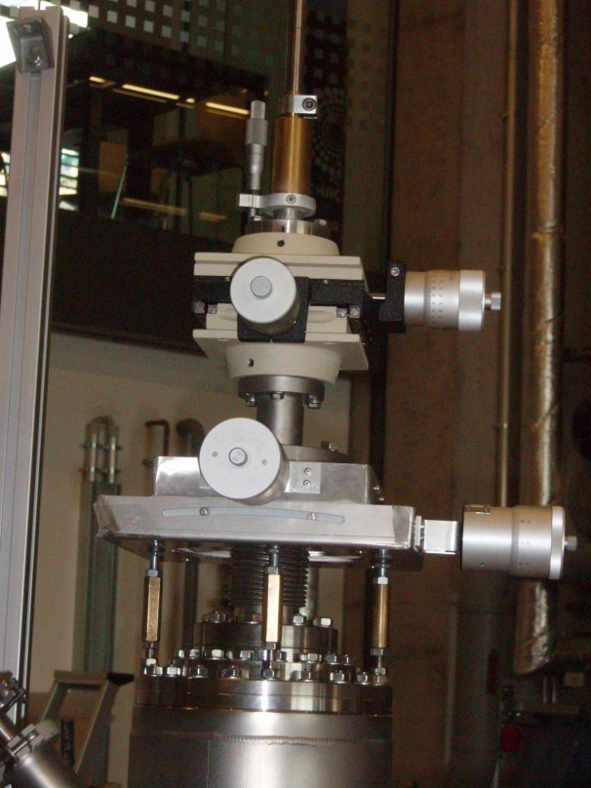
2010-2013 construction of the gas target in co-operation
with Frankfurt University, GSI and ITEP Moscow
Grants: 06FY9098I (BMBF Germany), PB 1044/B/H03/2010/38 (Poland)
(D.Tiedemann et al. Nucl. Instr. Meth. A764, 387-393 (2014))
13th SPARC Topical Workshop
Krakow, 16-20 September, 2016
Notes:
A complex system for the nozzle adjustement

Slide 26
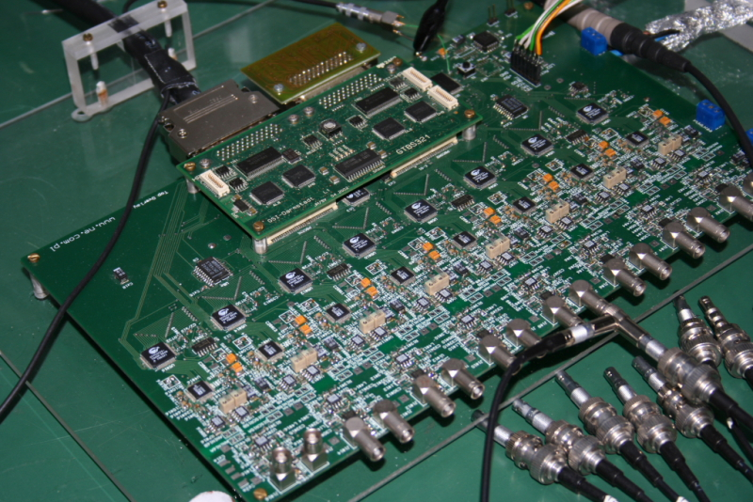
2006 – 2009 Polish teams provided an input to the development
of the digital electronics units
Main motivation – application in multistripe 2D and 3D x-ray
detectors
Simplification of data acquisition electronics
Improvements of time and energy resolution
Reduction of cross-talk effects
Control of signal shaping algorithms
Online data analysis
Low cost per channel
One of the first digital 12-channel boards
tested at GSI (M.Kajetanowicz, D.Sierpowski)
13th SPARC Topical Workshop
Krakow, 16-20 September, 2016

Slide 27
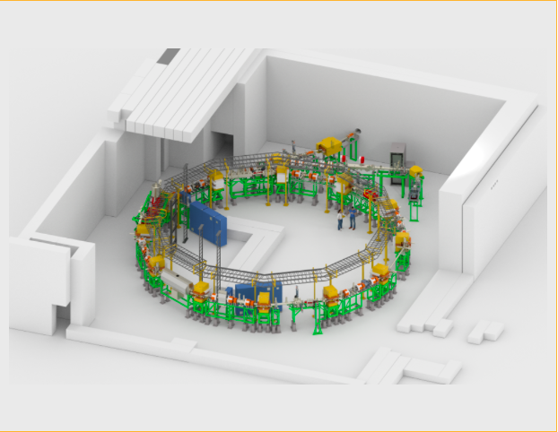
A more recent input to SPARC concerns CRYRING (in-kind contribution from Sweden), in particular, a technical work on refurbishing of the CRYRING UHV system.
Here, the main task of our technicians is to test, disassemble, complete,
reassemble and commission the backing system of the CRYRING, in particular backing jackets, heating circuit and control units (work in progress as well as preparation of a suitable collaboration contract for the Polish in-kind contribution )
CRYRING at GSI
(in-kind contribution from Sweden)
13th SPARC Topical Workshop
Krakow, 16-20 September, 2016

Slide 28
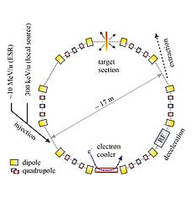
Plans for the next future: a new in-kind contribution
X-ray spectrometer project: CRYRING at GSI
Source characteristics:
1000mm x 1mm (horizontal x vertical)
Access through 10cm flange
www.gsi.de
13th SPARC Topical Workshop
Krakow, 16-20 September, 2016

Slide 29
Proposed setup:
detector
flange
source
virtual source
crystal
collimating/focusing optics
Detection requirements:
X-ray energies – 4keV-15keV
High & ultra high energy resolution (>≈1eV & <0.1eV)
High efficiency (X-ray rates at flange ≈20cts/(sec x 10mm²))
Timing – coincidence measurements at nsec resolution
TDR in preparation
13th SPARC Topical Workshop
Krakow, 16-20 September, 2016

Slide 30
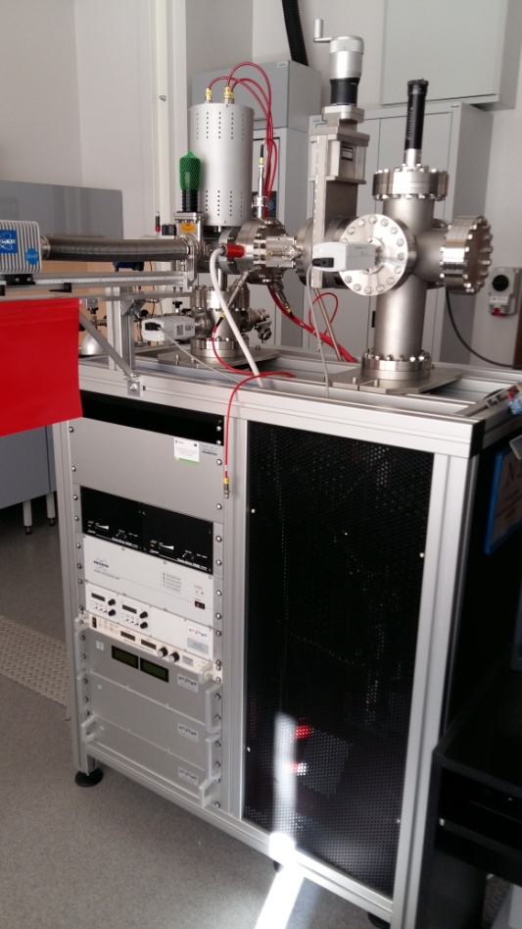
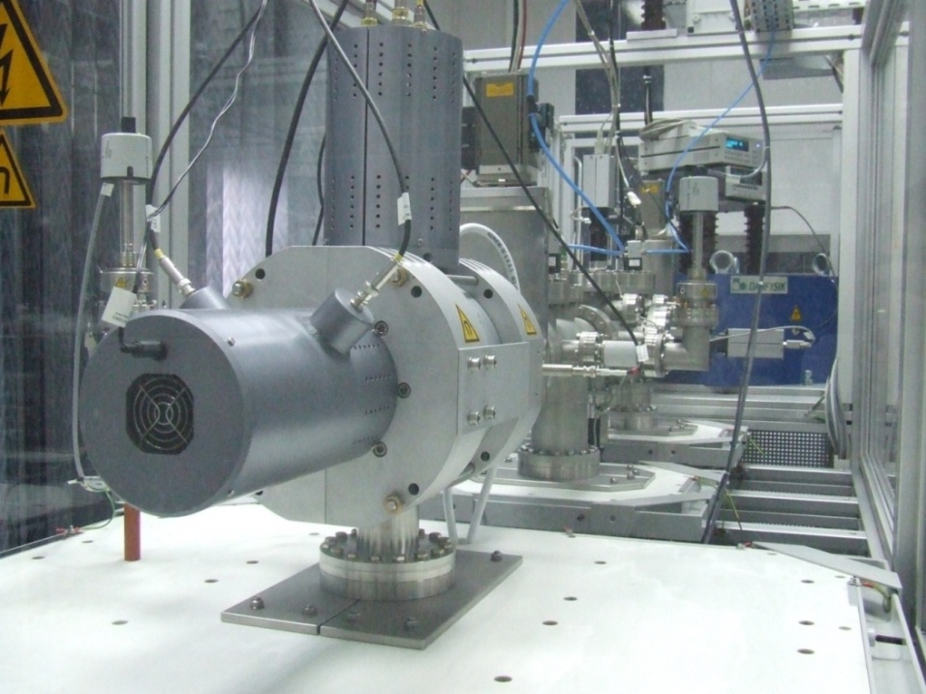
Teaching and motivation of students and young scientists
(production of HCI’s, spectroscopy and applications)
HCI laboratory in Krakow
Kielce EBIS facility
Commercial Dresden EBIT
Commercial Dresden EBIS-A
13th SPARC Topical Workshop
Krakow, 16-20 September, 2016

Slide 31
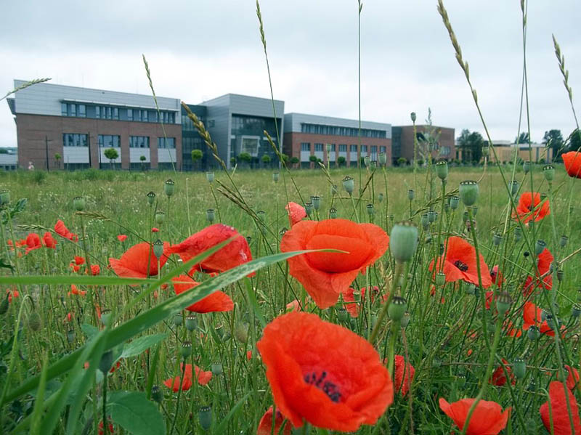
Thank you for your attention!
13th SPARC Topical Workshop
Krakow, 16-20 September, 2016

