Slide 1






Current developments at GSI and FAIR for Atomic Physics & SPARC
Thomas Stöhlker
Helmholtz Institute Jena, GSI, & Friedrich Schiller University, Jena

Slide 2

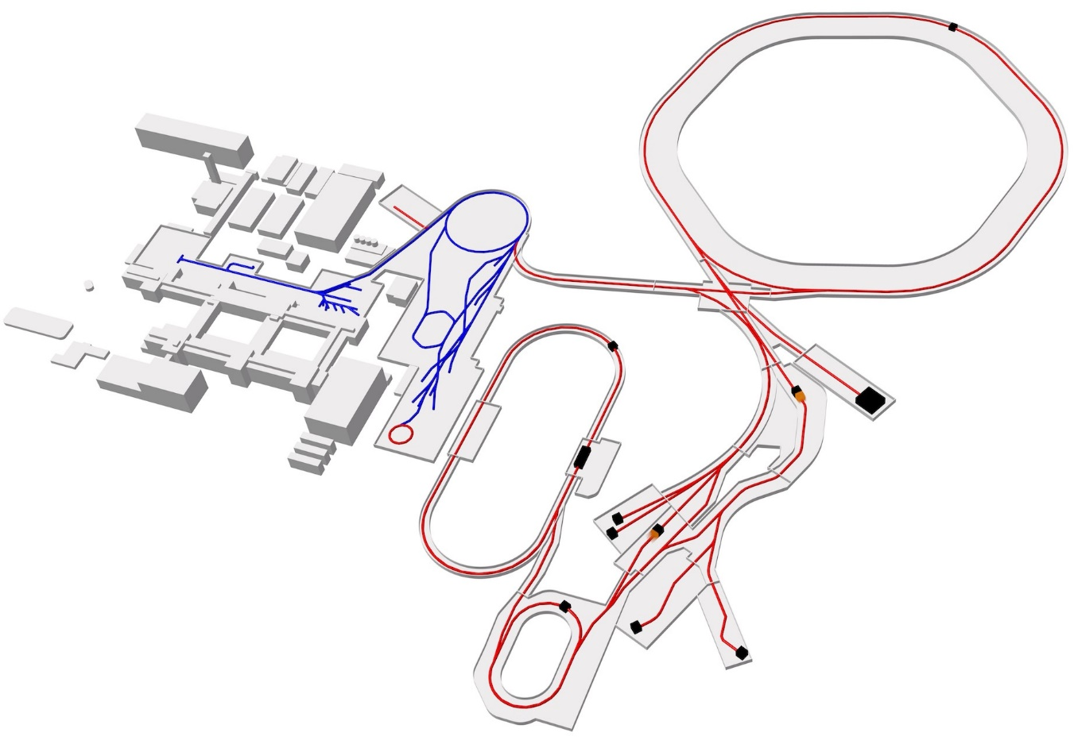
The International Facility for Antiproton and Ion Research
Ion Beams today
Z = 1 – 92
up to 2 GeV/nucleon
Ion Beams in the future
100 – 1000 fold intensity
Z = -1 – 92 antiprotons
up to 35 - 45 GeV/nucleon

Slide 3
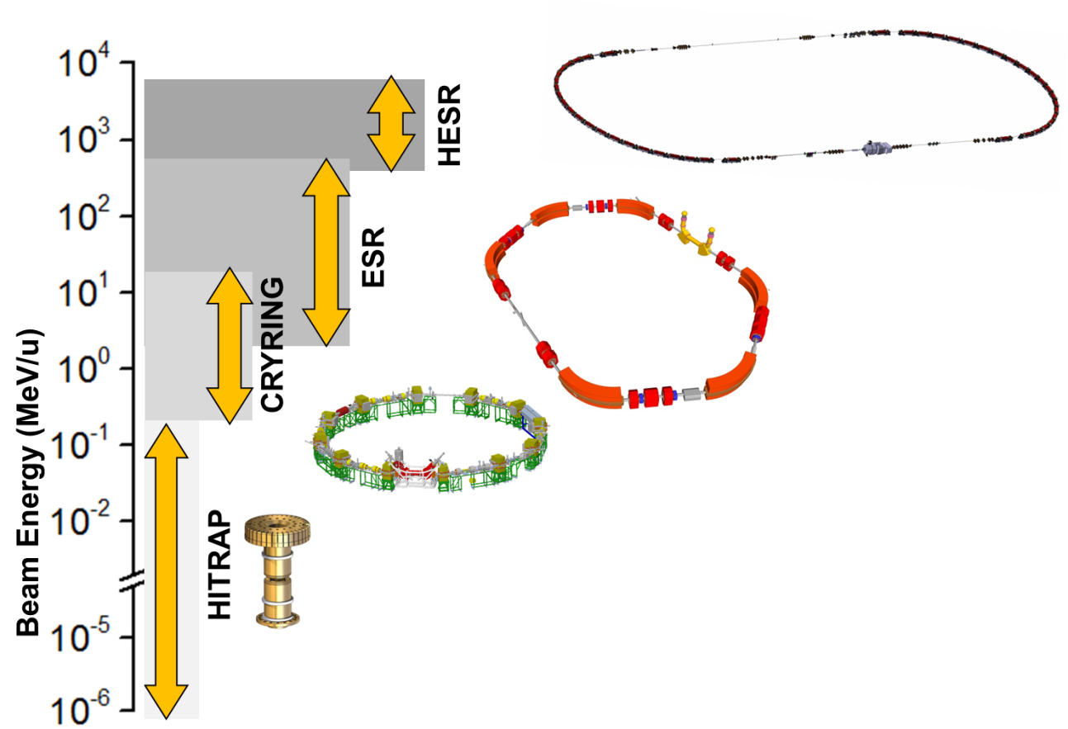
Beam Facilities / Trapping & Storage
Cooling: The Key for Precision
From Single Particles to Highest Intensities
Notes:
statt „Ions“ → neue Überschrift
Farbrahmen + farbl. Schrifteb

Slide 4
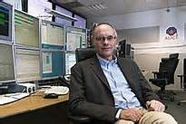
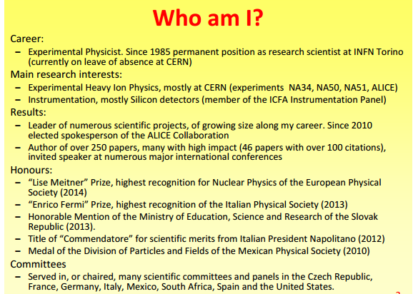
TOP 2 Berichte von den Zentren / Helmholtz
Nomination of New Joint Scientific Managing Director
Paolo Giubellino (Spokesperson of the
ALICE experiment at CERN)

Slide 5
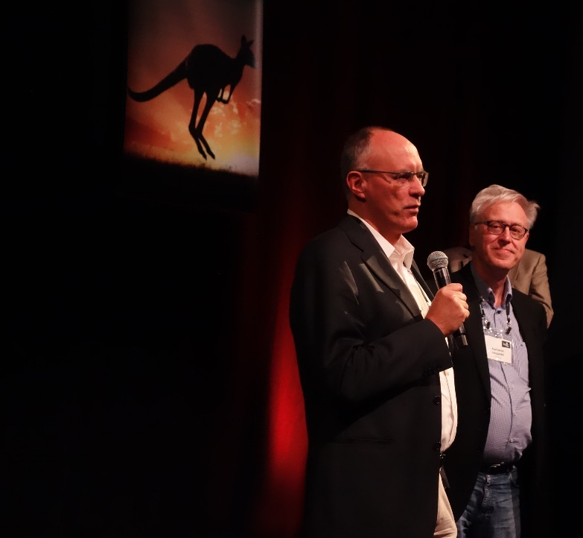
BMBF gives green light for the civil engineering of FAIR
Dear FAIR and GSI employees,
We are happy to announce that we have achieved a major step towards the realisation of FAIR. The BMBF cleared financial means for the civil engineering of FAIR, construction section north, yesterday after a coordination meeting with the FAIR/GSI management in Bonn.
Thanks to the clearance actual contracting of construction work can start for the northern building site of FAIR including the ring tunnel and further buildings and infrastructures. Already in September first calls for tender for excavation and sheeting will start.
Presuming a smooth progress of the tendering procedure we will be able to start construction works midyear 2017.
With best regards
Your FAIR and GSI Management Boards
Joerg Blaurock, Ursula Weyrich, Boris Sharkov, Karlheinz Langanke

Slide 6
New Joint Management for GSI and FAIR
✓
Joint Scientific Managing Director
Paolo Giubellino
will start his term 1st January 2017
Joint Administrative Managing Director
U. Weyrich as of 1st Nov. 2014
Joint Technical Managing Director
Jörg Blaurock as of 1st February 2016
→Expert for large scale plant engineering
and construction
✓
✓

Slide 7
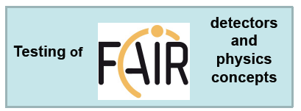
Intermediate Research Program “FAIR Phase 0”
Goals
  forefront research by employing and testing new FAIR detectors
  exploiting upgraded GSI accelerator facilities
  education of young scientists
  maintain skills and expertise
  serve national and international user community
Strongly recommended by Int. Review Committee
and endorsed by FAIR Council and GSI Supervisory Board
Start of “FAIR Phase 0”
works at GSI Campus for APPA, NUSTAR and partly for CBM (HADES)
CBM and PANDA need participation also in experiments at external research facilities

Slide 8
FAIR Phase 0
APPA
  using Cryring, UNILAC, SIS18, ESR and new APPA detectors for FAIR plus PHELIX
NUSTAR
  using higher intensities at SIS18/ESR and NUSTAR instrumentation for FAIR (e.g. kinematically complete reaction studies with R3B set-up)
CBM / HADES
  HADES using pion beam at SIS18 and partly CBM detectors
  CBM → exploiting CBM detector components at STAR/RHIC and NICA
PANDA / Hadron Physics
  HADES using PANDA detector components
  Participation in experiments at BES III@IHEP/ Beijing and JLAB/Newport

Slide 9
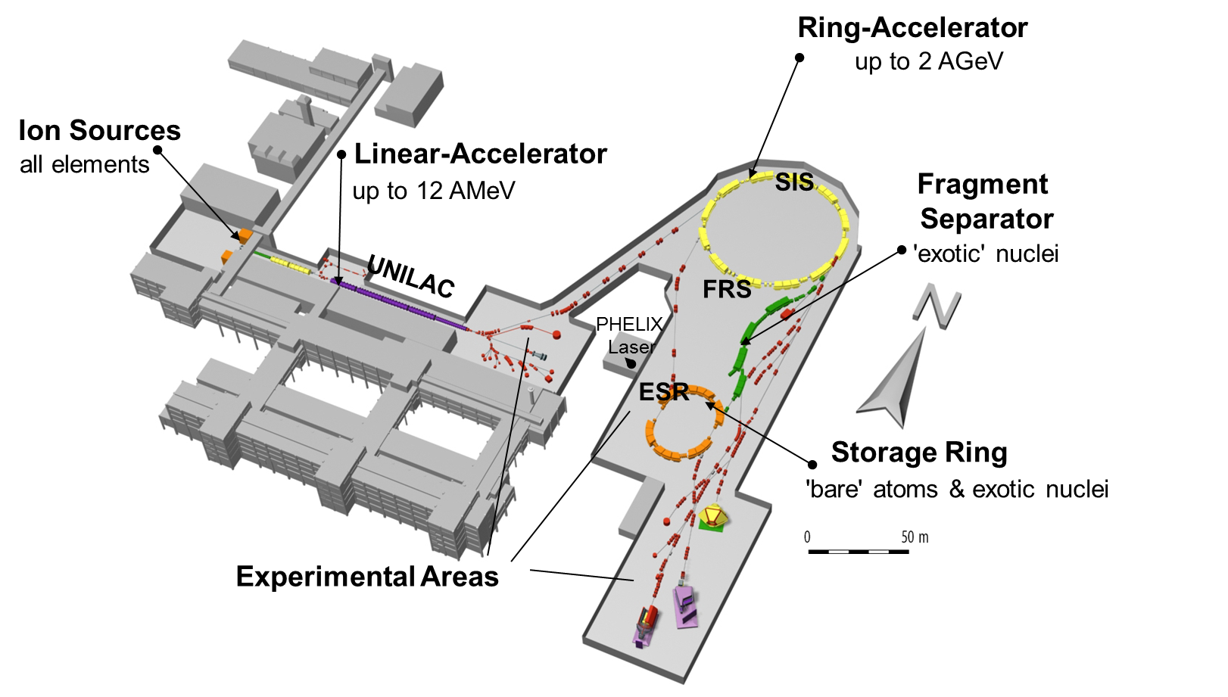
GSI Accelerator and Experimental Facilities
18
s
GLAD Magnet
(French
in-kind to FAIR)
CRYRING
(Swedish
in-kind to FAIR)

Slide 10
GSI Accelerator Facilities
- increased intensities after upgrade
18
18
s
CRYRING

Slide 11
Anticipated Beam Times
Beam time in months:
(total beam time / beam time for experiments)
This beam time schedule has been communicated to the BMBF (“Verbundforschung”)
Call for proposals: beam time at UNILAC in 2016
 | Shifts
Distributed | 180
Requested | 612

Slide 12
Preparation for FAIR Phase 0
Continuation of upgrade measures at the GSI accelerators and construction of FAIR instrumentation
Rich intermediate experimental program exploiting FAIR instrumentation at the upgraded GSI accelerators or at external facilities
Next steps:
Experiment proposals will be evaluated by an international Program Advisory Committee
First call for proposals: beginning of 2017;
first PAC meeting: April/May 2017
First beam time block: starting in the second half of 2018

Slide 13
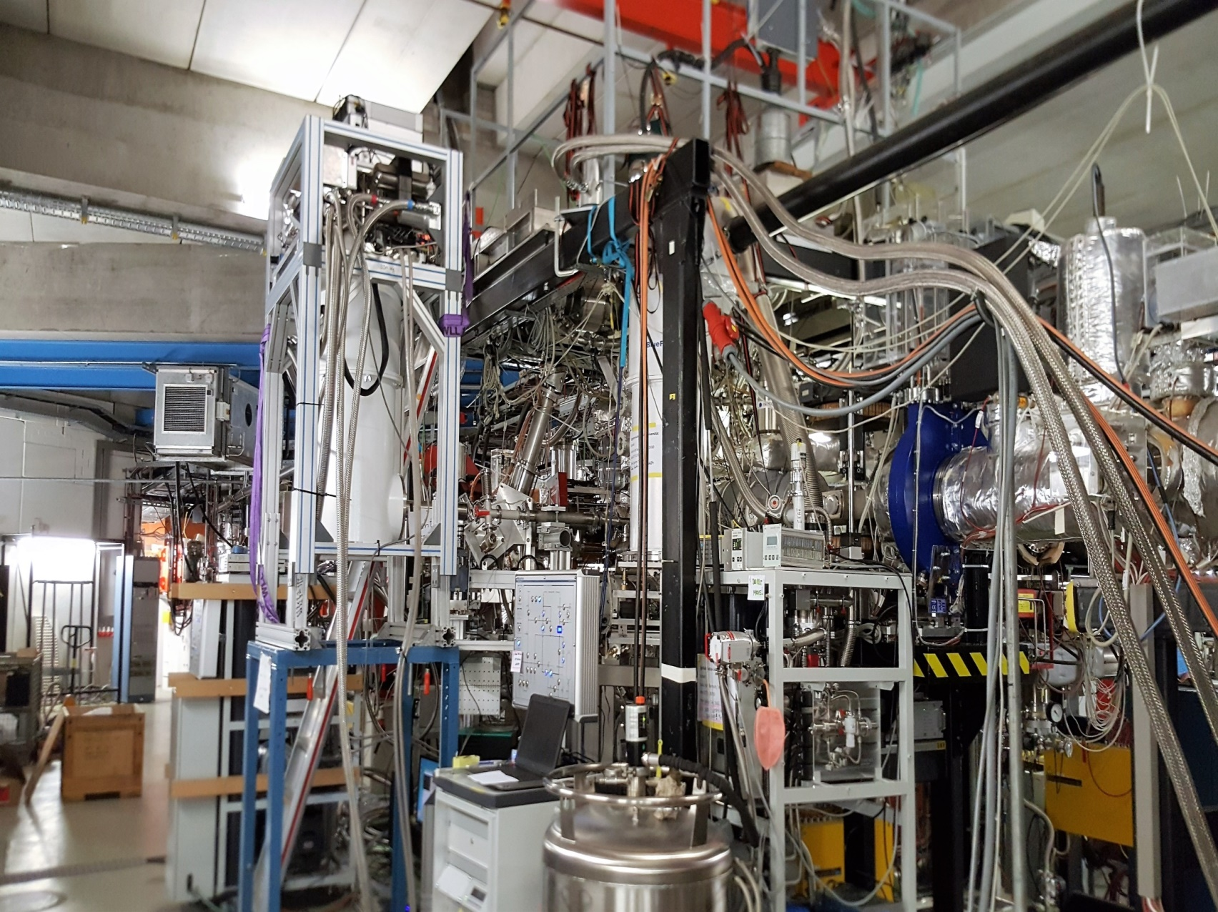


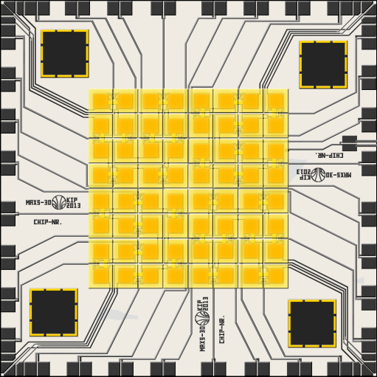

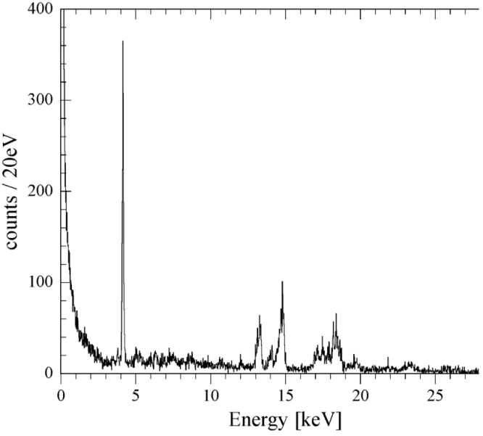


ESR beam time June/July 2016
Atomic Physics test of instrumentation
GSI/Frankfurt
Internal-Target
Heidelberg/HI-Jena
Micro-Cal
µ-calorimeter
Kassel
UV-XUV
GSI
Schottky
Giessen
Micro-Cal
40 Pixel
Li-like uranium
2s_{1/2} – 2p_{3/2}

Slide 14
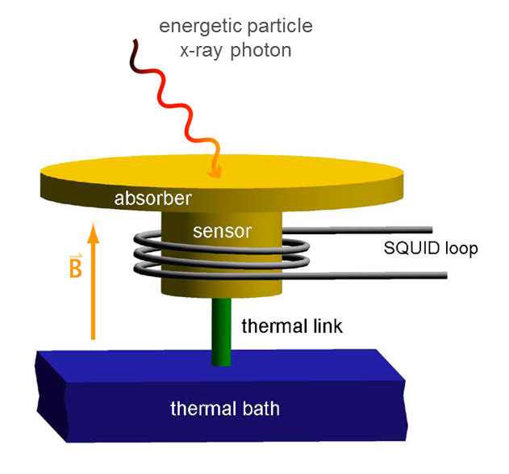
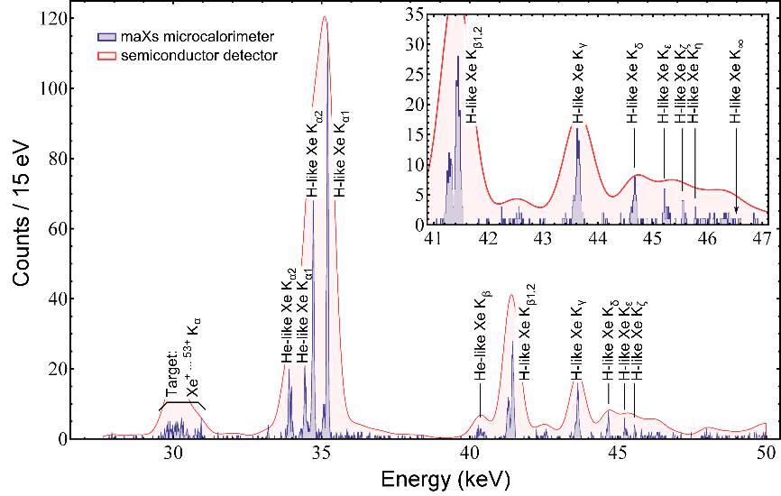
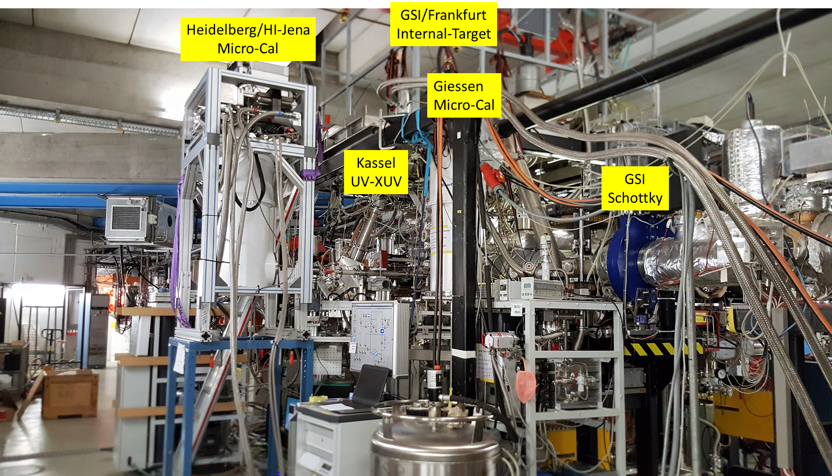
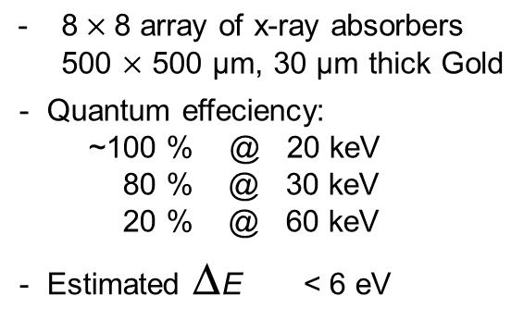

ESR beam time June/July 2016
Atomic Physics test of instrumentation
Precision x-ray spectroscopy for test of bound state QED
Metallic magnetic calorimeter maXs-30: First 2D array currently in use at the ESR (40 pixel)
:
2014:
Xe⁵⁴⁺ =>Xe
6 pixel
June 2016
D. Hengstler et al.

Slide 15

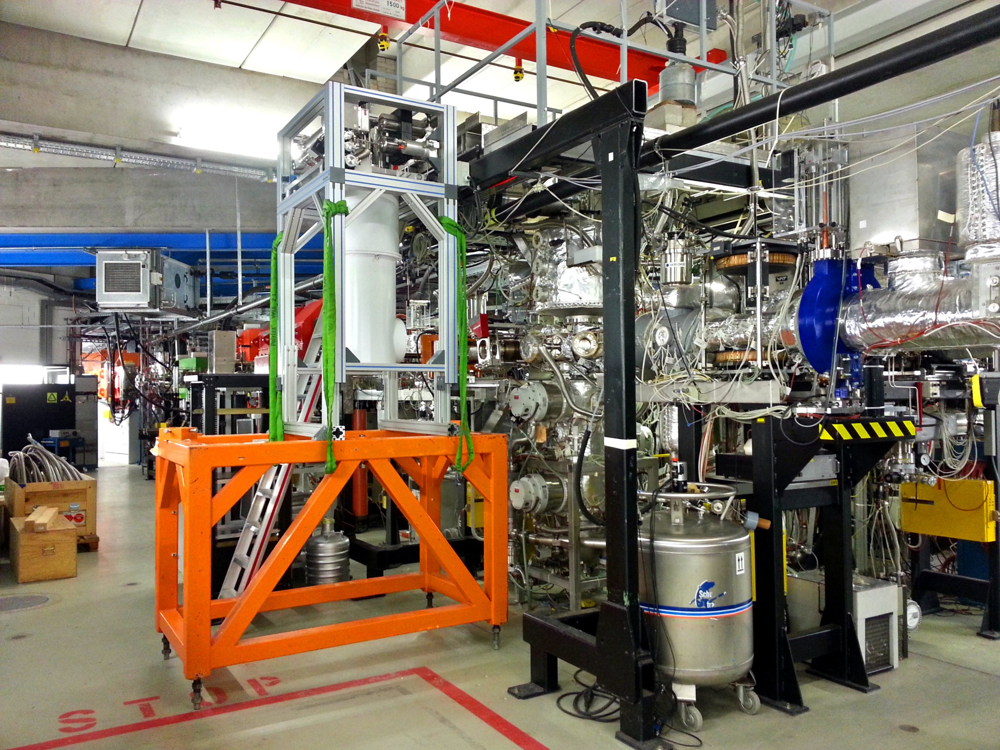
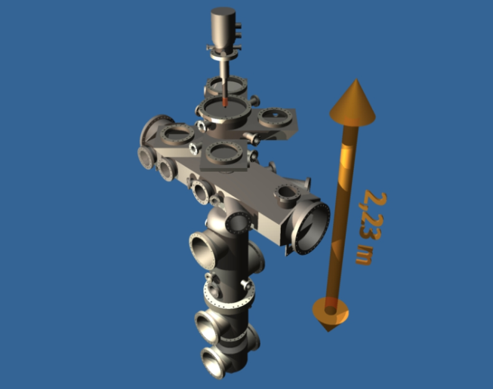
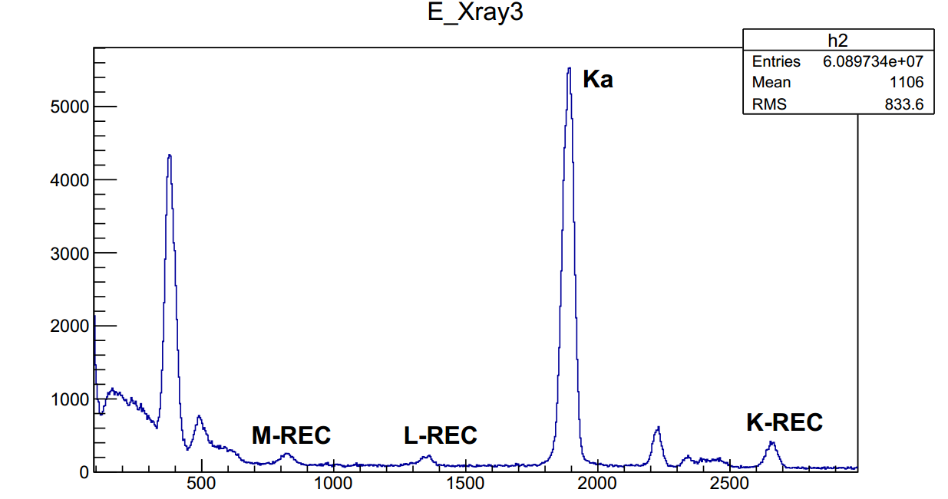
Motivation
Projectile x-ray radiation allows for cross-section for accurate cross- section determination
M
Target station at the ESR
(prototype target for FAIR developed by SPARC)
Stable operation of H₂ target: 10¹⁴ 1/cm²
^{R. Grisenti et al.}
X⁵⁴⁺ => H₂; 5.5 MeV/u
For in-ring collision experiments at energies below 10 MeV/u, the H₂ target is of utmost importance. Beam lifetimes are below 1 s!

Slide 16
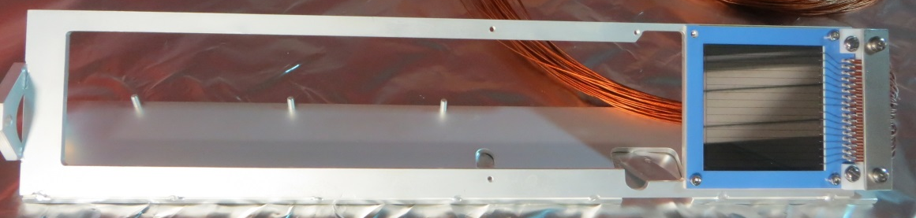
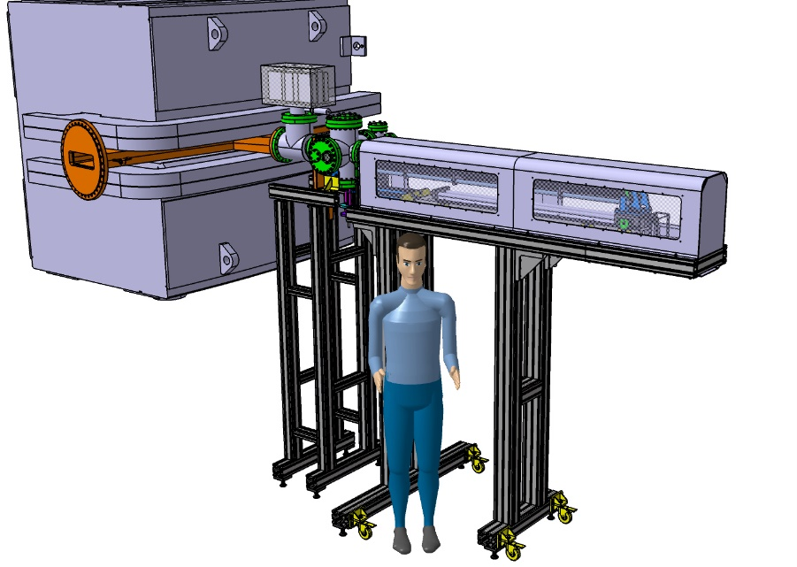
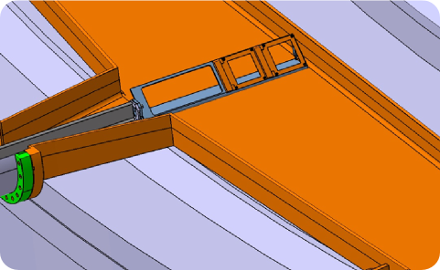
124Xe(p, γ) measurement for p-process nucleosynthesis
¹²⁴Xe(p,γ) measurement for p-process nucleosynthesis
New UHV position sensitive silicon detector
New detector manipulator
5-7 MeV/u ¹²⁴Xe⁵⁴⁺ ions stored in ESR
Successful proof-of concept (also for CRYRING)
DSSSDs
product
inside dipole
primary beam

Slide 17
Proof of principle
Preliminary data: ¹²⁴Xe @ 7 MeV/u
Target „off“
Target „on“
8, 6.7, 6 MeV/u and now running 5.5 MeV/u
Threshold for (p,n) is at 6.75 MeV/u
Data for 6.7 AMeV point to very small, if any at all, (p,n) at 7 MeV/u
Data for 8 MeV/u are (p,n) dominated
Gaussian +
Rutherford background fit

Slide 18
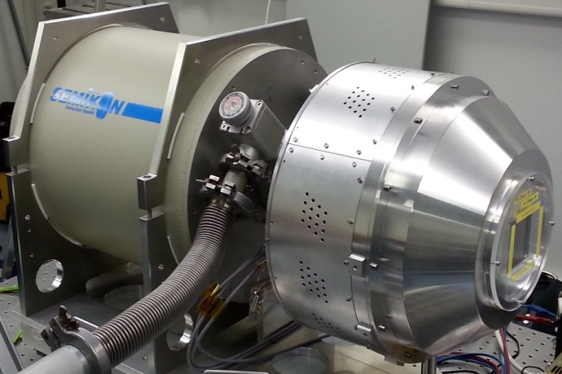
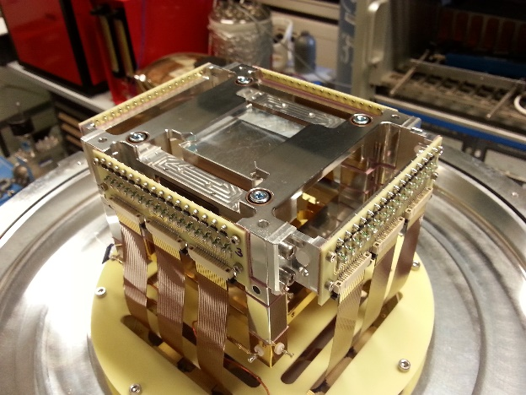
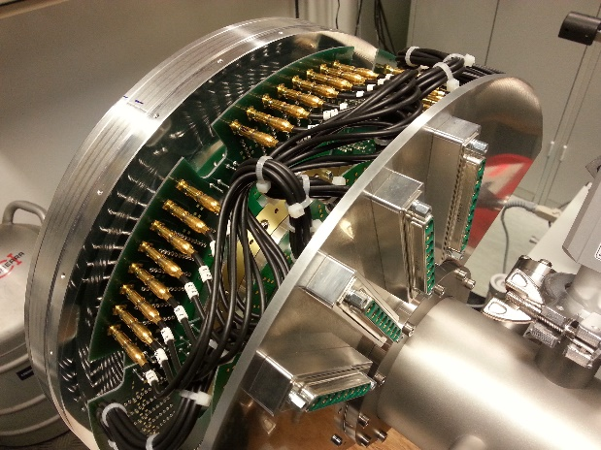
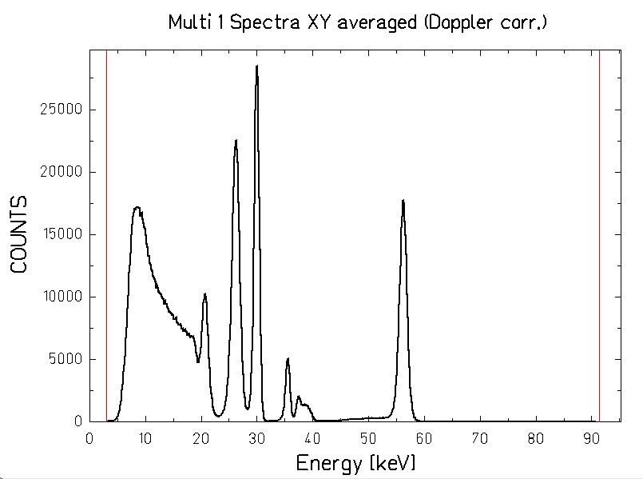
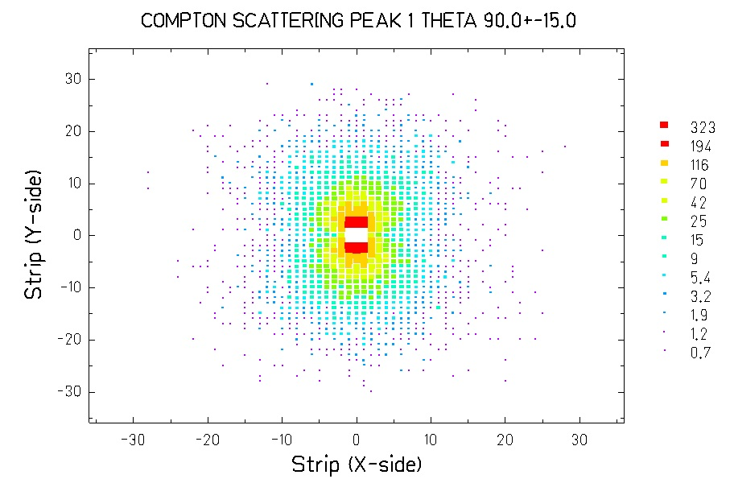
Novel Compton polarimeter
Uwe Spillman and Marko Vockert et al.

Slide 19
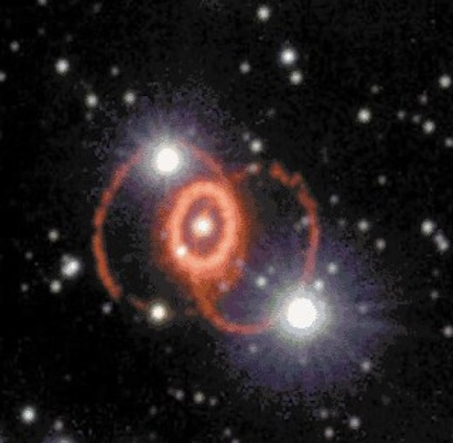


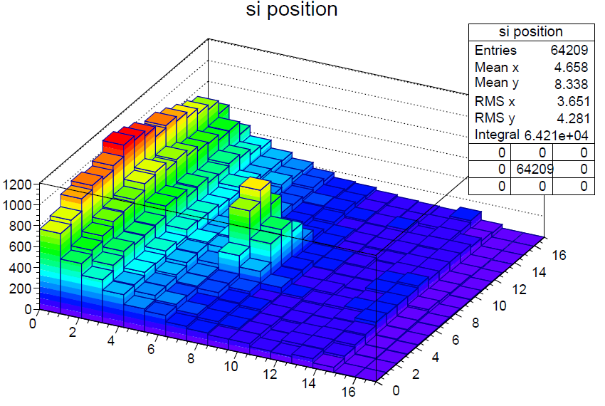

ESR beam time June/July 2016
Nuclear and Atomic Physics: ¹²⁴Xe(p,γ) Nucleosynthesis
New UHV grade silicon detector (GUF)
New detector manipulator (Uni Giessen)
5-7 MeV/u ¹²⁴Xe⁵⁴⁺ ions stored in ESR
Stable, dense H₂ target
Successful proof-of concept (also for CRYRING)
(p,g) signal
Astrum

Slide 20
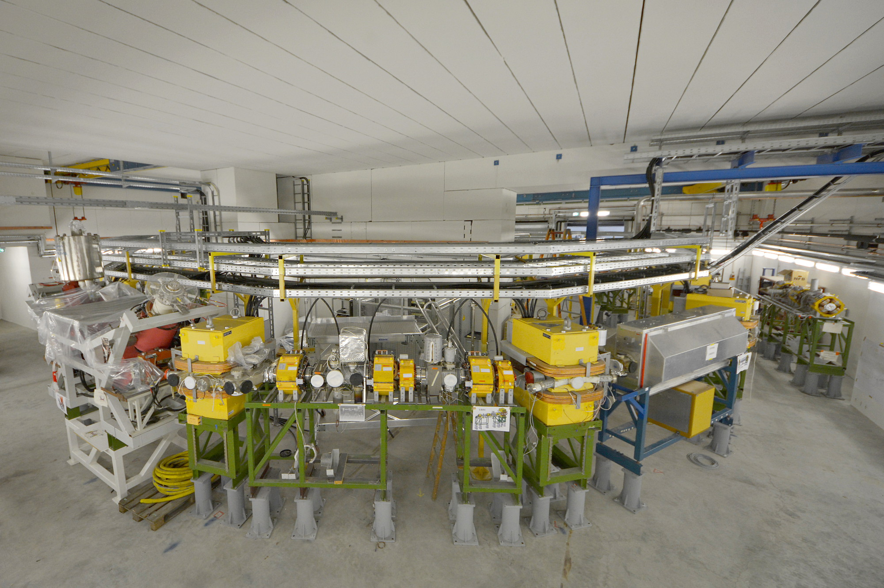
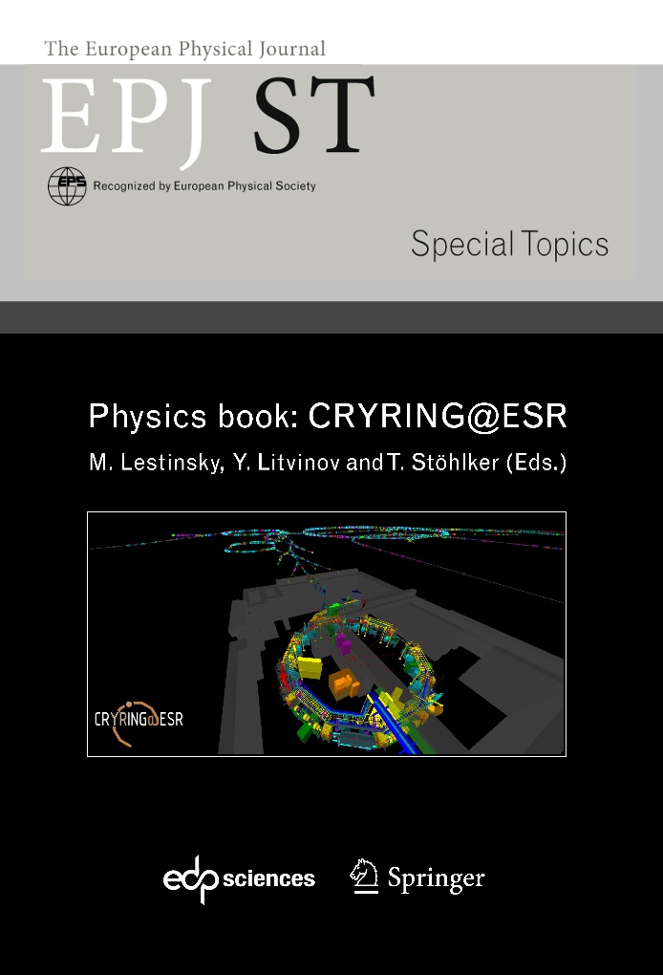
CRYRING / FAIR
Scientific goal:
  atomic and nuclear physics of exotic systems al low energy
circumference: 54 m
decelerate ions down to 7‰ c
UHV: p < 10⁻¹¹ mbar
gas and electron targets
e-cooler
several experiment stations
in print
CRYRING in the SIS18 target hall @ GSI/FAIR

Slide 21







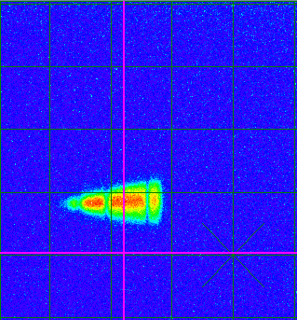
CRYRING: First transfer of ions from ESR to CYRING
Scintillating screen in the first section of CRYRING:
C⁶⁺ @ 6 MeV/u
CRYRING team
supported by:
FAIR
GSI
HI-Jena
KVI Groningen
Univ Cracow
Univ. Stockholm
A. Bräuning-Deminan,F. Herfurth, M. Lestinsky et al.

Slide 22
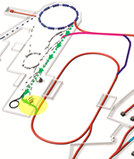
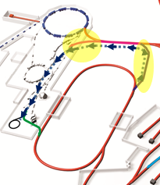
  Beamlines to Exploit the Full Physics Potential of FAIR
transfer of ions from SIS18 to the HESR
stable and exotic ions and antiprotons from HESR to ESR
SIS18
SIS18
What about FLAIR ?
Where are the slow-antiprotons ?
HESR
HESR
Early start of FAIR
Parallel operation
Early realization of pbar @ FLAIR
Exotic nuclei in storage rings

Slide 23
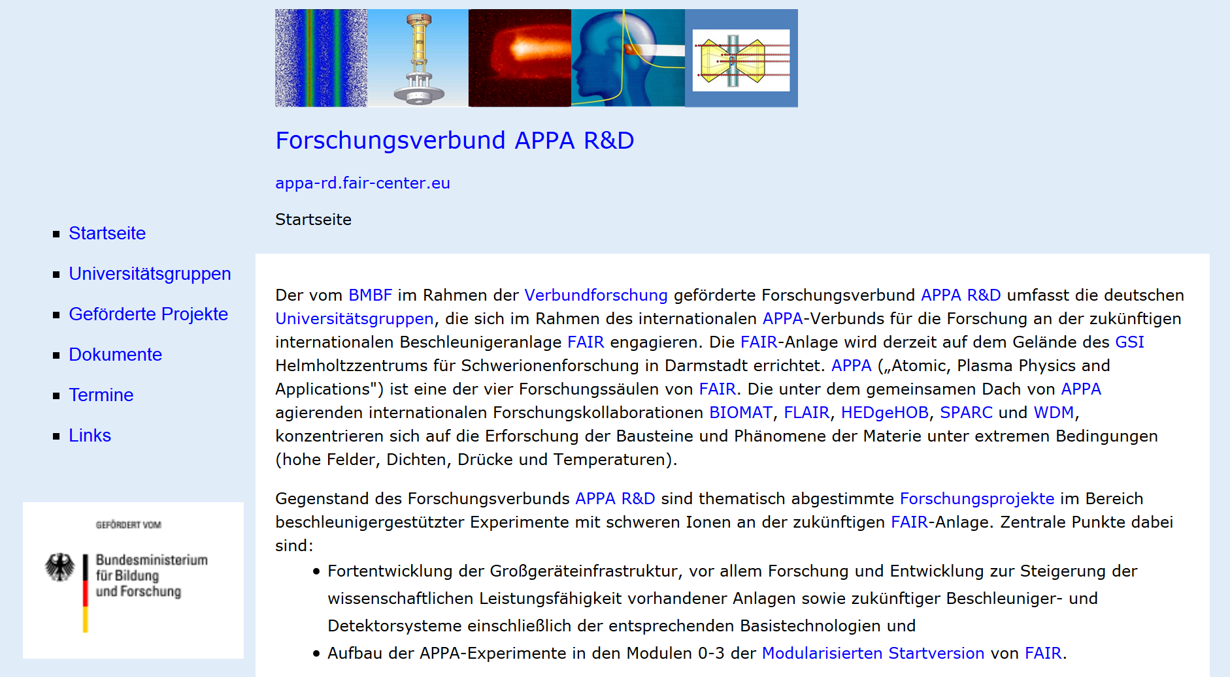
APPA R&D Web Pages
http://appa-rd.fair-center.eu/

Slide 24
APPA R&D
Funded Projects (6.8 M€)
Spokesperson
Stefan Schippers
05P15KHFAA: HU Berlin, Lösung der zeitabhängigen Dirac-Gleichung für hochgeladene Ionen in Laserimpulsen höchster
Intensitäten
05P15PMFAA: U Münster, Entwicklung eines Präzisions-Hochspannungsteilers und von Fluoreszenzdetektoren für den
Speicherring CRYRING / Weiterentwicklung und Betrieb von Einzelphotonendetektoren für die
Laserspektroskopie am ESR und an SPECTRAP
05P15RDFA1: TU Darmstadt, Forschungsarbeiten zur Implementierung von Laserkühlung und Wechselwirkung mit
Materie bei FAIR
05P15RDFAA: TU Darmstadt, Laserspektroskopie an CRYRING und HITRAP — Neue Techniken für die
Laserspektroskopie an der GSI
05P15RFFA1: U Frankfurt, Entwicklung von Diagnostik und Simulationen für plasmaphysikalische Experimente bei FAIR
05P15RFFAA: U Frankfurt, Umladedetektoren am CRYRING/LSR: Detektor-Manipulatoren und UHV-taugliche Si-Detektoren
05P15RGFAA: U Gießen, Aufbau und Tests von Experimentiereinrichtungen zur Elektronenstoß- und Röntgenspektroskopie
05P15RKFAA: U Kassel, Hochauflösendes Seya-Namioka-Fluoreszenzspektrometer für den Spektralbereich zwischen
35 nm und 700 nm für Experimente an Speicherringen für hochgeladene Ionen
05P15SJFA1: U Jena, Spektroskopie von Plasmen bei FAIR
05P15SJFAA: U Jena, Licht-Materie Wechselwirkung mit hochgeladenen Ionen
05P15VHFAA: U Heidelberg, Mikrokalorimeter-Arrays und Quantengas-Target für Experimente an der GSI/FAIR
05P15WOFA1: TU München, Optische Strahldiagnose für intensive Ionenstrahlen
05P16ODFA1: TU Dresden, Kühlung von Strahlen hochgeladener Ionen bei hochrelativistischen Energien mit Hilfe eines
gepulsten Lasersystems

Slide 25
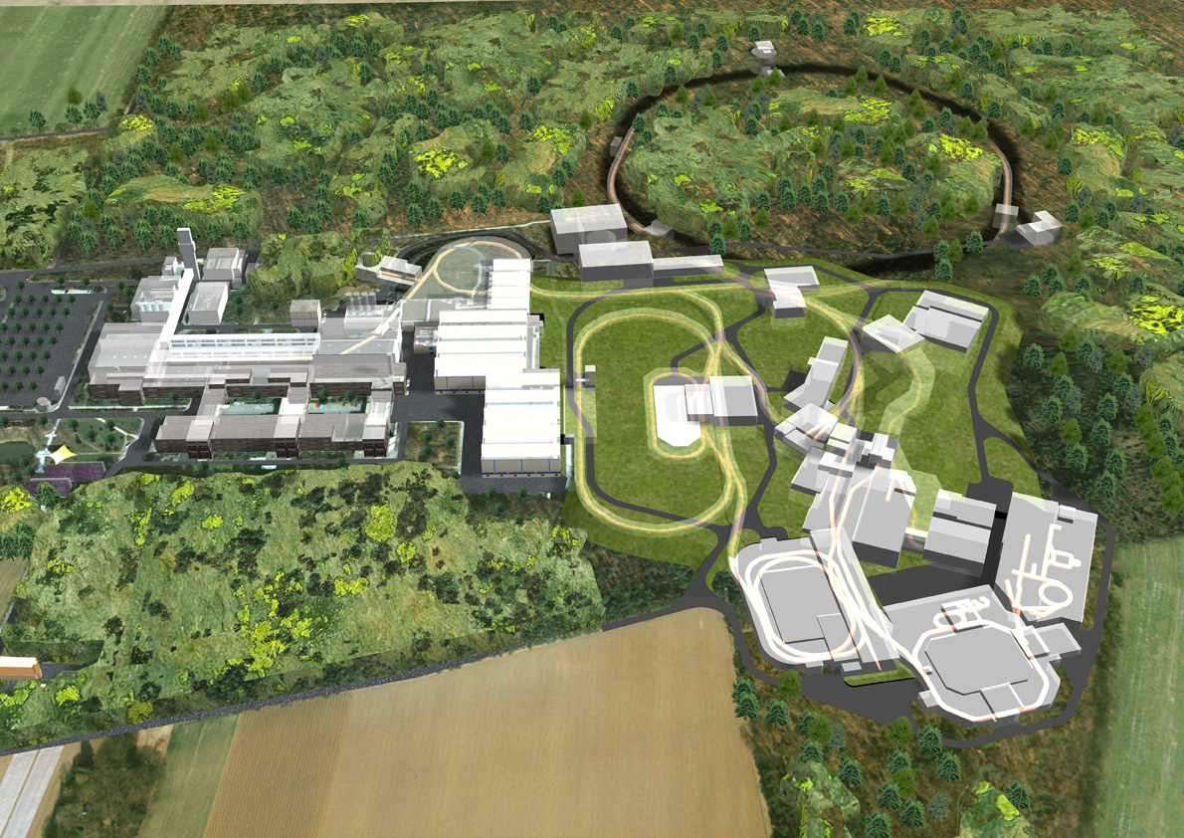
Atomic Physics at FAIR / SPARC
Unique Opportunities
. . . & Challenges
Have in mind:
- plenty of new ideas emerge!
- experiments will be done,
not even envisioned today !

