Slide 1
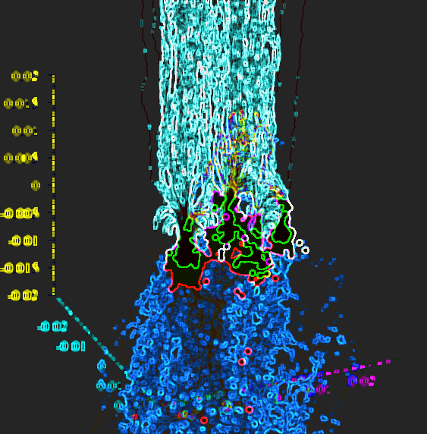
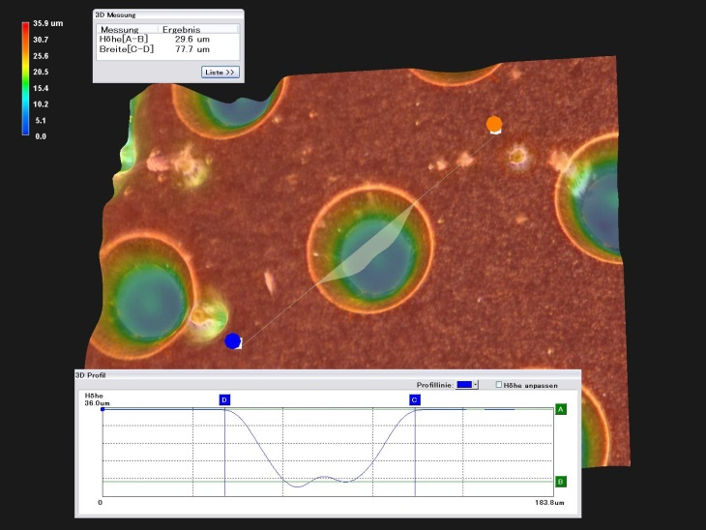
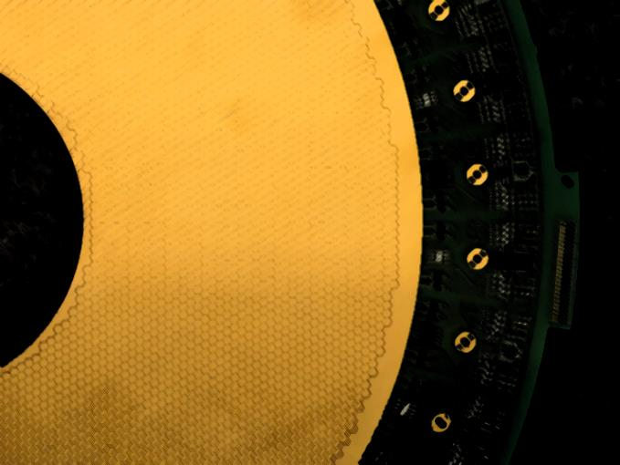
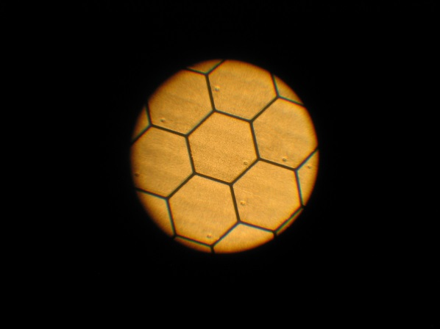
Detector Technologies and Systems Gaseous Detectors Bernd Voss (GSI)
Notes:
I am going to talk about gaseous detectors

Slide 2
Tentative agenda
14:00 - 14:15 Introduction to HGF/DTS 15'
14:15 - 14:35 Round of introductions 20'
14:35 - 15:20 Brainstorming and discussions 45'
15:20 - 15:30 Organizational issues 10‘
This is an informal meeting – so let’s discuss…

Slide 3
List of Participants (announced via DOODLE)
Take Saito (GSI)
Oliver Schäfer (DESY)
Andreas Wagner (HZDR)
Lothar Naumann (HZDR)
Quirin Weitzel (U Mainz)
Peter Wintz (FZJ)
Ties Behnke (DESY)
Stefan Roth (RWTH Aachen)
Jochen Kaminski (U Bonn)

Slide 4
List of Participants (present in addition)
Beata Walasek-Höhne (GSI, Accelerator)
André Ehret (GSI, PANDA)
Ingo Kaufeld (GSI, HICT)
Dariusz Miskowiec (GSI, ALICE)
Uli Weber (GSI, Biology)
André Prochatzka (GSI, SuperFRS)
Christoph Caesar (GSI, RBDL-Electronics)
Lars Schmitt (GSI, PANDA)

Slide 5
Potential topics
Networking & Sharing… …of information, knowledge, skills, infrastructure, hard- and software etc.
Infrastructure locally available at the sites which might be shareable
Student exchange and other networking platforms (workshops, on-site trainings, wiki pages, data bases etc.)
Knowledge base, esp. on topics relevant to gaseous detector systems (literature, basic data, tutorials etc.)
Wish list to HGF structure (e.g. from the requirements of future experiments)

Slide 6
Organizational
A separate DOODLE call to find a niche for ‘regular’ communication offering generic days/time-slots
Frequency of meeting, perhaps monthly, quarterly?
Do we need a mailing list? (KIT / GSI(Listserv))
Minutes of Video meeting January 13th 2016 will be distributed

Slide 7
Backup
(Introductory talk to the gaseous detectors topic)
Nami Saito
Gaseous Detectors

Slide 8
Gaseous Detectors Nami Saito (GSI/HIM)
Notes:
I am going to talk about gaseous detectors

Slide 9
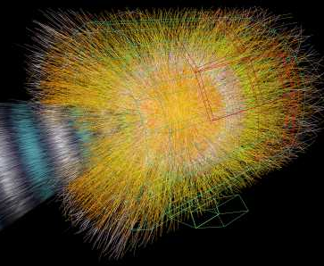
Beauty and Essence of Gaseous Detectors
We need an ideal detector...
in accelerator control, basic science, variety of applications
Gaseous detectors serve most needs:
‘Omnipotent’ and omnipresent
Beauty of gaseous detectors
- flexibility & tunability
- shape conformity, volume coverage
- affordability
- low material budget, radiation hardness
- durability, stability
- high precision, excellent resolution
Complementing solid state detectors
Charged particle tracks in Pb-Pb collisions
Gas
Solid
Nami Saito
Gaseous Detectors
Notes:
Let me start with Beauty and Essence of Gaseous Detectors.
For radiation detections for example in accelerator control, basic-science, medical imaging, or any other application, one may imagine an ideal detector detecting all radiation with high-rate, or nice resolution without disturbing radiation track, and so on..
Gaseous detectors serve most needs.
They are omnipotent measuring most of observables and omnipresent existing in any radiation facility.
The beauty of gaseous detectors is its flexibility and tunability in all aspects. Its shape can be well customized. The volume can be very very large.
In addition to that, affordability, low material budget (0.1%), radiation hardness (10Mrad), stability with nice precision and resolutions are all beauty of the gaseous detectors.
An example of gaseous detector is the [c] “ALICE-TPC”.
Its active volume is in the order of 100 cubic meters. If you imagine a solid state detector for such a volume, it would not be feasible…
In this sense, one may say, gaseous detectors are complementing solid sate detectors in realization.

Slide 10
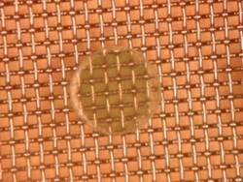
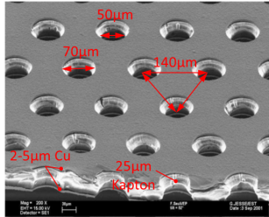
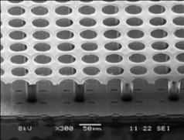
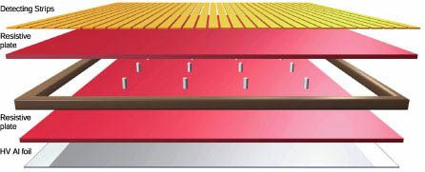
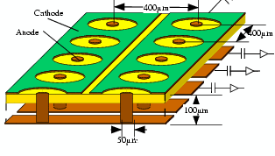
Bright Future of Gaseous Detectors Stay at forefront, synchronize developments
Past and future challenges:
R&D on the sensor material itself, improve on gas mixtures
Development of micro-patterned structures and fast systems
Quantum step: expand to meter scale detector inheriting fab-type industry
Strengthen interdisciplinary work
MT... extensive know how exists within Helmholtz
MT... expands and fosters closer collaboration between the centres
to build-up cross-community cooperation
Resistive Plate Chamber Micro-Mesh Gaseous Gas Electron Multiplier Integrated Grid on Si Micro Pixel Chamber Structure
Nami Saito
Gaseous Detectors
Notes:
Let me tell you about the BRIGHT future of gaseous detectors….
In the history of gaseous detectors, the groups in DTS have always been at the forefront. To keep going at the forefront, we do synchronized developments in all fields. It means, for example, an accelerator upgrade requires us higher performances of detectors, so we cope by further developing cutting edge technologies.
For that, R&D on the sensor material is needed. Improvements of the gas mixtures will be done for higher rate and better resolution.
Development of micro-patterned structures and fast systems are also needed. Here I show base technologies, RPC is suitable for fast response. I will show later our outstanding development of ceramic RPC. These are technologies with micro patterned structures, Micromegas and GEMs are used for amplification for example for high rate TPCs. Ingrid uses Si as gaseous detector, there we have a link to the solid-state detectors.
The micro-PIC uses PCB technology, and it has large potential to be a key technology in future projects due to its simple and compact structure.
These micro-patterned structures have been realized, but NOT on a large scale. So we need a BIG step to expand the size of micro-patterned structures to meter scale inheriting fab-type industry. Such a big step will manifest a new standard of radiation detector for future applications.
For that, we need to strengthen collaborations with related fields, like material science.
Matter and Technology is the knowledge holder on gaseous detector systems. So WE do coaching & teaching our partners especially in industry.
And of course we need to push more collaborations and the knowledge exchange within Matter and Technologies for the bright future.
-------------
need to do R&D on the sensor material itself, improve on gas mixtures
develop micro-patterned structures (which we already did→ GEM-TPC)
→ fast systems (ps) which we already did (cRPC)
quantum step: expand micro scale to cubic meters inheriting fab-type industry
MT is knowledge holder coaching & teaching partners, out-house experts
strengthen interdisciplinary work (e.g. on material science)
we have manifold loose collaborations but we need to go beyond, push collaborations and exchange (HZDR, HIM det lab)
-------------
Bright Future of Gaseous Detectors
Past and future challenges
There is a synchronization task: we have always been at the forefront of leading & cutting edge and need to stay and not fall behind
the quantum step is that we have to expand micro scale to cubic meters thus no longer have manual interactions but need to inherit fab-type industry!
Since MT are knowledge holder, coaching & teaching (of partners, out-house experts like TECHTRA, CERN, Universities)

Slide 11
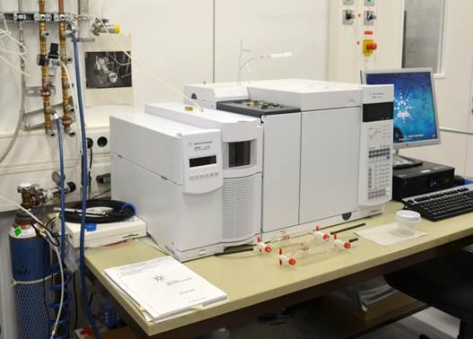
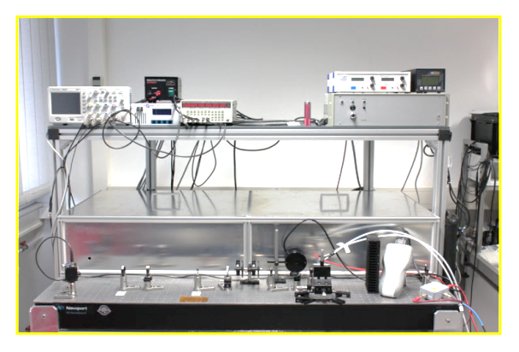
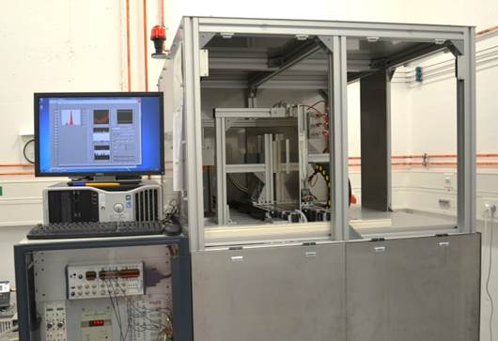
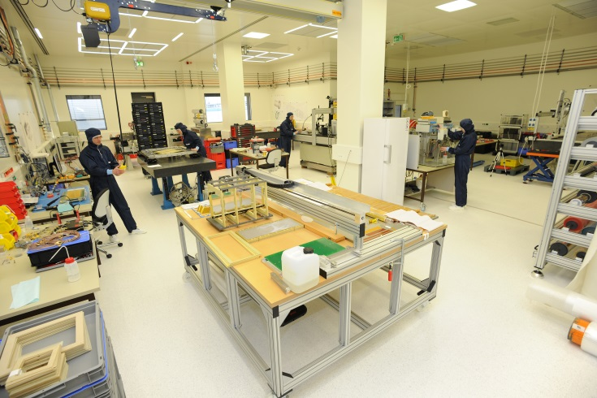
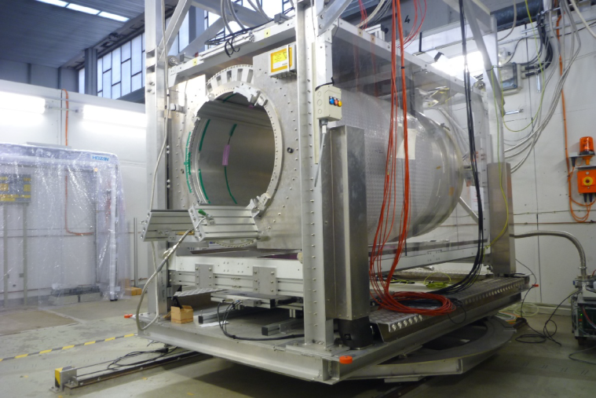
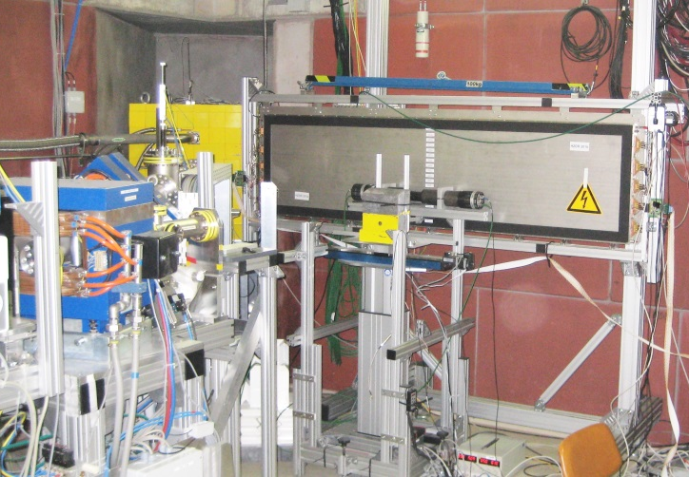
MT Common infrastructure Examples
Gas chromatography
2D-scan system
(Microscope, X-ray,
LASER, scintillator)
LASER test bench
X-ray Aging test stand
High-quality production sites (GSI)
Detector test in strong
magnetic fields (DESY)
e-beam facility (HZDR)
Nami Saito
Gaseous Detectors
Notes:
For the collaborative works we have common infrastructures in Matter and Technology.
Here is the examples,
gas investigation with chromatography, basic response tests with Laser, aging test with X-ray, and detailed inspection with scan-system.
and facilities, to assemble under professional conditions, test with extreme magnetic field, and a patented e-beam facility for performance tests.
---------------------------
ALL at infrastructures available within MT.
Lighthouse facilities

Slide 12
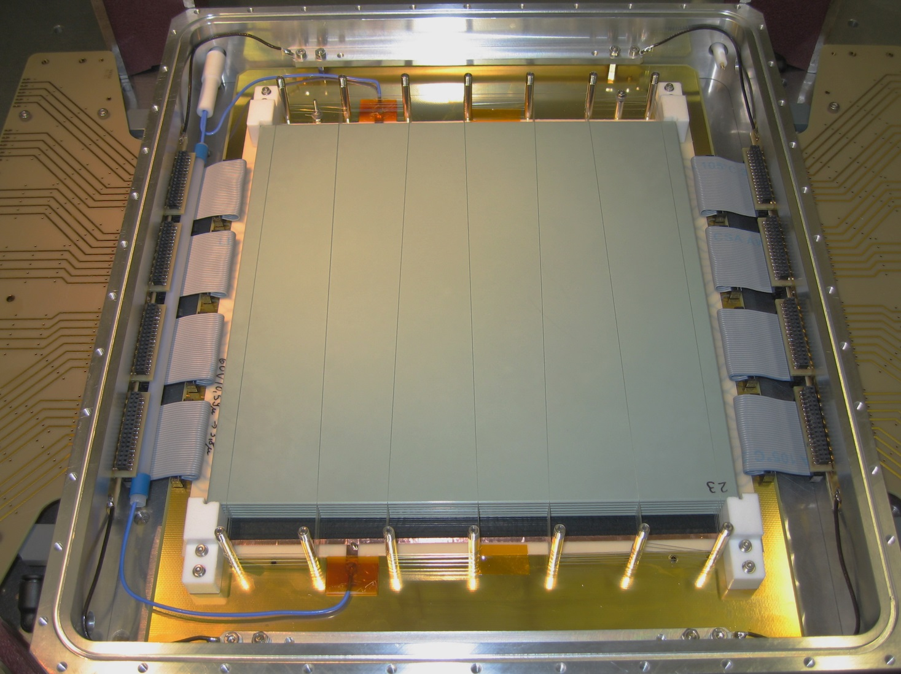
Ceramic Resistive Plate Chamber
cRPC for TOF
70 ps
500 MHz
Ceramic RPC: active area 20x20cm² (HZDR)
Nami Saito
Gaseous Detectors
Notes:
Here is an example of our developments.
Ceramic RPC has been developed for Time Of Flight, and achieved an excellent time resolution of 70 ps and outstanding rate capability of 500 MHz as a world record.

Slide 13
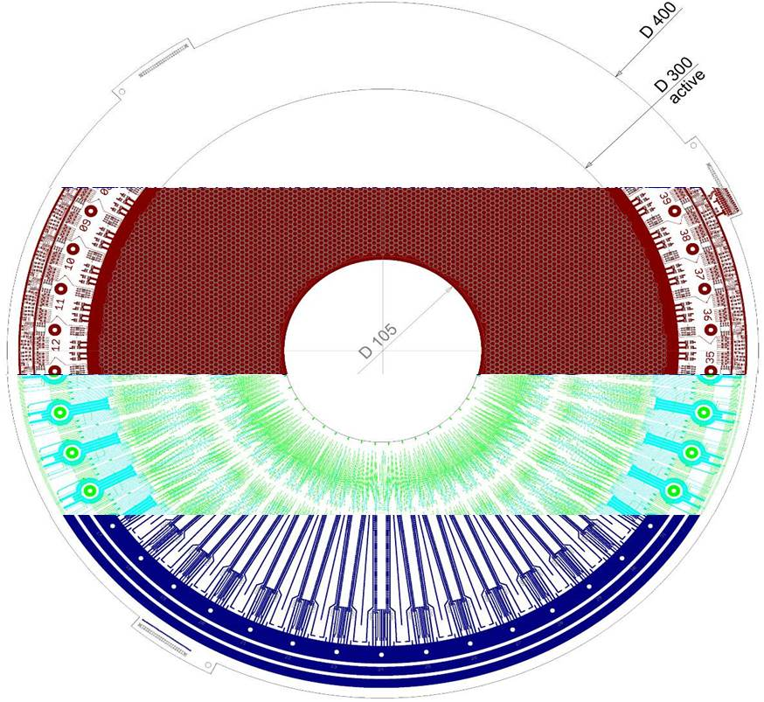
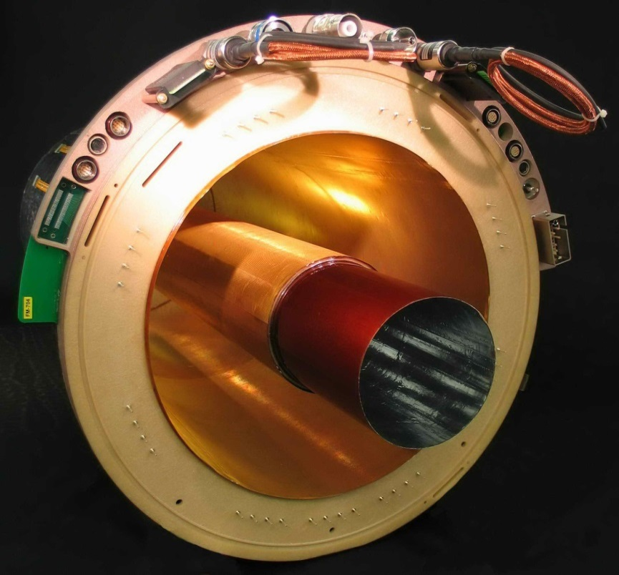
GEM-TPC prototype
(GSI)
Multi-layered pixelated
pad-plane
10000 channels
..100 l
First TPC operated in heavy-ion beam
Tracks with Au beam
Nami Saito
Gaseous Detectors
Notes:
Here is another example,
GEM-TPC prototype has been developed and tested with ion-beams. It works very well.
That was all, thank you for your attention.

