Slide 1

EIC@JLab
Yuhong Zhang
For ELIC Study Group
Common ENC/EIC Workshop at GSI, May 28 -30, 2009

Slide 2
Outline
Introduction
An EIC@JLab: 100<s<2600 with high luminosity
An EIC@JLab at High Energy: Design Update & Staging
More details on EIC@JLab Design
EIC@JLab R&D
Summary

Slide 3
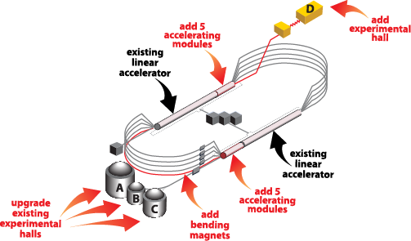
Great Opportunities Ahead of Us
12 GeV CEBAF Upgrade
  CD3 for upgrade approved,
  Construction already started
  Exciting fixed target program beyond 2020
What CEBAF will provide
  Up to 12 GeV CW electron beam
  High repetition rate (3x499 MHz)
  High polarization (>80%)
  Very good beam quality
  World first multi-pass recirculated SRF linac above GeV energy
12 GeV max energy
11 GeV max energy
Opportunity: Electron-Ion Collider on CEBAF
  Add a modern ion complex with a Green Field design
  Expand science program beyond 12 GeV CEBAF fixed target physics
  Open up new science domain with higher CM energy
Notes:
3

Slide 4
Science Motivation and Detector Requirements
Key issues in nucleon structure & nuclear physics
  Sea quark and gluon imaging of nucleon with GPDs (x >~ 0.01)
  Orbital angular momentum, transverse spin, and TMDs
  QCD vacuum in hadron structure and fragmentation
  Nuclei in QCD: Binding from EMC effect, quark/gluon radii from coherent processes, transparency
Machine/detector requirements
  High luminosity > 10³⁴: Low rates, differential measurements
  CM energy: s ~ 1000 GeV²: Reach in Q2, x
  Detactability: Angular coverage, particle ID, energy resolution
  ➔ favors lower, more symmetric energies!

Slide 5
ELIC Design Goals
Energy
  Wide CM energy range between 10 GeV and 100 GeV
  Low energy: 3 to 10 GeV e on 3 to 12 GeV/c p (and ion)
  Medium energy: up to 11 GeV e on 60 GeV p or 30 GeV/n ion
  and
  High energy: up to 10 GeV e on 250 GeV p or 100 GeV/n ion
Luminosity
  10³³ up to 10³⁵ cm⁻² s⁻¹ per interaction point
  Multiple interaction points
Ion Species
  Polarized H, D, ³He, possibly Li
  Up to heavy ion A = 208, all striped
Polarization
  Longitudinal at the IP for both beams, transverse of ions
  Spin-flip of both beams
  All polarizations >70% desirable
Positron Beam desirable

Slide 6
Design Challenges & Opportunities
Design an Electron-Ion Collider that
  Covers a wide CM energy range (10 to 100 GeV) in a unified & coherent way for highest science productivity
    Medium energy EIC is our immediate goal so it should be given first priority for maximum design optimization
    High energy EIC is a future goal so it should be leaved with greatest flexibility and upgrade potential
  Deliver best collider quality in terms of high luminosity, high polarization, multiple interaction points, maximum flexibility and reliability
  Takes maximum advantages of existing CEBAF
  Offers a good path for staging and future upgrade
  Requires minimum R&D and realizes in a most cost effective way
  Ion complex is a green field design so we have freedom to be innovative
  We can take benefit of knowledge learnt in the last several decades and incorporate many proofed great ideas/schemes in the design
  We have an opportunity to design a brand new class of hadron collider just we had done in CEBAF near twenty years ago.
Notes:
6

Slide 7
Outline
Introduction
An EIC@JLab: 100<s<2600 with high luminosity
An EIC@JLab at High Energy: Design Update & Staging
More on EIC@JLab Design
EIC@JLab R&D
Summary

Slide 8
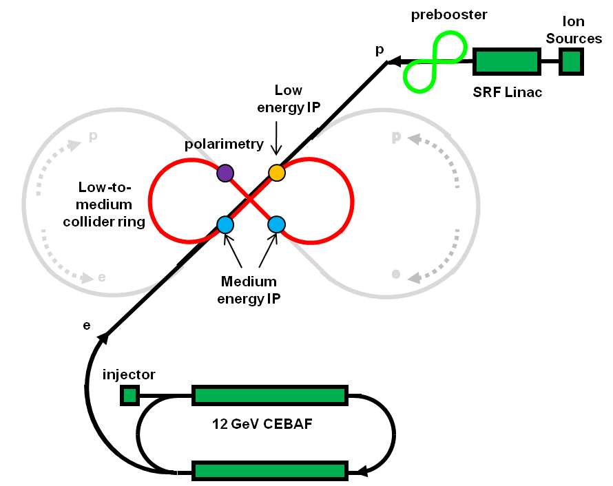
EIC@JLab at Low to Medium Energy
Three compact rings:
3 to 11 GeV electron
Up to 12 GeV/c proton (worm)
Up to 60 GeV/c proton (cold)

Slide 9
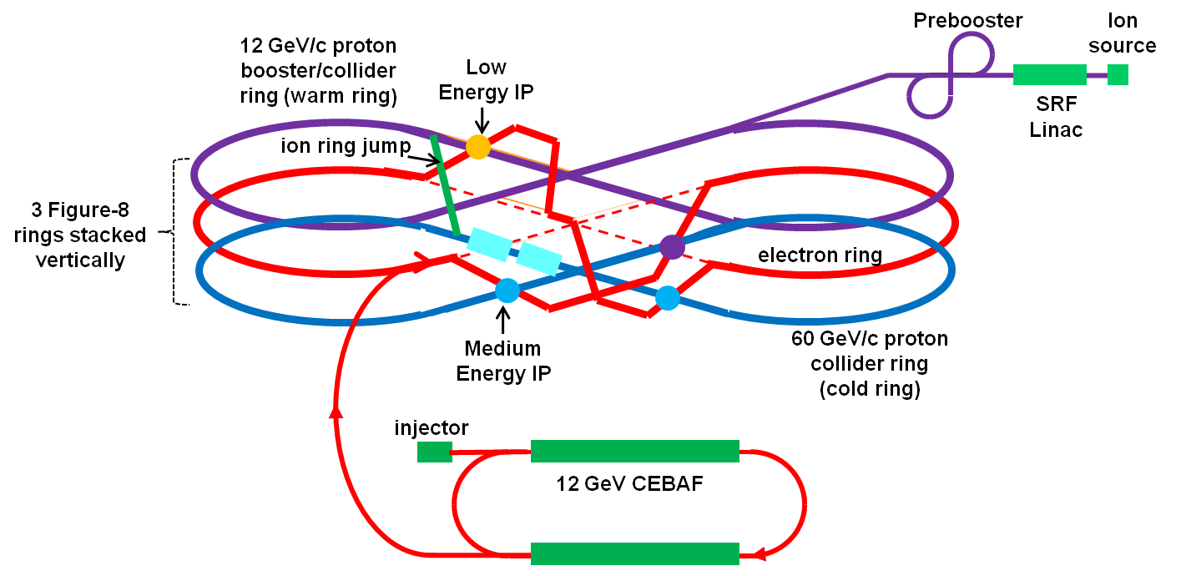
EIC@JLAB at Low to Medium Energy
polarimetry

Slide 10
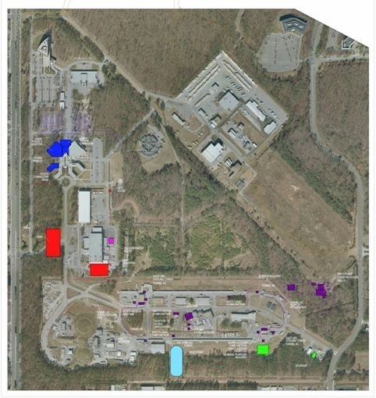
ELIC Figure-8 Collider Ring Footprint
Medium Energy IP
Arc | 157 m
Figure-8 straight | 150 m
Insertion | 10 m
Circumference | 634 m
Snake Insertion
60°
Low Energy IP
City of NN
WM
Ring design is optimized with
  Synchrotron radiation power of e-beam
  ➔ prefers large ring (arc) length
  Space charge effect of i-beam
  ➔ prefers small ring circumference
Multi IPs require long straight sections
Straight sections also hold required components (e-cooling, injection and ejections, etc.)
State
City of NN
MEIC Footprint (~600m)
SURA
ELIC Footprint (~1800m)
CEBAF

Slide 11
EIC@JLab Parameters at Low-to-Medium Energy
Beam Energy | GeV | 60/5 | 60/3 | 12/3
Collision freq. | MHz | 499
Particles/bunch | 10¹⁰ | 0.74/2.9 | 1.1/6 | 0.47/2.3
Beam current | A | 0.59/2.3 | 0.86/4.8 | 0.37/2.7
Energy spread | 10⁻⁴ | ~ 3
RMS bunch length | mm | 5 | 5 | 50
Horz. emit., norm. | μm | 0.56/85 | 0.8/75 | 0.18/80
Vert. emit. Norm. | μm | 0.11/17 | 0.8/75 | 0.18/80
Horizontal beta-star | mm | 25 | 25 | 5
Vertical beta-star | mm | 5
Vert. beam-beam tune shift / IP |  | 0.01/0.03 | 0.015/0.08 | 0.015/0.013
Laslett tune shift (p-beam) |  | 0.1 | 0.054 | 0.1
Peak Luminosity/IP, 10³⁴ | cm⁻²s⁻¹ | 1.9 | 4.0 | 0.59

Slide 12
Outline
Introduction
An EIC@JLab: 100<s<2600 with high luminosity
An EIC@JLab at High Energy: Design Update & Staging
More on EIC@JLab Design
EIC@JLab R&D
Summary

Slide 13
ELIC at High Energy & Staging
p
Interaction Point
SRF Linac
Ion Sources
electron ring
prebooster
p
p
ELIC collider ring
MEIC collider ring
Ion ring
Vertical crossing
 |  | Small | Large
Circumference | m | 1800 | 2500
Radius | m | 140 | 180
Width | m | 280 | 360
Length | m | 695 | 920
Straight | m | 306 | 430
e
e
e
injector
12 GeV CEBAF
Stage |  | Max. Energy (GeV/c) |  | Ring Size (M) |  | Ring Type |  | IP#
 |  | p | e | p | e | p | e
1 | Low | 12 | 5 (11) | 630 | 630 | Warm | Warm | 1
 | Medium | 60 | 5 (11) | 630 | 630 | Cold | Warm | 2
2 | Medium | 60 | 10 | 600 | 1800 | Cold | Warm | 4
3 | High | 250 | 10 | 1800 | 1800 | Cold | Warm | 4

Slide 14
EIC@JLab Parameters: High Energy
Beam Energy | GeV | 250/10 | 150/7
Collision freq. | MHz | 499
Particles/bunch | 10¹⁰ | 1.1/3.1 | 0.5/3.25
Beam current | A | 0.91/2.5 | 0.4/2.6
Energy spread | 10⁻⁴ | 3
RMS bunch length | mm | 5
Horz. beta-star | mm | 125 | 75
Vert. beta-star | mm | 5
Horz. emit., norm. | μm | 0.7/51 | 0.5/43
Vert. emit. Norm. | μm | 0.03/2 | 0.03/2.87
B-B tune shift per IP |  | 0.01/0.1 | 0.015/0.05
Laslett tune shift (p-beam) |  | 0.1 | 0.1
Lumi. per IP, 10³⁴ | cm⁻²s⁻¹ | 11 | 4.1
Major design change: symmetric IR ➔ asymmetric IR

Slide 15
Outline
Introduction
An EIC@JLab: 100<s<2600 with high luminosity
An EIC@JLab at High Energy: Design Update & Staging
More on EIC@JLab Design
EIC@JLab R&D
Summary

Slide 16
ELIC Baseline Design Choice
Energy Recovery Linac-Storage-Ring (ERL-R)
ERL with Circulator Ring – Storage Ring (CR-R)
Back to Ring-Ring (R-R)
by taking CEBAF advantage as full energy polarized injector
Reason of design change:
High current polarized electron/positron source R&D too challenging
    ERL-Ring: 2.5 A
    Circulator ring: 20 mA
    State-of-art: 0.1 mA
  ➔ Note we don’t have to have ERL in order to delivering high luminosity
  ➔ Key for high luminosity is high repetition, small beta* & short bunch
12 GeV CEBAF Upgrade polarized source/injector already meets beam requirement of ring-ring design
CEBAF-based R-R design still preserves high luminosity, high polarization (+polarized positrons…)

Slide 17
Achieving High Luminosity
ELIC design luminosity
L~ 4x10³⁴ cm⁻² s⁻¹ for medium energy (60 GeV x 3 GeV)
L~ 1x10³⁵ cm⁻² s⁻¹ for high energy (250 GeV x 10 GeV)
ELIC luminosity Concepts
  High bunch collision frequency (0.5 GHz, can be up to 1.5 GHz)
  Short ion bunches (σ_{z} ~ 5 mm) (also much smaller bunch charge)
  Relative long bunch (comparing to beta*) for very low ion energy
  Strong final focusing (β*_{y} ~ 5 mm)
  Large beam-beam parameters (~0.01/0.1 per IP,
        0.025/0.1 largest achieved)
  Need electron cooling of ion beams
  Need crab crossing colliding beams
  Large synchrotron tunes to suppress synchrotron-betatron resonances
  Equal (fractional) betatron phase advance between IPs

Slide 18
ELIC Ring-Ring Design Features
Unprecedented high luminosity
Electron cooling is an essential part of ELIC
Up to four IPs (detectors) for high science productivity
“Figure-8” ion and lepton storage rings
  Ensure spin preservation and ease of spin manipulation
  No spin sensitivity to energy for all species.
Present CEBAF injector meets storage-ring requirements
12 GeV CEBAF can serve as a full energy injector to electron ring
Simultaneous operation of collider & CEBAF fixed target program.
Experiments with polarized positron beam are possible.

Slide 19
Figure-8 Straight Sections & Interaction Regions
y
z
straight section
spin rotator
e
vertical bend
vertical bend
spin rotator
e
collision point
collision point
arc dipoles
~0.5 m
arc bend
i
~0.5 m
i
Vertical crossing angle (~30 mrad)
vertical bend
spin rotators
vertical bend
Minimizing crossing angle reduces crab cavity challenges & required R&D
Optional 2nd detector
Interaction Region
~ 60 m
IP
FODO
Crab cavity
Chrom
Matching quads
FF
FF
Matching quad
Chrom
Crab cavity
FODO
Detector space

Slide 20
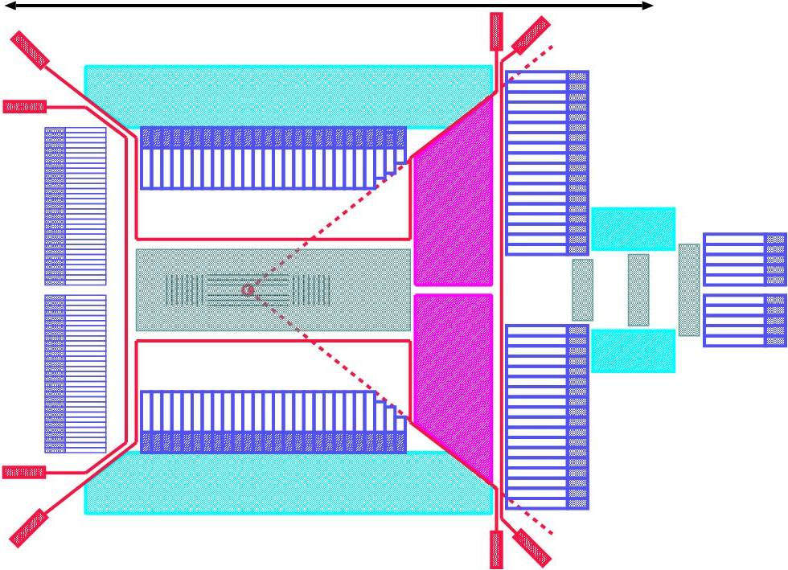
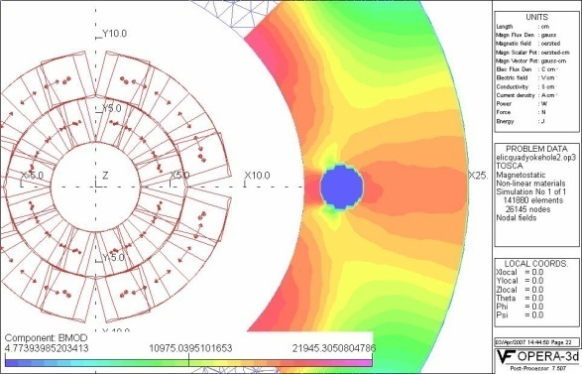
Interaction Regions and Detectors
8 meters (for scale)
140 degrees
Ent’s talk on ELIC detector design in this Workshop
TOF
Offset IP
→ ID ~ length solenoid
HCAL
Magnetic Field in cold yoke around electron pass.
PbWO₄ ECAL
Tracking
No need for add’l dipole!:
Θ > 10º
RICH
dipole
HCAL
solenoid
Add’l dipole field needed on ion side!
IP | Energy | Type | Space
1 | Medium | General purpose | 9+9 m
2 | Medium | Diffraction/low_Q²
3 | Low | DVCS-type
4 |  | (polarimetry)
Leant from LHeC
Electron
Proton
1st SC FF quad for ion
(P. Brindza, ME)
Electron FF quads
9 m
IP
Vertical crossing angle
Electron FF quads

Slide 21
Outline
Introduction
An EIC@JLab: 100<s<2600 with high luminosity
An EIC@JLab at High Energy: Design Update & Staging
More on EIC@JLab Design
EIC@JLab R&D
Summary

Slide 22
EIC@JLab Accelerator R&D
  We have identified the following critical R&D for ELIC
    Electron cooling
    Crab crossing and crab cavity
    Forming high intensity low energy ion beam
    Beam-beam effect
    Traveling focusing for very low energy ion beam
  Will discuss issues/requirements/state-of-art/challenges/activities
Level of R&D | Low-to-Medium Energy (12x3 GeV/c) & (60x5 GeV/c) | High Energy (up to 250x10 GeV)
Challenging |  | Electron cooling
Semi Challenging | Electron cooling Traveling focusing (for very low i energy) | Crab crossing/crab cavity
Likely | Crab crossing/crab cavity High intensity low energy i beam Beam-beam | High intensity low energy i beam Beam-beam
Know-how | Spin tracking IP design/chromaticity | Spin tracking IP design/chromaticity

Slide 23
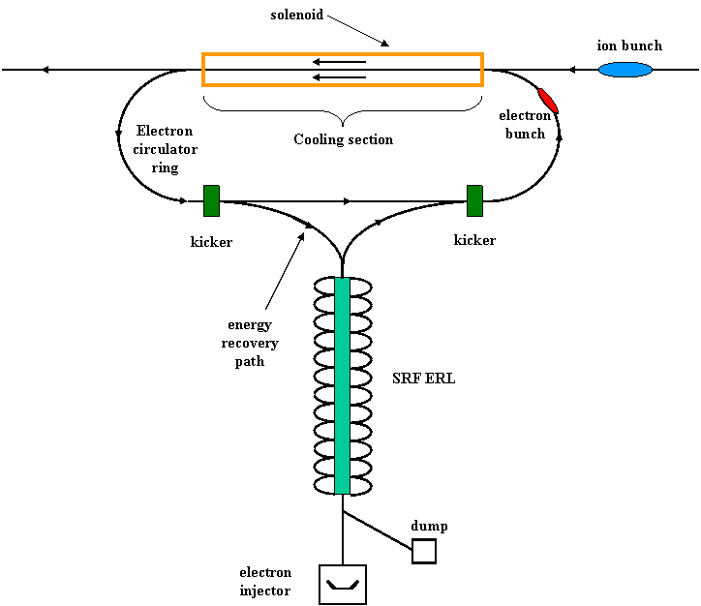
Electron Cooling: ERL Circulator Cooler
Issues
Essential for delivering ion bunches with small emittances and short length.
Cooling electron energy
  up to 6.5 MeV for low energy ELIC
  up to 33 MeV for medium energy ELIC
  up to 136 MeV for high energy
Up to 3 A CW un-polarized beam (~nC bunch charge)
ERL Based Circulator Cooler
SRF ERL able to provide high average current CW beam with minimum RF power
Circulator ring for reducing average current from source/ERL
ERL Key technologies
High intensity un-polarized electron source/injector
Energy Recovery Linac (ERL)
Fast kicker
Beam Dynamics R&D (staged cooling)
State-of-Art
  Fermilab electron cooling demo. (4.34 MeV, 0.5 A DC)
Electron circulator ring

Slide 24
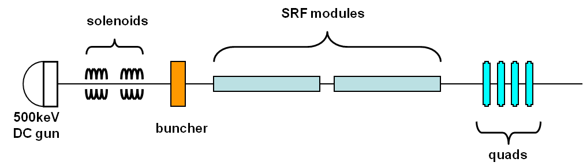
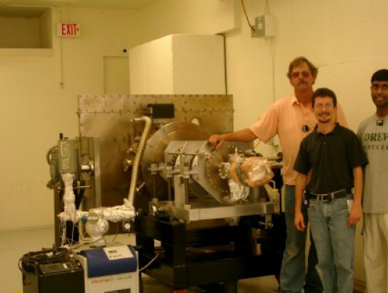
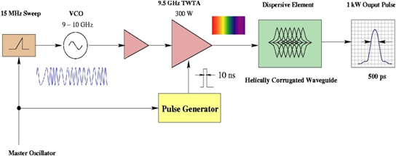
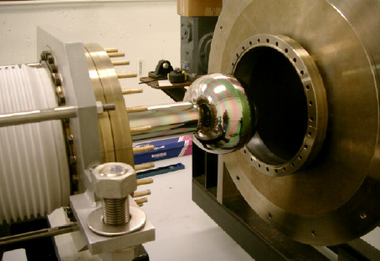
EC Enabling Technologies
High intensity e source/injector
30 mA, up to 136 MeV, 1 nC bunch charge
Cathode lifetime is ok with circulator ring
Conceptual design adopts light source (FEL) photo-injector
Beam qualities should be OK
Fast kicker
RF deflecting cavity
High power ultra-short pulse
(sub-ns, 20kW)
Beam energy | MeV | 125
Kick angle | 10⁻⁴ | 3
Integrated BdL | GM | 1.25
Frequency BW | GHz | 2
Kicker Aperture | Cm | 2
Peak kicker field | G | 3
Kicker Repetition Rate | MHz | 15
Peak power/cell | KW | 10
Average power/cell | W | 15
Number of cells | 20 | 20
JLab FEL Gun R&D
(J. Musson JLab, EE)

Slide 25
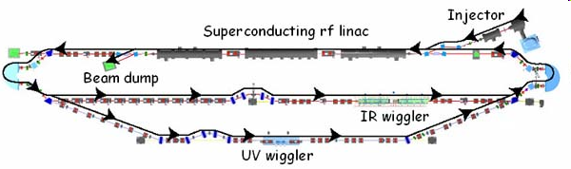

EC Enabling Technology: ERL
JLab FEL Program
Energy Recovery
Energy | MeV | 80-200
Charge/bunch | pC | 135
Average current | mA | 10
Peak current | A | 270
Beam power | MW | 2
Energy spread | % | 0.5
Normalized emittance | µm-rad | <30
ERL based FEL
High average power up to14 kW (world record)
mid-infrared region, extension to UV is planned
Photocathode DC injector, 10 mA class CW beam, sub-nC bunch charge
Beam energy up to 200 MeV, energy recovery
Next step/proposal: 100kW average power, 100 mA CW beam with ERL, nC-class bunch charge
JLab is world leader in ERL technology !
We are considering using this facility to test ERL based circulator cooler ring and for beam dynamics studies

Slide 26
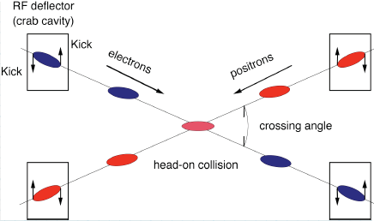
Crab Crossing & Crab Cavity
Issues
High bunch repetition requires crab crossing colliding beams to avoid parasitic beam-beam
Crab cavities are needed to restore head-on collision and avoid luminosity reduction
ELIC crossing angle: ~ 2x12 mrad (9+9 m IR)
Stage | Beam Energy (GeV/c) | Integrated Kicking Voltage (MV) | R&D
electron | 10 | ~ 1 | State-of-art
Proton | 12 | ~ 1 | State-of-art
Proton | 60 | 5 | Not too far away
Proton | 250 | 21
Crab cavity development & gradient limits
Phase & amplitude stability requirements
Beam dynamics/luminosity dependence of crab crossing
State-of-art:
KEKB Squashed cell@TM110 Mode
Crossing angle = 2 x 11 mrad
V_{kick}=1.4 MV, E_{sp}= 21 MV/m
Notes:
26

Slide 27
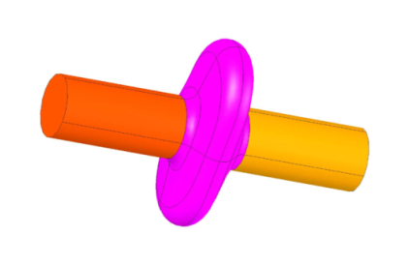

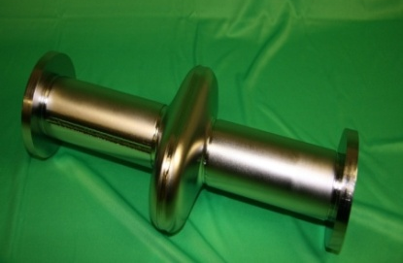
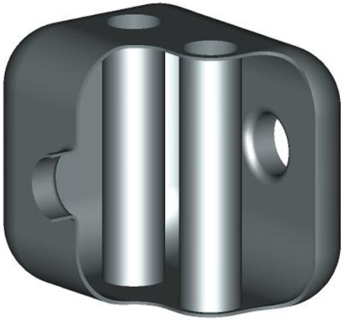
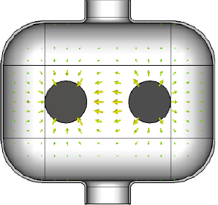
JLab Crab Cavity Development
Multi-cell TM110 and Loaded Structure of Crabbing Cavity (JLab/Cockcroft/Lancaster)
Elliptical squashed SRF cavity R&D for APS (JLab/LBNL/AL/Tsinghua Univ.)
H. Wang, R. Rimmer, 12/10/2008 Moun Collider Design Workshop
Single cell
New (Innovative) Program
Compact TEM-type, parallel-bar
Deflecting ➔ 12 GeV CEBAF
Crabbing ➔ ELIC
Providing high transverse kinking
Single cell: 37x50cm, 4 MV@500MHz
Multi-cell: ~ n x (37 cm), n x (4 MV)
J. Delayen, H. Wang, PRST 2009
J. Delayen, JLab seminar, 02/19/09
E&M Fields
Multi cell

Slide 28
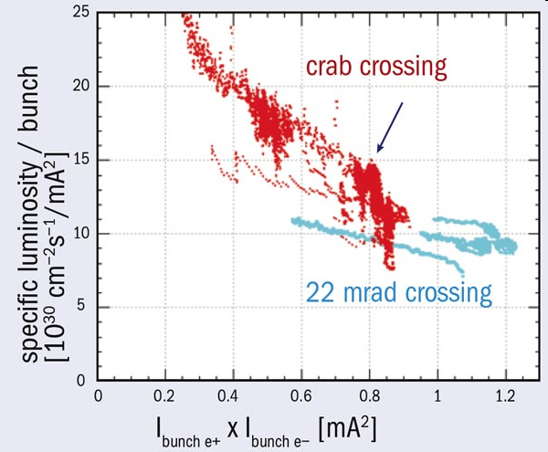
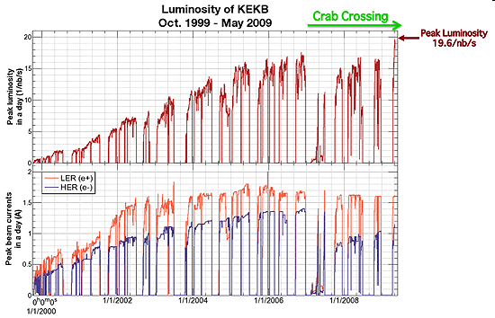
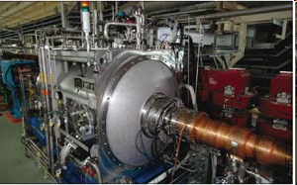
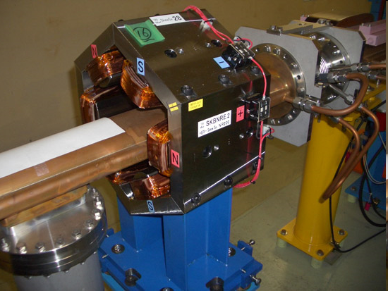
Great News From KEK
KEK Press Release (05/11/09)
“Using Crab Cavities, KEKB Breaks Luminosity World Record”
SymmetryBreaking (05/11/09)
“Record luminosity collisions due to “crab” crossing,
Trick: 28 skew sextupoles

Slide 29
Forming High Intensity Ion Beam
 | Length (m) | Energy (GeV/c) | Cooling Scheme | Process
Source/SRF linac |  | 0.2 |  | Full stripping
Accumulator-cooler Ring /prebooster | 100 | 3 | DC electron | Stacking/accumulating Energy booster
Low energy ring (booster) | 630 | 12 | Electron | Fill ring/Energy boosting RF bunching (for collision)
Medium energy ring (large booster) | 630 | 60 | Electron | Energy boosting RF bunching (for collision)
High energy ring | 1800 | 250 | Electron | Fill ring/energy boosting RF bunching
Stacking/accumulation process
Multi-turn (~20) pulse injection from SRF linac into an accumulator-cooler ring
Damping/cooling of injected beam
Accumulation of 1 A coasted beam at space charge limited emittence
Fill prebooster/large booster, then acceleration
Switch to collider ring for energy booster, RF bunching and initial/continuous cooing
Stacking proton beam in ACR
Circumference | M | 100
Arc radius | M | 3
Crossing straights length | M | 2 x 15
Energy/u | GeV | 0.2 -0.4
Electron current | A | 1
Electron energy | KeV | 100-200
Cooling time for protons | Ms | 10
Stacked ion current | A | 1
Norm. emit. After stacking | µm | 16
In addition to simulation study, we are considering team up with ORNL to study space charge effect at SNS

Slide 30
Beam-Beam Interactions
Simulation Model
Single/multiple IP, head-on collisions
Ideal rings for e & p, a linear one-turn map
Radiation damping & quantum excitations
Simulation Codes
BeamBeam3D by LBNL
Simulation Scope & Limitations
10k ~ 30k turns for a typical simulation run
(multi-days of NERSC supercomputer)
0.15 s of storing time (12 damping times)
reveals short-time dynamics with accuracy
can’t predict long term (>min) dynamics
70% of peak luminosity
My talk in this Workshop
Coherent instability
~D_{ip-ip}
Low-to-medium energy b-b problem
Non-relativistic, space charge dominated
Ring transport can’t be treated as a one-turn map, coupling everywhere
Long ion bunch (up to 20 x β*), longitudinal dynamics important
Traveling focusing scheme introduces non-linear optics
4
3
15
16
5
17
5
4
3
2
14
15
16
17
6
2
1
13
14
18
6
13
18
1
7
7
12
24
19
11
12
24
23
19
8
9
10
22
20
8
11
D_{ip-ip}
23
21
20
9
10
22
21
Notes:
30

Slide 31
Boosting luminosity at low ion energy: Traveling Final Focusing/Crab Waist
Traveling Final Focusing
Laslett tune-shift limits bunch charge for very low energy ions (space charge dominated)
Long bunch length enables more bunch charges, therefore high luminosity
Hour glass effect could kill luminosity if bunch length is much large than beta-star
“Traveling Focusing” (Brinkmann/Dohlus), can mitigate hour-glass effect
New realization: crab crossing beam with sextuples
Crab Waist
Proposed by P. Raimondi for Super-B factory for luminosity enhancement
It deals with large Piwinski angle and low vertical beat-star
Current Super-B design calls 0.2 mm beta-star while bunch length is 6 mm
Recent proof-of-principle experiment done at DAΦNE very positive
x
β
Y
e
-
e+
Crab cavity
slice 2
2
σ
x
/
θ
F₁
2
σ
*
θ
θ
slice 1
z
z
slice 2
2
σ
z
sextuple
2
σ
F₂
x
slice 1
Crabbed waist can be realized with a sextupole in with IP in x and at π/2 in y

Slide 32
Summary
EIC@JLab promises to accelerate and store a wide variety of polarized light ions and un-polarized heavy ions to collider with polarized electron or positron beam enabling a unique physics program.
The ELIC covers a wide CM energy range (10 to 100 GeV) in a coherent way. However, the low-to-medium energy one (CM energy 10 to 50 GeV) is our immediate goal & R&D focus.
EIC@JLab luminosity for e-p collisions should exceed 1x10³⁵ cm⁻²s⁻¹ at high energy end (250x10 GeV²), reach 4x10³⁴ cm⁻²s⁻¹ at medium energy (60x3~5 GeV²), and 6x10³³ cm⁻²s⁻¹ at low energy end (12x3 GeV²)
Positron beam can also be used for additional positron-ion and electron-positron collision programs. Both electron & positron beam possess high (>80%) polarization.
We have identified the critical R&D topics for EIC@JLab. In general, R&D for the medium energy EIC is much easy than for high energy one, which also provides a nice staging approach for accelerator R&D. We are aggressively pushing R&D programs to validity and optimize ELIC design
ELIC is the primary future of JLab!

Slide 33
ELIC Study Group
A. Afanasev, A. Bogacz, J. Benesch, P. Brindza, A. Bruell, L. Cardman, Y. Chao, S. Chattopadhyay, E. Chudakov, P. Degtiarenko, J. Delayen, Ya. Derbenev, R. Ent, P. Evtushenko, A. Freyberger, D. Gaskell, J. Grames, L. Harwood, T. Horn, A. Hutton, C. Hyde, R. Kazimi, F. Klein, G. A. Krafft, R. Li, L. Merminga, J. Musson, A. Nadel-Turonski, M. Poelker, R. Rimmer, C. Tengsirivattana, A. Thomas, M. Tiefenback, H. Wang, C. Weiss, B. Wojtsekhowski, B. Yunn, Y. Zhang - Jefferson Laboratory staffs and users
W. Fischer, C. Montag - Brookhaven National Laboratory
D. Barber - DESY
V. Danilov - Oak Ridge National Laboratory
V. Dudnikov - Brookhaven Technology Group
P. Ostroumov - Argonne National Laboratory
V. Derenchuk - Indiana University Cyclotron Facility
A. Belov - Institute of Nuclear Research, Moscow, Rssia
V. Shemelin - Cornell University

Slide 34
Backup Slides

Slide 35
ELIC Conceptual Design
Accumulator-cooler ring & prebooster
Green-field design of ion complex directly aimed at full exploitation of science program.
30-250 GeV protons
15-100 GeV/n ions
3-10 GeV electrons
3-10 GeV positrons
12 GeV CEBAF
Upgrade

Slide 36
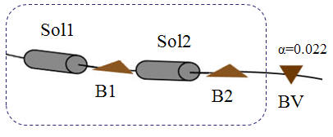
Electron Polarization
Producing/matching
Polarized electron source of CEBAF
Preserved in recirculated CEBAF
Injected into Figure-8 ring with vertical polarization
Turn to longitudinal polarization at IP using vertical crossing bends and solenoid spin rotators
Maintaining in the ring
electron self-polarization
SC solenoids at IRs removes spin resonances & energy sensitivity.
spin rotator
180º spin rotator
spin rotator
collision point
collision point
spin rotator
180º spin rotator
spin rotator
Solenoid spin rotator
Vertical bending dipole
Vertical bending dipole
Solenoid spin rotator
spin
Spin tune solenoid
spin tune solenoid
e
e
i
Arc bending dipoles
90º
90º
Arc bending dipoles
i
spin tune solenoid
spin tune solenoid
Vertical bending dipole
Spin rotators
Vertical bending dipole

Slide 37
Positrons in CEBAF/ELIC
International Workshop on Positrons at Jefferson Lab
March 25-27, 2009
“CEPBAF”, S. Golge (Ph. D thesis) / A. Freyberger
Polarized Positron Source, J. Dumas (Ph.D thesis) /J. Grames
Joint JLab/Idaho Univ. Position Program
10 MeV
5 MeV
converter
e+
Polarized source
Longitudinal emitt. filter
Transverse emitt. filter
15 MeV
e-
e
e-
-
e-
dipole
115 MeV
e+
dipole
15 MeV
dipole
e+
During positron production:
- Polarized source is off
- Dipoles are turned on
Unpolarized source
Non-polarized positron bunches generated from modified electron injector through a converter
Polarization realized through self-polarization at ring arcs
(M. Polker)

Slide 38
Other R&D

