Slide 1
Management Aspects of the HIT Project
Dr. Udo Weinrich

Slide 2
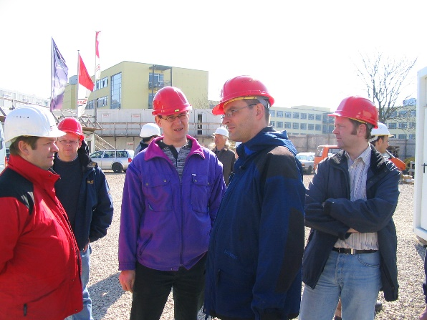
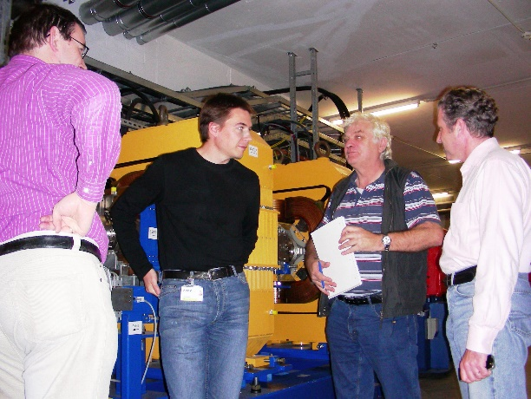
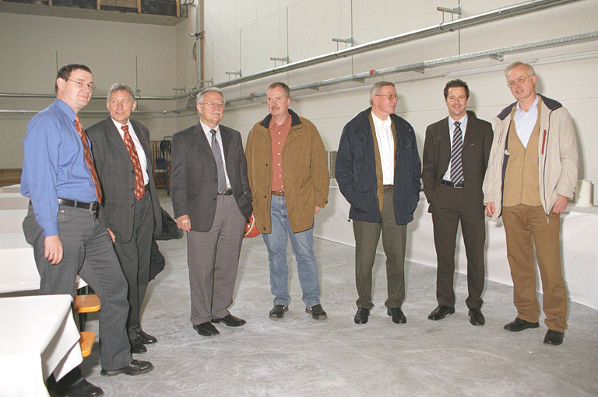
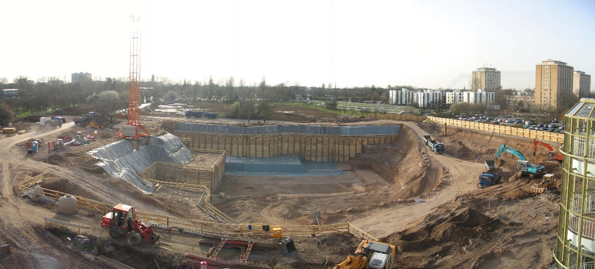
Outline
HIT Project
Organisation
Planning along all project phases
Reporting and other communication
Personal statements
2

Slide 3
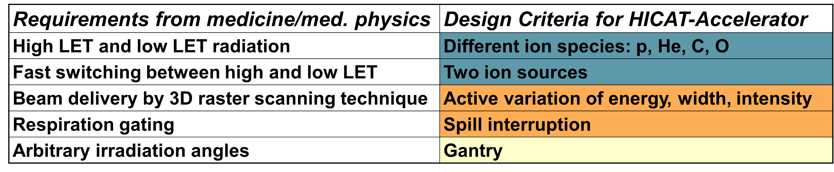
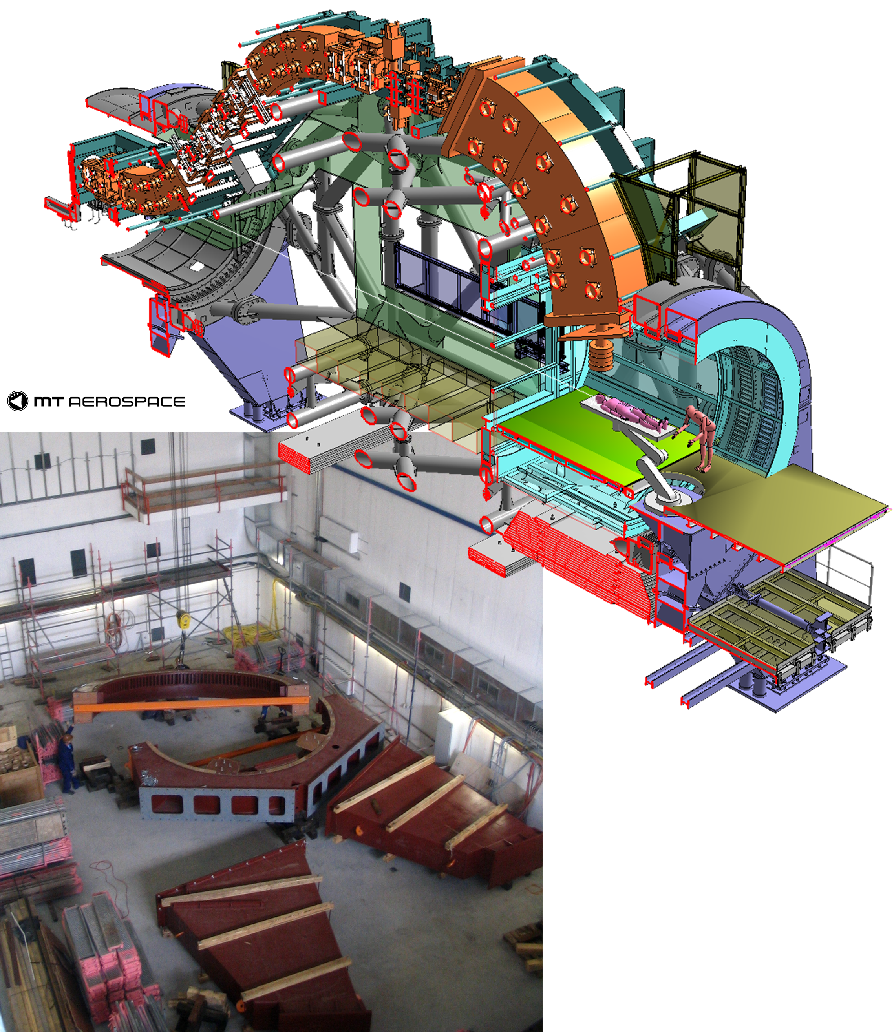
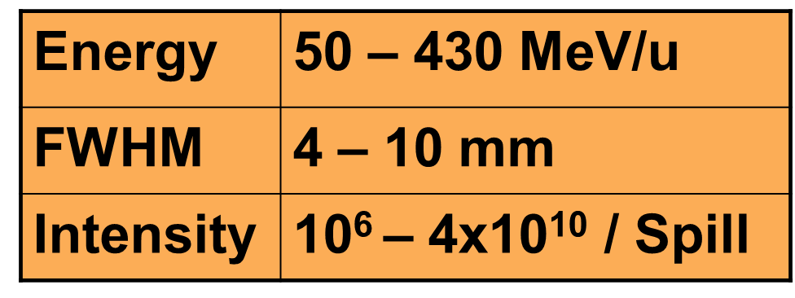
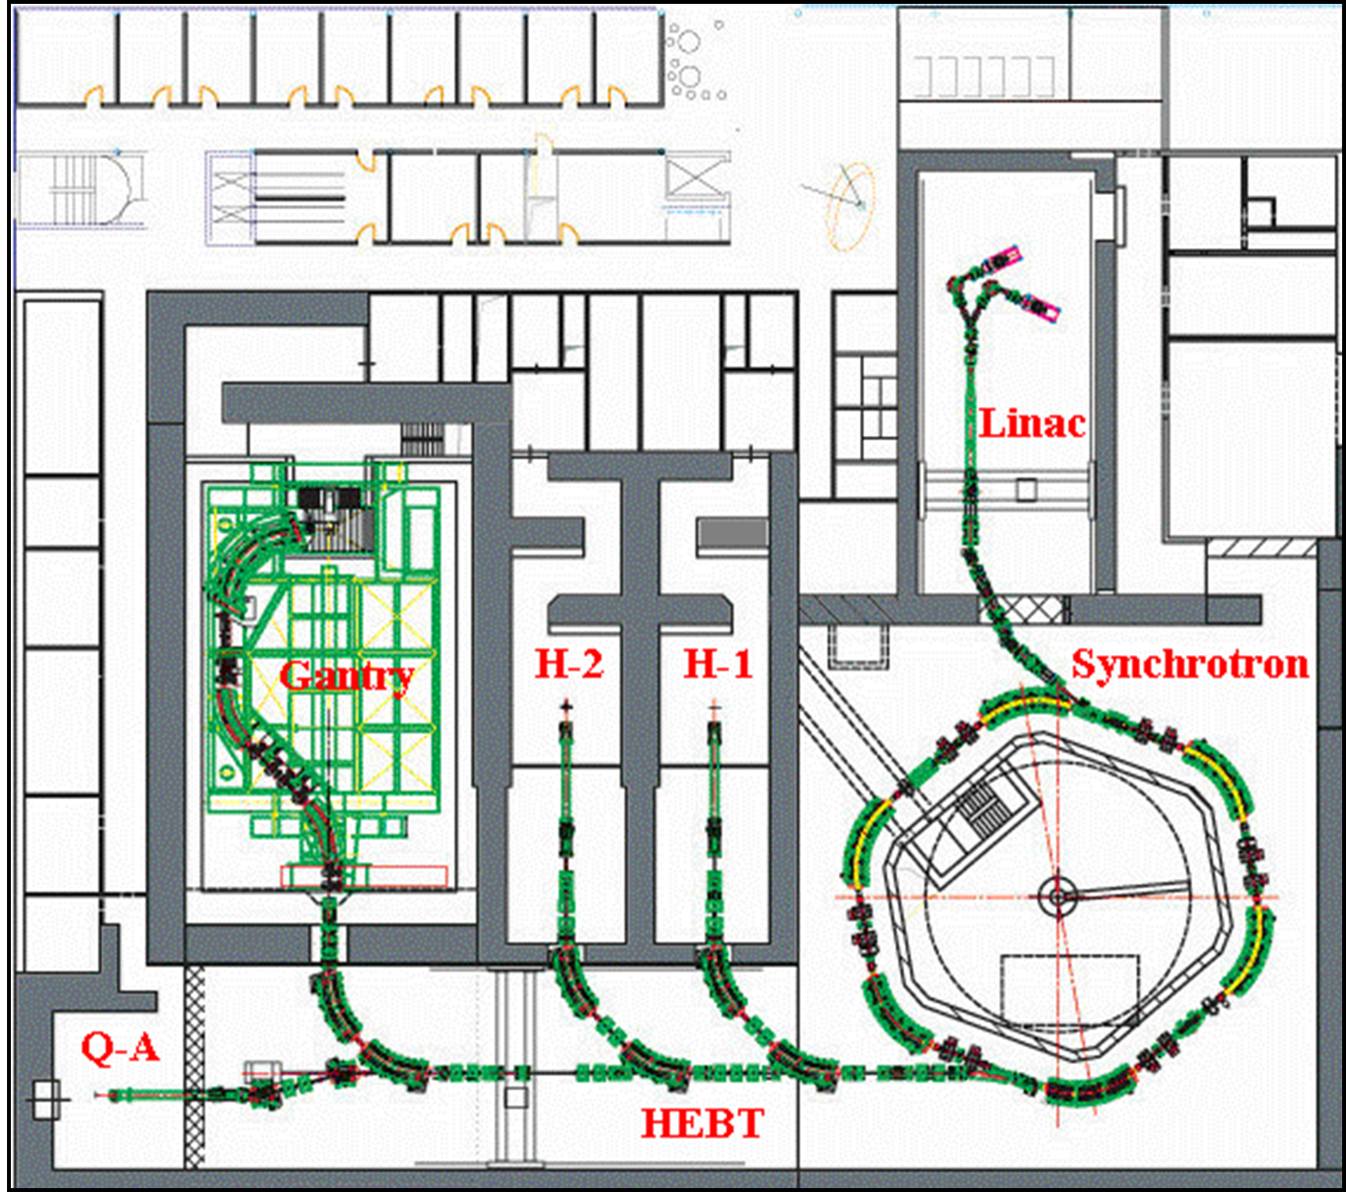
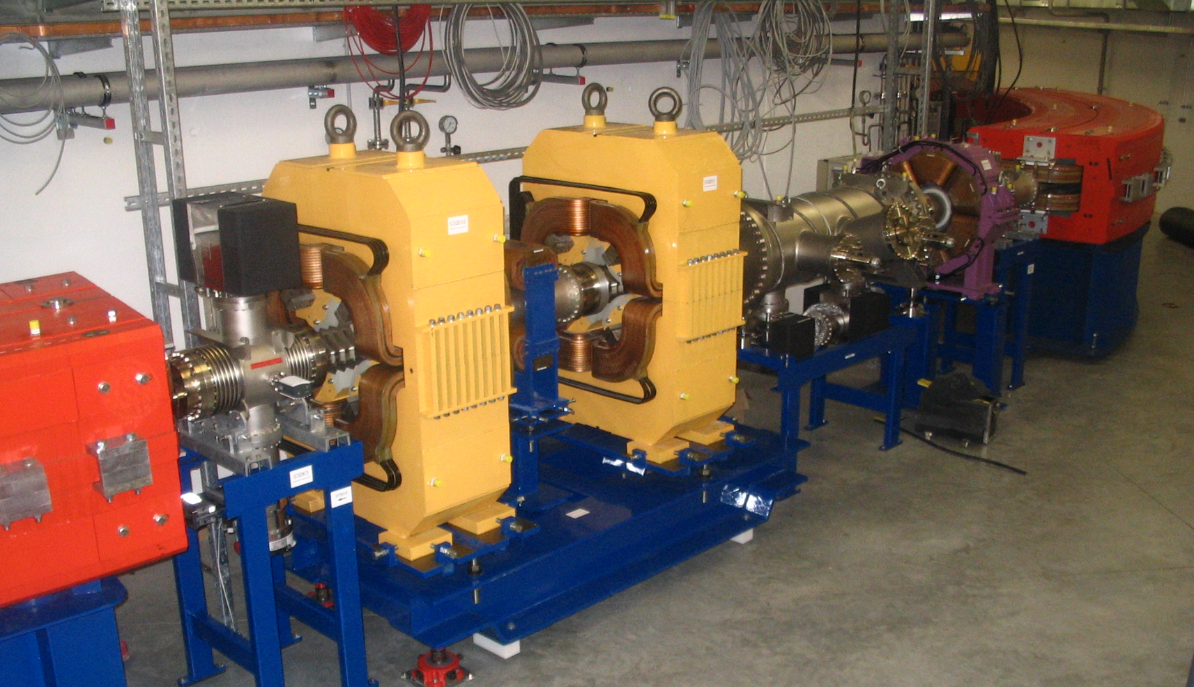
HIT Project (former HICAT)
3

Slide 4
Major Milestones
September 2000: Machbarkeitsstudie
Mai 2003: Genehmigung des Projektes
Oktober 2003: Firmen beauftragt
Mai 2004: Grundsteinlegung
Juni 2005: Richtfest
Oktober 2005: Montagebeginn Beschleuniger
September 2006: Gebäudeübernahme Klinik
Dezember 2006: LINAC-Strahl eingestellt
Januar 2007: Montagebeginn Gantry
Februar 2007: 1. Strahl im Synchrotron
Dezember 2007: Synchrotron/HEBT eingestellt
November 2009: Erster Patient behandelt
4

Slide 5
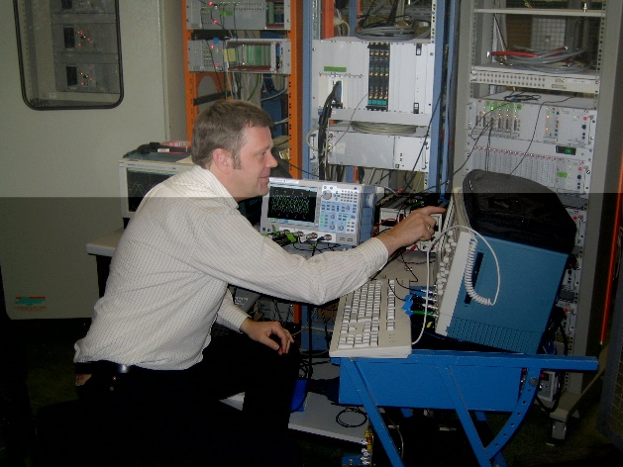
Tasks
technical leadership
assembly
delivery of beam diagnostics
service of beam diagnostics
know how transfer
5

Slide 6
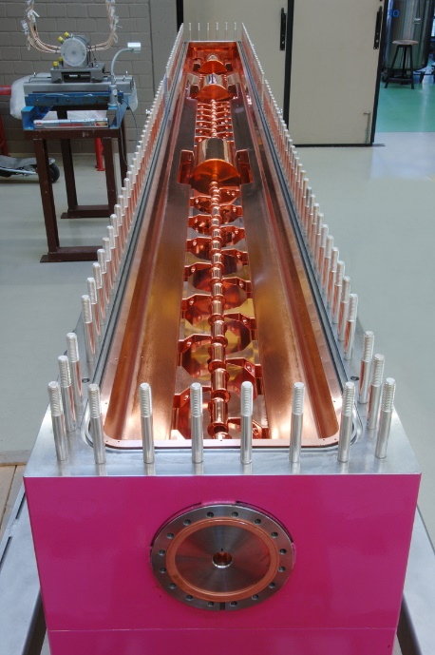
Project Team WBS (04/2006)
typical project structure
subproject leaders in department of project leader
technical responsibles in technical departments
6

Slide 7
Interfacing to users (04/2006)
sorted along topics
always including a clear deputy definition
7

Slide 8
Interfacing to Building (04/2006)
many strong technical links to building and infrastructure
sorted along technical issues and room issues
support responsibility in some rooms
8

Slide 9
Compliance with European laws
CE conformity
Risk analysis
Medical products and systems
9

Slide 10
Resource loaded planning
early for commissioning with beam
commissioning along the beam
on real persons rather than generic resources
10

Slide 11
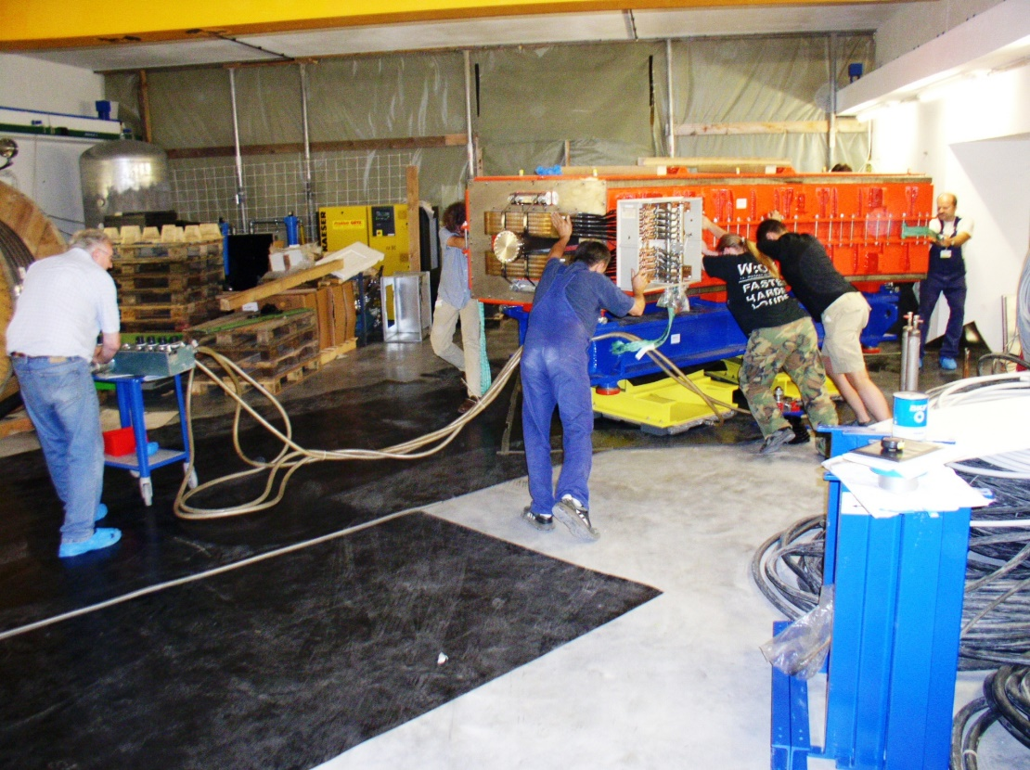
Administrative support
early agreement on overtime accumulation and compensation
11

Slide 12
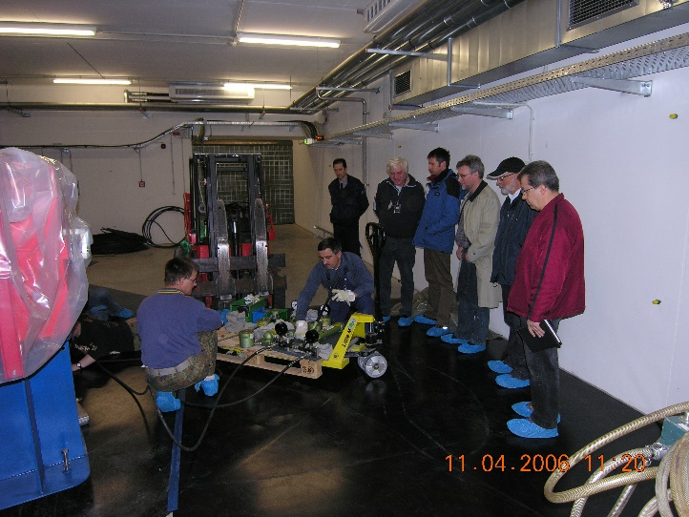
Request of building quality
easy to define
easy to request
difficult to get into contracts
even more difficult to get assured on the construction site
12

Slide 13
site and building
early agreement on 14 !! days reaction time on check and release of drawing from building planners
detailied process description for internal procedure in 6 steps
13

Slide 14
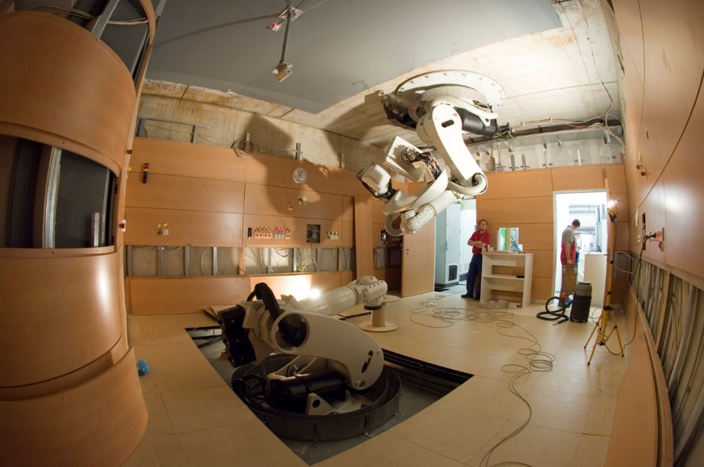
Assembly preparation
many deficits
not always easy to decide what is minor and what is major
14

Slide 15
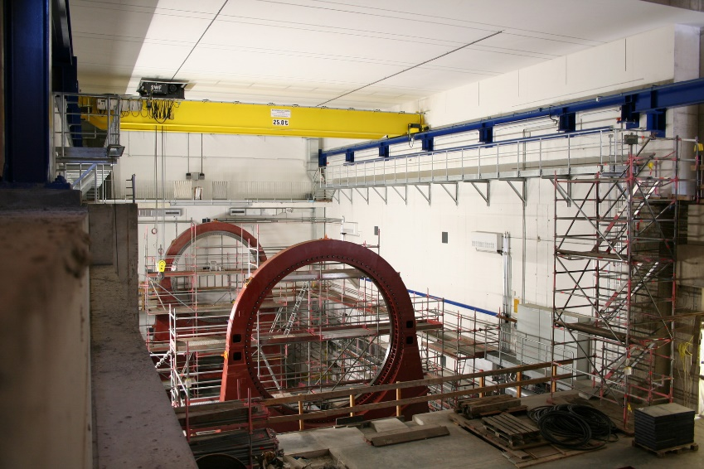
SiGEKO
early establishment of safety officer on construction site
agreement on overtime accumulation and compensation
15

Slide 16
Compliance with German laws
temporary operation permission
was eased by clear strategy for supporting documentation
16

Slide 17
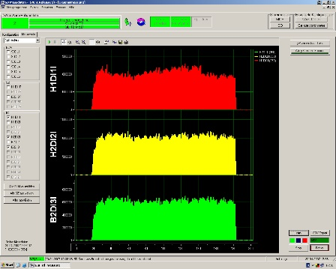
Beam sharing with users
commissioning with 3 shifts per day
from Monday noon to Saturday Evening
beam was the most critical resource
17

Slide 18
Shift planning
beam commissioning in shifts
continuous beam commissioning for many months
18

Slide 19
Transfer project to operation
tests and corresponding documentation
training and corresponding documentation
19

Slide 20
The end
20

Slide 21
Reporting to building coordination
building coordination meeting very difficult
21

Slide 22
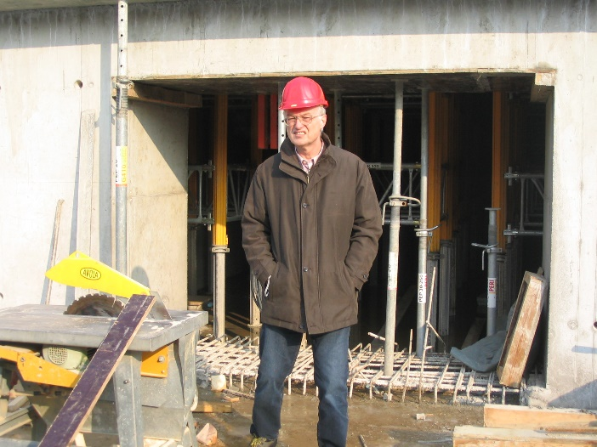
Reporting to GSI accelerator head
head of accelerator division H.Eickhoff
shows evolution within GSI organization
22

Slide 23
Reporting to upper management
several times per year directly to GSI Management
several times per year directly to management of university clinic of Heidelberg
23

Slide 24

Shift Reports
necessary to inform colleagues in a compact manner
24

Slide 25
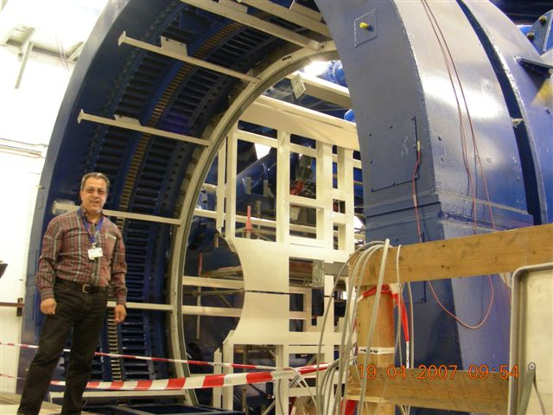
Weekly Reporting
internally
to operation meetings
25

Slide 26
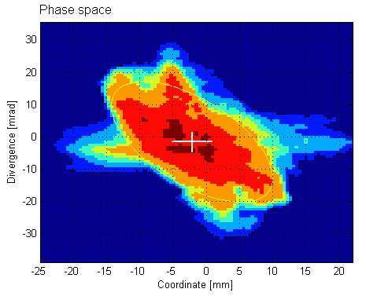
Reporting to HIT operation meeting
operation meeting started by GSI project team
rapid transfer to HIT operation team
26

Slide 27
Formal game with formal partners
building and medical project partners reacted very formally
at some occasions formal reactions were necessary
project lead of university hospital proved to be very professional in the end
27

Slide 28
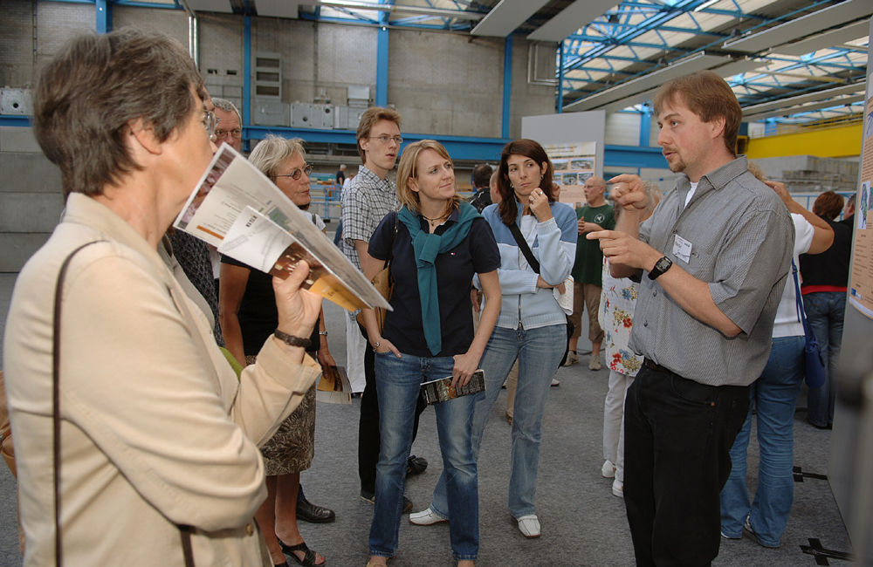
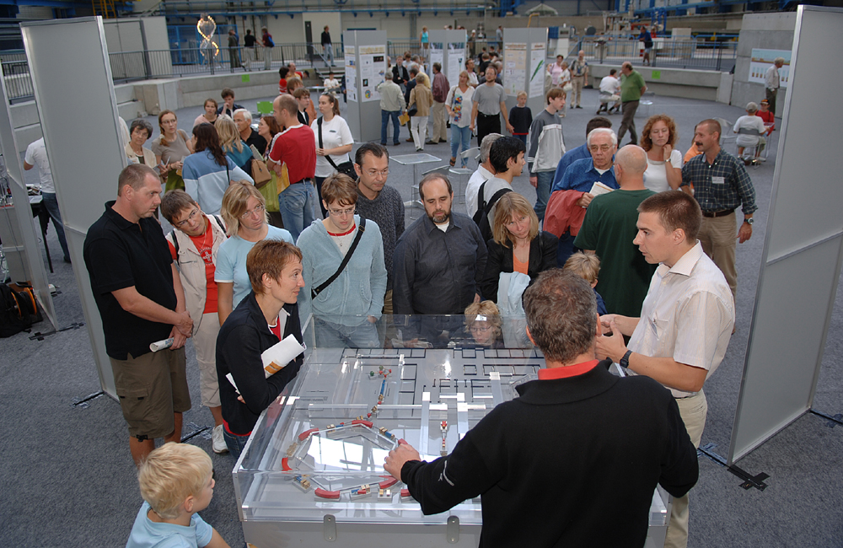
Open Day at GSI
documentation and participation of therapy team
28

Slide 29
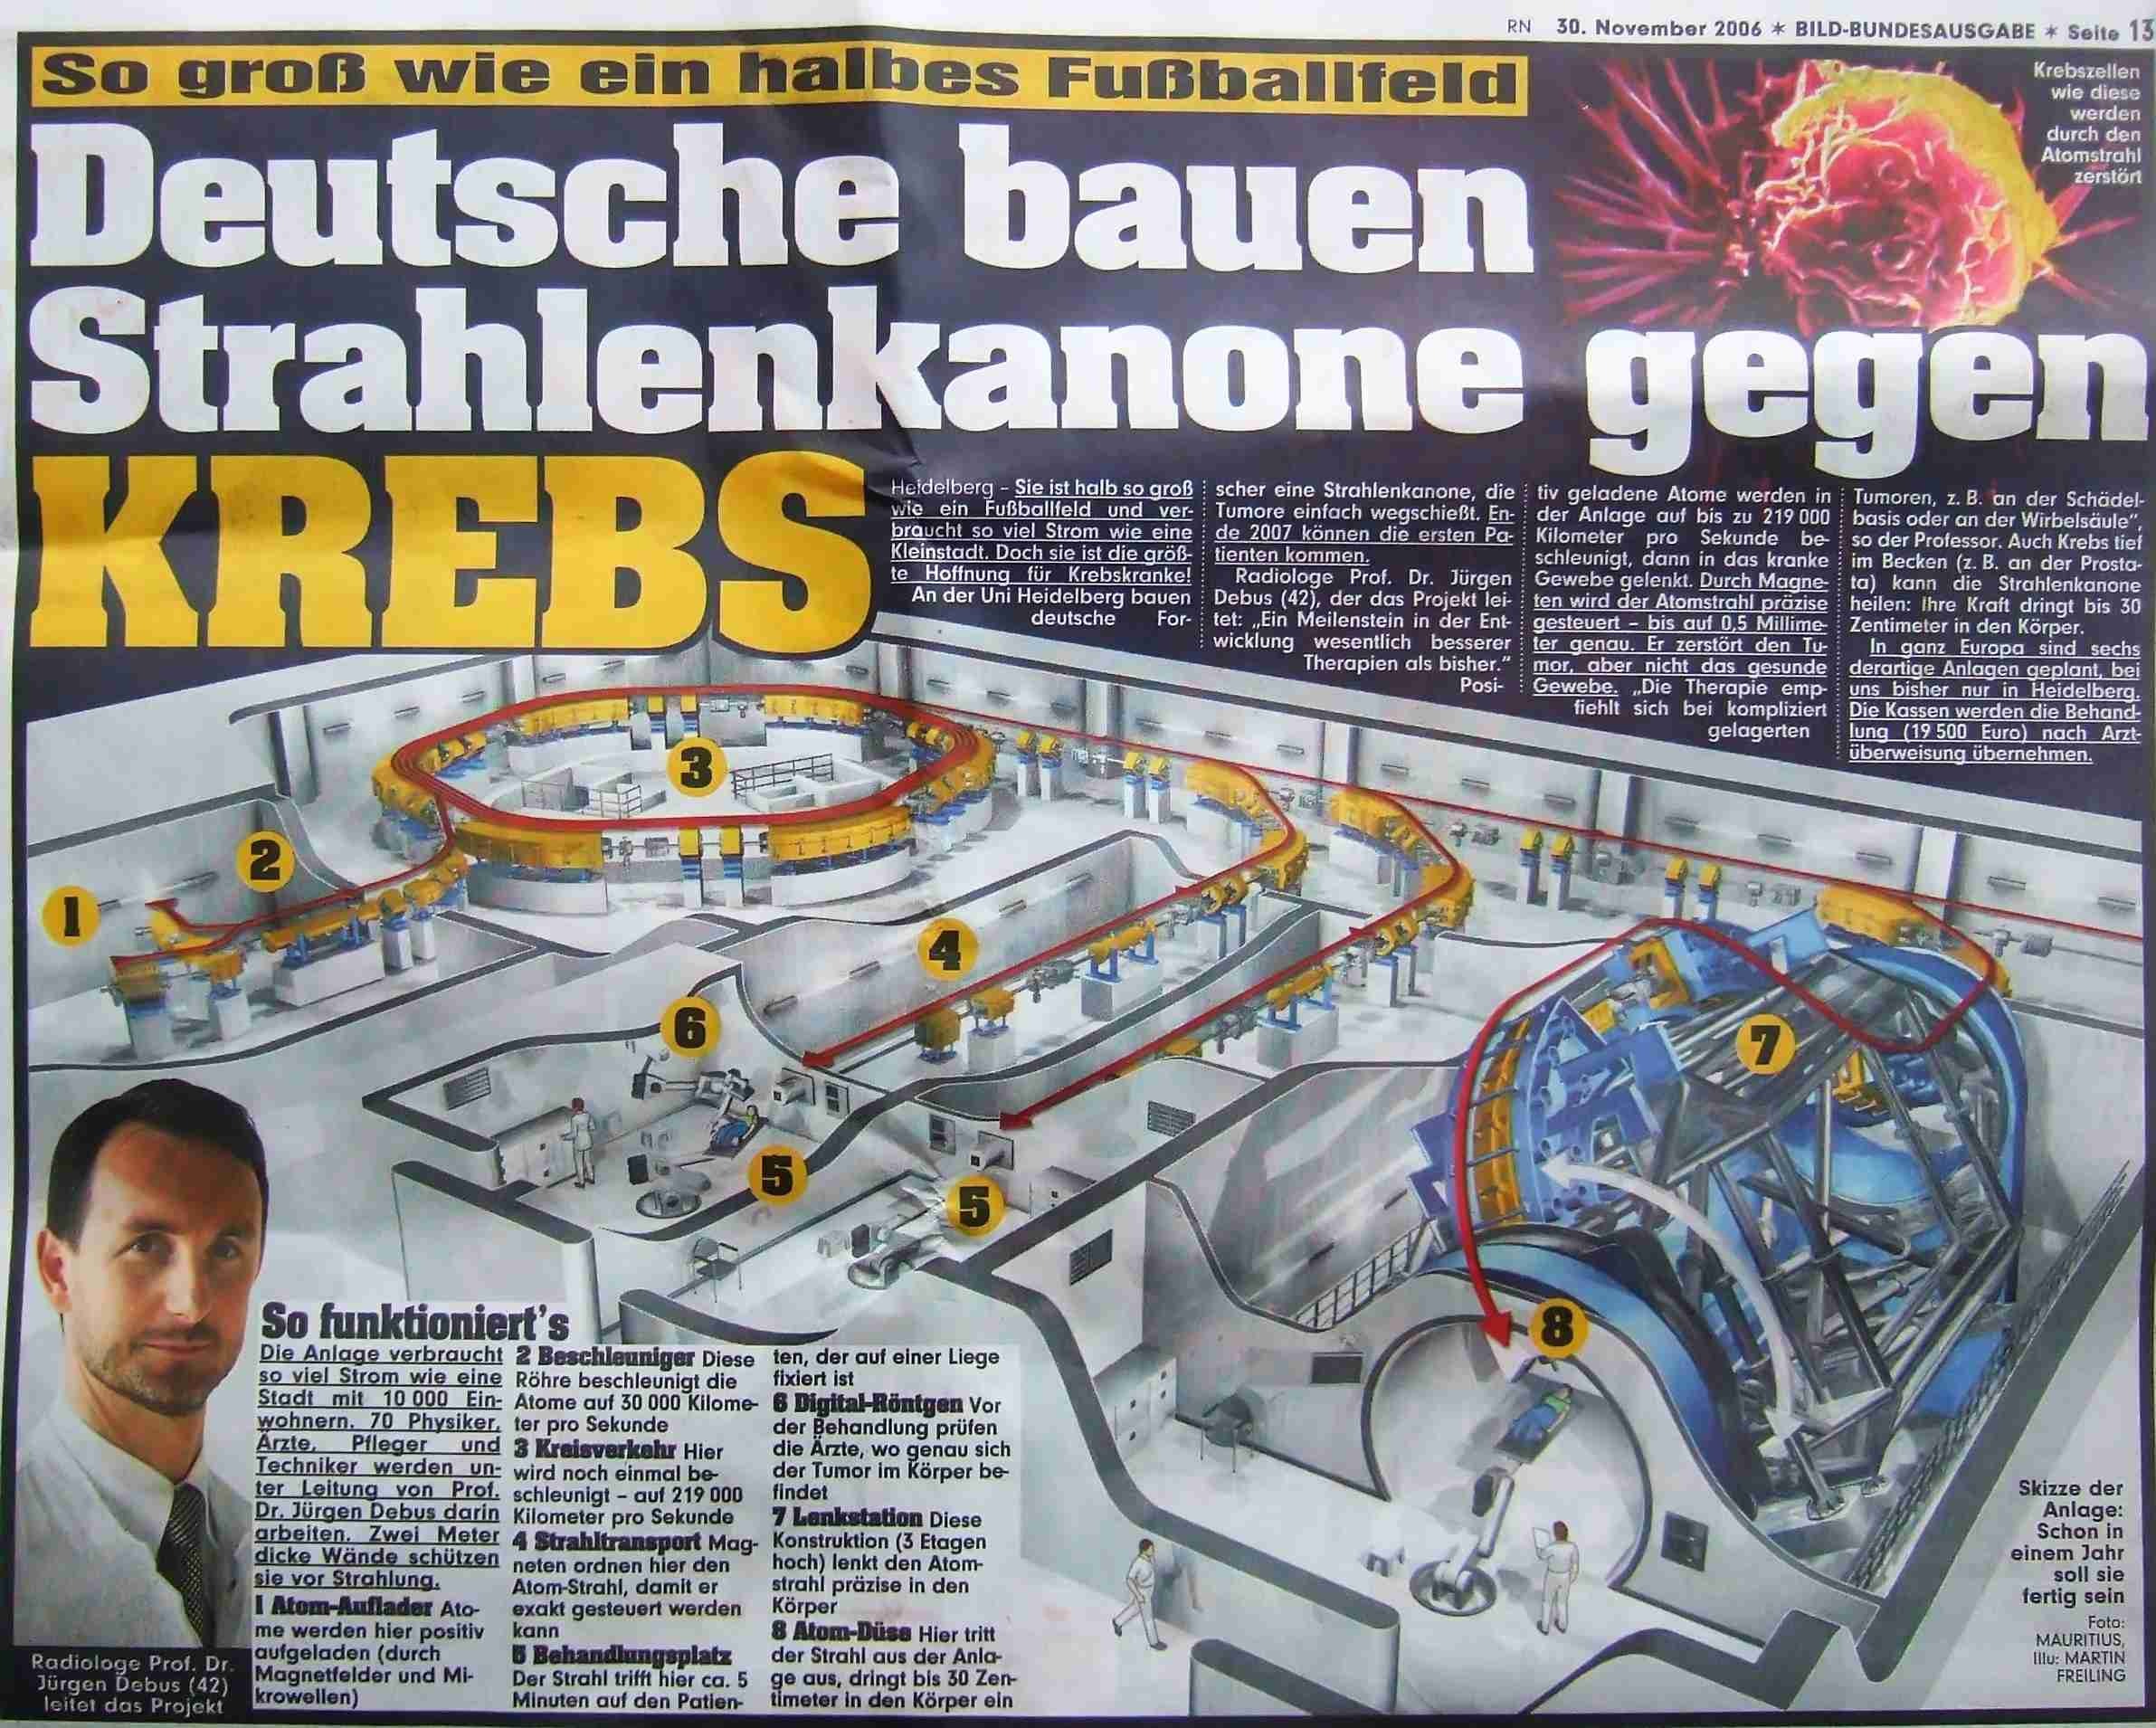
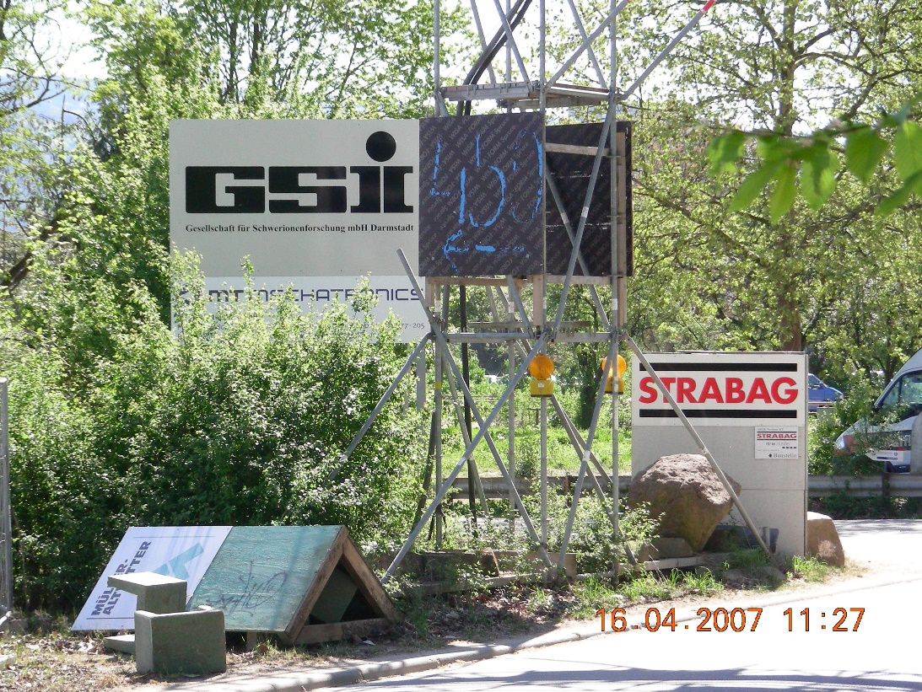
Public Relations in Heidelberg
own sign on construction site
29

Slide 30
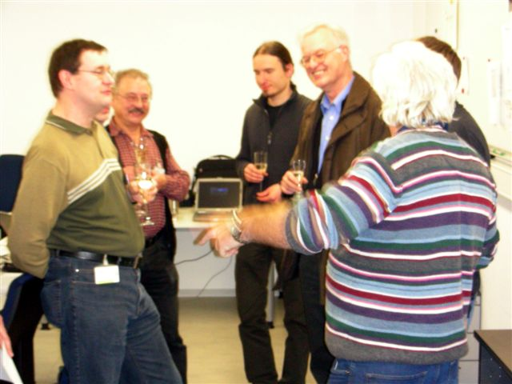
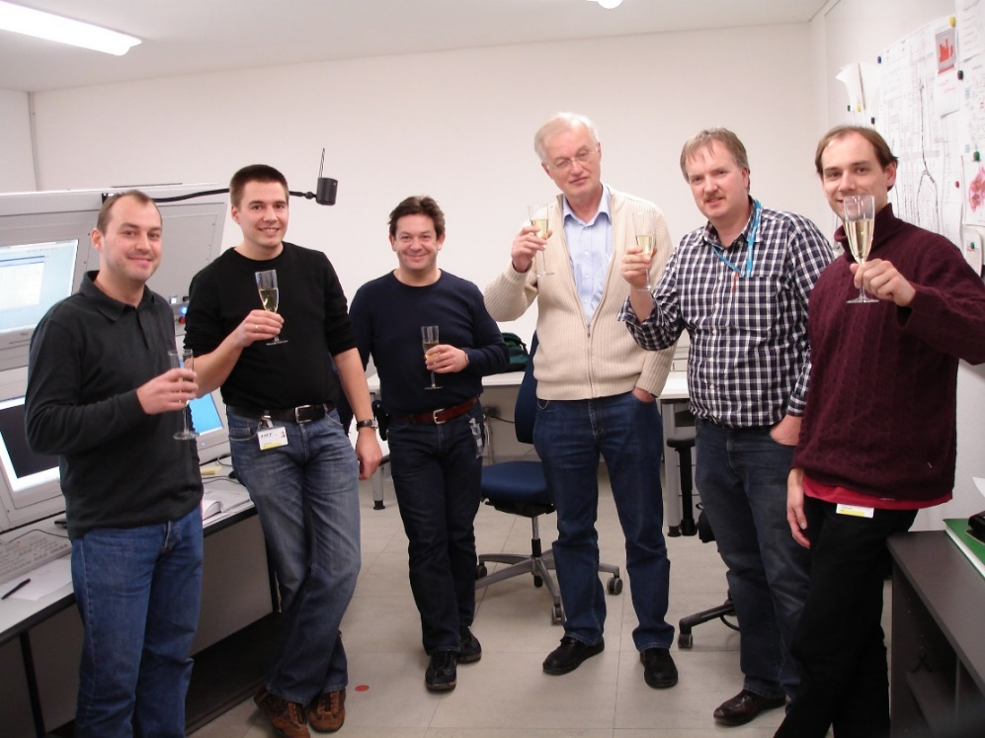
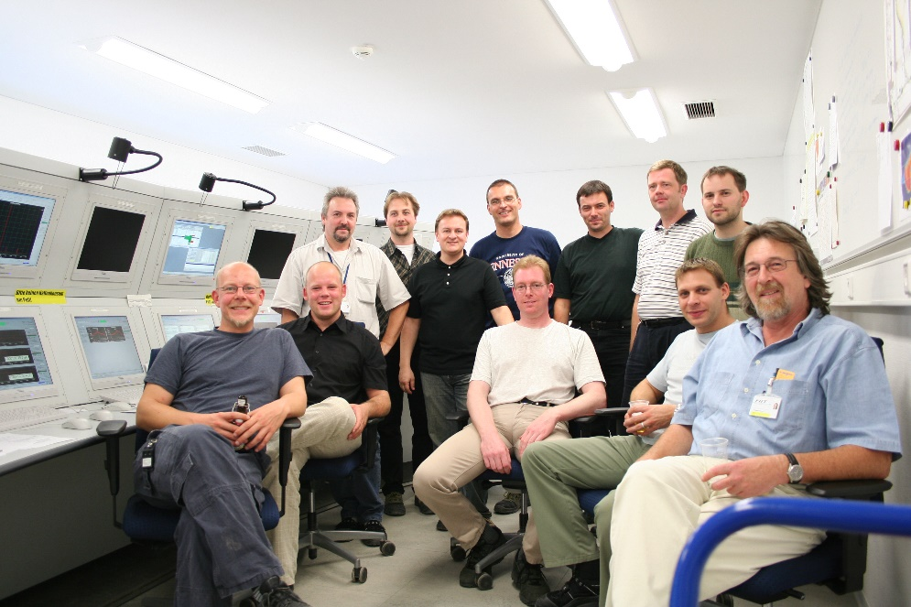
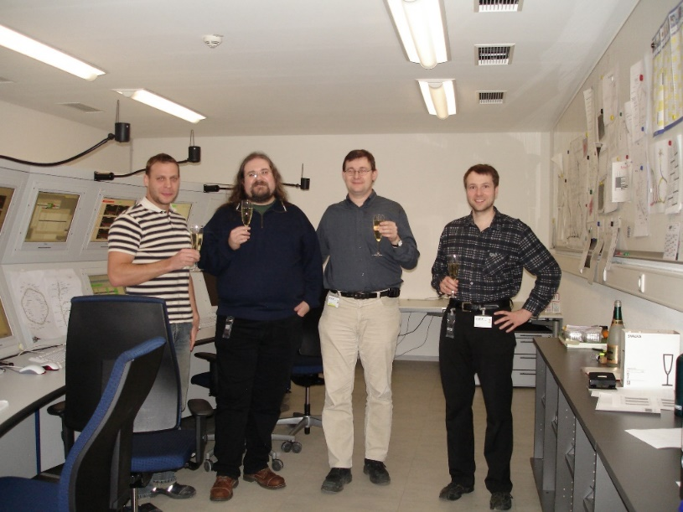
Success
30

Slide 31
Personal statements
I am grateful for all the experience I could gain within this great project – although it came along with a lot of stress
Complex or large projects will be successful due to and not despite of the focusing of the project leader towards project organization. Project Leaders are always under pressure to organize the existing and upcoming challenges within the project.
Complex or large projects will be successful due to and not despite of reporting by project members. Project Managers need to be informed of all critical items in order to organize things properly and they do not have the time to run after the information.
31

