Slide 1
X(3872)-Scan Reloaded
PANDA CM Vienna
Charmonium Exotics Session
1. Dec. 15
K. Götzen GSI Darmstadt

Slide 2
Idea
Nature of X(3872)
Need lineshape and width to understand structure
Approach at PANDA
Fine scan around nominal mass → energy dependent cross section
Analysis goals
Sensitivity of Γ measurement (conventional BW)
Sensitivity for virtual/bound state (molecular picture)
Analysis strategy
Analysis of X(3872) → J/ψ(ℓ⁺ℓ–) ρ⁰(π⁺π–) channel only
Full sim/reco → signal + background efficiencies ε_{S} and ε_{B}
Toy MC scan simulation with assumption for cross sections, integrated luminosities, BRs

Slide 3
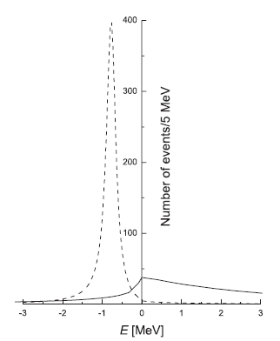
Molecular Picture (Hanhart et al)
Lineshapes from [Kalashnikova et al, Phys. Atom. Nucl. 73 (2010) 1592]
Here only interested in X(3872) → J/ψ π⁺π– (assuming lineshape as in B decays)
d
bound
virtual
$+ Γ0$
Parameter E_{f} determines
state to be bound or virtual

Slide 4
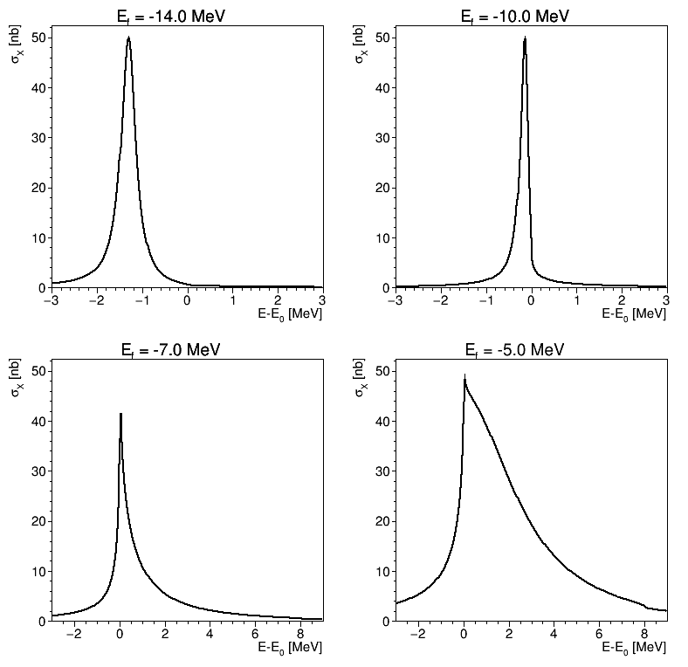
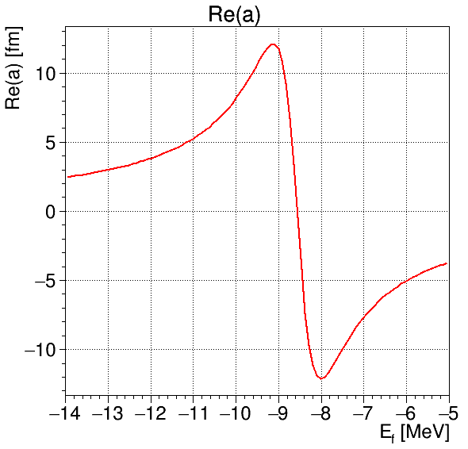
Lineshapes for different E_{f}
Scattering length D⁰D⁰*:
Always scaled to f_{max} = 50 nb here!
bound
bound
Re(a) > 0 : bound state
Re(a) < 0 : virtual state
E_{f} = -8.56 MeV
bound
virtual
virtual
virtual
(with f_{ρ}=0.00047, f_{ω}=0.00271, g=0.137, Γ₀=1.0 MeV)

Slide 5
Reconstruction Part

Slide 6
Parameters
Parameter | Value
BR(J/ψ → e⁺ e–) | 5.97 %
BR(J/ψ → μ⁺ μ–) | 5.96 %
BR(X → J/ψ ρ⁰) | 5 % (assumption)
σ(p → X) | 50 nb (assumption)
σ(p → J/ψ π⁺π– non-res)* | 1.2 nb (theory)
σ(p → inelastic) @ 3.872 GeV | 46 mb
L_{HL} (3.872 GeV) | 13683 (nb·d)⁻¹
L_{HR} (3.872 GeV) | 1368 (nb·d)⁻¹
L_{HESRr} (3.872 GeV) | 1170 (nb·d)⁻¹
σ_{E,abs} (absolute energy positioning) | 100 keV (assumption)
σ_{E,rel} (relative energy positioning) | 10 keV (assumption)
σ_{E,beam}(HL) | 168 keV
σ_{E,beam}(HR/HESRr) | 67 keV
Branching
Fractions
Cross sections
Luminosities
Resolutions
*[PRD 77 (2008) 097501]

Slide 7
Software and Data
Software
PandaRoot: Revision 28670
FairSoft: mar15p2
FairRoot: v15.03
Data @ E_{cm} = 3.872 GeV
Channel | #Events
p → J/ψ ρ⁰ → e⁺e– π⁺π– | 98k
p → J/ψ ρ⁰ → μ⁺μ– π⁺π– | 100k
p → J/ψ (→ e⁺e–) π⁺π– (NR) | 100k
p → J/ψ (→ μ⁺μ–) π⁺π– (NR) | 99k
DPM (J/ψ → e⁺ e– prefilter) | ≈10M = 9.58G generated
DPM (J/ψ → μ⁺ μ– prefilter) | ≈10M = 8.87G generated

Slide 8
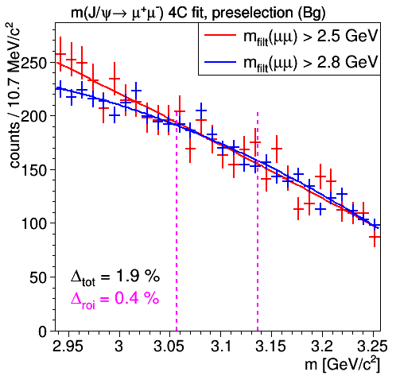
Background Prefilter QA
Filtering criteria
Require 4 charged tracks
Require one 2-track combination : m_{ee/μμ} > 2.8 GeV/c²
Suppression factor e⁺e– : ≈1/1000
Suppression factor μ⁺μ– : ≈1/900
Check filter bias (μμ only)
Cross check with criterion m_{μμ} > 2.5 GeV/c² (10M → 2.6G)
Slight difference at lower mass edge
Total integral difference: 1.9%
Difference in J/ψ ROI: 0.4% ⇒ Negligible effect!

Slide 9
Signal Reconstruction
Preselection e⁺e– :
Particle Identification : ElectronTight, PionAll (PidAlgoEmcBayes;PidAlgoDrc;PidAlgoDisc;PidAlgoStt;PidAlgoMdtHardCuts)
J/ψ → e⁺e– mass window: 2.0 < m(e⁺e–) < 3.4 GeV/c²
ρ⁰ → π⁺π– mass window: 0.27 < m(π⁺π–) < 1.0 GeV/c²
p → J/ψ ρ⁰ 4C fit : χ²<200
Preselection μ⁺μ–:
Particle Identification : MuonTight, PionAll (PidAlgoEmcBayes;PidAlgoDrc;PidAlgoDisc;PidAlgoStt;PidAlgoMdtHardCuts)
J/ψ → μ⁺μ– mass window: 2.5 < m(μ⁺μ–) < 3.4 GeV/c²
ρ⁰ → π⁺π– mass window: 0.27 < m(π⁺π–) < 1.0 GeV/c²
p → J/ψ ρ⁰ 4C fit : χ²<100

Slide 10
Correlation M(ℓ⁺ℓ–) vs. M(π⁺π–)
signal
hadron. bkg
(DPM)
J/ψ
ρ⁰

Slide 11
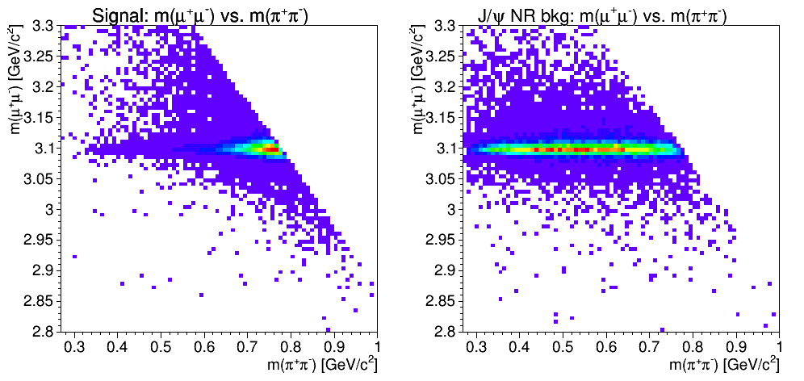
Correlation M(ℓ⁺ℓ–) vs. M(π⁺π–)
signal
J/ψ NR bkg
J/ψ
ρ⁰

Slide 12
p System after Preselection
p → J/ψ ρ⁰ → e⁺ e– π⁺ π–
p → J/ψ ρ⁰ → μ⁺ μ– π⁺ π–
signal
hadron. bkg
signal
hadron. bkg

Slide 13
Final Selection Criteria
Final selection e⁺e–
Electron PID(e±) > 0.95
m(e⁺e⁻) > 2.7 GeV/c²
p(e⁺e⁻) > 4.6 GeV/c
p_{cm}(e⁺e⁻) < 0.38 GeV/c
∡(p_{e+},p_{e-}) < 2 rad
Final selection μ⁺μ–
Muon PID(μ±) > 0.99
p_{cm}(μ⁺μ⁻) < 0.32 GeV/c
p_{cm}(μ±) > 1.37 GeV/c

Slide 14
Final Selection Results
J/ψ → e⁺e–
J/ψ → μ⁺μ–
ε_{S} = 11.4%
ε_{B,nr} = 3.5%, ε_{B,hd} = 2.6$·$10⁻¹¹
S:N = 4.6 : 1
ε_{S} = 14.0%
ε_{B,nr} = 2.7%, ε_{B,hd} = 1.1$·$10⁻¹⁰
S:N = 3 : 1
σ_{core} = 10 MeV/c²
σ_{core} = 8 MeV/c²
136
hd. scaled
hd. scaled
31
ROI
ROI
±5σ_{core}
±5σ_{core}

Slide 15
Energy Scan Part

Slide 16
Possible Approaches
Two obvious approaches possible to extract lineshape:
Cut on J/ψ and count
simple + robust
all backgrounds still in scanned lineshape
Fit signal in J/ψ mass
removes hadronic bkg
NR bkg still present
J/ψ mass
Scanned cross section
S
B_{nr}
B_{hd}
m_{J}
σ(E)
J/ψ mass
Scanned cross section
S
B_{nr}
Show 2. method here
being slightly better than 1.
B_{hd}
m_{J}
σ(E)

Slide 17
Uncertainty Assumptions for Scan
Beam related energy resolution: σ_{E,beam} = 67(HR) / 168(HL) keV
Absolute positioning resolution: σ_{E,abs} = 100 keV (shift)
Relative positioning resolution: σ_{E,rel} = 10 keV (~ error in E_{cm})
σ_{E,beam}
σ_{E,rel}
σ_{E,abs}
168keV
E_{cm}
step
67keV
intended positions

Slide 18
Procedure for Individual Scan
Scan procedure
Set parameter P (Γ or E_{f}) in signal function
Define scan region, number of points, L_{int} / point
Scale unfolded function σ_{S}(E) to σ_{S,max} = 50nb and adapt convoluted function σ_{S}'(E) → σ_{S}'_{,max} ≤ 50nb
For each energy scan point (E_{cm})
Modify energy E_{cm} → E_{cm}' due to σ_{E,abs} and σ_{E,rel} (Uncertainty for i-th scan point ΔE_{cm,i} = √i · σ_{E,rel})
Compute expected S₀ / B_{hd,0} / B_{nr,0} based on σ_{S}'(E_{cm}') / σ_{B,hd} / σ_{B,nr}
Generate Poissonians S / B_{hd} / B_{nr} from expected numbers
Generate J/ψ data with S+B_{nr} signal and B_{hd} background events
Do unbinned ML fit to extract N_{J/ψ} → Scan graph at E_{cm}
Fit graph with signal + background function → parameter P
Repeat N times to determine root-mean-square & bias of P
+ ΔN_{hi}
– ΔN_{lo}

Slide 19
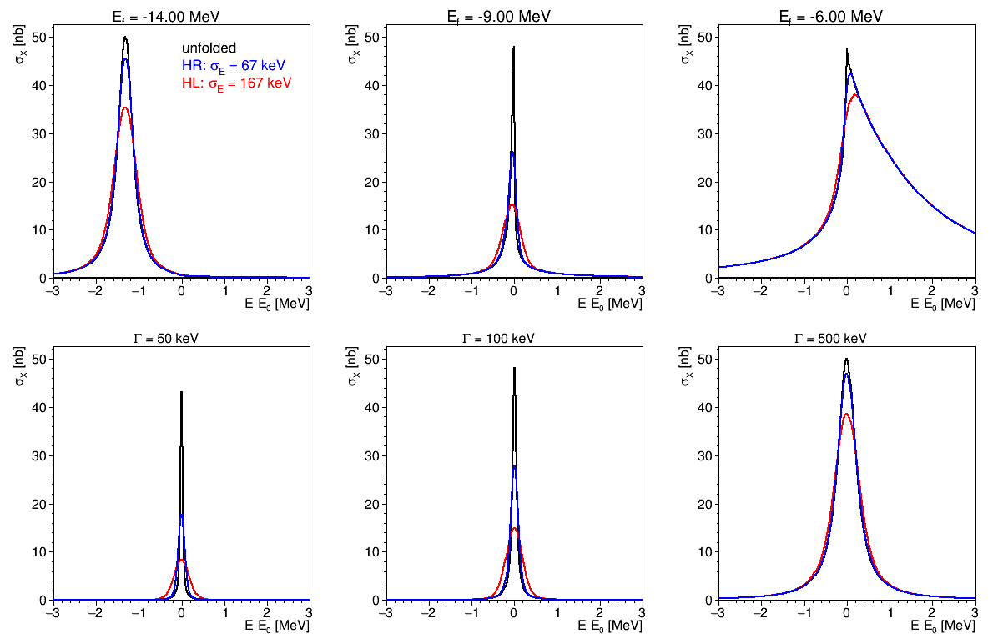
Lineshape Examples
E_{f} = -14 MeV
E_{f} = -9 MeV
E_{f} = -5 MeV
σ'_{max}
much
lower!
Molecule
Γ = 50keV
Γ = 100keV
Γ = 500keV
σ'_{max}
much
lower!
Breit-Wigner

Slide 20
Generated J/ψ Plots Examples
Signal pdf like in true reco; hadr. background flat
Scale efficiencies from ROI to full window width (ε_{S}×1.1, ε_{B}×4)
E_{cm} in peak
E_{cm} in tail
m(ℓ⁺ℓ–) [GeV/c²]
m(ℓ⁺ℓ–) [GeV/c²]
S = 275.8
+ 16.8
– 16.7
S = 26.1
+ 9.7
– 9.0

Slide 21
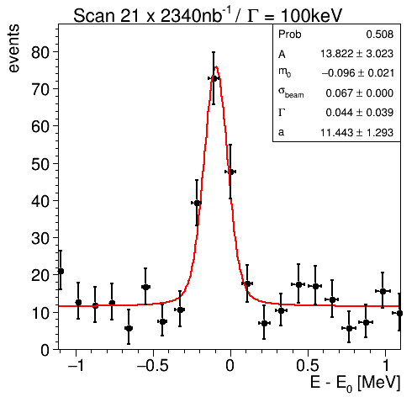
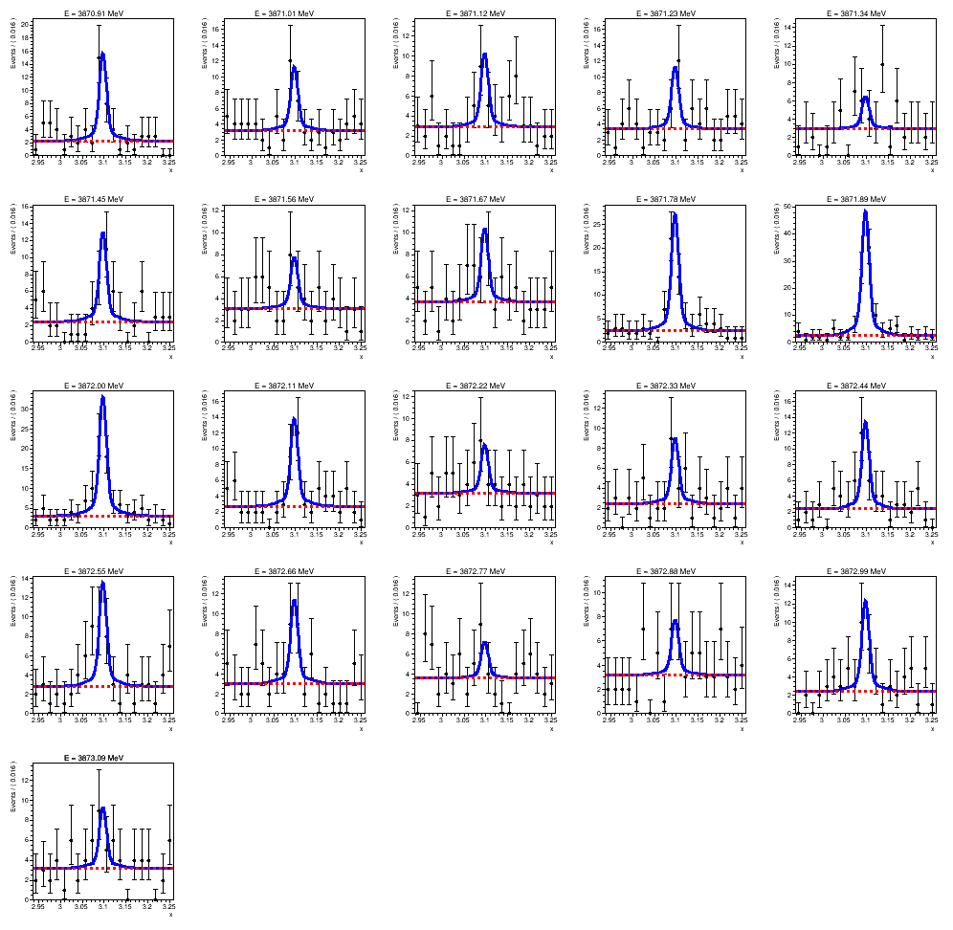
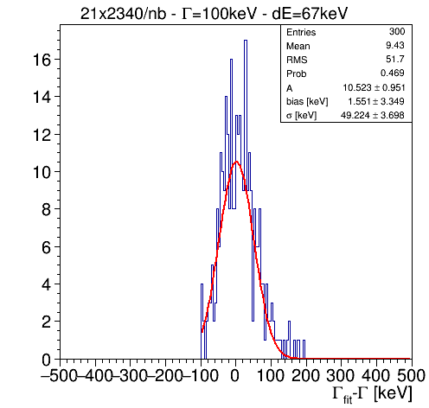
Illustration for Scan
BW, 21 x 2d in HESRr mode
3871.34 MeV
3871.89 MeV
300 times ...
μ = 9 keV
rms = 52 keV

Slide 22
Investigated Scenarios
Luminosity modes (E_{cm} = 3.872 GeV): N_{L} = 3
Parameter settings: N_{P} = 8
Investigated scenarios: N_{S} = 5
Toy MC fits: N_{MC} = 100 ... 300 (N_{tot} ≈ 50000)
Mode | HL | HR | HESRr
L_{int} [(nb·d)⁻¹] | 13683 | 1368 | 1170
BW | Γ [keV] | 50 | 70 | 100 | 130 | 180 | 250 | 500 | 800
Molecule | -E_{f} [MeV] | 14 | 12 | 10 | 9 | 8 | 7 | 6 | 5
Mainly show results for this one
Scan time [month] | 1.5 | 2 | 2 | 2 | 10
Points × days | 21 x 2 | 21 x 3 | 31 x 2 | 61 x 1 | 61 x 5
Physics mode | Breit-Wigner Γ | Molecule E_{f}
Number of fits | 150 ... 300 / setup | 100 / setup

Slide 23
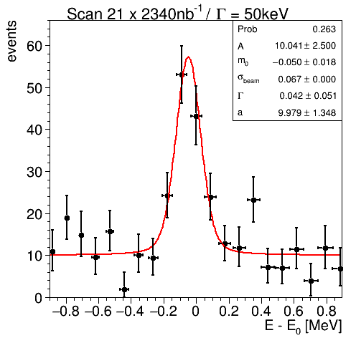
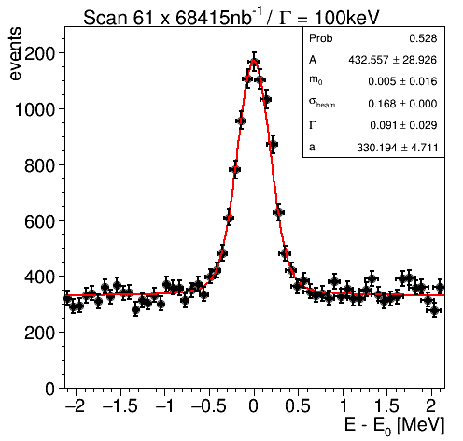
Scan Examples Breit Wigner
HESRr: 21 x 2 days
Γ = 50 keV
HL: 61 x 5 days
Γ = 100 keV

Slide 24
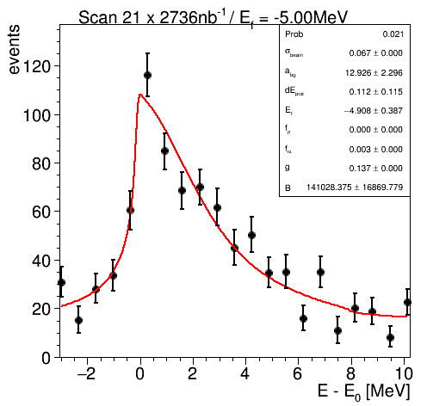
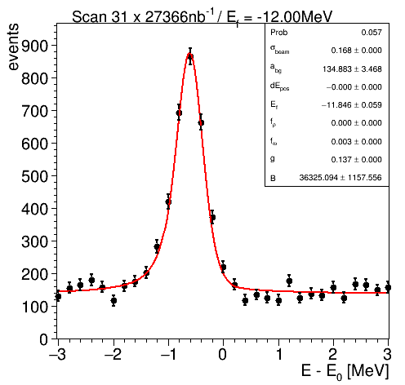
Scan Examples Molecule Lineshape
HR: 21 x 2 days
E_{f} = -5 MeV
HL: 31 x 2 days
E_{f} = -12 MeV

Slide 25
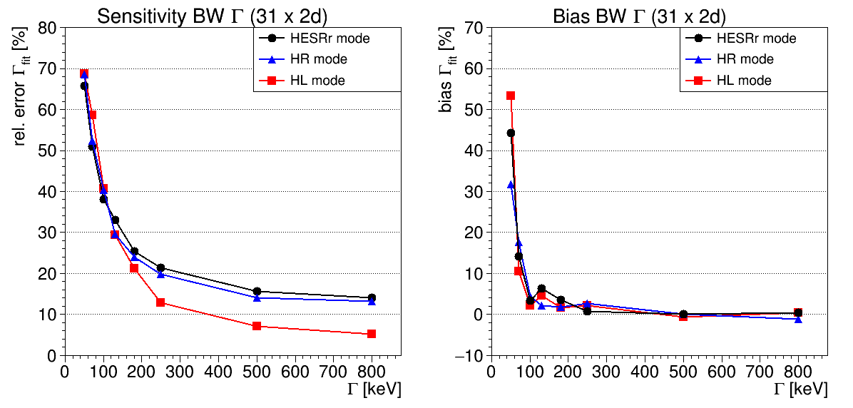
Sensitivities Breit-Wigner Γ (31 x 2d)
Extract standard deviation and bias from toy MC fits (ML)
Show relative error rms_{fit}/_{fit} and bias (_{fit} - Γ)/Γ in [%]
relative error
relative bias
→ reach 3σ @ Γ=130 keV!
(all modes)
3σ
≲ 5% bias for Γ ≥ 100 keV
σ_{HR}
σ_{HL}
σ_{HR}
σ_{HL}

Slide 26
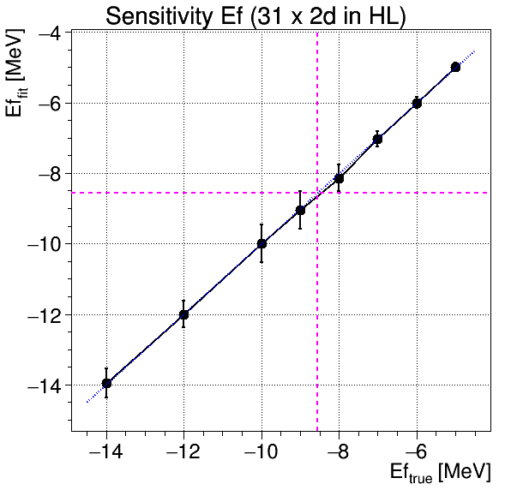
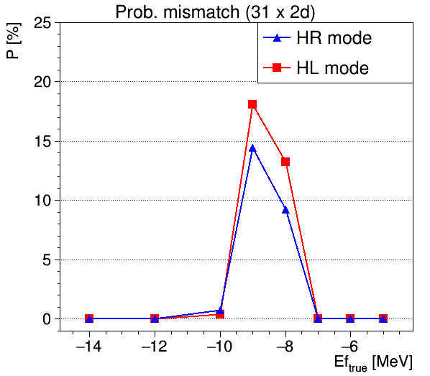
Sensitivities Molecule Lineshapes (31 x 2d)
Extract standard deviation and bias from toy MC fits
How well can virtual and bound state be distinguished?
Uncertainty = σ_{Gaussian} → Integrate in mismatch region
Mismatch probability (31 x 2d)
mismatch
(B → V)
virtual
integral
mismatch
(V → B)
bound
P>5%
2.25 MeV

Slide 27
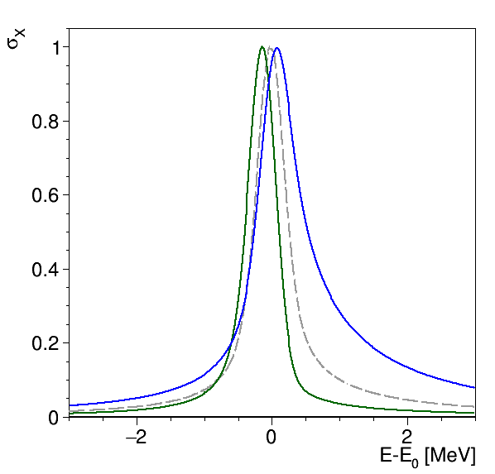
Probability of Mismatch (31x2d)
How do the lineshapes look like?
Mismatch probability (31 x 2d)
Colored lines: E_{f} @ P_{mis} = 5%
σ_{E,beam} = 168 keV
-9.75 MeV (bound)
-8.56 MeV (thresh)
-7.50 MeV (virtual)
bound
virtual

Slide 28
Summary
Investigation of X(3872)-Scan at PANDA in various scenarios
Determined sensitivity for BW width measurement
Reach Γ/σ_{Γ} > 3 at Γ ≳ 130 keV (2 months data)
For Γ ≥ 100keV bias ΔΓ/Γ ≤ 5% ( '' )
HL mode superior for Γ > 180 keV
Determined sensitivity for molecular lineshape measurement
Possible to distinguish bound/virtual state
Outside ΔE_{f} = 2.25 MeV trans. region P > 95% for correct id.
HL and HR modes seem comparable
Further steps
Improve suppression of J/ψ π⁺π– NR background
Start writing analysis document

Slide 29
BACKUP

Slide 30
Background Prefilter
Reasonable S/N sensitivity: need huge amount of BG
Example calculation:
Signal: σ_{S} = 50 nb, BR_{J/ψ} = 0.06, BR_{X} = 0.05, ε_{S} = 20%
Background: σ_{B} = 46 mb (inelastic @ E_{cm} = 3.872 GeV)
Neither feasible nor efficient to simulate completely
Use FairFilteredPrimaryGenerator to filter already at generator level

Slide 31
Final Selection J/ψ → e⁺e– Channel
Preselection
Final Selection
ε_{S} = 16.6%
ε_{B,nr} = ε_{S}, ε_{B,hd} = 1.7$·$10⁻⁸
S:N = 1 : 32
ε_{S} = 11.4%
ε_{B,nr} = 3.5%, ε_{B,hd} = 2.6$·$10⁻¹¹
S:N = 4.6 : 1
(ROI=±5σ_{core})
hd. scaled
ROI
ROI

Slide 32
Final Selection J/ψ → μ⁺μ– Channel
Preselection
Final Selection
ε_{S} = 21.8%
ε_{B,nr} = ε_{S}, ε_{B,hd} = 4.8$·$10⁻⁷
S:N = 1 : 670
ε_{S} = 14.0%
ε_{B,nr} = 2.7%, ε_{B,hd} = 1.1$·$10⁻¹⁰
S:N = 3 : 1
(ROI=±5σ_{core})
hd. scaled
ROI
ROI

Slide 33
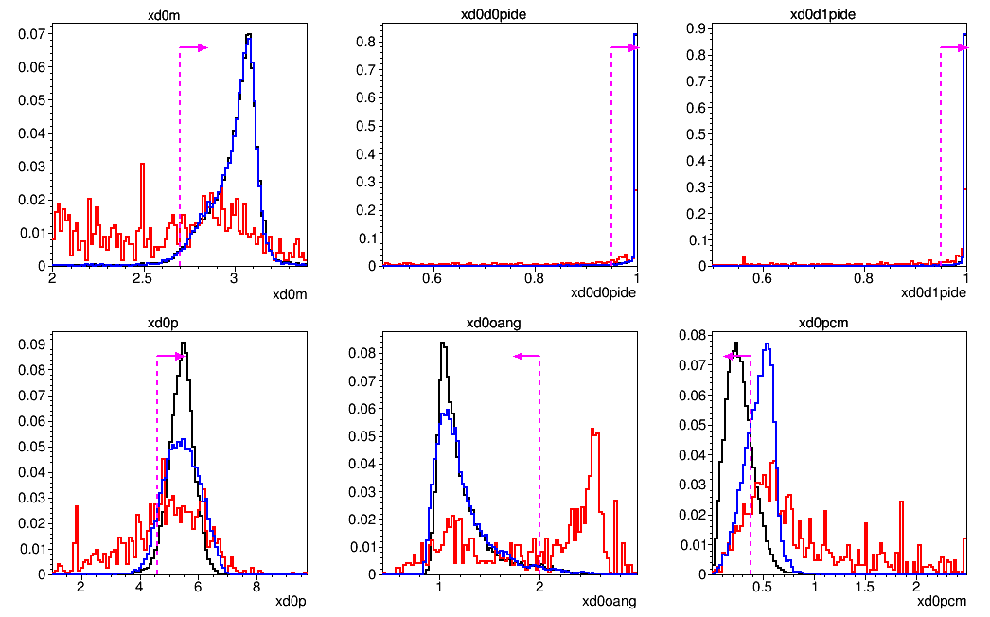
Criteria for J/ψ → e⁺e– Channel
m(e⁺e⁻) >2.7 GeV/c²
PID(e⁺)>0.95
PID(e⁻)>0.95
signal
hadronic bkg
J/ψ NR bkg.
p(e⁺e⁻) >4.6 GeV/c
∡(p_{e+},p_{e-}) < 2 rad
p_{cm}(e⁺e⁻) < 0.38 GeV/c

Slide 34
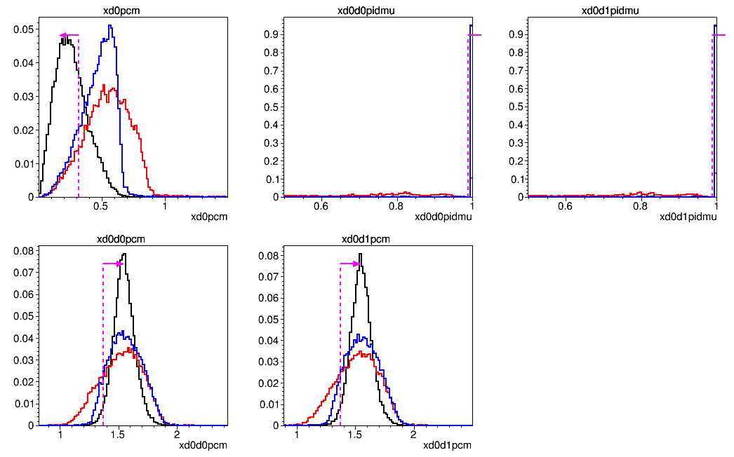
Criteria for J/ψ → μ⁺μ– Channel
p_{cm}(μ⁺μ⁻) < 0.32 GeV/c
PID(μ⁺)>0.99
PID(μ⁻)>0.99
signal
hadronic bkg
J/ψ NR bkg.
p_{cm}(μ⁺) > 1.37 GeV/c
p_{cm}(μ⁻) > 1.37 GeV/c

Slide 35
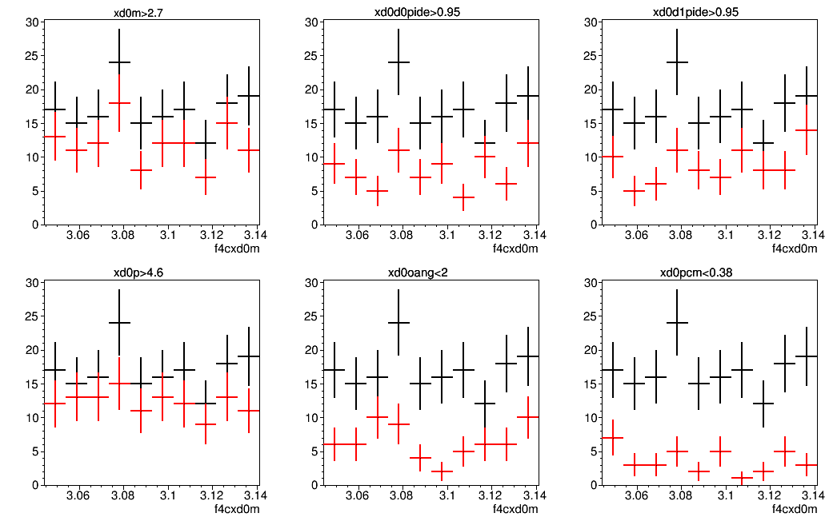
Flatness Check of Cuts
We want to interpolate background in ROI
Cuts should not distort background shape!
preselection
after cut
m(e⁺e⁻) >2.7 GeV/c²
PID(e⁺)>0.95
PID(e⁻)>0.95
p(e⁺e⁻) >4.6 GeV/c
∡(p_{e+},p_{e-}) < 2 rad
p_{cm}(e⁺e⁻) < 0.66 GeV/c
m(e⁺e–) [GeV/c²]
m(e⁺e–) [GeV/c²]
m(e⁺e–) [GeV/c²]

Slide 36
Flatness Check of Cuts
p_{cm}(μ⁺μ⁻) < 0.32 GeV/c
PID(μ⁺)>0.99
PID(μ⁻)>0.99
p_{cm}(μ⁺) > 1.37 GeV/c
p_{cm}(μ⁺) > 1.37 GeV/c
m(μ⁺μ–) [GeV/c²]
preselection
after cut
m(μ⁺μ–) [GeV/c²]
m(μ⁺μ–) [GeV/c²]

Slide 37
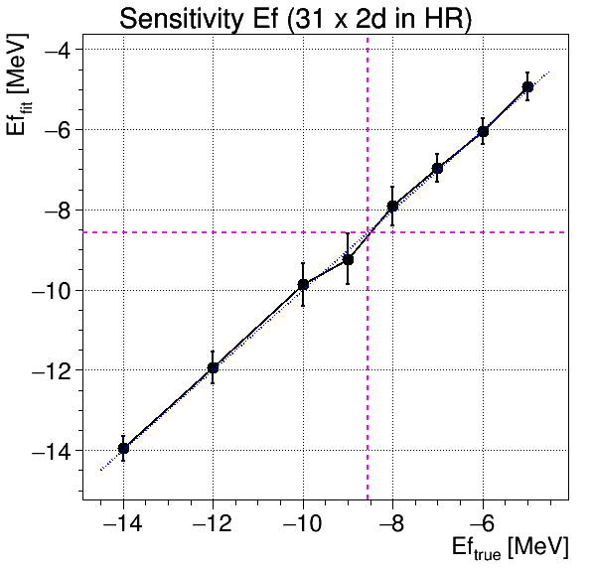
Sensitivities Molecule Lineshapes (31 x 2d)
Extract standard deviation and bias from toy MC fits
How well can virtual and bound state be distinguished?
mismatch
(B → V)
virtual
mismatch
(B → V)
virtual
mismatch
(V → B)
mismatch
(V → B)
bound
bound

