Slide 1

PANDA LV. Collaboration Meeting - Wien
FEM Simulation – strip barrel staves
30.10.2015 D. Grunwald, V. Fracassi, E. Rosenthal, S.Wolf, S. Schoenen

Slide 2
MVD - Stave BL 4 -Test Part
Stainless Steel | 13,8 | W/mK
Ceramic | 60,5 | W/mK
Carbon Foam | 245/70/70 | W/mK
Rohacell | 0,03 | W/mK
CFRP | 0,3/8/8 | W/mK
Flex PCB (Polyethylen) | 1,2 | W/mK
Rohacel
Pipe
Resistors
Flex PCB
CFRP
C-Foam
Top Side

Slide 3
MVD – Stave BL4 – Test part
Bottom Side

Slide 4
MVD- Stave BL 4 - Test Part
The model is based on the following assumptions:
Electrical Power: | 0,256 | W/Chip
Active area: | 3 x 3 | mm²
Number of Chips: | 66 (36+30)
Cooling in | 19,9 | °C
Cooling ΔT | ~1 | °C
Stainless Steel | 13,8 | W/mK
Ceramic | 60,5 | W/mK
Carbon Foam | 245/70/70 | W/mK
Rohacell | 0,03 | W/mK
CFRP | 0,3/8/8 | W/mK
Flex PCB (Polyethylen) | 1,2 | W/mK
Flux | 245 | mL/min
Medium | Water
Ambient Temp. | 28,5 | °C
Glue (Epoxy/Thermal Glue) | 0,3/1 | W/mK
Layer Thickness | 0,1 | mm
Summary – September 2015 - Tommaso Quagli
First validation of stave cooling system: satisfactory results!
Negligible heat transfer from the chips to the sensor
The uniformity of the glue layer is crucial
With maximum power,
T chip < 35°C and T sensor < 25°C

Slide 5
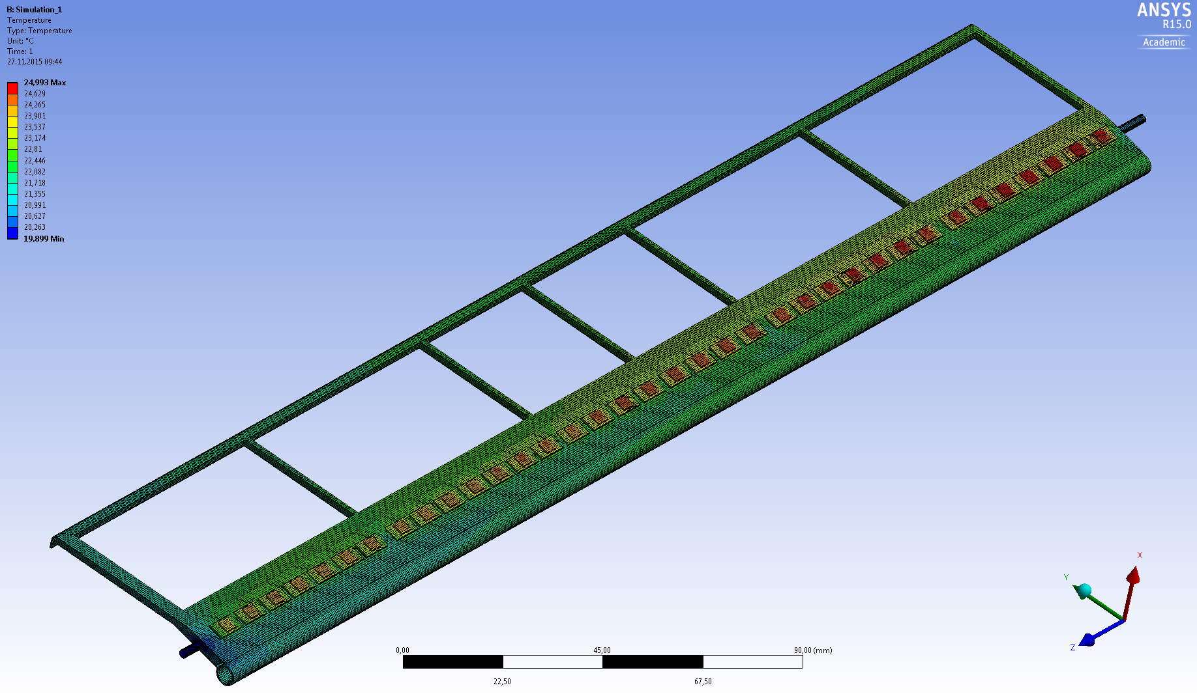
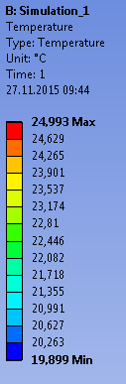
MVD – Stave BL4 – Test part
Start Point : Sumulation 1
 | Sim. 1
Thermal conduction | Yes
Convection | No
Radiation | No
Contact Ansys | Ideal

Slide 6
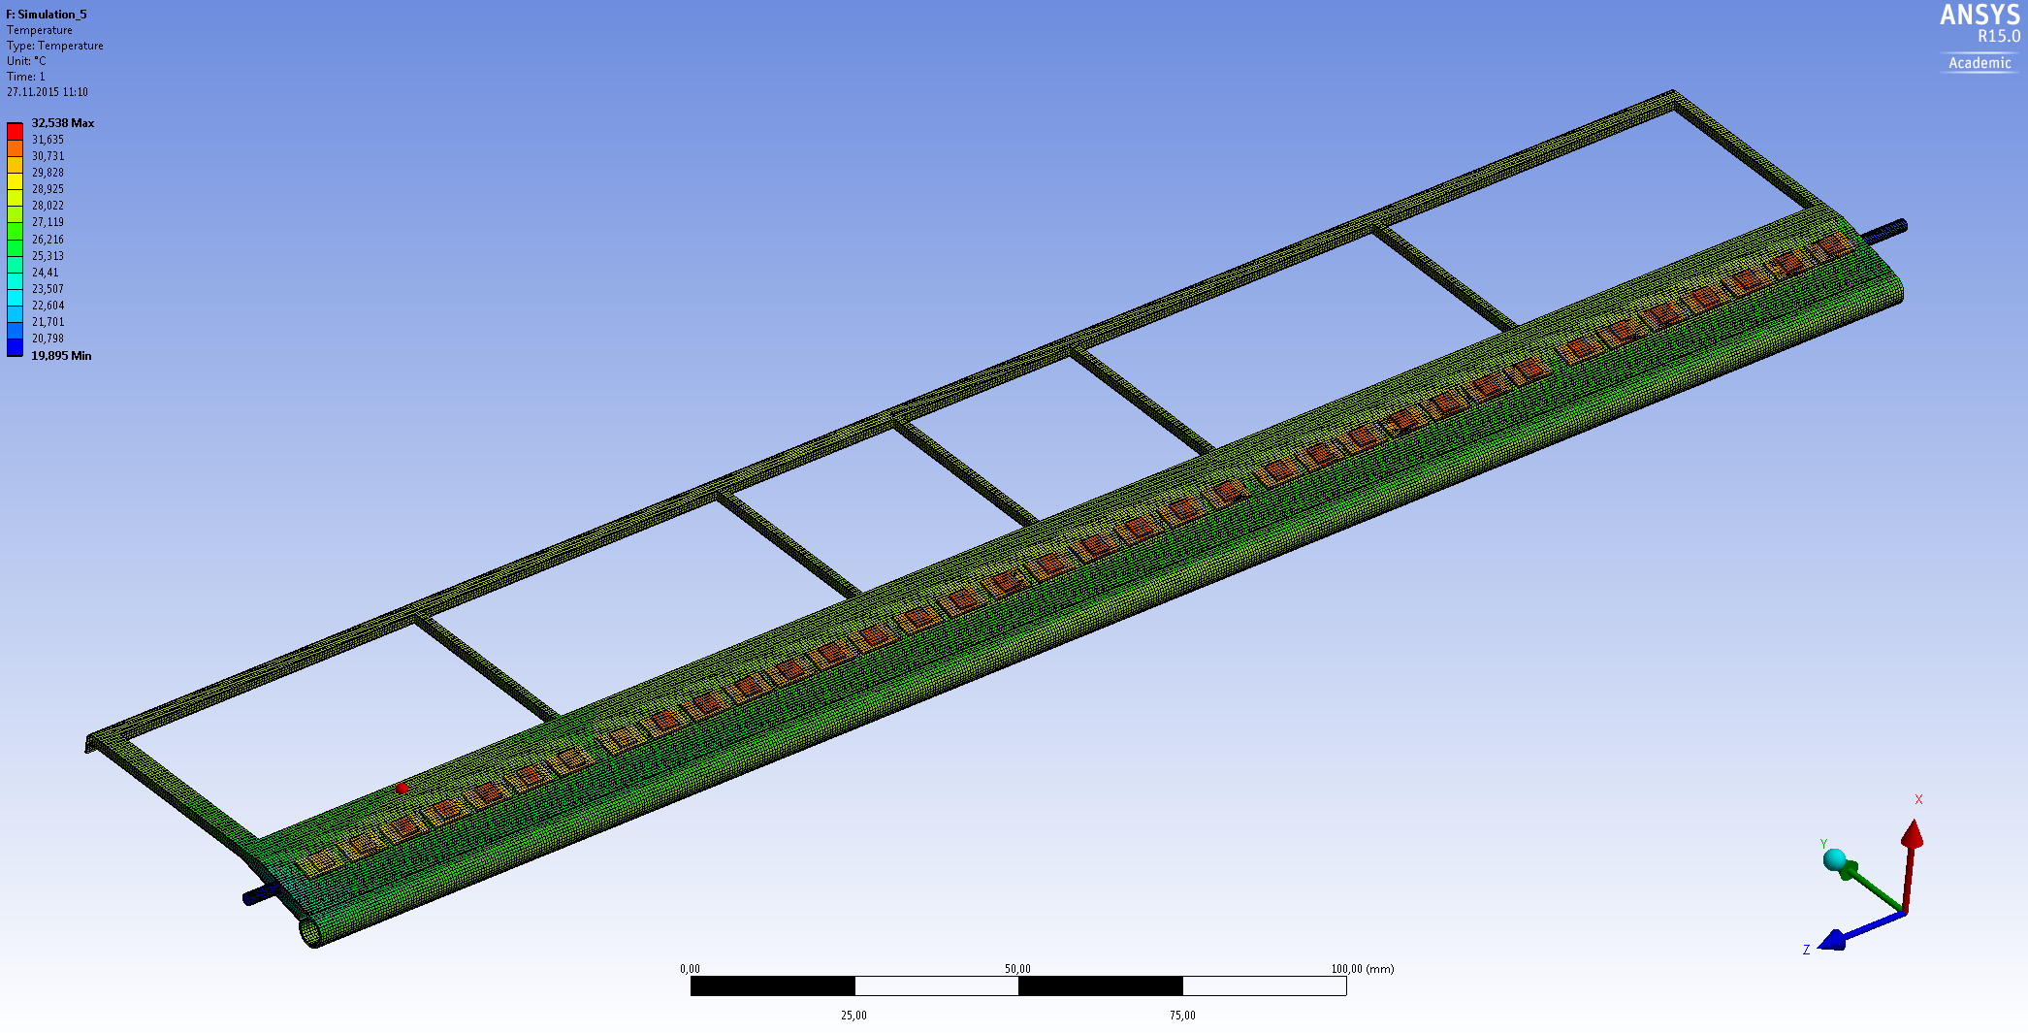
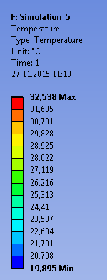
MVD – Stave BL4 – Test part
Sumulation 5
 | Sim.5
Thermal conduction | Yes
Convection | Yes | Alpha= 20W/m²K Ambient Temp.= 28,5°C
Radiation | No
Contact Ansys | Glue / Layer Th. | 0,3 / 1 W/mK 0,1 mm

Slide 7
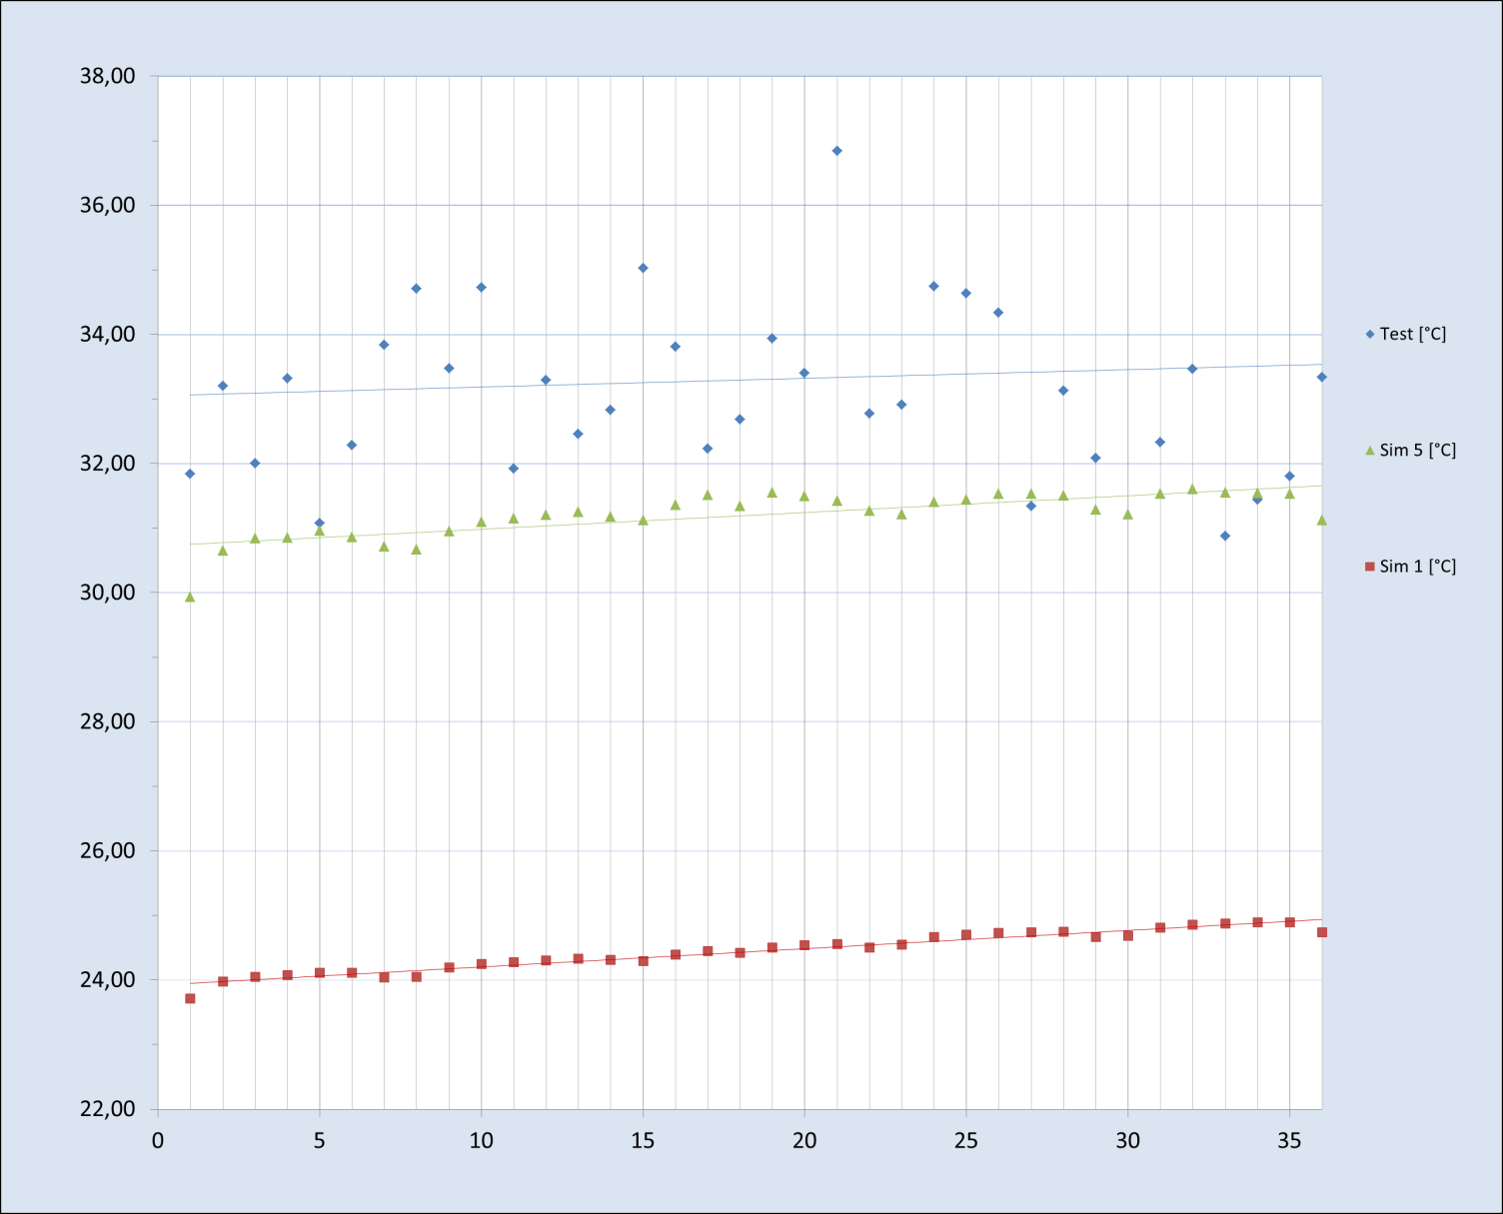
MVD- Stave BL 4 - Test Part
Temperature [°C]
Chips

Slide 8
Cooling Circuit - Quarter Disk
MVD- Disk
3x Modul long
3x Modul short

Slide 9
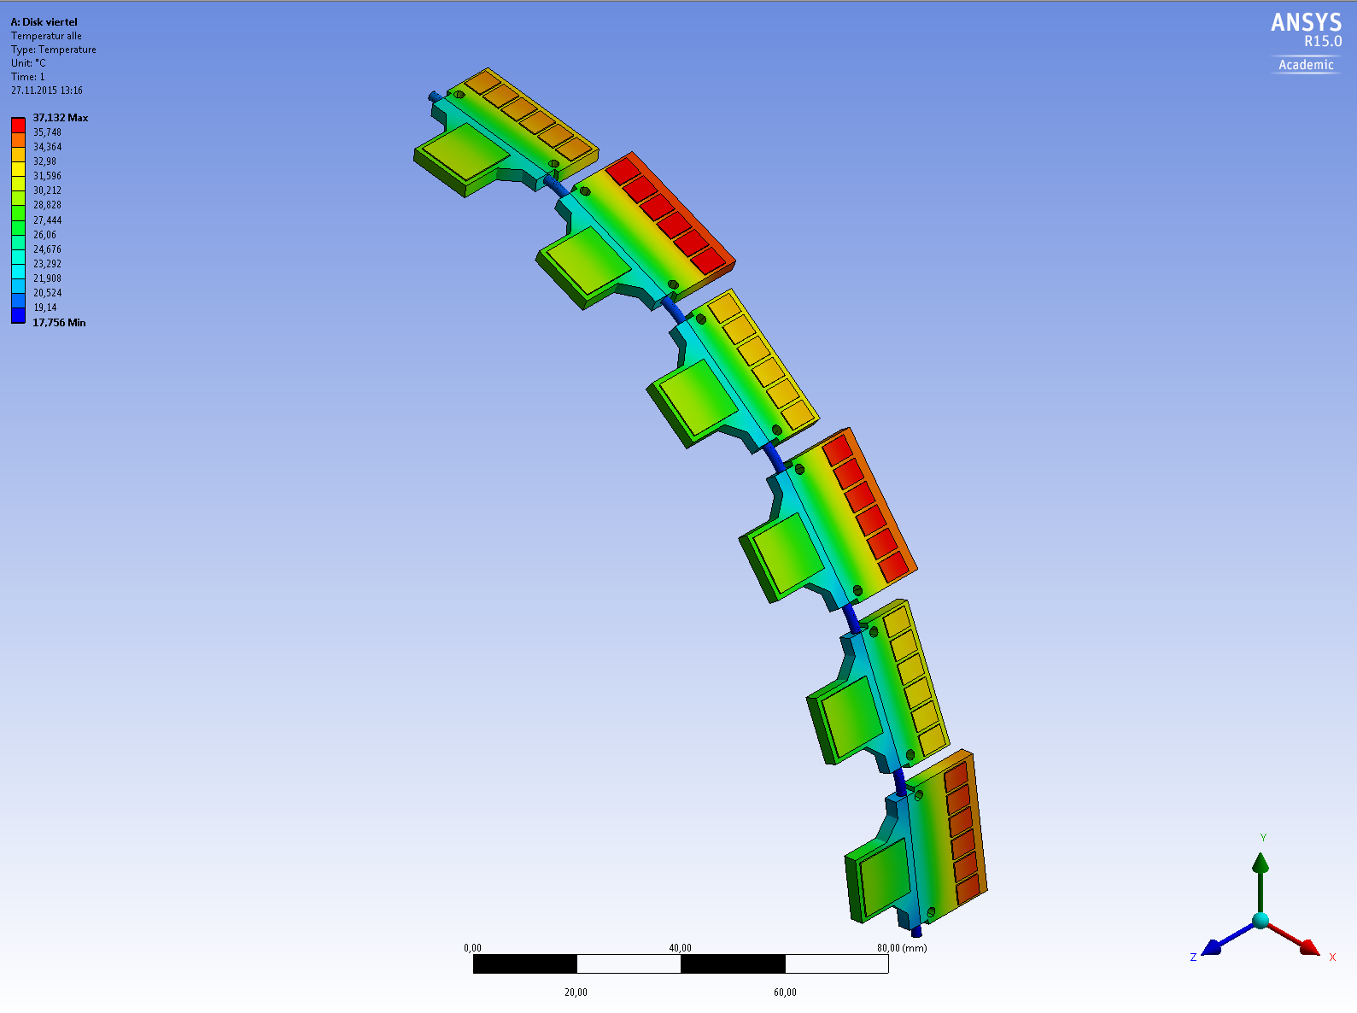
MVD- Disk
Cooling circuit – First Simulation without Flex PCB
3x Modul long
3x Modul short

Slide 10
MVD- Disk
Modul Long with Flex PCB
Flex PCB
Separating Line

Slide 11
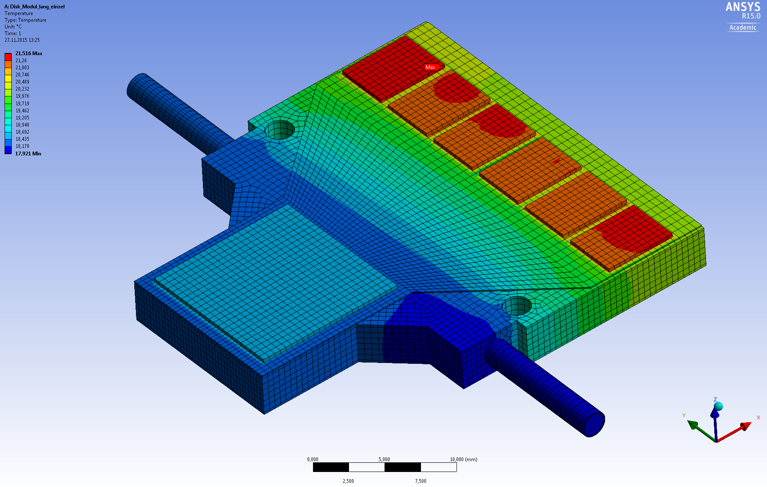
MVD- Disk
Modul Long with Flex PCB – 18°C – Contacts ideal

Slide 12
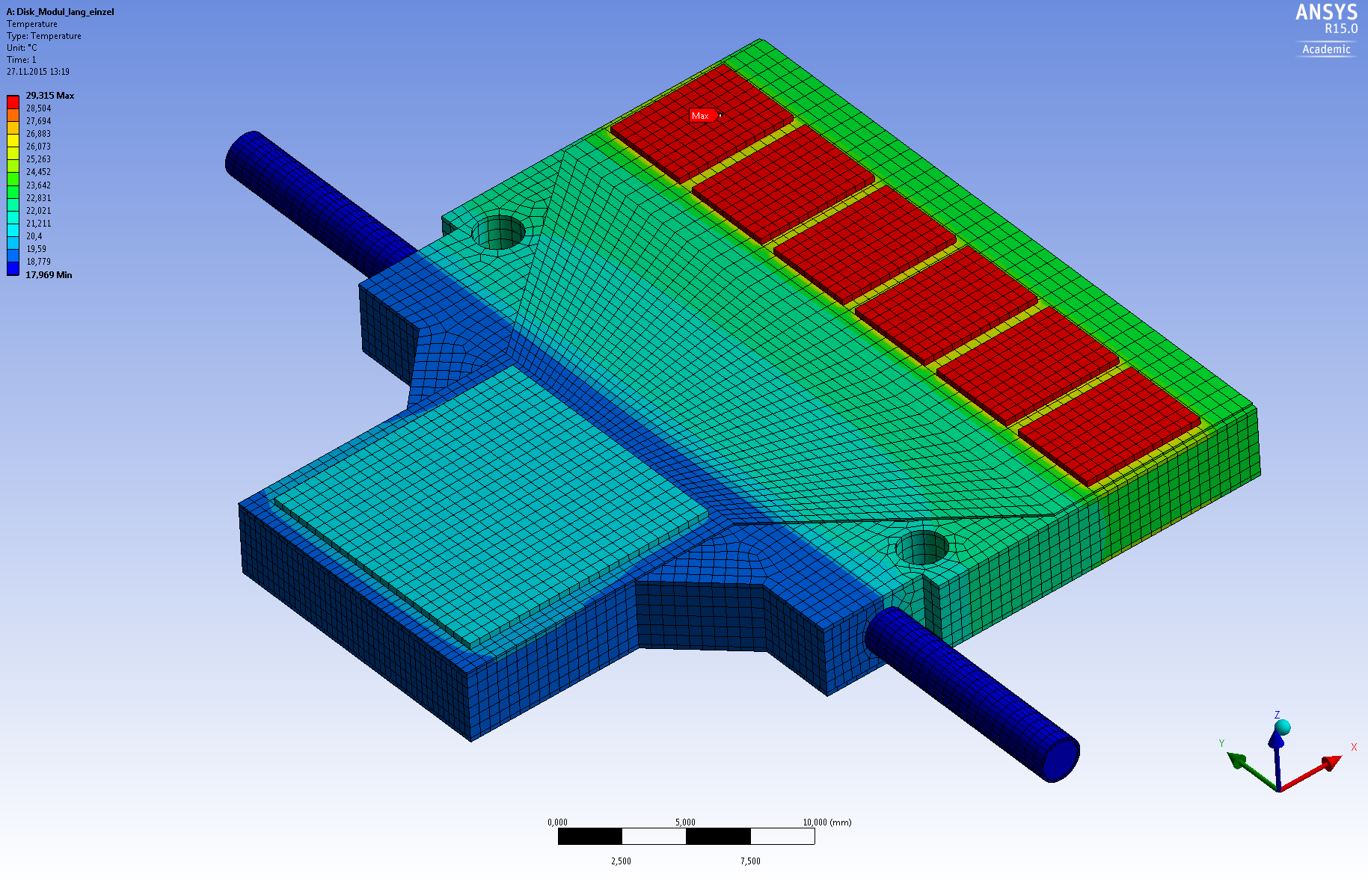
MVD- Disk
Modul Long with Flex PCB – 18°C – Glue 0,3 / 0,1 [W/mK]

Slide 13
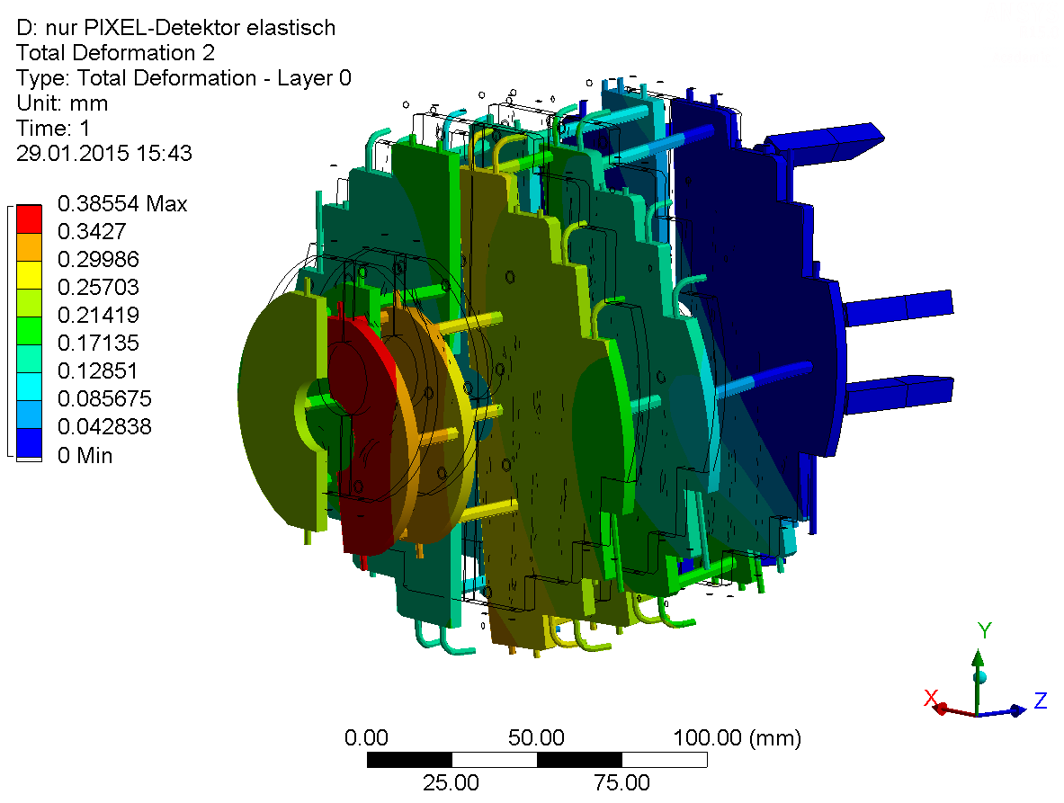
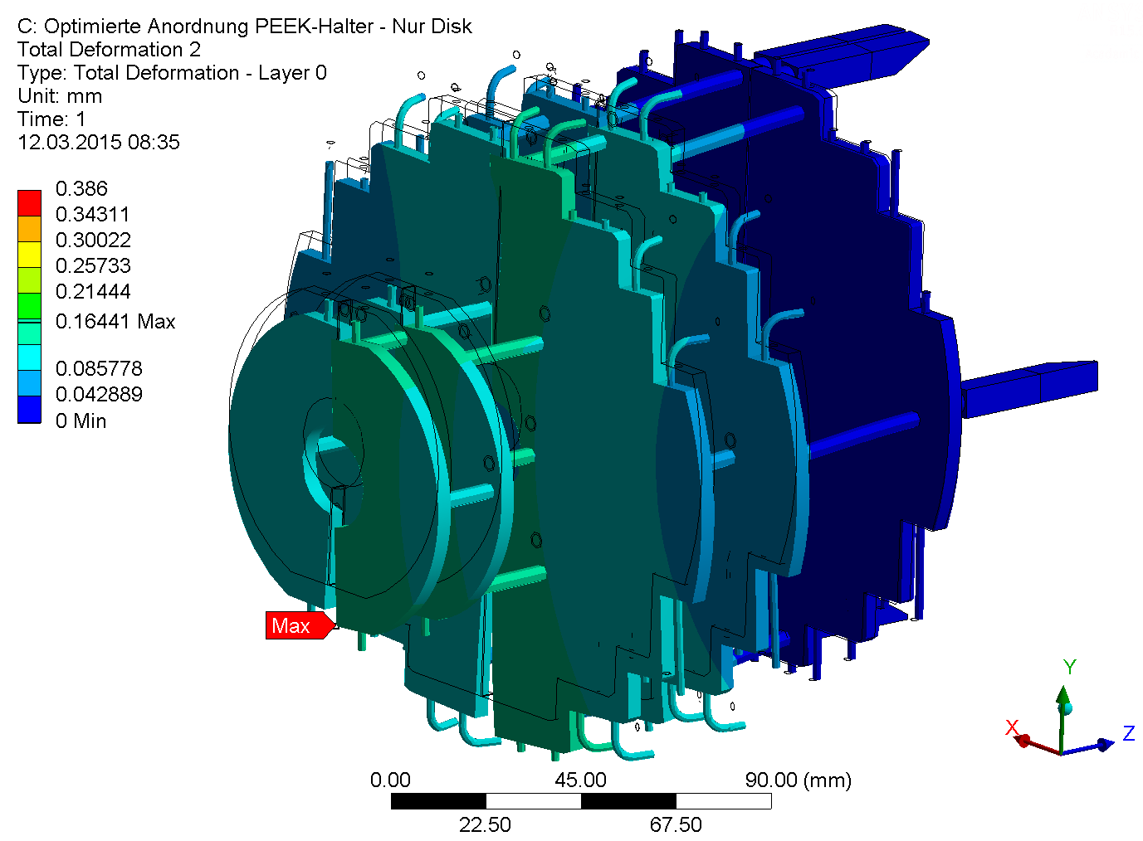
MVD - Support Structure
Calculation with all parts rigid except pixel disc Turin
original positions
optimal positions
deformation scale factor: 60 x
The new arrangement of the PEEK-holders has also positive effects onto the deformation inside the pixel disc: less bending of the POCO-foam plates, lower reaction forces transmitted by PEEK-holder
Stephan Schönen (s.schoenen@fz-juelich.de)

Slide 14
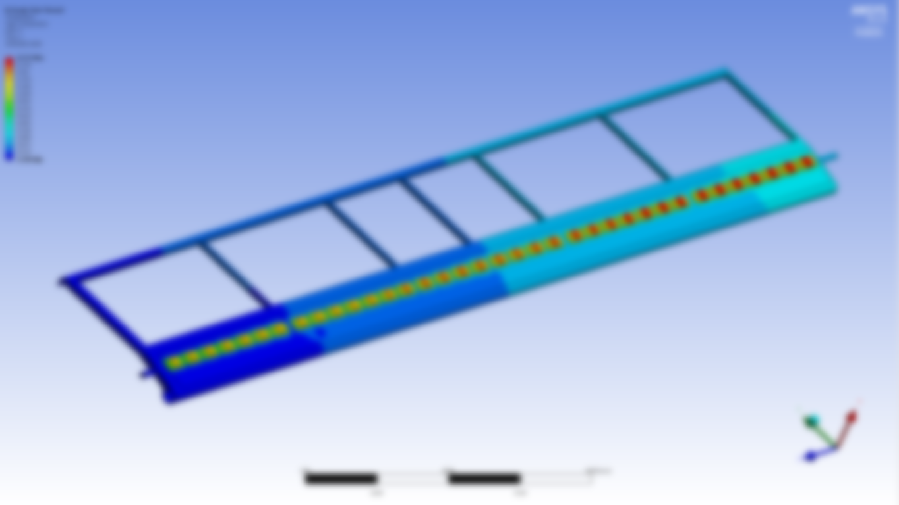
MVD- Barrel Stave and Disk
Thank you for your attention!

