Slide 1
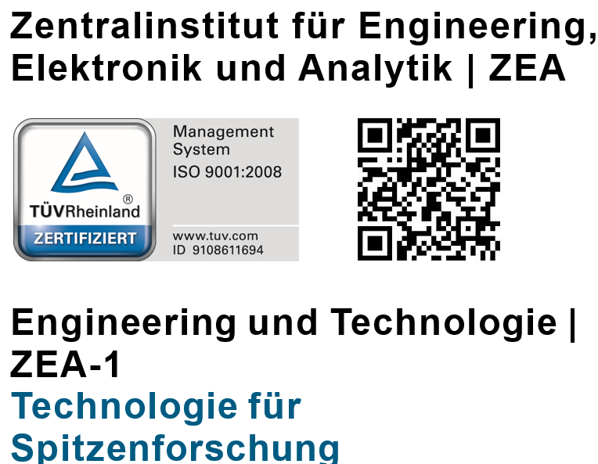
Micro Vertex Detector of PANDA Strip Detector
PANDA Mechanics Meeting
Vienna 2015.11.30

Slide 2
Work in Progress
Design
Stave (prototype fixed)
Arrangement of Service lines (goings on)
Disc attachment and Structure (pixel/strip) (goings on,FEM Calculation)
Manufacture
Two Barrel (4) Staves with cooling modules as Prototype mechanical hybrid at IKV
Disc Support for Readout electronics mechanical hybrid at IKV
Manufacturing of Stave structure with Cooling jigs manufacturing
Manufacturing of Disc support structure jigs manufacturing
Quality controls New X-ray machine assembly at ZEA 1
Thermal hydraulic investigation and tests
Hydraulic Test at ZEA 1 (Flow rate and temperature variation)Test rig upgrading: automatization (neu pump)
Investigation of cooling pipes
FEM Validation
Disc deformation behaviour (Presentation from Dirk G.)
Half shell deformation behaviour

Slide 3
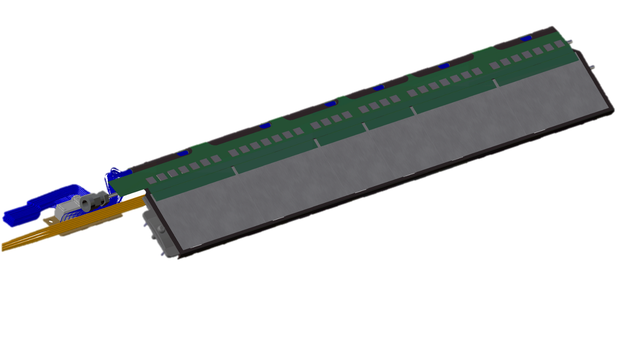
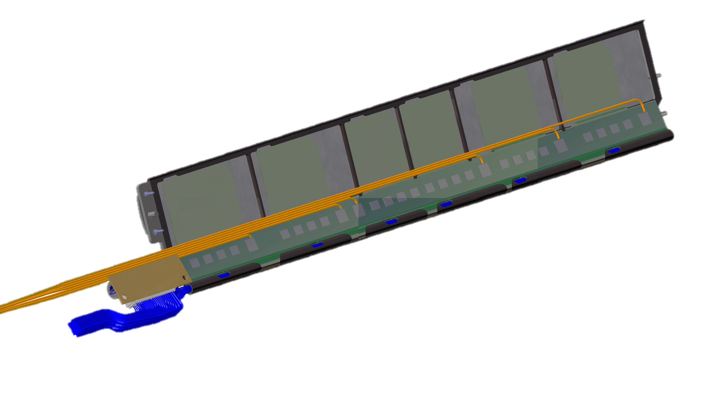
MVD Stave Barrel 4 Prototyp
Mechanical
Prototype
Currently two pieces are laminated at IKV Aachen
Top view
Full equipped
Prototype
Bottom view

Slide 4
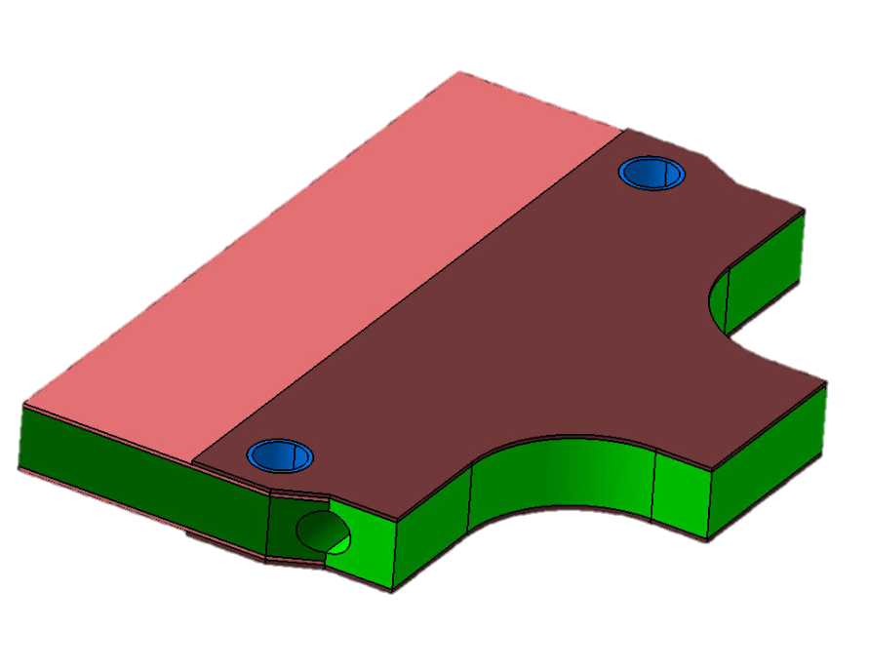
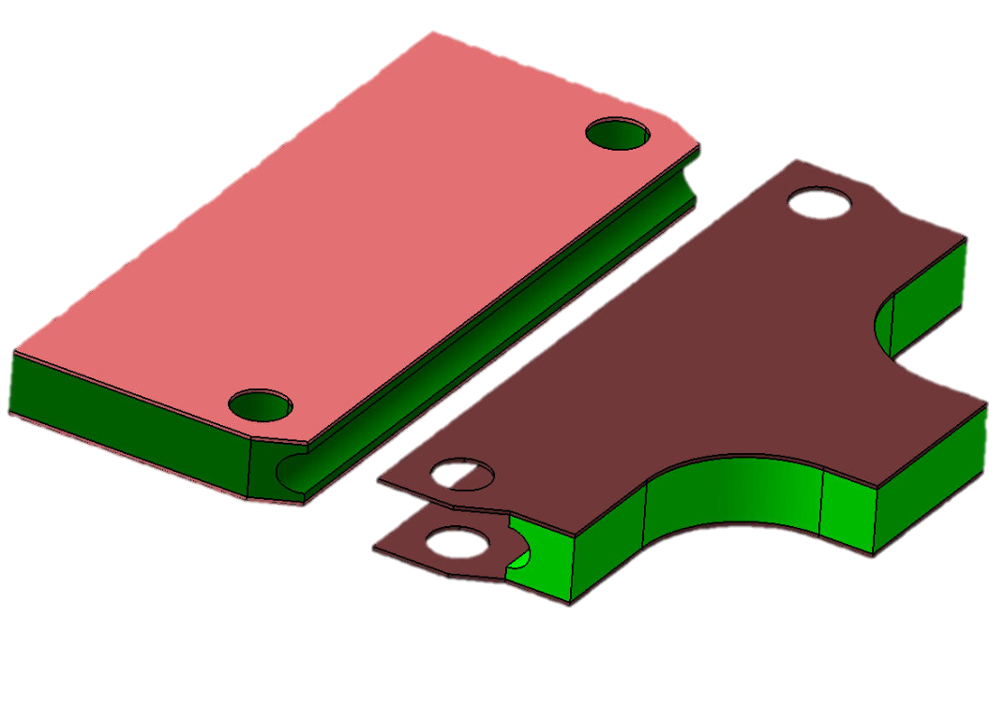
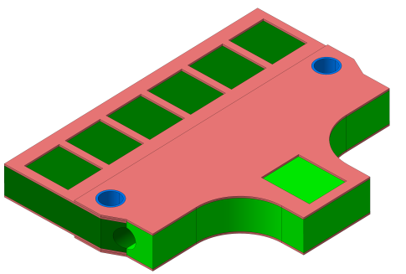
MVD Strip Disc cooling module
Currently two pieces are laminated at IKV Aachen
CFRP Preprag
Carbon foam
Draft
Cut outs for Chip positioning ?
Better cooling
Difficult to install the flexfoil with Chips

Slide 5
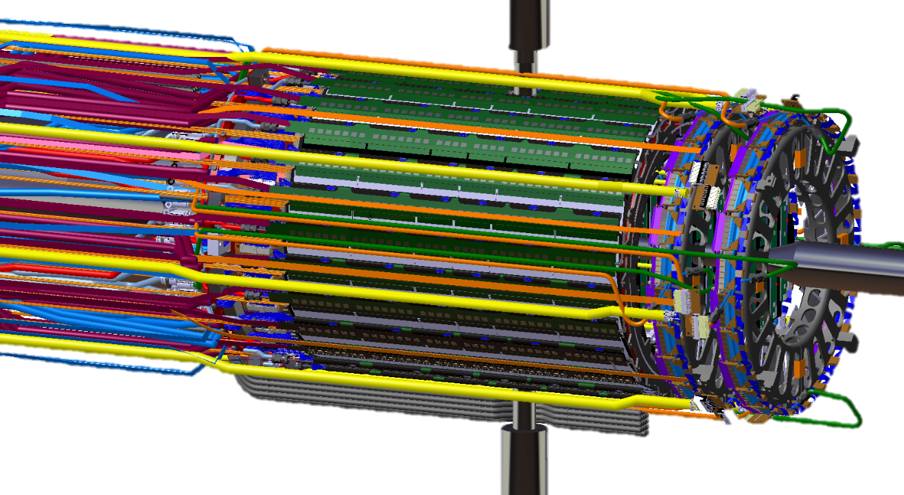
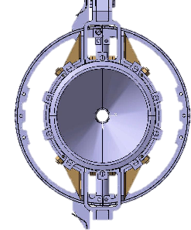
MVD Strip Design
Main Dimension
Frame Do/Di =282/274 mm
Disc Do/Di =265/144 mm
Barrel Do/Di =259/259 mm
141
157

Slide 6
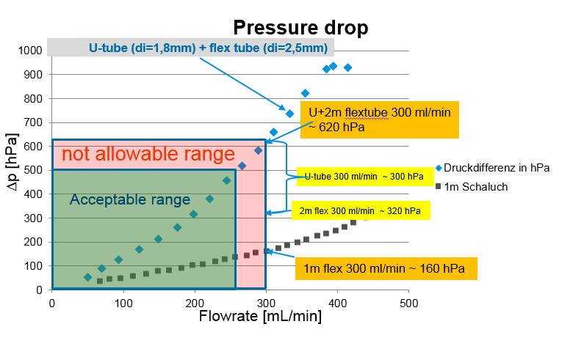
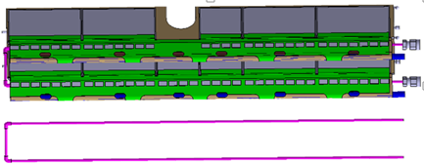
Hydraulic Tests
U-Tube Type4 (φ_{i} 1.8mm *720 mm)
Delta Pmax ~ 0,50 bar is to verify

Slide 7
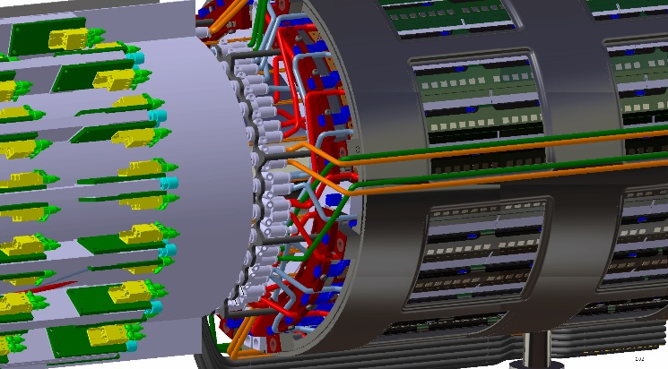
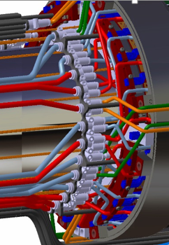
MVD Strip Barrel
arrangement of the Cooling tubes
Arrangement of the cooling tubes in front of the MVD
Advantage
Lower pressure drop
Less tubes over the GBT
Disadvantage
Less space for services lines at Pixel Barrel

Slide 8
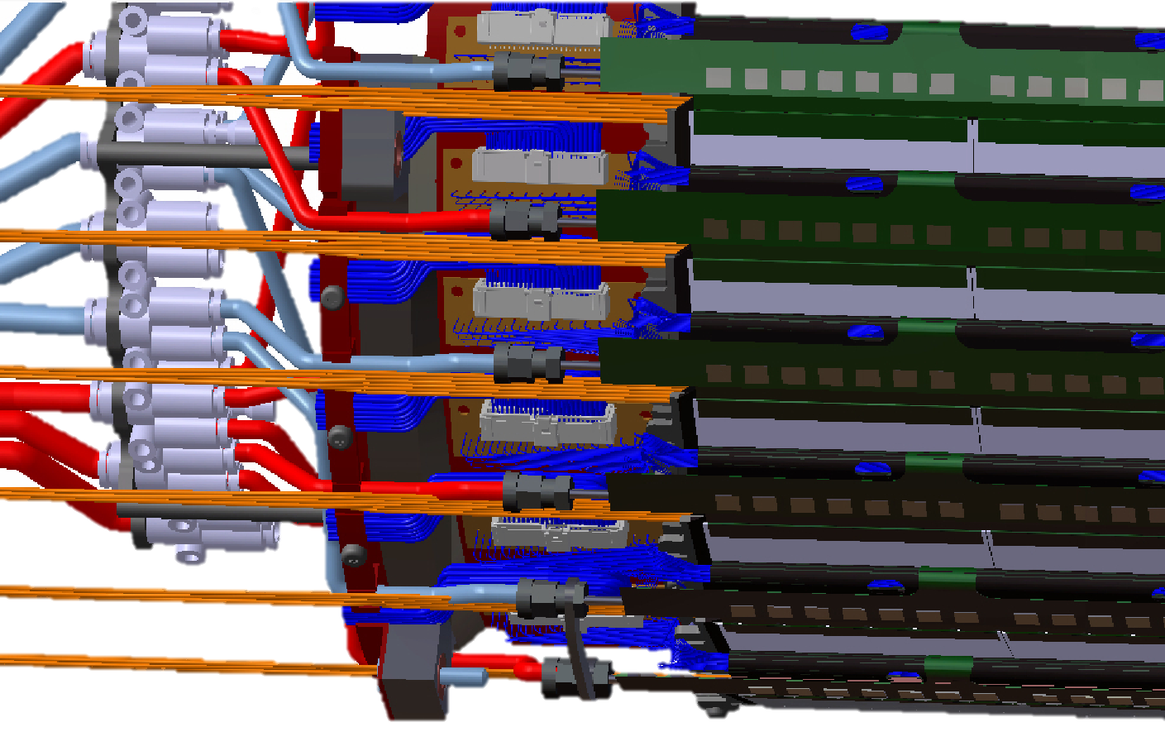
MVD Strip Barrel Service lines
Draft
Arrangement of the cooling tubes
in front of the MVD Strip Barrel
View from the outer part

Slide 9
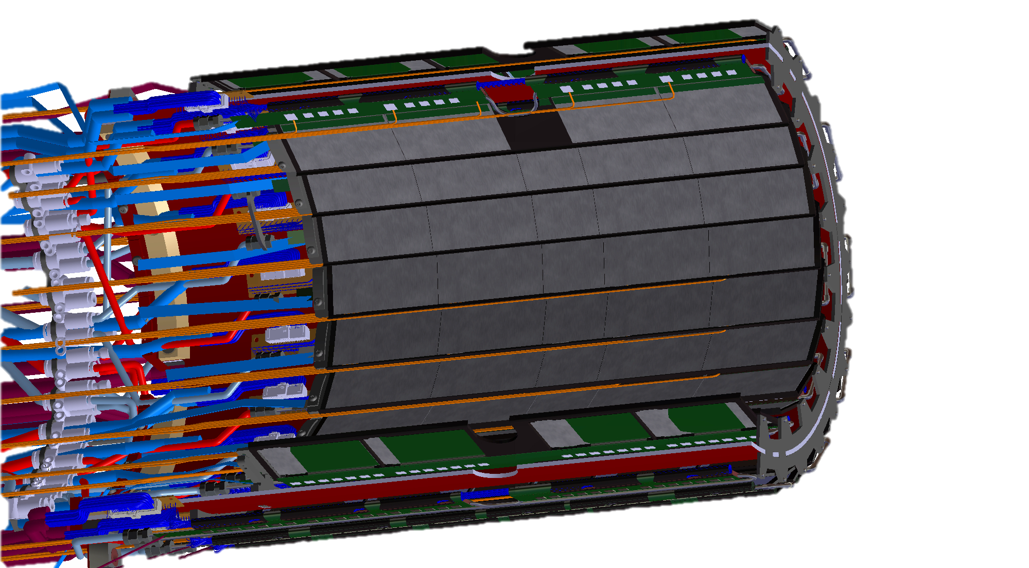
Barrel 3 Service lines
Arrangement of the cooling tubes and cables
in front of the MVD Barrel 3
View from the inner part
Draft

Slide 10
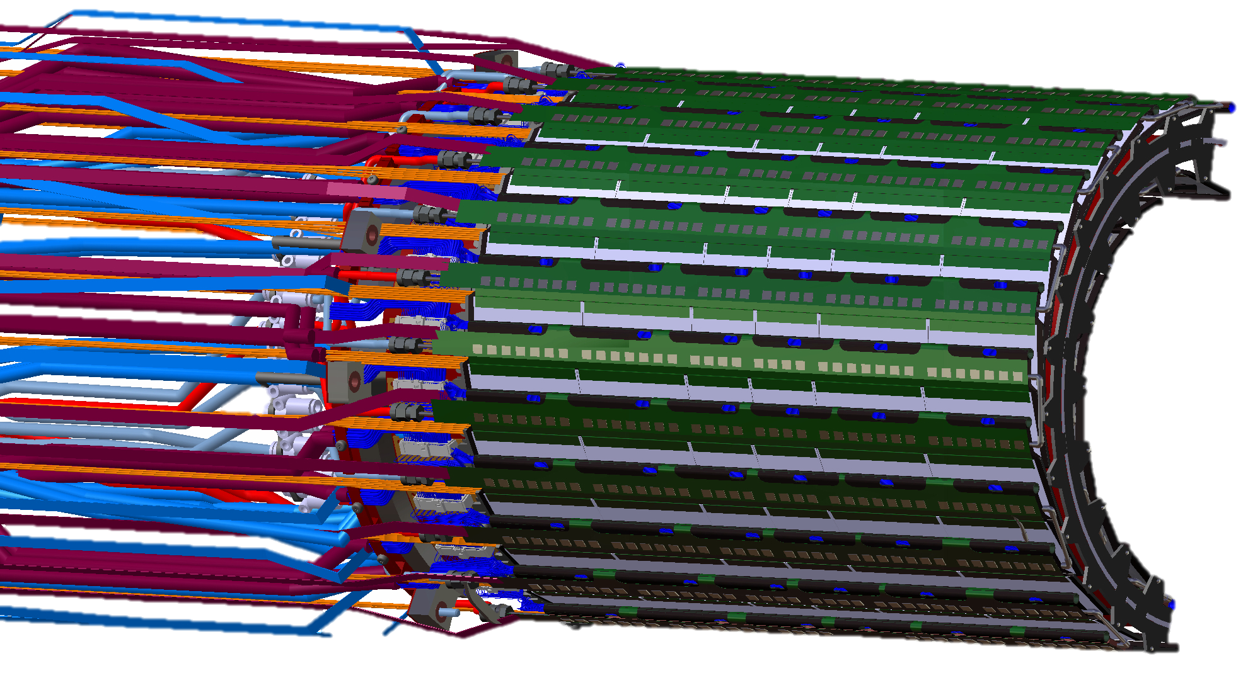
Barrel 4 Service lines
Arrangement of the service lines
in front of the MVD Barrel 4
View from the outer part
Draft

Slide 11
Outlook
Design
optimize the service lines, (support and connections points)
Disc structure with cooling hybrid
Tube and cable routing
Manufacture implementation
Manufacturing of father Stave hybrid structure with cooling
Manufacturing of Stave structure with Cooling
Manufacturing of further cooling modules
Manufacturing of jigs for alinements
Test hybrid of disc cooling module
Development and manufacturing of disc support structure
Development and manufacturing of jigs ( manufacturing, alinements, assembling)
Manufacturing of Disc support structure
Production controls
Quality controls New X-ray machine assembly at ZEA 1
Hydraulic and Thermal investigation
Test rig automatization
Extended pressure drop investigation (until control panel)
Thermal tests with complete Double-Stave (Pressure drop, leakage)
Quality Control (Delamination, glue, leakage, pressure…)
FEM Validation
Thermal investigation (full equipped double stave)
Mechanical deformation behaviour

