Slide 1
Super-FRS magnet configurations

Slide 2
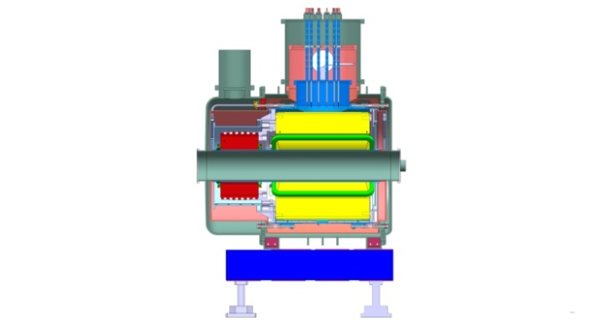
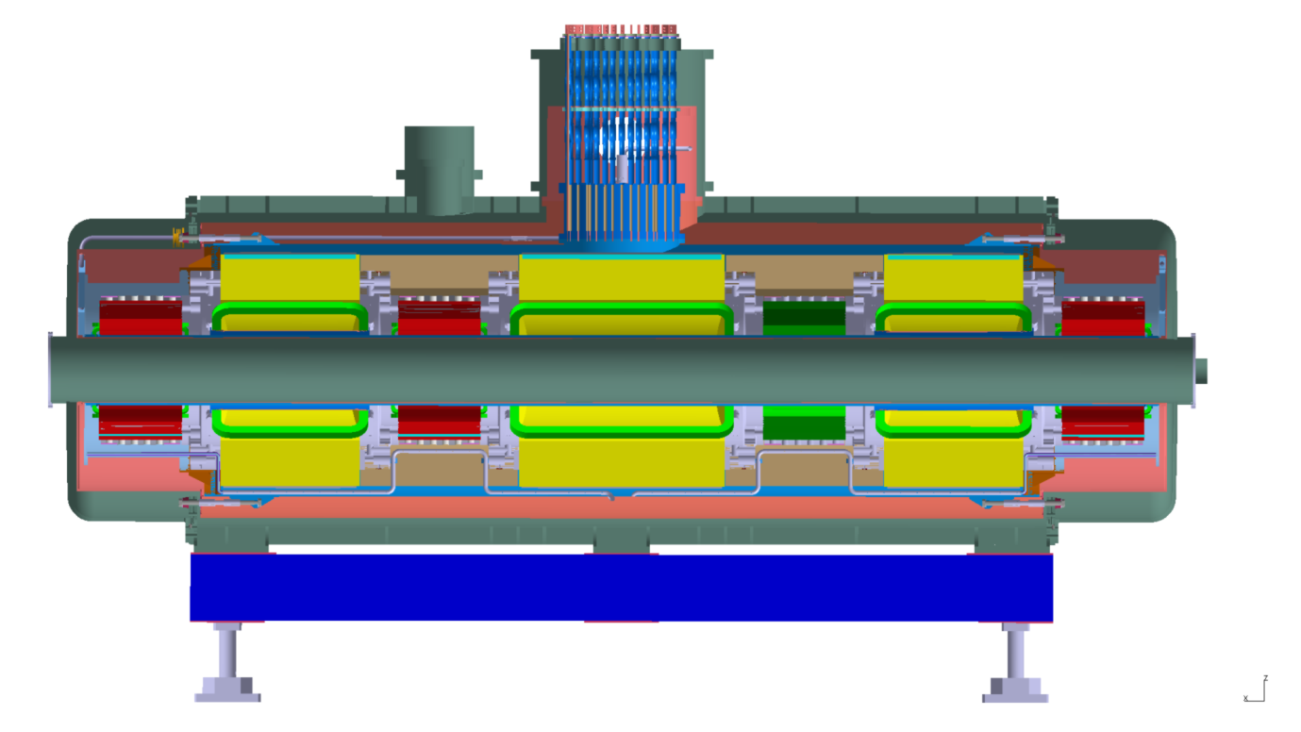
General Design of SC Multiplet
25 long multiplets + 8 short multiplets
Cold, laminated iron yoke (> 40 tons),
Warm beam pipe (38 cm inner diameter)
Common helium bath (~ 1300 liter helium)
1 pair of current leads per magnet
max. current < 300 A for all magnets
short multiplet
~ 7 m long, > 60 tons
1 x long quadrupole (LQ)
2 x short quadrupole (SQ) equipped with octupole (O) coil
3 x sextupole (S)
1 x steering dipole (ST)
S
SQ+O
S
LQ
ST
SQ+O
S
(longest multiplet system)

Slide 3
Magnet parameters
 | Quadrupole Type 3 | Quadrupole Type 4 | Sextupole | Steerer
Number of Magnets | 46 | 34 | 41 | 14 (13v/1h)
Effective length | 0.8 m | 1.2 m | 0.5 m | 0.5 m
Gradient/ Field Range | 1.0-10 T/m | 1.0-10 T/m | 4-40 T/m2 | 0-0.2 T
∫gdl | 0.8-8 T/m*m | 1.2-12 T/m*m | 2-20 T/m²*m | ≥ ± 0.1 T*m
Field Quality | For g< 0.8 g_{max} ±1·10⁻³ For g > 0.8 g_{max} ±6·10⁻³ | For g< 0.8 g_{max} ±1·10⁻³ For g > 0.8 g_{max} ±6·10⁻³ | ±5·10⁻³ | ±8·10⁻³
Usable aperture | Ø 380 mm | Ø 380 mm | Ø 380 mm | Ø 380 mm
Embedded Octupole | 105 T/m³ Int. 84 T/m³×m
Magnets are operated (DC) at all field levels between minimum and maximum !

Slide 4
Tolerances/accuracy
Axes tolerances of position, pitch yaw and roll of each single magnet in a multiplet in relation to the best multiplet axis which is represented by the references outside the Multiplet cryostat.
Maximum allowed total error between position of magnetic axis and mechanical axis (related to outside references of the cryostat) | ±0.2 mm
Tolerance on pitch and yaw (related to outside references of the cryostat) | ±0.29 mrad
Tolerance on roll (related to outside references of the cryostat) | ±1.15 mrad
Alignment only possible with regards to common best multiplet axis

Slide 5
Tolerances/accuracy
Accuracy (difference of the integrated flux density between two magnets which are identical in construction and powered with the same current)
Quadrupoles | ≤ 0.25 %
Sextupoles | ≤ 0.4 %
Steerer | ≤ 0.4 %

Slide 6
Configurations of magnets in 33 multiplets
28 standard configuration (21 triplets, 5 short multiplets), 5 special configurations

Slide 7
Maximum standard configuration
effective magnet length
beam direction
Distance between adjacent magnet centers [m]
If coordinate 0 at midpoint of long multiplet magnet positions and effective lengths are:
X | L_eff | Magnet Type
-2.9 | 0.5 | Sextupole
-2.0 | 0.8 | Short Quadrupole+Octupole
-1.1 | 0.5 | Sextupole/Steerer
0 | 1.2 | Long Quadrupole
1.1 | 0.5 | Sextupole/Steerer
2.0 | 0.8 | Short Quadrupole+Octupole
2.9 | 0.5 | Sextupole

Slide 8
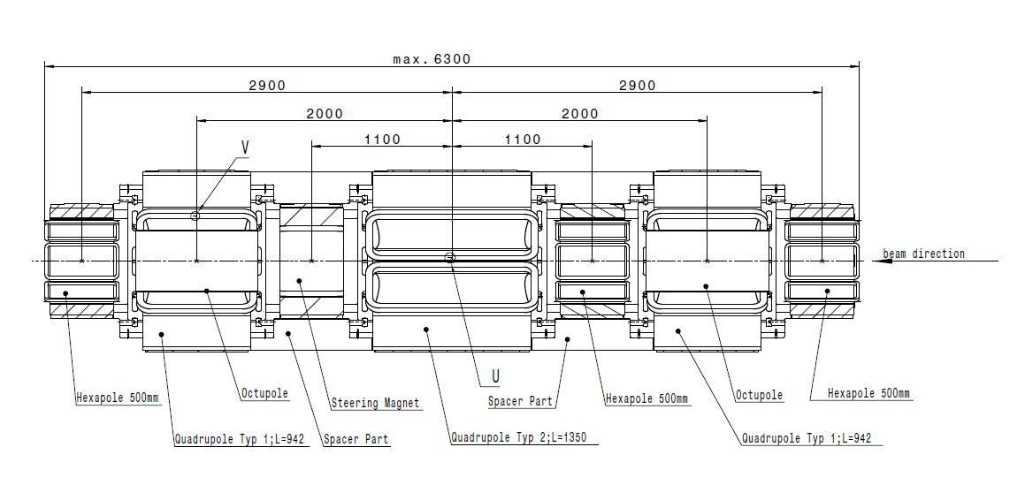
Maximum standard configuration
Chain: magnet → magnet column → He-vessel → cryostat
Open: Definition of coordinate origin (position of magnet with regards to fiducials)
Measured at warm by manufacturer

Slide 9
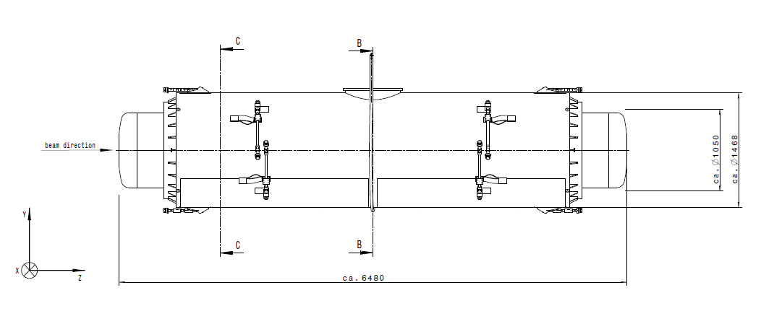
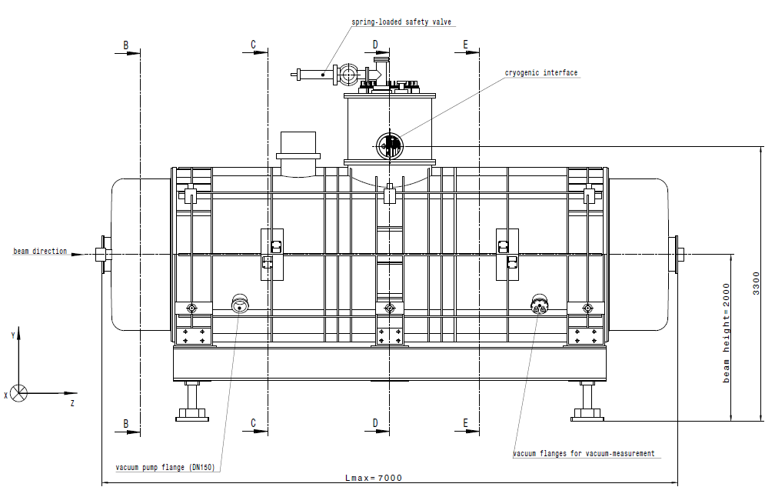
Long Multiplet
Chain: magnet → magnet column → He-vessel → cryostat
Measured at warm by manufacturer

Slide 10
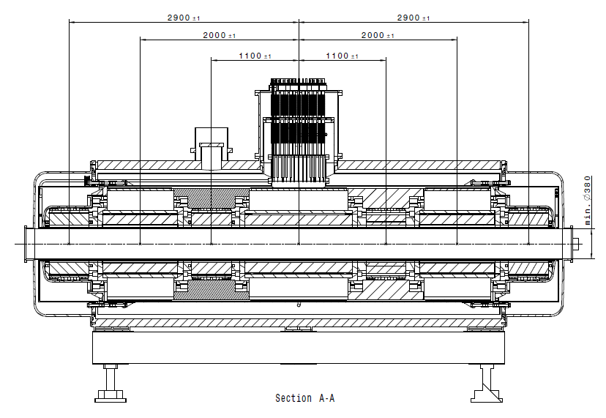

Slide 11
Special configurations
distance between adjecent magnet centers

Slide 12
Dipoles
 | Arranged in groups of 3
 | Dipole Type 2 | Dipole Type3
Number of Magnets | 3 | 21
Effective length | 2.40 m | 2.13 m
Gradient/ Field Range | 0.15-1.6 T | 0.15-1.6 T
Field Quality | ±3×10⁻⁴ | ±3×10⁻⁴
Usable aperture | 380x140 mm | 380x140 mm

Slide 13
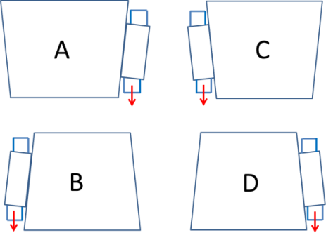
Configurations
Magnet | Conf. | Magnet | Conf.
FPF4MH1 | A | FHF1MH1 | C
FPF4MH12 | A | FHF1MH12 | C
FPF4MH13 | A | FHF1MH13 | C
FMF1MH1 | A | FRF2MH1 | A
FMF1MH12 | A | FRF2MH12 | A
FMF1MH13 | A | FRF2MH13 | A
FMF2MH1 | B | FRF3MH1 | D
FMF2MH12 | B | FRF3MH12 | D
FMF2MH13 | B | FRF3MH13 | D
FMF3MH1 | B | FLF2MH1 | B
FMF3MH12 | B | FLF2MH12 | B
FMF3MH13 | B | FLF2MH13 | B
11°dipole
branched dipole

