Slide 1
Super-FRS Dipole magnetics
Jorge Enrique MUÑOZ GARCIA & Lionel QUETTIER
November 19th, 2015

Slide 2
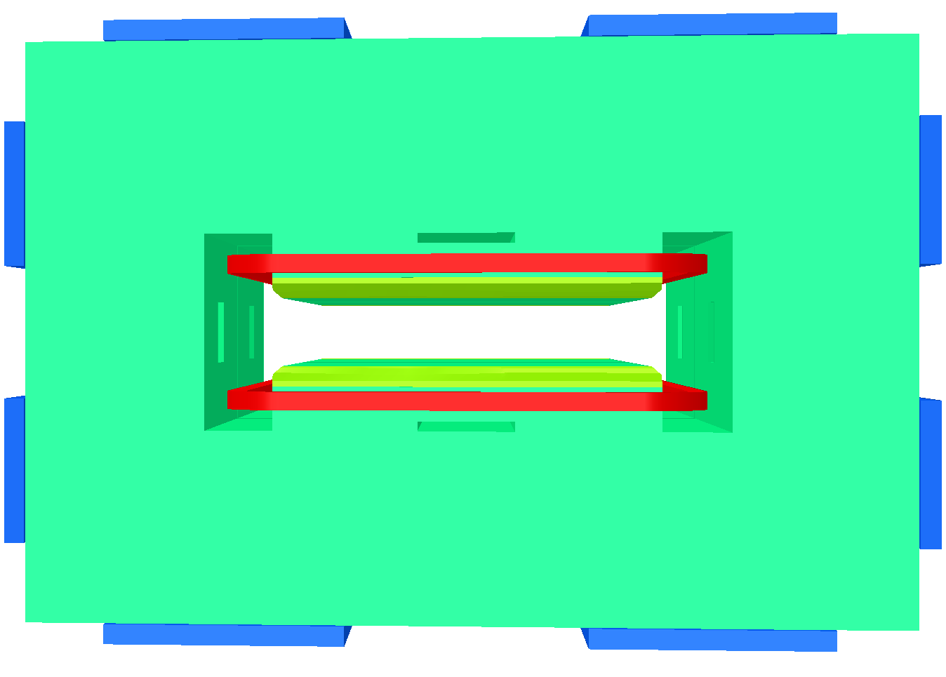
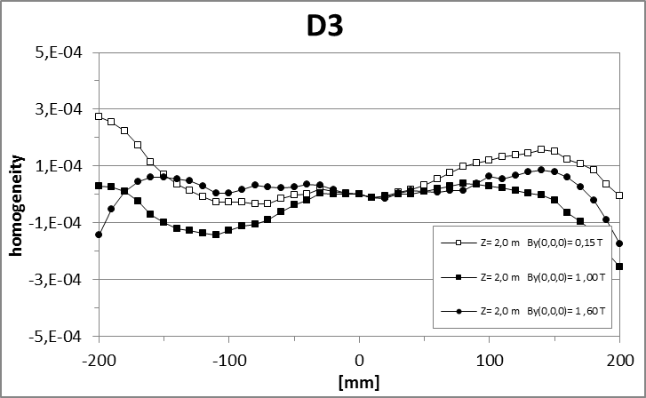
Magnetics: homogeneity dipoles
Current design
Integral field quality (relative) $Δ∫Bdl/∫Bdl$ ±3x10⁻⁴ OK
Z=±2.00 [m]
Jorge Enrique MUÑOZ GARCIA
Super-FRS Dipole | November 19th, 2015

Slide 3
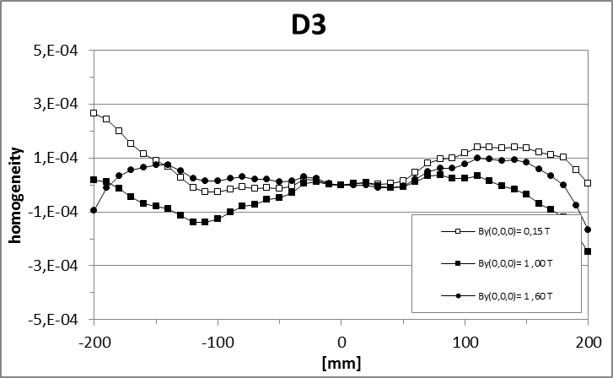
Magnetics: homogeneity dipoles
Current design: iron thermal contraction for T = -10 °C
Integral field quality (relative) $Δ∫Bdl/∫Bdl$ ±3x10⁻⁴ OK
Z=±2.00 [m]
-10 °C
Jorge Enrique MUÑOZ GARCIA
Super-FRS Dipole | November 19th, 2015

Slide 4
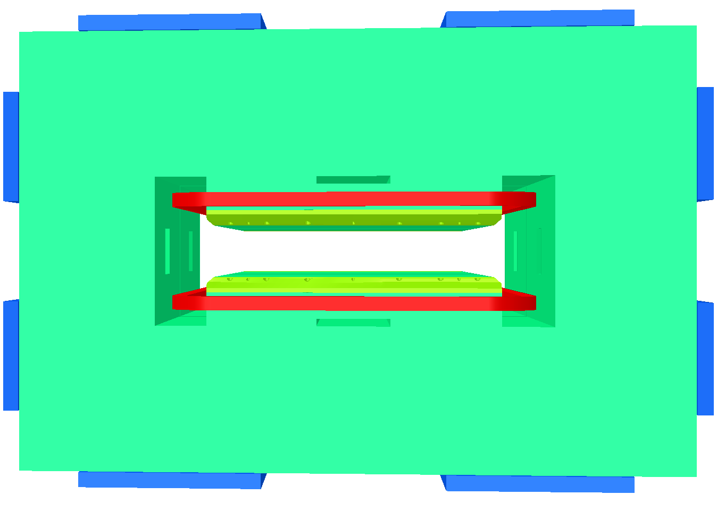
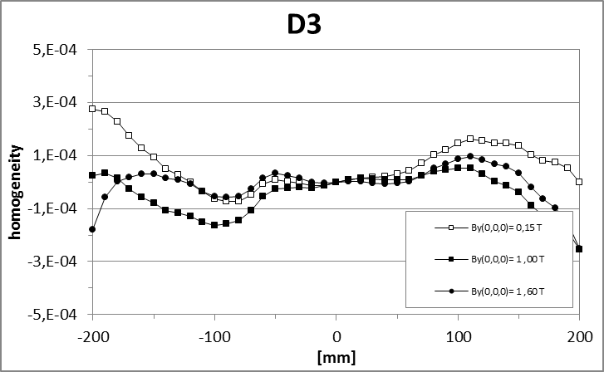
Magnetics: homogeneity dipoles
Current design: bolt-holes on the pole-chamfer for fixation
Integral field quality (relative) $Δ∫Bdl/∫Bdl$ ±3x10⁻⁴ OK
Z=±2.00 [m]
Jorge Enrique MUÑOZ GARCIA
Super-FRS Dipole | November 19th, 2015

Slide 5
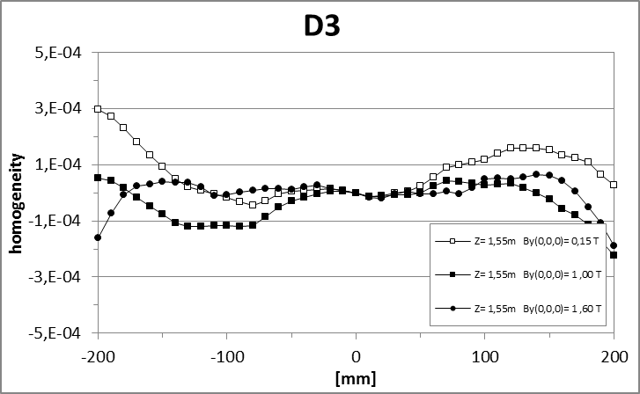
Magnetics: homogeneity dipoles
Integral field quality (relative) $Δ∫Bdl/∫Bdl$ ±3x10⁻⁴ OK
Z=±1.55 [m]
Jorge Enrique MUÑOZ GARCIA
Super-FRS Dipole | November 19th, 2015

Slide 6
Magnetics: homogeneity dipoles
Current design
Integral field quality (relative) $Δ∫Bdl/∫Bdl$ ±3x10⁻⁴ OK
Z=±2.00 [m]
Jorge Enrique MUÑOZ GARCIA
Super-FRS Dipole | November 19th, 2015

Slide 7
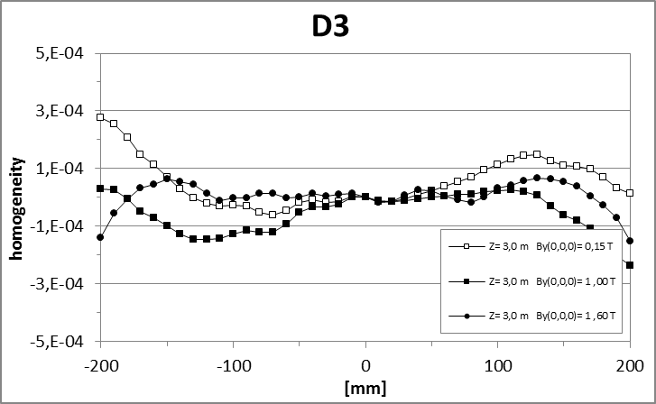
Magnetics: homogeneity dipoles
Integral field quality (relative) $Δ∫Bdl/∫Bdl$ ±3x10⁻⁴ OK
Z=±3.00 [m]
Jorge Enrique MUÑOZ GARCIA
Super-FRS Dipole | November 19th, 2015

Slide 8
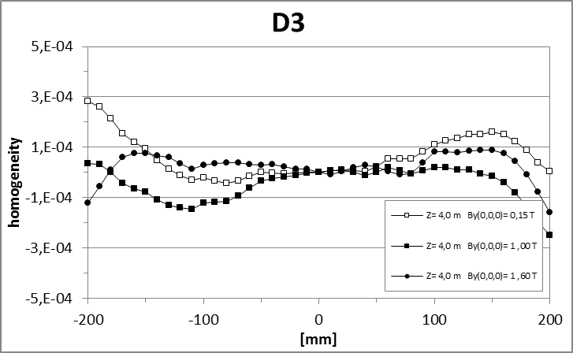
Magnetics: homogeneity dipoles
Integral field quality (relative) $Δ∫Bdl/∫Bdl$ ±3x10⁻⁴ OK
Z=±4.00 [m]
Jorge Enrique MUÑOZ GARCIA
Super-FRS Dipole | November 19th, 2015

Slide 9
Jorge Enrique MUÑOZ GARCIA
Super-FRS Dipole | November 19th, 2015

