Slide 1
Feasibility of J/ψ measurement in p+A collision @ 25GeV
Partha Pratim Bhaduri (VECC)
Anand Kumar Dubey (VECC)
S. Chattopadhyay (VECC)
Arun Prakash (BHU)

Slide 2
Motivation
Proton-nucleus (p+A) collisions is a fundamental component of any
heavy-ion physics programme
Defines the reference baseline relative to which we recognize HI
specific phenomena
p+A collisions provide a measure of the nuclear effects – helps in
disentangling the “QGP” effect from the “non-QGP” effects. Here
there is no formation time for the “secondary” medium , hence such
collisions provide as essential tool to correctly account for the effect
of the nuclear medium initially present.
Charm propagation in cold nuclear matter & normal absorption.
Notes:
2
2

Slide 3
The p-A System
The specifications of the system chosen are:
Target : Au (79 , 197)
Projectile : p (1, 1)
Beam energy : 25 GeV
Collision type : Minimum bias
Event generator :
Background : UrQMD
Signal : Pluto (J/ψ -> μ⁺ + μ⁻ )
Events simulated : 10,000
Muon detection system : Standard Geometry, Start version Geometry
An extremely asymmetric system
Notes:
3
3

Slide 4
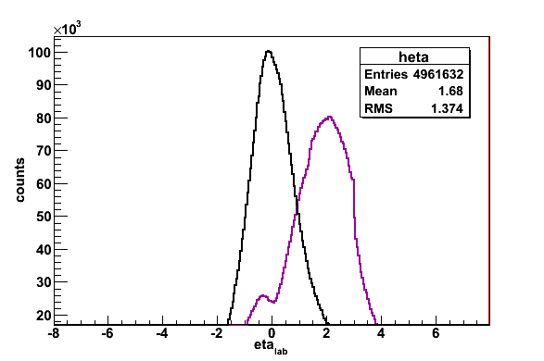
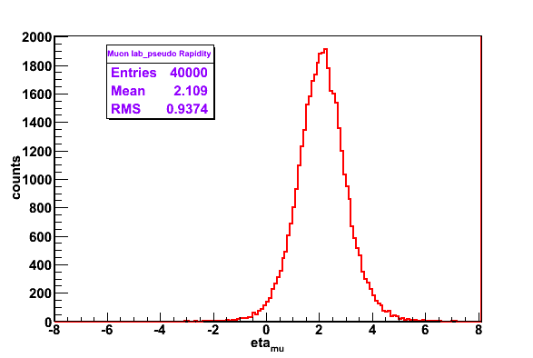
Acceptance (system asymmetry)
MUCH Detector acceptance rejects background
p-Au
Pluto
Au-Au
Detector coverage:
θ_{in} = 5.3 degree θ_{out} = 26.7 degree
eta_{max} = 3.07 eta_{min} = 1.44

Slide 5
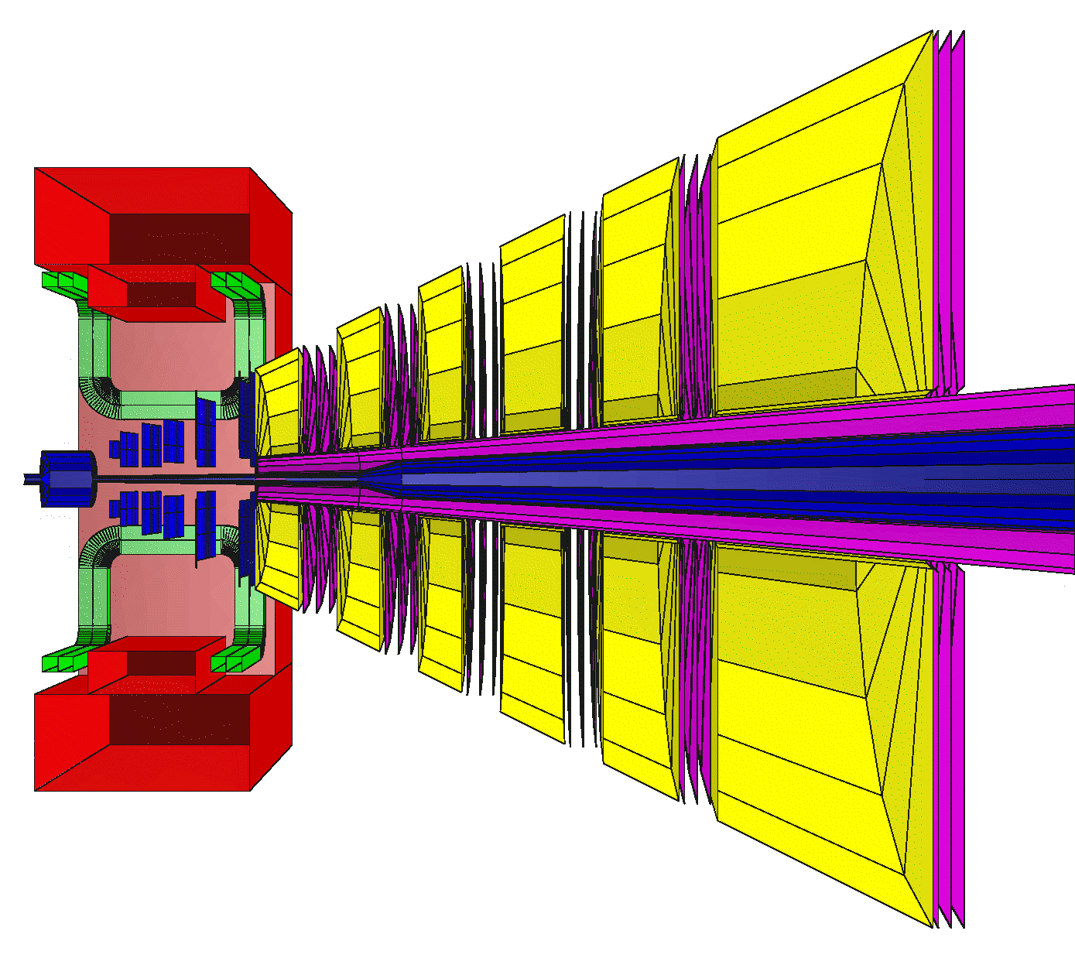
Muon Detection System: Standard Geometry
20 20 20 30 35 100 cm
Number of stations : 18
Number of absorbers : 6
Total absorber thickness:13.5 λ
Fe

Slide 6
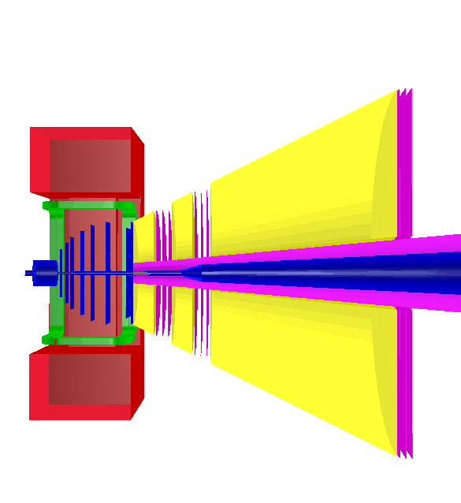
New Geometry (Reduced Number of stations)
Start Version
geometry
μ_{J/ψ}
9 stations
3 Fe absorbers
Total absorber
thickness: 13.5 λ
Fe
20 cm
20 cm
185 cm
μ_{J/ψ}

Slide 7
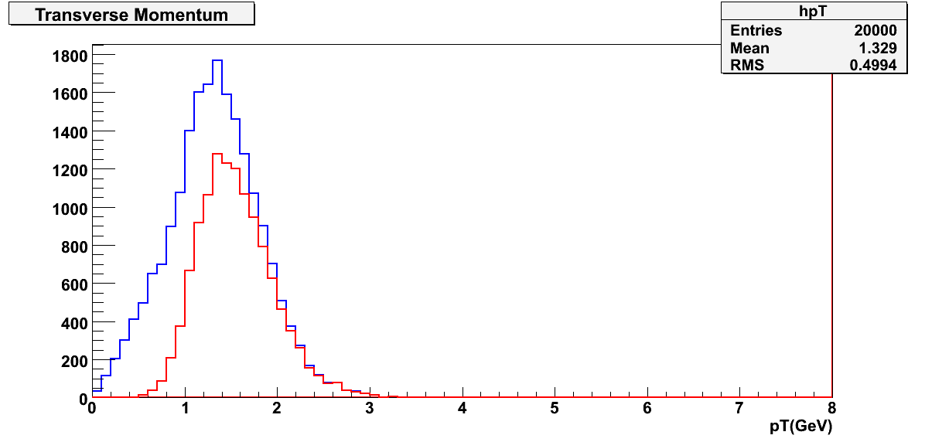
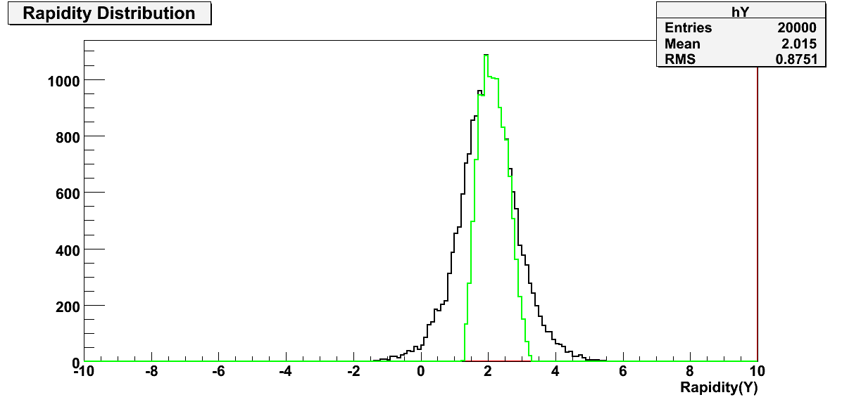
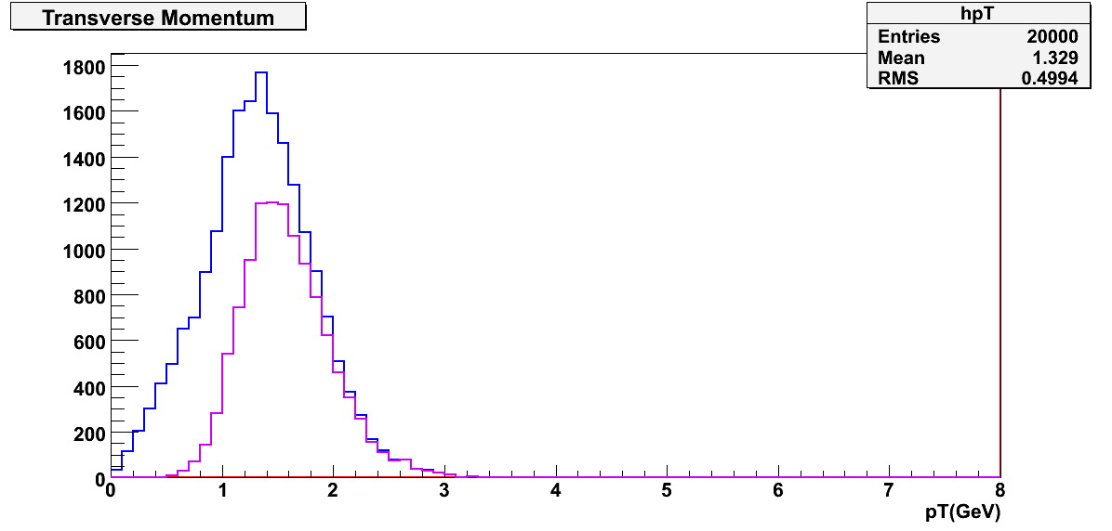
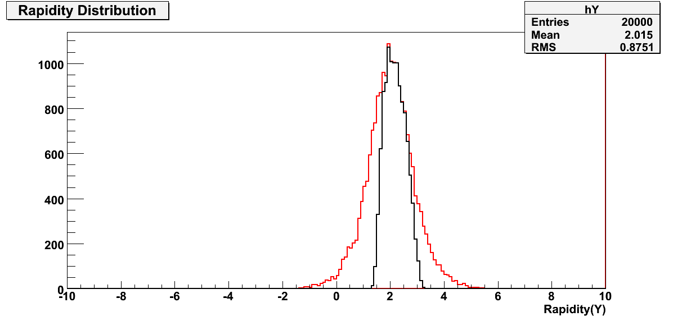
Pluto (signal muons)
generated
Standard geo
accepted
pT(GeV/c)
Rapidity(Y)
generated
accepted
Start version geo
Accepted tracks
(STS points>=4, MUCH Points>=70% of the total no. of muon detectors)

Slide 8
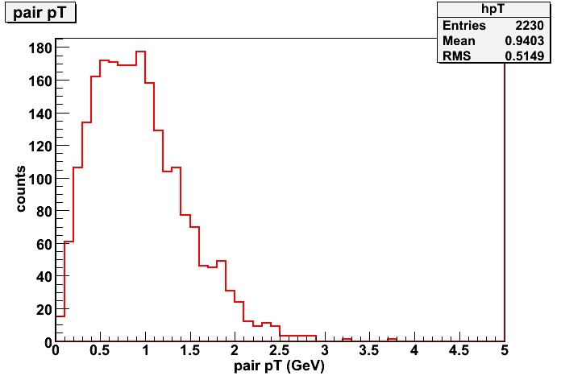
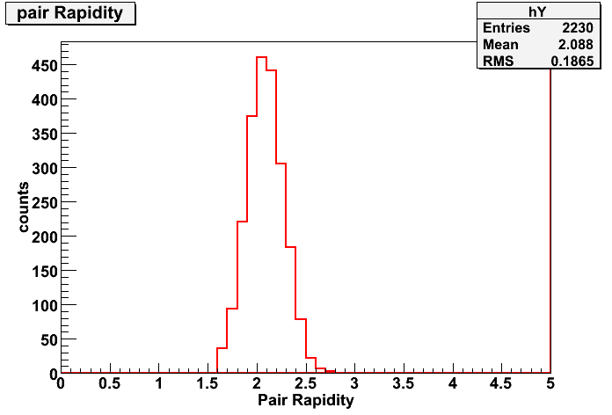
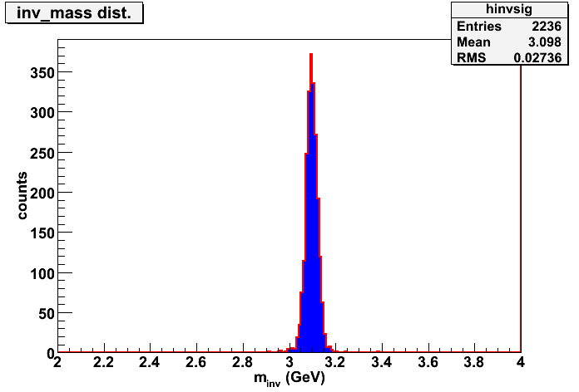
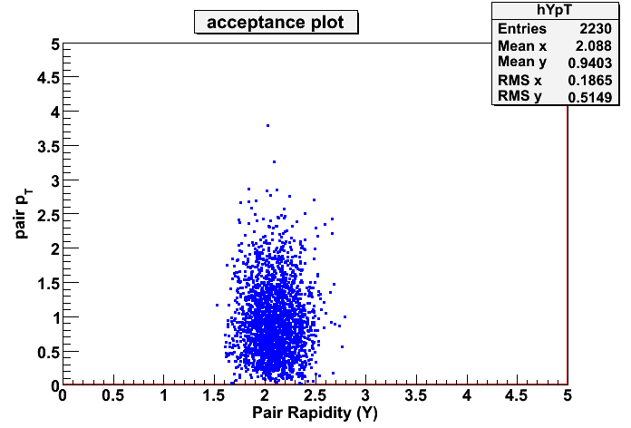
Reconstructed J/ψ Standard Geometry
Pair pT
Pair rapidity
Invariant mass
Reconstruction efficiency : 22.3 %,
(10 K embedded events, URQMD+PLUTO)

Slide 9
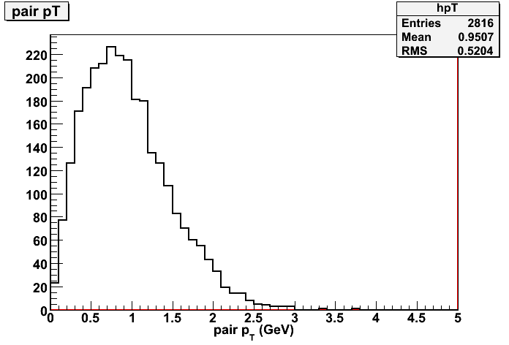
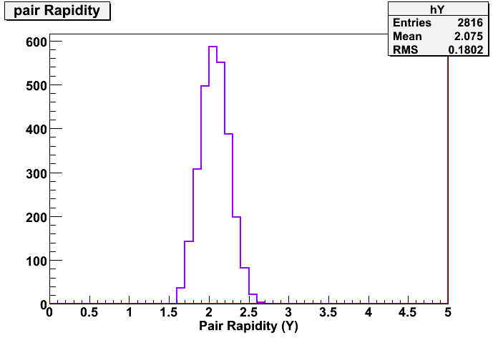
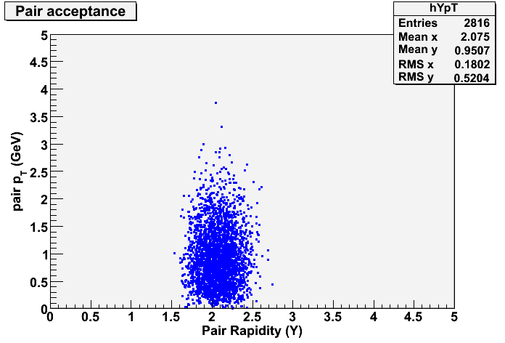
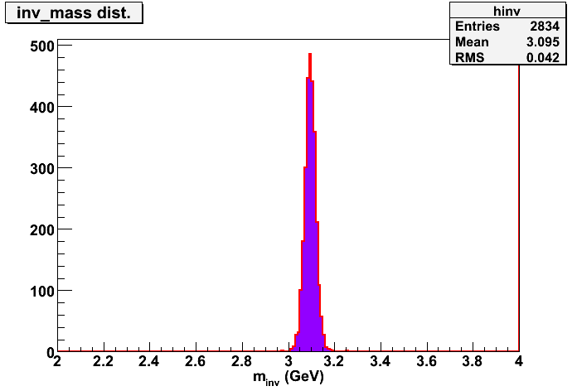
Reconstructed J/ψ Start version Geometry
Pair rapidity
Pair pT
Reconstruction Efficiency : 28.16 %

Slide 10
Summary & Future Plans
First estimates of reconstruction efficiency of J/y in SIS100 clearly shows the feasibility of measurement
Much less background in pA owing to the typical geometrical
acceptance
A START VERSION geometry of MUCH with 9 stations implemented. preliminary comparison conveys similar reconstruction efficiency. More study underway.
Estimation of background & calculation of S/B ratio will be done
Transport models (HSD) will be implemented to include the system asymmetry in production of signal muons .

Slide 11
BACKUPS

Slide 12
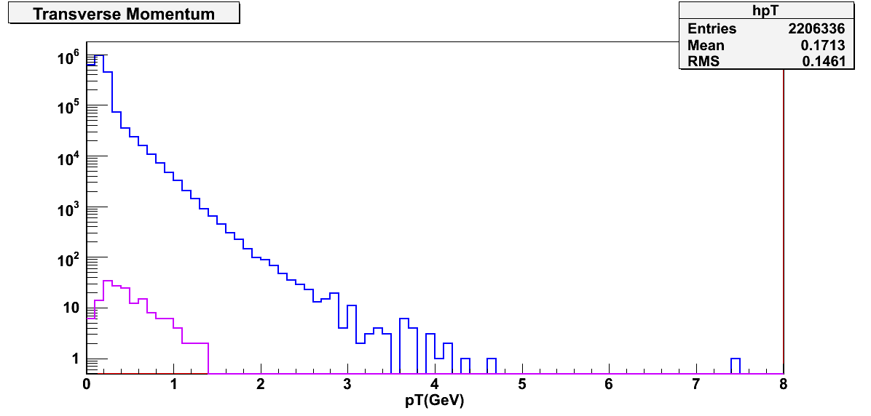
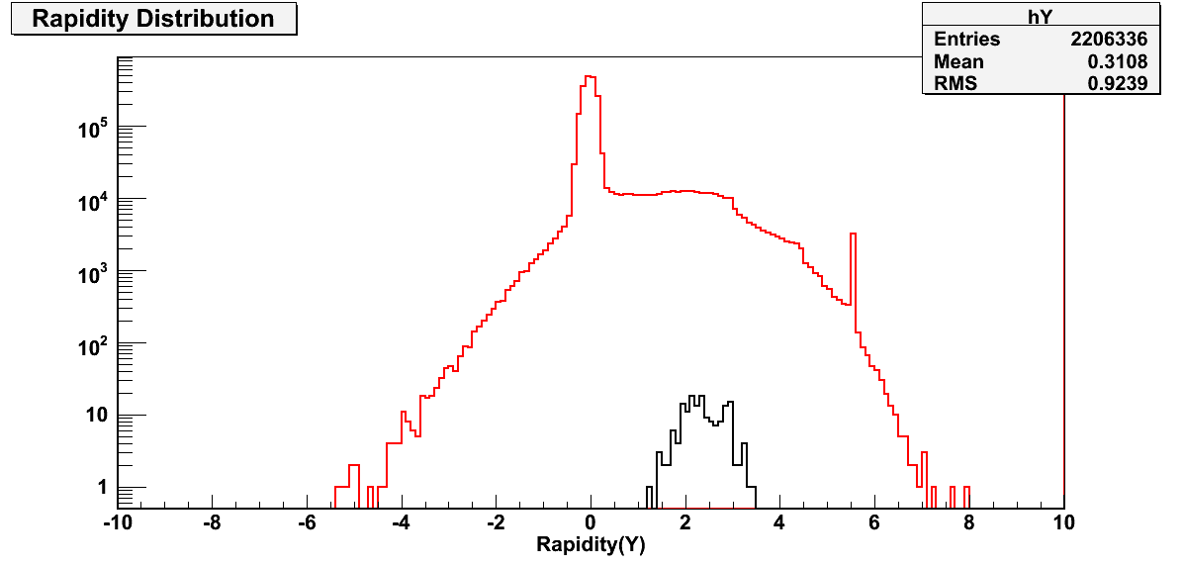
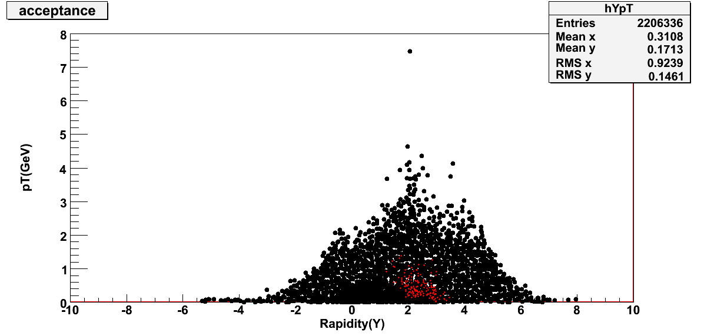
UrQMD (background)

Slide 13
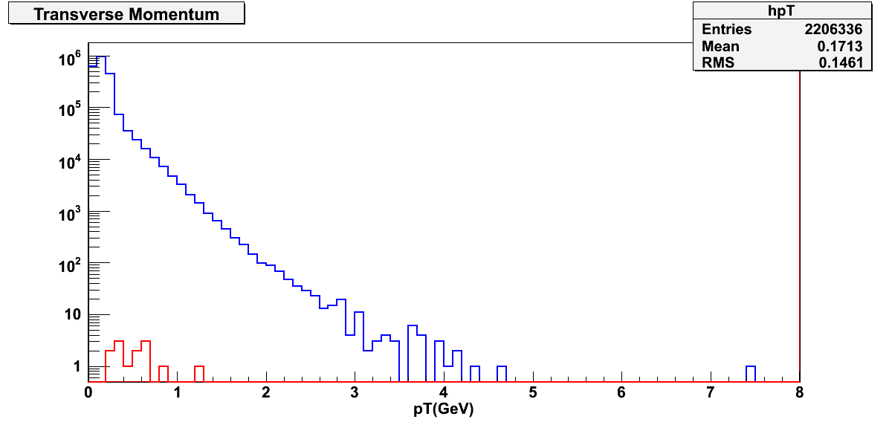
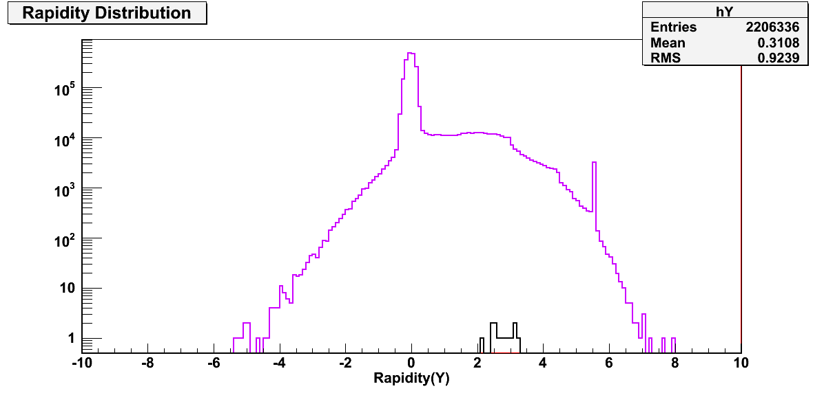
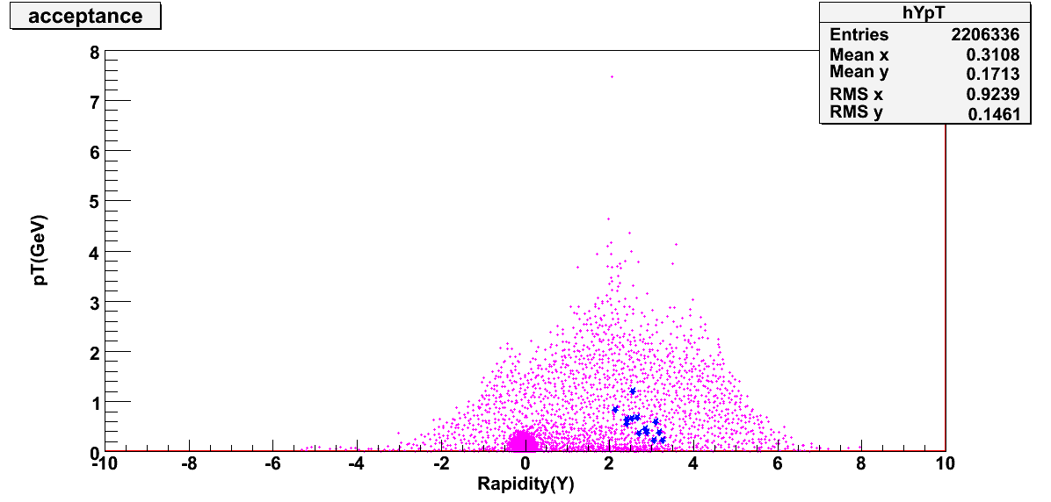
UrQMD (background)– start version geometry

Slide 14
Motivation
Aim of the relativistic heavy-ion collisions is to study the onset of de-confinement and the properties of the de-confined media in the laboratory.
Necessary to define unambiguous and experimentally viable probes for de-confinement.
Proton-nucleus (p+A) collisions is thus a fundamental component of any heavy-ion physics programme
Defines the reference baseline relative to which we recognize HI specific phenomena
p+A collisions provide a measure of the nuclear effects – helps in disentangling the “QGP” effect from the “non-QGP” effects. Here there is no formation time for the “secondary” medium , hence such collisions provide as essential tool to correctly account for the effect of the nuclear medium initially present.
Charm propagation in cold nuclear matter & normal absorption.
Notes:
14
14

Slide 15
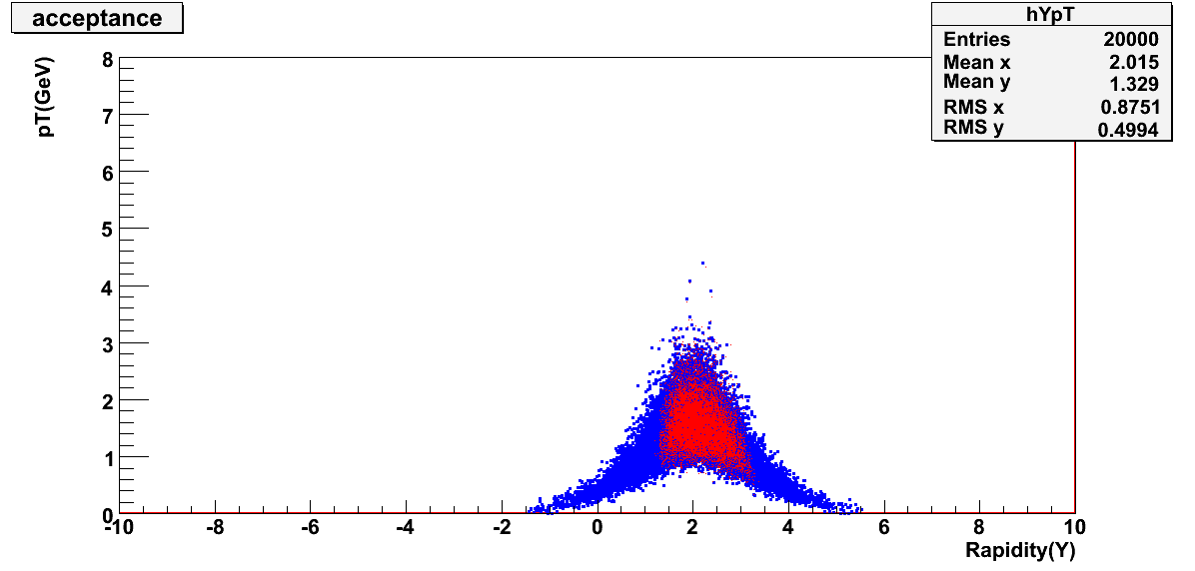
Pluto (signal muons)—Standard Geometry
Accepted tracks
(STS points>=4
Much Points>=70% of the total no. of muon detectors)

Slide 16
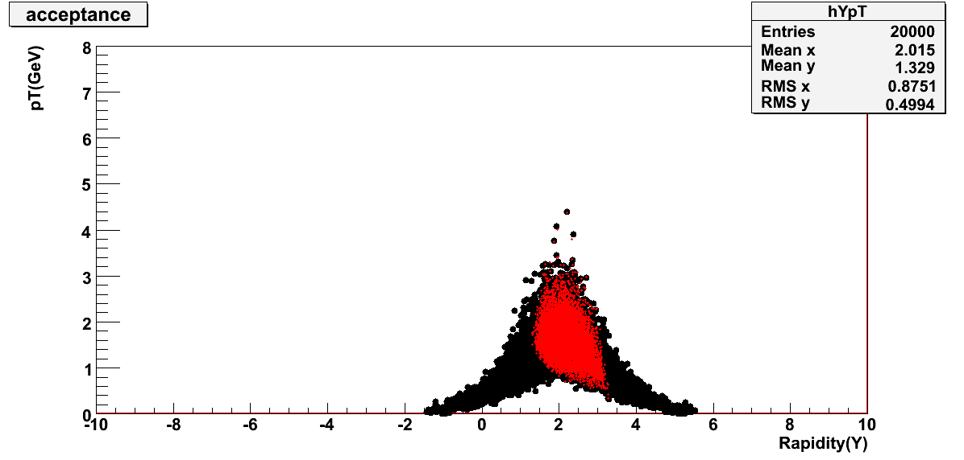
Pluto (signal muons)

