Slide 1
FAIR accelerator development
Prof. Dr. Oliver Kester

Slide 2
Outline
FAIR requirements
GSI upgrade
FAIR accelerator systems
  SIS100 – magnets, vacuum, rf-system
  Super-FRS magnets
  The collector ring – CR
Summary
2

Slide 3
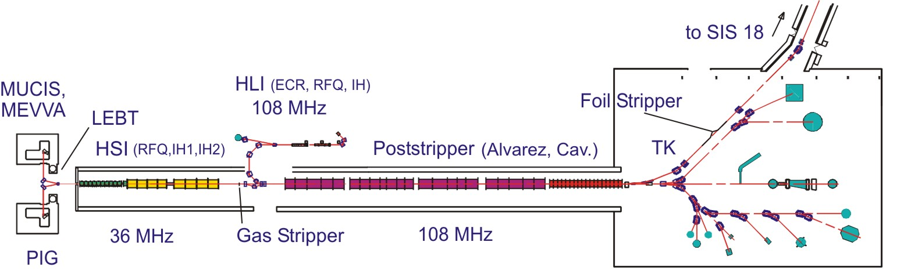

Intensity requirements for FAIR
Incoherent tune shift limits the maximum intensity in SIS18:
FAIR intensity goals can only be reached by lowering the charge states.
→ Gas stripper charge states will be used (e.g.: Ar¹⁸⁺ → Ar¹⁰⁺... U⁷³⁺ → U²⁸⁺).
→ No stripping loss (charge spectrum) in the transfer channel
$$−ΔQ∝\frac{Z^{2}}{A}$$
3

Slide 4
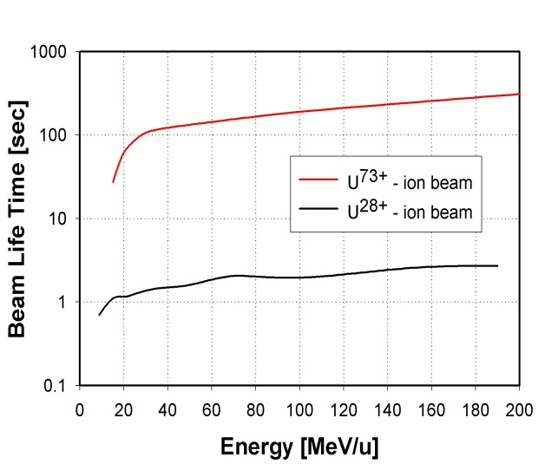
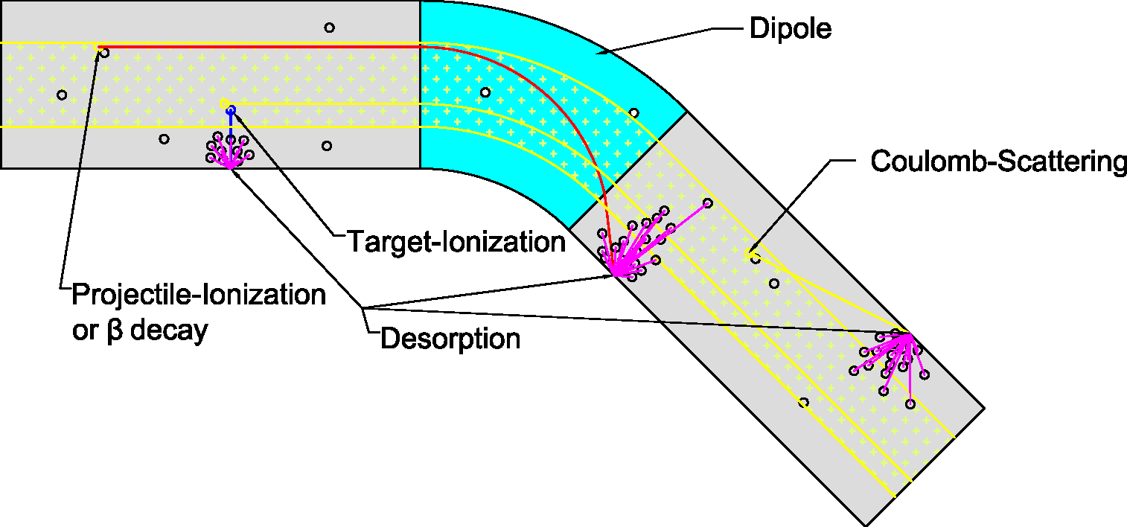
Intensities: status and goals
Space charge limit for low charge state ions (FAIR)
Space charge limit for high charge state ions
Space charge limit is higher for low charge states
Beam lifetime of medium charge states is lower due to stripping in the residual gas of the synchrotron
4

Slide 5
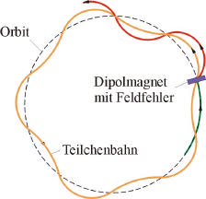
Resonances and space charge
Number of transverse oscillation per revolution =
tune Qx,Qy
5

Slide 6
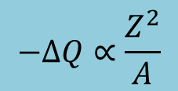
Space charge effects
Pipe
x
Slow halo
formation
If halo is too large
slow beam loss
take place
z
z
Bare tune
Lattice error or
Space Charge Structure
Resonance
G. Franchetti
Periodic crossing
of a resonance
$$−ΔQ∝\frac{Z^{2}}{A}$$
→ Resonance compensation system
6

Slide 7
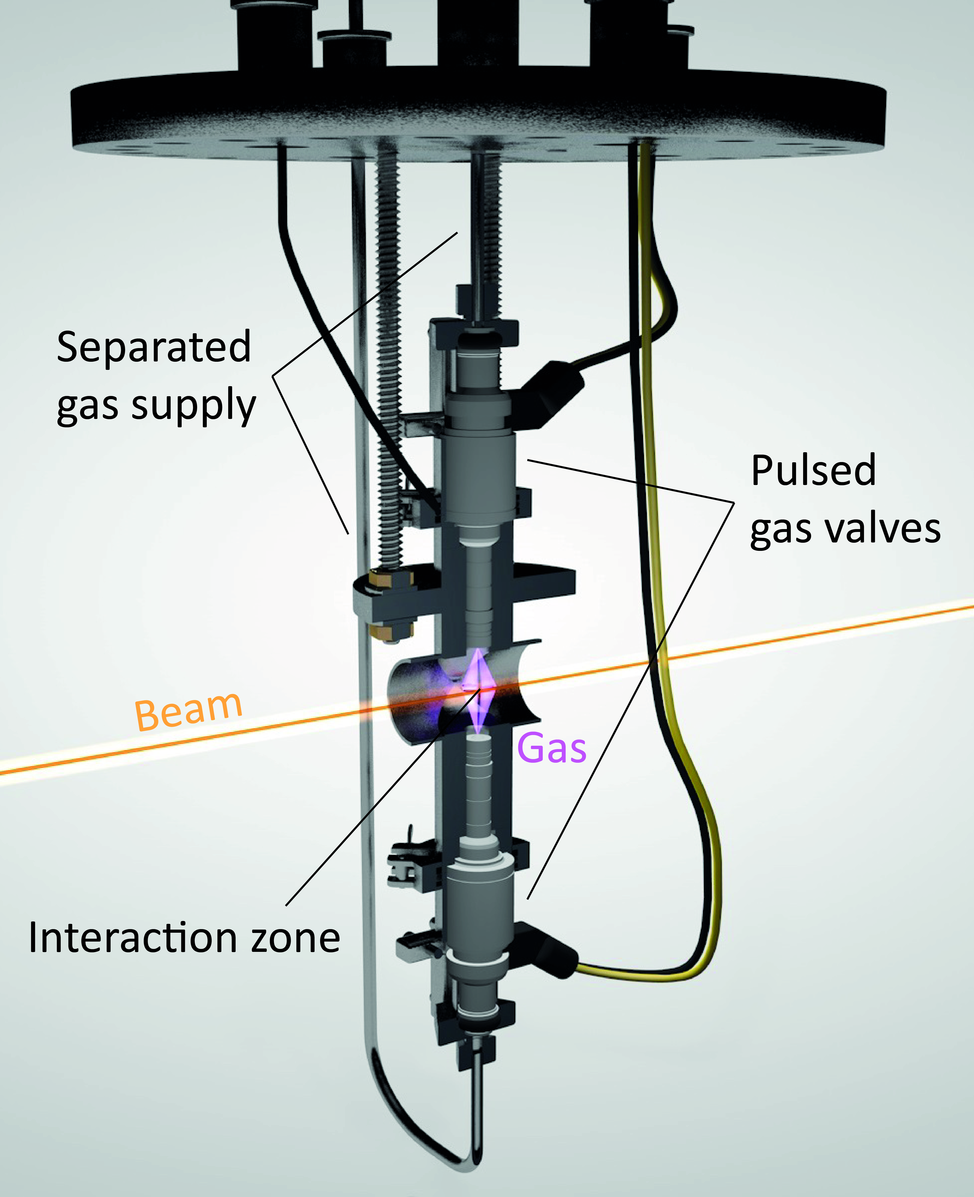
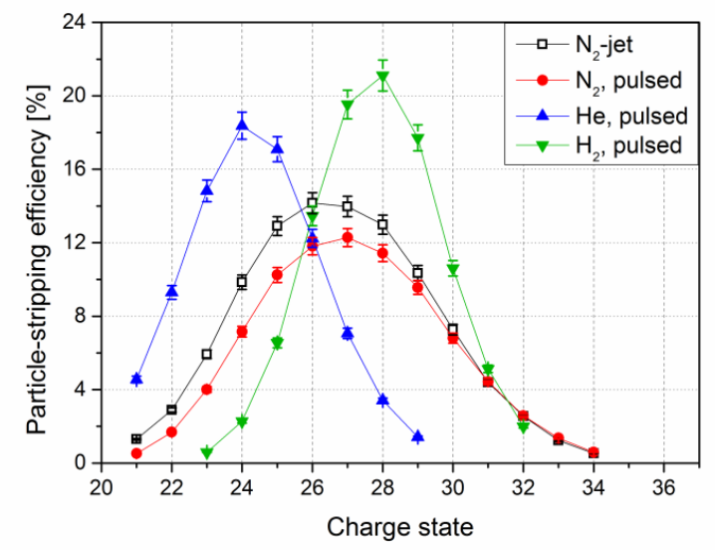
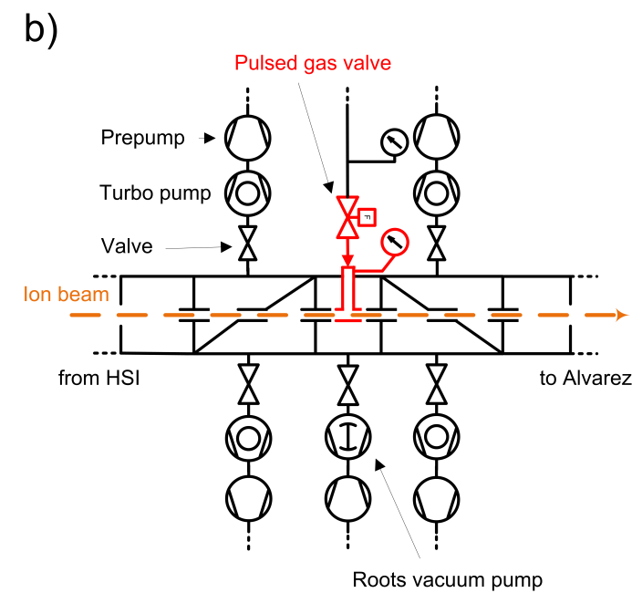
Charge state stripper for intense heavy ion beams
Pulsed gas stripper
High intensity capabilities
Higher gas pressure → pulsed gas valve (120 bar H₂ reached)
→ higher charge state, higher efficiency
85% of design brilliance reached
P. Scharrer
9.5 mA U²⁹⁺,pulse current → new record
Temporary setup to be integrated into routine operation
7

Slide 8
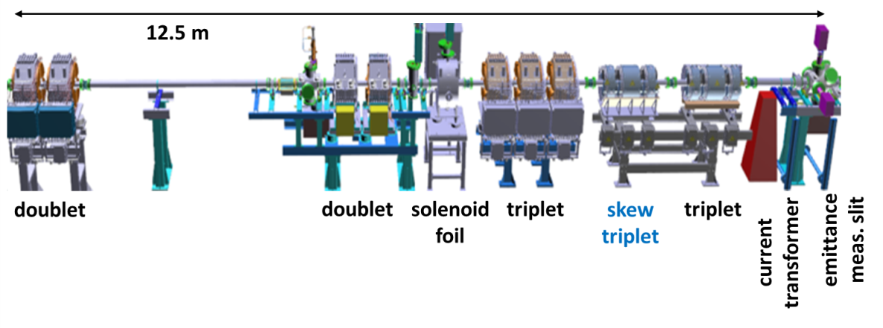
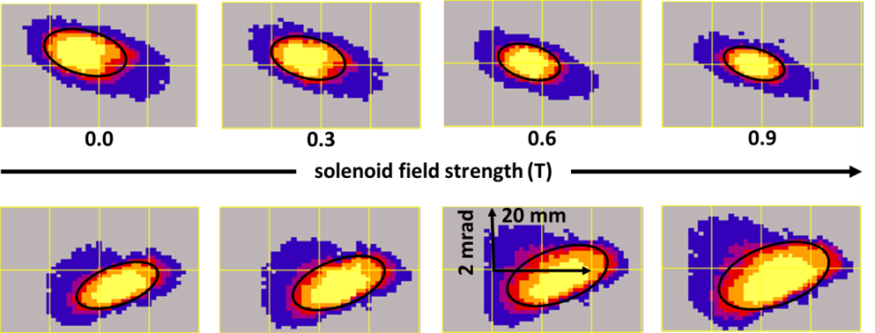
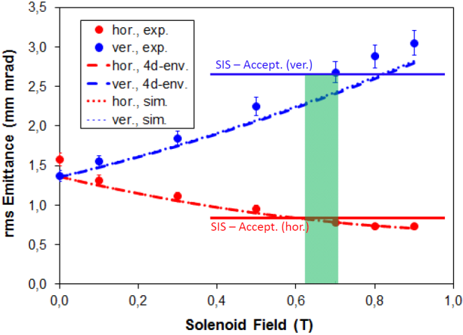
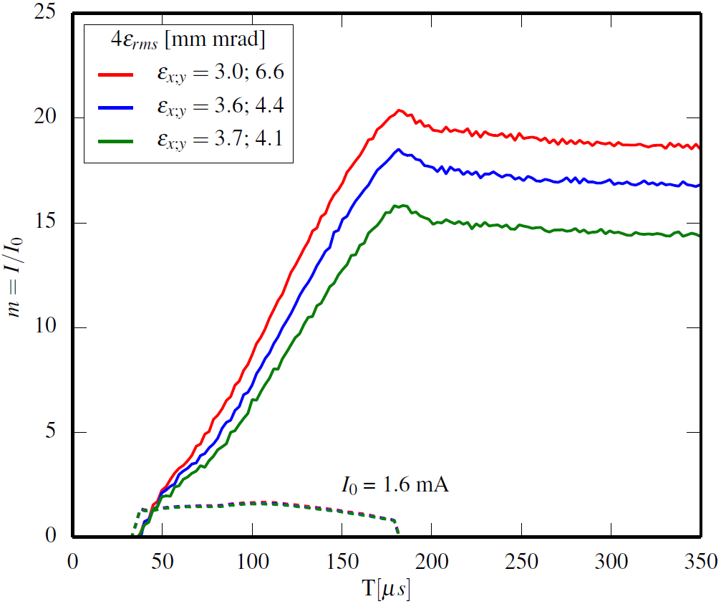
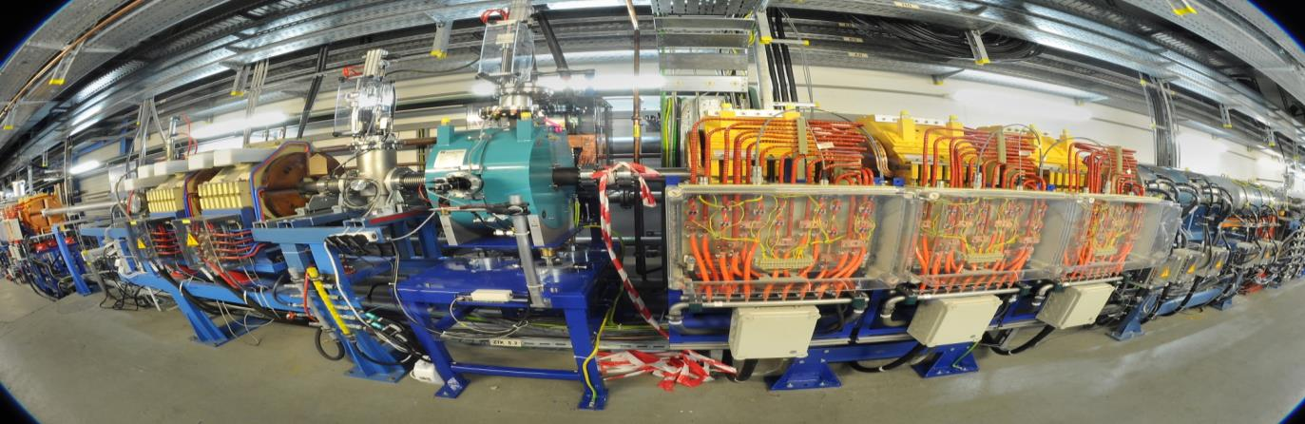
Emittance transfer: Beam tailored for optimum injection into the synchrotron
current in synchrotron I
B_{sol} = 0.9 T
B_{sol} = 0.4 T
B_{sol} = 0.0T
current in transfer channel I₀
C. Xiao
8

Slide 9
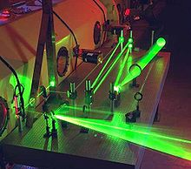
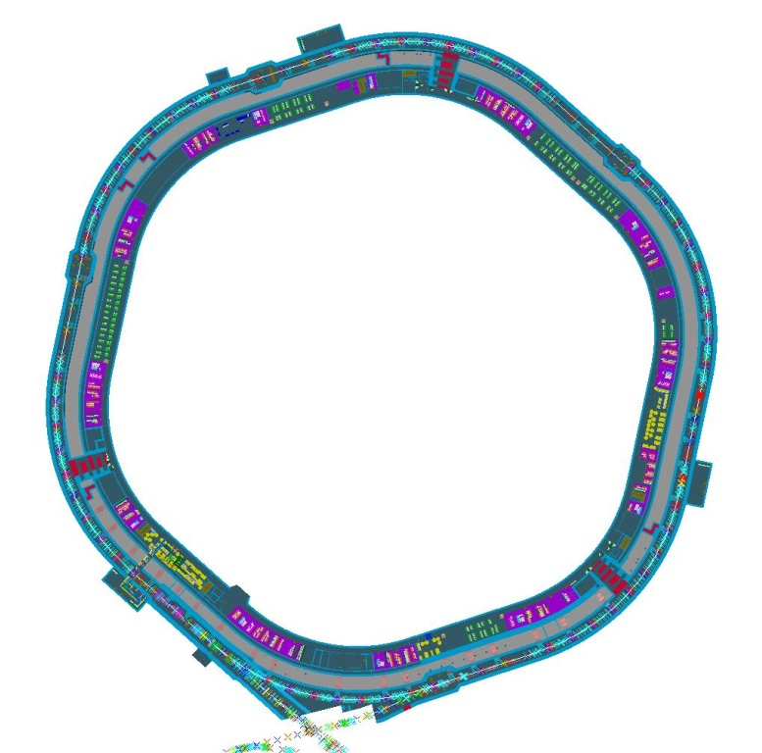
The SIS100 synchrotron
In order to fulfil the user requirements, SIS100 provides:
high energetic beams of all ion species from Proton to Uranium
beams of highest intensities per cycle and in average
beams of various time structures (single bunches, compressed bunches, bunch trains, long spills)
high flexibility in all settings from cycle to cycle which enables parallel operation of several experiments
Laser Cooling
Acceleration
Acceleration
Bunch
compression
SIS100
SIS300
Transfer
SIS100  SIS300
Extraction →
to Experiments
→ Injection
from SIS18
Images courtesy of M. Konradt / J. Falenski
9

Slide 10
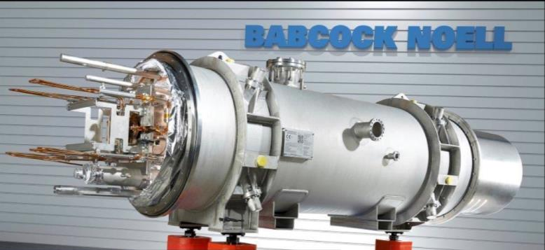
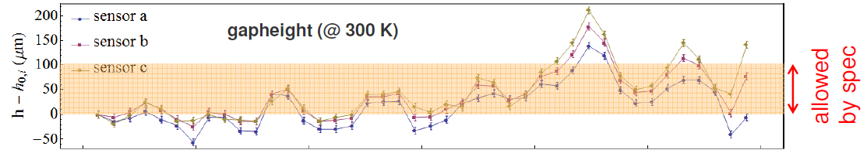
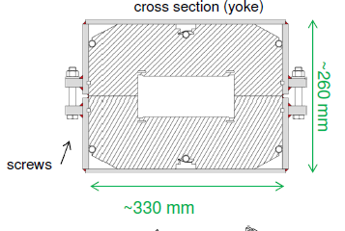
SIS100 dipole modules:
First of series magnet
Delivered to GSI: June 3rd 2013
Optimization of welding procedure: laser welding
Low heat input, low tension, lamination stamped to final geometry
New yoke has variation < 50 μm
10

Slide 11
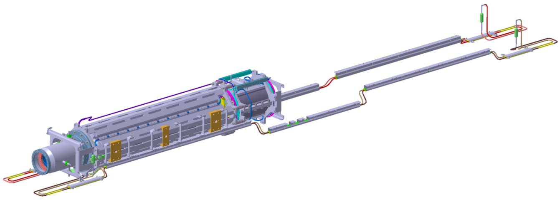
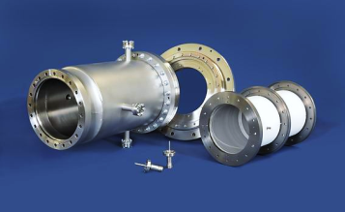
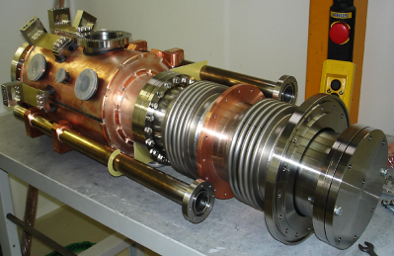
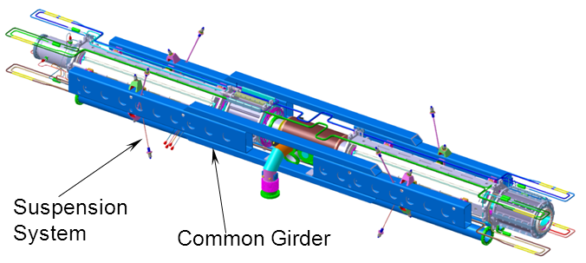
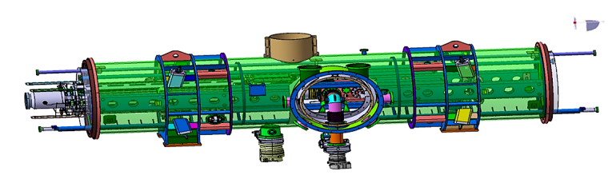
SIS100 Quadrupole Doublet Modules (QDM)
Module with QP, chrom. SP, BPM
Doublet with Cryo-Catcher module
→ test of 169 units in JINR/Dubna
Functional elements installed in
common girder
11

Slide 12
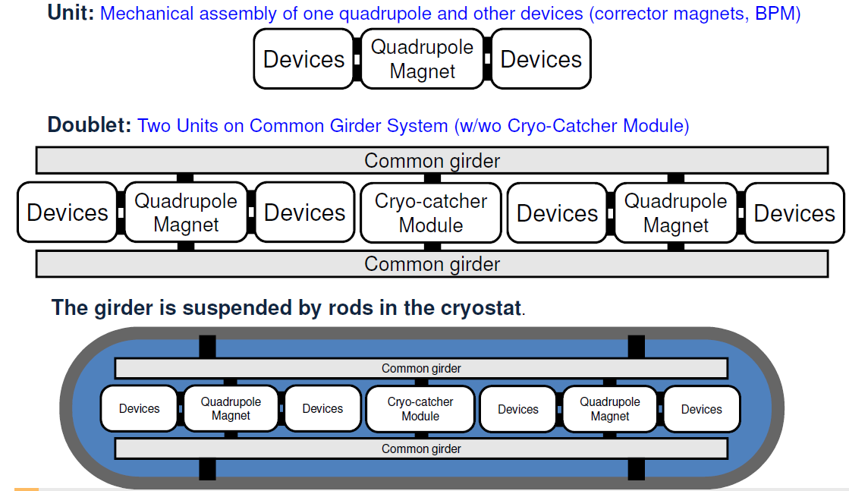
Overview modules structure
12

Slide 13
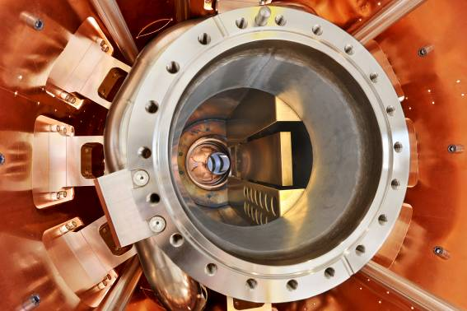
Dynamic Vacuum effect and collimation
Dynamic vacuum calculations show that in spite of the very well controlled losses, a huge pumping speed is required → XHV conditions
Cryogenic vacuum chambers
Adsorption pumps
13

Slide 14
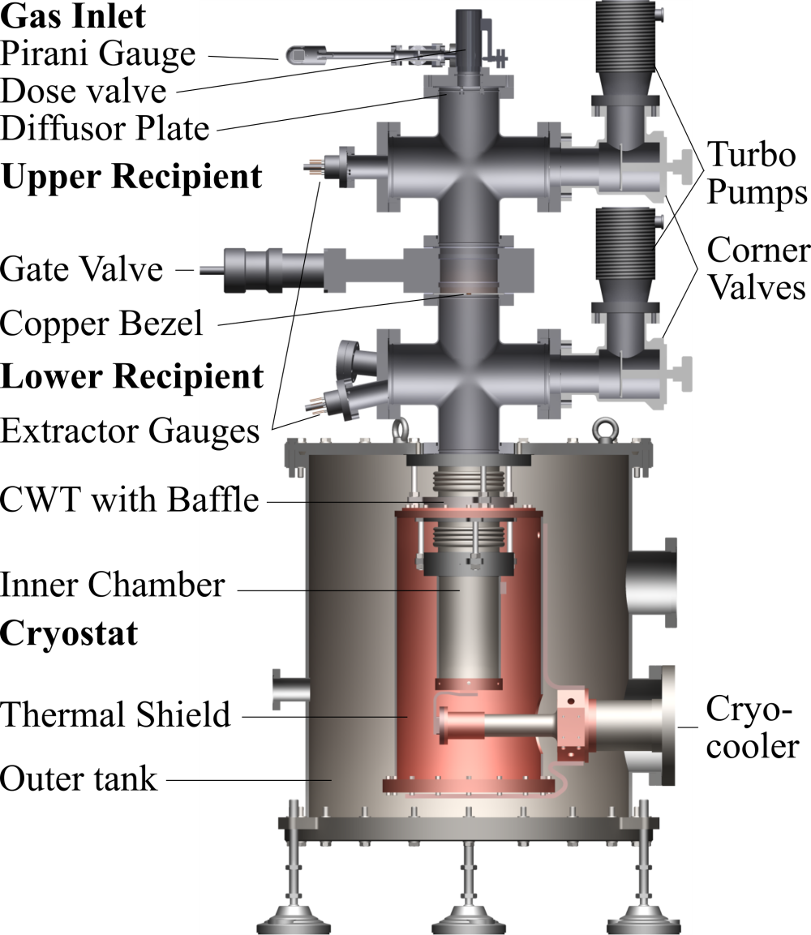
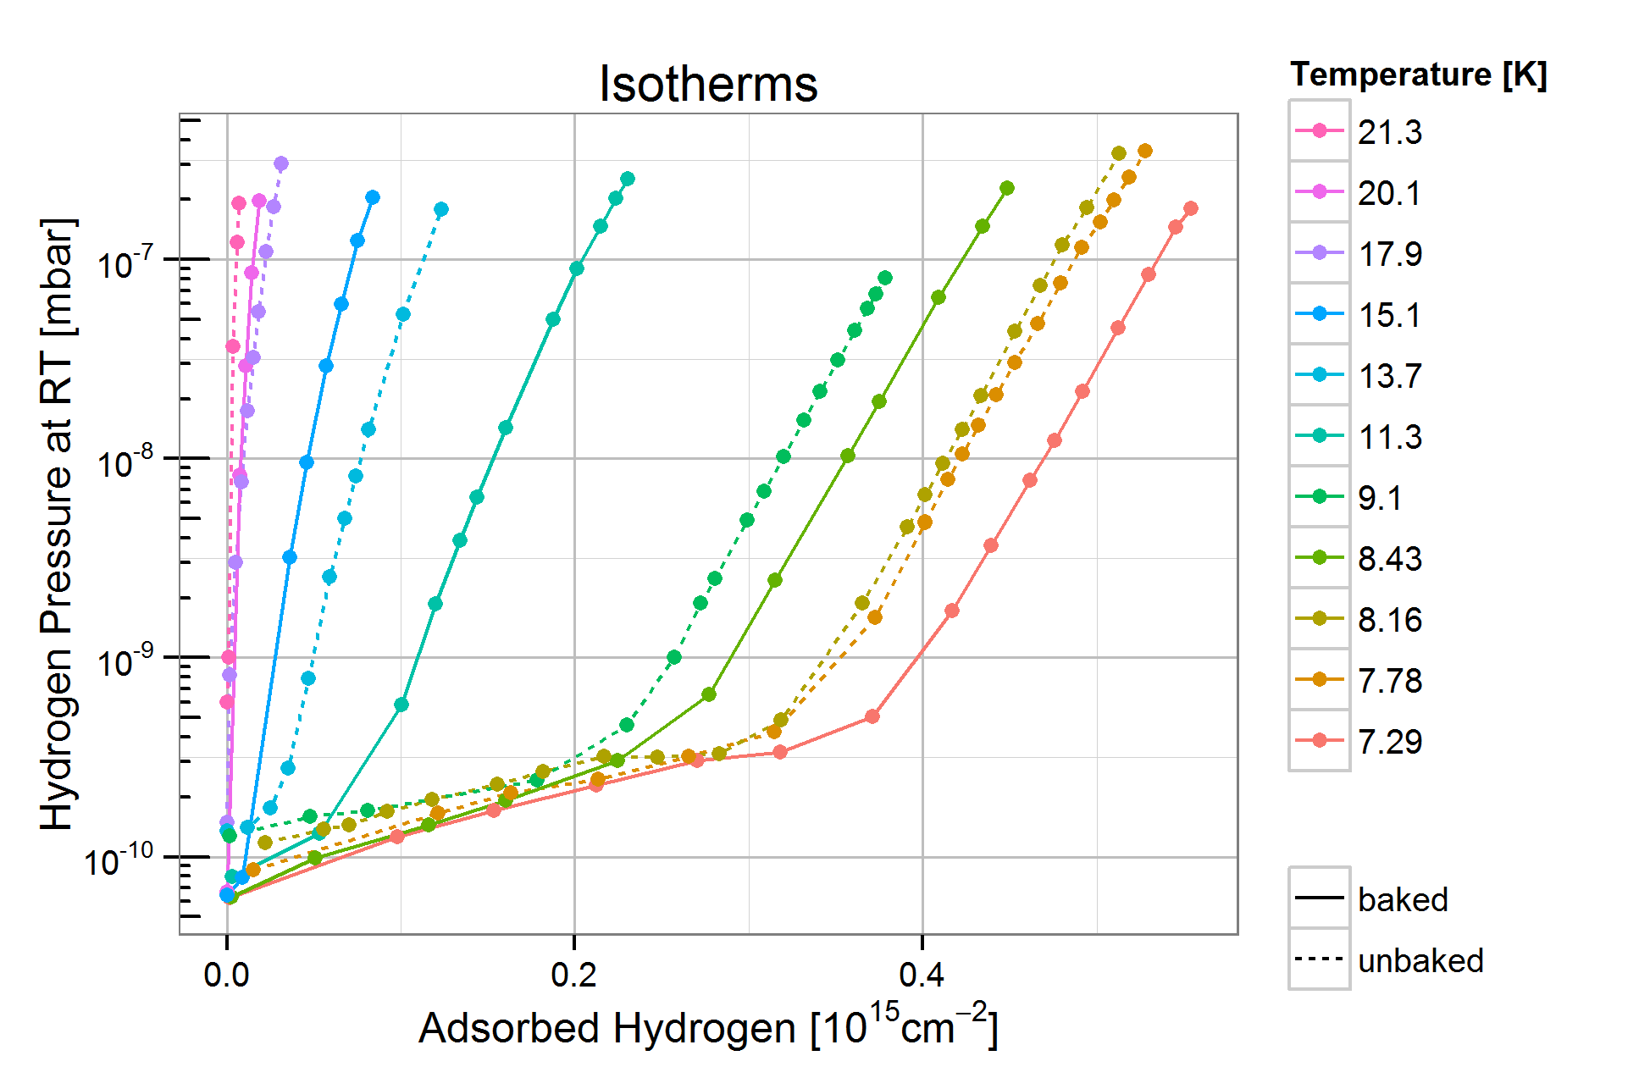
Cryogenic Surface Pumping
Cryogenic walls in the SIS100 Vacuum System act as surface pumps
Pumping speed and surface capacity required in the relevant temperature range
14

Slide 15
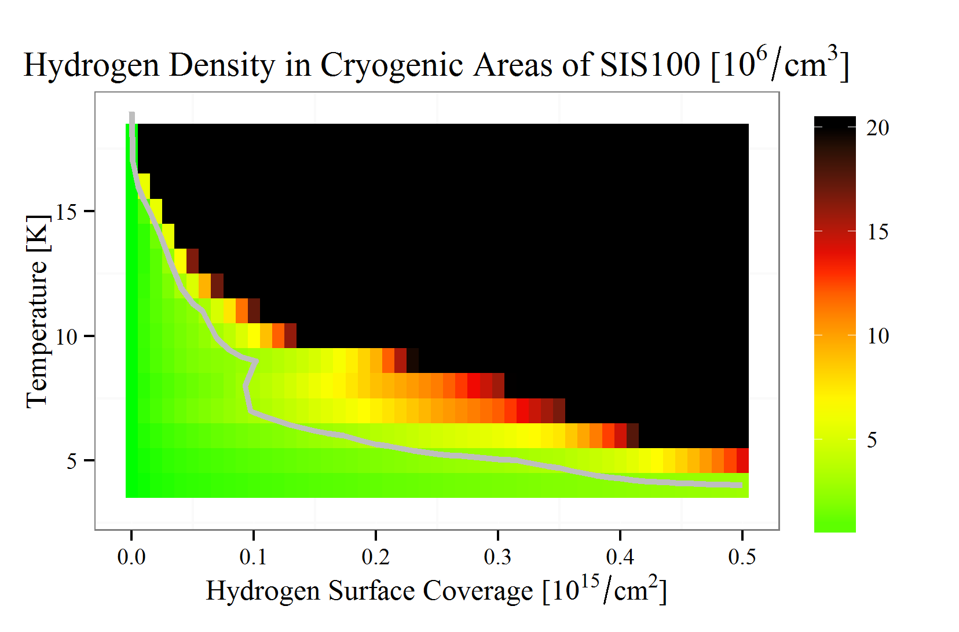
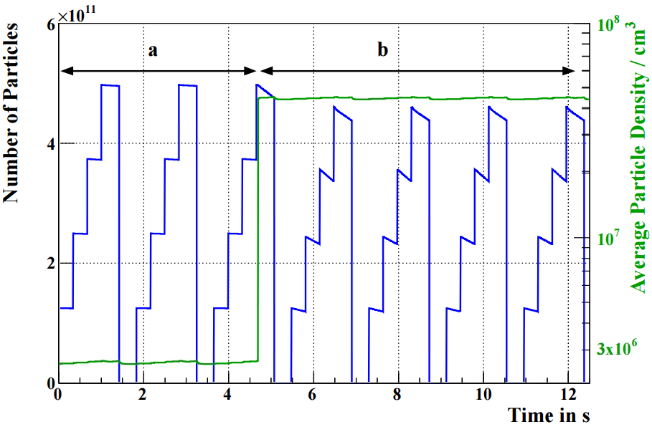
Cryogenic Surface Pumping
Surface coverage and temperature has been linked to residual gas density
Long term density stays low enough for stable operation
Equilibrium density is very sensitive to temperature rises
F. Chill
15

Slide 16
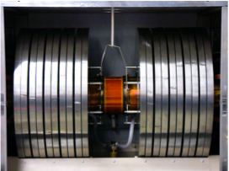
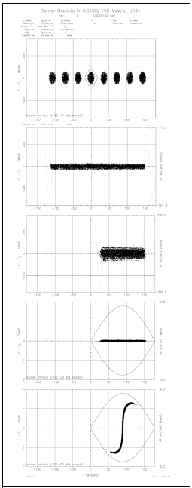
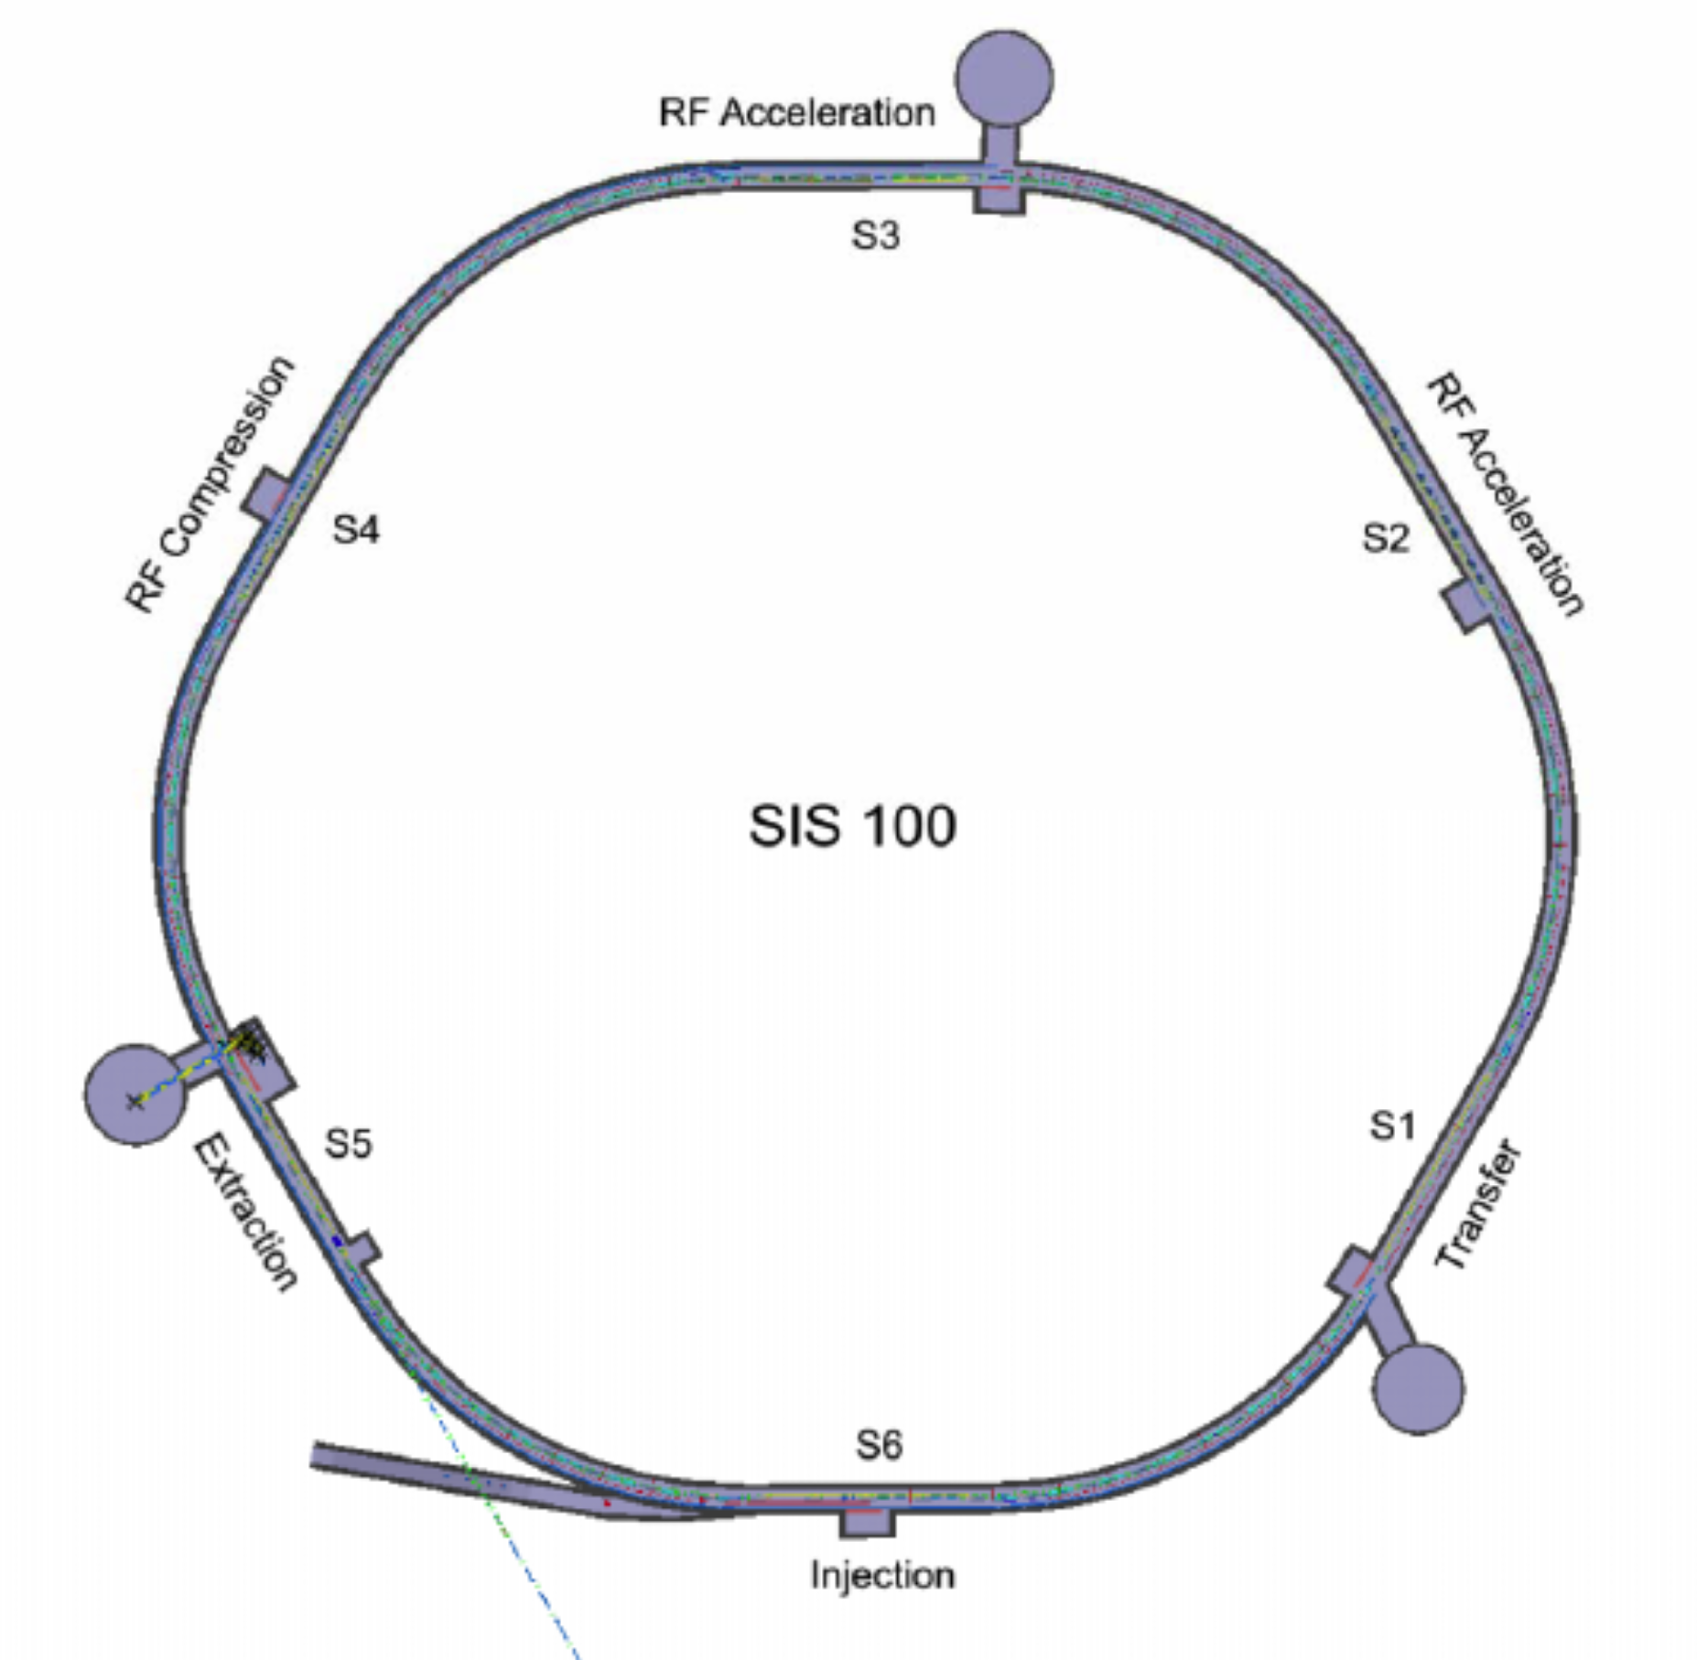
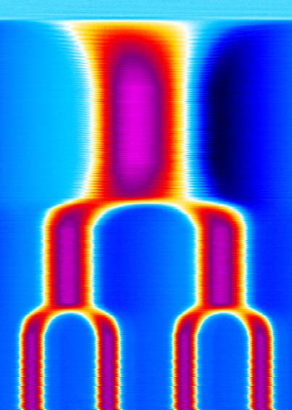
Bunch compression system in SIS100 under construction
Single bunch formation
16 magnetic alloy (MA)
loaded rf cavities with
total: 600 kV (400 kHz)
0.2 -> 1.5 GeV/u
8 bunches
rf compressor
section (≈40 m)
‘bunch merging’
SIS-100
L=1080 m
pre-compression
rotation
extraction
Extreme transverse
space charge
16

Slide 17
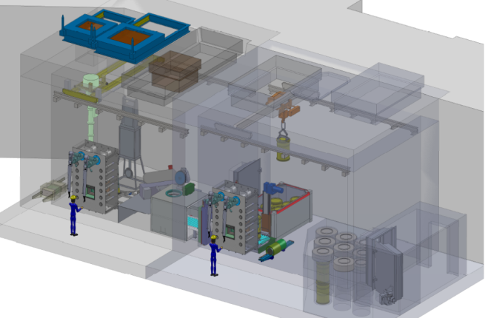
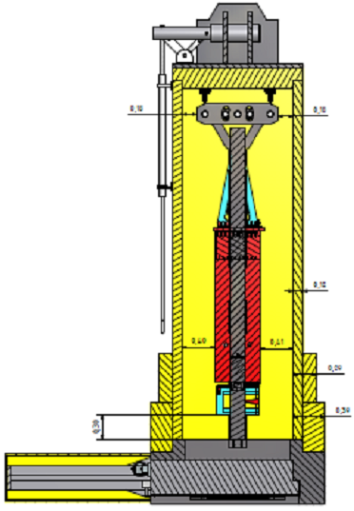
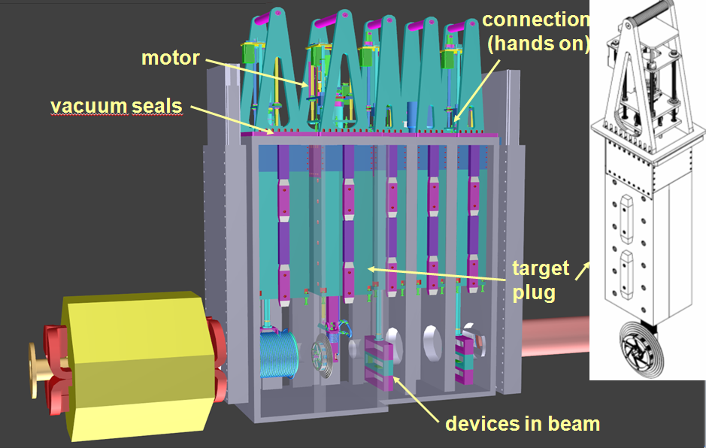
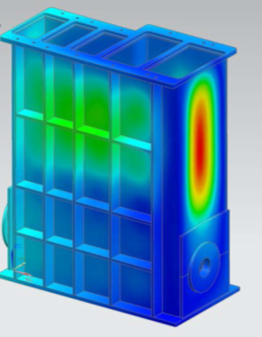
Super-FRS target region- collaboration with KVI Groningen
Target Chamber with plug inserts → radiation transport simulations
Target Wheel
Hot Cell Complex
Transport Flask
Remote Handling
Hot Cell
Transport Flask
17

Slide 18
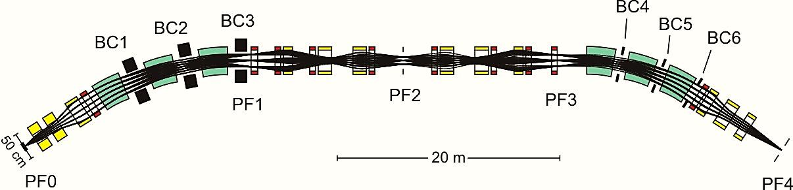
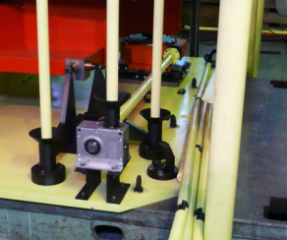
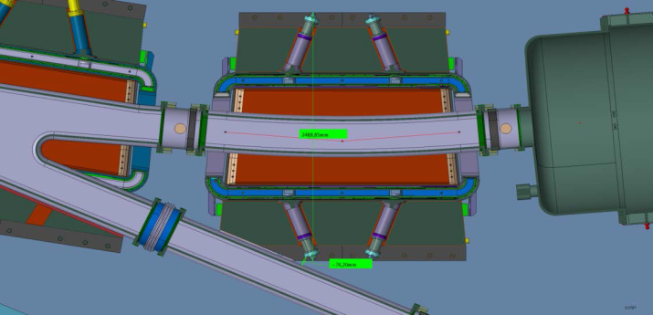
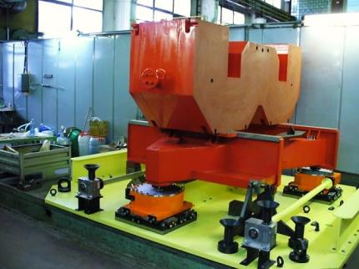
Sepial Super-FRS dipoles
High-radiation level
→ Normal conducting
Super
conducting
Radiation resistant dipole →BINP, Novosibirsk
Normal conducting magnets using
Mineral Insulating Cable
Remote connectors and alignment
engineering challenge
Branching SC dipoles → integration of y-shape vacuum chamber to reinforce cryostat
Development
at BINP
May 2011
18

Slide 19
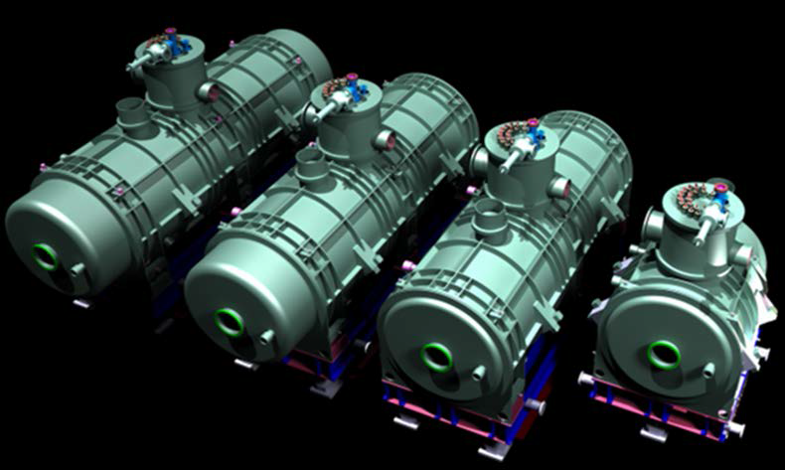
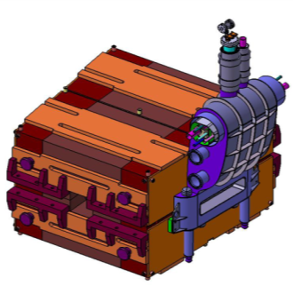
Super-FRS SC magnets
Iron dominated, cold iron (≈40 tons),
Common helium bath, LHe ≈ 1.300 l
Warm beam pipe (38 cm inner diameter)
The Super-FRS Multiplet contract was awarded to ASG and the practical work is started
→ PDR foreseen in February 2016
The Super-FRS-Dipoles are currently redesigned and prepared for tendering by Irfu, CEA, Saclay
25 long multiplets
8 short multiplets
CEA revised SC dipole design
19

Slide 20
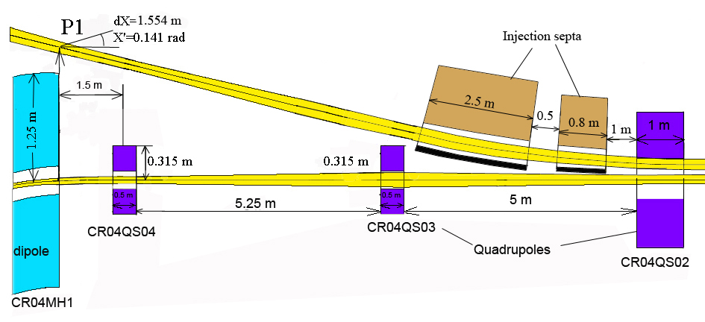
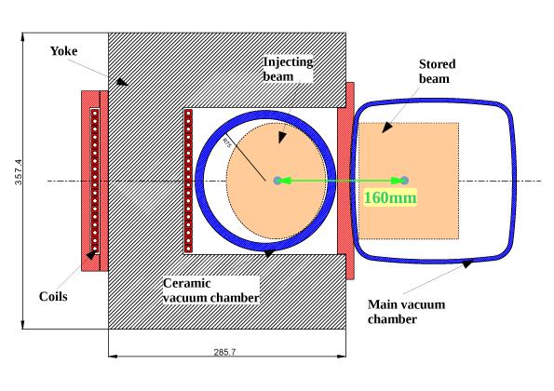
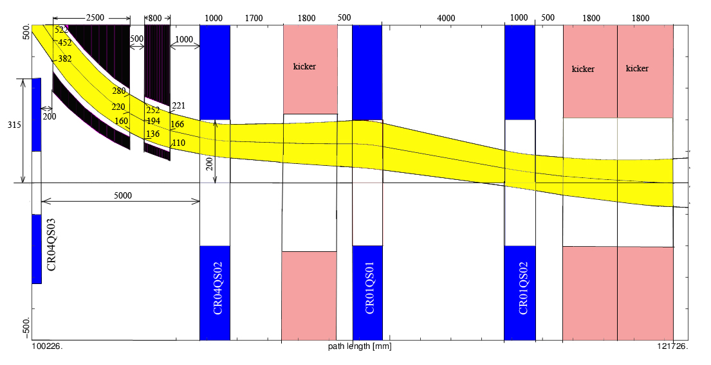
CR-injection (BINP proposal)
BINP proposal of the injection scheme:
Two injection septa
Lower beta in quads → smaller aperture sufficient
Reduced losses in the injection
Ceramic vacuum chamber
20

Slide 21
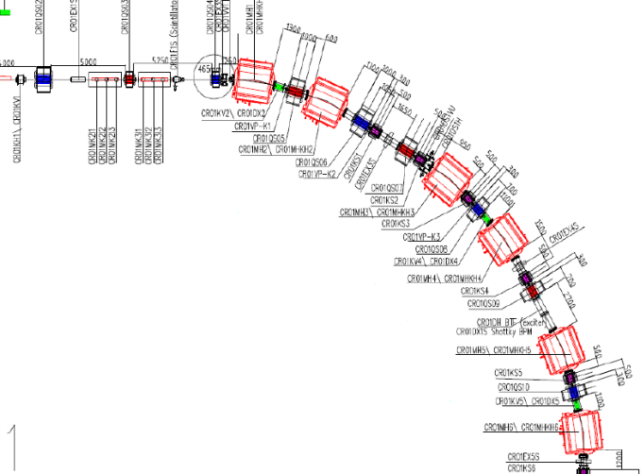
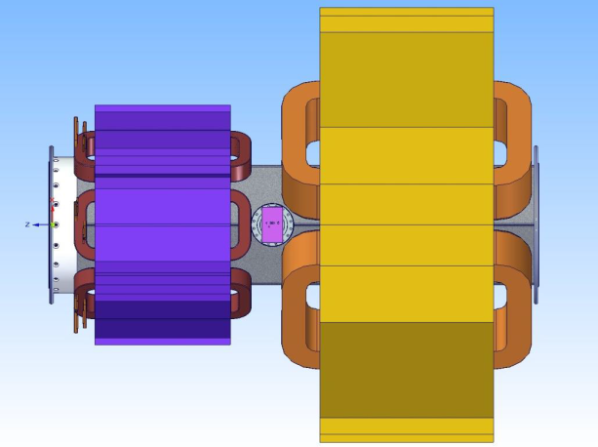
CR issues: Space restrictions
The CR is very compact and comprises many elements
About 100 of DN500
flange connections.
200 flanges in arcs! 300m sealing length !
DN200 flanges in long drifts
→ some sections vacuum chambers connected by welds
21

Slide 22
Summary
GSI accelerators → intense upgrade program
UNILAC and SIS18 upgrade for high intensity and high brilliance
from the source to the SIS100
Intensity limitations - the FAIR synchrotrons are well adapted to the needs
Dynamic vacuum effect → cryogenic pumping
Super-FRS target and magnet
BINP proposals for CR components – very tight space
22

Slide 23
Backup

Slide 24
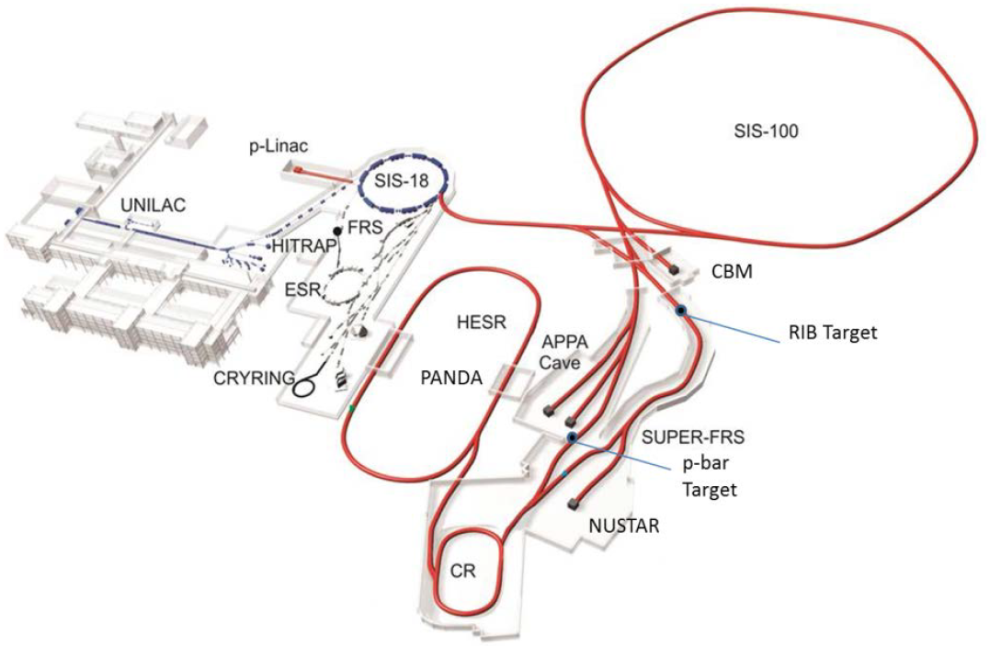
Accelerator Performance for FAIR Experiments
Primary Beams SIS 100
4.5 × 10¹¹ U²⁸⁺ ions/spill; 1.5 GeV/u
10¹⁰/s ²³⁸U⁹²⁺ up to 11 GeV/u
2 × 10¹³ protons/spill; 29 GeV
Secondary Beams
range of radioactive ion
beams up to 1.5 - 2 GeV/u; up to
a factor of 10’000 higher in intensity
than presently
antiprotons 1.5 - 14.1 GeV
Storage and Cooler Rings
radioactive ion beams
antiproton beams:
CR: 10⁸ antiprotons; 3 GeV
HESR: 10¹⁰ antiprotons; 1.5 - 14.1 GeV
Technical Challenges
Rapid cycling superconducting magnets
rf-systems and control
Beam lifetime (dynamic vacuum)
Cooled beams

Slide 25






Metal Vapor Vacuum Arc (MeVVA)
Discharge power: 50 kW
(13,3 MW/cm²)
Discharge current: ~1 kA
Duty Cycle: 1 Hz, 1 ms
must be increased to 2,7 Hz
→ thermal issues
New cathode materials required (alloys)
→ avoid to melt cathodes
25

Slide 26



Superconducting FRagment Separator
Transmission
26
Notes:
26

Slide 27



The FAIR storage rings
SIS100
CR
circumference 221 m
magn. rigidity 13 Tm
acceptance ε_{x,y} =
240 (200) mm mrad
Δp/p = ± 2.7 (1.5) %
BINP

