Slide 1
Bericht zu NUSTAR Kernstruktur im Kosmos
Tom Aumann → Norbert Pietralla
TU Darmstadt
KHuK Meeting Dez. 2015
Physikzentrum, Bad Honnef, 5.12.2015
Finland
France
Germany
India
Poland
Romania
Russia
Slovenia
Sweden
UK

Slide 2
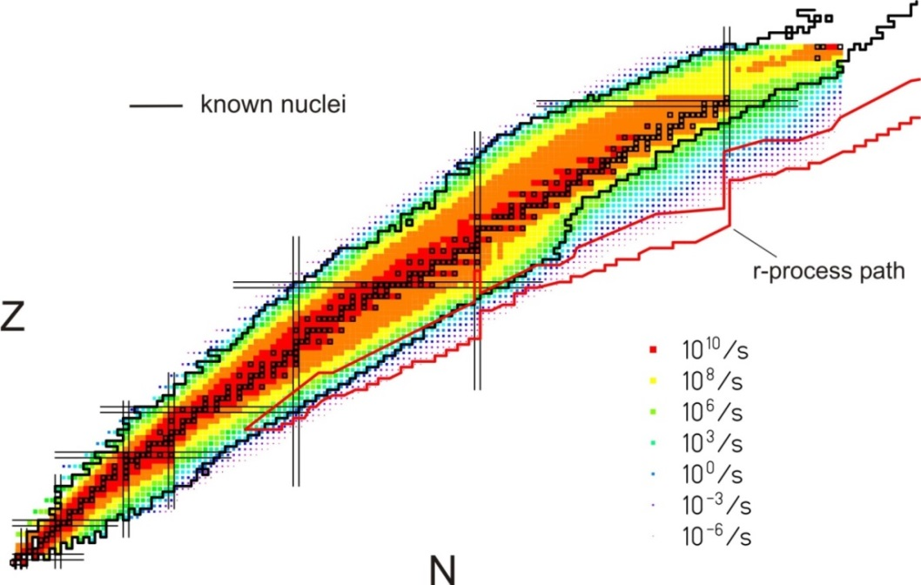
NUclear Structure, Astrophysics and Reactions
What are the limits for existence of nuclei?
Where are the proton and neutron drip lines situated?
Where does the nuclear chart end?
How does the nuclear force depend on varying proton-to-neutron ratios?
What is the isospin dependence of the spin-orbit force?
How does shell structure change far away from stability?
How to explain collective phenomena from individual motion?
What are the phases, relevant degrees of freedom, and symmetries
of the nuclear many-body system?
How are complex nuclei built from their basic constituents?
What is the effective nucleon-nucleon interaction?
How does QCD constrain its parameters?
Which are the nuclei relevant for astrophysical processes
and what are their properties?
What is the origin of the heavy elements?

Slide 3
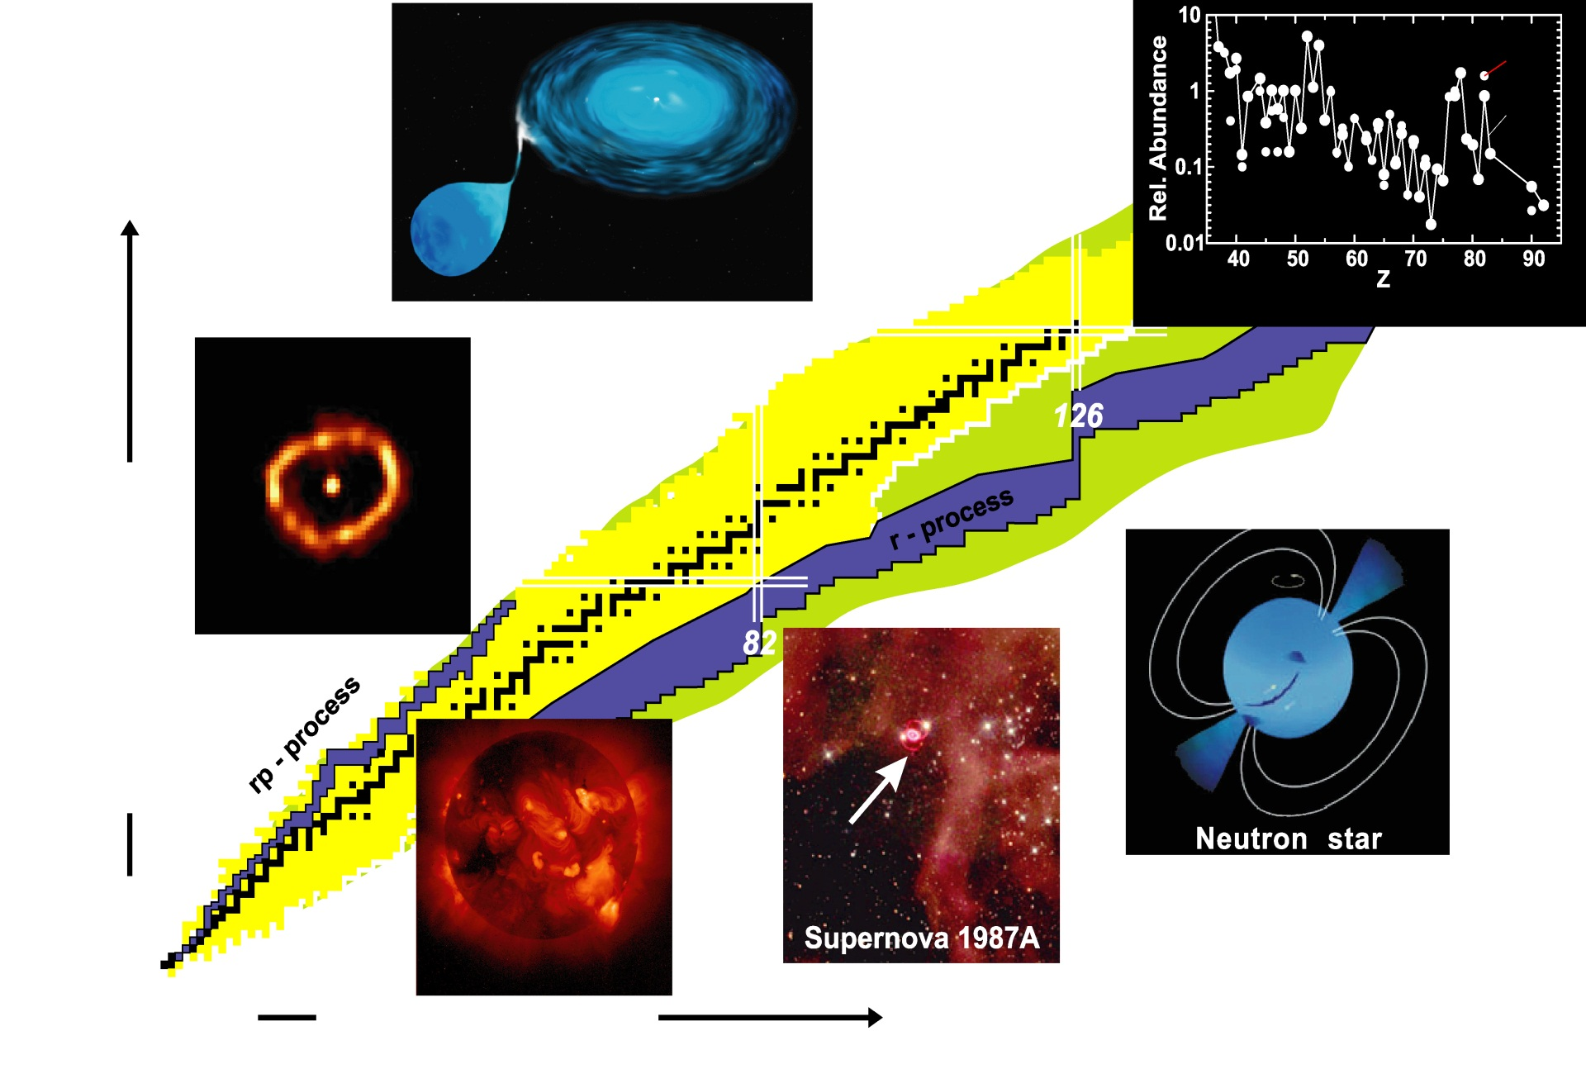
Nuclear physics in the universe
For the understanding of nucleosynthesis and stellar dynamics we need to know properties of many exotic nuclei.
X-ray burst
Accreting white dwarf
S_{p}=0
Elements in our solar system
3. r-Prozess-Peak
S_{n}=0
Proton number Z
Nova Cygni 1992
N=126:
e.g. ²⁰⁴Pt
@ RISING /
PreSPEC
Sun
Neutron number N

Slide 4
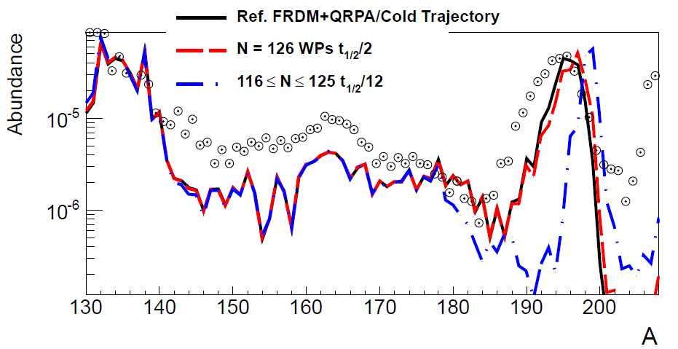
The N=126 physics case
Previous GSI measurements contradict earlier lifetime predictions!
→ Mass abundance not understood!
GSI
Phase-0
Phase-1
old T_{1/2} predictions
new T_{1/2} predictions
Phase-2
3rd waiting point
r-process path
NUSTAR aims to measure:
- masses
- β-lifetimes
- neutron-branchings
- strength distributions
- level structure
Important unique NUSTAR-LEB experiment
Mass abundance depends on the detailed structure
of N=126 nuclei around the 3rd r-process waiting point

Slide 5
NUSTAR experiment phases
Phase 0
R&D and experiments to be carried out with present facilities and FAIR/NUSTAR equipment
Phase 1
Core detectors and subsystems completed
First measurements with FAIR/Super-FRS beams
Carry out experiments with highest visibility as part of the core program and within the FAIR MSV
Phase 2
FAIR evolving towards full power
Completion of experiments within MSV
Essentially the full program of MSV can be performed
Phase 3
Moderate projects, which have been initiated on the way (outside MSV) can be included (e.g. experiments related to return line for rings)

Slide 6
NUSTAR project structure
Modularized Start Version (MSV)
1.2.1 | LEB Super-FRS
1.2.2 | HISPEC/DESPEC
1.2.3 | MATS
1.2.4 | LaSpec
1.2.5 | R³B
1.2.6 | ILIMA
1.2 NUSTAR
Extending or beyond MSV
1.2.8 | ELISe
1.2.9 | EXL
initially NESR required – alternative/intermediate „operation“ within MSV under discussion
New experiments
1.2.10 | Super-FRS Experiments
1.2.11 | SHE
„operation“ within MSV planned

Slide 7
NUSTAR @ FAIR
NUSTAR facility @ FAIR
GSI

Slide 8
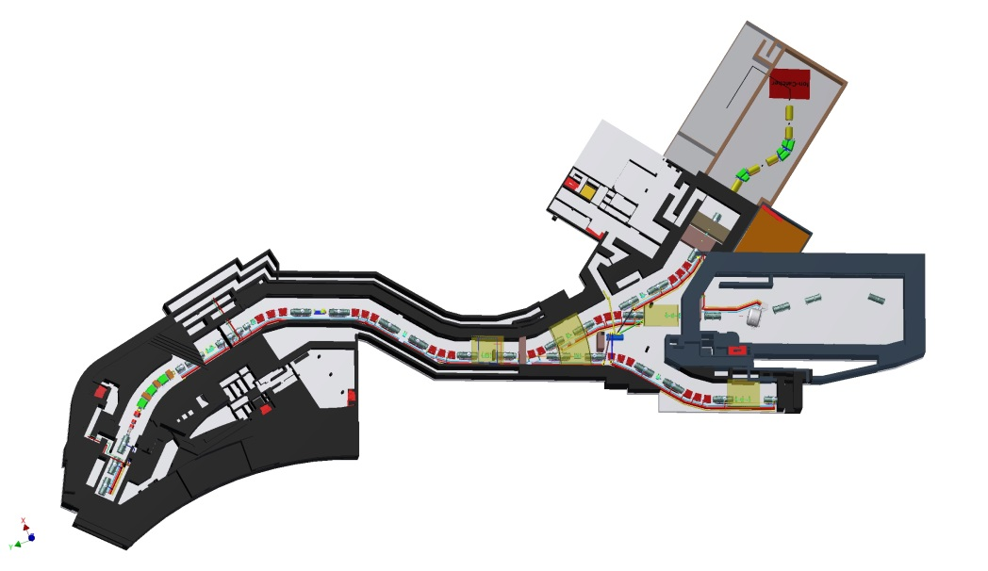
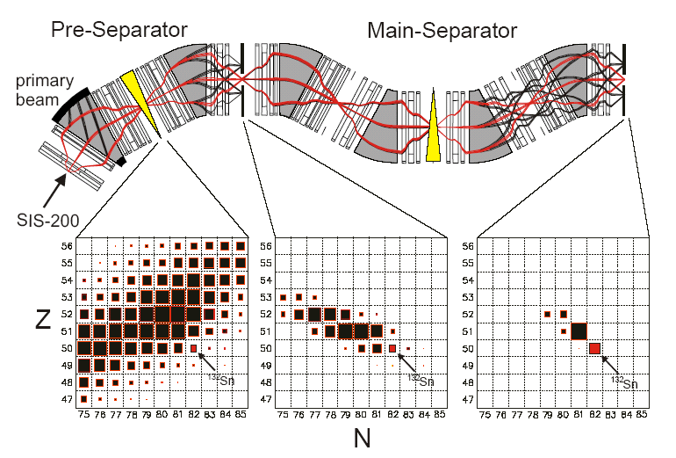
NUSTAR: RIB production and experiments
MATS /
LaSpec
LEB Super-FRS
Selection /
Identification
LEB-Cave
HISPEC/
DESPEC
R³B
Super-FRS collab.
to storage rings
ILIMA, EXL,...
Production
beam

Slide 9
NUSTAR work packages (MSV)
HISPEC/ DESPEC |  |  |  |  |  |  |  |  | !
 | 1.2.2.1 | 1.2.2.2 | 1.2.2.3 | 1.2.2.4 | 1.2.2.5 | 1.2.2.6 | 1.2.2.7.1 | 1.2.2.7.2 | 1.2.2.8 | 1.2.2.9 | 1.2.2.10 | 1.2.2.11 | 1.2.2.13 | 1.2.2.14 | 1.2.2.15 | 1.2.2.16.1 | 1.2.2.16.2 | 1.2.2.16.3 | 1.2.2.17 | 1.2.2.18
MATS
 | 1.2.3.1 | 1.2.3.2 | 1.2.3.3 | 1.2.3.4 | 1.2.3.5 | 1.2.3.6 | 1.2.3.7 | 1.2.3.8.1 | 1.2.3.8.2 | 1.2.3.8.3 | 1.2.3.9 | 1.2.3.10 | 1.2.3.11 | 1.2.3.12 | 1.2.3.13
 | TDR approved
 | TDR submitted
 | TDR in preparation
 | No TDR required
LaSpec
 | 1.2.4.1 | 1.2.4.2 | 1.2.4.3 | 1.2.4.4 | 1.2.4.5 | 1.2.4.7 | 1.2.4.8
LEB/ Super-FRS
 | 1.2.1.1 | 1.2.1.2 | 1.2.1.3
R³B
 | 1.2.5.1.1.1 | 1.2.5.1.1.2 | 1.2.5.1.1.3 | 1.2.5.1.2.1 | 1.2.5.1.2.2 | 1.2.5.1.2.3.1 | 1.2.5.1.2.3.2 | 1.2.5.1.2.4 | 1.2.5.1.2.5 | 1.2.5.1.2.6 | 1.2.5.1.3 | 1.2.5.1.4 | 1.2.5.1.5 | 1.2.5.2.1 | 1.2.5.2.2 | 1.2.5.2.3
ILIMA
 | 1.2.6.1 | 1.2.6.3 | 1.2.6.4 | 1.2.6.5 | 1.2.6.6
41 / 63 TDRs approved/submitted

Slide 10
HISPEC / DeSPEC foreseen instrumentation

Slide 11
AGATA-20 @ FAIR
20 ATCs
Germany 20% = 4 ATCs

Slide 12
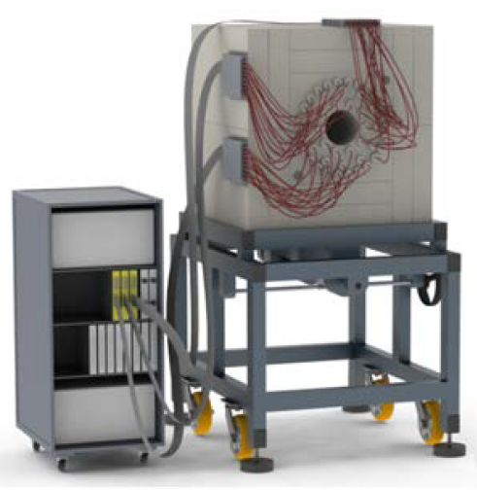
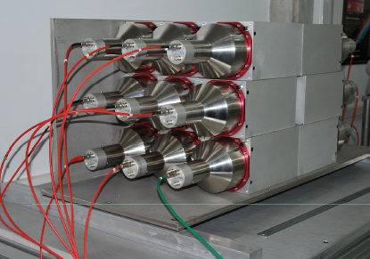
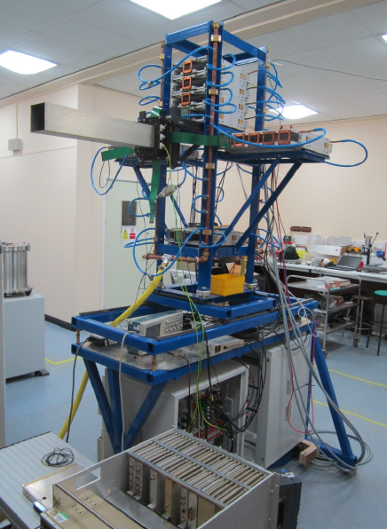
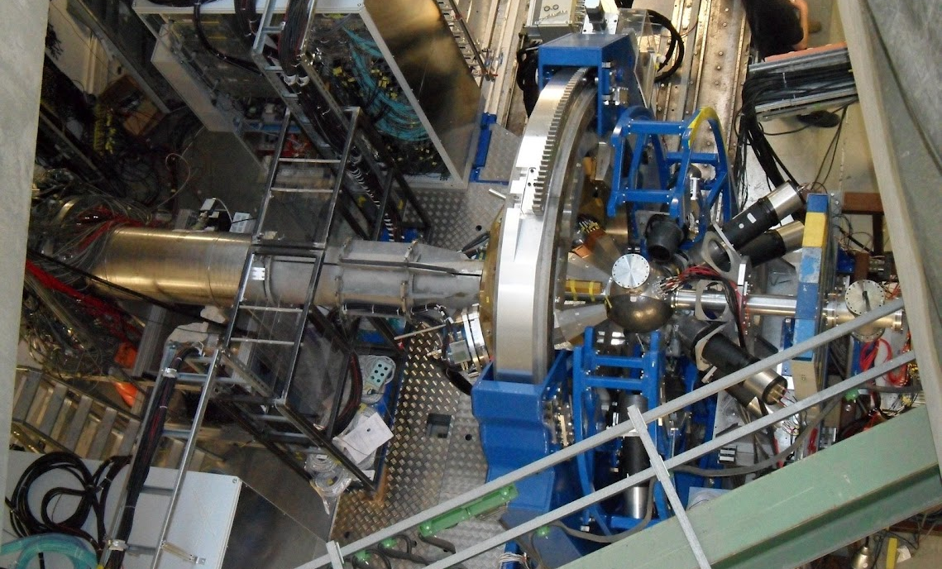
HISPEC/DESPEC: (almost) ready for operation
BELEN
DTAS
LYCCA
AIDA
AGATA

Slide 13
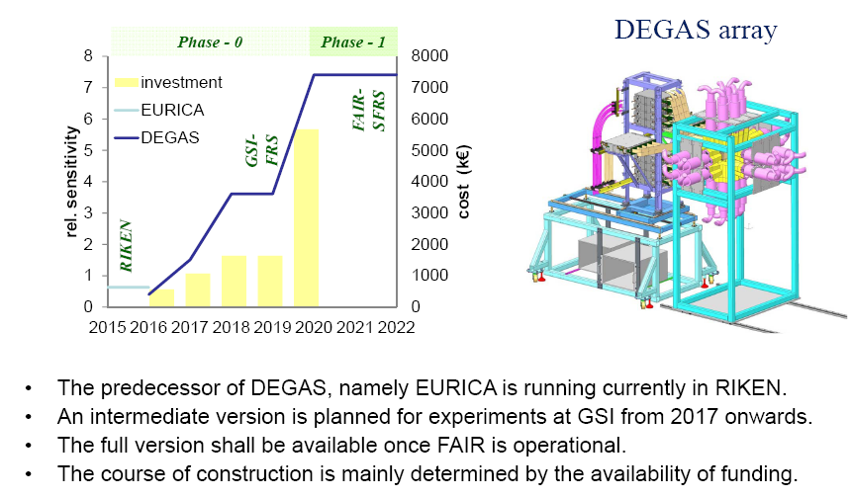
DEGAS – Core device of DeSPEC

Slide 16
GLAD magnet @ CEA Saclay

Slide 17
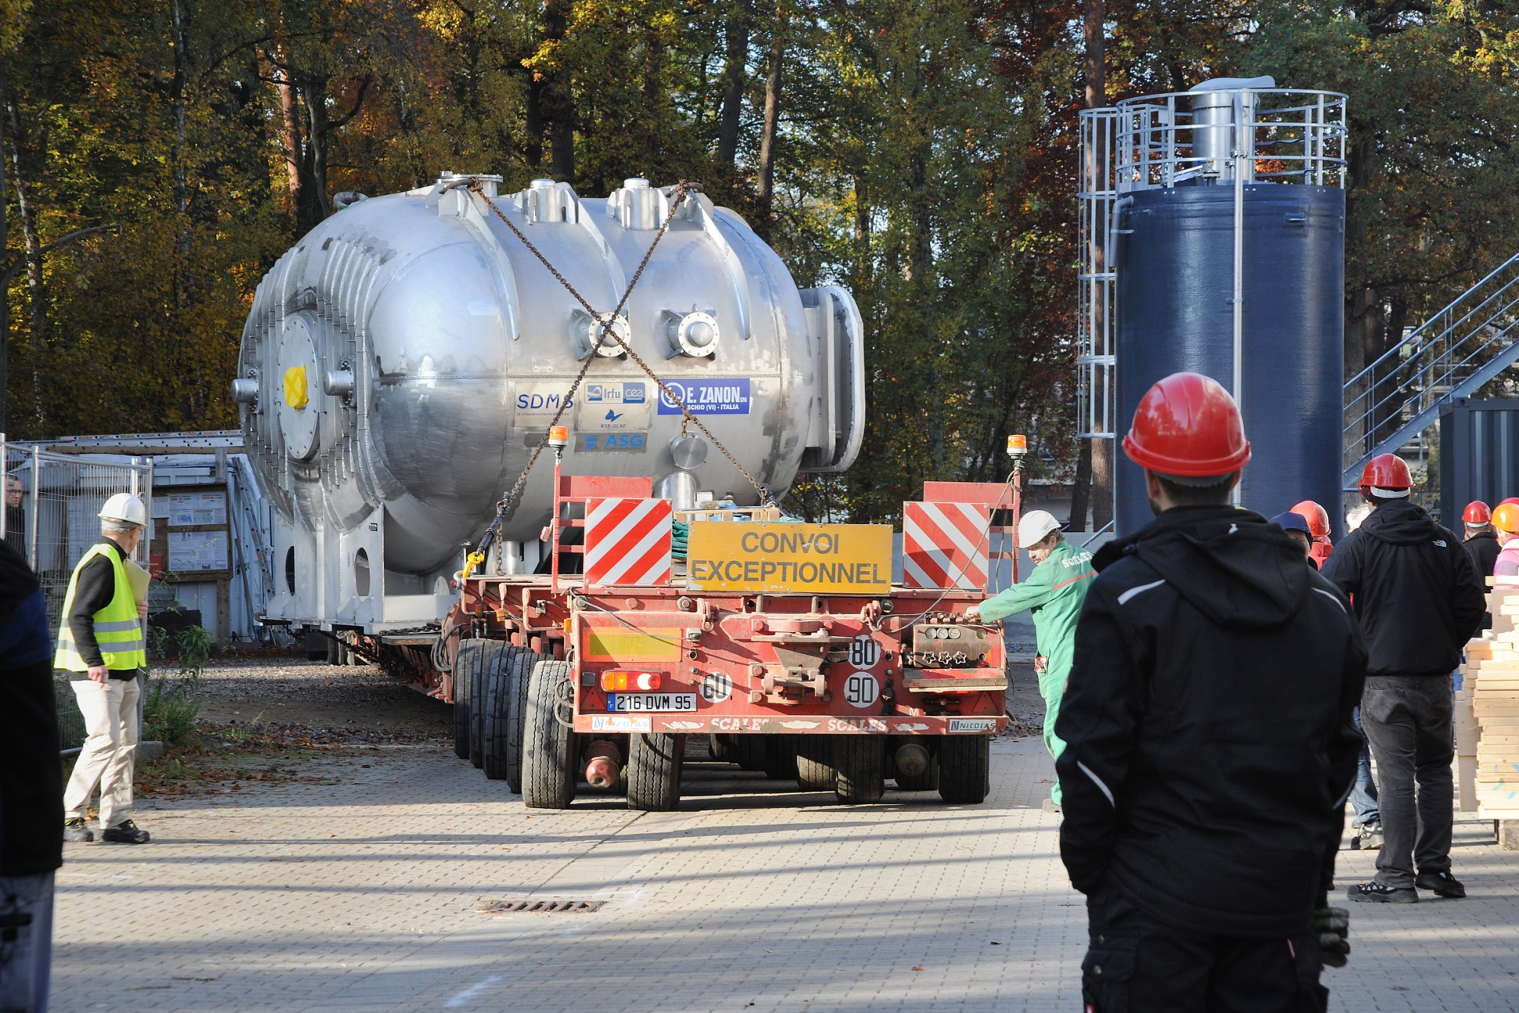
GLAD magnet @ GSI, arrival 4.11.2015
2017/18 Commissioning of full R3B (Cave C)

Slide 18
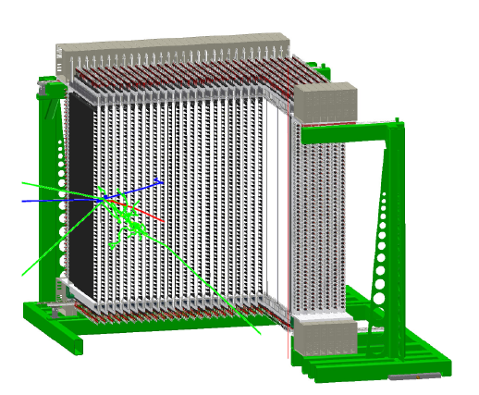
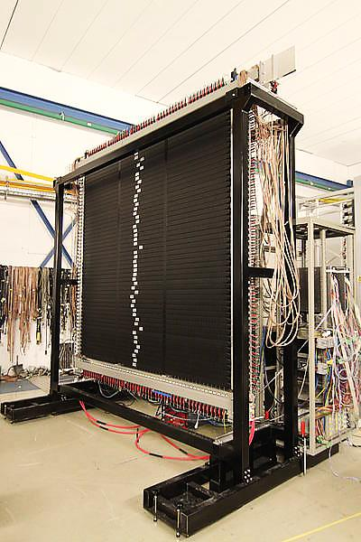
NeuLAND neutron detector
30 double planes
100 x 100 scintillator bars x 30 planes
6000 PMTs
excellent multi-neutron capability
Currently first experiments @ RIKEN

Slide 19
Beyond MSV: Previous NUSTAR @ „NESR“

Slide 20
EXL – Proof of Principle

Slide 21
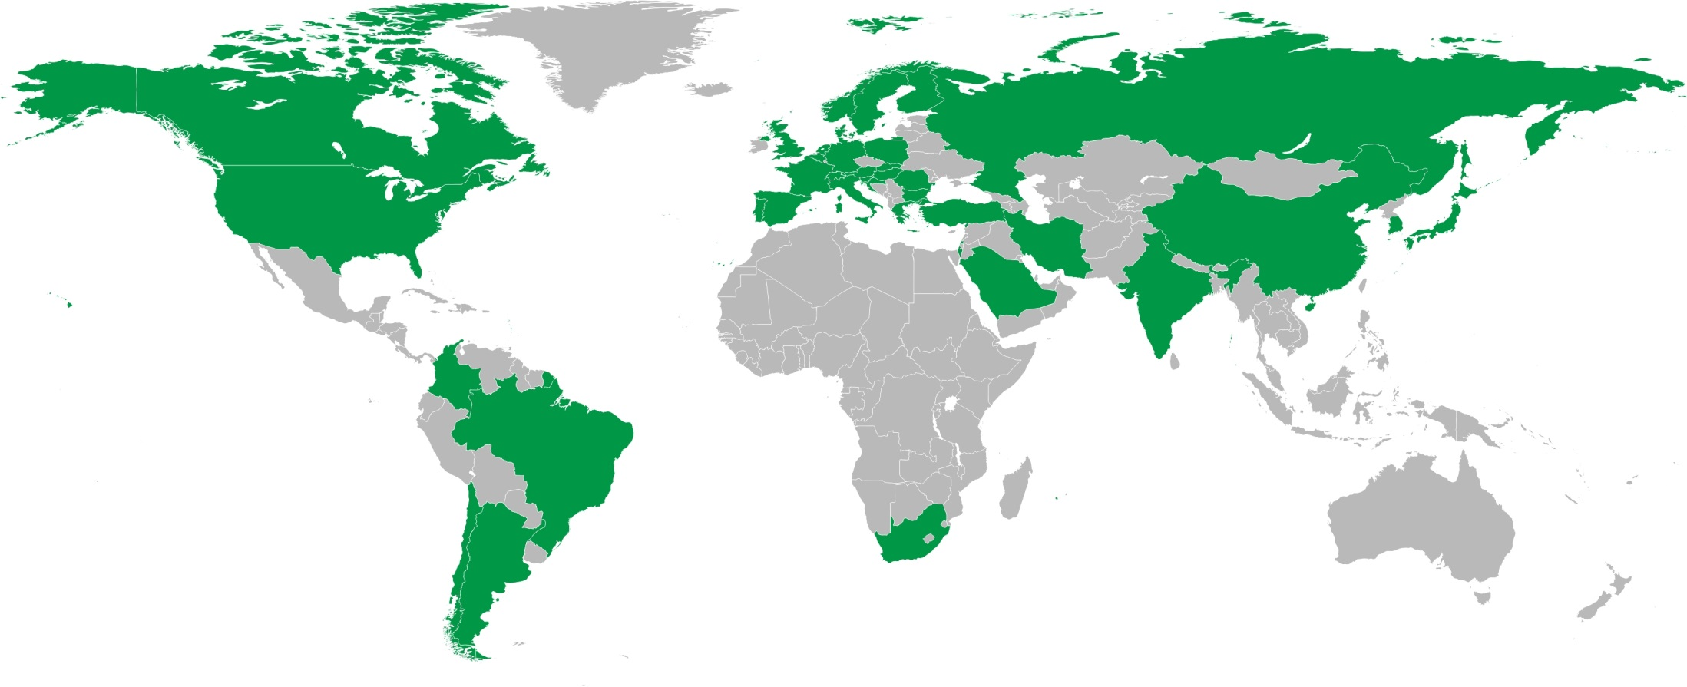
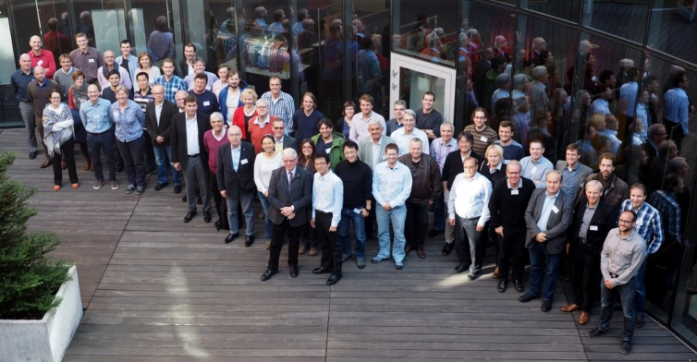
NUSTAR Collaboration
850 registered “interested”
scientists in NUSTAR
database
39 countries and more than 180 institutes
NUSTAR Week 2015, Warsaw

Slide 22
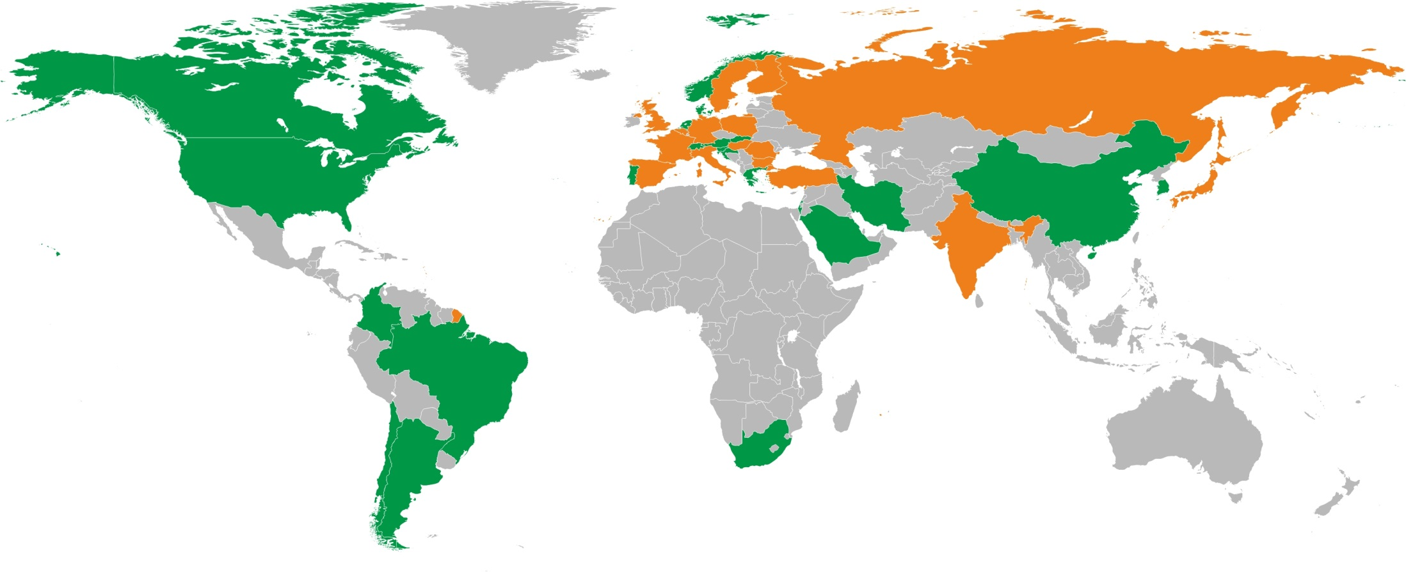
NUSTAR Collaboration – funding
Secured funding and expression of interest in funding
(status: July 2015)
16 countries (incl. 9 FAIR partner countries)

Slide 23
Comparison: funding vs. senior scientists
16 countries
59 institutes
39 countries
>180 institutes
Finland
France
Germany
India
Poland
Romania
Russia
Slovenia
Sweden
UK

Slide 24
NUSTAR experiment funding – phases
MEUR (2005)
Full NUSTAR
Phase 0
Phase 1
Phase 2
Phase 3
July 2015 - iteration within NUSTAR Collaboration ongoing

Slide 25
Scenario for phase 0 and phase 1 operation
2015 | 2016 | 2017 | 2018 | 2019 | 2020 | 2021 | 2022 | 2023
Super-FRS
construction and installation
commissioning
operation
NUSTAR caves
civil construction
Phase 0
Phase 1
NUSTAR experiments
construction and operation „outside“ FAIR
installation
commissioning
Vielen Dank !
operation at FAIR
25

