Slide 1
Planungen für Experimente an der GSI
Midterm Program of Research at GSI
Thomas Stöhlker
GSI-Darmstadt, HI-Jena & University Jena
KHuK Annual Meeting 2015
4-5 December 2015
Physikzentrum Bad Honnef

Slide 2
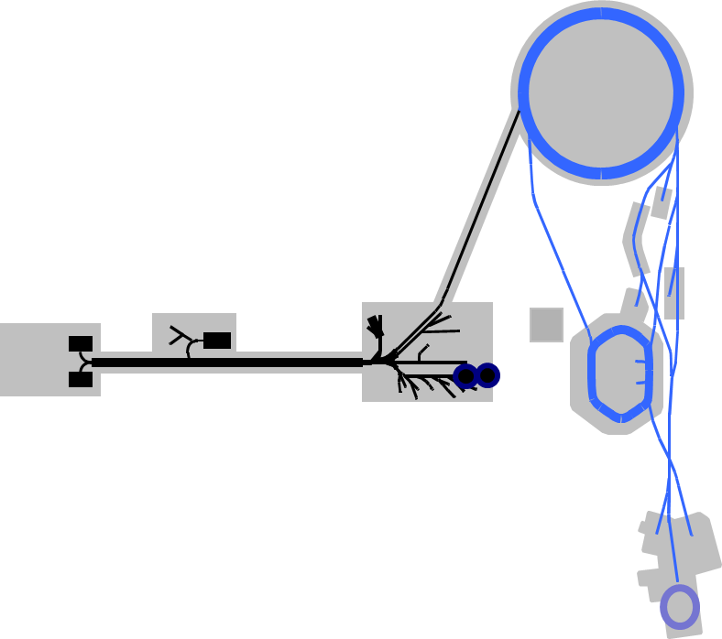
Outline
Anticipated beam time schedule (2016 – 2021)
Midterm Research Opportunities at GSI
  APPA
  NuSTAR
  NQM
  Hadron Physics
Summary
The presentation refers to experiments at GSI and external user facilities only. The Helmholtz Instituts Jena and Mainz are not covered here, since they do not provide research infrastructure related to user operation.

Slide 3
Mid-term research opportunities at GSI
(complemented by external activities)
APPA / MML
ESR-HITRAP- SPARC Atomic physics, strong field QED, atomic collisions, CRYRING border to nuclear physics
M Branch, Z0 BIOMAT Biophysics, heavy ion therapy, Material Science
/ Cave A
HHT/PRIOR WDM/HEDgeHOB Plasma physics, proton radiography
PHELIX WDM/HEDgeHOB Plasma physics, proton acceleration
CBM / MU
HADES CBM/HADES Di-lepton production in pion-induced and HI reactions
ALICE/LHC ALICE Run 2: QGP at highest energy, x3-10 statistics.
Upgrades for Run 3: Pb-Pb at 50 kHz
NUSTAR / MU
FRS NUSTAR Separator-/spectrometer expt.’s with exotic nuclei
FRS-ESR NUSTAR Nuclear physics with exotic beams in a storage ring
HISPEC/DESPEC NUSTAR In-beam and stopped-beam spectroscopy experiments
R3B@SIS18 NUSTAR Reactions with relativistic radioactive beams
SHIP, TASCA NUSTAR Physics and chemistry of SHE
Hadron physics / MU
External PANDA Search for exotic states at BESIII/Beijing/IHEP (since
Institutes 2006) and JLAB/Newport (starting 2015)
Notes:
diverse Änderungen s.o.

Slide 4
Anticipated Beam Times
Beamtime in months:
(total beam time / beam time for experiments)
Call for proposals: beam time at UNILAC in 2016
 | Shifts
To be distributed | 180
Requested | 612

Slide 5
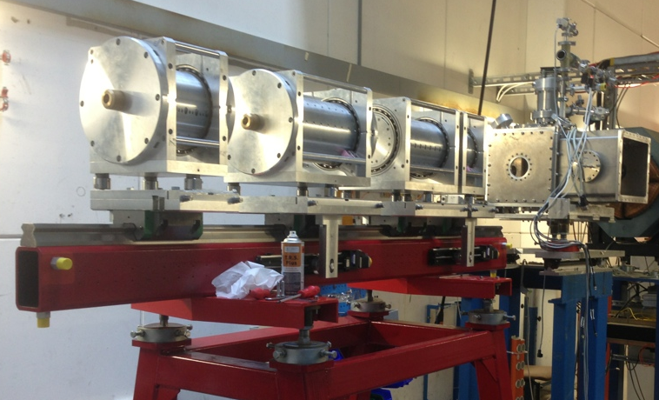
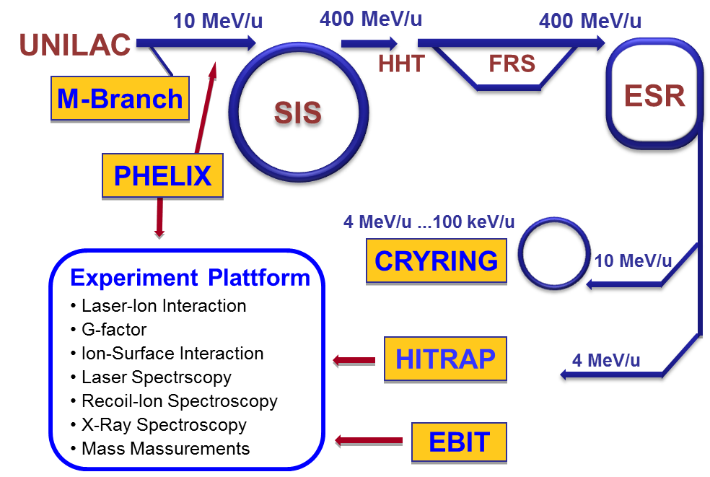
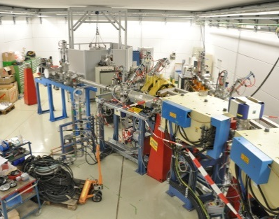
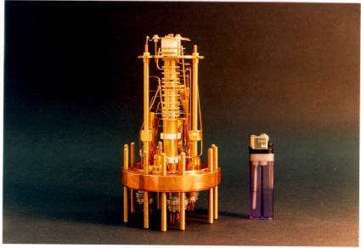
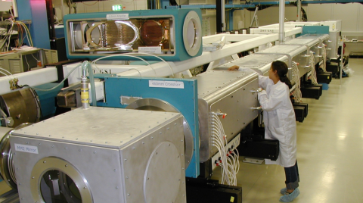
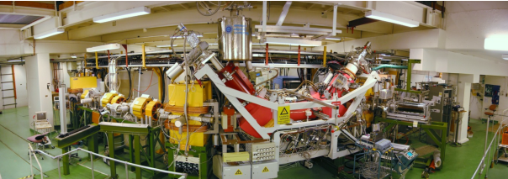
Midterm research progam
Ion Facilities at GSI used by APPA
Since 2009, in operation
New
PRIOR at HHT
M-branch UNILAC
ion trap facility HITRAP
Petawatt laser PHELIX
CRYRING
Serving the user communities / R&D beam experiments for FAIR (2015-2017)
UNILAC, PHELIX, SEBIT, and CRYRING will stay in operation
Serving the user communities / R&D beam experiments for FAIR (2017 and beyond)
UNILAC, PHELIX, SIS18, HITRAP, CRYRING, ESR, CAVE A, CAVE M, HHT

Slide 6
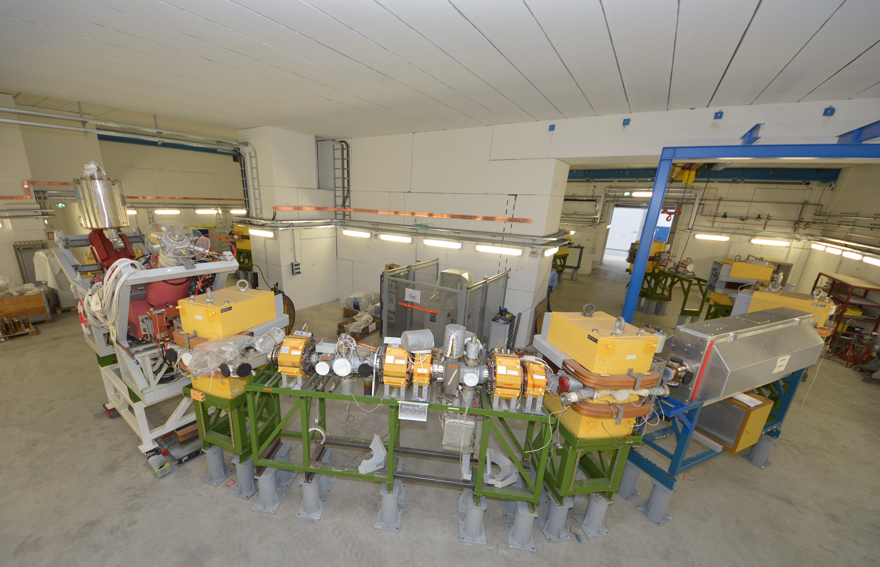
Midterm research program
SPARC/APPA
Novel science opportunities at CRYRING in combination with ESR
Exploiting novel FAIR detector systems already available
Test bench for FAIR controls
CRYRING
Ions at highest charge states but low energies
first beam (expected)............ 2016
circumference ……………………. 54 m
max energy…….…………………. 15 MeV/u
min energy…………………………..300 keV/u
swedish in-kind contribution to FAIR
Commissioning expected
for 2016

Slide 7
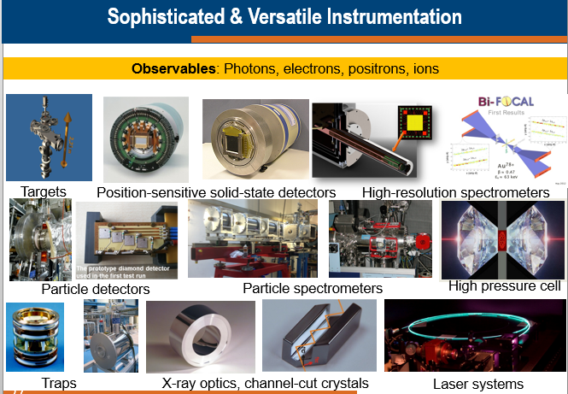
Midterm research program
APPA
Rapid technological advances in fields like laser, optics, x-ray detectors, and biomedical application implies a permanent scrutiny and update of the experimental methods and setups proposed by APPA.
=> beam times at GSI and external facilities are of utmost importance

Slide 8
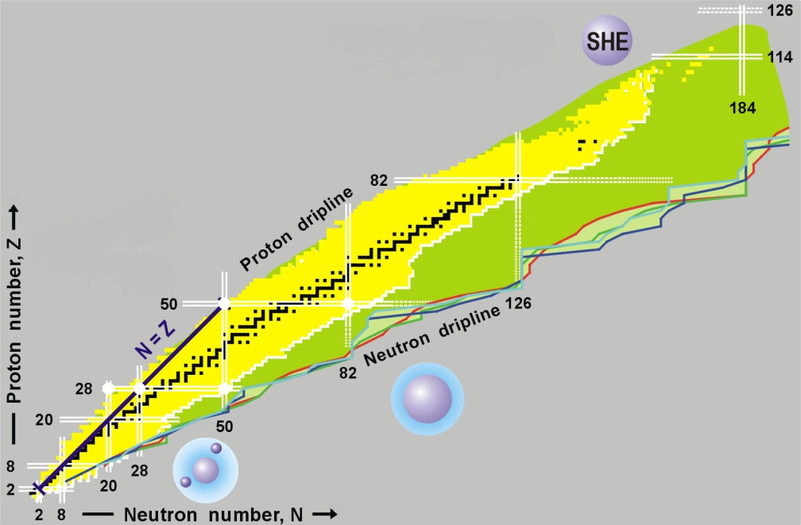
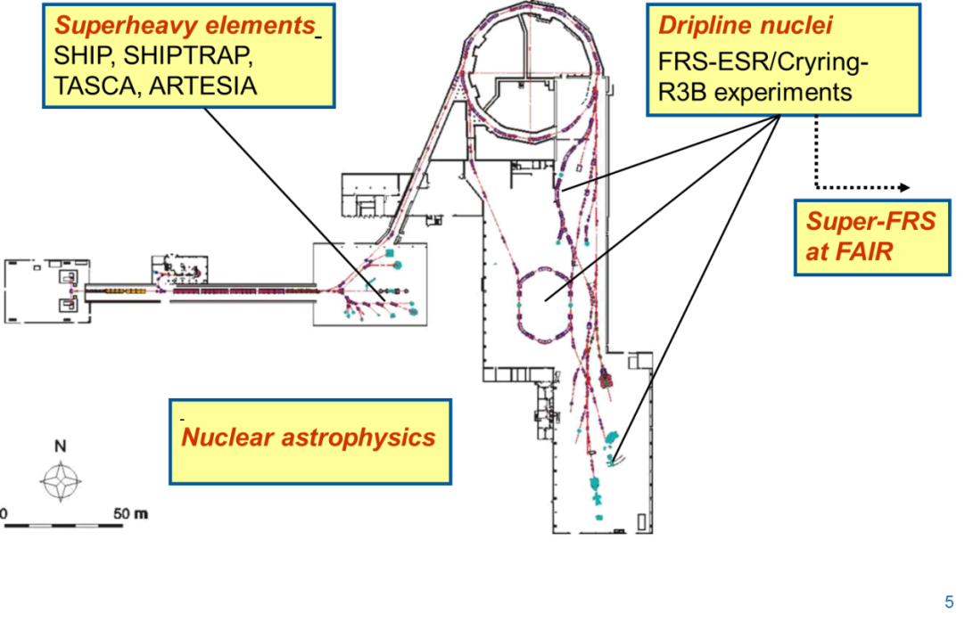
Midterm research program
NUSTAR tasks and goals
1. Setup of NUSTAR-facilities at GSI/FAIR
2. Research program (at GSI/FAIR and elsewhere)
3. User operation for experiments and FAIR-R&D:
UNILAC: SHIP/SHIPTRAP, TASCA/ARTESIA
SIS-18: FRS, ESR-Cryring, Cave C, gamma spectroscopy
SIS-18/100: preparation for Super-FRS
Notes:
....selbsterklärend – oder?

Slide 9

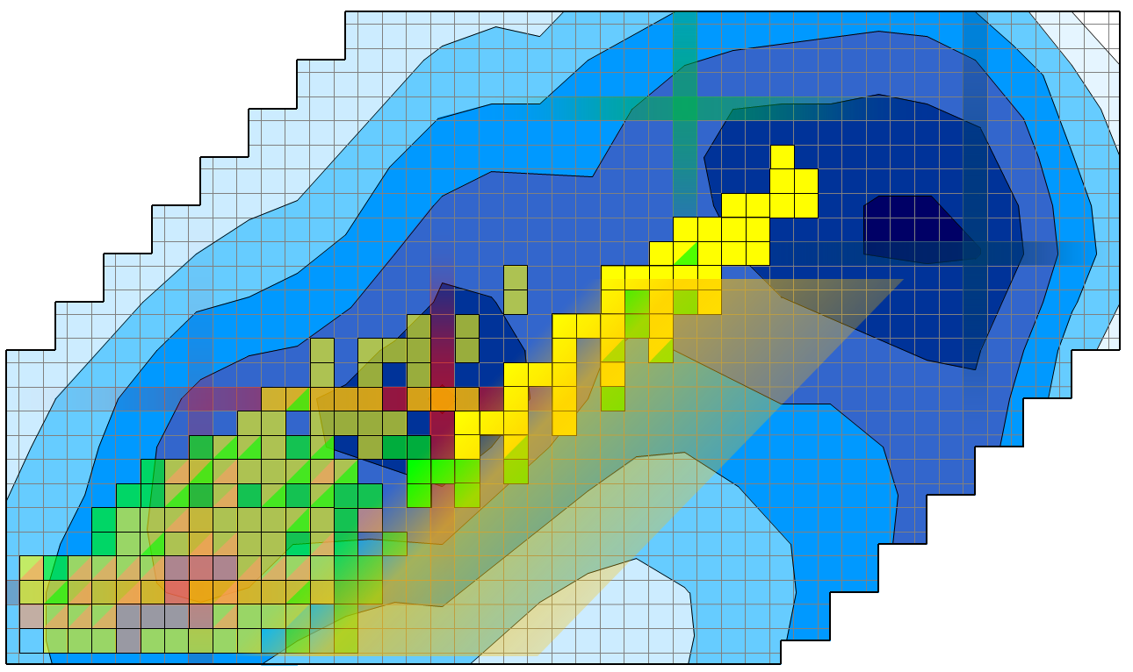
Superheavy Elements: Midterm Program (physics)
Reduced GSI research program, aligned with construction of
① n-rich isotopes to approach "island" center ② n-deficient isotopes: connect to mainland ③ detailed studies of nuclear and atomic properties up to Z ~ 114
120
Z
114
② Fusion reactions
② Fusion reactions
② Fusion reactions
108
Superheavy Elements: Midterm Program (chemistry)
Testing the architecture of the periodic table
Understanding relativistic effects in chemistry
Exploiting chemical Z-selectivity to support element assignments
③ Penning trap studies, α-/γ−spectroscopy ③ ③
SF
① Transfer reactions
184
α
100
β⁺ EC
β⁻
N
152
162
172
Notes:
Lieber Thomas,
anbei einige Ergänzungen zu Christophs Email.
Gruß,
Michael
Erst mal zu den aktuellen Highlights:
Erste Laserspektroskopie jenseits von Z=100, erstmals atomare Übergänge in Nobelium (Z=102) gemessen
Resoanzionisation von Nobelium in Gaszelle (100 mbar Ar) mit hoher Effizienz von etwa 10 % (Gesamteffizienz inkl. Stoppen, Abdampfen etc.!)
Identifikation des 1P1-Zustands in No-252,253,254
Identifikation von Rydberg-Zuständen in No-254, wird präzise Bestimmung des Ionisationspotentials ermöglichen
Messung der Hyperfeinstruktur (HfS) in No-253
verfügbare Raten 1-5 / s
Mittelfristig werden wir daher folgende Themen verfolgen:
Laserspektroskopie auf schwere Elemente auszudehnen, nächster Schritt Lawrencium (Z=103)
Tests von QED und Elektron-Korrelationen in schwersten Elementen jenseits von Uran
Untersuchungen der HfS der schwersten Elemente, Messungen zur Isotopie-Verschiebung um Spins, magnetische Momente, Quadrupolmomente und Änderungen in Ladungsradien zu bestimmen (unabhängig von bestimmten Kernmodellen)
Direkte Massenmessungen mit SHIPTRAP für Nuklide im Bereich Z=100-106, N=152
Fallen-unterstützte Zerfalls-Spektroskopie: Fallen zur Selektion der Nuklide (Isomere)
Ankerpunkte, um Zerfallsketten anzubinden, Festlegung der Massenoberfläche
Untersuchung der Entwicklung der Schalenstruktur und Bestimmung von Schalenstärken (z.B. bei N=152 für verschiedene Z)
Kernspektroskopie (alpha/CE – gamma /CE) zur Detailuntersuchung der Struktur schwerster Kerne Z = 100-110, N =152/162.
Entwicklung der Schalenstruktur und Deformation, Identifizierung und systematische Untersuchung der Systematik ihrer Anregungsenergie innerhalb von Isotonenreihen (gerades Z) oder Isotopenreihen (ungerades Z); Untersuchung kollektiver Zustände (Rotations-, Vibrationszustände), Untersuchung von Multi-Quasiteilchen-Zuständen (K – Isomere)
Untersuchung der Zerfallsmodi (alpha, EC, sf) schwerster Kerne, Q-Wert – Bestimmungen, Spaltenergie – Messungen zur Erforschung der Grenzen der Stabilität
Direkte Z – Identifizierung über den alpha – Zerfall oder den EC begleitende (K-) Röntgenstrahlung
Für alle Aktivitäten gilt nach als Ziel der Test und die Verbesserung theoretischer Modelle

Slide 10
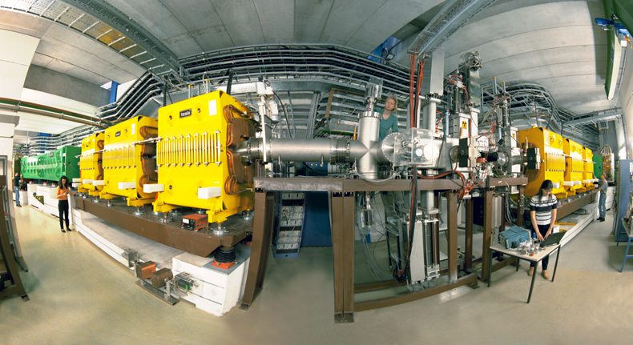
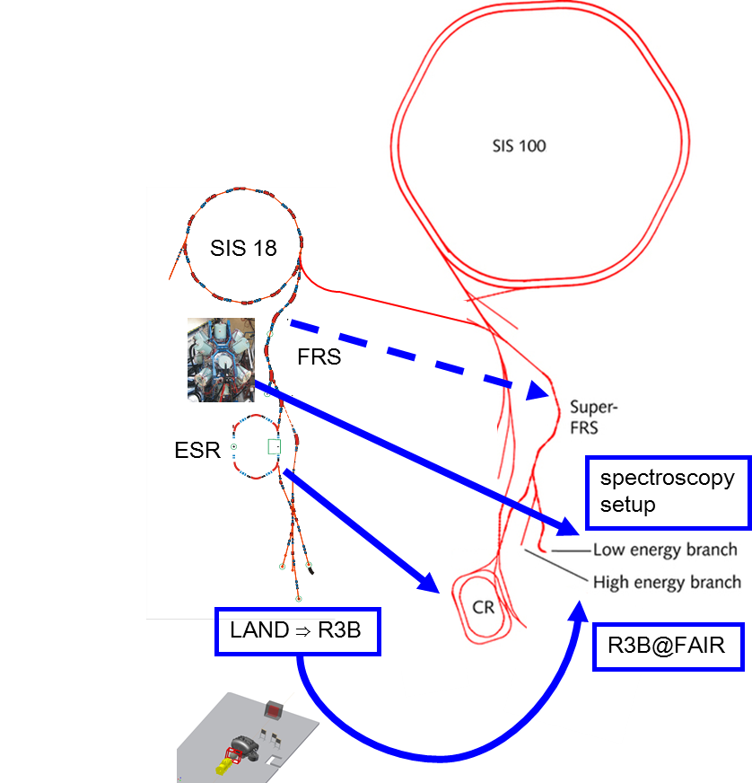
Midterm research program
NUSTAR@SIS program 2015-2022
NUSTAR phase-0: experiments with FAIR detectors (at GSI and elsewhere)
Concentrate on:
  selected scientific key questions
  “GSI-only experiments” (beams,
  energy range, instruments)
  use of NUSTAR-FAIR equipment
  ... yielding a continuous transition to:
NUSTAR phase-1: experiments at Super-FRS
Notes:
The overall strategy of NUSTAR is a continuous, modular, stepwise approach towards NUSTAR@FAIR.
The intermediate program („NUSTAR phase-0“) builds on the first use and exploitation of FAIR detectors in pilot experiments at the FRS (and to some limited extent: elsewhere – e.g. for tests, commissioning, debugging – and of course: finally demonstrator measurements e.g. at RIKEN [z.B. NeuLAND])
These pilot experiments allow for a resource-limited high-level programme: it concentrates on scientific key questions and high-lights, „GSI-only“ experiments (beams, energies,...) and – by definition – the first use of NUSTAR-FAIR equipment.
When Super-FRS will be completed, all equipment will be moved to FAIR and is immediately ready for first physics with more intense beams from FAIR!!!

Slide 11
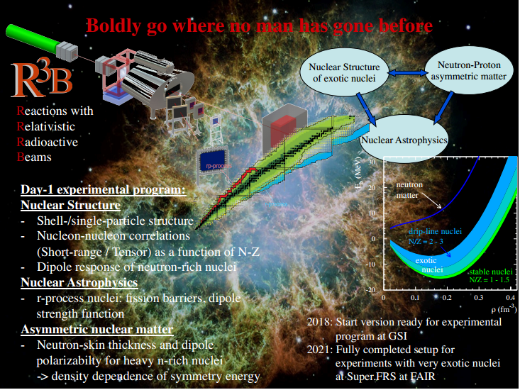
Midterm research program
NUSTAR / R³B
Notes:
As an example, we would like to mention the R3B setup: this is one of the main FAIR experimental setups (located at the High-Energy Branch of Super-FRS), which will be available in 2017, at least in its start version: GLAD (super-conducting large-aperture dipole magnet), NeuLAND (neutron detector for ToF-measurements, especially suited for neutron mutli-hit capabilities), and CALIFA (target calorimeter) and some more (ancillary) detectors are currently set-up in Cave-C and can be used for a new quality of experiments. Unprecedented measurements, not possible elsewhere in the world, will become feasible with exotic nuclei. These are reaction studies on n-rich isotopes (high A/Z) at highest beam energies (~GeV/u), where high magnetic rigidities are required (not possible with existing setup ALADIN-LAND!). A list of possible high-light experiments are depicted here.....

Slide 12
Superconducting R³B Dipole GLAD arrived at GSI
GLAD in the target hall at GSI
Vacuum test successful
Transport and installation at Cave C scheduled for 2016
Commissioning und first tests 2016/17
In 2018 , start of physics program with GLAD
using beams from SIS18 and FRS Strahlen at 1 GeV/u

Slide 13
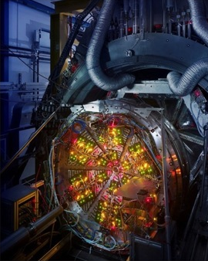
HADES physics program at SIS18
  Unique opportunity by combining a
  high-acceptance di-electron spectrometer with pion beams
Role of the meson cloud in the emissivity of (dense) baryonic matter
  Baryon-resonance electromagnetic form factors .................................................. π / (p) + p
  ρ-meson nucleon coupling ................................................ π / (p) + p
  In-medium vector meson
  propagation ....... (high intensity) ......... π / (p) + A
  Thermal radiation .................................... A + A
Strangeness production and propagation
  Production of multi-strange baryons
  and φ-mesons.................................... A + A
  Exclusive channels of e.g. Ξ decay ...... p+d
Includes important reference measurements for CBM

Slide 14
Excellent prospects for HADES operation with pion beams in 2018
Detector Upgrades
  HADES em-calorimeter
  enables measurement of neutral mesons
  em decays of (strange) baryon resonances
  improved pion suppression for di-electron physics
  recycles OPAL calorimeter
  MAPMT UV photo detector module compatible with HADES
  Compatible with HADES and CBM RICH system
  Jointly developed between CBM and HADES RICH-groups
  Improved rate capability and photo detection efficiency for HADES RICH
  New forward detection system
  under study, based on PANDA pre-series detectors
Accelerator upgrade
  Improved radiation shielding
  New extraction scheme
  5 10⁵ π on HADES target per spill

Slide 15
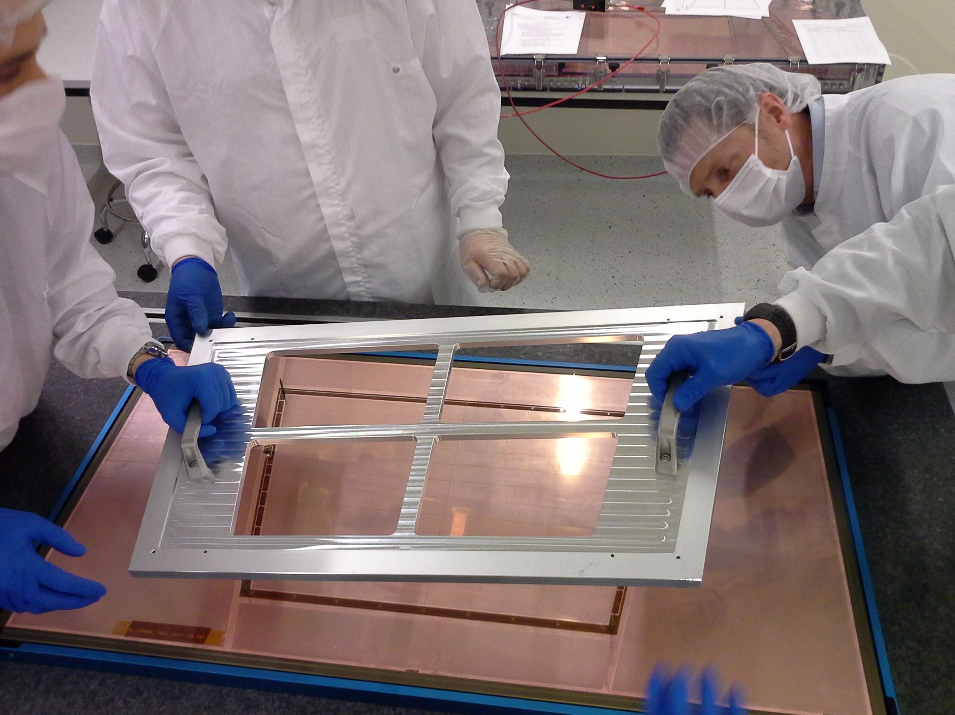
Midterm research program
ALICE – Upgrades for Run 3: Pb-Pb at 50 kHz
HGF application for investment funds jointly with DESY and KIT:
“Detectors for the full scientific exploitation of the
Large Hadron Collider”
4.2 MEUR requested by GSI for the ALICE upgrades.
GSI contribution:
Time Projection Chamber Upgrade TDR approved by LHCC and Upgrade Cost Group
  GEM framing
  Construction of 50% of Outer Read-Out Chambers (OROC)
Online-Offline Computing System O² TDR approved by LHCC and UCG
  both ALICE group and IT Scientific Computing (relevant for FAIR computing)

Slide 16
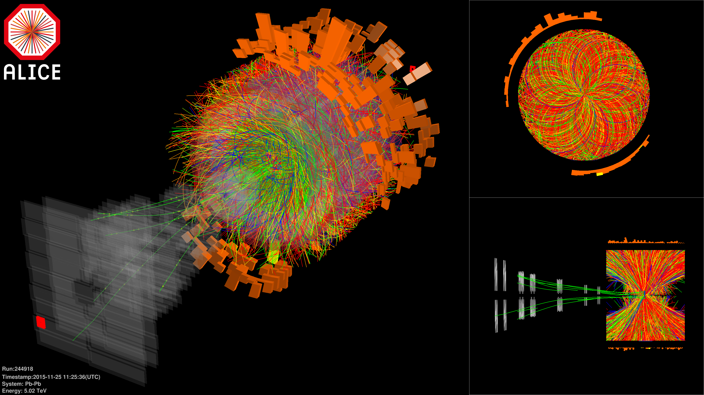
ALICE @ LHC: Pb-Pb collisions at √s_{NN} = 5.02 TeV
Data taking started on November 25
LHC design HI luminosity of 10²⁷ s⁻¹cm⁻² since December 1
Increase of statistics by a factor of 3-10 (probe, centrality, ...)

Slide 17
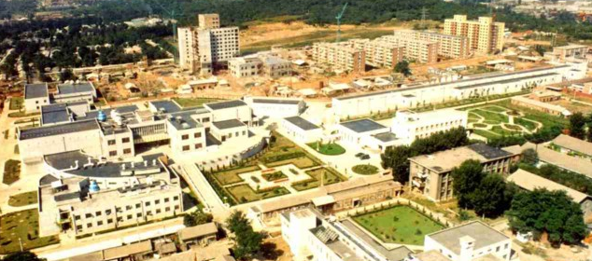
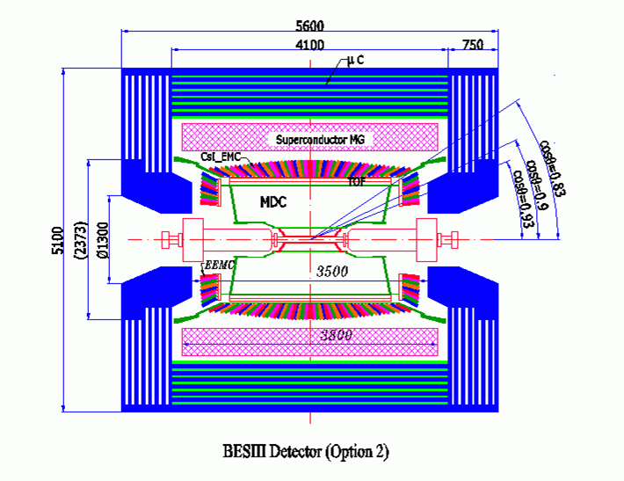
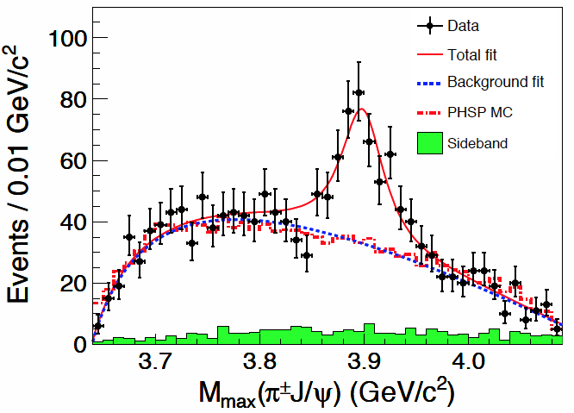
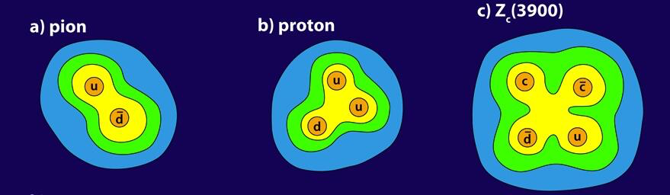
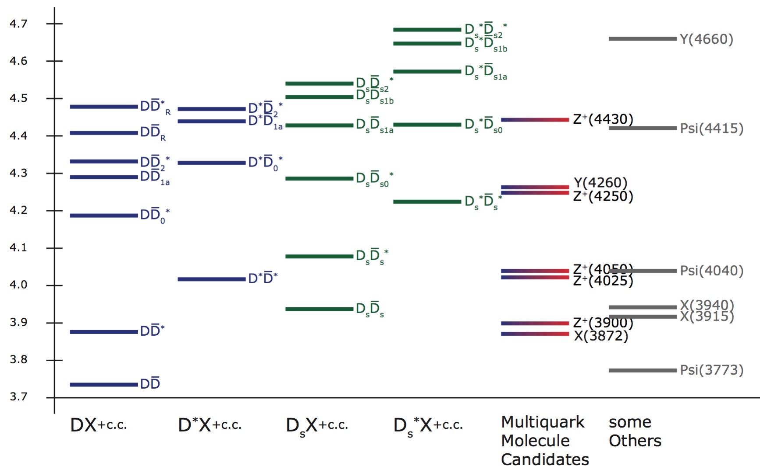
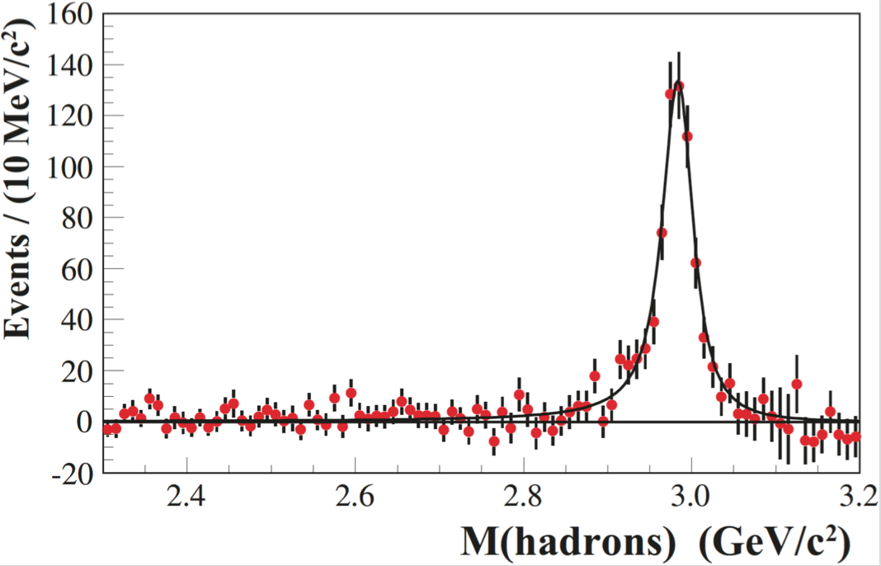
Midterm research program
GSI Hadronphysics on the way to FAIR
Search for Exotics at BESIII/Beijing/IHEP (since 2006)
Together with
BES e⁺e⁻ collisions
search for charm exotics (GSI) and electromagnetic physics (HIM)
LINAC
BESIII
BEPCII
IHEP, Beijing
next steps:
detailed studies and new states
investigate more DD^{(*)}_{(s)} thresholds
analyze final states involving η_{c} to
search for ground-state 4-quarks
APS: Z_{c}(3900)
Top 10 Physics News
Result in Physics 2013
Together with
FOR2359 (U Bo,U F,U Gi)
and SFB1044 (U Mz)
4-quarks …
this is as pioneering as the
discovery of the proton and the pion

Slide 18
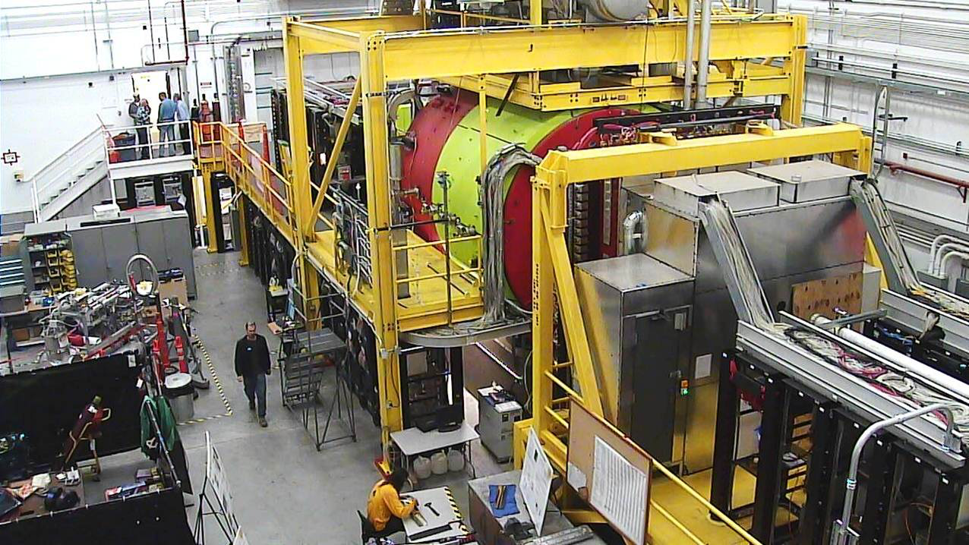
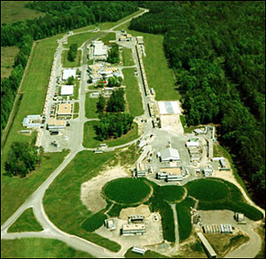
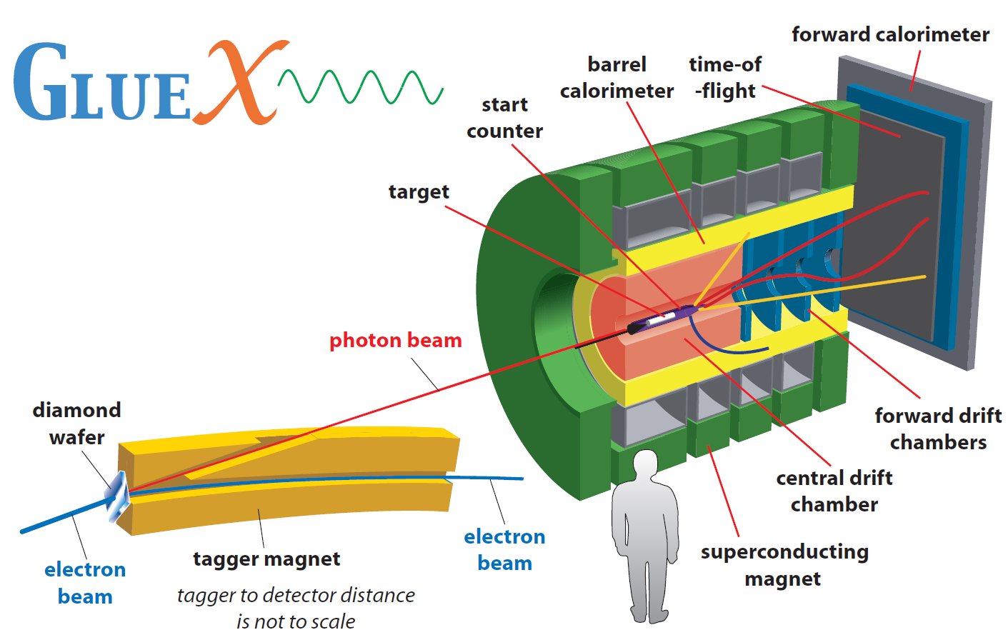
Midterm research program
GSI Hadronphysics on the way to FAIR
Search for Exotics at JLAB/Newport News (since 2015)
Hall-D (up to 12 GeV)
search for light hybrids in photo-production
GlueX,
finished 2014
participation in construction of the DIRC (together with MIT)
develop and improve partial wave amplitude analysis techniques
→ toolkit for PANDA
analysis of channels with strangeness open and hidden strangeness (ccbar-partner states)
→ search for multi-quarks?
1st physics beam time
→ spring 2016
Jefferson Lab,
Newport News

Slide 19
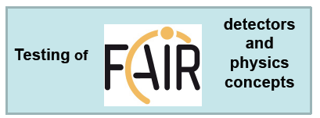
Midterm research program
beam time at GSI and external institutes
  serving the user communities and collaborations
  keeping scientific visibility (publications, conferences)
  education of young scientists
  maintaining technical expertise
  testing detectors, concepts
essential needs
  not excessive but SECURED funding (including resources for personnel)
  operation of accelerators (SIS18 and UNILAC)
  maintaining performance of existing infrastructure
  technical infrastructure: IT, laboratories, support people
  participation in national and international activities
  support of fund raising activities
  promotion of young scientists / postdocs

Slide 20
Midterm research program
Thank you for your attention !

