Slide 1

Antimatter with Heavy-Ion Beam
Zhangbu Xu
Introduction & Motivation
Evidence of first antihypernucleus
  and signal (for discovery)
  Mass and Lifetime measurements
What can we do with the discovery?
  Yields as a measure of correlation
  A case for RHIC energy scan
Outlook and Summary

Slide 2
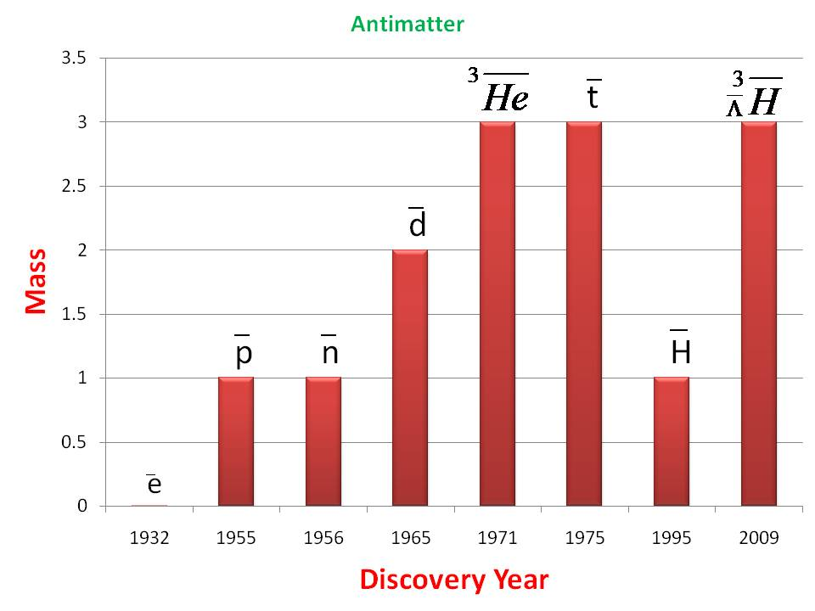

Antimatter
“Those who say that antihydrogen is
antimatter should realize that we are
not made of hydrogen and we drink
water, not liquid hydrogen”
-- Dirac
Quoted from A. Zichichi (2008)
Antiparticles and antimatter:
the basic difference

Slide 3
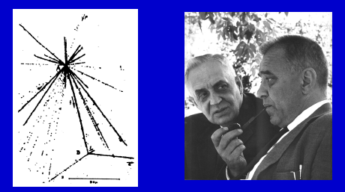
What are hypernuclei（超核）?
Nucleus which contains at least one hyperon in addition to nucleons.
Hypernuclei of lowest A
Y-N interaction: a good window to
understand the baryon potential
Binding energy and lifetime are
very sensitive to Y-N interactions
Hypertriton: ΔB=130±50 KeV; r~10fm
Production rate via coalescence
at RHIC depends on overlapping wave
functions of n+p+Λ in final state
Important first step for searching for
other exotic hypernuclei (double-Λ)
The first hypernucleus was discovered by Danysz and Pniewski in 1952. It was formed in a cosmic ray interaction in a balloon-flown emulsion plate.
M. Danysz and J. Pniewski, Phil. Mag. 44 (1953) 348
No one has ever observed
any antihypernucleus before RHIC
Notes:
3

Slide 4
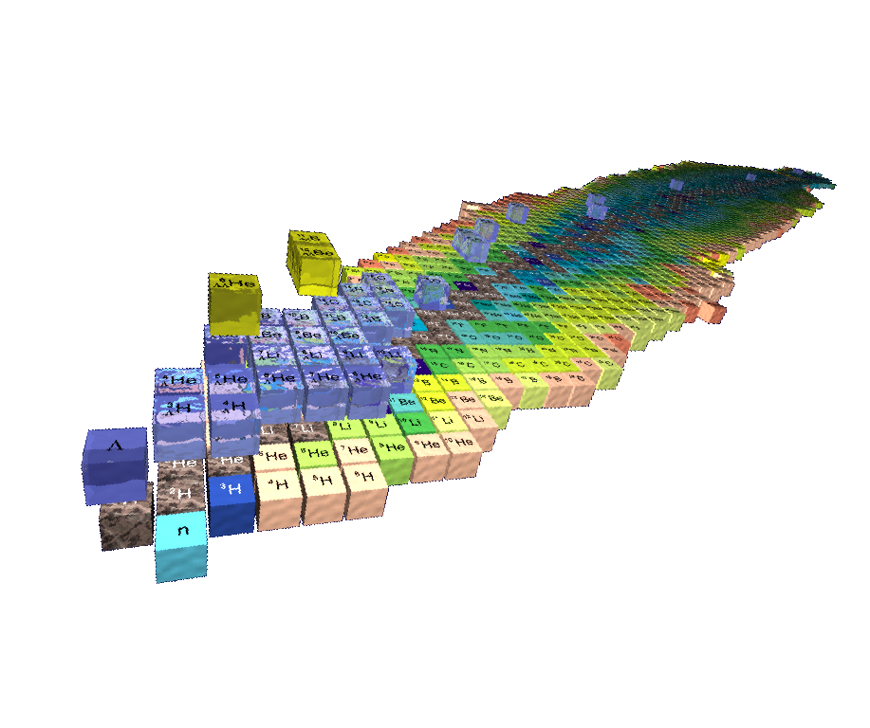
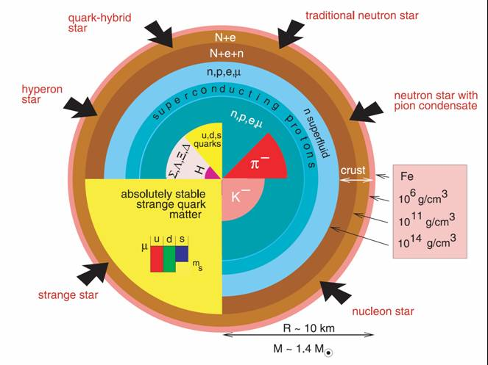
from Hypernuclei to Neutron Stars
      hypernuclei Λ-B Interaction Neutron Stars
S=-2
S=-1
S=-0
Saito, HYP06
Several possible configurations of Neutron Stars
  Kaon condensate, hyperons, strange quark matter
Single and double hypernuclei in the laboratory:
  study the strange sector of the baryon-baryon interaction
  provide info on EOS of neutron stars
J.M. Lattimer and M. Prakash,
"The Physics of Neutron Stars", Science 304, 536 (2004)
J. Schaffner and I. Mishustin, Phys. Rev. C 53 (1996):
Hyperon-rich matter in neutron stars

Slide 5
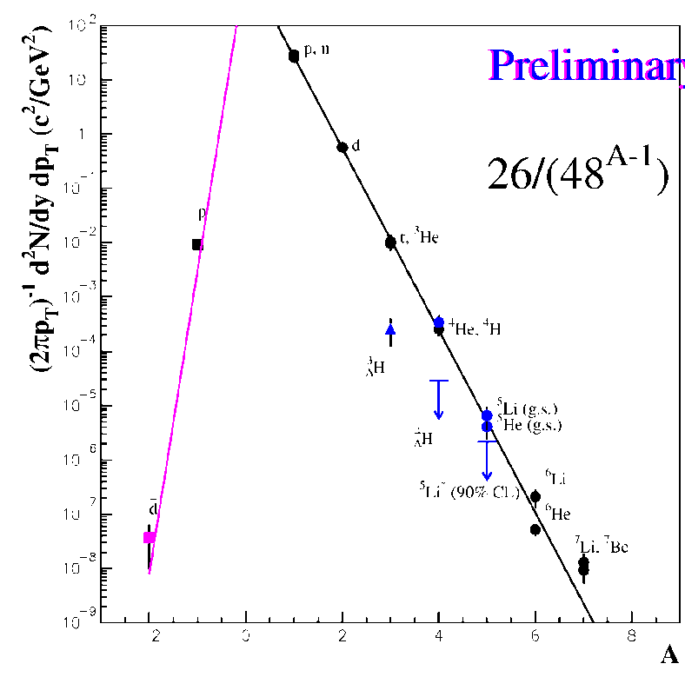
Can we observe hypernuclei at RHIC?
Low energy and cosmic ray experiments (wikipedia):
hypernucleus production via
  Λ or K capture by nuclei
  the direct strangeness exchange reaction
  hypernuclei observed
  energetic but delayed decay,
  measure momentum of the K and π mesons
|
In high energy heavy-ion collisions:
  nucleus production by coalescence, characterized by penalty factor.
  AGS data^{[1]} indicated that hypernucleus production will be further suppressed.
  What’s the case at RHIC?
聚并
Z.Xu, nucl-ex/9909012
[1] AGS-E864, Phys. Rev. C70,024902 (2004)
Notes:
5

Slide 6
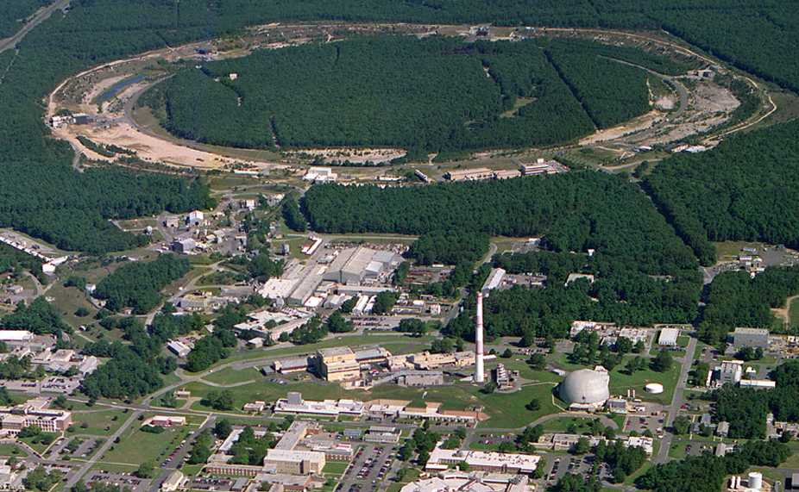
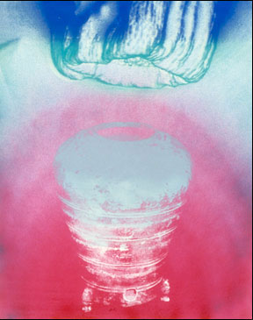
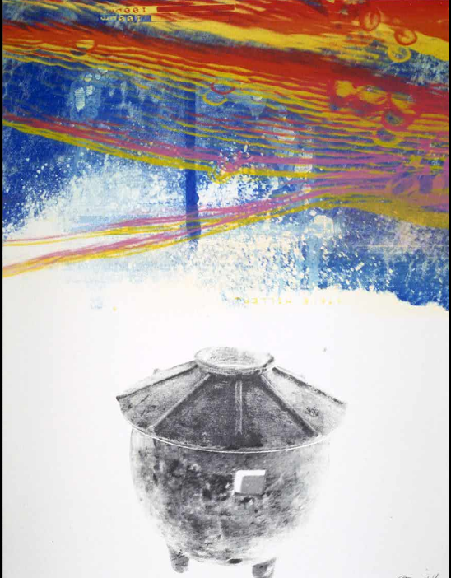
Relativistic Heavy Ion Collider (RHIC)
PHOBOS
BRAHMS
RHIC
PHENIX
STAR
v = 0.99995⋅c = 186,000 miles/sec
Au + Au at 200 GeV
AGS
TANDEMS
Animation M. Lisa

Slide 7
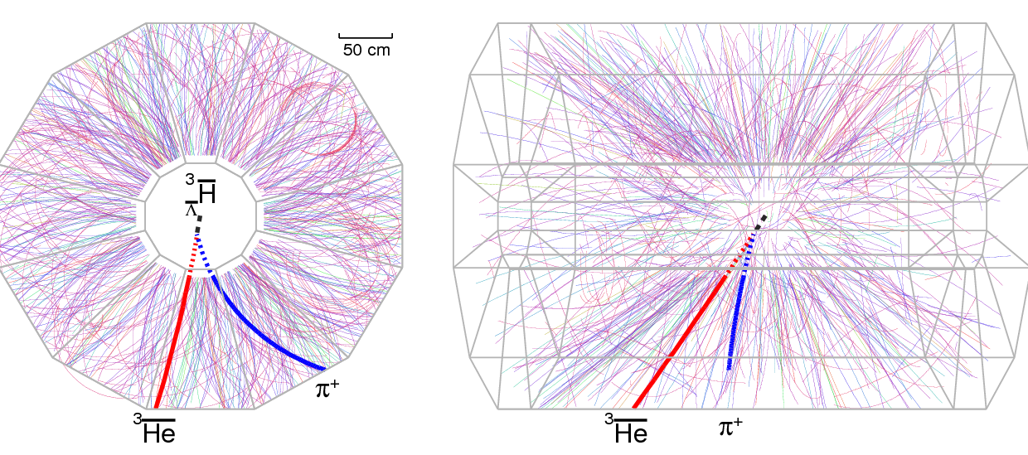
A candidate event at STAR
Run4 (2004)
200 GeV Au+Au collision
STAR talks:
J.H. Chen, QM09
J.H. Chen, HYP09
Z.B. Xu, RHIC/AGS 09

Slide 8
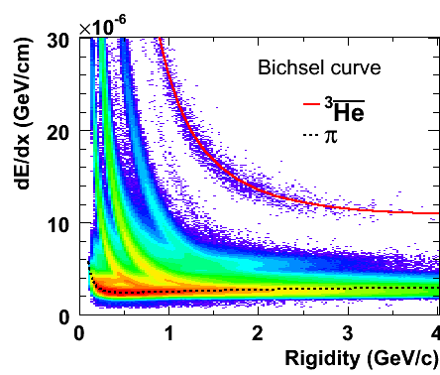

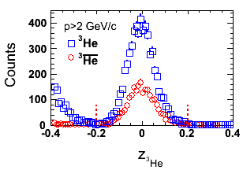
³He & anti-³He selection
Select pure ³He sample: -0.2<Z<0.2 & dca <1.0cm & p >2 GeV
  ³He: 2931(MB07) + 2008(central04) + 871(MB04) = 5810
  Anti-³He: 1105(MB07) + 735(central04) + 328(MB04) = 2168

Slide 9
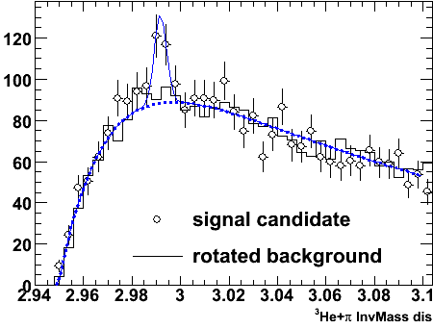
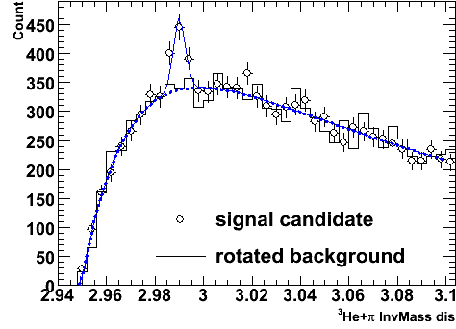
and Combined signals
Combine hypertriton and antihypertriton signal:
225±35
Signal observed from the data (bin-by-bin counting):
70±17;
Mass: 2.991±0.001 GeV; Width (fixed): 0.0025 GeV;
This provides a >6σ signal for discovery

Slide 10
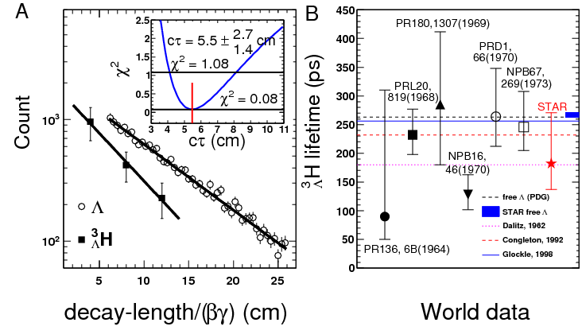
Comparison to world data
Lifetime related to binding energy
Theory input: the Λ is lightly bound in the hypertriton
[1] R. H. Dalitz, Nuclear Interactions of the Hyperons (Oxford Uni. Press, London, 1965).
[2] R.H. Dalitz and G. Rajasekharan, Phys. Letts. 1, 58 (1962).
[3] H. Kamada, W. Glockle at al., Phys. Rev. C 57, 1595(1998).

Slide 11
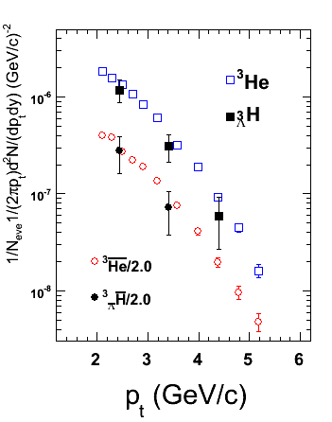
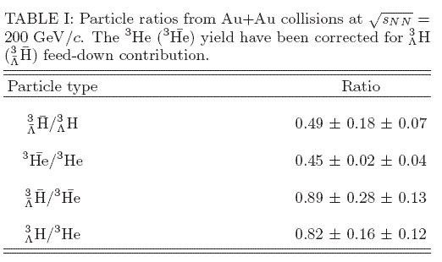
Measured invariant yields and ratios
STAR Preliminary
In a coalescence picture:
0.45 ~ (0.77)³

Slide 12
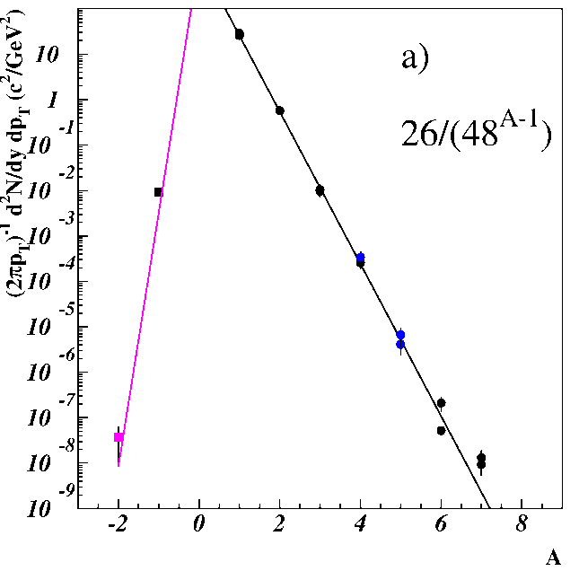
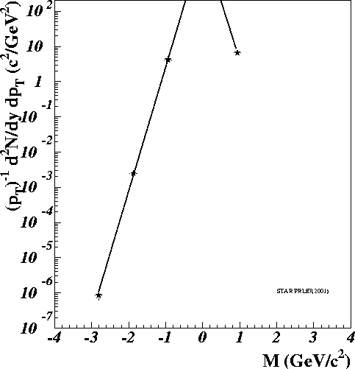
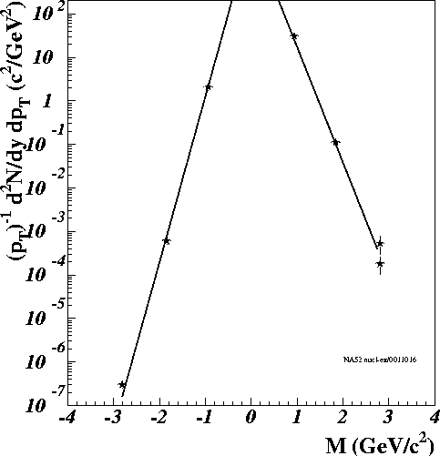
Matter and antimatter are not created equal
But we are getting there !
物质和反物质造而不平等
(AGS,Cosmic)
AGS
RHIC
SPS
STAR PRL 87(2003)
NA52
Nucl-ex/0610035

Slide 13
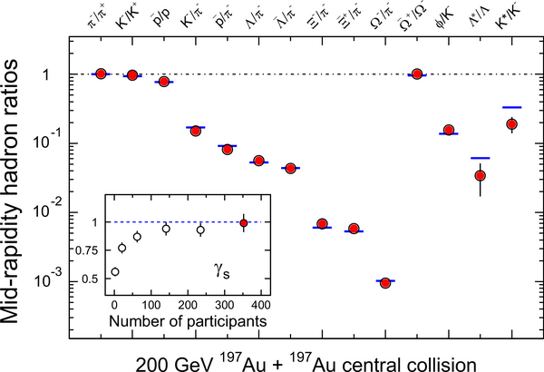
Flavors (u,d, s) are not created equal except in possible QGP
J. Rafelski and B. Muller, Phys.Rev.Lett.48:1066,1982
STAR whitepaper, NPA757(2005)

Slide 14
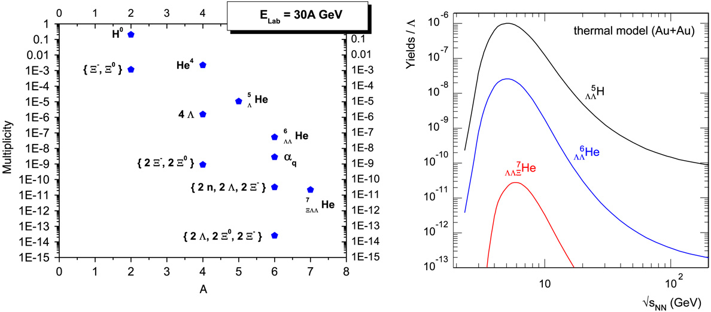
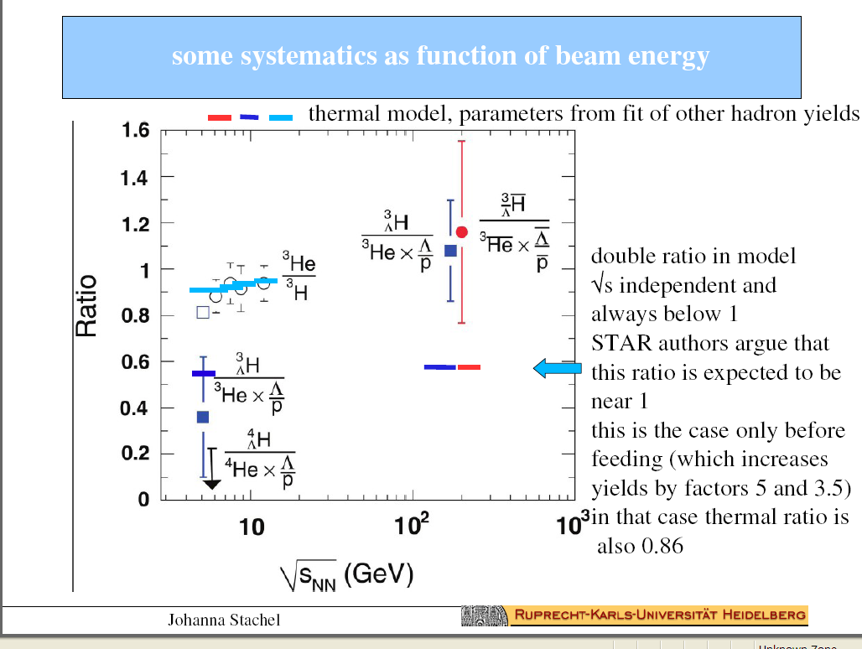
Thermal production
A. Andronic, P. Braun-Munzinger, J. Stachel, Nucl. Phys. A 772 (2006) 167.
P. Braun-Munzinger, J. Stachel, J. Phys. G 21 (1995) L17
A. Andronic: SQM09

Slide 15
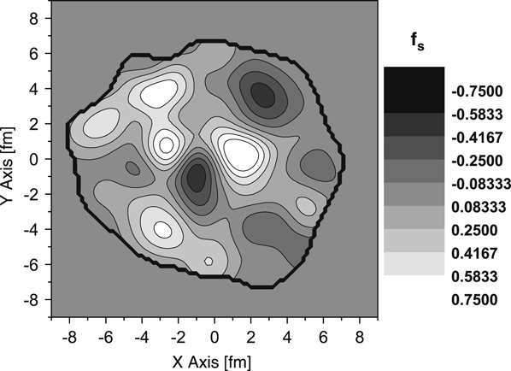
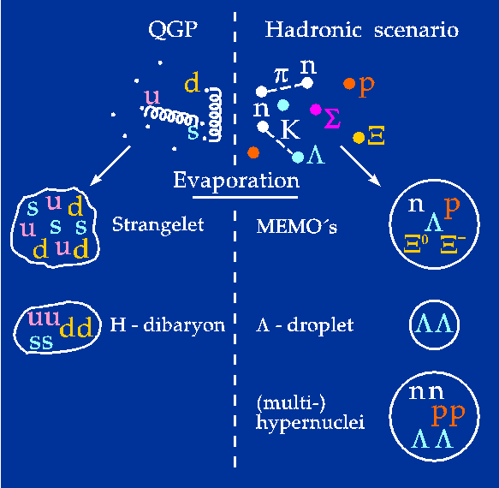
Strangeness Fluctuation
UrQMD E-by-E Distribution of the strangeness to baryon fraction in the transverse plane (z=0 fm).
Jan Steinheimer , Horst Stoecker, Ingo Augustin, Anton Andronic, Takehiko Saito,Peter Senger, Progress in Particle and Nuclear Physics 62 (2009) 313317
J. Steinheimer: SQM09

Slide 16
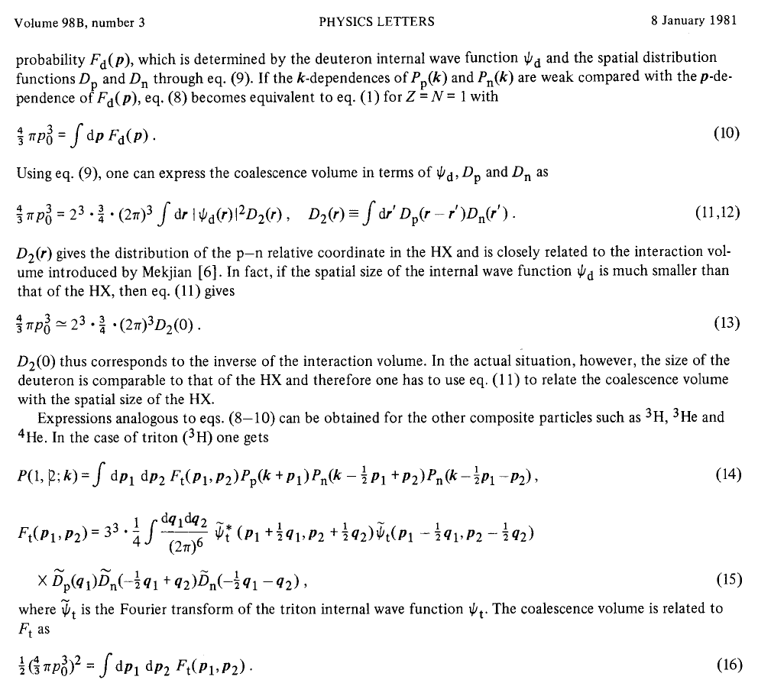
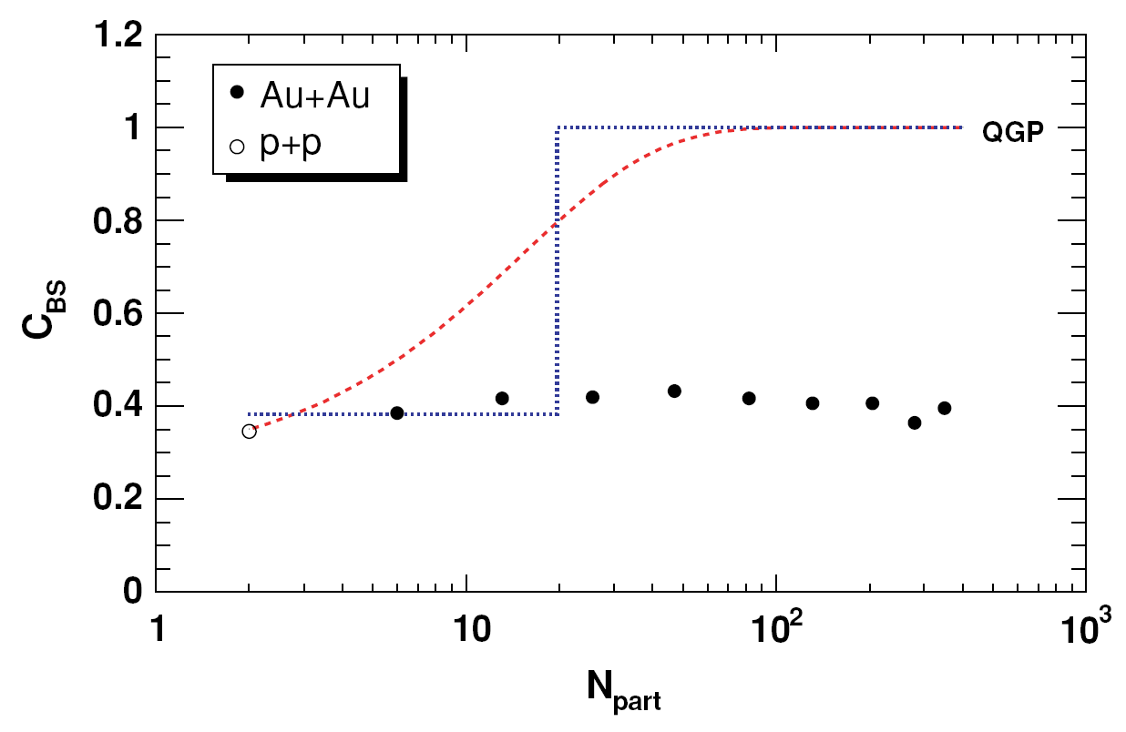
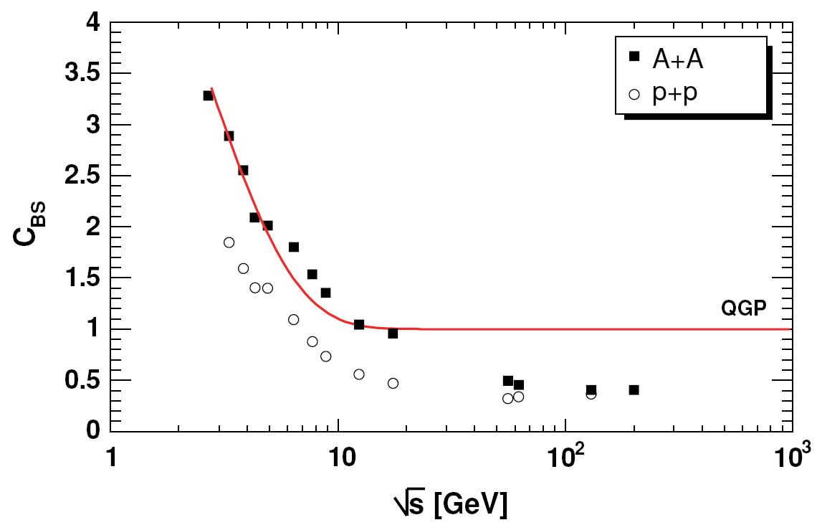
Yields as a measure of correlation
UrQMD
A=2➔Baryon density <ρ_{B}>
S. Haussler, H. Stoecker, M. Bleicher, PRC73
UrQMD
A=3 ➔ <ρ²_{B}>; <ρ_{Λ}ρ_{B}>
Caution:
measurements related to local (strangeness baryon)-baryon correlation Simulations of (all strangeness)—(all baryon) correlation

Slide 17
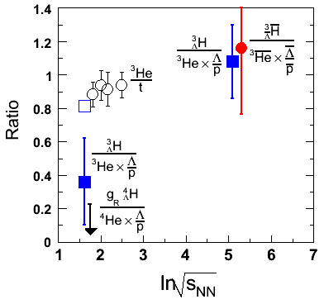
(³He, t, ³_{Λ}H)➔(u, d, s)
A=3, a simple and perfect system
9 valence quarks,
(³He, t, ³_{Λ}H)➔(u, d, s)+4u+4d
Ratio measures Lambda-nucleon correlation
RHIC: Lambda-nucleon similar phase space
AGS: systematically lower than RHIC
Strangeness phase-space equilibrium
³He/t measures charge-baryon correlation
uud
uud
uud
³He
udu
t
udd
³_{Λ}H
uds
udd
udd
udd

Slide 18
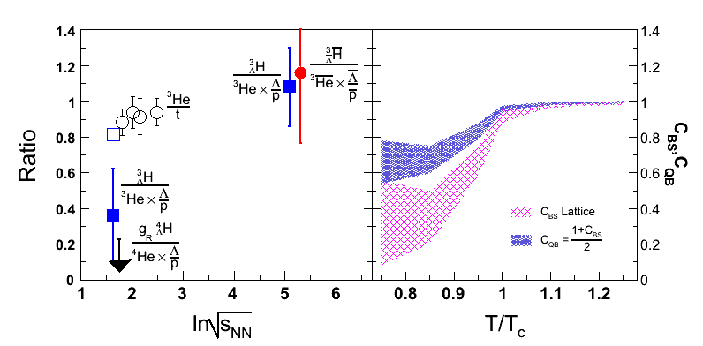
: Primordial Λ-B correlation
A. Majumder and B. Muller,
Phys. Rev. C 74 (2006) 054901
M. Cheng et al., PRD79(2009)
Caution:
measurements related to local (strangeness baryon)-baryon Lattice Simulations of (all strangeness)—(all baryon)
correlation correlation at zero chemical potential

Slide 19
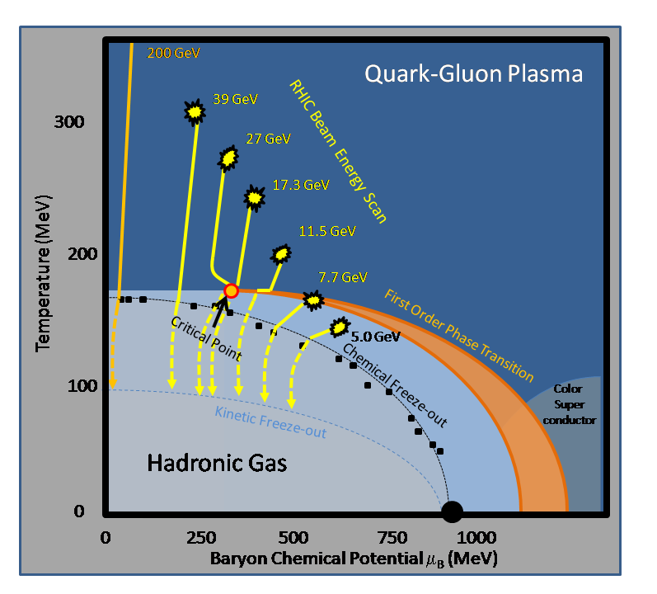
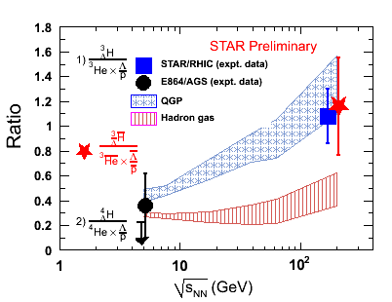
Energy scan to establish the trend
S. Zhang et al., arXiv:0908.3357 (PLB)
Beam energy | 200(30—200) GeV | ~17 (10—30)GeV | ~5 (5-10) GeV
Minbias events# (5σ) | 300M | ~10—100M | ~1—10M
Penalty factor | 1448 | 368 | 48
³He invariant yields | 1.6x10⁻⁶ | 2x10⁻⁴ | 0.01
³_{Λ}H/³He assumed | 1.0 | 0.3 | 0.05
Hypertriton only
STAR: DAQ1000+TOF

Slide 20
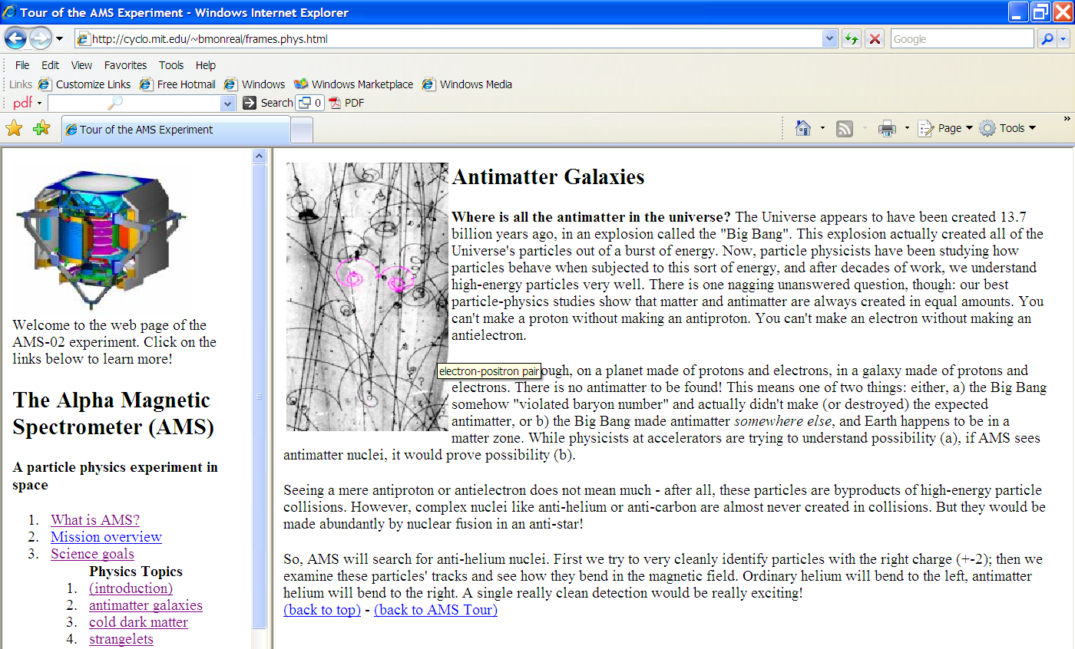
Antinuclei in nature (new physics)
To appreciate just how rare nature produces antimatter (strange antimatter)
RHIC: an antimatter machine
Seeing a mere antiproton or antielectron does not mean much– after all,
these particles are byproducts of high-energy particle collisions.
However, complex nuclei like anti-helium or anti-carbon are almost
never created in collisions.
AMS antiHelium/Helium sensitivity: 10⁻⁹
Dark Matter, Black Hole➔ antinucleus production via coalescence

Slide 21
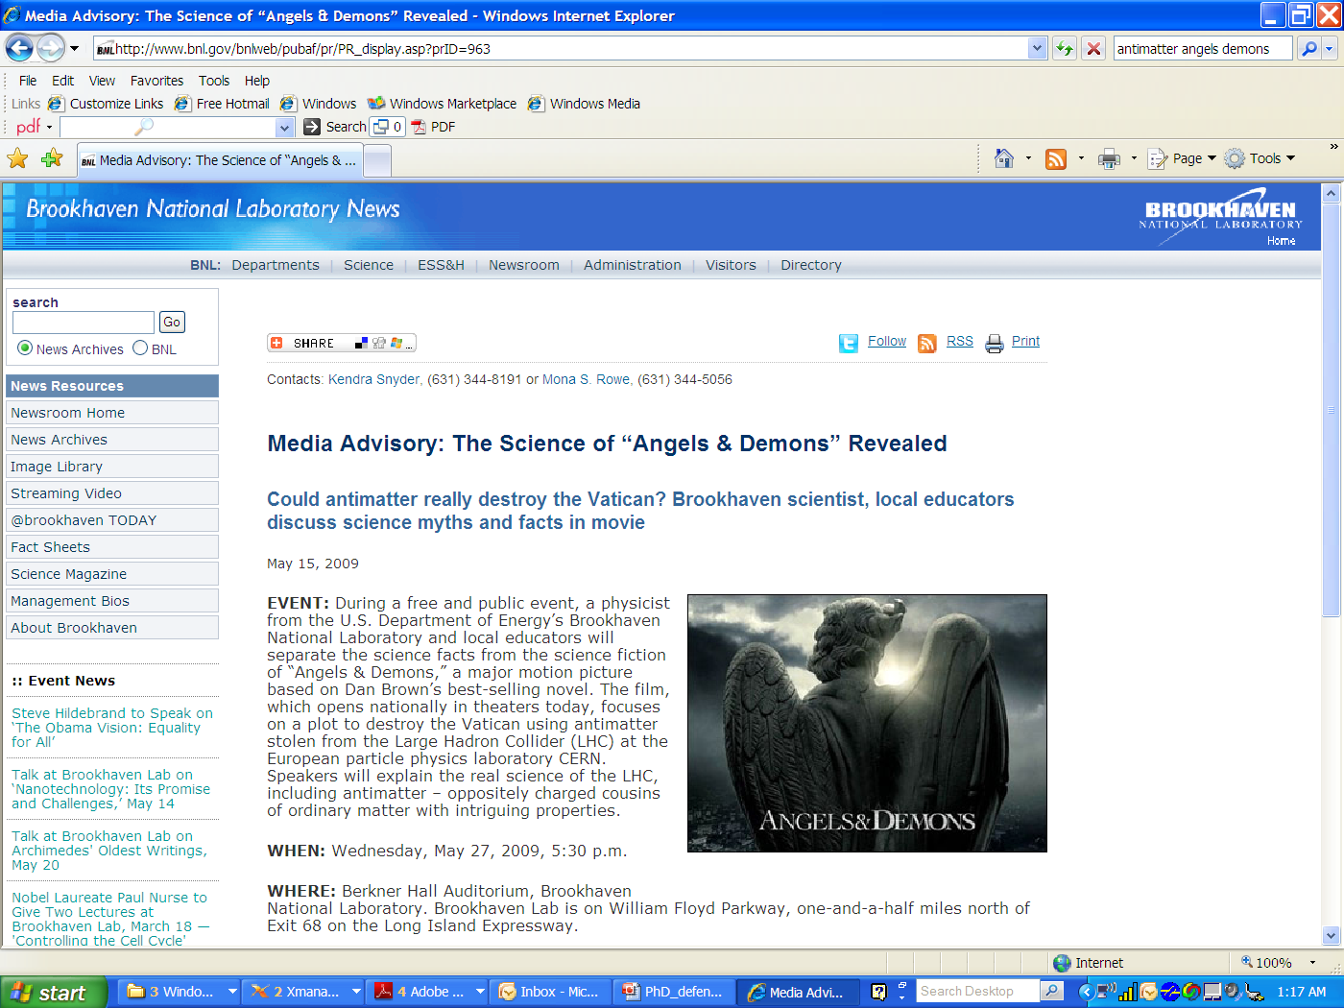
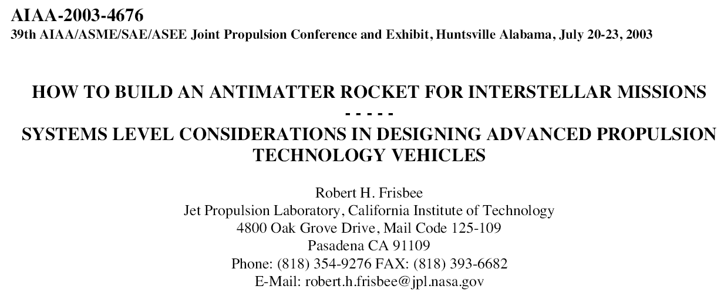
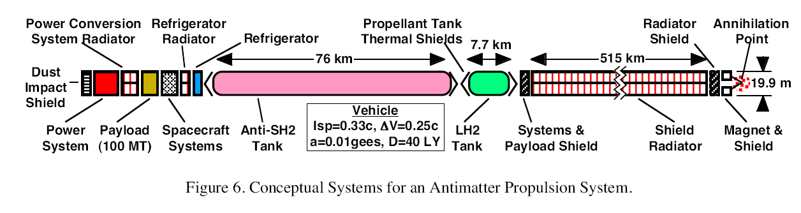
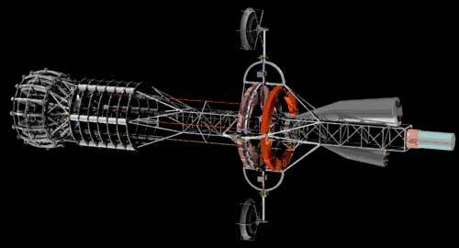
What can we do with antimatter?
Weapon? Rocket propulsion
《天使与魔鬼》

Slide 22
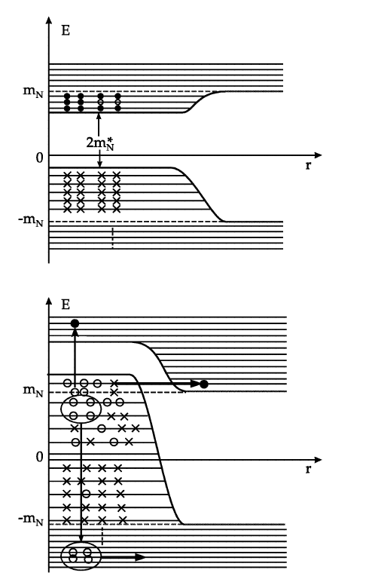
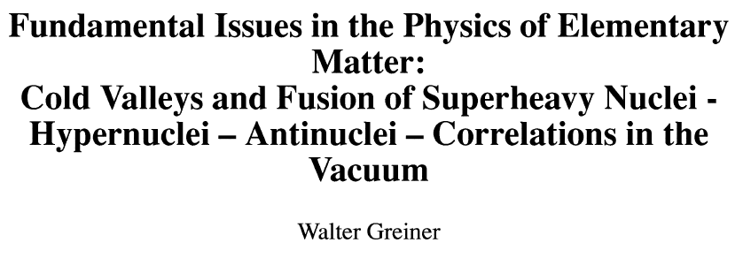
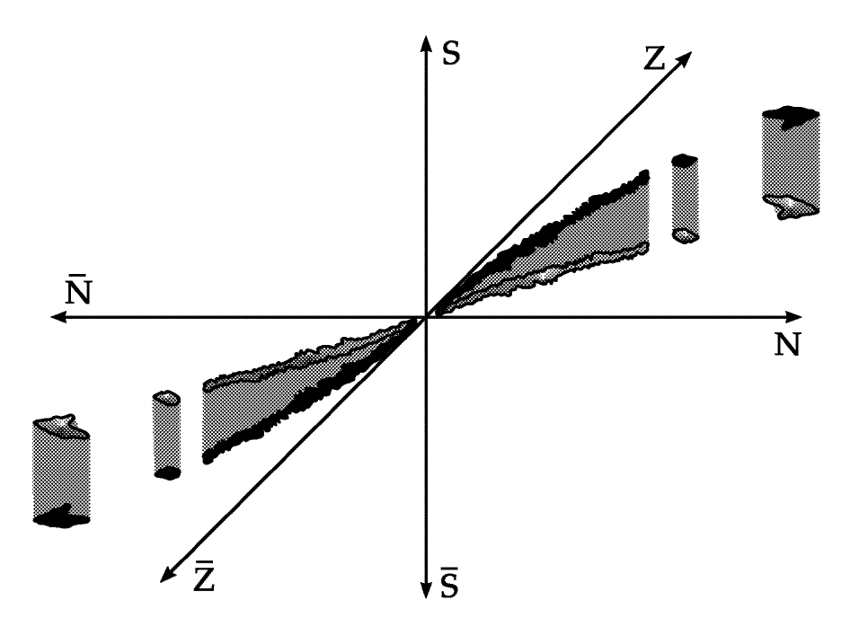
hypernuclei and antimatter from correlations in the Vacuum
Real 3-D periodic table
Pull ‾α from vacuum (Dirac Sea)

Slide 23
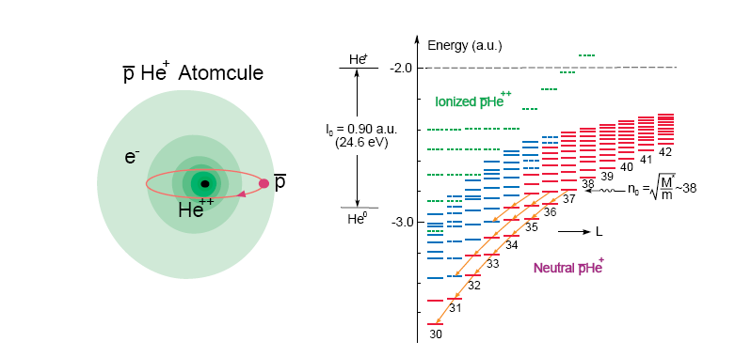
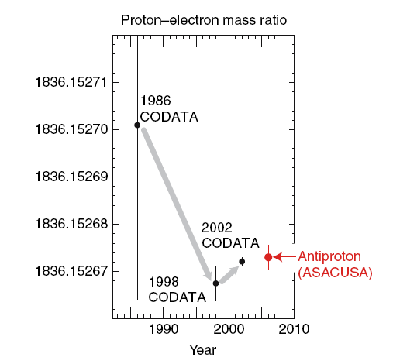
Creating first Antinucleus Atomcules
Metastable antiproton-helium atom discovered at KEK:
Iwasaki, PRL 67 (1991); nature 361 (1993) 238
Mass difference: p-pbar < 2x10⁻⁹; Hori, PRL 96 (2006);
measurement of baryon mass and magnetic moment
for CPT test at LEAR/CERN
http://asacusa.web.cern.ch/ASACUSA/index-e.html
‾d‾t ‾He3
What happens if we replace antiproton
with antideuteron, antitriton or antiHelium3
Atomic structure should be the same
for antideuteron and antitriton (-1 charge)
Reduced mass M* will be different.
Only RHIC can answer this question with
enough antimatter nuclei for such study
Possible Physics Topics:
Measure antinucleus mass and magnetic moment for CPT test,
Study the antinucleus annihilation process (sequence)
antinucleus-nucleus Annihilation
(what do they create? Hot or cold matter)
Maybe even antiAlpha Atomcule

Slide 24
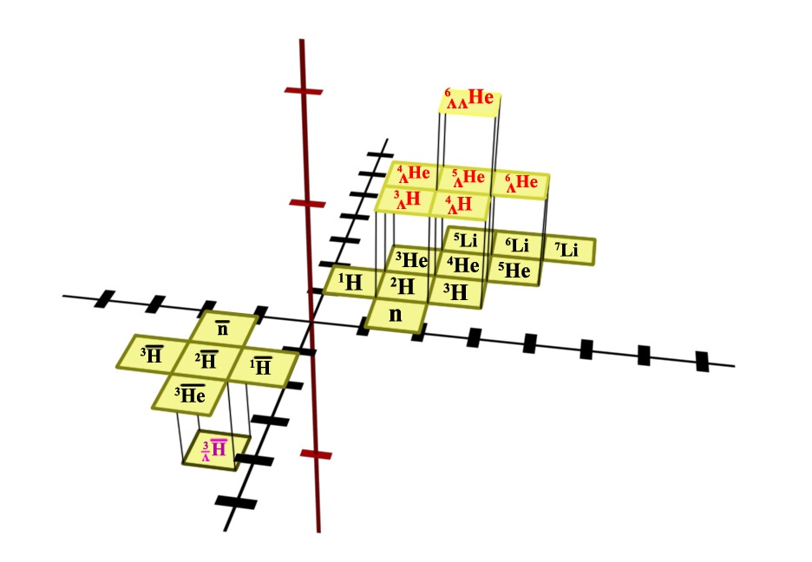
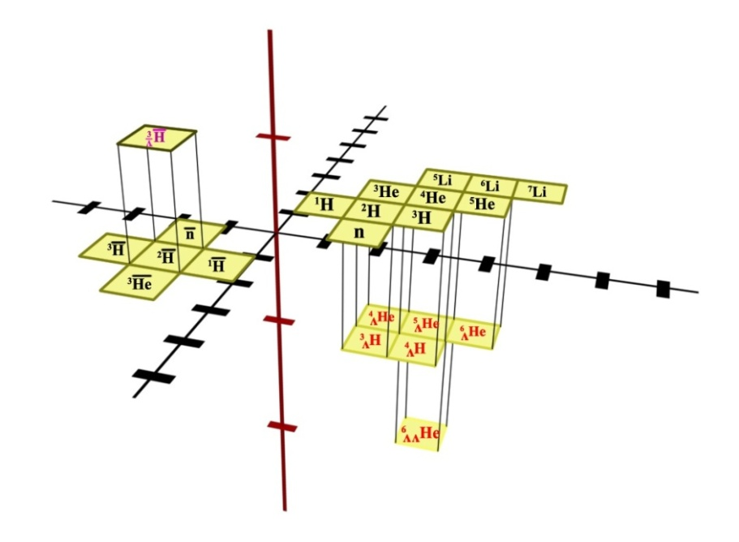
Vision from the past
‾α
?
??
2011
The extension of the periodic system into the sectors of hypermatter
(strangeness) and antimatter is of general and astrophysical importance.
… The ideas proposed here, the verification of which will need the
commitment for 2-4 decades of research, could be such a vision
with considerable attraction for the best young physicists… I can already
see the enthusiasm in the eyes of young scientists, when I unfold these
ideas to them — similarly as it was 30 years ago,…
---- Walter Greiner (2001)

Slide 25
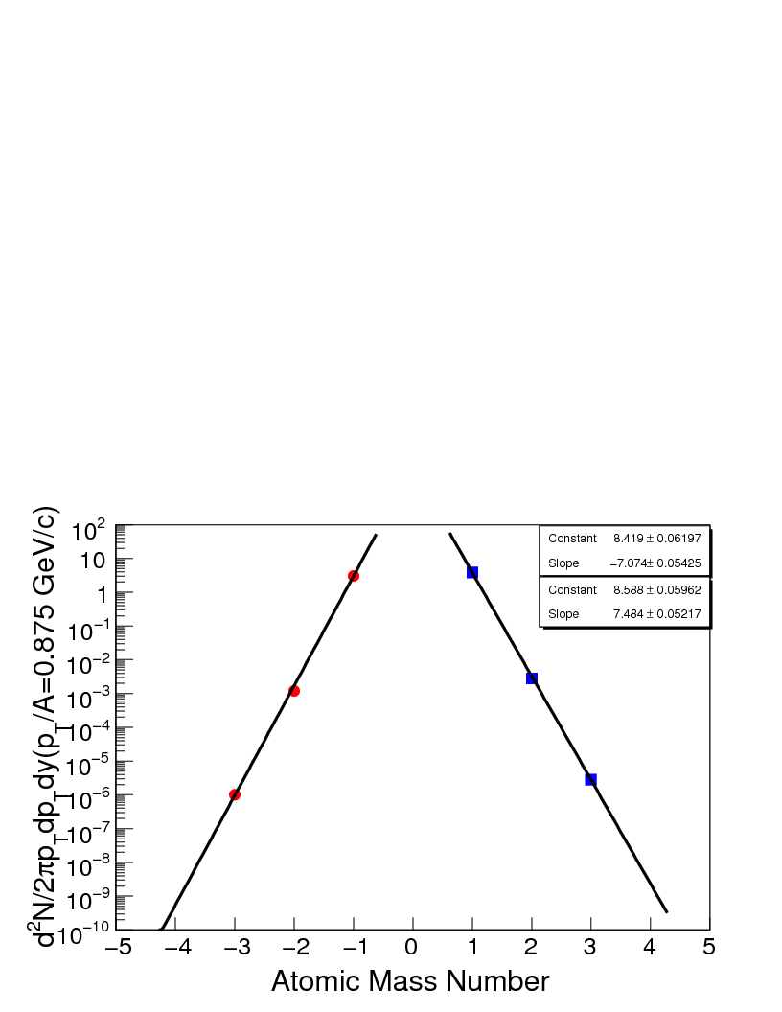
Projected Discovery of antimatter alpha particle from STAR run10
How many possible antimatter nuclei can we discover?
Antihypertriton, antialpha;
antihyperH4?
Can we get to antimatter ⁶He?
Unless technology and Physics change dramatically, NO!
>10‾α arXiv:0909.0566

Slide 26
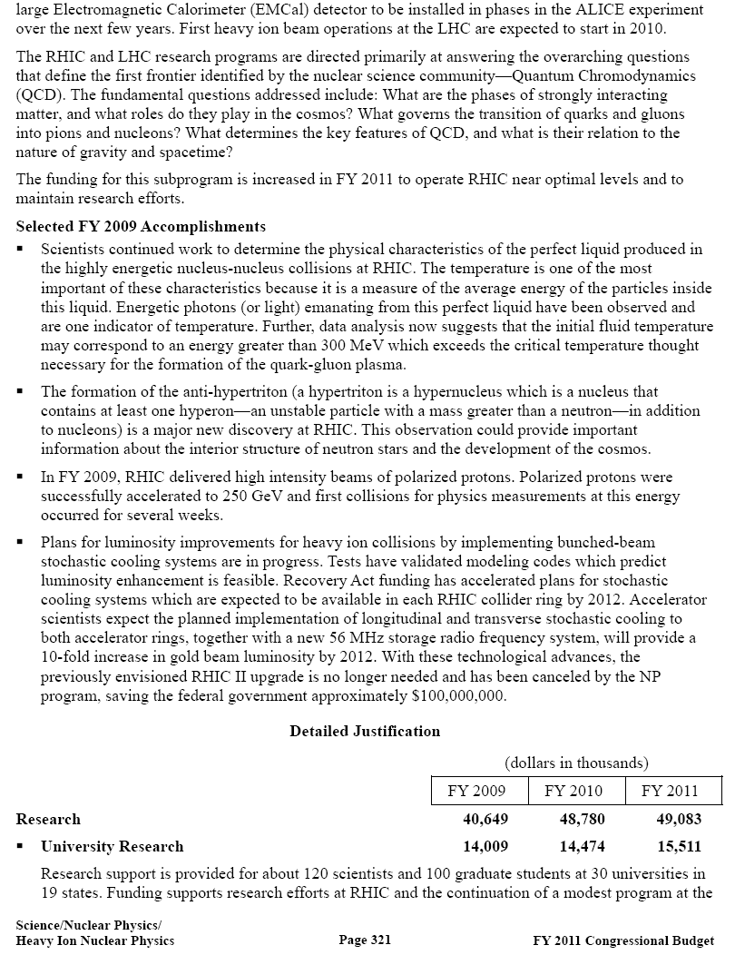
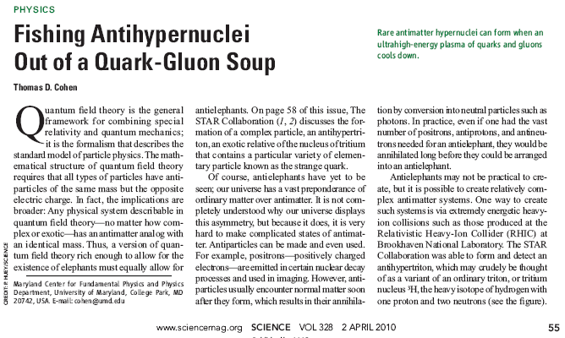
DOE FY2011 Congressional Budget Request for Science
"This experimental discovery may have unprecedented consequences for our view on/of the world" says Prof. Dr. Horst Stoecker, vice president of helmholtz gemeinschaft of german national laboratories, a veteran of relaticistic heavy ion physics, "antihypertriton pushes open the door to new dimensions in the nuclear chart: from to the antimatter world and to the world of anti-hypermatter - just a few years ago this would have been viewed as impossible.“

Slide 27
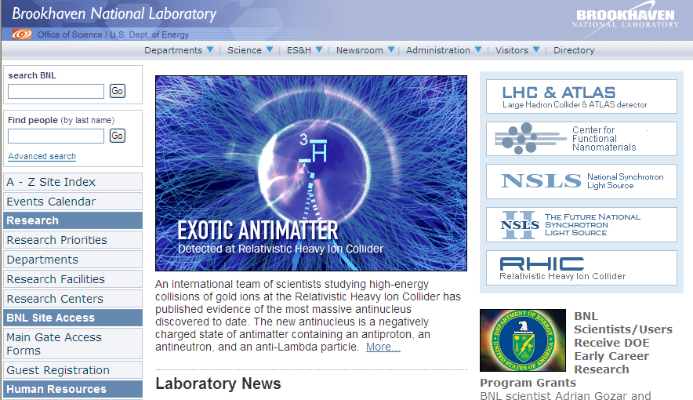
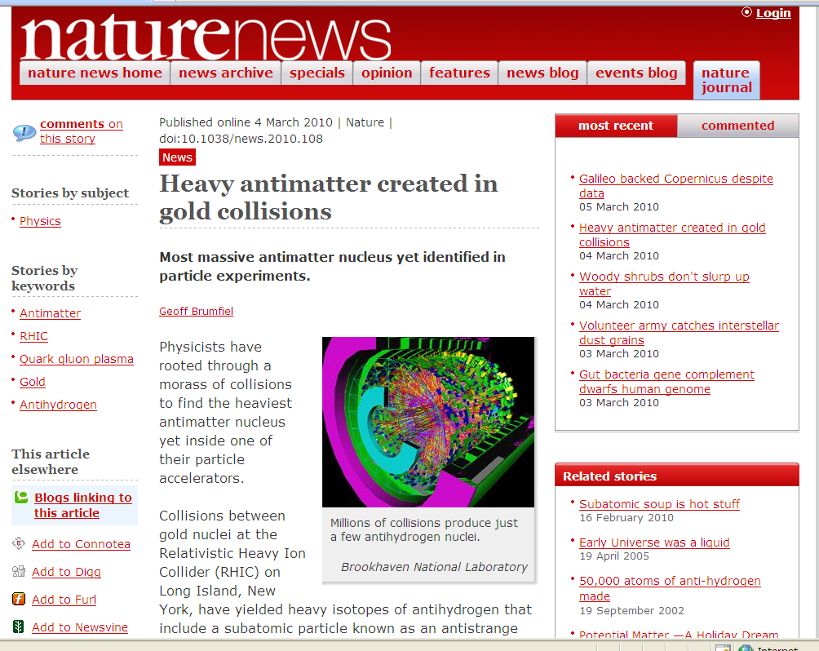

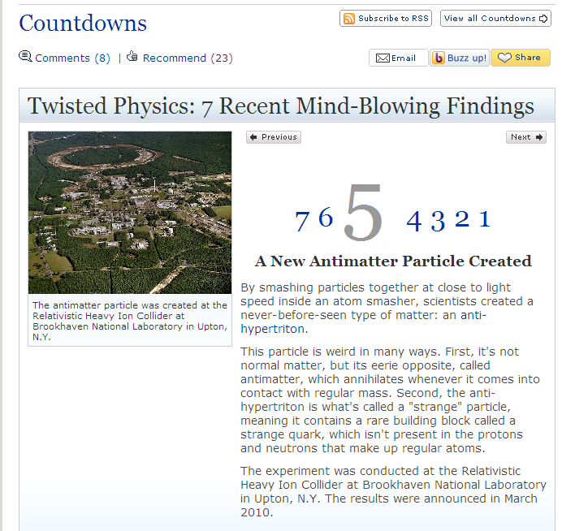
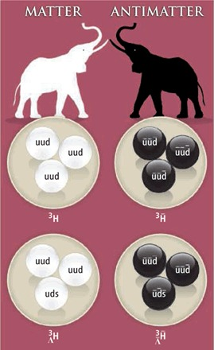

Fun news about the discovery
Science Perspectives Vol 328

Slide 28
Conclusions
has been observed for 1st time; significance ~4σ.
Consistency check has been done on analysis;
significance is ~5σ
The lifetime is measured to be
The / ratio is measured as 0.49±0.18, and
³He / ³He is 0.45±0.02, favoring the coalescence picture.
The / ³He ratio is determined to be 0.89 ± 0.28, and
/ ³He is 0.82 ± 0.16. No extra penalty factor observed
for hypertritons at RHIC.
Strangeness phase space equilibrium

Slide 29
Outlook
Lifetime:
  data samples with larger statistics
Production rate:
  Strangeness and baryon correlation
  Need specific model calculation for this quantity
  Establish trend from AGS—SPS—RHIC—LHC
_{Λ}³H→d+p+π channel measurement: d and dbar via ToF.
Search for other hypernucleus: ⁴_{Λ}H, double Λ-hypernucleus.
Search for anti-α, antinucleus atomcules
RHIC: best antimatter machine

Slide 30
Antiproton Atomcules
Metastable antiproton-helium atom discovered at KEK: Iwasaki, PRL 67 (1991)
Mass difference: p-pbar < 2x10⁻⁹; Hori, PRL 96 (2006);
best measurement of baryon mass and magnetic moment for CPT test at LEAR/CERN
http://asacusa.web.cern.ch/ASACUSA/index-e.html

Slide 31

Proposal
Phase0 (run10: search for possible signals):
  Using TPC and its material for possible atomcule creation
  Signature: Au+Au collisions followed by a delayed
  burst of charged pions originated in TPC
  Trigger and Delayed emmission using TOF
  ZDC+TOF (Au+Au) coincidence with
  delayed TOF multiplicity (dt~>200ns)
  Antiproton actomcule (3<NdTOF<5)
  Antideuteron atomcule (5<NdTOF<10)
  Antitriton atomcule (NdTOF>10)
Phase1 (run11: Helium bag)
  Using Helium gas to create antinucleus Helium Atom
  Helium is the only known material to create atomcules
  Replace the air between TPC and beampipe by helium bag (PHENIX has done this in the past)
  Reduce radiation length and create atomcules
  Using trigger logics from Phase0
Phase2: (precision measurements)
  Liquid Helium (tank or TPC) surrounding beam pipe
  Dedicated runs
  Liquid Helium (tank or TPC) replaces one of the BEMC module
Phase3 and beyond:
Dedicated beam line for laser spectroscopy ?
Helium gas
Current proposal concerns phase0 and phase1

Slide 32

Current hypernucleus experiments
PANDA at FAIR
2012~
Anti-proton beam
Double Λ-hypernuclei
γ-ray spectroscopy
SPHERE at JINR
Heavy ion beams
Single Λ-hypernuclei
HypHI at GSI/FAIR
Heavy ion beams
Single Λ-hypernuclei at
extreme isospins
Magnetic moments
MAMI C
2007~
Electro-production
Single Λ-hypernuclei
Λ-wavefunction
JLab
2000~
Electro-production
Single Λ-hypernuclei
Λ-wavefunction
FINUDA at DAΦNE
e⁺e⁻ collider
Stopped-K⁻ reaction
Single Λ-hypernuclei
γ-ray spectroscopy
(2012~)
J-PARC
2009~
Intense K⁻ beam
Single and double Λ-hypernuclei
γ-ray spectroscopy ☹
Basic map from Saito, HYP06
Notes:
32

