Slide 1


Slide 2

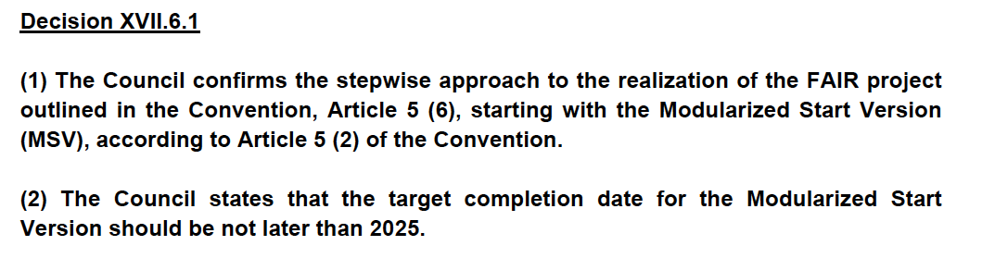

Slide 3
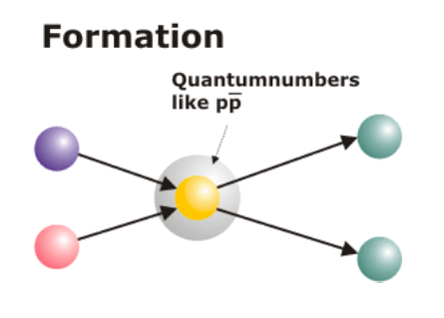
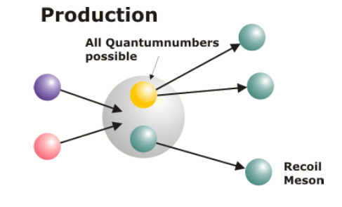
pp Annihilation
_
Gluon- Rich Environment
Direct resonant formation of states with
all non-exotic quantum numbers.
⟹ excellent precision in mass and
width measurement
Access to both exotic
and non-exotic quantum
numbers via production
and formation reactions
Versatility of physics program
(if coupled to universal detector)
_
Uniqueness of p probe
(no other p facility in this energy range in the world)
_

Slide 4
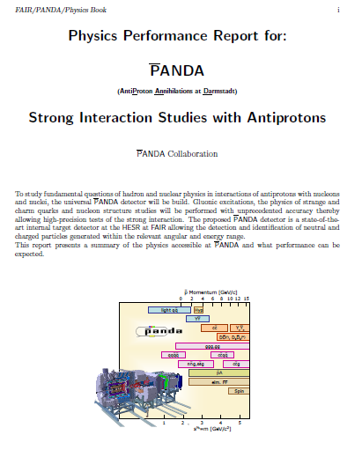
PANDA Physics Program
HADRON SPECTROSCOPY
  CHARMONIUM
  GLUONIC EXCITATIONS
  OPEN CHARM
  (MULTI)STRANGE BARYONS
NUCLEON STRUCTURE
  ELECTROMAGNETIC FORM FACTORS
  TMDs
  GPDs, TDAs
HYPERNUCLEAR PHYSICS
HADRONS IN THE NUCLEAR MEDIUM
ArXiV:0903.3905

Slide 5
Baryon Spectroscopy
New baryon states ?
Properties of already known states.
Symmetries in observed spectrum.
Prospects for PANDA
S=2 hyperons (Ξ)
S=0 baryons (N)
S=1 hyperons (Λ)
Baryons in PANDA
Large cross section σ for pp → YY
  pp → ΞΞ ≈ μb
  pp → ΩΩ ≈ 0.002 ÷ 0.06 μb
No extra mesons in final state
needed for strangeness or charm
conservation
Symmetry in hyperon and antihyperon
PANDA detector versatile
S=3 hyperons (Ω)
Charmed (Λ_{c}, Σ_{c},P_{c})
Hidden charm (N_{cc})
PANDA is a
Strangeness Factory

Slide 6
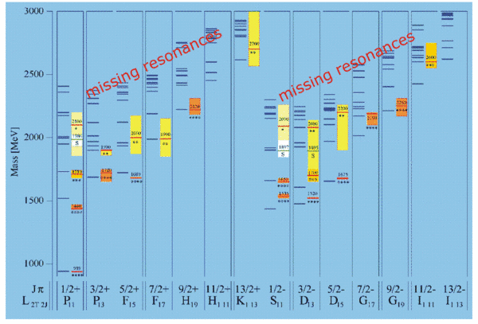
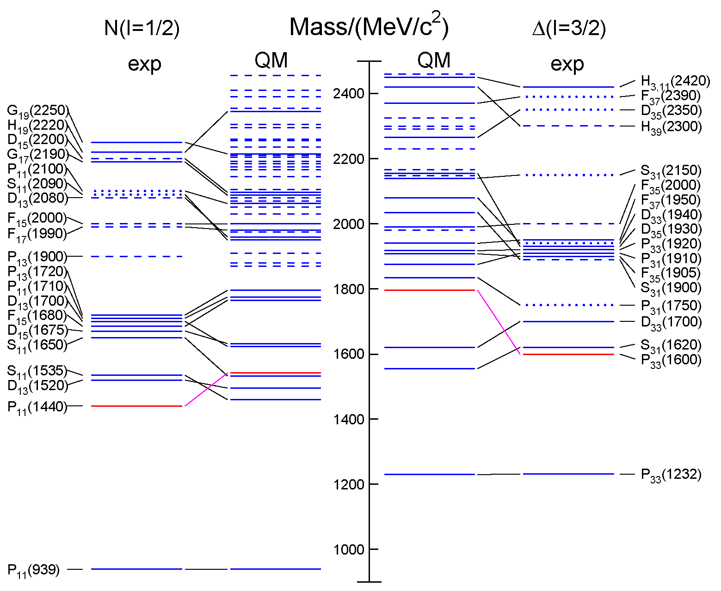
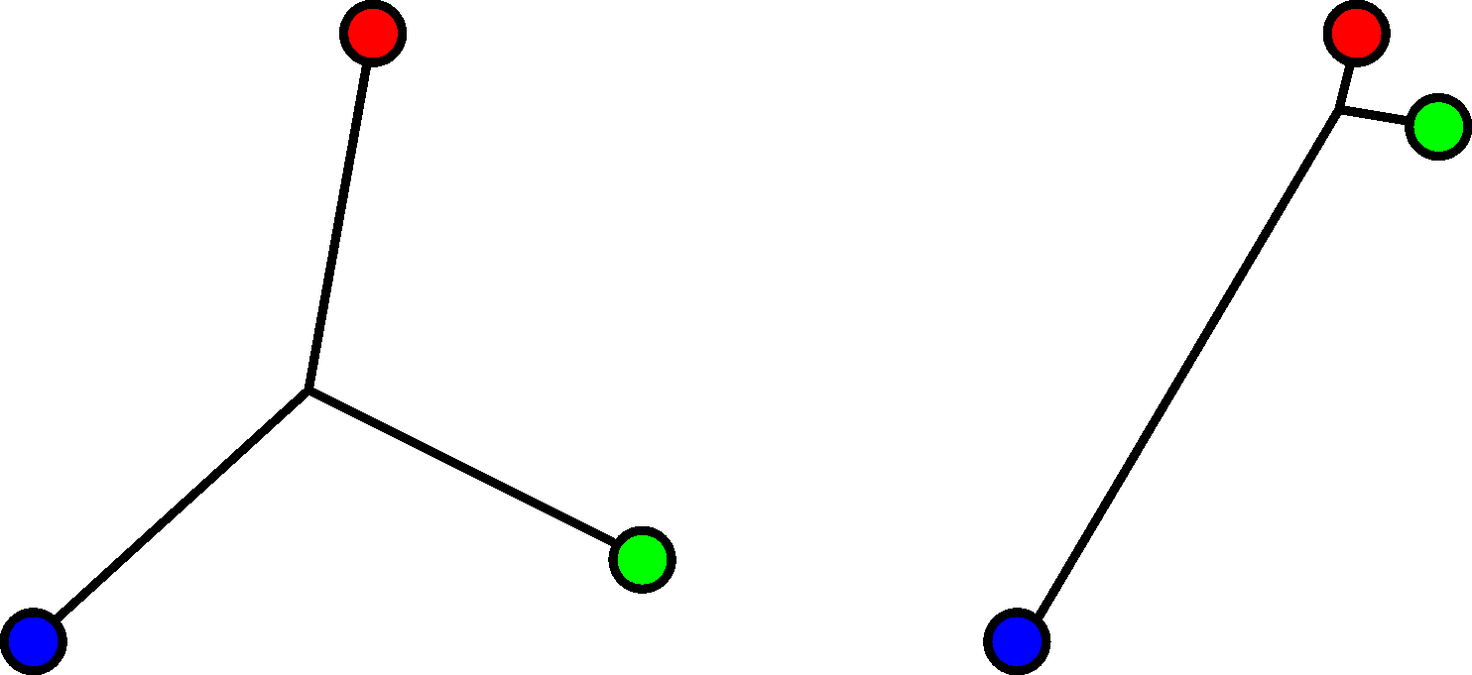
Open Questions
Missing resonances
Wrong masses, wrong sequence
Relevant degrees of freedom?
  3-quark or quark-diquark structure?
  single particle excitation modes
  meson-baryon dynamics

Slide 7
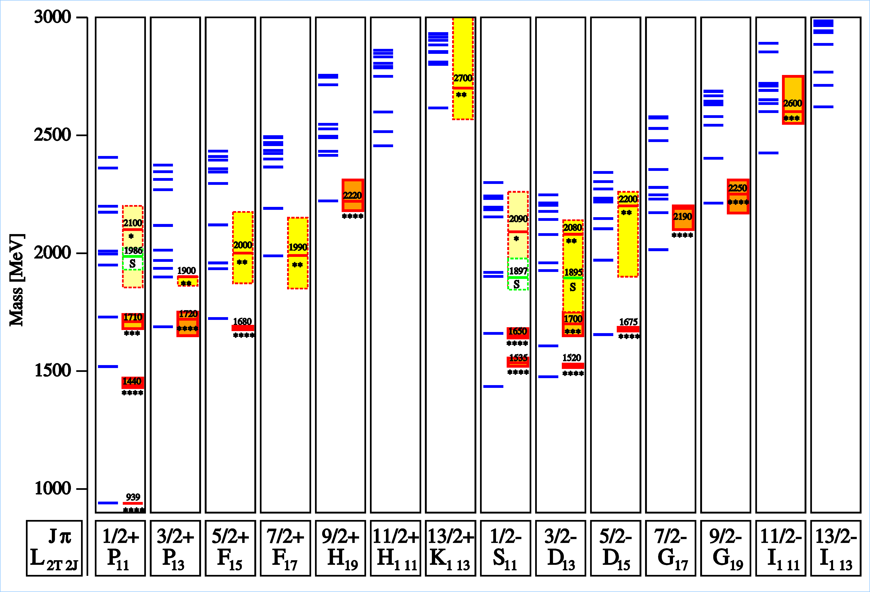
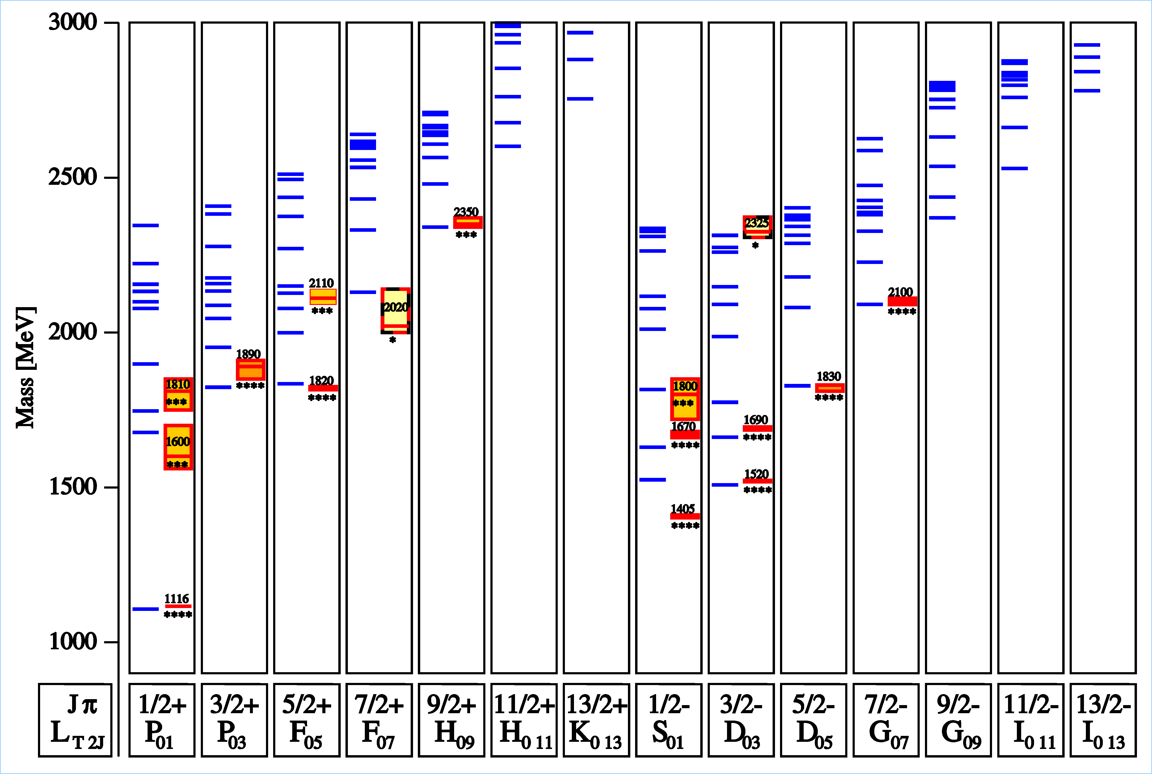
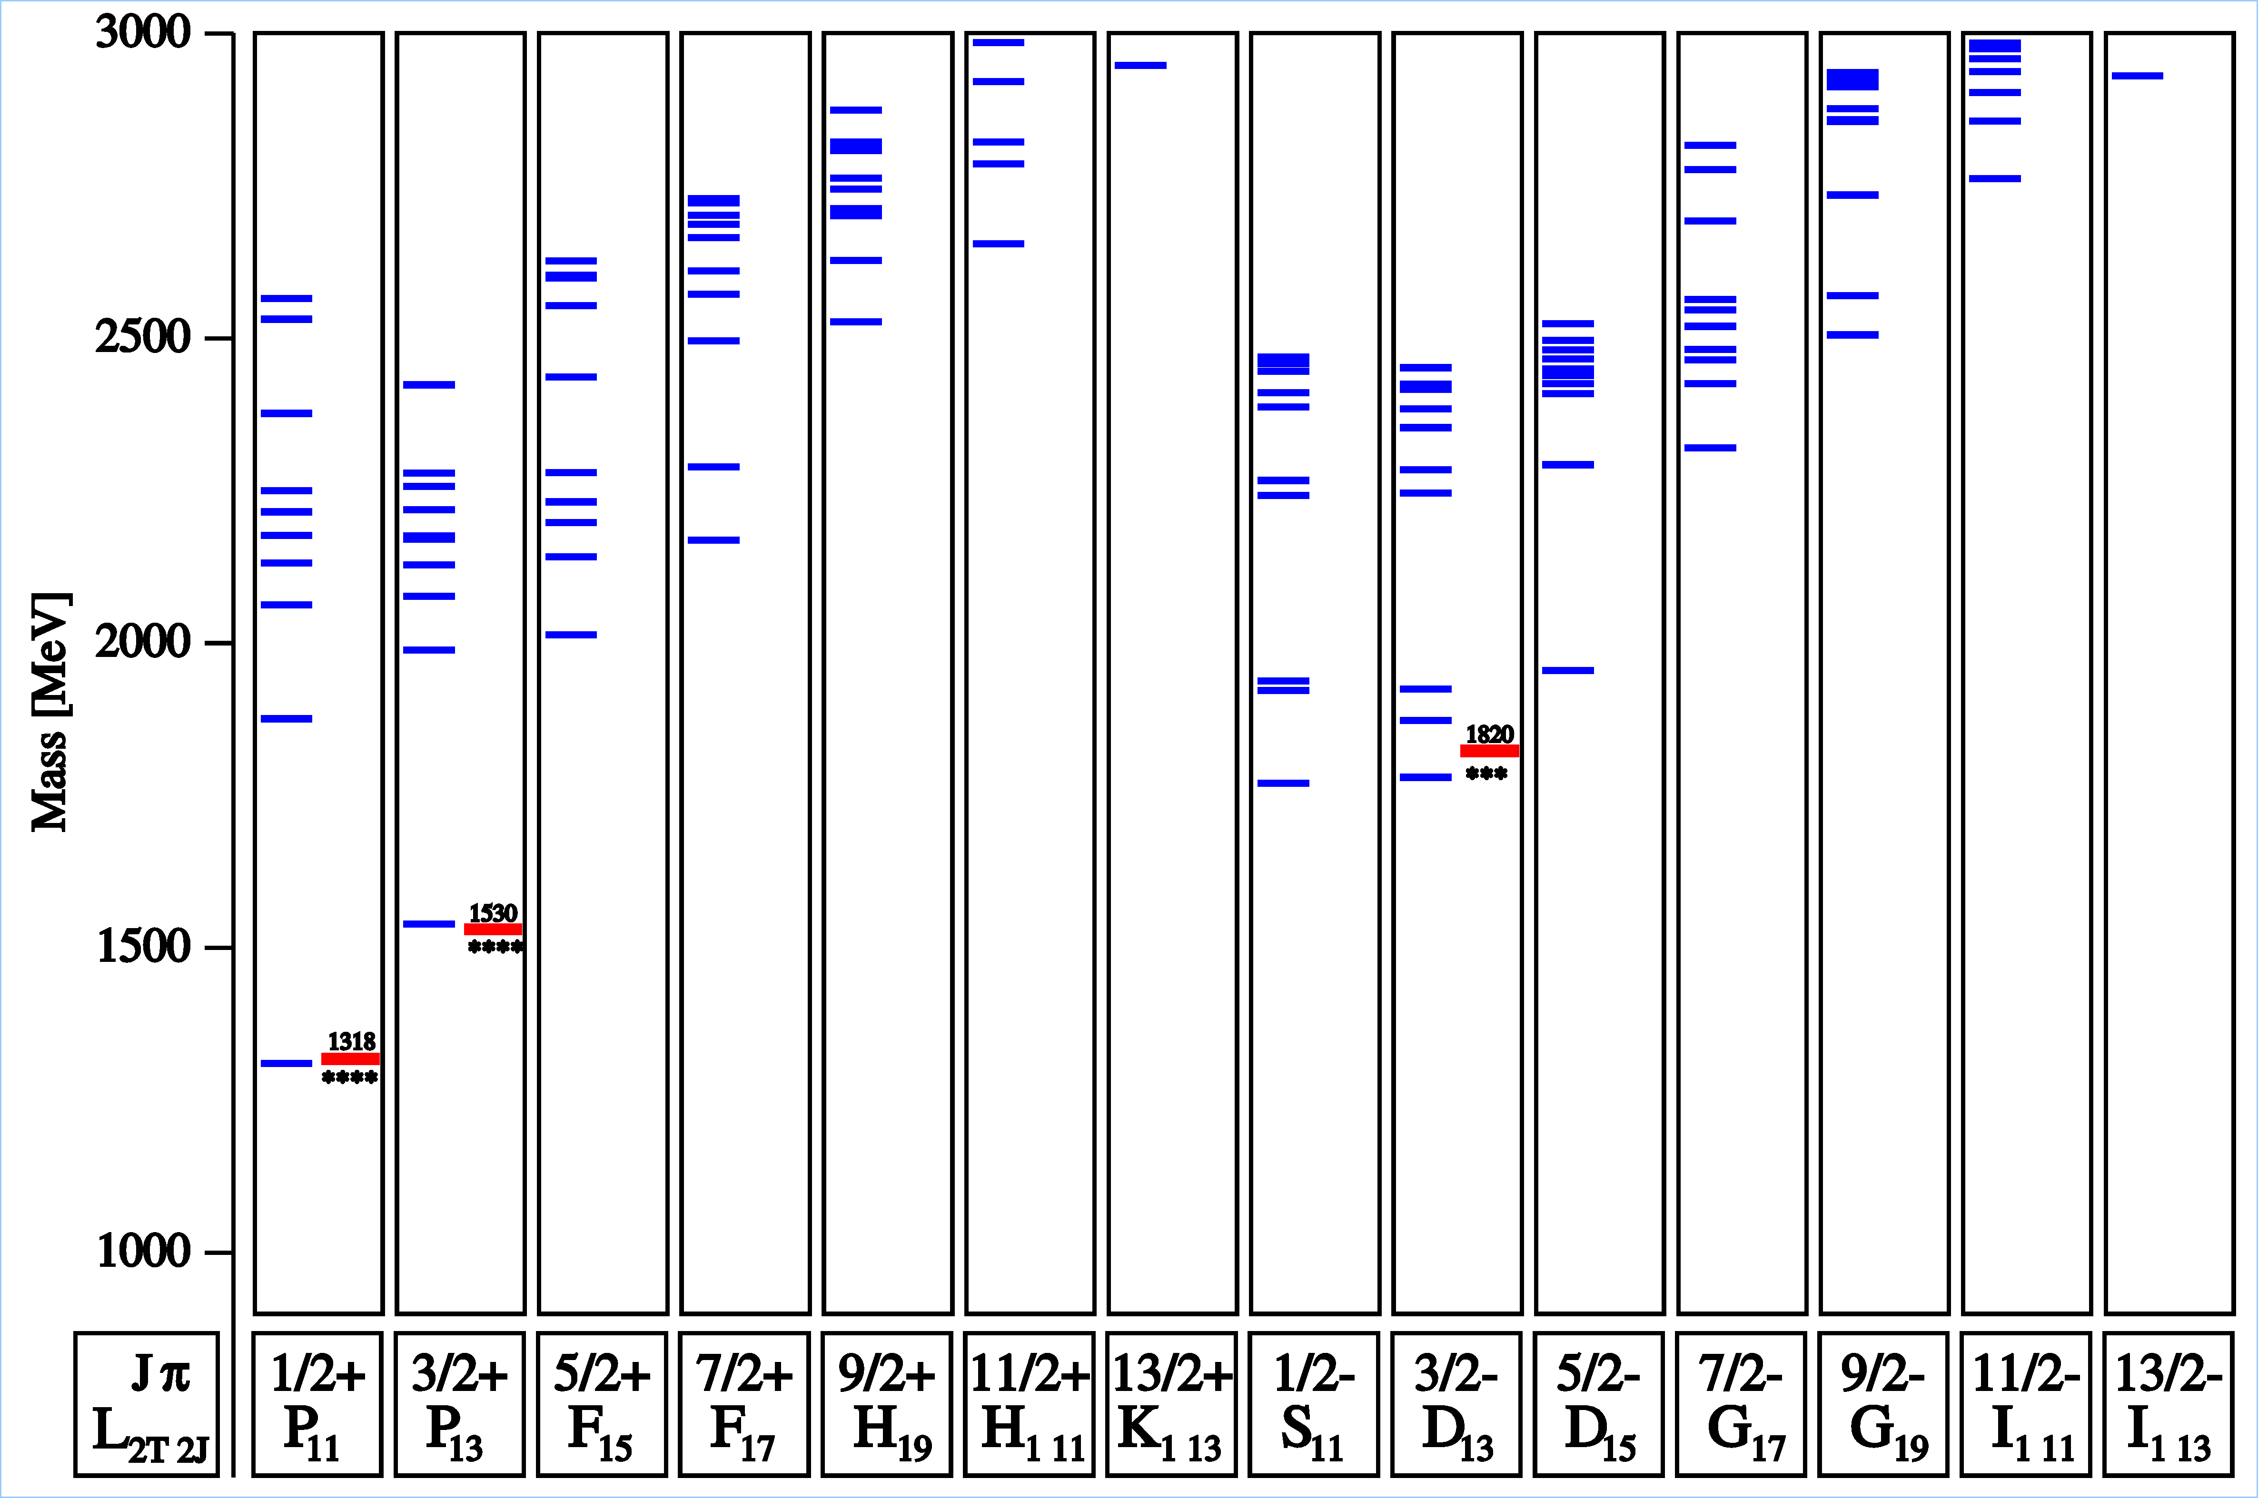
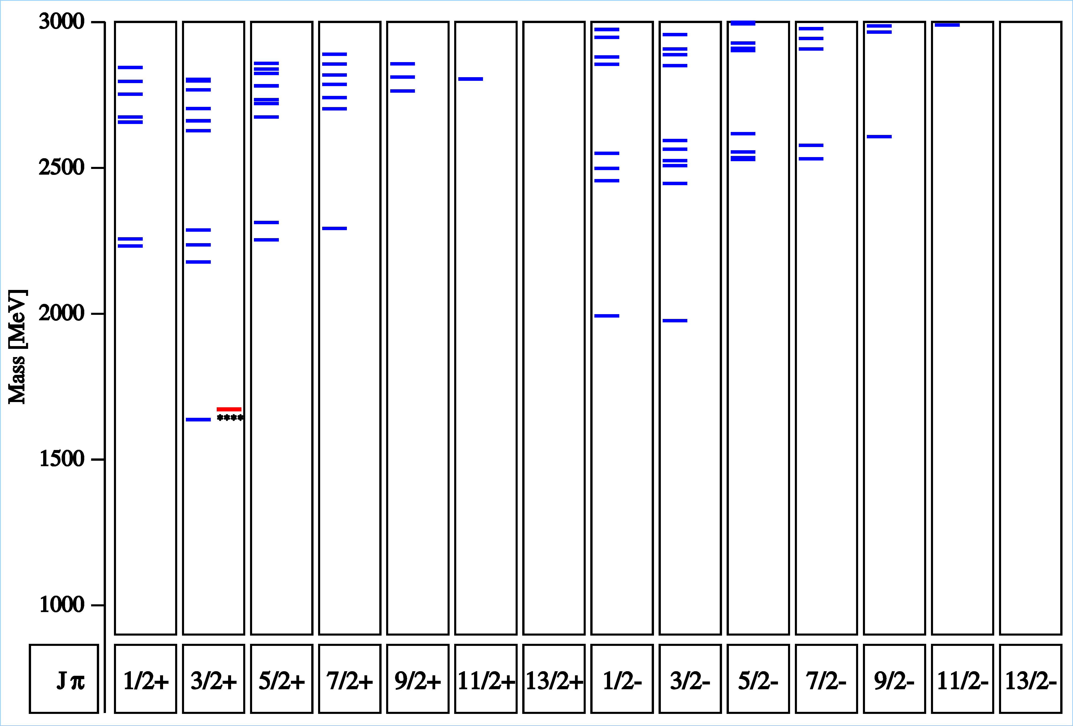
Excited Hyperon States?
U. Löring, B.Ch. Metsch, H.R. Petry,
Eur. Phys. J A 10 (2001) 309, 395,447
N∗ : 10 ∗∗∗∗
Λ∗ : 8 ∗∗∗∗
Δ : 7 ∗∗∗∗
Σ∗ : 5 ∗∗∗∗
Ξ∗ : 1 ∗∗∗∗
Ω∗ : 0 ∗∗∗∗

Slide 8
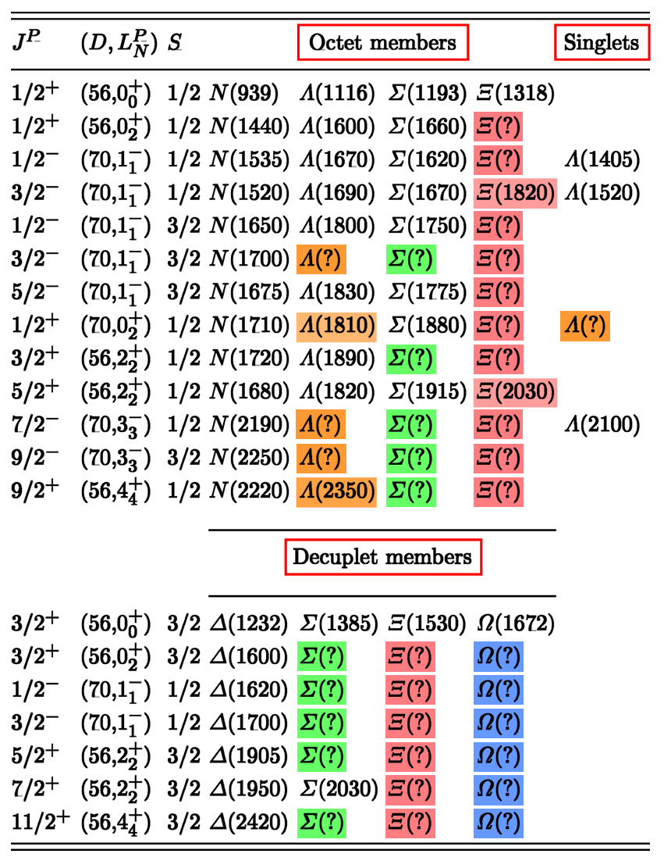
SU(6) x O(3) Classification
PDG:
octet Ξ states: no partner states of most known N* states
Ξ(1820) and Ξ(2030) “educated guess”
decuplet Ξ and Ω states: no Δ* partner state
note on Ξ resonances: “… nothing of significance on Ξ resonances has been added since our 1988 edition.”

Slide 9
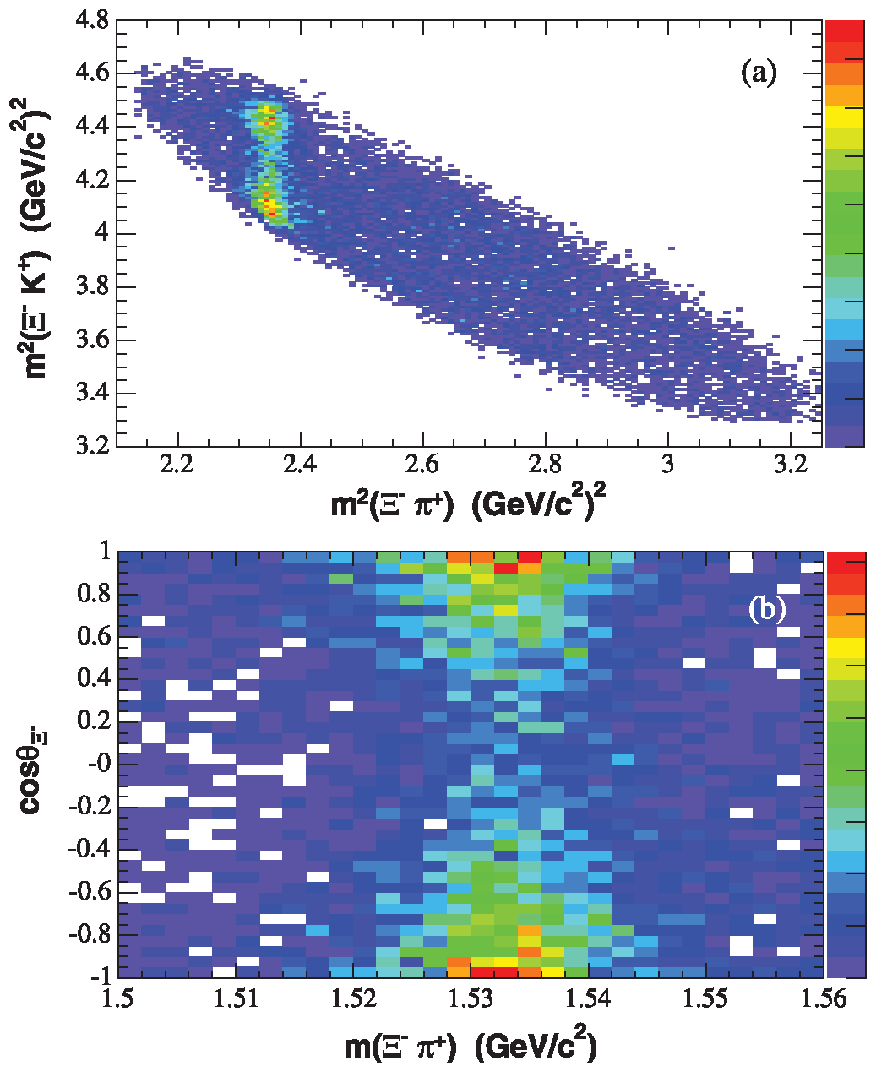
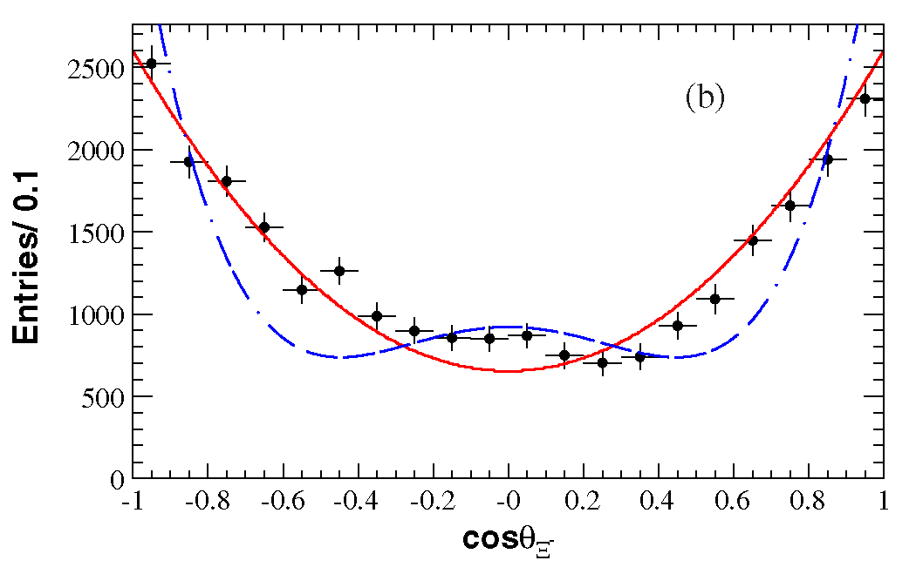
Data on Ξ States: Ξ(1530)
The only reasonably well studied Ξ resonance:
Ξ(1530) - decuplet g.s. J^{P} = 3/2⁺
Г = 9…10 MeV
decay: ~100% Ξπ
BaBar measured the Ξ(1530)⁰ spin J = 3/2 in Λ_{c}⁺ → Ξ⁻ π⁺ K⁺
Compare to Δ!!
J = 3/2
J = 5/2
BaBar 2008
B. Aubert et al.,
PRD 78 (2008) 034008

Slide 10
Why Study Excited Baryons with PANDA?
_
_
Large cross sections for p p → B B*
  σ(pp → ΞΞ) ≈ μb
  σ(pp → ΩΩ) ≈ 0.03 … 0.1 μb (prediction)
No extra mesons to balance strangeness or charm
Symmetry in baryon and antibaryon observables
Capabilities of the PANDA detector
PANDA is unique in baryon spectroscopy beyond nucleon and Δ !!
_
_
_
_

Slide 11
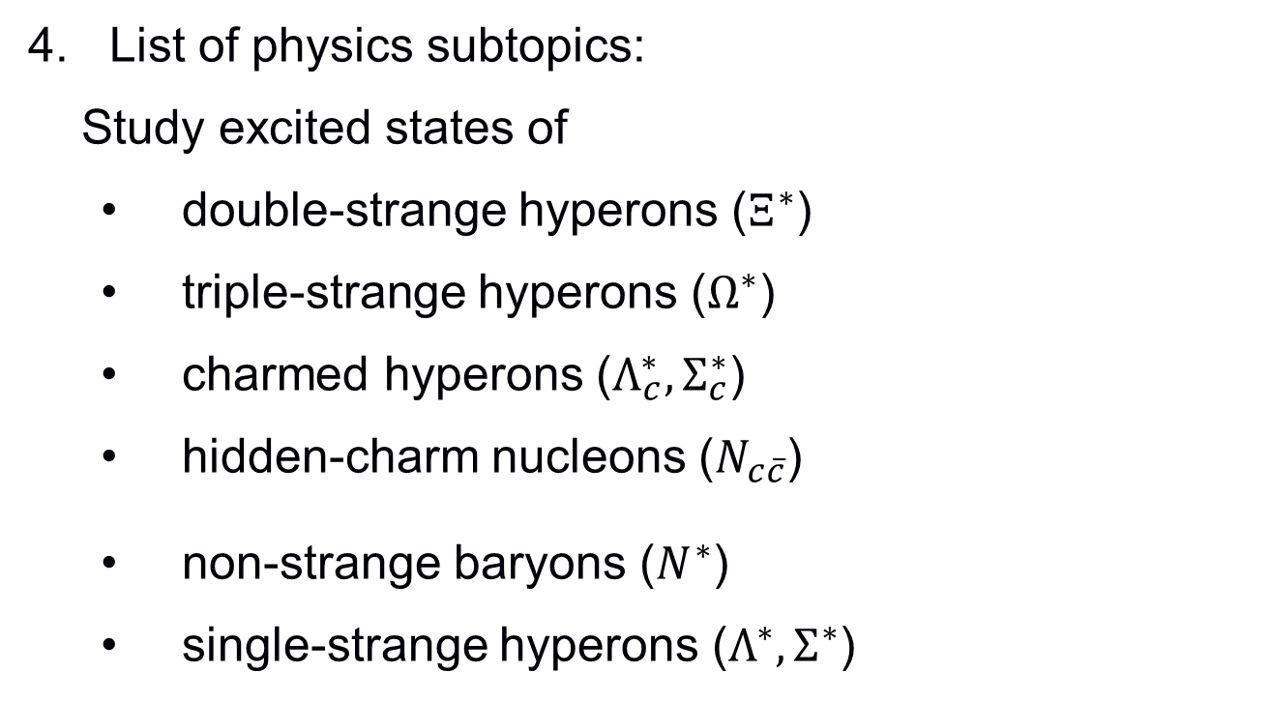
Physics Subtopics:
List of physics subtopics:
Study excited states of
  double-strange hyperons ($Ξ^{∗}$)
  triple-strange hyperons ($Ω^{∗}$)
  charmed hyperons ($Λ_{c}^{∗}, Σ_{c}^{∗}$)
  hidden-charm nucleons ($N_{c\overline{c}}$)
  non-strange baryons ($N^{∗}$)
  single-strange hyperons ($Λ^{∗},Σ^{∗}$)
Comes as by-product
Identify specific issues

Slide 12
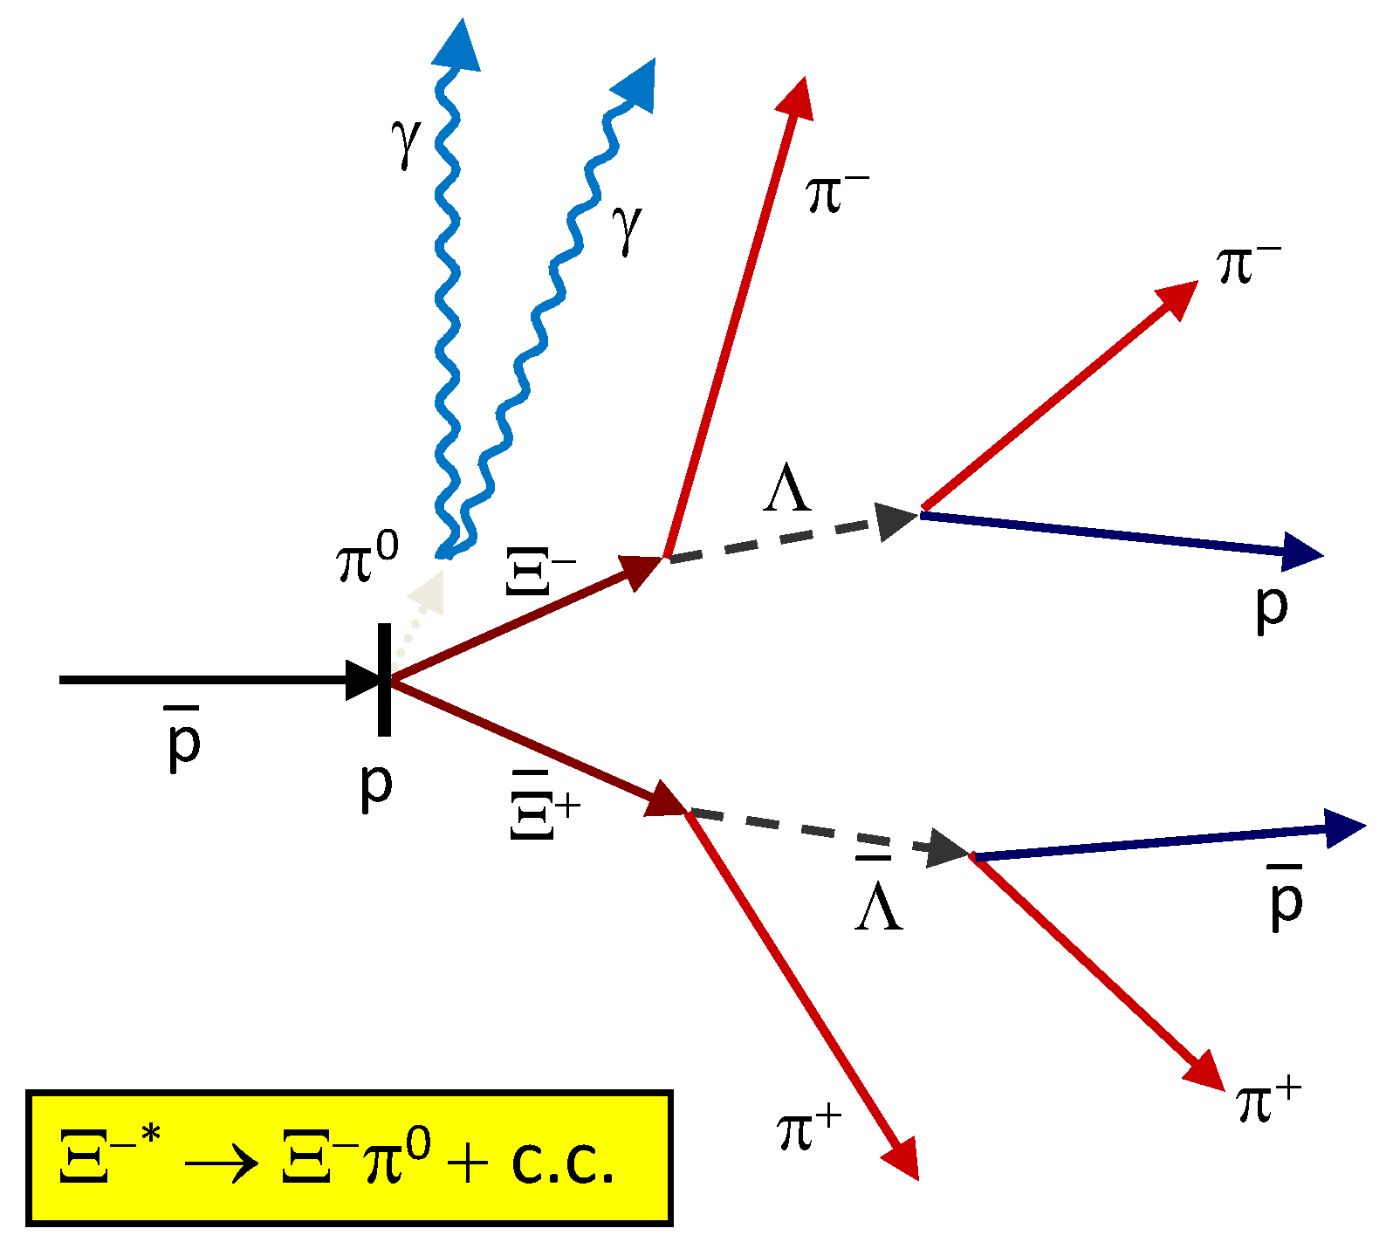
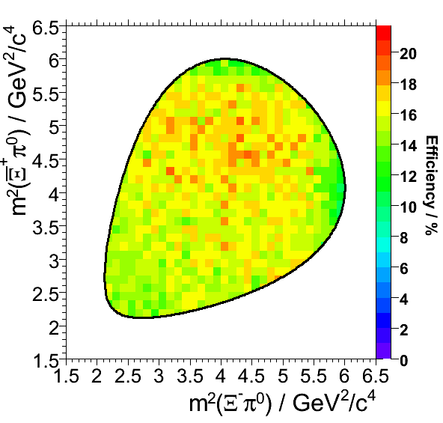
PANDA Physics Book: Ξ* → Ξπ
_
characteristic event topology
σ ~ μb: ~10⁷ Ξ /d produced
final states to be studied: Ξ* → Ξ π, Ξ η, Λ K, Σ K, Ξ(1530) π, Ξ π π, …
benchmark channel: 6.57 GeV/c p p → Ξ⁻ Ξ⁺ π⁰
no empty regions or discontinuities in Dalitz plot
Ξ⁻π⁰ mass resolution < 4 MeV; rec. eff. ~15%, S/B >19*
*DPM generated background
_
_
_
_

Slide 13
Simulation of pp → Ξ⁺Ξ⁻
_
_
p = 4 GeV/c
Pandaroot versions: scrut14 (2×10⁵ events), oct14 (10⁶ events)
Analysis in progress
Specific issues:
  ideal reco for displaced vertices
  no vertex fitter yet for Ξ → Λπ
  reduced efficiency for p as compared to p
  Multiple tracks for same MC index
  Λ mass spectrum after vertex fit
_

Slide 14
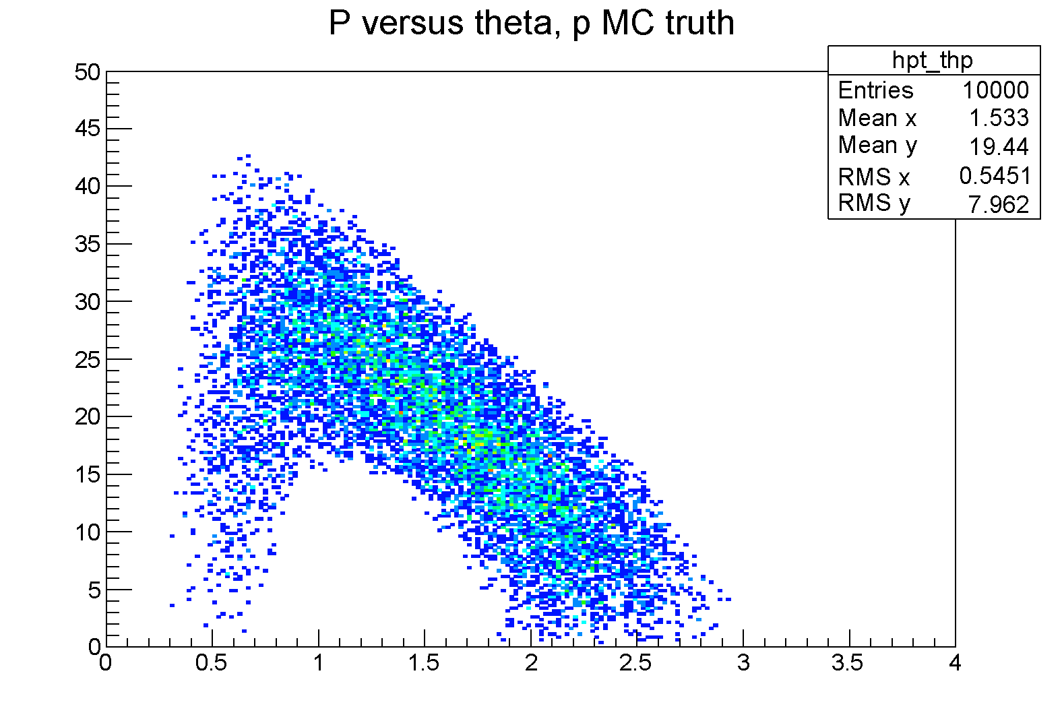
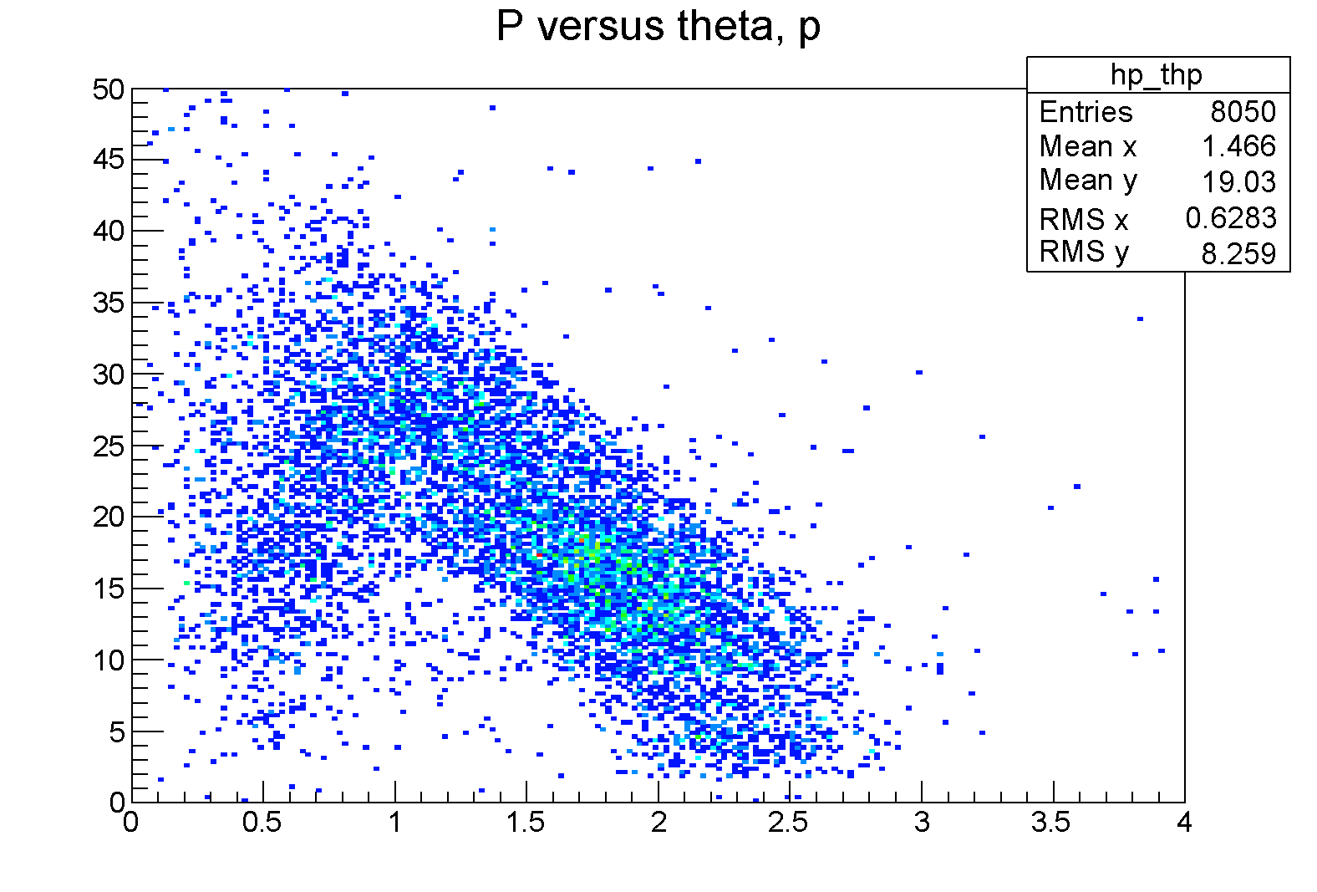
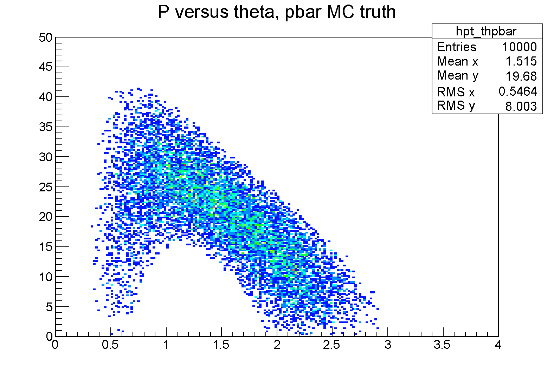
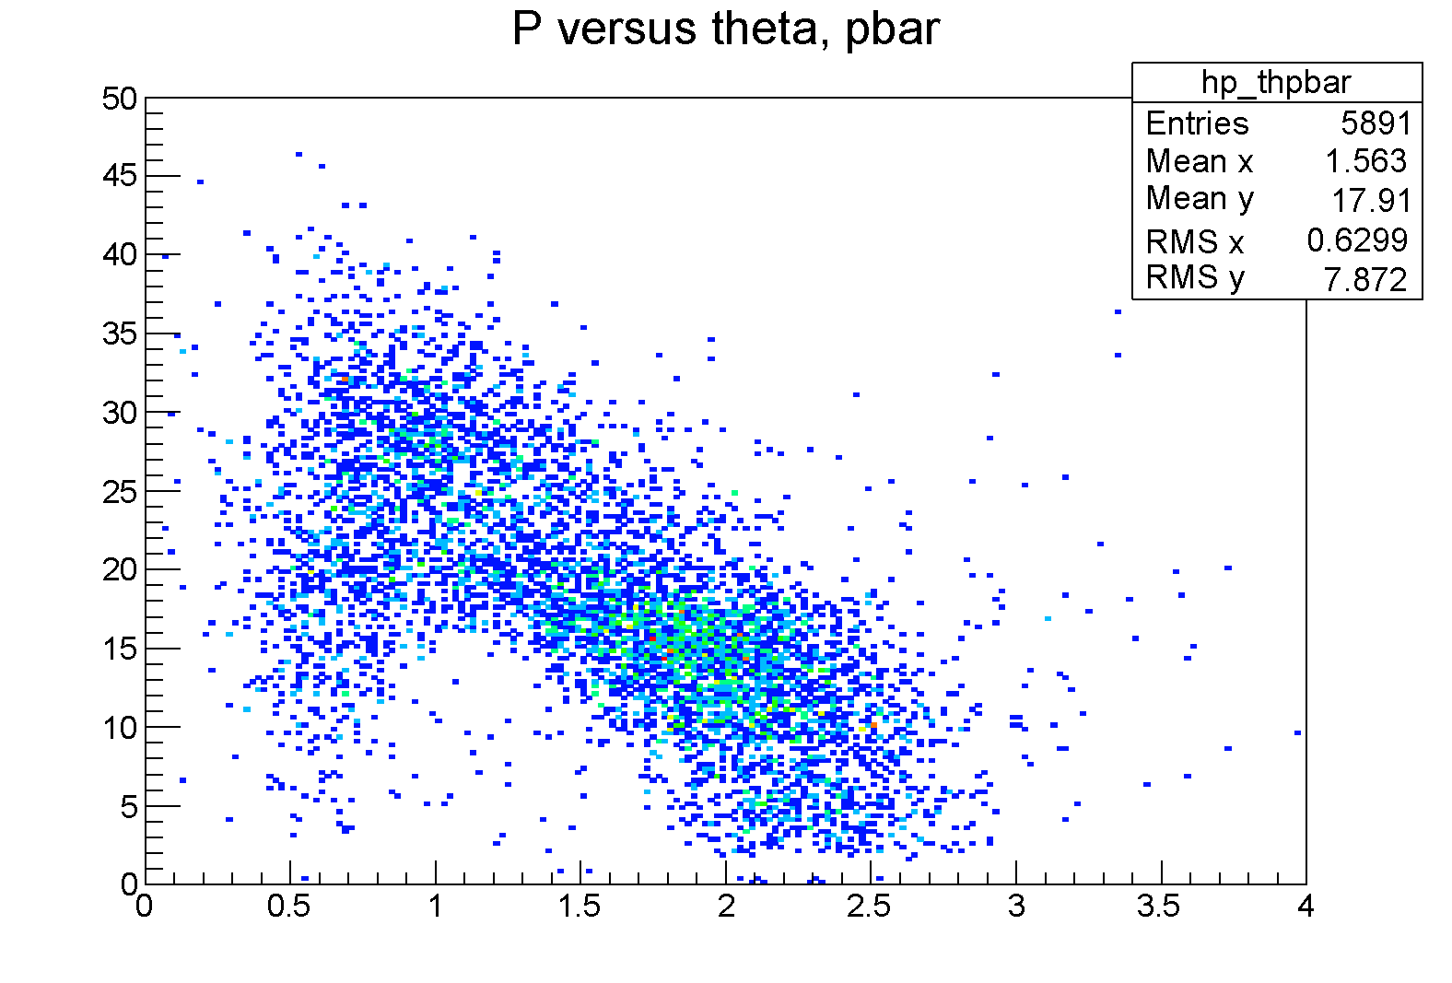
θ [º]
θ [º]
p [GeV/c]
p [GeV/c]

Slide 15
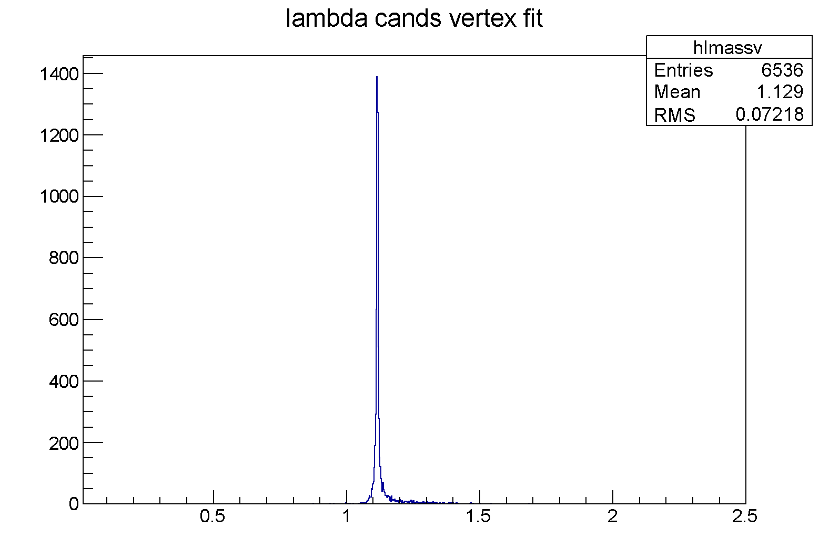
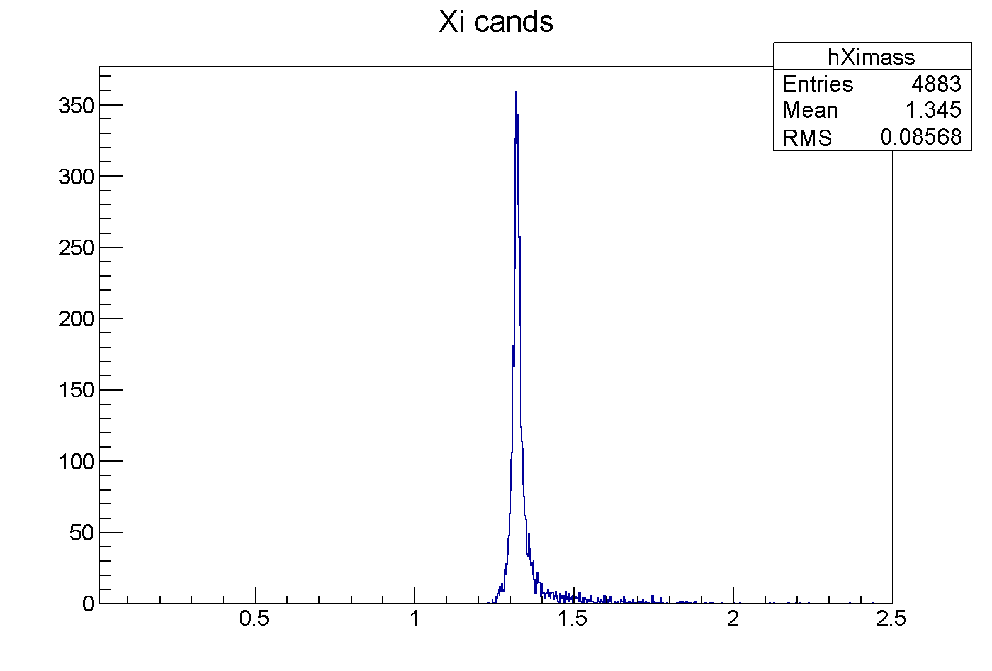
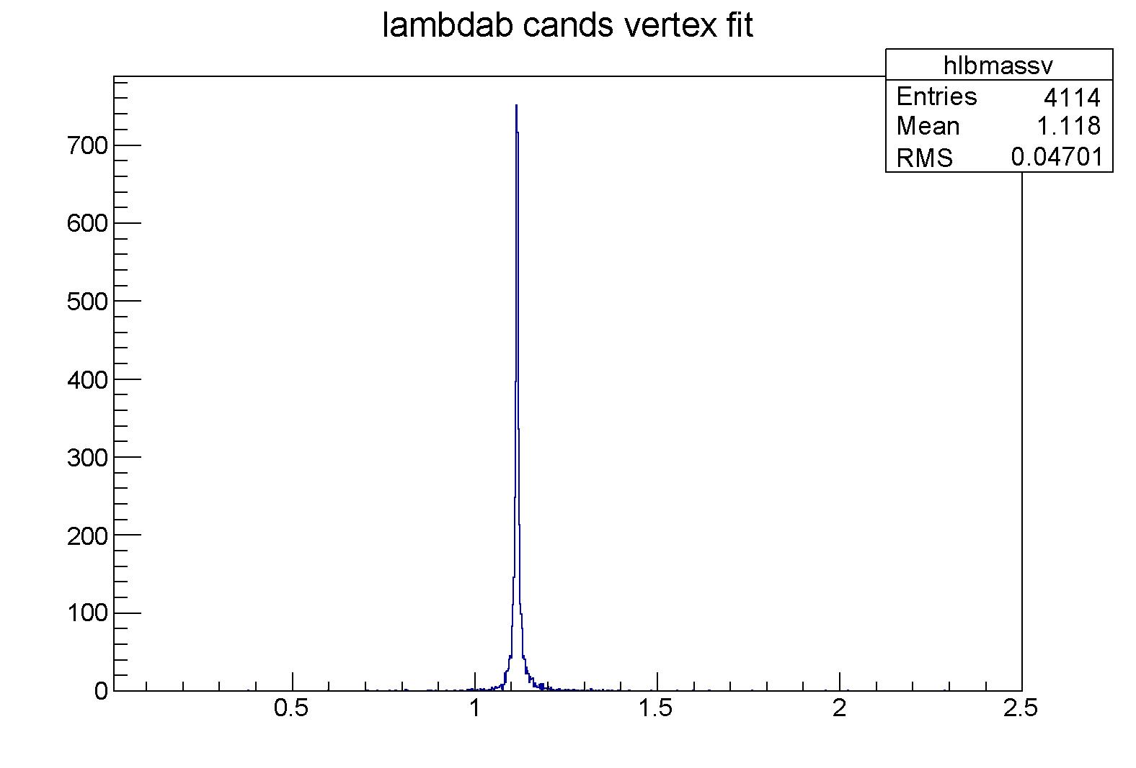
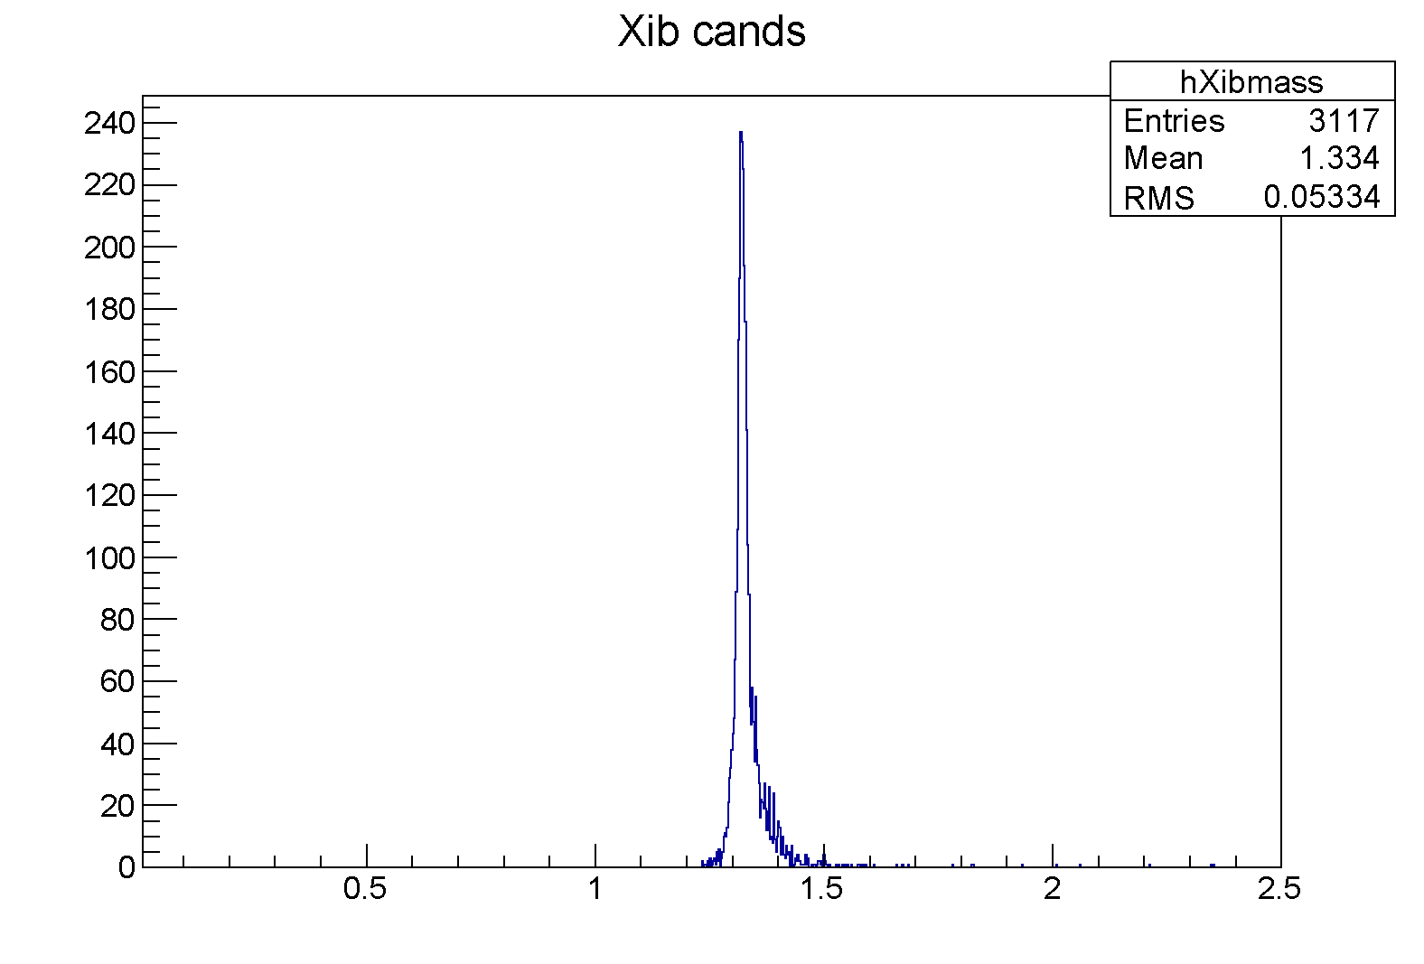
_
ΞΞ eff.: ~14%
M [GeV/c²]
M [GeV/c²]

Slide 16
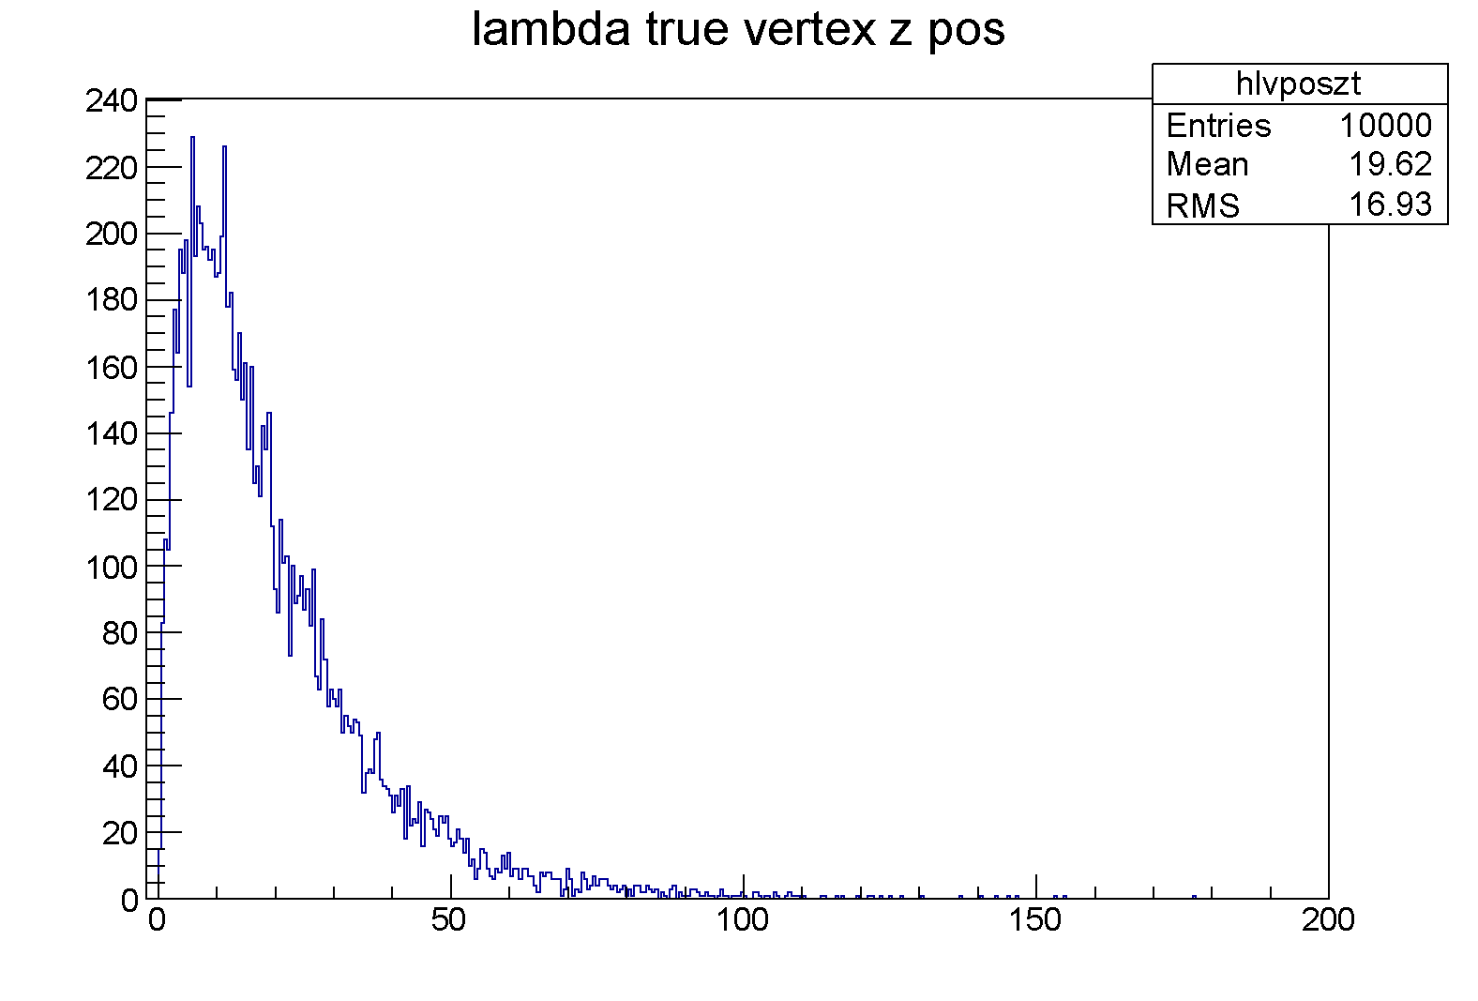
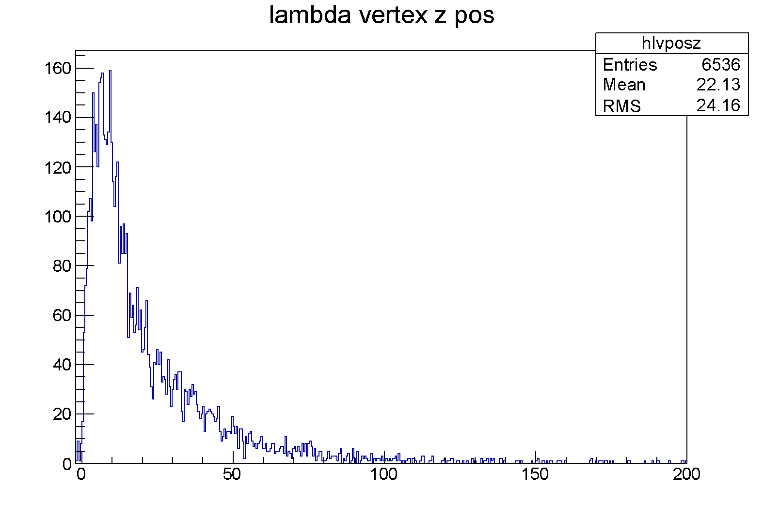
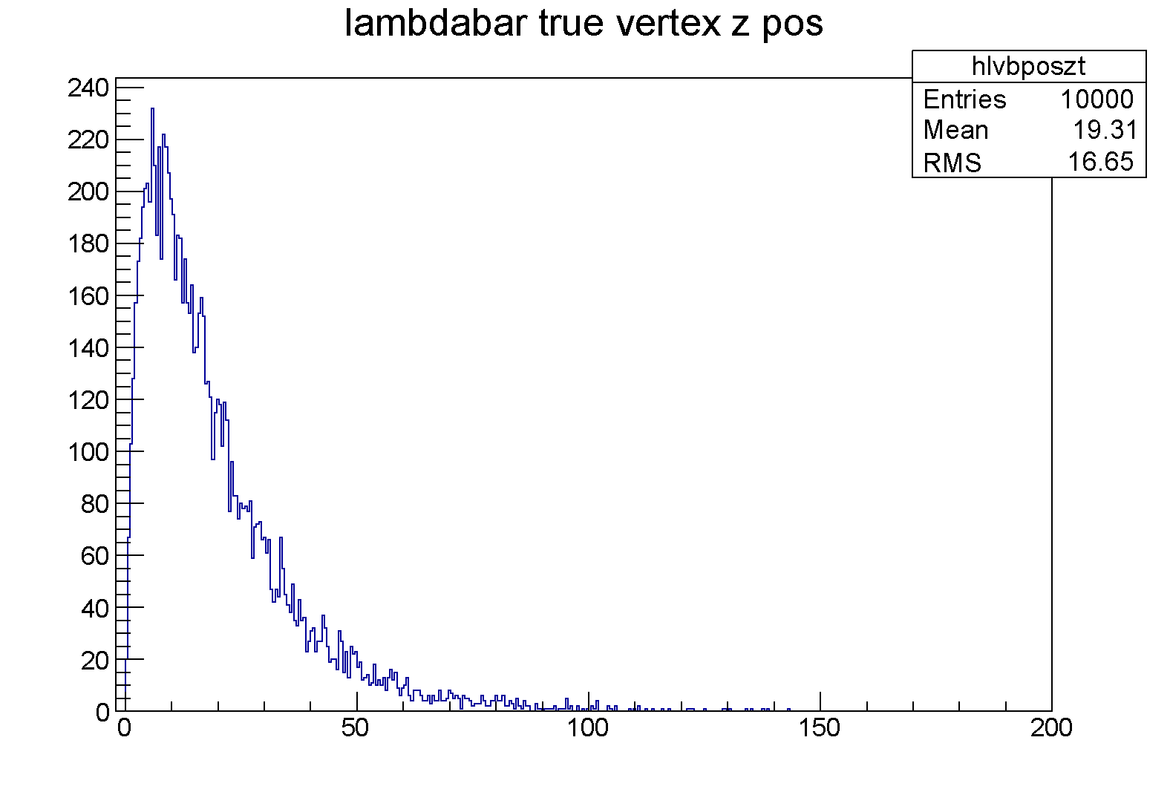
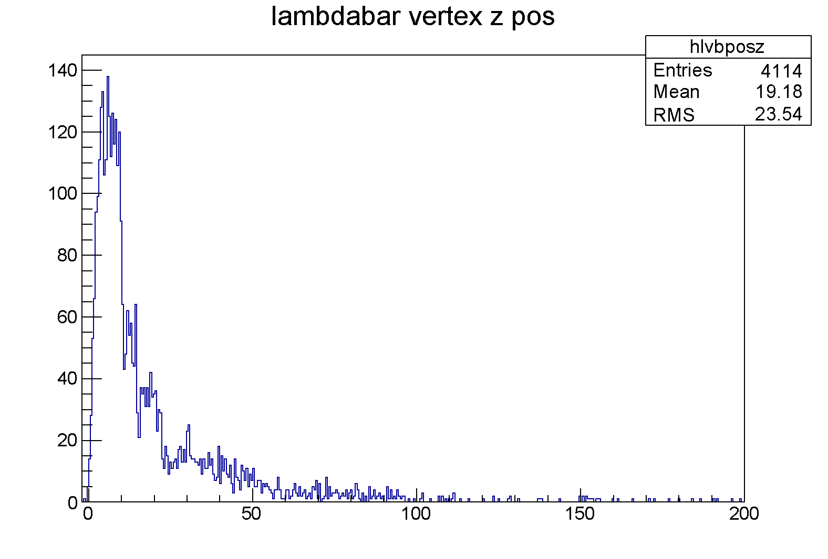
z [cm]
z [cm]

Slide 17
Status of HESR and the PANDA Detector

Slide 18
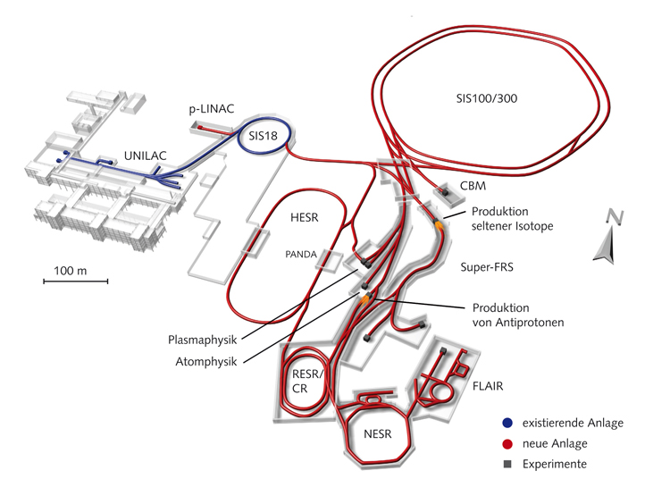
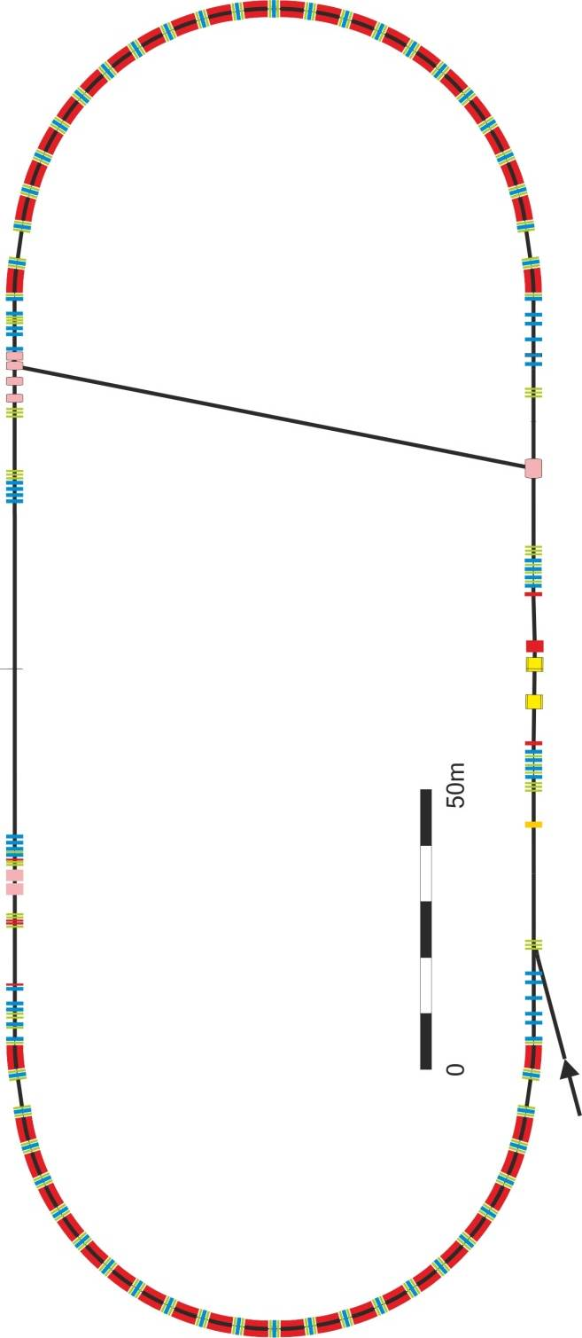
HESR
Kicker
Stochastic
cooling
PU
Electron cooler
PANDA

Slide 19
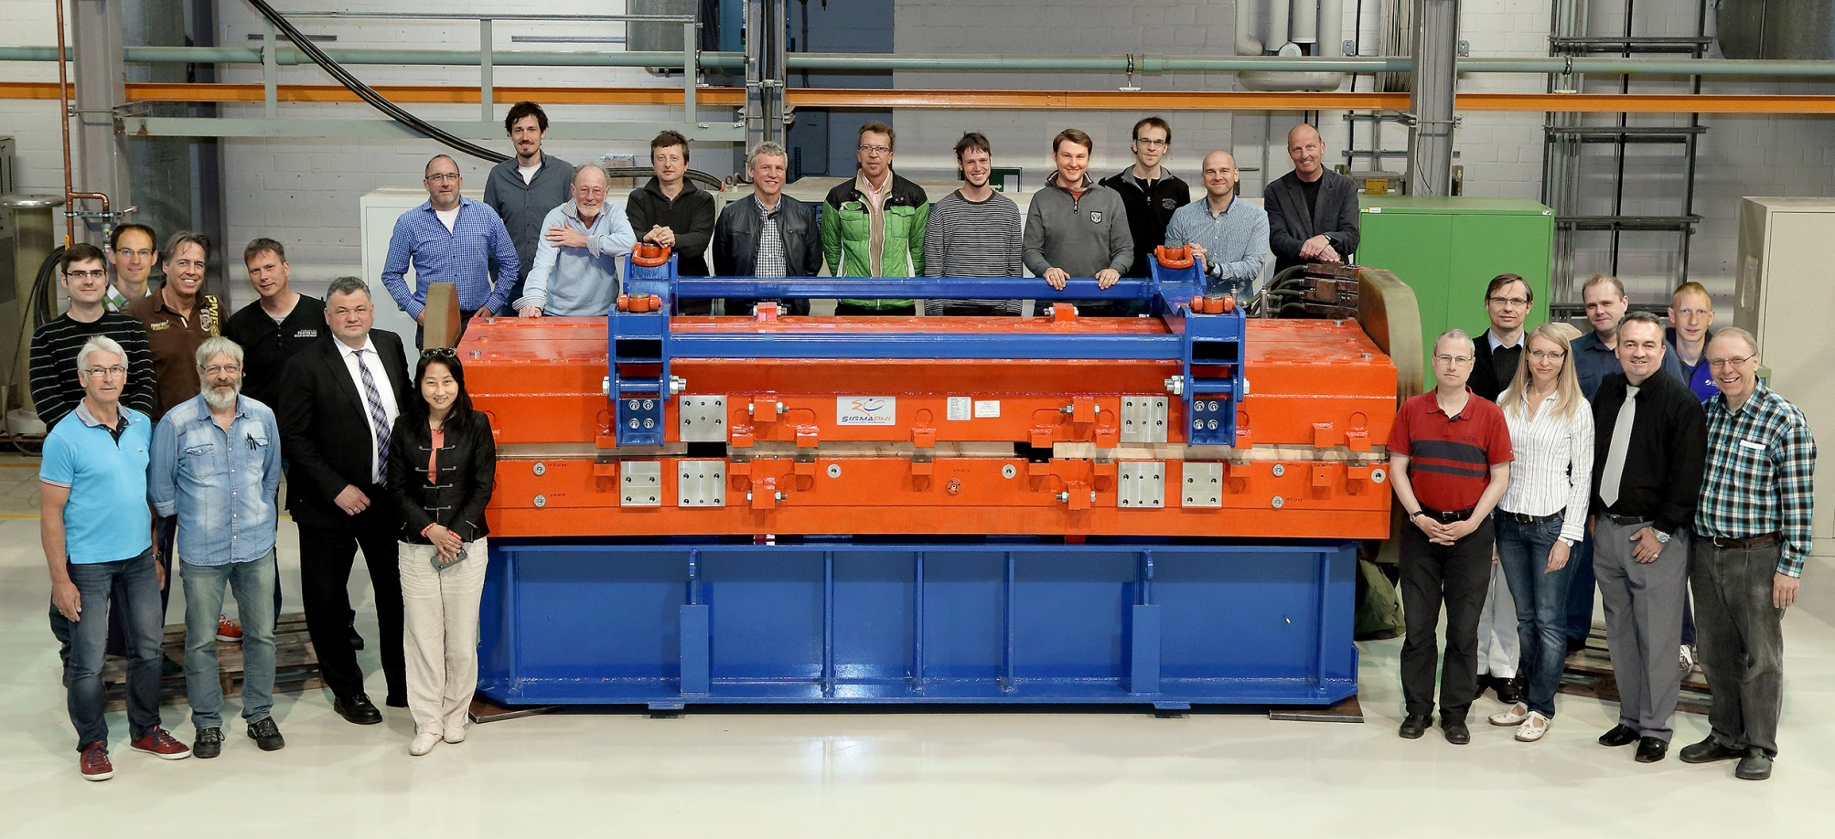
Status of HESR
9 of 46 dipoles delivered to FZJ (final one in Q2/2017)
10 of 84 quadrupoles delivered (final one in Q2/2017)
Dipole PoCos specified,will be ordered when supply building completed
Quad. Power Converters (PoCo) delivered
PANDA Chicane dipole PoCo delivered
RF and Stochastic Cooling: 1st tanks in 2015
HESR is on time and on budget

Slide 20
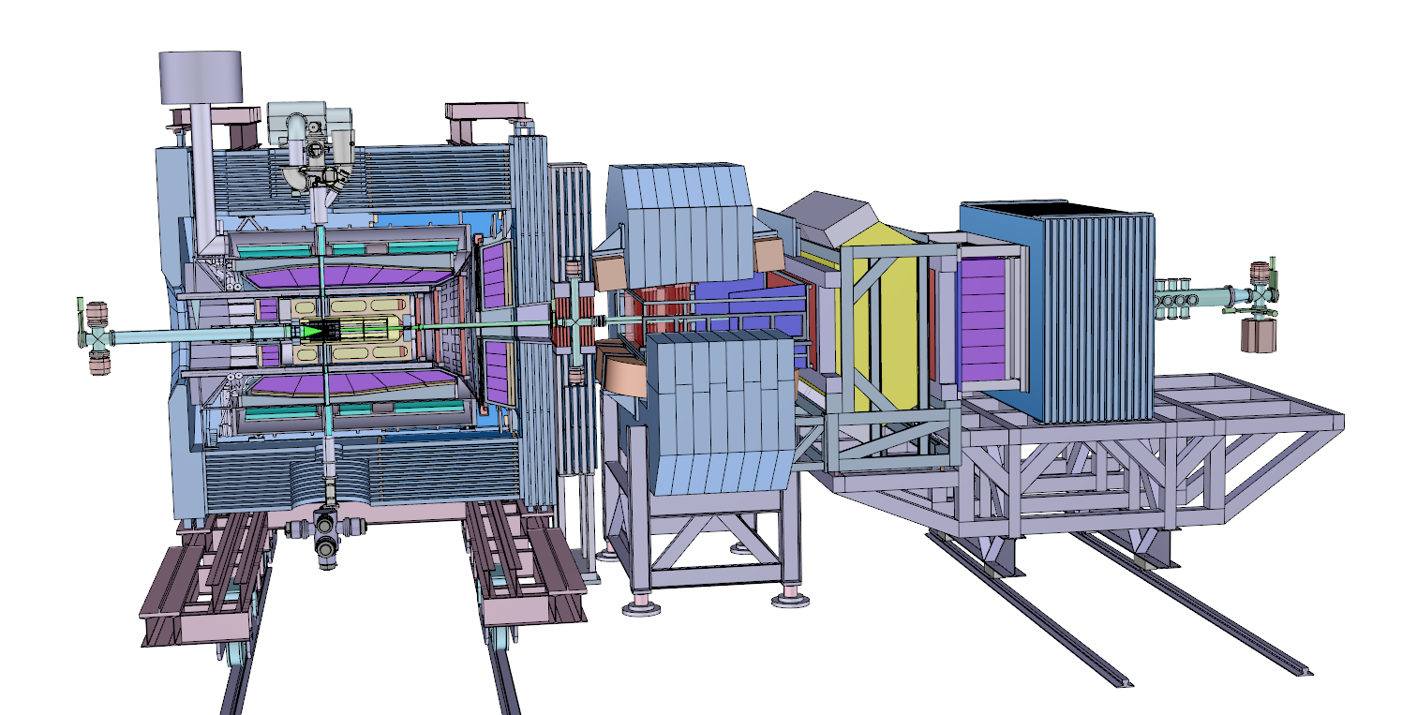
All PANDA Systems
13 m

Slide 21
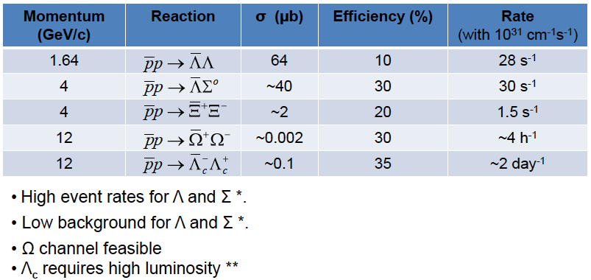
Rate Estimates for Hyperon Production

Slide 22
Potential Run-Plan – Overview first 2 years
survey light and heavy exotics generic open charm production
15.0
ΩΩbar and Λ_{c}Λ_{c}bar production and dynamics
excited Ωs generic open and hidden charm production
12.0
length of run
ΔΔ content of the deuteron – feasibility of pbard meson spectroscopy
8.0
X(3872) scan
7.0
χ_{c2} angular distribution
χ_{c1} ang. distr. and excited Ξs
5.75
5.55
ΞΞbar production and dynamics
Y(2175) and ΦΦ - T/PS-glueball search
4.4
Ξ-Atoms and excited Λs
3.75
3.0
pbar and Λbar-potentials (N, Ne, Ar targets)
2.0
1.64
GeV/c
time-like form-factors - meson spectroscopy -ΛΛbar physics

Slide 23
Summary/Conclusions
Many open questions on how complex structures are derived from underlying degrees of freedom
Antiprotons provide precision measurements
Broad/fascinating physics program at PANDA
High cross sections for baryon-antibaryon pairs
Accelerator on-time and on-budget
Detector proceeding swiftly
➔

Slide 24
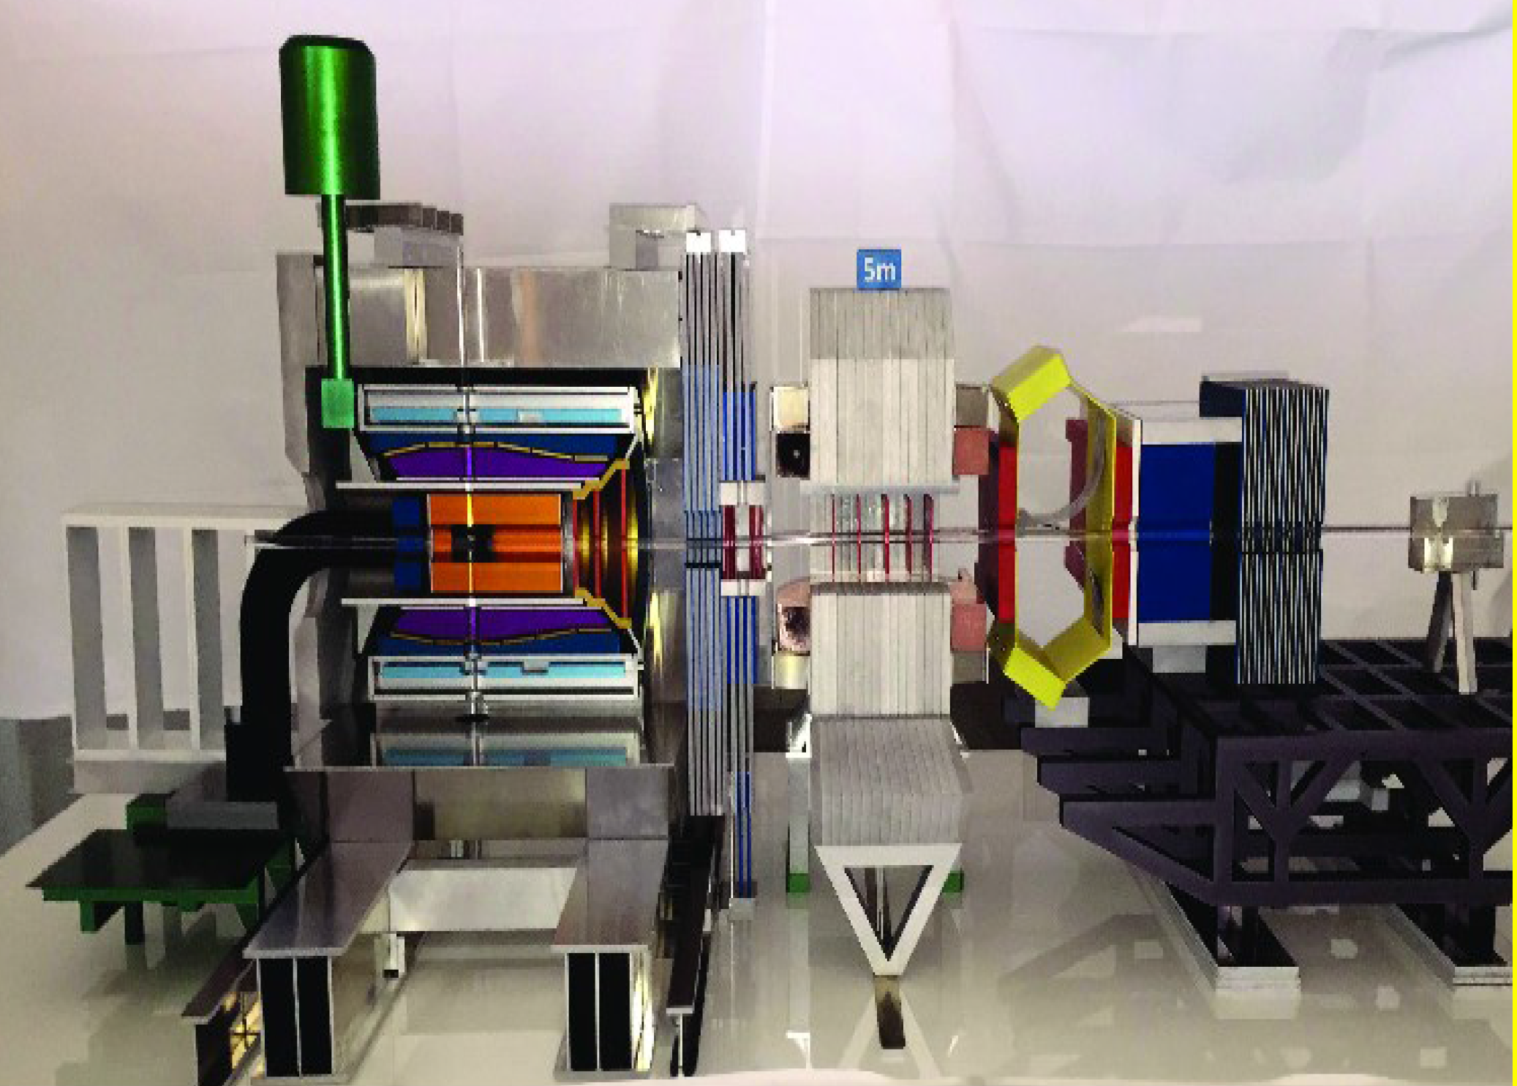
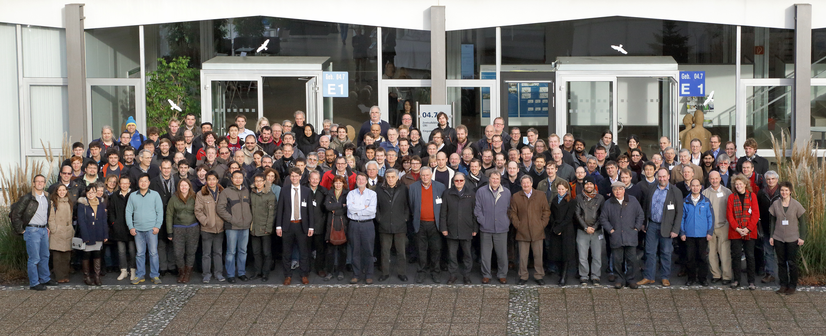

The PANDA Collaboration
~ 520 Members, 69 Institutes, 18 Countries
Austria, Australia, Belarus, China, France,
Germany, India, Italy, Poland, Romania,
Russia, Spain, Sweden, Switzerland,
Thailand, Netherlands, USA, UK

