Slide 1
Hardware characterization of ADC based DAQ-System for PANDA STT
A. Erven, L. Jokhovets, P.Kulessa, H.Ohm, K. Pysz, V. Serdyuk, P. Wintz
09.09.2015

Slide 2
General DAQ concept
Conception of an ADC based DAQ
Development of 16-channel prototype
Test of the prototype (test beam in May 2015)
Processing of the acquired data in order to get the spatial resolution
Conception of an ADC based DAQ
Maximize channel density/Process massive amount of data
Get the required accuracy
Nice to keep the system flexibility in term of bit resolution and sampling rate

Slide 3
Maximize channel density/ ADC choice
1. Sampling rate: Reduce a sampling rate in order to reduce power consumption and required processing power, thus reducing ADC and FPGA chip counts.
We have verified the system with the sampling rates 240, 166, 133, 120, and 80 MHz .
2. High integration: using of multichannel ADCs reduces overall board space requirements.
The 8-channel LTM9011-14 ADC is used.
3. Power consumption: Low power consumption per channel reduces heat in high channel count applications.
4. ADC to FPGA bandwidth matching
The pipelined ADCs offer the best trade off between power consumption and sampling rate
3.2 Choice of FPGA
3.1 Choice
of ADC type

Slide 4
ADC to FPGA bandwidth matching
1. matching of ADC output to FPGA input
The key feature is: ADCs PLL should perform up to 1GHz,
providing 1 GHz serial data stream. This is the highest data stream, that FPGA is still capable to capture.
125 MSPS/ 14 bit to 1000 Mb/s data stream (2 lines x 8 bit)
133 MSPS/ 12 bit resulting to 800 Mb/s data stream (2 lines x 6 bit)
167 MSPS/ 12 bit resulting to 1000 Mb/s data stream (2 lines x 6 bit)
Linear Technology LTM9011-14, is specified for a sample rate of 125 MSPS in 14- bit mode.

Slide 5
Second aspect – using almost all FPGA I/O banks to acquire the data
8 from 10 I/O banks to acquire the data
Each bank has 20 differential I/O pairs. This is enough for connecting of one 8-channel ADC to single FPGA bank.

Slide 6
Open eye test
Each LVDS signal enters FPGA chip passing individual adjustable I/O delay unit (IDELAYE2).
This unit delays LVDS data until the clock front pass in the opening eye.
It is performed with variable number of delay tabs (>=32). Each tab introduces delay of 70 ps.
Been tested in our experimental setup:
The opening eye value decreases from 8 to 4 delay taps (560 to 280 ns) with increasing LVDS line length from 14 to 28 cm.
Desired length of 1 GHz-LVDS-line connecting ADC and FPGA should be not more as 30 cm.

Slide 7
Electronic elements inside ATCA board

Slide 8
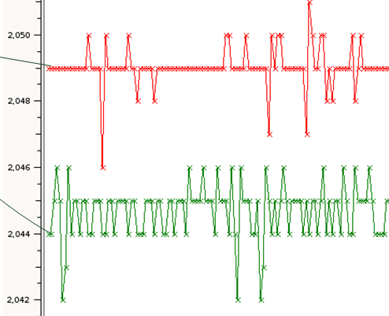
Noise/ offset measurements
12- bit mode, 166,7 MSPS
12- bit mode, 125 MSPS
Offset channel-to-channel deviation: 10 bit
Noise 125 MSPS: 1-2 bins
Noise 166,7 MSPS: 3-4 bins

Slide 9
Signal-to-Noise measurements
during test beam 05.2015
The whole chain Straw tube +10 m-cable +TRA/shaping amplifier +ADC
The same measurement (energy, HW), same TRA/shaping amplifier
The only difference is ADC: 240 MSPS-old LTC2242-12; 166 and 133 MSPS LTM9011-14
Noise 240 MSPS: ~20 bins compared with an average cluster (est. 30 bins)
Noise 166 and 133 MSPS: ~10-12 bins

Slide 10
power estimation
per channel
FPGA, each consuming ~8 W/ 64 ch. → 80mW
A/D channel, ~180mW
Analog electronic ~100mW
At all/channel →360mW
per board
360 x 0.360~ 130 W (spec. for ATCA board in crate <200 W)

Slide 11
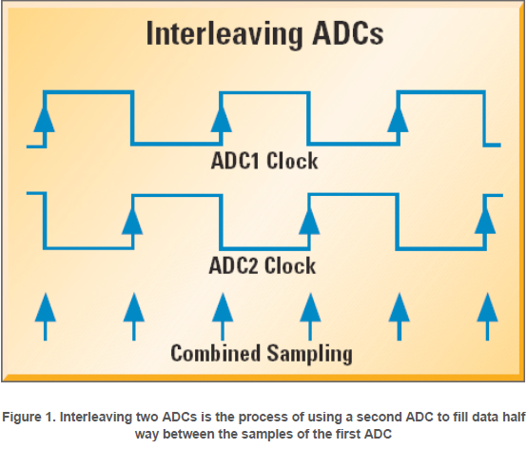
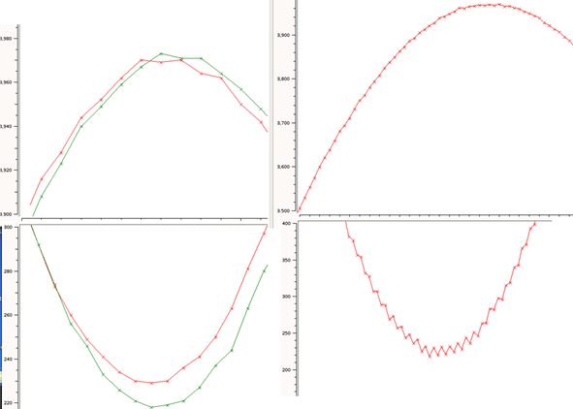
Interleaving ADCs for Higher Sample Rates
combine more than one analog-to-digital converter (ADC) in an effort to increase the effective sample rate
Matching of 2 channels to single one is not ideal, the differ offsets and gains of 2 LTM9011-14 ADCs destroys the sinus.
HMCAD1520 offers self-calibration feature
where offset, gain,
and linearity errors are minimized,
making it much easier to interleave them
without spurs.

Slide 12
Comparison: was, is and can be
 | LTC2242-12 (was) | LTM9011-14 (is proved) | HMCAD1520 (to be or not to be)
Power dissipation /ch., 166 MSPS | 740 mW (spec. only for 250 MSPS) | 180 mW | 123 mW
SNR (dB) | 65.4 | 73.1 | 70
ADC-to-FPGA matching | Poor, causing by single channel output running at 250 MHz | Very good, 2-LVDS serial lines per channel each running up to 1 GHz | Very good, 2-LVDS serial lines per channel each running up to 1 GHz
Sampling rate in 12-bit mode | 10-250 MSPS | 80-125-166(not spec.) MSPS | 80-166 MSPS, up to 1 GSPS by interleaving and in 8-bit mode
Flexibility to diff. experiment requirements | Poor, single mode 12-bit | Good, 12 /14-bit, increasing sample rate by low bit mode | Very good, 8/12/14, increasing sample rate by low bit mode
proved | yes | yes | No, but it offers the same control and data transfer as LTM9011-14
Channels/chip | 1 | 8 | 4

Slide 13
outlook
16-channel prototype was successfully tested
We should only scale up the verified design in order to build the whole 4636- channel DAQ system
THANK YOU!

