Slide 1
Beam time @Julich -2016

Slide 2
Status of the MVD activities in Torino
I ) Presentation at the mec. session
II) Results from beam tests of pixel prototypes
Daniela Calvo

Slide 3
Update of MVD services and requests
DCDC circuits
Optoelectronic (GBTx + VTRX) boards
Cooling plant
Services on platform in front of the magnet
Daniela Calvo
MVD group

Slide 4
MVD services - DCDC circuits

Slide 5
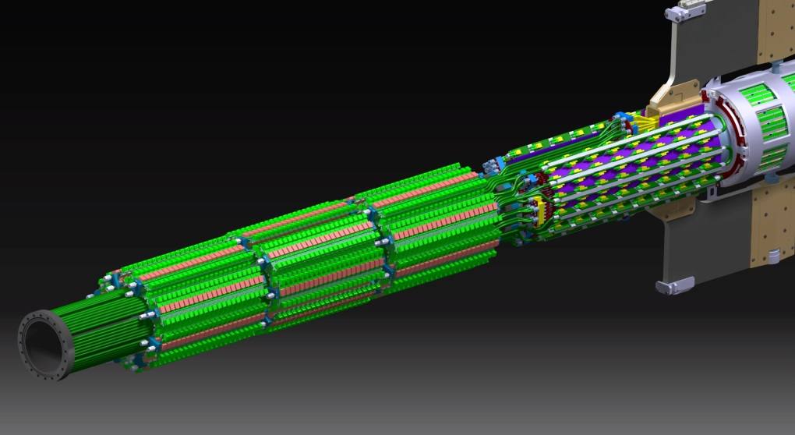
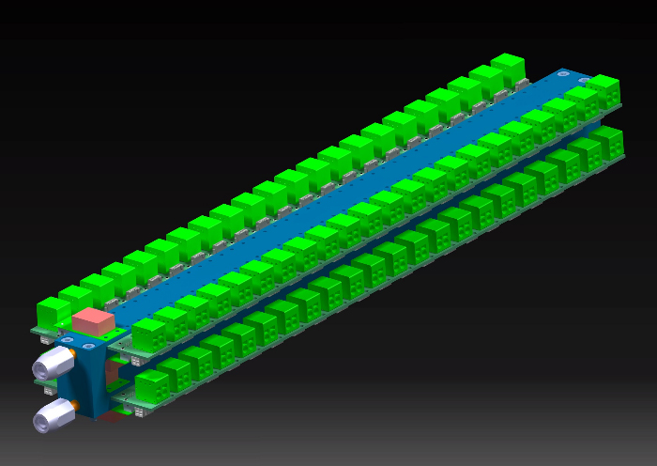
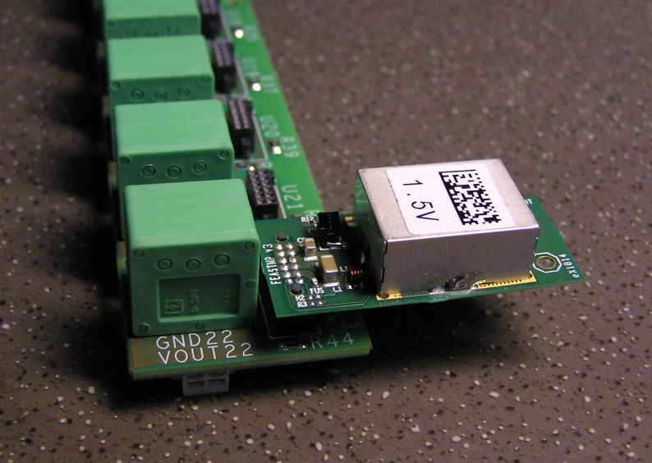
MVD service - DCDC circuits
24 blocks arranged in 3 sectors
(2112 DCDC circuits)
4 PCBs (left and right difference)
housing 22 DCDC circuits each

Slide 6
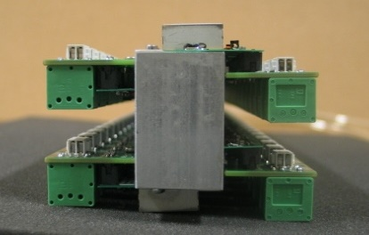
MVD services – first prototype
88 DCDC circuits (22 DCDC circuits each row)
Weight (without cables): ~ 1.3 Kg
Dimension (without cables):
455 mm (with cooling connectors) x 85 mm x 63 mm

Slide 7
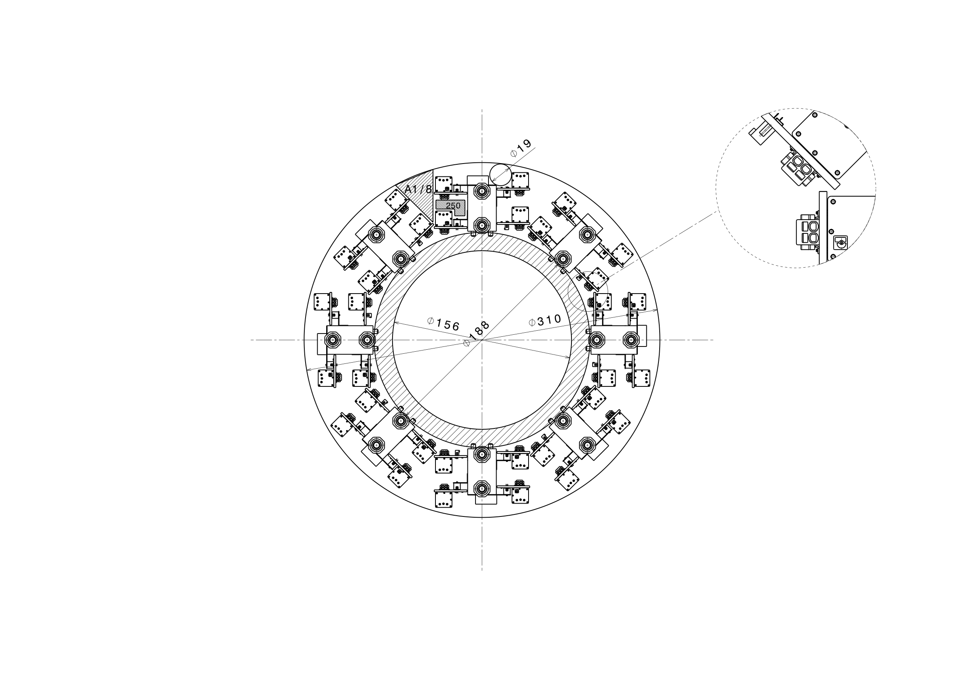
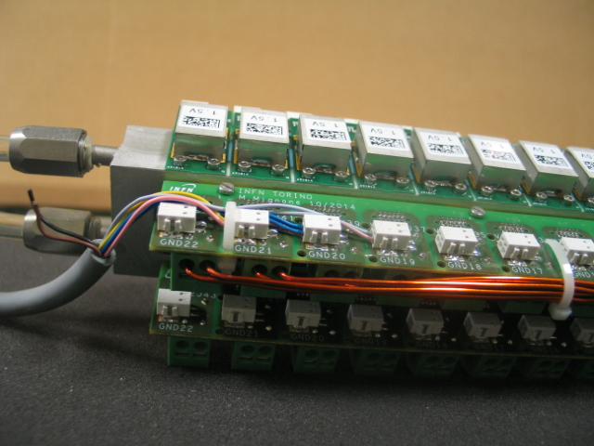
MVD services - Request
Available cross section: 56000 mm2
(between beam pipe and inner BEMC diameter)
Cooling pipes and supports: 9000 mm2
(dashed ring – challenge solution!)
DCDC circuits leave only ~ half of cross section for cables (needed cross section: 22300 mm2) and the cables will fill the empty parts between the circuits anyway.
(not reccommended!)
ONLY HALF of the needed CROSS SECTION is AVAILABLE for cables
IT IS NECESSARY MORE SPACE around the beam pipe for the MVD

Slide 8
MVD services – Optoelectronic boards

Slide 9
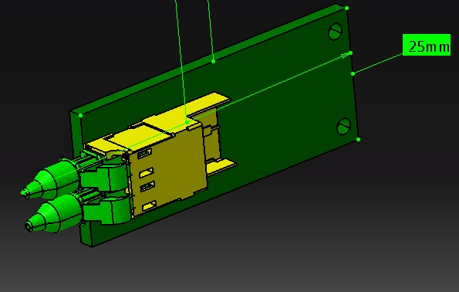
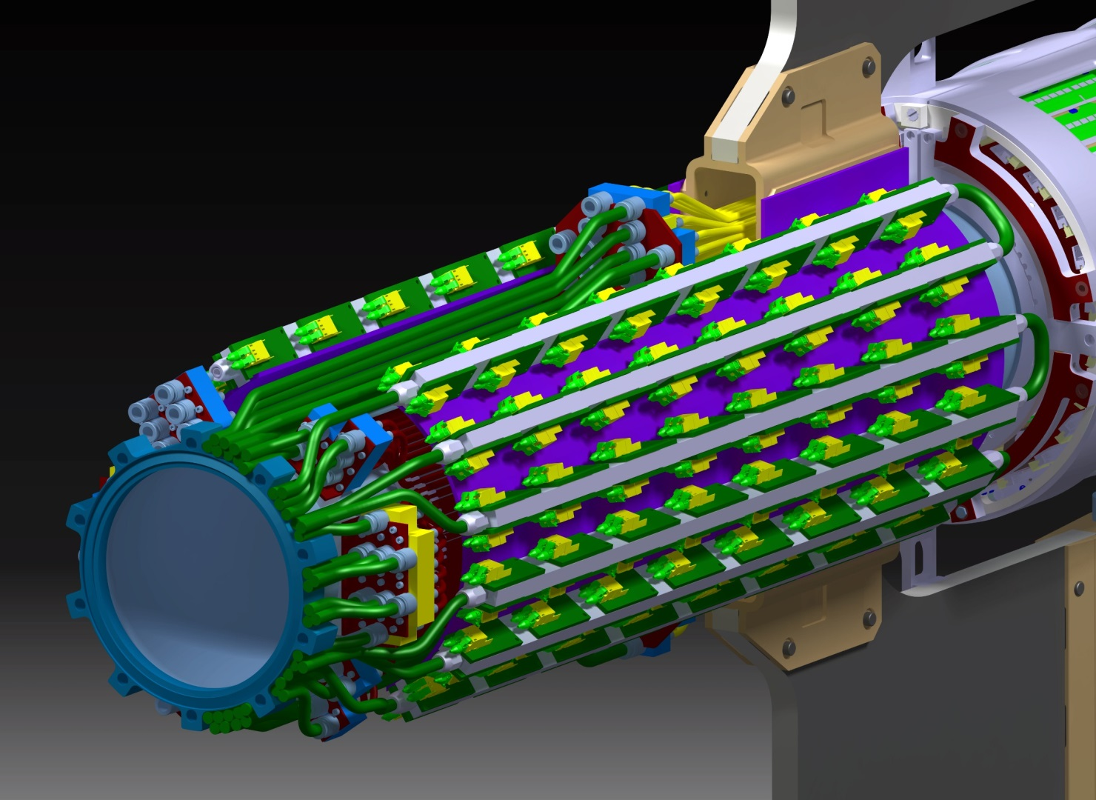
Optoelectronics board, old version
76 mm
60 mm
12 bars with 16 GBT boards each
(192 circuits)
Interspace between PCBs: 20 mm

Slide 10
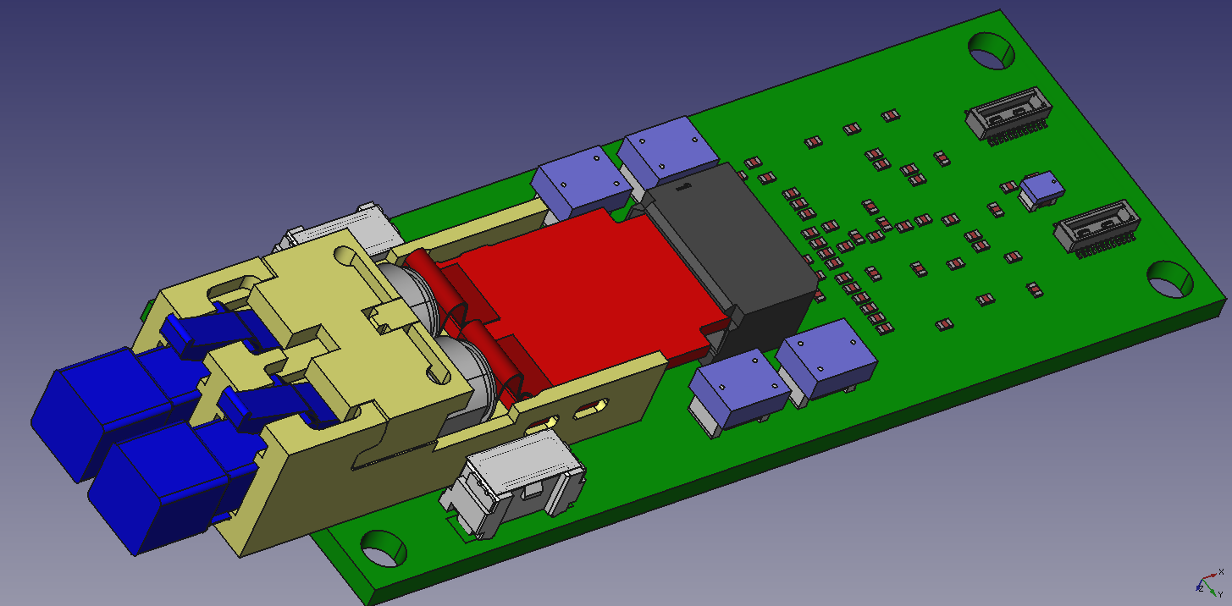
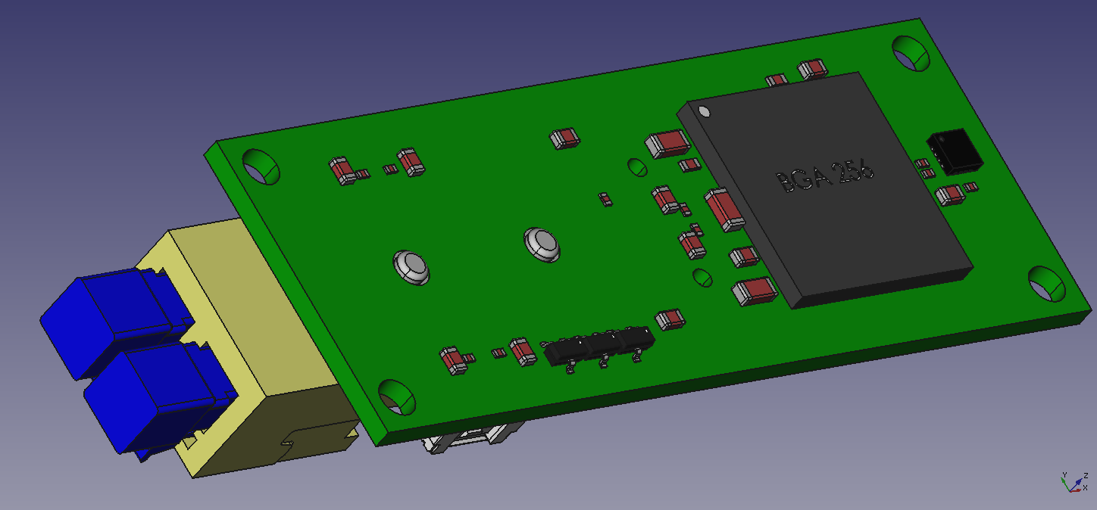
Optoelectronic board, new version – GBTx + VTRX
86 mm
25.4 mm
GBTx and VTRX on opposite sides, then 4.8 Gbit/s signals routed using vias
Two power supply connectors to fit the routing of the power supply cables, in fact two mounting configuration of the boards are foreseen.
Additional chip to distribute the SC out signal to the two connectors towards the FEE.
The cooling of the GBTx in this configuration should be easier (to be verified!).
The board dimension is larger than the estimated values ( 3 years ago) anyway.
15.5 mm

Slide 11
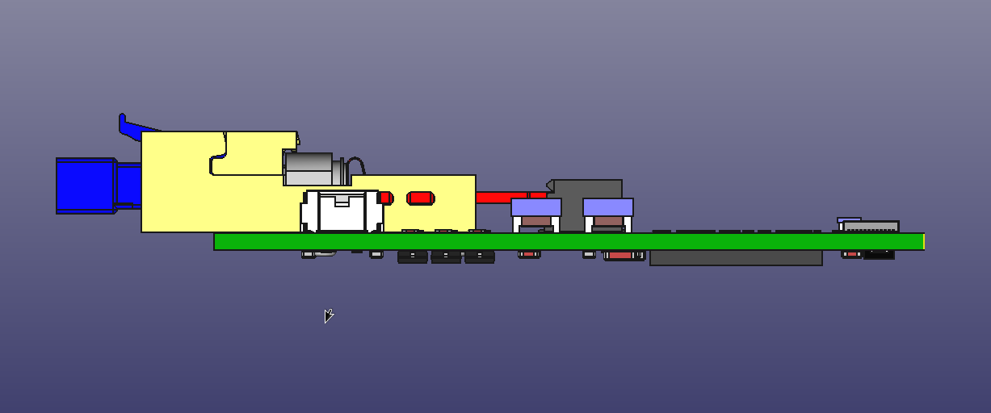
Opto. board, new version – board routing
Signal cable
16,5 mm
20 mm
Thermal bridge (copper)
Interference between optical fiber connectors and signal cables !!

Slide 12
Opto. board, new version – board number
86 mm
25.4 mm
Each connector includes : 5 e-links + SC signal
22 additional boards
to maintain the symmetry left– right during the routing of the semi disks and semi cylinders of the barrel part
to be able to send the SC signal to each pixel or strip module without connection between different modules
It is necessary to increase the GBT board number from 192 to 214.
It means 2 additional optoelectronic boards each bar, one each side

Slide 13
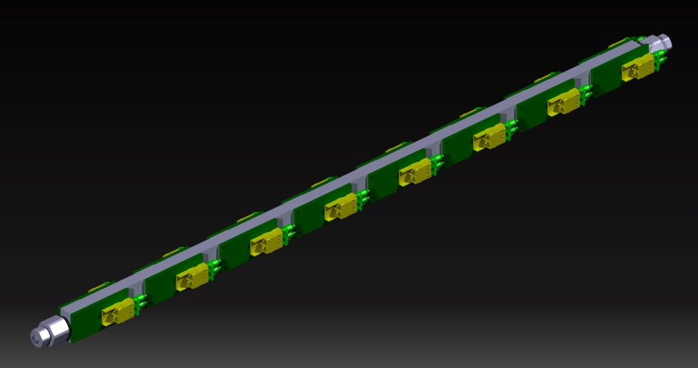
Requests
Additional 80 mm to arrange the 192 longer optoelectronics boards
Additional 86 mm to arrange an additional board along the rod
Additional 120 mm to avoid interference between optical fibers and signal cables
Interdistance:
15 mm longer
Possible solution ?: to shift upstream the beam pipe flange
A DCDC block (or partial block) has to be cut out, anyway!
IT IS NECESSARY MORE SPACE around the beam pipe for the MVD

Slide 14
MVD services – Cooling plant

Slide 15
Cooling plant ouside the pit
INLET RACKS (PIXEL, STRIP, SERVICES)
PLC

Slide 16
Cooling plant inside the pit
RETURN RACKS (PIXEL, STRIP, SERVICES)
INLET PUMP + WATER CLEANING UNIT
TANK+ VACUUM PUMP

Slide 17
Cooling plant - line paths inside PANDA Hall
RETURN LINES
INLET LINES

Slide 18
MVD services in front of the magnet

Slide 19
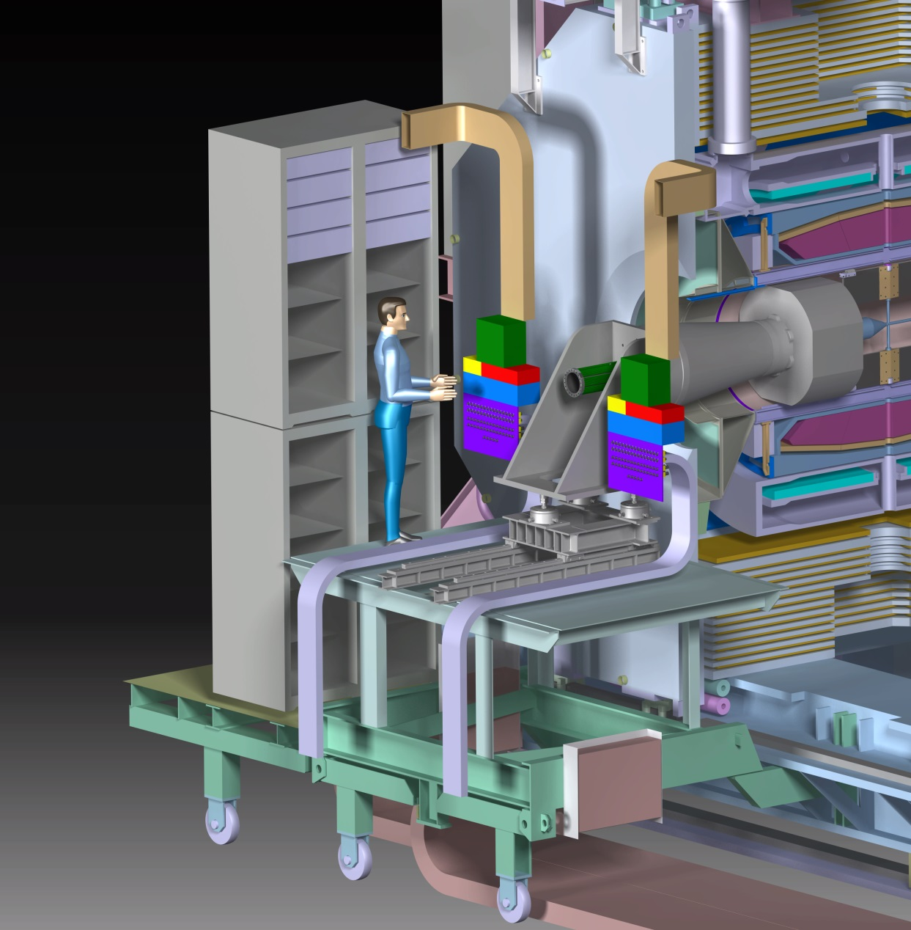
Racks - request
Use the racks starting from the top (222 U – 50% left and 50% right).
The reduction to 188 U is still under investigation.
MVD
MVD

Slide 20
Patch panels for cables - request
Patch panels
for MVD cables
Patch panels for MVD cables positioned close the BEMC support (left and right) with duct to route cables from racks.
A specific system could move and rotate the duct for positioning the patch panels at the external side of the racks, during the installation of detectors.
The system could be positioned on the top of the racks

Slide 21
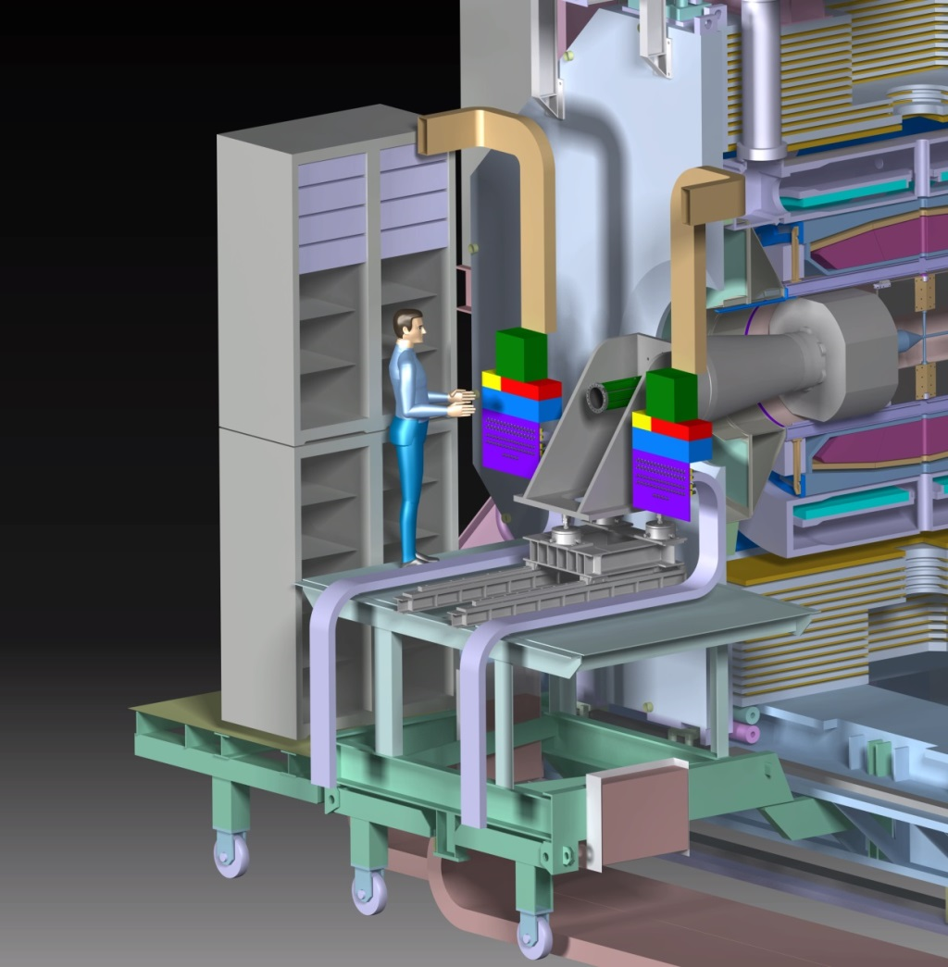
Routing of the cooling pipes and patch panel - request
The duct for the cooling pipes to the patch panels needs to be positioned under the platform floor
It should be a solution to foresee also the patch panel (for the cooling part) under the platform during the detectors installation. A system could move and rotate the patch panel to the final position, near the BEMC support. But it is necessary to go trough the platform floor.
Patch panel
Duct - cooling pipes
platform
Vertical section
platform

Slide 22
Results from beam tests
of pixel prototypes
Daniela Calvo
Torino MVD group

Slide 23
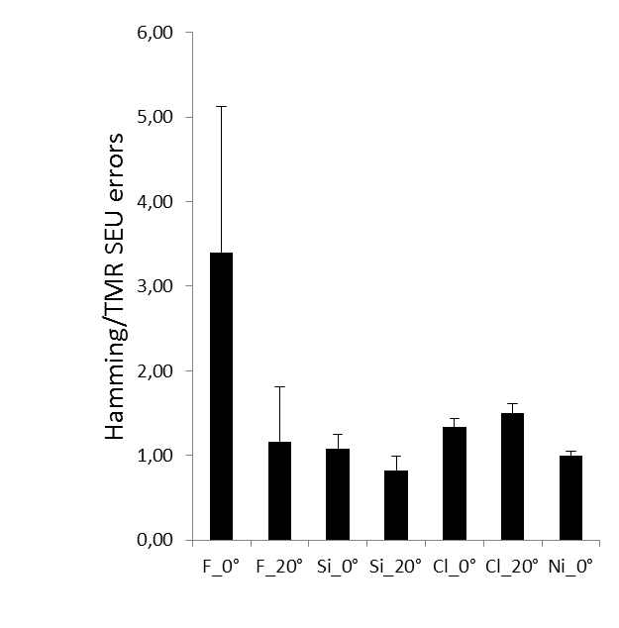
Test at LNL - July 2015
To complete the study of SEU of the pixel configuration registers of ToPix4
(to study the best trade off of the area vs protection level)
half of the matrix implements D-type Flip-Flops circuits with the Triple Modular Redundancy (TMR) error detection and correction circuitry
the second half of the matrix uses Hamming encoding that detects and corrects errors
(ToPix3 used TMR with latches)
July 2014
July 2015
?
< 1.3 x10⁻⁶ upsets/hour in the MVD

Slide 24
Test in Julich - May 2015
Pixel tracking station equipped with assemblies based on ToPix4, to perform:
ToT measurements as a function of the feedback current
Double Data Rate test
Efficiency evaluation

Slide 25
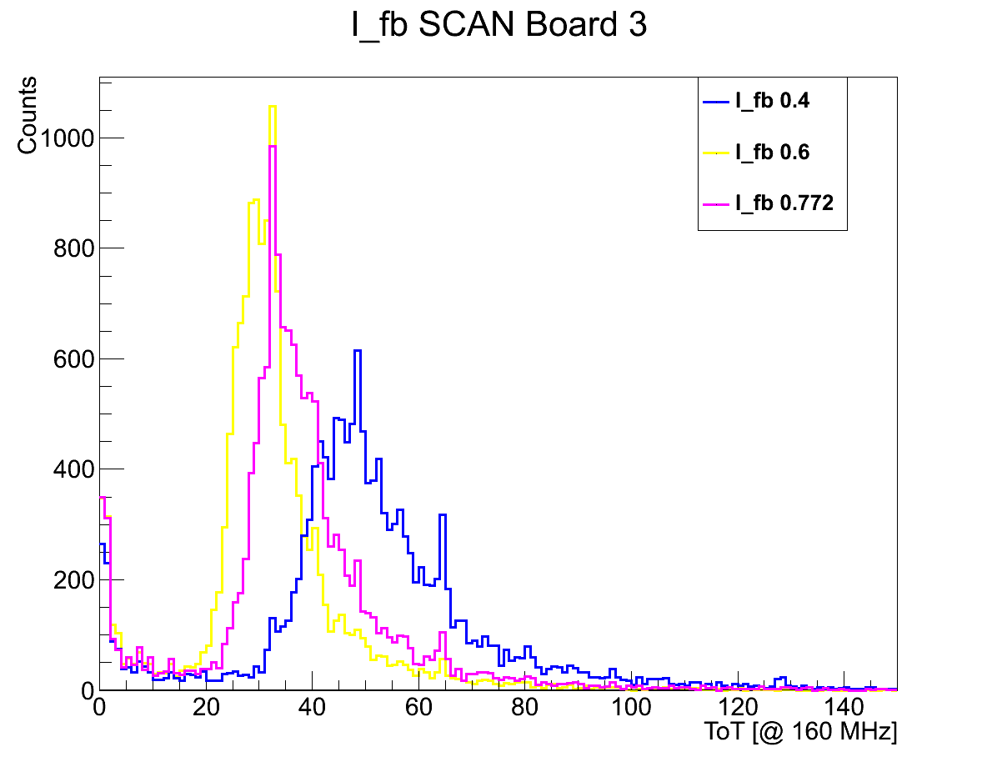
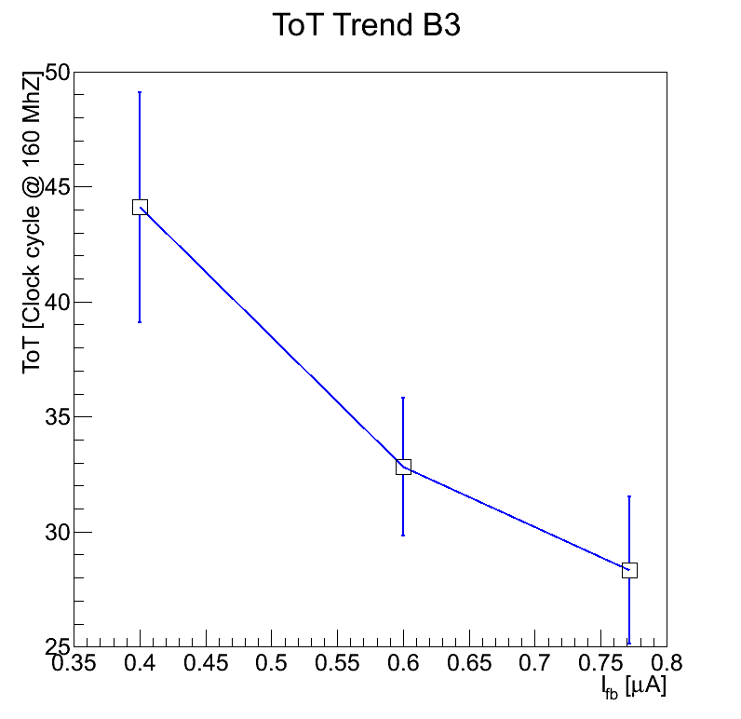
Test in Julich - 1
5,00 nA/pixel
7,5
9,65
Measured voltage [V] @ test point,
to regulate feedback current

Slide 26
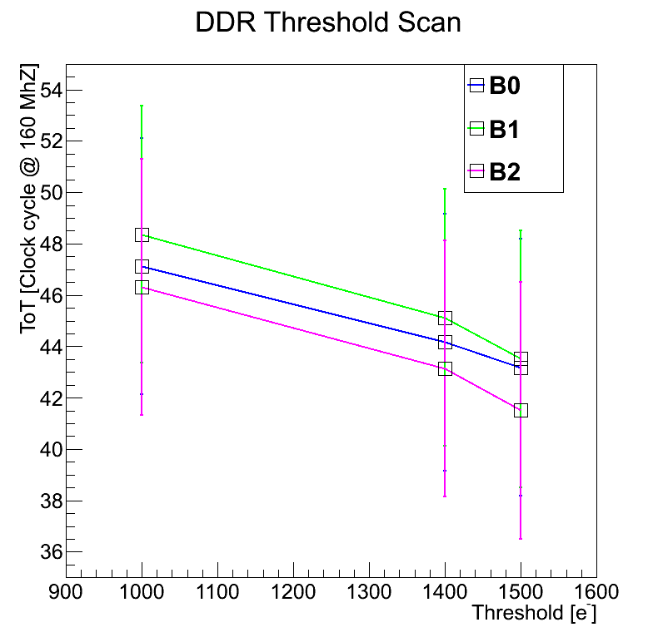
Test in Julich - 2

Slide 27
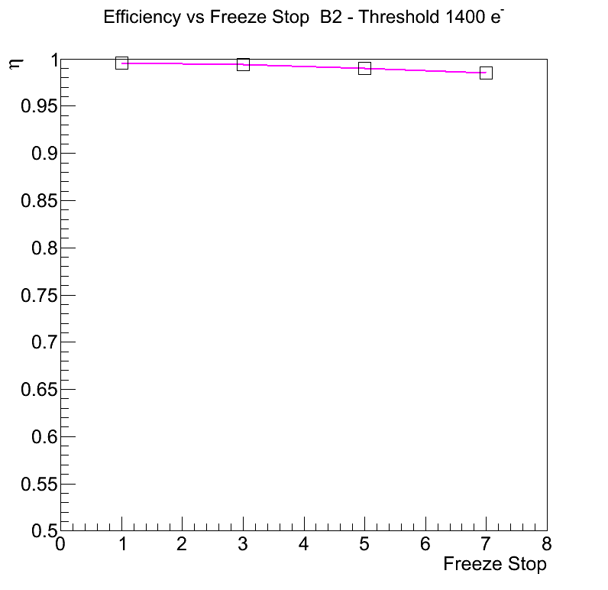
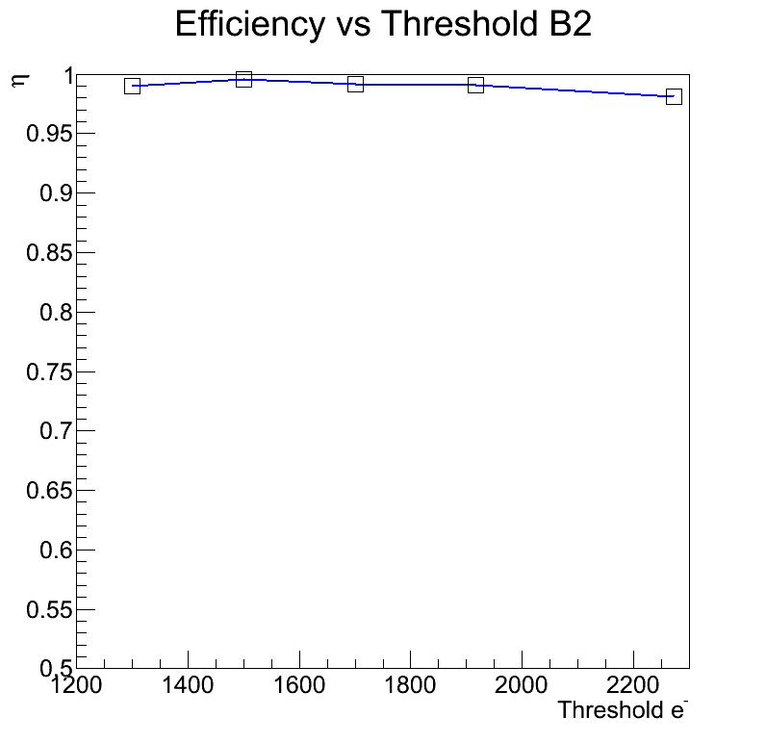
Test in Julich - 3
Efficiency vs Freeze Stop
Efficiency vs threshold

Slide 28
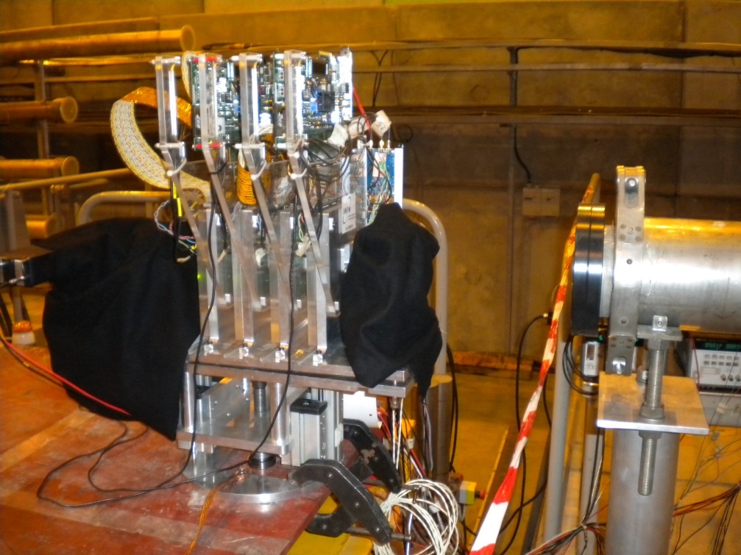
Test at CERN - July 2015
To perform tests with different particles and momentum (pions and protons, positive and negative polarity, the momentum ranges between 20 GeV/c up to 150 GeV/c).
To mask the furthest pixels in the long columns
To check the chip at different voltage supply
To run without the filter used in the daq to cut out the events without hits
4 pixel assemblies under test
2 scintillator stations each composed by a cross of two small scintillators to count the particle number in the sensor area ( 6.4 mm2)
1 cross between two scintillator to count the particle number/cm2

Slide 29
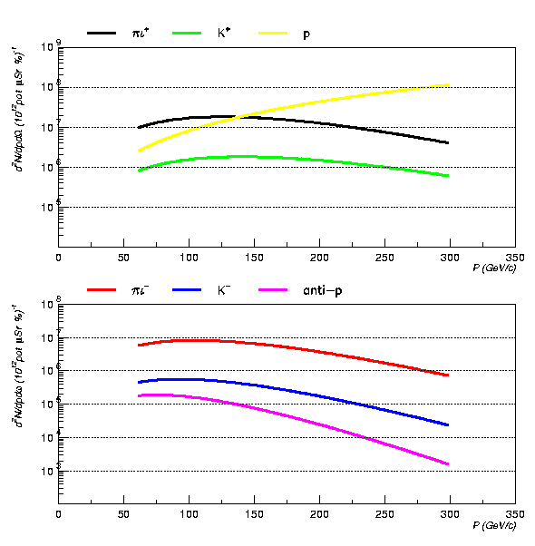
Test at CERN - 1
Unfortunately, tests with positive polarity were possible only
In addition, higher momentum corresponds to higher beam intensity
Tests @ 4 different momentum
20 GeV/c
50 GeV/c
100 GeV/c
150 GeV/c

Slide 30
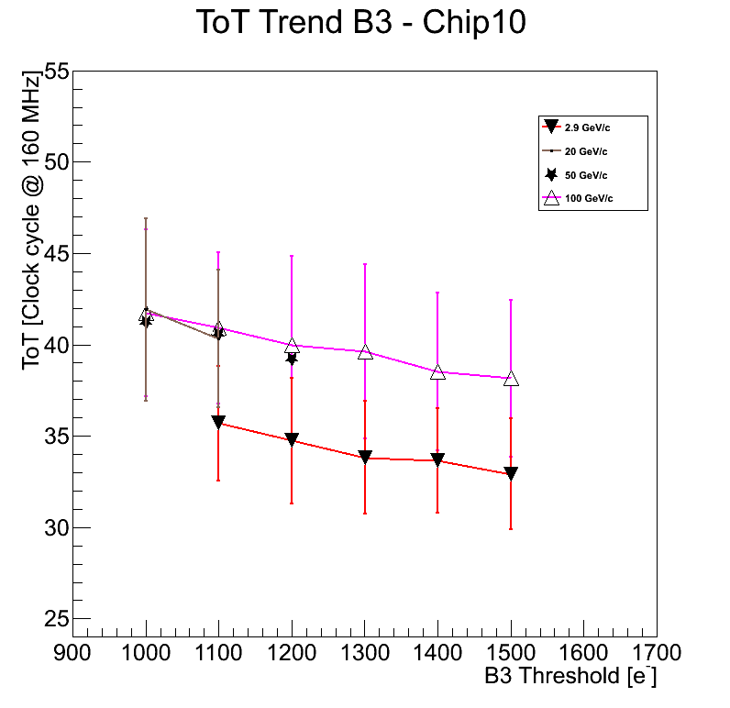
Test at CERN - 1
Preliminary plot !
2.9 GeV/c protons at Julich
Different % of pions and protons at 20, 50 and 100 GeV/c, at CERN
ToT and error values: most probable values and the gaussian sigma obtained using the convolution fit to the ToT distributions

Slide 31
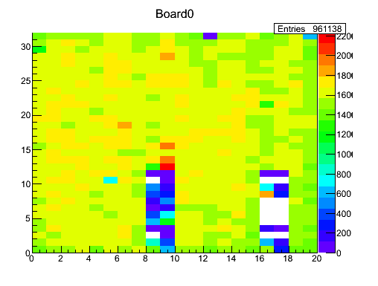
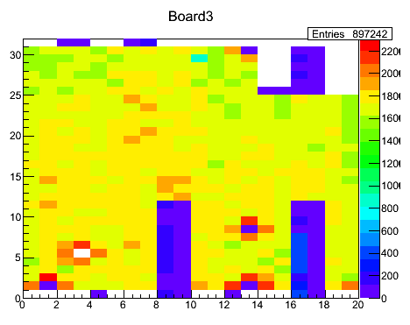
Test at Cern - 2
Momentum: 150 GeV/c, th: 1200 electrons
The furthest pixels in the long columns were masked
The evaluated number of hits/cm2 is ~ 3 Mhits/cm2 (also measured)
The masked pixels show hits in the raw map of the assembly, anyway.
A possible explanation is that they are created in the end column circuits. To be investigated!

Slide 32
Test at Cern – 3 and 4
Tests at different voltage supply need to evaluate the new working point of the chip.
We have achieved this conclusion during the data acquisition!!!!
Then the acquired data are meaningless.
The comparison of acquired data with and without filter at the level of data acquisition has to be still done

