Slide 1
Thermal screen of the cryostat
Joint Institute for Nuclear Research (Dubna)
Presented by Evgeny Koshurnikov,
GSI, Darmstadt
September 8, 2015

Slide 2
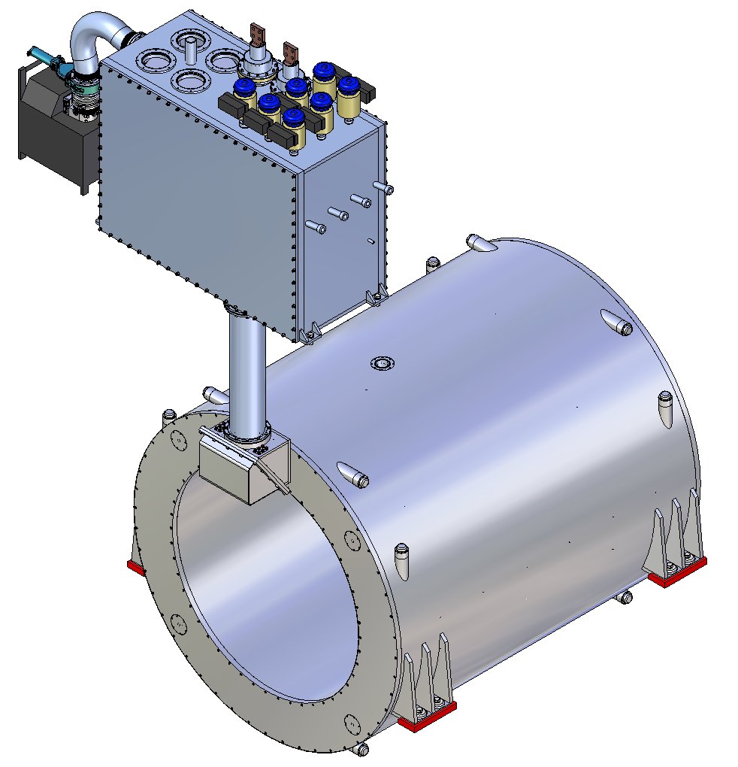
PANDA magnet cryostat and control Dewar
To minimize offset of the cold mass under action of the magnetic forces the outer vacuum shell of the cryostat and its supports have been reinforced

Slide 3
Thermal shield of the cryostat and its position in the cryostat
Radiation shield
The shield made of Al5083 plates is covered by about 30 layers of super-insulation. It weight is about 400 kg.
The shield will operate at 40–80K, and be cooled by helium gas supplied directly from the refrigerator.

Slide 4
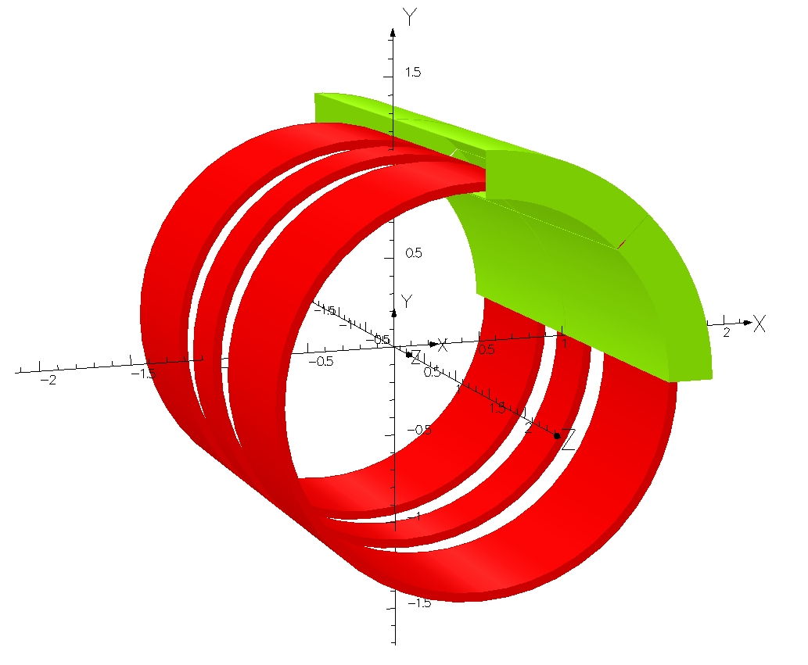
FE model for the calculation of the transient process in the screen
Quadrant of the thermal screen
FEMM_model
Specific resistance of the screen material at 60 K
ρ_{Cu} = 1∙10⁻⁹ Ohm∙m (Cu RRR = 20);
ρ_{Al} = 3.2∙10⁻⁸ Ohm∙m (Al5083)
ELEKTRA (transient) model
Model represents a quadrant of the screen and contains 12∙10⁶ elements. Influence of the yoke is taken into account by the boundary conditions on the inner surface of the yoke.

Slide 5
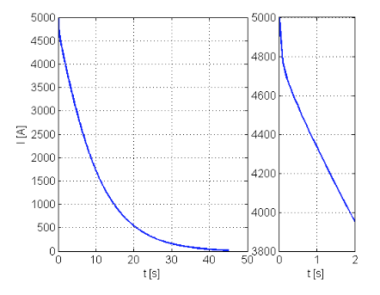
The rate of the field change in the area of the radiation screen
Maximal voltage in the transient process of the sc coil discharge is 500 V (R=0.1 Ohm)
Maximal dI/dt = 294 A/sek (τ=L/R ≈17 sek)
Coil current after an protected quench
The rate of the field change for computation of electromagnetic forces acted on the thermal screen was taken from CERN presentation (Panda Magnet Meeting, GSI, 15 April 2015)

Slide 6
Optimization of the shield material and configuration
Design options of the screen considered in the process of optimization
Copper shield without cuts
Copper shield separated on quadrants
Aluminum shield separated on quadrants
Aluminum shield separated on octants (cut width 6 mm)
Aluminum shield separated on octants (cut width 10 mm)
Aluminum shield separated on octants (cut width 10 mm) and 8 additional radial flange slits (10 mm)
Aluminum shield separated on octants (cut width 10 mm), 8 additional radial flange slits (10 mm) and current bridges between cylindrical shell parts (modeling the cooling tubes)

Slide 7
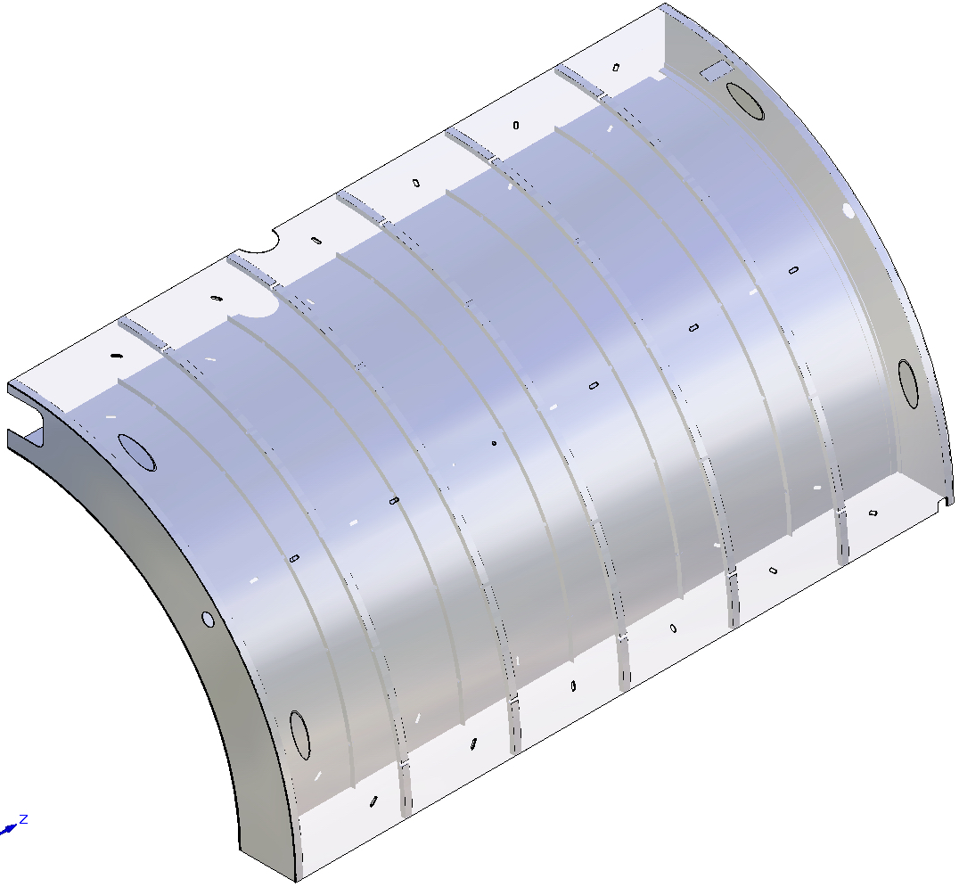
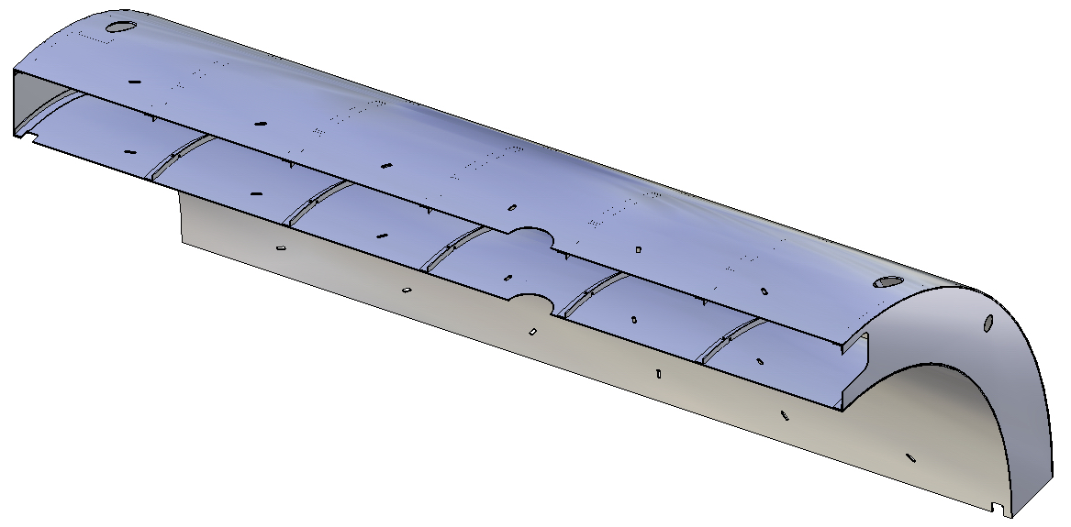
Option of the thermal screen separated on quadrants
Shield supports
Holes for radial suspension ties
Holes for axial suspension ties

Slide 8
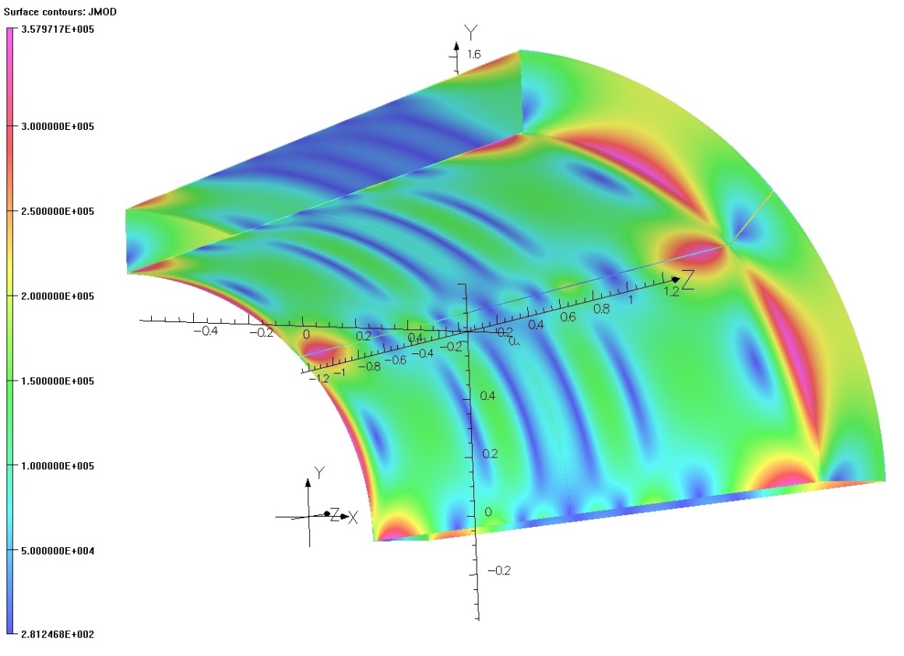
Influence of screen cuts and material properties on the Maximal eddy current density
A distinctive feature of the coil is high radial component of the field along the length of the coil and consequently a large induced currents.

Slide 9
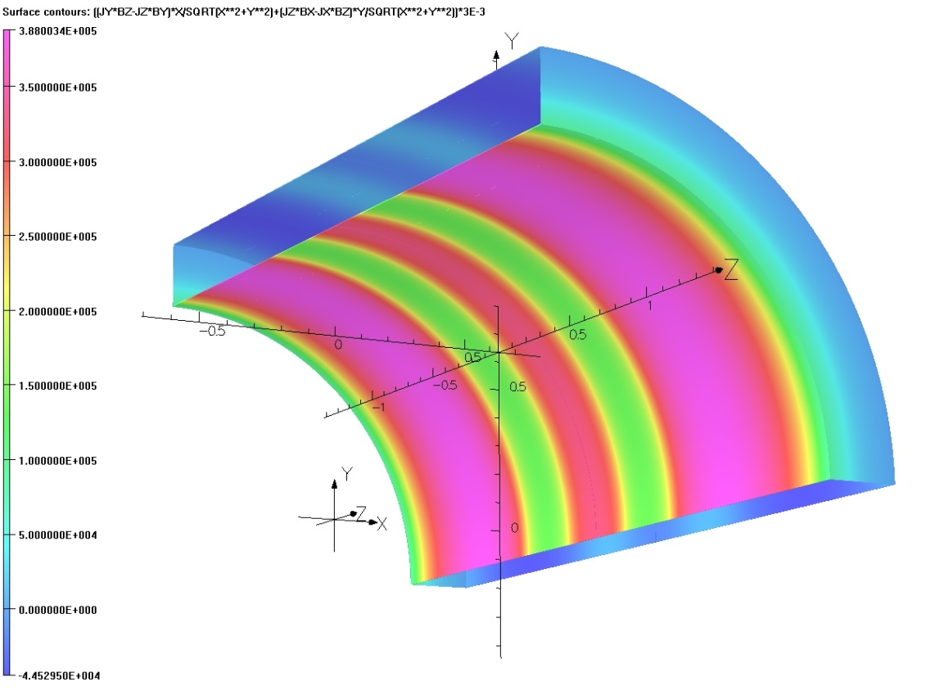
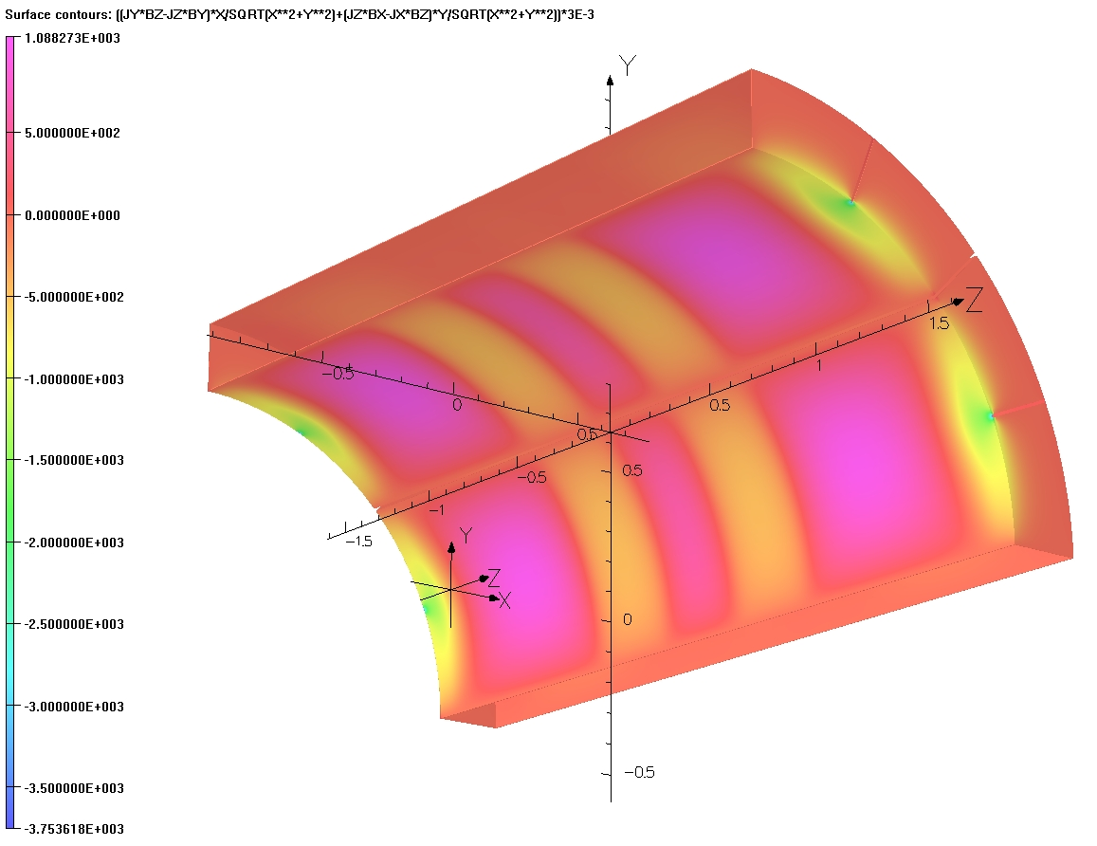
Influence of screen cuts and material properties on the maximal radial pressure

Slide 10
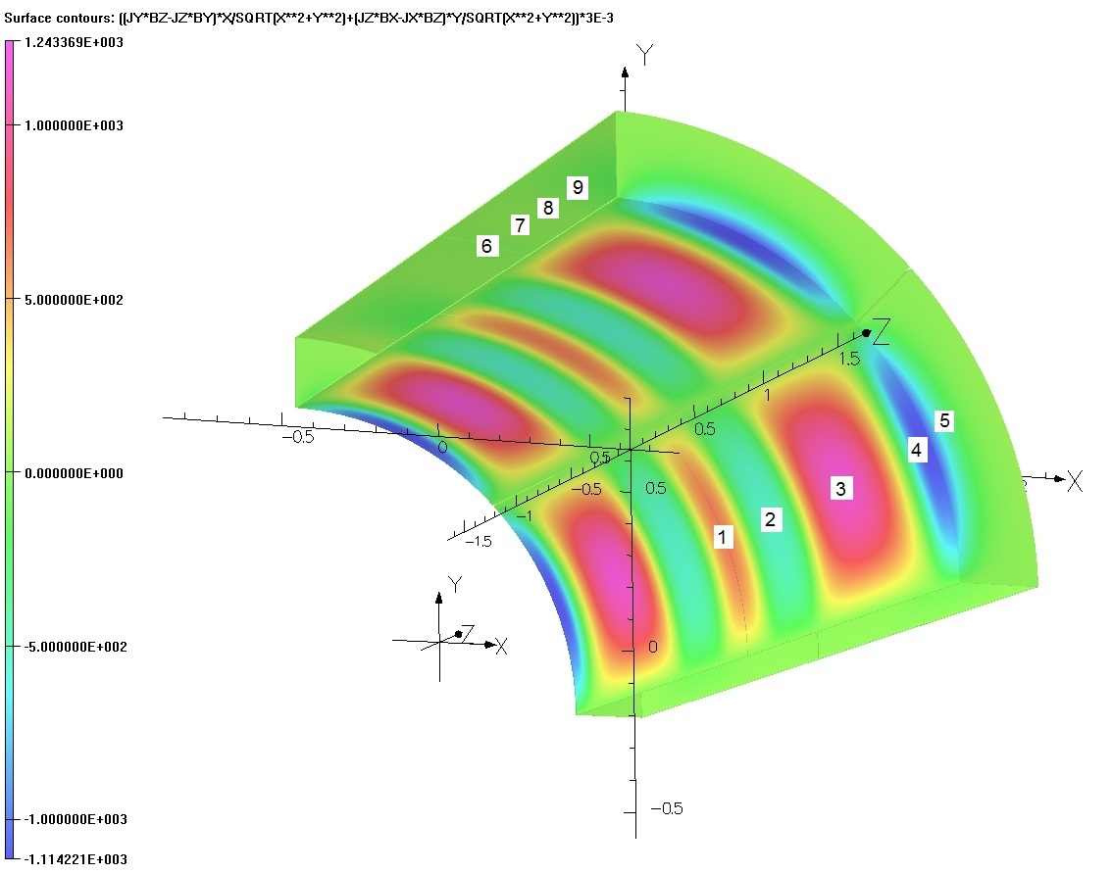
Influence of screen cuts and material properties on the radial forces applied to the selected regions
Table. The forces (N) acting on the selected regions of the screen

Slide 11
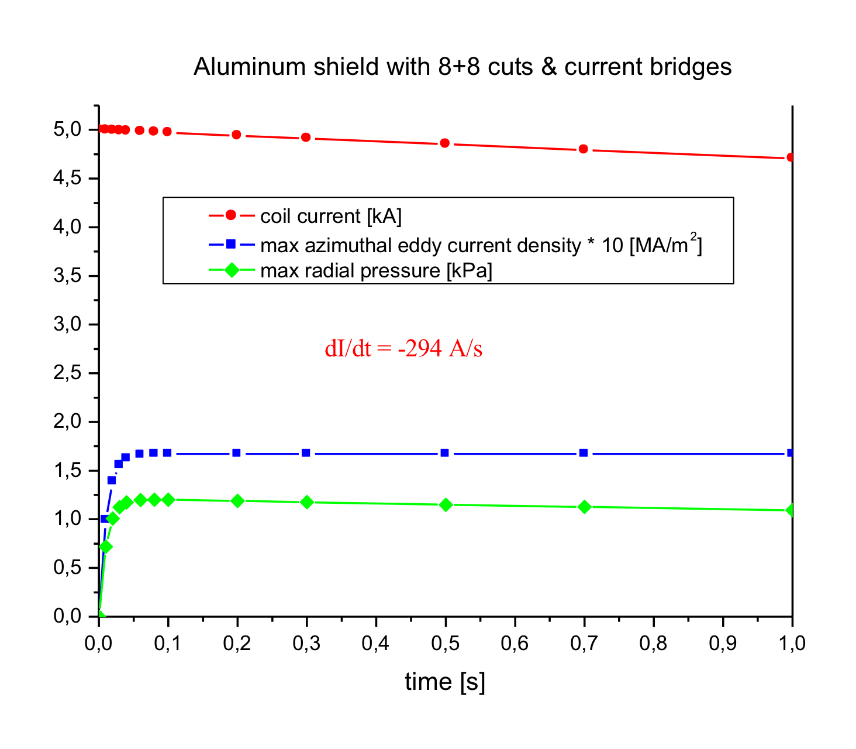
Maximal current density and magnetic pressure for transient process in the thermal screen
Force applied to the aluminum screens are pulsed nature - the current rise time of a few tenths of a second.

Slide 12
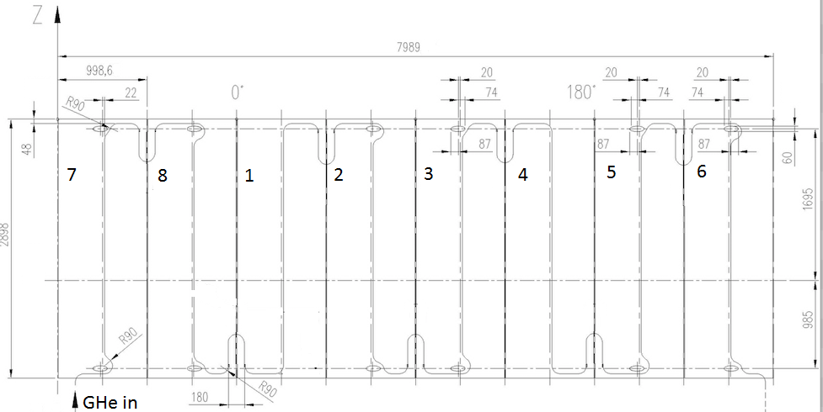
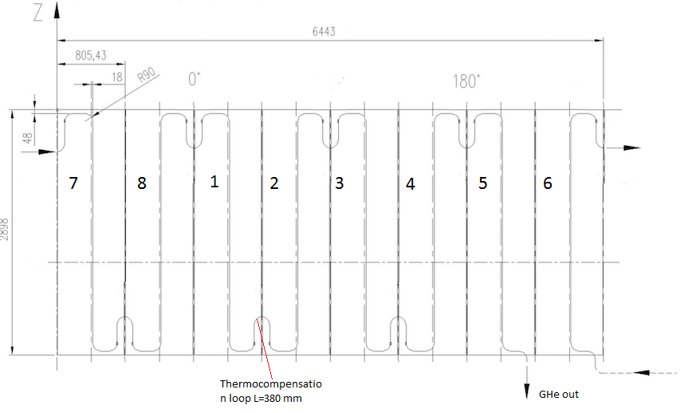
Arrangement of the cooling circuits on inner and outer shells of the screen separated on octants
The cooling pipes 12x1 of the outer and inner shells are connected in series.
The length of the cooling circuit is 62 m.
The cooling pipes on the neighbor plates of the shells are connected trough the thermo-compensation decoupling with high resistance (SS 304, L=0.38 m). The total resistance of one branch of the ss insulation decoupling R = 0.078 Ohm).
Maximal induced current through decoupling is 3.8 A (the forces applied to the decoupling are very low)

Slide 13
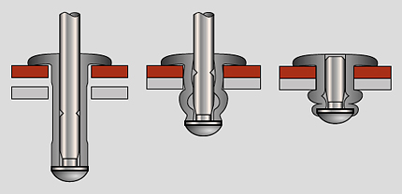
Fixation of the cooling pipe to the aluminium shell by blind rivets
100 mm
Copper contact plates
50 mm
Cooling pipe 12x1 (copper)
Blind rivets
Braizing (welding)
Aluminium shield
Blind (pop) rivets
d=6.4 mm,
Break steam – steel
AMg 3.5
Breaking shear force – 4950 N
ε = α_{al} – α_{cu} = 0.00415 – 0.0032 = 0.00091
σ = ε E_{cu} = 109 Mpa
F_{pipe} = σ x S_{pipe} = 3800 N

Slide 14
Radial support passed through the hole in the outer shell of the thermal screen

Slide 15
Thermal parameters of the screen
The total heat influx to the thermal screen because of the supports ≈112 W
Temperature drops on the thermal screen separated on octants at the temperature level 60 K (for twofold margin of the heat load) are
because of radiation load ≈3 K
because of heat influx trough the fiberglass supports ≈5 K.
total temperature drop ≈8 K
The total length of the cooling tubes of the inner and outer screen ≈61.4 m

Slide 16
Loads applied to the outer shell of an octant of the thermal screen
“+” and “–” indicate the
direction of radial force.
“-” means that the screen is
attracted to the coil
- fiberglass support d=8 mm, l=30 mm
- fiberglass support d=10 mm, l=30 mm
The total number of the fiberglass supports of 10 mm = 9pcz;
of 8 mm = 12 pcs
The total heat influx because of shield supports = 50 W
It is shown one half of the outer shell

Slide 17
Loads applied to an octant of the inner shell of the thermal screen
“+” and “–” indicate the direction of radial force.
“+” means that the screen is attracted to
the coil
- fibreglass support d=8 mm, l=30 mm
- fibreglass support d=10 mm, l=30 mm
The total number of the fiberglass supports of 10 mm = 9pcz;
of 8 mm = 18 pcs
The total heat influx because of shield supports = 62 W
It is shown one half of the inner shell

Slide 18
Loads applied to an octant flange of the thermal screen
The axial force separates the flange of the screen from the coil
F_{z}=103 N
Shield flange

Slide 19
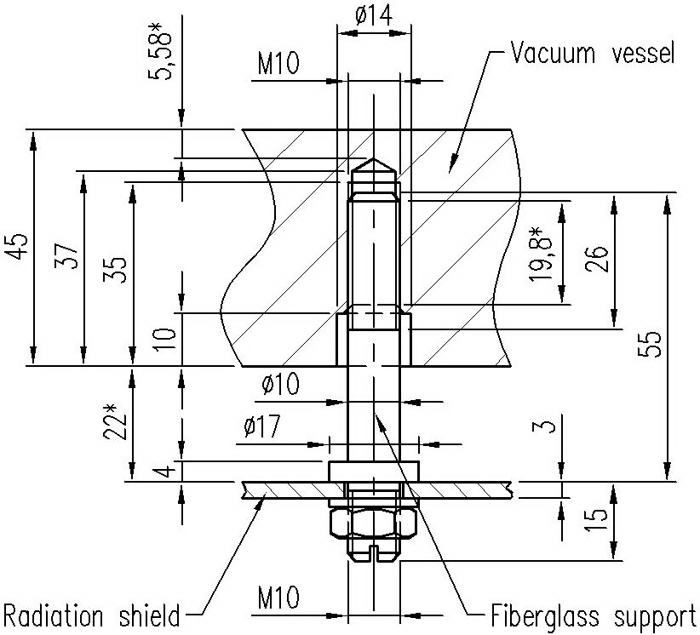
Slots in the cryostat shells to take into account temperature deformations of the screen
It is shown one half of the inner shell
^{Support pillar}
Maximal length of a slot is 7 mm

Slide 20
What option is more preferable: quadrants or octants?
Quadrants
The radial force applied to the most critical region of the inner screen shell is 1.6 time higher in compare with octant option
Mass of the outer shell of a quadrant is 47 kg
There are not a lot welding seams on the cooling tubes but the ss decoupling are two time longer
Octants
Radial, axial and azimuthal forces applied to the screen parts are essentially lower for this option
Mass of the outer shell of an octant is 23.4 kg only – it is much easy for handling
More welding seams with the thermo-compensation decoupling but the ss tubes are two time shorter

Slide 21
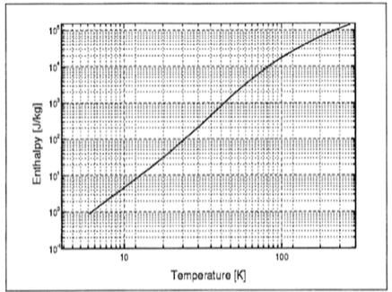
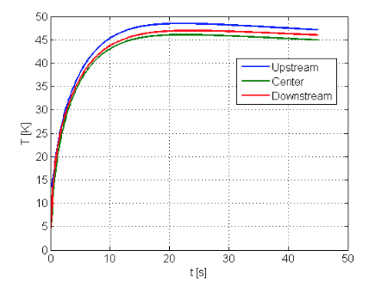
How to decrease the forces applied to the radiation shield additionally ?
Discharge rate of the superconducting coil 294 A/sec is rather an aggressive value. The impulse loads acted on the radiation shield are high enough and probably it takes addition supports to withstand them.
This discharge rate was chosen by Renzo many years ago and it looks that we need a revision of that decision. If we decrease the rate the coil temperature would increase from 50 K up to 60-80 K, but the mechanical loads on the shield and on the support cylinder would be decreased
Peak of the coil temperature 45-50 K
(CERN coputations)
Enthalpy of aluminium as a function of its temperature

Slide 22
What remains to be done this year?
to prepare thermal and mechanical analysis of the radiation screen
to complete the design of the radiation screen on the base of computations
to correct 3D model of the cryostat and control Dewar
to prepare assembly drawings of the main units of the cryostat and control Dewar

Slide 23
THANK YOU FOR YOUR ATTENTION!

Slide 24
Arrangement of the cold mass supports and cooling circuits of the screen and cold mass

