Slide 1
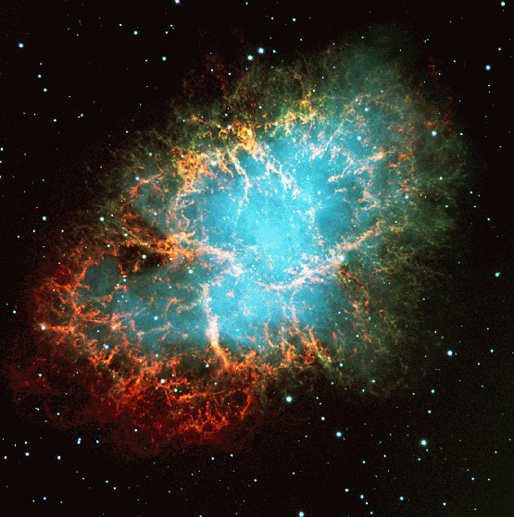
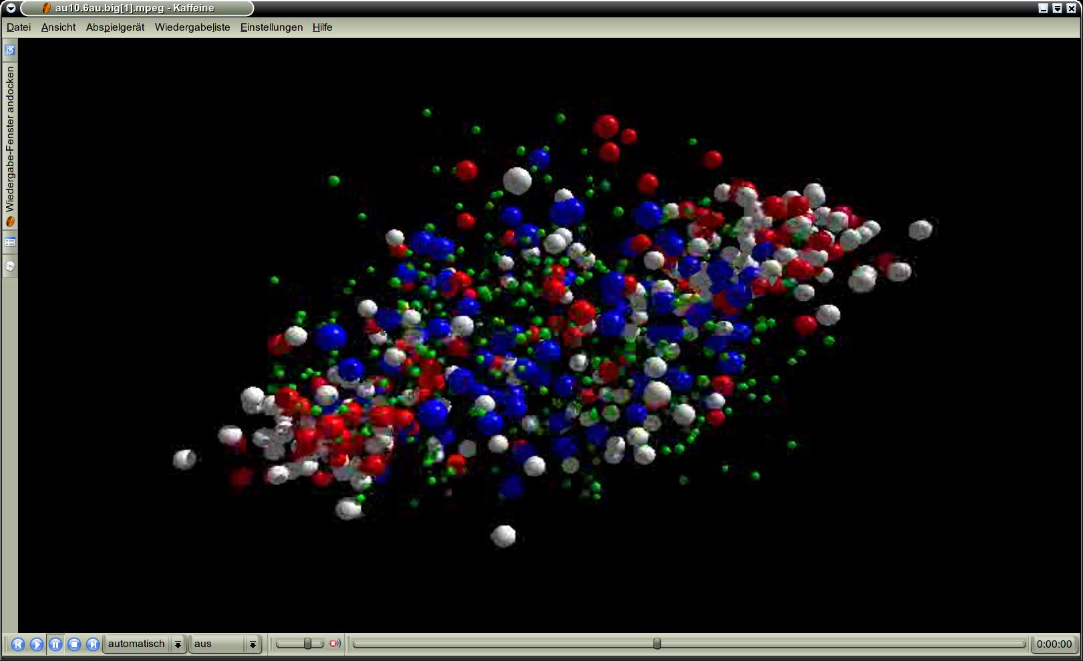
CBM and the nuclear matter EOS
Peter Senger (GSI)
Outline:
➢ EOS and heavy-ion collisions
EOS of symmetric nuclear matter at ρ < 3 ρ₀
Observables sensitive to EOS at ρ > 3 ρ₀ ?
The CBM experiments and its performance
Hyperons in Nuclear Matter, GSI, July 22, 2015

Slide 2
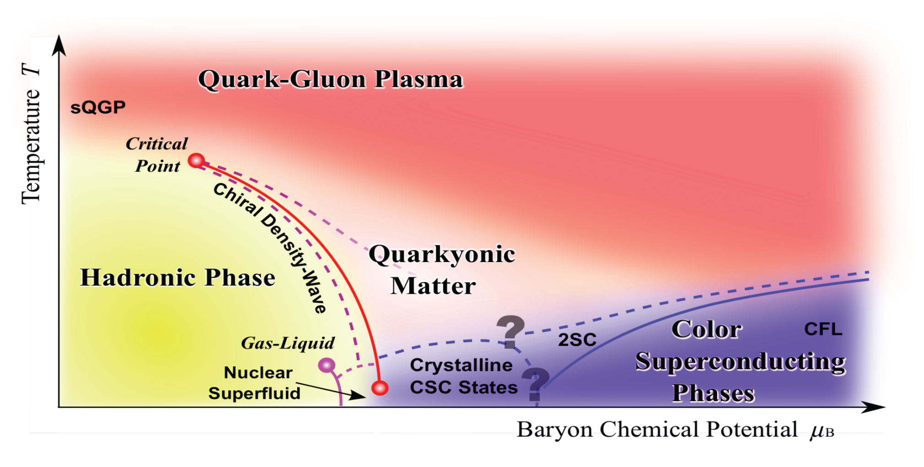
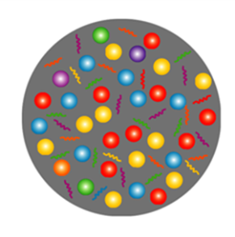
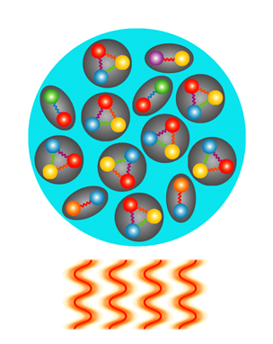
Exploring the QCD phase diagram
Courtesy of K. Fukushima & T. Hatsuda
At very high temperature:
➢ N of baryons ≈ N of antibaryons
Situation similar to early universe
➢ L-QCD finds crossover transition between
hadronic matter and Quark-Gluon Plasma
Precision experiments:
ALICE, ATLAS, CMS at LHC, STAR, PHENIX at RHIC

Slide 3
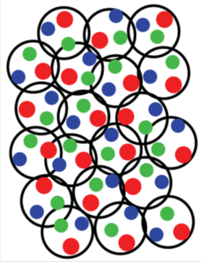
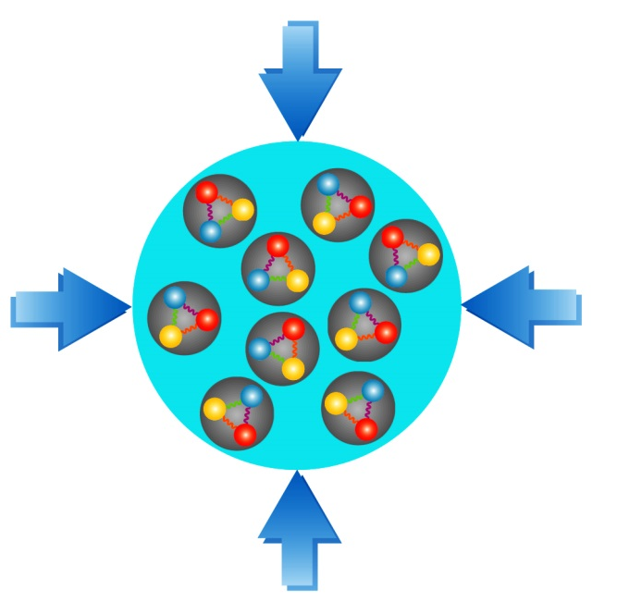
Exploring the QCD phase diagram
Courtesy of K. Fukushima & T. Hatsuda
At high baryon density:
➢ N of baryons >> N of antibaryons
Densities like in neutron star cores
➢ L-QCD not (yet) applicable
Models predict first order phase transition
with mixed or exotic phases
Experiments: BES at RHIC, NA61 at CERN SPS,
CBM at FAIR, NICA at JINR

Slide 4
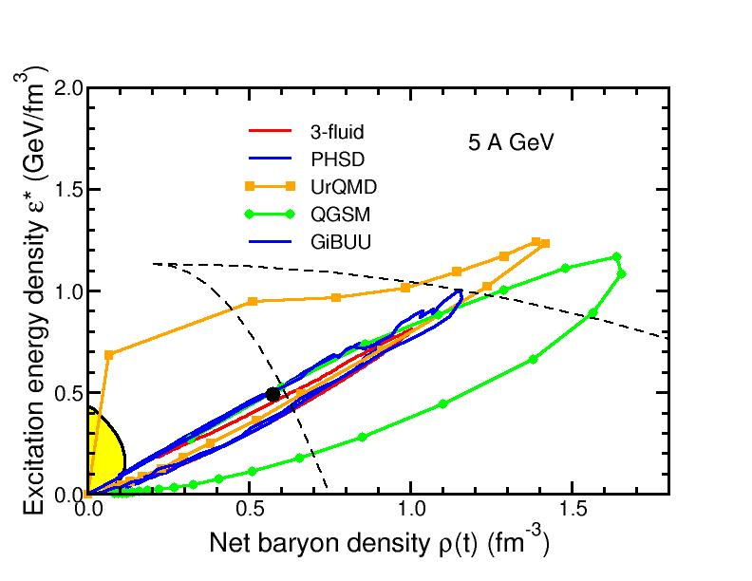
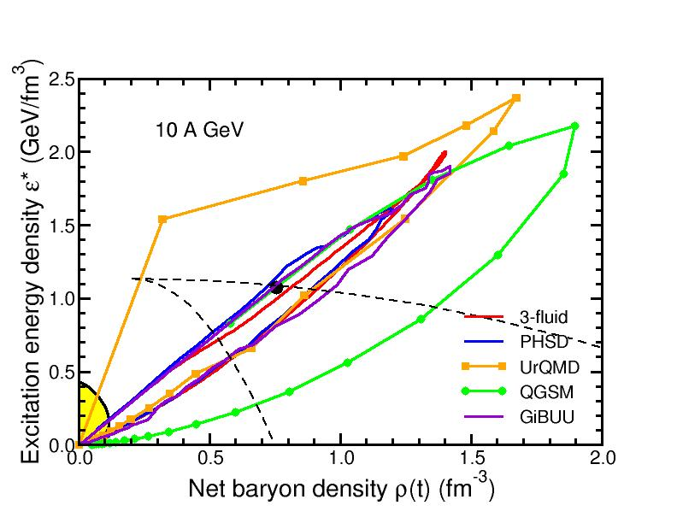


Baryon densities in central Au+Au collisions
I.C. Arsene et al., Phys. Rev. C 75, 24902 (2007), V. D. Toneev et al., Eur. Phys. J. C32 (2003) 399
5 A GeV
10 A GeV
8 ρ₀
5 ρ₀

Slide 5
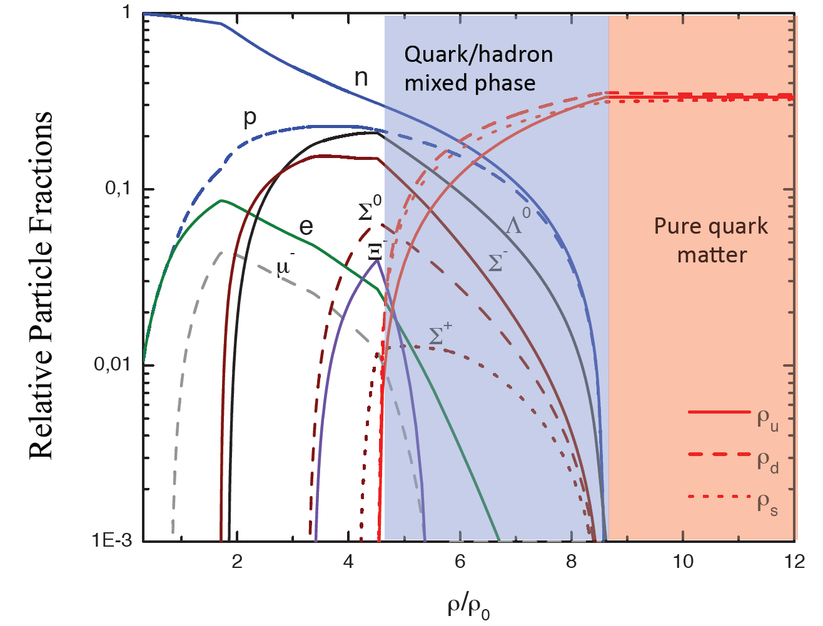
Quark matter in massive neutron stars?
Equation-of-state: Non-local SU(3) NJL with vector coupling
M. Orsaria, H. Rodrigues, F. Weber, G.A. Contrera, arXiv:1308.1657

Slide 6
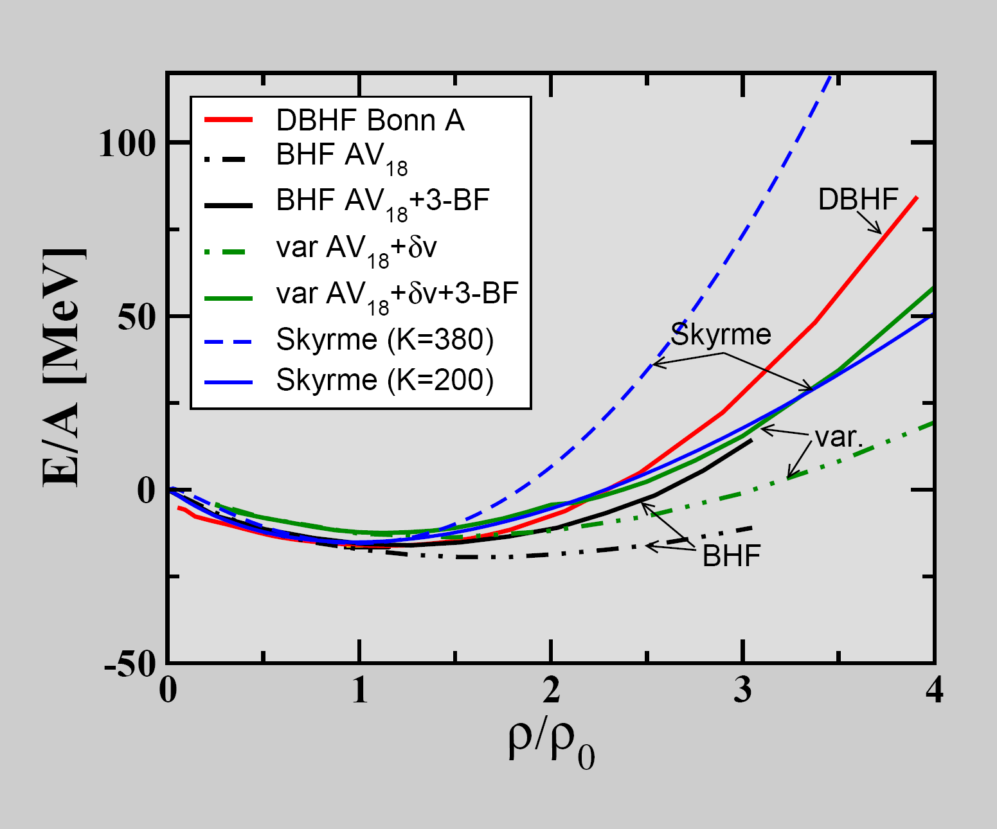
The equation-of-state of (symmetric) nuclear matter
Equation of state:
P = δE/δV⏐_{T=const}
V = A/ρ
δV/ δρ = - A/ρ²
P = ρ² δ(E/A)/δρ⏐_{T=const}
C. Fuchs, Prog. Part. Nucl. Phys. 56 (2006) 1
T=0: E/A = 1/ρ ∫ U (ρ)dρ
Effective NN-potential:
U(ρ)=αρ+βρ^{γ}
E/A(ρ_{ο}) = -16 MeV
δ(E/A)(ρ_{ο})/δρ = 0
Compressibility:
κ = 9ρ² δ² (E/A)/ δρ²
κ = 200 MeV: "soft" EOS
κ = 380 MeV: "stiff" EOS

Slide 7
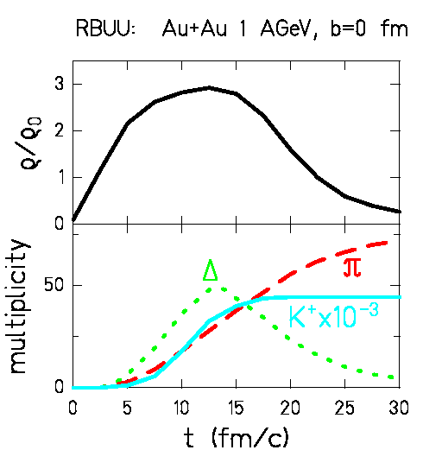
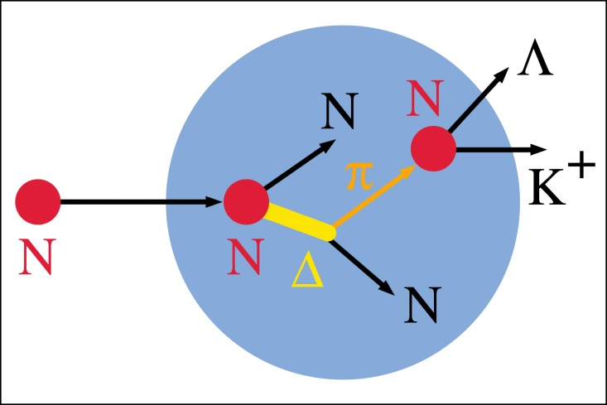
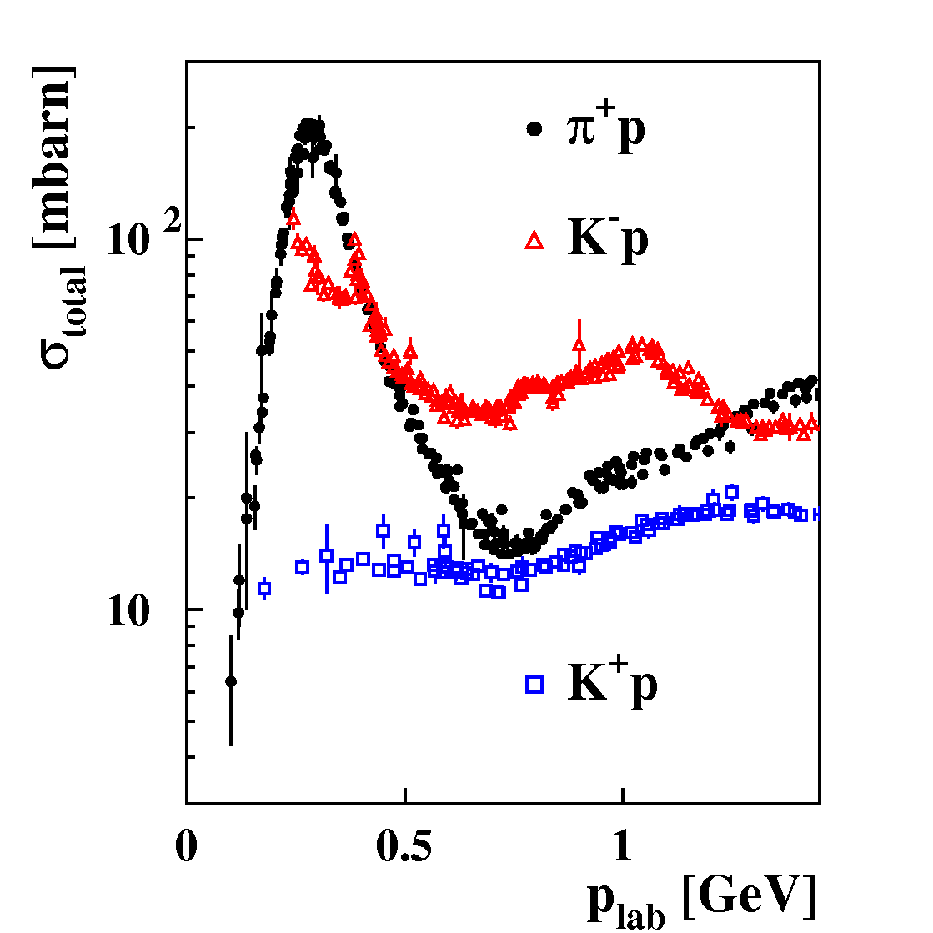
The equation-of-state of (symmetric) nuclear matter
Observable: Kaon production in Au+Au collisions at 1 AGeV
pp → K⁺Λp (E_{thres}= 1.6 GeV)
K⁺ mesons probe high densities
K⁺ mesons scatter elastically only

Slide 8
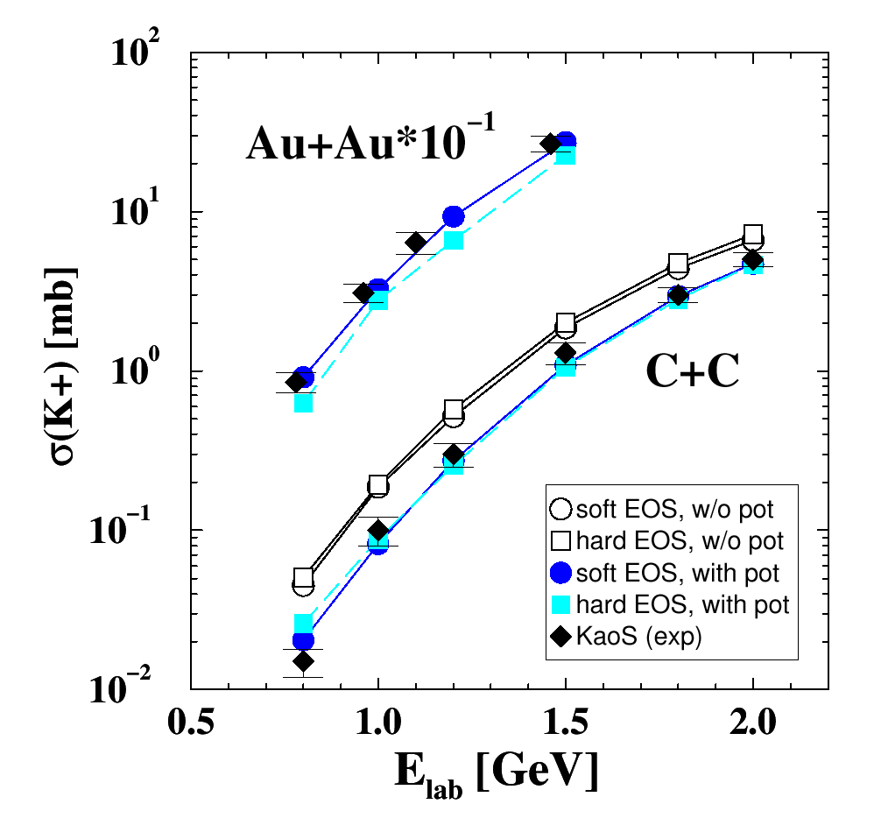
Probing the nuclear equation-of-state (ρ = 1 – 3 ρ₀)
by K⁺ meson production in C+C and Au+Au collisions
Idea: K⁺ yield ∝ baryon density ρ ∝ compressibility κ
Transport model (RBUU)
Au+Au at 1 AGeV:
κ = 200 MeV ⇨ ρ_{max}≈ 2.9 ρ₀ ⇨ K⁺
κ = 380 MeV ⇨ ρ_{max}≈ 2.4 ρ₀ ⇨ K⁺
Reference system C+C:
K⁺ yield not sensitive to EOS
Experiment:
C. Sturm et al., (KaoS Collaboration),
Phys. Rev. Lett. 86 (2001) 39
Theory:
Ch. Fuchs et al.,
Phys. Rev. Lett. 86 (2001) 1974

Slide 9
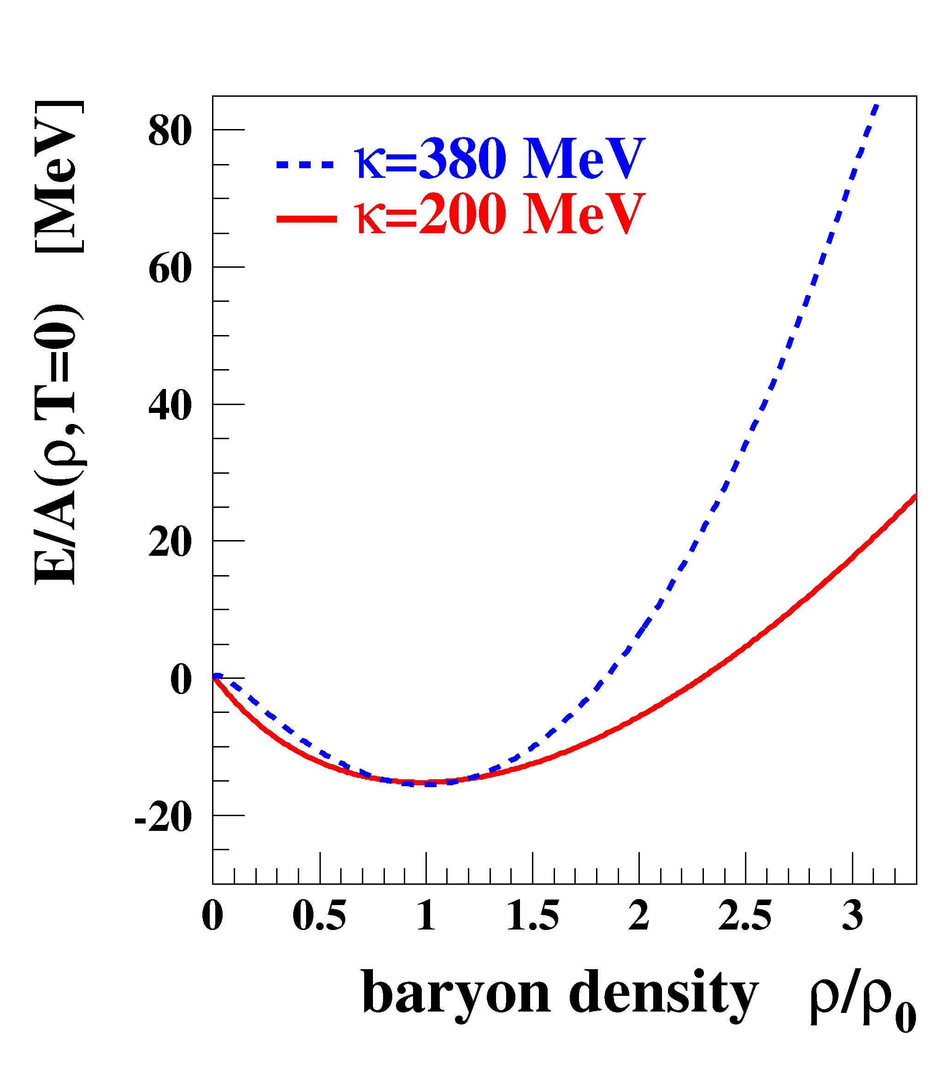
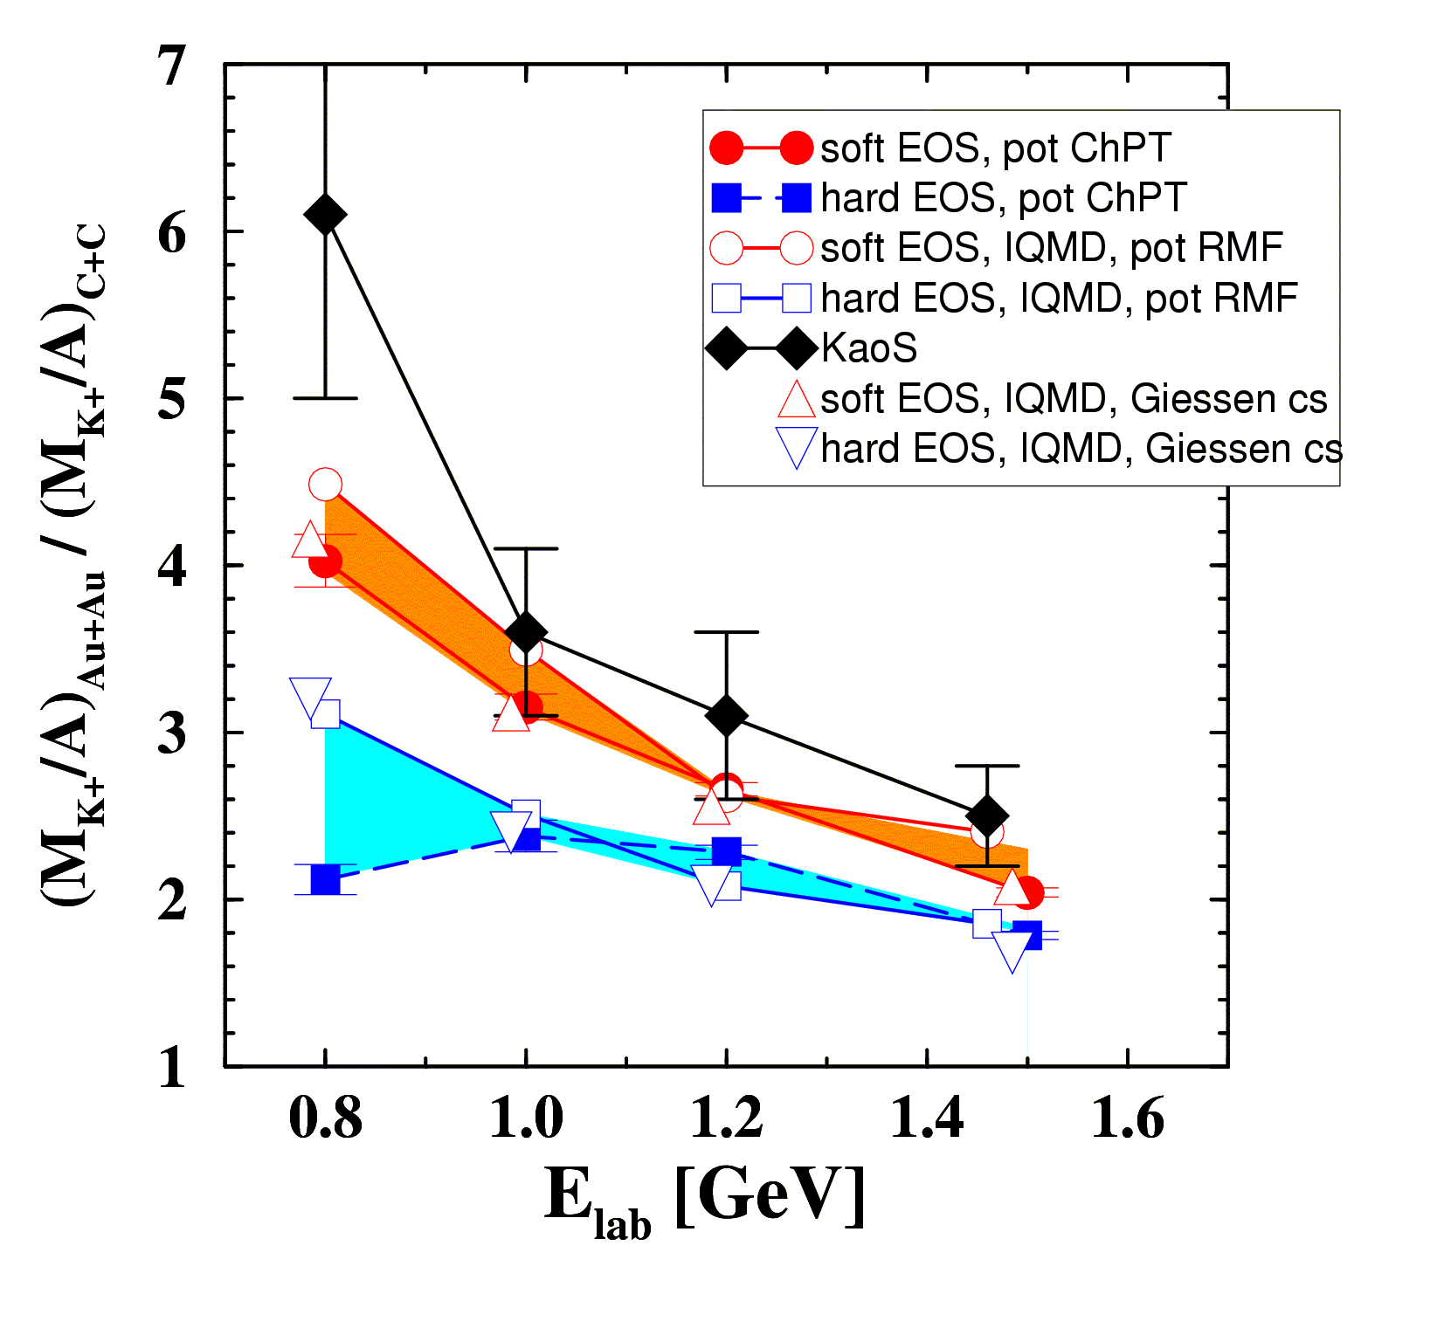
The compressibility of (symmetric) nuclear matter
Experiment: C. Sturm et al., (KaoS Collaboration) Phys. Rev. Lett. 86 (2001) 39
Theory: QMD Ch. Fuchs et al., Phys. Rev. Lett. 86 (2001) 1974
IQMD Ch. Hartnack, J. Aichelin, J. Phys. G 28 (2002) 1649
Au/C ratio: cancellation of systematic errors both in experiment and theory

Slide 10
The compressibility of (symmetric) nuclear matter
Experiment: C. Sturm et al., (KaoS Collaboration) Phys. Rev. Lett. 86 (2001) 39
Theory: QMD Ch. Fuchs et al., Phys. Rev. Lett. 86 (2001) 1974
IQMD Ch. Hartnack, J. Aichelin, J. Phys. G 28 (2002) 1649
soft equation-of-state: κ ≤ 200 MeV

Slide 11
EOS from the elliptic flow of fragments in Au+Au collisions
W. Reisdorf for the FOPI Collaboration, arXiv:1307.4210
A. Le Fevre et al., FOPI collaboration
arXiv:1501.02546

Slide 12
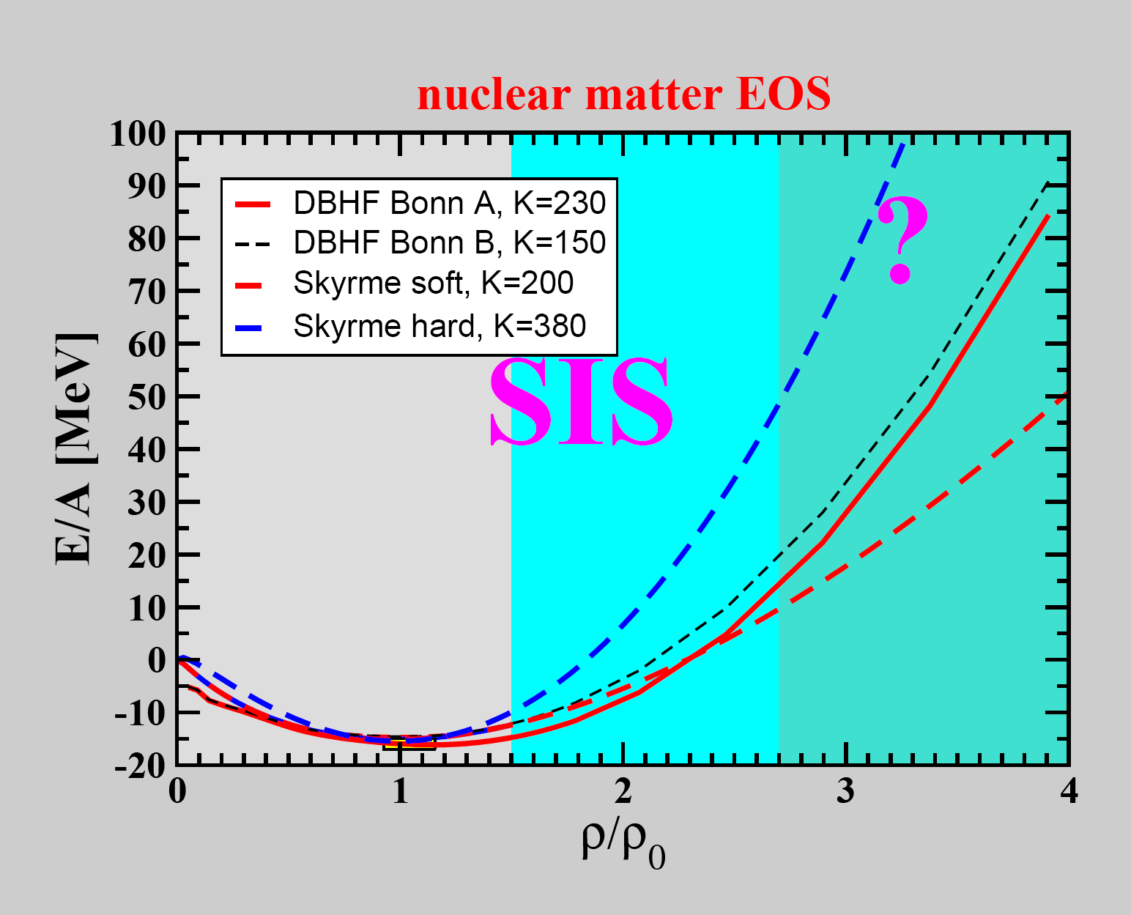
K⁺ production,
Fragment flow

Slide 13
?
K⁺ production,
Fragment flow

Slide 14
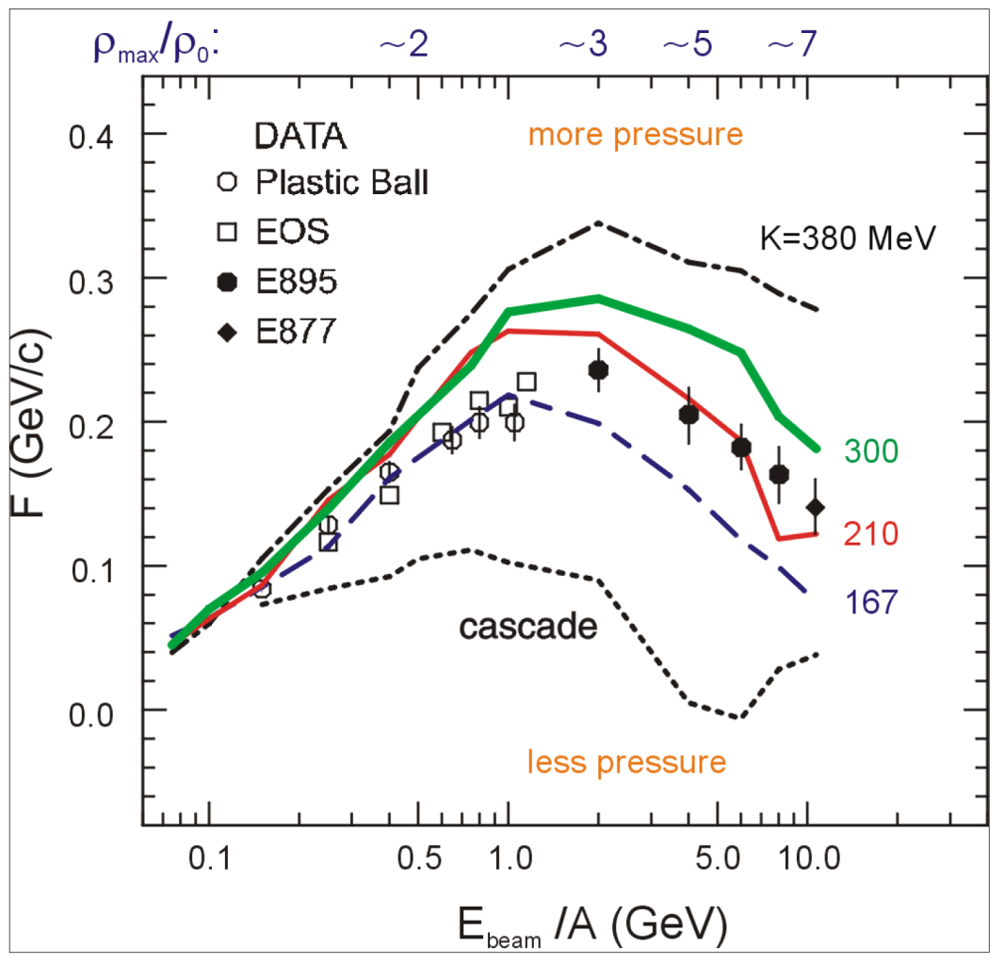
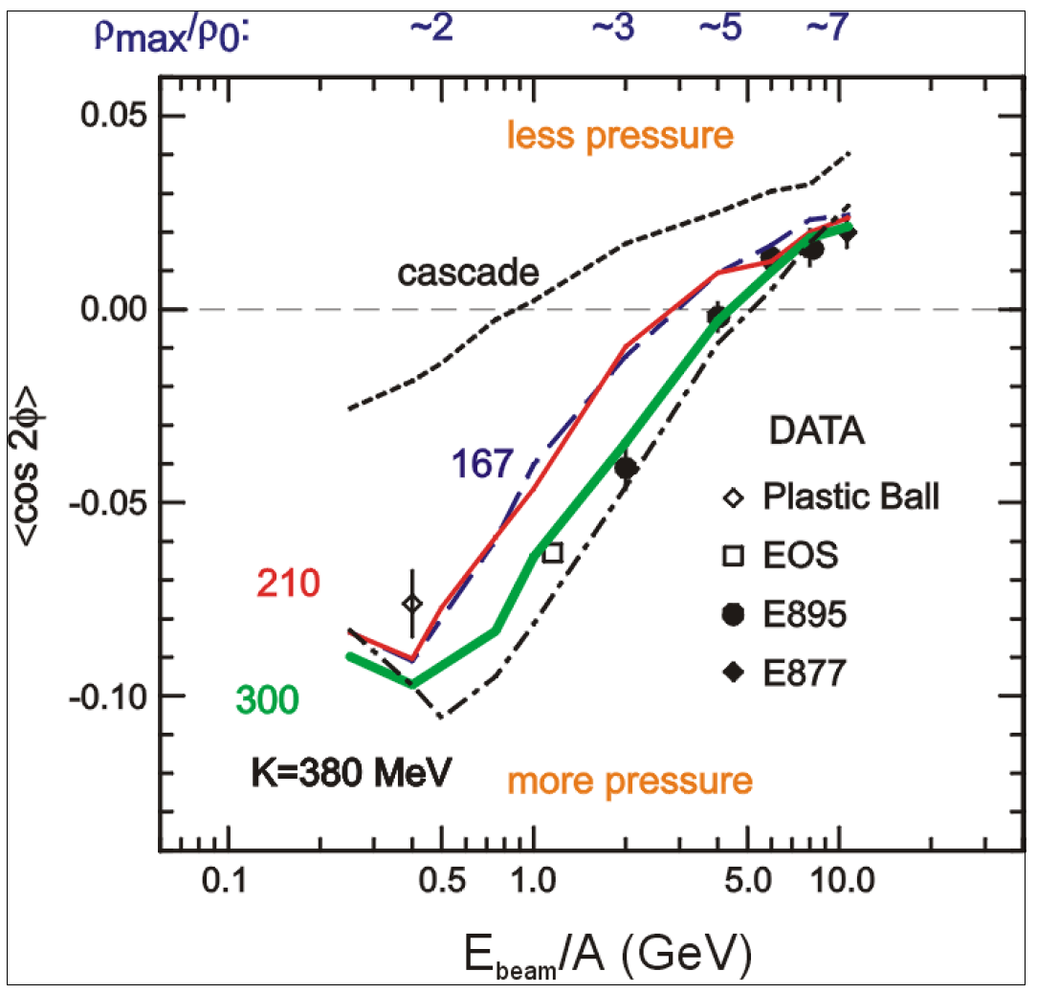
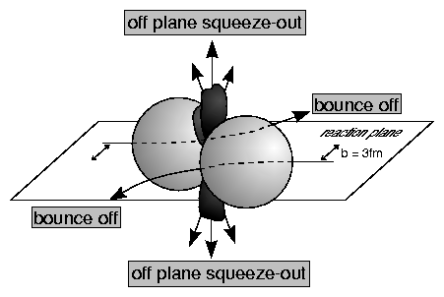
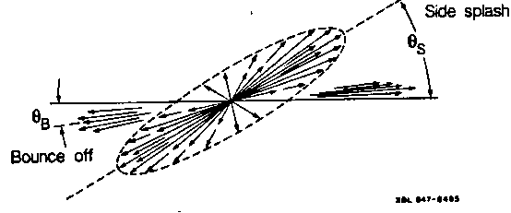
EOS from collective flow of protons
P. Danielewicz, R. Lacey, W.G. Lynch, Science 298 (2002) 1592
Transverse in-plane flow:
Elliptic flow:
F = d(p_{x}/A)/d(y/y_{cm})
dN/dΦ ∝ (1 + 2v₁ cosΦ + 2v₂ cos2Φ)

Slide 15
EOS from collective flow of protons
P. Danielewicz, R. Lacey, W.G. Lynch, Science 298 (2002) 1592
K = 170 – 210 MeV
K = 170 – 380 MeV
Transverse in-plane flow:
Elliptic flow:
F = d(p_{x}/A)/d(y/y_{cm})
dN/dΦ ∝ (1 + 2v₁ cosΦ + 2v₂ cos2Φ)

Slide 16
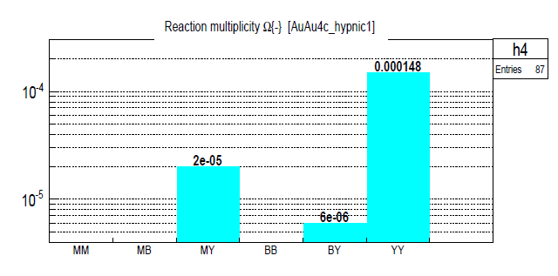
The equation-of-state of symmetric nuclear matter at neutron star core densities
Observable: multistrange hyperon production at (sub)threshold energies
Direct multi-strange hyperon production:
pp → Ξ⁻ K⁺K⁺p (E_{thr} = 3.7 GeV)
pp → Ω⁻ K⁺K⁺K⁰p (E_{thr} = 7.0 GeV)
pp → Λ⁰Λ⁰ pp (E_{thr} = 7.1 GeV)
pp → Ξ⁺ Ξ⁻ pp (E_{thr} = 9.0 GeV)
pp → Ω⁺ Ω⁻ pp (E_{thr} = 12.7 GeV
Ω⁻ production in 4 A GeV Au+Au
Hyperon production via multiple
strangeness exchange reactions:
Hyperons (s quarks):
pp → K⁺Λ⁰p, pp → K⁺K⁻pp,
pΛ⁰→ K⁺ Ξ⁻ p, πΛ⁰→ K⁺ Ξ⁻ π,
3. Λ⁰Λ⁰→ Ξ⁻ p, Λ⁰K⁻ → Ξ⁻ π⁰
4. Λ⁰ Ξ⁻ → Ω⁻ n, Ξ⁻K⁻ → Ω⁻ π⁻
Antihyperons (anti-s quarks):
1. Λ⁰ K⁺ → Ξ⁺π⁰ ,
2. Ξ⁺ K⁺ → Ω⁺ π⁺.
HYPQGSM calculations , K. Gudima et al.

Slide 17
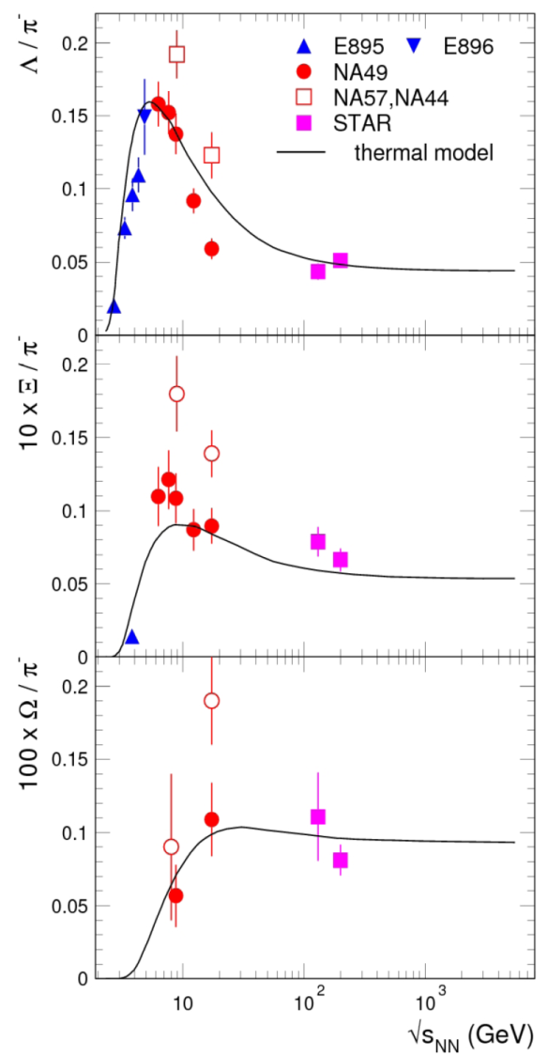
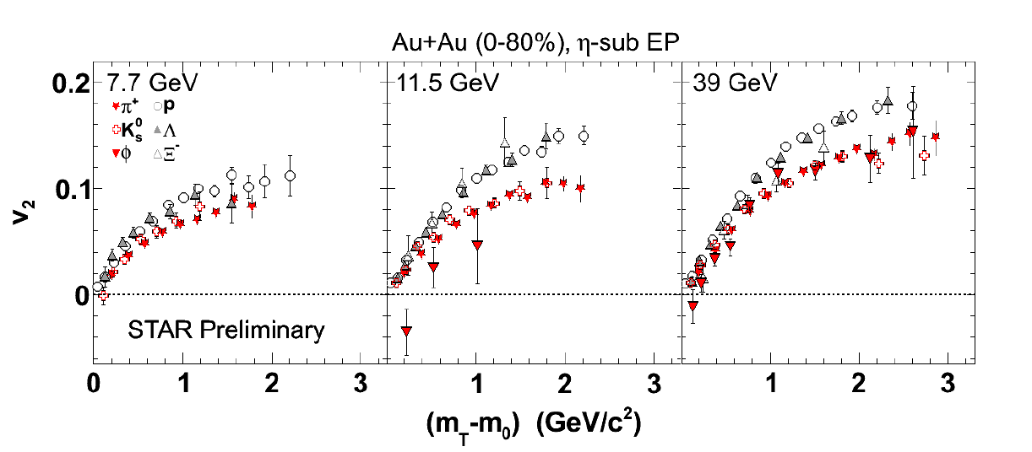
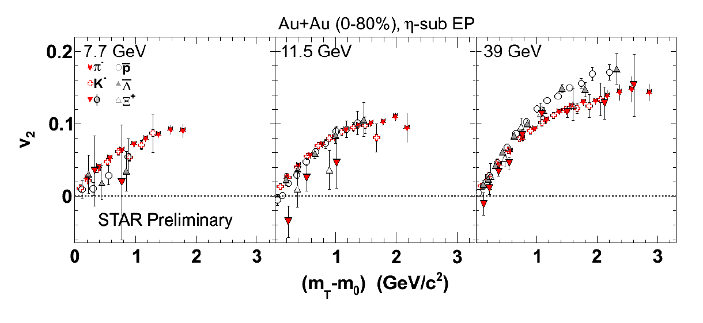
Strangeness
Data situation
Pb+Pb, Au+Au (central)
RHIC beam energy scan
FAIR

Slide 18
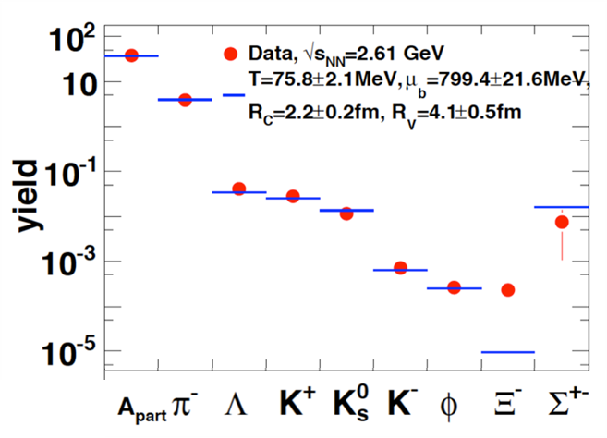
Strangeness
Data situation
HADES: Ar + KCl 1.76 A GeV
Phys. Rev. Lett. 103 (2009) 132301

Slide 19
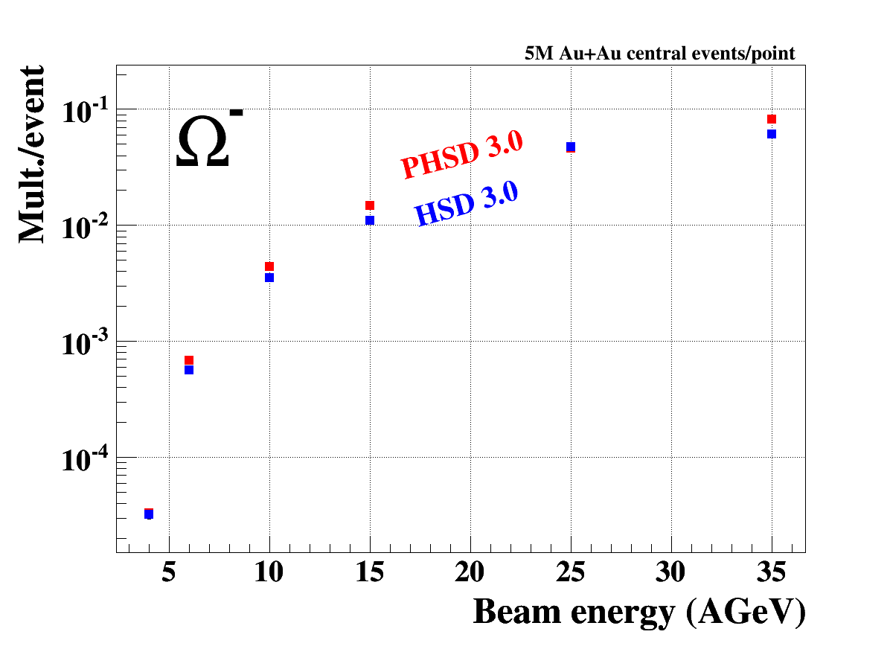
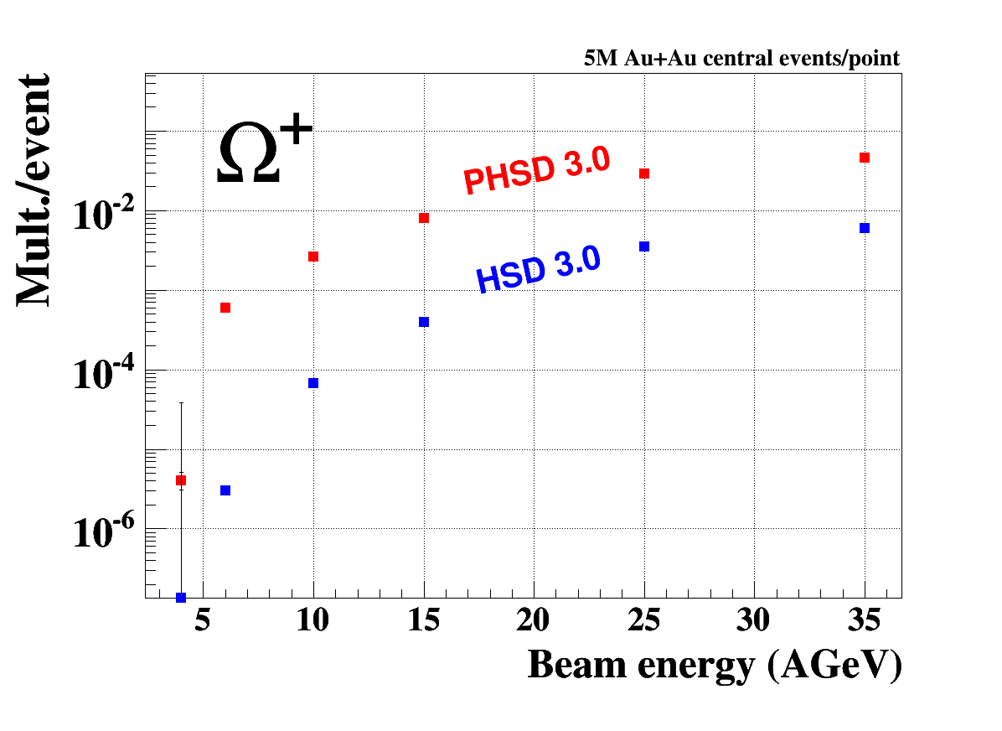
Strangeness
Multistrange (anti-)hyperon production
in HSD and PHSD transport codes at FAIR energies
I. Vassiliev, E. Bratkovskaya, preliminary results
(sss)
(sss)
HSD: Hadronic transport code
PHSD:Hadronic transport code with partonic phase (ε > 1 GeV/fm³)

Slide 20
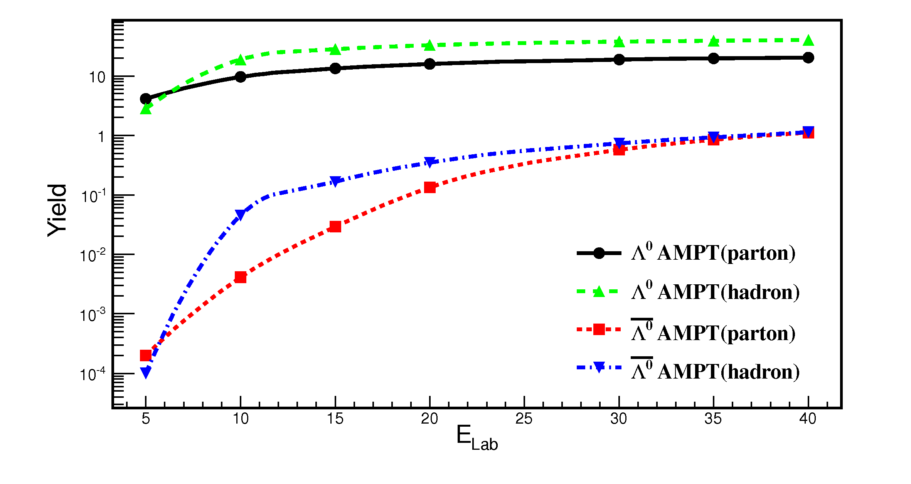
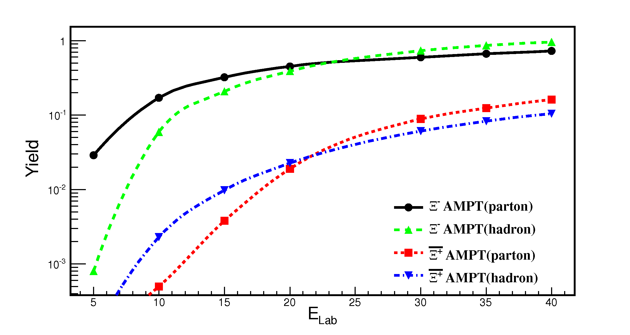
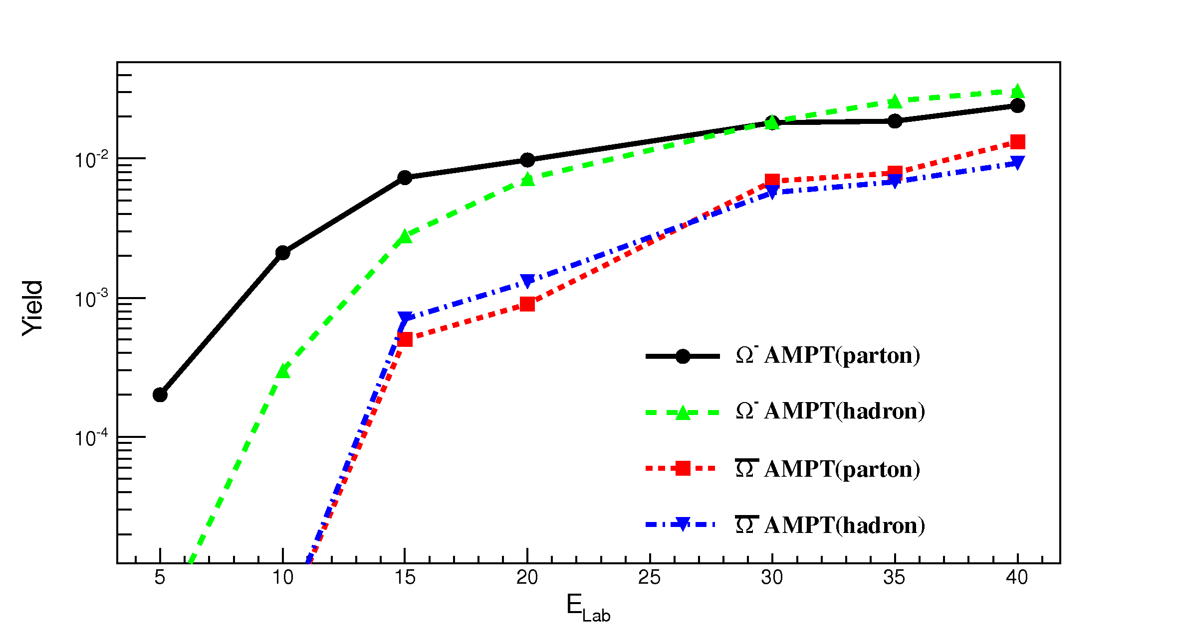
Production of (anti-)hyperons
in hadronic and partonic matter
Simulations using the AMPT code of C.M. Ko, Texas A&M Univ.
http://personal.ecu.edu/linz/ampt/
ampt-v1.26t1-v2.26t1.zip (9/2012)
Λ
Λ
Ξ⁻
Ω⁻
Ξ⁺
Ω⁺

Slide 21
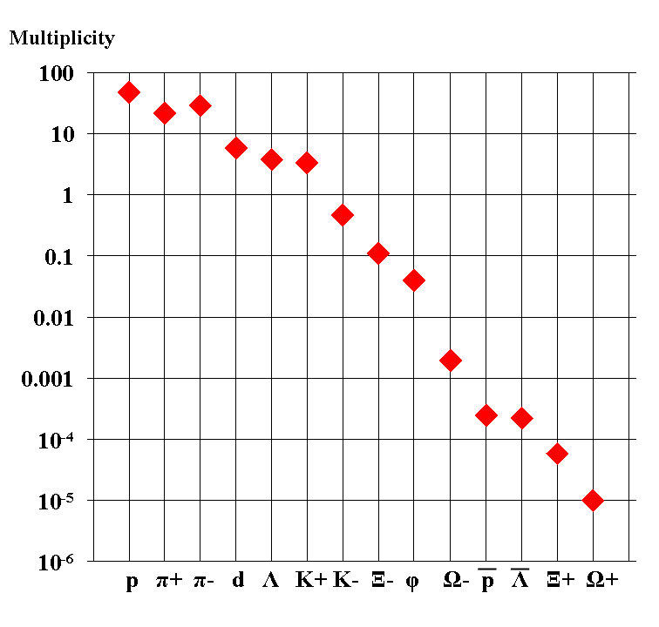
Experimental challenges
Particle yields in central Au+Au 4 A GeV
Statistical model, A. Andronic, priv. com.
AGS
extremely high
interaction rates
required !
e⁺e⁻
μ⁺μ⁻

Slide 22
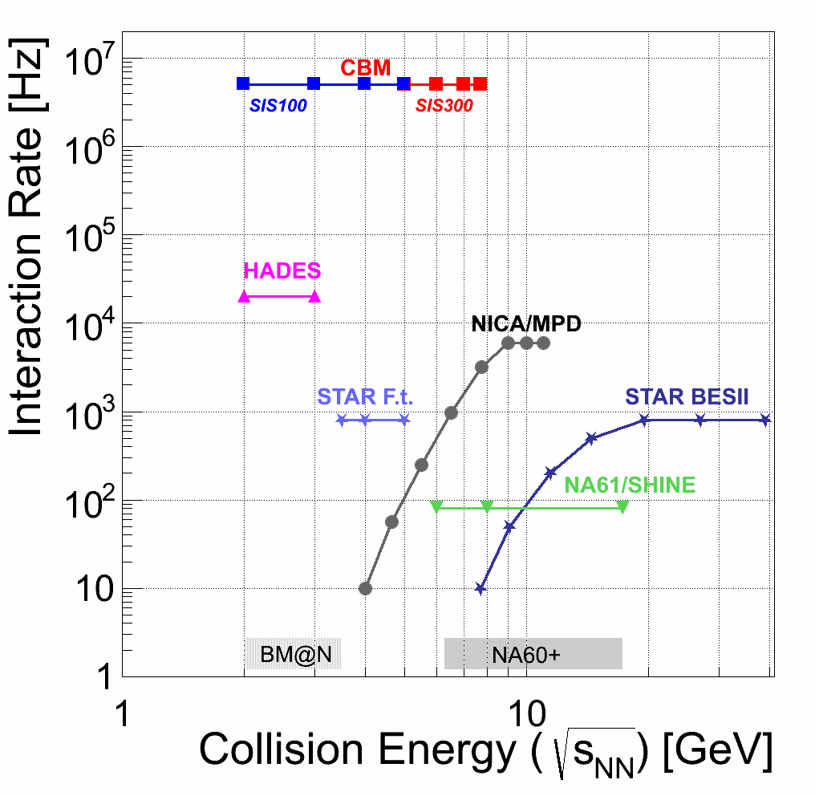
Experiments exploring dense QCD matter
high
net-baryon densities

Slide 23
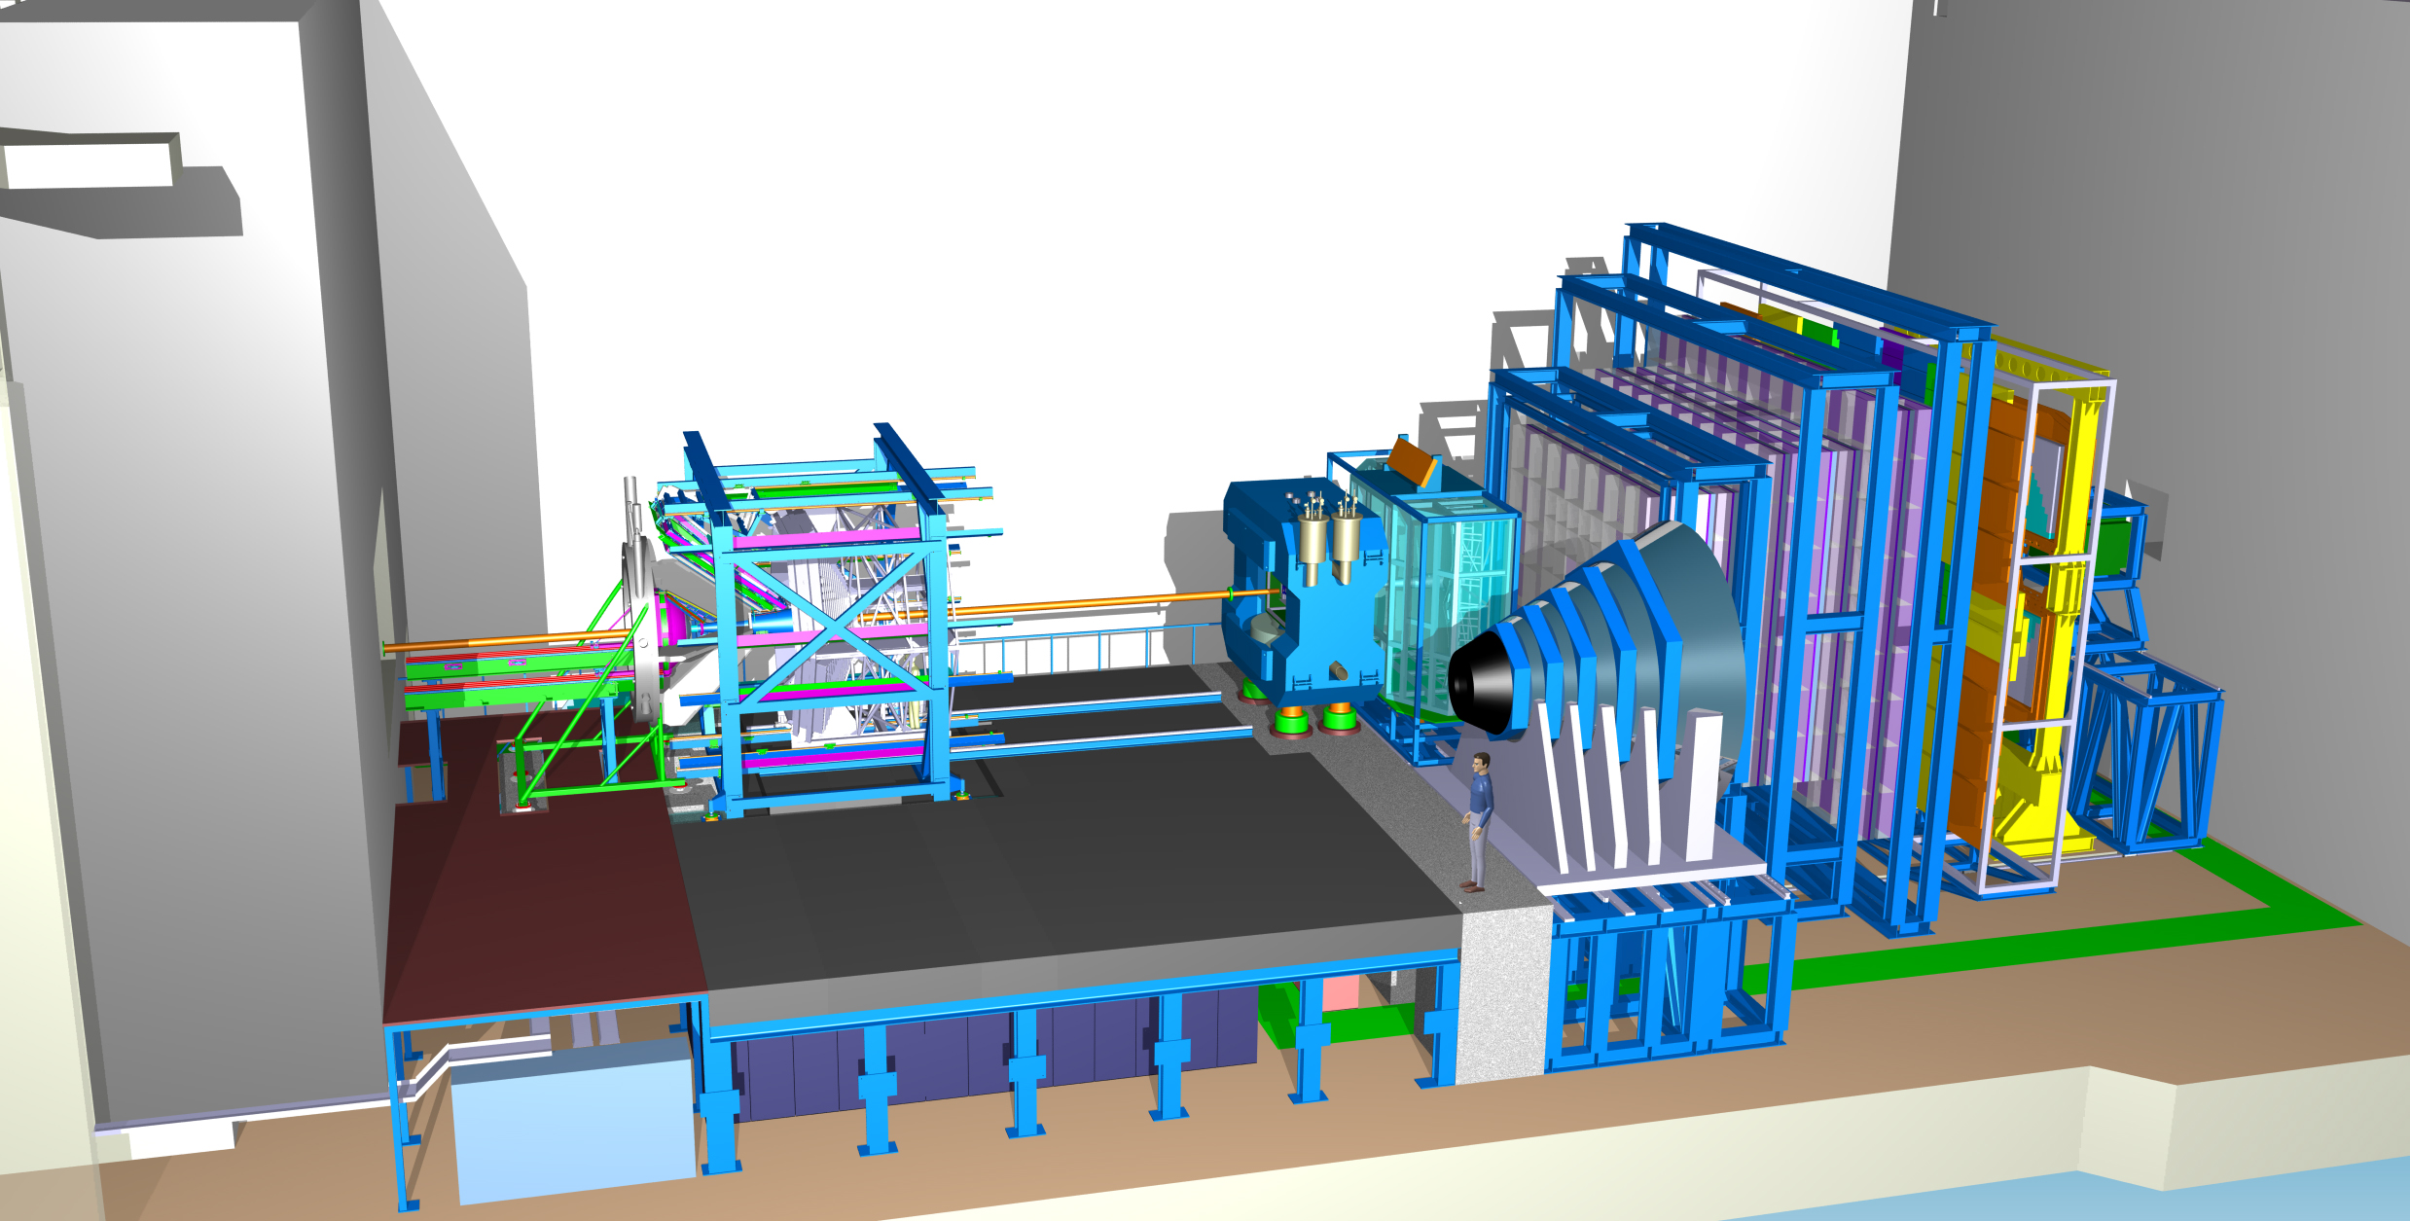
Experimental requirements
HADES
p+p, p+A
A+A (low mult.)
large acceptance
low material budget
CBM
Time of Flight
Dipol
Magnet
Silicon
Tracking
System
DAQ/FLES HPC cluster
(SIS100 version)
Projectile
Spectator
Detector

Slide 24
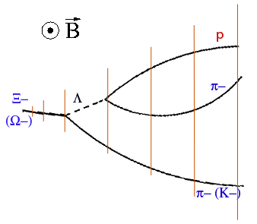
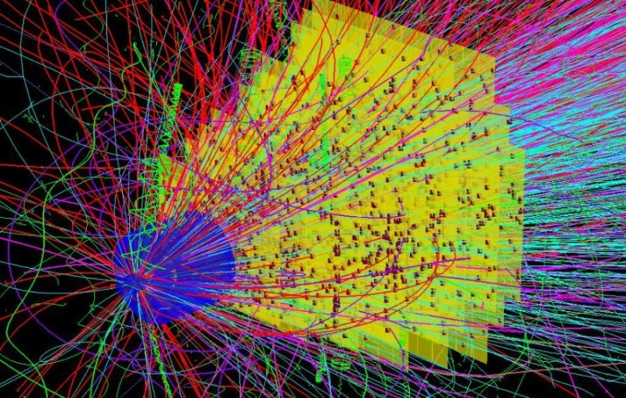
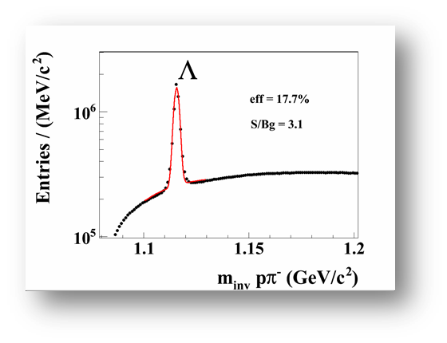
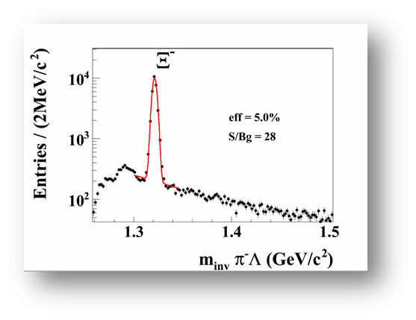
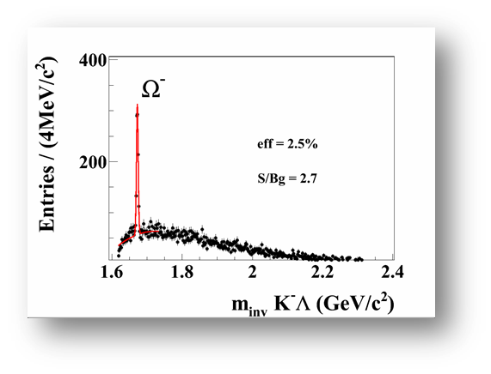
Simulations
Event generators UrQMD 3.3
Transport code GEANT3, FLUKA
Realistic detector geometries, material budget and detector response
reconstruction
Au+Au 25 A GeV:
Ω⁻/event = 1/1000
Notes:
24
24
24

Slide 25
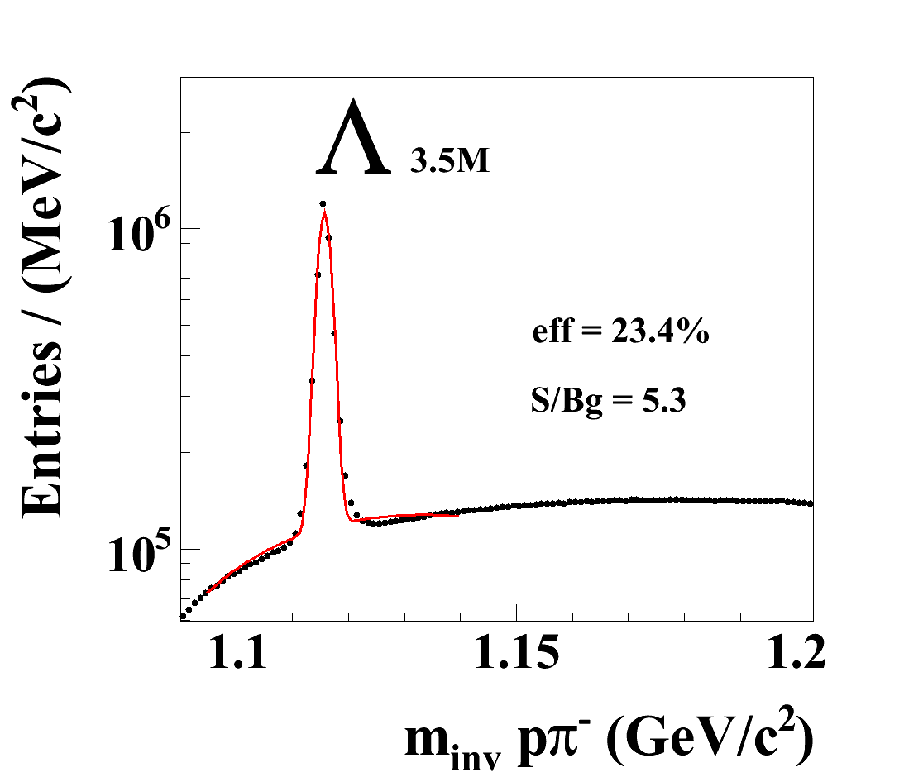
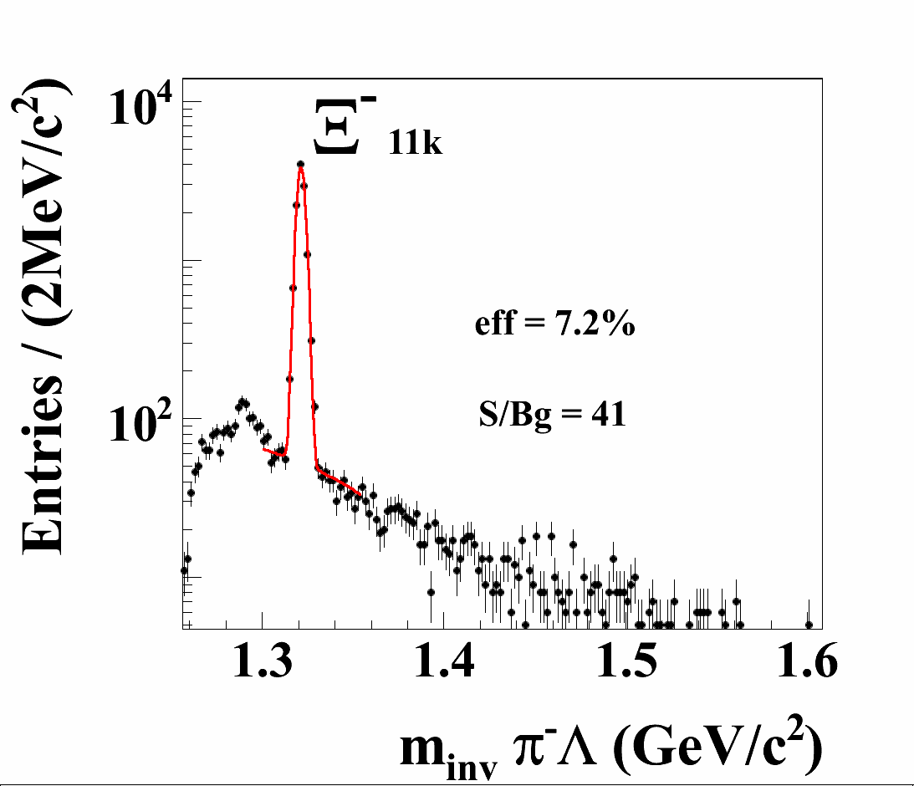
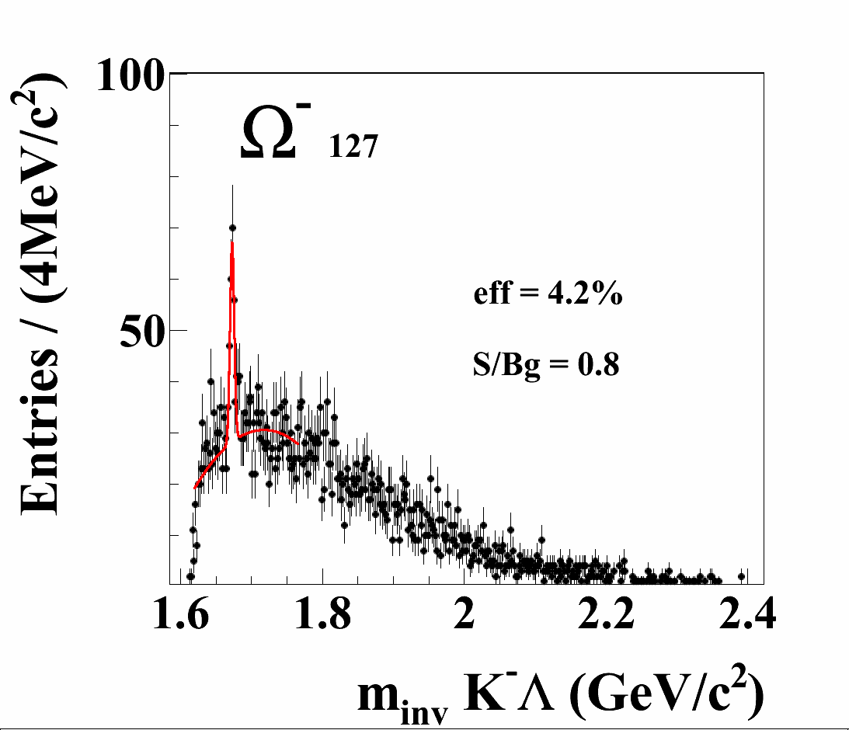
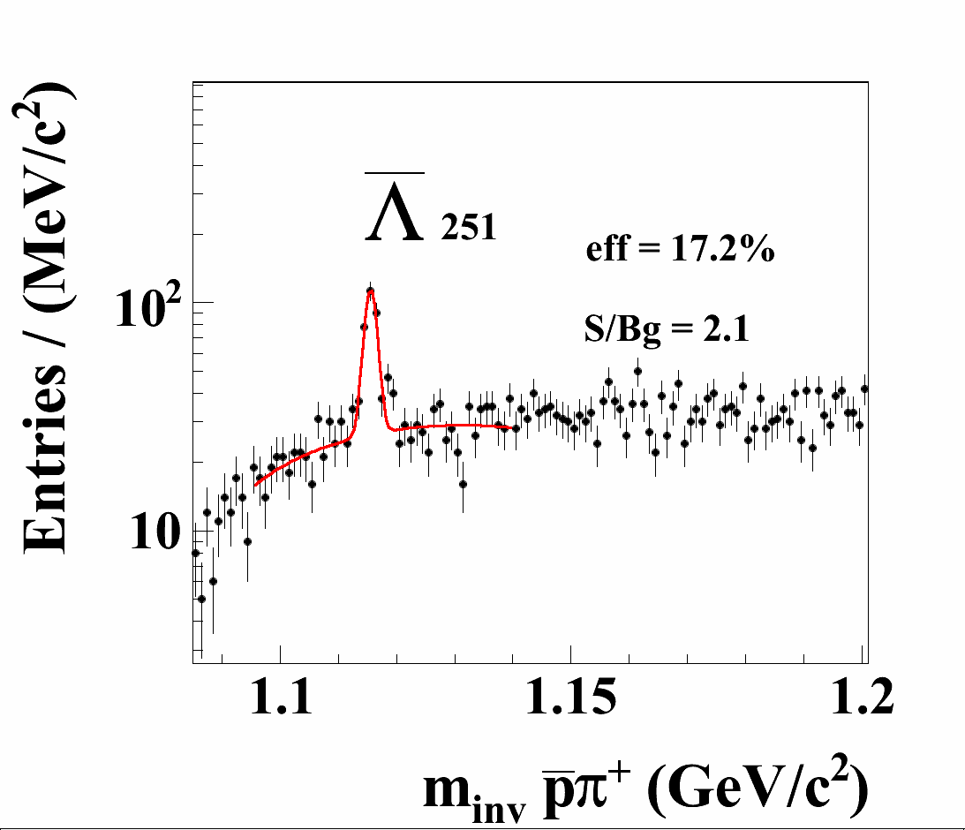
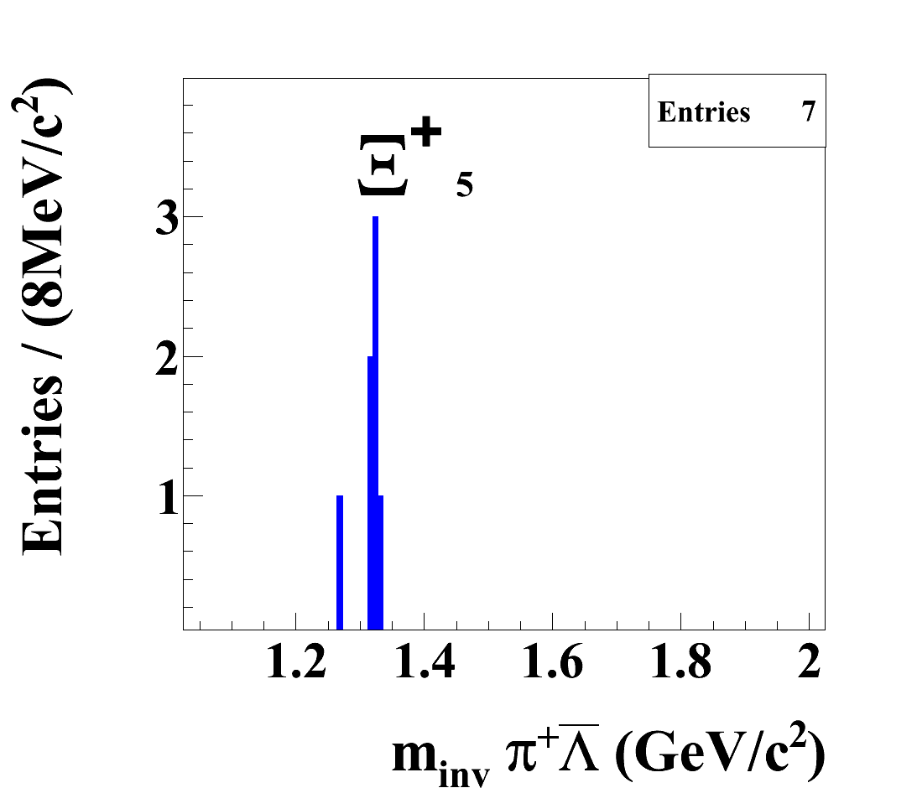
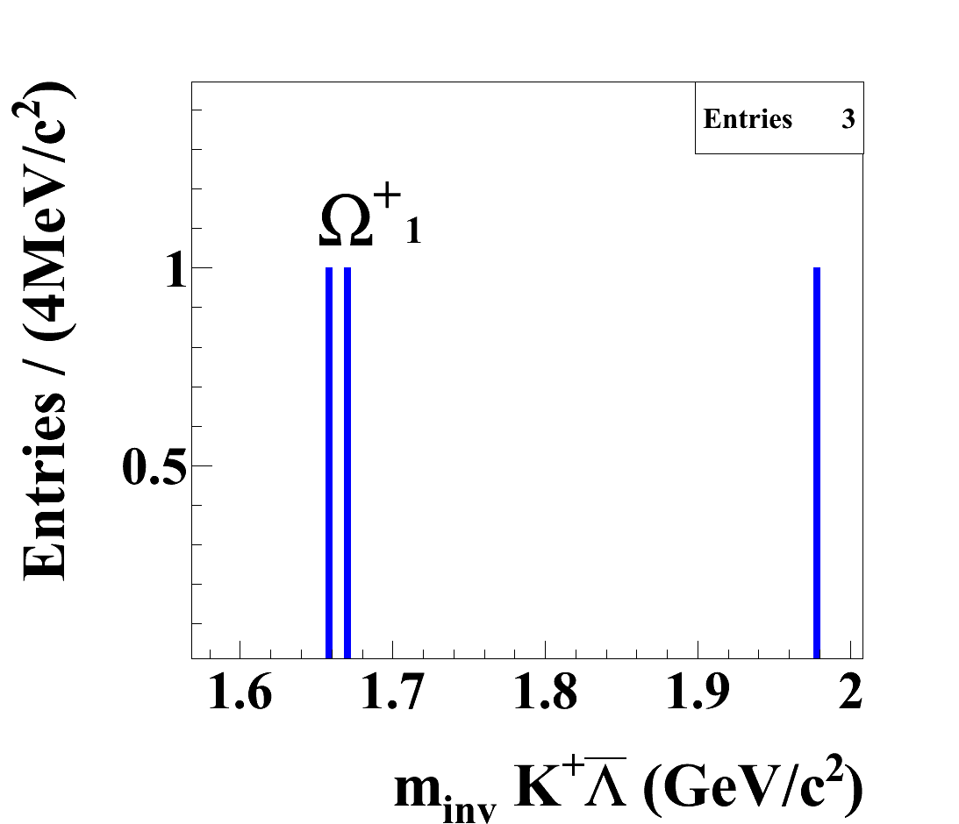
Au+Au 8 AGeV 1M central events

Slide 26
Hyperons in CBM
Au+Au, C+C at 4 energies (4, 6, 8, 10 A GeV)
Expected reconstructed yields for 4 weeks/energy min. bias Au+Au with 10⁷ beam ions/s (100 kHz events/s):
A GeV | Λ | Λ | Ξ⁻ | Ξ⁺ | Ω⁻ | Ω⁺
4 | 8.1∙10¹⁰ | 3.0∙10⁵ | 6.6∙10⁷ | 6.0∙10⁴ | 3.6∙10⁵ | 1.2∙10³
6 | 1.6∙10¹¹ | 5.0∙10⁶ | 3.4∙10⁸ | 1.8∙10⁵ | 2.4∙10⁶ | 1.2∙10⁴
8 | 2.1∙10¹¹ | 1.5∙10⁷ | 6.6∙10⁸ | 3.0∙10⁵ | 7.6∙10⁶ | 6.0∙10⁴
10 | 2.4∙10¹¹ | 3.8∙10⁷ | 9.6∙10⁸ | 2.0∙10⁶ | 1.3∙10⁷ | 1.5∙10⁵
In addition kaons and resonances (K*,Λ*,Σ*,Ξ*)

Slide 27
Conclusions
CBM will provide data on:
strangeness production
collective flow of identified particles
dilepton production
with unprecedented statistics in heavy-ion collisions at beam energies from 3 - 14 A GeV (Au beam up to 11 A GeV)
Questions
Are the yield, flow, spectra of multi-strange (anti-) hyperons
sensitive to the dense phase of the collision ?
➢ Is collective flow at high beam energies sensitive to the EOS?
Which transport/hybrid codes are suited to extract information
on the nuclear EOS from observables in high-energy collisions ?
How to disentangle effects of EOS and phase transition?

