Slide 1


Exotica production from ExHIC
Su Houng Lee – (ExHIC coll.)
1. Issues involved
2. Few words on “Multi-quark states”
3. Few aspects of coalescence model for hadron production
4. Exotica production in HIC

Slide 2
Issues involved
What’s the difference between compact multi-quark states and molecular states
When do they form in heavy ion collision within coalescence model
What is the production rate for multi-quarks or molecular states in Heavy Ion collision

Slide 3
I: Few words on “Multiquark states”
X(3872), Zc(3900), … Zb(10610), Zb(10650)
+ LHCb J/ψ p arXiv:1507.03414

Slide 4


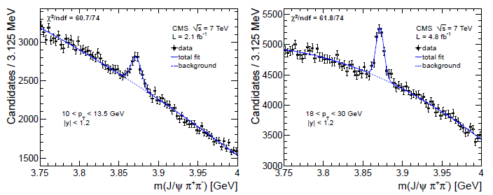

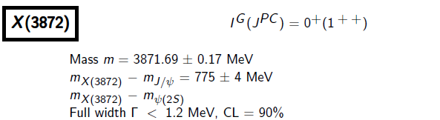
X(3872)
- 2003 -
- 2013 -

Slide 5
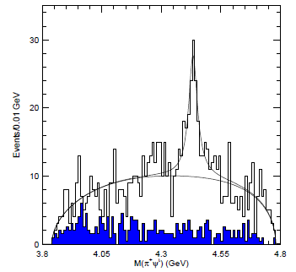
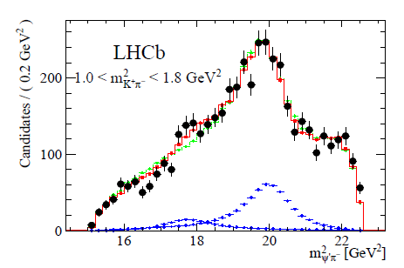

Z(4430)
- 2007 -
- 2014 -
Spin parity = 1+
G=+ → will look at C=-

Slide 6
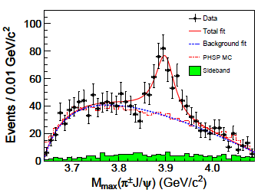
Z(3900)
- 2013 -
BESIII
(Belle)
Probably the same Quantum Number as Z(4430)
Hence,

Slide 7
Width of
A
π
V
- A1(1260) → ρ + π
- Z(3900) → J/ψ + π
- Z(4430) → ψ‘ + π
→ Although quark content is [(cu)(cd)], overlap is very small

Slide 8
Quark wave function for Tetraquark - s wave and spin 1
c
q
quark
c
q
antiquark
- Color singlet configuration: or
- Spin 1 configuration from : where
C=+
Color
Spin
C=-

Slide 9
Hamiltonian
Kinetic term
c
q
c
q
Color force
Favors over
c
q
c
q

Slide 10
C=+ state
(Woosung Park, SHL 14)
Or (Tornqvist 94)
C=- state
Or is molecular states
Or is 2s of in diquark picture (Maiani, Polosa, Riquer)

Slide 11
Real compact multiquark states
A 3-body or 4 body force could favor
and lead to compact 4 quark state
or artificially increase diquark correlation
1
2
3
4
Color Spin force
1
2
3
4

Slide 12
Tetra-quark – hadronic weak decay modes
1⁺
u
d
c
c
→
0⁻
c
1⁻
u
d
c
SHL, S Yasui, W Liu, C Ko (08)
- Binding against decay = - 79.3 MeV
Previous works on Tcc
Z. Zouzou, B. Silverstre-Brac, C. Gilgnooux, J Richard (86), D. Janc, M. Rosina (04), Y. Cui, S. L. Zhu (07)
QCD sum rules: F Navarra, M. Nielsen, SHLee, PLB 649, 166 (2007)
simple diquark: SHL, S. Yasui, W.Liu, C Ko EPJ C54, 259 (2008), SHL, S. Yasui: EPJ C (09)

Slide 13
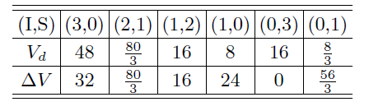
d*(2380)
- WASA-at-COSY-
d*
Δ
Δ
u
d
u
u
→
u
u
d
d
u
d
d
d
 | Color | Spin | Favor | V
(QQ)₁ | 3bar | 0 | 3bar | -2
(QQ)₂ |  | 1 | 6 | 2/3
(QQ)₃ | 6 | 0 | 6 | 1
(QQ)₄ |  | 1 | 3bar | -1/3
W.Park, A. Park, SHL, (PRD 15)

Slide 14
Summary so far
Molecular states: X(3872), Z(3900),Z(4430) ,d* (Tornqvist, Rosner ..)
if Tetraquarks, evidence for 3-body, 4-body QCD force
There could be compact mutiquark states such as Tcc, Tcb, ….
How could we distinguish them and find multiquark states with multiple heavy quarks
→ Answer for all: From HIC

Slide 15
Normal meson, Tetraquark and Molecule
 | Normal meson | Tetraquark | Molecule
Geometrical configuration
u
u
u
u
u
d
d
u
u
d
Example
Tcc
Molecule→ Ohkoda, Yasui … PRD86, 034019 (2012)
Tetraquark→ Woosung Par, SHL NPA 925, 16 (2014)
Λ(1405) → K-N distance: around 1.7fm (Sekihara et al. 2011 )

Slide 16
II: Few aspects of coalescence model for Hadron production in Heavy Ion Collision

Slide 17
Hadron production in ( p+π→C+X ) collision
c
C
u
β
d
G_{b/π}
D_{C/c}
π
c
u
b
dσ
γ
a
d
d
G_{a/p}
p
c
u
α
X

Slide 18
Particle production and freezeout in Heavy Ion Collision
T
Hadron
Multiquark formation
Light nuclei
Molecular structure formation
T_{C}
T_{H}
T_{F}
τ
QGP
Hadron phase
1 fm/c
5 fm/c
7 fm/c
17 fm/c

Slide 19
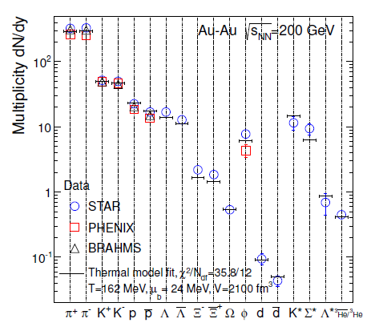
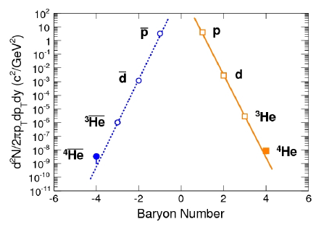
RHIC – Statistical model (PBM ..)
RHIC/STAR antimatter
S/N is conserved (Siemens, Kapusta 79)

Slide 20
Freeze out condition for nuclei in nucleon gas (Becattini et al.)
Freeze out condition (=cosmology)
T
Freeze out density
T_{H}
T_{F}
cf phase transition
τ
Hadron phase
7 fm/c
17 fm/c

Slide 21
Deuteron production at freeze out in Coalescence model
V_{C} : coalescence Volume
T_{C} : coalescence Temp
→ Independent of if

Slide 22
Hadronization and freezeout in Heavy Ion Collision
T
Hadron
Multiquark formation
Light nuclei Molecular structure formation
→ follow statistical model
T_{C}
T_{H}
T_{F}
τ
QGP
Hadron phase
1 fm/c
5 fm/c
7 fm/c
17 fm/c

Slide 23

Hadron production near phase bounday (T_{H} )
Coalescence model = Statistical model + overlap
Suppression of p-wave resonance (Muller and Kadana En’yo)
u
u
u
s
d
M
d
d
s
c
u
d
d
u
c
c
u
c
d

Slide 24
Production of multiquark states are suppressed
Success of Coalescence model
Coalescence model = Statistical model + overlap
u
s
d
u
d
d
u
u
u
u
u
d
s
c
u
d
u
d
u
d
d
u
u
d
c
u
c
Tetraquark configuration [overlap]<<1
Normal meson [overlap]=1
u
c
d

Slide 25
Hadron production through coalescence
u
d
u
d
u
d
u
Normal meson [overlap]=1
s
u
u
d
d
s
d
u
u
s
d
u
d
d
u
s
u
d
u
d
u
d
d
u
d
d
d
d
u
u
u
u
u
s
Molecular configuration: [overlap]=1
d
u
Tetraquark configuration [overlap]<<1
Coalescence model at Tc → ratio of yield

Slide 26
III: Heavy Exotics from Heavy Ion Collision

Slide 27
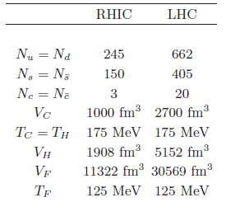
New perspective of Hadron Physics from Heavy Ion Collision
large number of c , b quark production
Vertex detector: weakly decaying exotics : FAIR 10⁴ D⁰ /month,
LHC 10⁵ D⁰/month
T_{cc} production
T_{cc}/D > 0.34 x 10 ⁻⁴ RHIC
> 0.8 x 10 ⁻⁴ LHC

Slide 28
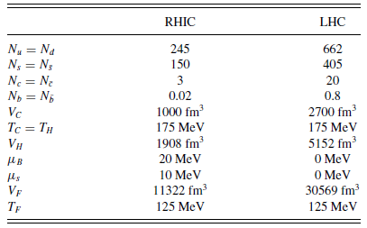



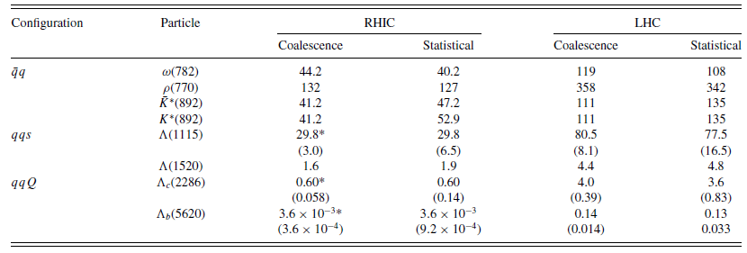
Details of coalescence model calculation (ExHIC PRL, PRC 2011)
Model central rapidity, central collision
Introduce charm fugacity LHC 10⁵ D⁰/month
Coalescence model model and Wigner function
Parameters to fit normal hadron production including resonance feedown from statistical model

Slide 29
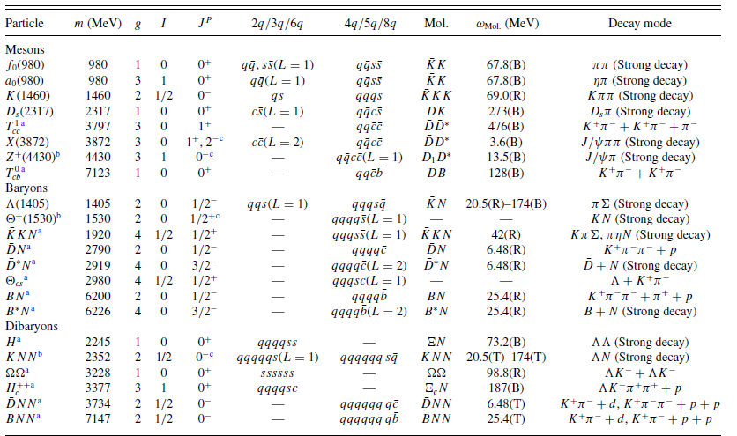
Hadron coalescence

Slide 30
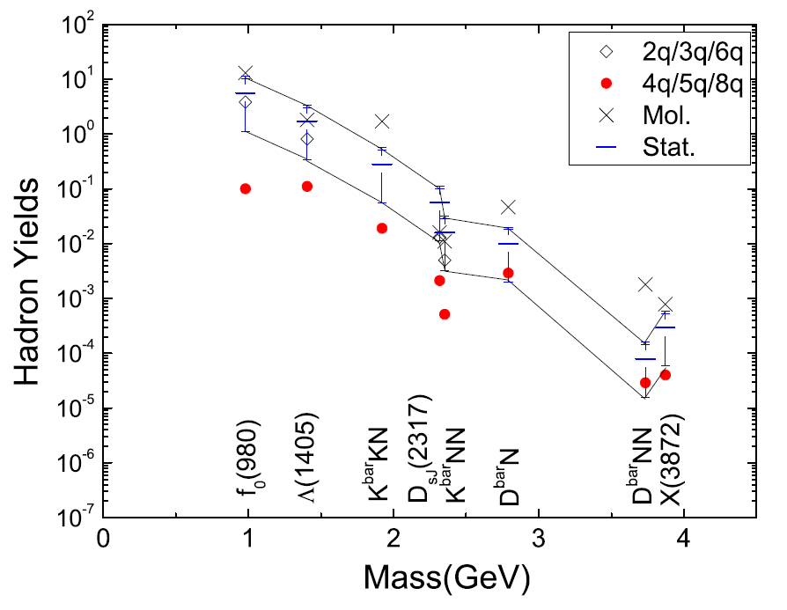
Yields are suppressed when the structures multiquarks
S. Cho, SHL

Slide 31
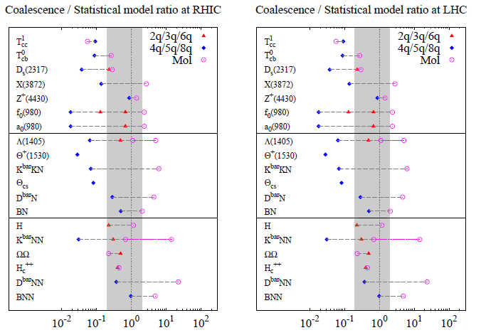
Fachini [STAR]
Expectations [overlap] at LHC

Slide 32
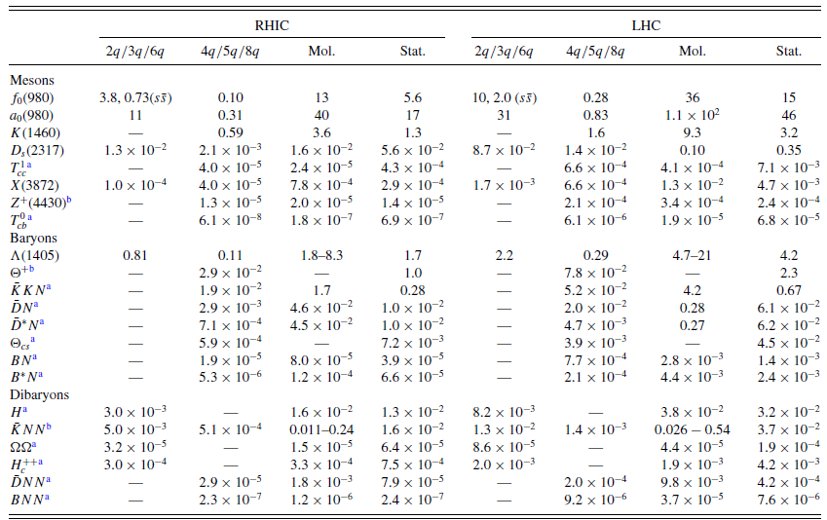
ExHIC (2011): multiquark/molecule candidates - yield

Slide 33
Summary → Issues involved
Whats the difference between compact multiquark states and molecular states
→ Need heavy quarks to enhance diquark correlation
→ Multiquarks will tell us about 3,4-body QCD force
When do they form in heavy ion collision
→ hadrons, multiquarks:
→ molecules, light nuclei
What is the production rate for multiquarks or molecular states in Heavy Ion collision
Coalescence model at Tc → ratio of yield

Slide 34
But Production of multiquark states are suppressed
Success of Coalescence model
u
u
d
s
d
d
u
d
d
u
u
d
d
s
c
u
Normal meson [overlap]=1
u
d
u
u
d
d
u
d
c
u
d
d
c
Tetraquark configuration [overlap]<<1
u
c
d
d

Slide 35
Deuteron production [Coalescence at T_{F} (125MeV) ]
V_{F} : Freezeout Volume
T_{F} : Freezeout Temp
V_{H} T_{H} : Hadronization
 | V (fm³) | V_{D}(T) (fm³) | N_{N} | Deuteron | Triton
N^{stat}(T_{H}) | 1908 | 0.7 | 30 | 0.25 | 0.0014
N^{coal}(T_{F}) | 11322 | 16 | 15 | 0.24 | 0.0014
V parameterization: .Chen, Greco, Ko, SHL , Liu 04

Slide 36
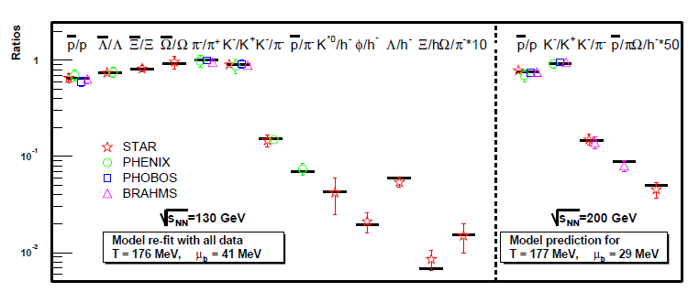
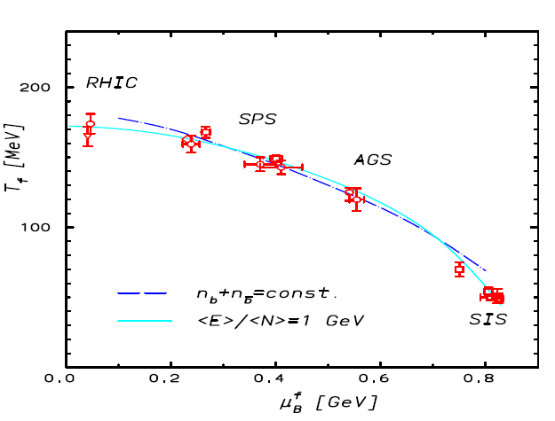
Statistical Model for Hadron Yield in HIC (PB Munzinger, Stachel, Redlich)
Freezeout points

Slide 37
Coalescence model
u
u
u
s
d
M
d
d
c
d
s
u
u
d
c
c
u
c
d
P_{T} dependence of ratio
Quark number scaling of v2
v4
Greco, et al
Greco et al

Slide 38
Hadron production near phase bounday (T_{H} )
Coalescence model = Statistical model + overlap
Suppression of p-wave resonance (Muller and Kadana En’yo)
u
u
u
s
d
M
d
d
s
c
u
d
d
u
c
c
u
c
d

