Slide 1
Super-FRS multiplet field

Slide 2
Outline
Multiplets
Magnet Configurations in Multiplets
Requirements on axis and angles
Magnetic field simulations
  Quadroples
  Coupling Quadrupole-Sextupole
Conclusions

Slide 3
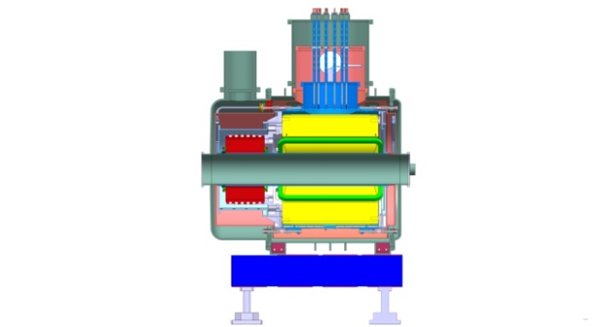
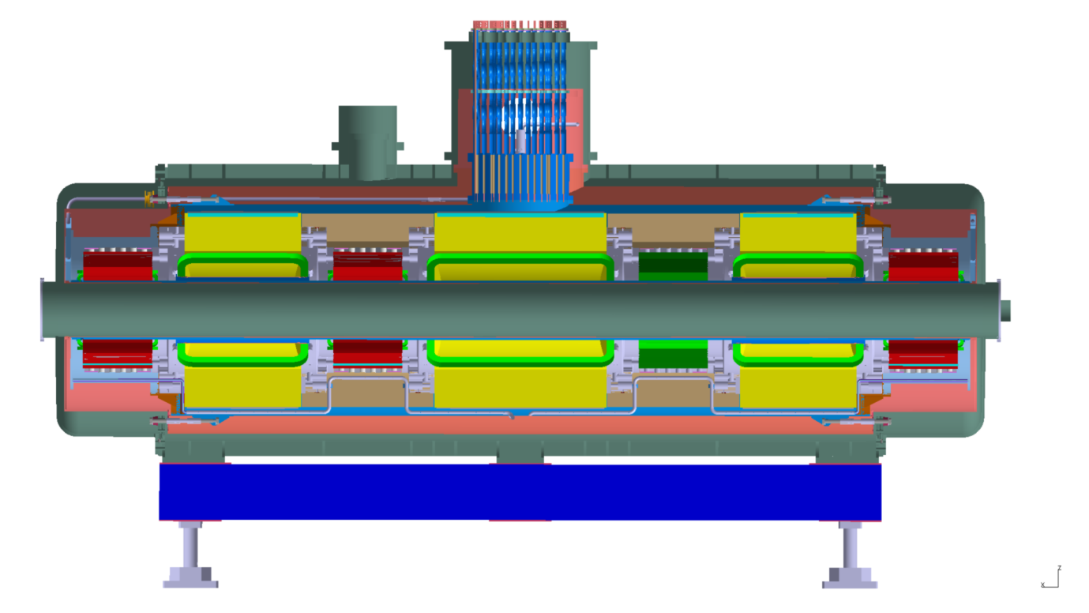
General Design of SC Multiplet
25 long multiplets + 8 short multiplets
Cold, laminated iron yoke (> 40 tons),
Warm beam pipe (38 cm inner diameter)
Common helium bath (~ 1300 liter helium)
1 pair of current leads per magnet
max. current < 300 A for all magnets
short multiplet
~ 7 m long, > 60 tons
1 x long quadrupole (LQ)
2 x short quadrupole (SQ) equipped with octupole (O) coil
3 x sextupole (S)
1 x steering dipole (ST)
S
SQ+O
S
LQ
ST
SQ+O
S
(longest multiplet system)

Slide 4
Configurations of magnets in 33 multiplets
28 standard configuration, 5 special configurations

Slide 5
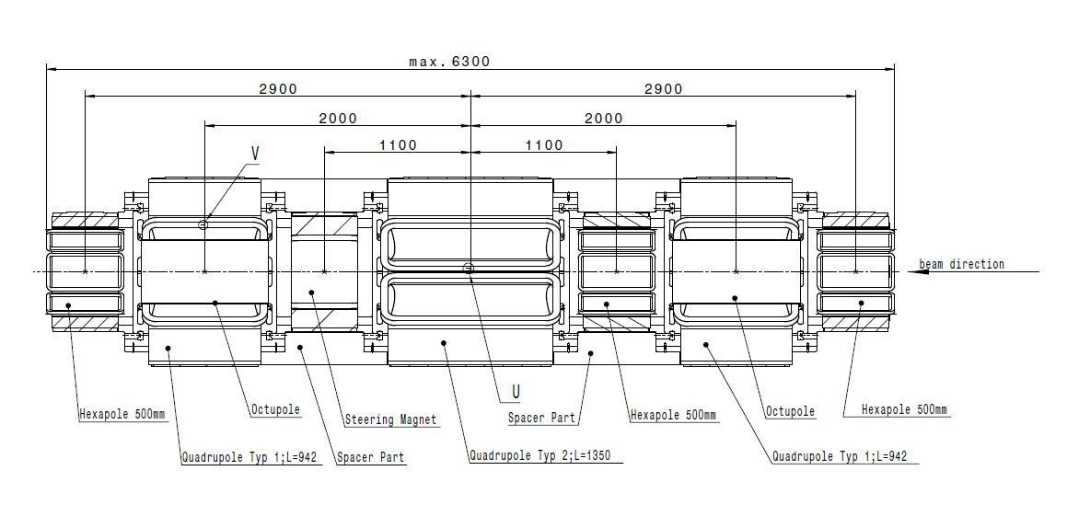
Maximum standard configuration

Slide 6
Special configurations

Slide 7
Magnet parameters
 | Quadrupole Type 3 | Quadrupole Type 4 | Sextupole | Steerer
Number of Magnets | 46 | 34 | 41 | 14 (13v/1h)
Effective length | 0.8 m | 1.2 m | 0.5 m | 0.5 m
Gradient/ Field Range | 1.0-10 T/m | 1.0-10 T/m | 4-40 T/m2 | 0-0.2 T
∫gdl | 0.8-8 T/m*m | 1.2-12 T/m*m | 2-20 T/m²*m | ≥ ± 0.1 T*m
Field Quality | For g< 0.8 g_{max} ±1·10⁻³ For g > 0.8 g_{max} ±6·10⁻³ | For g< 0.8 g_{max} ±1·10⁻³ For g > 0.8 g_{max} ±6·10⁻³ | ±5·10⁻³ | ±8·10⁻³
Usable aperture | Ø 380 mm | Ø 380 mm | Ø 380 mm | Ø 380 mm
Embedded Octupole | 105 T/m³ Int. 84 T/m³×m
Magnets are operated (DC) at all field levels between minimum and maximum !

Slide 8
Tolerances/accuracy
Axes tolerances of position, pitch yaw and roll of each single magnet in a multiplet in relation to the best multiplet axis which is represented by the references outside the Multiplet cryostat.
Maximum allowed total error between position of magnetic axis and mechanical axis (related to outside references of the cryostat) | ±0.2 mm
Tolerance on pitch and yaw (related to outside references of the cryostat) | ±0.29 mrad
Tolerance on roll (related to outside references of the cryostat) | ±1.15 mrad
Alignment only possible with regards to common best multiplet axis

Slide 9
Tolerances/accuracy
Accuracy (difference of the integrated flux density between two magnets which are identical in construction and powered with the same current)
Quadrupoles | ≤ 0.25 %
Sextupoles | ≤ 0.4 %
Steerer | ≤ 0.4 %

Slide 10
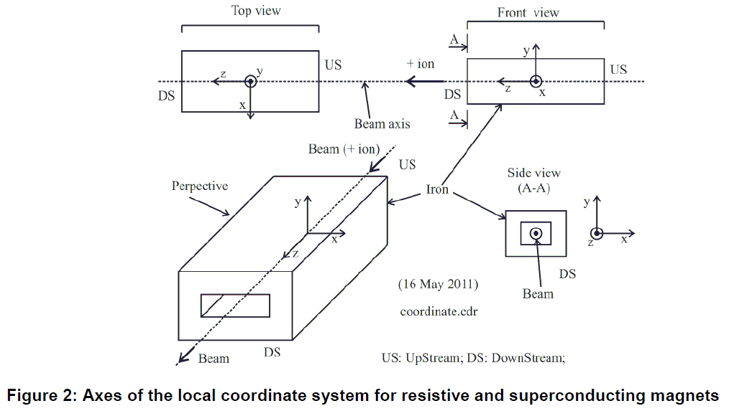
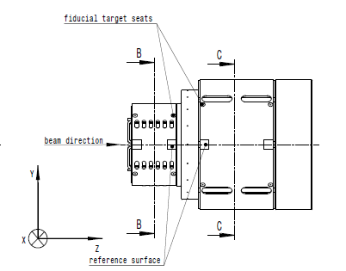
Coordinate system (Technical Guideline)
not fixed: origin of coordinate system

Slide 11
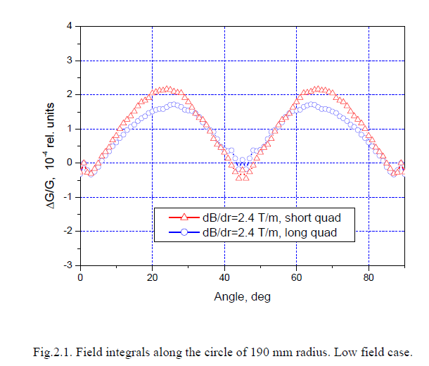
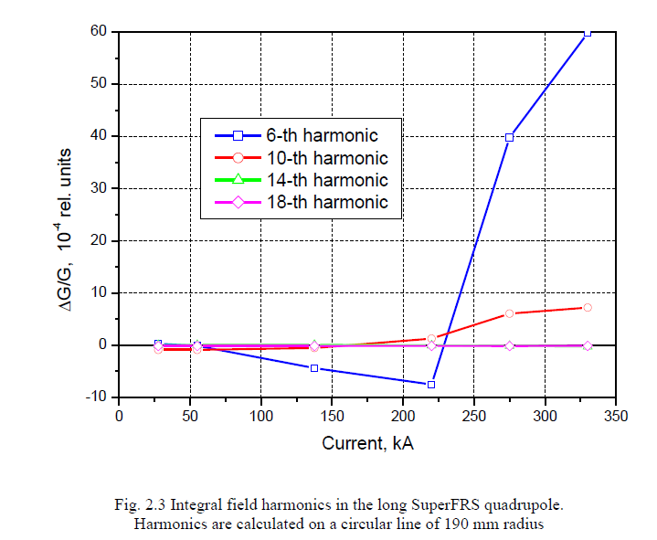
Magnetic field simulations
All field caculations by A. Kalimov (St. Petersburg)
Quadrupoles

Slide 12
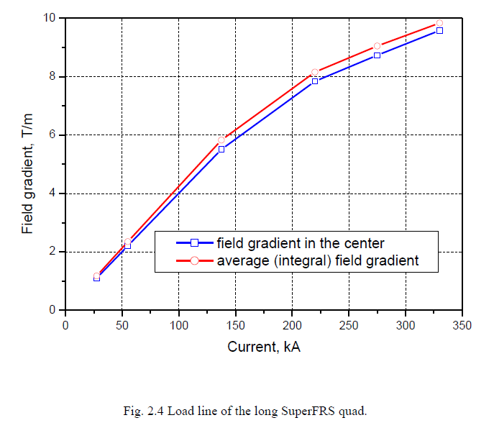
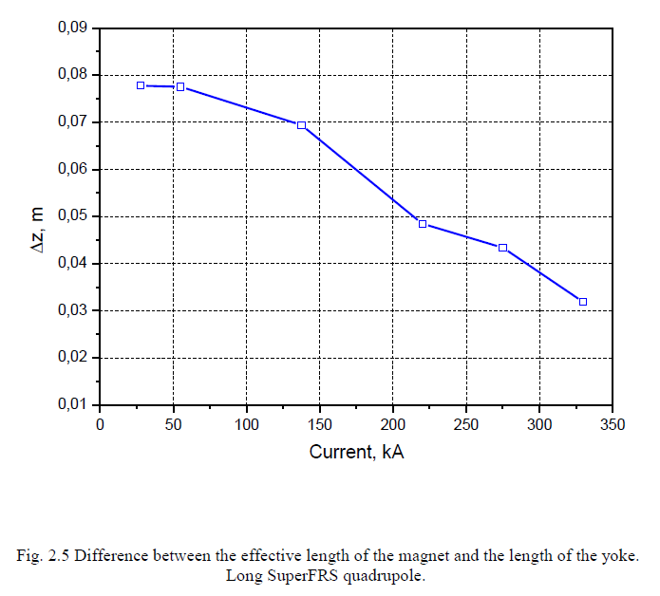

Slide 13
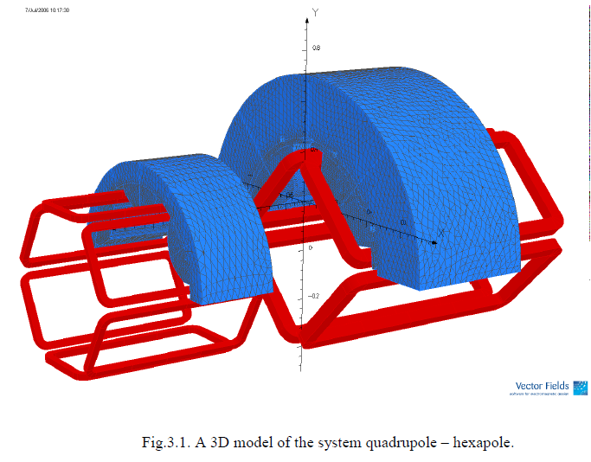
Coupling Quadruple-Sextupole
Variation of distance between yokes from 500 mm to 200 mm

Slide 14
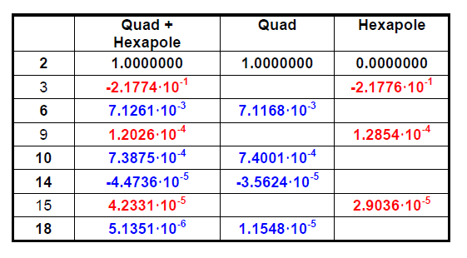
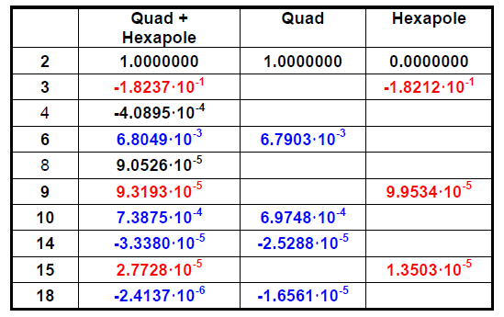
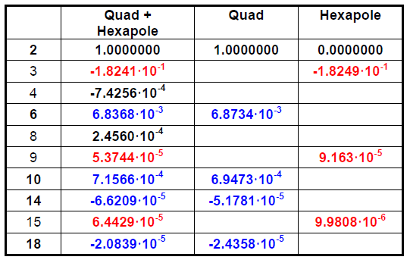
Coupling Quadruple-Sextupole
500 mm 250 mm
200 mm

Slide 15
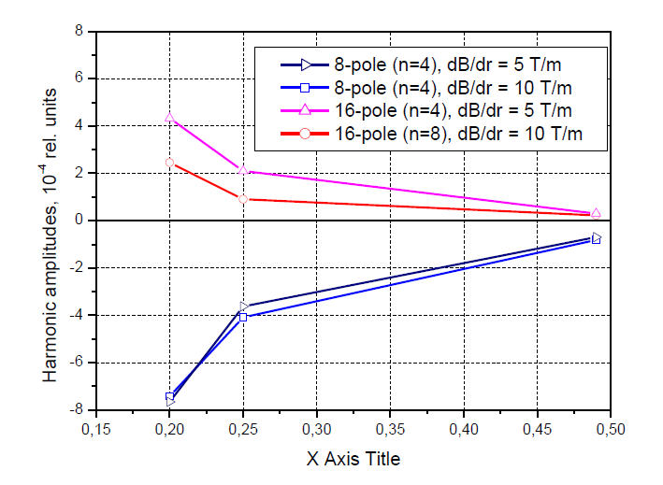
Coupling Quadruple-Sextupole
250 mm distance was chosen as compromise between space limit and field distortion

Slide 16
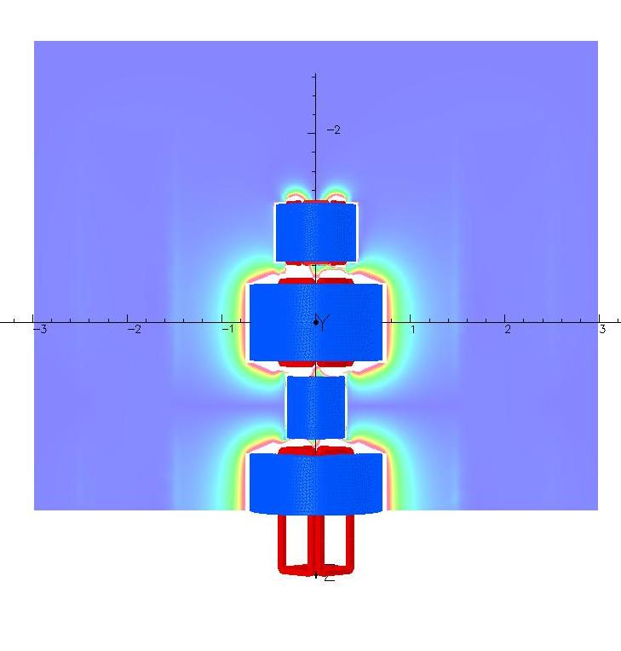
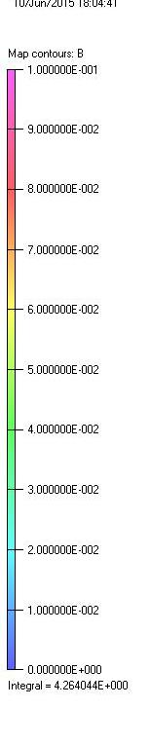
Strayfield

Slide 17
Conclusions
28 standard multiplets (long and short)
5 special configurations
Measurements at different field levels are required
Alignment only possible with regards to common axis of a multiplet
For given distance some cross-talk between magnet is expected

