Slide 1
Testing SuperFRS@CERN: Workshop on Survey and MM
Luigi Serio and Pierre Schnizer

Slide 2
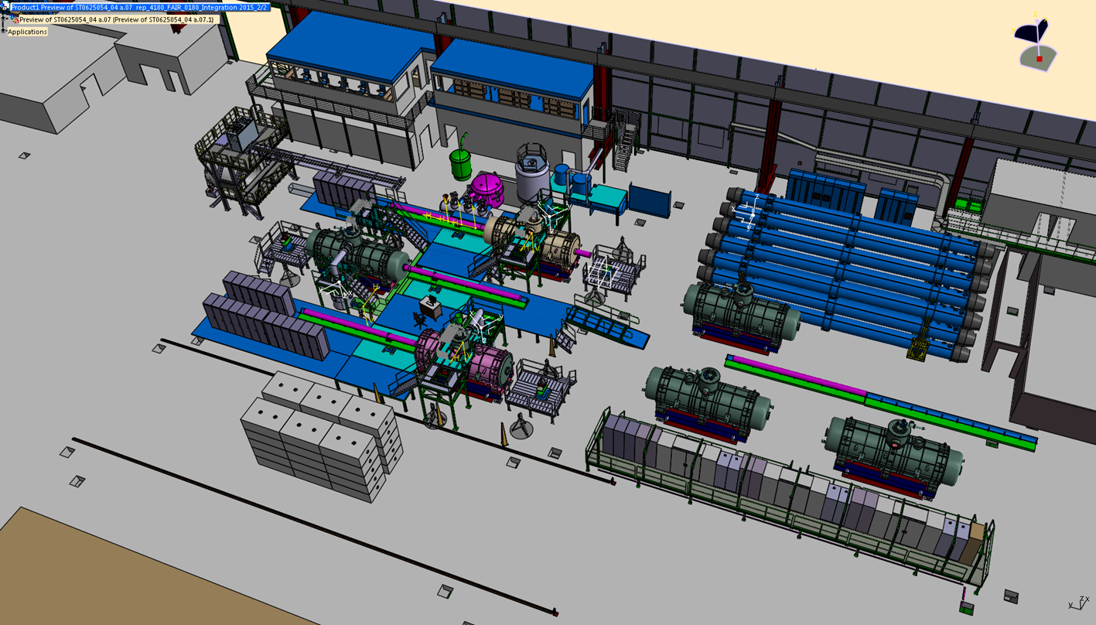
Status of the SFRS magnets test facility
Requirements and interfaces fixed
Layout and integration finalized (minor adj still possible)
Specifications established and procurements being launched
Construction started for LLI

Slide 3
Motivation for the Workshop
Bringing together people working on SFRS machine beam dynamics, magnets designer, magnetic measurements and alignment specialists for a final review of the requirements, assumptions, feasibility and efficient implementation of the MM program
In particular:
Review the magnetic measurements and alignment requirements justifications
Identify the measurements needs and ‘wishes’ for the machine (shall and should)
Review the foreseen measurement program to identify
Limitations – if any
Simplification – if possible
Focus on the technical and technology aspect
Project aspects to be sorted out by the project team if agreement reached on the above

