Slide 1
Beam dynamics of Super-FRS and MM requirements
John Winfield
GSI Helmholtzzentrum für Schwerionenforschung GmbH

Slide 2
Introduction
Super-FRS normally used as coupled two-stage Bρ-ΔE-Bρ separator (“achromatic” mode).
Also used as part of 0° (energy-loss) spectrometer, dispersive & other modes - see, e.g., “Physics Case for Super-FRS Collaboration”.
Field measurement programme is based mostly on experience with predecessor, FRS.
Larger aperture of magnets for the Super-FRS must be taken into account.

Slide 3
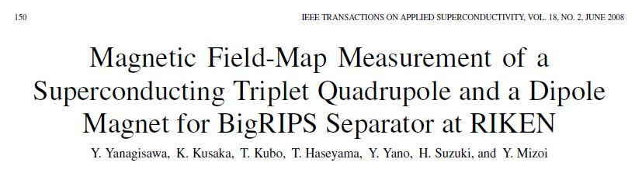
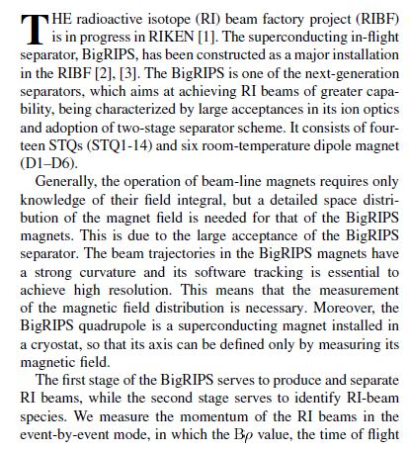

Slide 4
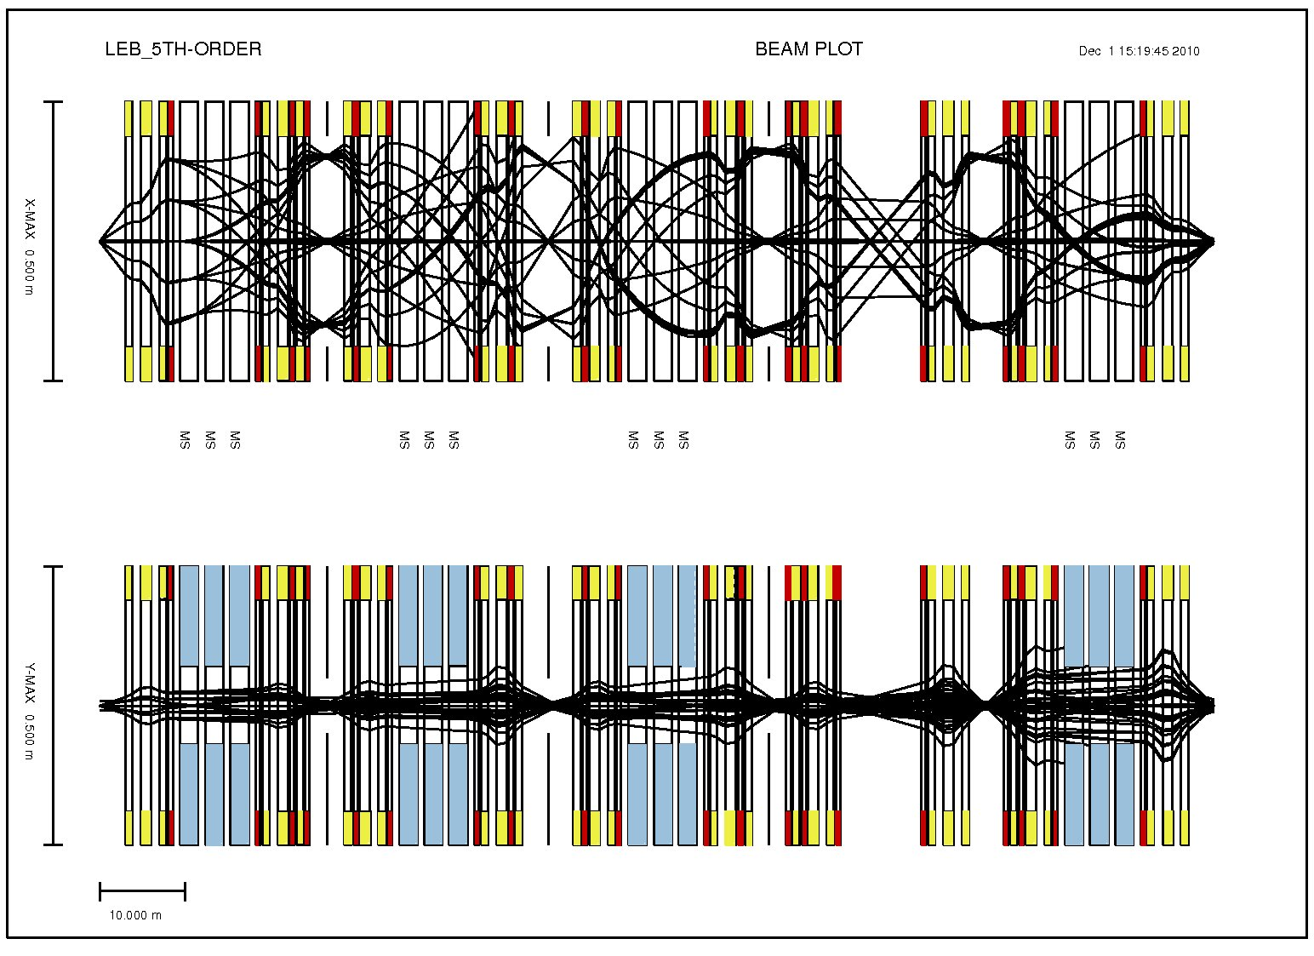
Ion optics: Low Energy Branch (Main Separator)
X
MF1
MF2
MF3
LF2
Y

Slide 5
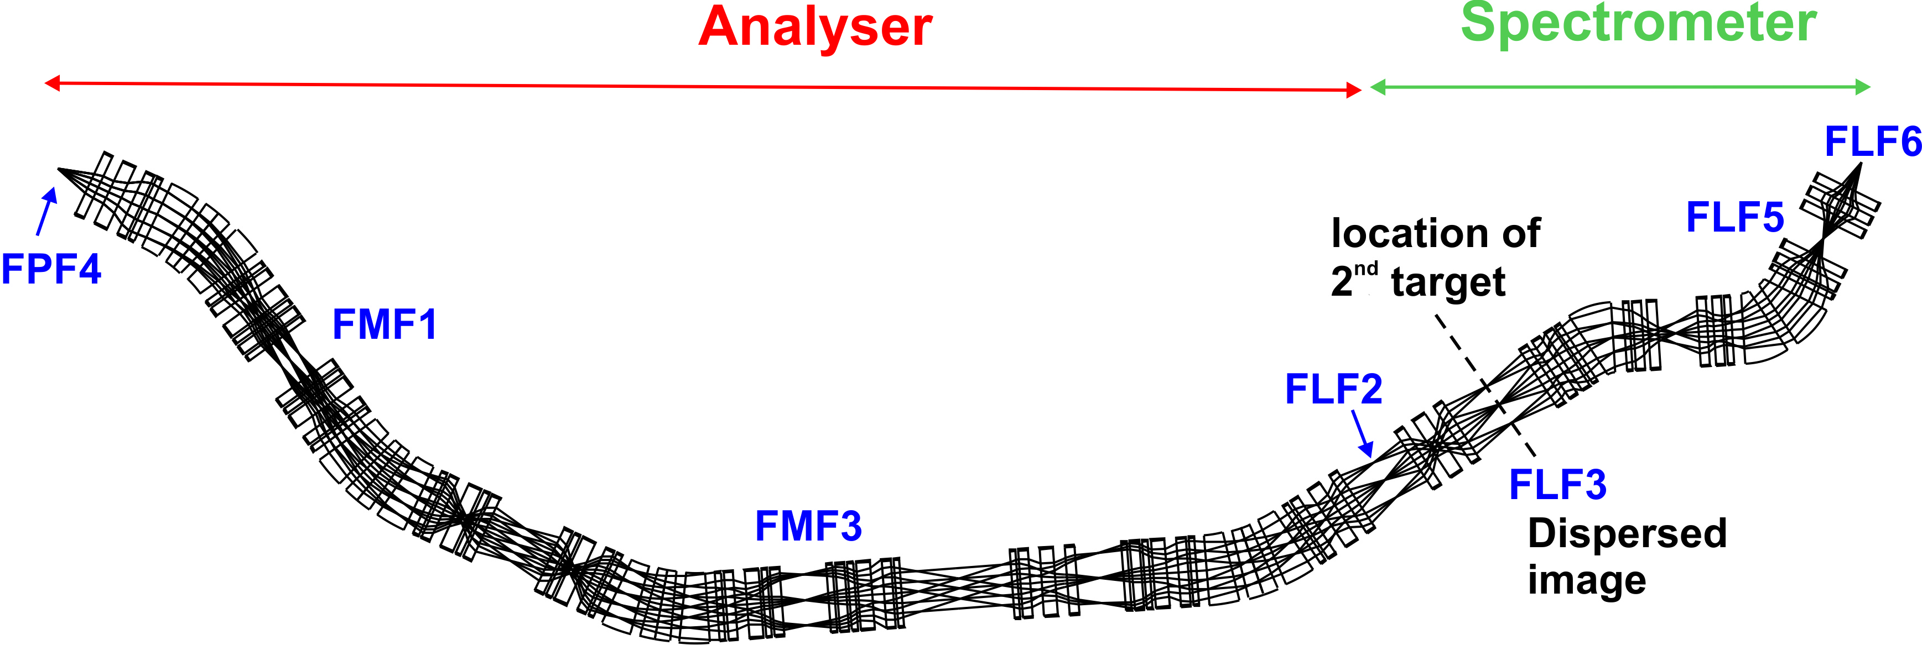
Dispersion-matched mode
M. Yavor, H. Geissel; 2003
Applied to give high-resolution momentum measurements in combination with secondary reaction studies. Also done for HEB-R³B(H. Geissel 2014-15)

Slide 6
Field measurements – some issues
First magnet of type, Series magnets.
Number of magnet excitations (current), range (max, min)
Extent of fringe field, step size
Number of vertical planes (dipole)
Harmonic analysis (quadrupole)
Embedded octupole with and without quad excited.

Slide 7
Dipole
For “1st of kind”: Complete field map incl. fringe fields.
  Transform field map to ion-optical transfer matrix for COSY/GICOSY/Mirko. E. Kazantseva at TU-Darmstadt & Martin Berz’s group at MSU working on this.
  Check field quality (SAT).
Many excitations: Aim is to set magnets more reliably. Usually, many Bρ settings during expt → want to spend as little time as possible. (FRS experience).
Several vertical planes:. Field near pole faces could differ from that at mid-plane. Difficult to extrapolate reliably from mid-plane (Lazzaro NIM A 570 (2007) 192, Manikona PhD thesis, MSU)

Slide 8
Quadrupole
Both entrance and exit fringe fields (→ effective length of magnet) should be measured for all quadrupoles, at many field excitations. (FRS experience: 6th order polynomial fits were made).
FRS quadrupoles: effective length can vary >3% depending on current excitation.
Fields vary according to focusing requirements.

Slide 10

Enge coefficients
In ion-optics programs, magnet fringe field fall-off typically represented by six parameter Enge function:
where z is distance perpendicular to EFB (for multipoles it coincides with reference trajectory),
D is the full aperture, and a₁ through a₆ are the Enge coefficients. These coefficients are fit to the measured fringe field data.

Slide 11
Current dependence of Enge coefficients (Q1000)
From: H. Takeda, RIKEN, Expert meeting on in-flight separators, 2010. Entrance side
a3
a1
a2
Q current (A)
Q current (A)
Q current (A)
a5
a6
a4
Q current (A)
Q current (A)
Q current (A)

Slide 12
Current dependence of Enge coefficients (Q1000)
From: H. Takeda, RIKEN, Expert meeting on in-flight separators, 2010. Exit side
a3
a1
a2
Q current (A)
Q current (A)
Q current (A)
a5
a6
a4
Q current (A)
Q current (A)
Q current (A)

Slide 13
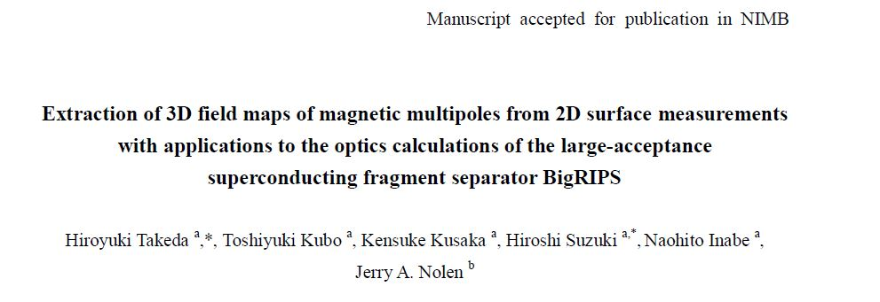
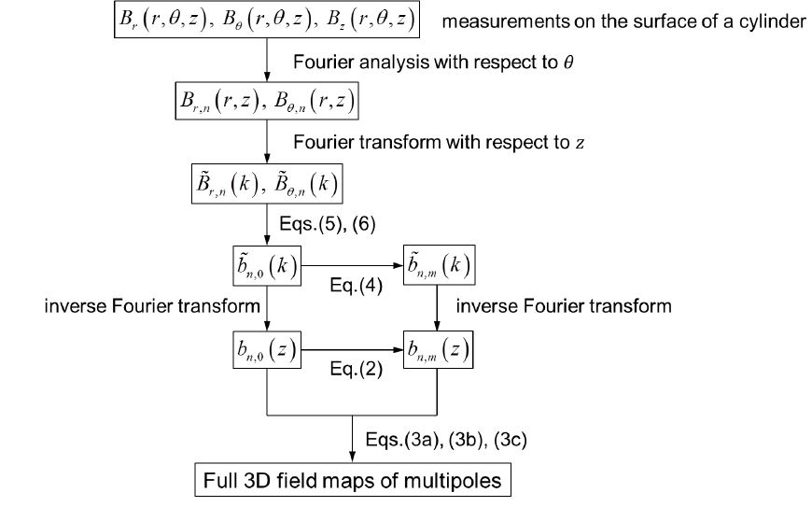
Harmonic analysis
Harmonic Analysis

Slide 14
Alexander Kalimov’s design
Specifications and calculation results
 |  | Type 3 quad
Eff. length, L | m | 0.8
Gradient range G. |  | 1.0-10 T/m
Gradient quality |  | <±8∙10⁻⁴, below 8 T/m
Useable horizontal aperture | mm | ±190
Useable vertical aperture | mm | ±120
Embedded octupole (B''') | T/m³ | 105
Harmonics must be obtained at several fields, incl. highest excitation.

Slide 15
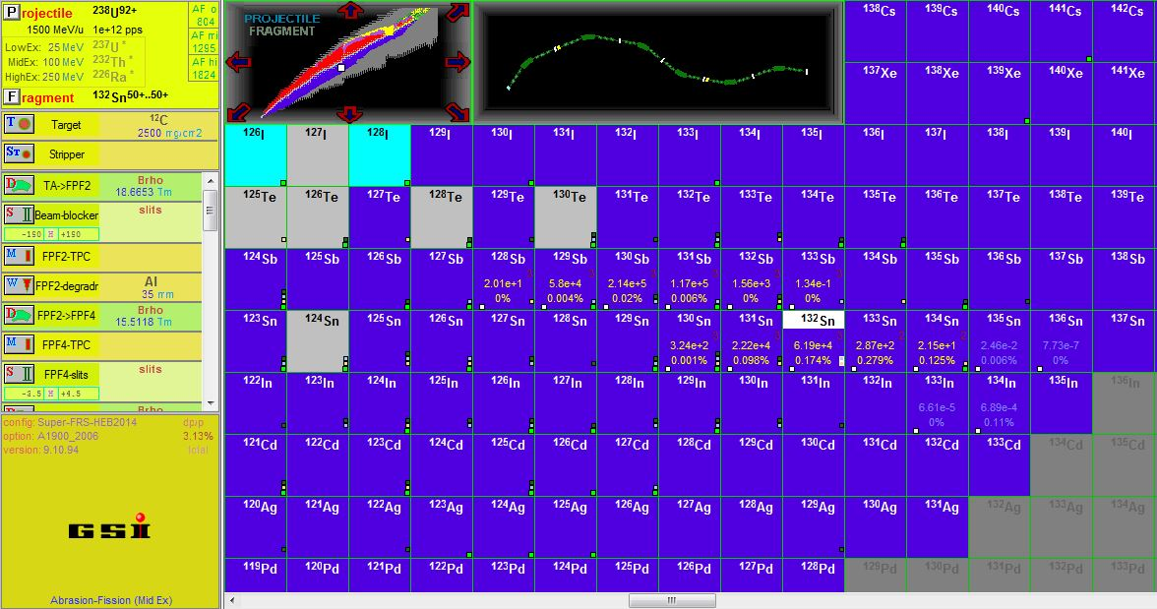
Simulation programs
Simulation and prediction programs such as MOCADI and LISE++ use matrix elements from ion-optics codes, which in turn are more reliable when based on actual magnet field measurements.

Slide 16
Summary

Slide 17
Backup slides

Slide 18
Hysteresis
FRS procedure: before fields are set, magnets are “ramped” by powering them from 0 to nominal current several times.

Slide 19
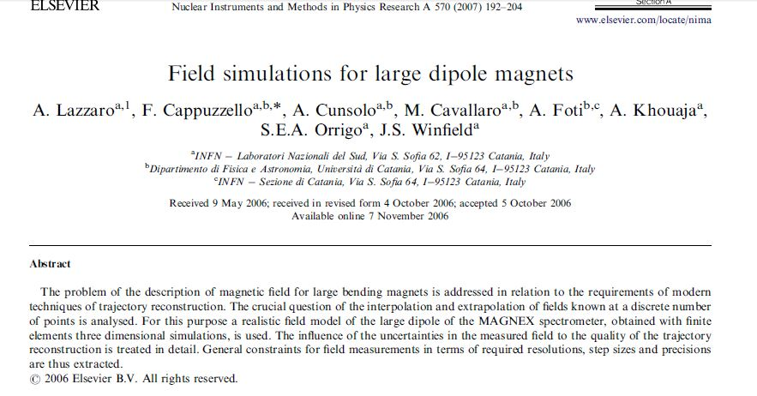
Standard approach to extrapolate field far from mid-plane inaccurate: needs high-order differentiation → v. sensitive to errors in mapping.
Better: measure in several planes & interpolate → 3D vector field, analytical & differentiable. Use DA to get high order transfer maps.

