Slide 1


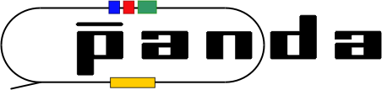
Status of the PandaRoot simulation of the Forward RICH
Budker INP
Konstantin Beloborodov
Budker INP, Novosibirsk, Russia
Novosibirsk State University, Russia
PANDA LIII. Collaboration Meeting
Uppsala, Sweden
8-12 June 2015

Slide 2
Outline
Geometry
Aerogel
Simulation
Reconstruction

Slide 3
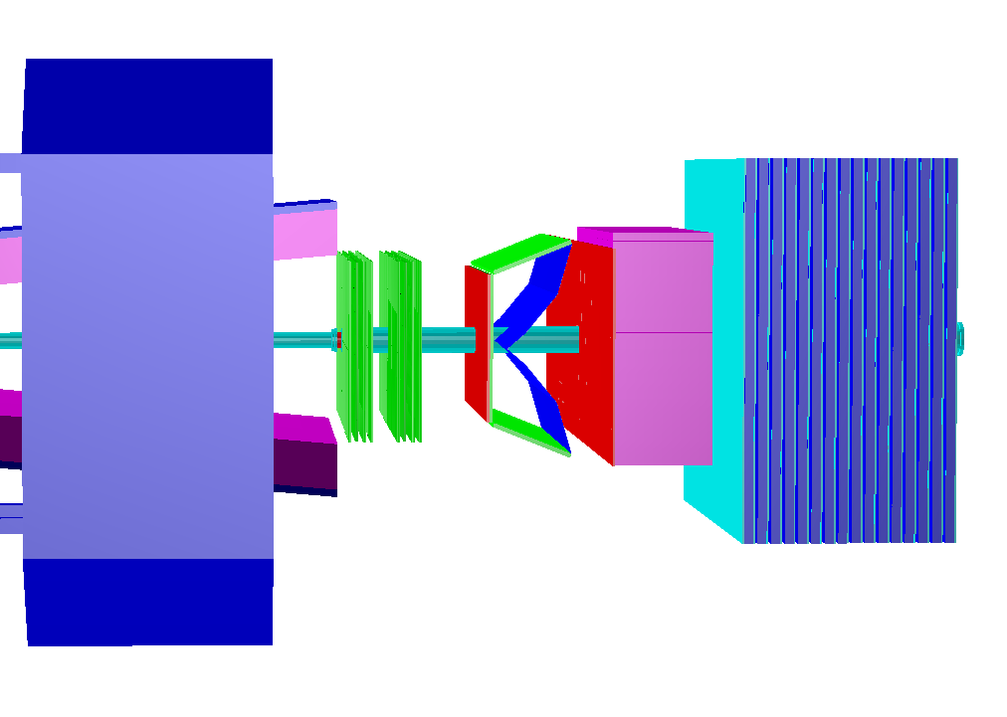
Forward RICH
Dipole magnet
RICH
Main goal | PID information for higher level triggers
π/K-separation | up to ~10 GeV/c
Radiator | Focusing aerogel
Refractive indices | ~1.05
Radiator thickness | 4 cm
Placement | Between FT5 and FT6
Vertical angle | ±5°
Horizontal angle | ±10°
FT5
FT6
TOF
HCAL
RICH
ECAL

Slide 4
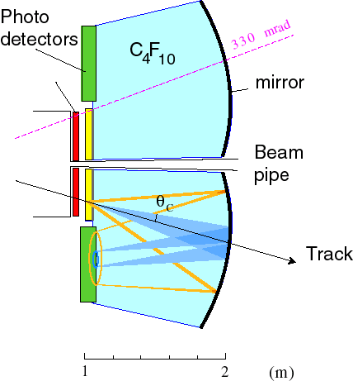
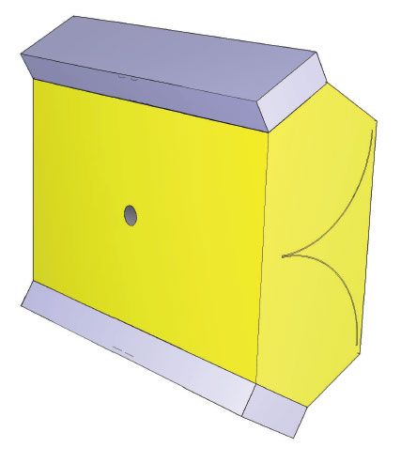
Geometric requirements
Placement along beam axis: between forward trackers 5 and 6
Angular acceptance: dimensions are the same or close to forward trackers dimensions
Aerogel radiator: multi-layer
Mirror: simple shape (flat, round, spheric)
Geometric efficiency: all Cherenkov photons should be detected if it possible
Photon detector: less sizes as it possible (due to cost optimization)
Shape of Cherenkov “ring” on the photodetector surface: simple (circle, ellipse)
…
spheric
round
flat
LHCb

Slide 5
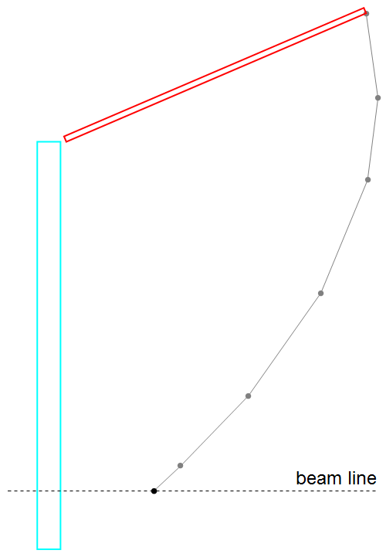
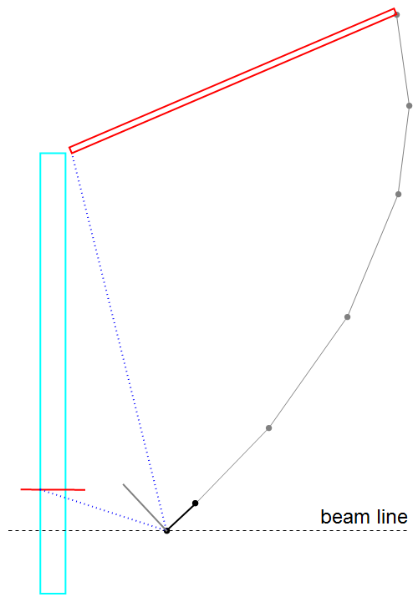
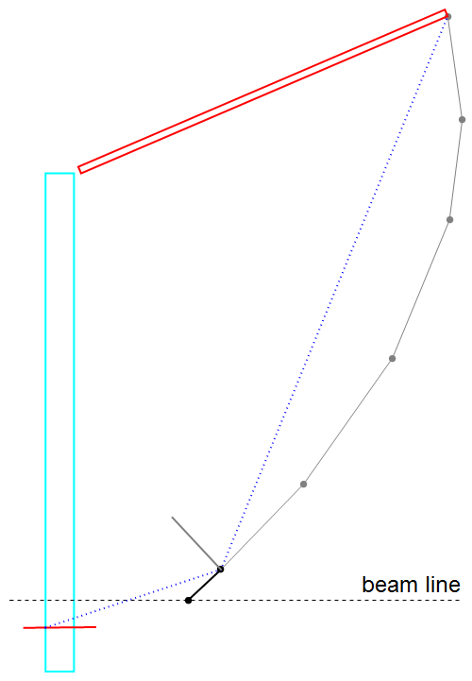
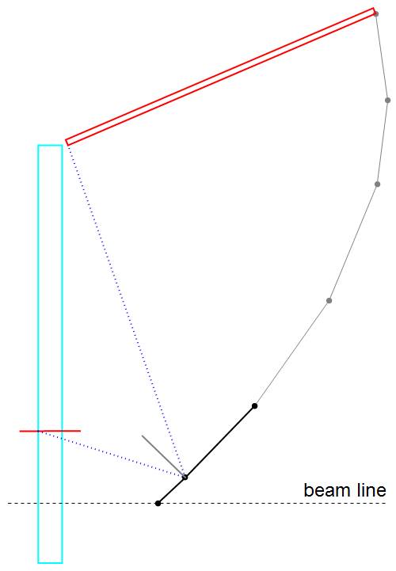
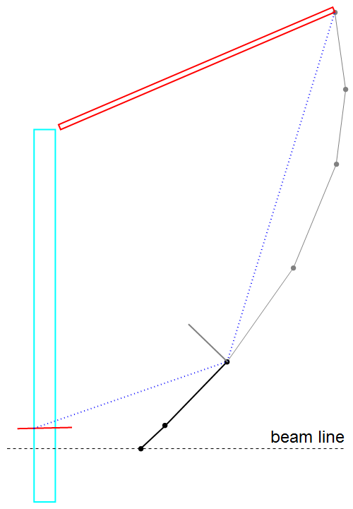
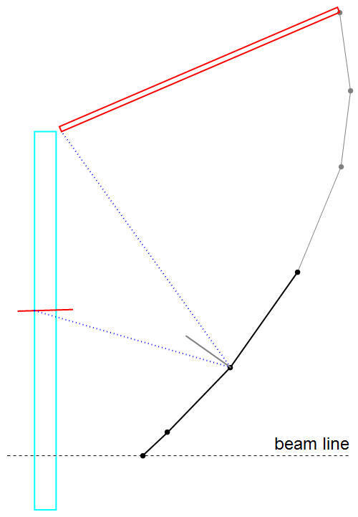
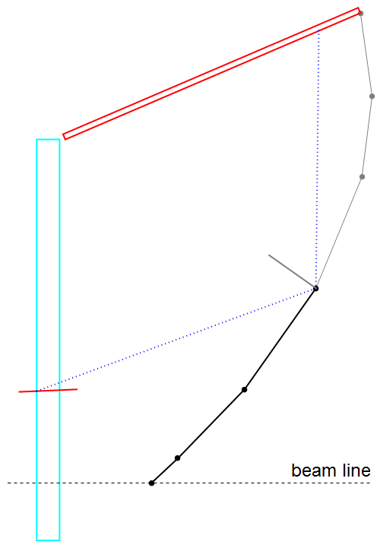
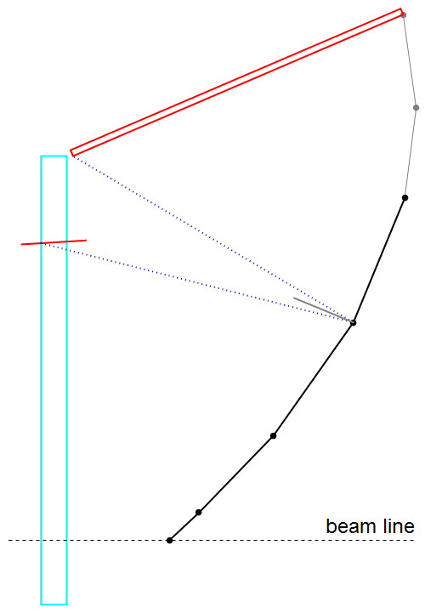
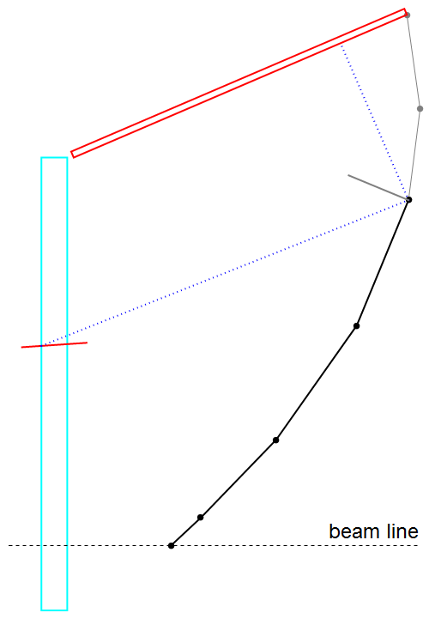
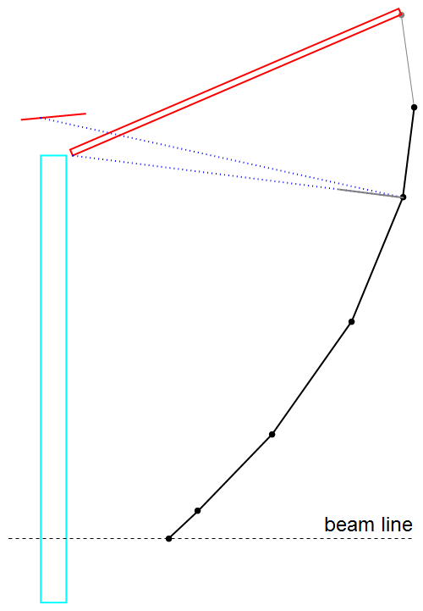
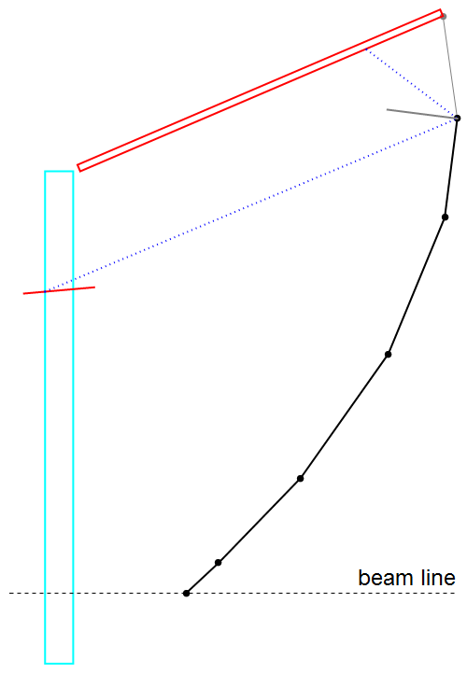
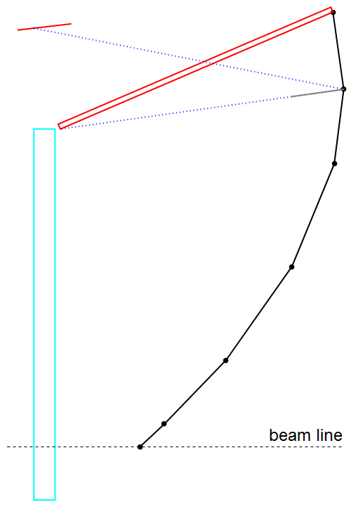
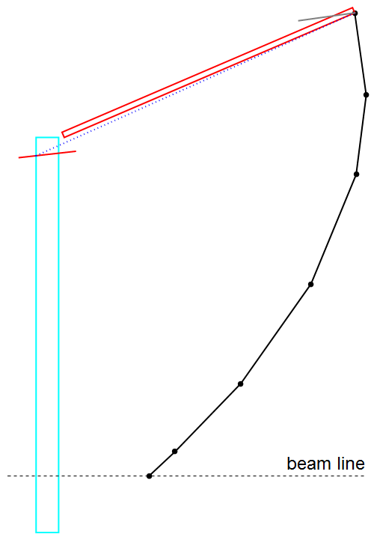
Mirror parameters optimization
Six segments flat mirror
(as an example)
Geometric efficiency:
Lower Č photon hits PhDet
Upper Č photon hits PhDet
All other Č photons automatically do the same
Photo detector width:
w( z, l₁, l₂, l₃, … ) → w_{min}
First segment has major influence on PhDet size!

Slide 6
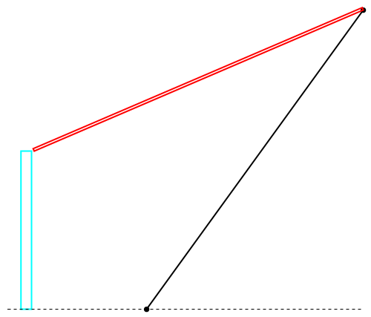
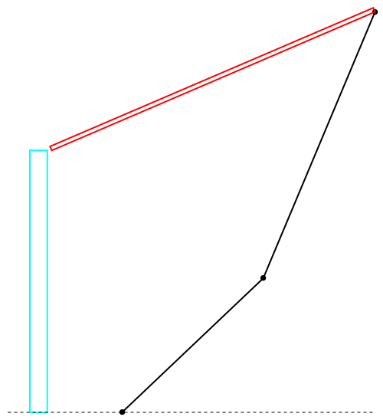
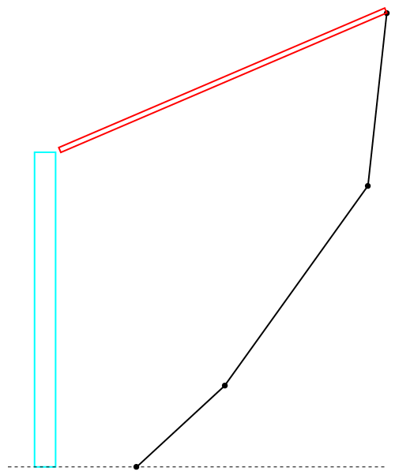
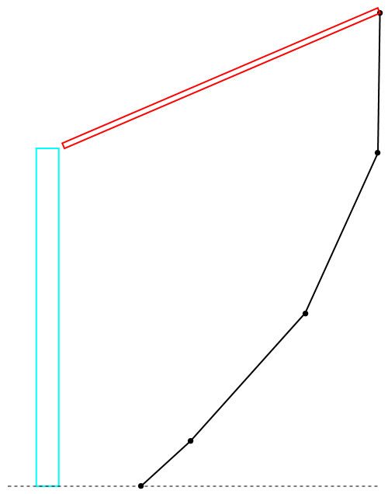
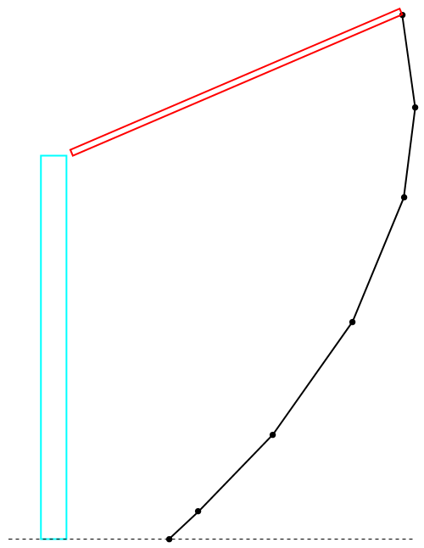
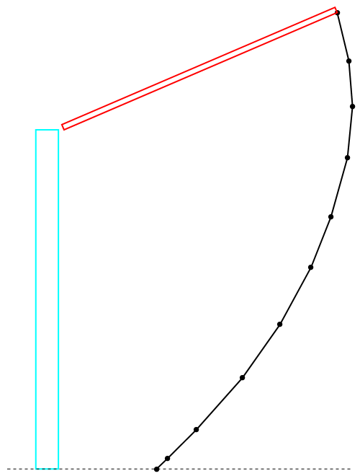
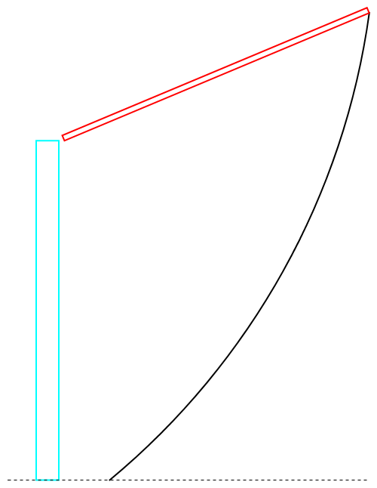
Optimal mirror configurations
1 segment
2 segments
3 segments
4 segments
6 segments
10 segments
Round

Slide 7
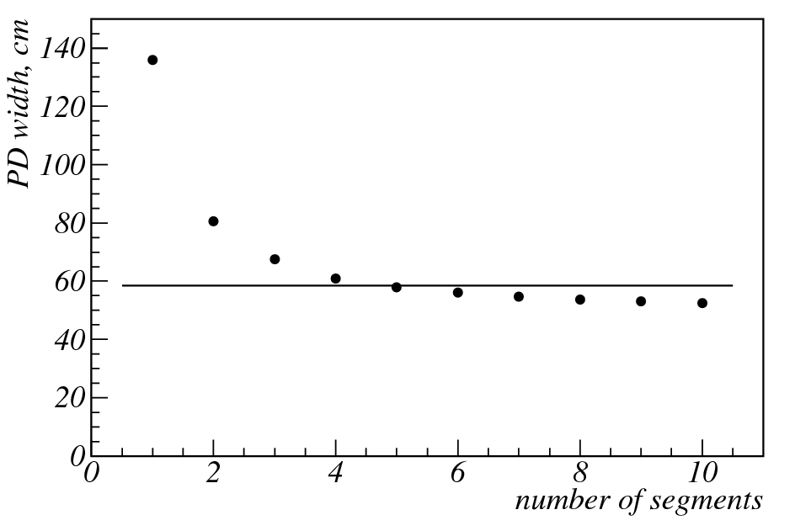
Some features of flat and round mirrors
feature | 3 segments | Round
PD width, cm | 67.5 | 58.5
Mirror focusing | no | yes
Aerogel focusing | yes | no
combinatorial background | yes | no
Cherenkov “ring” shape on PD surface | elliptical | complicated
Number of parts | 3 | 1
round mirror
Aerogel plate size = 60 cm (half height)

Slide 8
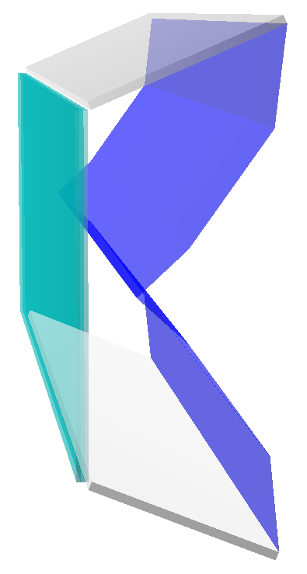


Multi-layer aerogel: parameter optimization
Two layers
Three layers
1.05 − δn
1.05 − δn
1.05 + δn
1.05
1.05 + δn
Software: FairSoft – apr13, PandaRoot – scrut14

Slide 9
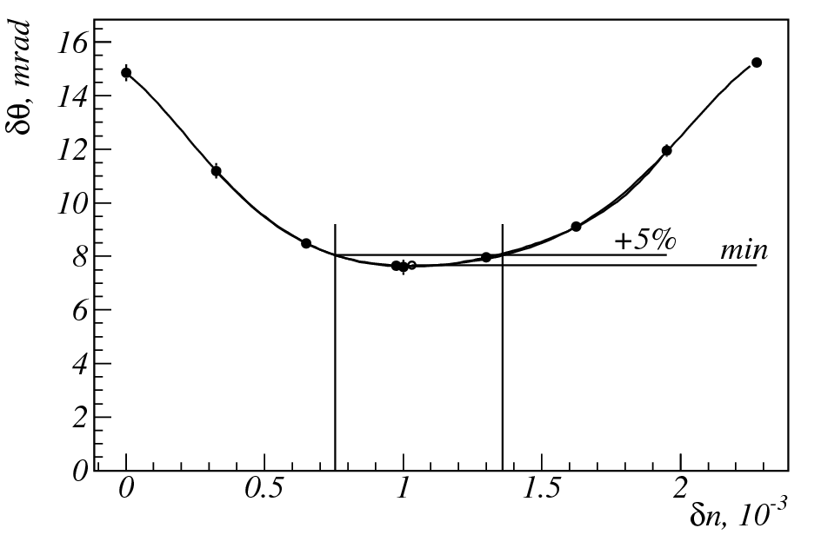
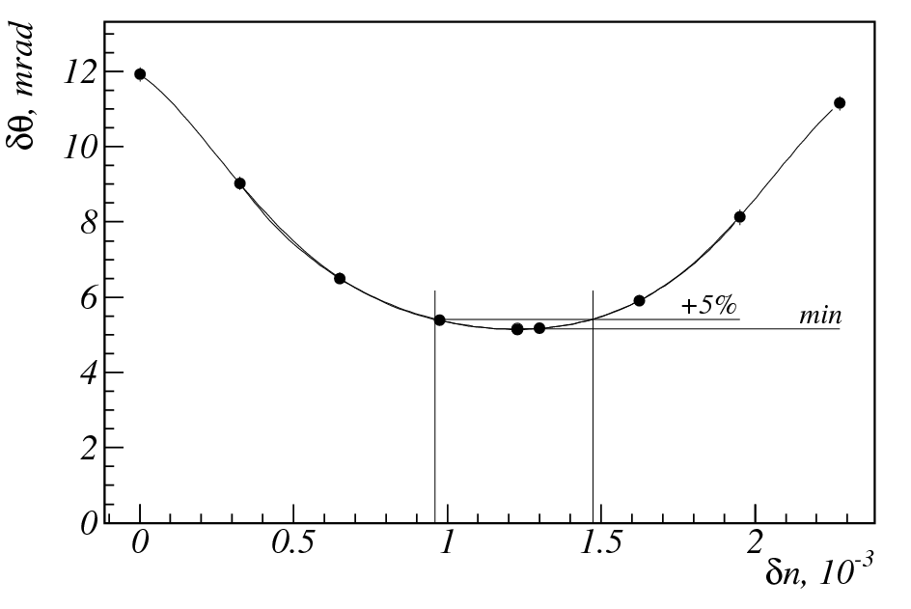
Multi-layer aerogel: optimal parameter
Two layers
Three layers
n = 1.05
δn_{opt} = 1.03·10⁻³
δn_{min} = 0.76·10⁻³
δn_{max} = 1.36·10⁻³
n = 1.05
δn_{opt} = 1.23 ·10⁻³
δn_{min} = 0.96 ·10⁻³
δn_{max} = 1.47·10⁻³
Three segments mirror and three layer aerogel were used in further simulations

Slide 10
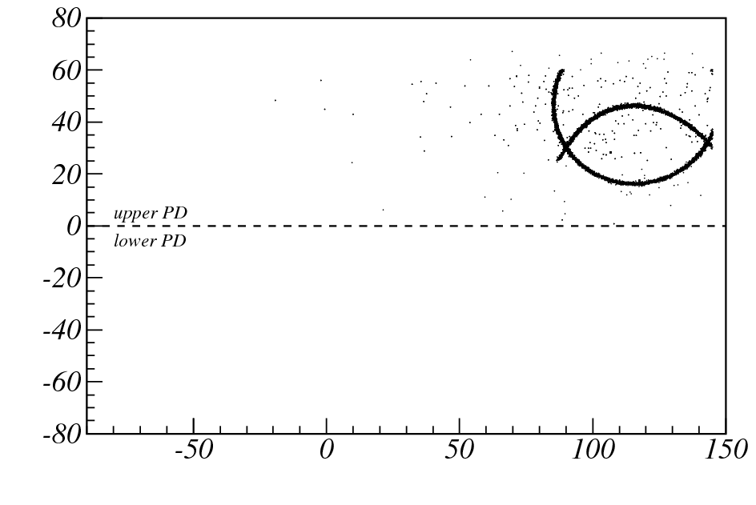
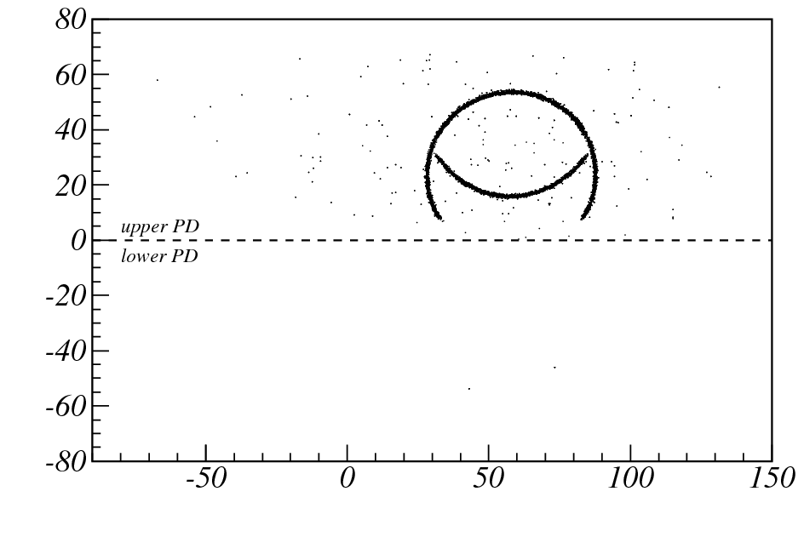
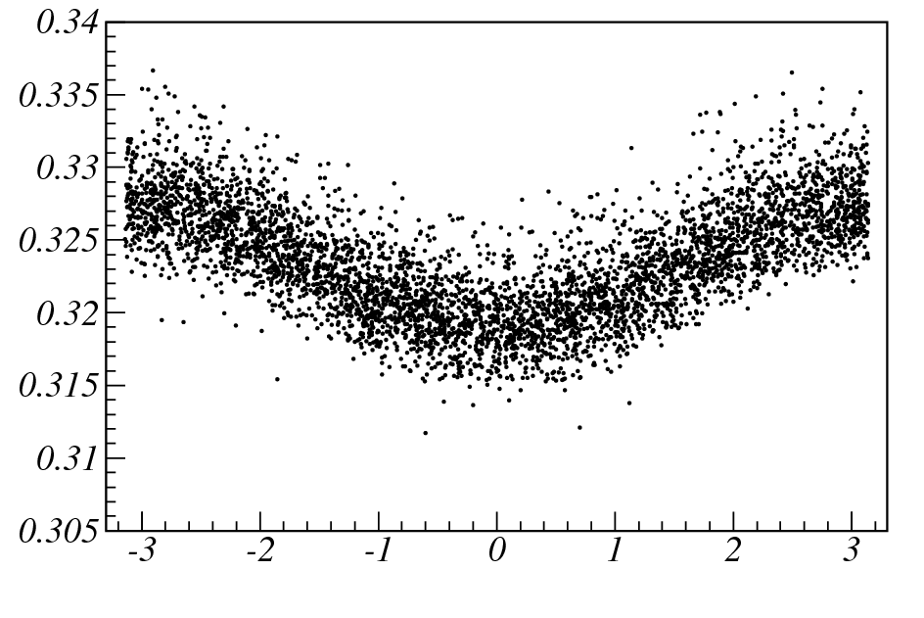
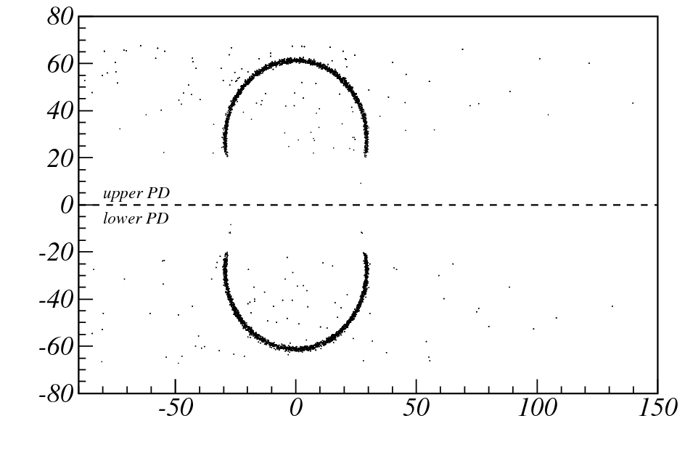
Events simulation and reconstruction
Y, cm
Reconstruction methods:
on photodetector surface (template)
photon track reconstruction (in order to obtain cherenkov angles for each hits)
Y, cm
θ_{C}, rad
Y, cm
X, cm
X, cm
θ_{C} = acos(1/n)
X, cm
φ_{C}, rad

Slide 11
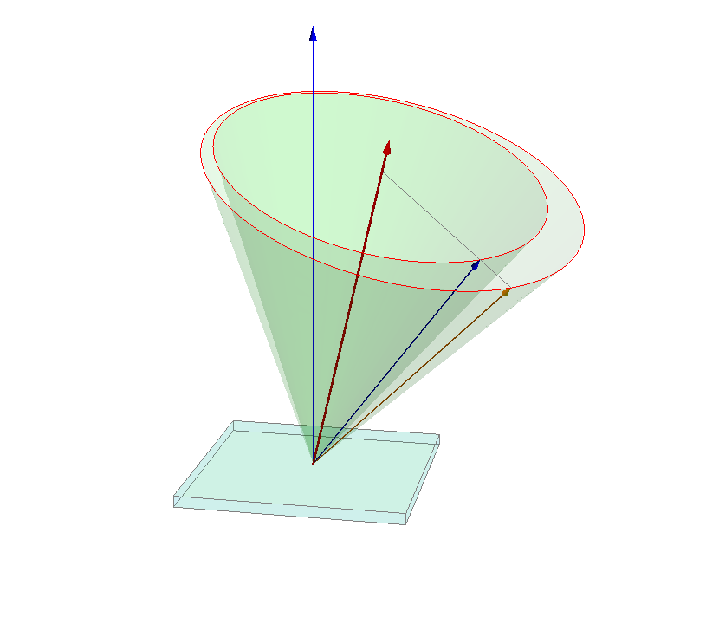
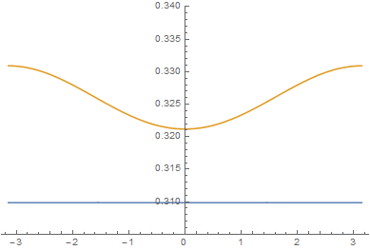
Refraction on the surface of the aerogel
θ_{c}, rad
φ_{c}, rad
θ_{c} = f( φ_{c}; β, n, α )
φ_{c} − azimuthal angle
β − velocity of the charge particle
n − refraction index of the aerogel
α − polar angle of the charge particle

Slide 12
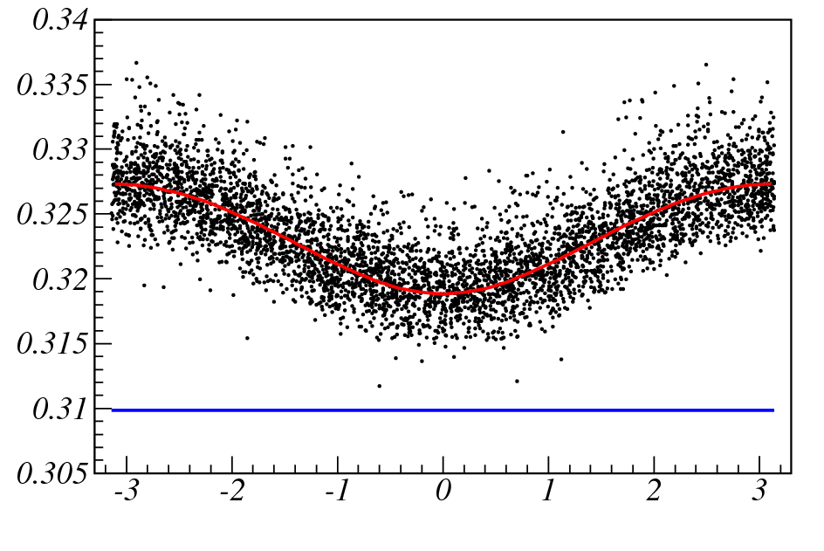
Fit result
μ
p = 10 GeV/c
β = 0.99994
β_{FIT} = 0.99912

Slide 13
Simulated effects
Simulation
  Geometry description
    RICH position
    Aerogel (size, number of layers, refraction index)
    Mirror geometry (round, flat)
  Materials properties for Cherenkov photons
Digitization
  Pixelation
  Quantum efficiency of photodetector
  Photodetector noise
  Dead time of photodetector
  Photodetector time resolution
  Crosstalks (not done)
Reconstruction (simple mode)
  Hit preselection
  Fit θ(φ) dependence
PID (not done)
  Probability calculation

Slide 14
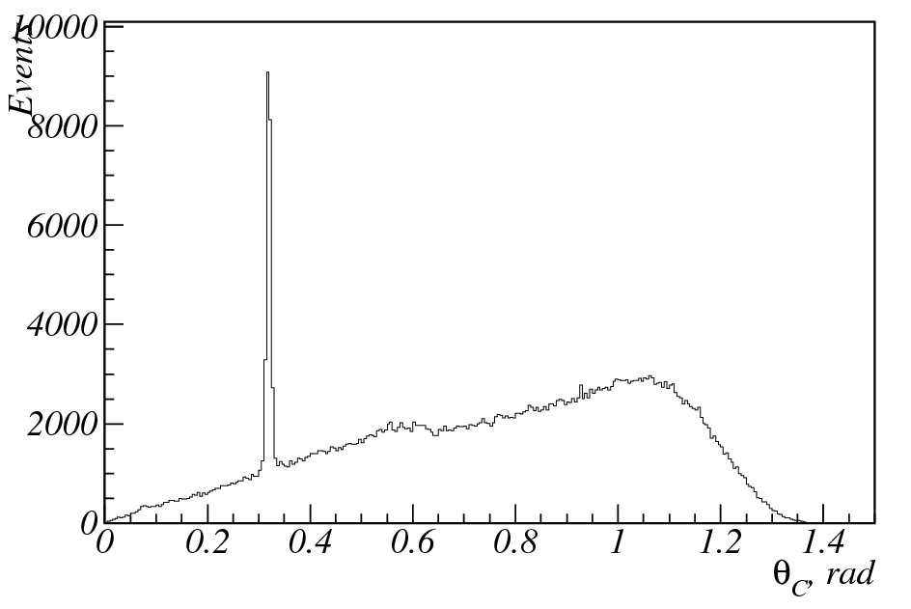
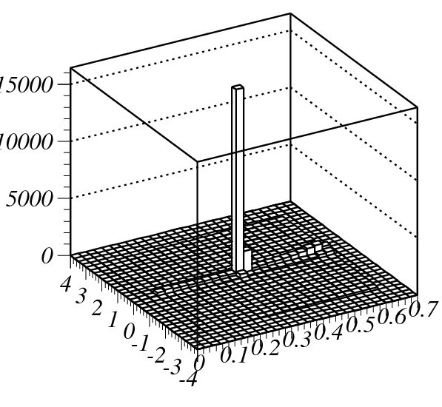
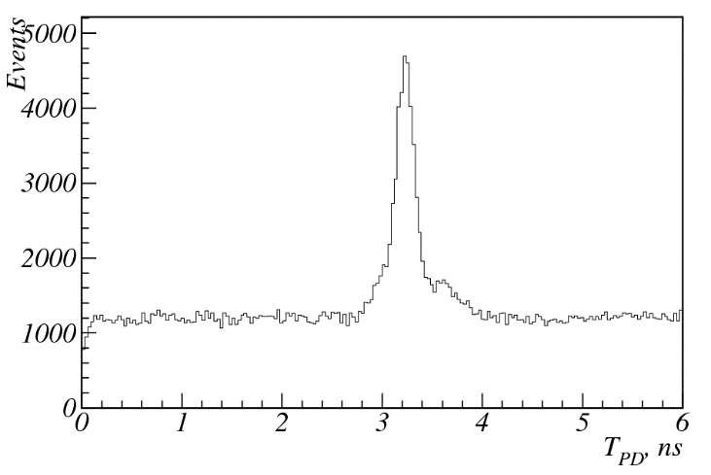
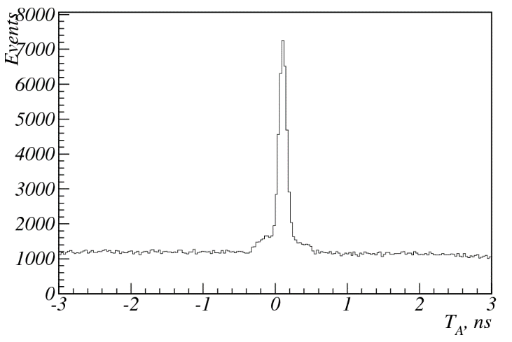
Hit selection for fit
1000 events
T_{A}, ns
θ_{C}, rad

Slide 15
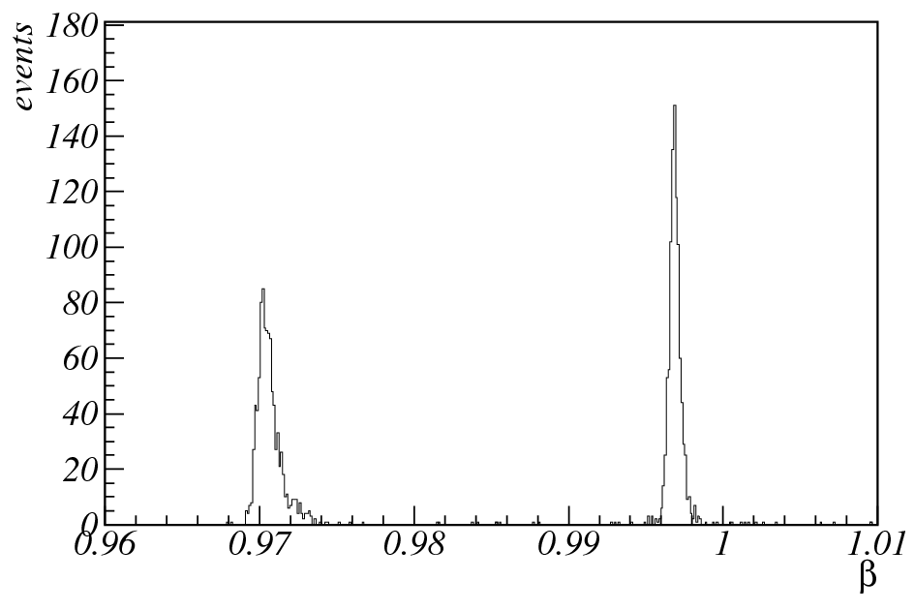
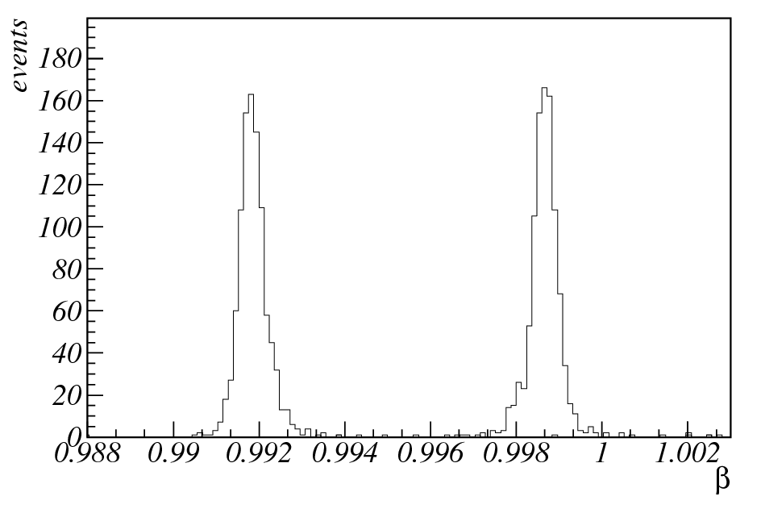
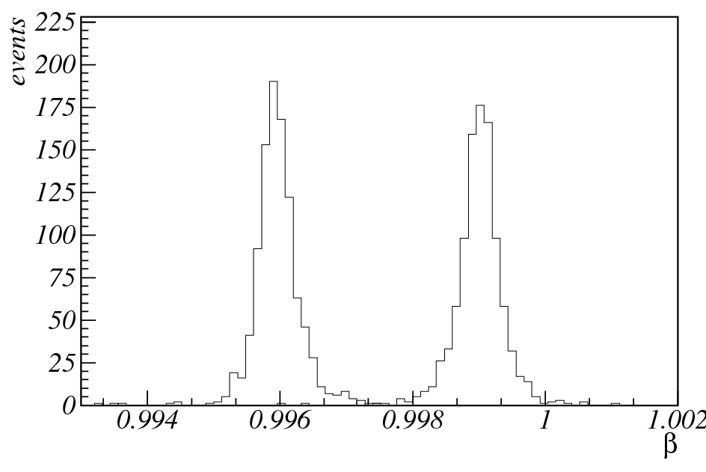
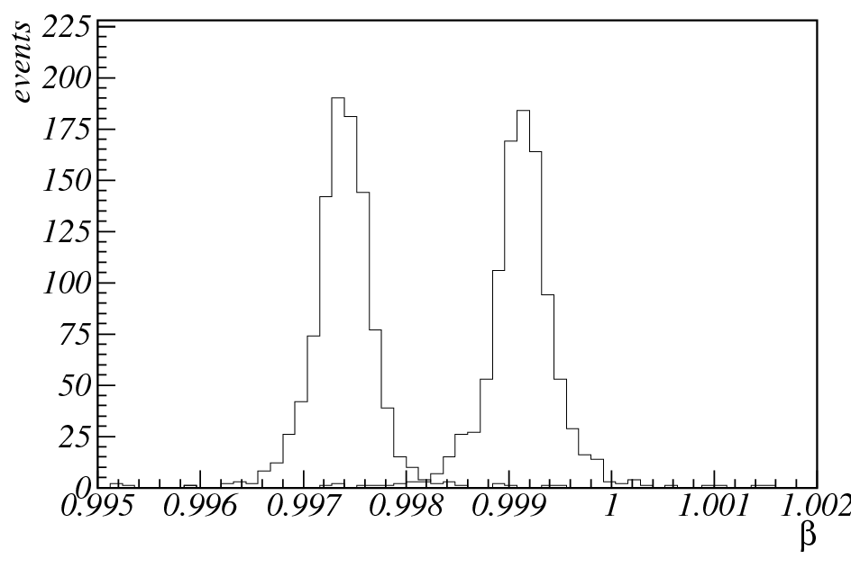
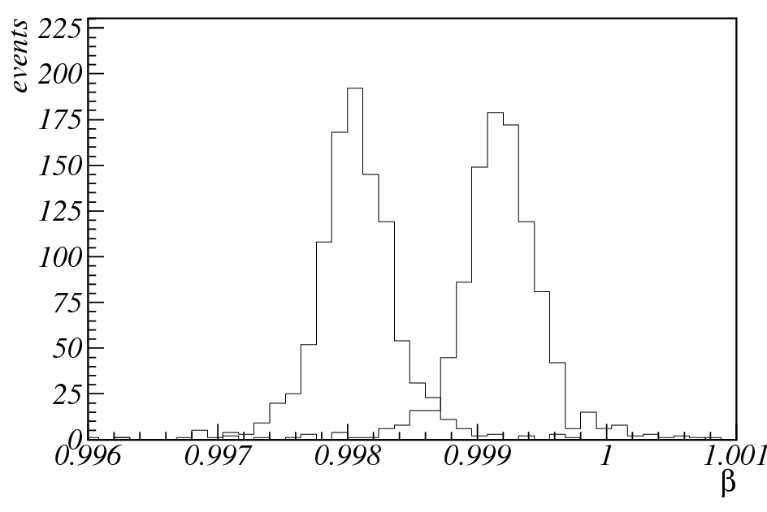
π/K-separation: first result
2 GeV/c
4 GeV/c
6 GeV/c
π
K
π
K
π
K
8 GeV/c
10 GeV/c
K
π
π
K

Slide 16
Conclusions
Geometry optimization for flat and round mirrors has been done
Optimization of refractive indices for two and three layers aerogel has been performed
First PANDAroot sim/digi/reco code for the Forward RICH has been created
Events with single K and π mesons (FairBoxGenerator) going directlyto FRICH are simulated
First and simple reconstruction of particle velocity has been realized
First results on π/K separation has been obtained

Slide 17
…

Slide 18
…

