Slide 1
EMC MC Match and EMC Visualization
| Tobias Stockmanns

Slide 2
Motivation
Tracking Detectors
EMC
8
x
5
9
6
4
7
x
10
3
2
x
1
1

Slide 3
1st Implementation – Go back to primary
8
5
9
6
4
7
10
3
2
1
12
11
13
0

Slide 4
2nd Implementation – Go Back to first outside EMC
8
5
9
6
4
7
10
3
2
1
12
11
13
0

Slide 5
2nd Implementation – Go Back to first outside EMC
8
5
9
6
4
7
10
3
2
11
1
12
13
0

Slide 6
New Implementation – EMC Nomenclature
8
5
Emc Point
9
6
4
7
10
3
2
1

Slide 7
New Implementation – EMC Nomenclature
8
5
Emc Point
9
6
4
7
Emc Hit –
All points in one
crystal
10
3
2
1

Slide 8
New Implementation – EMC Nomenclature
8
5
Emc Point
9
6
4
7
Emc Hit –
All points in one
crystal
10
3
2
Emc Cluster –
All hits in neighboring
crystals
1

Slide 9
New Implementation – EMC Nomenclature
8
5
Emc Point
9
6
4
7
Emc Hit –
All points in one
crystal
10
3
2
x
x
Emc Cluster –
All hits in neighboring
crystals
1
11
x
Emc Bump –
Subdivision of Cluster for multiple particles

Slide 10
New Implementation
For each EmcPoint if track is entering / exiting the crystal is stored
8
5
EmcPoint: entering: 1, 11, 4, 6, 7, 9 ,10 exiting: 4, 5, 6, 7, 8, 9, 10
9
6
4
7
10
3
2
1
11

Slide 11
New Implementation
For each EmcPoint if track is entering / exiting the crystal is stored
Each EmcHit stores tracks entering and exiting
8
5
EmcHit 0: in: 9 ,10 out -
1: in: 1 out 4, 5, 9, 10
2: in: 4 out 6, 7
3: in 6, 7, 11 out 8
9
6
4
7
10
3
2
0
1
2
3
1
11

Slide 12
New Implementation
For each EmcPoint if track is entering / exiting the crystal is stored
Each EmcHit stores tracks entering and exiting
Each EmcCluster stores tracks entering and exiting
8
5
EmcHit 0: in: 9 ,10 out -
1: in: 1 out 4, 5, 9, 10
2: in: 4 out 6, 7
3: in 6, 7, 11 out 8
EmcCluster 0: in 1,11 out 5, 8
9
6
4
7
10
3
2
0
1
11

Slide 13
New Implementation
For each EmcPoint if track is entering / exiting the crystal is stored
Each EmcHit stores tracks entering and exiting
Each EmcCluster stores tracks entering and exiting
Each EmcBump stores nearest track entering (not implemented yet)
8
5
EmcBump 0: in: 1
1: in 11
9
6
4
7
10
3
2
x
x
0
1
1
11

Slide 14
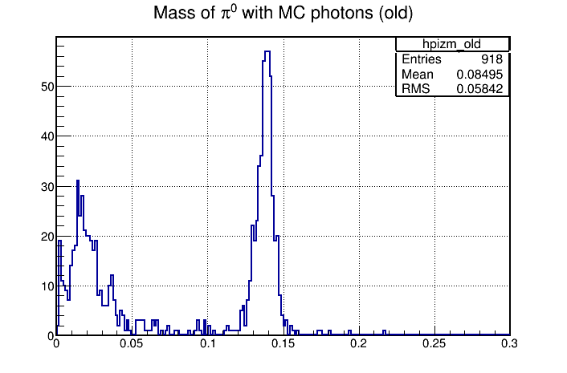
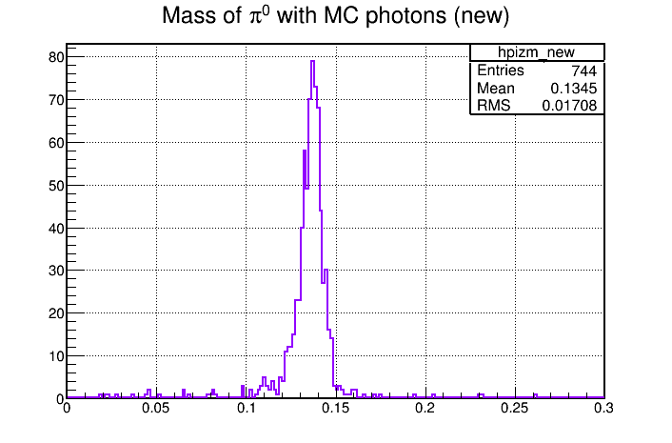
Result
Example from Lu: π⁰ reconstructed with MC matched photons

Slide 15
Summary and Outlook (first)
New MC matching for EMC implemented
Works as expected and gives better results than previous implementation
Outlook
Test of speed and number of generated particles still ongoing
MC match for EMC bumps

Slide 16
Emc visualization in Eventdisplay

Slide 17
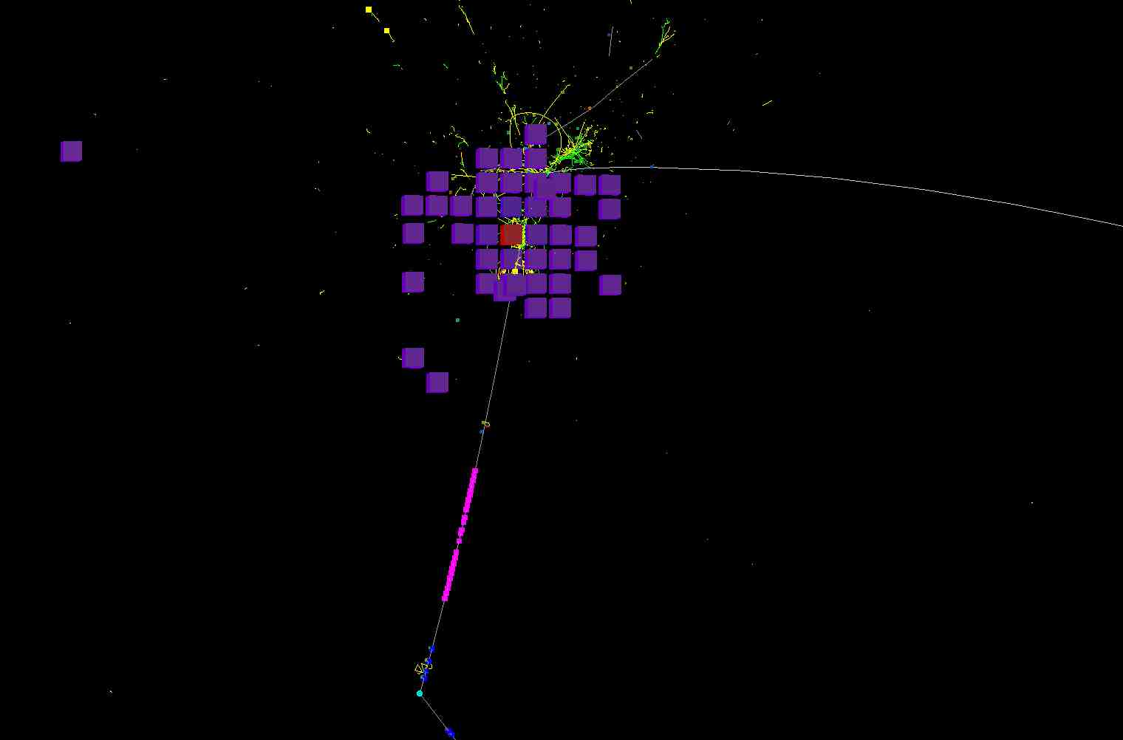
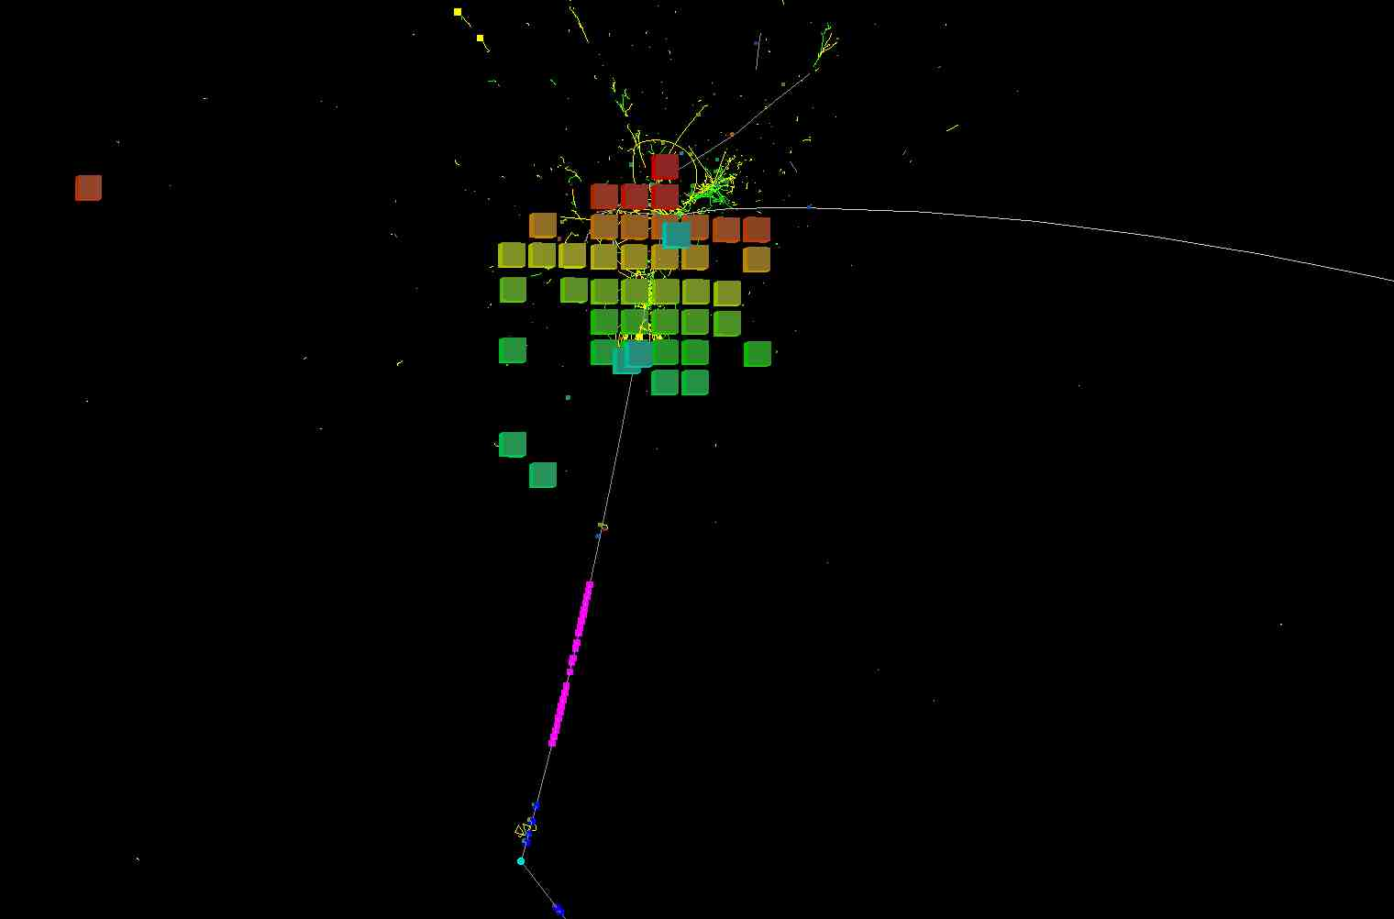
Motivation
Current implementation EMC visualization does not show energy

Slide 18
Change
New EmcHit draw method: PndEmcHitDraw
Allows cut on energy of EmcHits

Slide 19
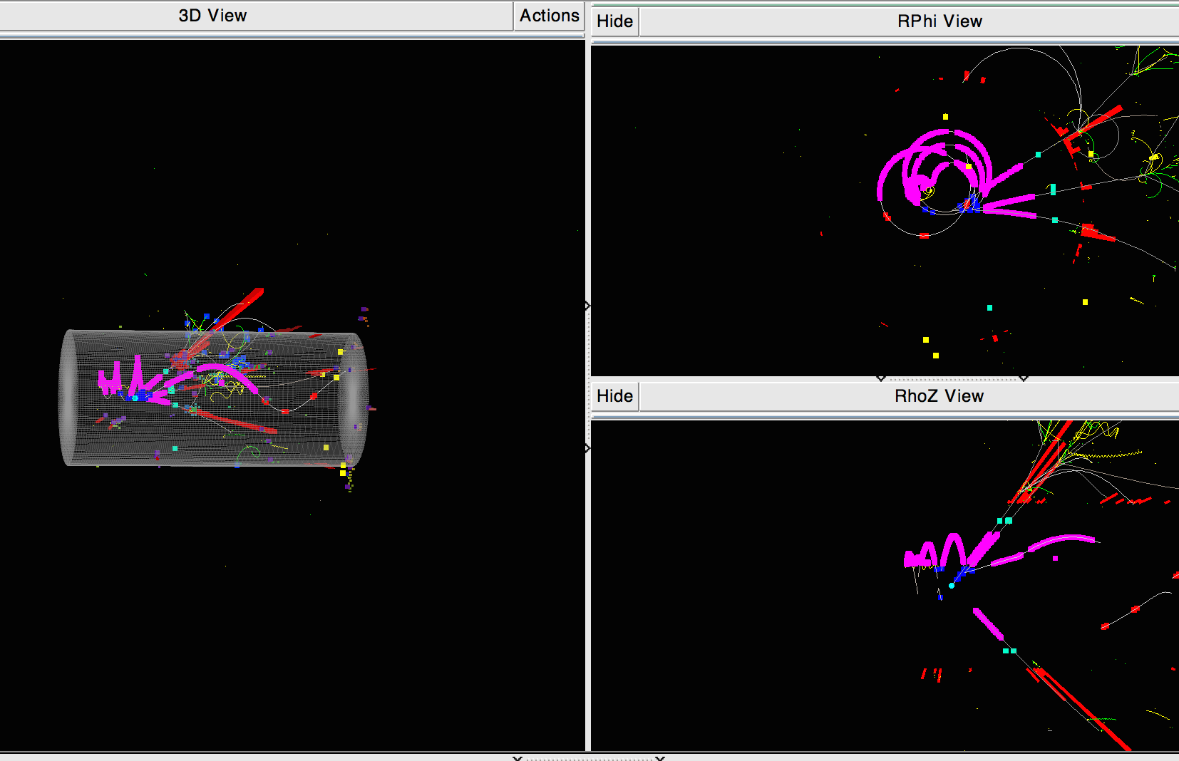
EMC Tower View

Slide 20
Summary
New PndEmcHitDraw draws color of hits depending on deposited energy
Cuts on energy in event display possible
Same behavior was introduced for EmcCluster/Bump drawing
New PndEmcHitCalo draw to show energy in towers
FairEventdisplay shows now projections in RPhi and ThoZ (dev branch of FairRoot)

