Slide 1
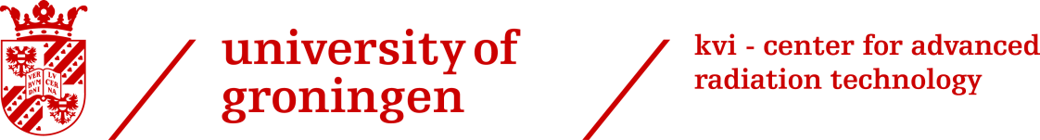




M. Tiemens – For the PANDA Collaboration
| 1
Disentangling PANDA’s Timebased Data Stream
Clusters – What and how?
1
2
The data stream of PANDA
Cluster finding methods & Comparison
3

Slide 2
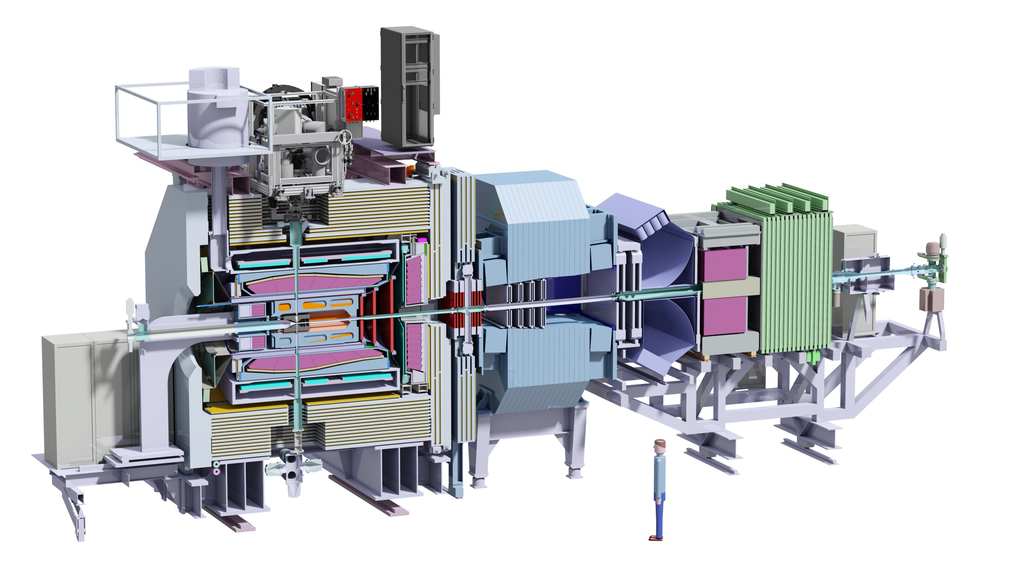
M. Tiemens
| 2
PANDA Experiment

Slide 3
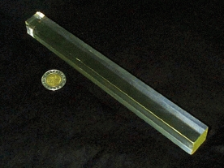
M. Tiemens
| 3
Particle Production
Rate: 20 MHz
Event
Particle hits EMC crystals

Slide 4
M. Tiemens
| 4
Shower Production
And creates a particle SHOWER
Which spreads out laterally
Particle hits EMC crystals

Slide 5
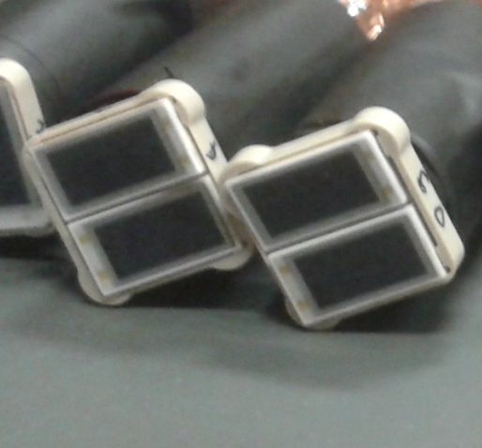
M. Tiemens
| 5
Shower Production
?
Hit ≡ Crystal with E > E_{thr}
LAAPDs
1 cm
2 cm
Creating hits in neighbouring crystals as well

Slide 6
M. Tiemens
| 6
Cluster Forming
(Cross-sectional view)
This creates groups of hits in the EMC, defined as CLUSTERS

Slide 7
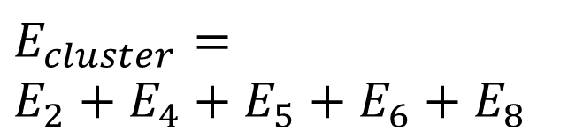
M. Tiemens
| 7
Cluster Finding
1 2 3
(Cross-sectional view)
EM Particle
Energy
4 5 6
$$E_{cluster}=$$
$$E_{2}+E_{4}+E_{5}+E_{6}+E_{8}$$
7 8 9

Slide 8



M. Tiemens
| 8
Cluster Finding
Rate: 20 MHz
pp → anything
$$p$$
$$\overline{p}$$
$$E_{cluster}=$$
$$E_{2}+E_{4}+E_{5}+E_{6}+E_{8}$$
$$γ,e^{−},e^{+}$$
And that is that.
Or is it?

Slide 9
M. Tiemens
| 9
Structure of the Data Stream
No Interaction
Between
Signals
EVENT 1
EVENT 2

Slide 10
M. Tiemens
| 10
Structure of the Data Stream
Pile-up
1
Which Hit Belongs To Which Event?
Event
2
Seen as 1
Event
t₁
t₂
Time Gap Between t₁ and t₂ Determined by Interaction Rate

Slide 11
M. Tiemens
| 11
Structure of the Data Stream
Time
Event 1
Event 2
Event 3
Event 4
Data
∆τ
Threshold for cutting data stream into timebunches

Slide 12
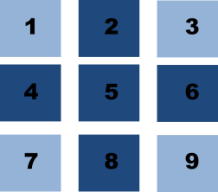
M. Tiemens
| 12
Cluster Finding - Methods
“Standard”
Well tested
Slow
Fails if e.g. 2 comes first, and then 8

Slide 13
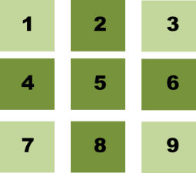
M. Tiemens
| 13
Cluster Finding - Methods
Online
[ 2, 4, 5, 6, 8 ]
Build neighbour relations
Fast
Many iterations

Slide 14
M. Tiemens
| 14
Cluster Finding - Methods
Distributed
Setting the Stage
Data Concentration
Online Event Building
Crystals
Digitisation
0101
16
8
All
Impression of the Readout Chain of the Detector

Slide 15
M. Tiemens
| 15
Cluster Finding - Methods
Distributed
What is it?
Each Data Concentrator reads out ~128 Crystals
i
i
Possible to look for clusters at this level
Example: Forward
Endcap (Impression)

Slide 16
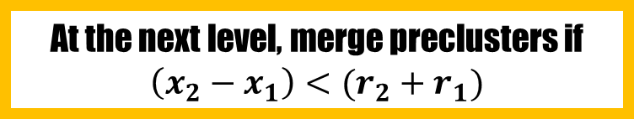
M. Tiemens
| 16
Cluster Finding - Methods
Distributed
How?
Look for clusters using the Online algorithm in each DC
1
Might not be a “real” cluster >>
First specify 3D location (x,y,t) and radius
2
r₁
r₂
At the next level, merge preclusters if
$$\left(x_{2}−x_{1}\right)<(r_{2}+r_{1})$$
3
Example: Clusters in 4 Data Concentrators

Slide 17
M. Tiemens
| 17
Cluster Finding - Methods
Distributed
Pros and Cons
Each DC has a small sample of the dataset → Fast
The next stage can use preclusters instead of hits → Fast
Some additional operations
If preclusters have very elliptical shapes, the radius will be greatly overestimated

Slide 18
M. Tiemens
| 18
Cluster Finding – Methods (Summary)
“Standard”
Online
Distributed
Treats each new hit as a cluster, and adds neighbouring hits to it
Builds neighbour relations for all hits in the current input stream
Uses that info to merge hits into clusters
Same as Online, but first map hits onto Data Concentrators (closer to real readout)

Slide 19
M. Tiemens
| 19
Comparing Methods (Preliminary)
i
Example channel: $5000×p\overline{p}→γγ, \overset{⃑}{p}\left(\overline{p}\right)=1 GeV/c$
i
TEST – PART 1:
Ability to reconstruct events

Slide 20
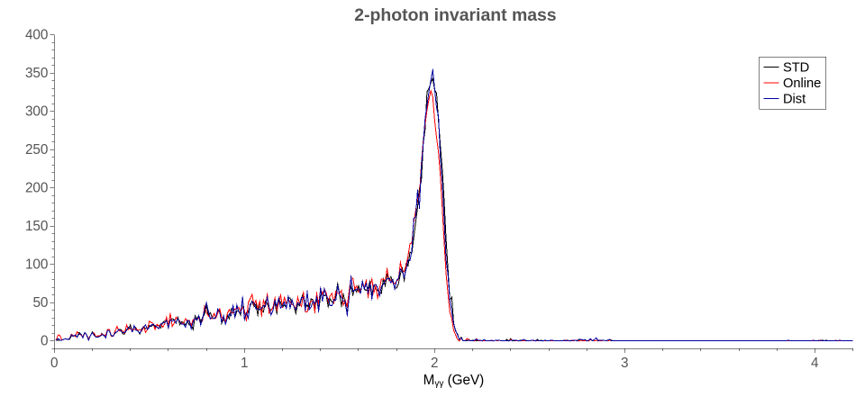
M. Tiemens
| 20
Comparing Methods (Preliminary)
i
Example channel: $5000×p\overline{p}→γγ, \overset{⃑}{p}\left(\overline{p}\right)=1 GeV/c$
i
TEST – PART 1:
Ability to reconstruct events

Slide 21
M. Tiemens
| 21
Comparing Methods (Preliminary)
i
Example channel: $5000×p\overline{p}→γγ, \overset{⃑}{p}\left(\overline{p}\right)=1 GeV/c$
i
N/A

Slide 22
M. Tiemens
| 22
Comparing Methods (Preliminary)
i
Example channel: $5000×p\overline{p}→γγ, \overset{⃑}{p}\left(\overline{p}\right)=1 GeV/c$
i
TEST – PART 2:
Time needed to reconstruct events

Slide 23
M. Tiemens
| 23
Comparing Methods (Preliminary)
i
Example channel: $5000×p\overline{p}→γγ, \overset{⃑}{p}\left(\overline{p}\right)=1 GeV/c$
i
TEST – PART 2:
Time needed to reconstruct events
TIMEBASED @20 MHz
Other
Precluster merging
Precluster finding

Slide 24
M. Tiemens
| 24
Conclusion
Different methods for cluster finding are being developed/evaluated.
All methods yield a similar number of events.
Online Cluster Finding is the fastest.
Processing time for all methods is comparable, but the two steps (precluster forming and merging) in distributed cluster finding are separately considerably faster.

Slide 25
M. Tiemens
| 25
Outlook
Optimize algorithms
Expand to more complicated channel, e.g. h_{c} → 7γ
Include background
Investigate effect of bump splitting
IMPORTANT SIDENOTE: Speed comparison done on CPU, may (probably will) differ on FPGA

Slide 26
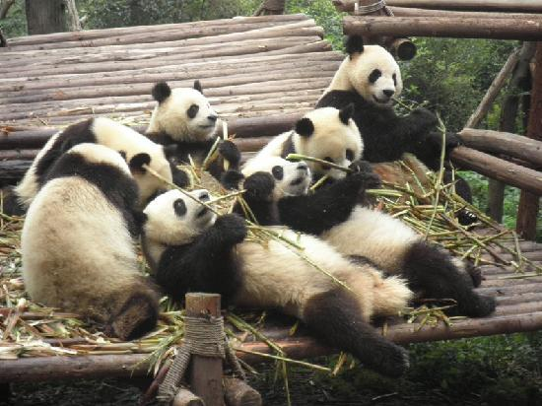
M. Tiemens
| 26
Thank you for your attention.
Here’s a cluster of pandas.

Slide 27

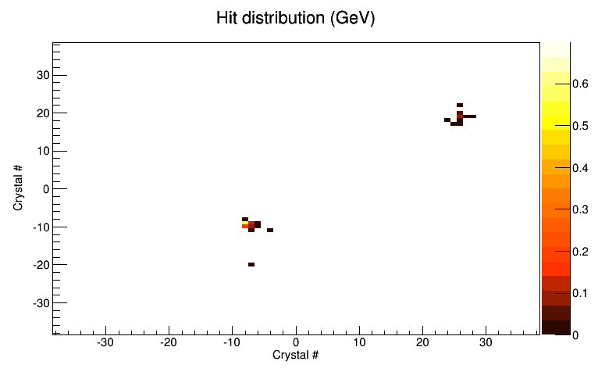
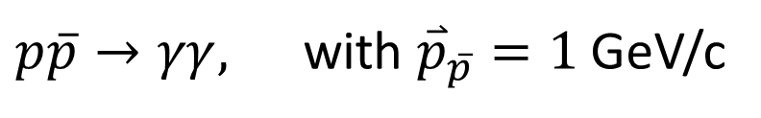
M. Tiemens
| 27
Backup: Split-offs
$p\overline{p}→γγ,$ with ${\overset{⃑}{p}}_{\overline{p}}=1$GeV/c
“Split-off”

Slide 28
M. Tiemens
| 28
Backup: Simulation details
Step 1: Event Generation
Step 2: Signal Interaction
Event 1
Occurs when particles enter the same detector element within its response time.
Poisson Distributed.
Event 2
EMC Hits

Slide 29

M. Tiemens
| 29
Backup: Simulation details
Step 3: Feature Extraction
Step 4: Advanced event prebuilding and event reconstruction
Single pulse:
E
x2
t
E₁ + E₂ + …
Pile-up pulse:
γ₁
Pile-up detection and recovery
$$\overline{p}p$$

Slide 30
M. Tiemens
| 30
Backup: “Bump splitting”
Effect of such overlapping clusters not yet investigated

