Slide 1
Measurement of 6D Beam Distributions at Low Beam Energy
A. Aleksandrov
Oak Ridge National Laboratory,
USA

Slide 2
Outline
Introduction
What
Why
How
Challenges
Practical Implementation
SNS Integrated Test Stand Facility
6D distribution measurement tools
Status and Plans

Slide 3
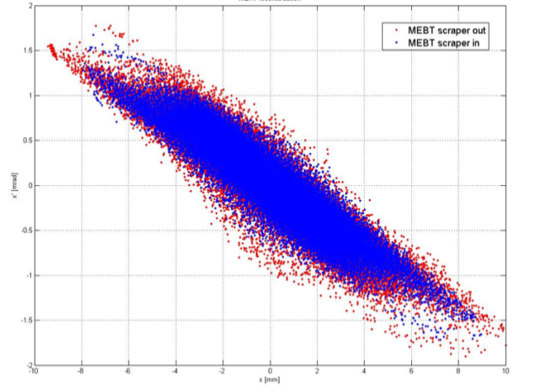
We will measure charge distribution function in 6D beam phase space
$x,x^{′},y,y^{′},w,φ$ - coordinates in phase space
$f_{2}\left(x,x^{′}\right)$- 2D distribution function
$f_{4}\left(x,x^{′},y,y′\right)$ - 4D distribution function
$f_{6}\left(x,x^{′},y,y^{′},w,φ\right)$ - 6D distribution function
$f_{3∗2}\left(x,x^{′},y,y^{′},w,φ\right)=$ $f_{2}\left(x,x^{′}\right)·f_{2}\left(y,y^{′}\right){·f}_{2}\left(w,φ\right)$
sometimes called 6D but
$f_{3∗2}\left(x,x^{′},y,y^{′},w,φ\right)≠f_{6}\left(x,x^{′},y,y^{′},w,φ\right)$
except for special case of no any correlations between degrees of freedom

Slide 4
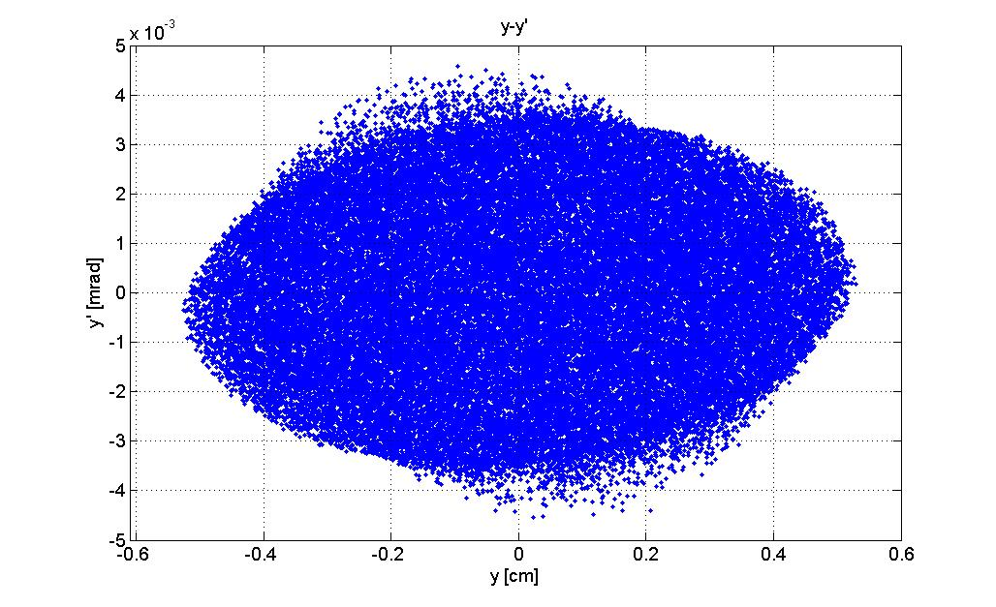
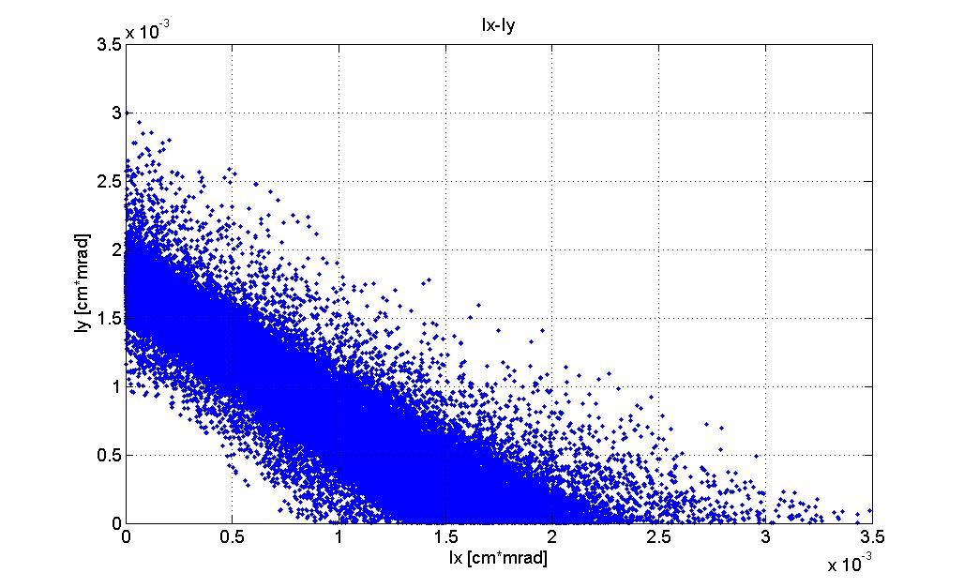
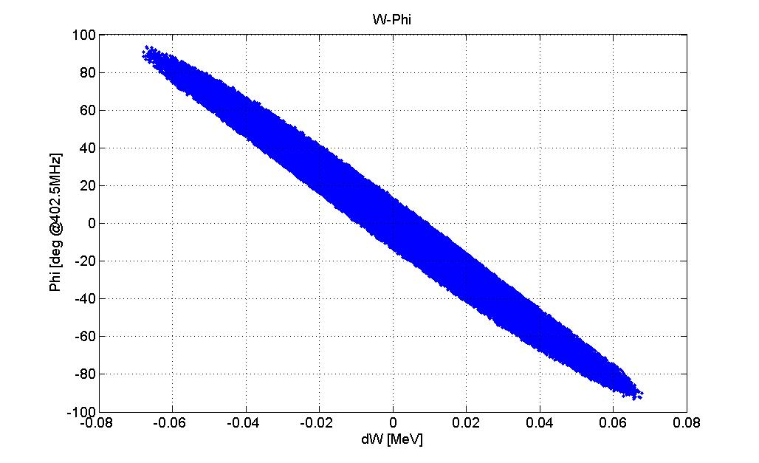
Example:
‘K - V like’ distribution

Slide 5
Realistic initial distribution is needed for PIC simulation of beam dynamics in linac
End-to-end simulation starting from ion source plasma surface
No comments
4D distribution measurement after ion source + PIC simulation through RFQ
Accurate 4D measurement at RFQ entrance is difficult
Beam dynamics simulation in RFQ is most challenging part of linac simulation: strong space charge, many cells, no diagnostics
6D distribution reconstruction from 2D emittances measured after RFQ
Absence of correlations between degrees of freedom is assumed without experimental validation
Dedicated experiment (LEDA) did not support this approach
Direct measurement of 6D distribution after RFQ

Slide 6
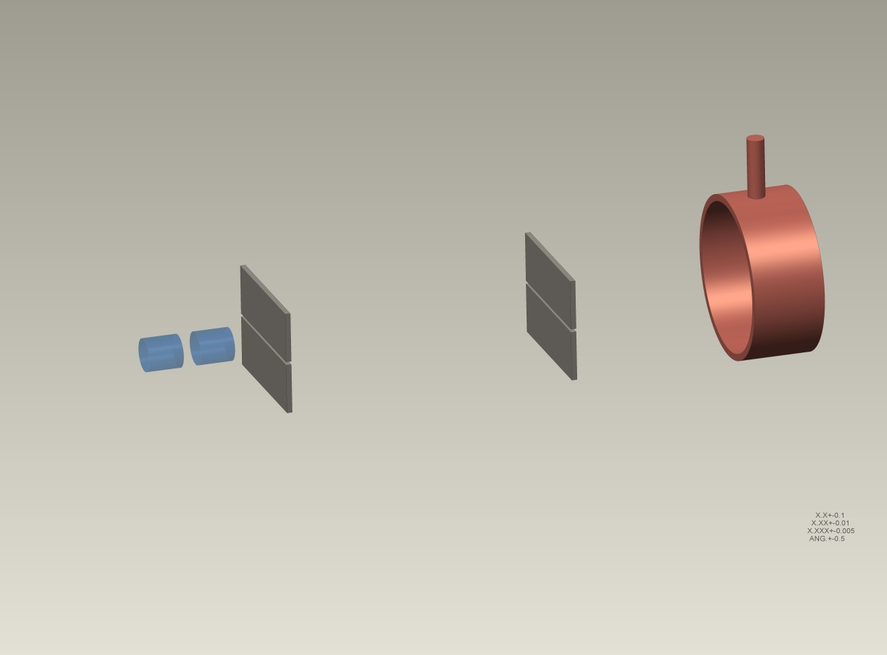
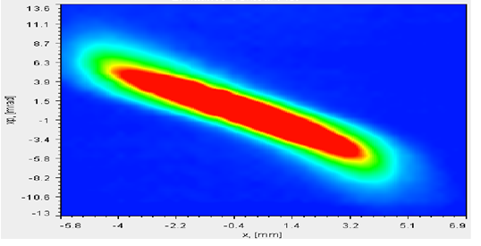
2D distribution measurement (emittance) using slit-slit technique
$$i_{FC}=f_{2}(y,y′)\frac{∆∙∆}{L}$$
L
$$s_{2}$$
$$s_{1}$$
FARADAY CUP
BEAM
SLIT_Y_2
SLIT_Y_1
$$y=s_{1}$$
$$y^{′}=\frac{s_{2}−s_{1}}{L}$$

Slide 7
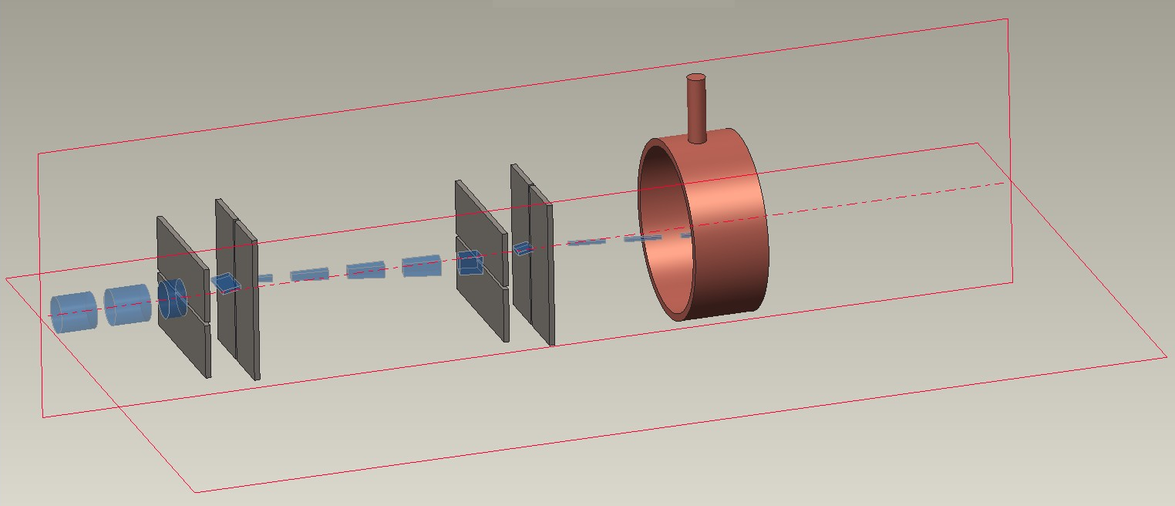
4D distribution measurement using four slits arrangement
FARADAY CUP
SLIT_X_2
$$i_{FC}=f_{4}(x,x^{′},y,y′)\frac{∆^{4}}{L^{2}}$$
BEAM
SLIT_Y_2
SLIT_X_1
SLIT_Y_1
$$x=s_{x1}$$
$$y=s_{y1}$$
$$x^{′}=\frac{s_{x2}−s_{x1}}{L}$$
$$y^{′}=\frac{s_{y2}−s_{y1}}{L}$$

Slide 8
6D distribution measurement arrangement
BENDING MAGNET
SLIT_Y_2
SLIT_X_2
SLIT_Y_1
SLIT_X_1
dx⋅dy⋅dx´⋅dy´
BEAMLET
dx⋅dy
BEAMLET
SLIT_X_3
RF deflector
Magnetic spectrometer for energy determination
RF deflector or other time resolving device for temporal degree of freedom
SLIT_X_4
FARADAY CUP
Looks simple, why don’t we see it everywhere?

Slide 9
“Curse of dimensionality” problem
High-dimensional spaces have very large volume: V$\sim a^{D}$
Large scan time
Low charge density
Large data sets
Same setup can measure all lower dimension projections
x - x’
x – y
x - φ
x - w
x’ - y - x
x’ - φ - x
x’ - w - x
….

Slide 10
Scan time estimate
$$N_{bins}=m_{}^{D}$$
dimensionality
Total number of bins
Number of steps per degree of freedom
For ${m=10, D=6 N_{bins}=10}^{6}$
1 2 …….. m
Total scan time at $1 \frac{step}{sec}:{ T_{total}=10}^{6} sec=280 hours$
Total scan time at $10 \frac{step}{sec}:{ T_{total}=10}^{5} sec=28 hours$
$$V_{□}$$
$$V_{○}$$
$$\frac{V_{○}}{V_{□}}=\frac{π^{D/2}}{Γ({ D}/2+1)2^{D}}=\left\{\begin{aligned} .79 ; D=2 \\ .52 ; D=3 \\ .081; D=6\end{aligned}\right.$$
Tens of hours total scan time

Slide 11
Signal strength estimate
$i=I_{0}∙\frac{exp⁡(−\frac{x^{2}}{2{σ^{2}}_{x}^{}}−\frac{x^{′2}}{2{σ^{2}}_{x^{′}}^{}}−\frac{y^{2}}{2{σ^{2}}_{y}^{}}−\frac{{y^{′}}^{2}}{2{σ^{2}}_{y^{′}}^{}}−\frac{w^{2}}{2{σ^{2}}_{w}^{}}−\frac{φ^{2}}{2{σ^{2}}_{φ}^{}})}{8π^{3}}\frac{∆_{x}}{σ_{x}^{}}$ $\frac{∆_{x′}}{σ_{x′}^{}}\frac{∆_{y}}{σ_{y}^{}}\frac{∆_{y′}}{σ_{y′}^{}}\frac{∆_{w}}{σ_{w}^{}}\frac{∆_{φ}}{σ_{φ}^{}}≈\frac{\exp{(…)}}{8π^{3}}{(∆/σ)}^{6}$
For $∆/σ≈.2$
current after all 6 slits
$i≈I_{0}∙2.6{∙10}^{−7}∙exp⁡(…)$
Number of particles in $I_{0}≈32 mA, τ≈50 μs$
beam pulse is $N_{0}≈{10}^{13}$
Number of particles after 6 slits: $N_{FC}≈2.6{∙10}^{6}$ at the distribution center $r=0$
$N_{FC}≈1.3{∙10}^{5}$ at $\overline{X}=1 σ$
$N_{FC}≈3.5{∙10}^{6}$ at $r=2 σ$
$N_{FC}≈16$ at $\overline{X}=2 σ$
$N_{FC}≈2.9{∙10}^{4}$ at $r=3 σ$
$N_{FC}≈4.9{∙10}^{−6}$ at $\overline{X}=3 σ$
$N_{FC}≈9.7$ at $r=5 σ$

Slide 12
Many hours of beam time allocated for single experiment
is big challenge for any large scale accelerator facility
Only feasible at a dedicated facility

Slide 13
SNS Integrated Test Stand Facility (ITSF)
Particles | H⁻
Energy | 2.5 MeV
Current | < 50 mA
Pulse width | < 1 ms
Rep rate | < 60 Hz
Power | < 7.5 kW
MEBT
RFQ
Ion Source

Slide 14
ITSF Diagnostics Beam Line Layout
MOVABLE SLITS
QUADROUPOLES
MEBT BEAM STOP WITH RADIATION SHIELDING
90-DEG. BENDING MAGNETS
BUNCH SHAPE MONITOR
VIEW SCREEN AND FARADAY CUP

Slide 15
ITSF MEBT

Slide 16
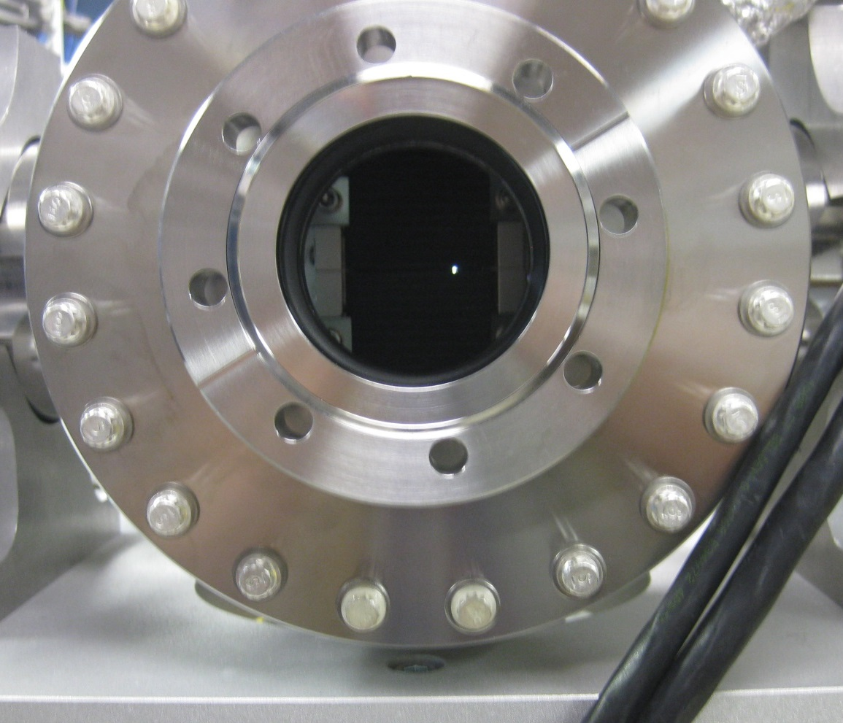
X-Y Slit arrangement
200-by-200 μm aperture

Slide 17
Simulated scan of ‘K - V like’ distribution

Slide 18
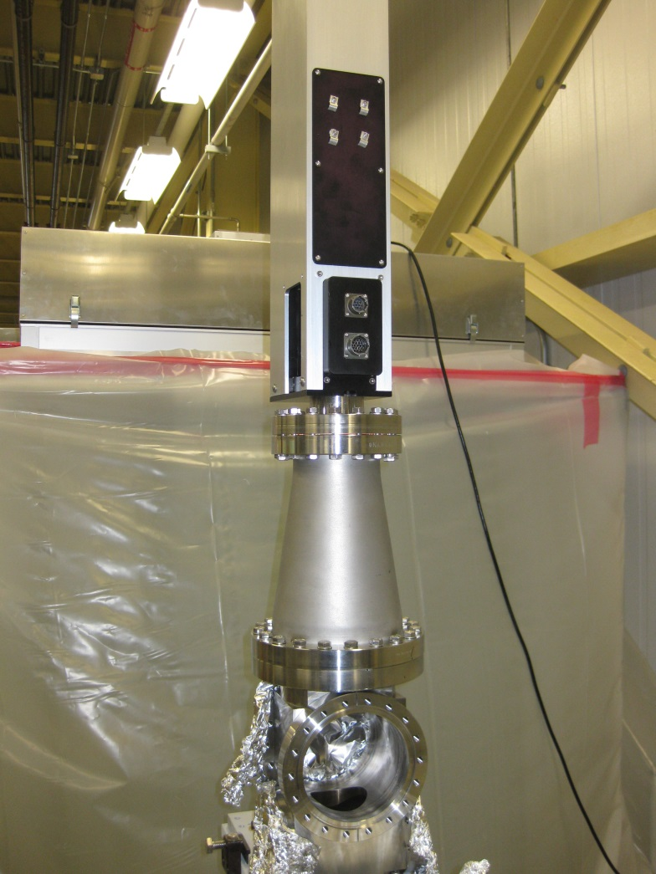
Equipment for E-φ degrees of freedom measurement to be installed
90⁰ bending magnet
‘RF deflector’ type longitudinal profile monitor, aka ‘Feschenko device’

Slide 19
Status
Ion Source operational
RFQ operational
Straight beam line operational
Safety systems, documentation in progress
DOE approval eventually
90⁰ bend beam line spring 2016

Slide 20
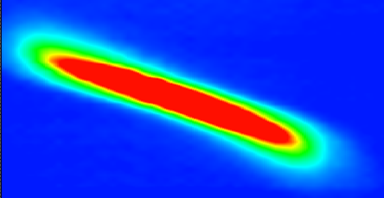
Speeding up W-φ plane measurement
magnet
magnet
magnet
energy selection slit
RF deflector
RF deflector
view screen
time selection slit
view screen
~10 times faster
imaging camera
Faraday Cup
~10 times faster
imaging camera
φ
2D optical readout has advantages and disadvantages
faster
smaller dynamic range of charge-to-light-to-charge conversion
W

Slide 21
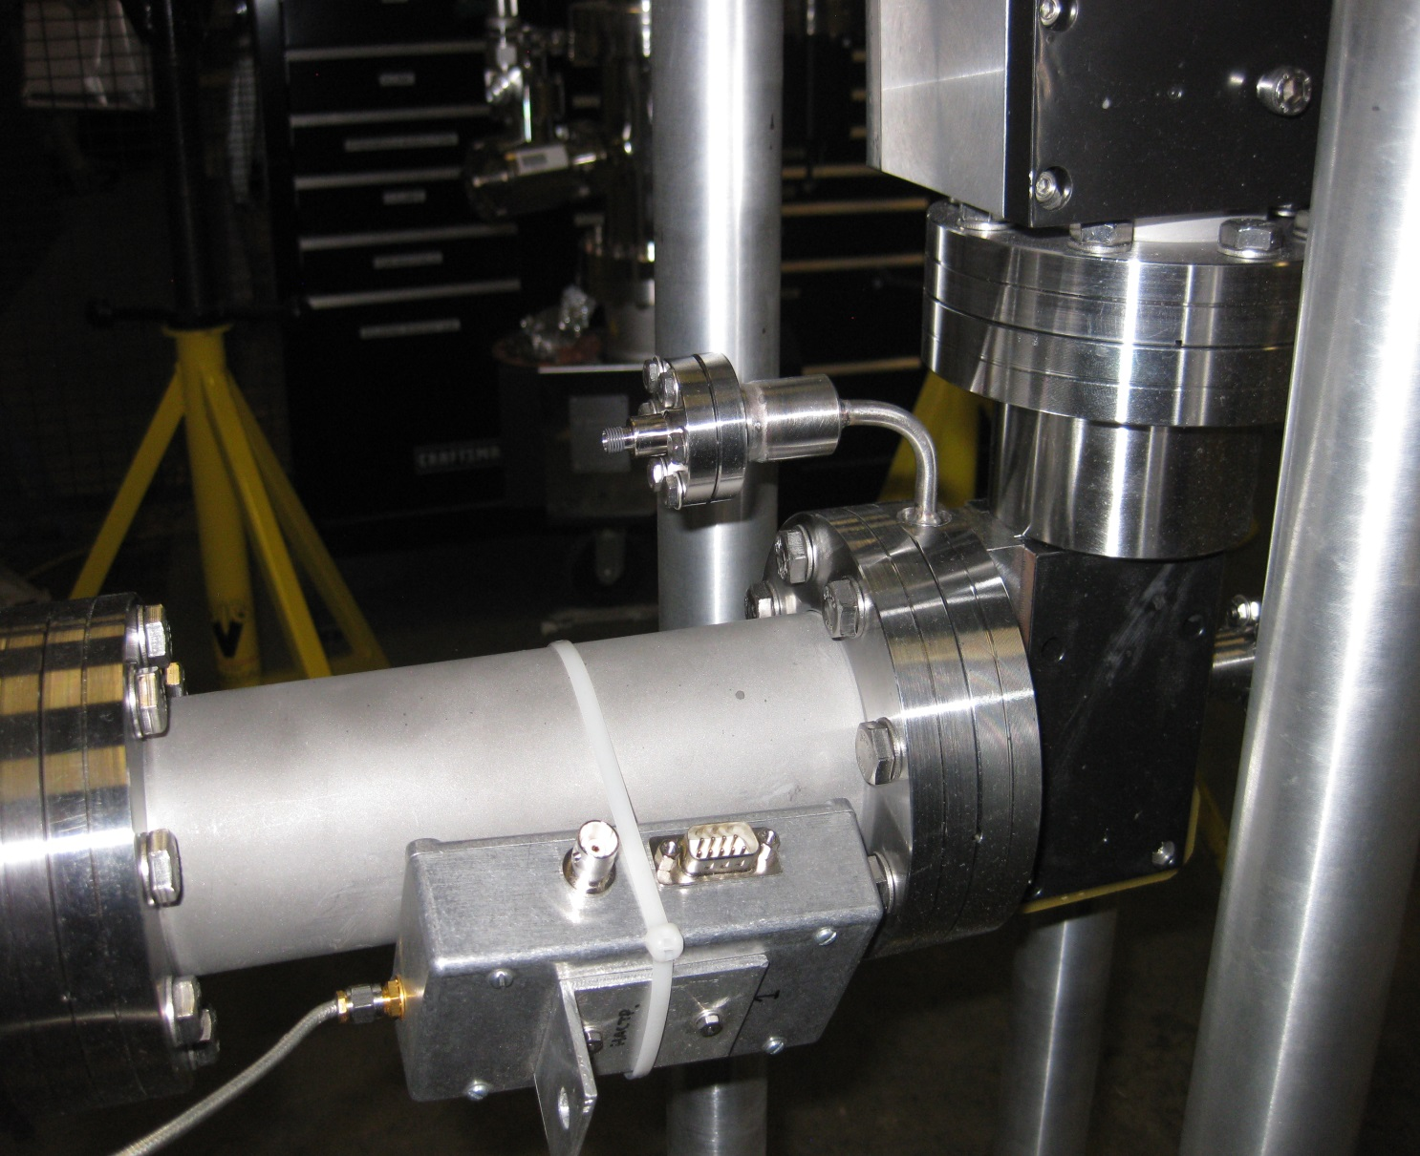
Detector modification is simple
Slit mounted on this flange
to be replaced
with view screen
SEM and Faraday Cup
to be replaced
with digital camera

Slide 22
Research goals
Optimize 6D phase space measuring system for maximum resolution and dynamic range
Develop algorithm for generating particle distributions for loading to PIC codes
Search for high-dimensional correlations in the measured distribution
Develop and verify methods of generating 6D distributions from low-dimensional projections
Repeat LEDA beam dynamics experiment with newly developed diagnostics

Slide 23
US National Science Foundation Grant with University of Tennessee (Sarah Cousineau is PI)
RFQ
MEBT-1
IS
4-D emittance
FODO
existing
future
Proposal highlights:
Direct 6D phase space measurement.
Study halo formation in FODO structure.
Benchmark codes (community resource), evaluate diagnostics.
Funding for 1 postdoc, 1 graduate student, 3 undergraduates for 3 years beginning in September 2015.
LEDA style beam dynamics experiment
To be designed, built and commissioned at ITSF

Slide 24
Thank you for your attention!

