Slide 1
Using Stripline BPMs to Measure the Longitudinal
Twiss Parameters in the SNS linac
Andrei Shishlo
ORNL
SNS Project
Florence, Italy
November 2015

Slide 2
Outline
Physics picture description
Harmonics analysis
Short RF cavity +drift+ BPM
Algorithm
SNS Results
Conclusions

Slide 3
Longitudinal Bunch Distribution from Stripline BPMs. Is it possible?
signal
2R
If v=c the signal will be proportional to ρ(z)
Our case v<c and r₀ <<R
There is now direct way to interpret the stripline BPM signal as the bunch density
Bunch usually too short for the frequency bandwidth of the existing electronics
No, it is not possible!
What can we do?
r₀
signal
From Alex Chao’s book
“Collective Instabilities in Accelerators”

Slide 4
Amplitude of Particular Harmonic
J. H. Cuperus, Nucl. Instrum. Methods 145, 219 (1977)
MONITORING OF PARTICLE BEAMS AT HIGH FREQUENCIES
- Harmonics of sum of electrodes BPMs signal at frequency
- Fourier harmonics of the longitudinal density distribution
- radius of the beam pipe
- relativistic parameters
Citation: “The response to higher harmonics is limited, and measurement of the bunch form is not possible.”
We are not going to use the higher harmonics
Let’s assume this for easy interpretation

Slide 5
Harmonic of Gaussian Distribution
Gaussian Longitudinal Distribution
BPM harmonic after Fourier transformation
- Longitudinal bunch size in deg.
Problem: for short bunches
results are useless
For long bunches
BPM is an analog of a Wire Scanner for the longitudinal size

Slide 6
SNS Linac Structure
SNS H⁻ linac
Length: 330 m (Superconducting part 230 m)
Production parameters:
Peak current: 38 mA
Repetition rate: 60 Hz
Macro-pulse length: 1 ms
Final Energy: 940 MeV (1000 MeV design)
Average power: 1.4 MW
Important for us Linac Diagnostics:
BPM - Beam Position and Phase Monitors

Slide 7
Longitudinal Twiss Analysis
CCL4
BPM1
BPM2
…
BPM{n}
…
Standard LSM Problem
n – number of BPMs
or we can do n measurements with one BPM

Slide 8
SCL Entrance Longitudinal Twiss Analysis
CCL4
BPM1
BPM2
…
BPM{n}
All SCL RF are OFF
Statistics:
40 measurements
13 BPMs
Does not work!
Errors are too big!

Slide 9
RF Cavity as Measuring Device
CCL4
SCL
RF
BPM1
BPM2
…
BPM{n}
dE
dE
dE
…
φ
φ
φ
Drifting
RF Kick
σ_{φ}
Maximal debunching
RF transforms longitudinal phases space
We have good models for short RF cavities
The RF transport matrix is known
Over-focusing in RF
z
RF cavity position

Slide 10
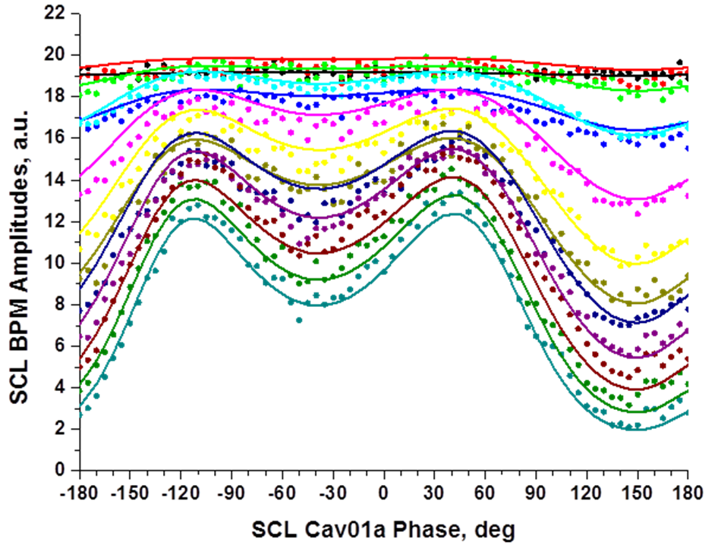
Longitudinal Twiss Analysis with SCL RF
CCL4
SCL
RF
BPM1
BPM2
…
BPM{n}
We can include a controllable element in the lattice and get more data
The Twiss errors should be reduced. For 5 deg step, matrix will be (72x14)x3.
Results (XAL units):
Alpha = 0.56 +- 0.02
Beta = 5.33 +- 0.13
Emitt = (0.928 +- 0.012)*10⁻⁶
A. Shishlo, A. Aleksandrov,
Phys. ST Accel. and Beams 16, 062801 (2013).
Over focusing
Defocusing

Slide 11
SCL Twiss for CCL4 Phase Scan
BSM
CCL4
SCL
RF
BPM1
BPM2
…
BPM{n}
CCL4 Phase Scan
-20 ↔ +40 deg
Design phase = 0 deg
SCL01a Phase Scan
For Long. Twiss
We want to verify our method with something different
Studies performed on 09.22.2012
Simultaneous BSM-410 measurements
Peak beam current 35 mA

Slide 12
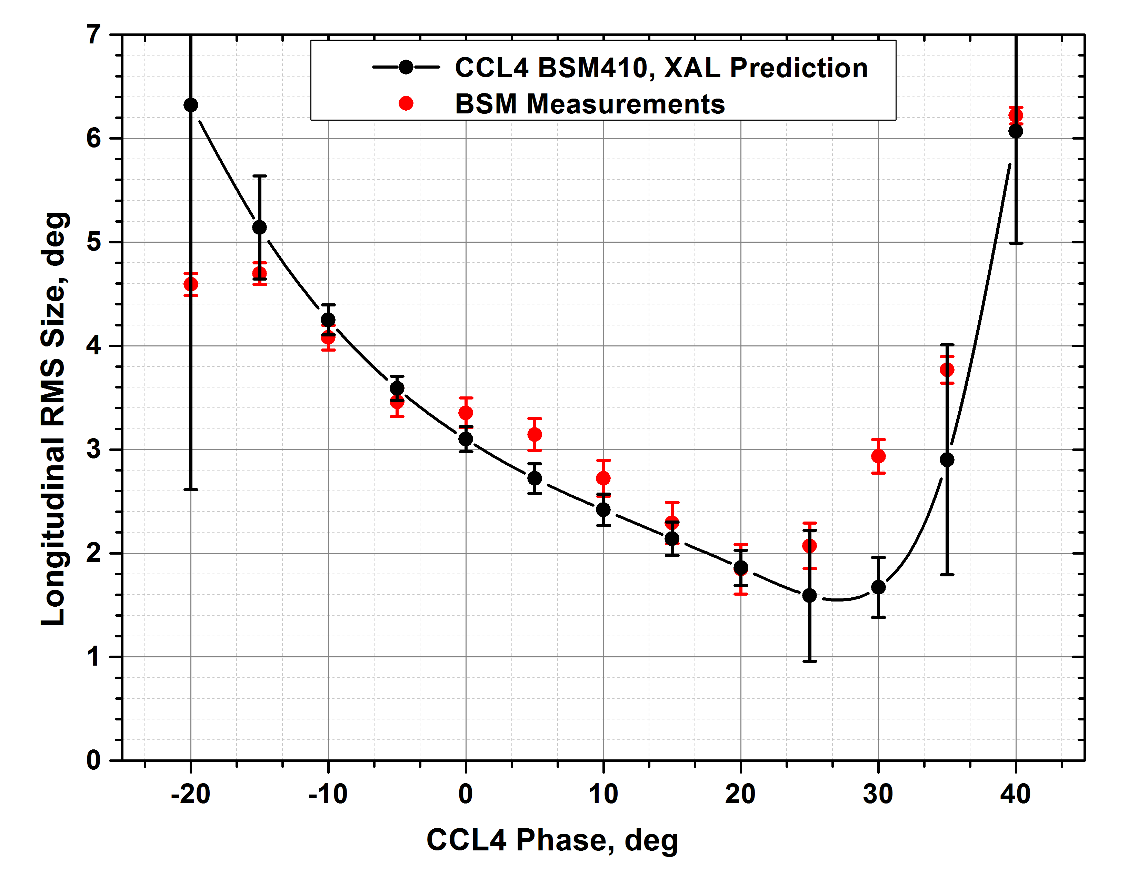
CCL Bunch Length for Two Methods
Design
Results are very close. It proves the applicability of the new method.
Limitations: assumption of Gaussian distribution in the bunch.
If we are far from the matched case (design) the bunch could be non Gaussian.

Slide 13
Longitudinal Twiss along SCL (1)
SCL
RF
01a
SCL
RF
01b
SCL
RF
01c
SCL
RF
02a
SCL
RF
02b
SCL
RF
02c
BPM1
BPM2
…
BPM{n}
We can use each cavity in SCL as the measuring point for the longitudinal Twiss
Data were collected in April, 2013
Only cavities in the first 12 cryomodules were scanned (34 cavities)
The BPM amplitude calibration was calculated by using the same scan data, so only about half of BPMs were calibrated properly.
For the first cavity we used the analysis described, but for all downstream cavities we assumed a constant normalized emittance. It means we fitted α, β Twiss parameters only and un-normalized BPM amplitudes.

Slide 14
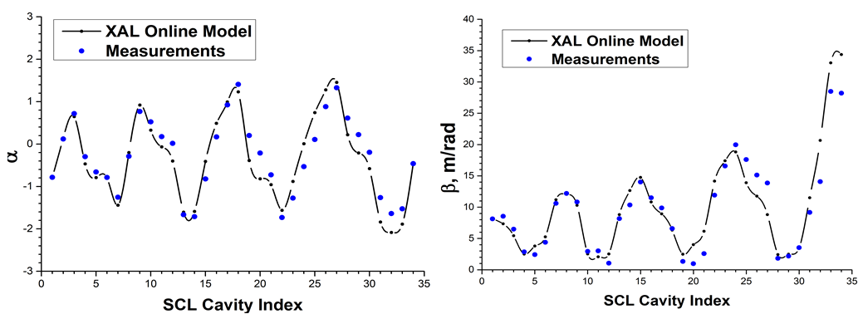
Longitudinal Twiss along SCL (2)
We have measurements at the entrance of each cavity, and we can calculate Twiss by using Online Model and the initial Twiss
Results are in a good agreement
The existing discrepancies grow with the distance from the beginning. Probably OM is not very good for very unmatched beams.
In longitudinal direction we have a very unmatched beam. The matching will be done in the future.

Slide 15
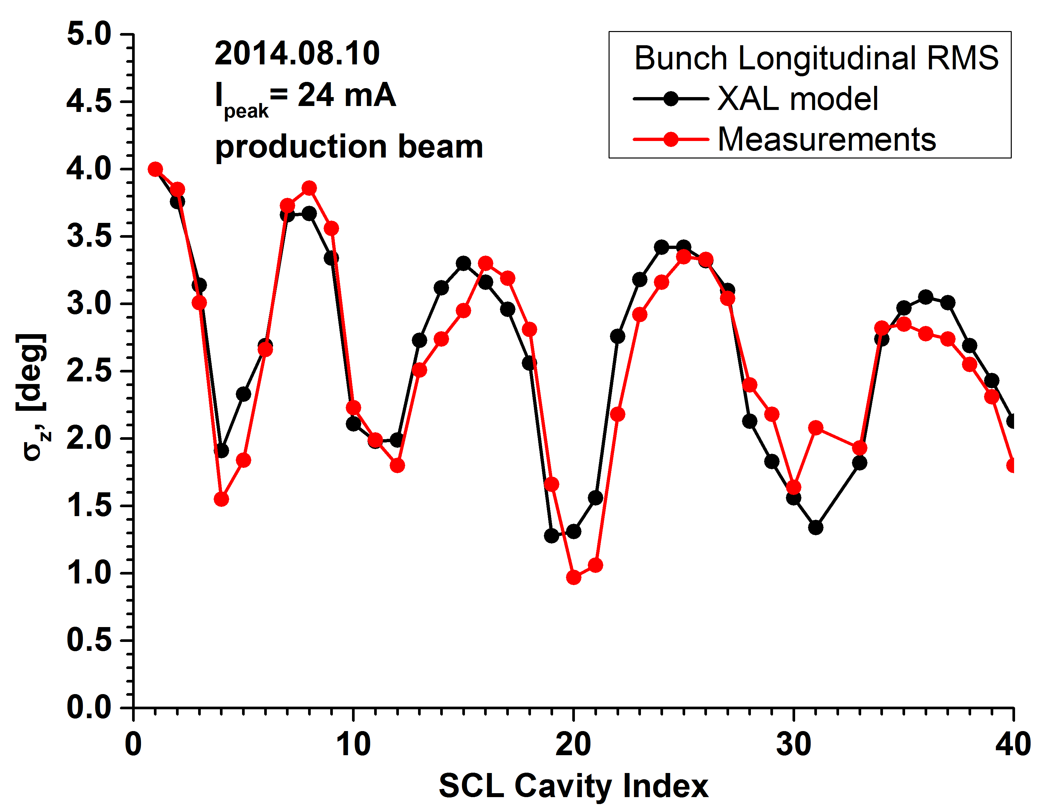
Results of “Z” Twiss Analysis 2014
2014.08.10
Longitudinal beam size
Peak current 24 mA
Production beam
Beam un-matched longitudinally
Agreement Model/Measurements is good.

Slide 16
Conclusions
A non-invasive method of measurements of Longitudinal Twiss parameters with stripline BPMs is developed
The method was validated on SNS SCL linac

Slide 17
Latest Attempt J-PARC

Slide 18
J-PARC BPMs’ Signals
BPM’s Length
bunch
T
Beam
t
A
B
Signal from
A end
t
T
Signal from
B end
Signal from the B-end is late because it takes time for the bunch to reach this end and time for signal to go back.

Slide 19
Bunch Length and Amplitude of Harmonic
- constant defined by the BPM geometry
- total bunch charge
- RMS bunch length
(*)
Formulas (1) and (2) give us the ability to calculate the RMS bunch length if we know the Const and have the BPM waveform.
It means we need a calibration!

Slide 20
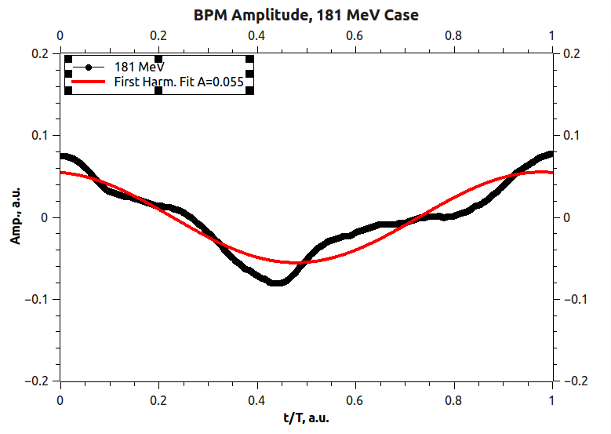
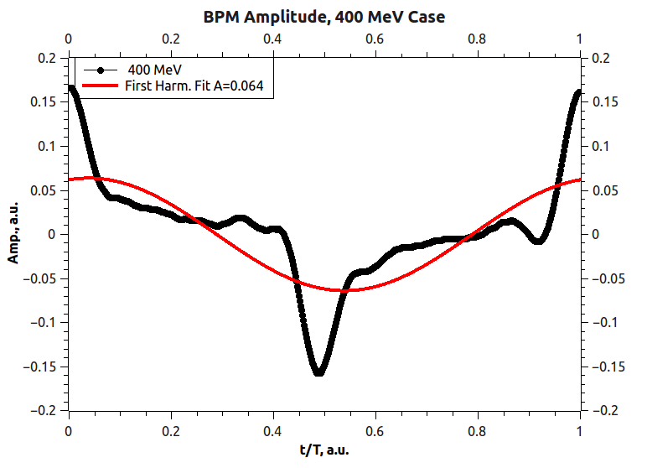
J-PARC BPM ACS21B:BPM Signals
All ACS Cavities are OFF
All ACS Cavities are ON
J-PARC BPMs’ show the energy dependency in the peak positions
It is not exactly an expected time shift: probably termination is not perfect
Correction factors are needed

