Slide 1
Lessons learned on the Minimum diagnostics requirements for beam commissioning and characterization
Thomas Shea
ESS

Slide 2
Outline
Motivation and Scope
Overview of SNS Linac Commissioning Runs
  From Berkeley in 2002 to ORNL in 2006
Stories and Lessons, organized by theme
  Challenges
  Integration
  Protection
  Development
  Verification
  Human performance
Conclusions

Slide 3
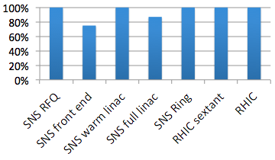
Motivation
Document some lessons from commissioned machines (like SNS) that can be applied to new machines (like ESS)
Percentage of figures in commissioning papers that include data from diagnostics:
  Others: approaching 100%.
  Most compare beam dynamics predictions to diagnostics’ measurements

Slide 4
Scope
Definition of commissioning
  Technical demonstration with initial beam
  Readiness for early operations and performance ramp
  Not the achievement of design goals
Hadron Linacs
  Including single pass transport line to destination (usually a target)
  Primarily SNS
  Some additional examples from BNL linac, LAMPF, RHIC transport lines and single pass commissioning
Notes:
(can’t afford time and expense to achieve design goals without beginning operations phase)
Not covering: ring injection or non-measurement devices that diagnostics groups may also deploy (scrapers, collimators, choppers, beam stops, etc

Slide 5
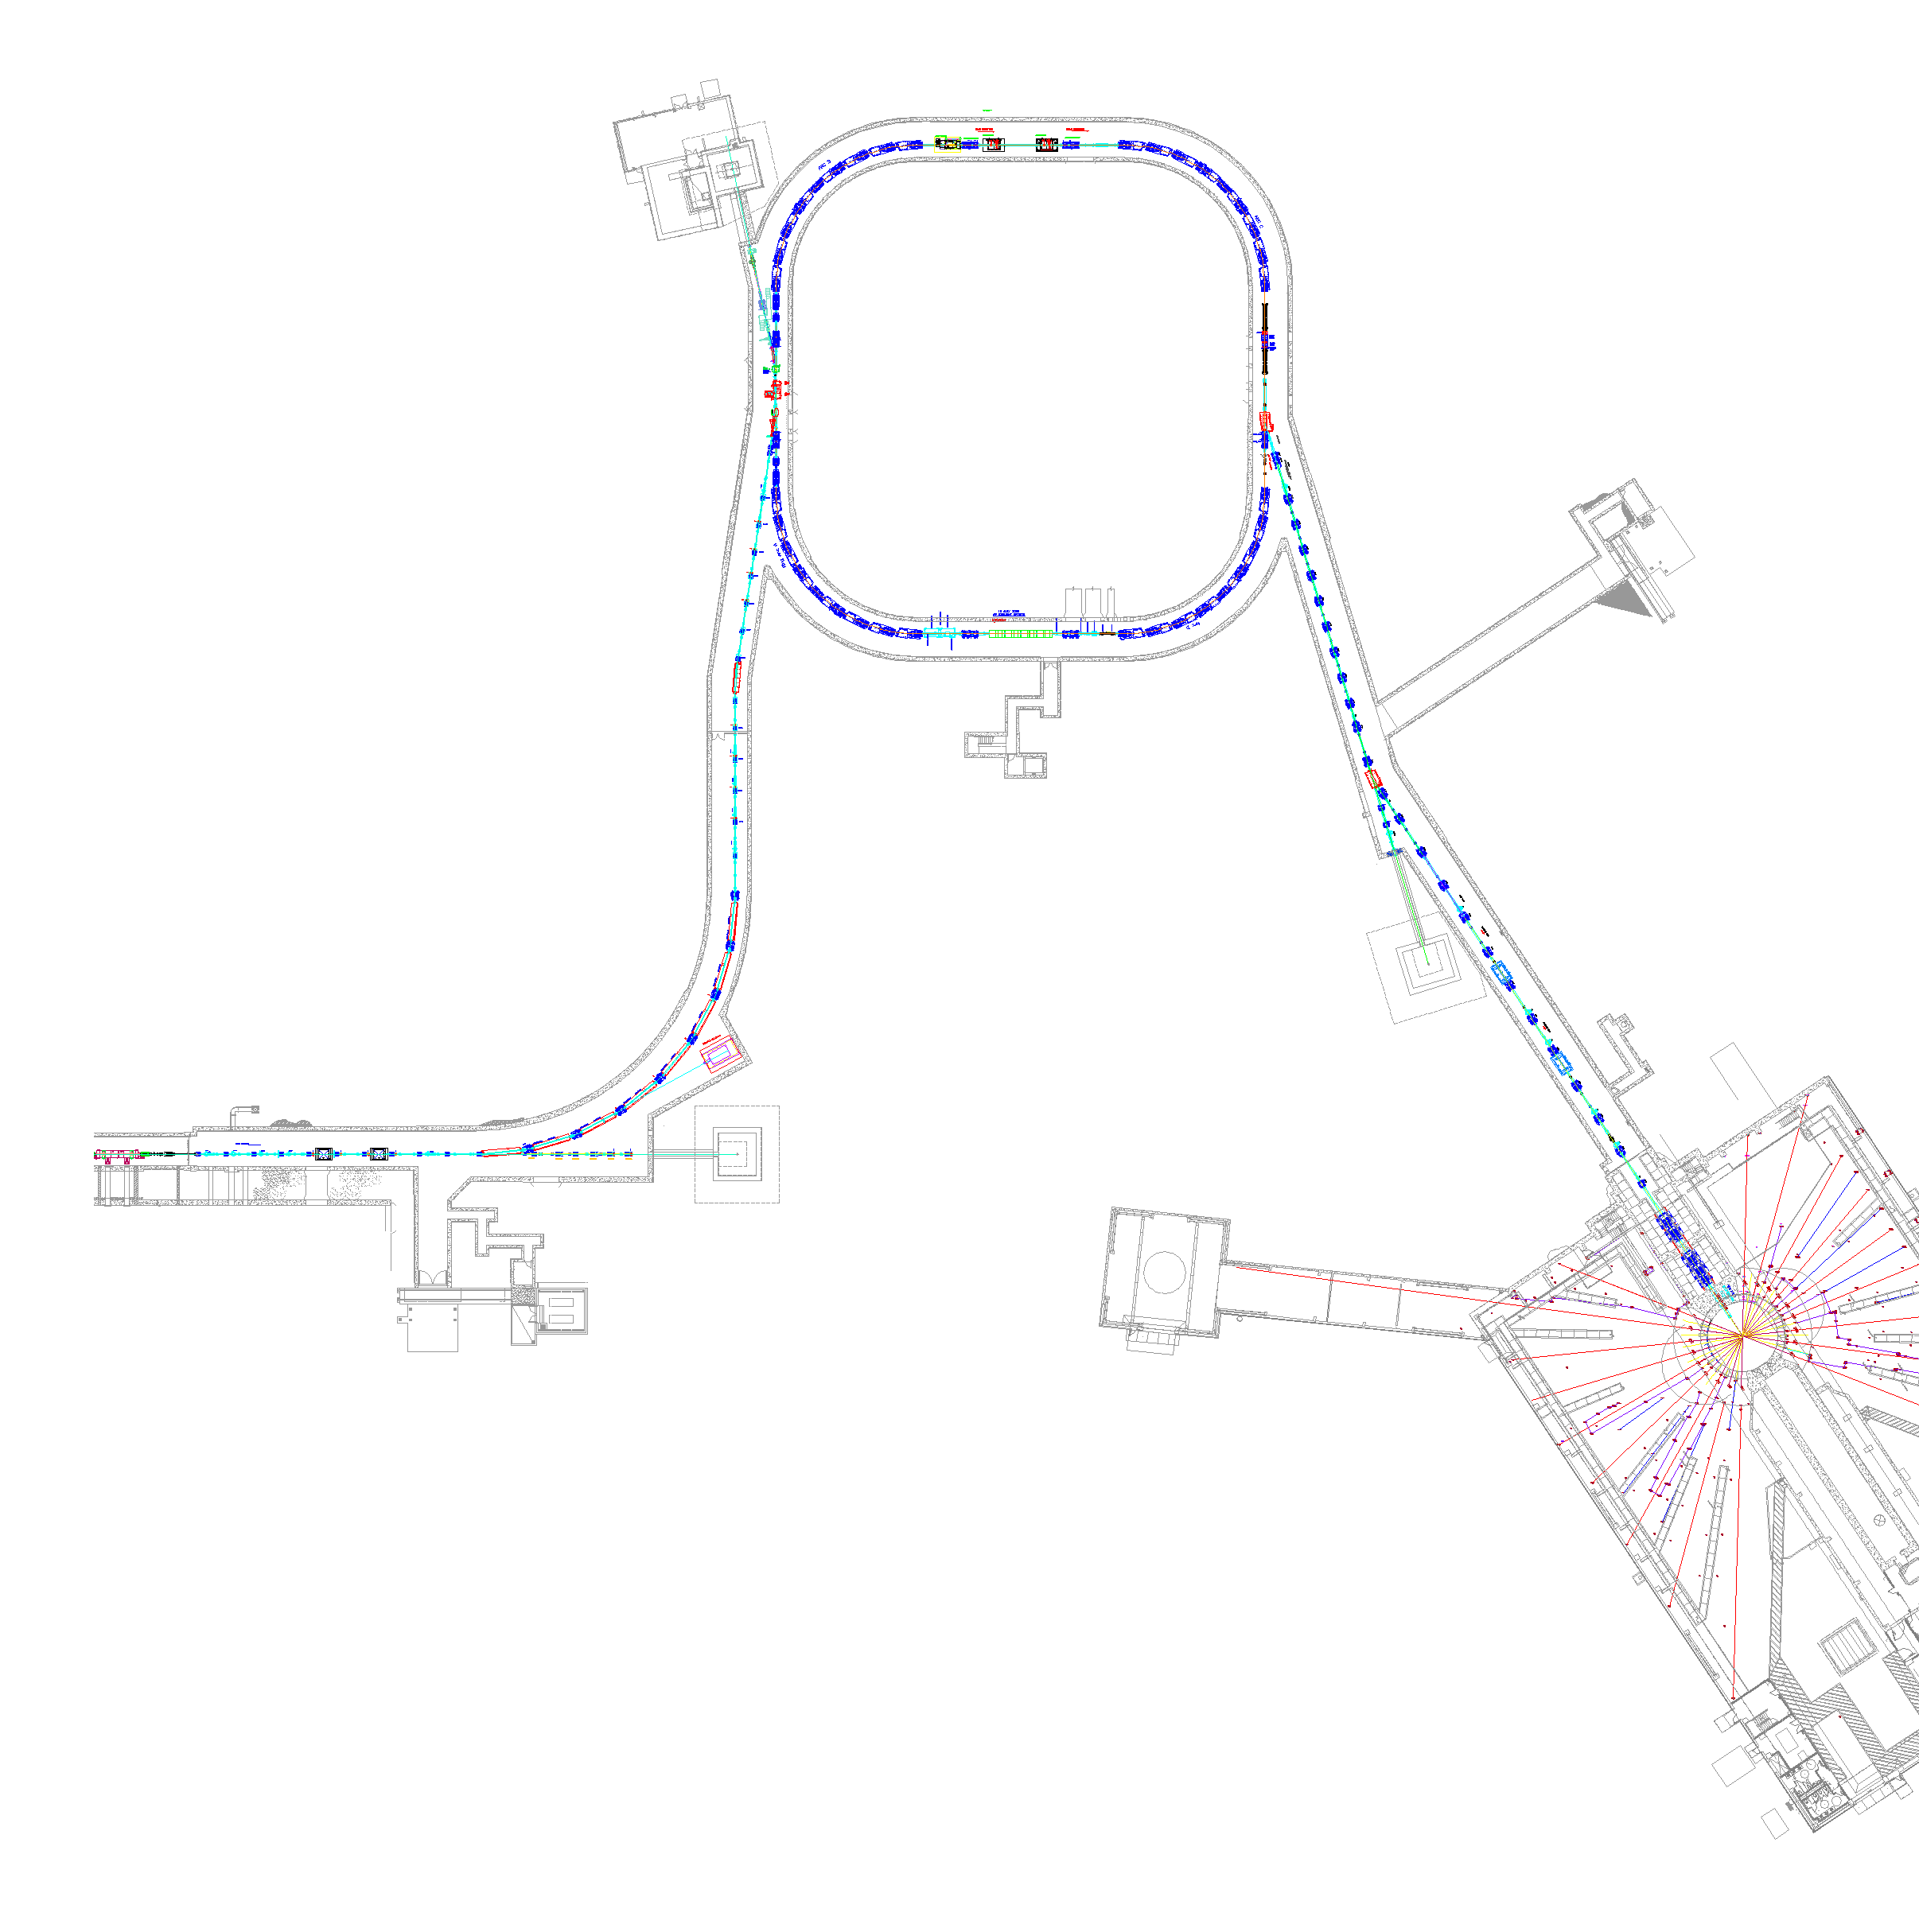
SNS Accelerator Complex
150 kW injection dump
1 GeV LINAC
Accumulator Ring: Compress 1 msec long pulse to 700 nsec
Collimators
Front-End:
Produce a 1-msec long, chopped,
H⁻ beam
Extraction
Injection
RF
2kW momentum dump
2.5 MeV
87 MeV
186 MeV
387 MeV
1000 MeV
RTBT
Ion Source
HEBT
7.5 kW beam dump
RFQ
DTL
CCL
SRF, β=0.61
SRF, β=0.81
Design parameters
Kinetic Energy [GeV] | 1.0
Beam Power [MW] | 1.4
Repetition Rate [Hz] | 60
Peak Linac Current [mA] | 38
Linac pulse length [msec] | 1.0
SRF Cavities | 81
7.5 kW beam dump
Liquid Hg Target
M. Plum

Slide 6
Commissioning ran in parallel with installation
1
2
3
4
5
6
7
8
9
2002
2003
2004
2005
2006
Run #1: - RFQ at LBNL (2.5 MeV), Jan 25th through Feb 2002
- beam stop for design beam power
Run #2: - Front End at LBNL (2.5 MeV), Apr 4 to May 31, 2002
- beam stop for design beam power
Run #3: - Front End at ORNL (2.5 MeV), Nov 5, 2002 to Jan 31, 2003
- beam stop for design beam power
Run #4: - Front End, DTL tank 1, D-Plate (7.5 MeV), Aug 26 to Nov 17, 2003
- beam stop and radiation shield for design beam power
Run #5: - Front End & DTL tank 1,2,3 (39 MeV) Spring 2004
- Beam stop and radiation shield for reduced beam power (50us, 1Hz)
Run #6 : - Front End, DTL, CCL modules 1,2,3 (158 MeV) Fall 2004
- Beam stop and radiation shield for reduced beam power (50us, 1Hz)
Run #7 : - Front End, DTL, CCL, SCL (1 GeV), Aug 2005
Run #8 : - Front End, DTL, CCL, SCL, Ring (1 GeV), Feb 2006
Run #9 : - Front End, DTL, CCL , SCL, Ring, Target (1 GeV), April 28, 2006

Slide 7
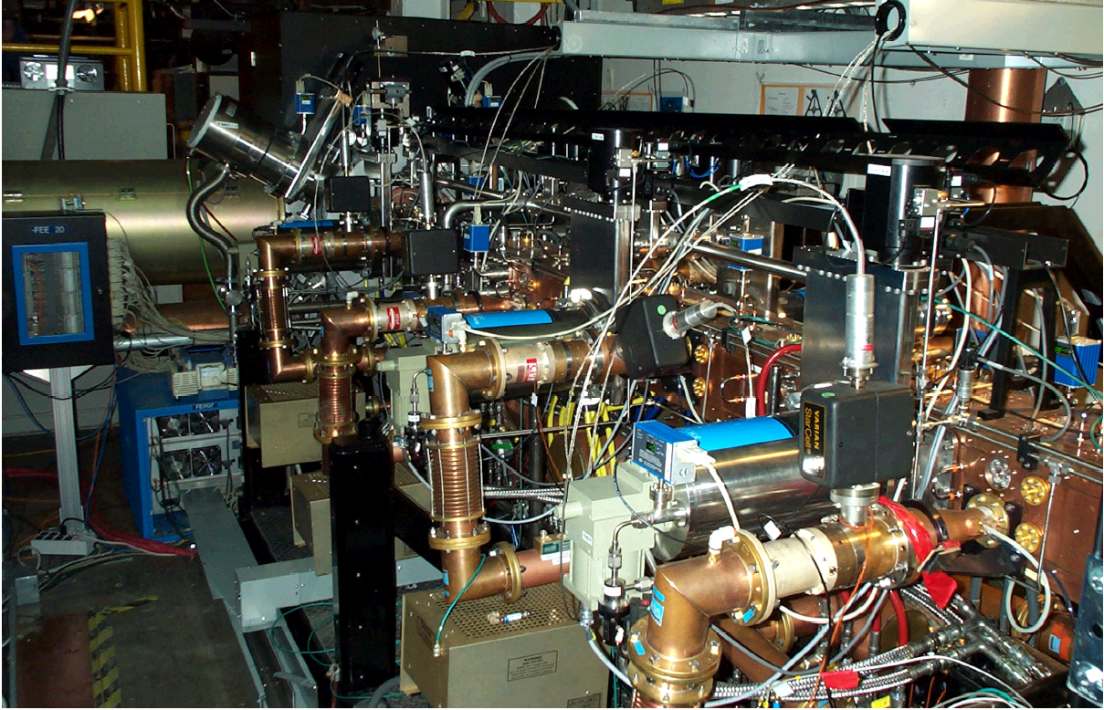
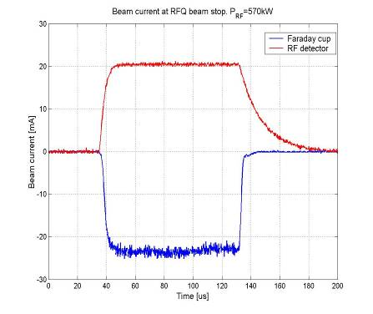
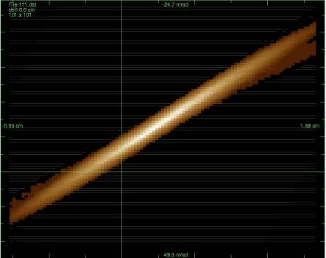

RFQ at Berkeley - 2 Diagnostic Devices
Commissioning: Jan 25th through Feb 2002
1
2002
2003
2004
2005
2006
8 mA transmitted on first pulse, 24 mA current on first day. Emittance: 0.325 pi mm mrad (goal: 0.3 pi mm mrad)
Emittance integrated with controls, all else via scopes
RFQ
1 Emittance (one plane)
1 Faraday Cup (scope)
J. Staples, LBNL

Slide 8
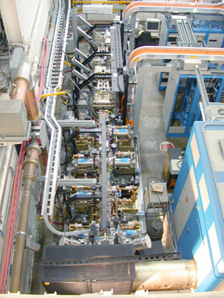
Front End at Berkeley - 16 Devices
April 4, 2002 to May 31, 2002
2
2002
2003
2004
2005
2006
MEBT
All diagnostic systems were prototypes of linac systems from 4 partner labs
All integrated with EPICS at LBNL in one week; all delivered useful information for commissioning
MEBT
6 Position
2 Current
5 Wires
1 Laser (test)
1 Emittance (0ne Plane)
RFQ
Ion Source
Photo Daryl Oshatz, LBNL

Slide 9
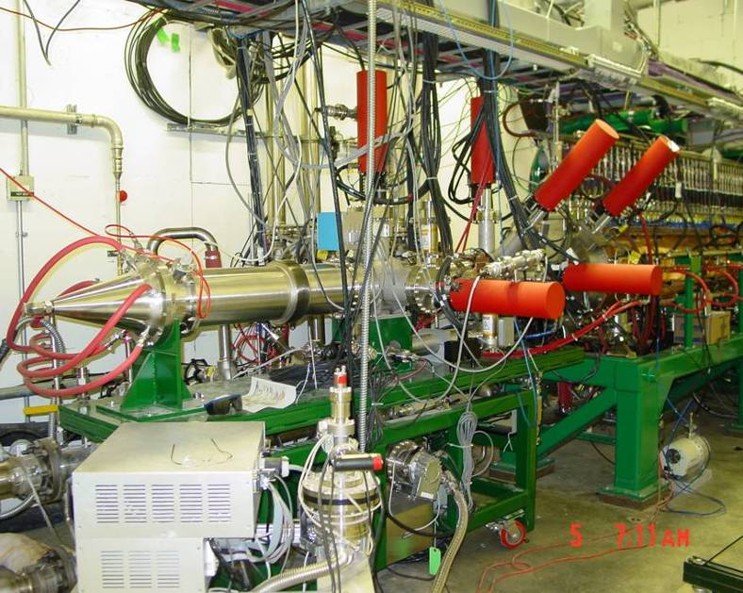
Through DTL Tank 1: 31 Devices
August 26 through Nov 17, 2003
4
2002
2003
2004
2005
2006
last run at full current until beam on target
Dedicated test bench (D-Plate)
MEBT
6 Position
2 Current
5 Wires
2 Thermal Neutron
1 Fast Faraday Cup
1 Faraday/Beam Stop
Differential BCM
DTL/D-Plate
2 Position 1 Current 2 Wire 7 Ion Chamber 4 Thermal 3 Semi 2 Faraday Cup 1 Bunch
1 Video 1 Halo 3 Neutron 1 Beam Stop Faraday Cup
1 Emittance (Slit and Collector) Differential BCM

Slide 10
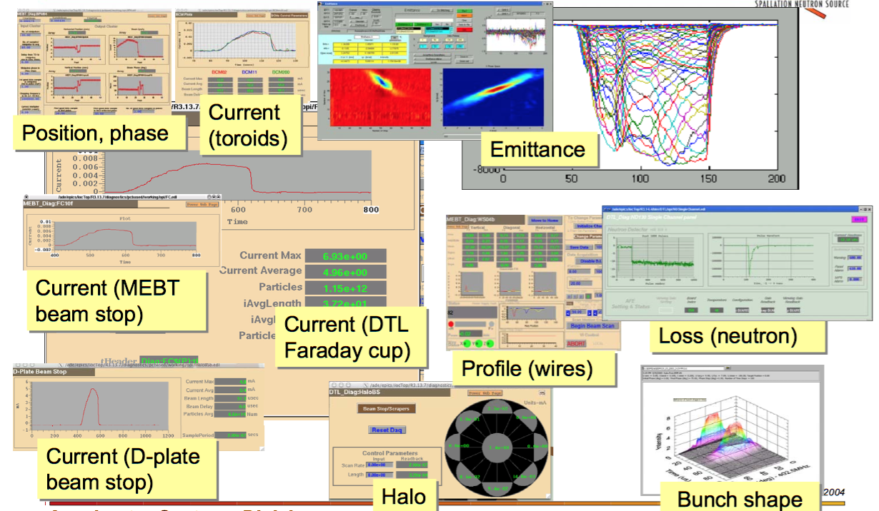
Subset of Diagnostics in Operation
During DTL1 Commissioning

Slide 11
Complete Linac: 326 Devices
Commissioned August 2005
7
2002
2003
2004
2005
2006
Superconducting Linac
MEBT
6 Position
2 Current
5 Wires
2 Thermal Neutron
1 Emittance Horizontal
1 Emittance Vertical
1 Fast Faraday Cup
1 Mode-locked Laser
1 Faraday/Beam Stop
D-box video
D-box emittance
D-box beam stop
D-box aperture
Differential BCM
CCL
10 Position 9 Wire
8 Neutron, 3 BSM,
2 Thermal
28 Loss 3 Bunch
1 Faraday Cup 1 Current
1 Dump
DTL
10 Position 5 Wire 12 Loss
5 Faraday Cup 6 Current
6 Thermal and 12 PMT Neutron
Differential BCM
SCL
32 Position 86 Loss
8 Laser Wire
7 PMT Neutron
HEBT
11 Position
5 Wire
17 BLM, 3 FBLM
2 Current
LDump
6 Loss
6 Position
1 Wire ,1 BCM
CCL/SCL Transition
2 Position 1 Wire
1 Loss 1 Current
Notes:
Over 10 unique classes of measurement; many more types of devices deployed to support this,

Slide 12
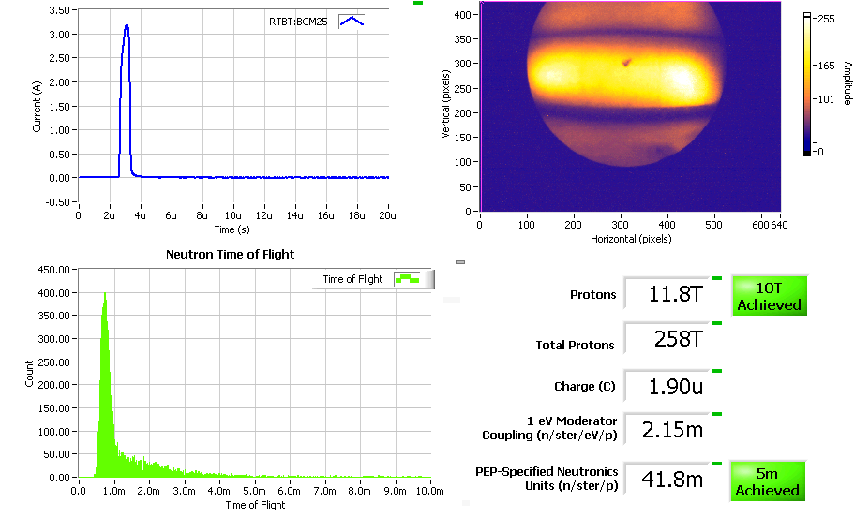
Commissioning Display: Integrated Accelerator, Target and Neutron Diagnostics

Slide 13
Story time!
Notes:
Not compete by any measure. Just a few vignettes to highlight experiences, both good and bad.

Slide 14
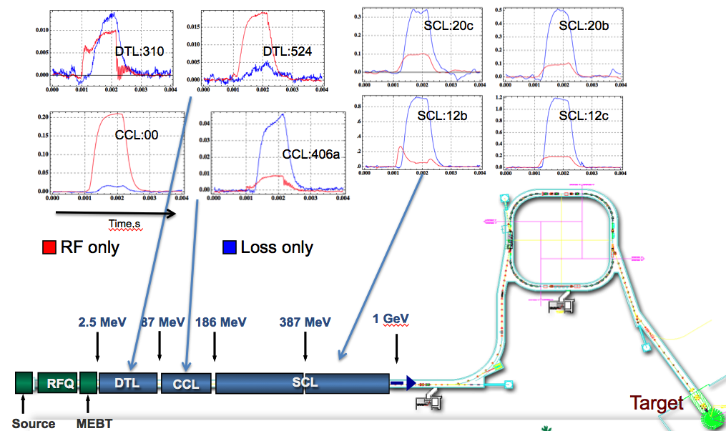
Challenges:
Background in BLM signals
A. Zhukov
Notes:
analog processing does not subtract background waveform. Threshold is a scaler.
Upgrade: digital processing

Slide 15
Challenges:
Electromagnetic Interference
c. 2004, In order of decreasing impact. Efforts focused on BCM and Loss systems
System | Signal level | Frequency Range | Comments on Noise
BCM | Tens of mV into 50 ohms | Few Hz to hundreds of MHz | Must heavily filter waveform and baseline subtract to reduce noise to few percent.
Loss | Hundreds of pA | < 35kHz | Noise on fast channel = 30% beam loss. Slow channel OK.
Faraday Cup/ Beam Stops | Hundreds of mV | DC – few MHz | Same issues as BCM low frequency range, but stronger signal.
Wire Scanners | microAmps | < 40 kHz | Noisy waveforms, but requirements exceeded by analysis and averaging
BPM | Ten mV into 50 ohms | Few MHz around RF (402.5 and 805 MHz) | Near 402.5 MHz RF systems, measure 805 MHz, and vise versa
Notes:
The lower frequency devices (DC through super-audio) are the most challenging. Many inductively coupled sources of interference, including switch-mode modulators.
Most BCMs could have been lower bandwidth devices with better S/N.

Slide 16
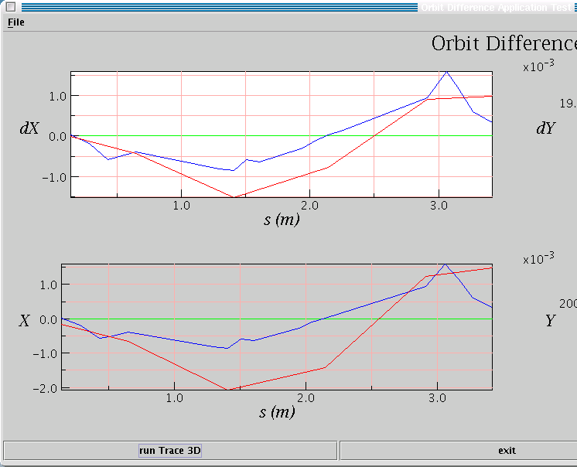
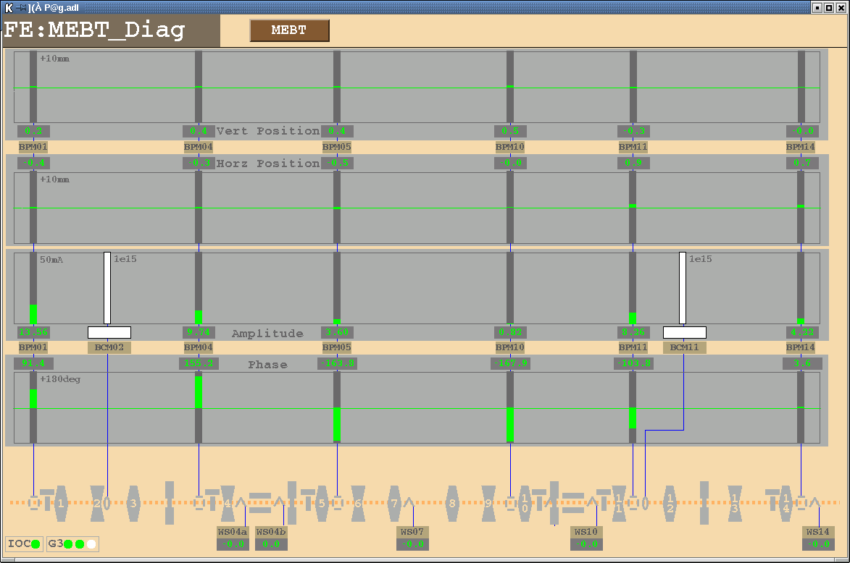
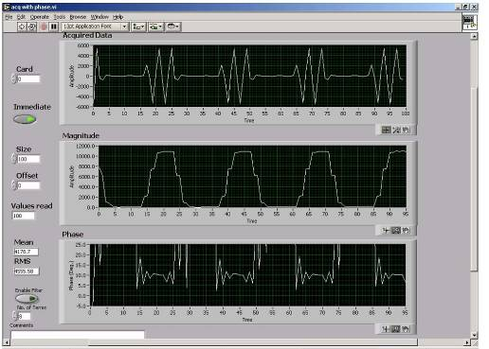
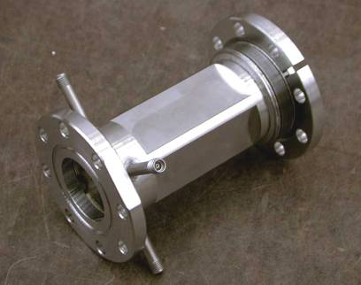
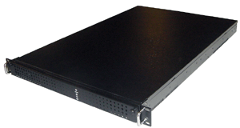
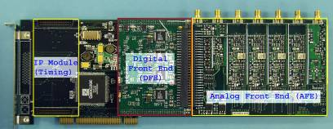
Integration:
Beam Dynamics and Diagnostics meet at the Application Layer
“99% complete is 100% failure” *
Network Attached Devices:
1 week to integrate all MEBT diagnostics at LBNL (from 4 labs) with timing and EPICS screens
the orbit app worked live from ORNL - simply initialize with the Process Variable names
app
EPICS screen
Channel Access
Cables & install
- LBNL
Electrodes - LBNL
Electronics, NAD software - LANL
* W. Blokland, 2001

Slide 17
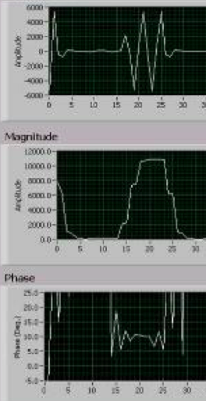
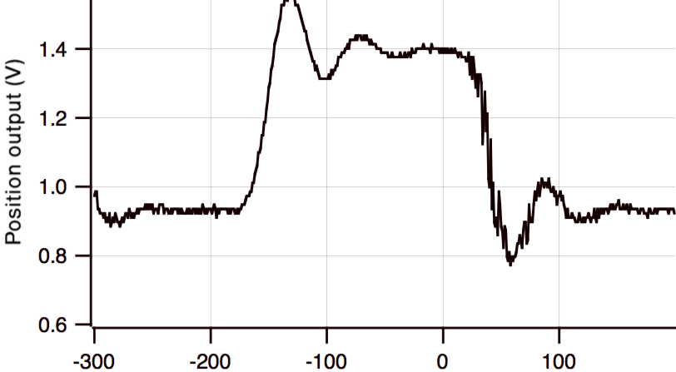
Protection:
Commission with tiny “safe” pulses
  Specify performance with low current, short pulse (“safe”) beam such that beam can be lost most anywhere without causing damage
  Bonus: Allows tuning RF resonators without impact of beam loading
SNS vector receiver
< 1 µs
1990 BNL Linac to Booster position electronics, 200 ns
Notes:
devices happed to perform OK with safe beam, but in retrospect, more emphasis on this regime might help.

Slide 18
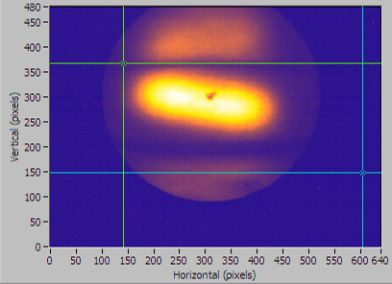
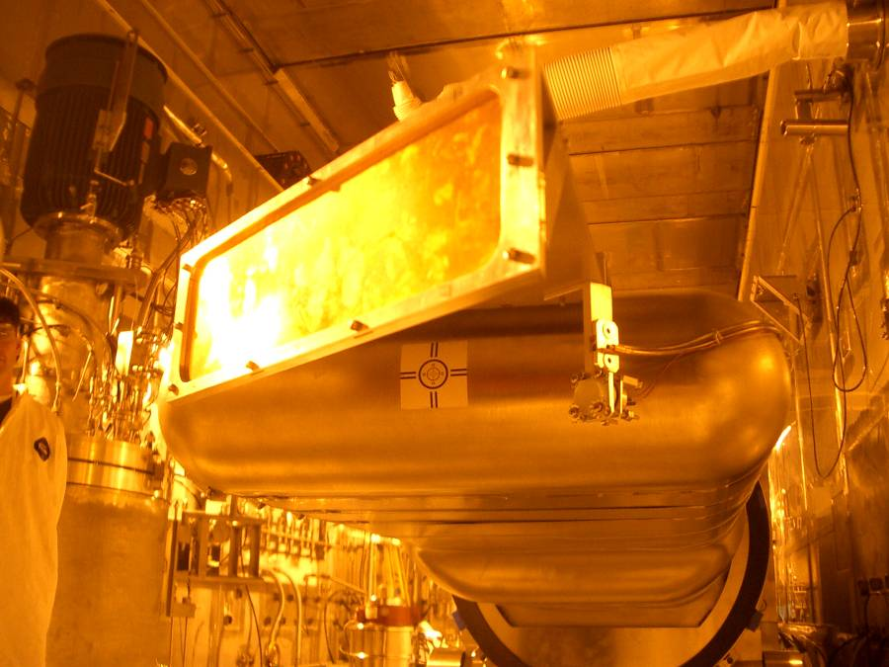
Protection:
Target and Dumps
Backstory on target diagnostics:
  Early in the project, removed virtually all beam instrumentation from target station – accelerator folks did not have to deploy diagnostics in nuclear environment
  Convinced target folks that we could easily predict beam parameters and detect errant conditions
  Left only thermocouple halo monitor (which works but not for low power beam), but still installed temporary imaging system
  Surprise! Tilted beam. Problem traced to skew quad moment from Lambertson.
  Permanent imaging system now deployed
Tilted beam on the temporary target view screen. Also, centroid 6 mm from predicted position
Dump story: In 2008, destroyed momentum dump with too much beam power (8-10 kW vs. 2 kW rated power)
Developed new beam current monitor to measure small beam current to dump
M. Plum

Slide 19
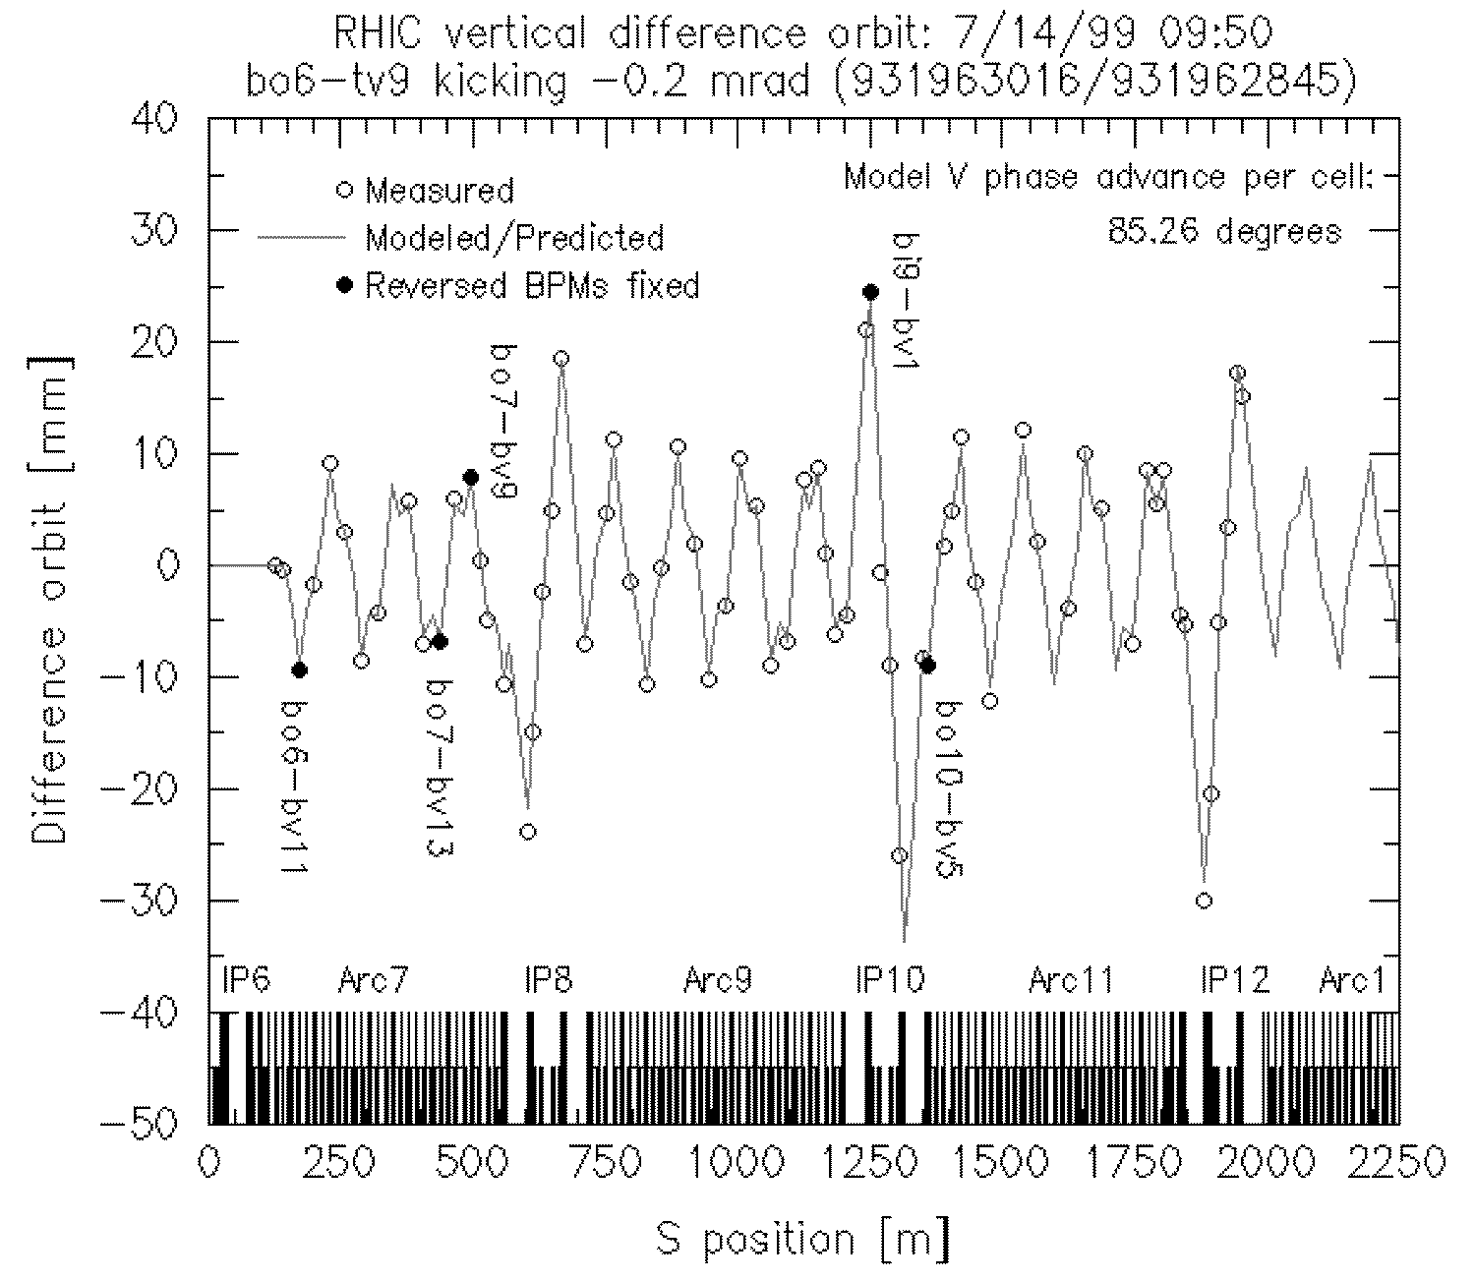
Verification:
Difference Orbits
Quickly verify optics and BPMs
Difference orbit: App uses online model, live and saved BPM readbacks, kick strength is free parameter, …
BPMs: ~mm precision in this mode, data on each pulse, self trigger within wide timing gate
Notes:
Similar in SNS and other machines
BNL linac to booster: orbit correction app provided similar function, nearly on day 1.

Slide 20
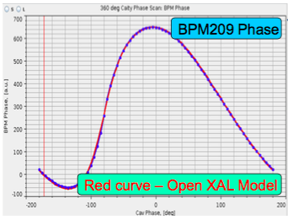
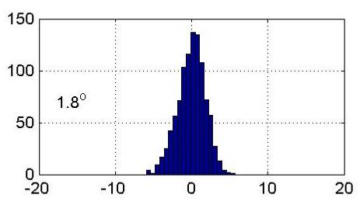
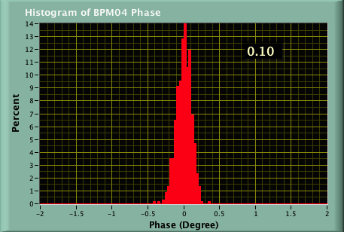
Development:
SNS BPM Position/Phase Measurement
“We know that BPMs in proton linacs
don’t work”*
Worked even embedded within DTL
Measure harmonic away from RF (like @BNL Linac to Booster line)
Vector receivers (I-Q at SNS): retain phase
Results:
Scrap dedicated phase monitors
Didn’t really need measurements with energy degrader-faraday cups for DTL tuning
Diagnostics engineers helped design LLRF
With automated tuning apps, 8 hours reduced to 32 min
0.1 deg. at ORNL, 2 years later
1.8 deg. at Berkeley, 2002
* R. Siemann, 2000
Notes:
Still kept many wire scanners and also built the energy degrader faraday cups just in case.

Slide 21
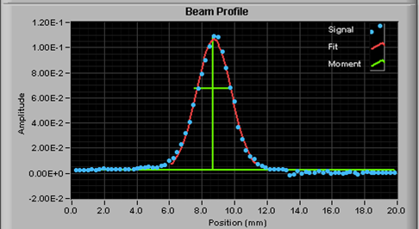
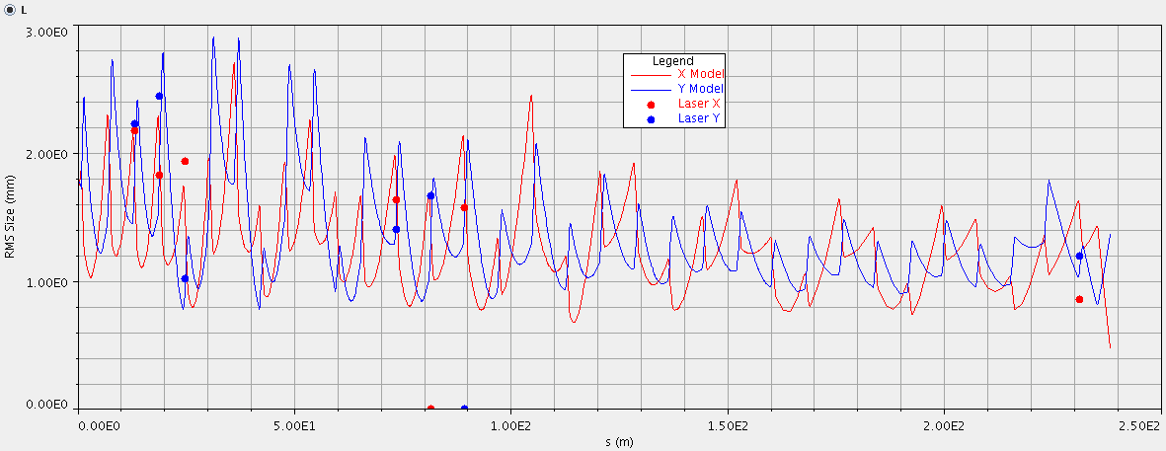
Development:
H- Laser Wire
Photo-neutralization- Detected current from liberated electrons vs. photon beam position
Virtually non-invasive
Result: didn’t build invasive wire scanners near SC cavities – risk reduction.
J. Galambos. Assadi, et. al.

Slide 22
Human Performance
Configuration errors
  Complex controls integration in RHIC
Shortcuts under pressure
  Noise filters on machine protect inputs: now a suspected contributor to SC cavity degradation -> fixed this and also deployed differential BCM
Commission early and often, but not too often
  Enough staff to install and integrate diagnostics, then support operations phase
  24 by 7 commissioning adds too much peak load
RHIC commissioning,
Aug 16, 1999 Owl shift loglook entry:
“…BPM reading in general
were difficult to interpret since some BPMS read data from other BPMs/plans/rings. We corrected the large orbit deviation at yo9-bv1… No progress, however, at the main Losses…”

Slide 23
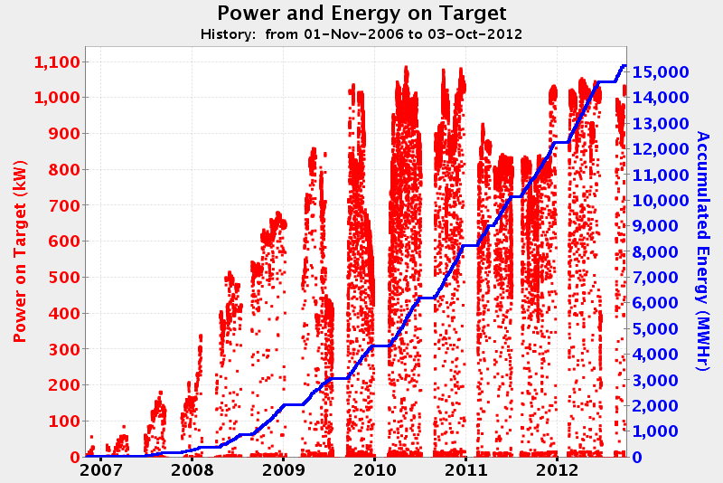
Early Operations and Performance Ramp
SNS chose to ramp power rapidly rather than staying conservative
Shook out issues during a period when lower availability was tolerated. Only a few years of this will be tolerated by user community: work fast!
Diagnostics: The minimum for commissioning may not be enough for this phase and there is limited time for new development.

Slide 24
(biased) Conclusions
Diagnostics requirements for an SNS-like linac and target are (just the highlights):
For commissioning only, at a relaxed pace:
BPM with phase and calibrated amplitude, co-designed with LLRF
BLM (with background mitigation) and diff BCM integrated into machine protect
BCM for reporting and target/dump protection
Target/dump imaging and halo monitoring, capable of verifying interface requirements
A sprinkling of profile monitors (emittance for front end)
All integrated with high level physics apps; verified performance with “safe” beam pulses
Require dedicated diagnostics shifts for verification and calibration
If Commissioning and/or Performance Ramp is on an aggressive schedule, consider:
More beam distribution measurements (emittance, longitudinal and transverse profile, with extended dynamic range) measurements to support multiparticle model verification
Diversity and redundancy for virtually all measurements, with focus on protection and non-invasive measurements
Suite of automated verification/tuning applications, and on-line data analysis tools
De-focus (just a couple of examples)
Dedicated phase monitors
Energy degrader/faraday cups for setting RF
Notes:
Woefully incomplete, but highlights are there, and reasonable consistent with consensus.

Slide 25
Bonus slide:
Minimum Accelerator Diagnostics
For a commissioning a hadron linac feeding a target station and ultimately, user instruments, the minimum is…
none
  With no schedule pressure, scan and twiddle knobs while asking users what they see. Fix components when the beam destroys them.
Suggest a more nuanced approach to determine
appropriate diagnostics

Slide 26
thanks
Particular thanks to many Diagnostics and Beam Dynamics colleagues at BNL, LANL, LBNL, and ORNL.
Input from :M. Plum, J. Galambos, A. Aleksandrov, W. Blokland, A Shishlo, A. Zhukov, T. Satogata, S. Assadi, J. Staples, A. Ratti, J. Power, D. Purcell, C. Deibele, T. McManamy, C. Goetz, R. Witkover

