Slide 1
Future challenges for minimum diagnostics requirements for beam commissioning and characterisation:
The ESS as an example
Marc Munoz,
Beam Dynamics meets Beam Diagnostics,
Firenze 4-6 November 2015

Slide 2
Contents
General remarks
Light sources example
ESS
  General introduction of the ESS
  Time schedule for commissioning and initial operations
  Beam Commissioning Planning
  Next steps

Slide 3
Commissioning challenges
Commissioning duration will get shorter. Requires better preparation.
Large In-Kind contribution in projects.
Beam Instrumentation tends to be one of the first targets for budgets cut
Nuclear safety authorities demands are increasing
And machines are getting more complex
Good preparation is needed if we want to ensure a commissioning of the machines on time.
Good planning, simulation and training is needed.

Slide 4
Complex machines
Some examples
  Increasing power:
    Commissioning with limited test beam
    MPS fundamental part of the machine
  Smaller emittances:
    Stronger requirements in stability
    Better BPMs
    Shorter bunches
Commissioning of the user’s instruments is also more complex, they will require more communication between both communities

Slide 5
A success history, commissioning of Light Sources

Slide 6
Light Sources in the 2000
SLS: Commissioning in 2001, ~ 5 month
Spear-3: Commissioning in 2004
Diamond: Commissioning in 2006, ~ 3 month
Soleil: Commissioning in 2006, ~ 3 month
Petra-III: Commissioning in 2009
ALBA: Commissioning in 2011, ~ 4 month

Slide 7
Lessons learned
For most part, commissioning of the new machines has become easier
Sharing of experiences:
  Very good communication between the European labs
Common tools:
  Use of a common platform for physics applications (MiddleLayer) [Spear-III, ALS, CLS, Australian Synchrotron, Diamond, Soleil, ALBA, MaxIV,…]
  Sharing and reusing of code: you can have basic tested applications running in day 1 of your commissioning
Online model for testing software before commissioning
Gradual improvements of diagnostic

Slide 8
The ESS. How we are preparing commissioning

Slide 9
Accelerator overview
352.21 MHz
704.42 MHz
2.4 m
4.6 m
3.8 m
39 m
56 m
77 m
179 m
204 m
Target
Source
LEBT
RFQ
MET
DTL
Spokes
Medium β
High β
HEBT & Contingency
75 keV
3.6 MeV
90 MeV
216 MeV
571 MeV
2000 MeV
Tuning Dump
Parameter | Value | Units
Max energy | 2 | GeV
Peak current | 62.5 | mA
Repetition Rate | 14 | Hz
Pulse length | 2.86 | ms
Average Power | 5 | MW
RF Frequency | 352/704 | MHz
Maximum losses | 1 | MW/m
Species | Proton
Device | Total Number
RFQ | 1
DTL tanks | 5
Spokes Tanks | 13
Spokes Cavities | 26
Cryo tanks (M-β) | 9
RF cavities (M-β) | 36
Cryo tanks (H-β) | 21
RF cavities (H-β) | 84
Klystrons/IOTs | 120
Modulators | 30-60

Slide 10
ESS schedule
Installation and testing: 2016-2018
Commissioning of Accelerator (parallel to installation) during 2018 and 2019.
Initial commissioning and operation without the HEBT cryomodules.
1st proton production en 2019
Instrument hot-commissioning 2019-2020…2025
Initial operation until end 1st quarter 2021
Installation of High-β cryomodules 1-11:
  Commissioning July-September 2021
Restart operations, stop end 1st quarter 2022
  Commissioning August-September 2022
Ramping of the power during the period 2020-2025

Slide 11
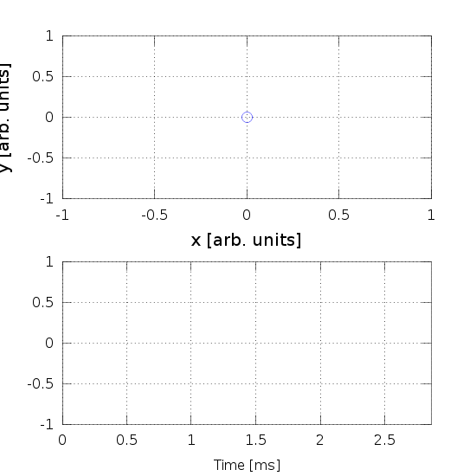
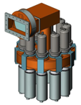
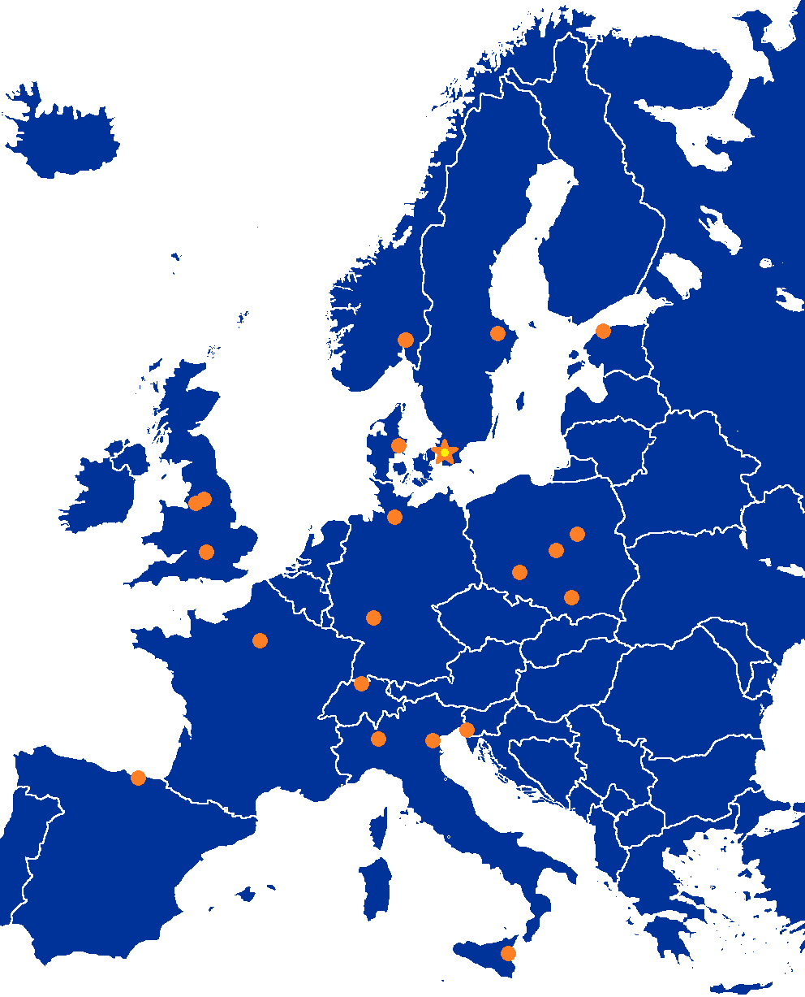
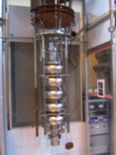
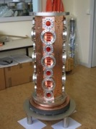

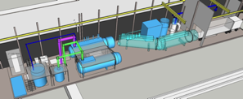

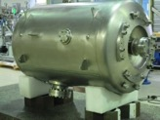
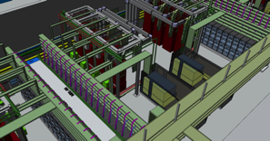
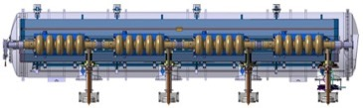
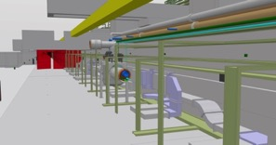


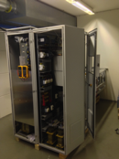
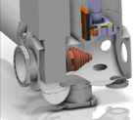


Accelerator Selected technologies
PARTNERS
ESS AD
Notes:
Explain in-kind and bilateral agreements for pre-construction phase which now are being transformed into in-kind contracts for construction

Slide 12


Partner Institutions
In-kind (main contributions)
Univ Agder (Ion source expert)
ATOMKI (RF-LPS)
CEA (RFQ, SRF, Diagn)
CNRS (SRF, Cryo)
Cockcroft Inst (Diagn)
Daresbury Lab (SRF, Vacuum)
Elettra (RF, Magn, PS, Diagn)
ESS-Bilbao (MEBT, RF)
GSI (Diagn, Vacuum, Cryo)
Huddersfield Univ (RF distrib)
IFJ PAN (Installations)
INFN Catania (Source, LEBT)
INFN Legnaro (DTL)
INFN Milan (SRF)
NCBJ (LLRF)
RAL (Diagn)
RHUL (Diagn)
Tallinn UT (RF)
TU Lodz (LLRF)
Univ Oslo (Diagn)
Warsaw UT (LLRF)
Wroclaw UT (Cryo)
Nothing signed
Contract
HoA
IKC
Not IKC, 32%
Planned IKC, 49%
Possible IKC, 16%
Paid contracts
Aarhus Univ (Beam del)
DESY (Diagn)
Lund Univ (LLRF, RF)
PSI (Diagn)
Uppsala Univ (Tests)
SE,DK, 3%

Slide 13
Considerations about the commissioning
ESS would operate with a long pulse (2.86 ms).
High peak current: 62.5 mA-> space charge dominates at low energy
High power (up to 5 MW)
Only stop to accept the nominal parameters is the Target
Most of the (invasive) diagnostic could not cope with the long pulse
Large percentage of In-Kind contribution
Systems should be fully tested and commissioned before start of BC
  Beam diagnostic, Low level RF, would need the beam

Slide 14
Sequence for commissioning to Target (no HBL cavities)
Staged commissioning:
IS-LEBT: ~1 month
IS-LEBT-RFQ-MEBT: ~3 weeks
IS-LEBT-RFQ-MEBT-DTL1: ~2 weeks
IS-LEBT-RFQ-MEBT-DTL1-DTL2-DTL3-DTL4: ~2 months
IS-LEBT-RFQ-MEBT-DTL1-DTL2-DTL3-DTL4-DTL5-SC Linac–HEBT-Dump: ~1 month
IS-LEBT-RFQ-MEBT-DTL1-DTL2-DTL3-DTL4-DTL5-SC Linac–HEBT-A2T-Target: ~ 1 month
Temporary Diagnostic Line/Beam Stop
Dates are somewhat in flux, under optimization.
The goal is to get 1st Proton on Target 28 Jun 2019

Slide 15
Destinations
Limited destinations, can not take the full power. MPS should take care of limiting which beam can be send/produced:
  MEBT FC: peak power 230 W (10 us@14Hz, maybe 100 us@1Hz)
  DTL FC: peak power 5.65 kW (10 us@14Hz, 100 us@1Hz)
  Medium Beta Dump (10 us@14Hz, 100 us@1Hz)
  Tuning Dump: 12 kW
Unlimited destinations
  LEBT Stop
  Target
Provisional numbers.

Slide 16
Beam modes
Probe Beam: 5-10 us, 1Hz:
  first beam through a particular section; non-damaging even in the case of total beam loss; used to verify that machine configuration is not grossly incorrect
Fast tuning: 5-10 us, 14 Hz:
  limited beam loading; used for fast scans to rapidly determine/verify RF setpoints and measure beam profiles with wire scanners. Does LEBT chopper allow this?
Slow tuning: 50-100 us, 1 Hz:
  longest pulses that allow operation of invasive proton beam instrumentation devices like wire scanners; long enough beam pulses to diagnose and monitor RF feedback and the onset of beam loading; used to perform more precise single-pulse measurements
Long pulse verification 2.86 ms, 1/30 Hz:
  except in LEBT, only used when machine reasonably tuned to the tuning dump or the target; slowly-increasing pulse lengths are used to tune RF feedforward, verify beam loading and Lorentz force detuning compensation, and tune for low beam losses. Check IS stability and absorber. Check Aurelien document.
Production: 2.86 ms, 14 Hz:
Hybrid beams?
Provisional numbers.

Slide 17
How we are planning and preparing the BC
Working groups:
  Beam Commissioning Working Group
  Proton Beam Instrumentation Task Force
  Startup Working Group
Internal documentation keep in a wiki system, together with task list
Documents that need to be shared externally or affect the whole of ESS are copied in the ESS PML/documentation system

Slide 18
BC Working Group
Online Documentation:
  https://ess-ics.atlassian.net/wiki/display/BCP/Beam+Commissioning+Planning+Home
Members:
  M. Munoz (Chairman), H. Danared, M. Eshraqi, E. Tanke, R. Zeng, T. Shea, A. Ponton, …
Regular meetings to discuss, produce documentation on the wiki and review it.
Create list of objectives and procedures to commission the accelerator.
No a priori assumption about the diagnostic available (but we try to keep it grounded in realistic assumptions)
The results are used to define the beam diagnostic needed, as well as high level applications required

Slide 19
Example: MEBT
Objectives
Procedures
Transmission > 99.3%
Output beam current, 6.5 mA → 63 mA
Output beam energy controllable within ±10 keV of design
Flat top length, 5 us to 3 ms
Pulse length (nominal) < 2.860020 ms
Twiss parameters matched throughout flat-top
Transverse 99% output emittance less than that in integrated lattice design
Longitudinal 99% output emittance less than that in integrated lattice design
Thread the beam to the entrance of DTL
  Using short, low power beam
  Set quadrupoles gradient to design values
  Center the beam at the BPMs using steeres, Bunchers off/detuned
  BPM and corrector polarity check (beam based, difference orbit)
  Quad polarity check (beam based)
  Find center of each quads (BBA)
  Scan x&y
  Step quad field
  Scan x&y
Setting Buncher 1
  LLRF setting
  Phase the buncher
  Rough using reflected power measures
  Phase and amplitude scans using time-of-flight
  Set the synchronous phases to -90 degrees and amplitudes to the design value of each
  Measure the beam energy with TOF using BPMs
  If the RFQ's output energy is not matched to the DTL's input energy and or if the output longitudinal Twiss parameters are not matched to those for the DTL's input, adjust the amplitudes and phases
  Adjust RF amplitude
Transport the beam to the chopper
  Center beam at quads if required after 4.2

Slide 20
PBI Taskforce
Online documentation:
  https://ess-ics.atlassian.net/wiki/display/PBITF/PBI+Taskforce+Home
Roles:
  Stephen Molloy, Chair, Secretary
  Andreas Jansson, Group Leader for Beam Instrumentation
  Mamad Eshraqi, WP Leader for Beam Physics
  Others called in as necessary
    Many thanks to the Beam Instrumentation, Beam Physics, & Aarhus University teams for their enthusiastic cooperation with this process
Meetings:
  Ad-hoc and based on linac sections
  Typically proceed as follows
    Meeting #1: Discuss the various needs of the section, decide on tasks
    Meeting #2: Present strawman proposal, & review
    Meeting #3: Determine pseudo-final proposal
    Meeting #4: Address remaining issues

Slide 21
Assumptions for the BPI
The region of interest extends from the interface between the ion source and LEBT all the way to the Target, including the Tuning Beam Dump.
The purpose of commissioning is to achieve the L3 requirements.
  This must take into account the staged construction of the linac
    E.g., devices only required for >1 MW operation have less time-pressure than others
The purpose of PBI is:
  Beam measurements required for set-up of component to design values.
    For example, cavity phase scans making use of beam phase monitors.
  Debugging of off-normal beam conditions.
    Specifically those conditions not otherwise communicated to the control system
  Demonstrate achievement of the L3 requirements, including interface requirements, and the ACC:TGT interface requirements.
    Only those requirements related to the beam
    Including subsequent monitoring of those parameters
  Machine optimisation and development.
This is the 3rd or 4th definition for Beam Commissioning

Slide 22
LEBT Proposal
Doppler Measurement for species fraction. For commissioning, possibly relocated to test-stand during operations. Not yet decided.
From S. Molloy
Allison Scanner
Transverse x & y position & profile. Gated to suppress signal from chopped beam.

Slide 23
MEBT Proposal
DC remainder from RFQ takes ~3 quads to be cleaned out, so an additional measurement here is necessary
3 WS’s, 2 NPM’s, & a BSM give a very complete suite of measurements of the 6-D phase-space
Chopper & Dump
From S. Molloy
Fast current monitor (~1 GHz BW) to measure chopping efficiency
“Slit & grid” 4-D transverse phase space measurement

Slide 24
DTL Proposal
Faraday Cups for beam commissioning/startup. Note that the transmission of tank #1 depends strongly on RF phase/amplitude, which can therefore be coarsely tuned based on the BCM. Transmission is very good for remaining tanks, even if powered off.
Unequal number of BPM’s in each tank to assist with trajectory correction. Proposed distribution is 6,4,3,2,2
From S. Molloy
No WS’s. Incoming mismatches are not visible after tank #1, so must be corrected in the MEBT. DTL quads are PMQ’s, so no transverse optics to correct.

Slide 25
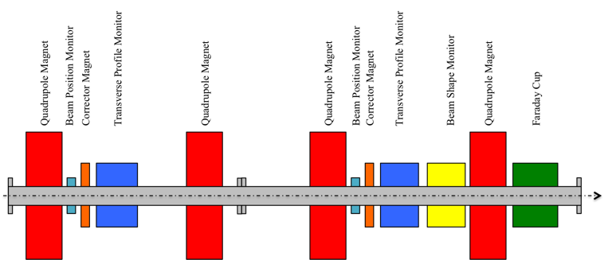
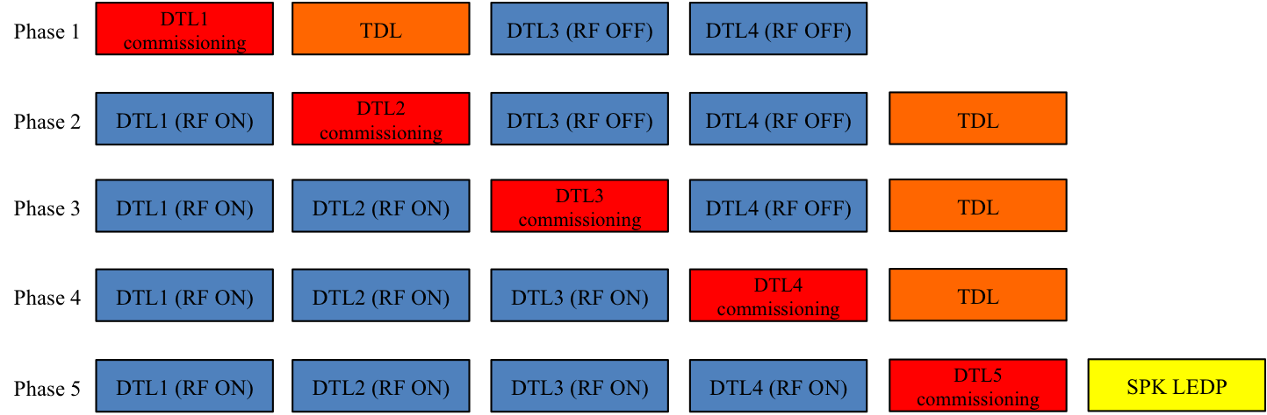
DTL: Commissioning Proposal
Temporary Diagnostics Line for DTL commissioning
One possible configuration shown here
From S. Molloy
Note that this proposal is consistent with the proposed installation sequence

Slide 26
Cold linac + HEBT + Dogleg
These sections are broadly similar
  Doublet lattice separated by acceleration (or drift) slots
Overarching decisions
  Wire-scanners installed as triplets, not singlets
    Reduces the aging of individual scanners
  One BPM per unit cell
  Non-invasive profile monitors
      i.e., residual gas ionisation or beam induced fluorescence
    Not critical for commissioning, and so re-prioritised to a subsequent phase
      Operations/power-ramp up

Slide 27
Spoke Proposal
Three WS to measure DTL output transverse phase-space
NPB co-located with WS
From S. Molloy
Faraday Cup acting as a low-power beam stop. For commissioning DTL Tank#5
Faraday Cup acting as a low-power beam stop for machine start-up
Single BPM in each LWU

Slide 28
Medium-Beta Proposal
Three WS to measure transverse phase-space after the frequency jump (352 MHz acceleration → 704 MHz)
From S. Molloy
Faraday Cup for machine start-up

Slide 29
High-Beta Proposal
A placeholder for a transverse measurement in case the performance of the Medium-Beta linac requires it.
From S. Molloy

Slide 30
HEBT & Dogleg Proposal
From S. Molloy
WS triplet near the end of the HEBT. Slow phase advance leads to a large separation

Slide 31
A2T Proposal
Post-raster BPMs verify correct triggering of the raster magnets. Measured amplitude of beam position and B-dot loops in the raster magnets can be correlated with the beam spot on the luminescent coatings in the Target.
Steerers located symmetrically around the raster action point to allow for verification of the downstream optics and probing of
From S. Molloy
Raster system
Raster system
Cross-over point in the Neutron Shield Wall. Position measured here should not be affected by deflections close to the raster action point. This BPM will therefore allow verification of the lattice values.
Action point of raster system. 180deg out of phase (both planes) from the cross-over point in the Neutron Shield Wall. WS will therefore measure the same beam as at the cross-over.

Slide 32
Status today
We have defined and justified what we want to measure
At this point, we have defined a realistic set of BI for ESS, and the basic procedures to follow for commissioning
This suite of BI needs to be validated with partners
In the process of finishing the requirements for the devices

Slide 33
Commissioning and Operations
Commissioning diagnostic and operations diagnostic has to be compatible
Temporary diagnostic during commissioning
Applications developed during commissioning could be ported to Operations

Slide 34
Preparing for the Beam Commissioning
“Virtual” beam commissioning
  Simulations using a virtual accelerator
  Verification of the procedures
  Test of the software before commissioning
  Training of accelerator experts
Understanding of the beam instrumentation devices
Use the experience of similar projects (SNS, J-Parc, Linac4)

Slide 35
Development Framework
OpenXAL has been selected to be used as the framework for Control Room Applications
  Developed at SNS (http://xaldev.sourceforge.net)
    Open Source collaboration with dozens of developers across several sites: SNS, FRIB, TRIUMF, CSNS, GANIL and ESS
    Pure Java for cross platform development and deployment
    Application Framework for rapidly developing modern applications
    Toolbox of Java packages
    Collection of applications (over four dozen) and services
    EPICS Channel Access support
  New model for the accelerator being developed at ESS
  Investigating the use inside ipyhton notebook

Slide 36
Control Systems Tools Integration
Good planning of the beam commissioning allows us to prepare a good list of the tools required from the Control Systems and the High Level Applications needed
HLA should be tested before BC using the virtual accelerator. No time enough to debug them during BC
Test and training with the main tools (elog, archiver, etc) before beam commissioning

Slide 37
Conclusions
The time and diagnostic devices for Beam Commissioning are limited
Planning before hand is essential
“Virtual Commissioning” and “Dry Runs” should be used to detect faults and test the systems
  Beam time is too valuable to used to debug software and fixed trivial faults
Experience from similar labs is fundamental

Slide 38
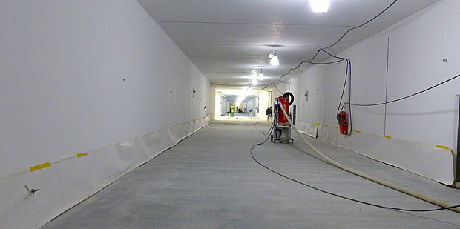
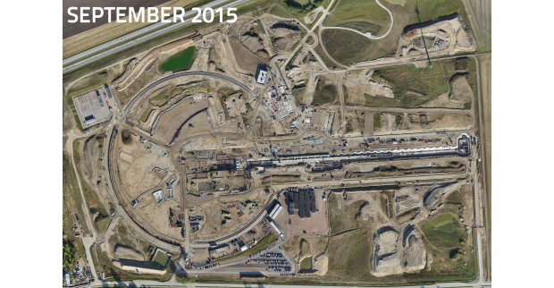
I would like to thanks the help from M. Eshraqi, R. Miyamoto, E. Tanke, S. Molloy, Y. Levinsen and T. Shea for the comments in preparing this presentation.
Soon to be filled!

