Slide 1



Measurements of small impedances
Mostacci
Bench measurements nowadays represent an important tool to estimate the coupling impedance of any particle accelerator device. The well-known technique based on the coaxial wire method allows to excite in the device under test a field similar to the one generated by an ultra-relativistic point charge. We discuss the basics of the coaxial wire method and review the formulae widely used to convert measured scattering parameters to longitudinal and transverse impedance data. Coaxial resonator configurations are suitable for measuring small impedances. We discuss typical measurement examples of interest for the CERN Large Hadron Collider.
Trieste 23-27 Settembre 2013

Slide 2
OUTLINE
(Bench) measurements of small impedances
Machine impedance model
Intuition and experimental verification
Resonant coaxial wire set-up
Coaxial transmission line optimisation
Coaxial wire
method
for small impedance
for any impedance
New machine components are designed according to coupling impedance optimization.
Check for the validity of existing machine upgrading actions.
In novel machines, high performances (e.g. high intensity, big sizes) require that coupling impedance of each device is small.
EM codes estimation needs to be guided …
Small Impedance

Slide 3
MOTIVATION: MACHINE IMPEDANCE MODEL
Identify main impedance contributors
B. Salvant, CERN, Erice 2014
Identify main impedance contributors
If not (most of the time),
need to reconsider…
Assess impedance of individual elements
Measurements of observables with bench
Assess impedance of individual elements
Sum the impedance contributions
Machine optics
(β functions)
Sum the weighted impedance contributions
Longitudinal impedance model
Transverse impedance model
Compute beam observables
Measurements of observables with beam
Compute beam observables
agreement?
agreement?

Slide 4
MOTIVATION: MACHINE IMPEDANCE MODEL
Identify main impedance contributors
B. Salvant, CERN, Erice 2014
Identify main impedance contributors
This talk
Assess impedance of individual elements
Measurements of observables with bench
Assess impedance of individual elements
Sum the impedance contributions
Machine optics
(β functions)
Sum the weighted impedance contributions
Longitudinal impedance model
Transverse impedance model
M. Migliorati
Compute beam observables
Measurements of observables with beam
Compute beam observables

Slide 5
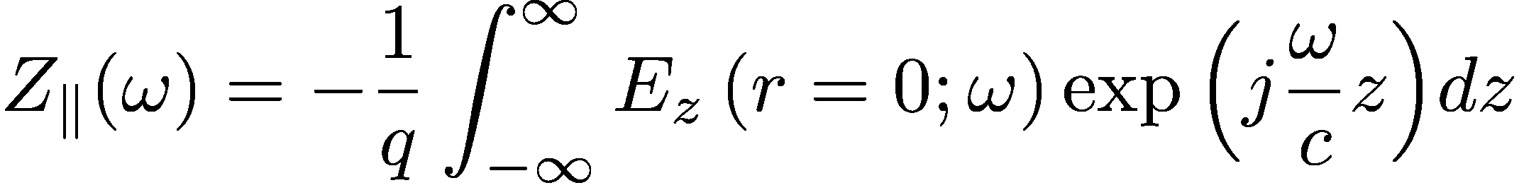
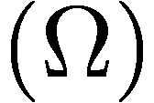
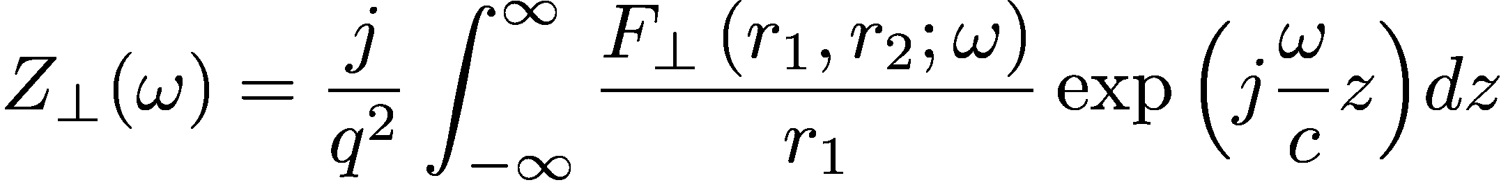
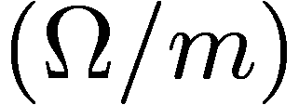
BASIC DEFINITIONS
L. Palumbo, V. Vaccaro, M. Zobov, LNF-94/041
Impedance of most element of modern accelerators is carefully optimized (measurements and simulations).
Coaxial wire technique: resistive beam pipes, collimators, beam pipe cross section variations, magnetic kickers ...
Bench
Measurement
Resonant and non-resonant bead pull methods: accelerating and/or deflecting RF devices.
not small …
Notes:
Impedance data stored in a database to derive the impedance model of the machine and eventually compute instability thresholds.

Slide 6
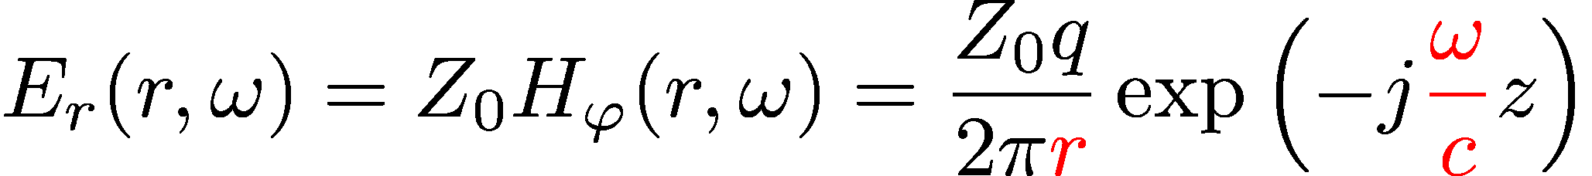
COAXIAL WIRE METHOD: THE INTUITION
Ultra-relativistic
beam field
TEM mode
coax waveguide
Device Under Test
2b
2a
Coaxial wire
r
Single wire centered/displaced
Two wires

Slide 7
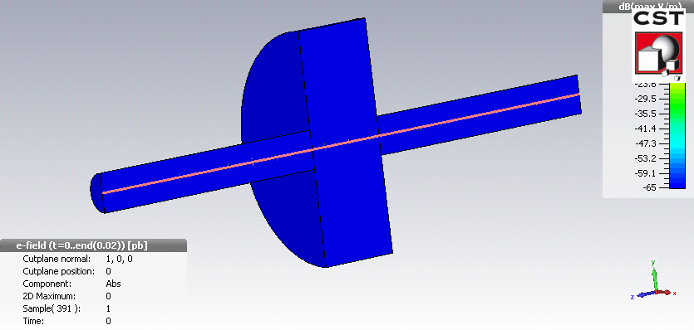
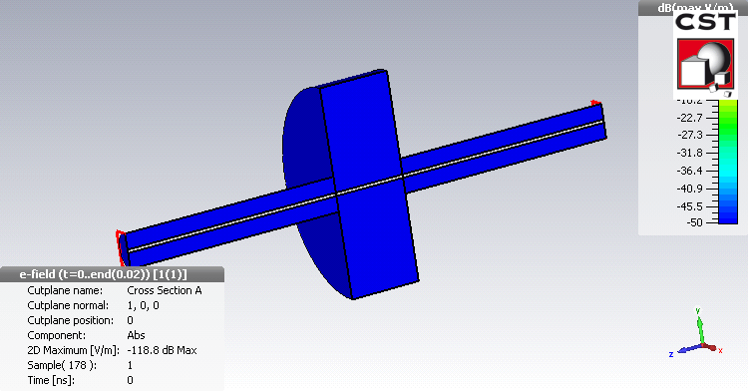
BEAM vs STRETCHED WIRE: SIMULATION
Electron beam travelling on axis
Cavity mode excitation
Electric pulse traveling on the wire
Cavity mode excitation and power reflection
Courtesy of M. Migliorati

Slide 8
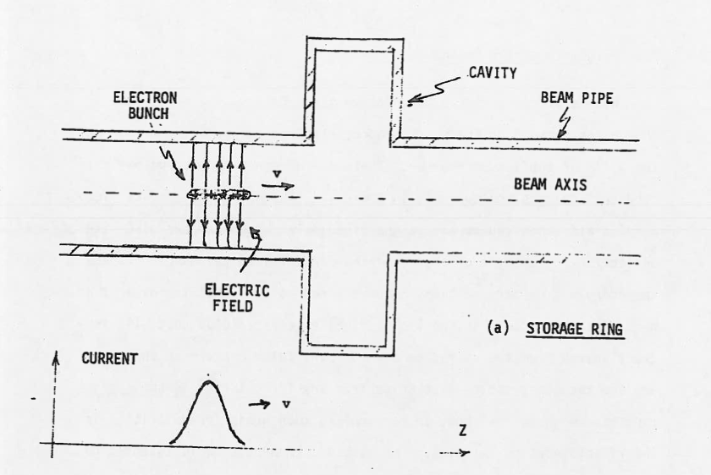
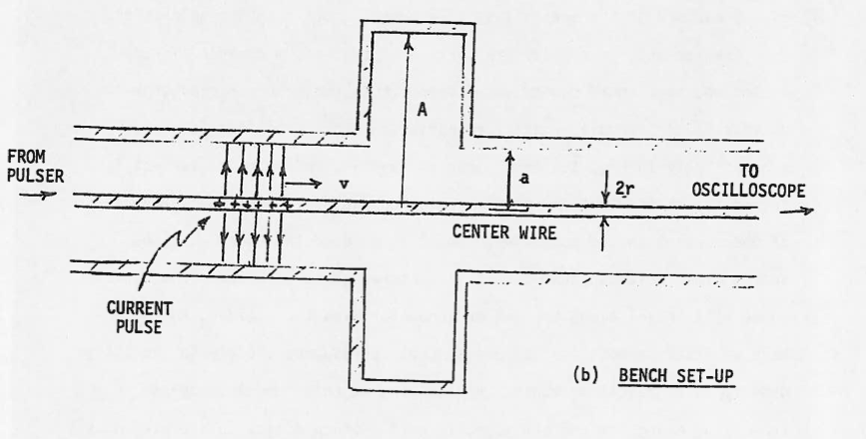
THE INTUITION: TIME DOMAIN VIEW
M. Sands, J. Rees, SLAC Report PEP-95, 1974
Beam energy is lost to “fill the obstacle”
Coupling impedance accounts for such an energy loss, explained with an E field on axis.
Pulse energy is lost to “fill the obstacle” (time domain view, transient view).
Due to some discontinuity, the beam is loosing momentum.
Due to some discontinuity, the pulse on the coaxial line is loosing amplitude.
The field “slice” of a short electric pulse on a TEM line or a short bunch leads to essentially the same image current distribution on the inner surface of the beam pipe or inner surface of the outer conductor of the coaxial line.

Slide 9
THE INTUITION: FREQUENCY DOMAIN VIEW
M. Sands, J. Rees, SLAC Report PEP-95, 1974
Beam energy is lost to “fill the obstacle”
Impedance accounts for such an energy loss, explained with an E field on axis.
Frequency domain view (permanent regime)
The loss of amplitude of the electric signal is compensated by the source.
Electric pulse on the wire is reflected due to the discontinuity.
Due to some discontinuity, the beam is loosing momentum.
The presence of the obstacle induces a reduction of the transmitted signal as well as a reflected signal. Impedance can be measured with transmission or reflection measurement.

Slide 10
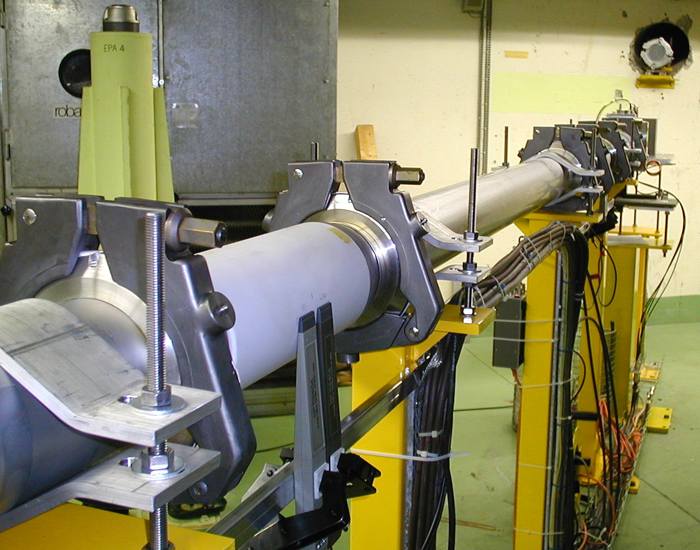
BEAM vs STRETCHED WIRE: EXPERIMENT
Goal of the experiment: to investigate the transmission properties of a coated ceramic chamber with the CERN EPA electron beam.
Titanium coating (1.5 μm)
EPA beam line
Thickness << skin depth
Beam Dump
Ref. Chamber
DC resistance 1 Ohm
Reference chamber
(non coated)
500 MeV electron bunch
(7e10 particles, σ~ 1 ns)
Coated
Chamber
Magnetic field probe
EPA 1999: shielding properties
EPA 2000: effect of external shields
L. Vos, F. Caspers, et al., AB-Note-2003-002 MD
Notes:
The shielding properties of thin metallic layers of finite length areimportant for LHC (fast kickers, silicon detectors).
Beam electric field can penetrate through infinitely long metallic layers of thickness much smaller than the skin depth.
Bench measurements (coaxial wire) on a kicker prototype suggested that finite thin layer have different shielding properties from infinitely long ones. Numerical (HFSS) studies predicted the shielding properties of a finite length thin layer (PAC 99).
Beam measurements assess the shielding properties but show that they can be spoiled by the addition of a second layer.
Coaxial wire bench measurements on the chambers used in the beam line confirmed later the experiment conclusions.

Slide 11

EPA experiment: BENCH set-up
The same ceramic chambers used in the beam experiment have been measured within a coaxial wire set-up, using the same magnetic field probes.
Just like in the early days of coaxial wire techniques (Sand and Rees,1974)
VNA in time domain mode (Fourier Transform)
wire diameter: 0.8 mm
Matching resistors: 240 Ohm
Synthetic pulse (300 MHz BW)
50 Ohm
DUT + wire
ns
HF magnetic
Field probe
VNA
A. Mostacci, F. Caspers, et al., CARE workshop, 2004

Slide 12
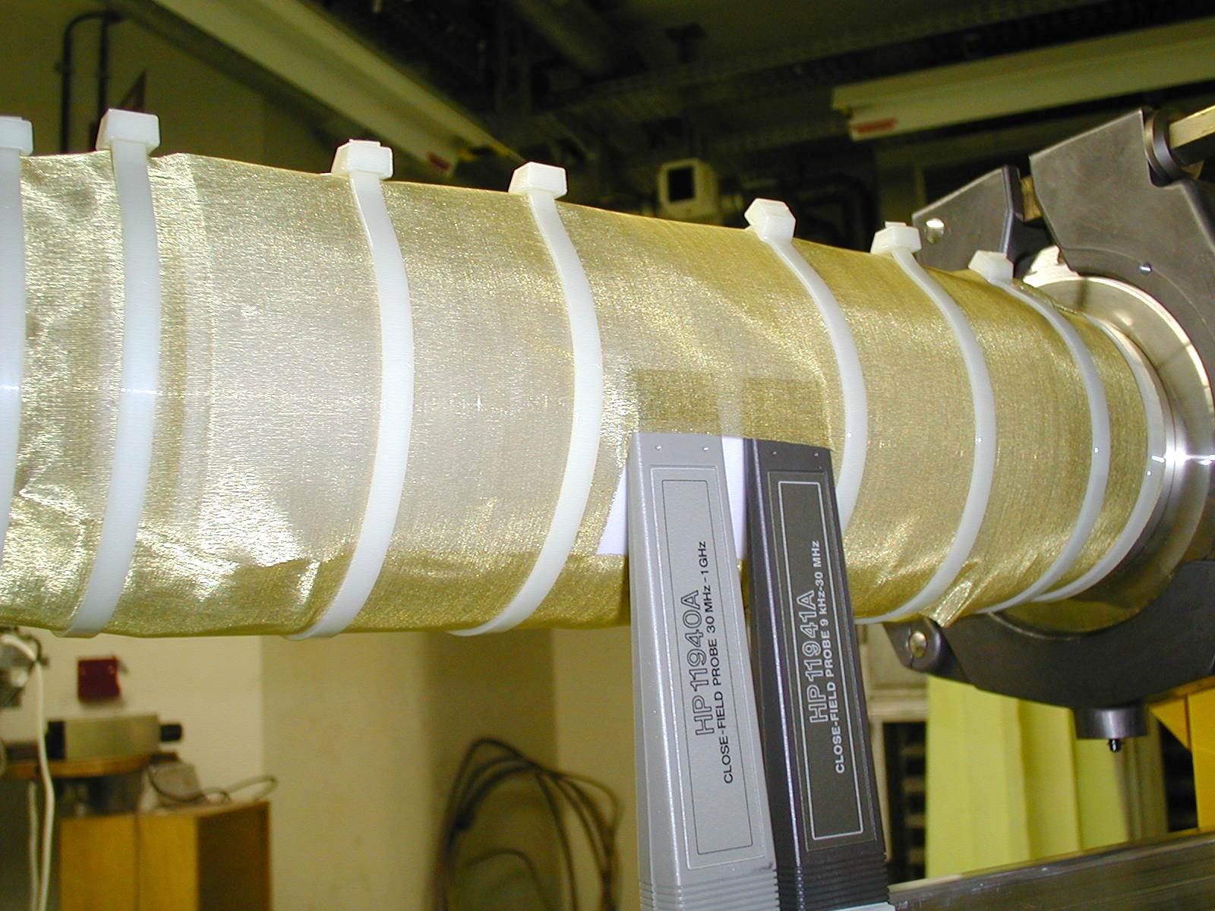
Bench vs beam measurement in EPA
Beam/wire axis
Vacuum chamber
Shallow cavity
External shield
Titanium coating
The external shield is electrically connected to the vacuum chamber.
Ceramic chamber
Field probe

Slide 13
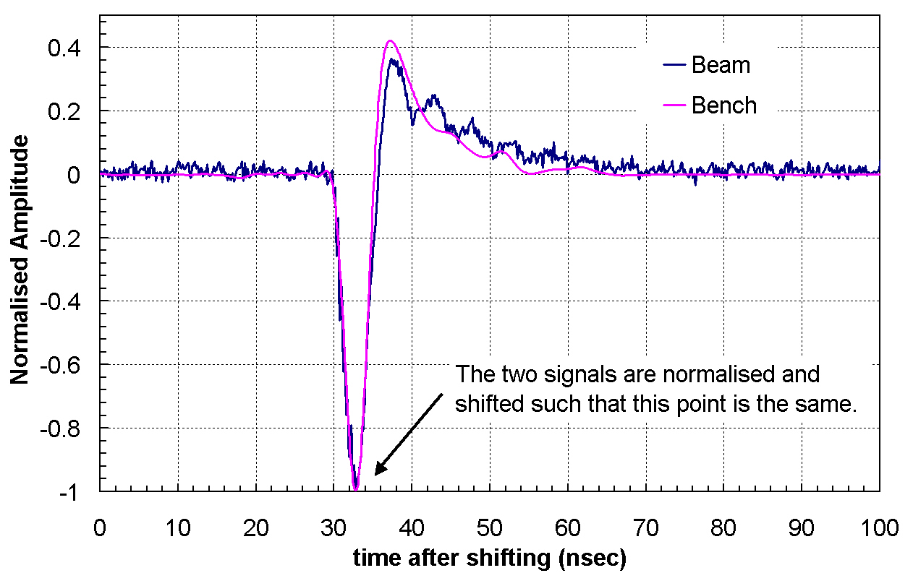
Bench vs beam measurement in EPA
The external shield carries image currents and field penetrates the thin resistive (titanium) layer if this external bypass is present.
Beam/wire axis
Vacuum chamber
Shallow cavity
External shield
Titanium coating
Ceramic chamber
Field probe

Slide 14
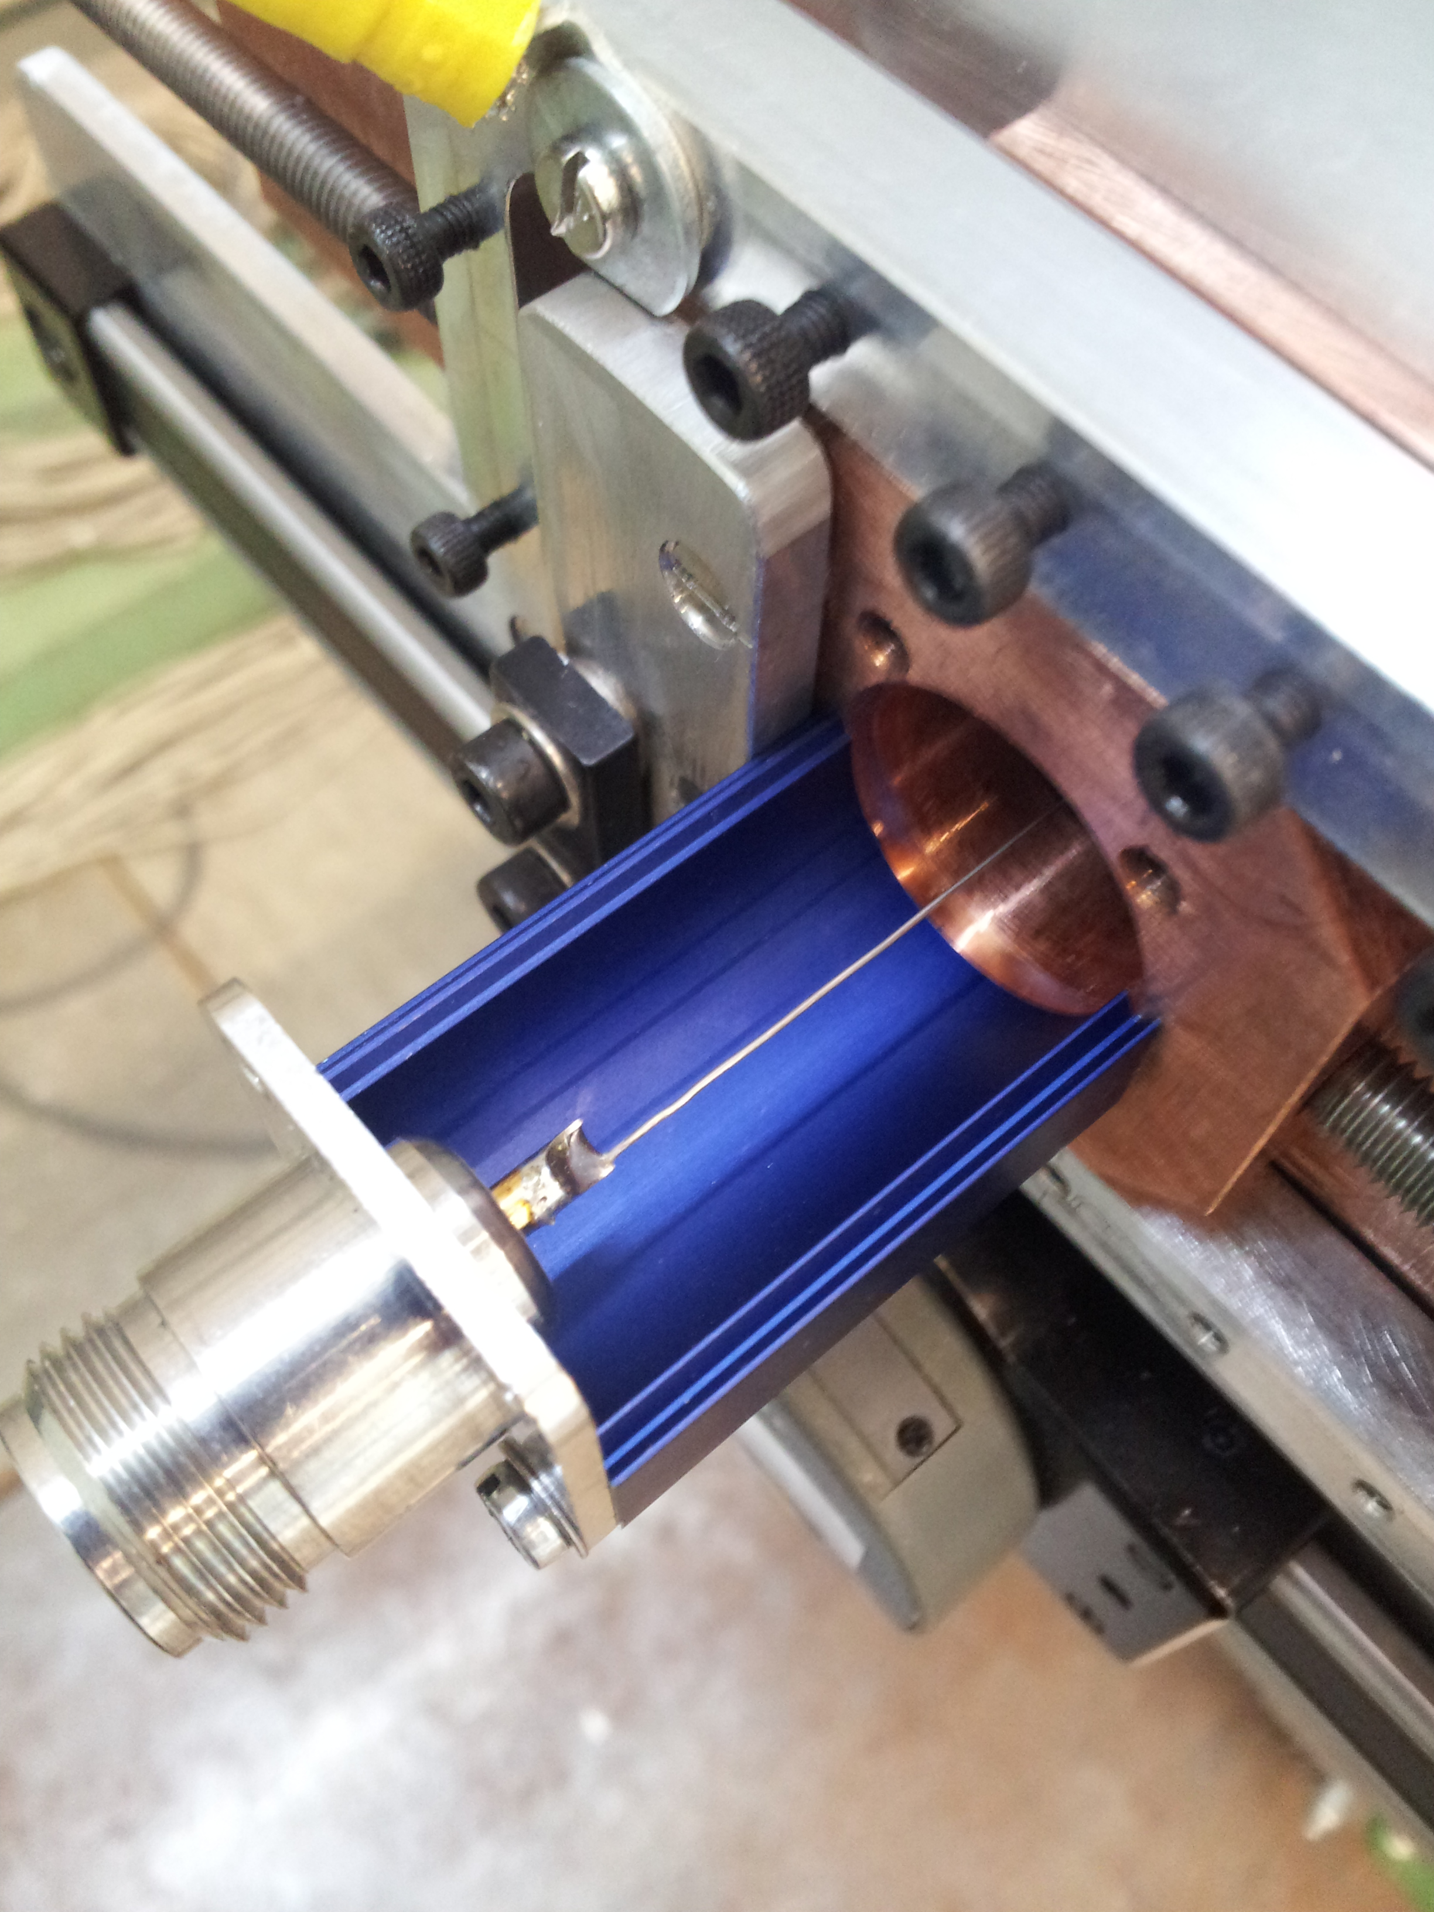
LONGITUDINAL IMPEDANCE WITH VNA
Device Under Test
Matching
Network
Matching
Network
Vector Network Analyser
Single wire WITHOUT matching network
Transmission line properties (Time Domain Reflectometry)
Insight on the measurement set-up
Matching network computation
Single wire WITH matching network (resistors + attenuators)
Modes identification
Wire displacement effect
Transverse impedance evaluation (from longitudinal impedance)

Slide 15
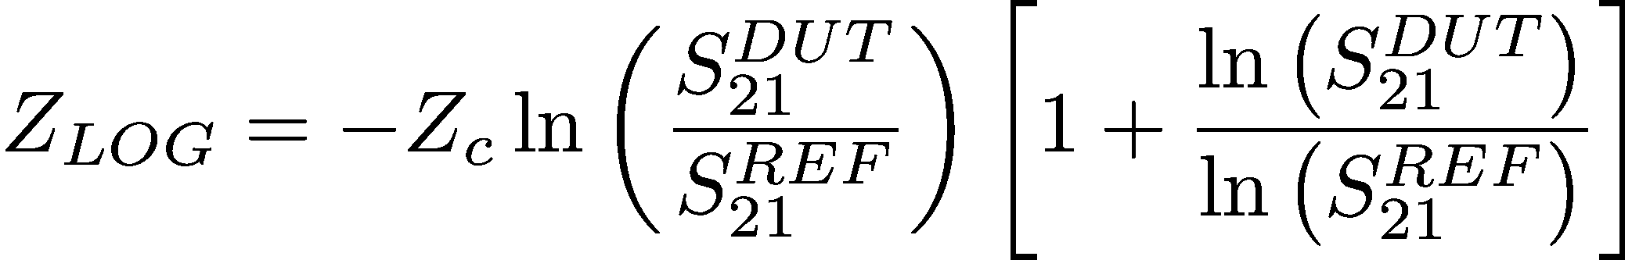
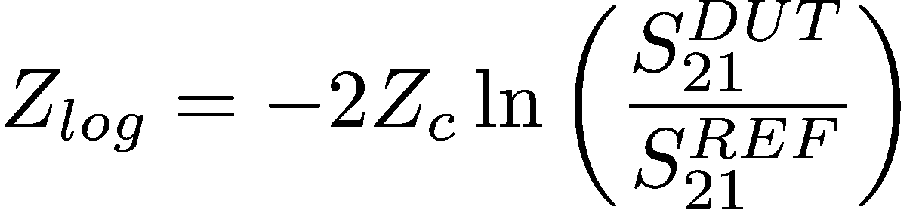
RELATIONS BETWEEN FORMULAS
Distributed impedance
Lumped element:
DUT length << λ, pipe diameter
Improved log formula (Vaccaro, 1994)
Hahn-Pedersen formula (1978)
High frequency/long DUT
Exact in the frame of lumped element hypothesis
Implemented in modern VNA
Log formula (Walling et al, 1989)
Sands-Rees formula (1974)
Very versatile formula, also for lumped elements with reduced accuracy.
The wire method is strictly valid for frequencies below cut-off.
Notes:
The improved log formula may diverge for a frequency independent lumped impedance as f->0...

Slide 16
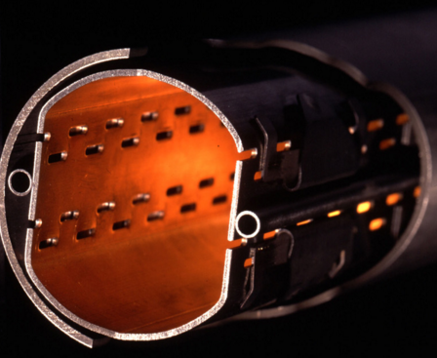
LHC BEAM PIPE
Pumping
holes
Weldings

Slide 17
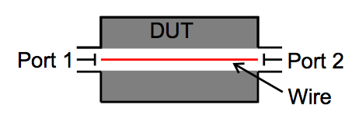
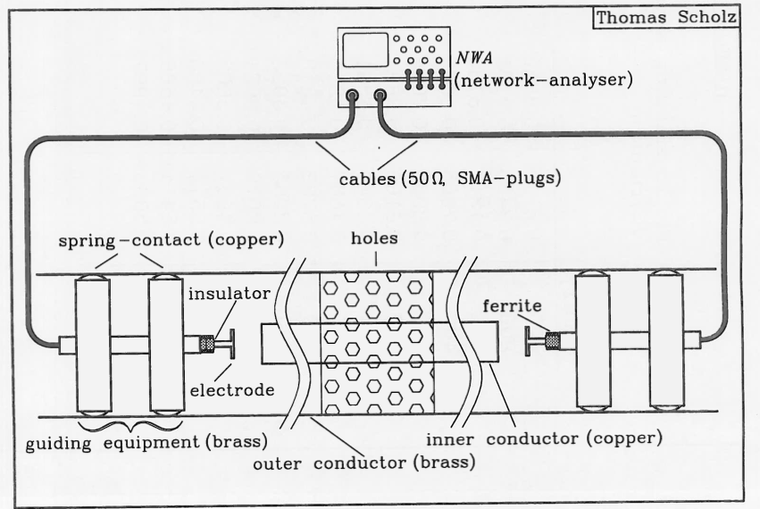
RESONANT METHODS FOR SMALL IMPEDANCES
A reliable technique is to apply an inner conductor, which is capacitively (weakly) coupled and operates as a transmission resonator
The change in resonance frequency of this TEM line resonator (as compared to a reference measurement) indicates the imaginary part of the (wall) impedance (using the identical inner conductor), and a change in Q stands for the real part.
The capacitive coupling is immune to connector repeatability, instrument
drift or calibration uncertainties.
Weak coupling on each side is estimated via reflection measurement.
The coupling elements and other discontinuities in the set-up cause detuning too, thus increasing the uncertainty of the results of the imaginary part of the impedance.
F. Caspers, T. Scholz, Particle Accelerators, 1995

Slide 18
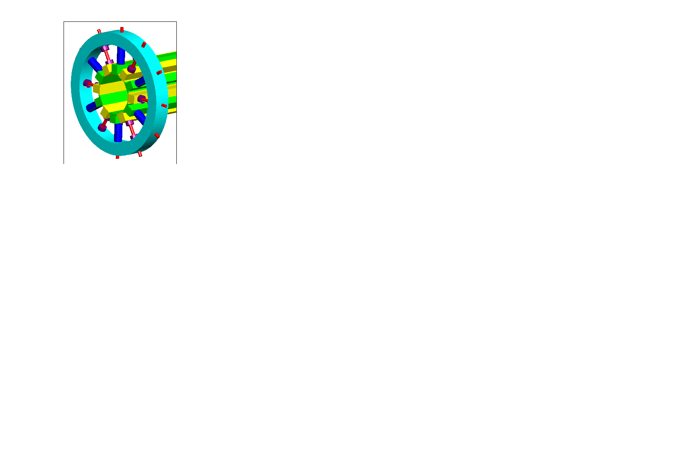
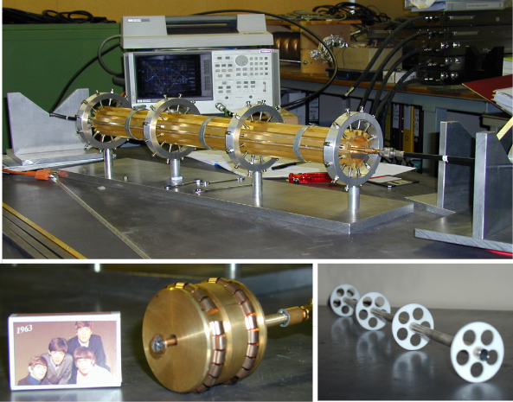
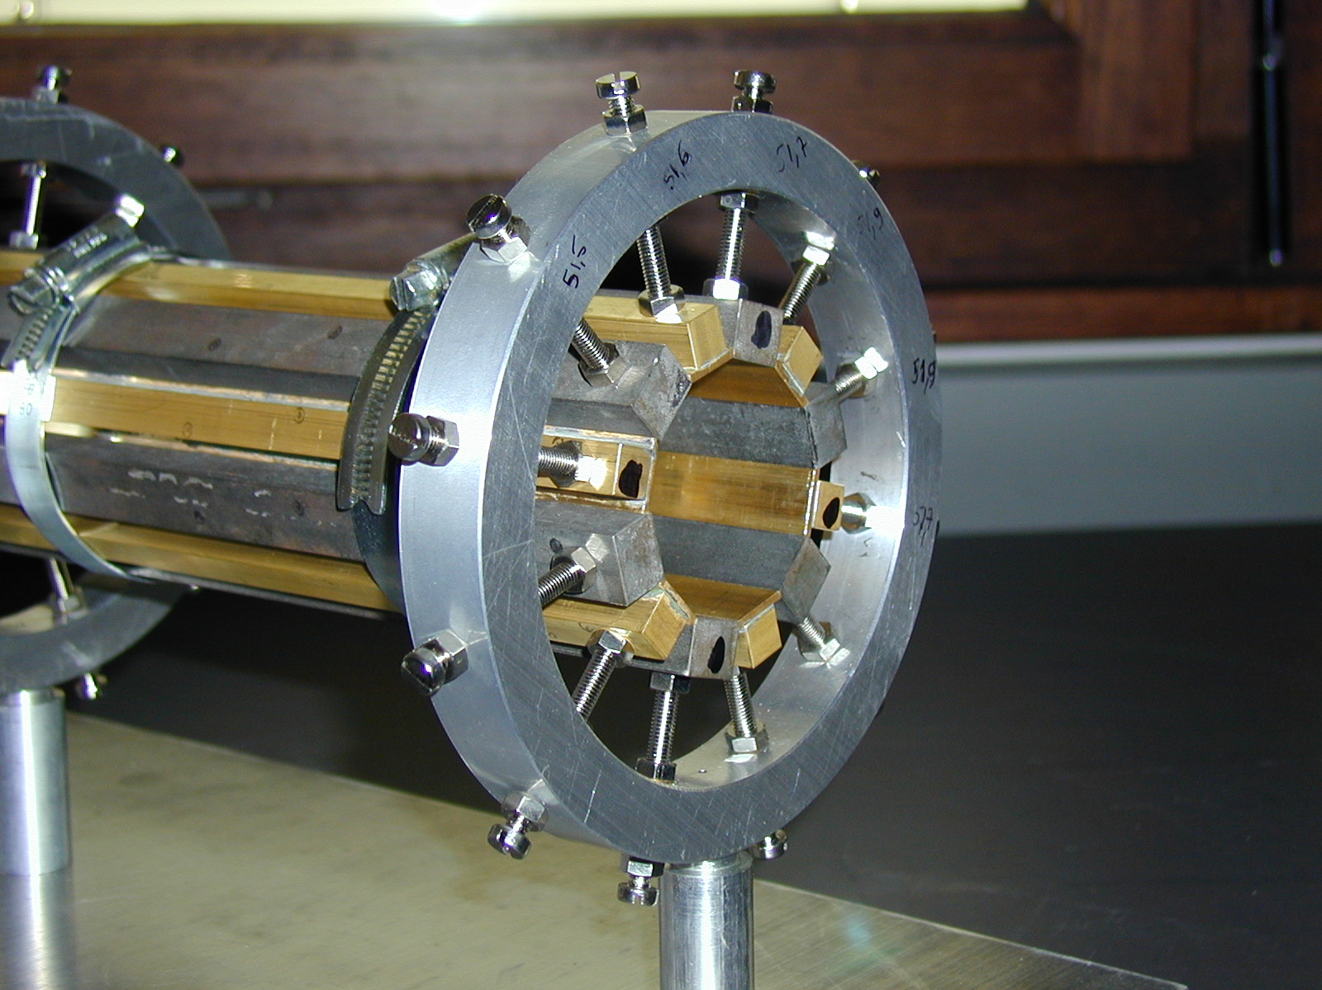
LHC BEAM PIPE: EFFECT OF THE WELDINGS
Study of the impedance of azimuthally varying conductivity.
Q factor measurement for different bar configurations in a coaxial resonator.
A. Mostacci, F. Caspers, 2002

Slide 19
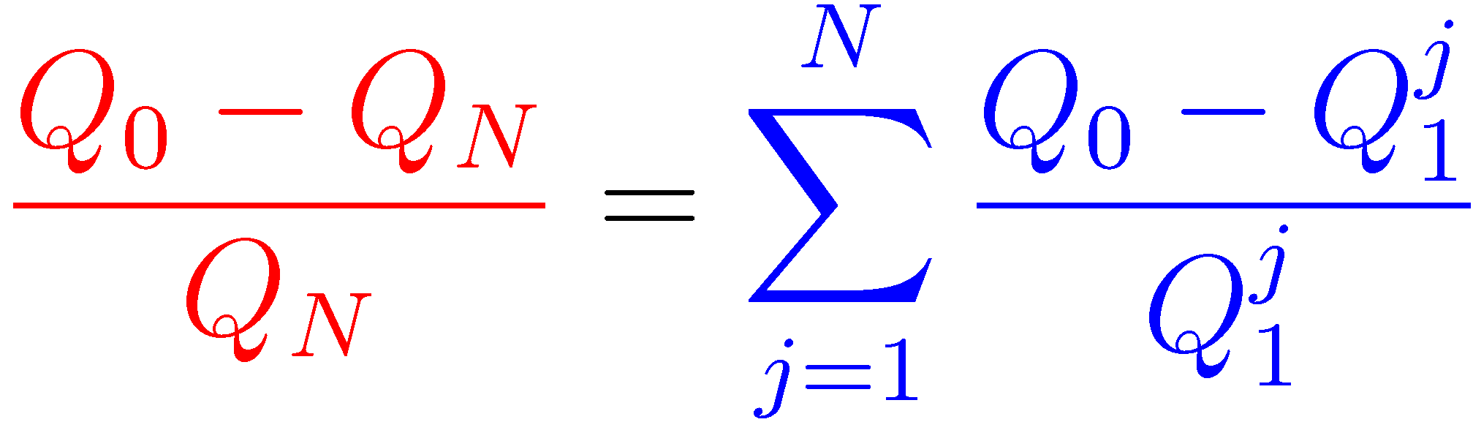


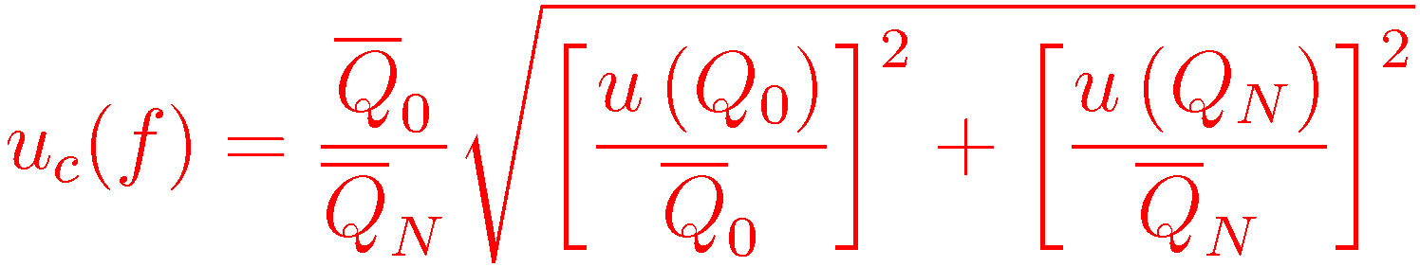
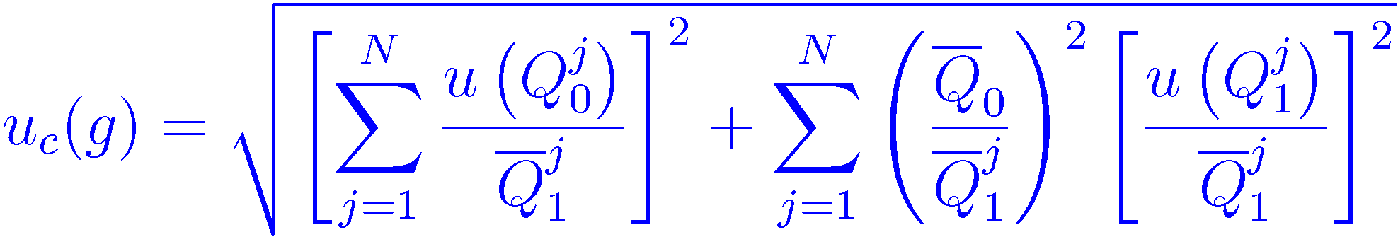
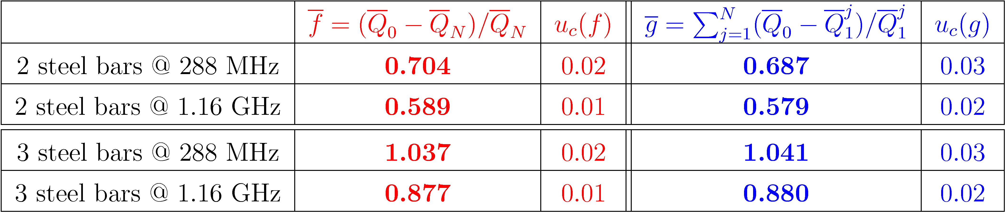
BENCH MEASUREMENT RESULTS
Image current constant over the azimuth at all the relevant frequencies.
N steel bars
Theory
steel bar j
1) Tune the capacitive coupling to get symmetric coupling (monitoring S11 and S22).
2) Measure the unloaded Q for each case (need only S21 meas. for symmetric coupling).
The results are samples at the mode resonant frequencies.
A. Mostacci, PRST-AB, 084402, 2005

Slide 20
COAXIAL resonator methods FOR KICKERS
H. Day, A Mostacci, June 2013
Frequency resolution is limited due to the length of the DUT.
High-Q, narrowband resonances may be lost.
Automatic meas. needed
For symmetric coupling:
The Q of a lossy line resonator is independent from the length of the resonator.
The losses (i.e. the Q) include both that from the beam coupling impedance as well as that due to the finite resistance of the wire. Wire contribution must be removed.
T. Kroyer, F. Caspers, et al., CERN AB-Note 2007-028

Slide 21
COAXIAL resonator methods FOR KICKERS
H. Day, A Mostacci, June 2013
Frequency resolution is limited due to the length of the DUT.
High-Q, narrowband resonances may be lost.
Automatic meas. needed
T. Kroyer, F. Caspers, et al., CERN AB-Note 2007-028

Slide 22
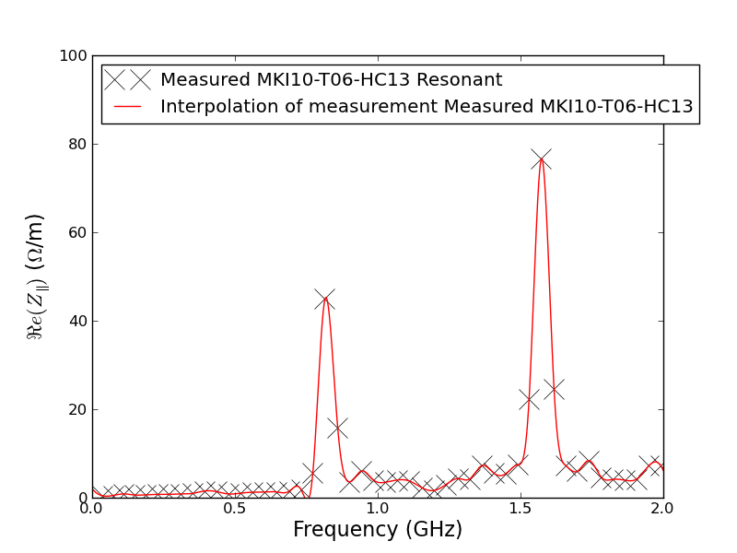
LHC INJECTION KICKERS
Extremely low impedance can be measured !!
H. Day , CERN 2013

Slide 23
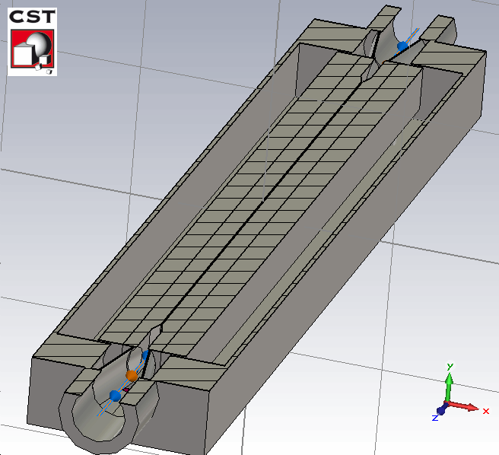
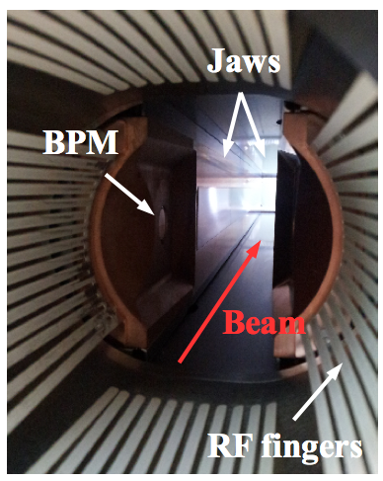
LHC TCTP collimator
N. Biancacci et al., TCTP collimator meas., 2014

Slide 24
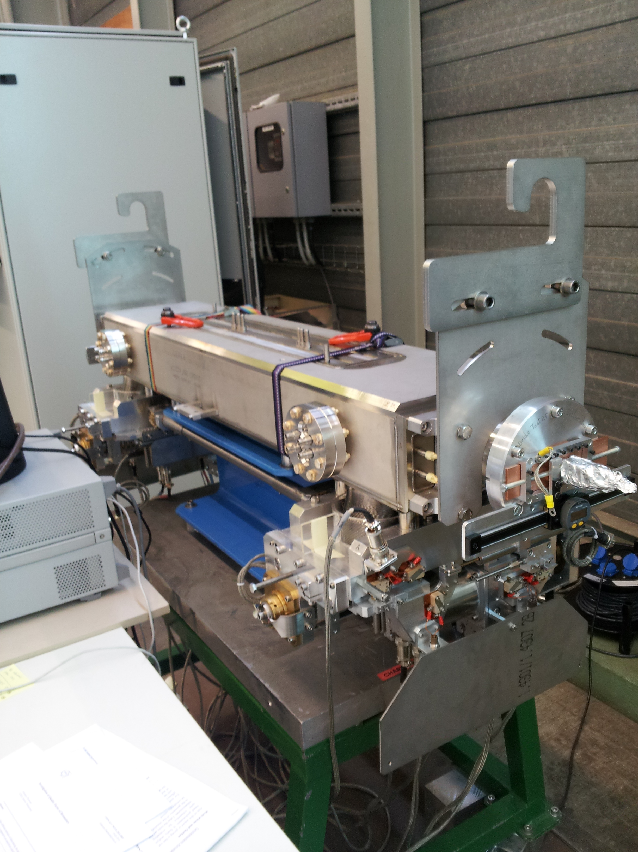
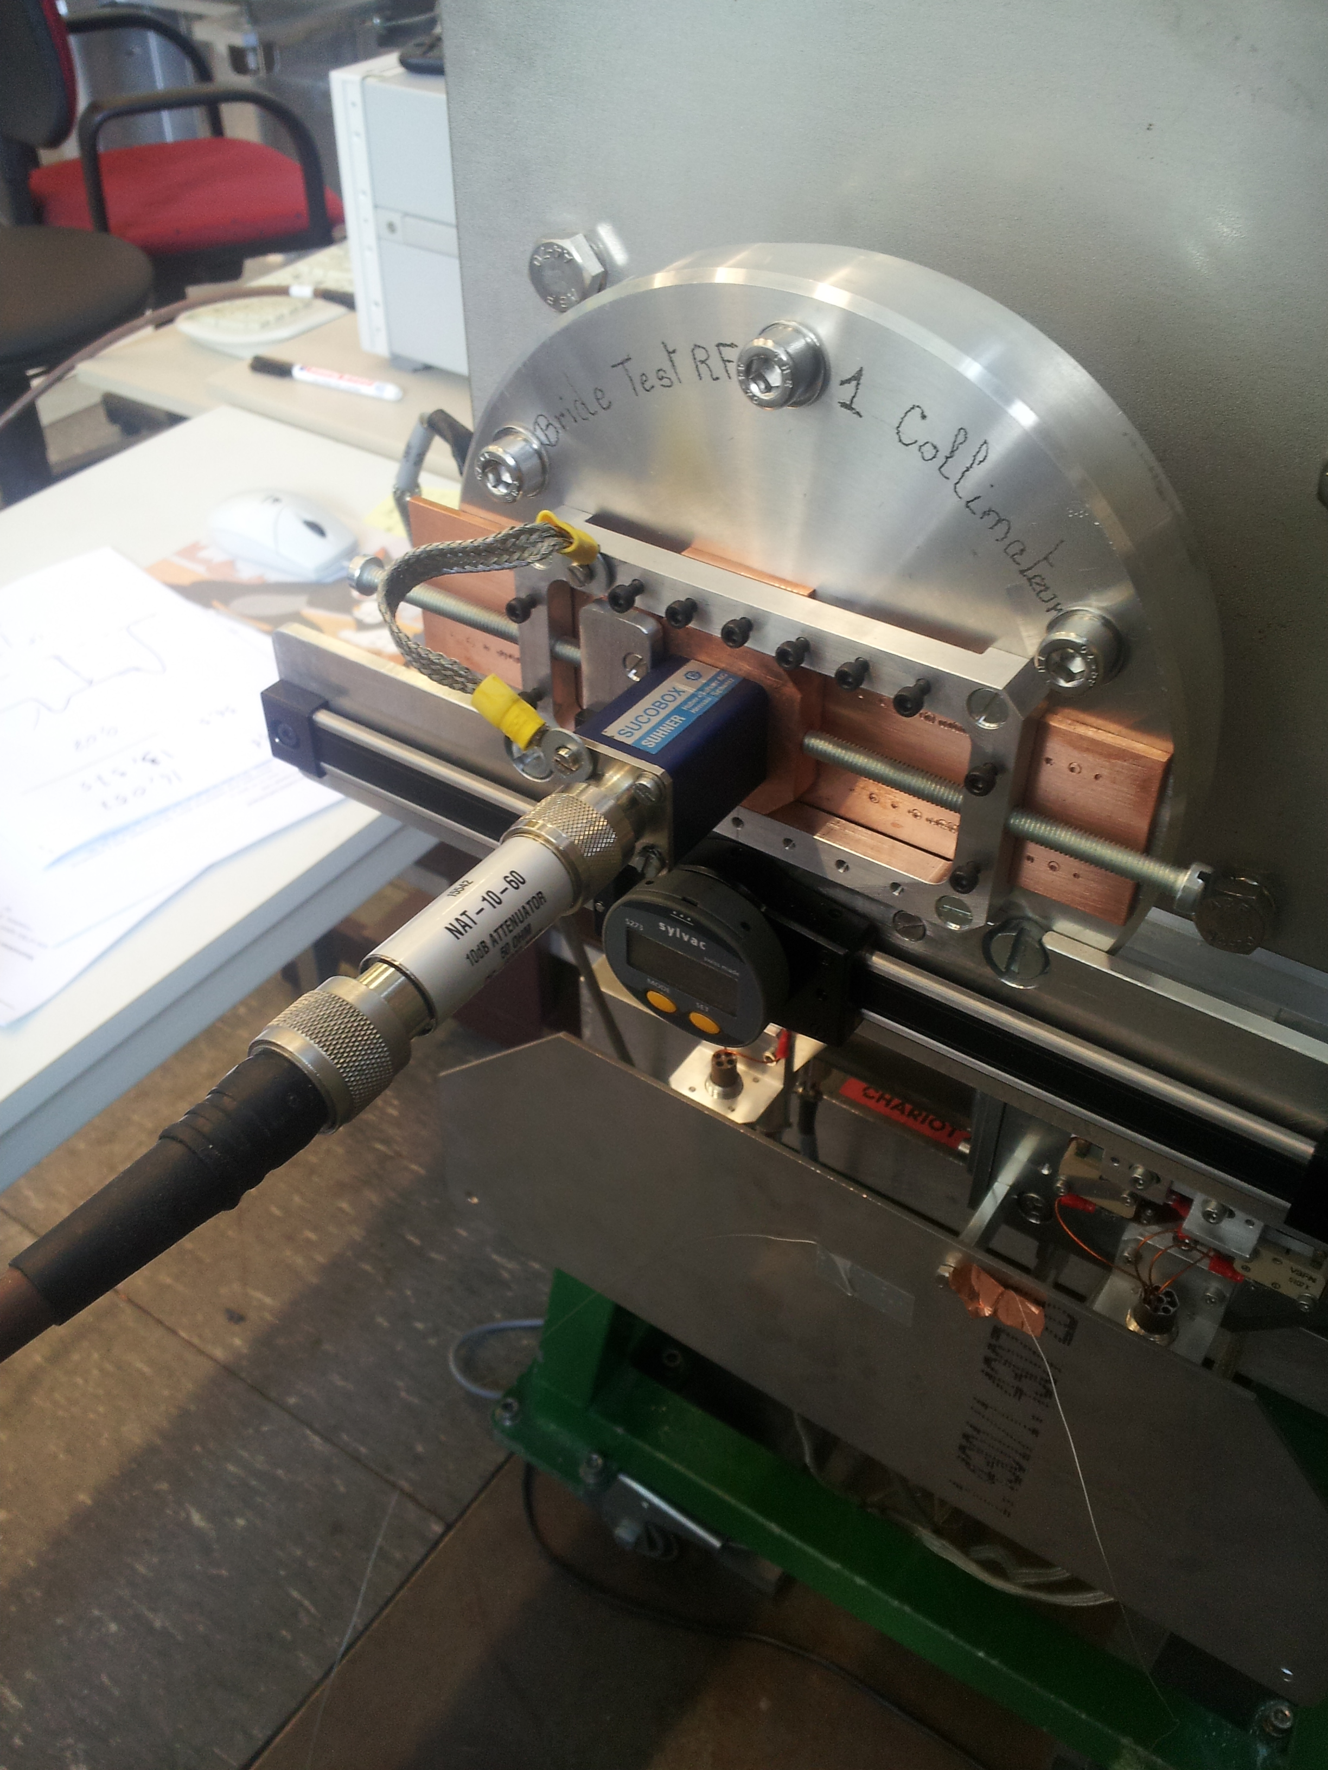
LHC TCTP collimator wire Measurement
LHC collimator
Wire (0.5mm)
N. Biancacci et al., TCTP collimator meas., 2014

Slide 25
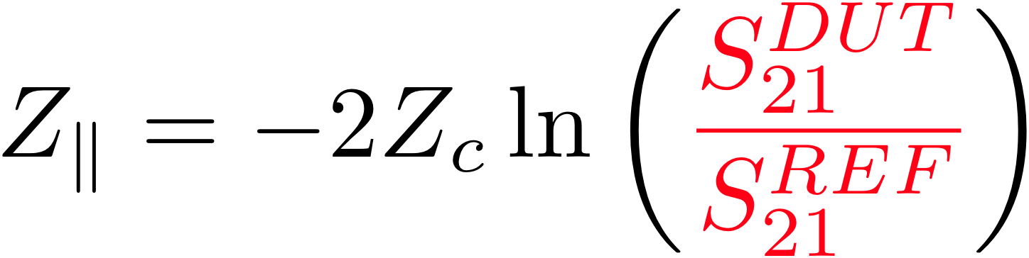
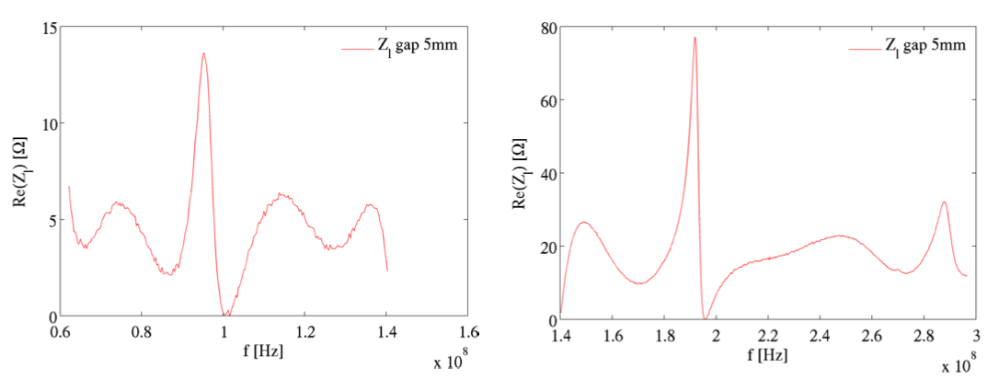
LONG. IMPEDANCE MEASUREMENT RESULT
April 2014 measurement
Port 1
No ferrite to dump transverse mode
Port 2
Wire (0.5mm)

Slide 26
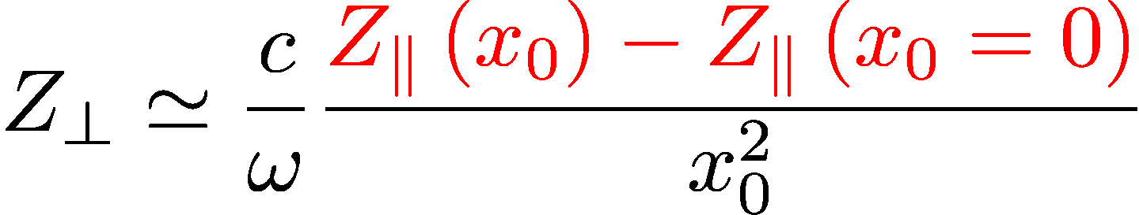
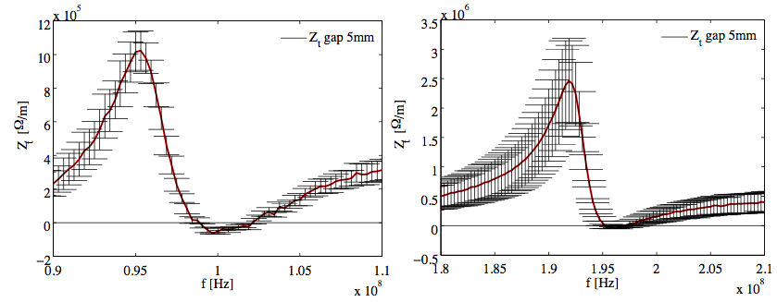
TRANS. IMPEDANCE MEASUREMENT RESULT
April 2014 measurement
Port 1
No ferrite to dump transverse mode
Port 2
Wire (0.5mm)
Parabolic fit (with uncertainty) of Z|| vs wire displacement

Slide 27
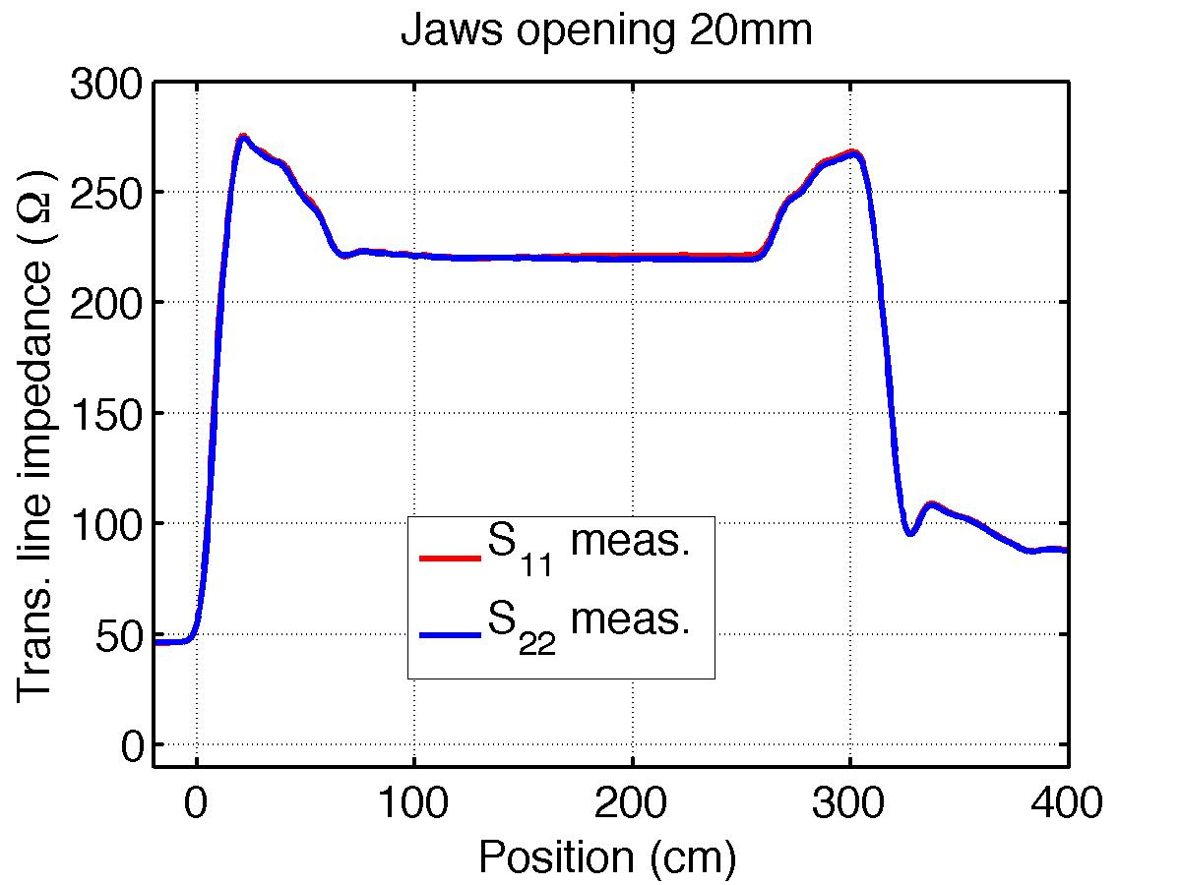
Coaxial transmission line
Characterisation of the z-dependency of the characteristic impedance of the wire.
Movable jaws
BPM + RF fingers
REFLECTION measurement
FFT of S parameters
N. Biancacci et al., TCTP collimator meas., 2014

Slide 28
Measure of jaws alignment
REFLECTION measurement
FFT of S parameters
N. Biancacci et al., TCTP collimator meas., 2014

Slide 29
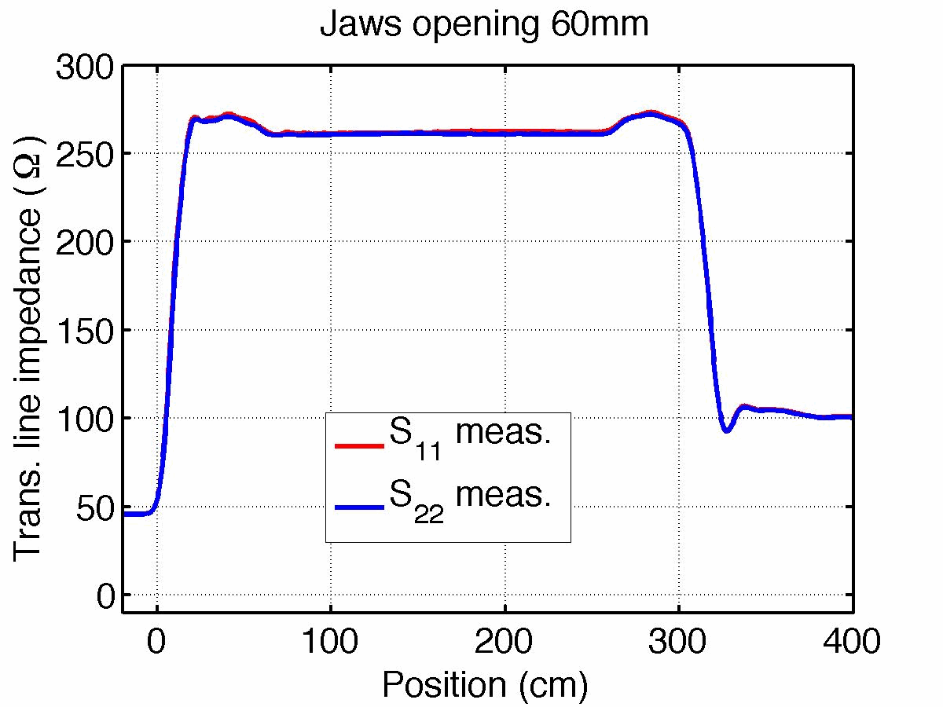
Coaxial transmission line properties
Matching in impedance measurement is critical.
N. Biancacci et al., TCTP collimator meas., 2014

Slide 30
CONCLUSION
Measurements of small impedances
Basis of the method
Coaxial wire method

Slide 31
CONCLUSION
Measurements of small impedances
Basis of the method
Resonator set-up for small impedances
Coaxial wire method

Slide 32
CONCLUSION
Measurements of small impedances
Basis of the method
Resonator set-up for small impedances
Coaxial wire method
Coaxial wire set-up optimization with TDR
Thank you for your attention

