Slide 1

Monitoring Fast Instabilities
T. Levens
Beam Instrumentation Group, CERN
Contributions and material:
L. Carver, R. Jones, G. Kotzian, T. Lefevre, E. Metral, M. Ojeda, D. Valuch, T. Wlostowski (CERN)
R. Steinhagen (GSI)
A. Arteche, S. Gibson (Royal Holloway)
J. Ellis, T. Lucas (ACAS)

Slide 2
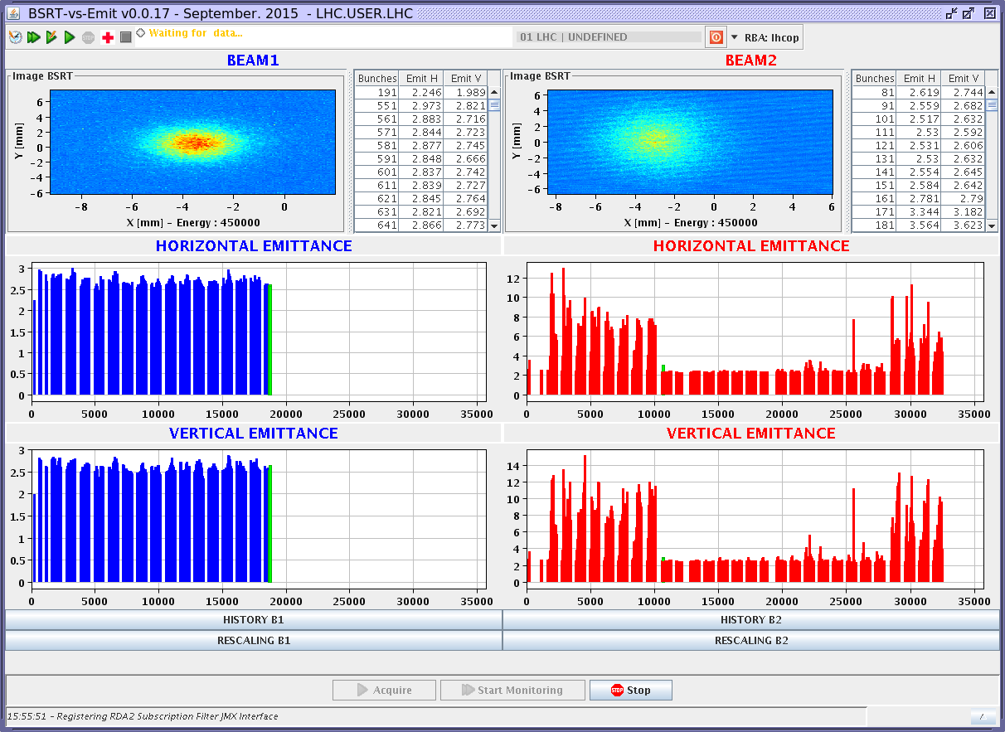
Introduction
A beam becomes unstable when a moment of its distribution exhibits exponential growth. From an operators point of view, usually first seen as emittance growth and losses on certain bunches:
Instabilities can happen at various, and not always predictable, times during regular operation of accelerators and often define the maximum intensity that can be stored/accelerated.
The question… what instrumentation is available to detect instabilities as they occur?
Nominal emittances on Beam 1
Beam 2 blown up in horizontal and vertical planes at start and end of batch
Emittances in centre of batch nominal

Slide 3
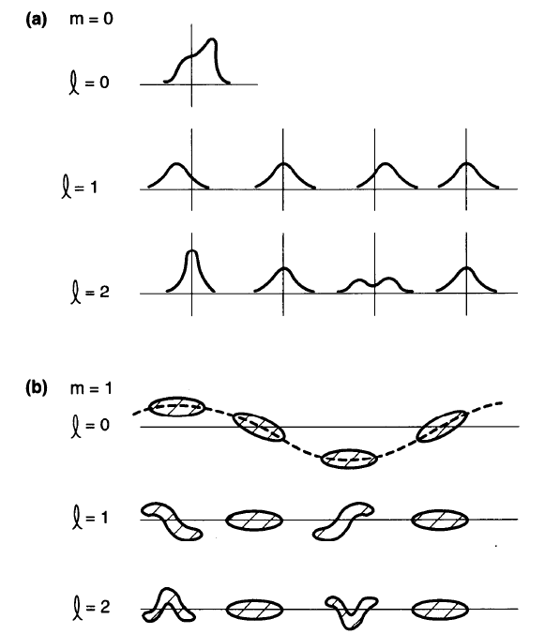
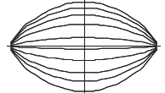
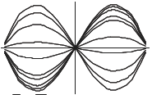
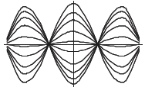
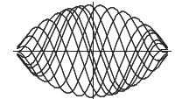
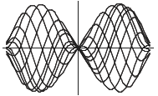
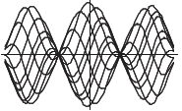
Transverse mode numbers
The Head-Tail (radial) mode numbers correspond to parts of the bunch oscillating with different phases relative to each other.
For mode ±N, there are N stationary points. Seen by a transverse BPM:
Mode 0: rigid bunch motion
Mode ±1: head and tail out of phase
Mode ±2: head and tail in phase, center in opposition
Q’ = 0
Mode 0
Mode ±1
Mode ±2
Q’ ≠ 0

Slide 4
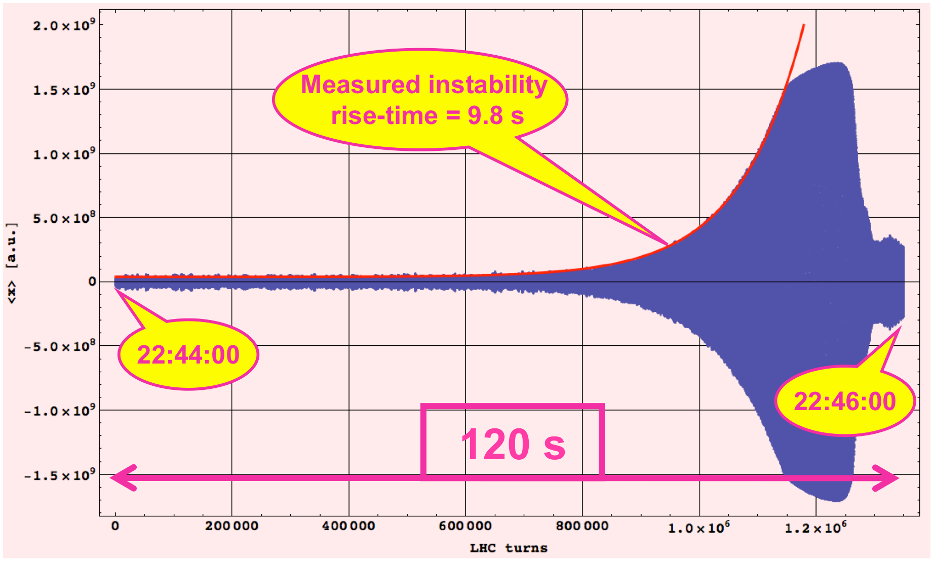
Instability rise time
Looking at the beginning of an instability (where there is exponential growth) the rise time is defined as the time taken for the amplitude of the envelope to increase by: e¹ ≈ 2.7.
Can also be measured directly on a FFT plot from a rise of 8.7dB.

Slide 5
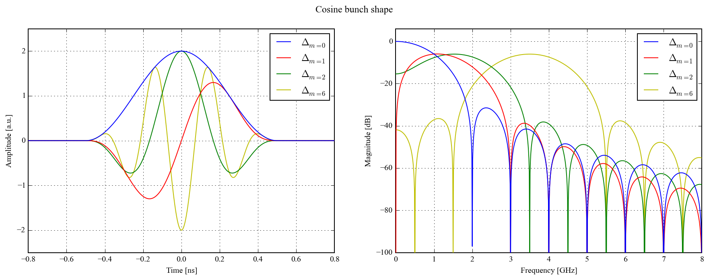
A note on beam spectrum
The envelope of the beam spectrum depends strongly on bunch shape and length. For a typical LHC bunch (4σ ≈ 1ns) the spectrum extends to several gigahertz.
Further, when considering intra-bunch motion, the spectral content is shifted to higher frequencies as the mode increases.
This talk concentrates on instrumentation for the LHC. Note that machines with different bunch lengths and parameters will require instrumentation with very different specifications.

Slide 6
Available instrumentation
…and the problems with it…

Slide 7
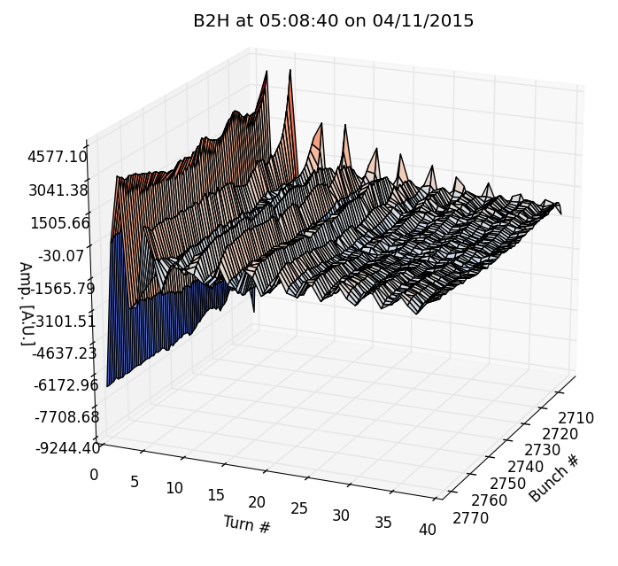
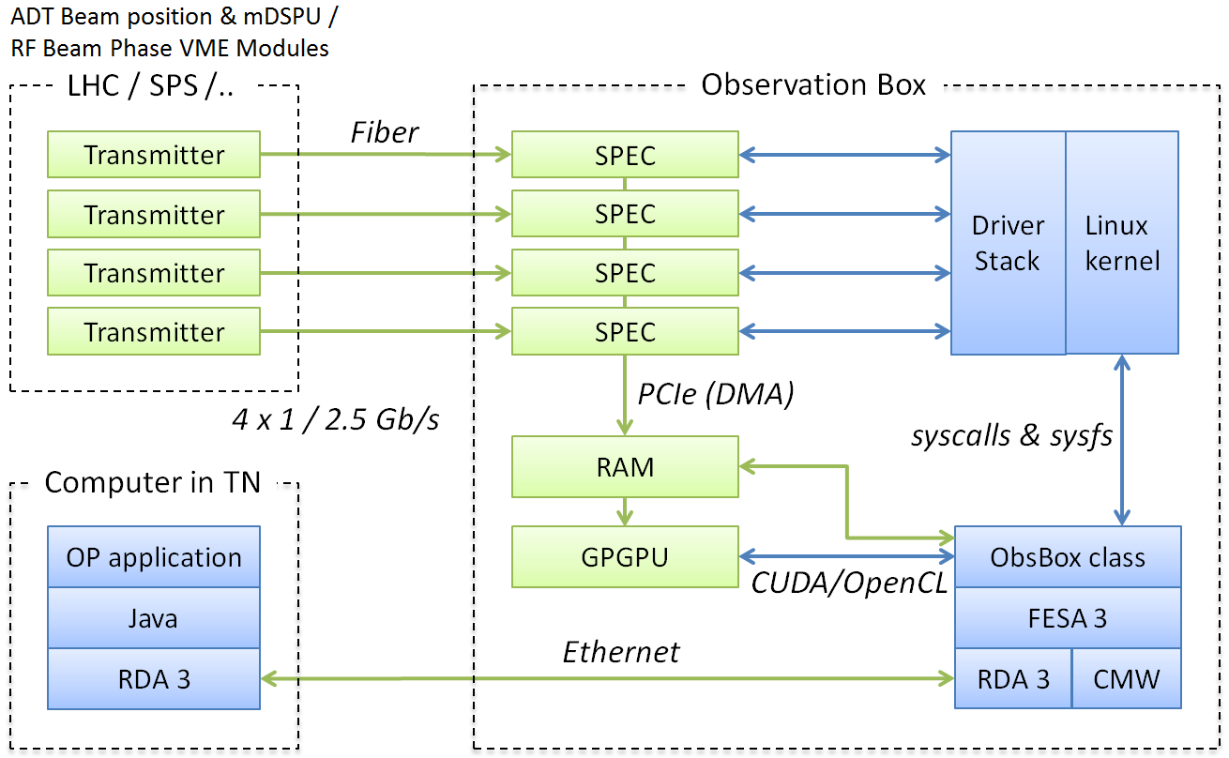
Bunch-by-bunch BPM system
Bunch-by-bunch BPM measurements can be used for measuring rigid bunch motion. LHC Transverse Damper (ADT) pickups previously limited to 73 turns for all bunches and readout speed limited by VME bus.
Upgraded with an “Observation Box” to store bunch-by-bunch data (40MSPS) from all ADT pickups. Data streamed into server memory with a PCIe card. Each server supports 4x 40MSPS links and can capture 4.2 million turns (~30GB) for all bunches limited only by server memory.
Future plans for bunch-by-bunch
tune calculation using GPUs.
Observation Box architecture

Slide 8
Head-Tail monitor
A wideband 180º hybrid calculates the sum and difference of a pair of stripline BPM electrodes.
Signals are directly digitised with a fast (>10GSPS) oscilloscope.
Originally planned
for chromaticity
measurement
(H-T phase shift),
but excitation
amplitude too
large for regular
operation.
Now primarily used
for measuring
intra-bunch
instabilities.
FAST DIGITIZER
(>10GSPS)
SHORT 7/8” COAXIAL CABLES
WIDEBAND 180º HYBRID (MACOM H-9)
LONG STRIPLINE BPM

Slide 9
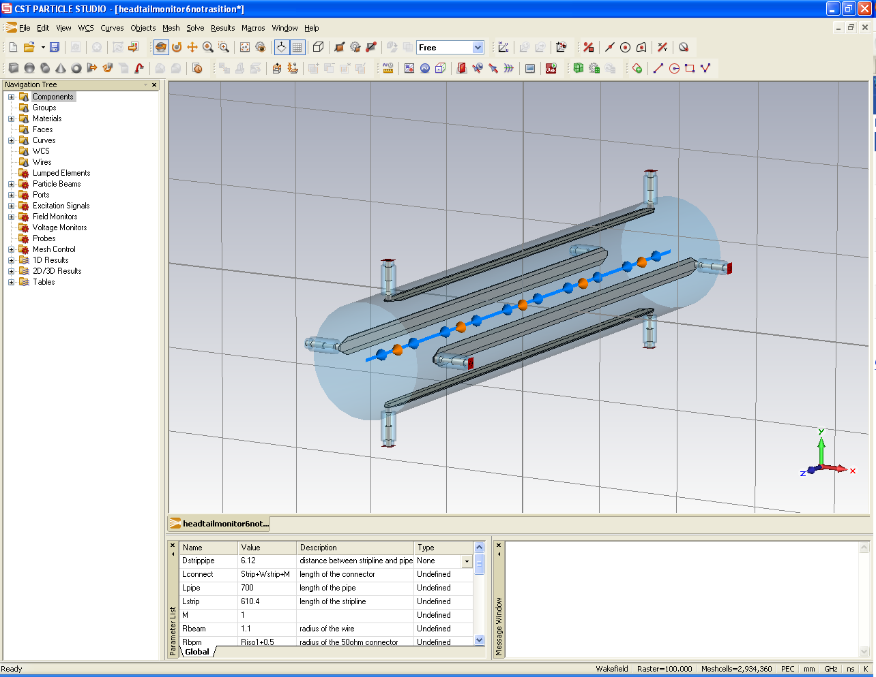
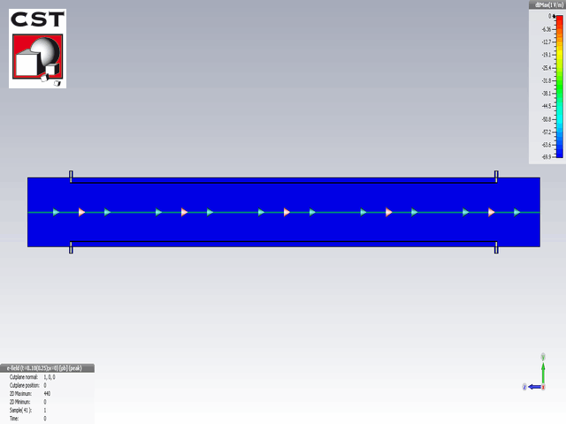

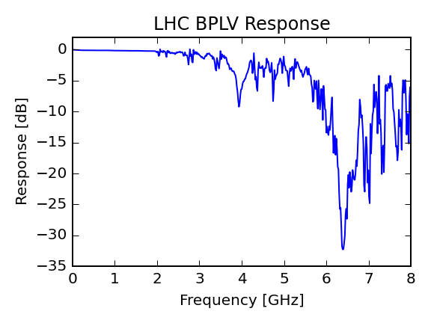
Stripline BPM
G. Kotzian [1]
L
BEAM
LHC BPLX
L=40cm, τ=2.6ns
SPS BPCL
L=60cm, τ=4.0ns
short or load
^
|Z_{T}|
Z_{T}
…
BUNCH
PROFILE
NOTCHES IN
FREQ. RESPONSE
τ=2L/c
f=1/(2τ)
ω
Notches can be removed gating on the initial pulse in the time domain and discarding second pulse. Frequency response is then limited by the BPM structure, feed-throughs, etc.
NB: This requires long BPM and adequate bunch spacing to avoid mixing of the two pulses from the same or subsequent bunches.
[1] G. Kotzian, LIU-SPS High Bandwidth Damper Review, July 30, 2013

Slide 10
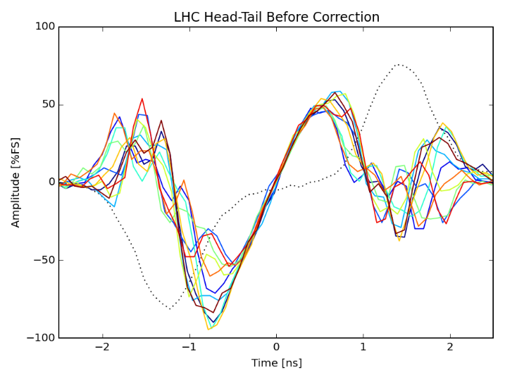
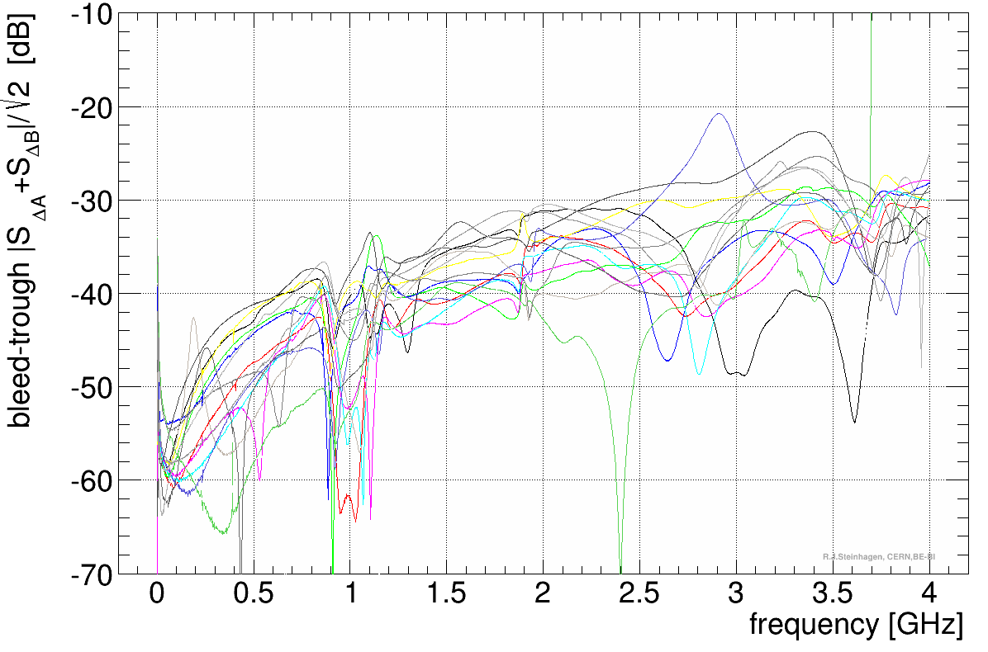
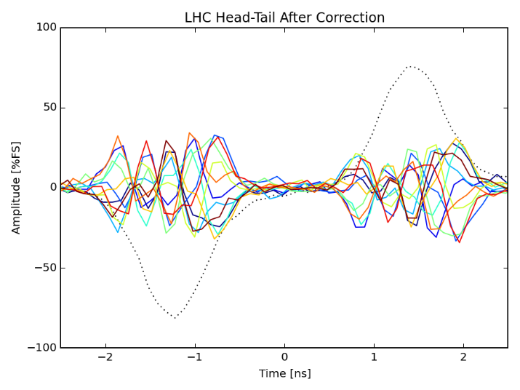
Hybrids
Calculates analogue SUM (Σ) and DIFFERENCE (Δ) of two signals
In the case of BPM electrodes we have a large common mode signal (>100V) with very small difference (<1V) due to oscillations
Require amplitude/phase matching of hybrid inputs to maximise CMRR
Hybrids have limited isolation (% level “bleed-through” of Σ into Δ) and suffer from higher order effects limiting dynamic range of digitizer
Isolation of a selection of H-9 hybrids [2]
[2] G. Kotzian et al, “Evaluation of Strip-line Pick-up System for the SPS Wideband Transverse Feedback System”, IBIC, Oxford, 2013

Slide 11
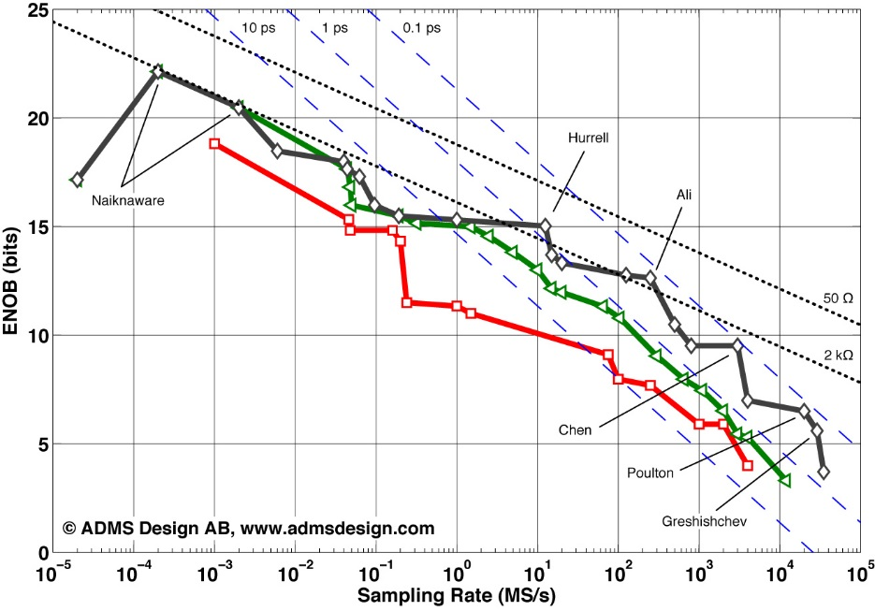
Practical problems with fast digitizers
Large data files due to high sampling rate
  Online analysis needed to isolate interesting data
Short acquisition length (e.g. LHC 11 turns for all bunches) makes it difficult to catch an instability
  Online trigger system essential
  New digitizers with very large acquisition memories available
  (1.6s = ~18k turns = 64GB)
Slow readout
  ~10-15 seconds for LHC
  Limits time between triggers
  Must trigger at optimal time
Limited dynamic range (ENOB)
  Can only see larger instabilities
  Reaching fundamental limits
Digitizer ENOB vs Sampling Rate [3]
— 1990
— 2000
— 2012
Typical ENOB for digitizers (6-7 bits)
[3] B.E. Jonsson, “ADC performance evolution: Sampling rate and resolution”, Converter Passion, August, 2012

Slide 12
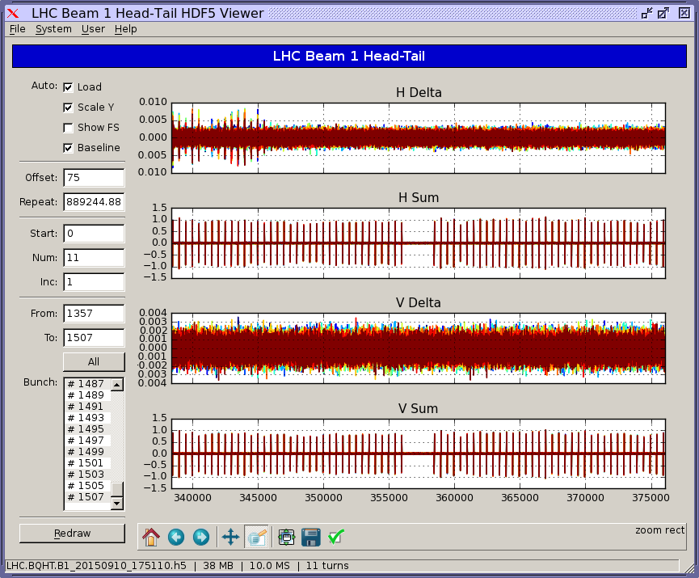
Despite that…
When triggered on an instability, can determine which bunches have become unstable and the radial mode…
Start of batch unstable in horizontal plane
No activity later in the batch or in the vertical plane (note different scales for H+V)

Slide 13
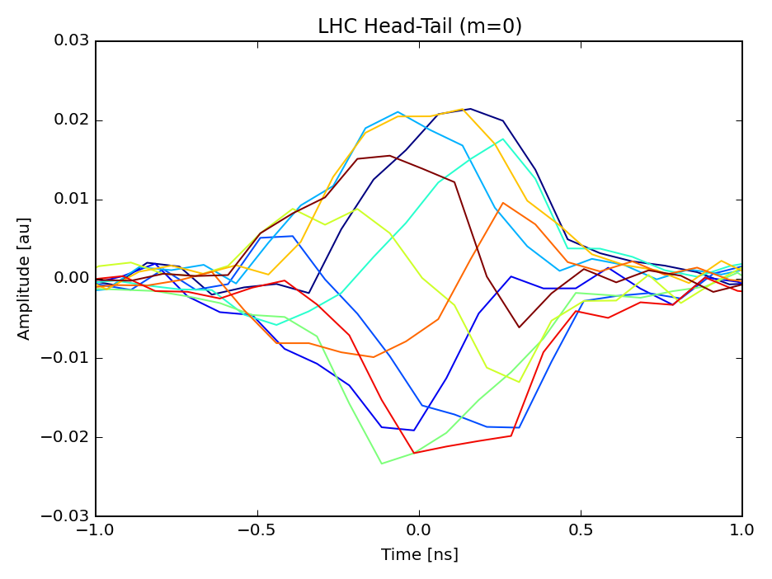
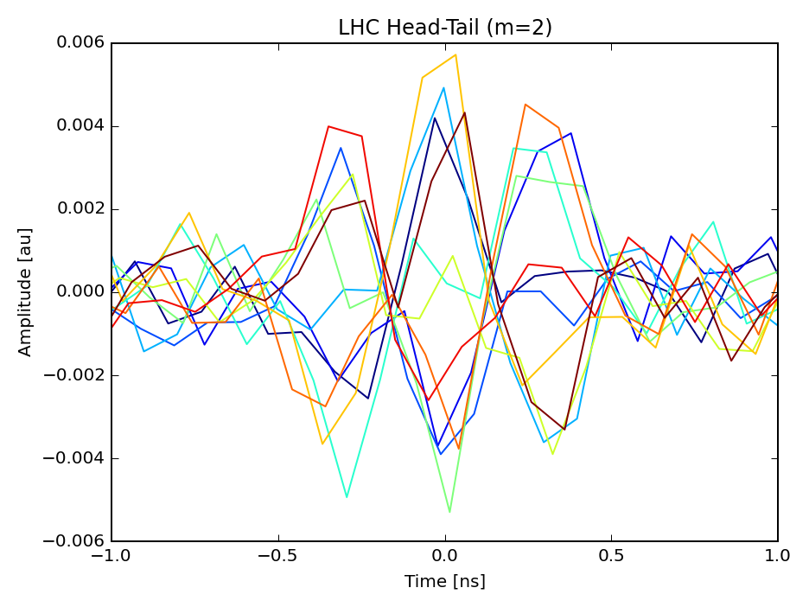
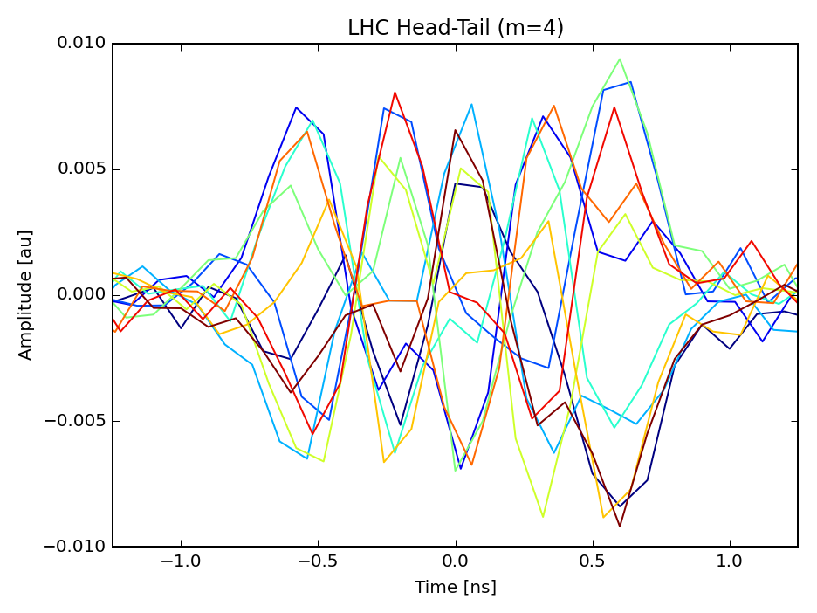
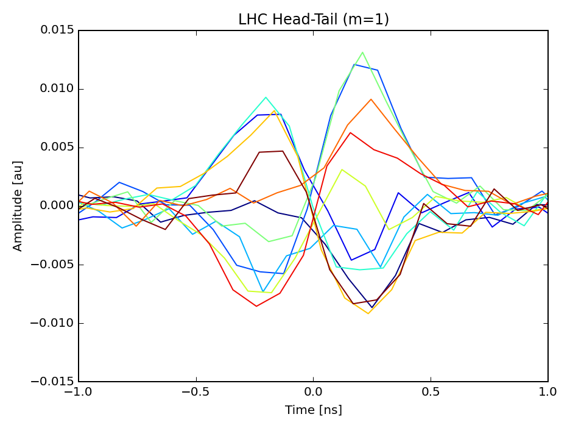
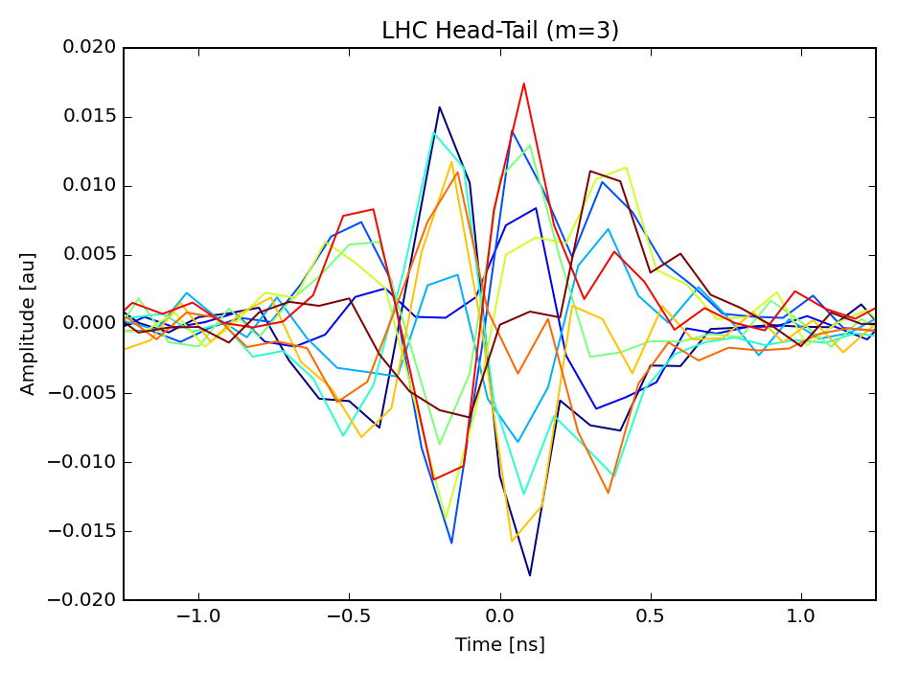
MODE 0
MODE 2
MODE 4
MODE 1
MODE 3

Slide 14
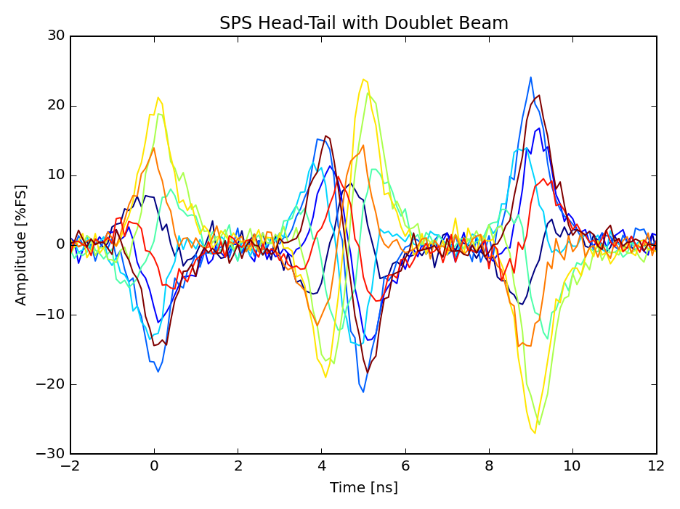
One more example…
Doublet (5+20ns) bunch spacing in SPS:
Can resolve both bunchlets by using initial pulse of first and reflection of second – need to be careful of reflections, cable dispersion, etc.
τ_{PU}=4.0ns
1st
bunchlet
Mixture of
bunchlets
2nd
bunchlet

Slide 15
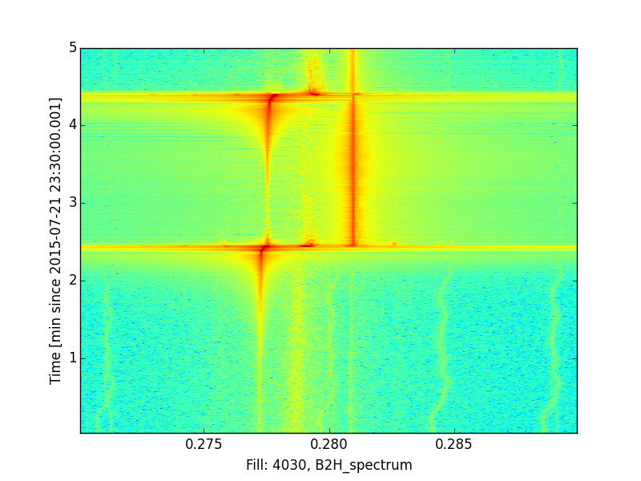
Tune measurement system
Instabilities can be seen as growth in amplitude of the tune line or Q_{S} sidebands – indicative of the azimuthal mode number. Instability rise time can be measured from the amplitude growth.
Usual difficulty at LHC… what is the tune before the instability?
Exponential growth
at Q-Q_{S}

Slide 16
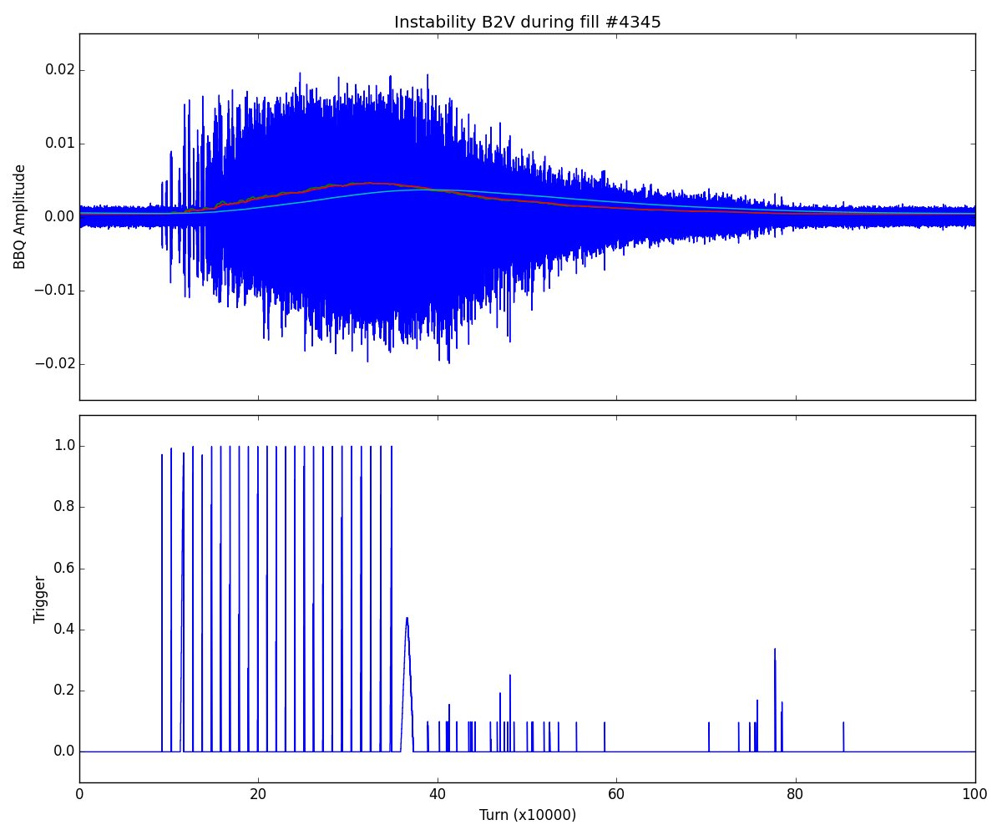
Online instability detection
The LHC BBQ system is most sensitive instrument available for detecting transverse oscillations. Instability detection can be performed by looking at the growth in BBQ amplitude spectrum. Initial developments of algorithm by J. Ellis. Since 2015 the algorithm has been running online in the LHC (FPGA implementation).
Three moving average filters of different lengths are applied to r.m.s. input signal.
If the condition:
σ_{short} > σ_{medium} > σ_{long}
is exceeded for a certain number of turns the trigger is fired.
Works reasonably but still being tuned in order to be robust against injection transients, abort gap cleaning excitation, …
Triggers

Slide 17

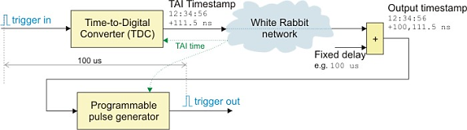
Instability trigger distribution
After detecting an instability, need to distribute a trigger
to systems distributed around the LHC.
CERN’s timing networks are currently unidirectional with no easy way to collect and distribute triggers from remote devices without extensive extra cabling.
During LS1 a new White Rabbit [4] network has been deployed connecting BI and RF equipment and allowing the exchange of triggers.
All nodes are synchronised down to sub-nanosecond level by the White Rabbit network. Trigger events are time-stamped using an time-to-digital converter and can be repeated at many destinations after a programmable delay.
T. Wlostowski, et al
[4] http://www.ohwr.org/projects/white-rabbit

Slide 18
Ongoing developments
…how we are trying to improve things…

Slide 19
Electro-Optical BPM
To overcome limits with traditional stripline BPMs at high frequencies, a new Electro-Optical (EO) BPM is being developed for HL-LHC transverse diagnostics in collaboration with Royal Holloway.
Baseline design:
Effectively a button BPM with pick-ups replaced by EO-crystals.
A fibre-coupled design with laser and detectors housed 160 m away from accelerator tunnel.
Incoming light is collimated by a GRIN lens and polarized before entering the crystal.
The electric field of passing bunch at the crystal induces a rotation in the polarization, by the linear Pockels electro-optic effect.
Light emerging from the crystal passes through an analyser and is then fibre-coupled to the distant photodetector.
[5] S.M. Gibson, A. Arteche, et al, “High Frequency Electro-Optic Beam Position Monitors for Intra-Bunch Diagnostics at the LHC”, IBIC, Melbourne, 2015

Slide 20
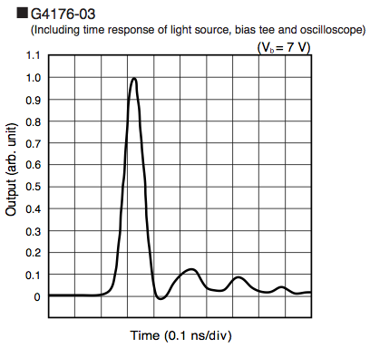
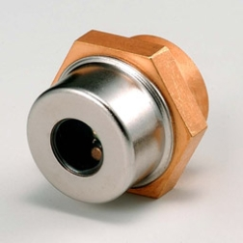
Electro-Optical BPM
Alternative design:
A fibre-coupled interferometer which uses phase modulation rather than a polarization analyser.
Short, equal fibre lengths between the splitters improve tolerance to thermal instabilities and provide synchronization between pick-ups.
The coherence of light is exploited to suppress the common mode signal. The difference signal is directly measured by the photodetector. Potential for enhanced resolution.
Detection:
For either configuration, detection is envisaged based on metal-semiconductor-metal (MSM) photodetectors:
  Rapid rise times (<30 ps); good spectral response (including IR variant); polarity independent bias, low dark current (100 pA at T=25 C).
[5] S.M. Gibson, A. Arteche, et al, “High Frequency Electro-Optic Beam Position Monitors for Intra-Bunch Diagnostics at the LHC”, IBIC, Melbourne, 2015

Slide 21
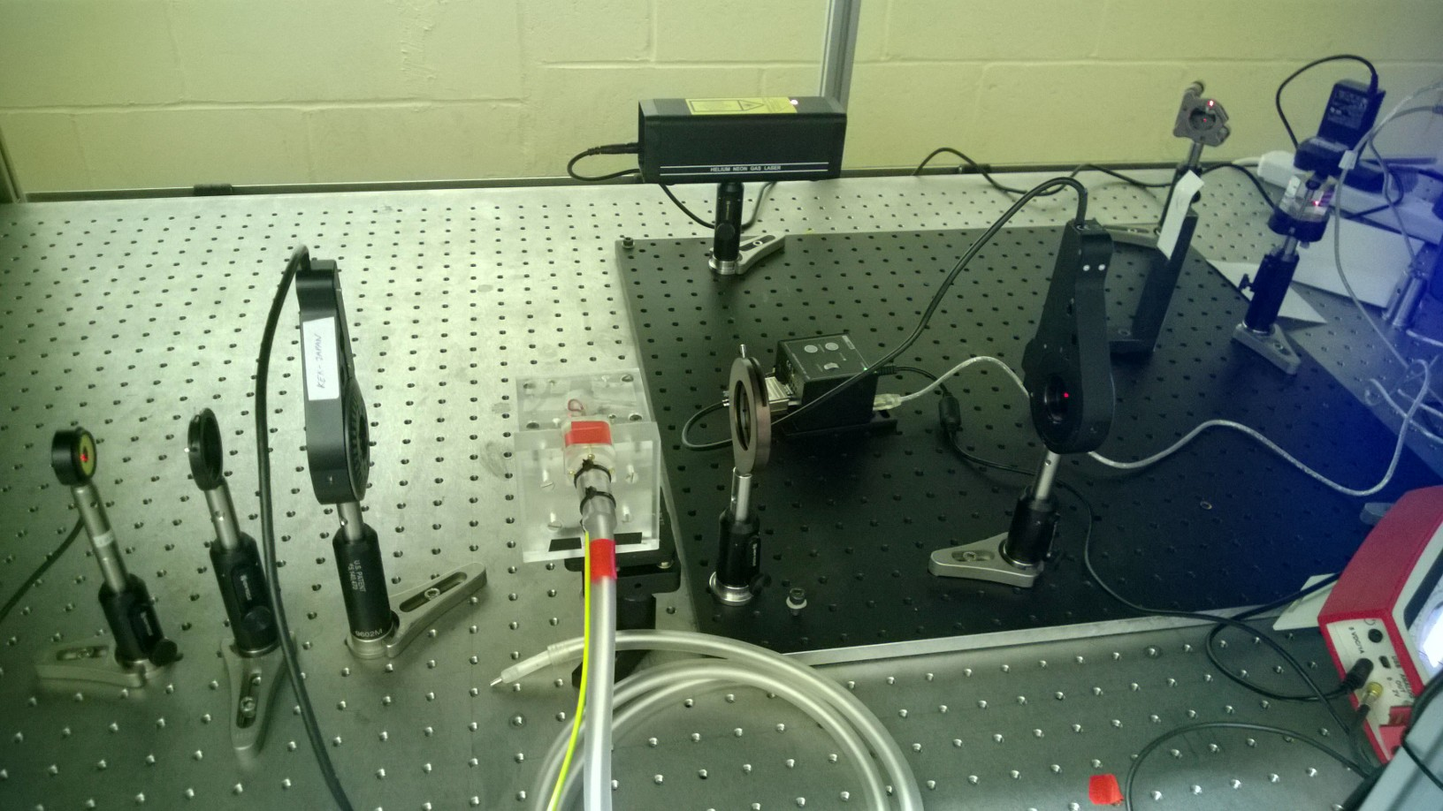
Simulation of EO-BPM response
Both the Polarizer-Analyser and Interferometric configurations have been simulated by A. Arteche to reproduce the EO signals generated in response to a passing bunch. Crystal polarisation has been measured with an automated test bench and fits well with predictions. For full details see [5].
Laser
Analyser
Detector
Polarizer
Crystal
[5] S.M. Gibson, A. Arteche, et al, “High Frequency Electro-Optic Beam Position Monitors for Intra-Bunch Diagnostics at the LHC”, IBIC, Melbourne, 2015

Slide 22
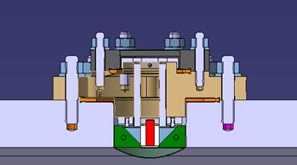
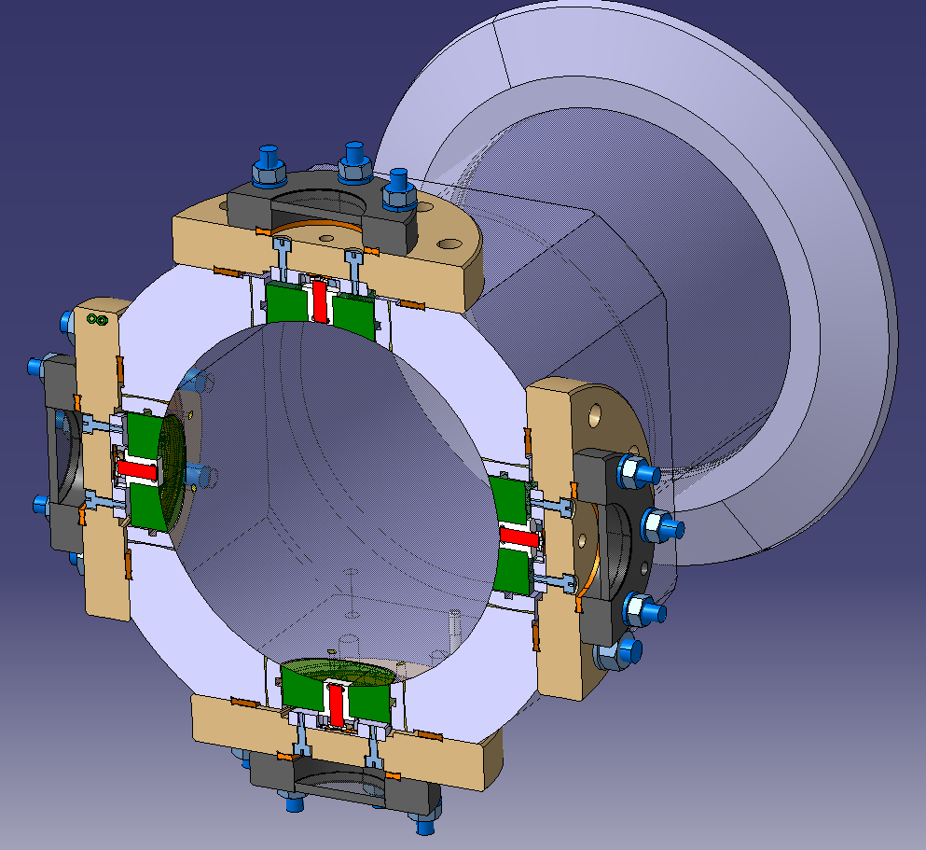
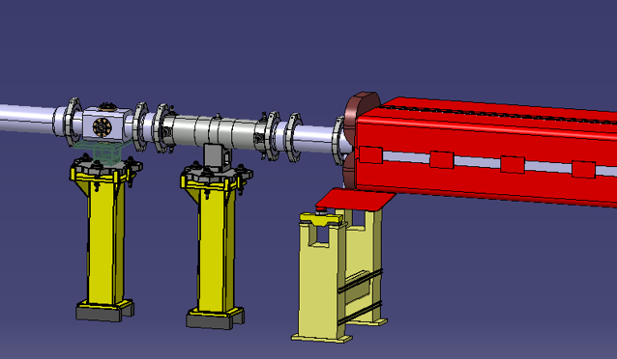
A prototype EO-BPM for CERN SPS
Cross-sectional view of design with
EO-crystal highlighted in red, between two reflecting prisms.
Illuminated via anti-reflection viewports for maximum flexibility and/or fiber-vacuum feedthroughs.
Plan to test Polarizer-Analyser and Interferometric configurations in orthogonal planes.
Installation scheduled for YETS15/16.
EO-BPM
BPCL.421
Mechanical design: A. Demougeot, CERN

Slide 23
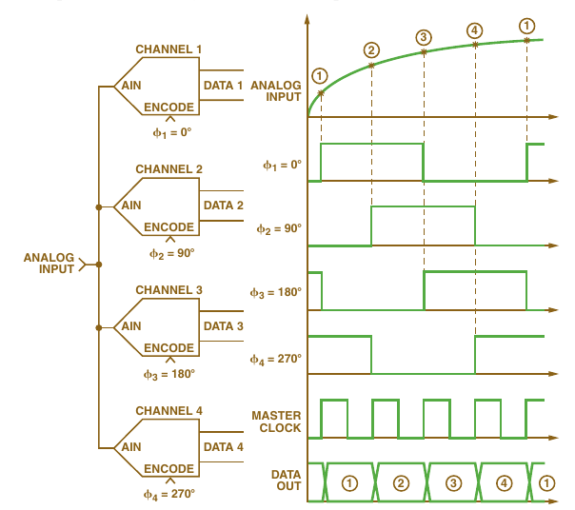
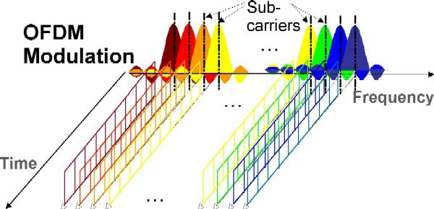
How to improve ADC ENOB?
Two methods to be considered:
Time domain interleaving
  Method used by most high-speed
  digitizers & oscilloscopes
  Limited by thermal noise and jitter
Orthogonal frequency multiplexing
  Samples discreet frequency bands
  Sometimes called cochlear radio
The result will be equivalent with either method, assuming the Nyqist-Shannon sampling criteria and bandwidth requirements are observed…

Slide 24
Multi-Band Instability Monitor (MIM)
Proposed and initially developed by R. Steinhagen and T. Lucas [6]. Samples BPM signal frequency domain at discreet bands using a bank of RF bandpass filters:
As each band has limited bandwidth, it can be mixed down to baseband and sampled high resolution ADCs.
[6] R. Steinhagen, et al, “A Multiband-Instability-Monitor for High-Frequency Intra-Bunch Beam Diagnostics”, IBIC, Oxford, 2013

Slide 25
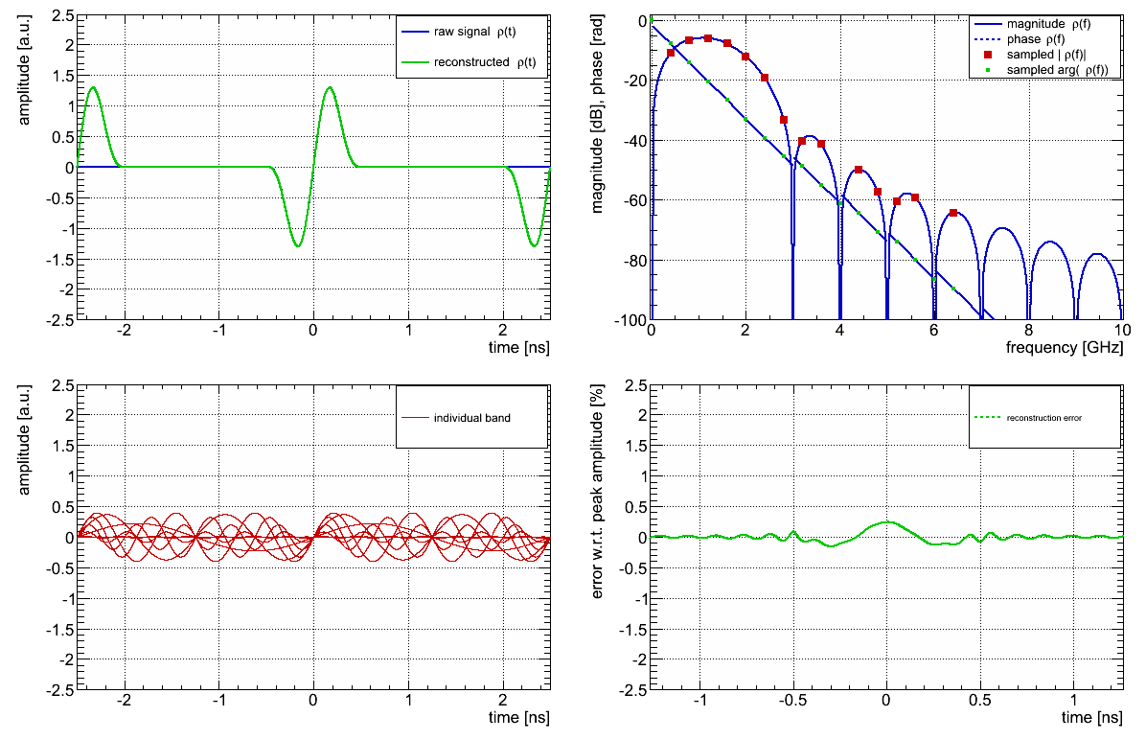
Reconstruction from MIM
Simulated reconstruction for 16 bands by R. Steinhagen:
Error at percent level for 16 bands.
[6] R. Steinhagen, et al, “A Multiband-Instability-Monitor for High-Frequency Intra-Bunch Beam Diagnostics”, IBIC, Oxford, 2013

Slide 26
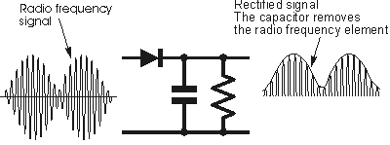
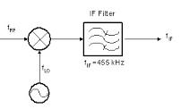
MIM sampling options
Once in baseband, different options to sample signals:
Direct diode detection (similar to BBQ)
  Pros: simple, robust, sensitive, 24-bit ADCs
  Cons: no phase information, not bunch-by-bunch
Heterodyne receiver & I/Q demodulation (similar to ADT)
  Pros: amplitude & phase, bunch-by-bunch
  Cons: complex, LO generation, limited to 16-bit ADCs
Initial versions of MIM are based on diode detection. Although no phase information (so cannot reconstruct time domain) can take advantage of the spectral shift based to determine instability mode.
MIM concept can be extended to high frequency, as has been demonstrated at the Australian Synchrotron by T. Lucas [7] with a three band system up to 12 GHz for short electron bunches.
[7] T. Lucas, et al, “An Optical Intra-Bunch Instability Monitor for Short Electron Bunches”, IBIC, Melbourne, 2015

Slide 27
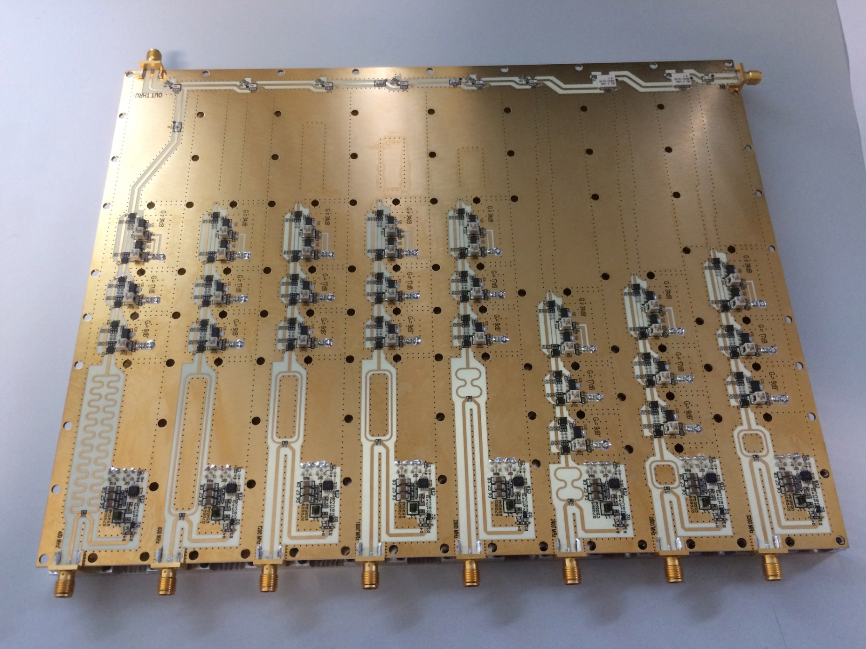
MIM filter bank for LHC
V1 8-band filter (400MHz…3.2GHz) designed by D. Valuch
Through line with directional couplers & low-pass filters
Input
Stripline band-pass filters inside PCB
Switchable amplifier stages (10,20,40dB)
Wilkinson divider
Diode detector+ buffer
3.2GHz
400MHz
Full range outputs for bunch-by-bunch upgrade

Slide 28
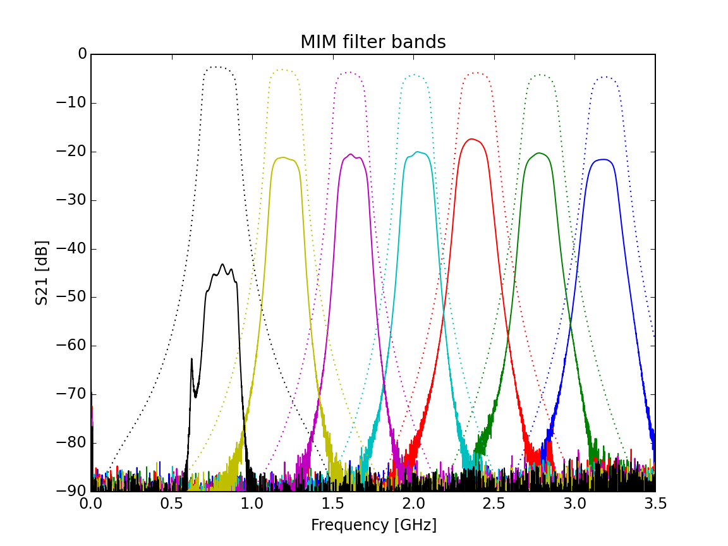
MIM filter bank for LHC
Insertion loss from directional couplers, switches, splitters
Low pass filtered 400MHz band not included
Simulation (filter only)
Measured
Problem with 800MHz band under investigation

Slide 29
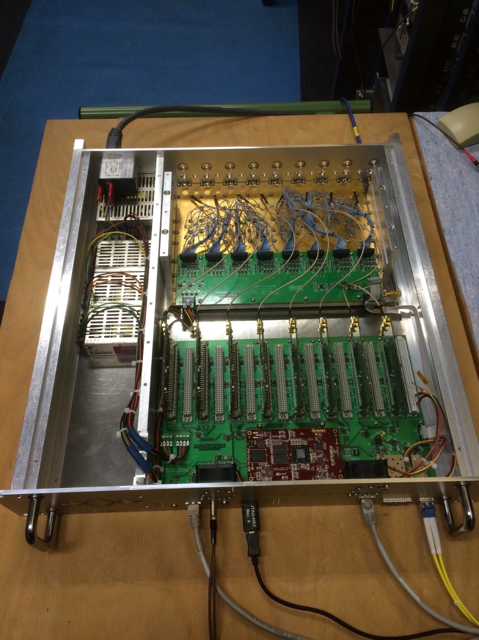
MIM readout electronics for LHC
Readout electronics based on 4MSPS 24-bit ADCs sampling diode detectors.
Up to 16 channels:
  2x 8ch filter banks
  Σ&Δ for a single plane
Online processing for trigger generation and streaming of data over Ethernet.
Prototype scheduled for installation before end of this year.
Filters &
control
24-bit ADCs
FPGA

Slide 30
Summary
Instabilities are a major limiting factor for operation of the LHC and occur and unpredictable times making them hard to catch with all instruments synchronously.
Current instruments are limited in terms of number of turns acquired and resolution.
Therefore we need a robust detection and trigger distribution system to trigger all instruments at appropriate times after detecting an instability.
Development in progress with the aim of improving BPM performance using EO crystals.
A Multi-Band Instability Monitor under development for high dynamic range instability detection and diagnostics.
Many thanks to everyone who contributed material!

