Slide 1
High Intensity Effects on Tune Observables in the Synchrotron SIS18
- A Beam Diagnostics View -
R. Singh, P. Forck, P. Kowina, GSI
with contributions by:
O. Boine-Frankenheim, O. Chorniy, R. Haseitl, W. Kaufmann, K. Lang, GSI & M. Gasior, CERN
Workshop ‘Beam Dynamics meets Diagnostics’, Florence, November 5th, 2015
High Intensity: ΔQ $≳$ 0.05 space charge tune spread & coherent tune shift
measurements at SIS18 with up to 10¹³ charges
Observables: Tune spectra, time resolved bunch oscillations, chromaticity
modifications by in-coherent tune spread & coherent tune shift
Point-of-view: Results of measurements & usage for operation at SIS18
Main work & original talk performed by Rahul Singh,
but he can’t participate in this workshop

Slide 2
Outline
Outline of the talk:
Motivation: Vision of tune measurement for operational usage
Hardware: BPM system and excitation method
Theoretical expectation: Tune spectra including space charge
Measurements and interpretation: Tune spectra for high intensity beams
Measurement: Quadrupole oscillations
Conclusion

Slide 3
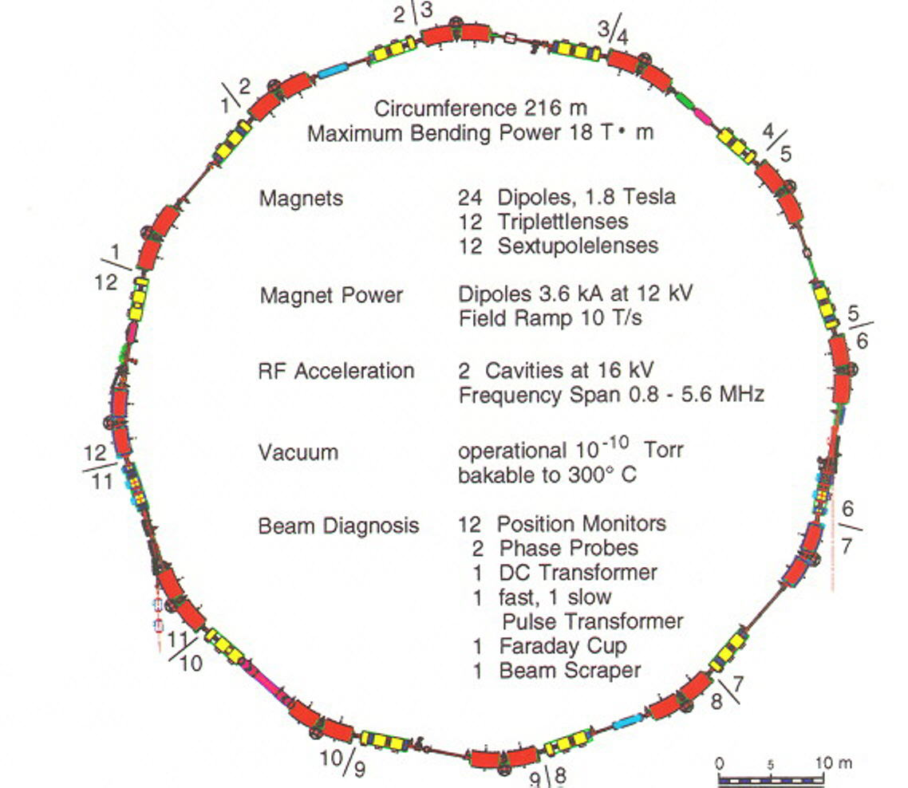
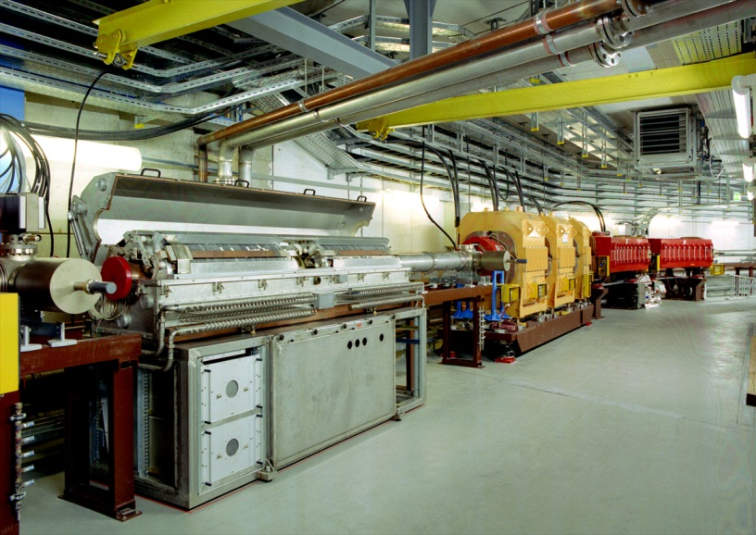
GSI Heavy Ion Synchrotron SIS18 (Bρ=18Tm): Overview
Dipole, quadrupole,
rf cavity 0.8 < f < 5 MHz
acceleration
acceleration
Important parameters of SIS18
Important parameters of SIS-18
Ion range (Z) | 1 → 92 (p to U)
Circumference | 216 m
Injection type | Horizontal multi-turn
Energy range | 11 MeV/u → 2 GeV/u
Ramp duration | 0.1 → 1.5 s
Acc. RF | 0.8 → 5 MHz
Harmonic | 4 (= # bunches)
Bunching factor | 0.4 → 0.08
Tune h/v | 4.2 or 4.4 / 3.4
Trans. size σ_{h} / σ_{v} | ≈ 10 / 5 mm injection
Circumference | 216 m
Inj. type | Multiturn
Energy range | 11 MeV → 2 GeV
Acc. RF | 0.8 → 5 MHz
Harmonic | 4 (= # bunches)
Bunching factor | 0.4 → 0.08
Ramp duration | 0.06 → 1.5 s
Ion range (Z) | 1 → 92 (p to U)
injec-
tion
injec-
tion
extrac-
tion
extrac-
tion
Upcoming FAIR:
SIS18 used as booster
high intensities up to ‘space charge limit’
precise control of beam parameter for emittance conservation & low losses
electron cooling
acceleration
BPMs: 12 regular + 5 for special purpose
+ stripline exciter

Slide 4
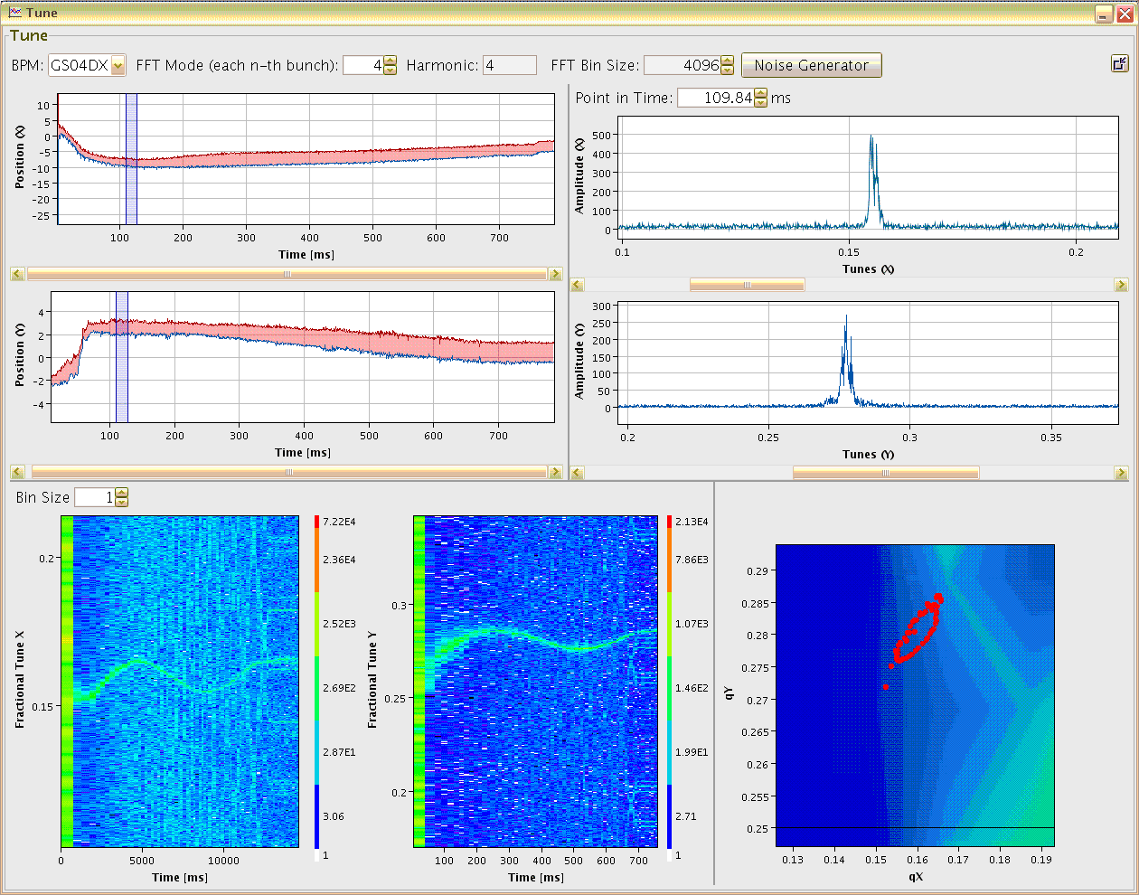
Tune Determination at SIS18: Online Display in Control Room
5 mm
Online display for
tune measurement
during acceleration
Excitation with
band-limited noise
Time resolution:
4096 turns ≈ 20 – 4.5 ms
Variation during ramp:
triplett to duplett focusing
Result:
Online display for user
Sufficient signal strength
with moderate excitation
Minor emittance growth
Maximum Position Variation
Tune at fixed time
0.05
5 mm
horizontal
horizontal
0
200
time [ms]
500
700
2 mm
horizontal tune
0.05
2 mm
vertical
vertical
0
200
time [ms]
500
700
vertical tune
Tune versus time
Working Diagram
horizontal
vertical
vert. Q_{y}
hori. frac. tune Q_{x}
vert. frac. tune Q_{y}
δ Q_{x} ≈ 0.015
δ Q_{y} ≈ 0.020
Beam parameter:
10¹⁰ Ar¹⁸⁺ , 11 → 300 MeV/u
within 0.7 s
tune variation by
imperfect focusing ramp
Position of maximum in spectrum
hori. Q_{x}
time [ms]
time [ms]
P. Kowina et al., Proc. BIW’10; R. Haseitl et al., Proc. DIPAC’11, G. Jansa et al., Proc. ICALEPCS’09

Slide 5
Tune Spectra at SIS18: Beam Intensity Modification
Higher current: The „global“ peak moves to the left. The symmetry of the spectrum is broken.
Relevant GSI SIS18 parameters
Parameter | Typical Value
Circumference | $216$ m
Beam current | ${{10}^{7}−10}^{13}$charges
Injection energy | $11.4$ MeV/u ( $β=0.15)$
Betatron tune $Q_{x} \& Q_{y}$ | 4.31 or 4.17 & 3.28
Synchrotron tune $Q_{s}$ | $0.007$ ($\sim 1.4$ kHz)
Trans. size σ_{x} & σ_{y} | 6...10 & 3...5 mm
$$I =4 mA$$
$$I =1 mA$$
Low current: Tune spectra has symmetric sidebands due to synchrotron motion.
Most measurement and tests at prolonged injection flat-top with highest ΔQ performed.
General questions:
Why is the tune spectrum modified at increasing beam current ?
Very practical: Which peak is the coherently shifted tune ?
What can we learn from this modification for further beam parameters ?

Slide 6
Outline
Outline of the talk:
Motivation: Vision of tune measurement for operational usage
Hardware: BPM system and excitation method
Theoretical expectation: Tune spectra including space charge
Measurements and interpretation: Tune spectra for high intensity beams
Measurement: Quadrupole oscillations
Conclusion

Slide 7
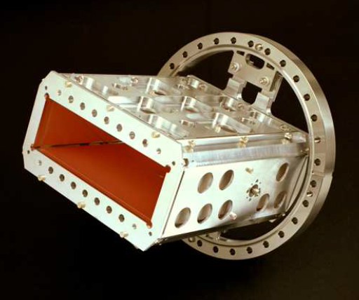
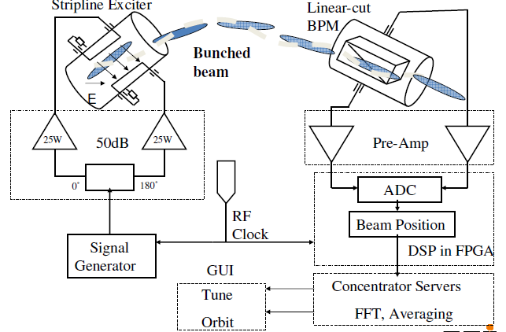
Tune , Orbit & POsition System TOPOS → Oversampling
General functionality:
The beam is excited by band-limited noise or sweep
Broadband amplification & oversampling of bunches
Position value for each bunch
Fourier transformation gives the non-integer tune Q ^{f}
Mainly spectrum in baseband i.e. Q ^{f} < 1/2
Linear cut BPM:
Size: 200 x 70 mm², length 260 mm
Position sensitivity:
S_{x} = 0.44 %/mm, S_{y} = 1.6 %/mm
Digital Electronics
(LIBERA from I-Tech):
ADC with 125 MSa/s
9 effective bits
FPGA: position evaluation etc.
Remark: For FAIR-SIS100 12 eff. bits ADC
Different excitations:
noise or sweep
R. Singh (GSI) et al., Proc. HB’10, U. Springer et al., Proc. DIPAC’09

Slide 8
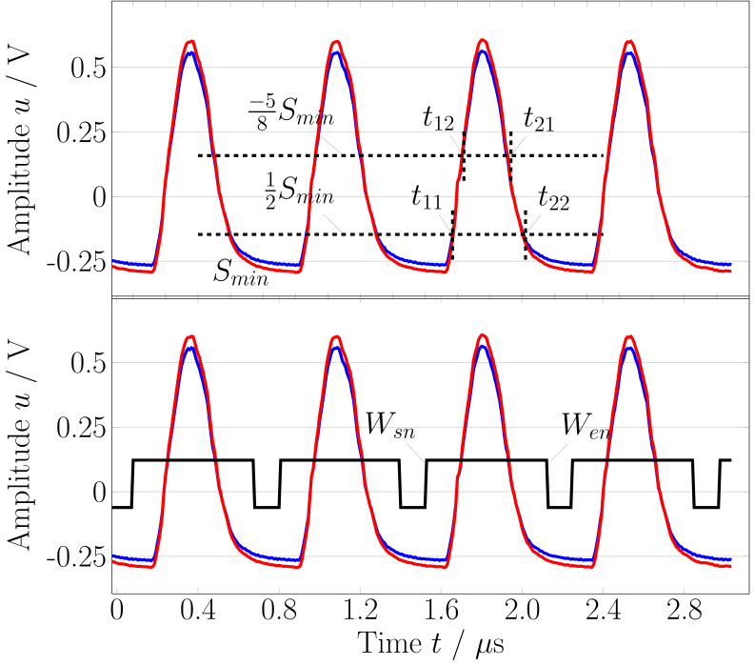
Tune , Orbit & POsition System TOPOS → Oversampling
General functionality:
The beam is excited by band-limited noise or sweep
Broadband amplification & oversampling of bunches
Position value for each bunch
Fourier transformation gives the non-integer tune Q ^{f}
Mainly spectrum in baseband i.e. Q ^{f} < 1/2
Example: One turn = 4 bunches @ 35 MeV/u
U_{right}
U_{left}
Steps for digital processing:
Baseline restoration
Integration of bunches
⇒ position for each bunch
Tune: FFT on position of
same bunch turn-by-turn i.e.1 of 4 per turn
From raw data: bunching factor,
ω_{synch} & head-tail bunch shape
Different excitations:
noise or sweep
R. Singh (GSI) et al., Proc. HB’10, U. Springer et al., Proc. DIPAC’09

Slide 9
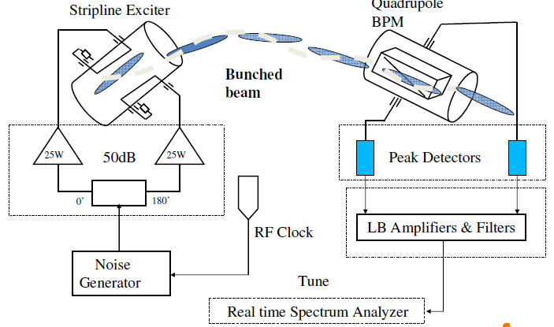
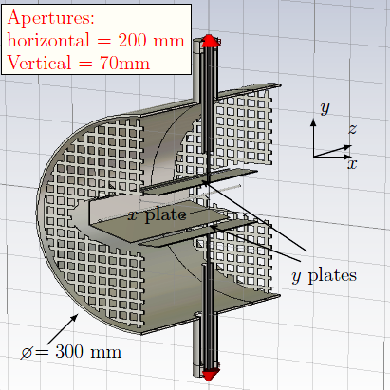
Base-band Tune system BBQ→ analog Peak Detection
The beam is excited to betatron oscillation by band-limited noise or chirp:
The beam position is determined by analog manner via peak detector measured
Filtering of base-band component deliver the non-integer tune Q ^{f}
System designed by M. Gasior (CERN) and honored by Faraday Cup Award, see e.g. BIW’12
‘Quadrupolar’ BPM:
Size: 200 x 70 mm², length 210 mm
Position sensitivity:
S_{x} = 1.4 %/mm, S_{y} = 2.1 %/mm
Different excitations:
noise or sweep
or DAQ: ADC + FFT calc
BBQ design: M. Gasior BIW’12; GSI measurements; R. Singh (GSI) et al., Proc. HB’12 and DIPAC’13

Slide 10
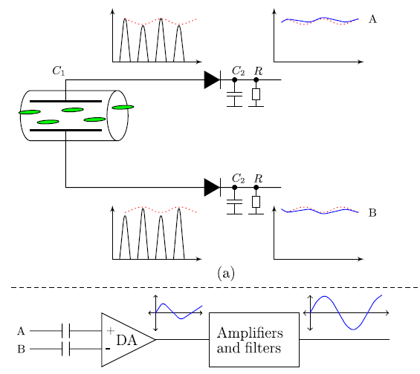
Base-band Tune system BBQ→ analog Peak Detection
The beam is excited to betatron oscillation by band-limited noise or chirp:
The beam position is determined by analog manner via peak detector measured
Filtering of base-band component deliver the non-integer tune Q ^{f}
System designed by M. Gasior (CERN) and honored by Faraday Cup Award, see e.g. BIW’12
Steps of analog processing:
Peak detection
Amplification of the difference
Filtering
Feeding to spectrum analyzer or DAQ
⇒ weighted folding of spectrum to baseband
BBQ design: M. Gasior BIW’12; GSI measurements; R. Singh (GSI) et al., Proc. HB’12 and DIPAC’13

Slide 11
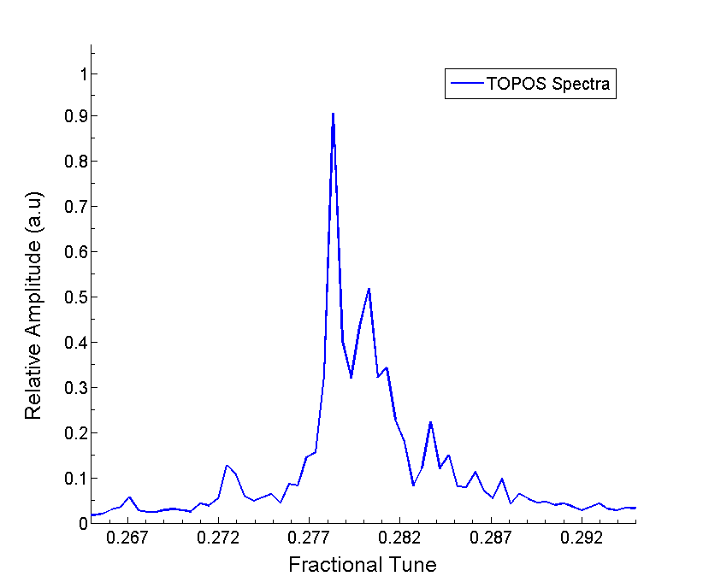
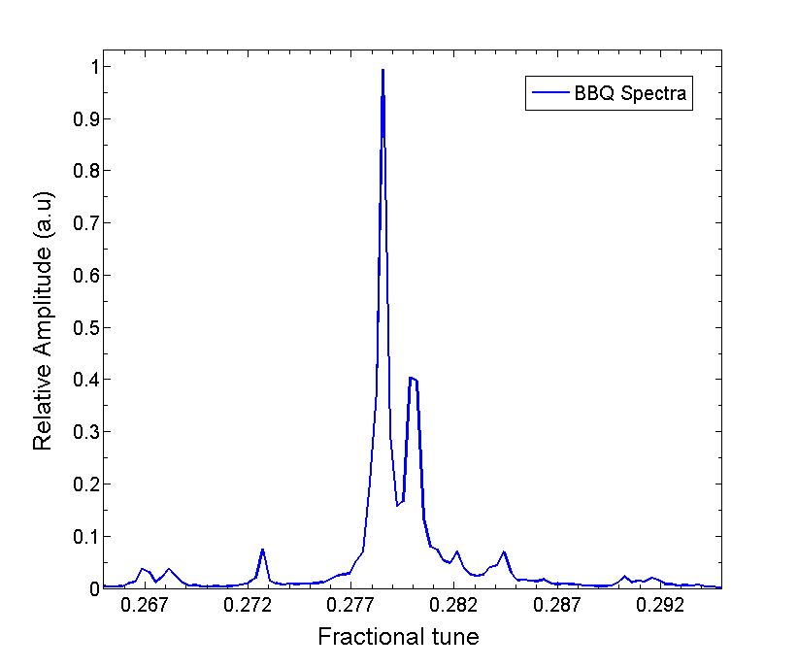
Comparison BBQ versus TOPOS
BBQ:
Peak detection using analog circuit
i.e. no further treatment possible
High dynamic range
Result: tune with higher sensitivity
⇒ ‘Easy-to-use’ device
k = 0
Ni⁷⁺ beam:
11 MeV/u
2 ⋅ 10¹⁰ ions
vertical
BBQ spectrum
k = 1
TOPOS spectrum
k = -1
TOPOS:
Oversampled digitization of the BPM signals
Full time domain information
Versatile data processing possible
e.g. picking 1 of 4 bunches, filtering ...
Results: Position, tune, longitudinal profile
synchrotron frequency ω_{s}
⇒ versatile due to full information stored
Remark: Improved algorithms in preparation
based on linear regression fit
(presently only as offline version)
Same raw data but different algorithms
tradition: integration & y ∝ Δ/Σ
(presented data)
Amplitude
novel: linear fit Δ_{i} versus Σ_{i}
5 x higher signal-to-background + higher resolution
+ better common mode suppression
R. Singh et al., IBIC’15
Notes:
TOPOS is the position and orbit measurement system, and tune is calculated from the FFT of the position across the whole cycle, when the beam excitation is also applied. The technical system, and implementation in FPGA and huge data acquisition was part of a separate 3-4 year project which was almost completed when I joined.
My initial contribution to the TOPOS was to use it, and face problems in its operation. Over the period of time, I understood the problem areas in the algorithm, and came up with an alternate position calculation algorithm, thus I will briefly explain it.
Compare the baseline restoration algorithm to the regression fit, pros and cons.
Another contribution was to understand the noise sources in the BPM.

Slide 12
Outline
Outline of the talk:
Motivation: Vision of tune measurement for operational usage
Hardware: BPM system and excitation method
Theoretical expectation: Tune spectra including space charge
Measurements and interpretation: Tune spectra for high intensity beams
Measurement: Quadrupole oscillations
Conclusion

Slide 13
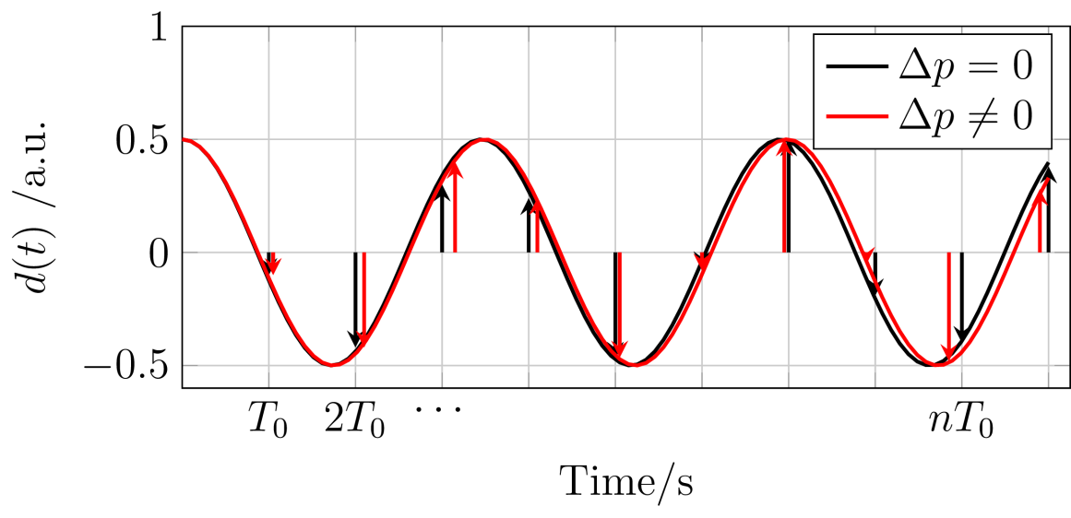
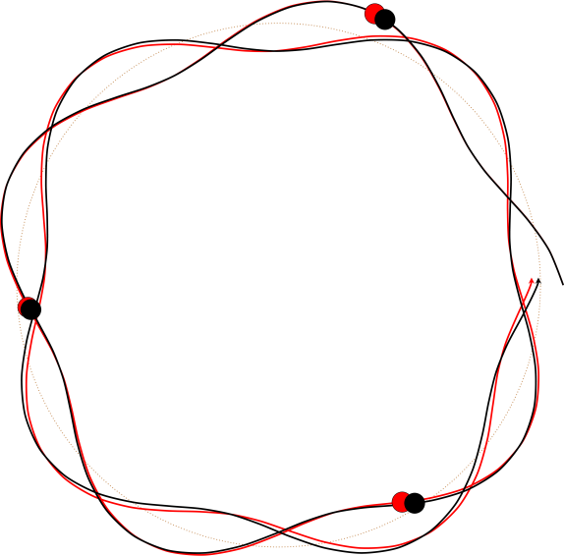
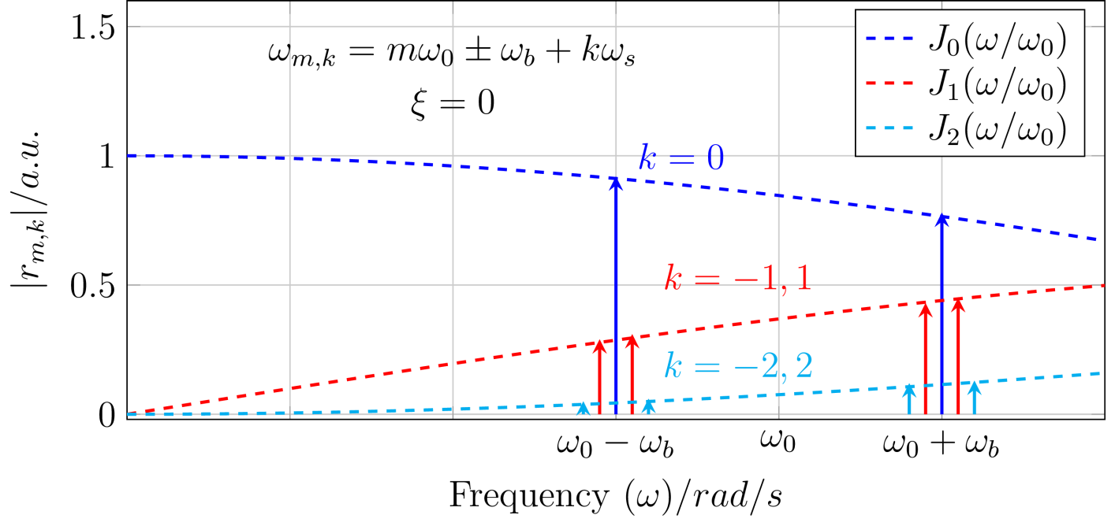
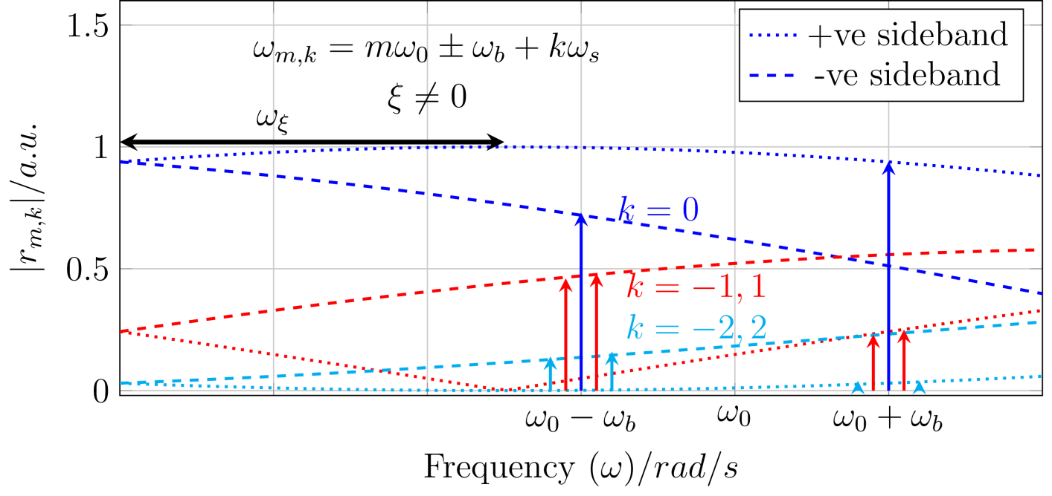
Basic of Tune Spectrum: Non-interacting Particle Model
Basis of single particle movement:
Dipole moment d(t) comprises betatron = amplitude x(t) & synchrotron = phase I(t) modulation
$$Δ$$
$$d_{ }\left(t\right)∝ x_{ }\left(t\right){∙I}_{ }\left(t\right)$$
Frequency of harmonics m & mode k
Sideband amplitude given by
Bessel-function J_{k} of order k
Envelope shifted!
$$ω_{ξ}={\frac{ξ}{η}Q_{0}ω_{0}}_{ }$$
ω_{b} betatron freq. ω₀ rev. freq. a bunch length,
Finite chromaticity ξ modifies sideband’s heights !

Slide 14
Time Domain Mode Structure: Non-interacting Particle Model
Bunch center-of-mass
Example: five consecutive turns
$$k=0$$
$$τ_{b}$$
k = 0
k = 1
$$\overline{x}\left(τ,t\right)$$
$$k=1$$
5
4
3
2
ξ = 0
1
Turn 1 2 3 4
$$t/s$$
Time τ / ns
Time τ / ns
ξ = 1
Eigen-functions:
${\overline{x}}_{k}\left(τ,t\right)={\overline{x}}_{k}\left(τ\right)⋅cos(\left(ω_{b}+kω_{s}\right)t)$
Rigid oscillations for zero chromaticity
ξ = 2
$${\overline{x}}_{k}\left(τ,t\right)={\overline{x}}_{k}\left(τ\right)∙cos[\left(ω_{b}+kω_{s}\right)t+ω_{ξ}τ]$$
Time τ / ns
Time τ / ns
SIS18 injection:
Q₀ = 3.27, η = 0.92
Non -zero chromaticity ⇔ intra-bunch movement
Chromatic tune freq. $ω_{ξ}=\frac{ξ}{η}Q_{0}ω_{0}$

Slide 15
Simple Formulas: coherent Tune Shift and incoh. Tune Spread
Model assumptions: round constant beam & pipe radius, constant or KV distribution, constant synchrotron tune ...
Transvers impedance $Z_{⊥}=i\frac{Z_{0}}{2{π{\left(β_{0}γ_{0}b\right)}_{}^{2}}_{}}$
Coherent tune shift $∆Q_{c}=i\frac{q^{2}}{A}∙\frac{N B_{f}∙R^{2}Z_{⊥}}{2Q_{0}β_{0}W_{0}}$
$$bare Q$$
$$∆Q_{c,y}$$
Incoh. tune spread $∆Q_{sc}=\frac{1}{4πε_{0}c}∙\frac{q^{2}}{A}∙\frac{NB_{f}∙R}{W_{0}{β_{0}}^{3}{γ_{0}}^{2}ε}$
$$∆Q_{sc,y}$$
$$∆Q_{sc,x}$$
$$∆Q_{c,x}$$
Relation ${∆Q}_{c}={∆Q}_{sc}∙{\left(\frac{a}{b}\right)}^{2}$
beam radius
pipe radius
Space charge parameter $q_{sc}=\frac{\left|∆Q_{sc}\right|}{Q_{s}}$
q_{sc} includes effect of longitudinal oscillations
b pipe radius, R synchrotron radius, $Z_{0}=\sqrt{µ_{0 /ε_{0} }}$
A ion mass, q ion charge
N number of ions, B_{f} bunching factor, Q₀ bare tune
W₀ kinetic energy per nucleon, β velocity, γ Lorentz factor
a beam radius, ε transverse emittance
Notes:
So, how do the space charge effects, modify the tune spectra?
First the more challenging and interesting effect, which was the prime motivation of all these detailed examples.
The distance between the head-tail modes change in a characteristic way, explained by certain theoretical and numerical studies, and our measurements match with the prediction quite well, and rather beautiful interpretation of tune spectra is obtained.
These are the examples of the theoretical curves, and the spectrum on the side for the given beam conditions exactly show, how the characteristic modification occurs.

Slide 16
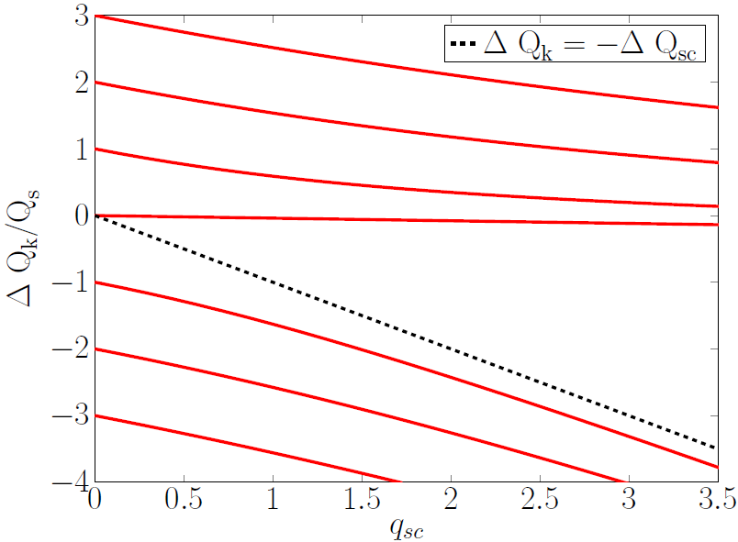
Analytical Model: Space Charge Modification of Tune Spectra
Assumption of analytical description of head-tail modes by M. Blaskiewicz (1998):
Transverse phase space: KV-distribution
Longitudinal ‘airbag’ phase space: phase → constant momentum only two velocities v_{s} = ± v_{s0}
⇒ synchrotron tune: Q_{s} = π v_{s0} /(R ω₀ a)
Example for SIS18 parameter
Low intensity: spacing of sidebands: ${∆Q}_{k}=kQ_{s}$
High intensity: spacing of sidebands:
${ΔQ}_{±k}=−\frac{∆Q_{sc}+∆Q_{c}}{2}±\sqrt{\frac{(∆Q_{sc}−∆Q_{c})^{2}}{4}+(kQ_{s})^{2}}$
ΔQ_{c} = 0.06 ΔQ_{sc}
ΔQ_{c} coherent tune shift
ΔQ_{sc} incoherent tune spread
$$q_{sc}=\frac{\left|∆Q_{sc}\right|}{Q_{s}}$$
Findings:
$k=0$ it is $∆Q_{0}=−∆Q_{c}$ i.e. value of shifted bare tune as of importance for operating
k > 0, head-tail modes come closer $\text{a}\text{s} q_{sc}=∆Q_{sc}\text{/}Q_{s} \text{increases}$
k < 0 almost constant slope (but larger Landau damping ⇔ broader and lower spectral lines)
M. Blaskiewisz: Fast head-tail instabilities with space charge, Phys. Rev. Acc.. Beams 1, 044201, (1998)
A. Burov, Head-tail modes for strong space charge, Phys. Rev . Acc. Beams 12, 044202, (2009)
O. Boine-Frankenheim et .al., Transverse Schottky noise spectrum for bunches with space charge, Phys. Rev .Acc.. Beams 12, 114201, (2009)
Notes:
So, how do the space charge effects, modify the tune spectra?
First the more challenging and interesting effect, which was the prime motivation of all these detailed examples.
The distance between the head-tail modes change in a characteristic way, explained by certain theoretical and numerical studies, and our measurements match with the prediction quite well, and rather beautiful interpretation of tune spectra is obtained.
These are the examples of the theoretical curves, and the spectrum on the side for the given beam conditions exactly show, how the characteristic modification occurs.

Slide 17
Outline
Outline of the talk:
Motivation: Vision of tune measurement for operational usage
Hardware: BPM system and excitation method
Theoretical expectation: Tune spectra including space charge
Measurements and interpretation: Tune spectra for high intensity beams
Measurement: Quadrupole oscillations
Conclusion

Slide 18
Measurements: Overview of Beam Parameters
Parameter | Symbols | Value | Value
Beam | ^{A} Ion ^{q+} | ²³⁸ $U^{ 73+}$ | ¹⁴ $N^{ 7+}$
Energy | $$W_{0}$$ | $11.4$ MeV/u | $11.56$ MeV/u
No. of particles | $$N_{p}$$ | $$(1 …12)∙{10}^{8}$$ | $$(1 …15) ∙{10}^{9}$$
Emittance | $$ε_{x} \& ε_{y}(2σ)$$ | $45 \& 22$ mm-mrad | $33 \& 12$ mm-mrad
Tune | $$Q_{x0} {\& Q}_{y0}$$ | $$4.31 \& 3.27$$ | $$4.16 \& 3.27$$
Bunching factor | $$B_{f}$$ | $$0.4$$ | $$0.37$$
Synchrotron tune | $$Q_{s0} \& Q_{s, meas}$$ | $$0.007 \& 0.0065$$ | $$0.006 \& 0.0057$$
Chromaticity | $$ξ_{x} \& ξ_{y}$$ | $−0.94 \& −1.85$set | $−1.7 \& −2.$1 meas.
Longitudinal Schottky
Current Transformer
Ionisation Profile Monitor
TOPOS or BBQ
TOPOS
Measurement of all relevant beam parameters
to calculate $q_{sc}$ for horizontal and vertical direction, respectively:
$$q_{sc,x}=\frac{\left|∆Q_{sc}\right|}{Q_{s, meas}}=\frac{R}{4πε_{0}c}∙\frac{q^{2}}{A}∙\frac{N_{p}{/ B}_{f} }{{Q_{s,meas}W}_{0}{{ β}_{0}}^{3}{{ γ}_{0}}^{2} ε_{eff, x} }$$
Presented tune spectra are measured
by BBQ or TOPOS
effective emittance $ε_{eff, x}=1/2 ({ ε}_{x}+\sqrt{ε_{x}ε_{y}{ Q}_{x0}/Q_{y0 }})$

Slide 19
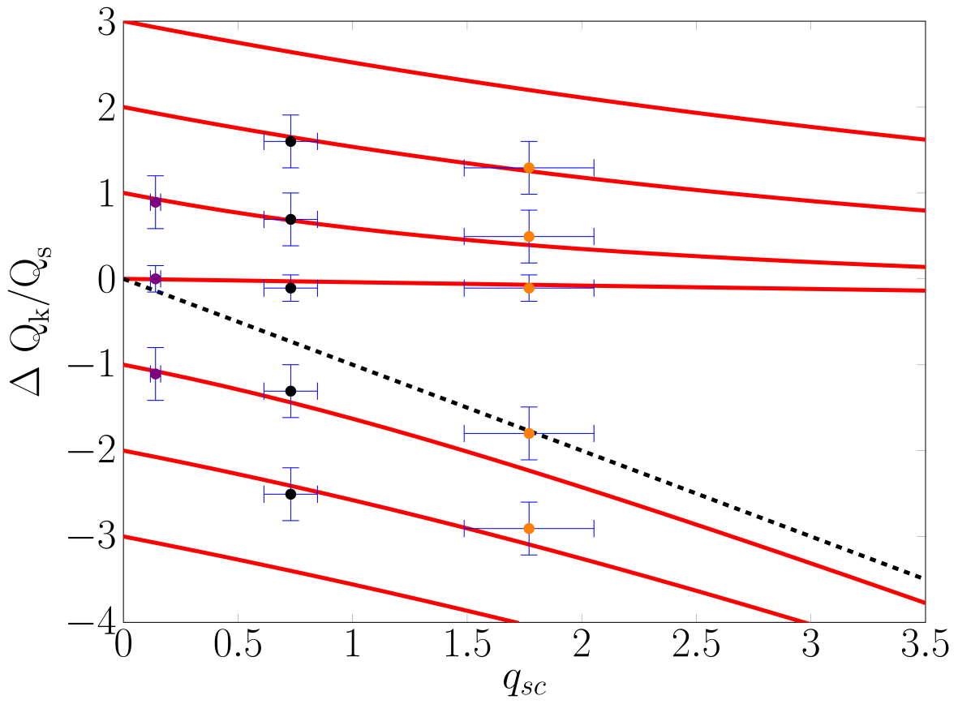
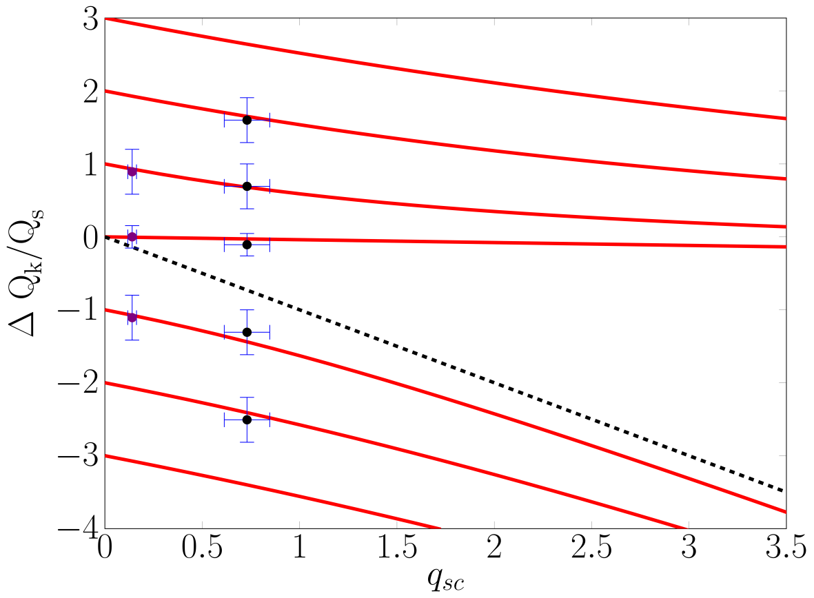
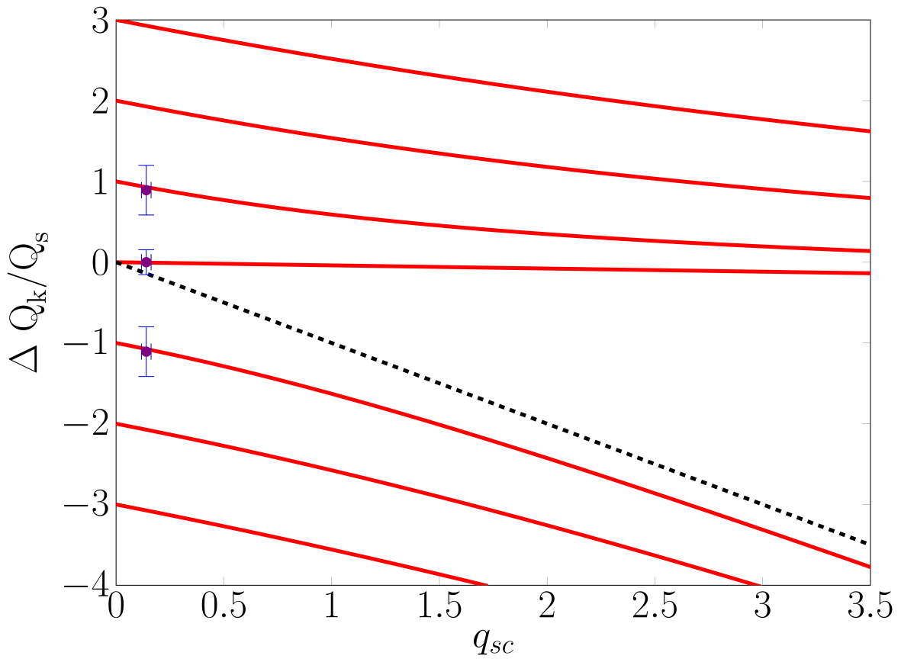
Measurements: Moderate Space Charge Parameter
Beam: U⁷³ ⁺, 11.4 MeV/u, (1 ... 12) ⋅ 10⁸ ions, $Q_{s}=0.007⟺f_{s}=\frac{Q_{s}ω_{0}}{2π}=1.4 kHz$
Measured spectra
ΔQ_{c} = 0.06 ΔQ_{sc}
Fractional horizontal tune Q^{f}_{x}
Red lines: predicted lines using measured beam parameters:
$$ΔQ_{±k}=−\frac{∆Q_{sc}+∆Q_{c}}{2}±\sqrt{\frac{(∆Q_{sc}−∆Q_{c})^{2}}{4}+(kQ_{s,meas})^{2}}$$
$$q_{sc}=\frac{\left|∆Q_{sc}\right|}{Q_{s,meas}}$$
R. Singh et al., Interpretation of transverse tune spectrum in a heavy-ion synchrotron, Phys. Rev. Acc. Beams 13, 034201 (2013)

Slide 20
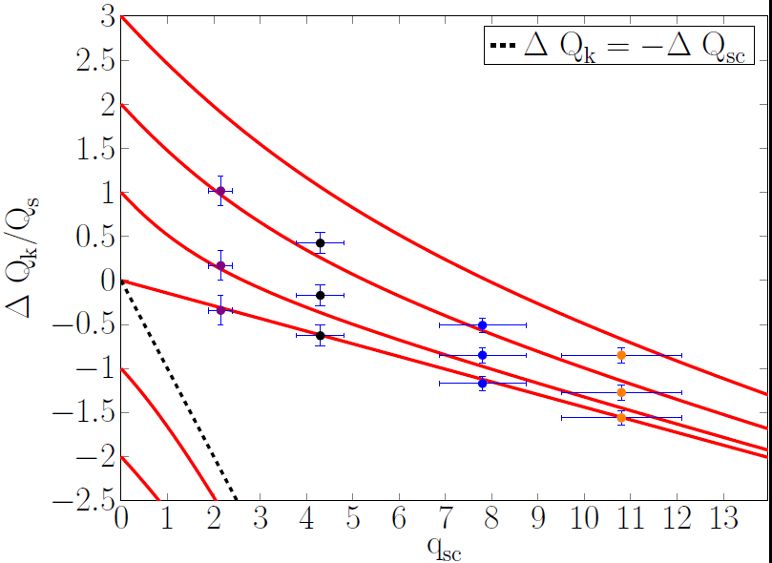
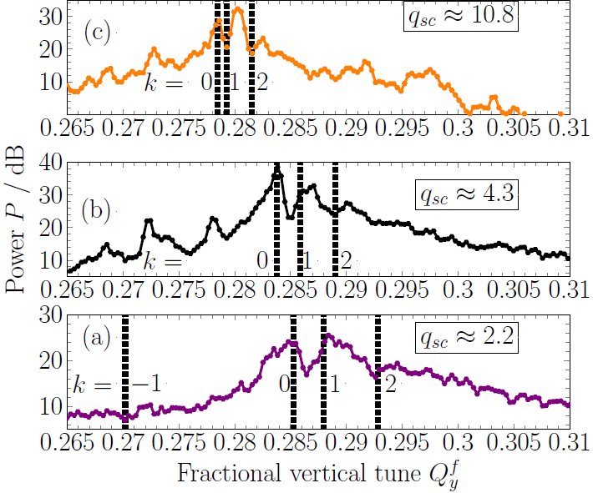
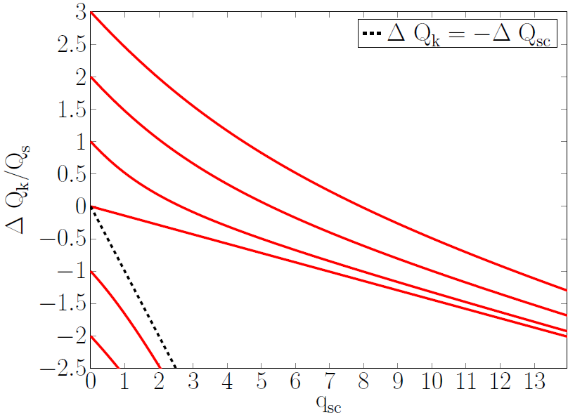
Measurements: Strong Space Charge Parameter
Beam: N⁷⁺, 11.56 MeV/u, (3 ... 15) ⋅ 10⁹ ion, $Q_{s}=0.006⟺f_{s}=\frac{Q_{s}ω_{0}}{2π}=1.2 kHz$
(smaller transverse size than U⁷³⁺ beam)
Measured spectra
ΔQ_{c} = 0.14 ΔQ_{sc}
Predicted spectra : red lines
$$ΔQ_{±k}=−\frac{∆Q_{sc}+∆Q_{c}}{2}±\sqrt{\frac{(∆Q_{sc}−∆Q_{c})^{2}}{4}+(kQ_{s,meas})^{2}}$$
$$q_{sc}=\frac{\left|∆Q_{sc}\right|}{Q_{s, meas}}$$
R. Singh et al., Interpretation of transverse tune spectrum in a heavy-ion synchrotron, Phys. Rev. Acc. Beams 13, 034201 (2013)

Slide 21
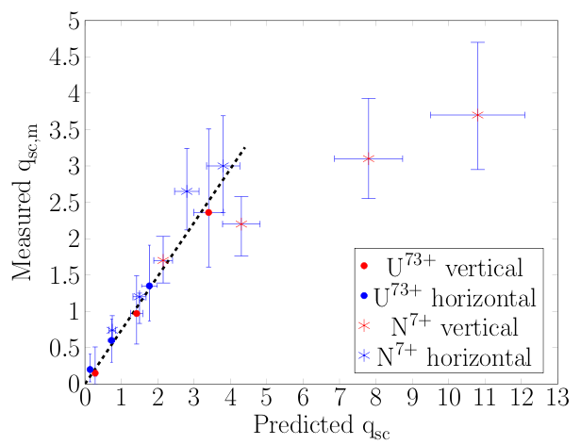
Comparison of predicted and measured Space Charge Parameter
The values q_{sc} from the depicted measurements with U⁷³⁺ and N⁷⁺
Slope $\sim 0.75$
$$δq_{k0→1}$$
Measurement of all parameters:
Predicted $q_{sc,x}=\frac{R}{4πε_{0}c}∙\frac{q^{2}}{A}∙\frac{N_{p}{/ B}_{f} }{{Q_{s,meas}W}_{0}{{ β}_{0}}^{3}{{ γ}_{0}}^{2} ε_{eff, x} }$
Measured $q_{sc}$ based on the distance between lines
of modes $k= 0$and $1$: δ q_{k 0→ 1}
Findings:
General trend well reproduced i.e. reason for modified tune spectra was found
Significant deviation for higher values of q_{sc} (as expected from analytic model)
→ Does a better model with high prediction power exists ?
Can such model be applied to SIS18 parameter providing a plots of tune spectra ?
R. Singh et al., Interpretation of transverse tune spectrum in a heavy-ion synchrotron, Phys. Rev. ST Acc. Beams 13, 034201 (2013)

Slide 22
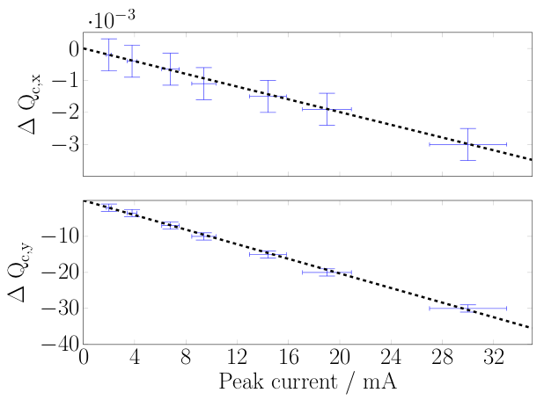
Measurements: Determination of coherent Tune Shift ΔQ_{c}
The coherent tune shift ΔQ_{c} from the depicted N⁷⁺ spectra and further spectra with Ar¹⁸⁺
$${Im(Z}_{⊥,x})=−(0.23±0.04) MΩ/m^{2}$$
$${Im(Z}_{⊥,y})=−(1.78±0.04) MΩ/m^{2}$$
For k = 0 : $∆Q_{c}$= $∆Q_{k=0}$ i.e. value of coherently shifted bare tune as of importance for operating
Results:
Expected linear scaling coherent tune shifts versus peak beam current $I_{p}$
For value of slope the resistive, effective impedance Z$⊥$ can be determined
⇒ estimation of effective beam pipe radius $b_{x}\sim 115±5.5$mm & $b_{y}=35±1$ mm
R. Singh et al., Interpretation of transverse tune spectrum in a heavy-ion synchrotron, Phys. Rev. Acc. Beams 13, 034201 (2013)

Slide 23
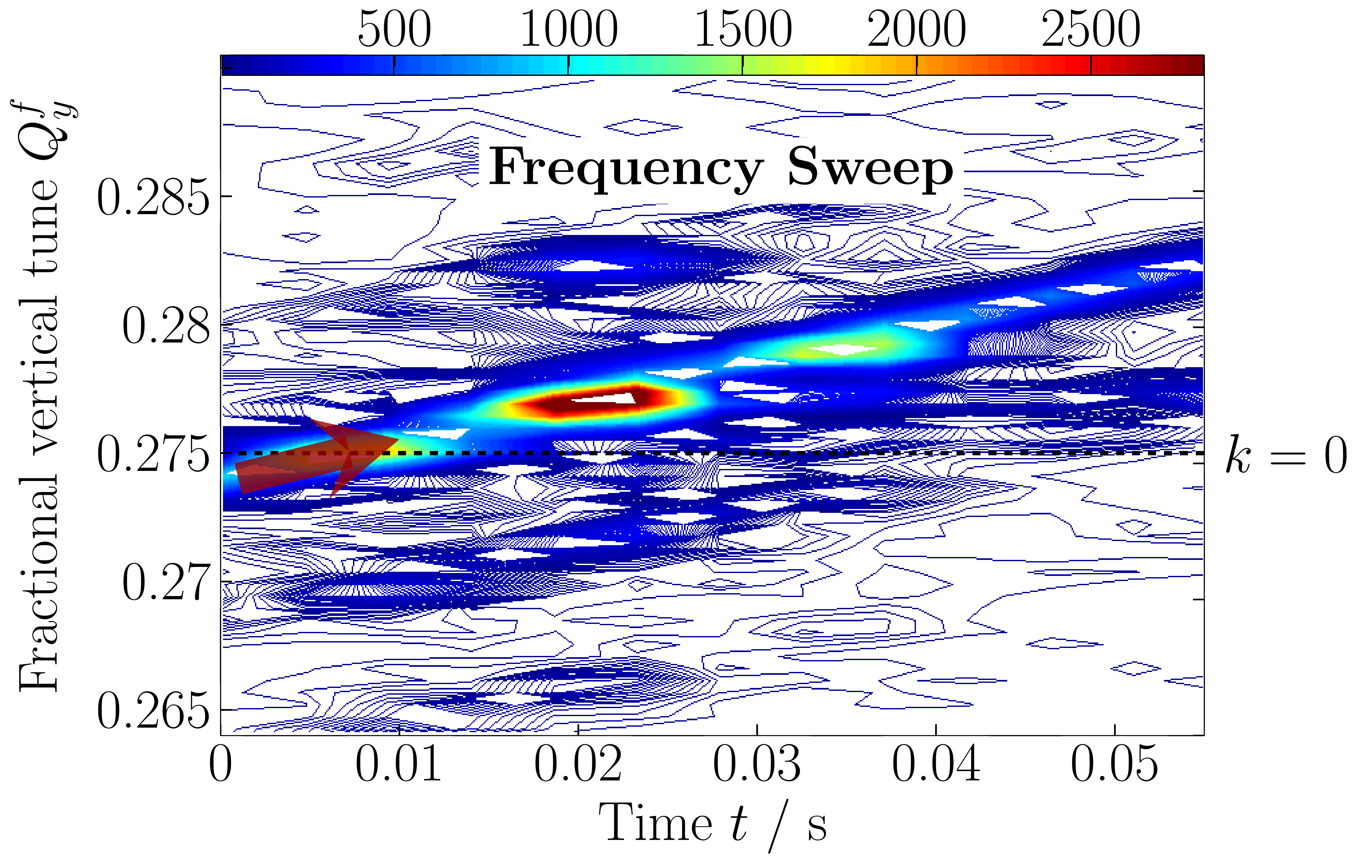
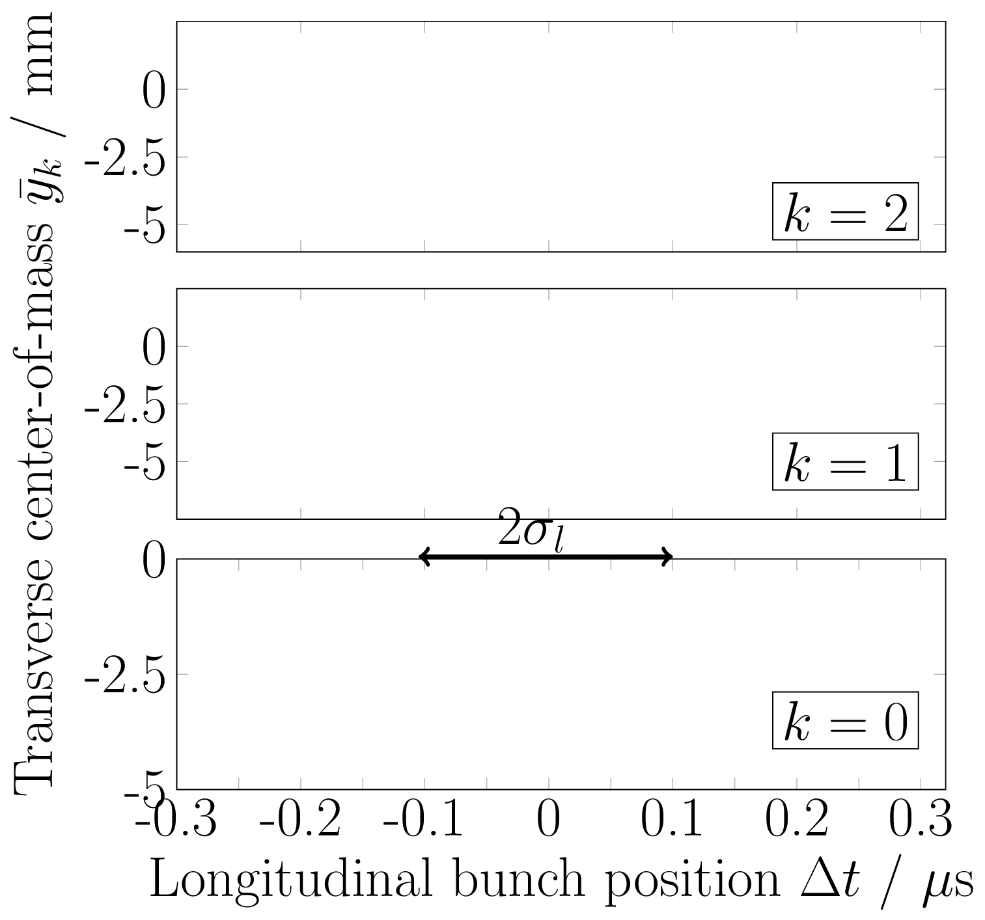
Time Domain Identification of Head-tail Modes
Frequency sweep allows the observation of bunch center oscillations i.e. head-tail modes
Beam parameter: 15 ⋅ 10⁹ N⁷⁺ at 11.5 MeV/u, Q_{y} = 3.75, ξ = -2.1
Tune spectrogram during sweep:
11 consecutive turn-by-turn center-of-mass recordings:
Results:
Sweep excitation allows excitation of individual head-tail modes
The mode-structure verifies the spectra interpretation
Remark: Eigen-functions for high intensities could be determined, if it of interest
Notes:
The head tail modes were further identified in time domain, to indeed confirm that the negative modes could not be excited, and the left most mode is actually k=0 mode. On top of that, the mode structure could be used to calculate other beam parameters such as chromaticity.
These are some of the first clean measurements of excited head-tail modes. Normally they occur, when some of them cross their instability thresholds.

Slide 24
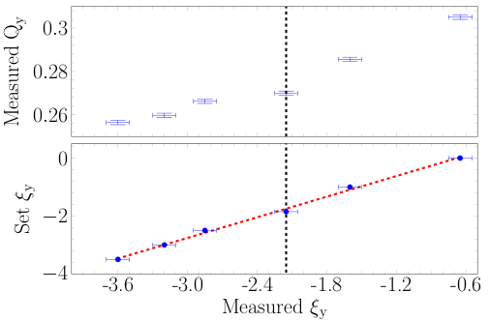
Determination of Chromaticity from Head-tail Oscillations
Fit of measured head-tail modes to the classical (i.e. without space charge) eigen-functions
${\overline{y}}_{k}\left(τ,t\right)={\overline{y}}_{k}\left(τ\right)∙cos\left[\left(ω_{b}+kω_{s}\right)t+ω_{ξ}τ\right]+y_{offset}$
Beam parameter: low current 15 ⋅ 10⁹ N⁷⁺ at 11.5 MeV/u
Fit result: ξ _{set} = 1.19⋅ ξ _{meas} + 0.80
Transverse center-of-mass ${\overline{y}}_{k}$ /$mm$
Results:
Precise determination of chromaticity ξ
SIS18: Deviation between set & actual value
& coupling to tune due to uncorrected closed orbit
⇒ Reliable method but only for offline analysis
Longitudinal bunch position $τ$ /$μ$s
Bold lines: measured bunch center
Dotted lines: least squares fit with
chromaticity ξ as fit parameter
R. Singh et al., Interpretation of transverse tune spectrum in a heavy-ion synchrotron, Phys. Rev. Acc. Beams 13, 034201 (2013)
Notes:
The eigenmodes have exclusive dependence on Chromaticity. (Inspired by O.R. Jones measurements)
All the measured modes were fitted according to the analytical prediction for a square-bag model.
Chromaticity measured in both planes. Comparision with traditional method
NOW:
Chromaticity measurements were performed based on the head-tail mode structure.
The coupling between the planes due to improper alignment of the quadrupoles, or the skew components was also measured.
All this due to proper understanding on the two complimentary systems. Now systems in regular operation.

Slide 25
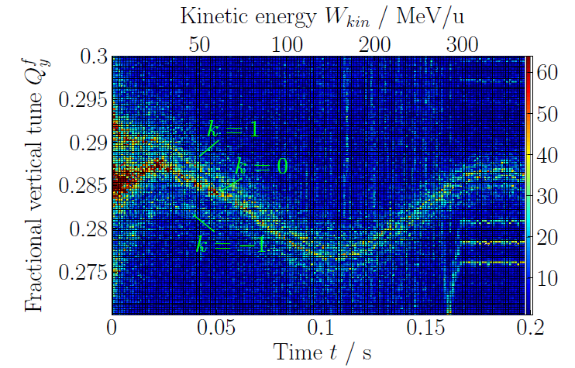
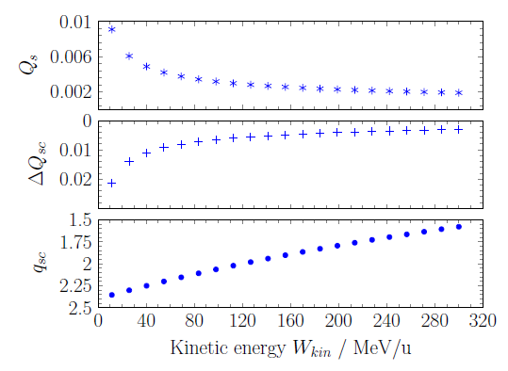
Measurement: Head-tail Modes at higher Energies
During acceleration:
transverse emittance decreases
synchrotron tune Q_{s} decreases
⇒ q_{sc} > 1 i.e. relevant modification of spectrum
acceleration of 10¹⁰ Ar¹⁸⁺
Typical values at other synchrotrons at injection:
Parameter | SIS18 | SPS | RHIC | ANKA
I_{peak} / $mA$ | $$10$$ | $$1400$$ | $$500$$ | $$12$$
ε / $mmmrad$ | $$22$$ | $$0.2$$ | $$10$$ | $$0.15$$
Lorentz fac. $γ$ | $$1$$ | $$27$$ | $$4$$ | $$100$$
Tune spr. $ΔQ_{sc}$ | $$− 0.05$$ | $$− 0.1$$ | $$− 0.02$$ | $${− 10}^{−4}$$
Synch. tune $Q_{s}$ | $$0.007$$ | $$0.015$$ | $$0.0015$$ | $$0.008$$
SC para. $q_{sc}$ | $$\sim 7$$ | $\sim$ 7 | $$\sim 13$$ | $$\sim 0$$
-
-
R. Singh et al., PRST-AB 2013 and IBIC’13

Slide 26
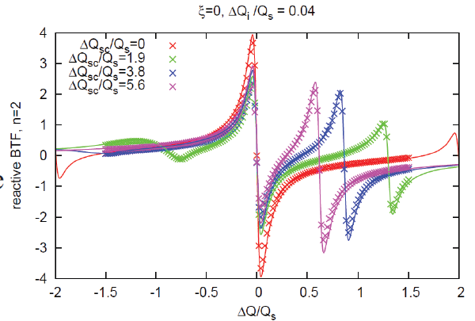
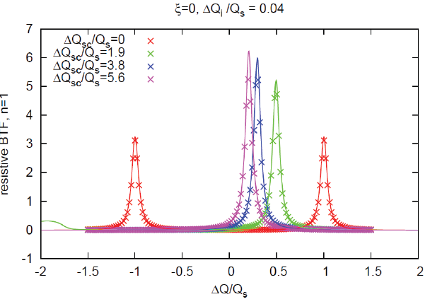
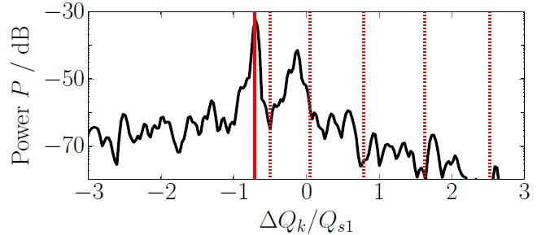
Comparison to advanced theoretical Predictions
Theoretical investigations by other groups
as seen by a beam diagnostics person:
Head-tail modes discussed for instabilities
Eigen-frequencies predicted as a function of q_{sc}
Landau damping stronger for negative modes
Bunch length influences Q_{s}(σ_{bunch} ) ⇒ changes in spectrum
Chromaticity influences the peak height and width
But: Seldom plotted in terms of beam observables
⇒ Prediction missing for height & width for SIS18
Example: Plot of calculated BTF(q_{sc} )
M. Blaskiewicz,
V.H. Ranjbar, PAC’13
reactive BTF_{rea}
k = 0
k = 2
Example: PIC spectrum by code PATRIC (Boine-Frankenheim et al.)
resistive BTF_{res}
q_{sc} = 5
Q_{c} = 0.15⋅Q_{sc}
a = 0.4⋅ b
0
1
2
3 = k
k = -1
k = 1
Measured tune spectrum:
P(ω) = BTF²_{rea}(ω) + BTF²_{res}(ω)
M. Blaskiewisz: Fast head-tail instabilities with space charge, Phys. Rev. Acc. Beams 1, 044201, (1998)
A. Burov, Head-tail modes for strong space charge, Phys. Rev. Acc. Beams 12, 044202, (2009)
O. Boine-Frankenheim et .al., Transverse Schottky noise spectrum for bunches with space charge, Phys. Rev. Acc. Beams 12, 114201, (2009)
M. Blaskiewicz, V.H. Ranjbar Transverse beam transfer functions via Vlasov equation, Proc., PAC2013, Pasadena p. 1427 (2013).
→conclusion

Slide 27
Outline
Outline of the talk:
Motivation: Vision of tune measurement for operational usage
Hardware: BPM system and excitation method
Theoretical expectation: Tune spectra including space charge
Measurements and interpretation: Tune spectra for high intensity beams
Measurement: Quadrupole oscillations
Conclusion

Slide 28
Quadrupole Oscillations with Tune Shift
Envelope oscillation results in a time dependent quadrupole moment of the beam
Occurrence: E.g. injection mismatch by wrong transfer line focusing called ‘beta mismatch’
y
beam
cross section
y
beam
cross section
U_{t}
Beam’s quadrupole moment:
$$x\left(t\right)$$
$$σ_{x}(t)$$
$$\overline{σ_{x}}$$
$$y(t)$$
U_{l}
$$\overline{x,}\overline{y}$$
U_{r}
$$σ_{y}(t)$$
$$\overline{σ_{y}}$$
x
x
U_{b}
Offset & size oscillations:
$x\left(t\right)=\overline{x}+ A_{x}cos(ω_{0}Q_{x}t)$
y$\left(t\right)=\overline{y}+ A_{y}cos(ω_{0}Q_{x}t)$
$σ_{x}\left(t\right)=\overline{σ_{x}}+ A_{xx}cos(ω_{0}Q_{coh,1}t)$
$σ_{y}\left(t\right)=\overline{σ_{y}}+ A_{yy}cos(ω_{0}Q_{coh,2}t)$
Shift of quadrupole lines for coasting beam KV-distribution:
Tune without space charge contribution ΔQ_{sc} = 0:
$Q_{coh,1}=2∙Q_{0,x}$ & $Q_{coh,2}=2∙Q_{0,y}$
Tune with space charge contribution ΔQ_{sc} ≠ 0: $Q_{coh,1}=2∙Q_{0,x}−\frac{1}{2}\left(3−\frac{σ_{x}}{σ_{x}+σ_{y}}\right)ΔQ_{sc,x}$
$Q_{coh,2}=2∙Q_{0,y} −\frac{1}{2}\left(3−\frac{σ_{y}}{σ_{x}+σ_{y}}\right)ΔQ_{sc,y}$
⇒ ΔQ_{sc} can be determined from Q_{coh,1} & Q_{coh,2}
BPM signal: four plate combination
$Ξ ∝\frac{\left(U_{r}+U_{l}\right) − (U_{t}+U_{b})}{U_{r}+U_{l}+U_{t}+U_{b}}$
W. Hardt, On the incoherent space charge limit for elliptic beams, CERN/ISR/Int. 300 GS/66.2 (1966)
I. Hofmann, Stability of anisotropic beams with space charge, Phys. Rev. E 57 (4), 4713 (1997)
M. Chanel, Study of beam envelope oscillations.by measuring the Bema Transfer function with quadrupolar pick-up and kicker, EPAC’96,

Slide 29
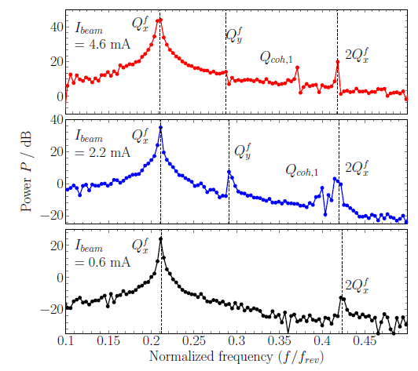
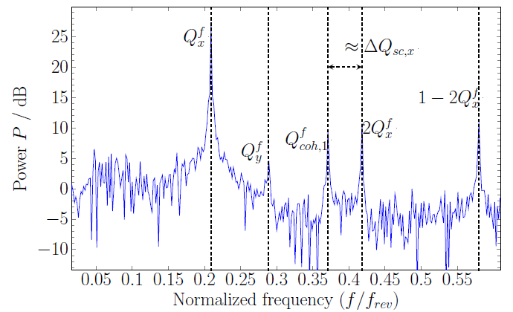
Quadrupole Oscillations with Tune Shift
Example: Horizontal tune spectra (coasting beam)
horizontal beta-mismatch:
Example: Variation of beam current:
BBQ
I_{beam} = 6 mA
1024 turn FFT
Result: in-coherent tune spread ΔQ_{sc} measurable
Technical realization:
uses BBQ setup as for tune
but analog combing (U_{R} + U_{L} ) and (U_{T} + U_{B} ), resp.
presently: no quadrupole exciter available
256 turn FFT
Result:
ΔQ_{sc} shifts with beam intensity
approximately according to expectation
Beam parameter:
N⁷⁺ at 11.4MeV/u,
ε_{x} (2σ) = 32 µm, ε_{y} (2σ) = 51 µm, Q_{x0} = 4.2, Q_{y0} =3.3
$$Q_{coh,1}=2∙Q_{0,x}−\frac{1}{2}\left(3−\frac{σ_{x}}{σ_{x}+σ_{y}}\right)ΔQ_{sc,x}$$
$$Q_{coh,2}=2∙Q_{0,y}−\frac{1}{2}\left(3−\frac{σ_{y}}{σ_{x}+σ_{y}}\right)ΔQ_{sc,y}$$
R. Bär et al., NIM A, 415, 460 (1998), R. Singh et al., Proc. IBIC’14

Slide 30
Summary and Outlook
Experimental finding:
System for online tune measurement realized, excitation with acceptable emittance growth
Measurement of all beam parameters required for correct interpretation of tune spectrum
Tune spectra: Eigen-frequencies significantly shifted for q_{sc} $≳$ 0.5 by head-tail modes
Coherently shifted tune ΔQ_{c} at k = 0 mode ⇒ this value is right number for operation !
However, k = 0 mode is not always the highest peak
⇒ spectrum must be interpreted e.g. by recording the mode structure of bunches !
Estimation of tune spread ΔQ_{sc} available ⇒ usage for operation and MD-times ?
Comparable findings see e.g. V. Kornilov et al., PRST-AB 15, 114201 (2012)
General understandings and outlook:
Estimation of spectrum modification required
Interpretation of in-coherent ΔQ_{sc} required for usage during accelerator operation
Extension to realistic beam e.g. with Gaussian distribution desired
Possible improvement from beam dynamics community: plots of typical beam observables
⇒ desired for tune spectra: Prediction for height & width for actual accelerator setting
Thank you for your attention !

Slide 31
Extra slides

Slide 32
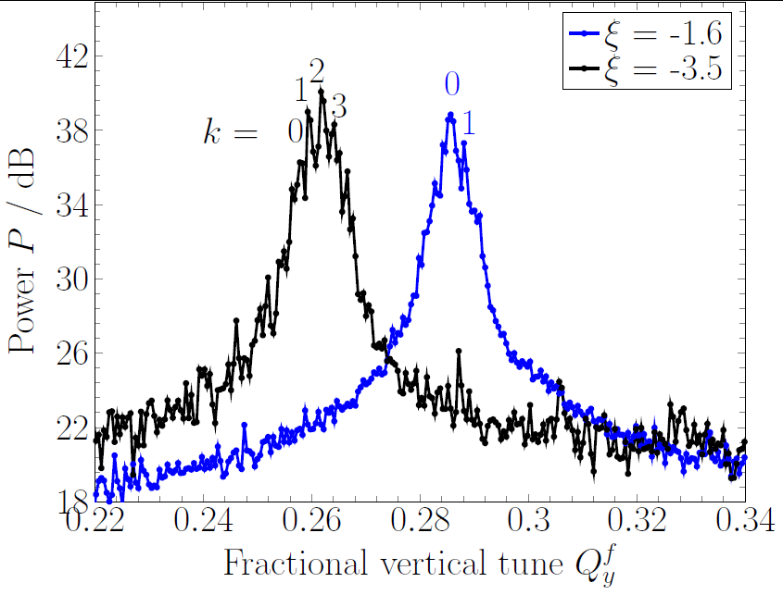
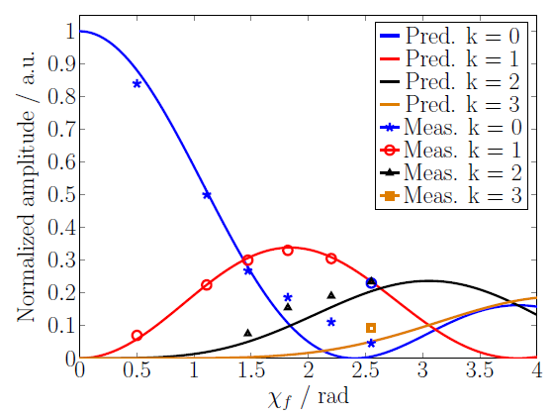
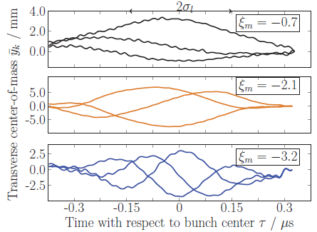
Measurement: Tune Spectra for different chromaticities ξ
Tune spectra for different chromaticities ξ :
Comparison of expectation by Bessel-functions J_{k}(χ_{f} )
to height of measured modes
Beam parameter:
15 ⋅ 10⁹ N⁷⁺ at
11.5 MeV/u
Obvious result:
Amplitude of different modes depend on ξ
⇔ k = 0 is not always the highest peak
Chromatic phase: $χ_{f}=−\frac{ξA_{m}}{η_{0}}$
i.e. dependence on ξ & bunch length A_{m}
Head tail oscillations k = 0:
Bunch shape for different ξ
for 3 consecutive turns:

Slide 33
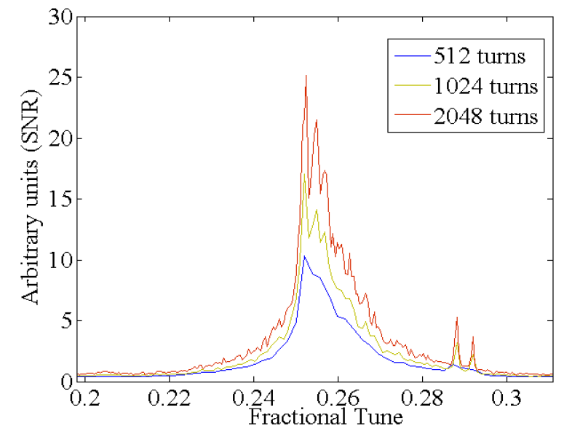
Resolution and Noise Reduction of Tune Spectra
Resolution of tune spectra: Variation of FFT length for 40960 turns
either short FFT length and many averages
or longer FFT and less averages
2 ⋅ 10⁹ ions at 11.4 MeV/u, vertical tune spectrum
Beam: 2 ⋅ 10⁹ ions at 11.4 MeV/u, vertical tune spectrum
R. Singh et al., Proc. HB’10

Slide 34
Position Determination: Integration versus least square Fit
Traditional: Integration
Novel: Ordinary least square fit algorithm:
1. Creation of window of a single bunch with N samples
2. Calculation of sum and difference for each sample:
$Σ_{i}=U_{i,l}+U_{i,r}$ and $Δ_{i}=U_{i,l}−U_{i,r}$ for i = 1...N
‘Plotting’ Δ_{i} versus Σ_{i}
3. Assumption: From $x=\frac{1}{S}∙\frac{Δ}{Σ}$ ⇒ $Δ_{i}=a{∙Σ}_{i} + b$
with a=x⋅S and b as fit parameter
⇒ Least square fit of Δ_{i} as a function of Σ_{i}
General solution for fit parameter a :
$a=\frac{\sum_{i=1}^{N}{\left(Σ_{i}−\overline{Σ}\right)}\left(Δ_{i}−\overline{Δ}\right)}{\sum_{i=1}^{N}{{{ \left(Σ_{i}−\overline{Σ}\right)}^{2}}_{}}}=\frac{cov(Σ,Δ)}{var\left(Σ\right)}$ & $b=\overline{Δ}−a\overline{Σ}$
with average value $\overline{Σ}=\frac{1}{N}\sum_{i=1}^{N}{Σ_{i}}$ & $\overline{Δ}=\frac{1}{N}\sum_{i=1}^{N}{Δ_{i}}$
4. Position $x=a/S$ i.e. from fit value from diff-over-sum
Advantage:
No baseline reconstruction required
Robust against offset etc. (here fit parameter b)
i.e. high common and differential mode suppression
Easy to implement
For closed orbit: window over many bunches
Example: One turn @ 35 MeV/u
1. Creation of window for
one bunch of N samples
2. Determine baseline values B_{l/r}
3. Subtraction U_{i,L/r} – B_{l/r} for i = 1...N
4. Integration of bunch signal
$I_{l/r}=\sum_{i=1}^{N}{\left(U_{i,l/r}−B_{l/r}\right)}$
5 .Position: $x=\frac{1}{S}∙\frac{I_{l}−I_{r}}{I_{l}+I_{r}}$
S is the position sensitivity

Slide 35
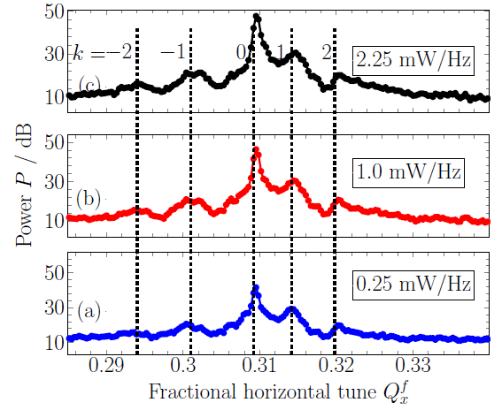
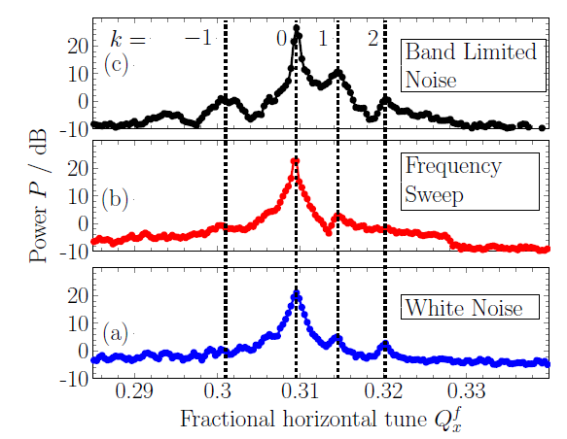
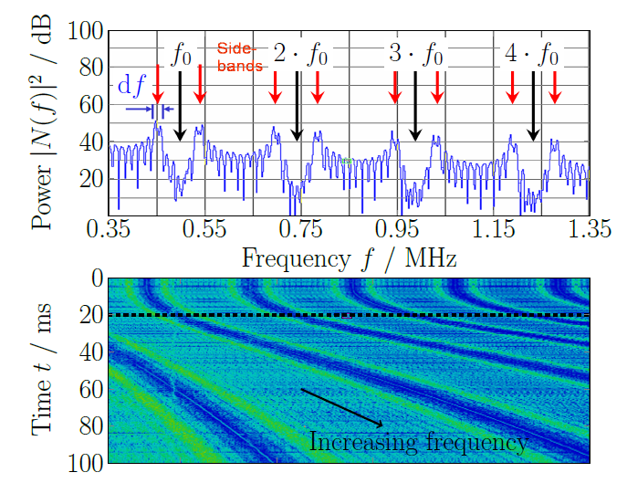
Tune Spectra for different experimental Parameter
Variation of excitation power:
Variation of excitation type:
Result:
signal-to-noise varies
general tune spectrum remains
Beam parameter:
5⋅10⁸ U⁷³⁺ at 11.4 MeV/u
Result: No significant difference
Spectrum of
band limited
noise:

Slide 36
Analytical Theory : High Intensity Effects
longitudinal profile
Synchrotron tune
distribution
momentum distribution
Real bunch
voltage
time
Model
(Airbag distribution)
voltage
time
The model allows analytical solution of the Vlasov equation including space charge forces
⇒ $ΔQ_{k}=−\frac{∆Q_{sc}+∆Q_{coh}}{2}±\sqrt{\frac{(∆Q_{sc}−∆Q_{coh})^{2}}{4}+(kQ_{s})^{2}}$
THEORY : M. Blazkiewicz, Fast head tail instability with space charge, Phys. Rev ST Accel. Beams 1, 044201, (1998)
SIMULATIONS : O. Boine-Frankenheim and V. Kornilov, Transverse Schottky noise spectrum for bunches with space charge,Phys. Rev ST Accel. Beams 12, 114201, (2009)

