Slide 1
Design of Coronagraph for the observation of beam halo at LHC
Toshiyuki Mitsuhashi (KEK),
Enrico Bravin,
Rhodri Jones,
Federico Loncarolo
Hermann Schmickler,
Georges Trad (CERN)

Slide 2
Agenda for my talk
What is the coronagraph
Plan of observation of beam halo with coronagraph in the LHC
Diffraction analysis for phase 1 coronagraph
Mie-scattering noise from optical component surface
Arrangement of phase 1 coronagraph on B2 optical table
Optical testing of Phase 1 coronagraph with 30m optical testing line
How is the performance of coronagraph limited?
Phase 2 coronagraph
Possibility of appodization to reduce leakage diffraction fringes

Slide 3
What is the coronagraph?
an introduction

Slide 4
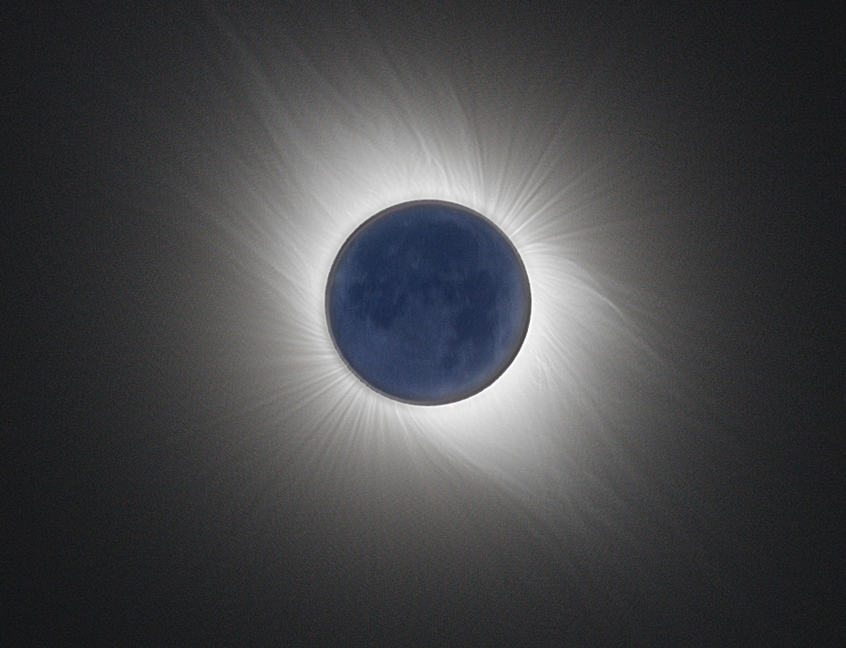
Everything was start with astronomer’s dream……
Eclipse is rare phenomena, and only few second is available for observation of sun corona, prominence etc.
Artificial eclipse was dream of astronomers, but……..

Slide 5
The coronagraph to observe sun corona
Developed by B.F.Lyot in 1934 for a observation of sun corona by artificial eclipse.
Special telescope having a
“re-diffraction system” to eliminate the diffraction fringe.

Slide 6
Optical system of Lyot’s corona graph
Field lens
Relay lens
Baffle plate (Lyot stop)
Objective lens
Opaque disk
Baffle plates to reduce reflection

Slide 7
3 stages-optical system in the Lyot’s coronagraph
1st stage : Objective lens system
2ed stage : re-diffraction system
3ed stage :
Relay lens

Slide 8
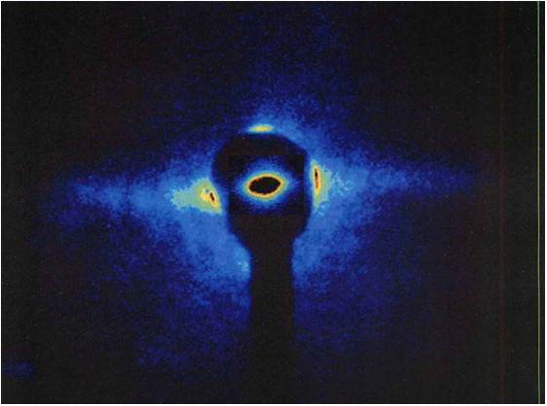
Observation inPF,KEK 2005
Beam core + halo (superimposed)

Slide 9
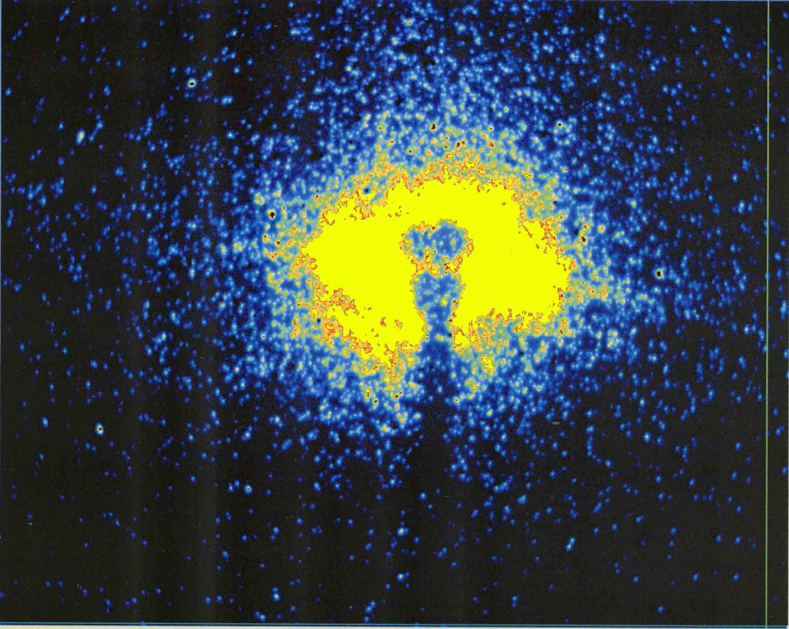
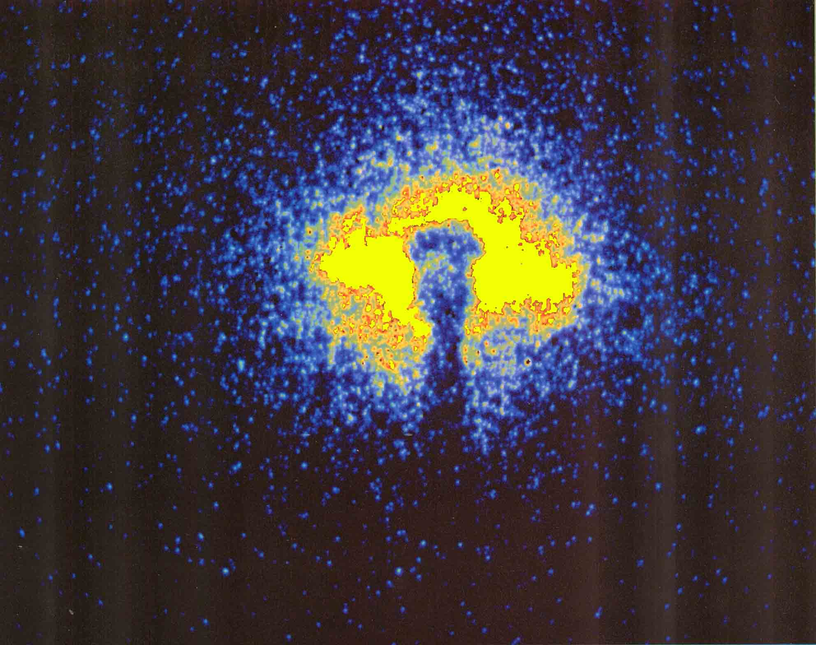
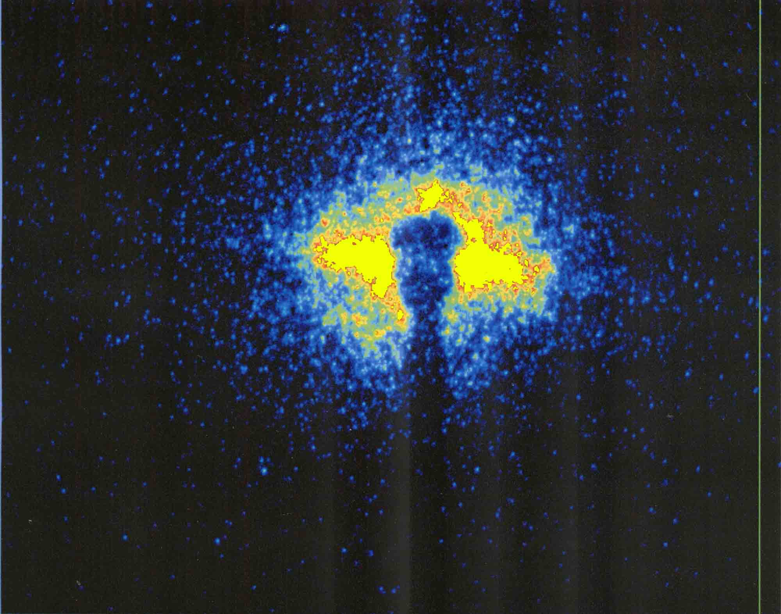
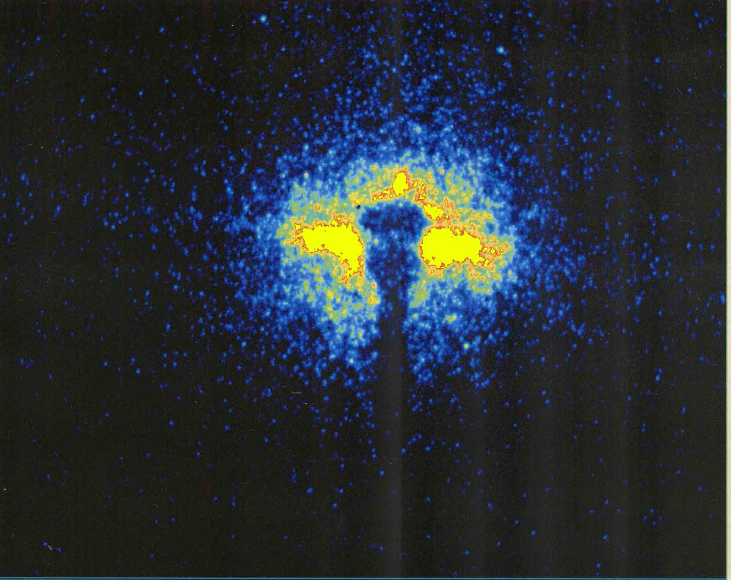
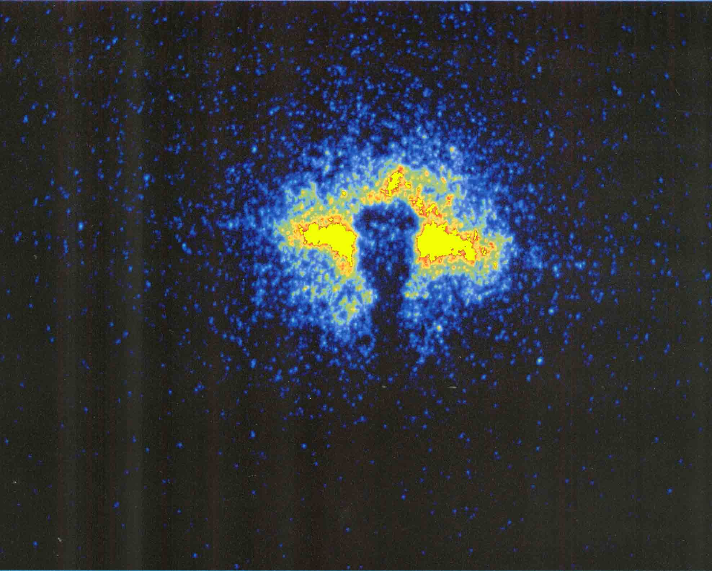
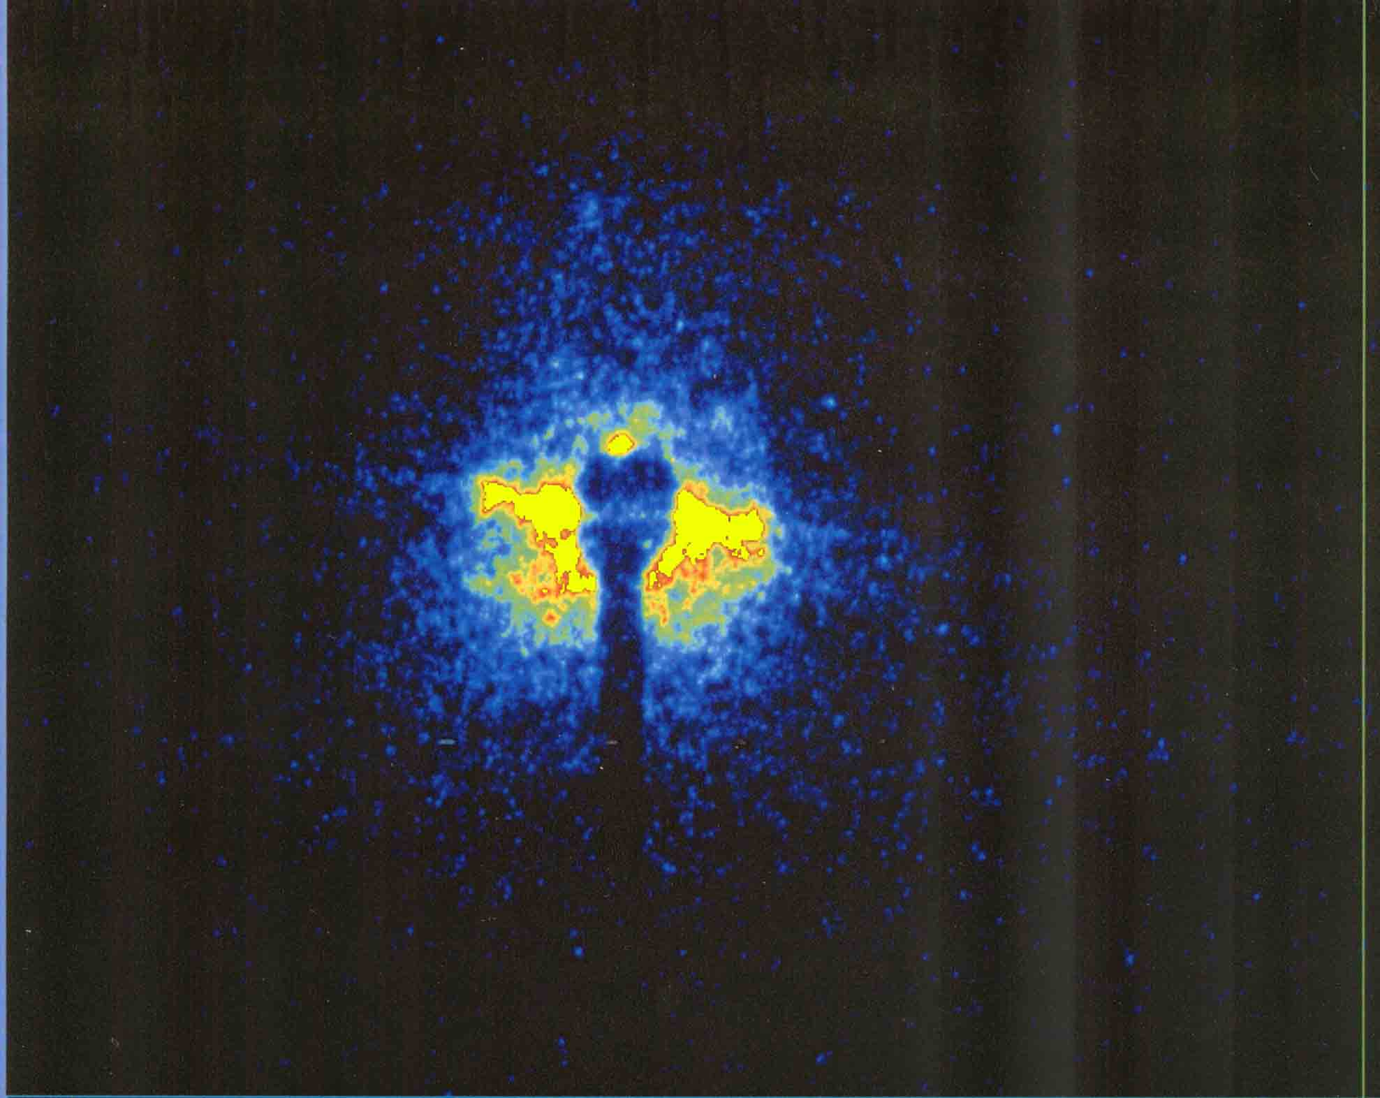
Beam halo images in the single bunch operation at the KEK PF measured at different current 2005.
65.8mA
61.4mA
54.3mA
45.5mA
35.5mA
396.8mA
Multi-bunch
bunch current 1.42mA

Slide 10
2. Plan of halo observation by using the coronagraph in LHC
The coronagraph is planned to apply for an observation of beam halo image in the LHC. This project will perform by two phases.

Slide 11
Phase1: Test observation,
Designed and constructing a coronagraph by modifying the optical design of coronagraph constructed in 2005 in the KEK.
Aiming a halo observation with 10³ to 10⁴ contrast to the beam core, and it will set in B2 SR monitor line.
Phase2: Design and construct an optimum coronagraph for the LHC,
aiming 10⁵ to 10⁶ contrast.

Slide 12
Table1: Key conditions for design the coronagraph
at PF (2005) and LHC (2015).
 | PF (BL28) | LHC(B2)
Distance between source point and objective lens | 8.0m | 28.5m
Beam size in horizontal (1σ of beam core) | 263μm | 330μm/3.75μmrad 270μm/2.5μmrad
Beam size in vertical (1σ of beam core) | 80μm | 430μm/3.75μmrad 350μm/2.5μmrad
Minimum size of opaque disk against beam core | 6σ of beam core | 5 σ of beam core

Slide 13
Table2: The optical design of previous
and phase 1 coronagraph.
 | PF (BL28) | LHC(B2)
Focal length of objective lens | 2000mm | 2000mm
Objective lens aperture | 50 x 50mm | 25 x 25 mm
Transverse magnification | 0.333 | 0.0754
Opaque disk size in radius | 0.5mm | 0.110-0.162mm
Focal length of field lens | 500mm | 800mm
Movable range of Lyot stop | 2 x 2mm to 20 x 20 mm | 2 x 2mm to 20 x 20 mm
Focal length of relay lens | 36mm | 500mm

Slide 14
3. Diffraction analysis
for
Phase 1 Coronagraph

Slide 15
Diffraction from first objective system
The entrance pupil of the objective lens

Slide 16
Diffraction in first stage λ=500nm
Magnification of objective system=0.0754

Slide 17
Opaque disk
Function of the field lens : make a image of objective lens aperture onto Lyot stop
Field lens
Objective system
Re-diffraction optics system
Re-diffraction optical system
Opaque disk

Slide 18
Diffraction in re-diffraction system

Slide 19
Opaque disk
Blocking diffraction fringe by
Lyot stop
Objective
lens
Re-diffraction optics system
Re-diffraction optical system
Opaque disk

Slide 20
Lyot stop at +/-5mm

Slide 21
Diffraction background in final image plane

Slide 22
Overflowed fringe inside of Lyot stop
?
Blocking diffraction fringe by
Lyot stop

Slide 23
Diffraction background at 3ed stage
in log scale
3.7x10⁻⁴

Slide 24
Diffraction pattern will be localized in Vertical and horizontal plane, we can possibility to distinguish halo from diffraction by rotating field.

Slide 25
Diffraction pattern will be localized in Vertical and horizontal plane, we can possibility to distinguish halo from diffraction by rotating field.

Slide 26
4. Mie-scattering noise from optical component surface

Slide 27
Background source in coronagraph
Noise from defects on the lens surface (inside) such as scratches and digs.
2. Noise from the optical components (mirrors) in front of the coronagraph.
3. Reflections in inside wall of the coronagraph.
4. Noise from dust in air.
5. Rayleigh scattering from air molecule.

Slide 28
Background source in coronagraph
Noise from defects on the lens surface (inside) such as scratches and digs.
2. Noise from the optical components (mirrors) in front of the coronagraph.
3. Reflections in inside wall of the coronagraph. Apply baffles
4. Noise from dust in air. Apply dust filter
5. Rayleigh scattering from air molecule.
Not significant in few ten meter optical path

Slide 29
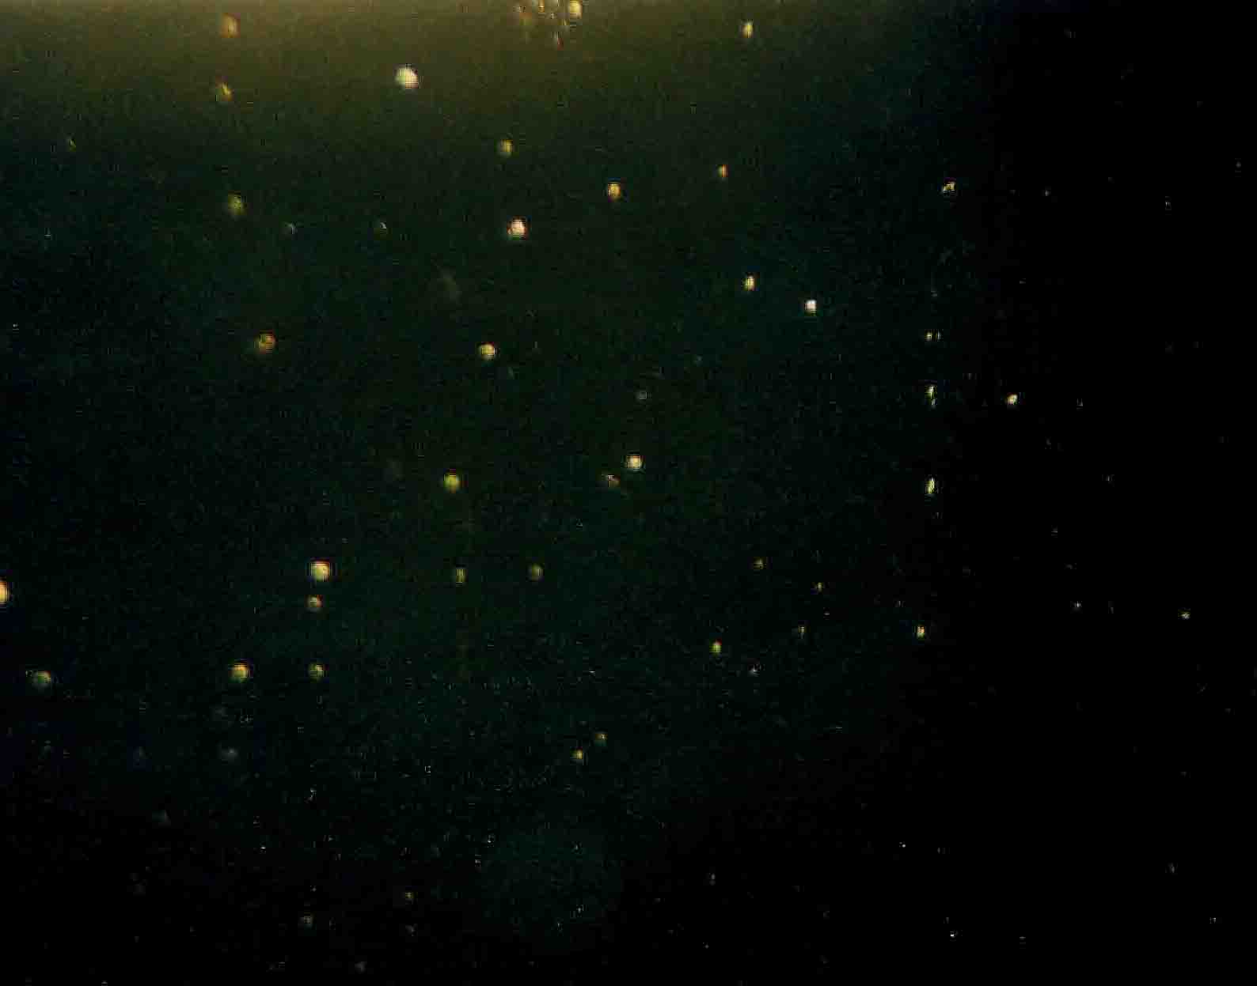
Digs on glass surface of scratch & dig 60/40
The optical surface quality 60/40 guarantees no larger scratches than 6μm width, and no larger dig than 400μm.
200μm
5mm

Slide 30
Noise source in the pupil has two effects,
Refraction in noise source
phenomena in sun or moon halo is produced by this effect.
Mie scattering by noise source
opaque dust or dig on lens or on any optical components are classified this effect.
Dust in air also has same effect.

Slide 31
Mie scattering,
it’s diffraction treatment

Slide 32
Case 1. Noise source in the entrance pupil of
objective lens
P(x, y): pupil function with assembly of diffraction noise sources on the lens
d₀
d_{i}

Slide 33
Let us approximate i-th noise source in the pupil as a opaque disk having a diameter of r₀ , Using the Babinet’s principle,
=
i-th noise source which spread in the aperture
Then pupil function having many noise source is given by,

Slide 34
When the mean distance of noise source is longer than 1st order transverse coherent length , pupil function with noise sources is simply given by,
Then the impulsive response on the image plane is given by,
in here, M=d_{i} /d₀ denotes geometrical magnification.

Slide 35
The intensity of diffraction from noise sources is inverse-proportional to extinction rate,
Extinction rate = entrance pupil aperture area
/ total area of noise source
To escape from noise produced by the objective lens is most important issue in the coronagraph!!

Slide 36
Simulation result of background produced by dig on objective surface

Slide 37
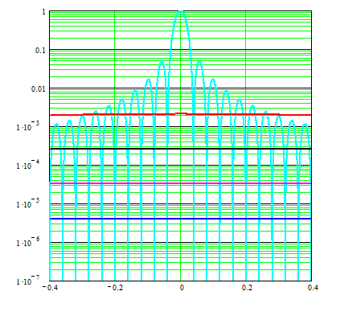
A zoom up plot near Airy disk
400μm
200μm
100μm
50μm

Slide 38
How to eliminate Mie scattering??
A careful optical polishing for the
objective lens.
Reduce number of glass surface.
use a singlet lens for the objective lens.
3. No coating (Anti-reflection, Neutral density etc.) for objective lens.

Slide 39
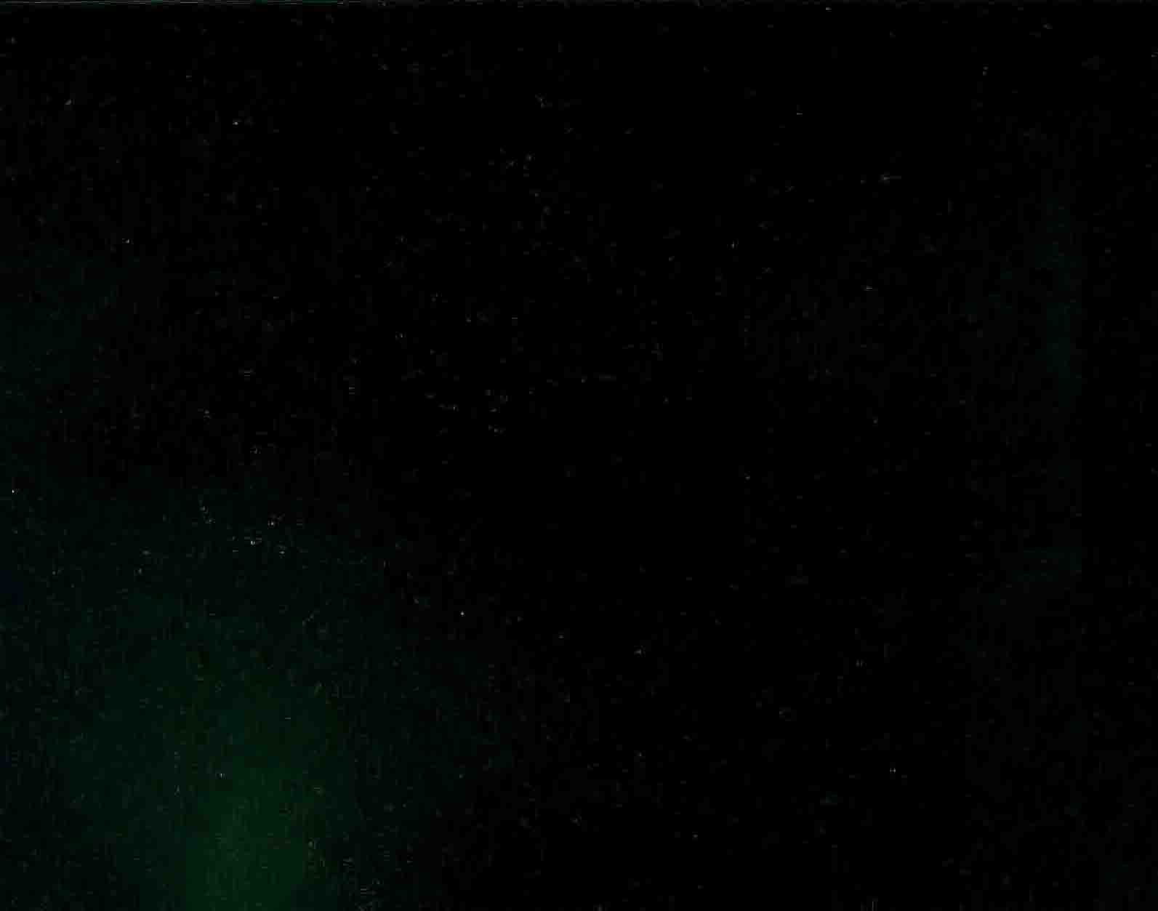
Comparison between normal optical polish and careful optical polish for coronagraph
S&D 60/40 surface of the lens
Surface of the coronagraph lens

Slide 40
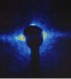

Example of Mie-Scattering noise

Slide 41
5. Arrangement of phase 1 coronagraph on B2 optical table

Slide 42
Present Layout B2
Imaging line
Calibration line

Slide 43
Arrangement of the Phase 1 coronagraph

Slide 44
Surrounding dark box and tubes

Slide 45
6. Optical testing of Phase 1 coronagraph with 30m optical testing line

Slide 46
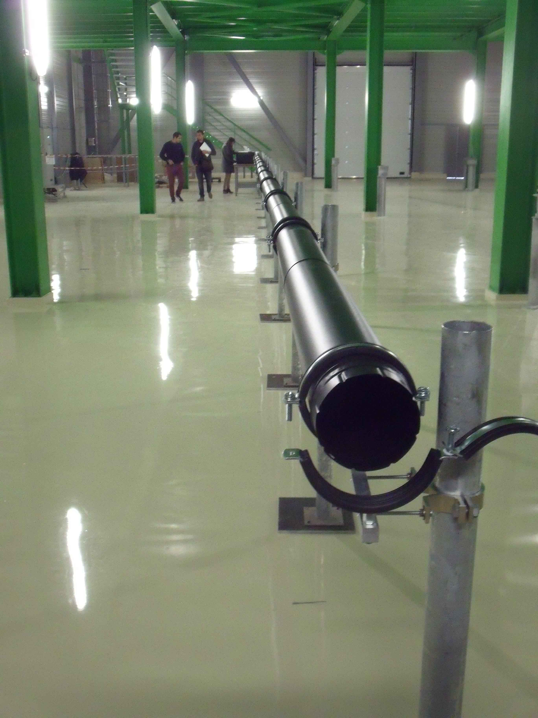
30m Optical testing line for Phase 1 coronagraph

Slide 47
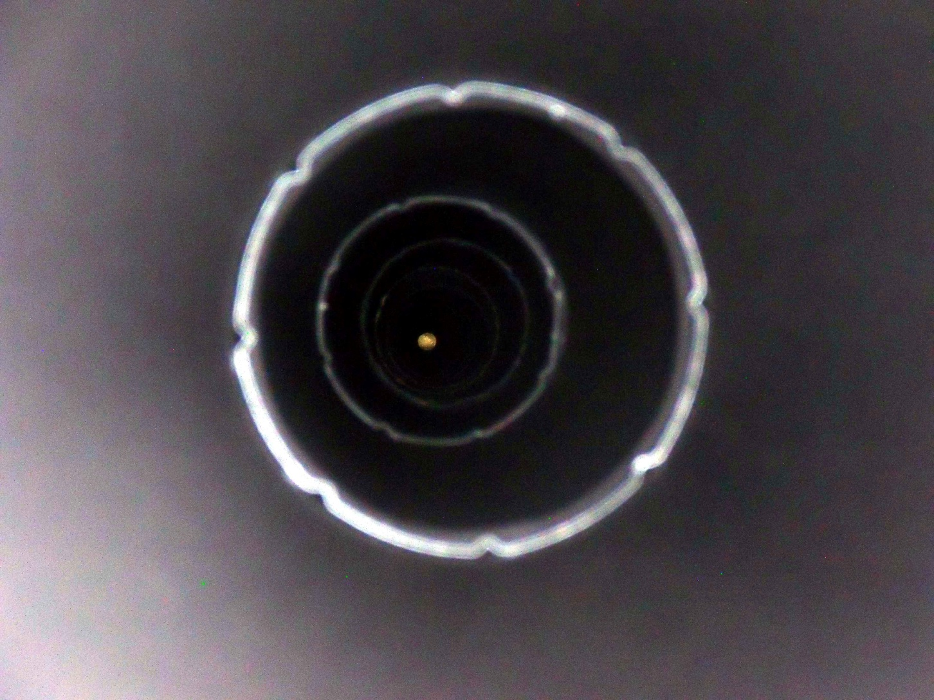
Inside view of 30m duct
Opposite end of duct

Slide 48
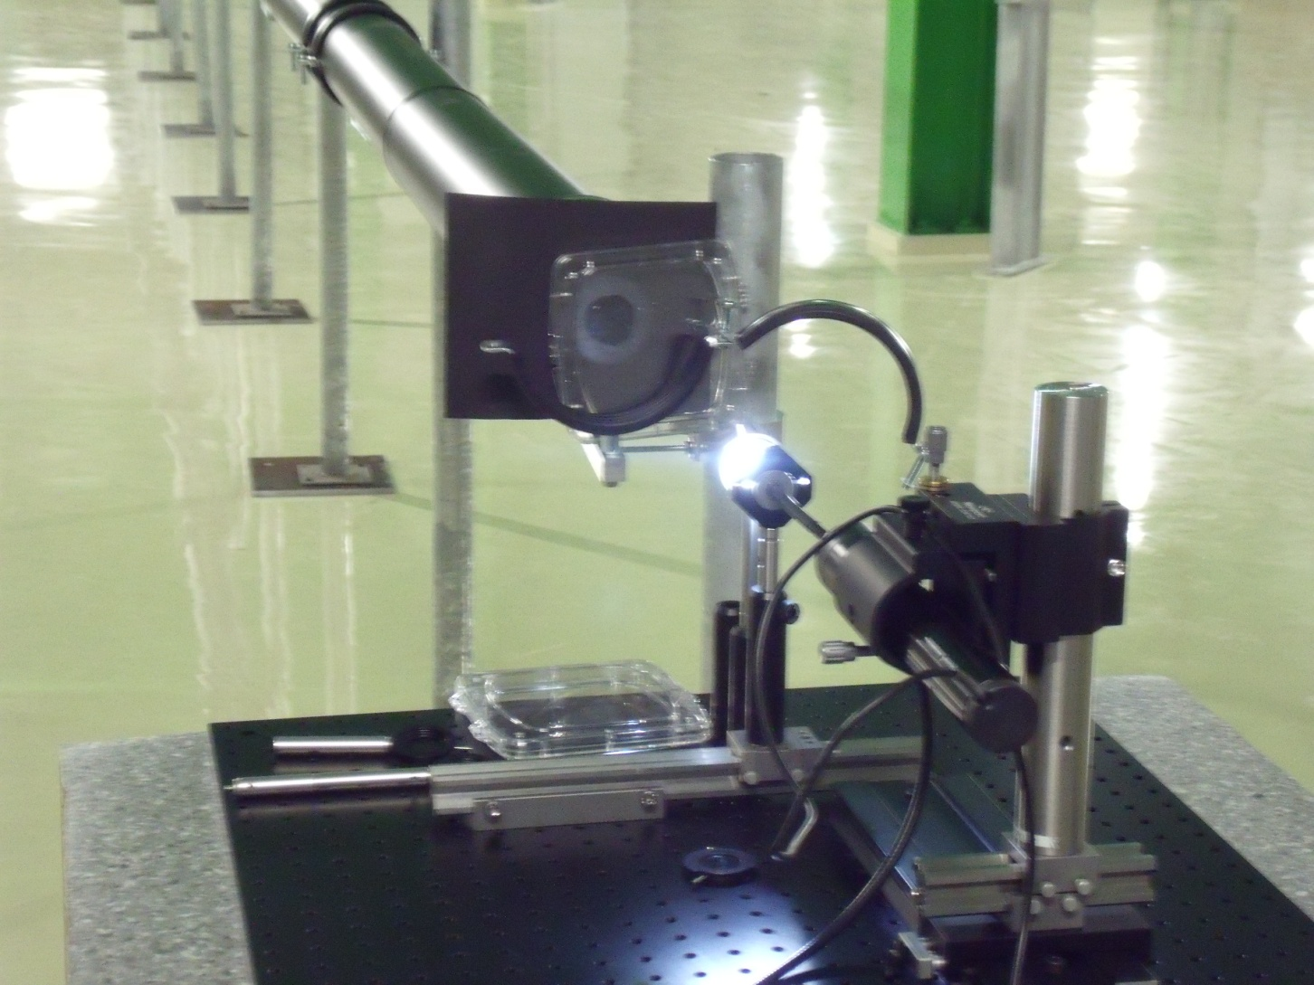
Light source

Slide 49
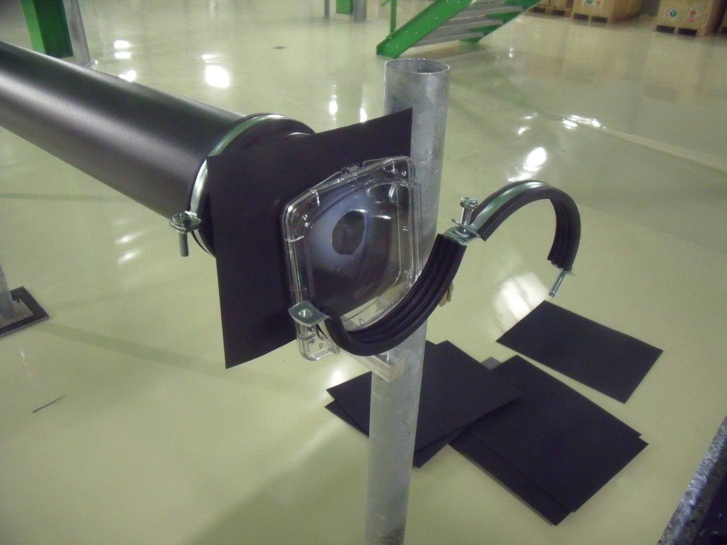
Artificial halo source, plastic plate with some finger prints.

Slide 50
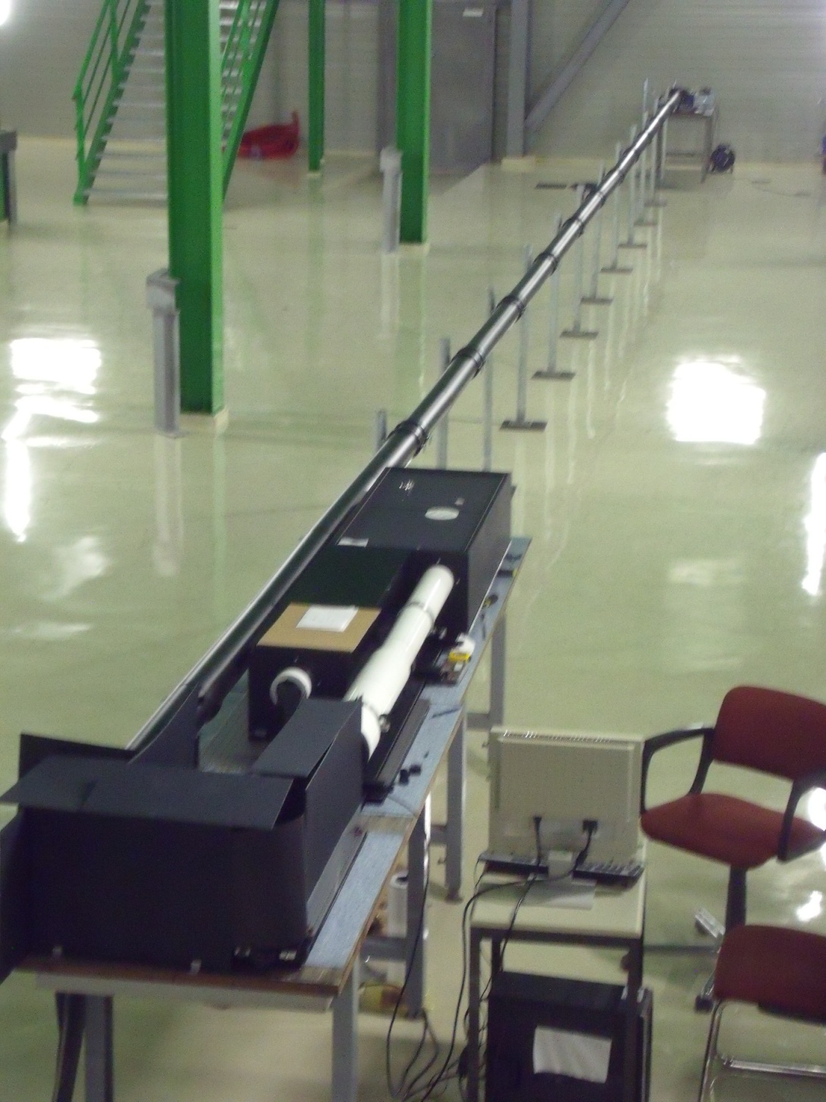
Phase 1 coronagraph set on one end of optical line

Slide 51
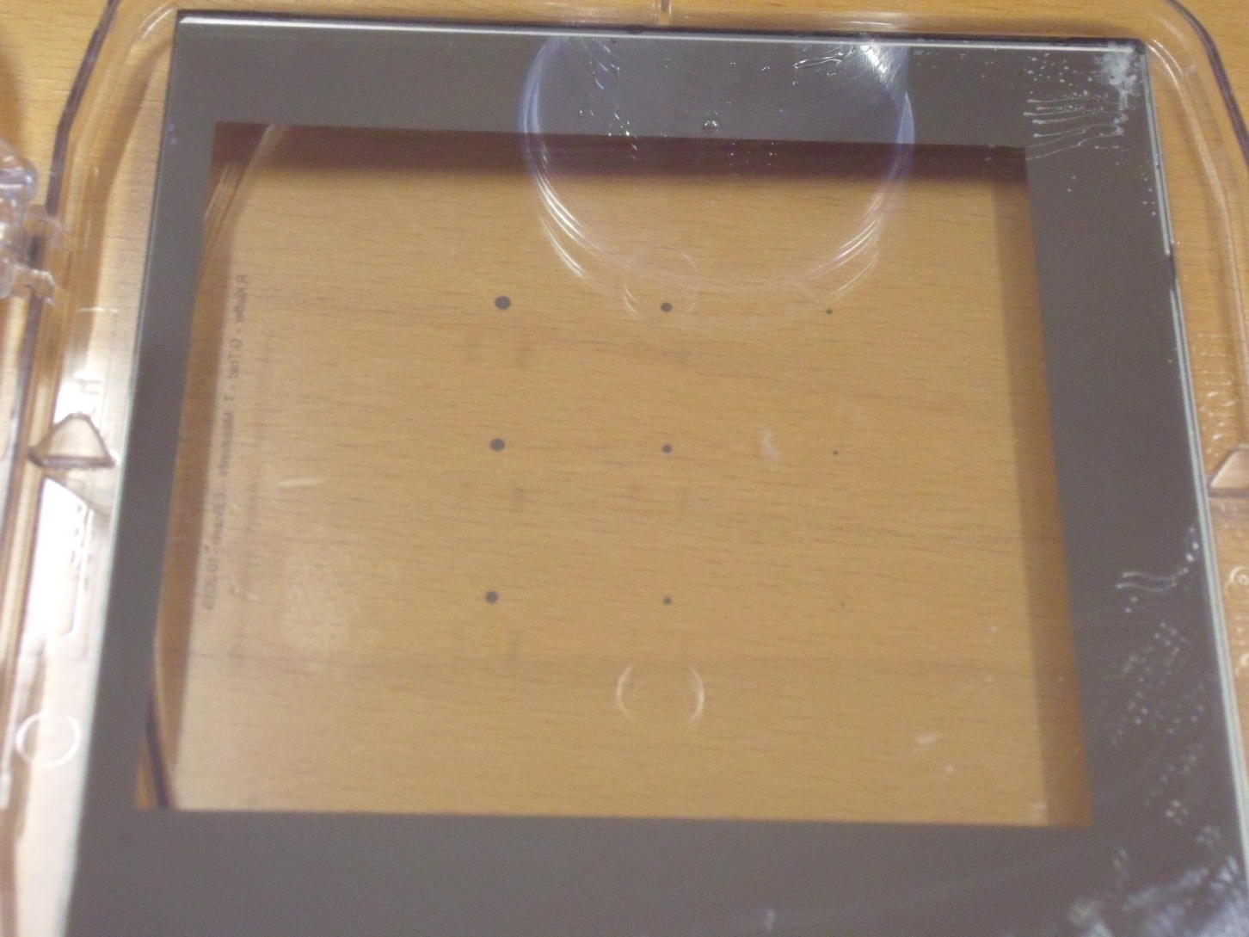
Opaque disk assembly, 200μm to 2000μm by 225μm pitch

Slide 52
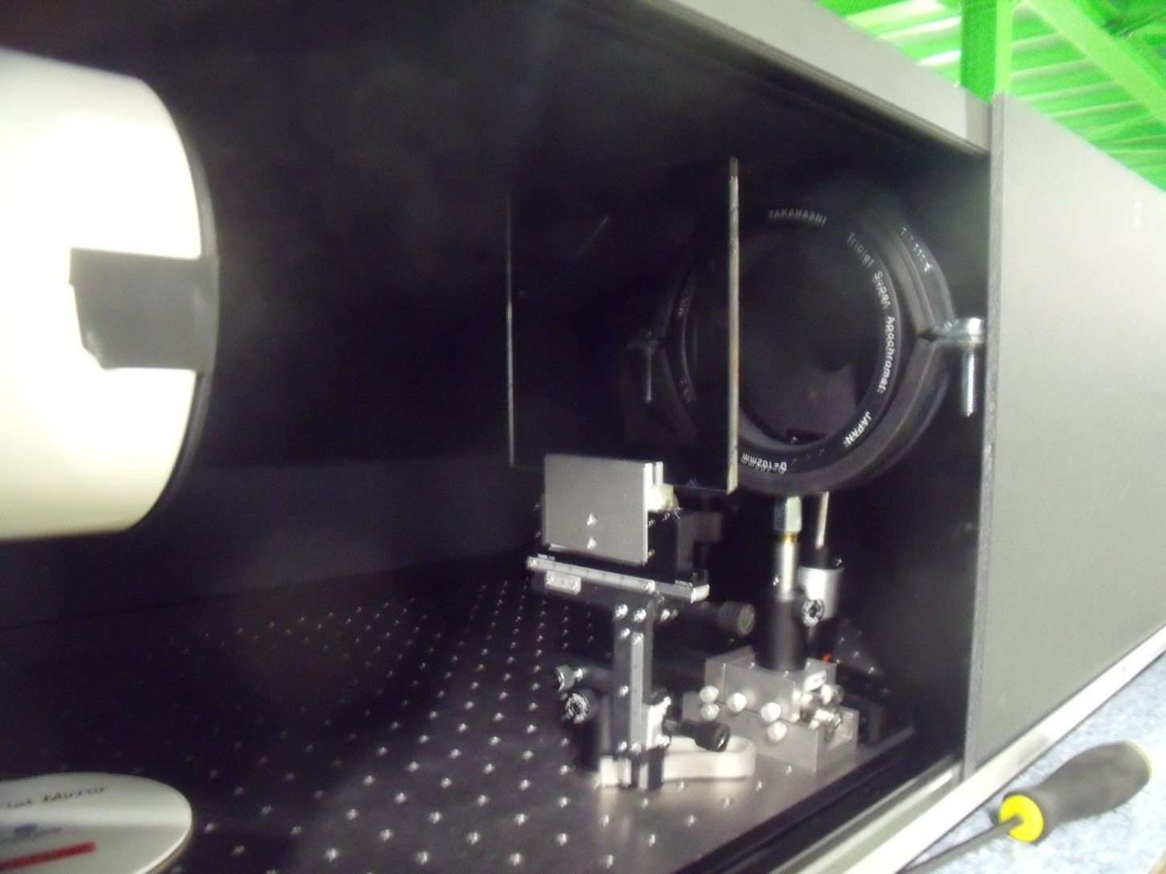
Opaque disk and field lens for re-diffraction system

Slide 53
Exposure time 50μsec, light source
400-500μm in diameter

Slide 54
425μm Exposure time 250msec
Annular eclipse

Slide 55
425μm Exposure time 250msec with Artificial halo

Slide 56
425μm Exposure time 500msec

Slide 57
425μm 500msec Artificial halo

Slide 58
425μm 1000msec

Slide 59
2x10⁻⁷ to the peak intensity
425μm Exposure time 10sec
1x10⁻⁴ to the peak intensity

Slide 60
650μm Exposure time 250msec
Almost full eclipse

Slide 61
650μm 250msec artificial halo

Slide 62
625μm exposure time 500msec with artificial halo

Slide 63
624μm Exposure time 1000msec
With artificial halo

Slide 64
Summary for phase 1 coronagraph design
Coronagraph optics for phase 1 observation of beam halo is designed for B2 SR monitor beam line at LHC.
From diffraction analysis the background in phase1 coronagraph from leakage of diffraction fringe is estimated to 3.7x10⁻⁴. Other of 2 fringes in the centre, most of diffraction fringes have intensities of 10⁻⁵ to 10⁻⁶ range.
The digs having a diameter smaller than 100mm are the majority. An order of 10⁻⁴ to 10⁻⁵ background can be appeared phase 1 using the B2 SR monitor line.

Slide 65
7. How is the performance of coronagraph limited?

Slide 66
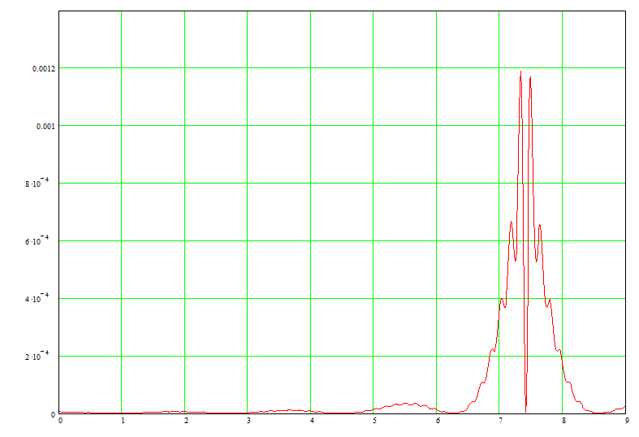
Corse period correspond to inner aperture diameter
Fine period correspond to outer aperture diameter

Slide 67
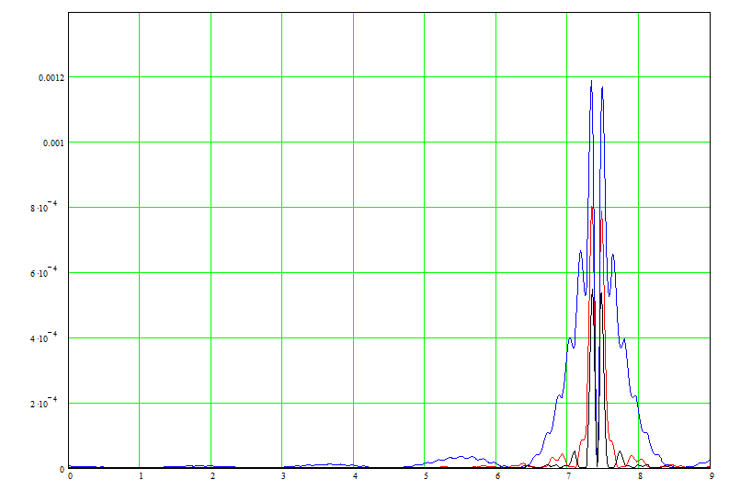
Back to diffraction fringe on Lyot stop
0.162mm
0.6mm
1.0mm

Slide 68
Back to diffraction fringe on Lyot stop
0.162mm
0.6mm
1.0mm
Larger opaque disk has small diffraction fringe

Slide 69
As in previous slide, the diffraction pattern produced by the field lens aperture has two kind of period;
Rough period come from diameter of opaque disk
Fine period come from outer diameter of the field lens.
The measure leakage of diffraction fringe in inside of Lyot stop is mainly come from the 1st one.

Slide 70
8. Phase 2 coronagraph
1. The leakage of diffraction fringe reduces by increase of opaque disk diameter.
We can realize better contrast with bigger image size of the beam core.
We should design the focal length of objective lens longer.
2. Chromatic shift on optical axis is given by focal length divided by the Abbe number, designing long focal length means increase of chromatic foal shift.
We should apply reflector focusing system for the objective instead of the objective lens system in phase 2.

Slide 71
Coronagraph having a magnification of 0.5
Opaque disk
Lyot stop
16000mm
8000mm
8000mm
4000mm
5000mm
5000mm
Objective lens
Field lens
relay lens

Slide 72
Reduction the actual length of long focus of the simple objective lens with a combination of focus and defocus lenses.
Telephoto type lens

Slide 73
Telephoto type with reflectors
First mirror
concave
Focus of first mirror
Synthesized focus of two mirrors
Second mirror
convex

Slide 74
Optical design
Entrance pupil for the first stage
First mirror
concave
R=4000mm
Objective mirror system f=8000mm
Magnification ≈0.5
1700mm
Field lens
5200mm
Second mirror
convex
R= -800mm
Entrance pupil for re-diffraction system
5000mm
5000mm
Relay lens
Magnification =1
Lyot stop
8mm x 8mm

Slide 75
For easy alignment, use on axis focusing system
m₁
m₂
_{bf}

Slide 76
Put an aperture at certain height h
h
m₁
m₂
_{bf}

Slide 77
Put an aperture at certain height h
h
m₁
m₂
_{bf}
R₁=4000mm, M=4, Cf=8000mm, R₂=-800mm

Slide 78
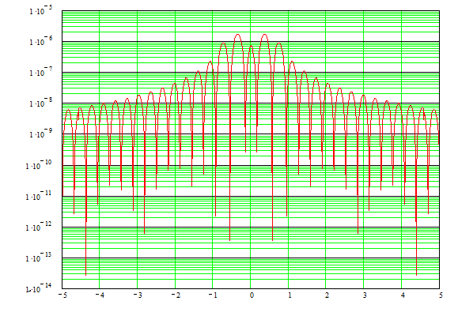
Diffraction background at 3ed stage
In Log scale 2x10⁻⁶ to 10⁻⁷

Slide 79
9. Possibility of appodization to reduce leakage diffraction fringes

Slide 81
Main diffraction fringe can eliminate by Lyot stop
Small diffraction fringes are stil existing in inside of Lyot stop

Slide 82
Appodization at aperture of relay lens . A new idea for coronagraph
Since usual appodization is applied to the objective lens aperture. And it is not applicable for coronagraph because it’s Mie scattering noise.
We can apply an appodization at relay lens aperture which is conjugated point to objective lens aperture.

Slide 83
Opaque disk
Lyot stop
16000mm
8000mm
8000mm
4000mm
5000mm
5000mm
Objective lens
Field lens
relay lens
Gaussian appodization filter at relay lens aperture

Slide 84
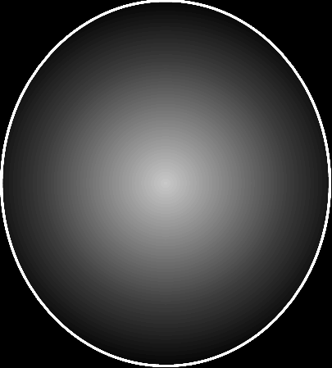
Appodization of Gaussian graduation
On relay lens aperture

Slide 85
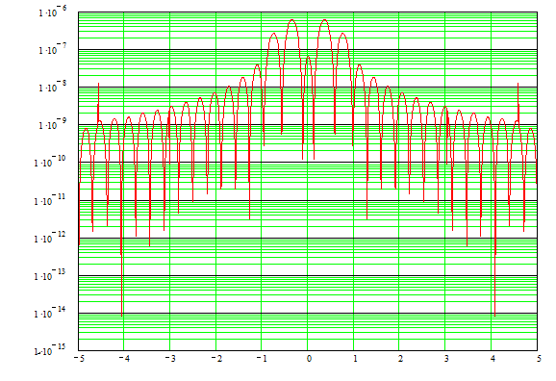
Gaussian appodization a=3mm

Slide 86
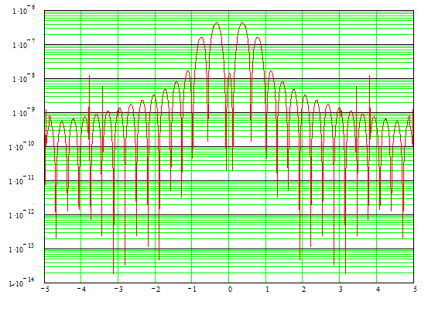
Gaussian appodization a=2.5mm

Slide 87
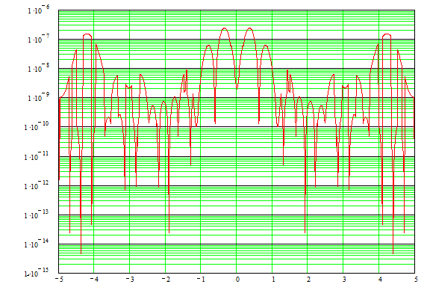
Gaussian appodization a=2mm

Slide 88
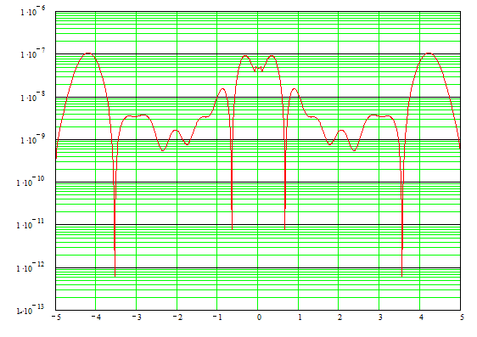
Gaussian appodization a=1.5mm

Slide 89
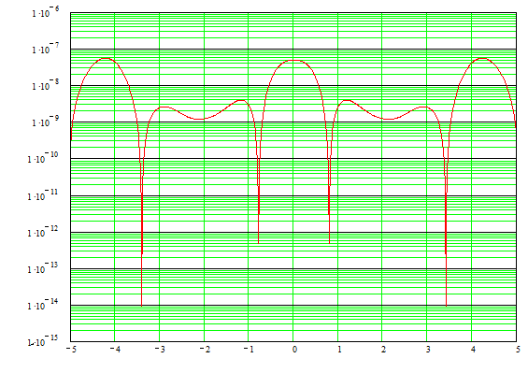
Gaussian appodization a=1mm

Slide 90
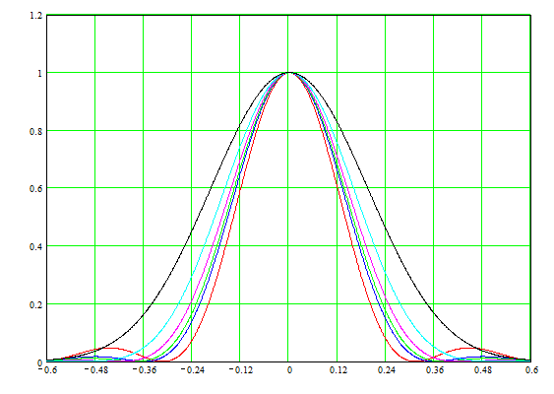
Reduction of spatial resolution at final image
1.5mm
4mm

Slide 91
Conclusion from Gaussian appodization
Gaussian appodization at relay lens aperture can improve the contrast of noise diffraction.
Such appodization increase width of diffraction for halo image, and will reduce spatial resolution.
Appodization also reduce illumination from halo onto the relay lens aperture and reduce the intensity of halo image. So careful comparison of contrast between noise diffraction and halo image will necessary

Slide 92
Please note this discussion is only for the theoretical background produced by diffraction phenomena. Reducing practical backgrounds such as Mie scattering from optical components are other issues.

Slide 93
Thank very much for your attention!

