Slide 1
Residual Gas Ionization Profile Monitors (IPM) @ Fermilab
4 November 2015
Beam Dynamics Meets Diagnostics
Jim Zagel

Slide 2
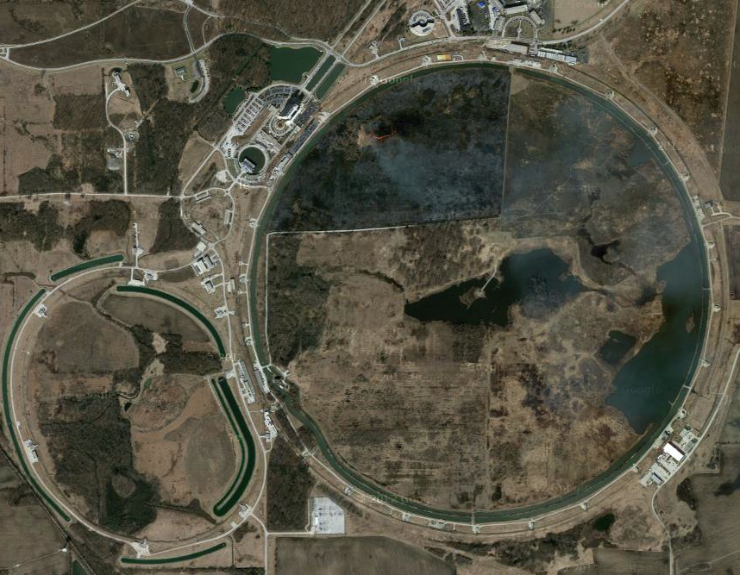
Fermilab In the NOvA ERA
ν to Nova
Proton Source and Linac
Booster Synchrotron
Tevatron
Muon Campus
Recycler and
Main Injector
Jim Zagel, R.Thurman-Keup | Beam Profile Measurement at Fermilab Using Residual Gas Ionization Profile Monitors

Slide 3
Fermilab IPM Basic Types
Booster (400MeV – 8 GeV)
  Electrostatic 10KV Clearing Field)
Main Ring (8 GeV -150GeV)
  Electrostatic 30KV Clearing Field
Recycler Ultra High Vacuum (8 GeV)
  Electrostatic 30KV Clearing Field, e-11 Torr vacuum.
Main Injector Mark-II (8 GeV -150GeV)
  Permanent Magnetic Field 1KG and 10KV Clearing Field.
Main Injector Mark-III (8 GeV -150GeV)
  Adds a Control Grid and Flash Test Strip.
Tevatron (150 GeV – 1 TeV)
  Electromagnet 1 KG and 10KV Clearing Field.

Slide 4
IPM Concept Electrostatic
Clearing Field Anode (8-30KV)
Electrons
Field shaping electrodes
Beam
(into page)
Ionization Happens
Ions
Wire mesh RF Shield
Microchannel Plate (MCP)
Anode strips
for Signal Pickup

Slide 5
IPM Concept Magnetic Containment
Magnet with vertical B field
Cathode -10 KV
Electron Suppression Grid
Ions
Field shaping electrodes
Beam
(into page)
Ionization Happens
Electrons
Wire mesh gate
Microchannel Plate (MCP)
Anode strips
500 μm spacing

Slide 6
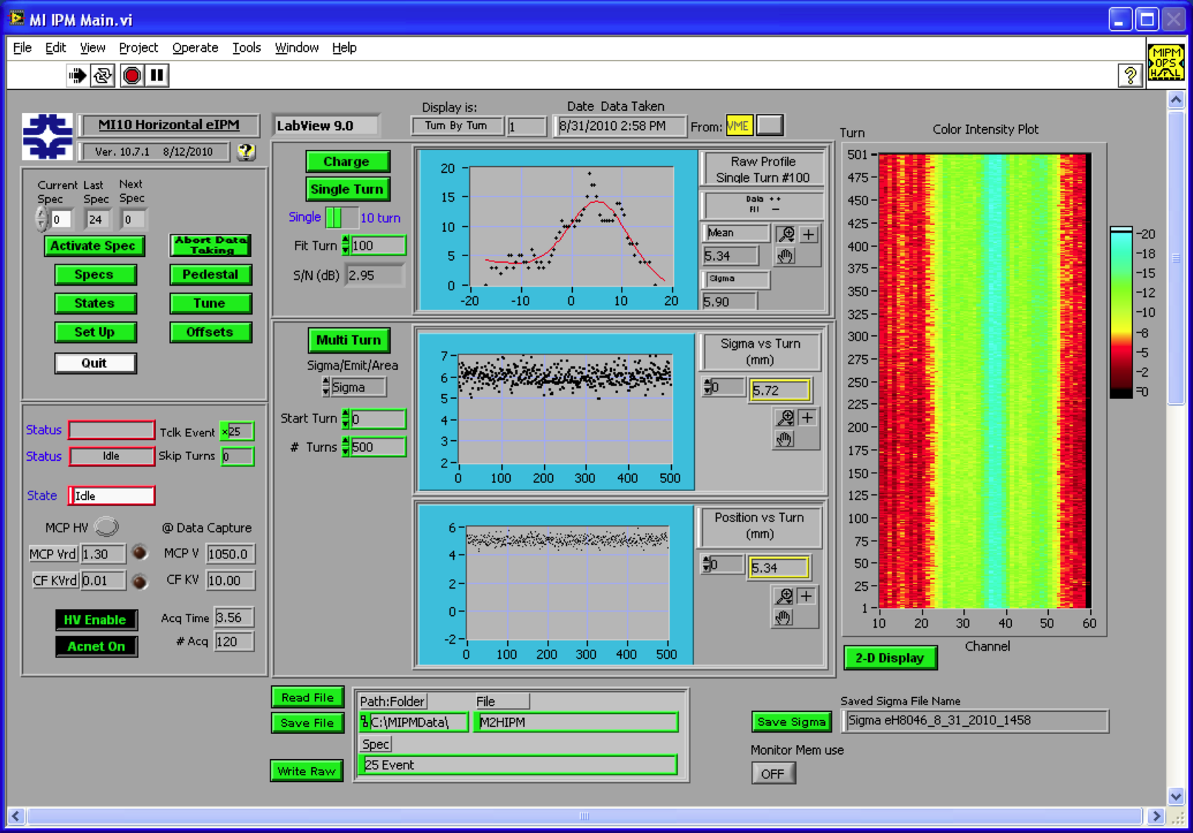
Main Injector’s “Three Headed Monster”
Negative Clearing Field collecting electrons

Slide 7
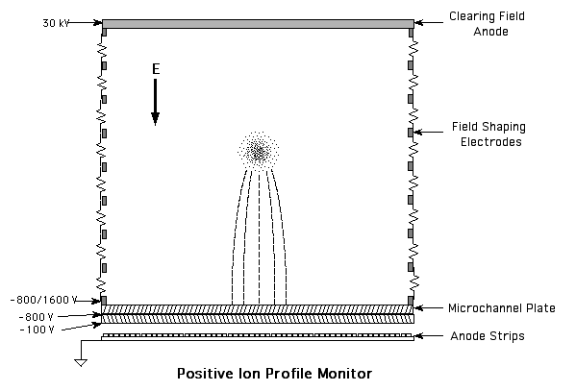
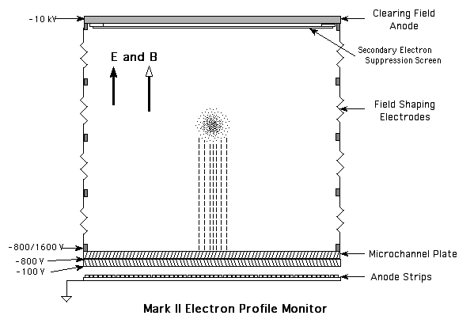
Ion vs Electron
Positive Ion Collection
Electron Collection
Combined Signal from Electrons plus Secondary's
From 10/3/2003 TIPM Review

Slide 8
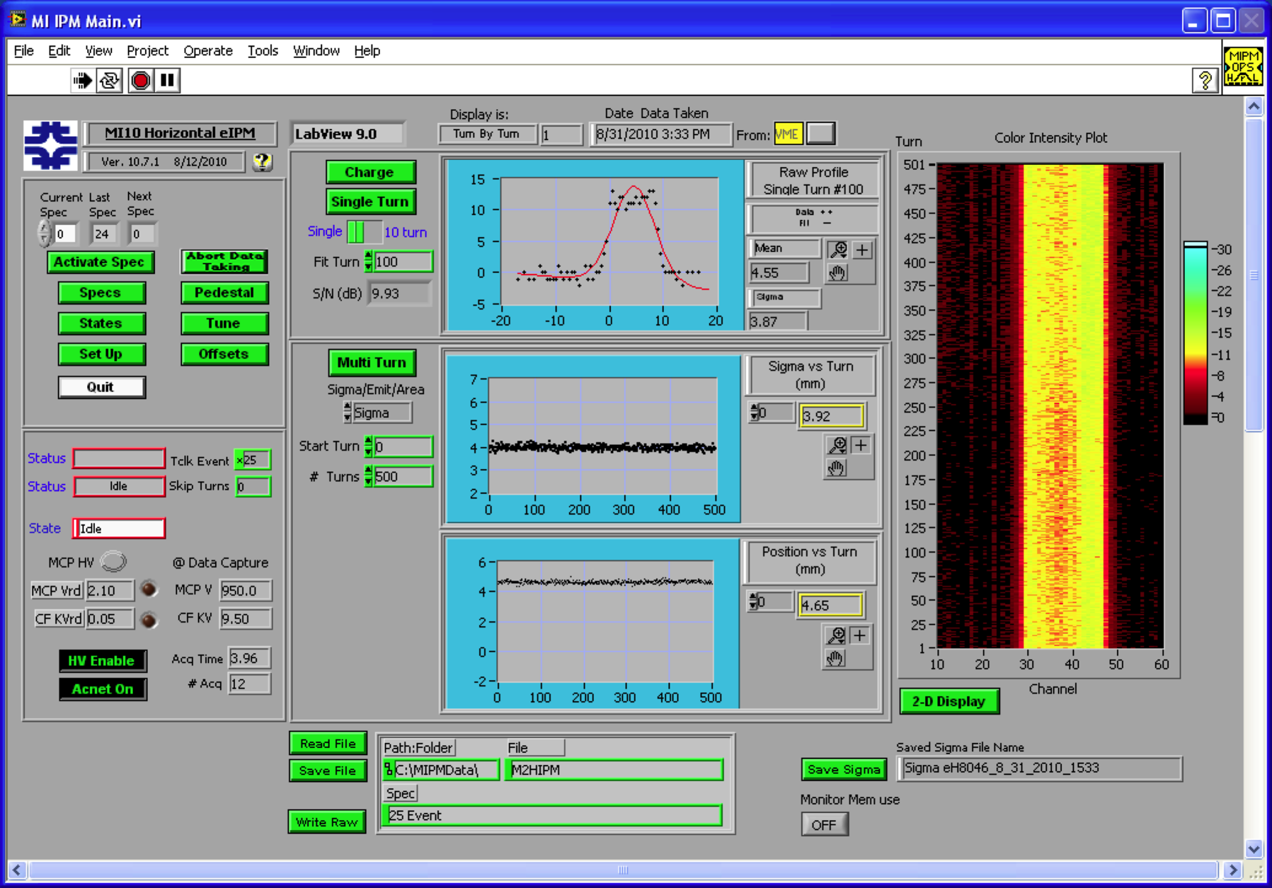
Clearing Field Polarity Reversed to Collect Ions

Slide 9
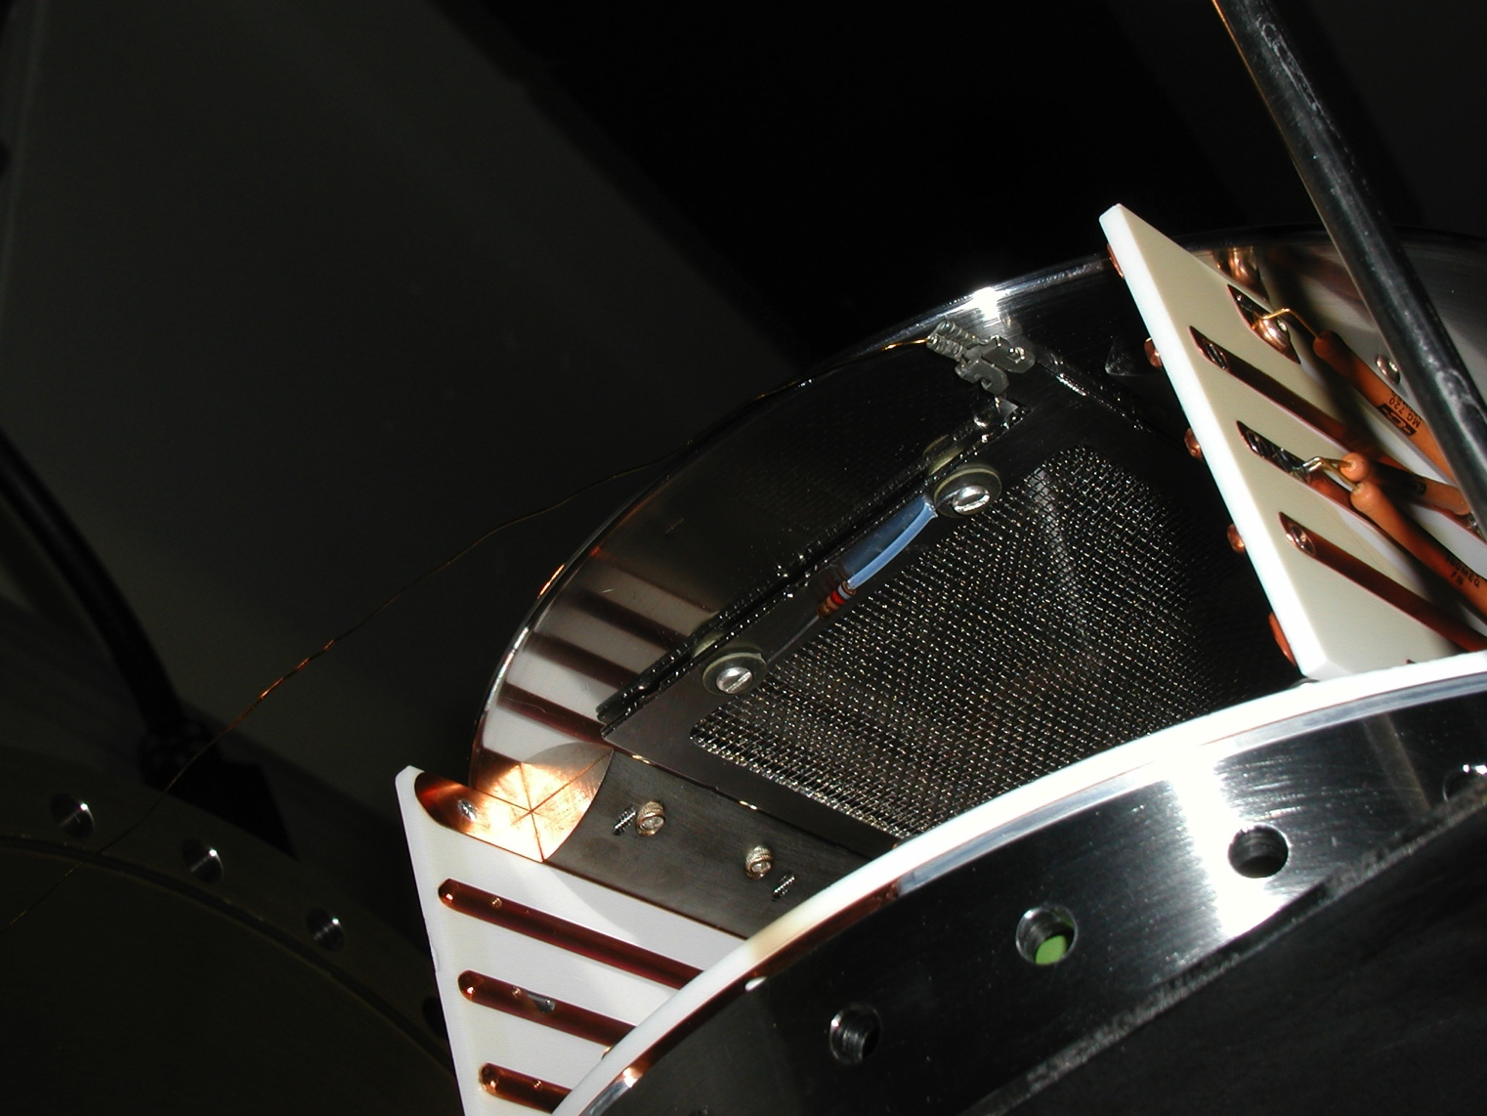
Mark-II Secondary Suppression Screen
820Ω Resistor Should Have Been 8MΩ

Slide 10
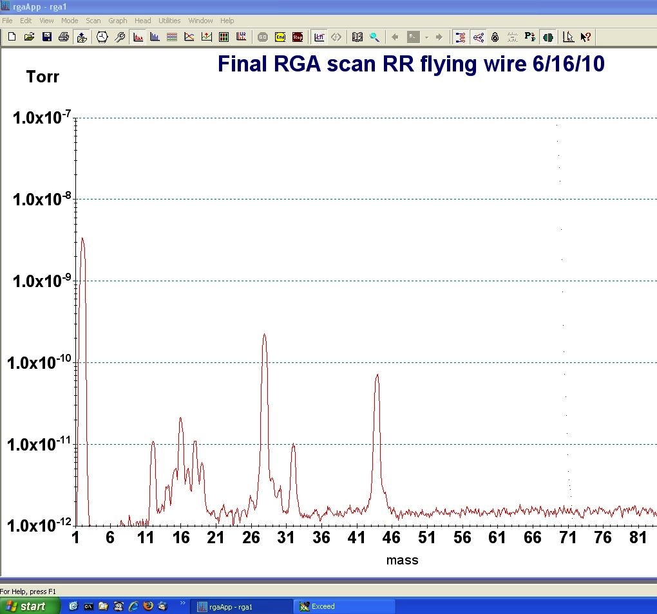
Residual Gas Components
RGA Scan Oct-2014 Recycler Ring 400 From 401-409 BV
13:54 | USER PEAKS | Torr
2 | H₂ | 3.90E-11
17 | OH/NH₃ | 5.20E-11
18 | H₂O | 9.90E-11
28 | N₂/CO | 9.90E-11
32 | O₂ | 7.70E-11
44 | CO₂ | 9.90E-11
RGA Scan June 2010 Recycler Ring 419-420
H₂
760 Torr = 1 Atmosphere = 101325 Pascal
10⁻¹⁰ Torr = 1.333x10⁻⁸ Pa
N₂/CO
CO₂
USA Labs use still Torr
CH₄
C
H₂O
O₂

Slide 11
Residual Gas Components
RGA Scan Oct-2014 Recycler Ring 400 From 401-409 BV
13:54 | USER PEAKS | Torr
2 | H₂ | 3.90E-11
17 | OH/NH₃ | 5.20E-11
18 | H₂O | 9.90E-11
28 | N₂/CO | 9.90E-11
32 | O₂ | 7.70E-11
44 | CO₂ | 9.90E-11
RGA Scan June 2010 Recycler Ring 419-420
H₂
760 Torr = 1 Atmosphere = 101325 Pascal
10⁻¹⁰ Torr = 1.333x10⁻⁸ Pa
N₂/CO
CO₂
USA Labs use still Torr
CH₄
From Wikipedia
C
H₂O
O₂
Torr was named after Evangelista Torricelli, an Italian physicist and mathematician who discovered the principle of the barometer in 1644.
(One millimeter of mercury is approximately equal to one Torr.)

Slide 12
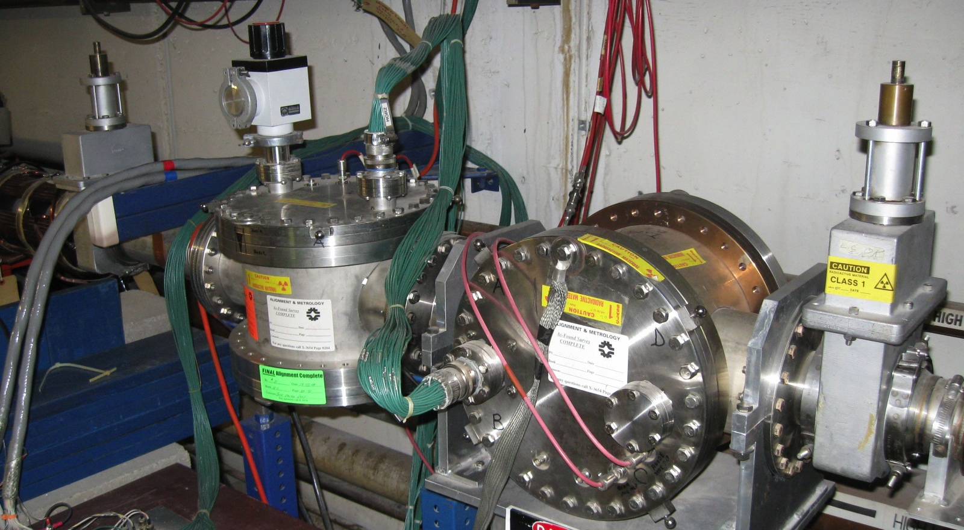
Booster
Horizontal and Vertical co-located in Long 5
These are electrostatic instruments with a max of 8 KV

Slide 13
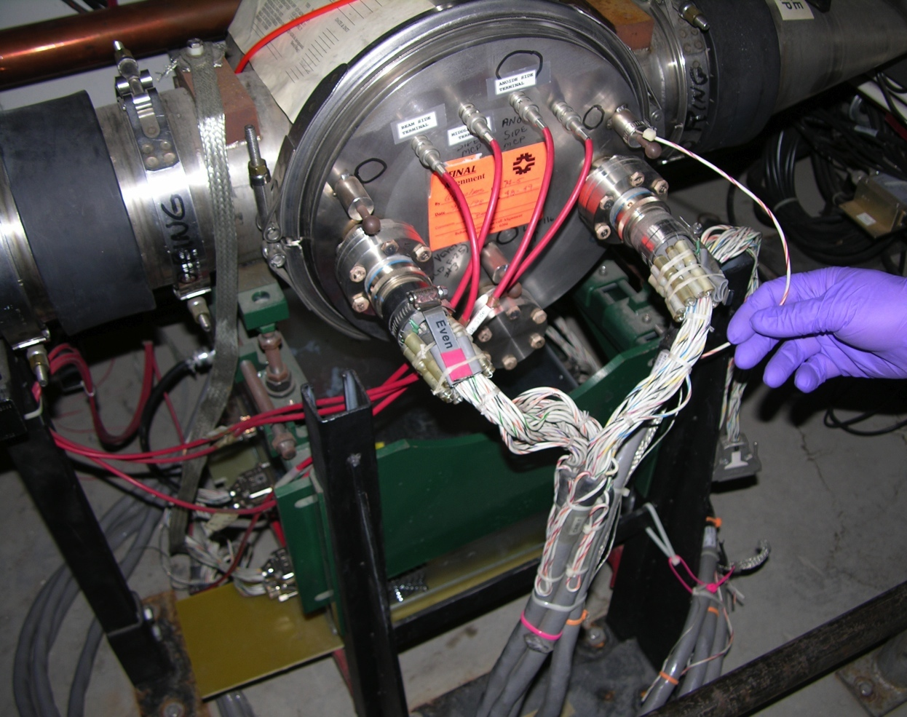
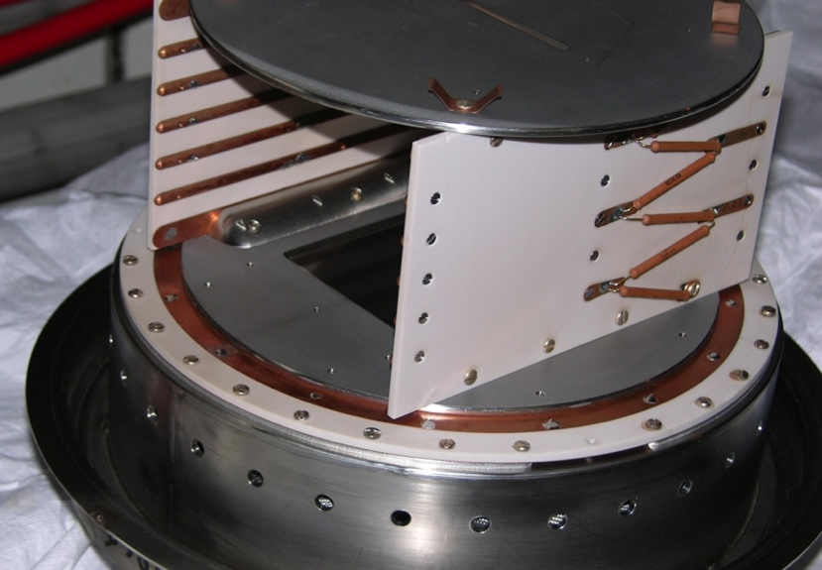
Main Ring/Main Injector Electrostatic
30KV Electrostatic,
Vertical was at Q103,
Horizontal at Q102.
30 KV was shown to be sufficient to overcome space charge at 8 GeV beam injection into MI, but not at 120 GeV.

Slide 14
Main Ring/Main Injector Electrostatic
30KV Electrostatic,
Vertical was at Q103,
Horizontal at Q102.
30 KV was shown to be sufficient to overcome space charge at 8 GeV beam injection into MI, but not at 120 GeV.
These have been functionally replaced with Mark-III IPM’s
They were removed from the Main Injector and are currently being rebuilt for use in the Booster.

Slide 15
Main Ring/Main Injector Electrostatic
30KV Electrostatic,
Vertical was at Q103,
Horizontal at Q102.
30 KV was shown to be sufficient to overcome space charge for better than 8 GeV Beam in MI.
These have been functionally replaced with Mark-III IPM’s
and are currently being rebuilt for use in the Booster.
One concern on using 30KV electrostatic cans in Booster is beam rigidity at 400 MeV Injection energy.
Beam deflection is calculated to be:
at 400 MeV, < 88 micro-radians.
at 8 GeV Extraction, < 7 micro-radians.

Slide 16
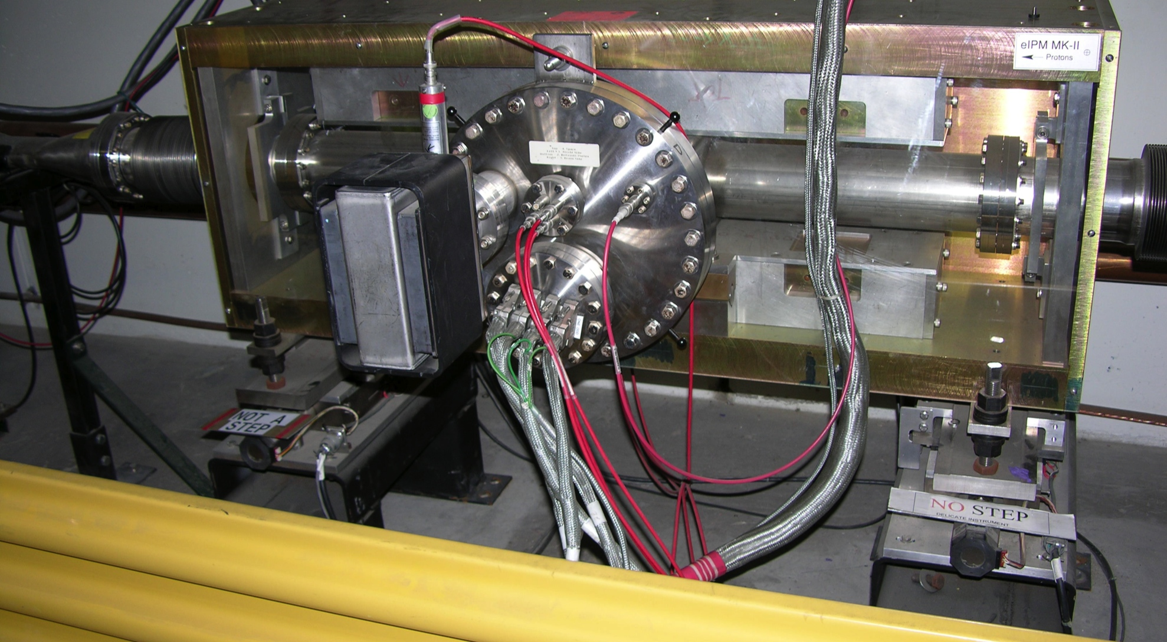
Main Injector Mark-II
Horizontal Measurement Permanent Magnet at Q104
Independent up and downstream +/- 25mm in horizontal plane for alignment and MCP Exposure

Slide 17
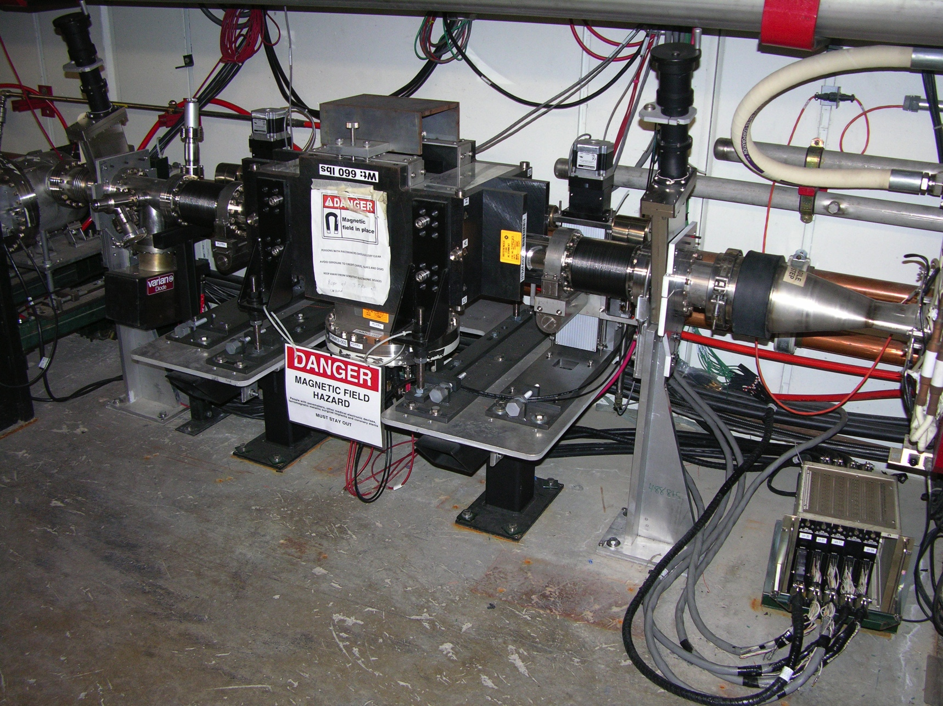
Main Injector Mark-III Vertical
The vacuum vessel moves in the plane of the measurement, while the magnet is fixed.

Slide 18
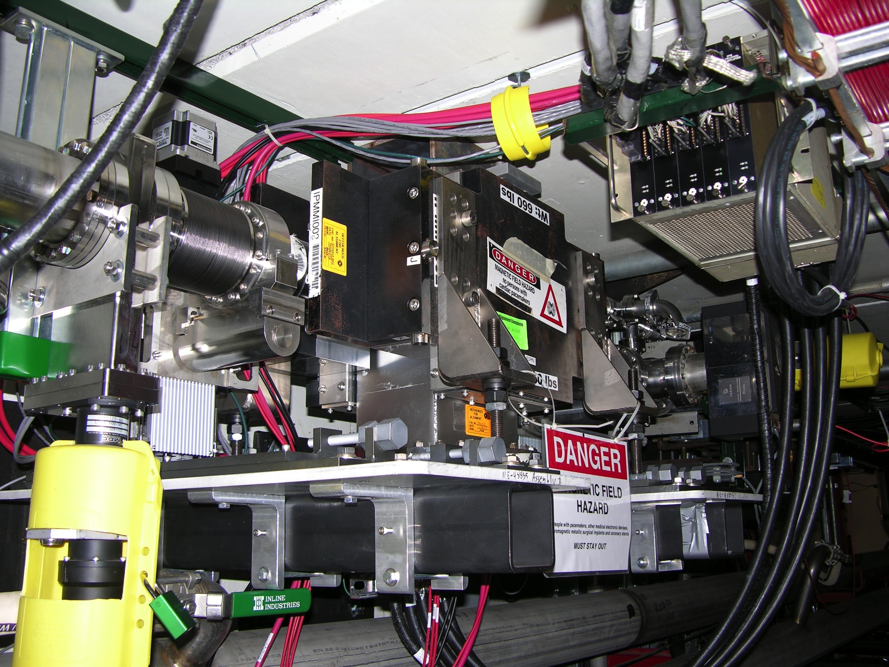
Recycler Mark-III Vertical

Slide 19
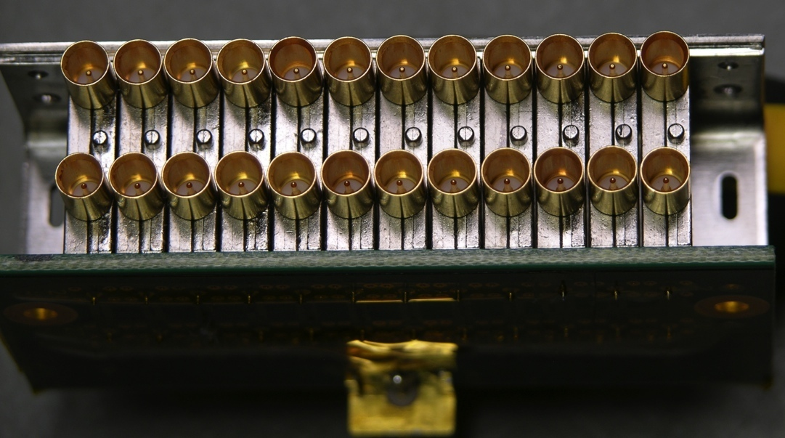
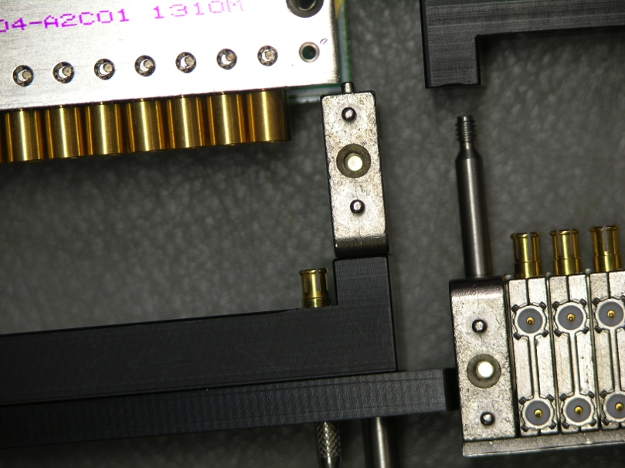
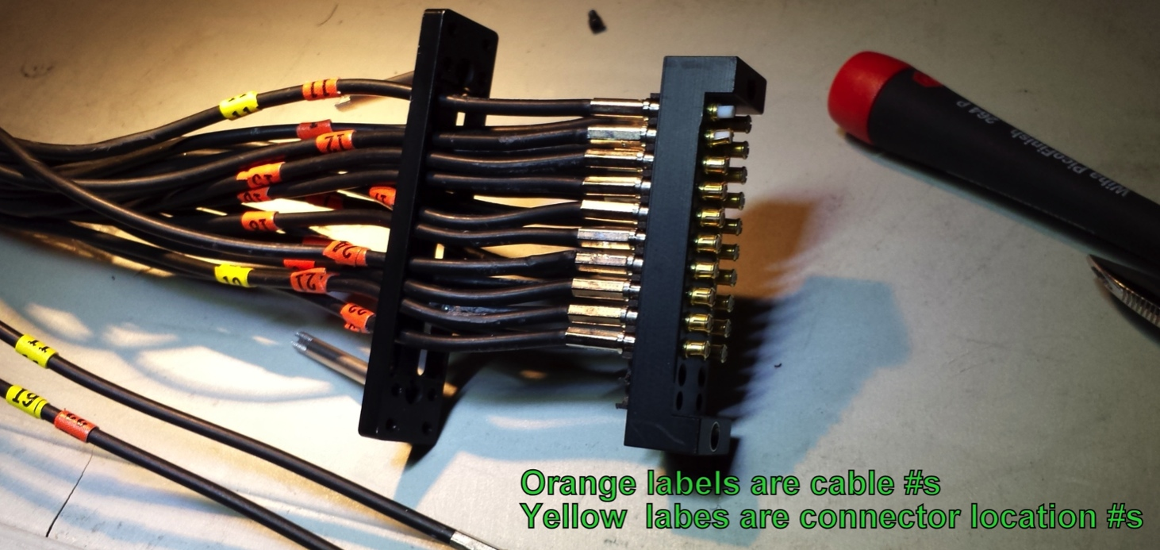
Tunnel Preamp Connectors

Slide 20
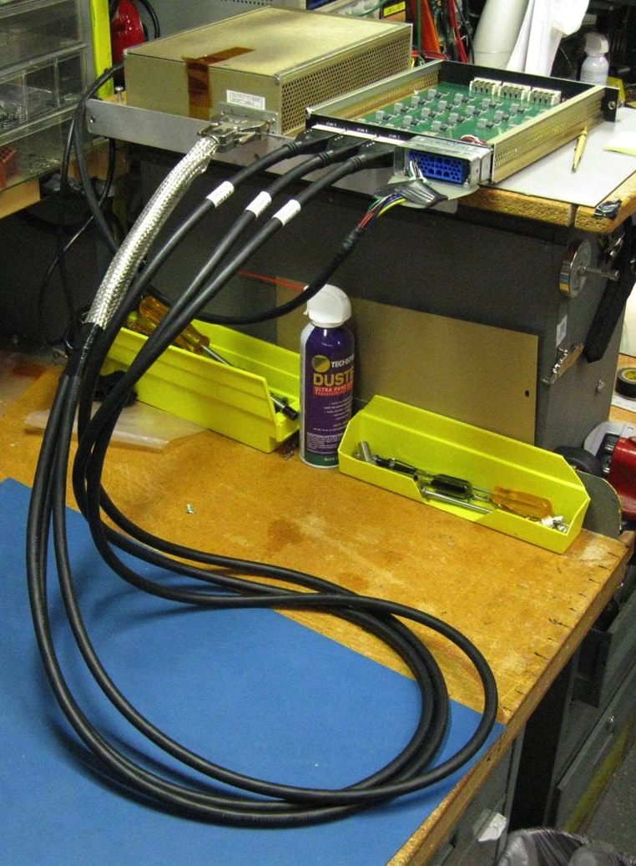
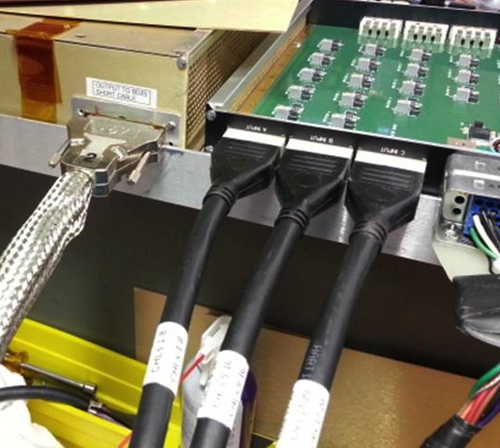
New Preamp Connector Scheme
Harting connector more reliable than Winchester

Slide 21
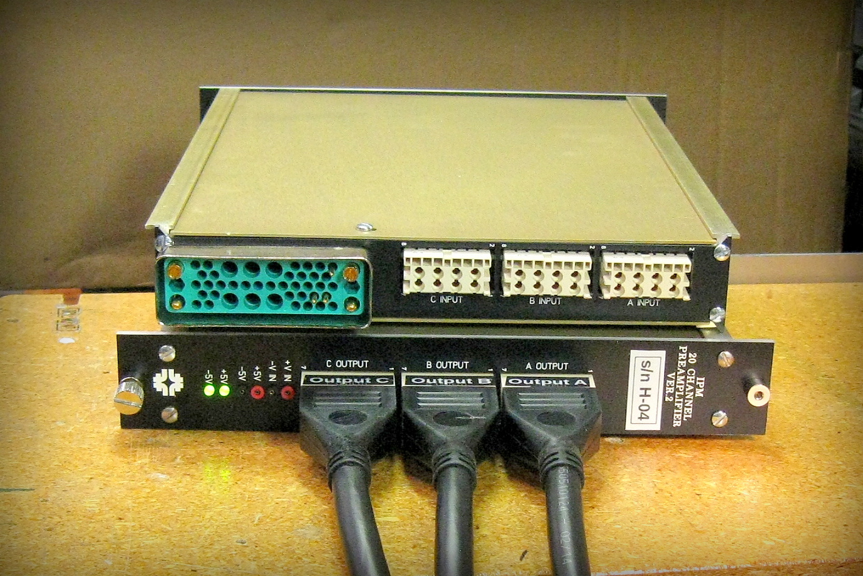
Preamp Connectors

Slide 22
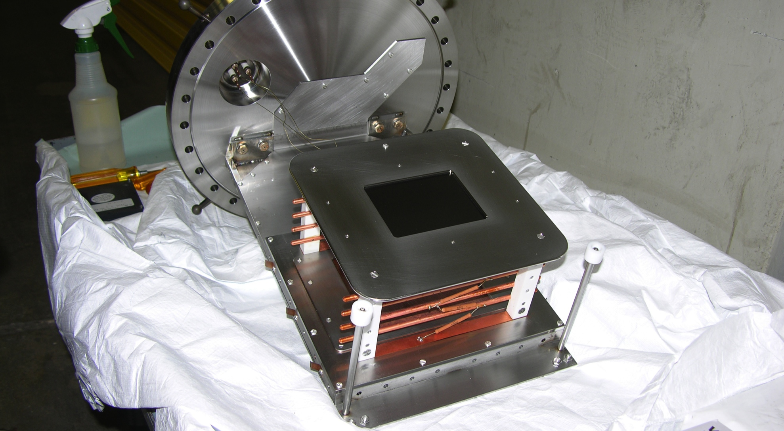
Mark-II, and Tevatron Internals
Tray design for quick extraction for MCP replacement, assures accurate realignment.

Slide 23
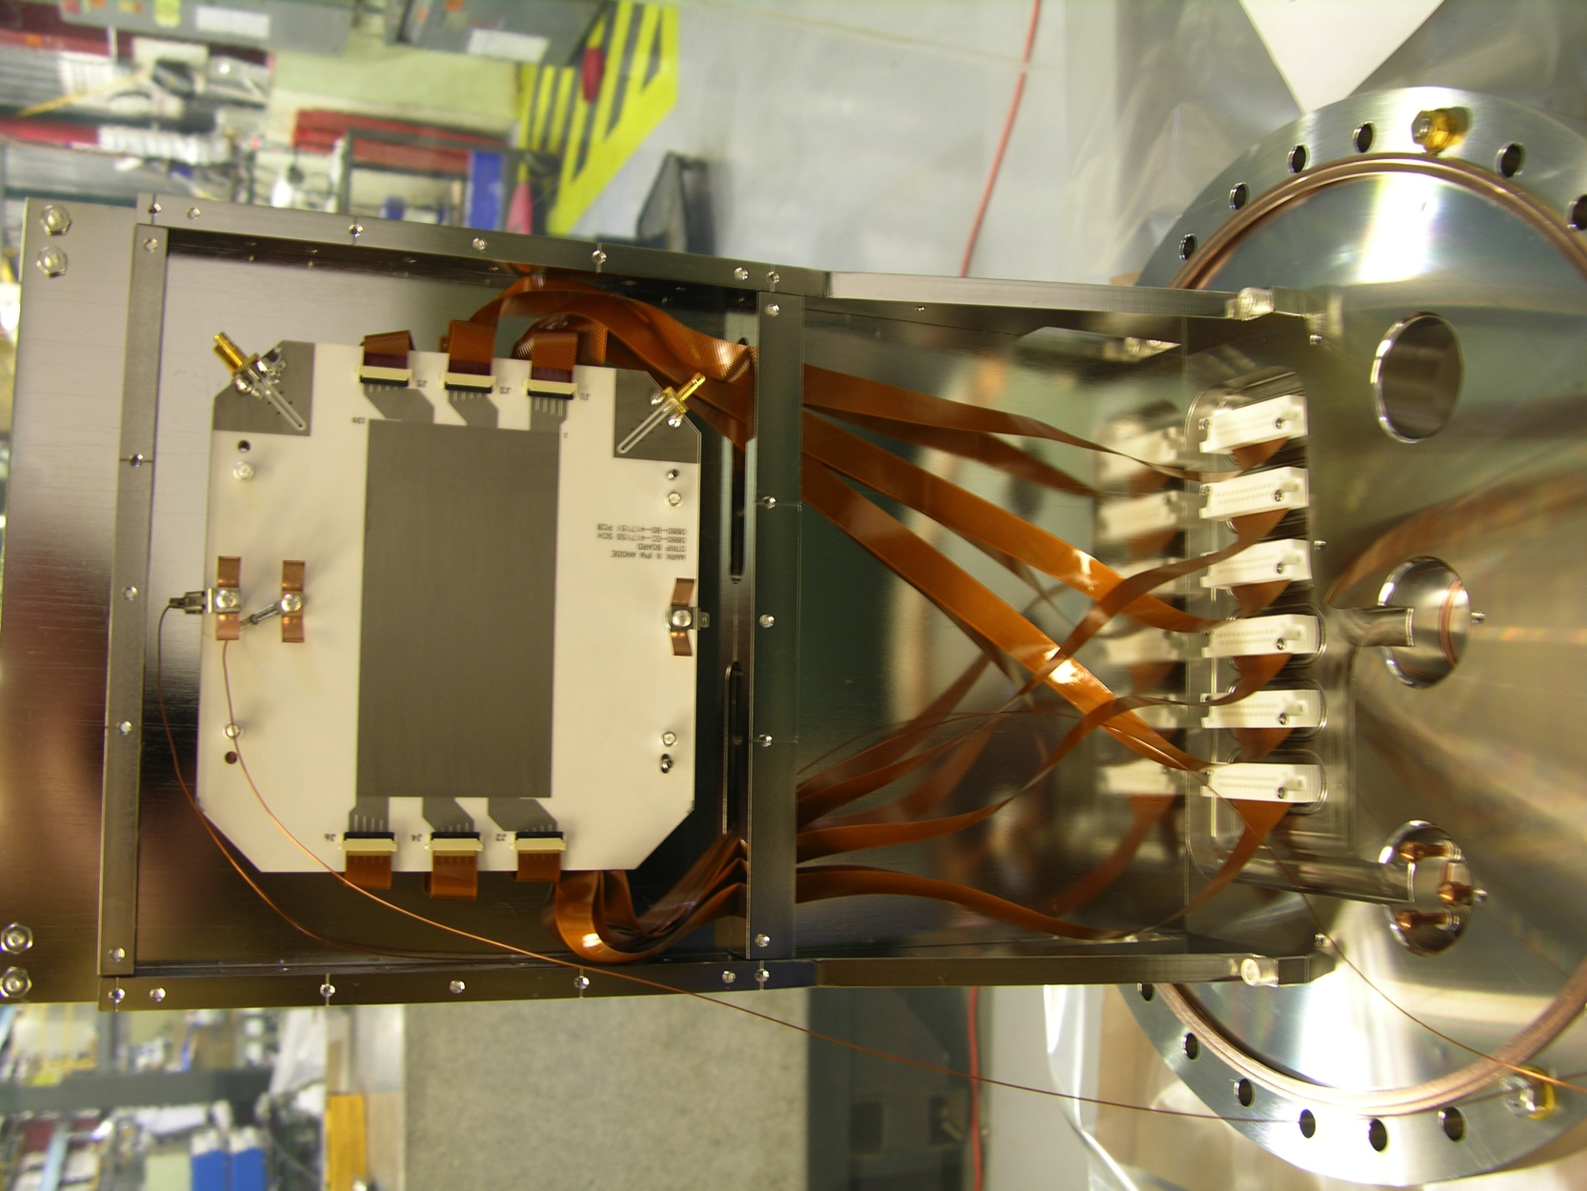
Mark-III Internals

Slide 24
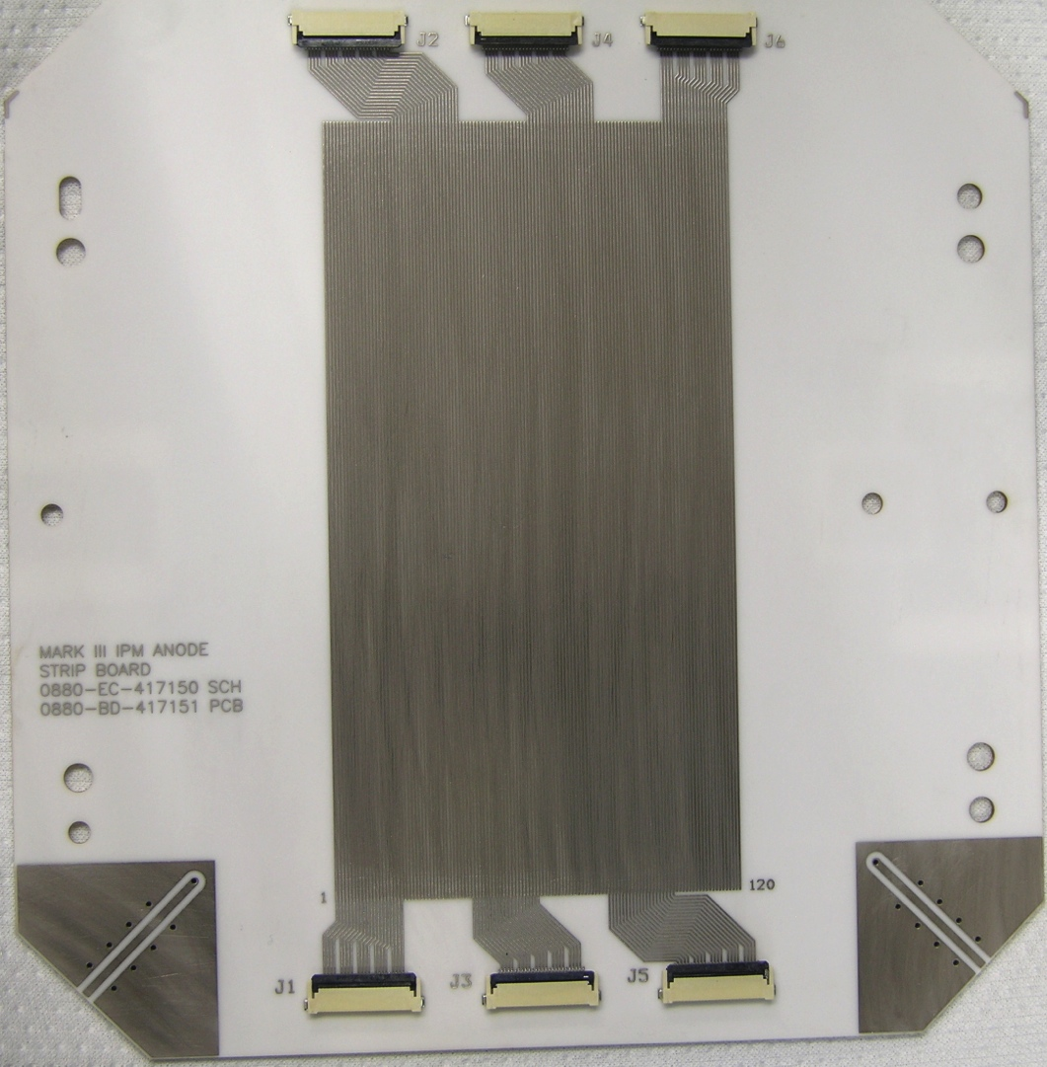
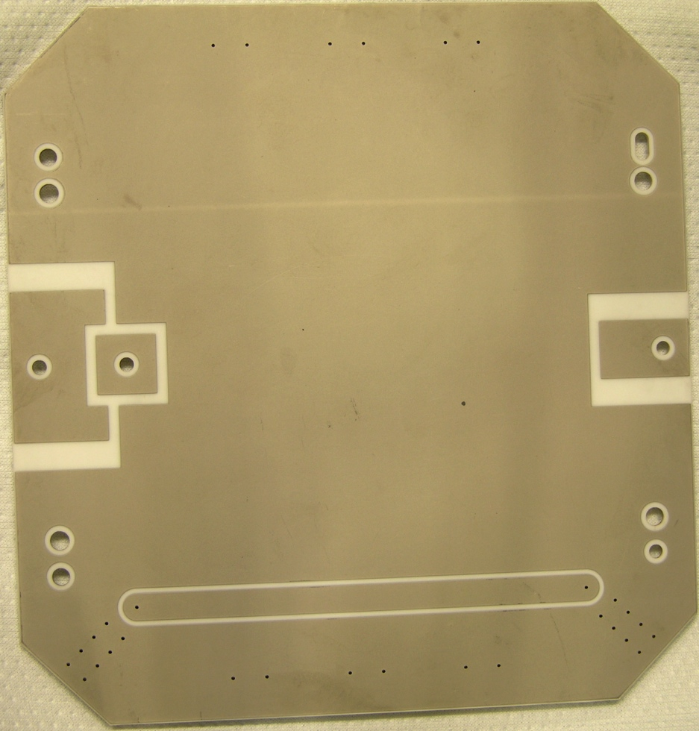
Anode Strip Board
Main Injector/Recycler Details
  Ceramic
  Mass terminated connectors.
    80% copper, 20% space.
MCP Power Pads
  50Ω Flash Test Strip

Slide 25
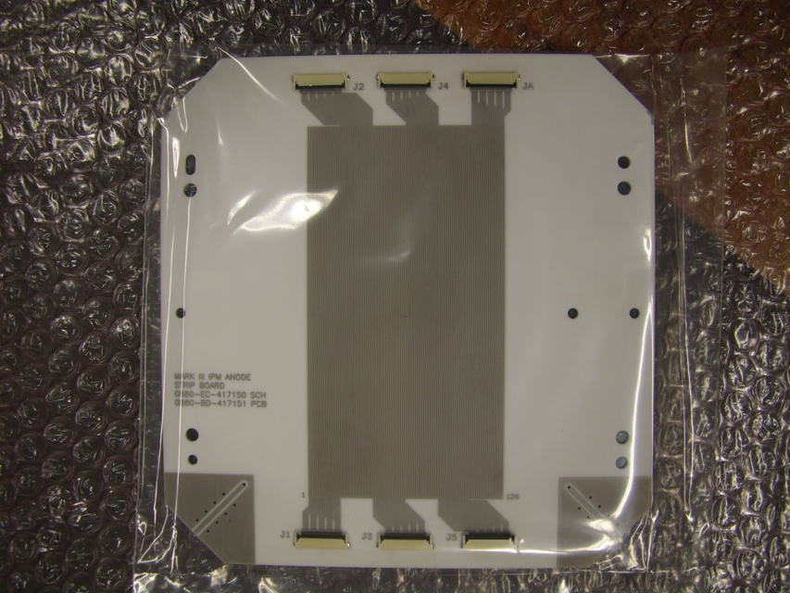
Anode Strip Board cont’d
Beam Size determines # of Strips and Pitch
Booster
  Beam sigma 4.5 mm
  48 Strips at 1.5 mm Pitch
  1.2E12 to 4.5E12 protons
Main Injector/Recycler
  Beam sigma 4.5 - 1.5 mm
  120 Strips at 0.5 mm pitch
  MI up to 6 booster batches
  RR slip stack up to 12 batches
  RR max intensity 5E13
Tevatron
  Beam sigma 1.5 mm
  128 Strips at 0.25 mm Pitch

Slide 26
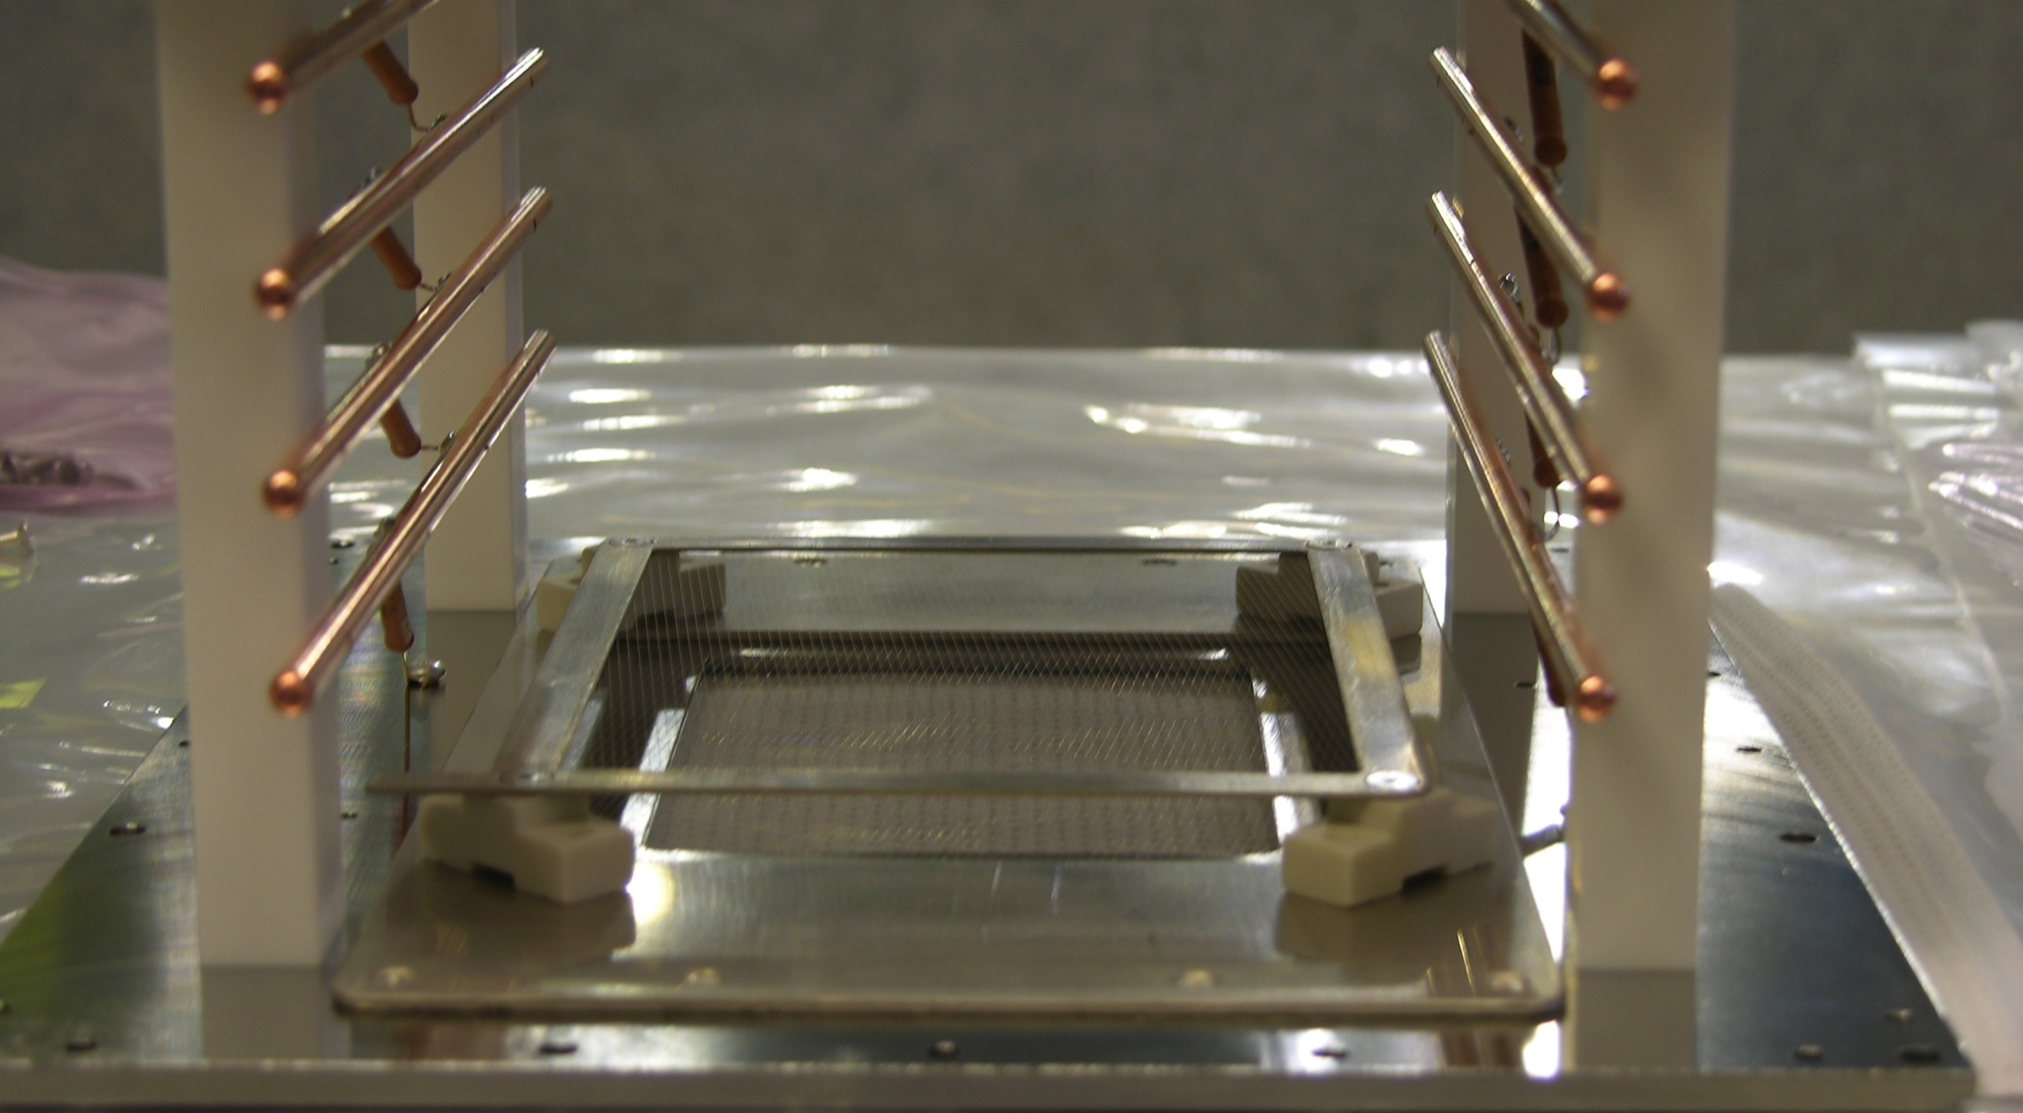
Mark-III Control Grid

Slide 27
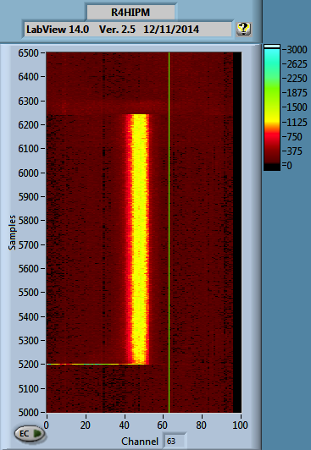
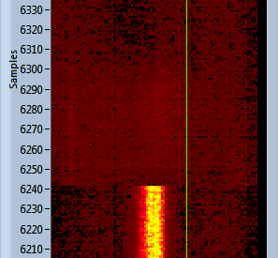
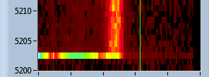
Control Grid Upstairs Test R4H
Turn off
Turn on

Slide 28
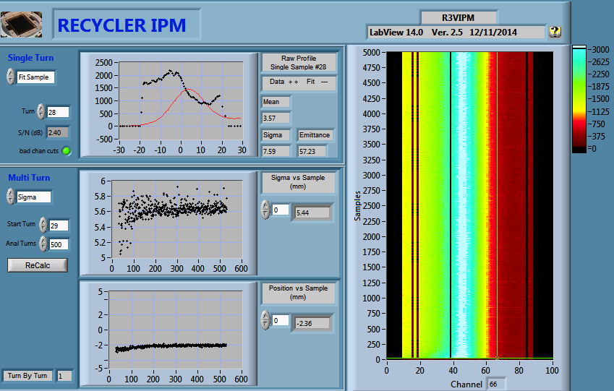
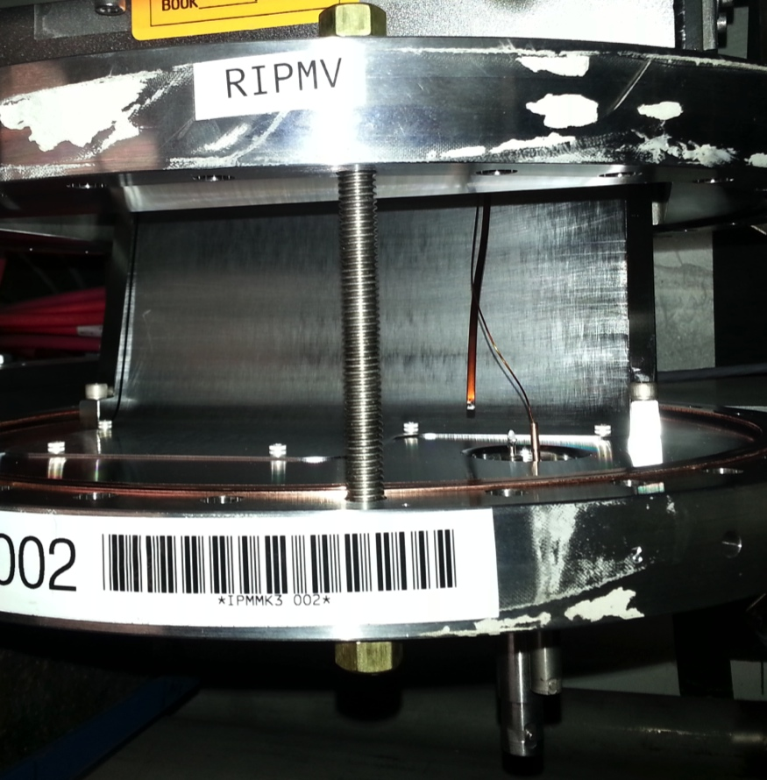
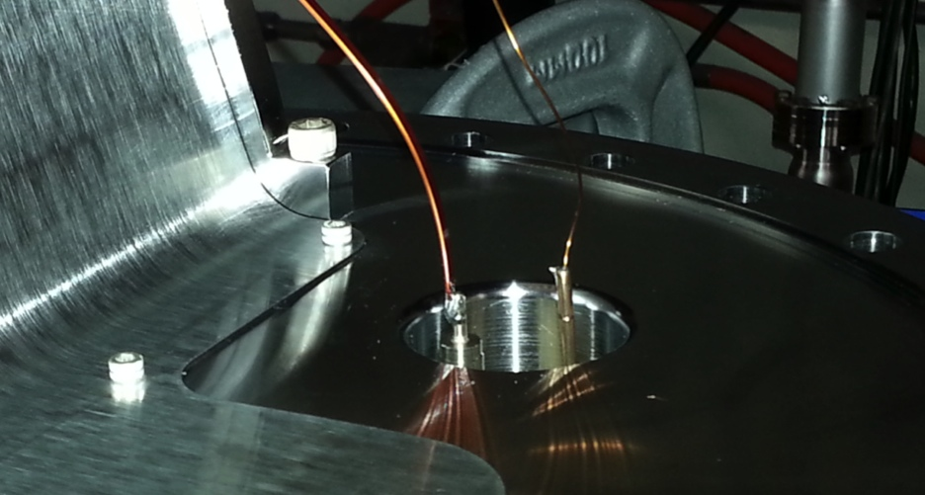
Pulsing 10KV in a Magnetic Field
Recycler Vertical showed a shoulder on the bottom, (left in screenshot.)
The Control Grid Lead had broken off the feed through.
Fixed

Slide 29
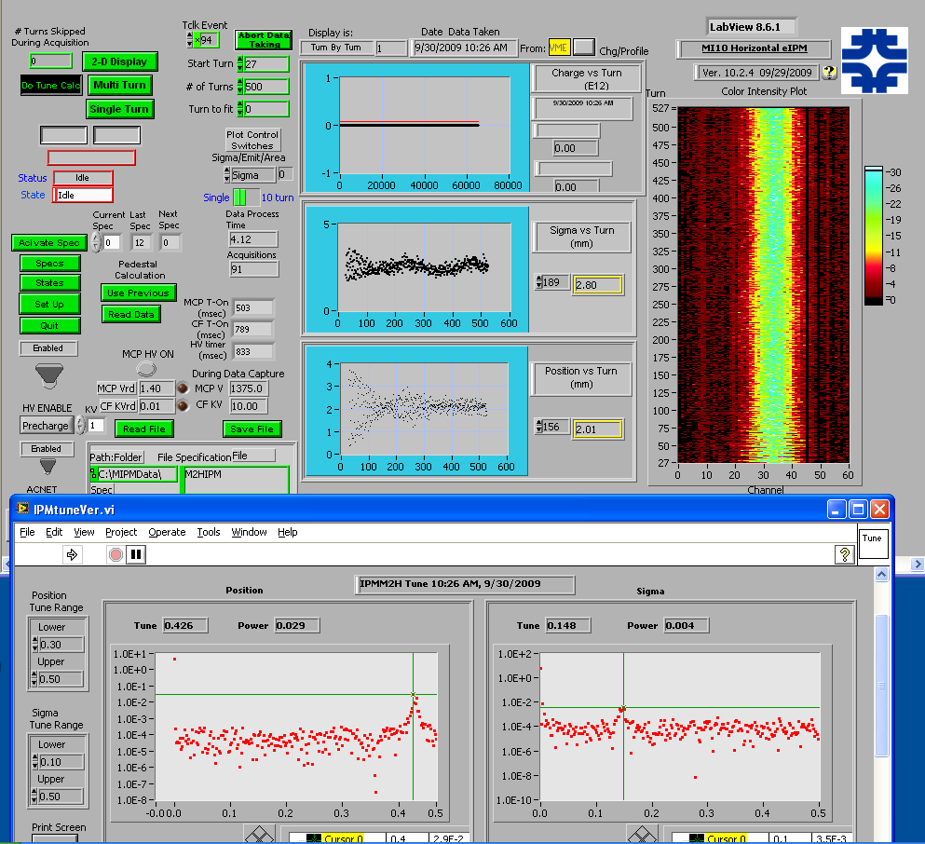
Injection Mismatch
Main Injector:
Injection tuning study.
Poor beam line tune leads to injection oscillations in both Position and Sigma for the first 300 turns.
FFT of first 500 turns yield fractional tune

Slide 30
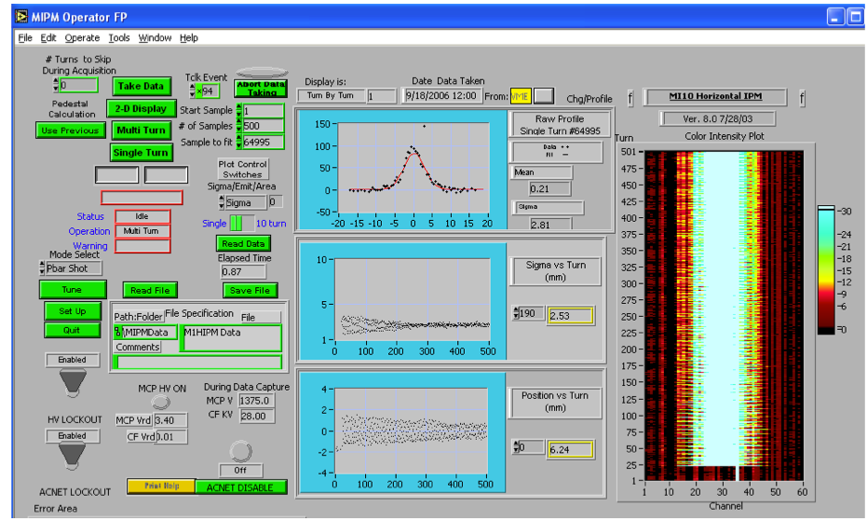
Main Injector / P-Bar injection Measurement
Position oscillations for >500 turns, Sigma settles in under 300 turns.

Slide 31
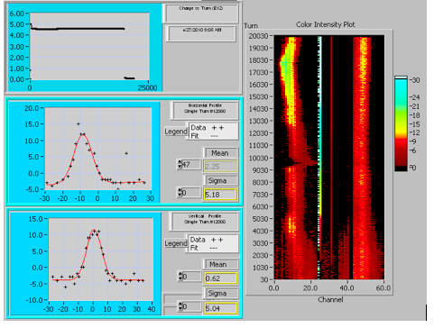
Typical Data Displays
Main Injector Console Application
Booster LabView Front End
Horizontal Vertical
Top Left trace indicates beam intensity. Top Right is raw data color intensity plot
Bottom left 2 plots – can plot sigma and position vs turn, or individual turn profiles.

Slide 32
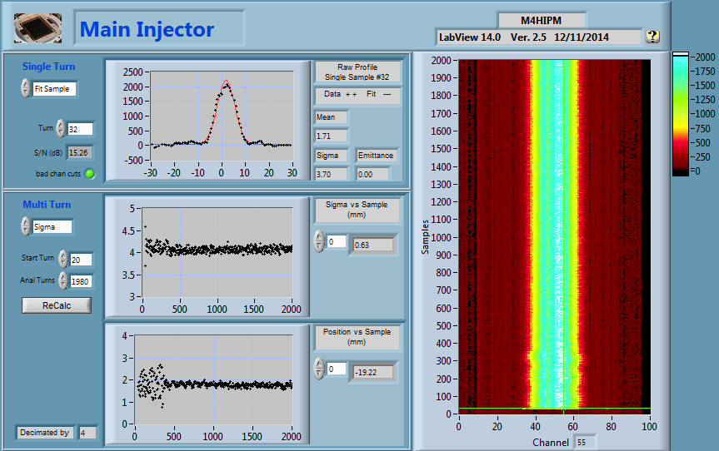
Main Injector Damper Turn On

Slide 33
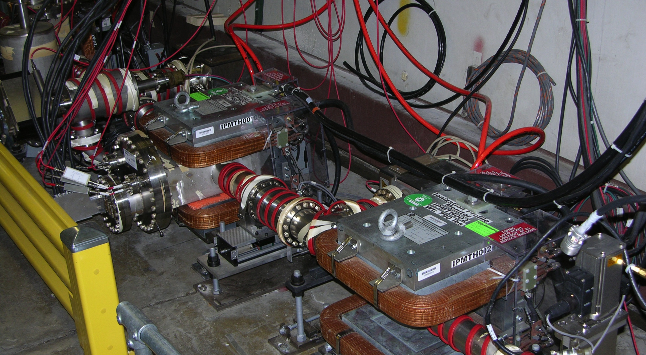
Tevatron
Measured 36 Proton and 36 Anti-Proton bunches per turn using QIE Chips in tunnel.
Horizontal Detector
Horizontal Correction Magnet

Slide 34
IPM at IOTA
Re-purpose the Tevatron IPM’s to the new IOTA ring
  IOTA → Integrable Optics Test Accelerator
    Noun (from Wikipedia)
      1. the ninth letter of the Greek alphabet ( ι )
      2. an extremely small amount.
  Accelerator ring designed primarily to study the behavior of a nonlinear integrable lattice
    V. Danilov and S. Nagaitsev, Phys. Rev. ST Accel. Beams 13, 084002 (2010)
  The purpose of a nonlinear integrable lattice is to make beam dynamics more robust by generating large stable tune spreads and preserving dynamic aperture
    Studies require monitoring the evolution of the beam profile on short time scales to detect beam growth and instabilities
    Ideally profile measurements every turn

Slide 35
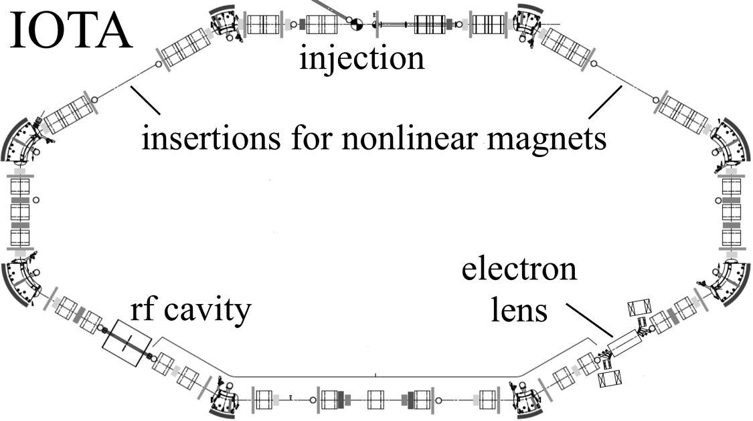
IPM at IOTA
2.5 MeV, 10¹¹ protons
40 m circumference
(30 MHz / 2.34 MHz modulation)
Reuse the Tevatron IPM
sans magnet
(G. Stancari, D. Crawford)
  Space charge is small
Vacuum needs to be 10⁻¹¹ Torr
Ionization cross section much higher due to low beam energy
  M.E. Rudd et al., Phys. Rev. A 28, 3244(1983)
  Balances the very high vacuum
Expected number of ionizations per turn is ~18.
  Expected number of ionizations per bunch in MI is ~100

Slide 36
IPM Measurement Summary
All Systems
  Turn by turn measurements.
    Turns could be averaged for any accuracy desired.
  Used for injection tuning/matching.
    Routinely used for first 500 turns to see injection oscillations.
    Position and Sigma measurements anywhere in the cycle.
  Collects up to 65K samples per channel

Slide 37
IPM Measurement Summary 2
New Main Injector
  High Speed Digitizers 80MHz
    Multiple samples each batch for better accuracy/sample
    Allows for digital filtering of signals on A/D
  96 Channels are digitized
  Control Grid to gate off electrons for unmeasured batches
    Should significantly increase MCP life time.
  Up to 65000 samples at either
    1 Batch per revolution
    Spread across all batches for a few turns

Slide 38
Recent References
Dirk Bartkoski, PhD Dissertation:
Analysis, Prototyping, and Design of an Ionization Profile Monitor for the Spallation Neutron Source Accumulator Ring, December 2013
https://www.researchgate.net/publication/269393015
Nuclear Instruments and Methods in Physics Research Section A Accelerators Spectrometers Detectors and Associated Equipment 11/2014; 767:379–384. DOI:10.1016/j.nima.2014.09.020
9th Ditanet Topical Workshop on Non-Invasive Beam Size Measurement
for High Brightness Proton and Heavy Ion Accelerators, April 2013
https://indico.cern.ch/event/229959/
International Beam Instrumentation Conference (IBIC):
September 2015-Melbourne, Australia: http://www.ibic2015.org
September 2014-Monterey, California: https://conf-slac.stanford.edu/ibic-2014/
Next:
September 2016-Barcelona, Spain: http://www.ibic2016.org/
Note: IBIC of interest is not the INTERNATIONAL CONFERENCE ON INDUSTRIAL BIOTECHNOLOGY

Slide 39
Extra Material

Slide 40




Booster Injection
One concern on using 30KV electrostatic cans in Booster;
beam rigidity @ 400MeV Injection
We start with the momentum before deflection, p₀ and end with a momentum p after deflection
(1)
where q is the charge of the particle and t is the duration of the deflecting field, E. Assuming that p₀ is perpendicular to E, the angle of deflection is
(2)
For small transverse deflections, or non-relativistic particles, t = l/|v₀|, with |v₀| being the initial velocity and l being the length of the electric field region
(3)
The initial |v₀||p₀| can be written in terms of kinetic energy and mass and the angle is finally
Derivation and details from R.Thurman-Keup

Slide 41
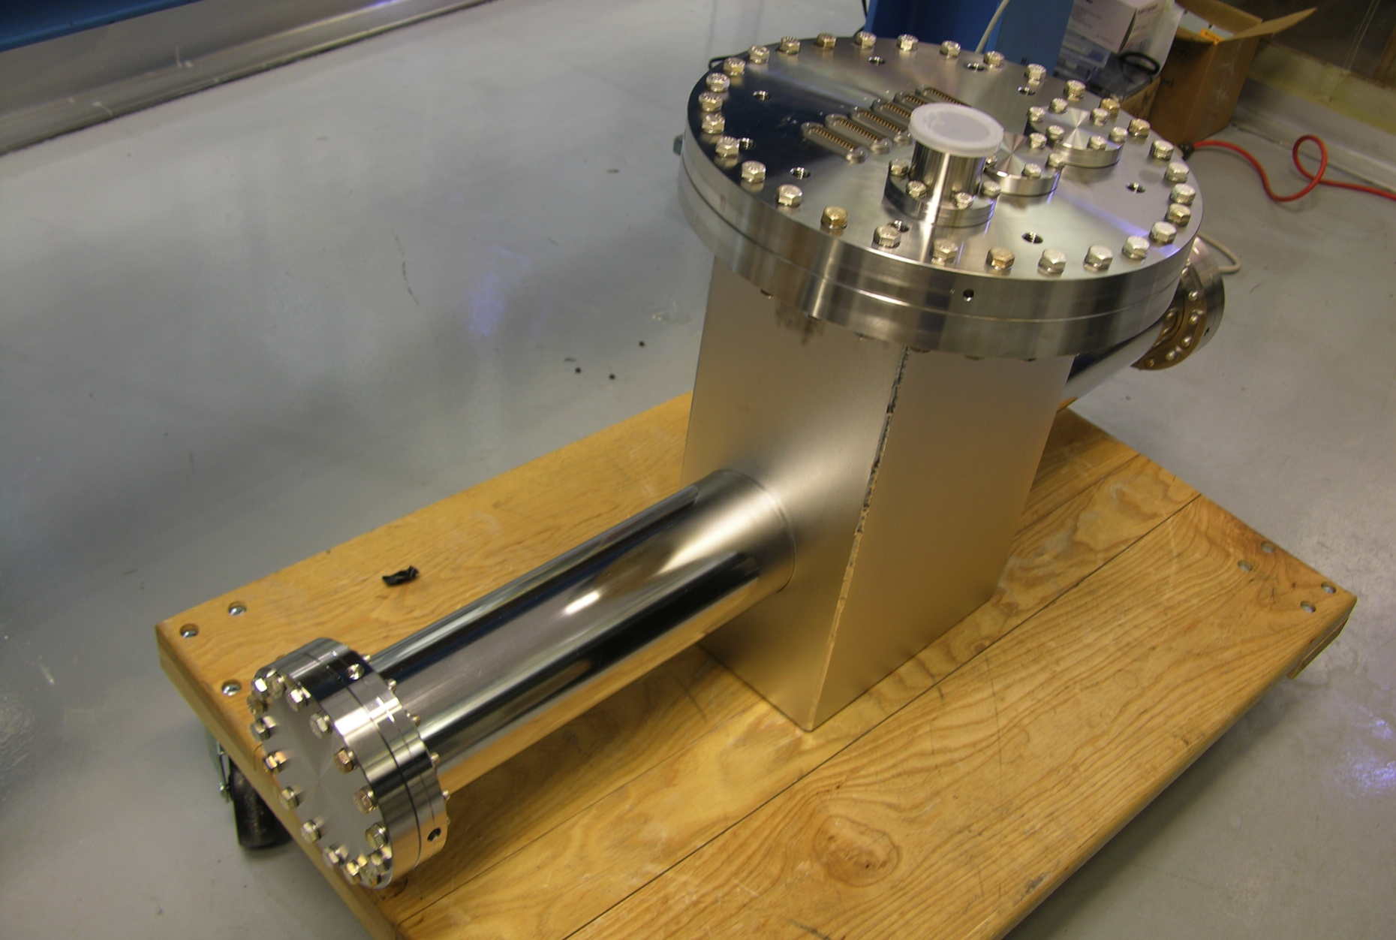
Mark-III Vacuum Vessel

Slide 42
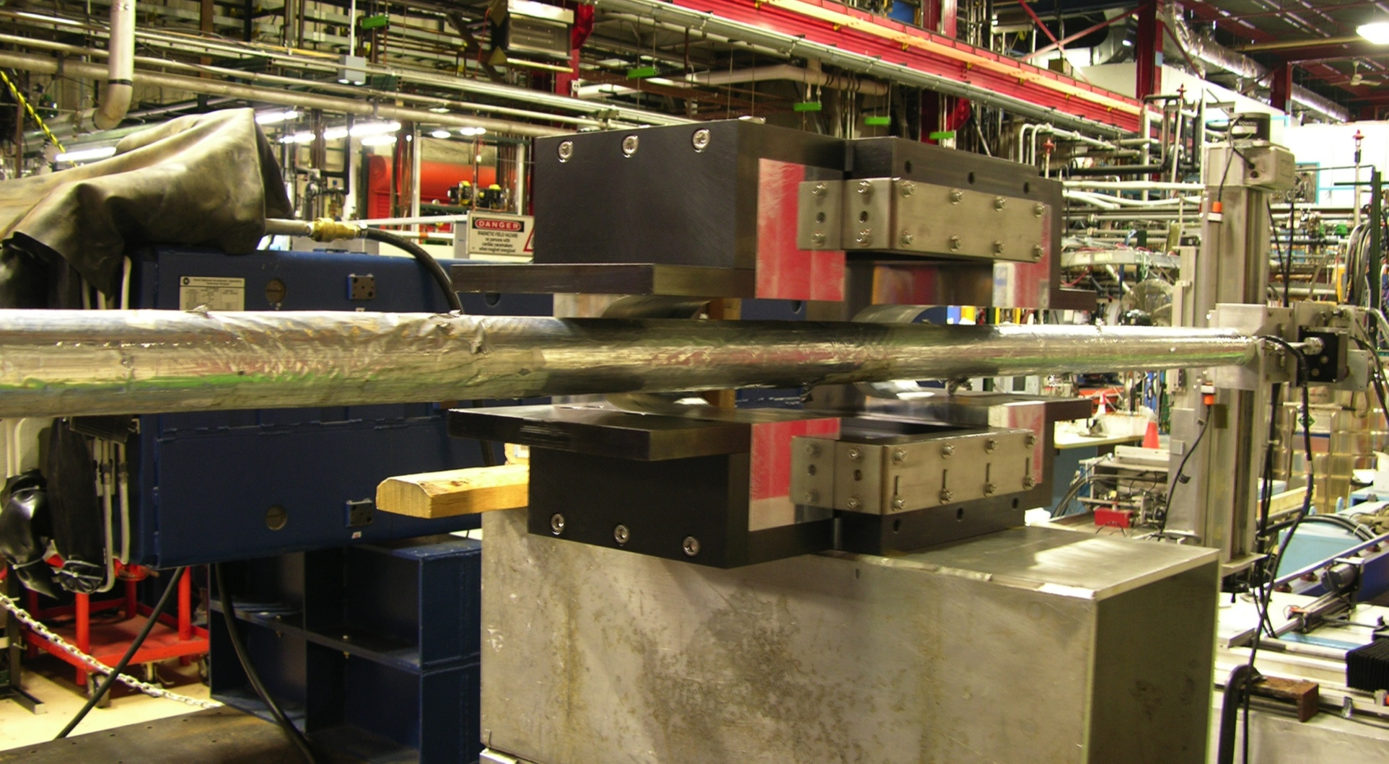
Main Injector Mark-III Magnet
Magnet MIIPM001 on measurement stand for integral field map.
Similar to Mark-II but smaller.
1KG center field and half correction up and downstream,
Local 3 bump shunted, so beam sees close to zero integrated field.

Slide 43
MI Orbit Perturbation
Measured magnet integrated field is -0.001T-m
Maximum displacement around the ring for the measured field integral is
For the Main Injector ρm ≈ 27 T-m
and the maximum β is 50, Tune, ν is 0.43,
D ≈ 0.001 m

Slide 44
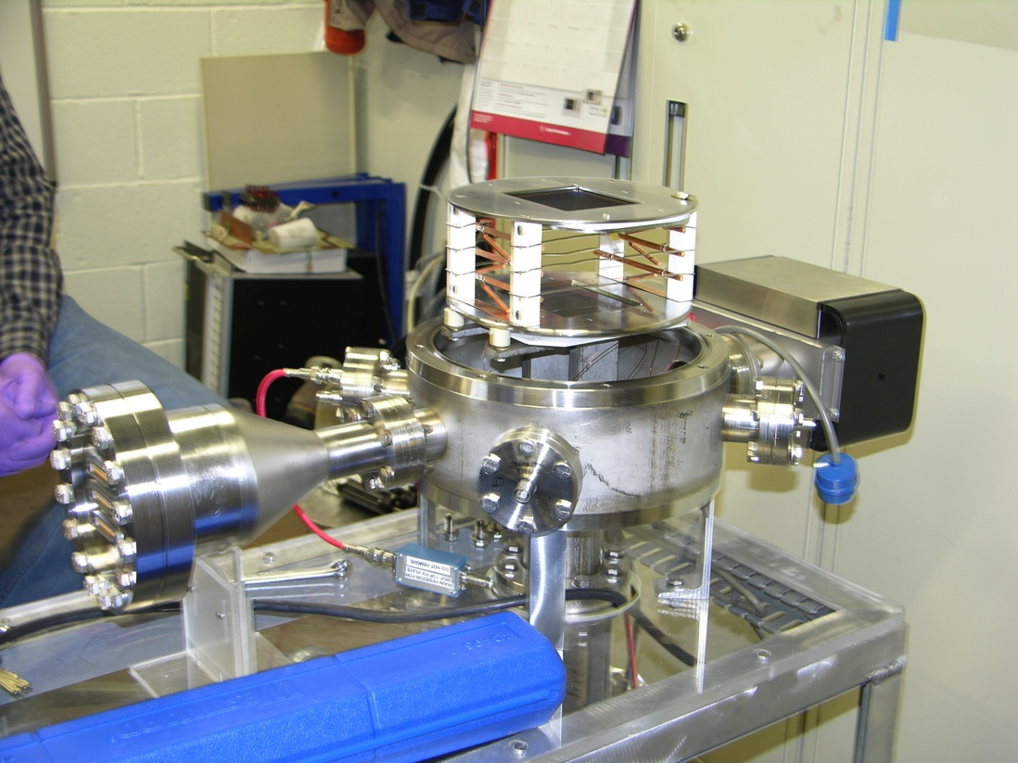
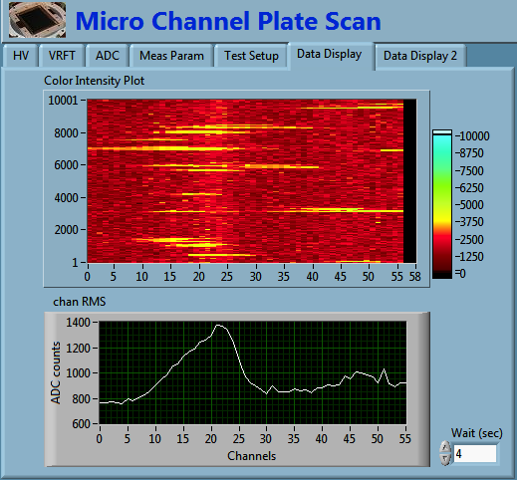
MCP Test Chamber
Facility to scan MCPs for suitability and look at areas of reduced gain

Slide 45
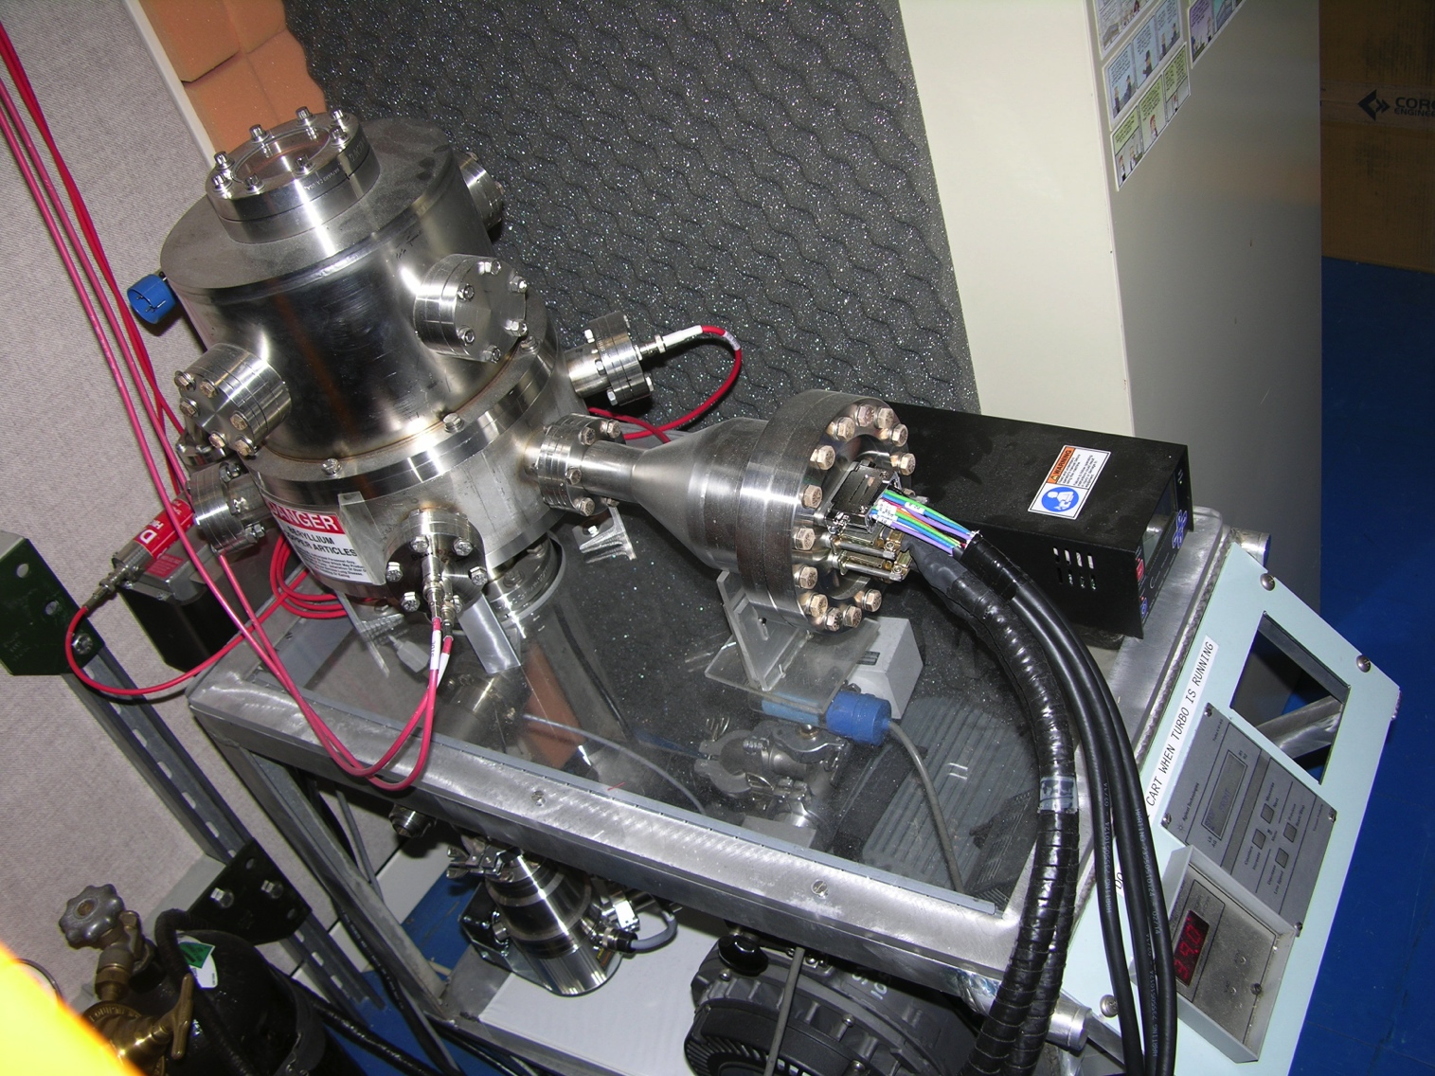
MCP Test Chamber Reconfigured
Ion Pump and Ion Gauge moved away from test region
Next step is to reduce the spacing between EGN and MCP under test

