Slide 1
Non-Destructive Profile Measurement in Rings with Strong Space Charge
R Williamson, B Pine, C Wilcox
With many contributions from ISIS Diagnostics and Accelerator Physics Groups
Beam Dynamics Meets Diagnostics 2015
Firenze, Italy

Slide 2
Contents
Introduction to ISIS
Residual Gas Ionisation Monitor
Simulations
Measurement errors
Comparison measurements to simulation
Profile correction
Application to operation and R&D
Plans for the future

Slide 3
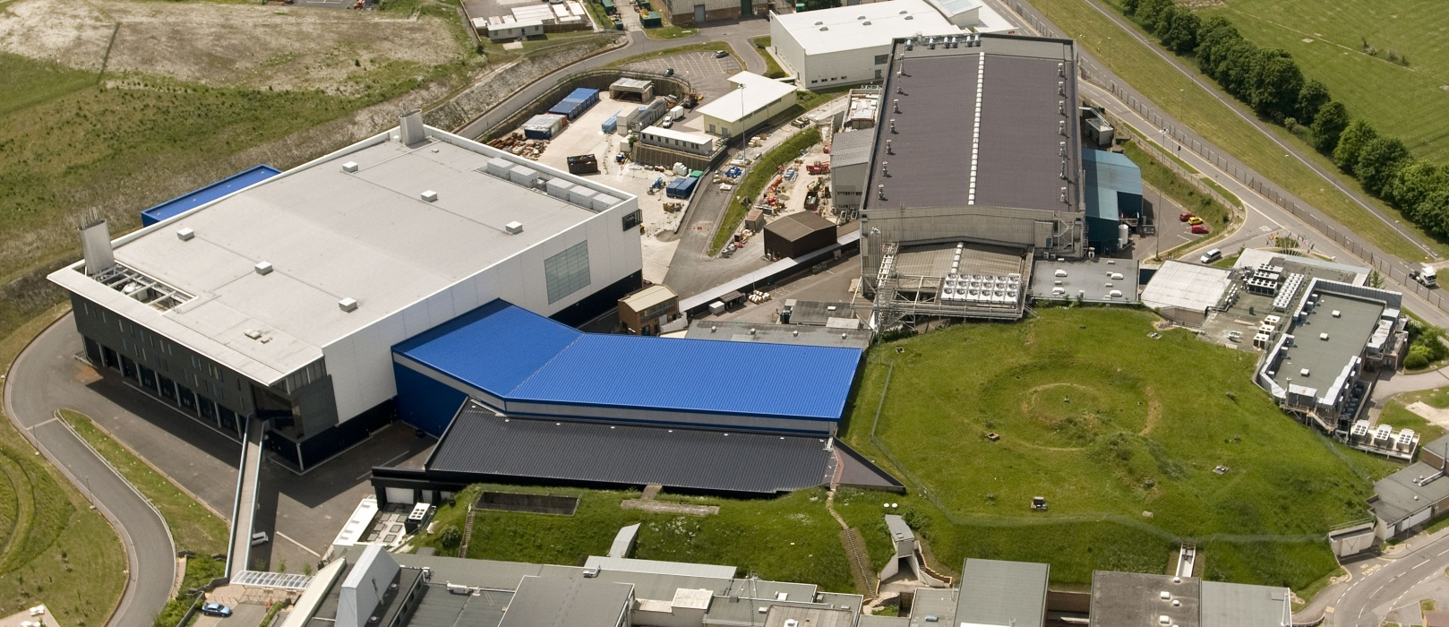
Introduction
Target Station 1 (40 pps)
H⁻ ion source, 35 keV
H⁻ RFQ, 665 keV
H⁻ Linac, 70 MeV
Target Station 2 (10 pps)
800 MeV Synchrotron

Slide 4
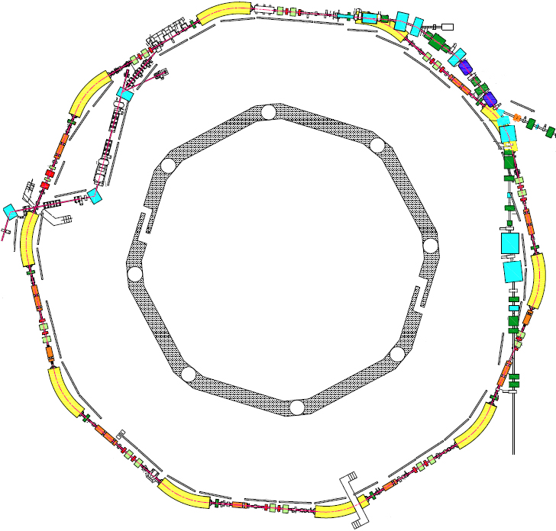
Introduction
Extraction
Circumference: 163 m
Energy: 70–800 MeV
Repetition Rate: 50 Hz
Intensity: Up to 3x10¹³ ppp
Mean Power: Up to 190 kW
Tune Shift: ~0.5
Injection: 130 turn
charge exchange
RF system: h=2, 1.3-3.1 MHz, 160 kV/turn
h=4, 2.6-6.2 MHz, 80 KV/turn
Extraction: single turn, vertical
Injection

Slide 5
Residual Gas Ionisation Profile Monitor
- Principle of Operation
Detector
Non-destructive measurement of beam profile and width
Ions/electrons produced proportional to beam intensity
Guided to detector
Ions / electrons
Proton Beam
+ High Voltage Electrode

Slide 6
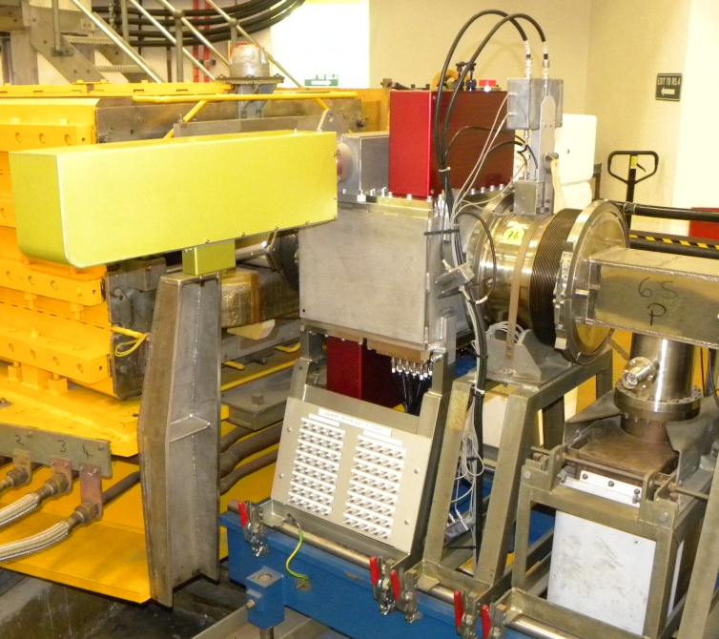
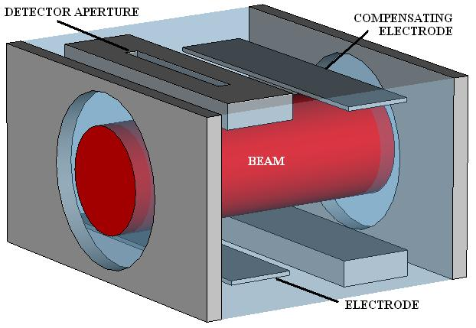
Residual Gas Ionisation Profile Monitor
- ISIS Design
Compensating electrodes double as calibration device – single channel
Up to 60 kV drift field
300 π mm mrad, ~100 mm wide average
10⁻⁷ mbar in synchrotron
340 mm
550 mm
446 mm

Slide 7
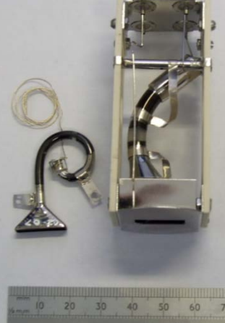
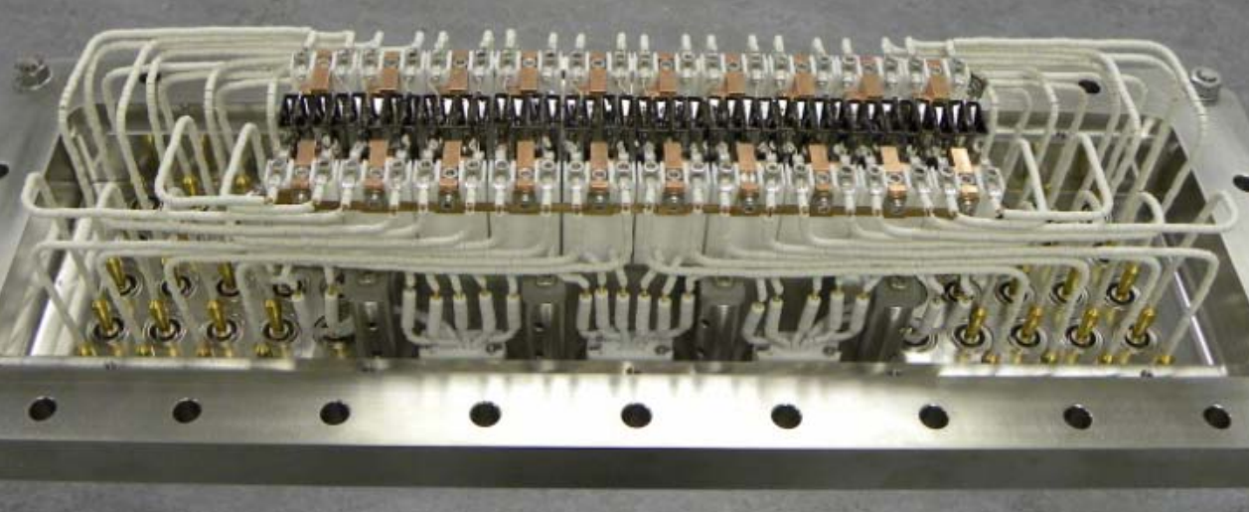
Residual Gas Ionisation Profile Monitor
- Detector Development
Single channel electron multipliers - channeltrons®
Upgrade from one moveable channeltron® (averaged profile) to 40 fixed channeltrons® (single pulse profile)
6 mm centre to centre separation
Single, moveable channeltron® used to calibrate multichannel
S Whitehead, S Payne, A Pertica et al.
BIW’ 10

Slide 8
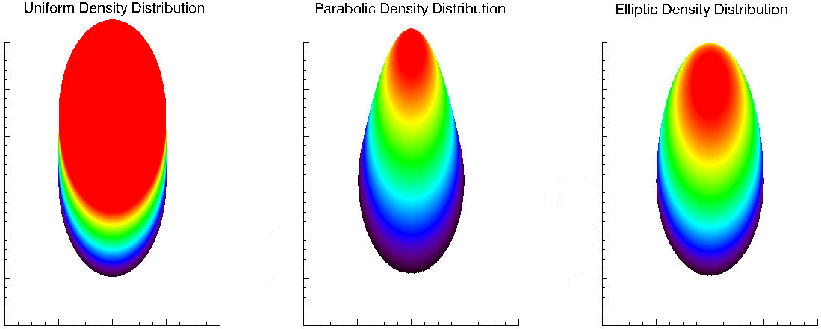
3D Electrostatic Model
Beam modelled as concentric cylinders
  Centred
  “Normal” beam distributions
Compensating field

Slide 9
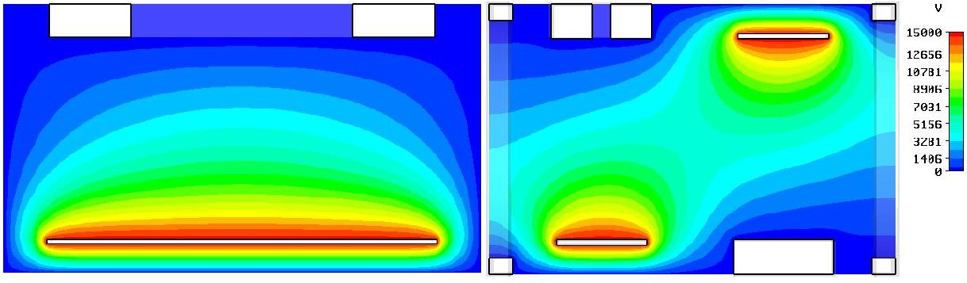
Measurement Error
– 2D Drift Field
Non-uniform electric field
Pushes ions outward from central axis
Measured profile widened
Feature of monitor geometry
y
Ideal ion path
Actual ion path
x

Slide 10
Measurement Error
– Space Charge
1x10¹³ ppp
Pushes ions out from centre of beam
Measured profile widened
Dependent on beam charge, size, energy, distribution, intensity and drift field voltage
30 kV
2 kV
3 kV
20 kV
10 kV
4 kV
15 kV
25 kV
5 kV
1 kV
0 kV
Space Charge Field
+ High Voltage Electrode
B. Pine
EPAC ‘06

Slide 11
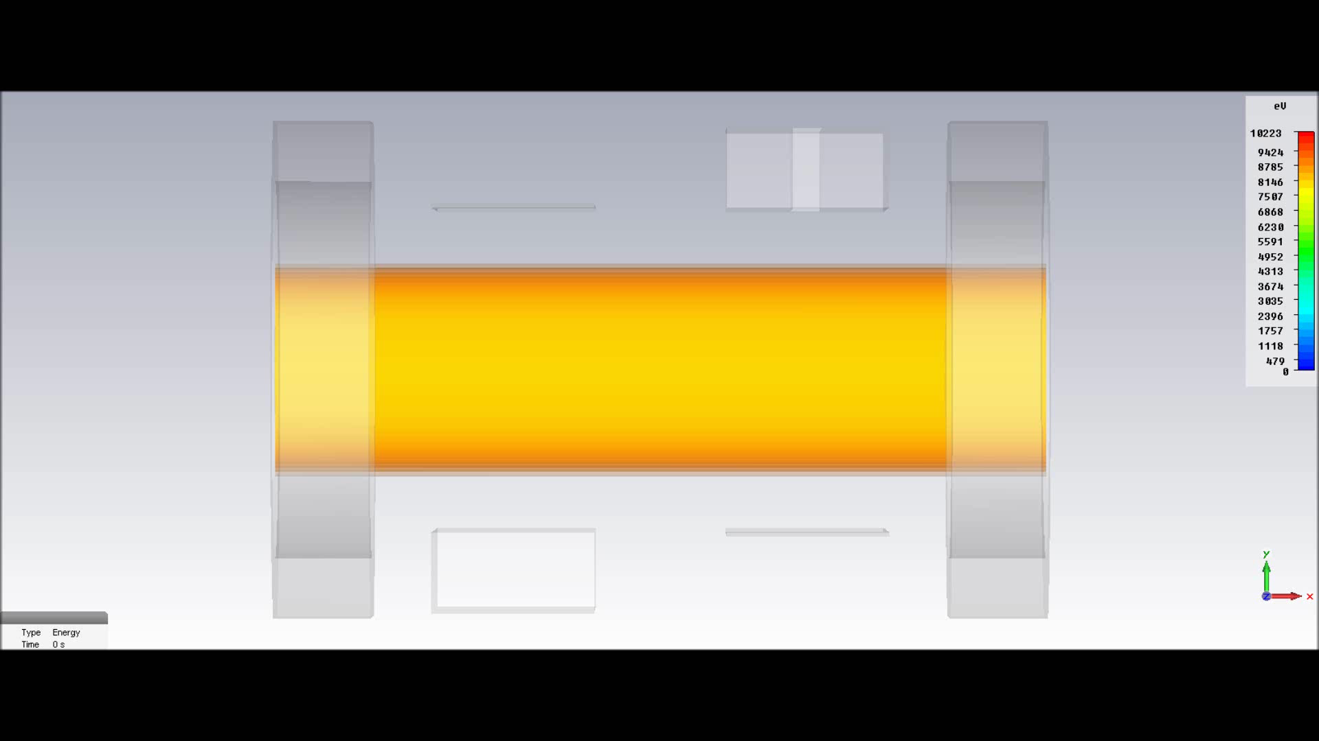
Ion Tracking
– Full 3D
Simple in house code
  Load electric field
  Create ions distributed evenly throughout beam volume
  Track ions with zero initial velocity until enter the detector or exit the monitor
  Weight tracks with beam distribution

Slide 12
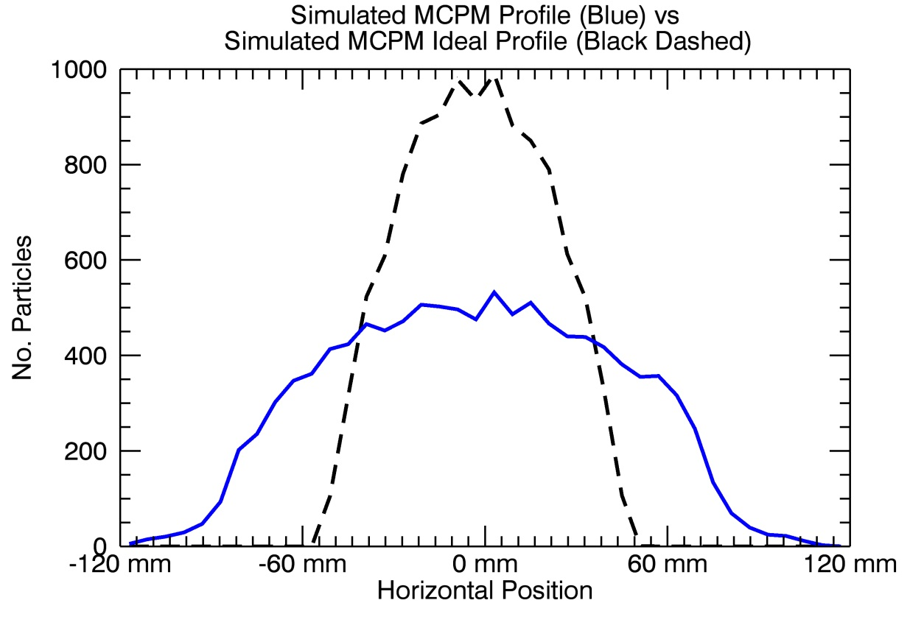
Ion Tracking Results
Combined errors can double the measured profile width in normal running conditions
Long tails present on profiles
Ideal profile
Simulated profile

Slide 13
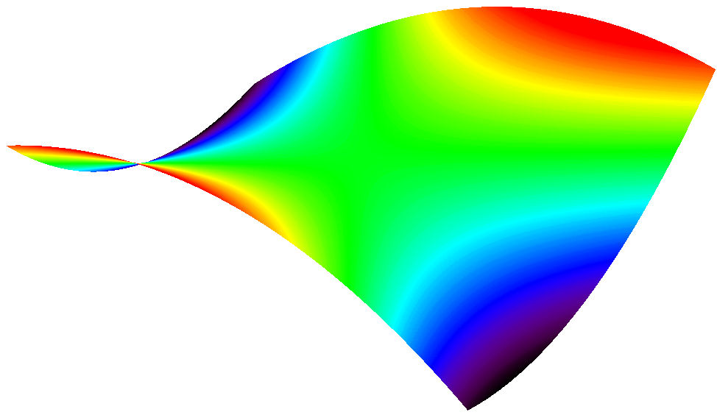
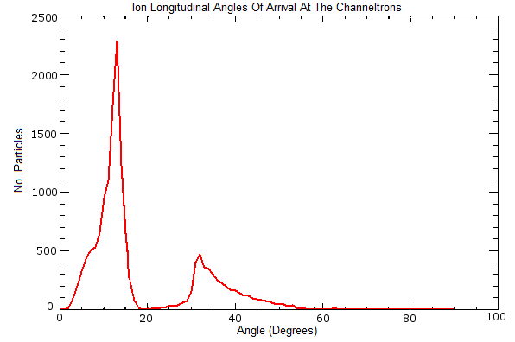
Measurement Error
– Longitudinal Drift Field
Non-uniform electric field
Longitudinal electric potential saddle point
More complicated ion trajectories
Not a pure 1D projection
Ideal ion path
Actual ion path
y
z

Slide 14
Initial Position of Detected Ions
Distorted 2D slice
More ions from monitor centre
Some oscillatory trajectories
Projection of detector aperture
Edge of electrode

Slide 15
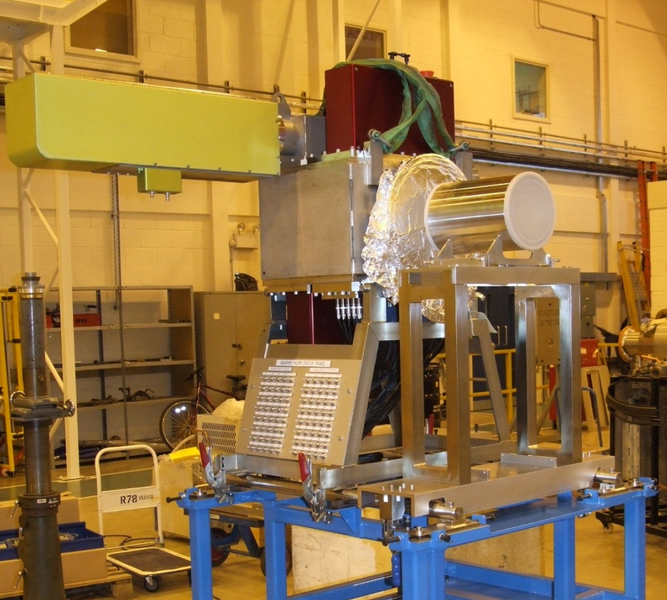
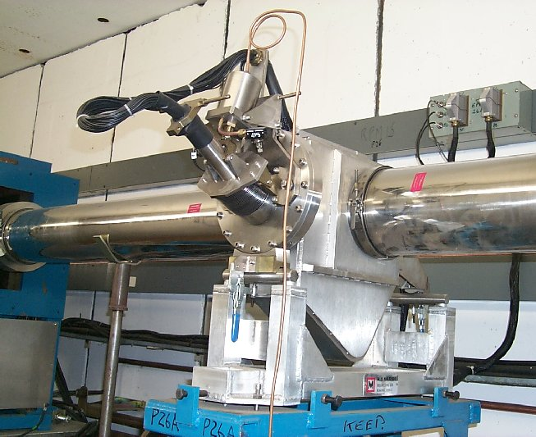
EPB Profile Study
Check understanding of profile monitor with other diagnostics
  Position monitor (planned)
  Ionisation profile monitor
  3 x SEM grid profile monitors
Profile
Grid
Grid
Position
Grid
SEM Grid
Ionisation Profile Monitor

Slide 16
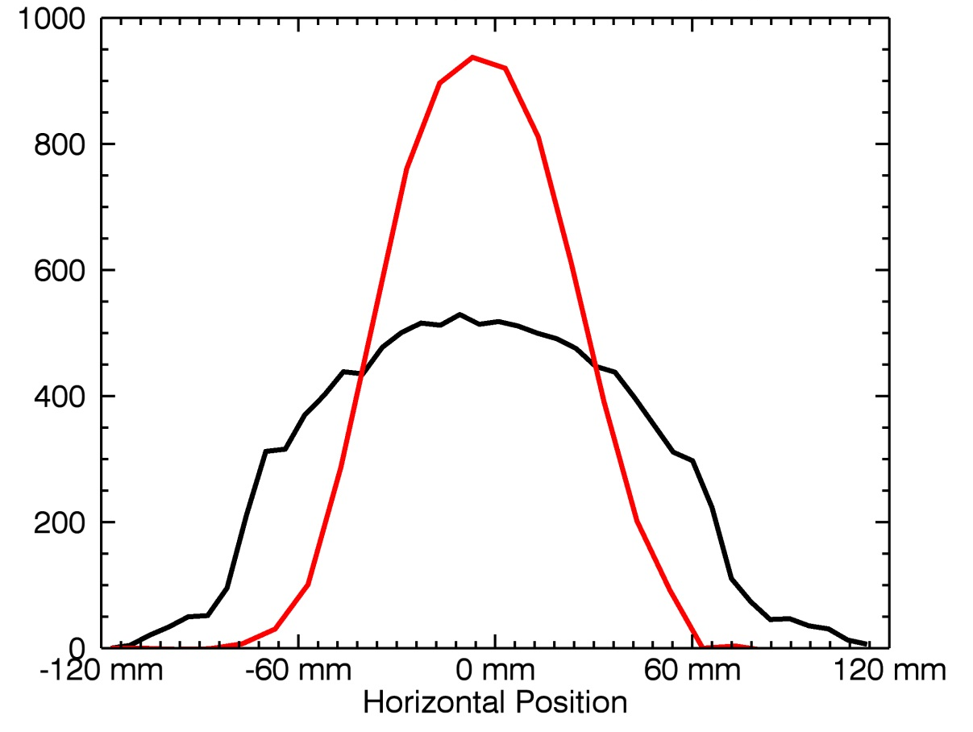
SEM Grid Vs Ionisation Profile
Measurement at 2.5x10¹³ ppp
Nominal 15 kV drift field
95% width:
SEM Grid – 100 mm
IPM – 158 mm
Accuracy +/- 3 mm

Slide 17
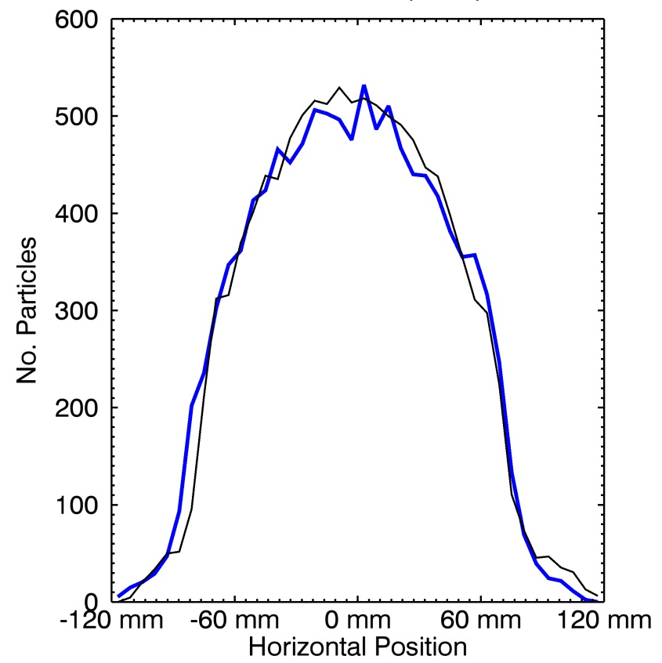
Simulation Vs Measurement
Model beam in ionisation monitor as measured using SEM grid profile monitor
Simulate resulting profile
Compare with measured ionisation profile
Many profile comparisons in the synchrotron confirm model with space charge and drift field
EPB comparisons promising
Simulated profile (black)
Measured profile (blue)

Slide 18
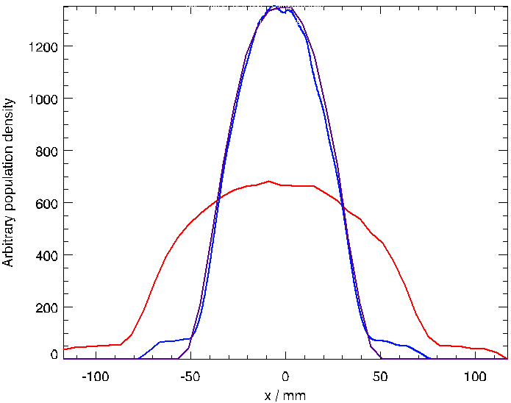
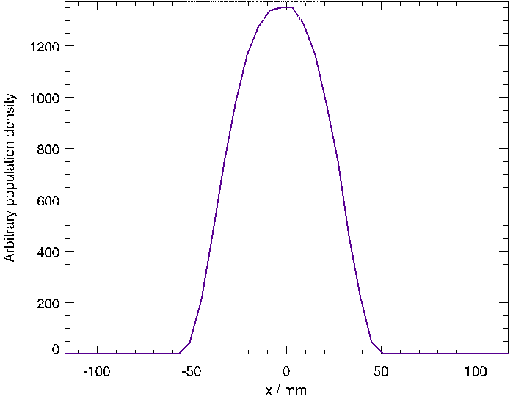
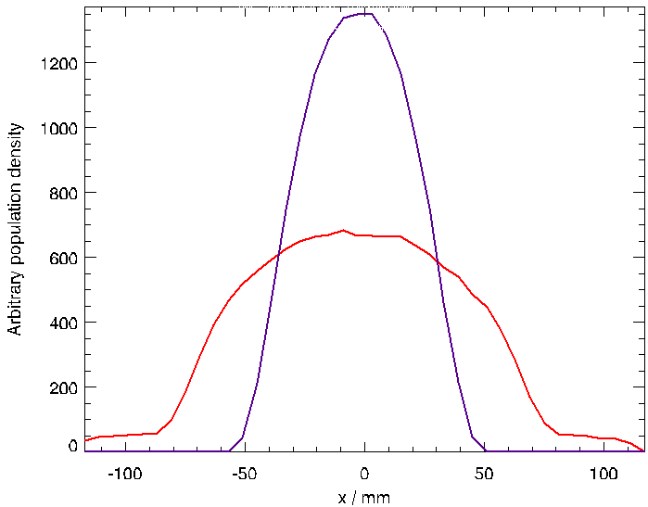
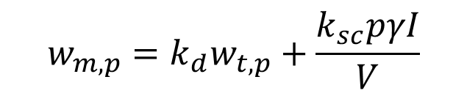
Profile Correction
Drift field correction
Space charge correction
Beam intensity
$$w_{m,p}=k_{d}w_{t,p}+\frac{k_{sc}pγI}{V}$$
R. Williamson
EPAC ‘08
Relativistic gamma
Drift field voltage
Ionisation monitor measured width and true beam width at percentage p
Derived from combination of simulation and measurements
Correct synchrotron profiles to within 6 mm
Profile tails
Simulated data
Ideal profile (purple)
Simulated profile (red)
Corrected profile (blue)

Slide 19
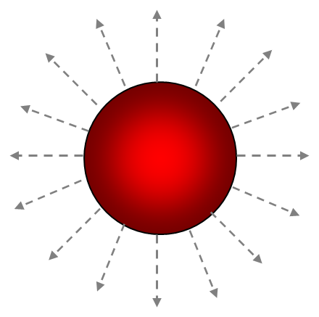
Error Summary
In decreasing order of importance
2D non-uniform drift field
  Verification at low intensities
  ~30% error on width
  Simple correction
  Shaping fields
Space charge
  Verification with altering drift field
  Error dependent on beam parameters, drift field, ~30% error on width
  Simple correction for centrally peaked, centred distributions
  Increase drift field voltage
3D non-uniform drift field
  Needs to be experimentally verified
  Small effect
  Remove compensating field?

Slide 20
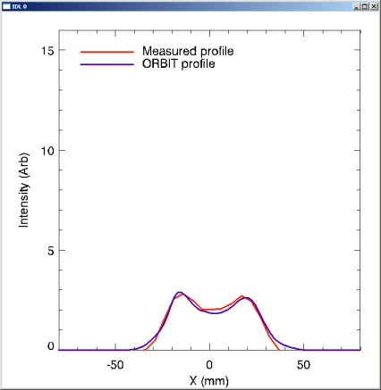
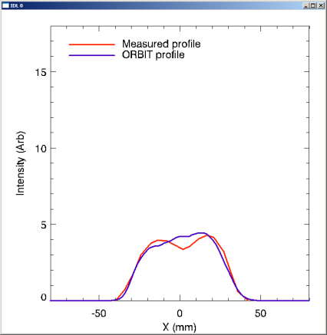
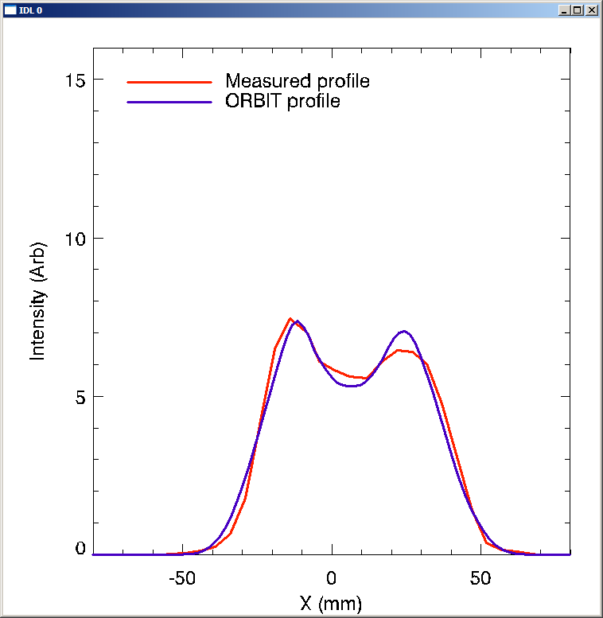
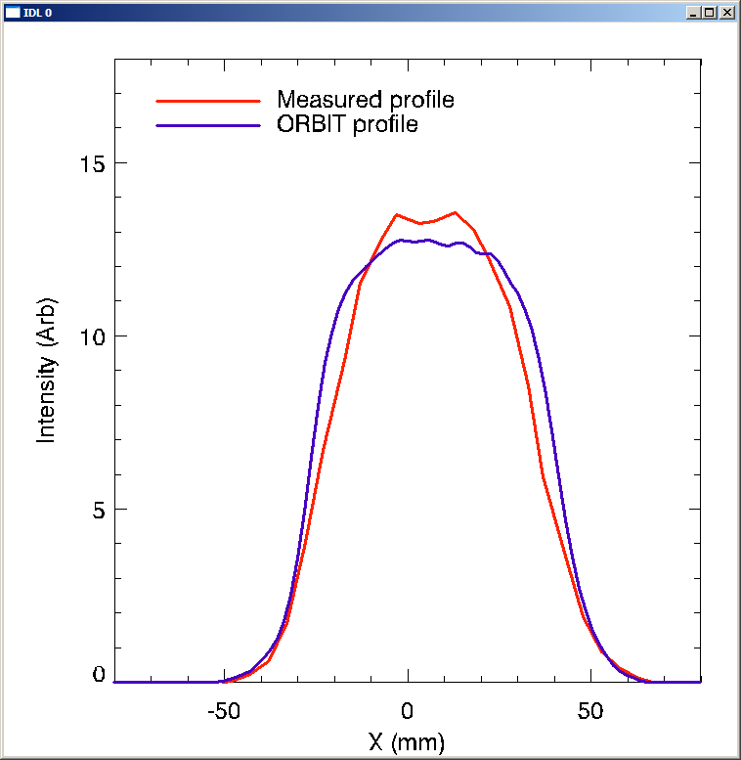
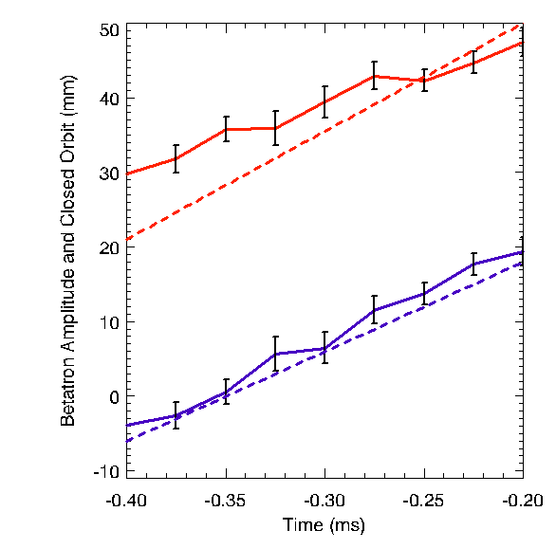
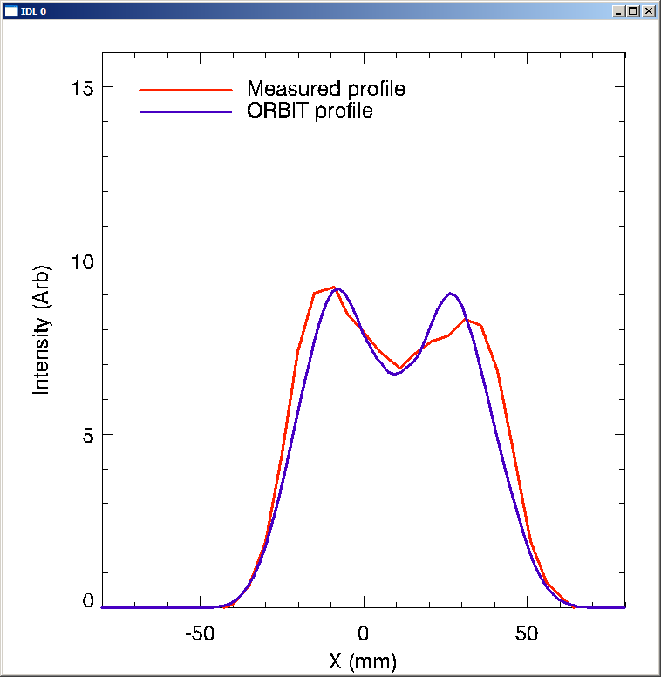
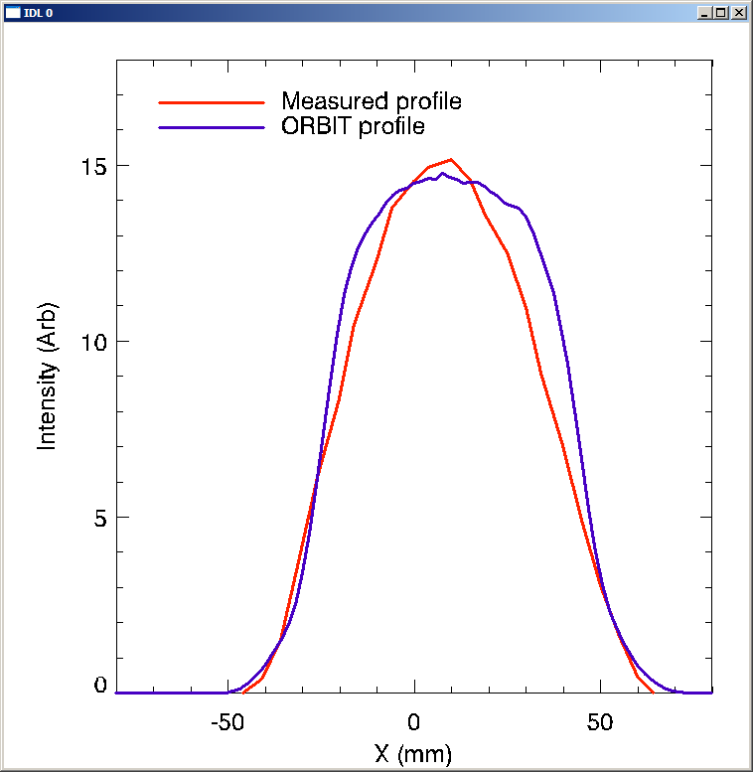
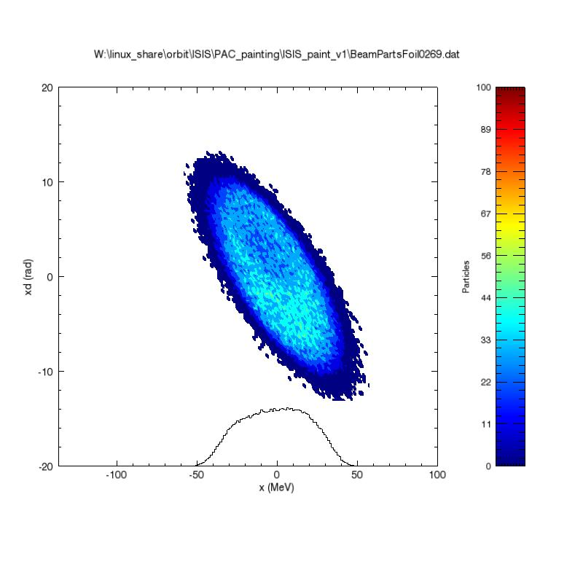
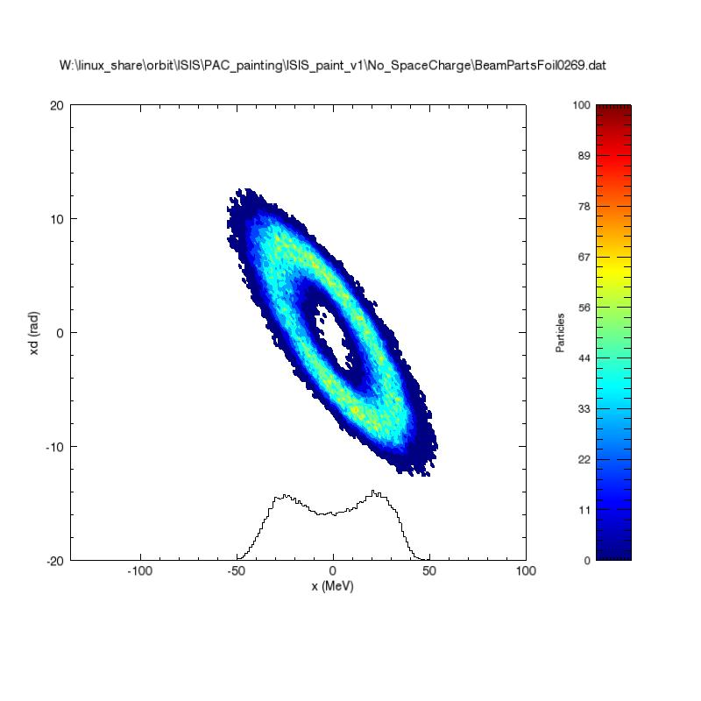
Injection Painting Measurements
Low intensity
Drift corr.
High intensity
Drift and SC corr.
Closed orbit and Relative Betatron amplitude measured over injection
Results used in ORBIT simulation of painting
Beam distributions generated by ORBIT compared to MCPM measurements at high and low intensity
2.5x10¹² ppp
2.5x10¹³ ppp
-0.3ms
-0.3ms
Space charge correction applied to HI data
-0.2ms
-0.2ms
B. Jones
EPAC ‘08
-0.1ms
-0.1ms

Slide 21
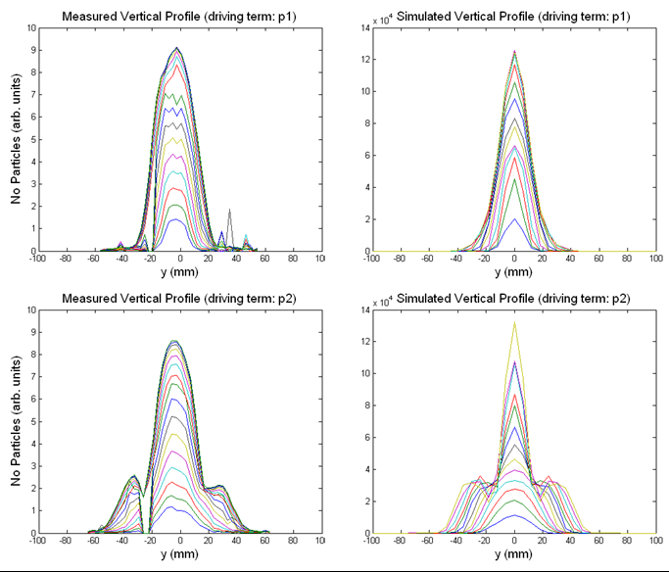
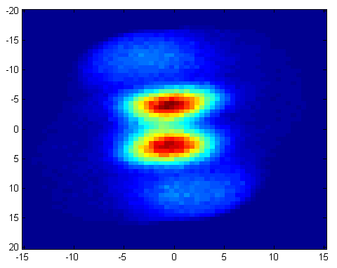
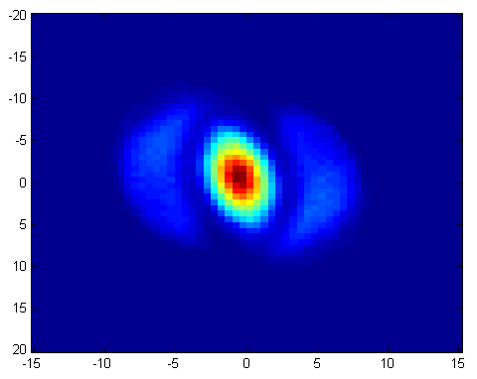
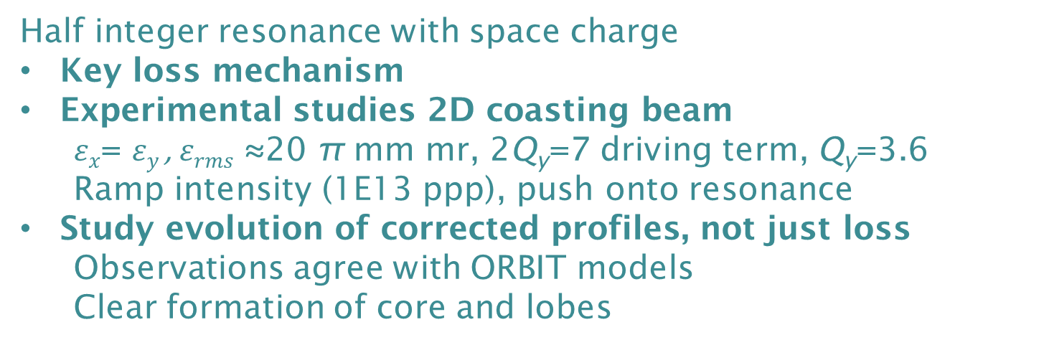
Half Integer Studies
Half integer resonance with space charge
Key loss mechanism
Experimental studies 2D coasting beam
  $εx$= $εy$, $εrms$ ≈20 π mm mr, 2Q_{y}=7 driving term, Q_{y}=3.6
  Ramp intensity (1E13 ppp), push onto resonance
Study evolution of corrected profiles, not just loss
  Observations agree with ORBIT models
  Clear formation of core and lobes
Measured
ORBIT
Using to understand loss mechanism
  1D and 2D models of core-to-halo dynamics
Good model of profile monitor key
Driving Phase 1
Driving Phase 2
C. Warsop
Space Charge ‘15

Slide 22
Summary
Good model of the ISIS residual gas ionisation profile monitor
Measurement errors
  2D non-uniform drift field
  Space charge
  3D non-uniform drift field
Simulations Vs Measurement
Correction works well for “normal” centred beams
  Applied in different scenarios
Key measurements for understanding machines with high space charge

Slide 23
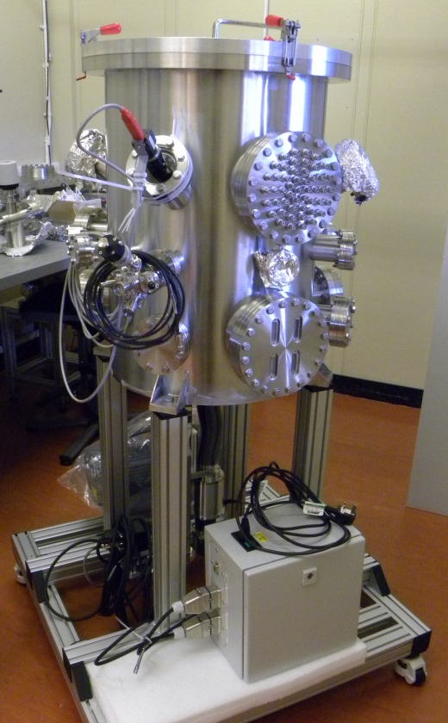
Plans for the Future
Effectiveness of profile correction for different beam types
  Intensity
  Off-centre
  Unusual beam distributions
Experimental check of beam width by different methods in the synchrotron
Characterisation of the channeltrons® in new diagnostic vacuum vessel
Development of the correction model and the monitor itself

Slide 25
Additional slides

Slide 26
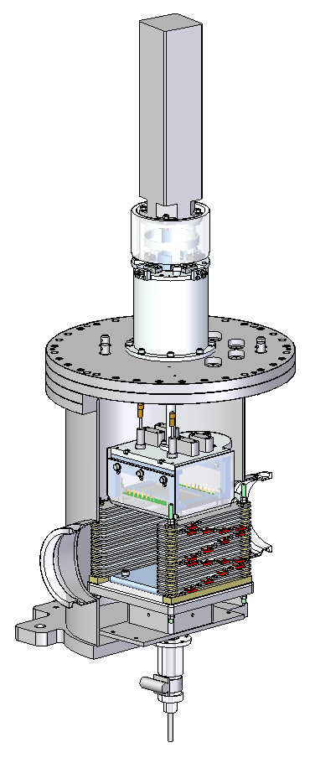
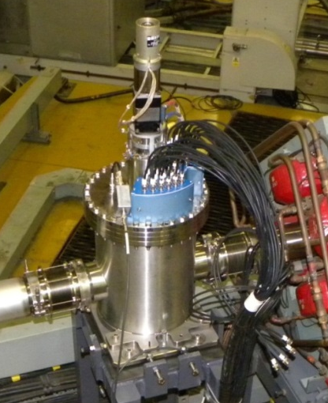
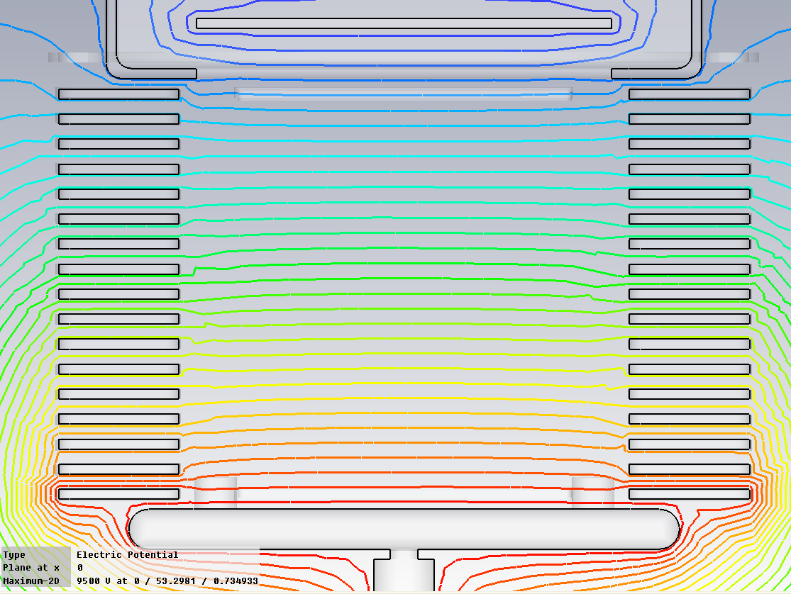
HEDS Monitor
Stepper motor and resolver
  Newer IPM installed in HEDS space between the Linac and ring in 2010.
  Beam profile here is narrow (~19mm width) so channeltrons not suitable.
  32 channel micro channel plate (MCP) used to detect ions instead.
  MCP can be rotated 90º to allow for calibration of each channel.
  Shaping field electrodes added to the design to remove widening effect of the drift field.
32 channel MCP detector
Beam
Shaping field electrodes

