Slide 1




FCC Challenges
F. Zimmermann, CERN
BeDi2015, Florence, 4 Nov. 2015
on behalf of the FCC global design study team
special thanks to S. Aumon,
M. Benedikt, J. Gutleber, K. Oide, and D. Schulte
photo. J. Wenninger
Work supported by the European Commission under Capacities 7th Framework Programme, Grant Agreement 312453

Slide 2

Outline
Motivation & Overview
FCC-hh
- parameters, aspects, challenges
FCC-ee
- parameters, aspects, challenges
Collaboration Status
Conclusions

Slide 3

Physics Motivation:
pushing the energy frontier
A very large circular hadron collider seems the only approach to reach 100 TeV c.m. collision energy in coming decades
Access to new particles (direct production) in the few TeV to 30 TeV mass range, far beyond LHC reach.
Much-increased rates for phenomena in the sub-TeV mass range →increased precision w.r.t. LHC and possibly ILC
M. Mangano
The name of the game of a hadron collider is energy reach
Cf. LHC: factor ~4 in radius, factor ~2 in field → O(10) in E_{cms}
$$E∝B_{dipole}{×ρ}_{bending}$$

Slide 4
Strategic Motivation
European Strategy for Particle Physics 2013:
  “…to propose an ambitious post-LHC accelerator project….., CERN should undertake design studies for accelerator projects in a global context,…with emphasis on proton-proton and electron-positron high-energy frontier machines..…”
ICFA statement 2014:
  ”…. ICFA supports studies of energy frontier circular colliders and encourages global coordination.….”
US P5 recommendation 2014:
  ”….A very high-energy proton-proton collider is the most powerful tool for direct discovery of new particles and interactions under any scenario of physics results that can be acquired in the P5 time window….”

Slide 5

Future Circular Collider Study
GOAL: CDR and cost review for the next ESU (2018)
International FCC collaboration (CERN as host lab) to study:
pp-collider (FCC-hh) → main emphasis, defining infrastructure requirements
80-100 km infrastructure in Geneva area
e⁺e⁻ collider (FCC-ee) as potential intermediate step
p-e (FCC-he) option
HE-LHC with FCC-hh technology
~16 T ⇒ 100 TeV pp in 100 km

Slide 6
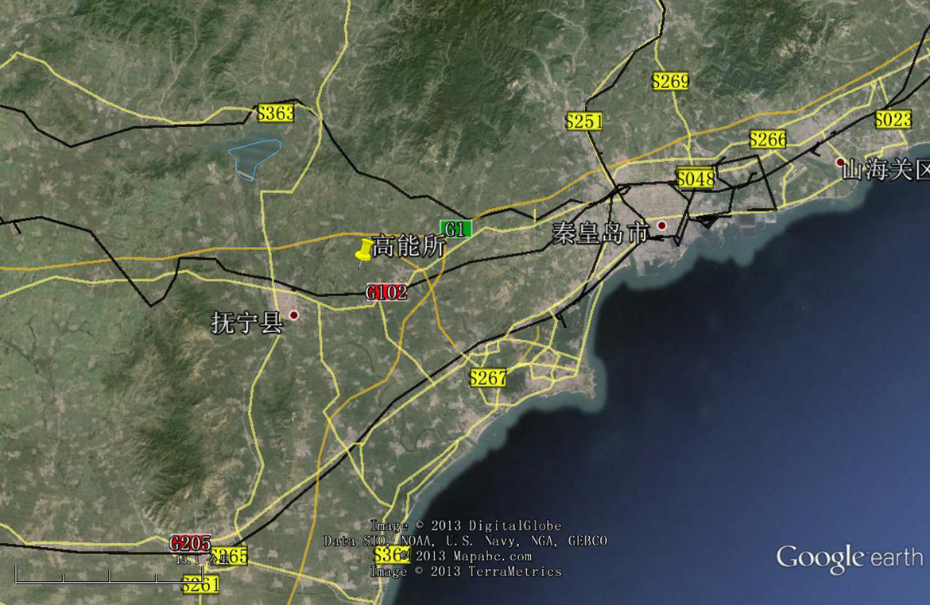
CepC/SppC study (CAS-IHEP) 54 km (baseline)
e⁺e⁻ collisions ~2028; pp collisions ~2042
Qinhuangdao (秦皇岛）
CepC, SppC
50 km
100 km
easy access
300 km east
from Beijing
3 h by car
1 h by train
“Chinese Toscana”
Yifang Wang

Slide 7

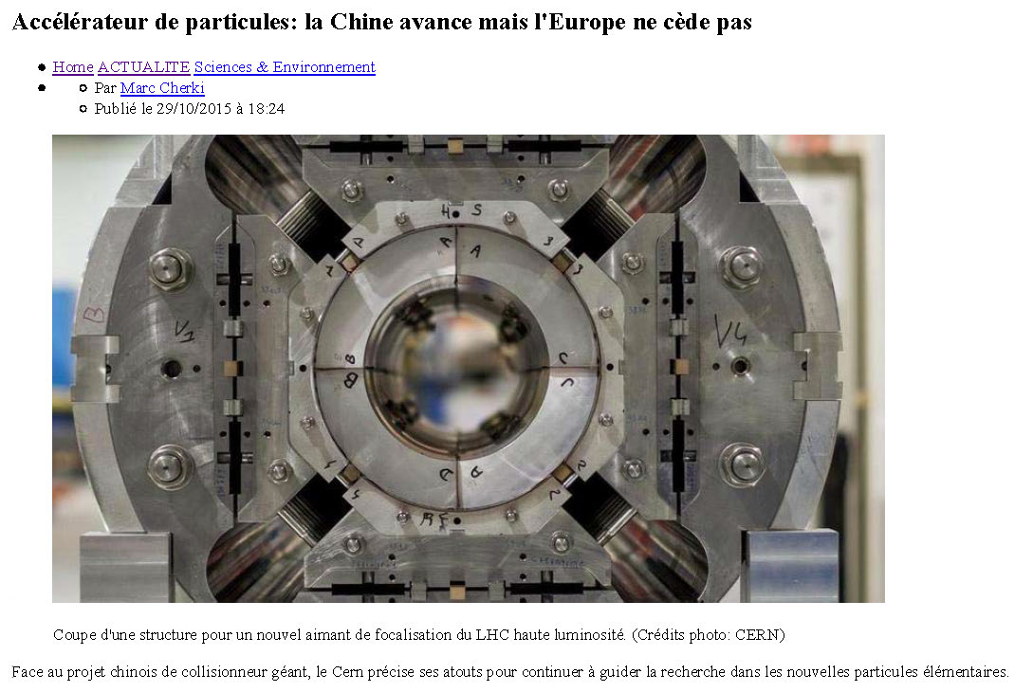

Slide 8
CERN Circular Colliders and FCC
1980
1985
1990
1995
2000
2005
2010
2015
2020
2025
2030
2035
Constr.
Physics
LEP
Design
Proto
Construction
Physics
LHC
Design
Construction
Physics
HL-LHC
20 years
FCC
Design
Proto
Construction
Physics
CDR by end 2018 for next strategy update

Slide 9
Hadron collider parameters
parameter | FCC-hh |  | SPPC | LHC | HL LHC
collision energy cms [TeV] | 100 |  | 71.2 | 14
dipole field [T] | 16 |  | 20 | 8.3
# IP | 2 main & 2 |  | 2 | 2 main & 2
bunch intensity [10¹¹] | 1 | 1 (0.2) | 2 | 1.1 |  | 2.2
bunch spacing [ns] | 25 | 25 (5) | 25 | 25 |  | 25
luminosity/Ip [10³⁴ cm⁻²s⁻¹] | 5 | 25 | 12 | 1 |  | 5
events / bunch crossing | 170 | 850 (170) | 400 | 27 |  | 135
stored energy/beam [GJ] | 8.4 |  | 6.6 | 0.36 |  | 0.7
synchr. rad. [W/m/aperture] | 30 |  | 58 | 0.2 |  | 0.35

Slide 10
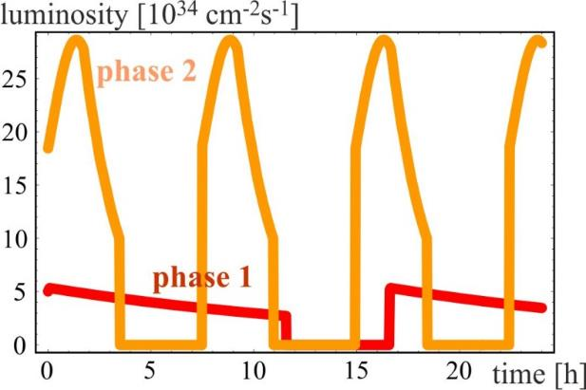
Luminosity evolution
radiation damping: τ~1 h
  for both phases:
  beam current 0.5 A unchanged!
  total synchrotron radiation power ~5 MW.
phase 1: β*=1.1 m, ΔQ_{tot}=0.01, t_{ta}=5 h, 250 fb⁻¹ / year
phase 2: β*=0.3 m, ΔQ_{tot}=0.03, t_{ta}=4 h, 1000 fb⁻¹ / year

Slide 11
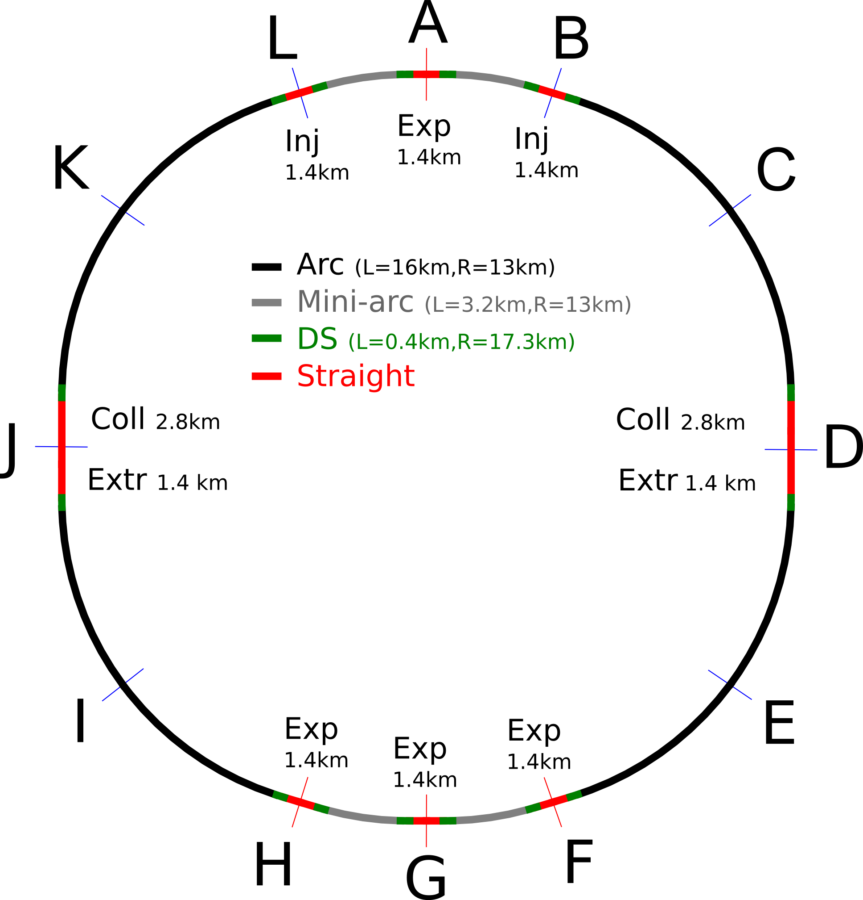
FCC-hh preliminary layout
100 km layout for FCC-hh
Two high-luminosity experiments (A and G)
Two other experiments (F & H) grouped with main experiment in G
Two collimation lines
  each 2.8 km long!
Two injection and two extraction lines
Orthogonal functions for each insertion section

Slide 12
Unprecedented beam power
8GJ stored energy / beam
  Airbus A380 at 700km/h
  24 times larger than in LHC at 14TeV
  can melt 12t of copper
  or drill a 300m long hole
  machine protection
  beam abort
any beam loss important
  e.g. beam-gas scattering, non-linear dynamics
  can quench arc magnets
  background for the experiments
  activation of the machine
  collimation system
  transfer and injection

Slide 13
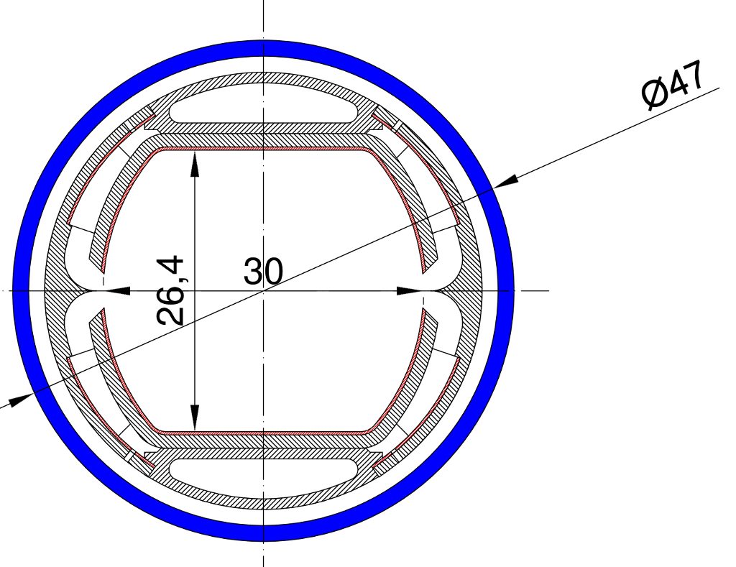
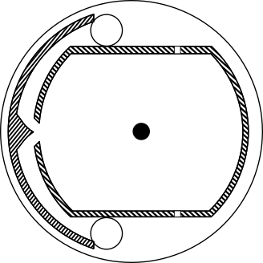
FCC-hh beam pipe design
asymmetric FCC design with 1 slit
- possible trapped modes due to
final slit length
- off-centered beam axis (1.5 mm)
symmetric FCC design with 2 slits
- avoids tpumping holes
- trapped modes still possible
- the present design choice
1) R. Kersevan http://goo.gl/qSo0iB
2) R. Kersevan https://goo.gl/aK24yC
R. Kersevan, O. Boine-Frankenheim

Slide 14
beam-screen temperature
Picked 50 K for efficiency and beam stability
But for 4.5 K magnets can also consider 110K
Ph. Lebrun
L. Tavian
V. Baglin
Based on LHC screen
300MW
200MW
100MW
Multi-bunch/resistive part of TMCI effects
2.5 times larger
D. Schulte

Slide 15
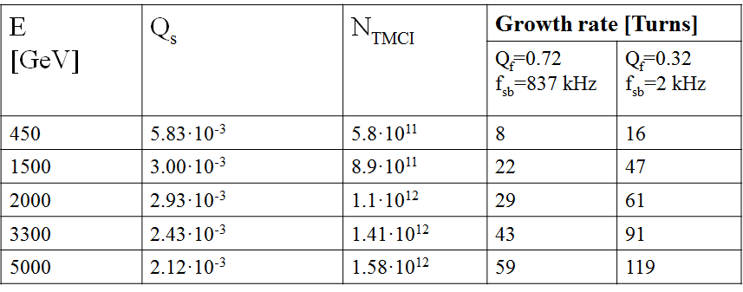
TMCI & CB instability – beam screen
TMCI threshold due to k=0 reaching -Q_{s}
Coupled-bunch instability growth rate
Impedance averaged over the mode spectrum
O. Boine-Frankenheim
F. Petrov

Slide 16
key FCC-hh BeDi challenges
cont. control of transverse & longitudinal emittance by noise excitation, keeping ΔQ or pile-up constant →SR emittance measurement, tune-shift measurements?, bunch-by-bunch luminosity measurement?
beam stability → feedback systems (5 ns), octupoles,..
collimation system: choice of collimator gaps (system length!) → orbit & optics control at collimators
machine protection
  safe injection → orbit & optics in transfer line & ring
  acceptable losses during ramp & in store → BLMs
  rapid beam abort → early failure detection
  good IR optics control for phase 2 → AC dipole??

Slide 17
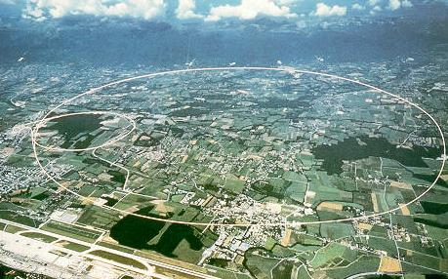
LEP – highest energy e⁺e⁻ collider so far
circumference 27 km
in operation from 1989 to 2000
maximum c.m. energy 209 GeV
maximum synchrotron radiation power 23 MW

Slide 18
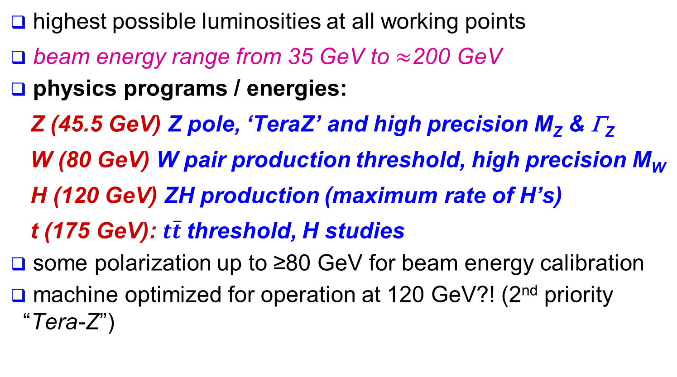
FCC-ee physics areas
highest possible luminosities at all working points
beam energy range from 35 GeV to $≈$200 GeV
physics programs / energies:
  Z (45.5 GeV) Z pole, ‘TeraZ’ and high precision M_{Z} & Γ_{Z}
  W (80 GeV) W pair production threshold, high precision M_{W}
  H (120 GeV) ZH production (maximum rate of H’s)
  t (175 GeV): $t\overline{t}$threshold, H studies
some polarization up to ≥80 GeV for beam energy calibration
machine optimized for operation at 120 GeV?! (2nd priority “Tera-Z”)
A. Blondel, P. Janot, et al.

Slide 19
Lepton collider key parameters
parameter | FCC-ee |  |  | CEPC | LEP2
energy/beam [GeV] | 45 | 120 | 175 | 120 | 105
bunches/beam | 60000 | 1400 | 98 | 50 | 4
beam current [mA] | 1450 | 30 | 6.6 | 16.6 | 3
luminosity/IP x 10³⁴ cm⁻²s⁻¹ | 100 | 5.3 | 1.2 | 2.0 | 0.0012
energy loss/turn [GeV] | 0.03 | 1.67 | 7.55 | 3.1 | 3.34
synchrotron power [MW] | 100 |  |  | 103 | 22
RF voltage [GV] | 0.2-2.5 | 3.6-5.5 | 11 | 6.9 | 3.5
FCC-ee: 2 separate rings CEPC baseline: single beam pipe like LEP

Slide 20
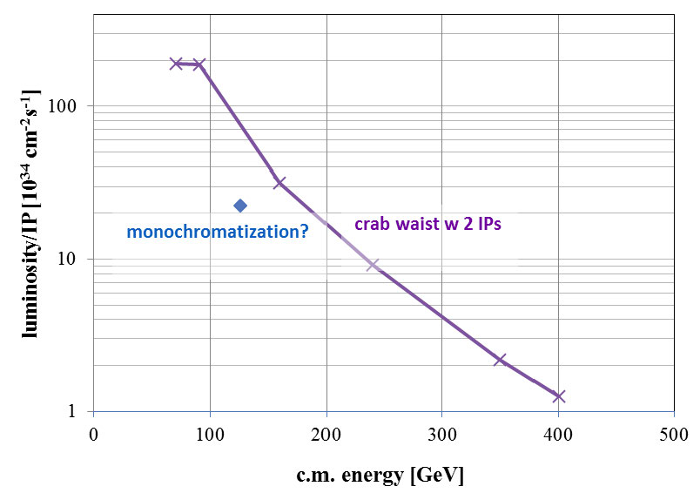

e⁺e⁻ luminosity vs. c.m. energy
FCC ee
α_{QED}
Z
H?
WW
HZ
$$t\overline{t}$$
?
CEPC

Slide 21

beamstrahlung
hard photon emission at the IPs, ‘Beamstrahlung’, can become lifetime / performance limit for large bunch populations (N), small hor. beam size (σ_{x}) & short bunches (σ_{s})
e
γ
e
ρ : mean bending radius at the IP (in the field of the opposing bunch)
η : ring energy acceptance
lifetime expression by V. Telnov, modified version by A. Bogomyagkov et al
for acceptable lifetime, ρ×η must be sufficiently large
  flat beams (large σ_{x}, small σ_{y}) !
  long bunches !
  large momentum acceptance: ≥1.5% at 175 GeV
    - LEP: <1% acceptance, SuperKEKB ~ 1.5%
J. Wenninger, et al

Slide 22

SuperKEKB = FCC-ee demonstrator
beam commissioning will start in January 2016
K. Oide et al.
top up injection at high current
β_{y}* =300 μm (FCC-ee: 1 mm)
lifetime 5 min (FCC-ee: ≥20 min)
ε_{y}/ε_{x} =0.25% (similar to FCC-ee)
off momentum acceptance (±1.5%, similar to FCC-ee)
e⁺ production rate (2.5x10¹²/s, FCC-ee: <1.5x10¹²/s (Z crab waist)
SuperKEKB goes beyond FCC-ee, testing all concepts

Slide 23

IP
30 mrad
“Middle straight”
∼1570 m
FCC-hh
∼12 m
9 m
FCC-ee layout
Based on, and compatible with, FCC-hh layout
(in green)
0.8 m
“90/270 straight”
∼4.7 km
Common
RF
Common
RF
As the separation of 3(4) rings is within 15 m,
one wide tunnel may be possible around the IR.
K. Oide
IP

Slide 24
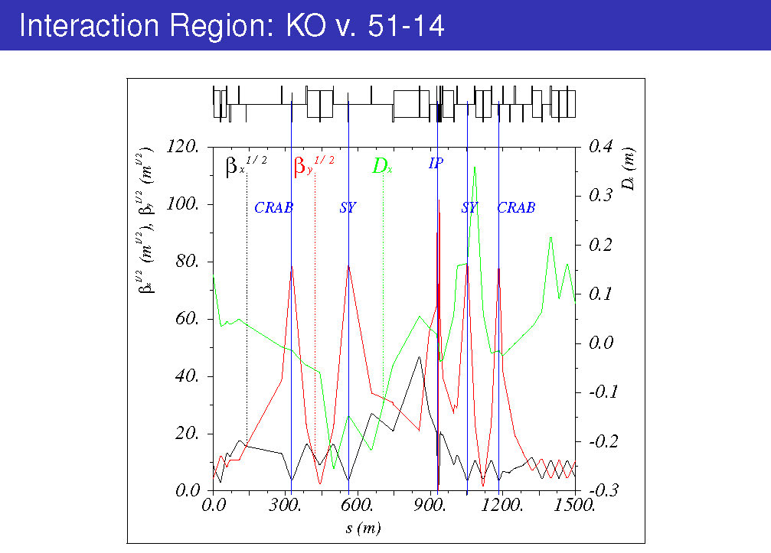
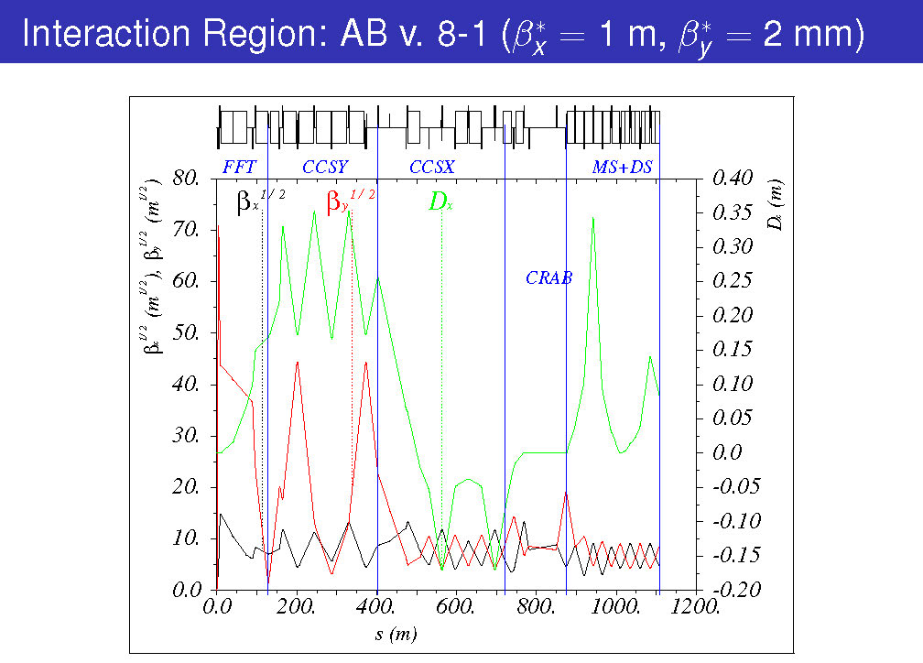
IR optics – 2 variants
both feature local chromatic correction in y plane; crab waist
2 sextupoles only, virtual crab waist
ξ_{x} corrected using arcs
sextupole pairs, E_{γ,c}≤100 keV
5 sextupoles, incl. crab waist
ξ_{x} corrected locally,
E_{γ,c}≤400 keV
K. Oide
A. Bogomyagkov

Slide 25
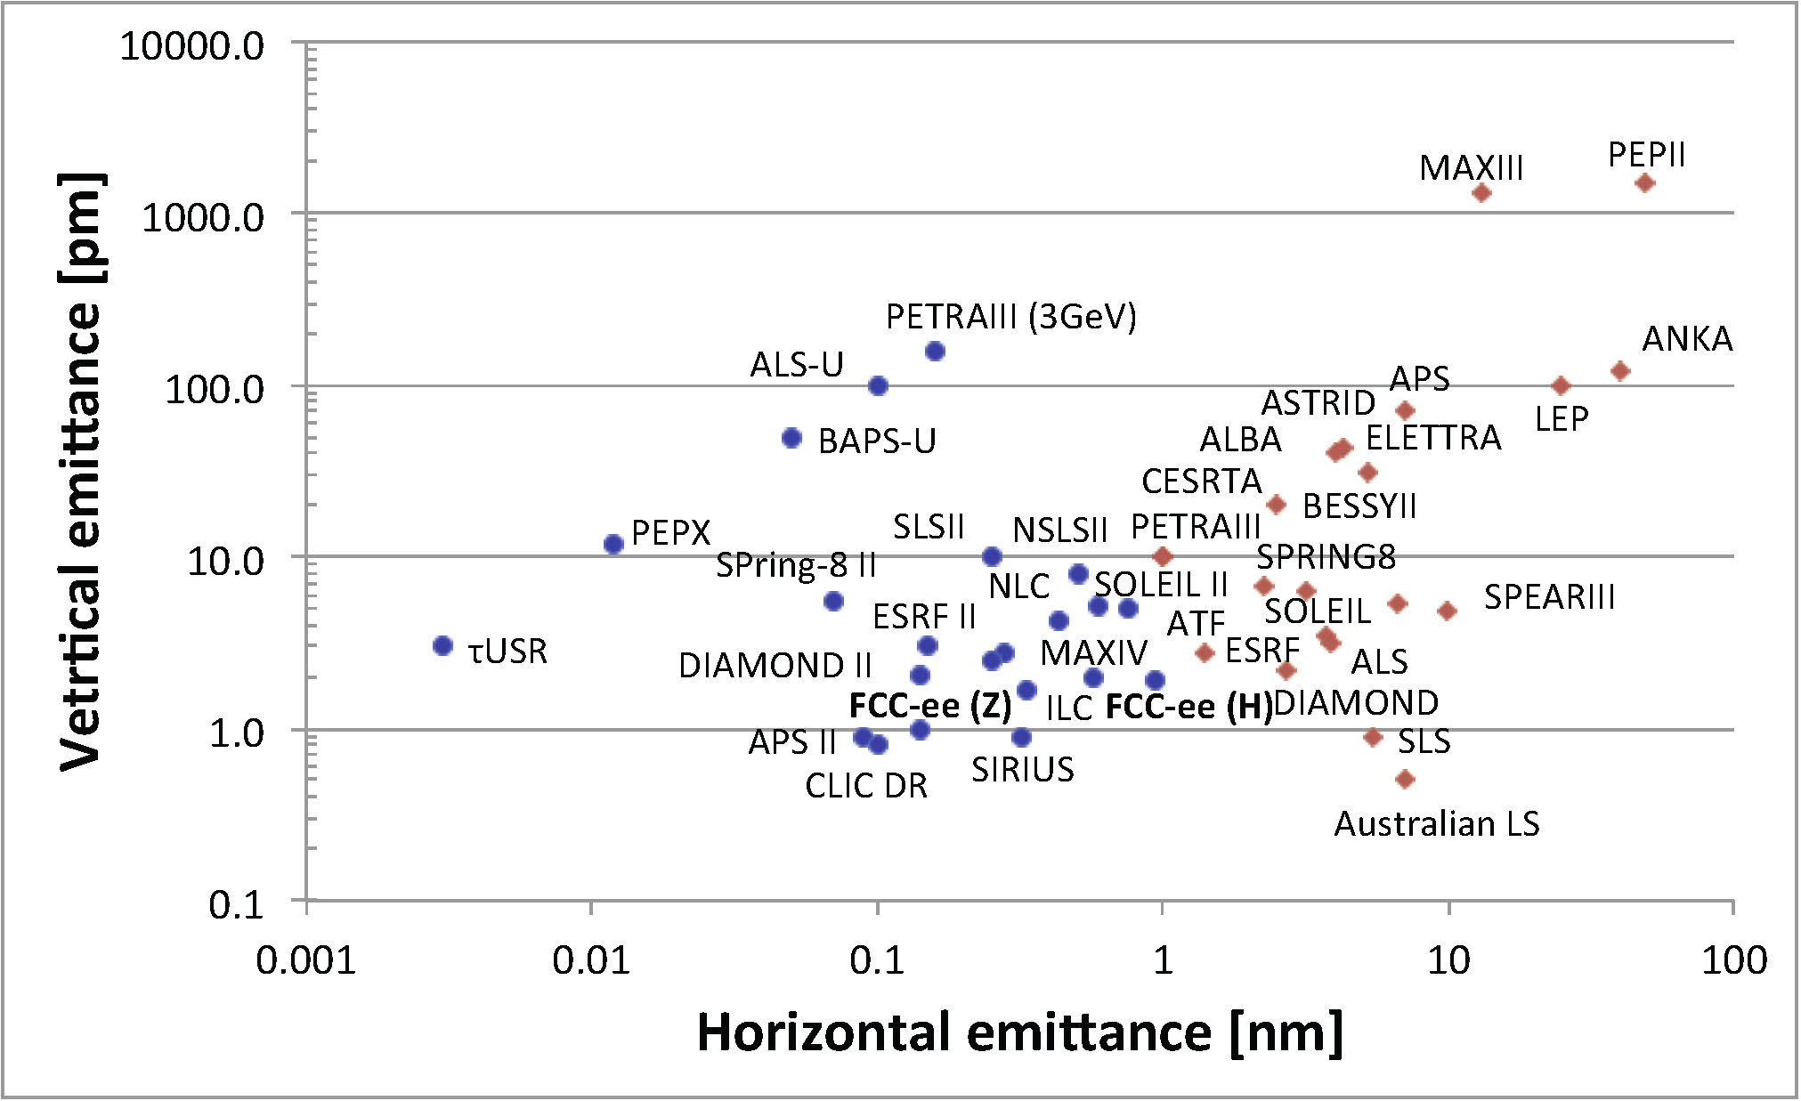
emittance landscape
FCC-ee hadron beams resembling e- light source
LHC
FCC-hh
FCC-ee: where no ring has operated so far
Y. Papaphilippou

Slide 26
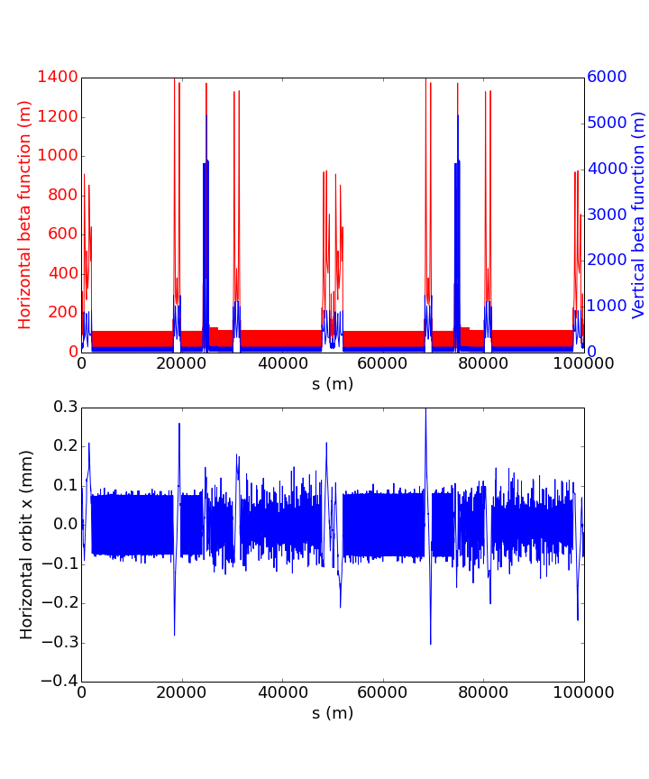
175 GeV
vertical emittance with errors
IP
IP
0.010 mm transverse misalignments in quadrupoles
2 RF sections – tapering mandotary
local chromaticity correction around the IPs.
after Orbit correction and tapering (dipole-quad-sext.)
working point
orbit H&V and Vertical dispersion are sensitive to extra peak in beta function
no rolls…
need some extra BPMs and closed-orbit correctors in the straight sections ..
S. Aumon
work in progress…
?

Slide 27
critical photon energy in arc
project | Ε_{g} [keV]
LEP | 724
LHC | 0.04
KEKB LER | 2
FCC-hh | 5
FCC-ee Z | 20
FCC-ee ZH | 300
FCC-ee tt | 1000

Slide 28
IP beam sizes
project | status | β_{y}* [mm] | σ_{y}* [nm]
LEP | measured | 50 | 3200
LHC | measured | 600 | 16000
KEKB | measured | 6.0 | 940
FCC-hh | design | 1100 | 7000
S-KEKB | design | 0.3 | 50
FCC-ee | design | 2.0 | 50
SLC | measured | 2.0 | 500
FFTB | measured | 0.167 | 70
ATF2 | measured | 0.1 | ~40
storage
rings
single
pass

Slide 29
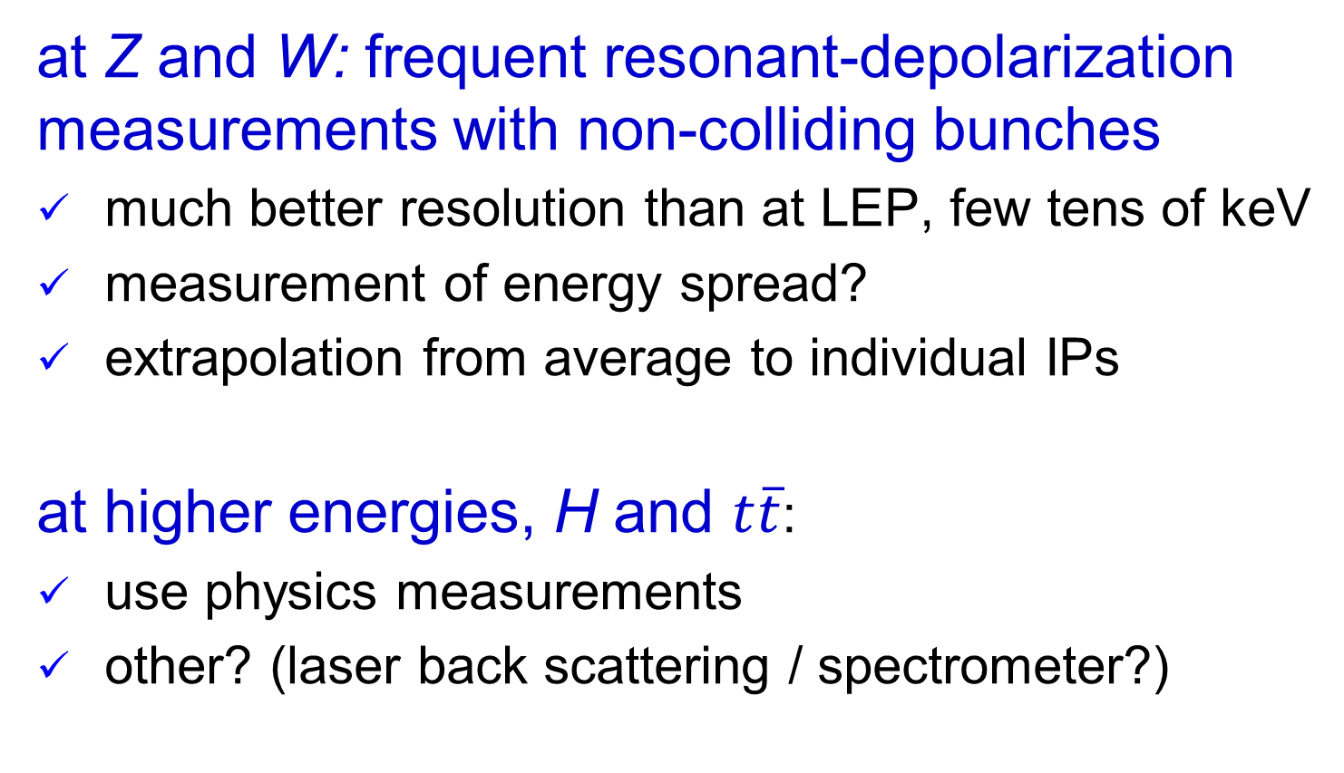
FCC-ee energy calibration
at Z and W: frequent resonant-depolarization measurements with non-colliding bunches
much better resolution than at LEP, few tens of keV
measurement of energy spread?
extrapolation from average to individual IPs
at higher energies, H and $t\overline{t}$:
use physics measurements
other? (laser back scattering / spectrometer?)

Slide 30
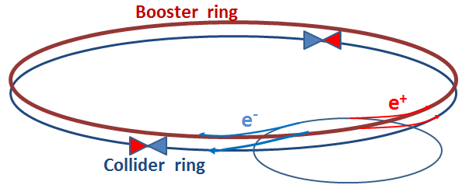
FCC-ee injection: top-up
booster in the main tunnel must provide beams for top-up injection to sustain the extremely high luminosity
  top up frequency ≈0.1 Hz
  booster injection energy ≈5-20 GeV
  bypass around the experiments
A. Blondel

Slide 31
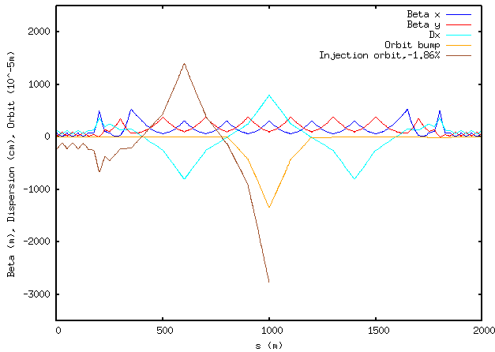
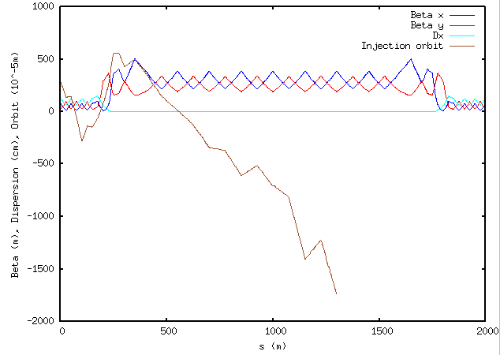
top-up injection schemes
conventional scheme
(off energy), two dipole kickers
multipole injection (on energy),
sextupole kicker
<= Beam
<= Beam
Residual betatron
oscillation (10σ)
Kicker
Kicker
Wire septum
Septum
injection losses?, perturbation of stored beam?,
background effect on particle-physics detector?
M. Aiba

Slide 32
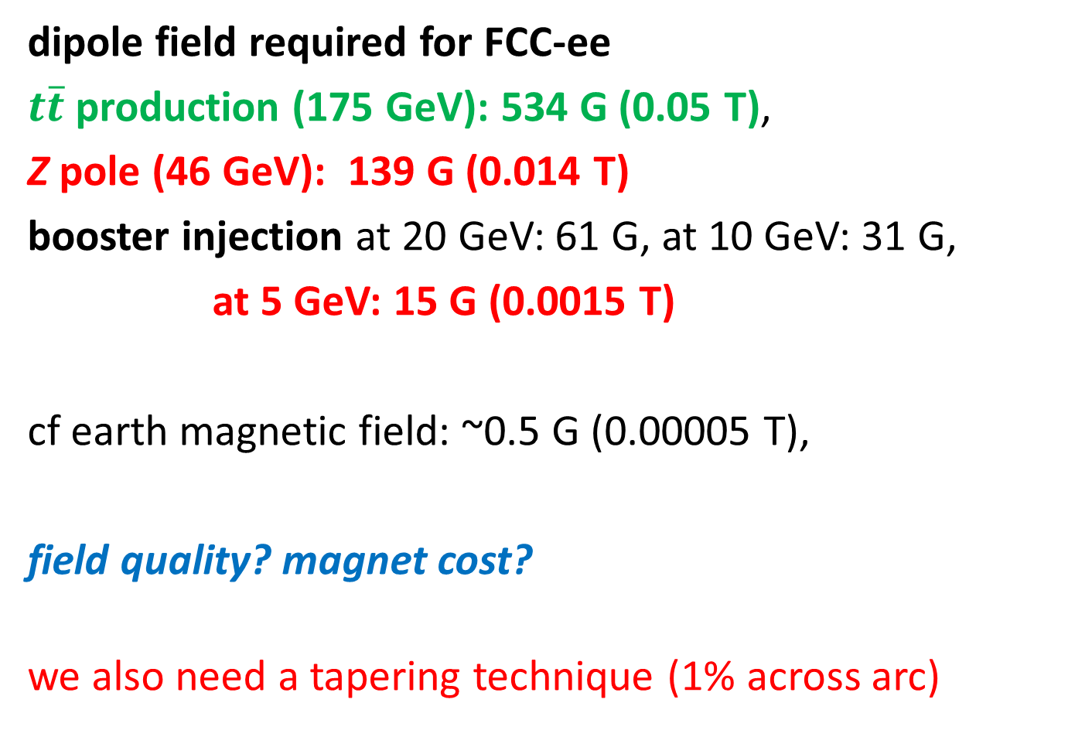
low dipole fields!
dipole field required for FCC-ee
$t\overline{t}$ production (175 GeV): 534 G (0.05 T),
Z pole (46 GeV): 139 G (0.014 T)
booster injection at 20 GeV: 61 G, at 10 GeV: 31 G,
at 5 GeV: 15 G (0.0015 T)
cf earth magnetic field: ~0.5 G (0.00005 T),
field quality? magnet cost?
we also need a tapering technique (1% across arc)

Slide 33
key FCC-ee BeDi challenges
achieving design emittances – the lowest ever! → correcting orbit, coupling, dispersion, esp. vertical
measuring small beam sizes → SR monitors with high photon energies
beam stability → bunch-by-bunch feedback systems
radiative Bhabha scattering, and beamstrahlung, … → beam-loss diagnostics
top-up injection, … → orbit and optics control good IR optics control for ultimate luminosity with crab waist and β_{y}* - 1-2 mm (σ_{y}*~ 50 nm) → IR BPMs, non-invasive profile monitors (?)
precise energy calibration → polarimetry, others …

Slide 34



Study time line towards FCC CDR
2014 |  |  |  | 2015 |  |  |  | 2016 |  |  |  | 2017 |  |  |  | 2018
Q1 | Q2 | Q3 | Q4 | Q1 | Q2 | Q3 | Q4 | Q1 | Q2 | Q3 | Q4 | Q1 | Q2 | Q3 | Q4 | Q1 | Q2 | Q3 | Q4
Study plan, scope definition
Explore options
“weak interaction”
conceptual study of baseline “strong interact.”
FCC Week 2015:
work towards baseline
FCC Week 17 & Review
Cost model, LHC results
→ study re-scoping?
FCC Week 2016
Progress review
Elaboration,
consolidation
FCC Week 2018
→ contents of CDR
Report
CDR ready

Slide 35
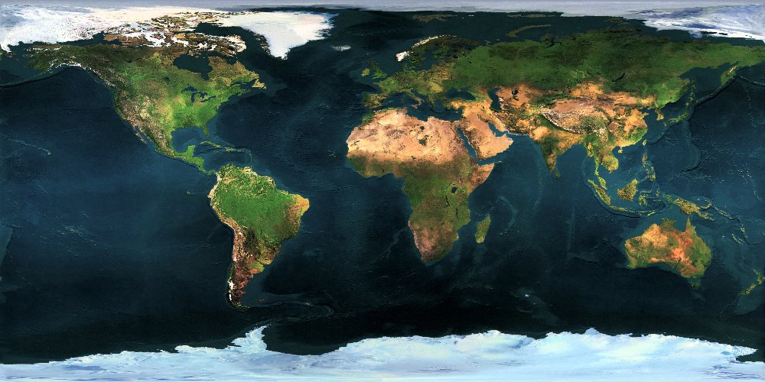























Collaboration Status
FCC International Collaboration
62 institutes
23 countries + EC
Status: 14 September 2015

Slide 36
FCC Collaboration Status
62 collaboration members & CERN as host institute, 30 October 2015
ALBA/CELLS, Spain
Ankara U., Turkey
U Belgrade, Serbia
U Bern, Switzerland
BINP, Russia
CASE (SUNY/BNL), USA
CBPF, Brazil
CEA Grenoble, France
CEA Saclay, France
CIEMAT, Spain
CNRS, France
Cockcroft Institute, UK
U Colima, Mexico
CSIC/IFIC, Spain
TU Darmstadt, Germany
TU Delft, Netherlands
DESY, Germany
TU Dresden, Germany
Duke U, USA
EPFL, Switzerland
GWNU, Korea
U Geneva, Switzerland
Goethe U Frankfurt, Germany
GSI, Germany
U. Guanajuato, Mexico
Hellenic Open U, Greece
HEPHY, Austria
U Houston, USA
IIT Kanpur, India
IFJ PAN Krakow, Poland
INFN, Italy
INP Minsk, Belarus
U Iowa, USA
IPM, Iran
UC Irvine, USA
Istanbul Aydin U., Turkey
JAI/Oxford, UK
JINR Dubna, Russia
FZ Jülich, Germany
KAIST, Korea
KEK, Japan
KIAS, Korea
King’s College London, UK
KIT Karlsruhe, Germany
Korea U Sejong, Korea
MEPhI, Russia
MIT, USA
NBI, Denmark
Northern Illinois U., USA
NC PHEP Minsk, Belarus
U. Liverpool, UK
U Oxford, UK
PSI, Switzerland
U. Rostock, Germany
Sapienza/Roma, Italy
UC Santa Barbara, USA
U Silesia, Poland
TU Tampere, Finland
TOBB, Turkey
U Twente, Netherlands
TU Vienna, Austria
Wroclaw UT, Poland

Slide 37
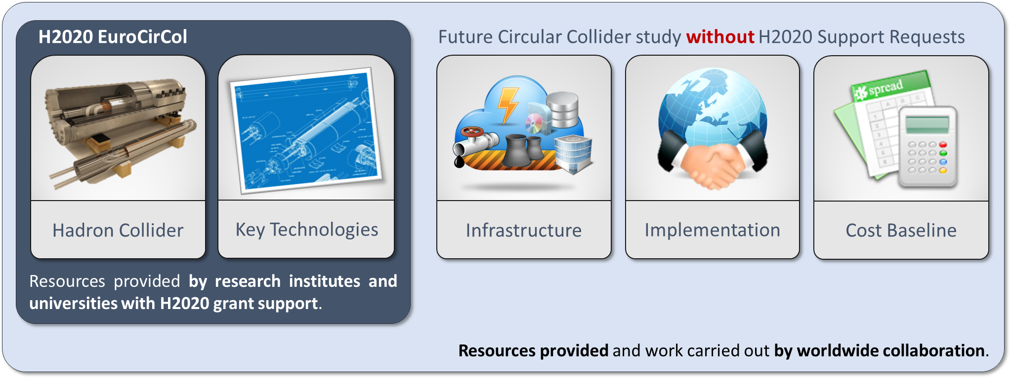
EuroCirCol EU Horizon 2020 Grant
EC contributes with funding to FCC-hh study
Core aspects of hadron collider design: arc & IR optics design, 16 T magnet program, cryogenic beam vacuum system
Recognition of FCC Study by European Commission.

Slide 38
EuroCirCol Consortium + Associates
CERN | IEIO
TUT | Finland
CEA | France
CNRS | France
KIT | Germany
TUD | Germany
INFN | Italy
UT | Netherlands
ALBA | Spain
CIEMAT | Spain
STFC | United Kingdom
UNILIV | United Kingdom
UOXF | United Kingdom
KEK | Japan
EPFL | Switzerland
UNIGE | Switzerland
NHFML-FSU | USA
BNL | USA
FNAL | USA
LBNL | USA
Japan
KEK
Finland
TUT
United Kingdom
STFC, UNILIV, UOXF
Netherlands
UT
Germany
KIT, TUD
France
CEA, CNRS
CERN
Switzerland
EPFL, UNIGE
Italy
INFN
Spain
ALBA, CIEMAT
Consortium Beneficiaries, signing the Grant Agreement

Slide 39
Conclusions
High energy circular colliders are a powerful option for future accelerator-based High Energy Physics!
We now need to urgently prepare a solid design for the next strategy update, using all possible synergies and the rising activities worldwide.
The design of high energy circular colliders presents many challenging requirements on beam quality and optics control as well as new operational procedures, which call for adequate, and possibly novel beam diagnostics

Slide 40
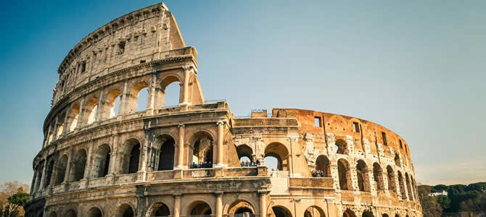







FCC Week 2016
Rome, 11-15 April 2016
http://cern.ch/fccw2016
we look forward to seeing you in Rome!

